Slide 1
Notes:
Tonight is our Matric Farewell!

Slide 2
Notes:
Tonight is our Matric Farewell!

Slide 3
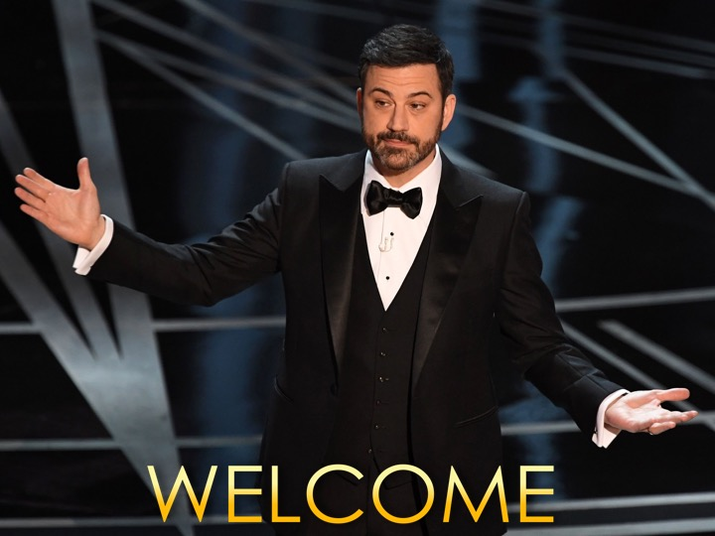
Notes:
Welcome to regulars and newcomers.

Slide 4
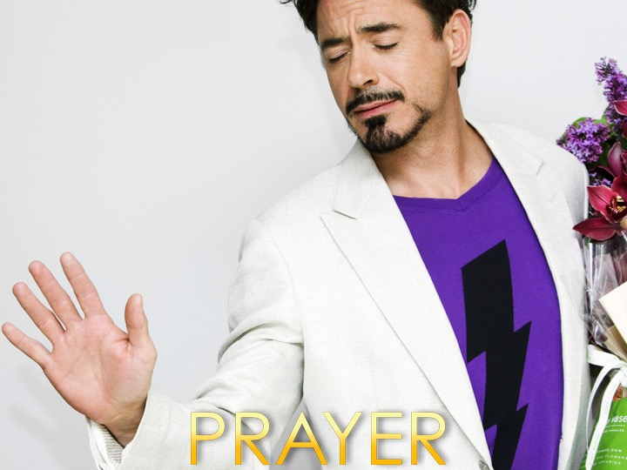
Notes:
Prayer: Let’s open our meeting in prayer.

Slide 5
Notes:
Tonight is our Matric Farewell night, where we will be honouring our marvellous Matrics!

Slide 6
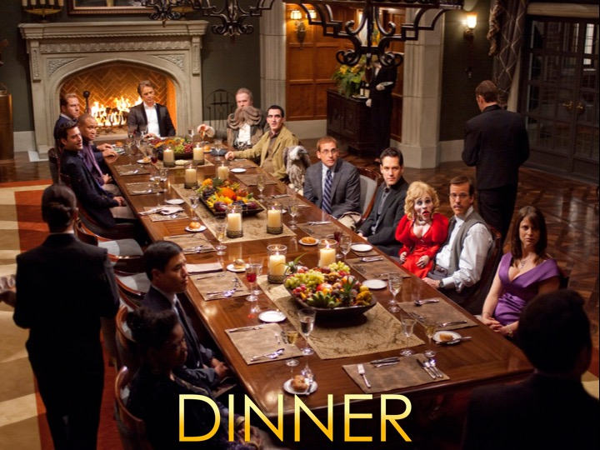
Notes:
It’s Dinner time, please help yourself!

Slide 7
Notes:
We will now have a performance from the Present Princes.

Slide 8
Notes:
Encounter Youth Ballot: (1) As a group, choose one person from each category. (20 Circle your choice on the piece of paper. (3) Votes will be counted, and winners will be announced! (4) Winners will get the opportunity to say a one minute speech!

Slide 9
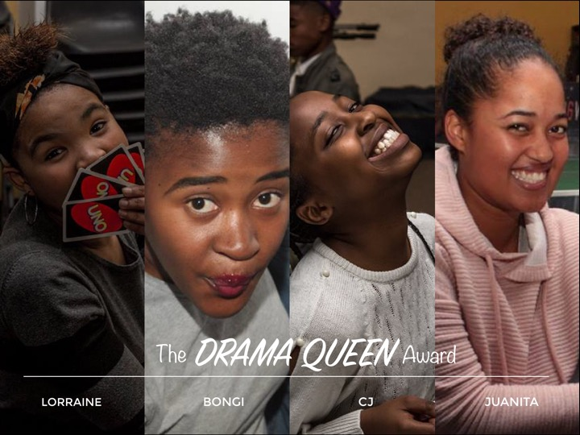
Notes:
The Drama Queen award: This award goes to the most dramatic girl in our group, the options are, Lorraine, Bongi, CJ, or Juanita.

Slide 10
Notes:
The Most Fashionable Award: This award goes to the person who has the best sense of fashion in our group. Your options are, Ashley, Jason, Mpho and Tammy.

Slide 11
Notes:
The most photogenic: This award goes to the individual who consistently looks amazing in photographs, your choices are, Hendrichs, Bongi, Jason or Peter.

Slide 12
Notes:
The Best Photographer Award: This award goes to the man who takes the best photos! Your options are, Asher, Channing, or Pastor Mark.

Slide 13
Notes:
The Best Dancer Award: This award goes to the person/group who dances the best! Your choices are, Masi, Lorraine, Mpho or the Present Princes.

Slide 14
Notes:
The Best Leader Award: You can decide who wins this award, choose who you think the best leader is! Write their name down on the ballot paper!

Slide 15
Notes:
The Drama King Award: This prize is given to the most dramatic man in our youth group! Your choices are, Mdu, Tumi or Jason!

Slide 16
Notes:
The Best DJ Award! This award is given to the person that your group thinks is the best DJ. Your choices are, Junior, Grace, Channing or Salmon.

Slide 17
Notes:
The Best Accent Award is given to the person with the most interesting accent, your choices are, Masi, Tamlyn, or anyone else who you think has the best accent.

Slide 18
Notes:
Karaoke Time: (1) Each group will be called on to stage to perform a song. (2) A random song will be chosen, and the group has to sing the song. (3) Lyrics to the song will be placed on the screen. (4) The song will only play for 2 minutes, so give it all you’ve got!

Slide 19
Notes:
Group 1 will be singing, My Love by West Life. This video can be found on Youtube at: https://www.youtube.com/watch?v=n7iGdIjEnwg

Slide 20
Notes:
My Love by West Life. Get it on YouTube at: https://www.youtube.com/watch?v=n7iGdIjEnwg

Slide 21
Notes:
Group 2 will be singing, Cheap Thrills by Sia. This video can be found on Youtube at: https://www.youtube.com/watch?v=LqrqgALM1Ug

Slide 22
Notes:
Cheap Thrills by Sia. Get it on YouTube at: https://www.youtube.com/watch?v=LqrqgALM1Ug

Slide 23
Notes:
Group 3 will be singing, One Love by Bob Marley. This video can be found on Youtube at: https://www.youtube.com/watch?v=YXG-GUaRDCQ

Slide 24
Notes:
One Love by Bob Marley. Get it on YouTube at: https://www.youtube.com/watch?v=YXG-GUaRDCQ

Slide 25
Notes:
Group 4 will be singing, Down by Jay Sean. This video can be found on Youtube at: https://www.youtube.com/watch?v=fTy1ZIBuDs0

Slide 26
Notes:
Down by Jay Sean. Get it on YouTube at: https://www.youtube.com/watch?v=fTy1ZIBuDs0

Slide 27
Notes:
Group 5 will be singing, Waka Waka by Shikira. This video can be found on Youtube at: https://www.youtube.com/watch?v=I-Og8r30A3M

Slide 28
Notes:
Waka Waka by Shikira. Get it on YouTube at: https://www.youtube.com/watch?v=I-Og8r30A3M

Slide 29
Notes:
Group 6 will be singing, Baby by Justin Bieber. This video can be found on Youtube at: https://www.youtube.com/watch?v=1a5SWpp9Wfg

Slide 30
Notes:
Baby by Justin Bieber. Get it on YouTube at: https://www.youtube.com/watch?v=1a5SWpp9Wfg

Slide 31
Notes:
Group 7 will be singing, Party in the USA by Miley Cyrus. This video can be found on Youtube at: https://www.youtube.com/watch?v=kfa-26JfdDA

Slide 32
Notes:
Party in the USA by Miley Cyrus. Get it on YouTube at: https://www.youtube.com/watch?v=kfa-26JfdDA

Slide 33
Notes:
Group 8 will be singing, I’m Alive by Celine Dion. This video can be found on Youtube at: https://www.youtube.com/watch?v=tELtFxZqQCM

Slide 34
Notes:
I’m Alive by Celine Dion. Get it on YouTube at: https://www.youtube.com/watch?v=tELtFxZqQCM

Slide 35
Notes:
It’s now time for dessert. This will be brought to your table, so sit back and enjoy!

Slide 36
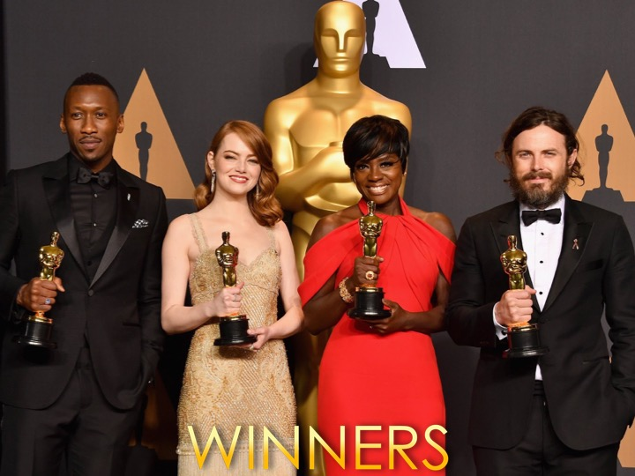
Notes:
Our Winners from the Ballot will now be announced!

Slide 37
Notes:
Winner for the Drama Queen award.

Slide 38
Notes:
Winner for the Most Fashionable award.

Slide 39
Notes:
Winner for the Most Photogenic award.

Slide 40
Notes:
Winner for the Best Photographer award.

Slide 41
Notes:
Winner for the Best Dancer award.

Slide 42
Notes:
Winner for the Best Leader award.

Slide 43
Notes:
Winner for the Drama King award.

Slide 44
Notes:
Winner for the Best DJ award.

Slide 45
Notes:
Winner for the Best Accent award.

Slide 46
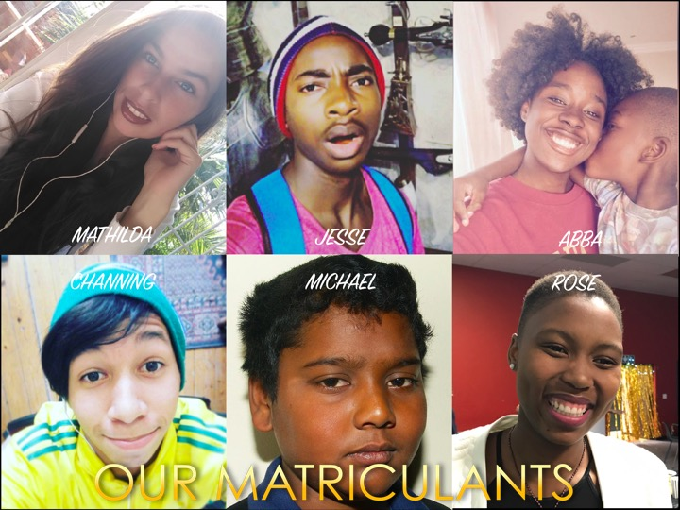
Notes:
We would like to take a moment and honour our Matriculants! The class of 2017 are, Mathilda, Jesse, Abba, Channing, Michael, and Rose!

Slide 47
Notes:
We would now like to give special mention to our Heroes, who make everything happen. To Pastor Mark and Debbie, thank you so much for all you do for us teens! Thank you that every year, another group of Matrics leave, fired up and ready to face the world, largely because of your input! Thank you very much!

Slide 48
Notes:
Announcements: On Sunday mornings we are presenting The Victory Series. This week Sunday's topic is Spiritual Errors.

Slide 49
Notes:
Announcements: Next Friday it is #Stress Night. Be there, you don’t want to miss out!

Slide 50
Notes:
Close: Thank you for coming to our Matric Farewell, be blessed!

