Slide 1
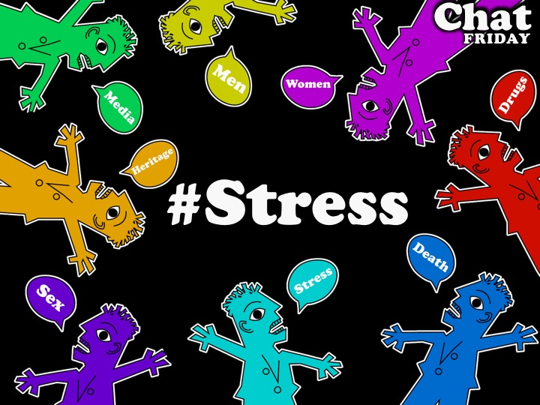
Notes:
Welcome to Chat Friday.

Slide 2

Notes:
Welcome to regulars and newcomers!

Slide 3
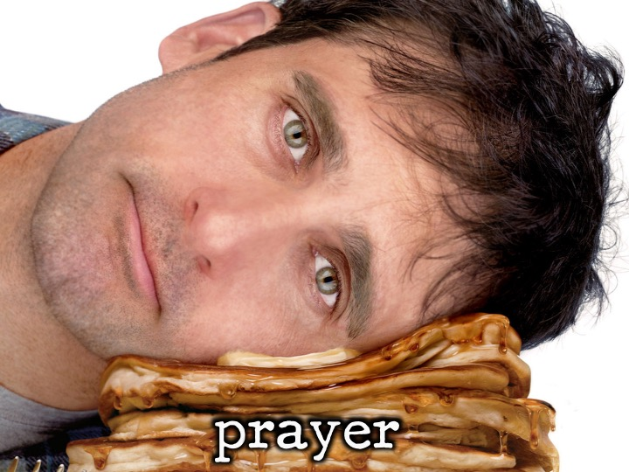
Notes:
Prayer: Let’s open our meeting in prayer.

Slide 4
Notes:
Tonight is #Stress night.

Slide 5

Notes:
We will now watch a funny clip from The Office (US), get it on youtube at: https://www.youtube.com/watch?v=mB7z1LzG8qQ

Slide 6

Notes:
We will now watch a funny clip from The Office (US), get it on youtube at:
https://www.youtube.com/watch?v=mB7z1LzG8qQ

Slide 7
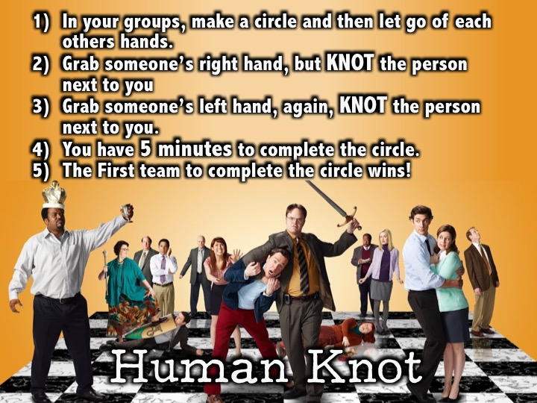
Notes:
The Human Knot: (1) In your groups, make a circle and then let go of each others hands. (2) Grab someone’s right hand, but KNOT the person next to you (3) Grab someone’s left hand, again, KNOT the person next to you. (4) You have 5 minutes to complete the circle. (5) The First team to complete the circle wins!

Slide 8
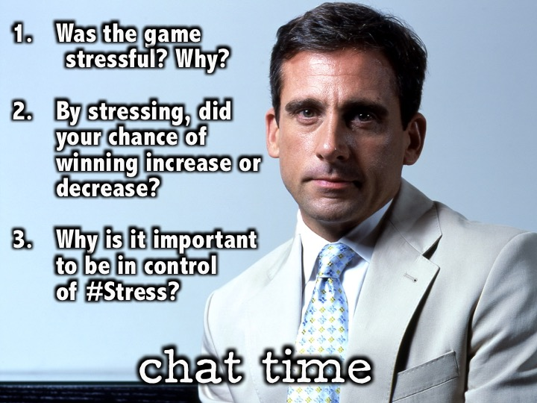
Notes:
Small Group Interaction: (1) Was the game stressful? Why? (2) By stressing, did your chance of winning increase or decrease? (3) Why is it important to control #Stress?

Slide 9

Notes:
We will now watch a video from Ellen Degeneres that talks about stress. Get it on youtube at: https://www.youtube.com/watch?v=8L3mPeeiQk0

Slide 10
Notes:
We will now watch a video from Ellen Degeneres that talks about stress. Get it on youtube at: https://www.youtube.com/watch?v=8L3mPeeiQk0

Slide 11
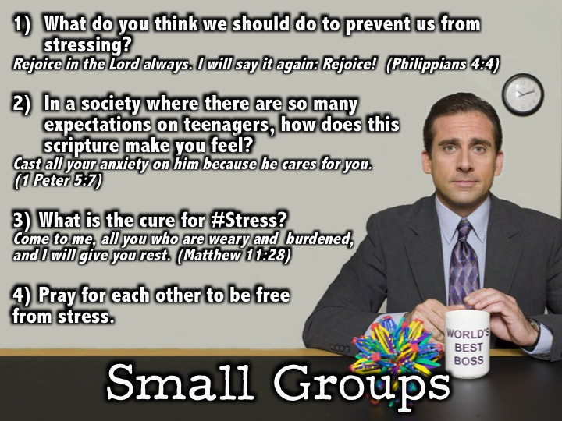
Notes:
Small Group Interaction: (1) What do you think we should do to prevent us from stressing? Rejoice in the Lord always. I will say it again: Rejoice! (Philippians 4:4) (2) In a society where there are so many expectations on teenagers, how does this scripture make you feel? Cast all your anxiety on him because he cares for you. (1 Peter 5:7) (3) What is the cure for #Stress? Come to me, all you who are weary and burdened, and I will give you rest. (Matthew 11:28) (4) Pray for each other to be free from stress.

Slide 12
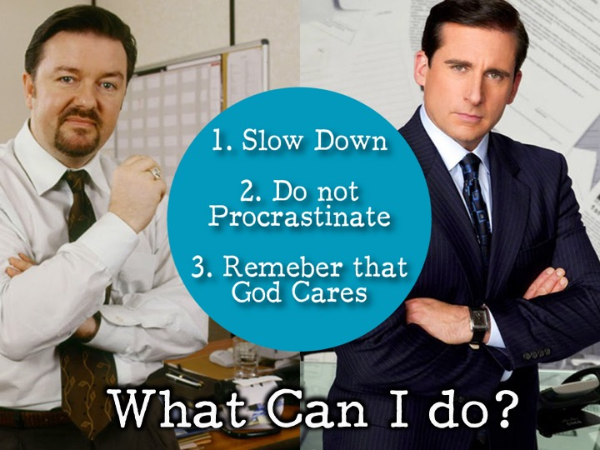
Notes:
3 Things you can do to prevent yourself from stressing: (1) Slow Down. (2) Do not procrastinate. (3) Remember that God cares.

Slide 13

Notes:
Announcements: On Sunday mornings we are presenting The Victory Series. This week Sunday's topic is Sexual Sins.

Slide 14
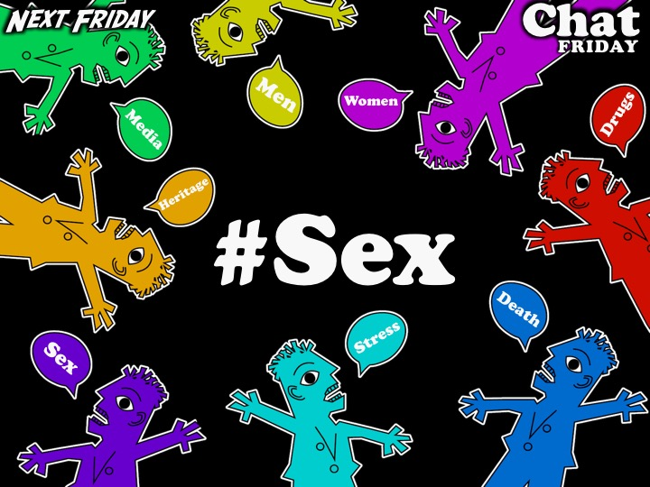
Notes:
Announcements: Next Friday it is our #Sex Night.

Slide 15
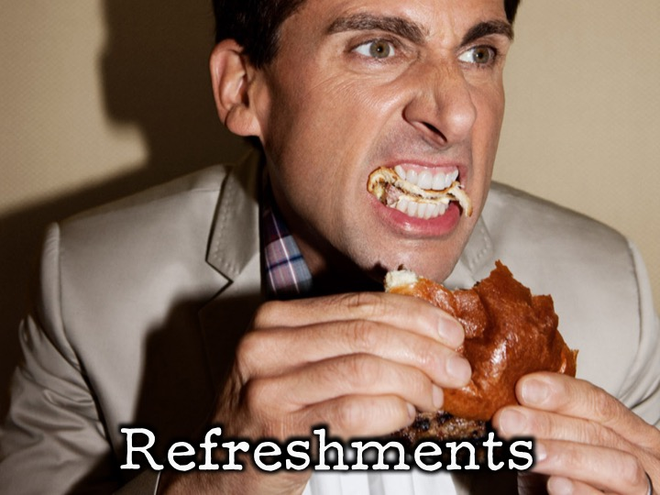
Notes:
Refreshments: It is time for refreshments.

Slide 16
Notes:
#Stress night.

