Slide 1


Slide 2
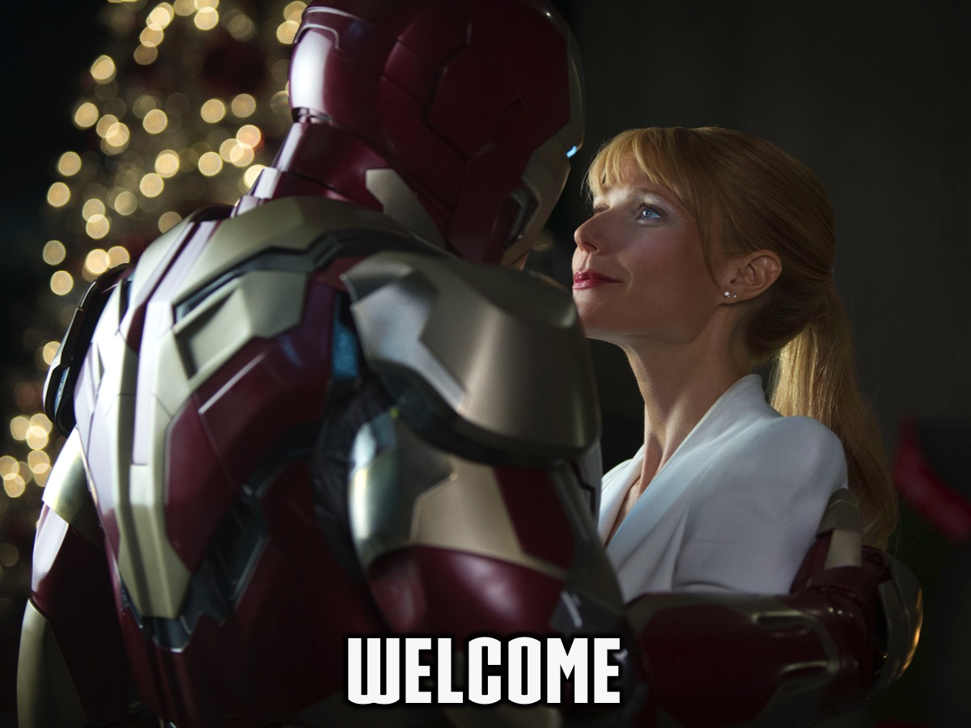
Notes:
Welcome to regulars and newcomers!

Slide 3

Notes:
Prayer: Let’s open our meeting in prayer.

Slide 4
Notes:
Tonight is #Sex Night.

Slide 5

Notes:
Video: Iron Man 3 Trailer. Get it on Youtube at: https://www.youtube.com/watch?v=2CzoSeClcw0

Slide 6
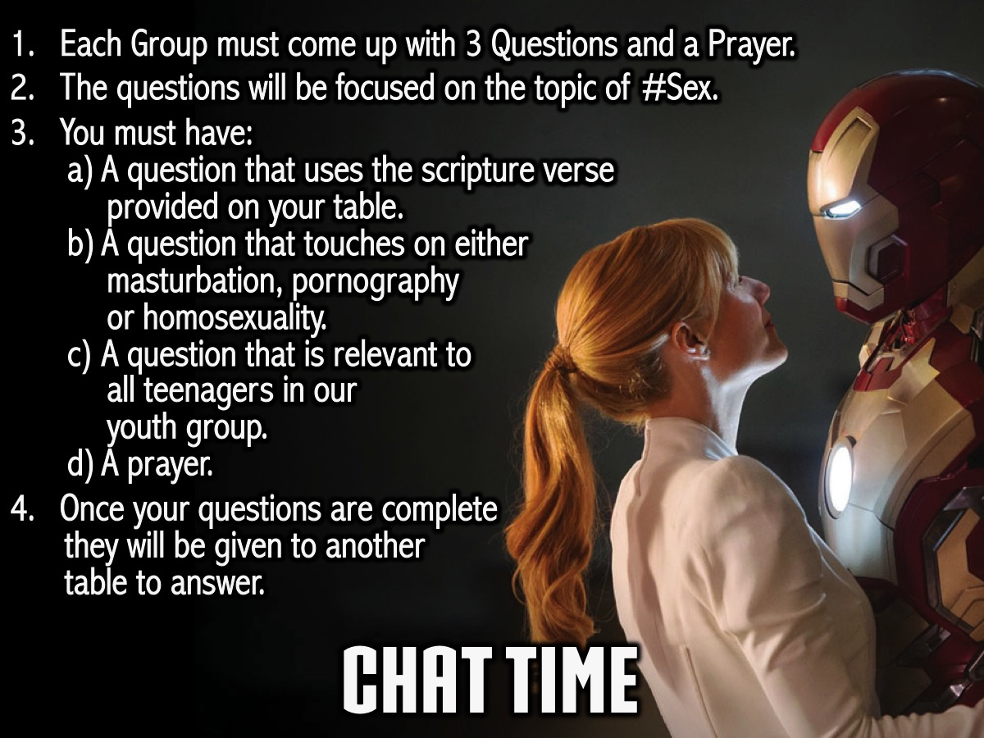
Notes:
Chat Time: (1) Each group must come up with 3 Questions and a Prayer. (2) The questions will be focused on the topic of #Sex. (3) You must have: (a) A question that uses the scripture verse provided on your table. (b) A question that touches on either, masturbation, pornography or homosexuality. (c) A question that is relevant to all teenagers in our youth group. (d) A prayer. (4) Once your questions are complete, they will be given to another table to answer.

Slide 7

Notes:
So, basically you are creating the small group time like we used to do after the event on a Friday night!

Slide 8
Notes:
Chat Time: (1) Each Group must come up with a set of 3 questions. (2) The questions will be focused on the topic of #Sex. (3) You must have: A question that uses the scripture verse provided on your table; a question that touches on either, masturbation, pornography or homosexuality; a question that is relevant to all teenagers in our youth group and a closing prayer. (4) Once your questions are complete, they will be given to another table to answer.

Slide 9
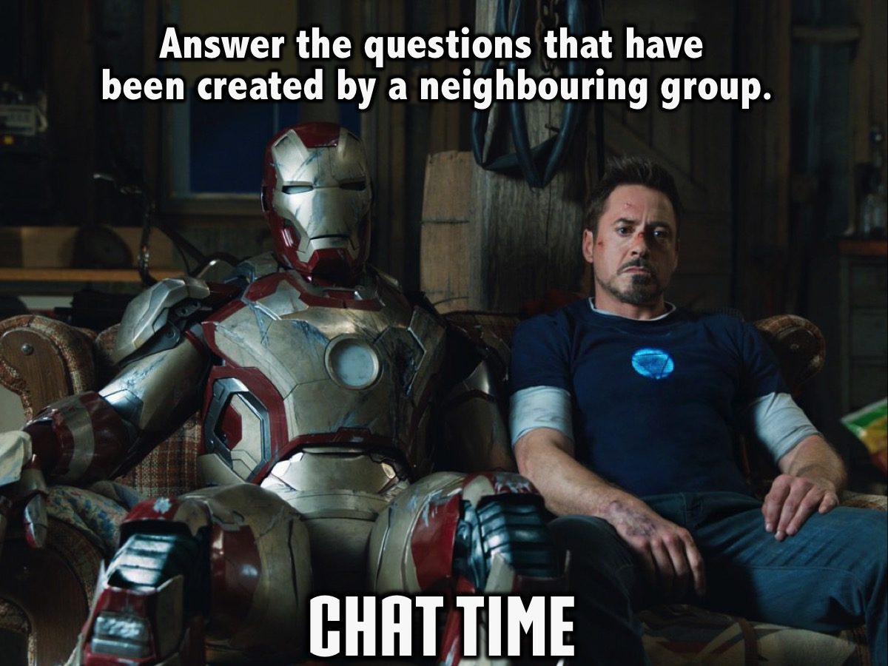
Notes:
Chat Time: Groups can now answer the questions given to them by another table.

Slide 10
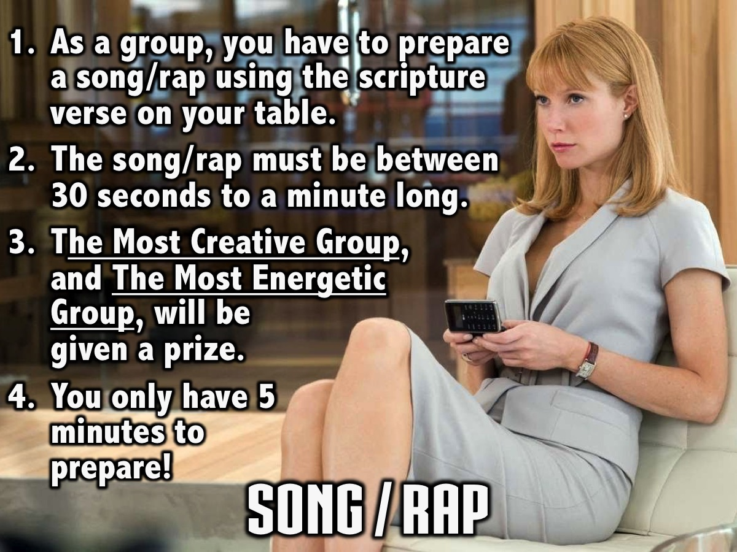
Notes:
Song / Rap: (1) As a group, you have to prepare a song/rap using the scripture verse on your table. (2) The song/rap must be between 30 seconds to a minute long. (3) There will be prizes for The Most Creative Group, and The Most Energetic Group. (4) You only have 5 minutes to prepare!

Slide 11

Notes:
Personal Reflection: You are going to spend 5 minutes completing the personal reflection page.

Slide 12
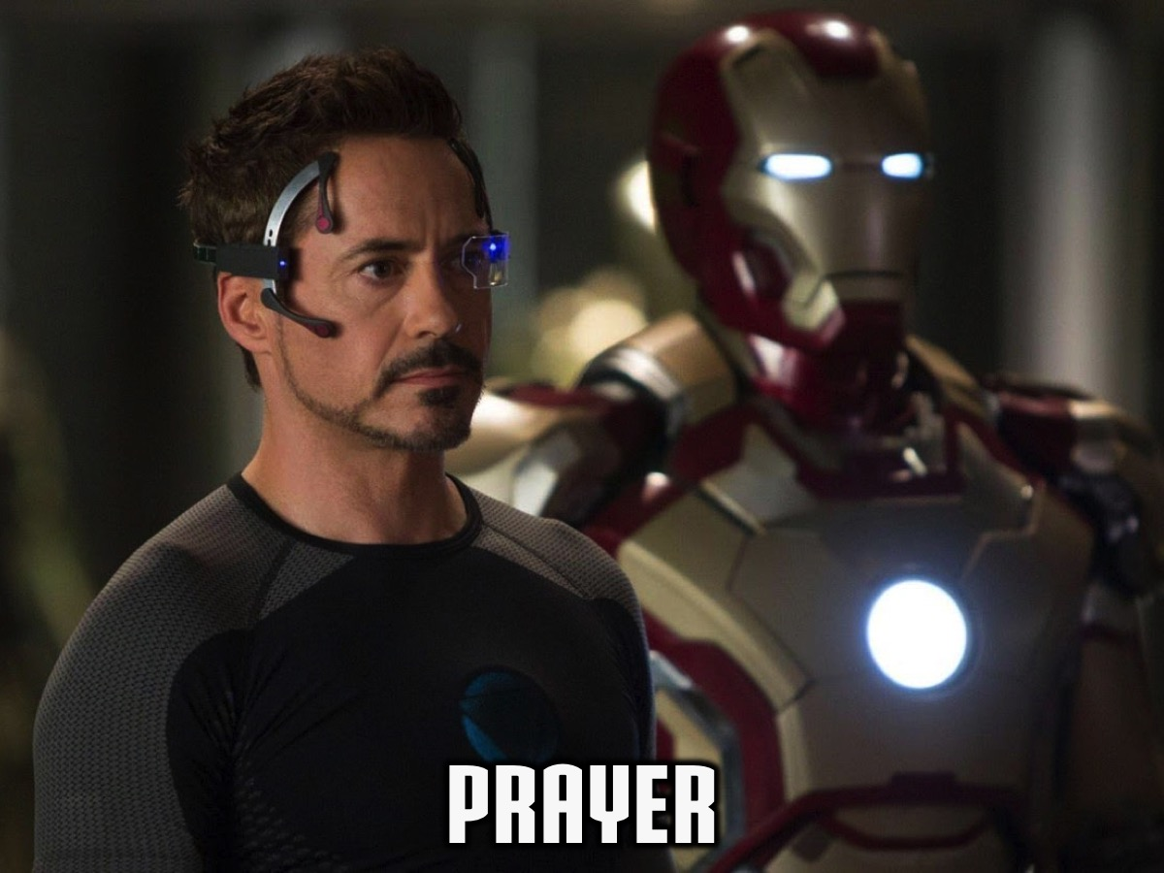
Notes:
Prayer: We are going to end the night off with a moment of prayer. Let’s all stand together in a circle holding hands to pray for sexual purity in our group.

Slide 13

Notes:
Please listen up for the following announcements!

Slide 14
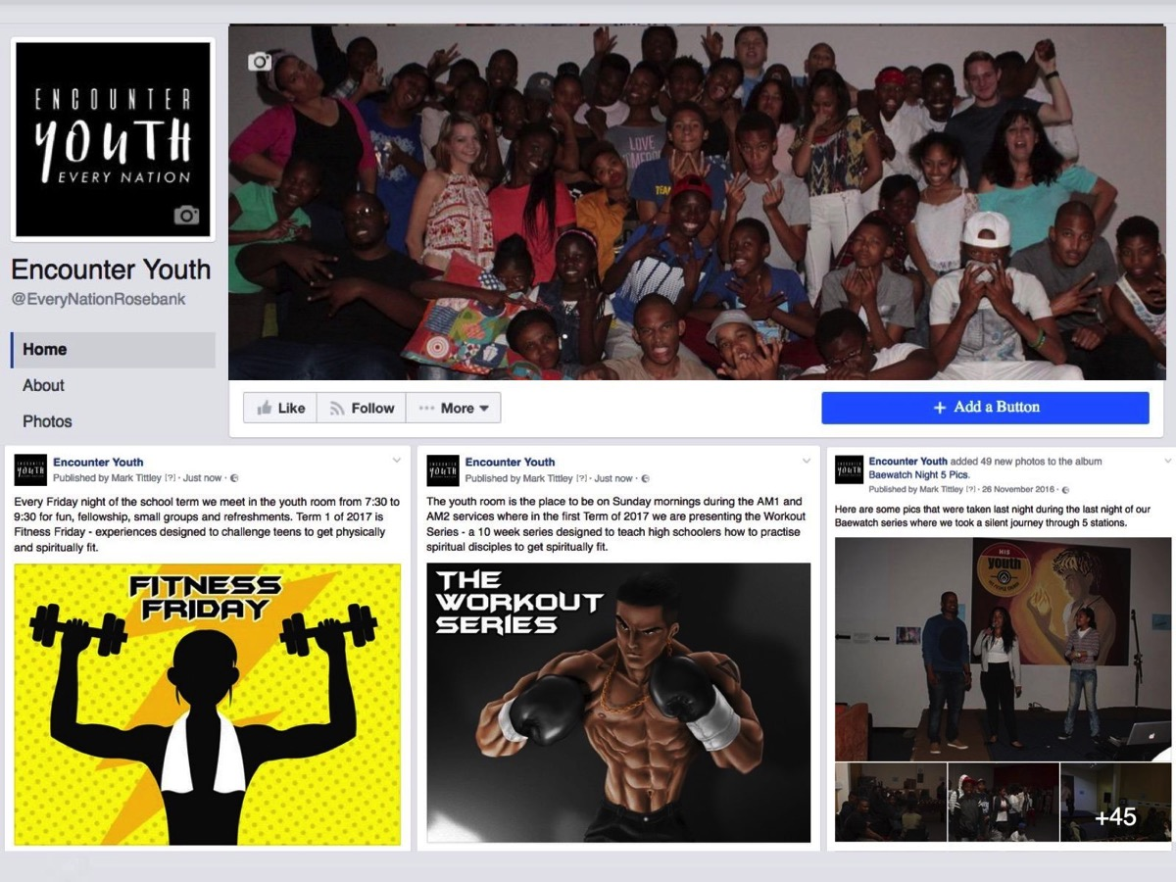
Notes:
Announcements: Like us on Facebook to keep up to date with the latest news.

Slide 15
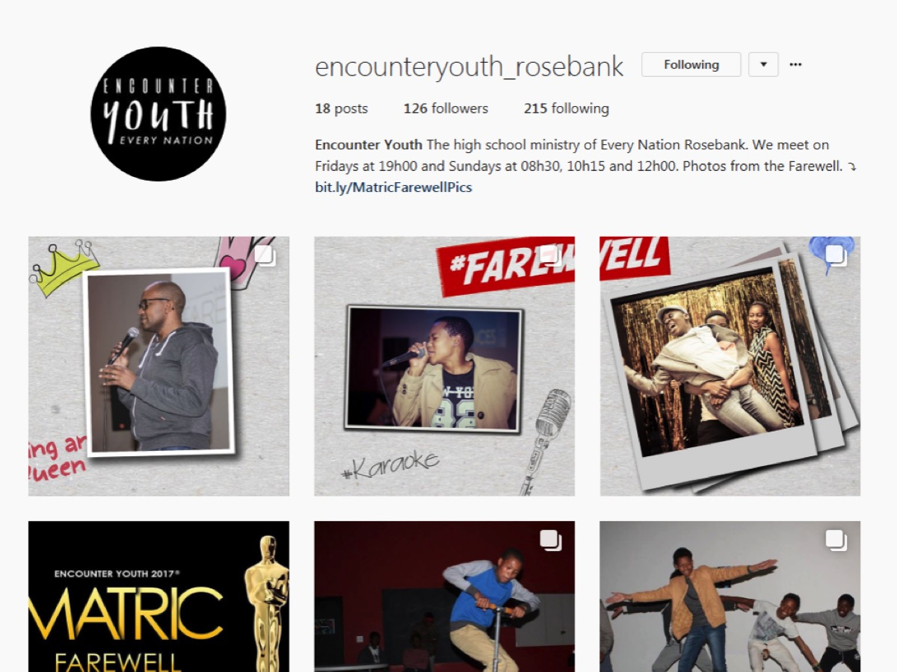
Notes:
Announcements: Follow us on Instagram! @EncounterYouth_Rosebank

Slide 16

Notes:
Announcements: Join our Friday WhatsApp group - signup sheets are on the table by the door.

Slide 17

Notes:
Announcements: Please put your praise and requests in the box!

Slide 18

Notes:
Announcements: We have Youth at schools, If we’re not at your school, check if your school already has an SCA group!

Slide 19

Notes:
Announcements: On Sunday mornings we are presenting The Victory Series. This week Sunday's topic is Addictions.

Slide 20

Notes:
Announcements: Next Friday it is our #Heritage Night.

Slide 21
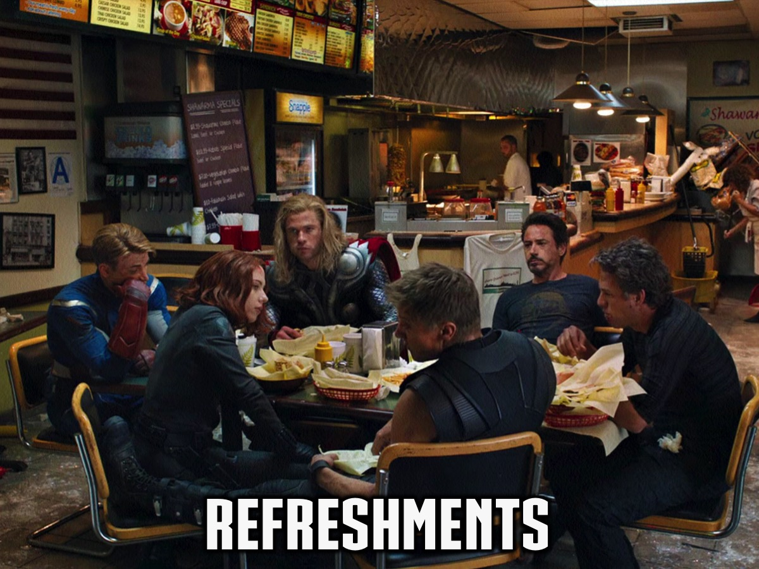
Notes:
Refreshments: It is time for refreshments.

