Slide 1
Notes:
Heritage Night!

Slide 2
Notes:
Welcome to regulars and newcomers!

Slide 3
Notes:
Prayer: Let’s open our meeting in prayer.

Slide 4
Notes:
Welcome: Tonight is #Heritage Night.

Slide 5
Notes:
We’re going to do speed relating!
Make TWO Circles, one facing inside, and one facing outside.
Questions will be shown on the screen, discuss the questions with the person in front of you.
When instructed, you will move to the next person.

Slide 6
Notes:
1. Where were you born?

Slide 7
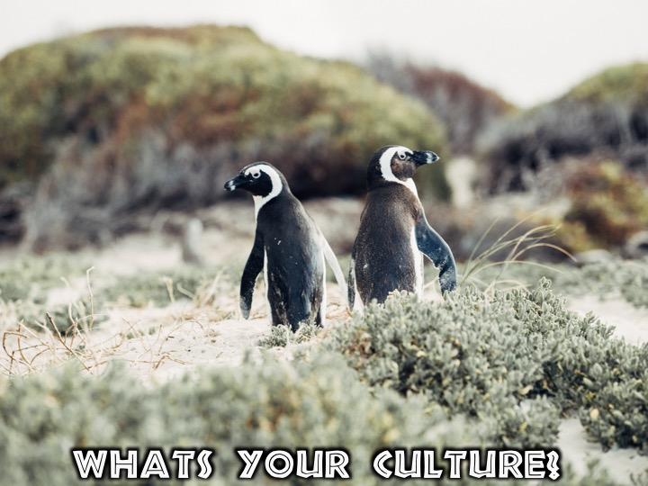
Notes:
2. What’s your culture?

Slide 8
Notes:
3. Are you proud of your culture?

Slide 9
Notes:
4. What do you know about the Zulu culture?

Slide 10
Notes:
5. What are your plans for Heritage day?

Slide 11
Notes:
What do you know about the Sotho culture?

Slide 12
Notes:
What is your favorite thing about South Africa?

Slide 13
Notes:
What do you know about the Afrikaans culture?

Slide 14
Notes:
What do you know about the Tshwane culture?

Slide 15
Notes:
Where is your favorite place in South Africa?

Slide 16
Notes:
What do you know about the Xhosa Culture?

Slide 17
Notes:
What is your Favorite Animal?

Slide 18
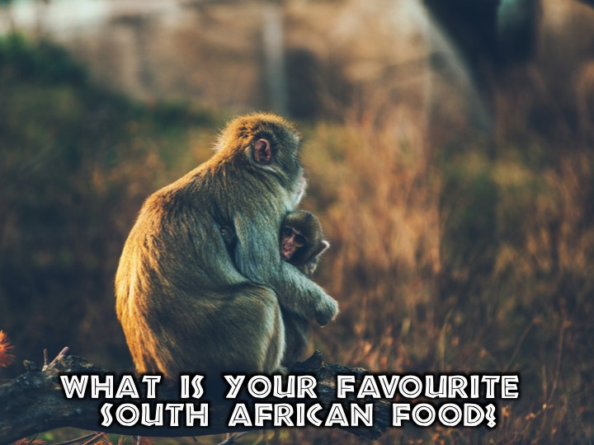
Notes:
What is your favorite South African Food?

Slide 19
Notes:
What do you know about the Venda culture?

Slide 20
Notes:
What is your best South African memory?

Slide 21
Notes:
Tranlation!
As a group, write a paragraph, in English, about everything you love about South Africa!
Use Google Translate, and translate your paragraph to the language written on your page.
Nominate one member of your team to go on stage, and read your paragraph, first the translated paragraph, then in English.
Prizes will be given to the group with the most interesting presentation!

Slide 22
Notes:
Small Group Interaction:
(1) What have you learnt about another culture tonight?
(2) Why is it important to love people from other cultures?
“Do to others as you’d have them do to you.” - Luke 6:31
(3) How can you better embrace other cultures?
(4) Pray that this week you will be able to love people from all cultures and walks of life.

Slide 23
Notes:
Please listen up for the following announcements!

Slide 24
Notes:
Announcements: Like us on Facebook to keep up to date with the latest news.

Slide 25
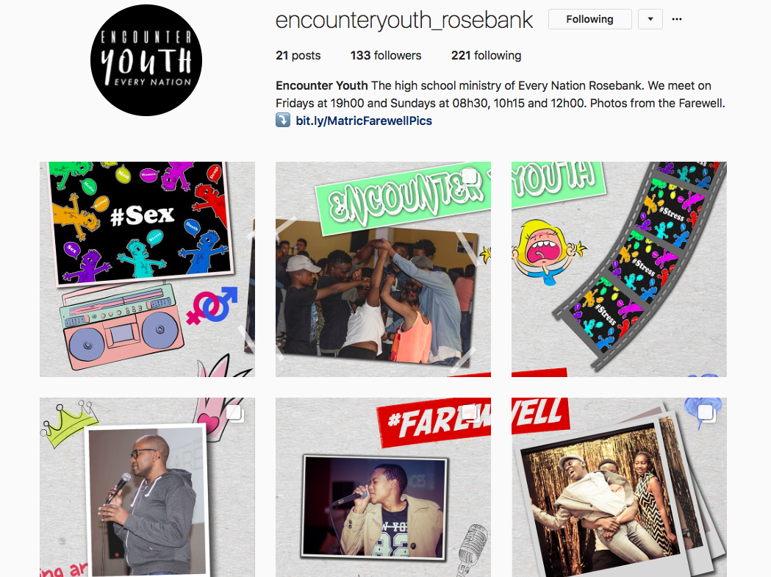
Notes:
Announcements: Follow us on Instagram! @EncounterYouth_Rosebank

Slide 26
Notes:
Announcements: Please put your praise and requests in the box!

Slide 27
Notes:
Announcements: We have Youth at schools, If we’re not at your school, check if your school already has an SCA group!

Slide 28
Notes:
Announcements: On Sunday mornings we are presenting The Victory Series. This week Sunday's topic is Living in Victory.

Slide 29
Notes:
Announcements: Next Friday is our Party Night!

Slide 30
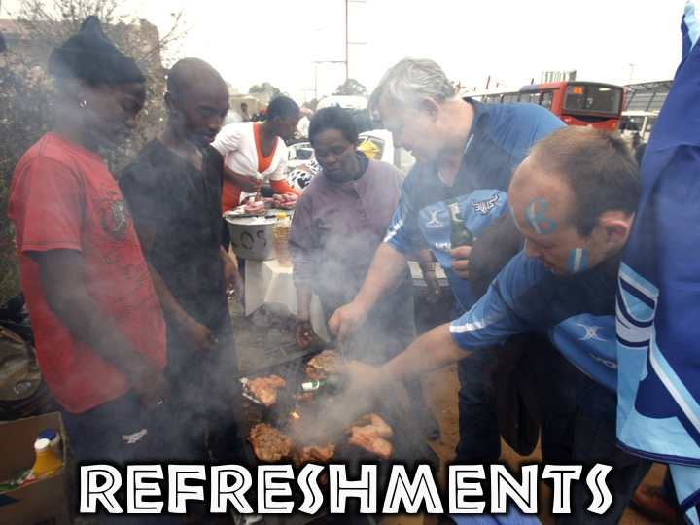
Notes:
Refreshments: It is time for refreshments.

