Slide 1

Notes:
Tonight is our #Party Night!

Slide 2
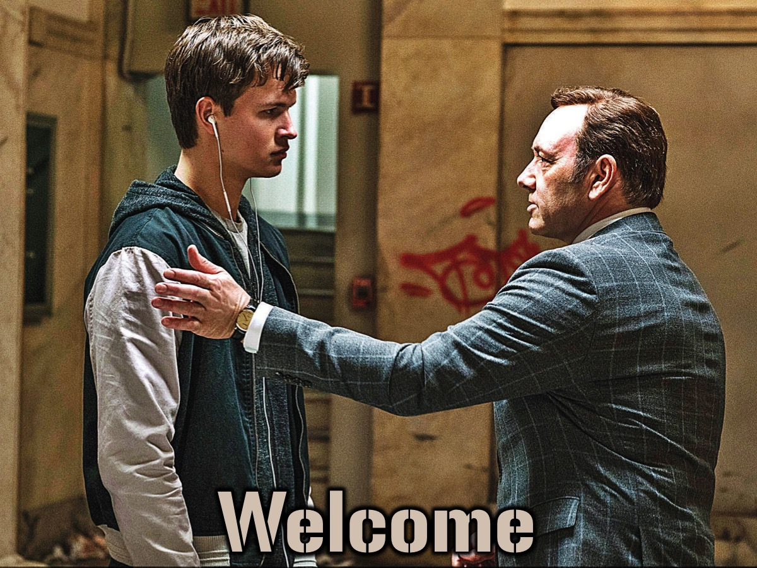
Notes:
Welcome to regulars and newcomers!

Slide 3
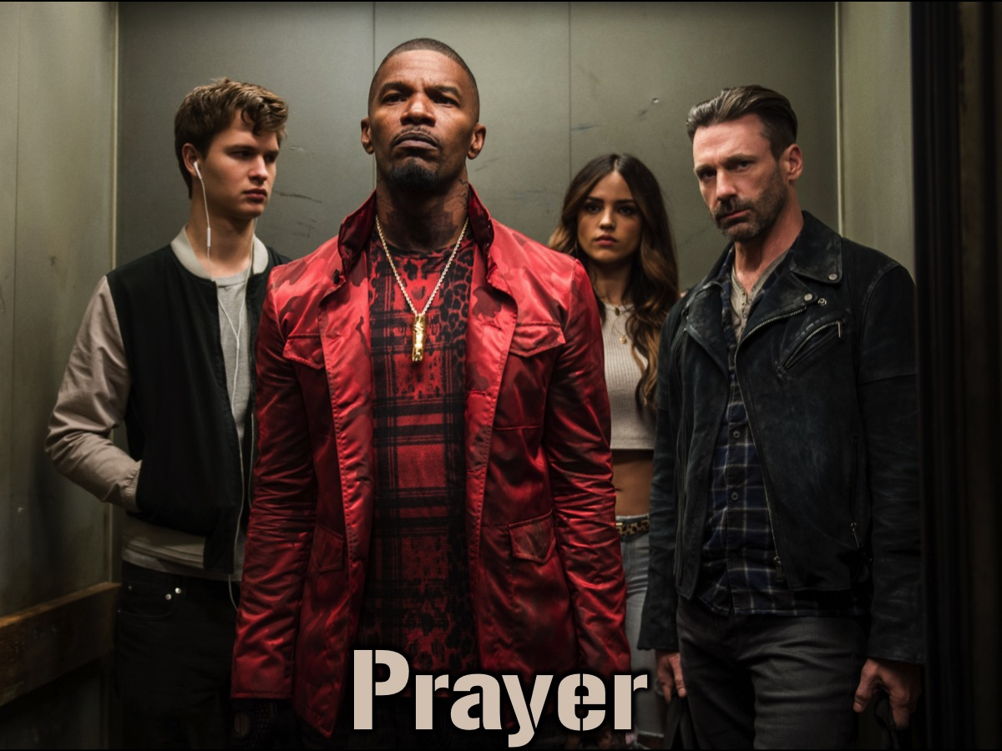
Notes:
Prayer: Let’s open our meeting in prayer.

Slide 4

Notes:
Announcements: Please listen up for the following announcements!

Slide 5
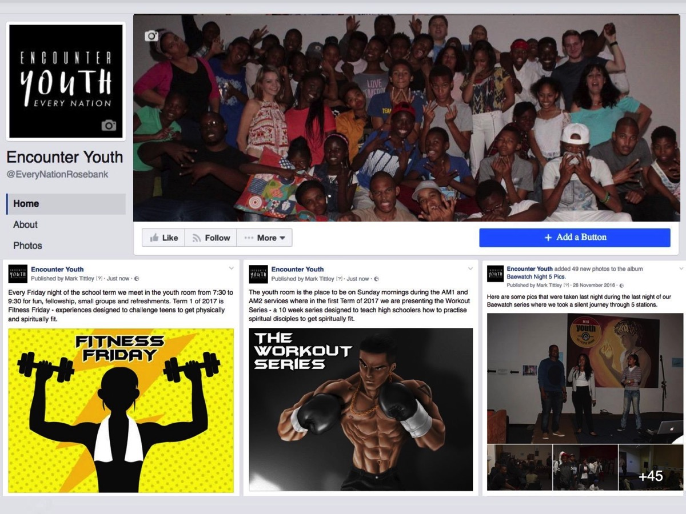
Notes:
Like us on Facebook to keep up to date with the latest news.

Slide 6
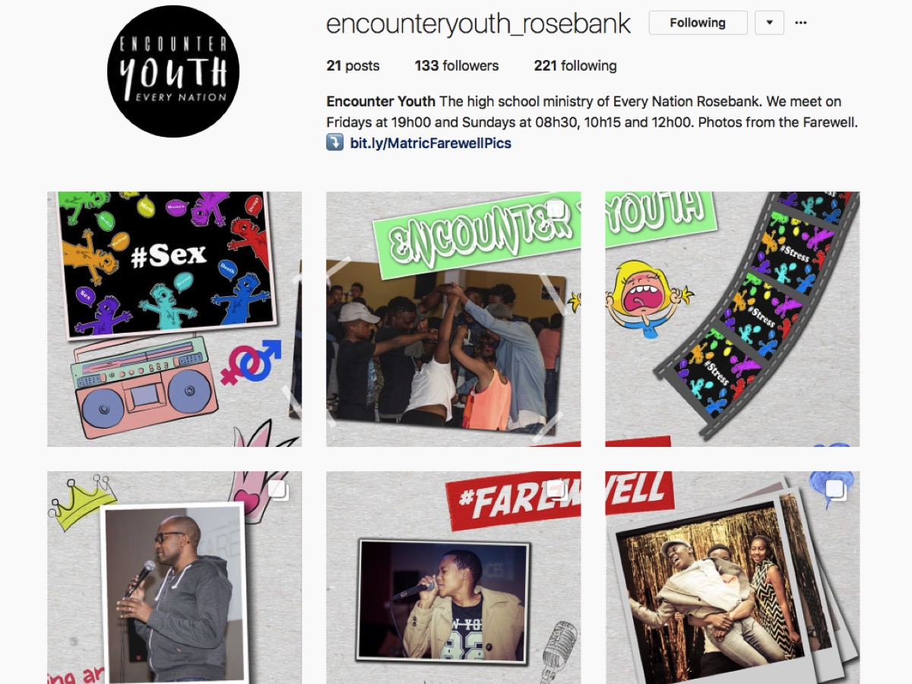
Notes:
Follow us on Instagram! @EncounterYouth_Rosebank

Slide 7

Notes:
Please put your praise and requests in the box!

Slide 8

Notes:
Next Term we are doing the TV Series on Friday!

Slide 9

Notes:
Next Term we are doing the TV Series on Friday!

Slide 10

Notes:
Next Term we are doing the TV Series on Friday!

Slide 11

Notes:
Next Term we are doing the TV Series on Friday!

Slide 12

Notes:
Next Term we are doing the TV Series on Friday!

Slide 13

Notes:
Next Term we are doing the TV Series on Friday!

Slide 14

Notes:
Next Term we are doing the TV Series on Friday!

Slide 15

Notes:
Next Term we are doing the TV Series on Friday!

Slide 16

Notes:
Next Term we are doing the TV Series on Friday!

Slide 17

Notes:
Next Term we are doing the TV Series on Friday!

Slide 18

Notes:
Next term we are doing the God Series on Sundays!

Slide 19
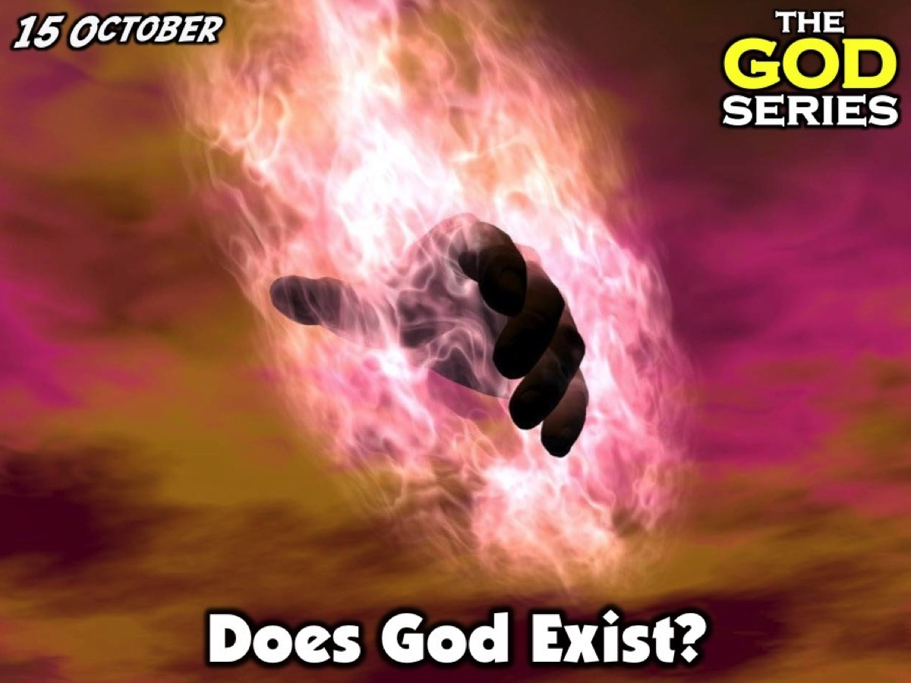
Notes:
Next term we are doing the God Series on Sundays!

Slide 20

Notes:
Next term we are doing the God Series on Sundays!

Slide 21

Notes:
Next term we are doing the God Series on Sundays!

Slide 22
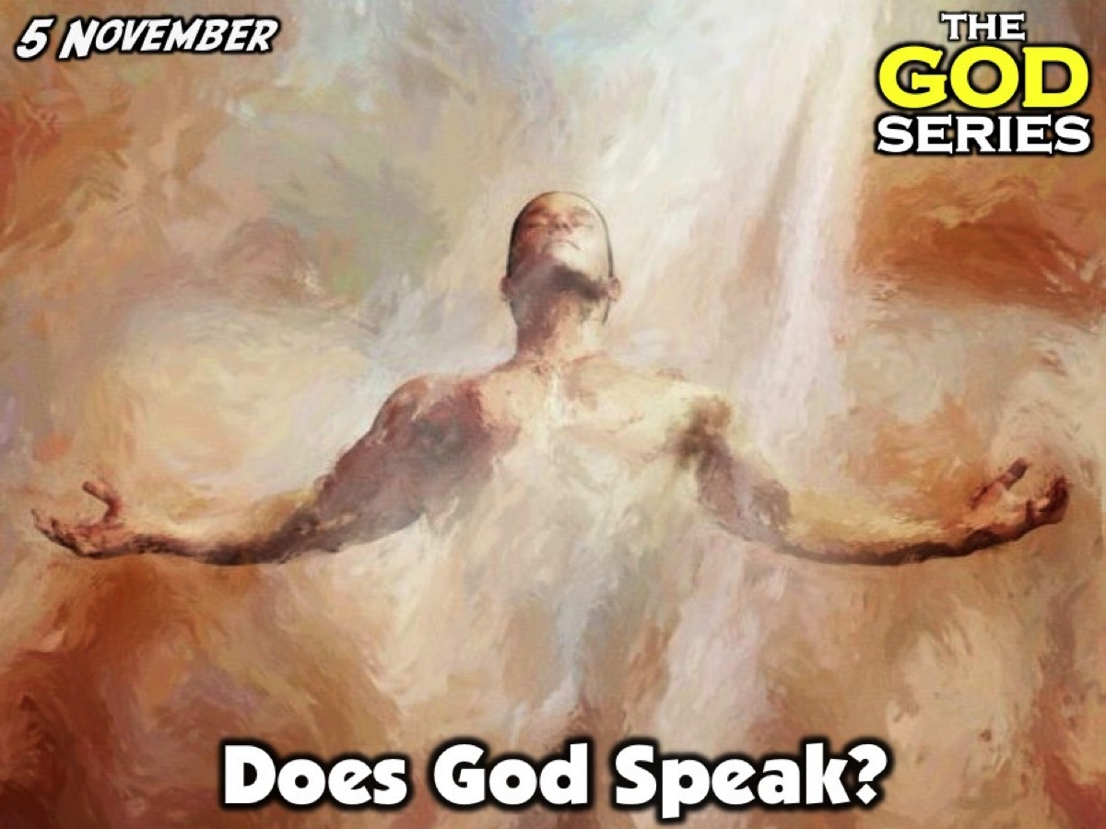
Notes:
Next term we are doing the God Series on Sundays!

Slide 23

Notes:
We interrupt the series to have a combined Family service in the sanctuary.

Slide 24

Notes:
Next term we are doing the God Series on Sundays!

Slide 25

Notes:
Next term we are doing the God Series on Sundays!

Slide 26

Notes:
Next term we are doing the God Series on Sundays!

Slide 27
Notes:
Tonight is our #Party Night

Slide 28
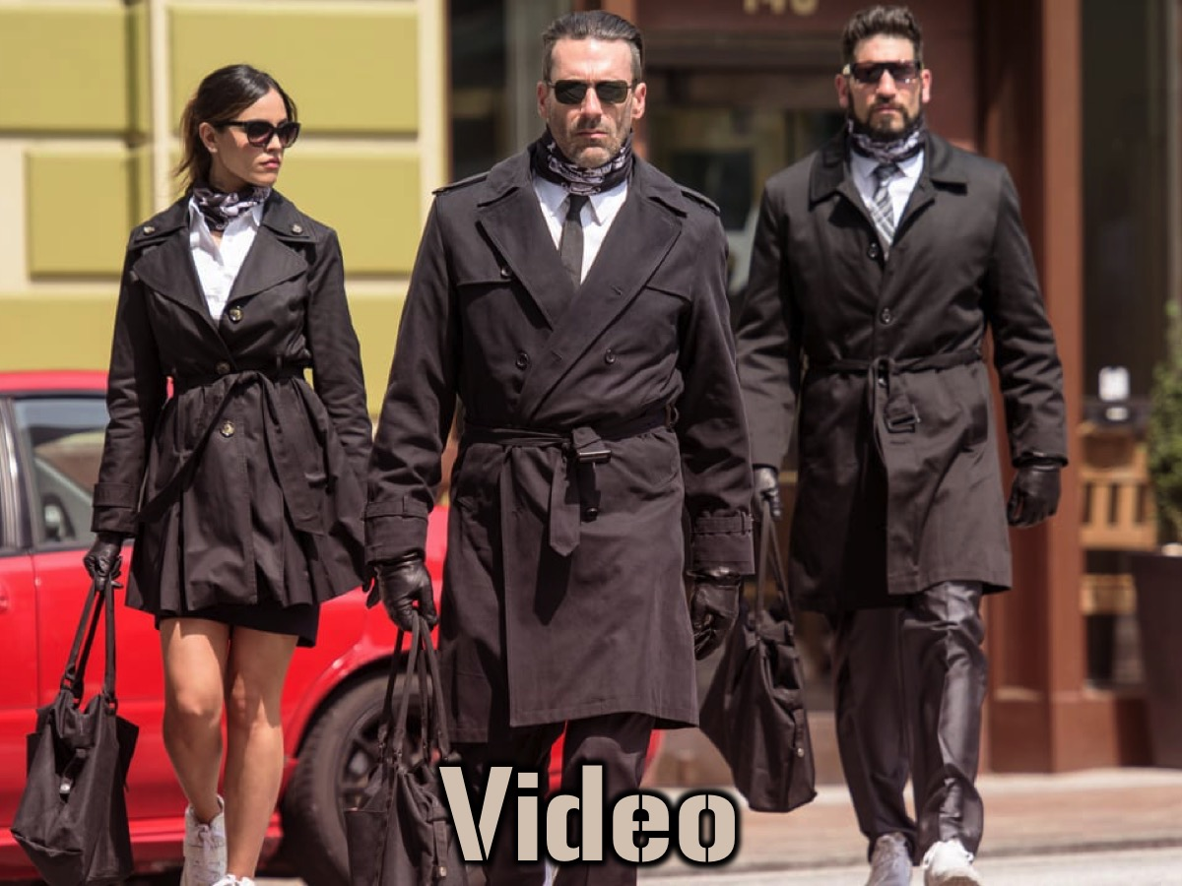
Notes:
Video: The Trailer for Baby Driver (2017). This can be found on Youtube at https://www.youtube.com/watch?v=zTvJJnoWIPk

Slide 29

Notes:
Video: The Trailer for Baby Driver (2017). This can be found on YouTube at https://www.youtube.com/watch?v=zTvJJnoWIPk

Slide 31
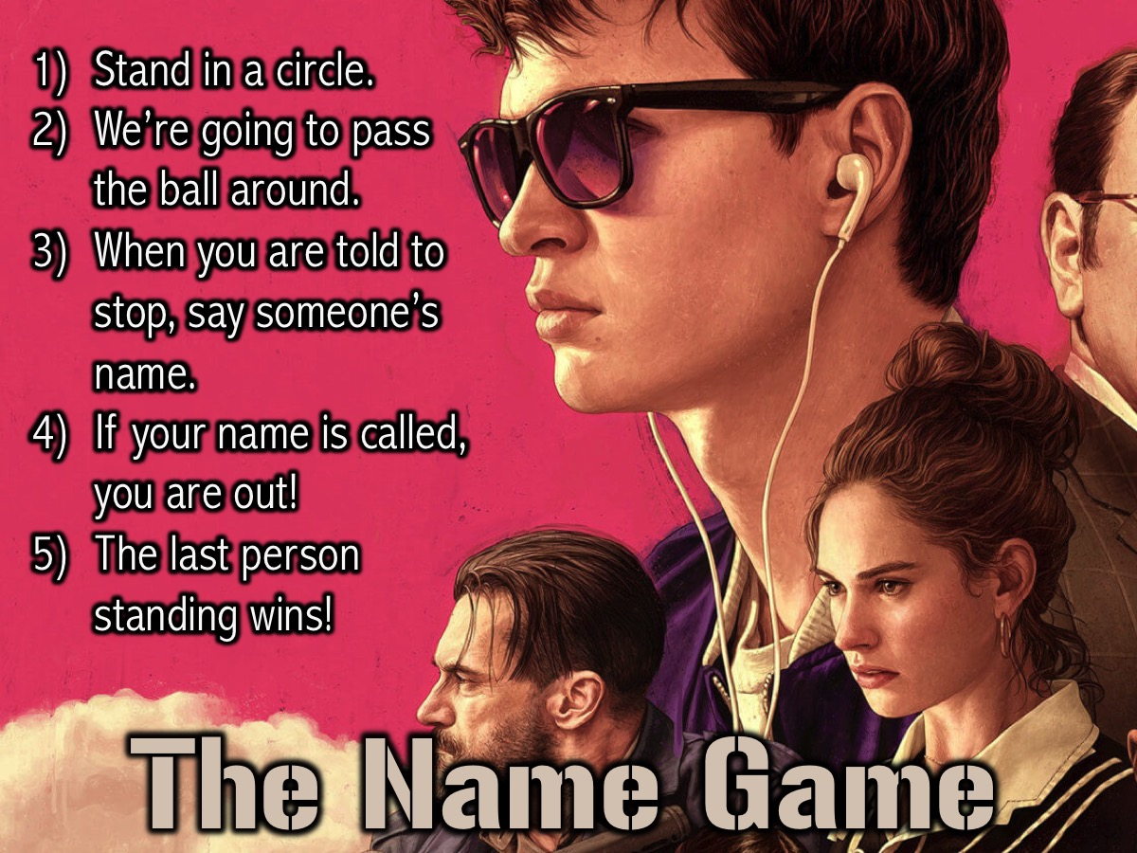
Notes:
The Name Game: (1) Stand in a circle. (2) We’re going to pass the ball around. (3) When you are told to stop, say someone’s name. (4) If your name is called, you are out! (5) The last person standing wins!

Slide 32
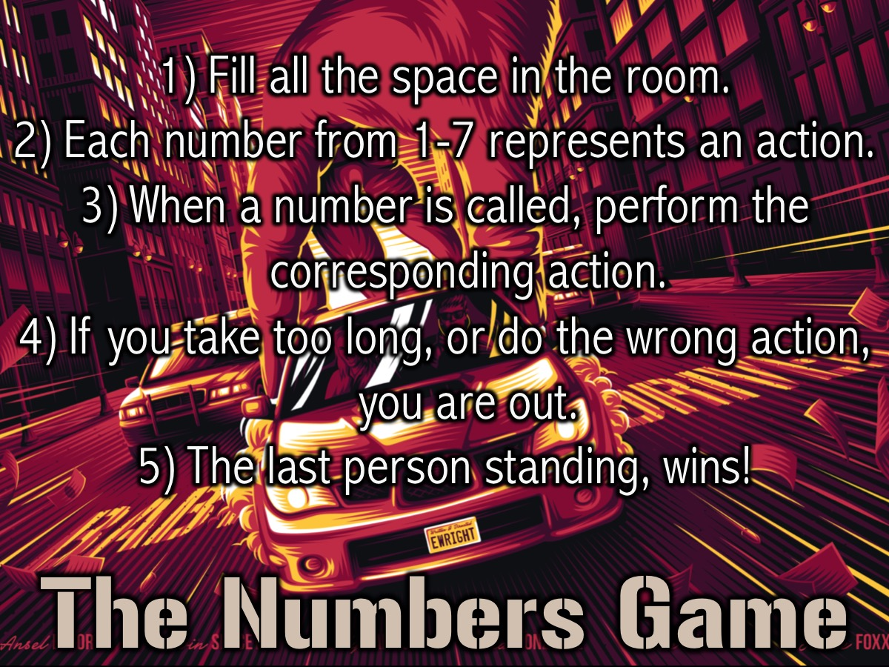
Notes:
The Numbers Game: (1) Fill all the space in the room. (2) Each number from 1-7 represents an action. ¹Walk on the spot, ²Sit on the floor, ³Lie on your back, ⁴Lie on your Stomach, ⁵Do not move, ⁶Run on the Spot, ⁷Kneel and pray!) (3) When a number is called, perform the corresponding action. (4) If you take too long, or do the wrong action, you are out. (5) The last person standing, wins!

Slide 33

Notes:
Video: Highlights from the third term of youth! (2017)

Slide 34
Notes:
Video: Highlights from the third term of youth! (2017)

Slide 35
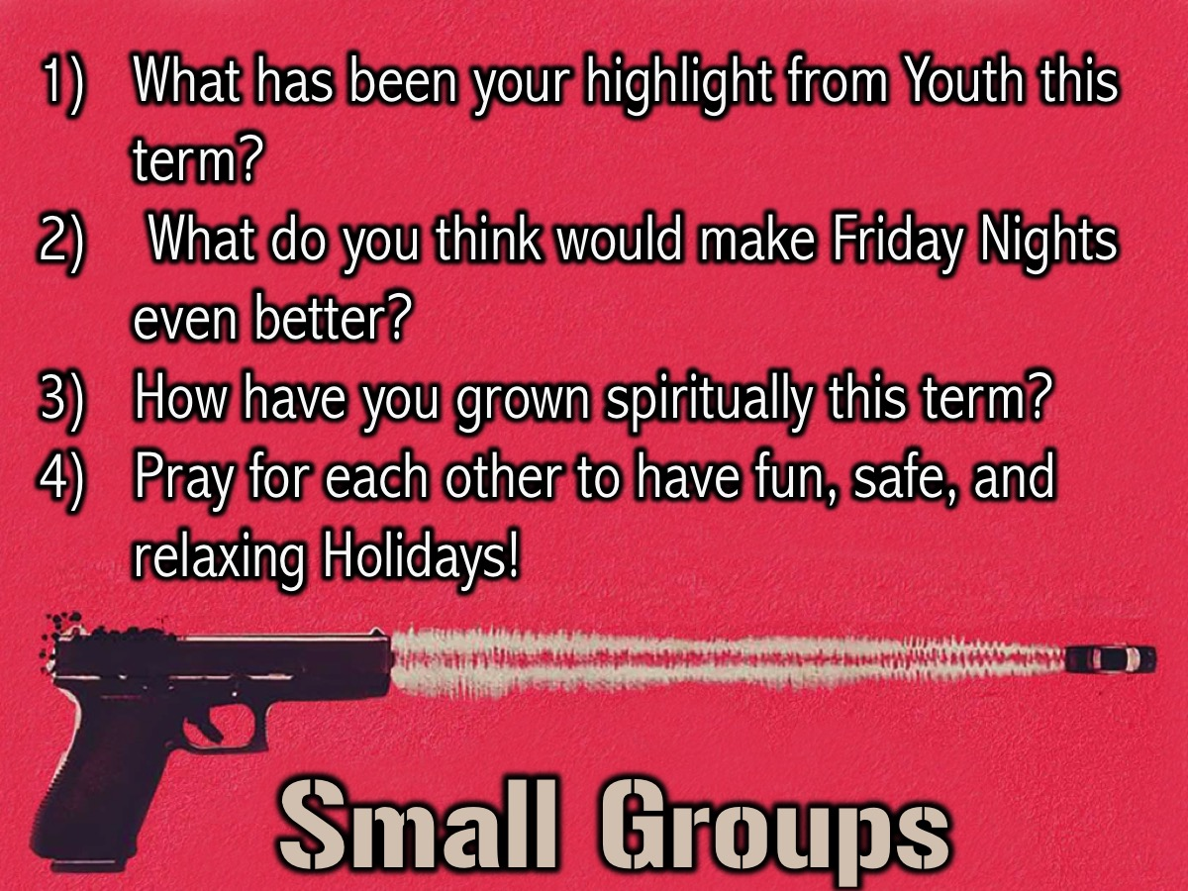
Notes:
Small Group Interaction: (1) What has been your highlight from Youth this term? (2) What do you think would make Friday Nights even better? (3) How have you grown spiritually this term? (4) Pray for each other to have fun, safe, and relaxing Holidays!

Slide 36
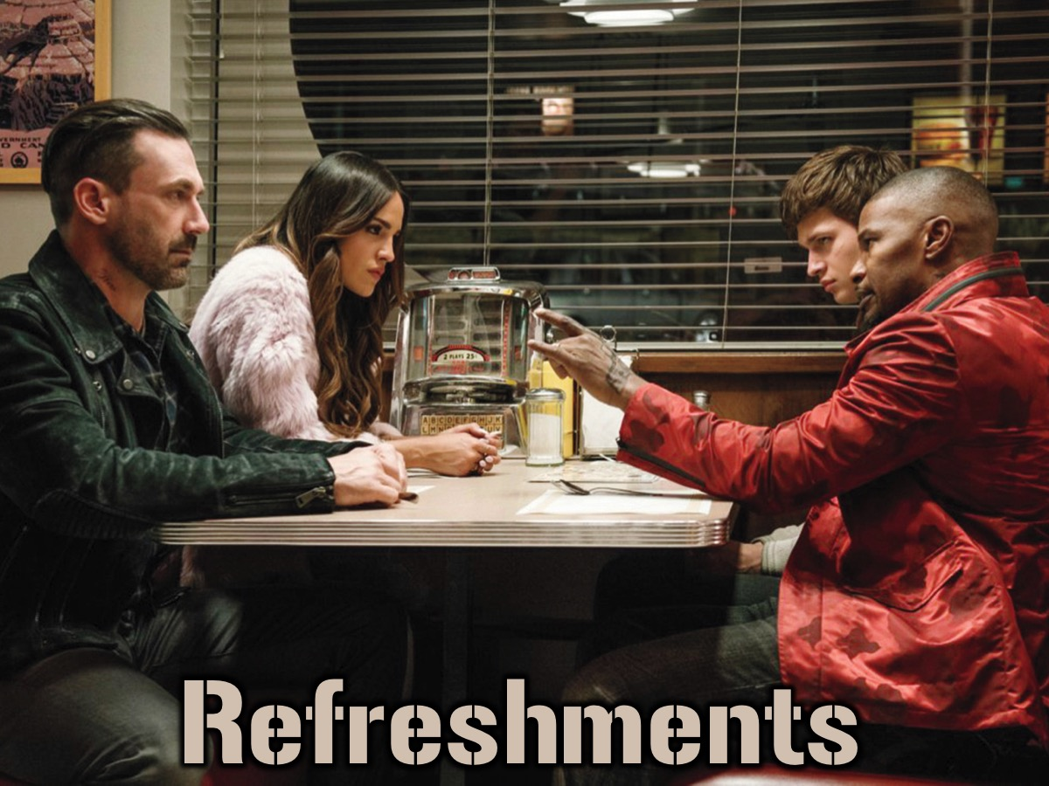
Notes:
Refreshments: It is time for refreshments. Tonight we have Doughnuts and Milkshake!

Slide 37
Notes:
#Party Night!

