Slide 1
Notes:
This week is our Clash of Clans Night.

Slide 2
Notes:
Welcome to Escape Friday.

Slide 3
Notes:
ANNOUNCEMENT: On Sunday morning in our Breakout Series we are dealing with Religion.

Slide 4
Notes:
ANNOUNCEMENT: Next Friday night is our Breakout Party as we end Term 1 on a high note.

Slide 5
Notes:
Tonight is our Clash of Clans Night.

Slide 6
Notes:
Here is a trailer from the Clash of Clans video game…

Slide 7
Notes:
VIDEO: Clash Of Clans - Official TV Commercial! HD. Get it on YouTube at: https://www.youtube.com/watch?v=ksK5DaYNts4

Slide 8
Notes:
Welcome to newcomers and regulars.

Slide 9
Notes:
We are going to watch a Clash of Clans Live Action Movie Trailer.

Slide 10
Notes:
VIDEO: Clash of Clans Live Action Movie Trailer Commercial. Get it on YouTube at: https://www.youtube.com/watch?v=CaObO42bjiI

Slide 11
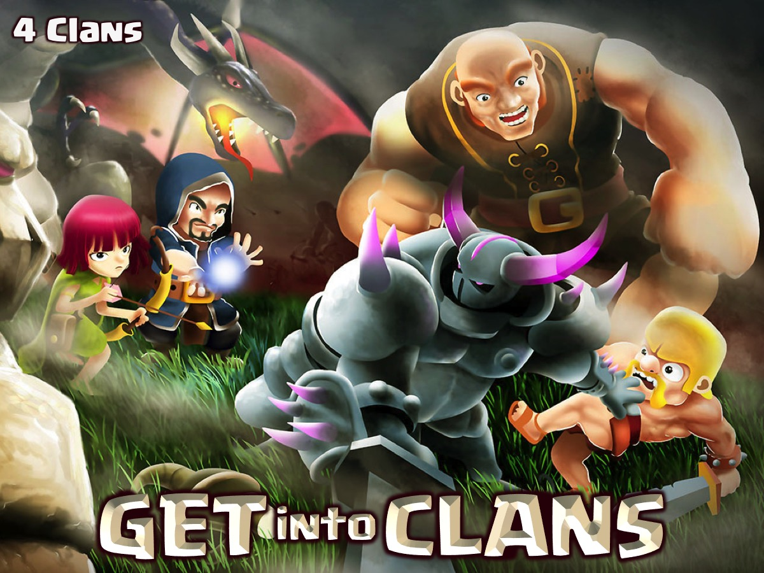
Notes:
GET into CLANS: We are going to divide into 4 Clans.

Slide 12
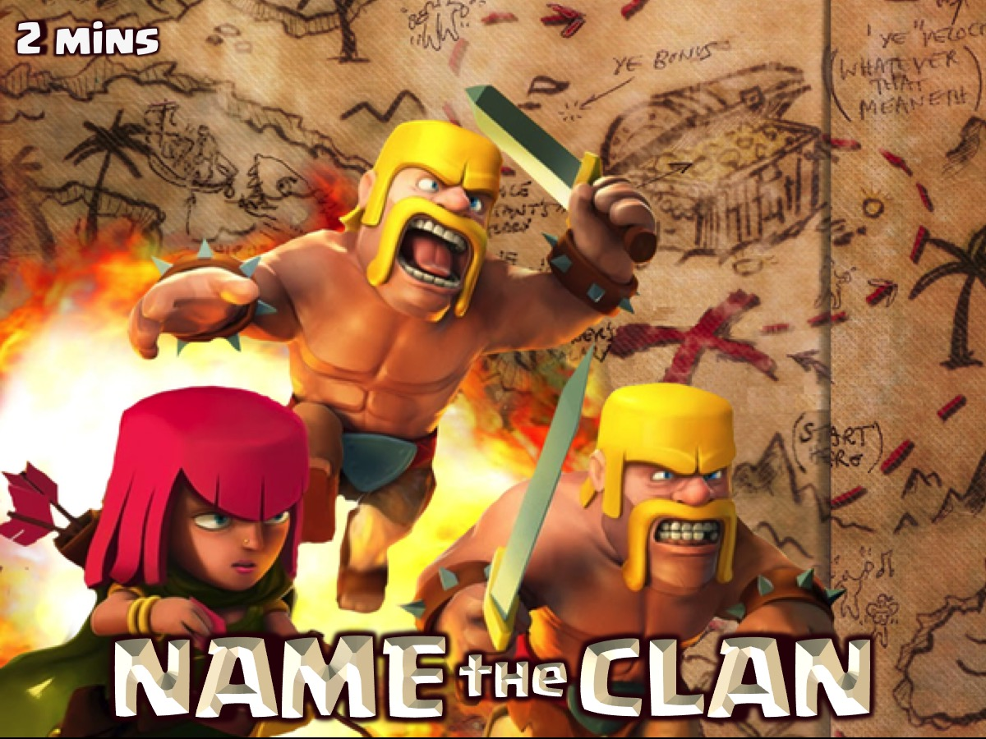
Notes:
NAME the CLAN: Each team has 2 minutes to come up with a name for their Clan which will be judged for points.

Slide 13
Notes:
MAKE the CRY: Each team has 3 minutes to create a war cry for their Clan that will be judged by our judges for points.

Slide 14
Notes:
BUILD the FORT: Your Clan has 3 minutes to build a fort on a table out of boxes.

Slide 15
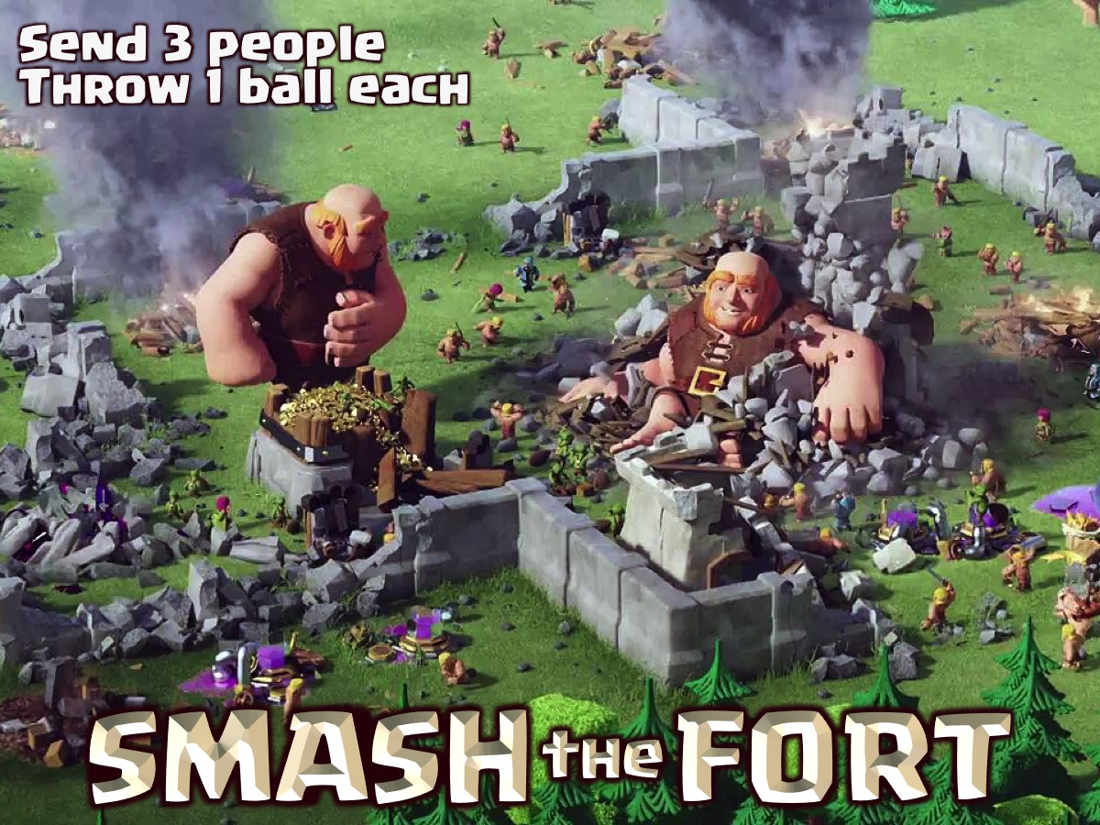
Notes:
SMASH the FORT: Each clan sends 3 people to each throw 1 ball at any of the other three teams forts. Each box left on the table will win a point for the Clan.

Slide 16
Notes:
ROLL the DICE: There will be three rounds where each team will roll the pair of dice and you will score points depending on what you roll in each round.

Slide 17
Notes:
DODGE the BALL: Teams will battle each other at Dodge Ball and will win a point for each team member that is still alive at the end of 3 minutes.

Slide 18
Notes:
SCORE the GOAL: A game of netball where the goal is a person standing on a chair to catch the ball. We could have four or five people on a team. You will play for 3 minutes and you will win a point for each goal that you score in that time.

Slide 19
Notes:
CHECK the SCORES: Teams will be rewarded depending on the points they have earned during the night.

Slide 20
Notes:
SMALL GROUPS. Here are the small group questions: (1) What were your clan’s strengths/weaknesses? (2) What did your clan have to do to conquer? (3) How do we become part of God’s clan? For God chose to save us through Jesus. Christ died for us so that we can live with him forever. (1 Thessalonians 5:9-10). To all who believe and accept him, he gives the right to become children of God. (John 1:12). (4) Pray for each other to find their place in God’s clan.

Slide 21
Notes:
ANNOUNCEMENT: Next Friday night is our Breakout Party as we end Term 1 on a high note.

Slide 22
Notes:
Refreshments are served.

Slide 23
Notes:
ANNOUNCEMENT: Next Friday night is our Breakout Party.

