Slide 1
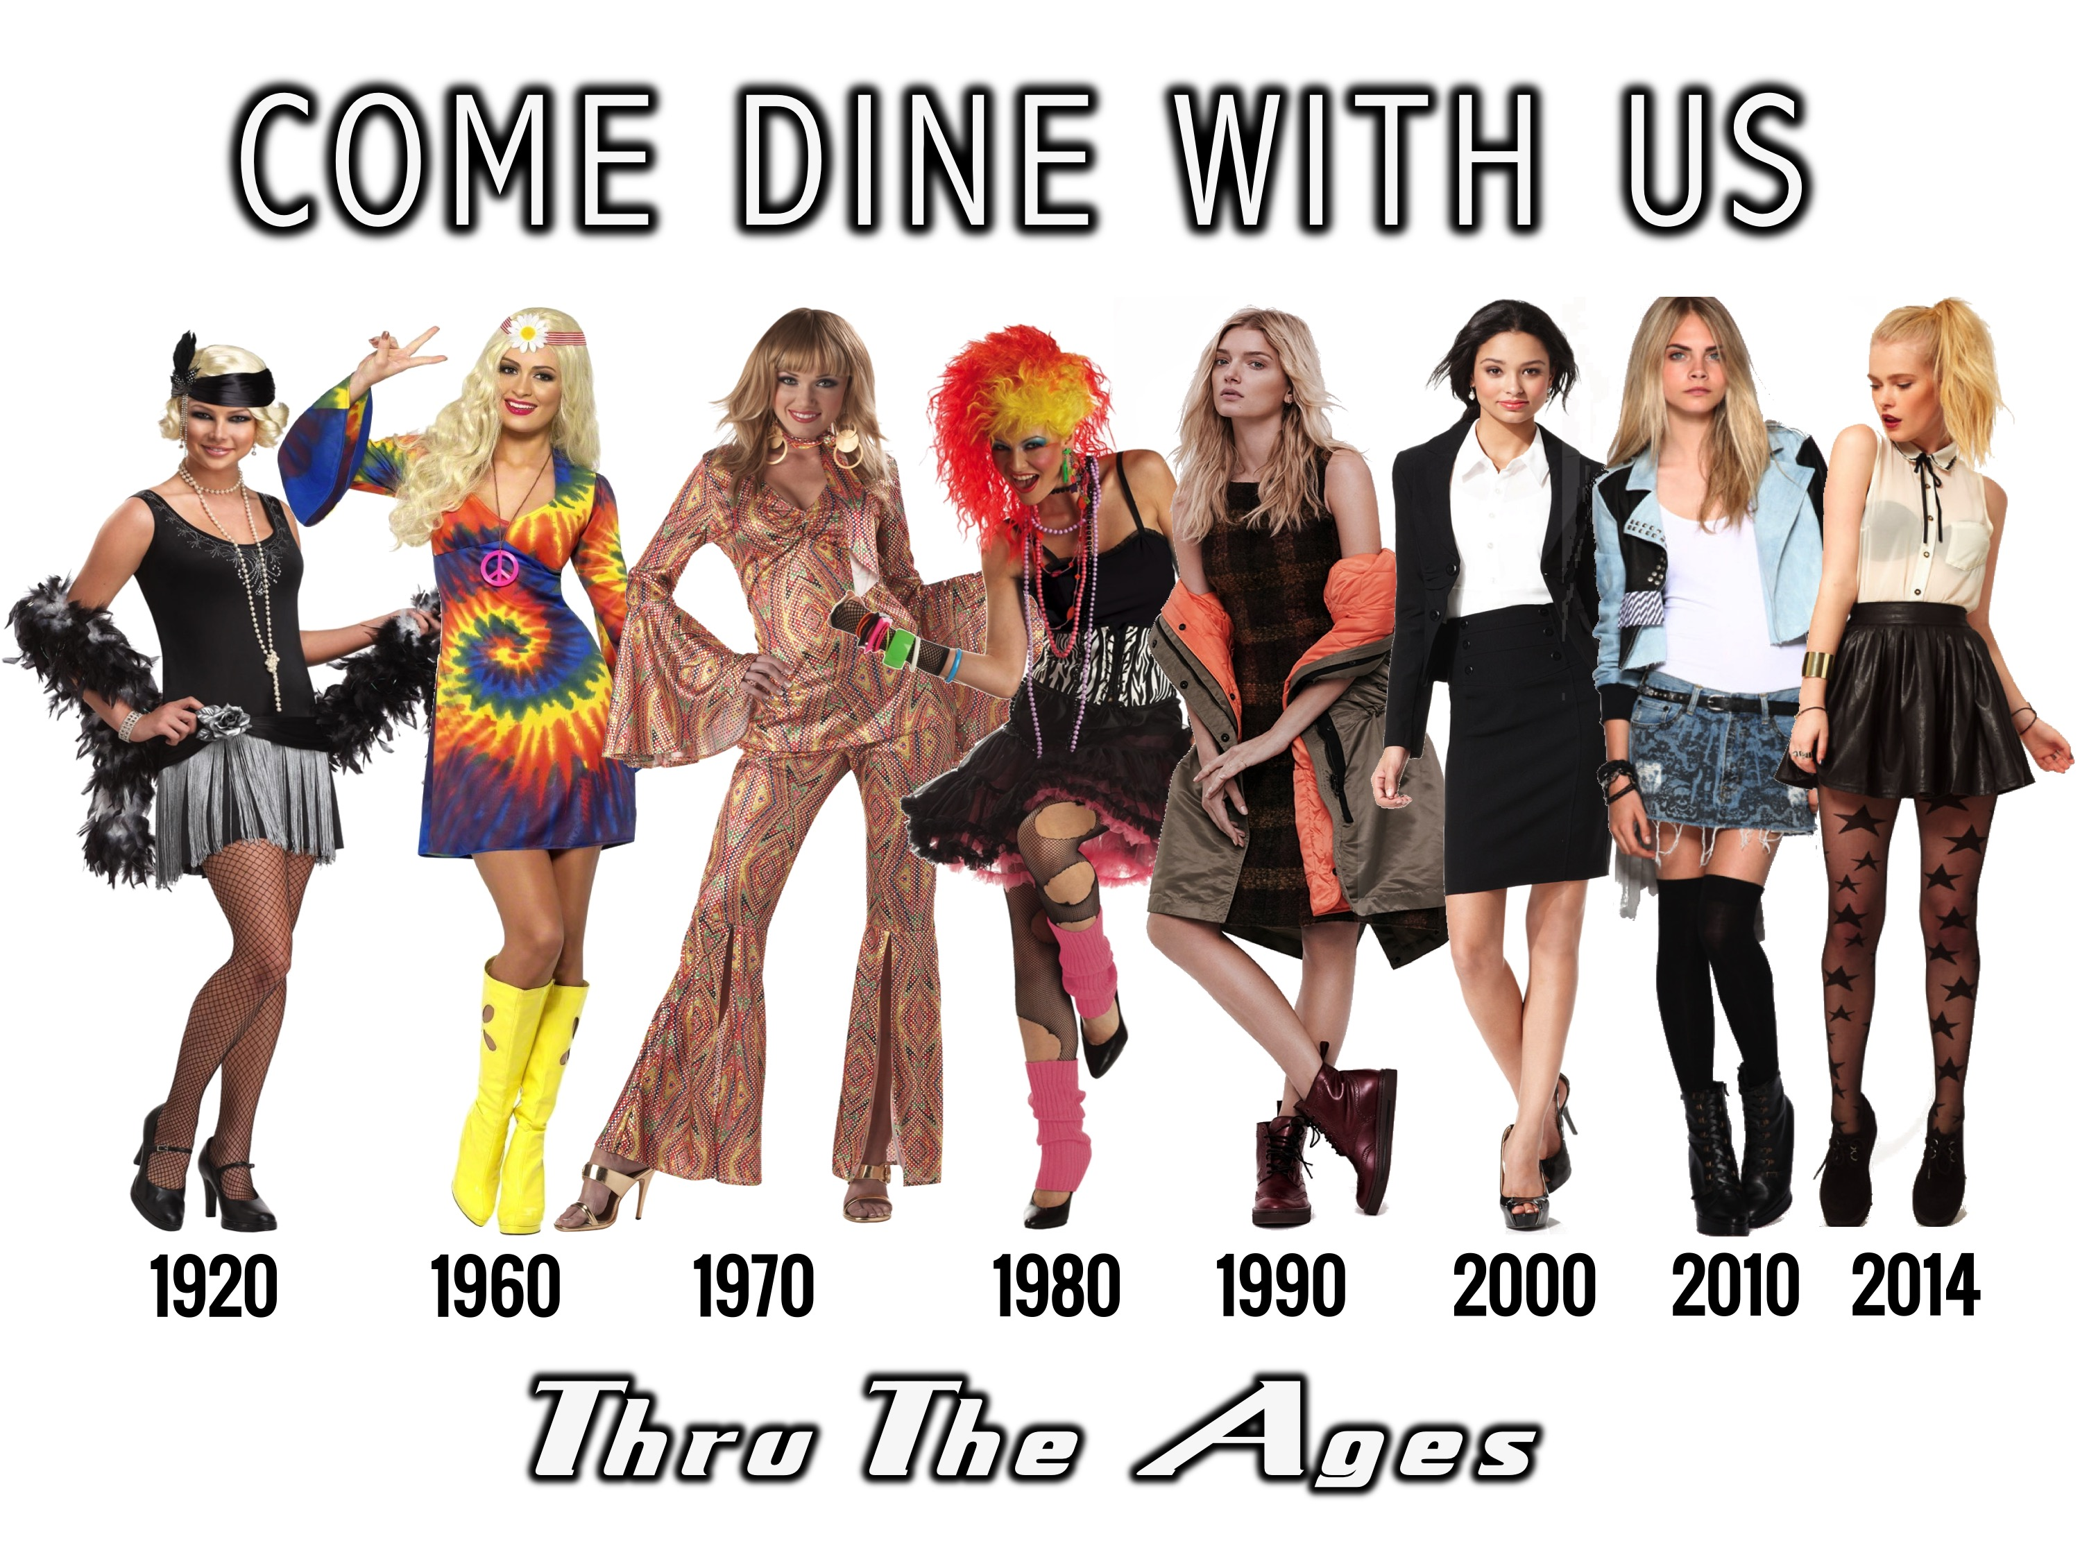
Notes:
This Friday night is our last night of the term and it is our Come Dine With Us event. We are starting in the conference room were teens will be welcomed and shown the 8 menus for the 8 tables. They will each choose one of the tables and then move through to the youth room and sit at that table. Each table is themed around a different decade from 1920 to 2014.

Slide 2
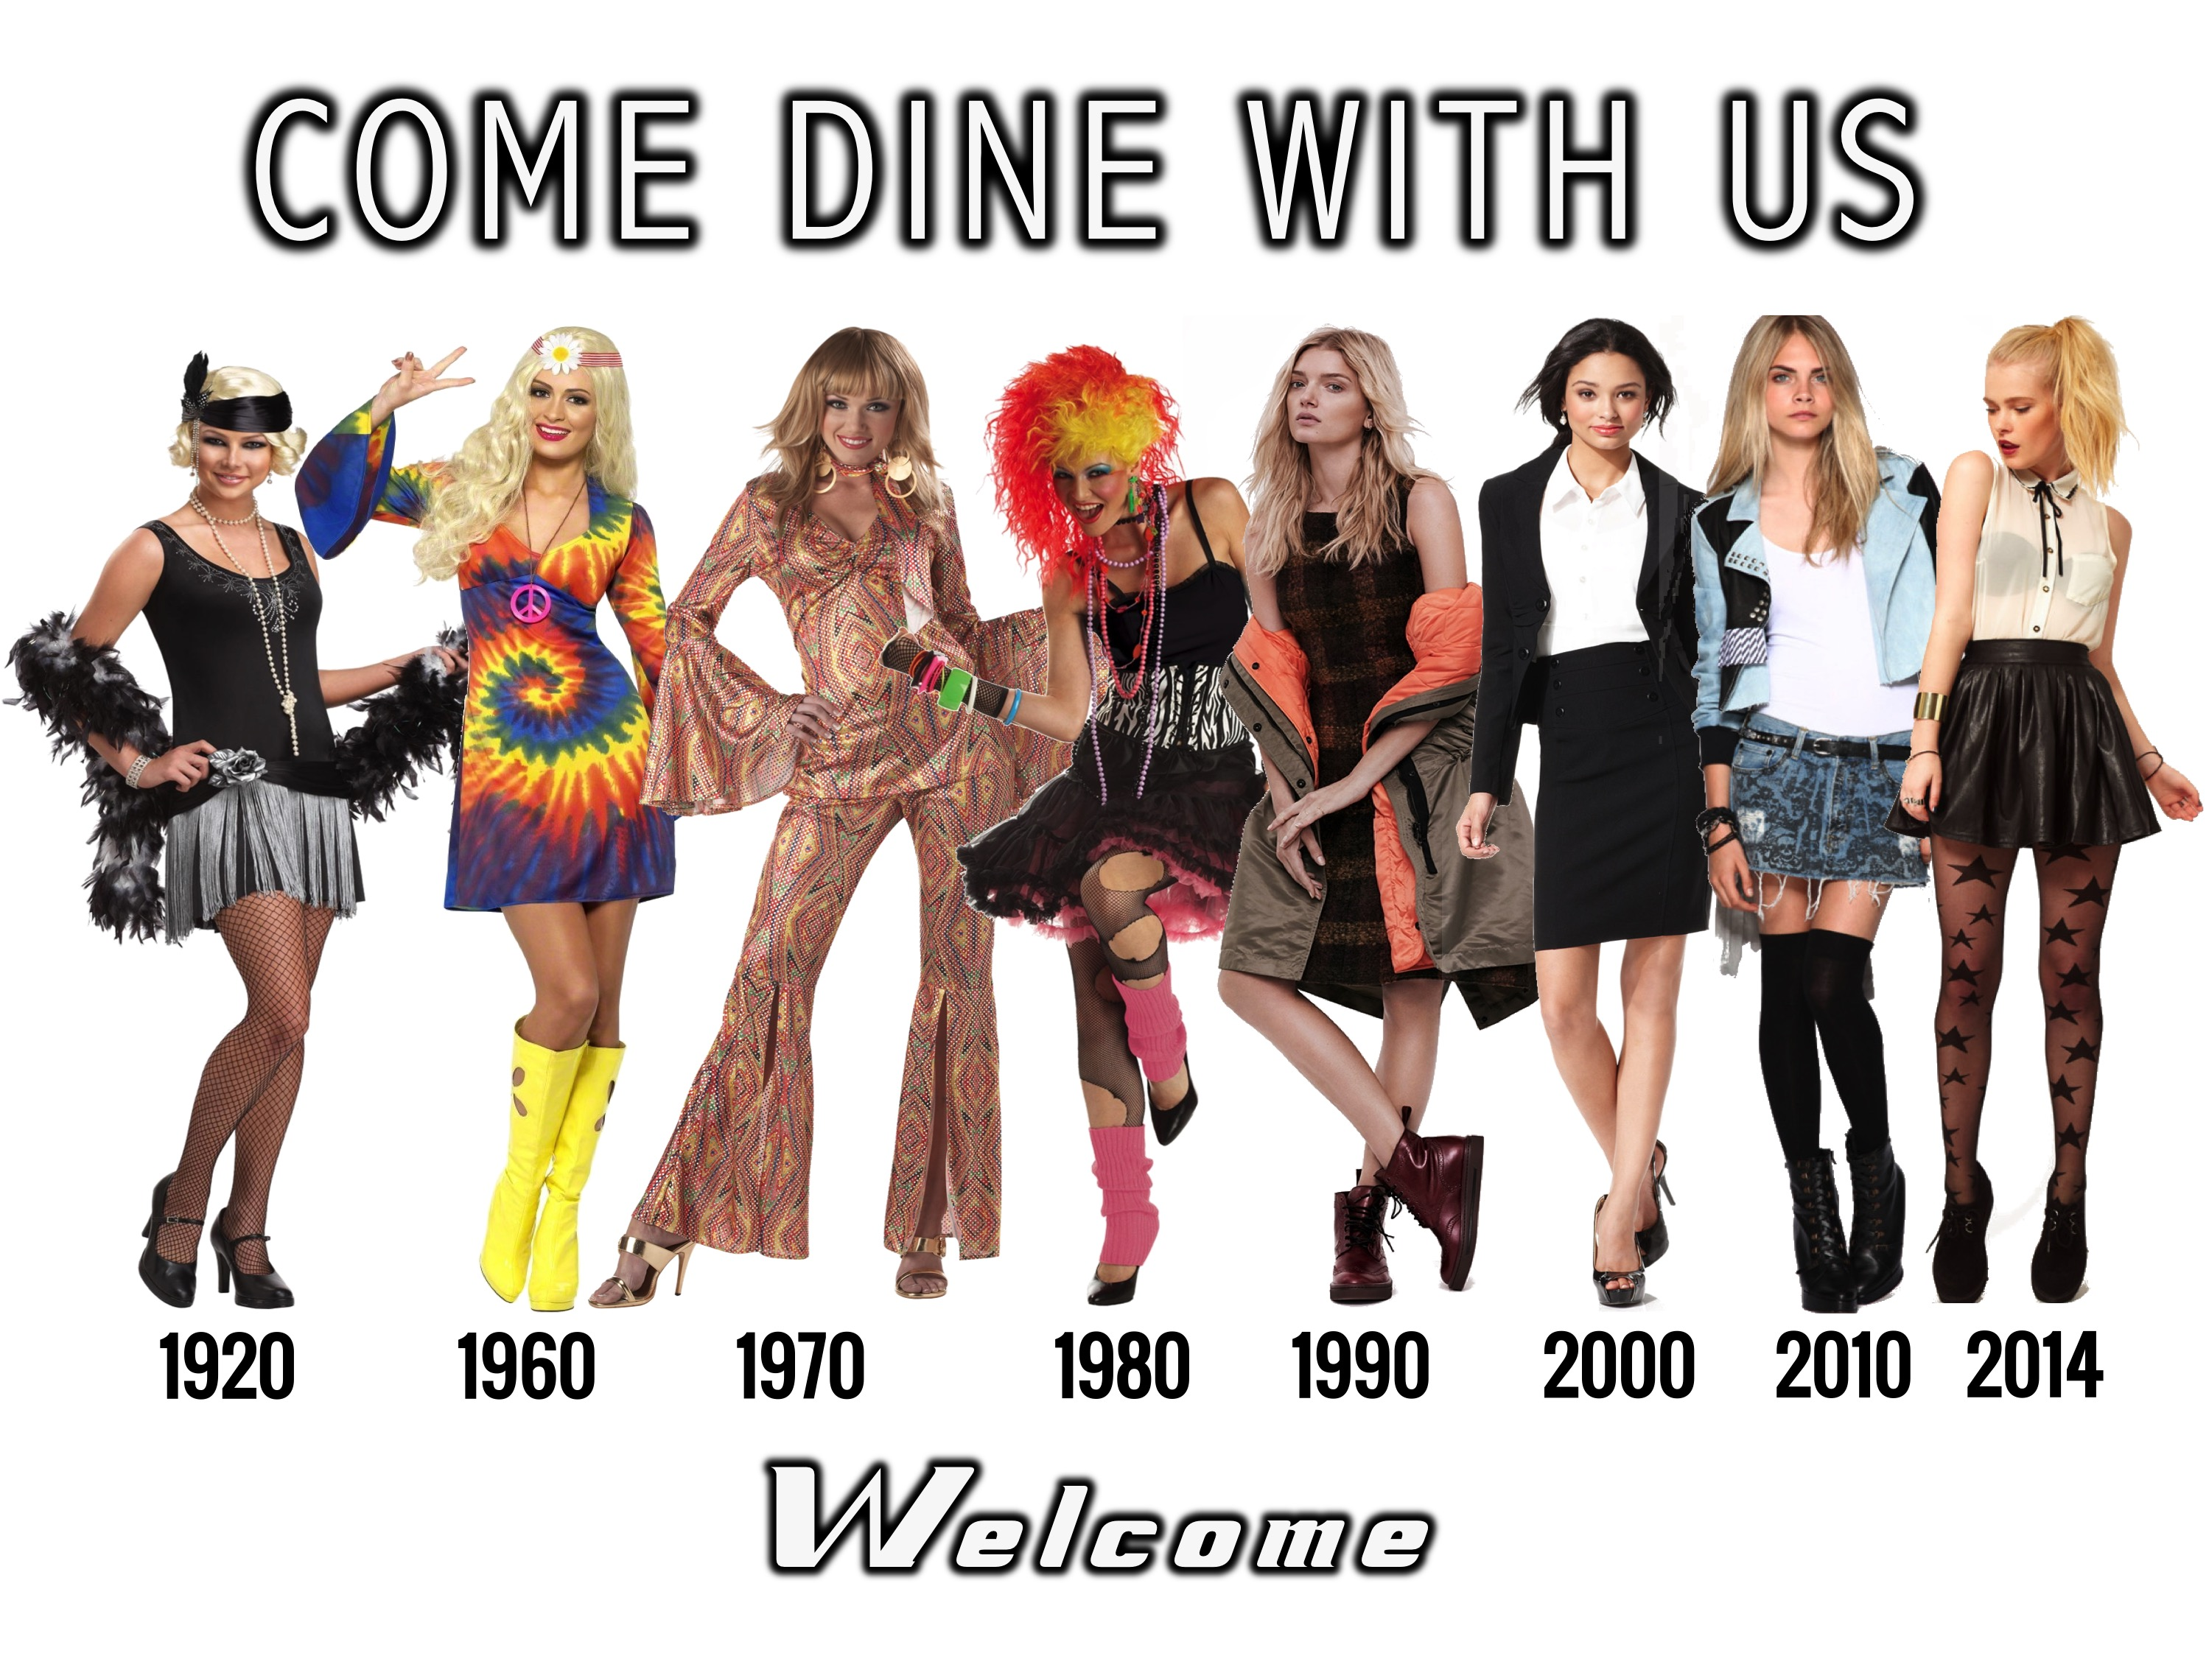
Notes:
Welcome to Come Dine With Us night. Are there any newcomers here tonight?

Slide 3

Notes:
The Menus – you will have a chance to check out the 8 menus from each of the tables in the youth room tonight.

Slide 4
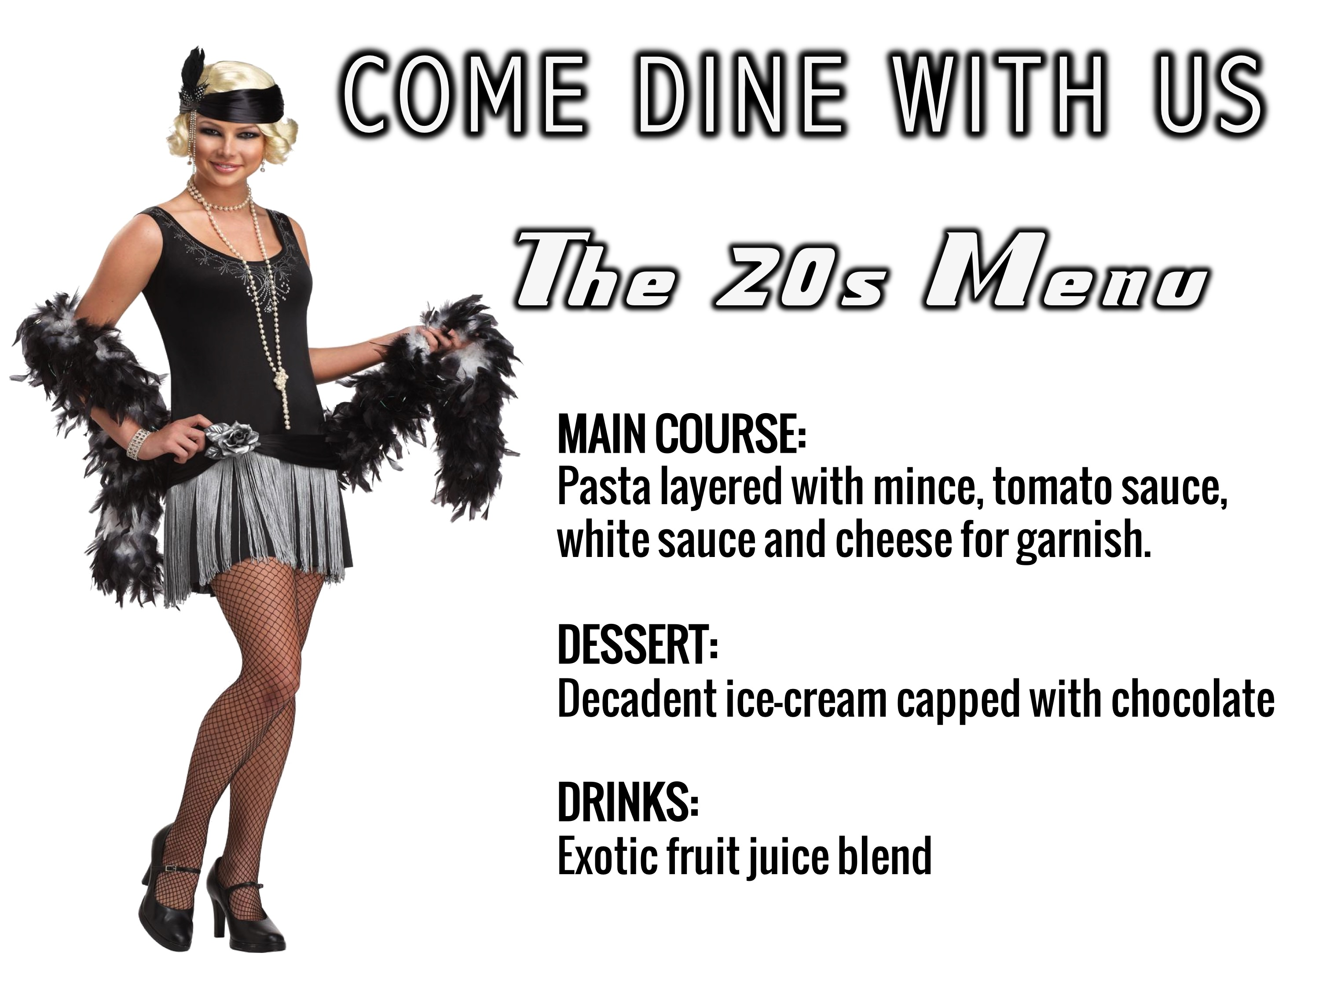
Notes:
The 20s Menu (Genavieve). MAIN COURSE: Pasta layered with mince, tomato sauce, white sauce and cheese for garnish. DESSERT: Decadent ice-cream capped with chocolate. DRINKS: Exotic fruit juice blend.

Slide 5
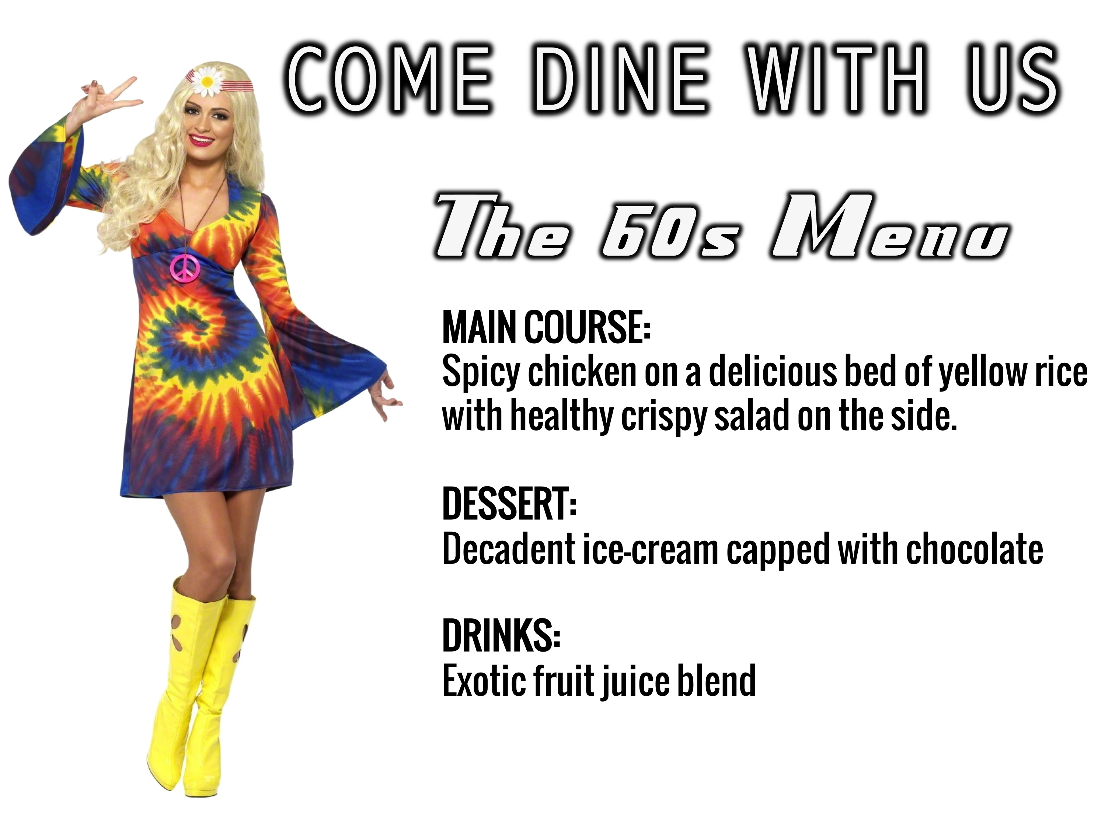
Notes:
The 60s Menu (Keene). MAIN COURSE: Spicy chicken on a delicious bed of yellow rice with healthy crispy salad on the side. DESSERT: Decadent ice-cream capped with chocolate. DRINKS: Exotic fruit juice blend.

Slide 6
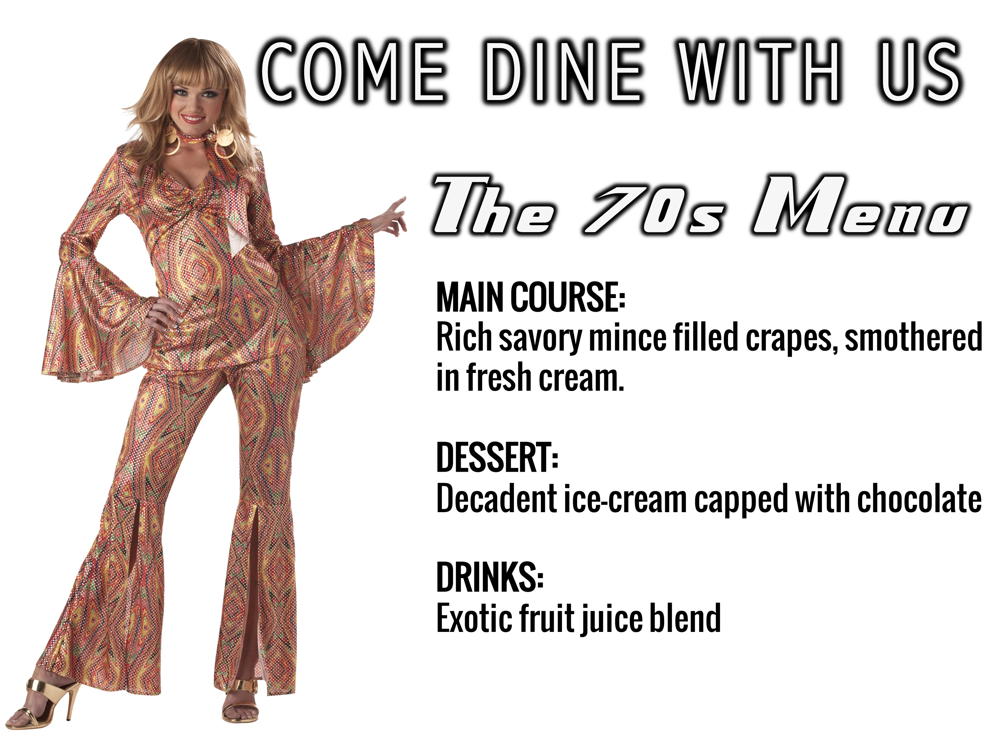
Notes:
The 70s Menu (Shalom). MAIN COURSE: Rich savory mince filled crapes, smothered in fresh cream. DESSERT: Decadent ice-cream capped with chocolate. DRINKS: Exotic fruit juice blend.

Slide 7
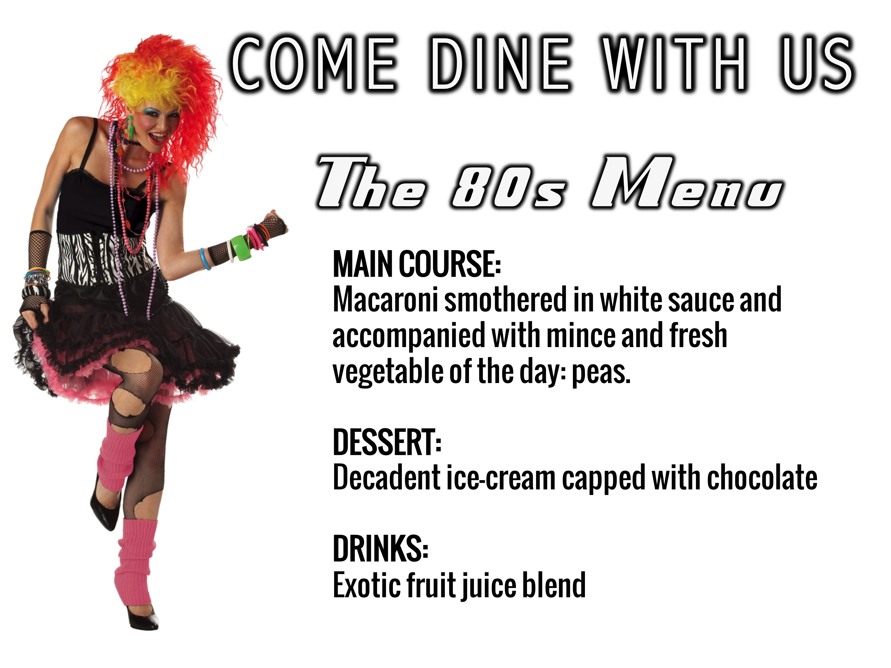
Notes:
The 80s Menu (Micah). MAIN COURSE: Macaroni smothered in white sauce and accompanied with mince and fresh vegetable of the day: peas. DESSERT: Decadent ice-cream capped with chocolate. DRINKS: Exotic fruit juice blend.

Slide 8
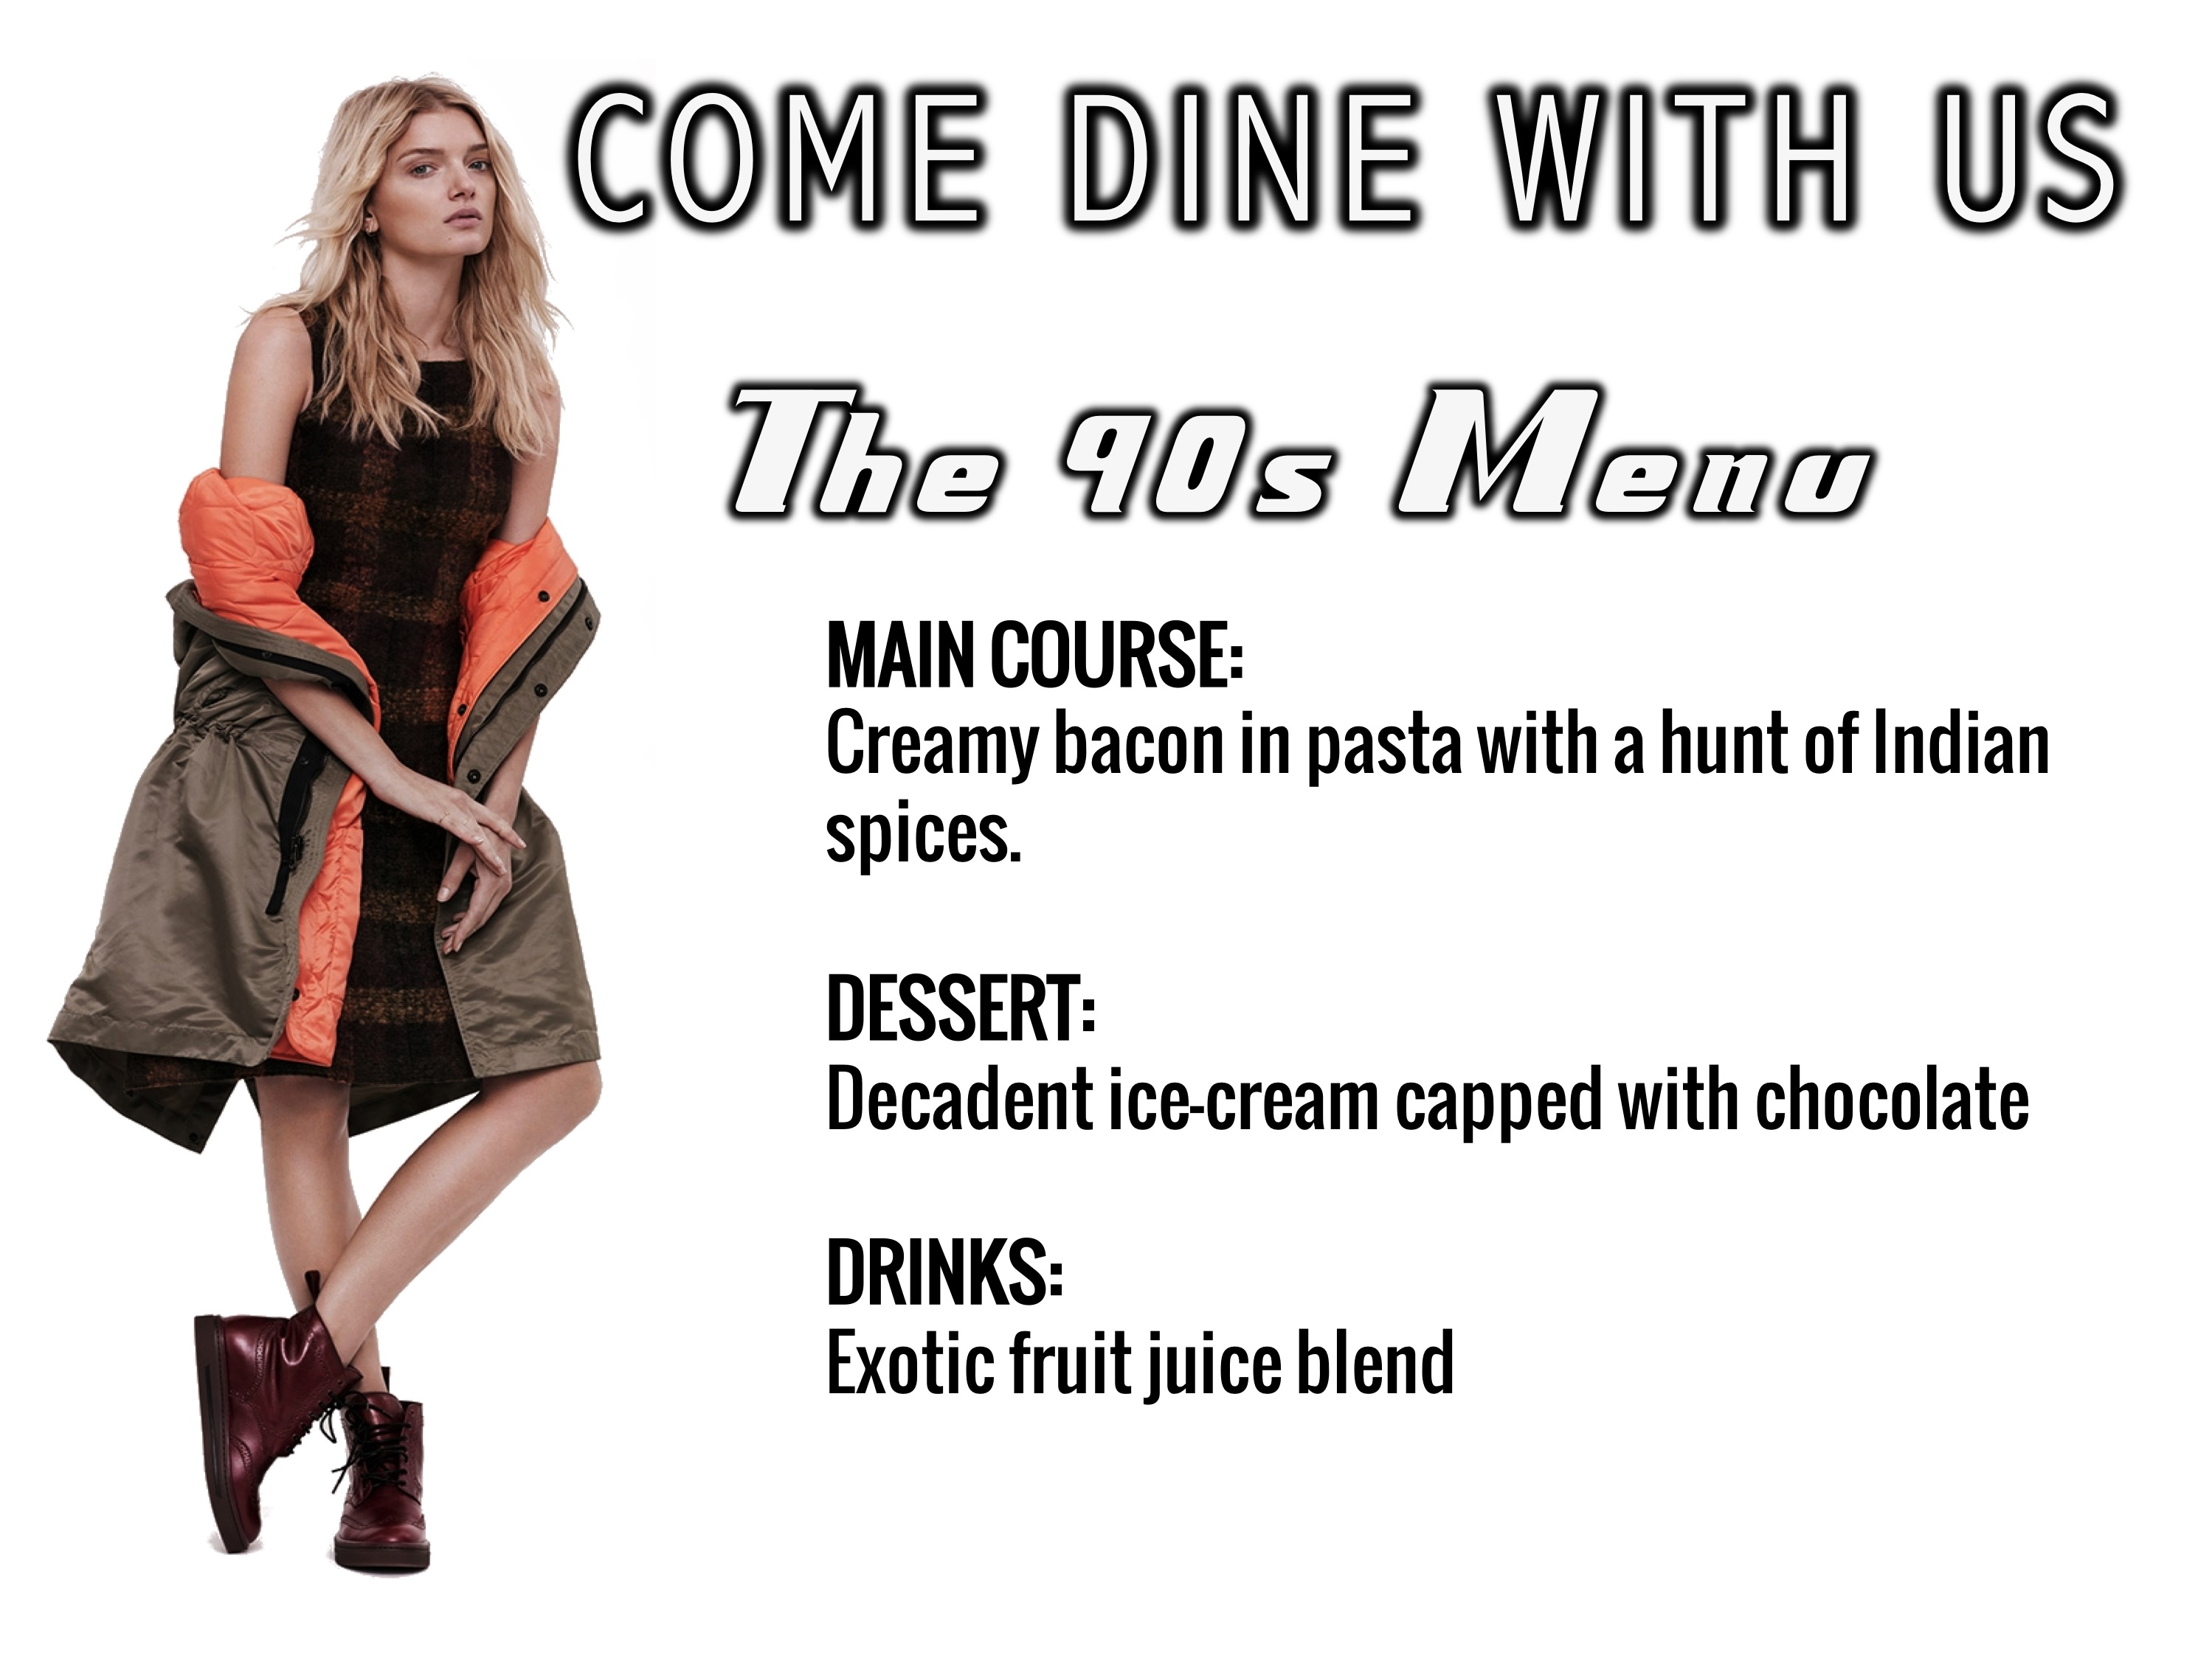
Notes:
The 90s Menu (Hannah). MAIN COURSE: Creamy bacon in pasta with a hunt of Indian spices. DESSERT: Decadent ice-cream capped with chocolate. DRINKS: Exotic fruit juice blend.

Slide 9
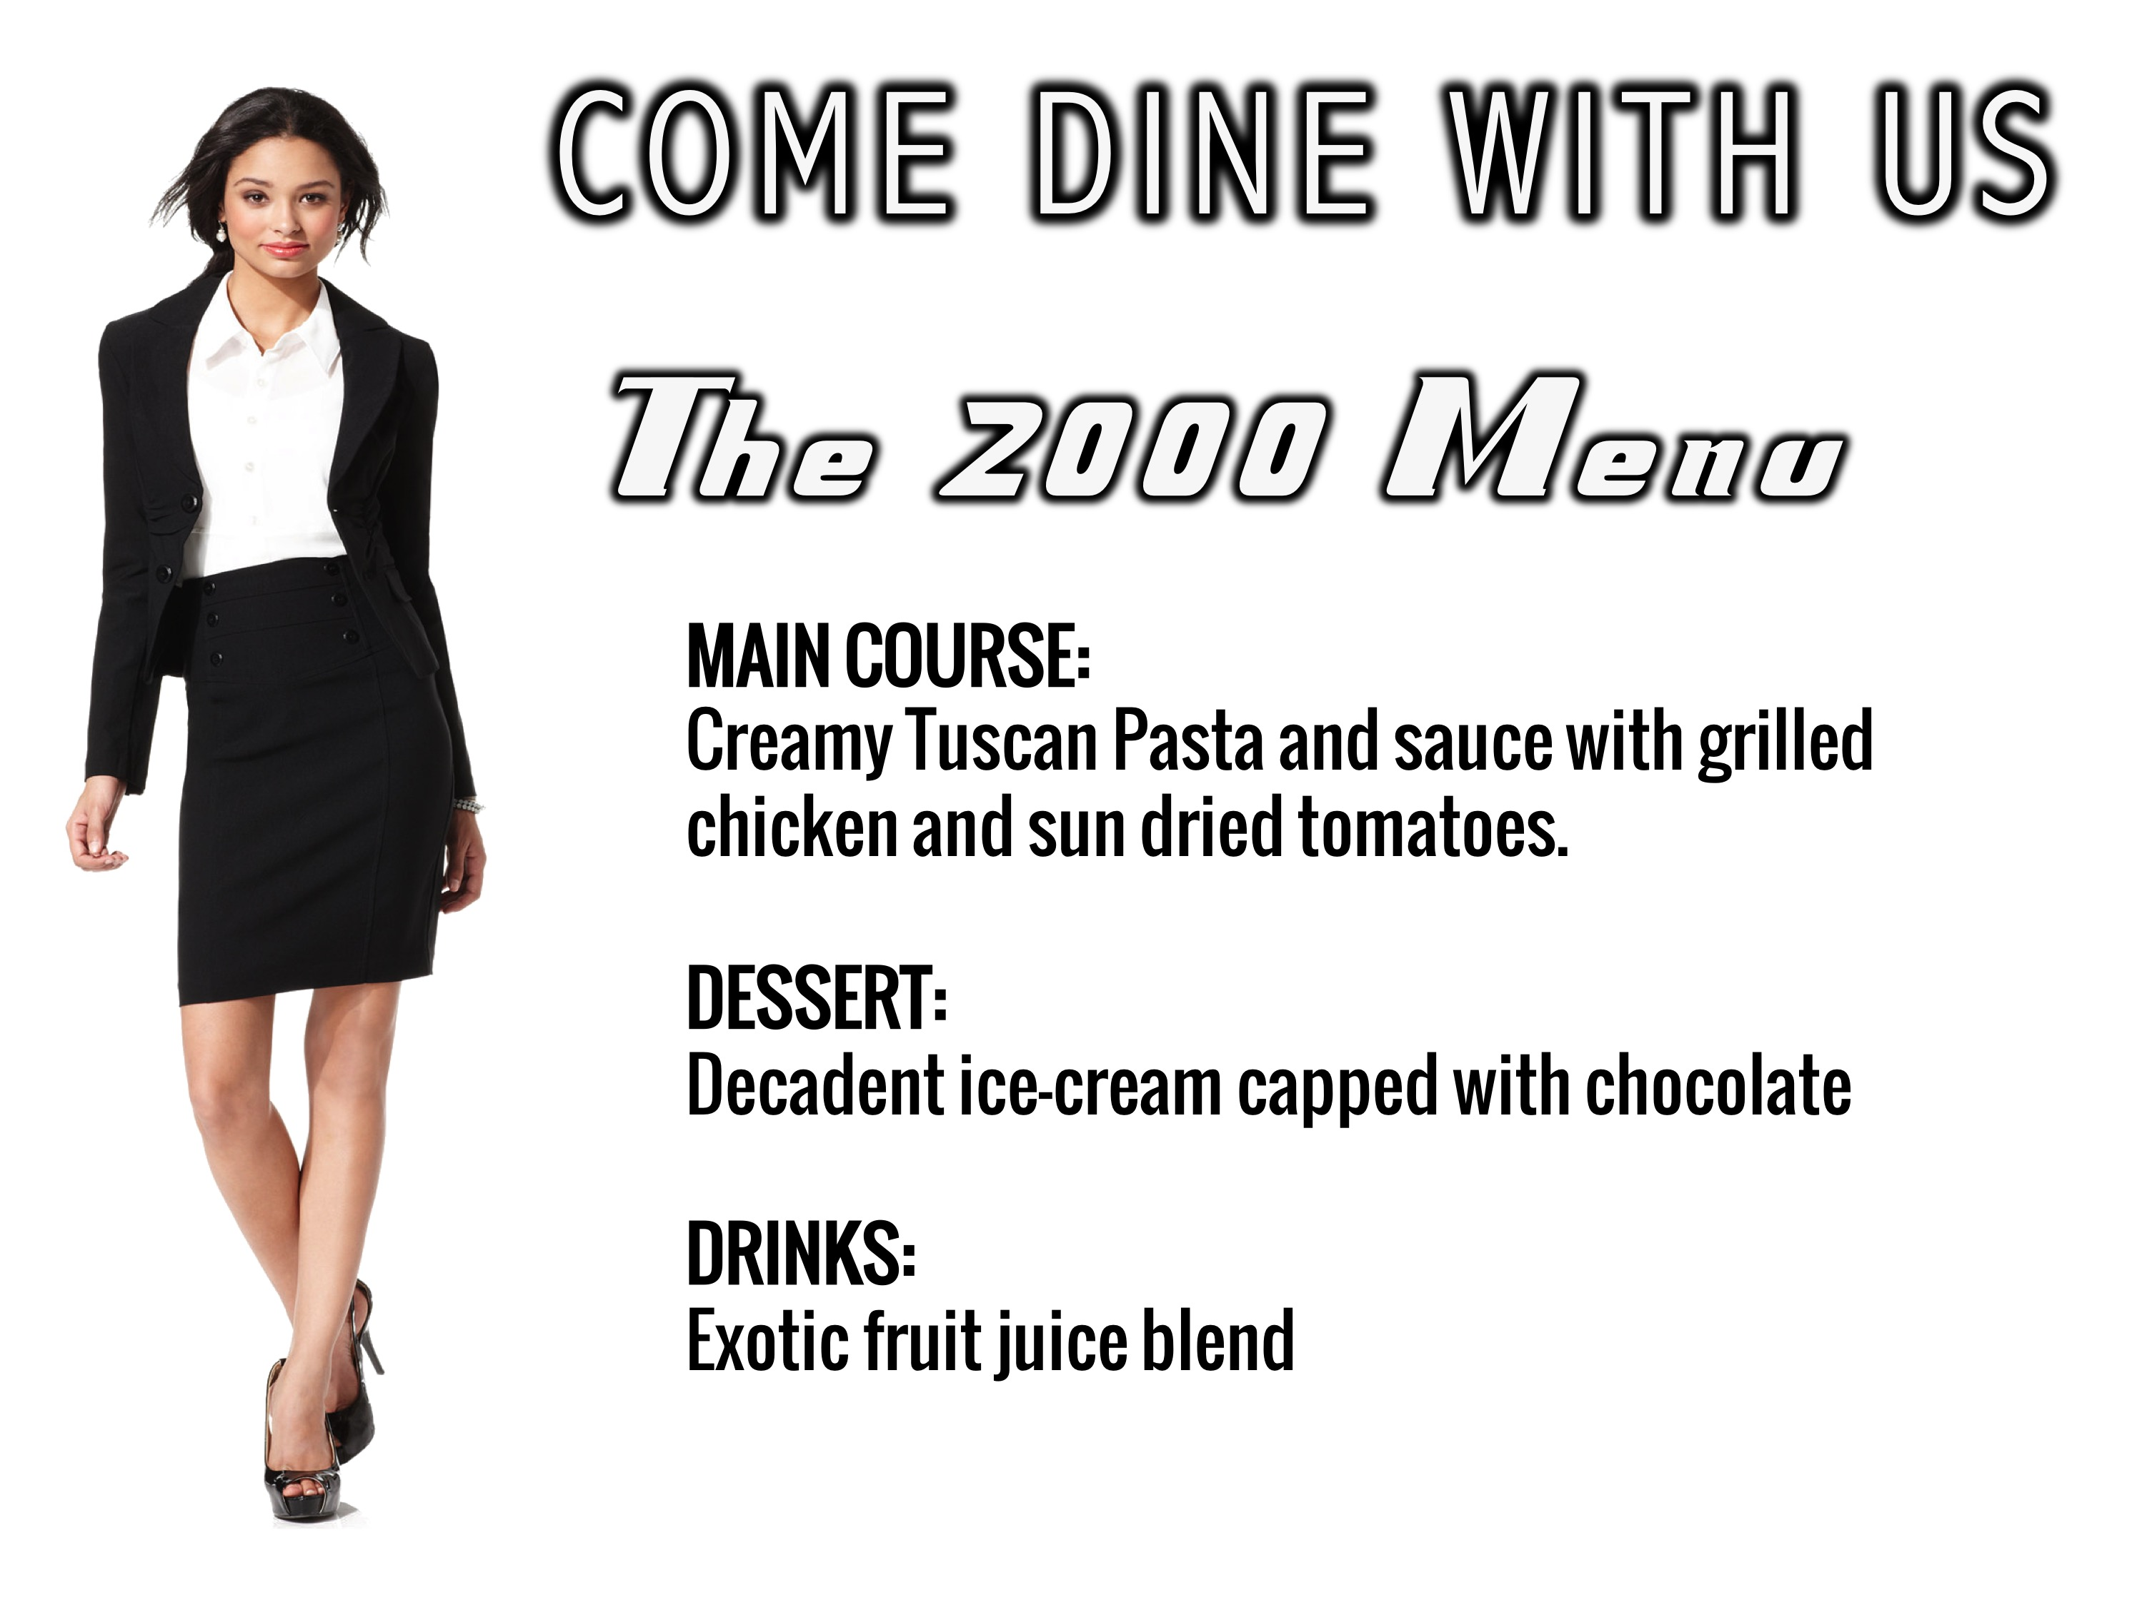
Notes:
The 2000 Menu (Rebecca). MAIN COURSE: Creamy Tuscan Pasta and sauce with grilled chicken and sun dried tomatoes. DESSERT: Decadent ice-cream capped with chocolate. DRINKS: Exotic fruit juice blend.

Slide 10
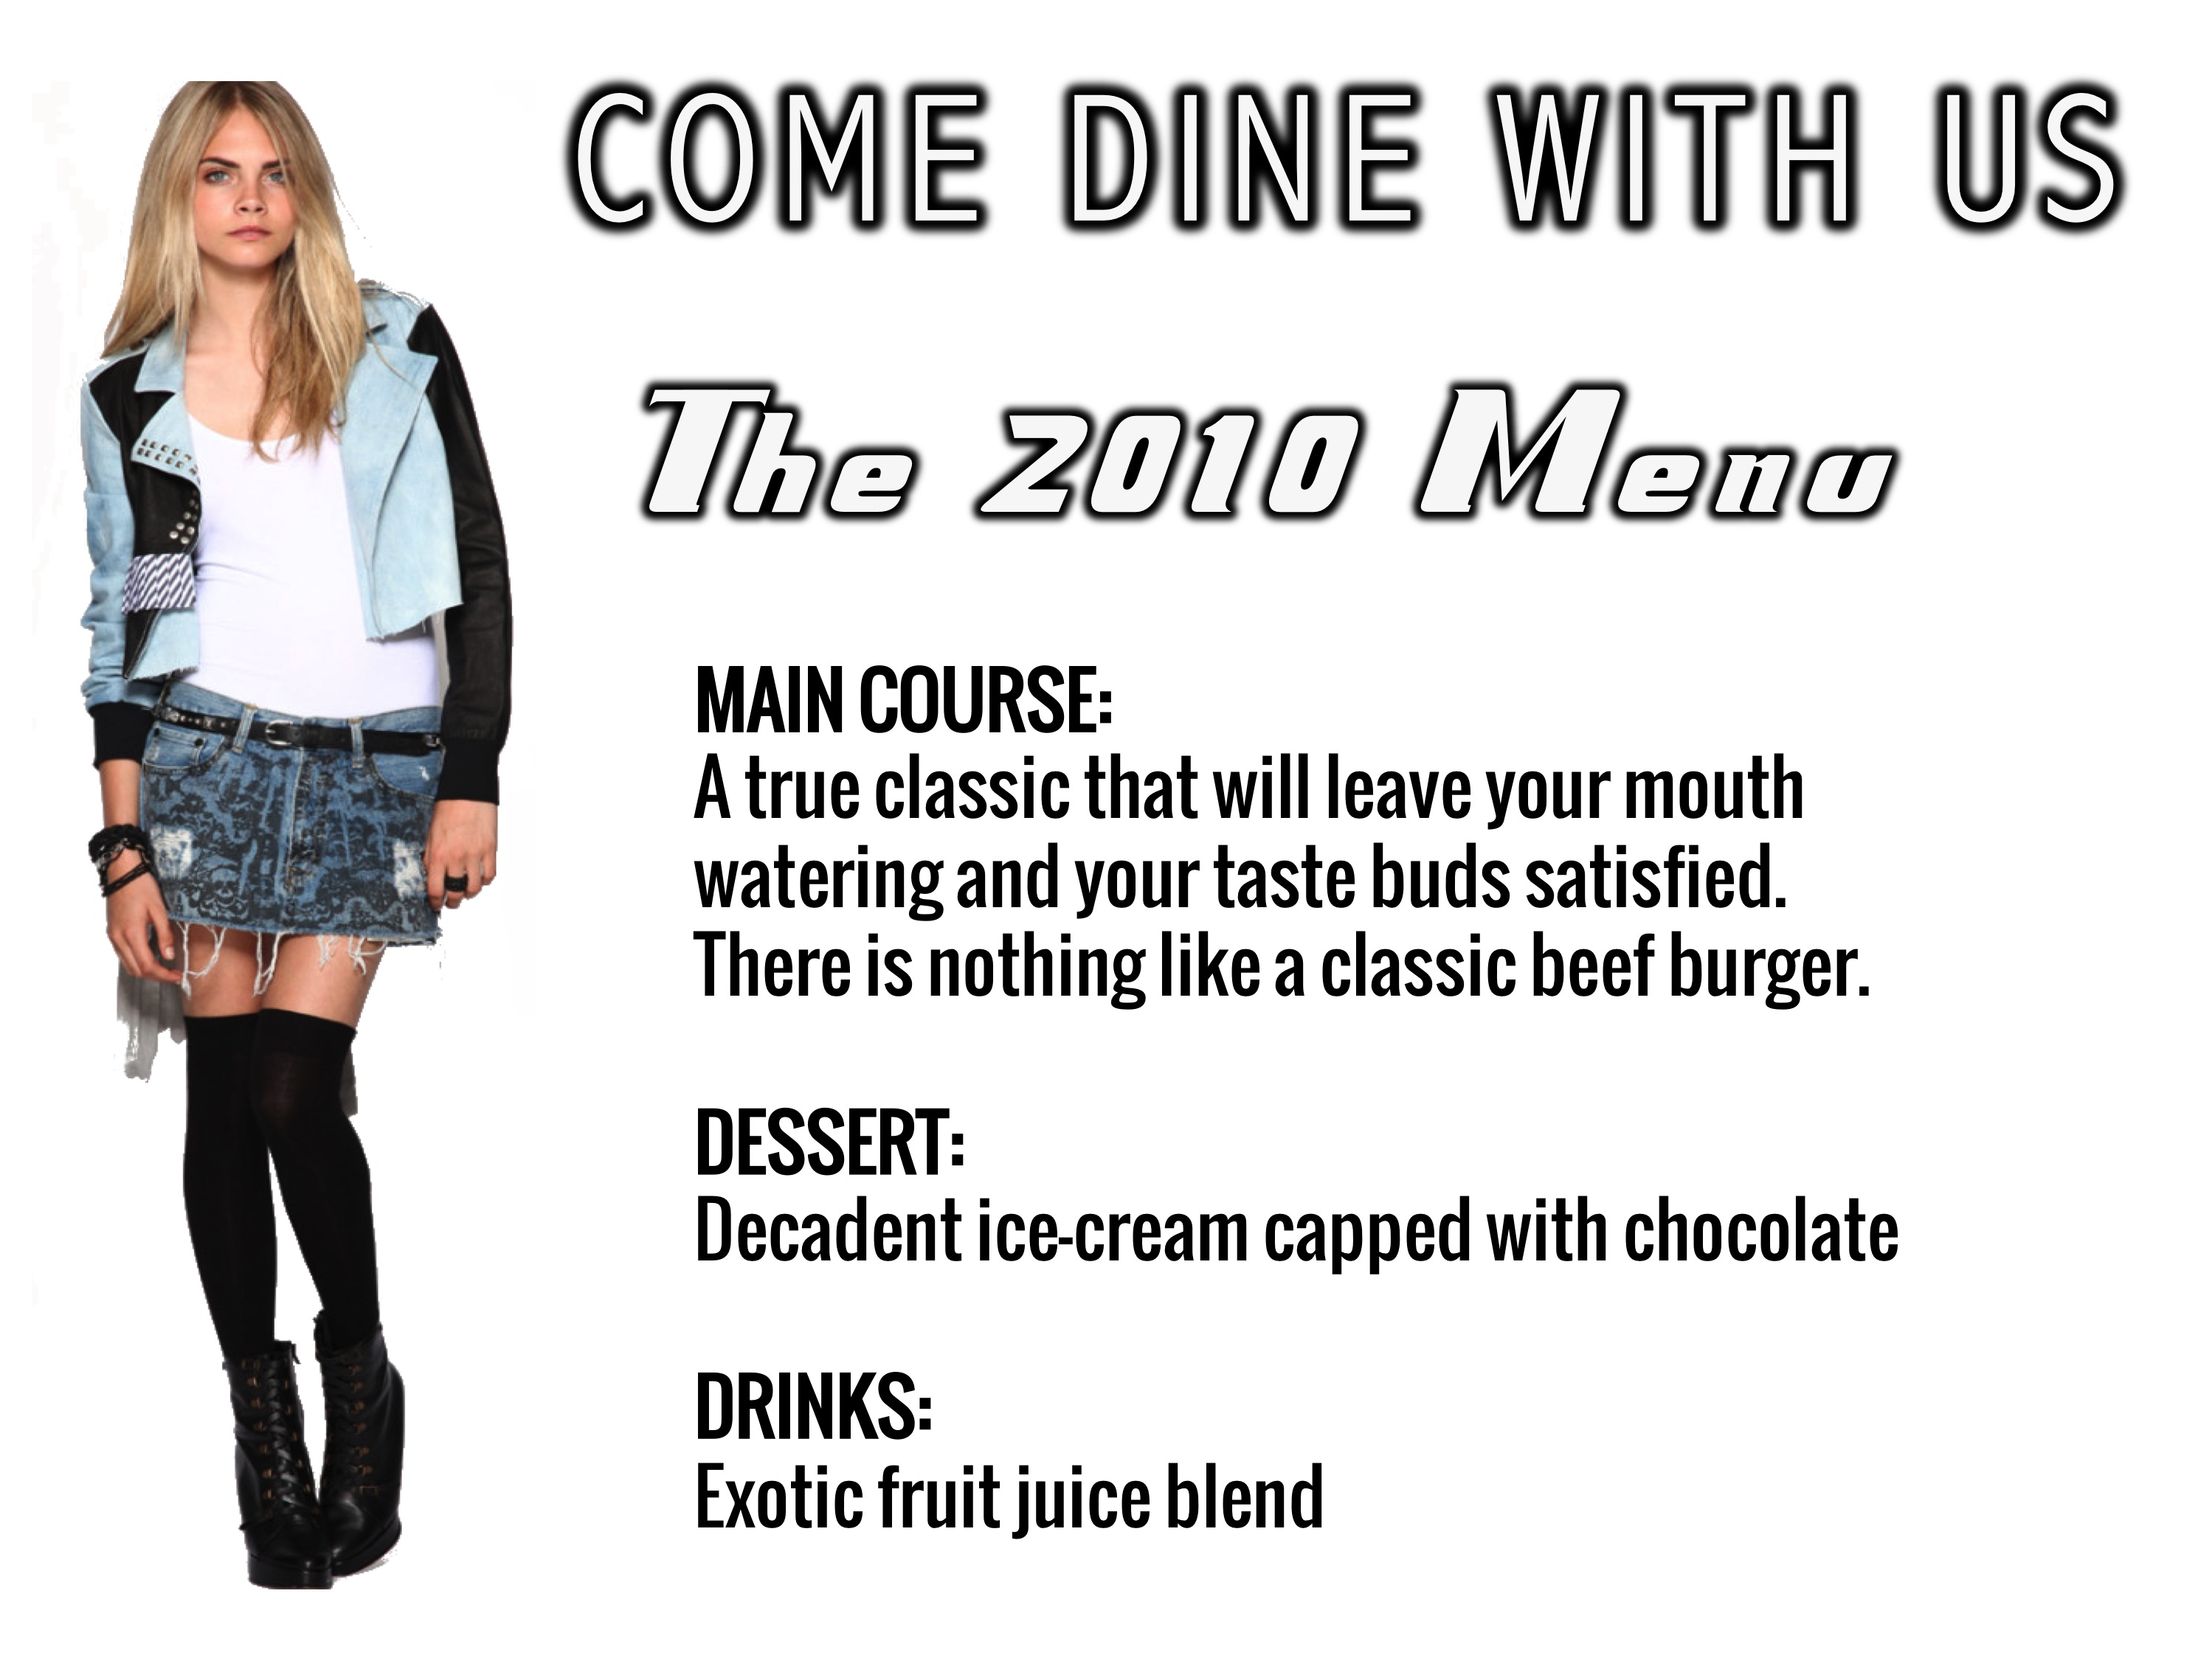
Notes:
The 2010 Menu (Caitlin). MAIN COURSE: A true classic that will leave your mouth watering and your taste buds satisfied. There is nothing like a classic beef burger. DESSERT: Decadent ice-cream capped with chocolate. DRINKS: Exotic fruit juice blend.

Slide 11
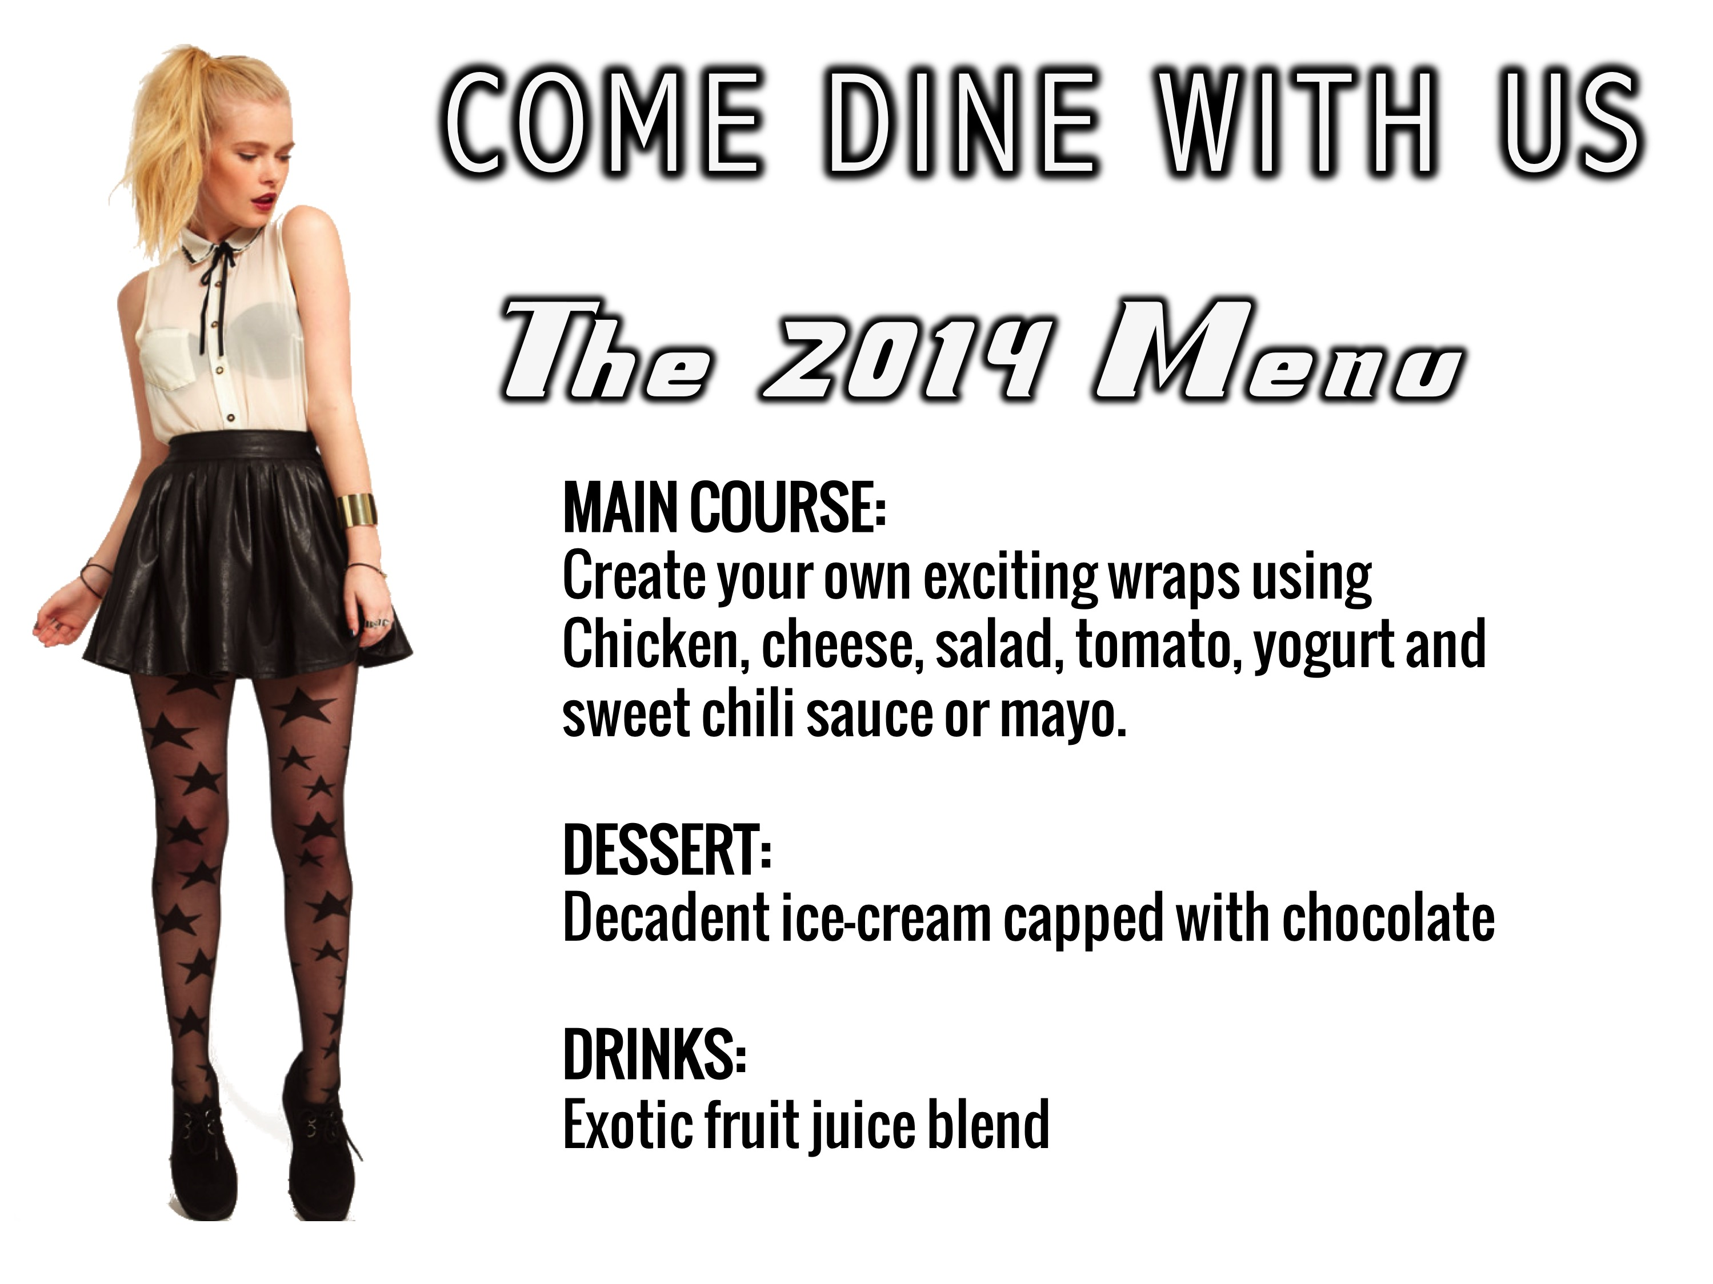
Notes:
The 2014 Menu (Carien). MAIN COURSE: Create your own exciting wraps using Chicken, cheese, salad, tomato, yogurt and sweet chili sauce or mayo. DESSERT: Decadent ice-cream capped with chocolate. DRINKS: Exotic fruit juice blend.

Slide 12

Notes:
Choose a Decade: Check out the menus and take a ticket.

Slide 13
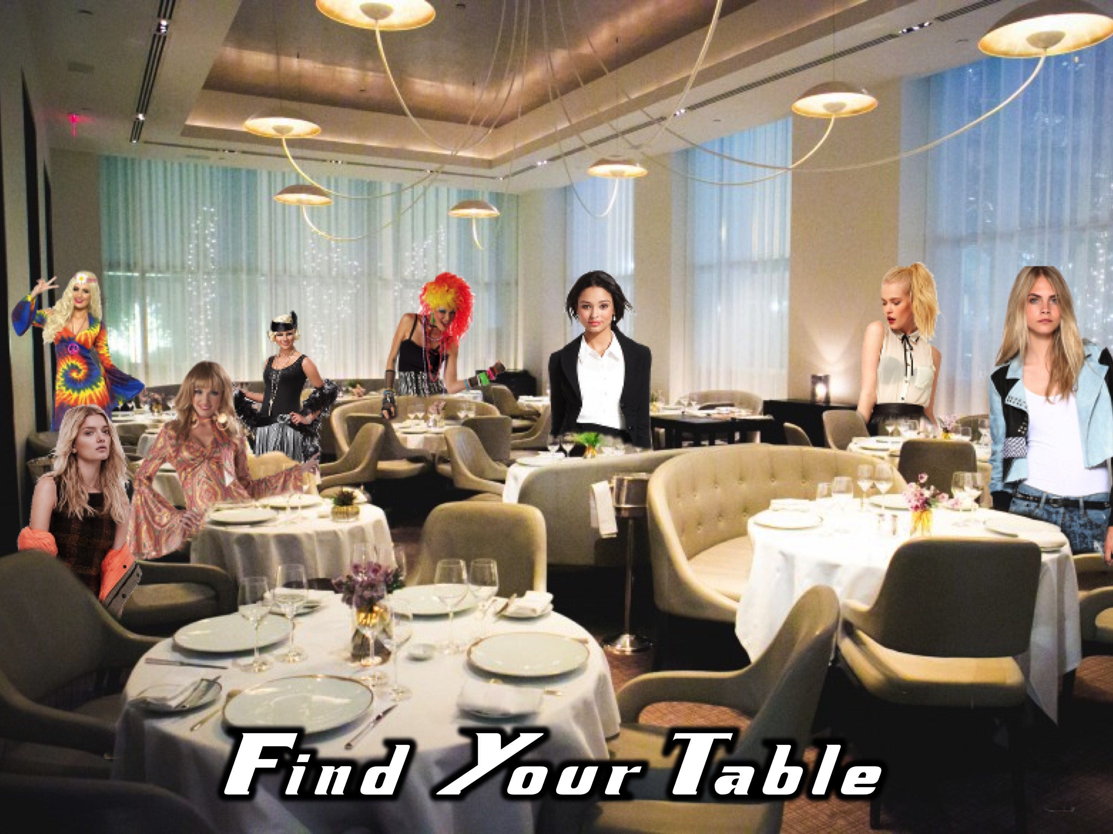
Notes:
Find Your Table and take a seat and make sure you know the people at your table.

Slide 14

Notes:
Welcome Hosts

Slide 15
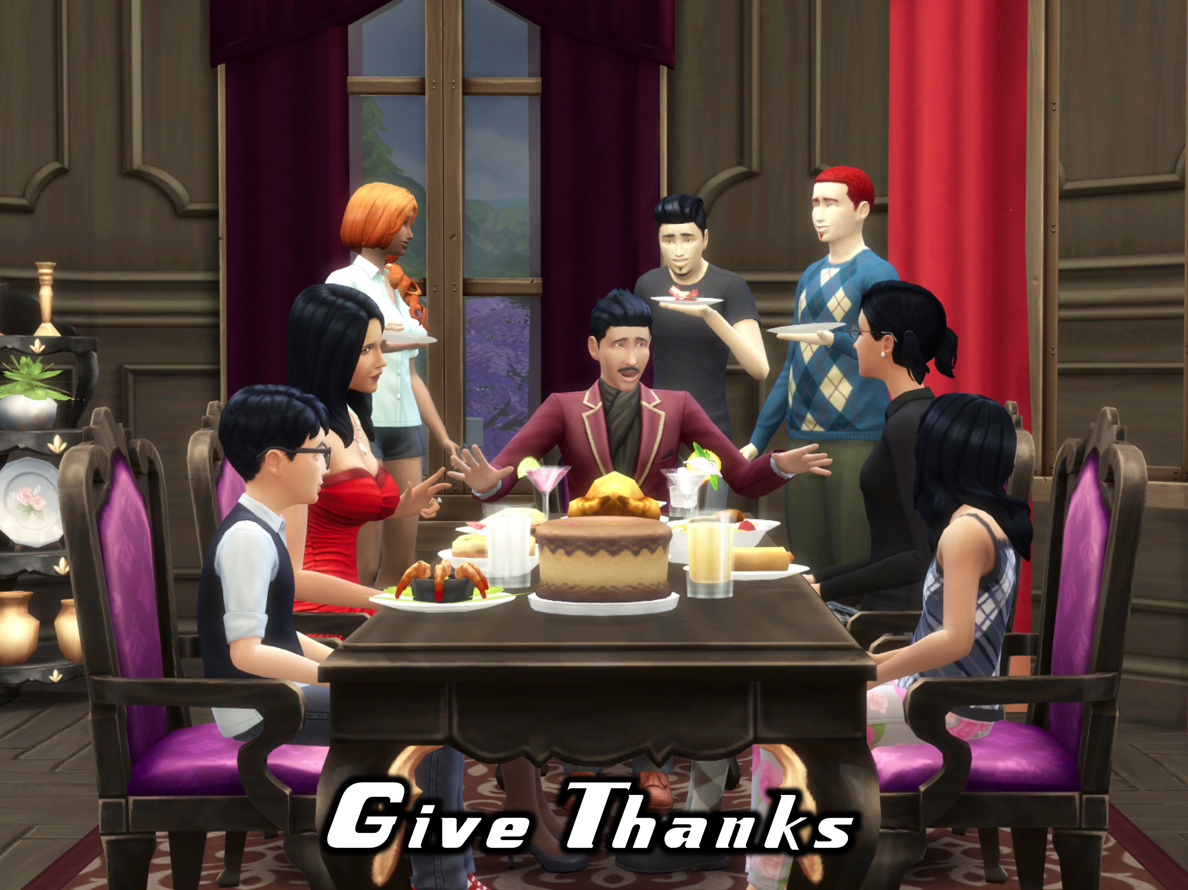
Notes:
Give Thanks – We will say grace at this point.

Slide 16
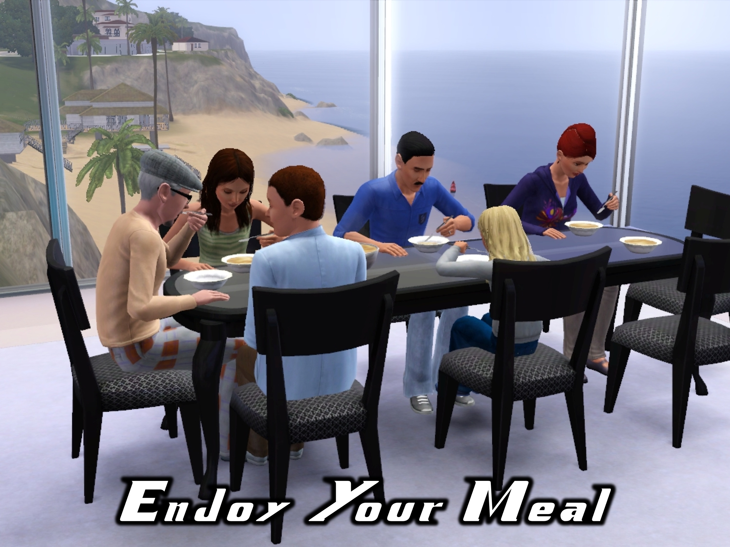
Notes:
Enjoy Your Meal

Slide 17

Notes:
Music Videos

Slide 18

Notes:
Video: Come Dine With Me Top Songs Short. A compliations of songs from 1920 to 2014 taken from YouTube. Check out the following links for songs used in the full length video to be playd during the main meal:
1920s: https://www.youtube.com/watch?v=hxH1LwvPGTc
1960s: https://www.youtube.com/watch?v=vQx_0VBSRcA
1970s: https://www.youtube.com/watch?v=04UCWMsAqhI
1980s: https://www.youtube.com/watch?v=wm7ZB06o8NY
1990s: https://www.youtube.com/watch?v=OZKFjEm-35w
2000s: https://www.youtube.com/watch?v=te9unX_KtKk
2010s: https://www.youtube.com/watch?v=ge8H6i24UAU
2014s: https://www.youtube.com/watch?v=BgpH204TLe8

Slide 19

Notes:
Enjoy Your Meal

Slide 20

Notes:
Video: Come Dine With Me Top Songs Long. A compliations of songs from 1920 to 2014 taken from YouTube. Check out the following links for songs used in the full length video to be played during the main meal:
1920s: https://www.youtube.com/watch?v=hxH1LwvPGTc
1960s: https://www.youtube.com/watch?v=vQx_0VBSRcA
1970s: https://www.youtube.com/watch?v=04UCWMsAqhI
1980s: https://www.youtube.com/watch?v=wm7ZB06o8NY
1990s: https://www.youtube.com/watch?v=OZKFjEm-35w
2000s: https://www.youtube.com/watch?v=te9unX_KtKk
2010s: https://www.youtube.com/watch?v=ge8H6i24UAU
2014s: https://www.youtube.com/watch?v=BgpH204TLe8

Slide 21
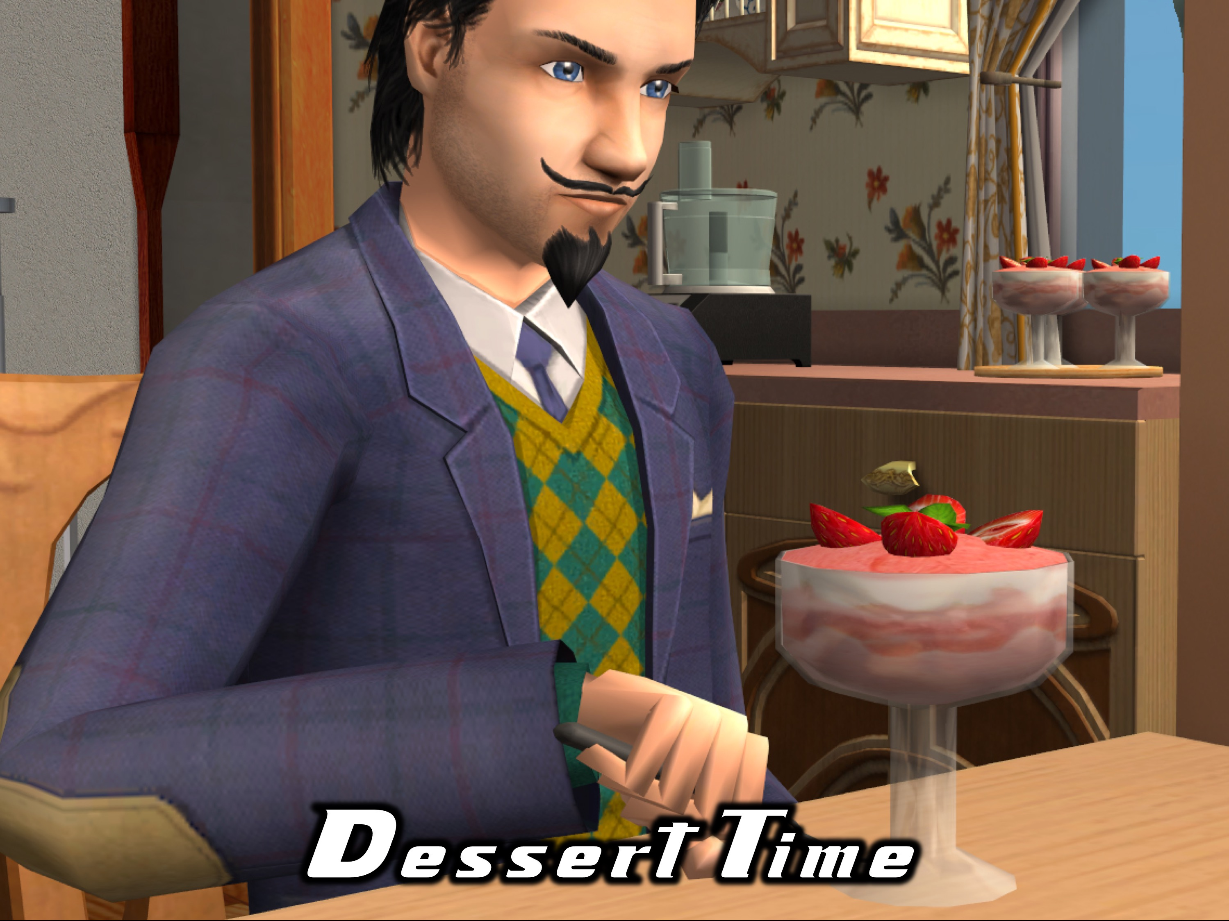
Notes:
Dessert Time

Slide 22
Notes:
Video: Come Dine With Me Top Songs Long. A compliations of songs from 1920 to 2014 taken from YouTube. Check out the following links for songs used in the full length video to be played during the main meal:
1920s: https://www.youtube.com/watch?v=hxH1LwvPGTc
1960s: https://www.youtube.com/watch?v=vQx_0VBSRcA
1970s: https://www.youtube.com/watch?v=04UCWMsAqhI
1980s: https://www.youtube.com/watch?v=wm7ZB06o8NY
1990s: https://www.youtube.com/watch?v=OZKFjEm-35w
2000s: https://www.youtube.com/watch?v=te9unX_KtKk
2010s: https://www.youtube.com/watch?v=ge8H6i24UAU
2014s: https://www.youtube.com/watch?v=BgpH204TLe8

Slide 23
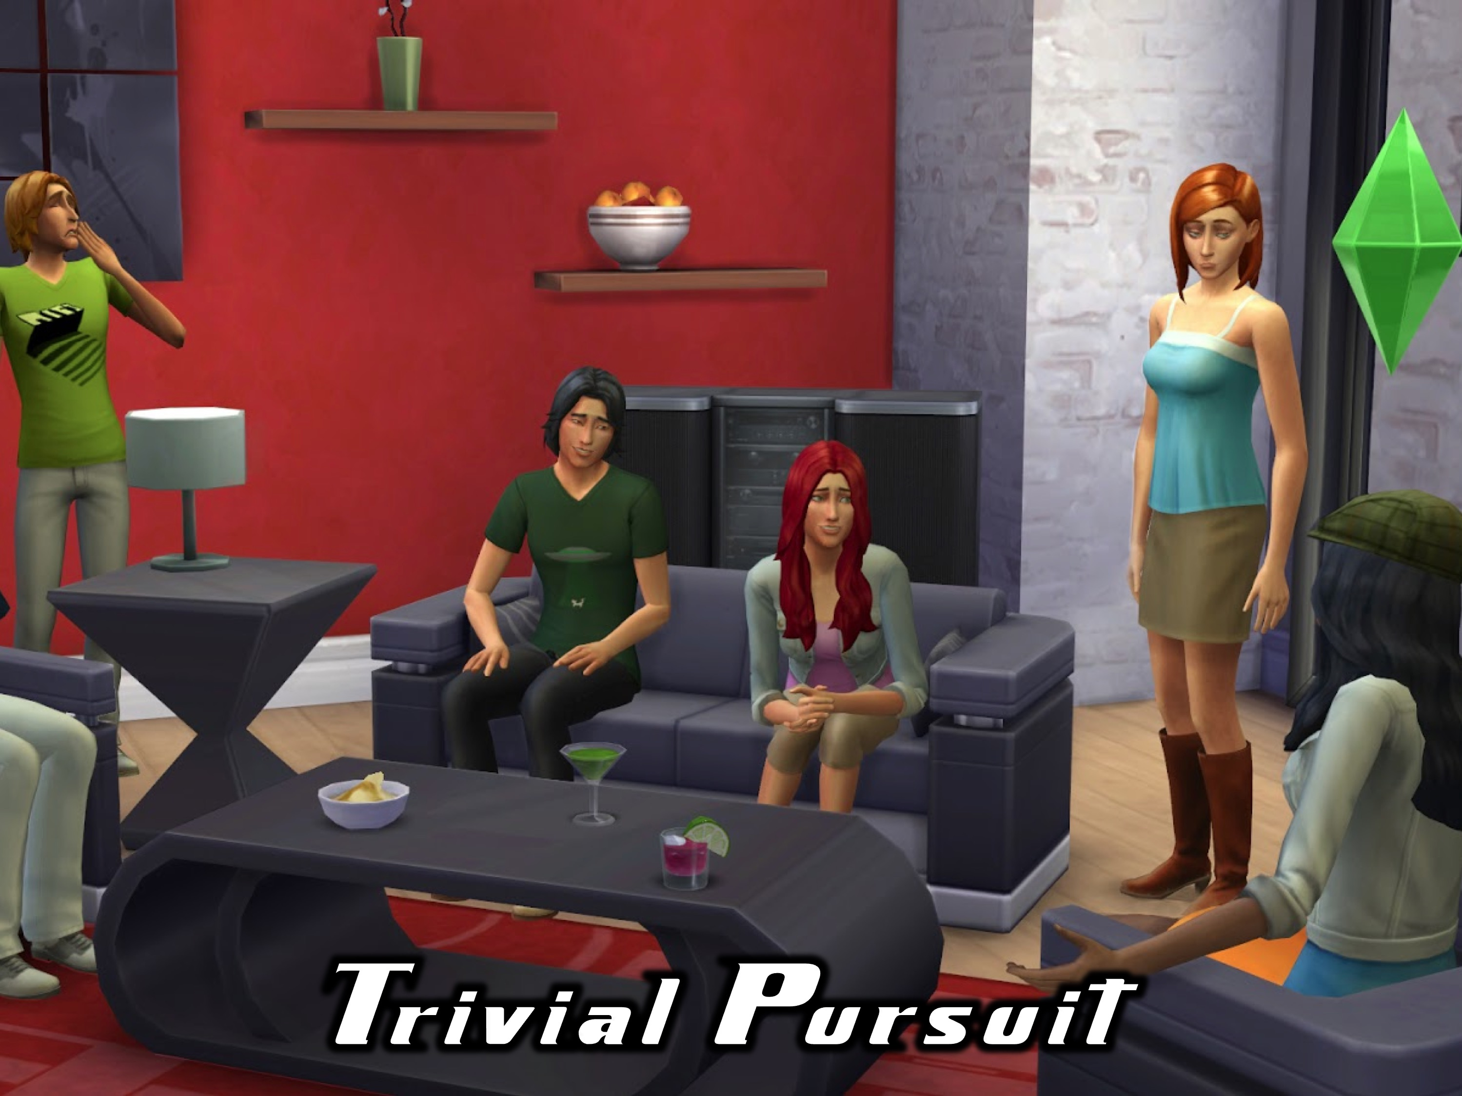
Notes:
Trivia Pursuit: Each table will have to answer questions about stuff that happened at His Youth during this term. Each table is given an envelope with 20 questions for the host to read out.
1. Who were the moles in the Mole night? Tiague, Keene and Micah
2. What was the purpose of the mole in the Mole night? To sabotage the game
3. Name 5 countries we visited in the Amazing Race: US, Japan, Australia, England, Russia, China, India, Greenland, Germany and Egypt
4. We had a tie on Survivor Night. Who were they? Taynita and Talitha
5. Do you remember who won Survivor Night? Talitha
6. Who were the presenters on the Star School night? DK and Taynita
7. What were the names of the worlds created on Utopia night? Ka-ching, Soya, Crazy Joy Fighters and Chain Reaction
8. Who was the first Hero we looked at in our Sunday Series? Joseph
9. Which Hero had a worm eat a plant that gave him shade? Jonah
10. What were the classes in Star School Night? Clue: singing was one! Act and Dance
11. What were the three events in the arena in the Hunger Games night? Grenade wars, Sticker wars, Peg wars.
12. We had a Head Girl and a Head Boy for 2014 as models on Project Runway night! What schools were they from? Parktown Boys and Girl
13. In which country did you have to build an ice sculpture on the Amazing Race? Greenland
14. What did you have to do for Germany on the Amazing Race? Drink Ginger Beer
15. Who was the winner of our Project Runway night? Super Model Shalom
16. What did contestants do in Smack Down on Survivor? To smack the cup off the other persons tray
17. Who preached on Peter in the Heroes series on a Monday morning? Kenan and Asher Pardey
18. Who preached on Rebekah in our Heroes Series? Debbie
19. What did the contestants have to do in the USA on the Amazing Race night? Eat 2 Hot dogs and drink a can of coke
20. Who was the adult leader that took part in the Hunger Games! Hannes

Slide 24

Notes:
Thank you

Slide 25
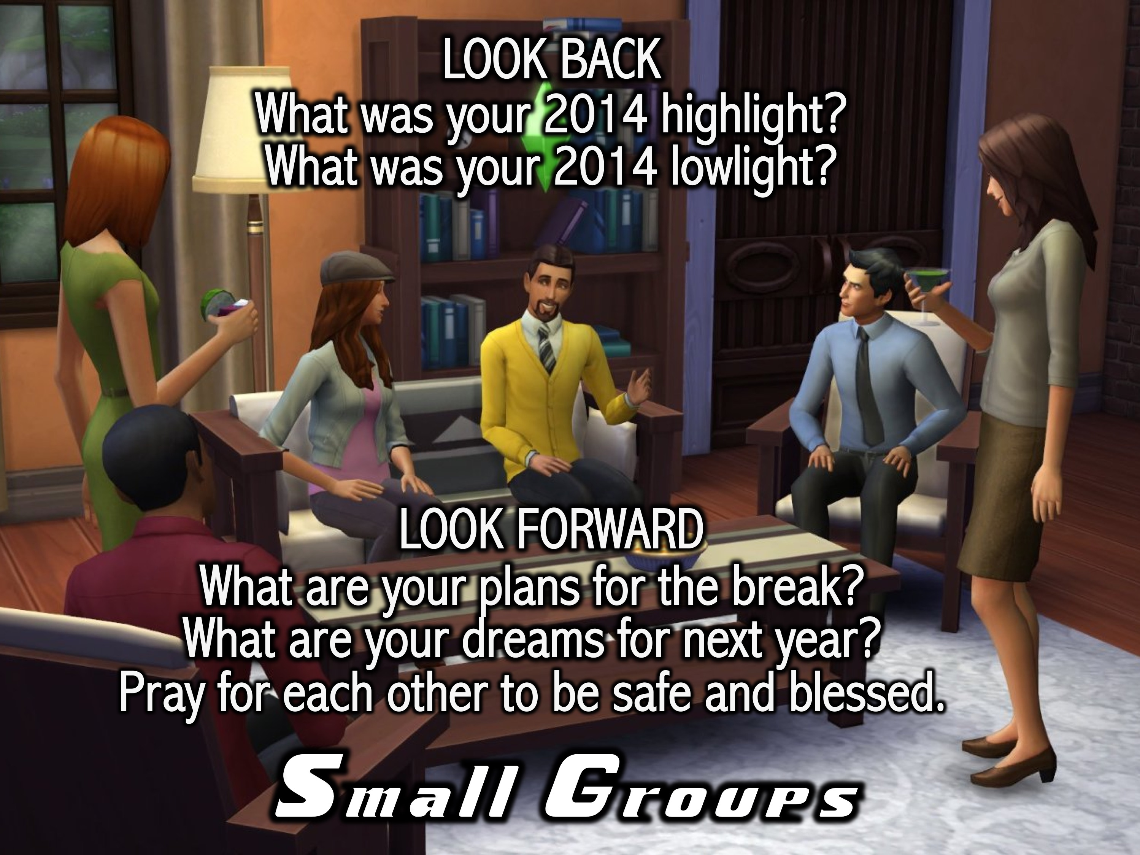
Notes:
Small Groups: Here are the questions for our small group time: (1) What was your 2014 highlight? (2) What was your 20145 lowlight? (3) What are your plans for the break? (4) What are your dreams for next year? (5) Pray for each other to be safe and blessed.

Slide 26
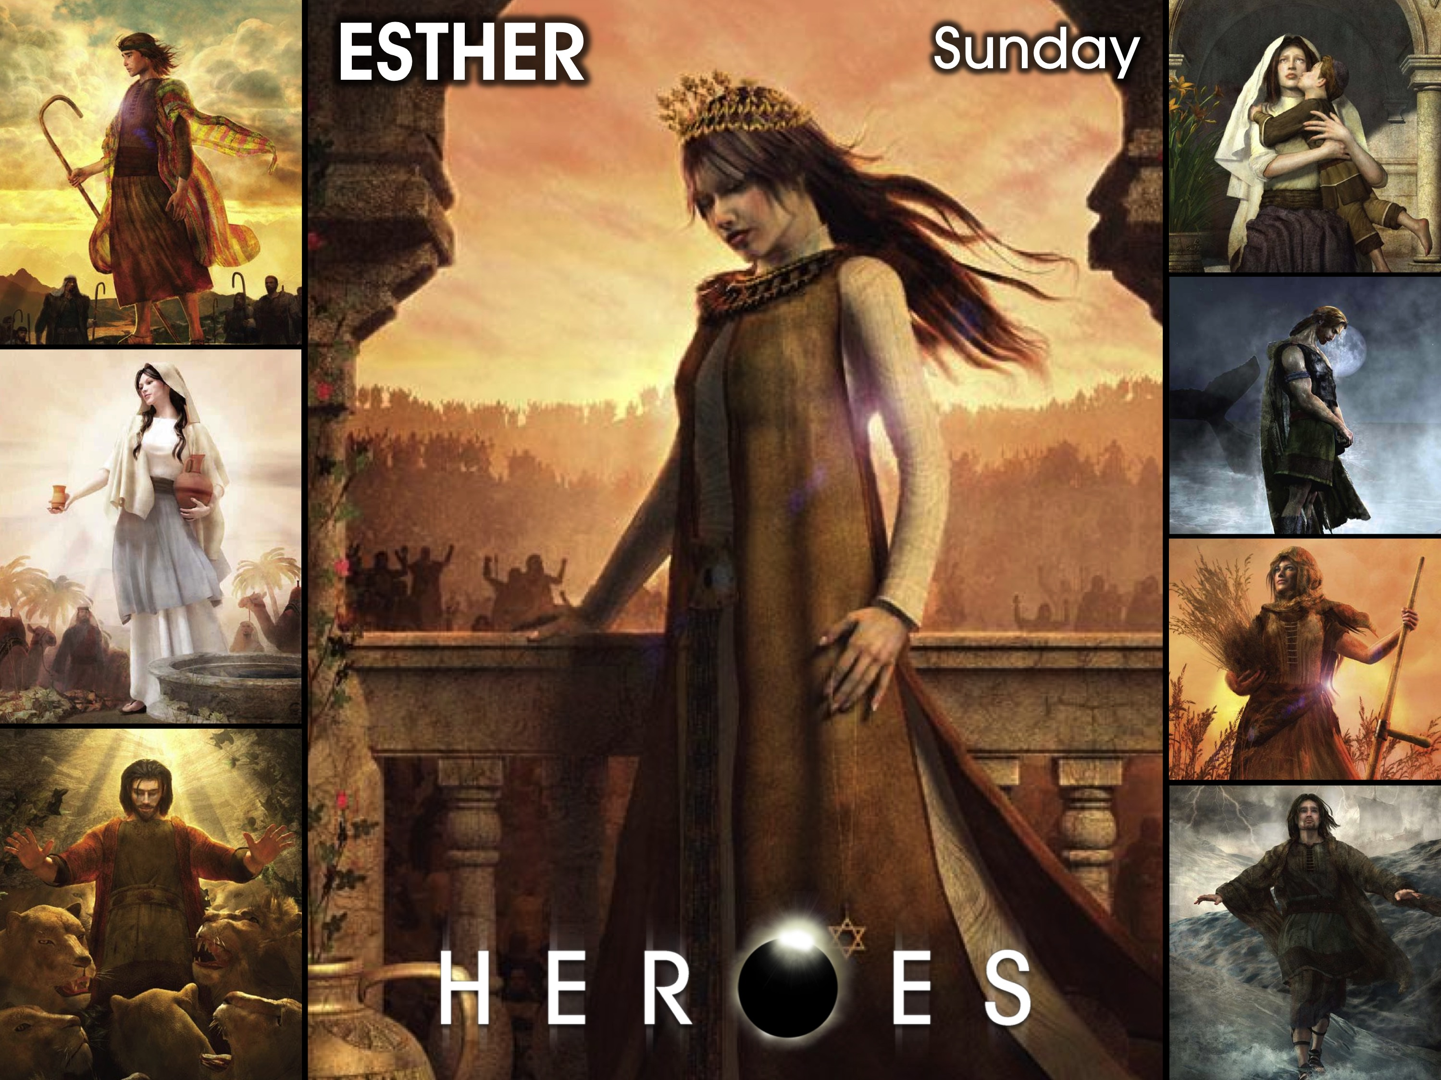
Notes:
On Sunday morning it is the Heroes Series and we will be looking at the life of Esther.

Slide 27

Notes:
There is no youth next Friday night. We will be back on the Friday night when school starts in 2015.

