Slide 2
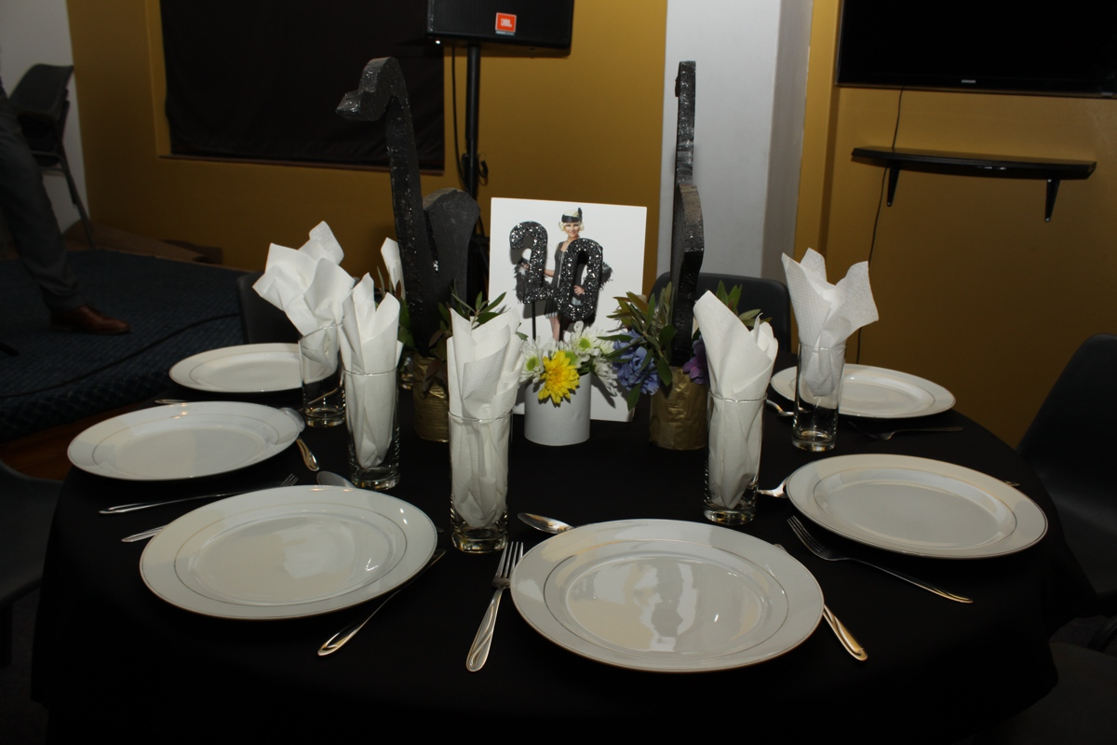
Notes:
The 20s table

Slide 3
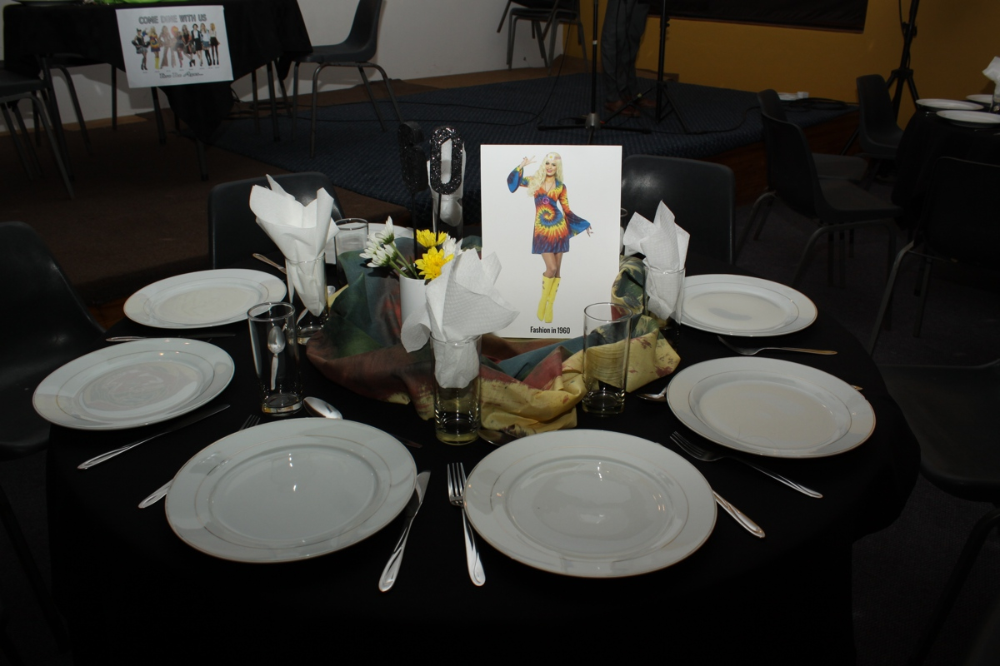
Notes:
The 60s table

Slide 4
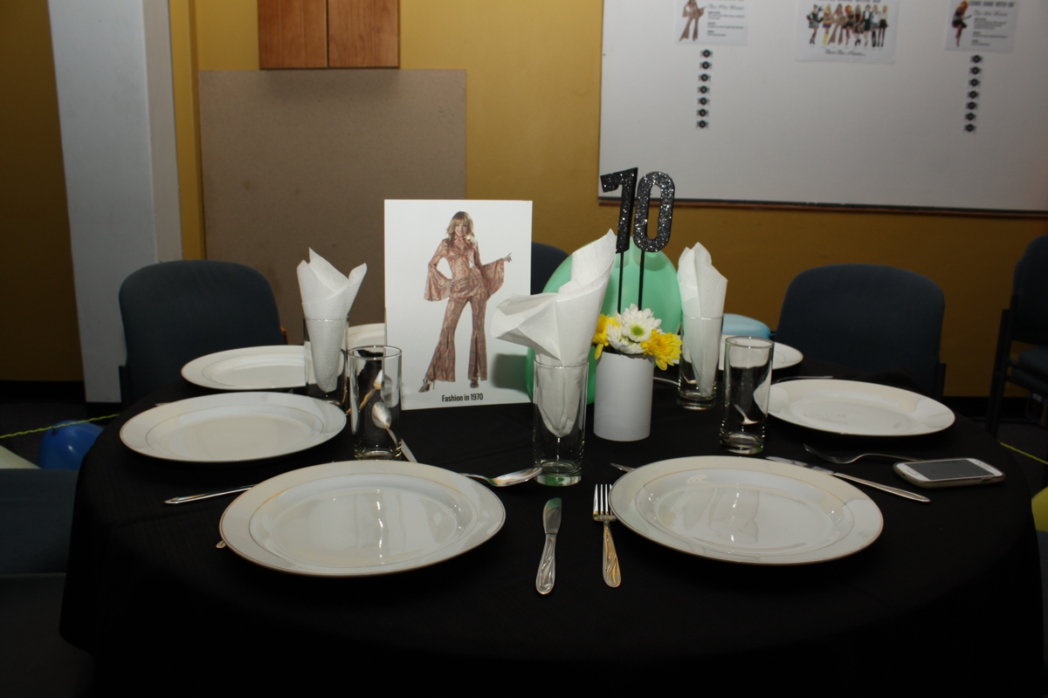
Notes:
The 70s table

Slide 5
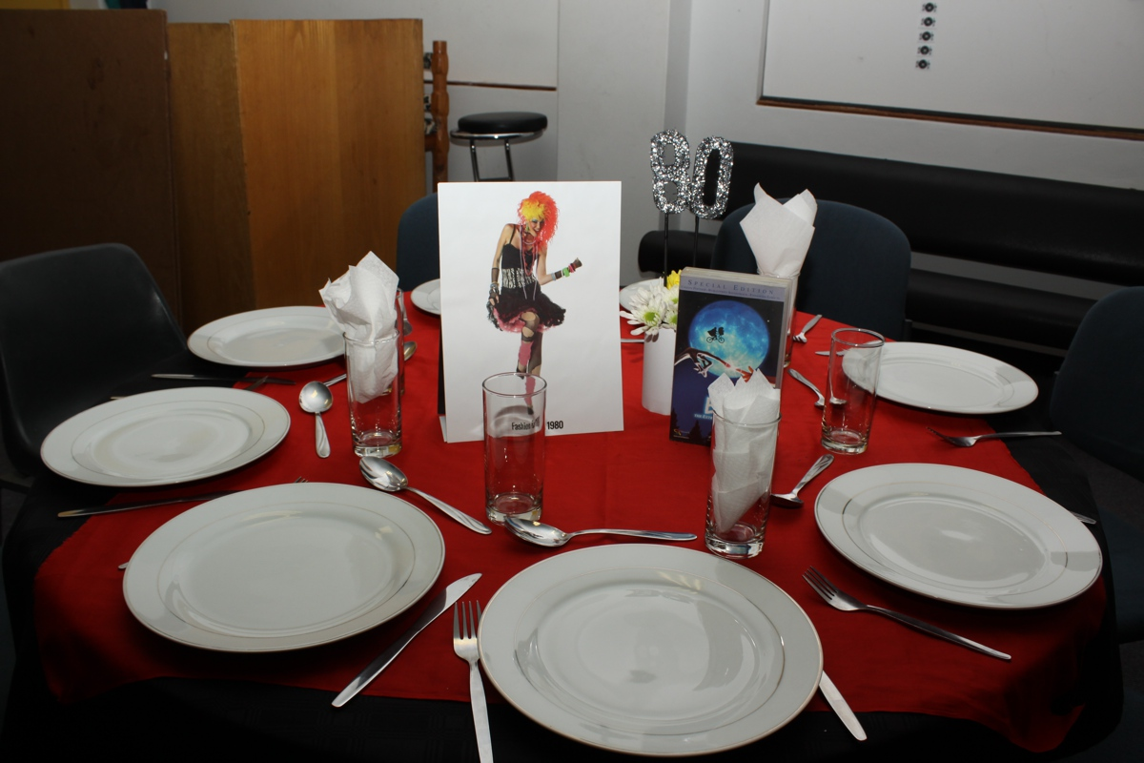
Notes:
The 80s table

Slide 6
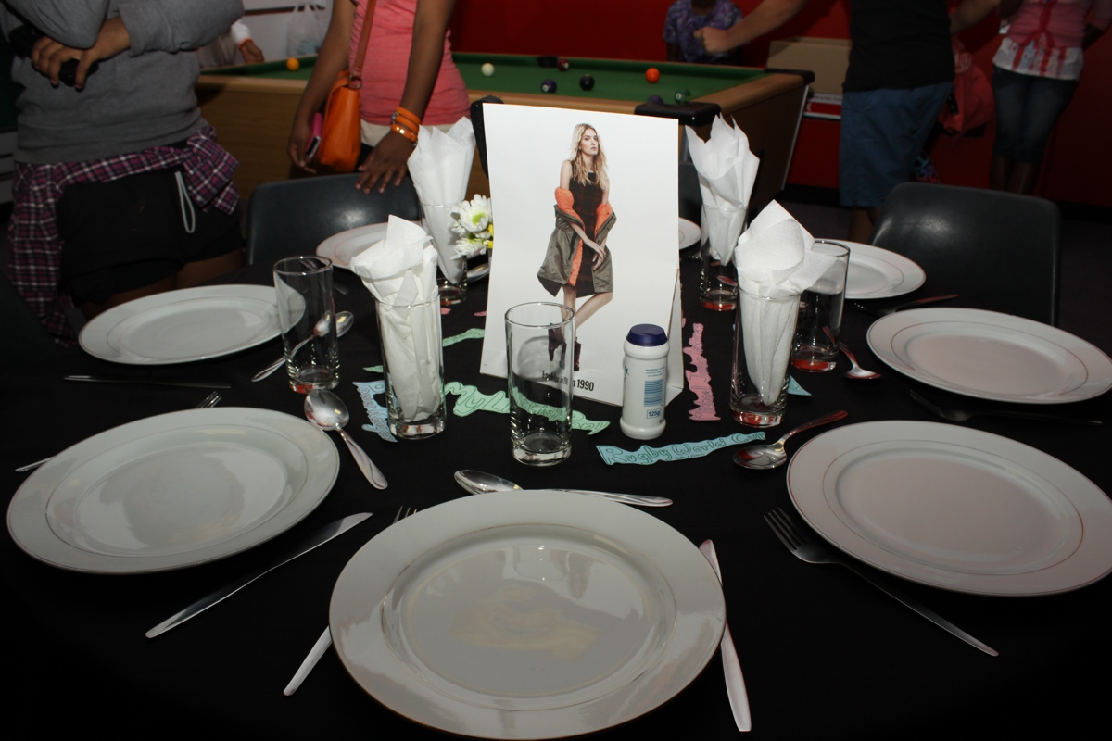
Notes:
The 90s table

Slide 7
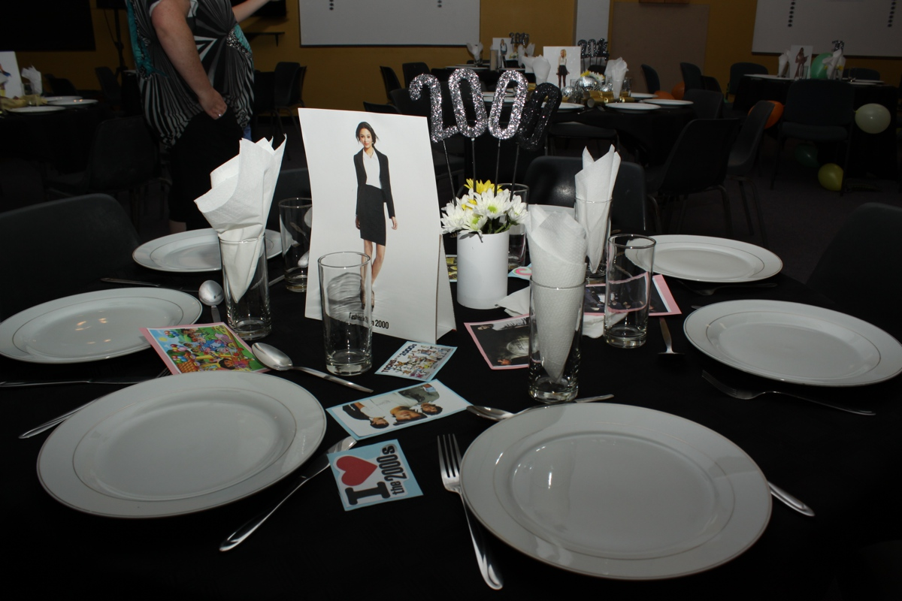
Notes:
The 2000s table

Slide 8
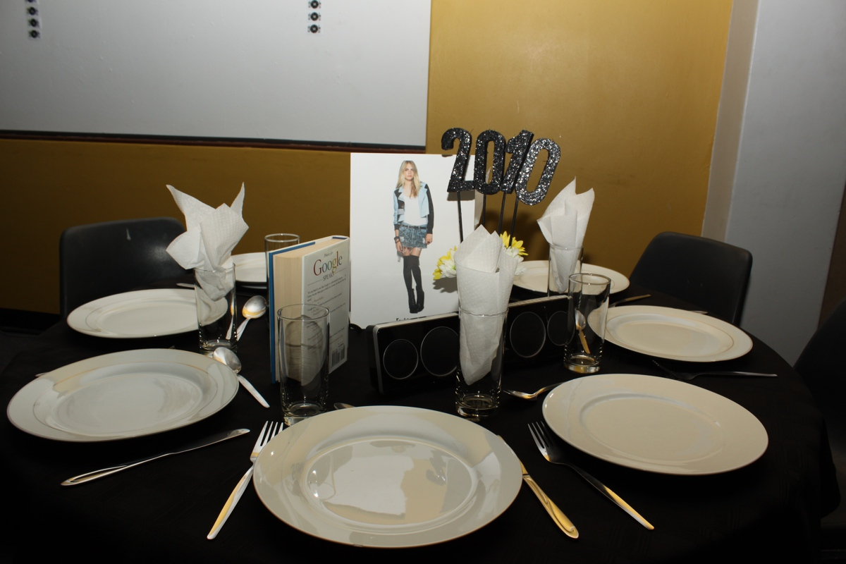
Notes:
The 2010s table

Slide 9
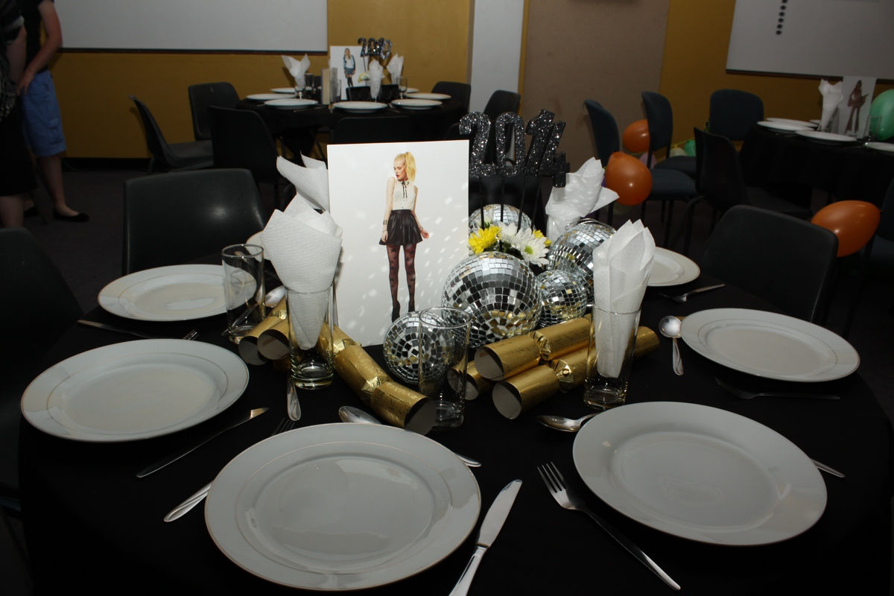
Notes:
The 2014 table

Slide 10
Notes:
Some of the room decor

Slide 11
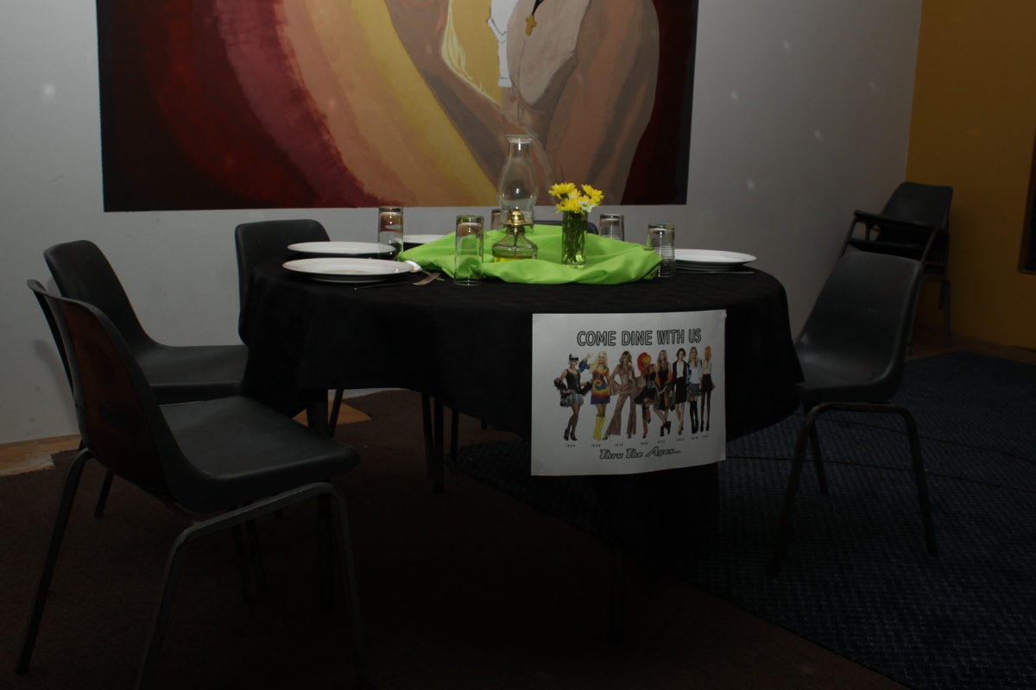
Notes:
Some of the room decor

Slide 12
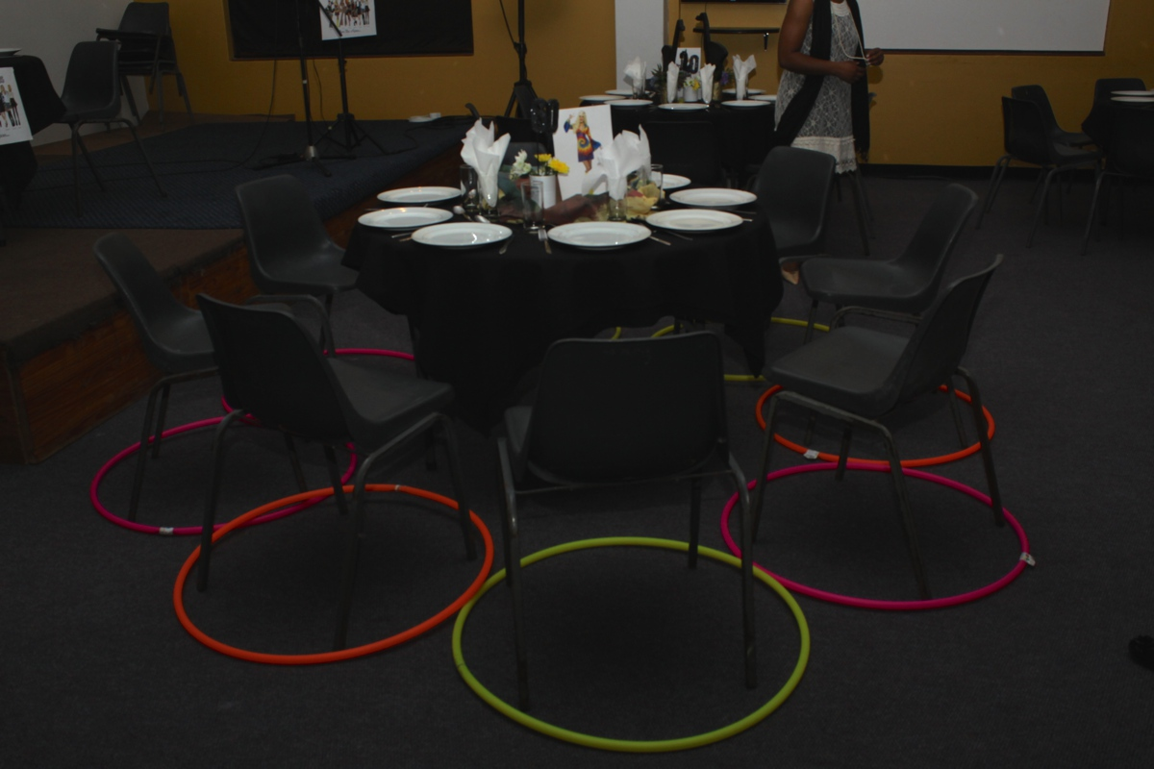
Notes:
The 60s table

Slide 13
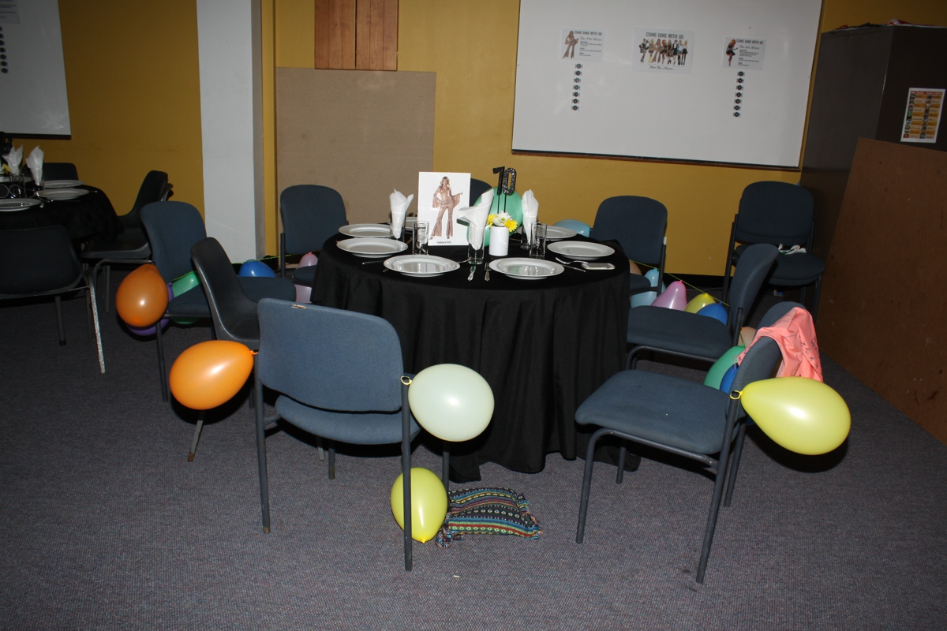
Notes:
The 80s table

Slide 14
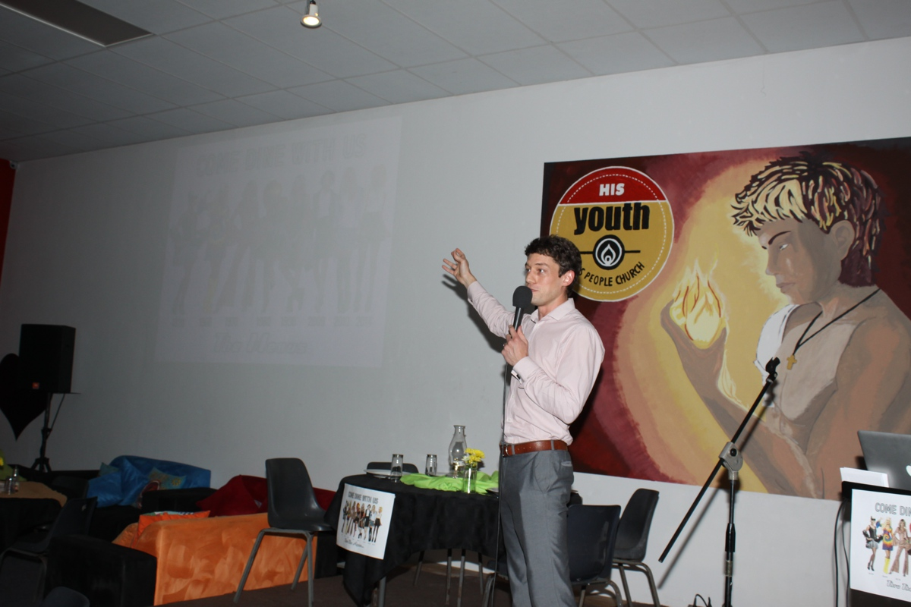
Notes:
The welcome and overview of the night

Slide 15
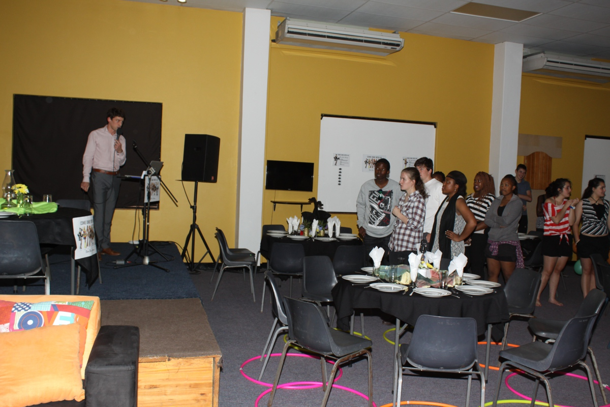
Notes:
The welcome and overview of the night

Slide 16
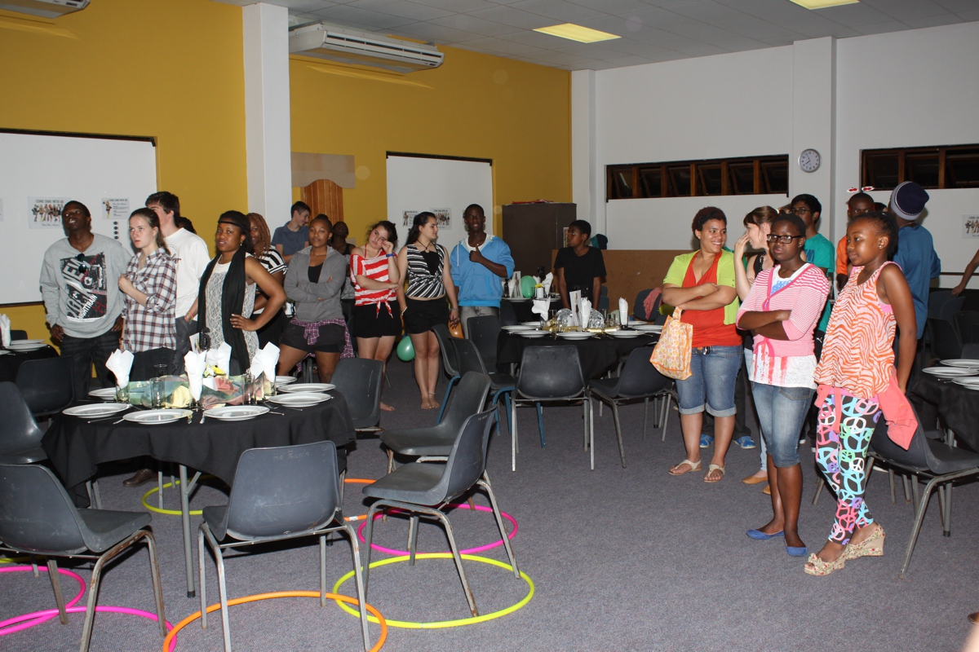
Notes:
The welcome and overview of the night

Slide 17
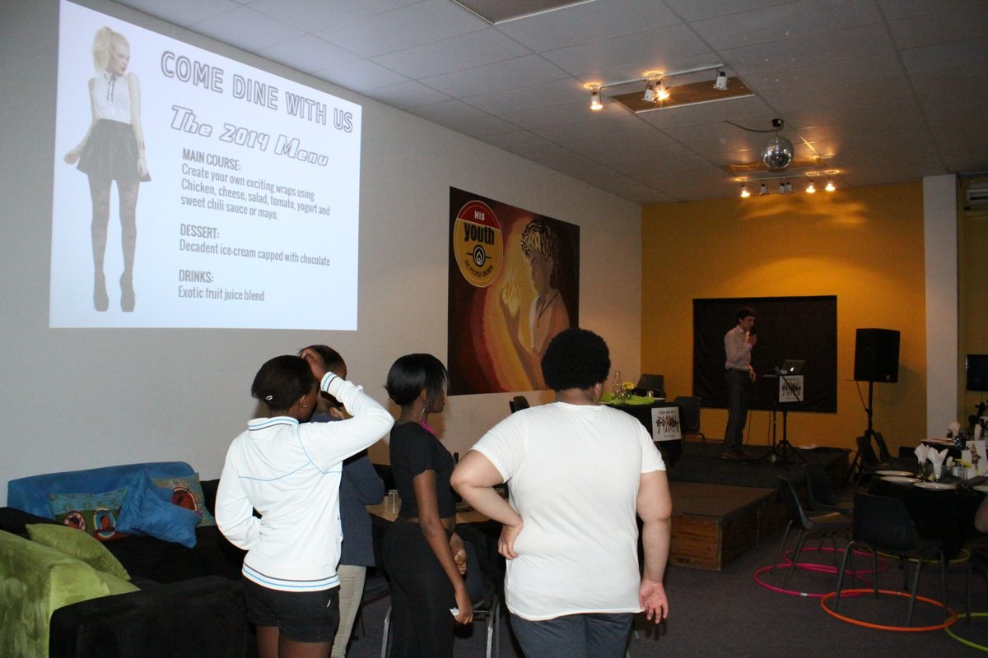
Notes:
The menus are introduced.

Slide 18
Notes:
Welcome of newcomers

Slide 19
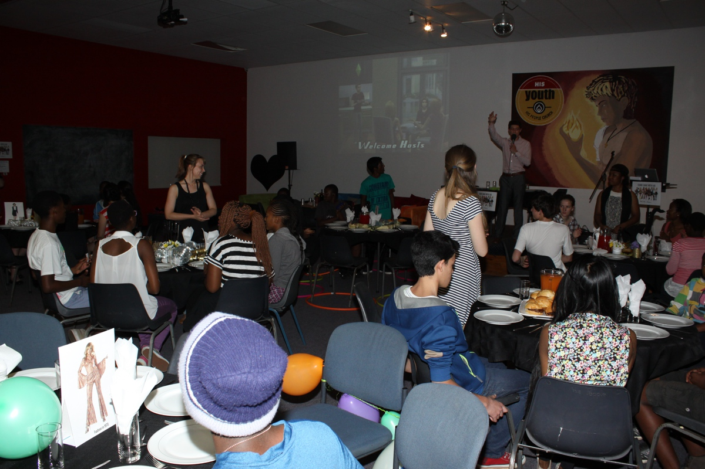
Notes:
Welcome of the eight hosts

Slide 20
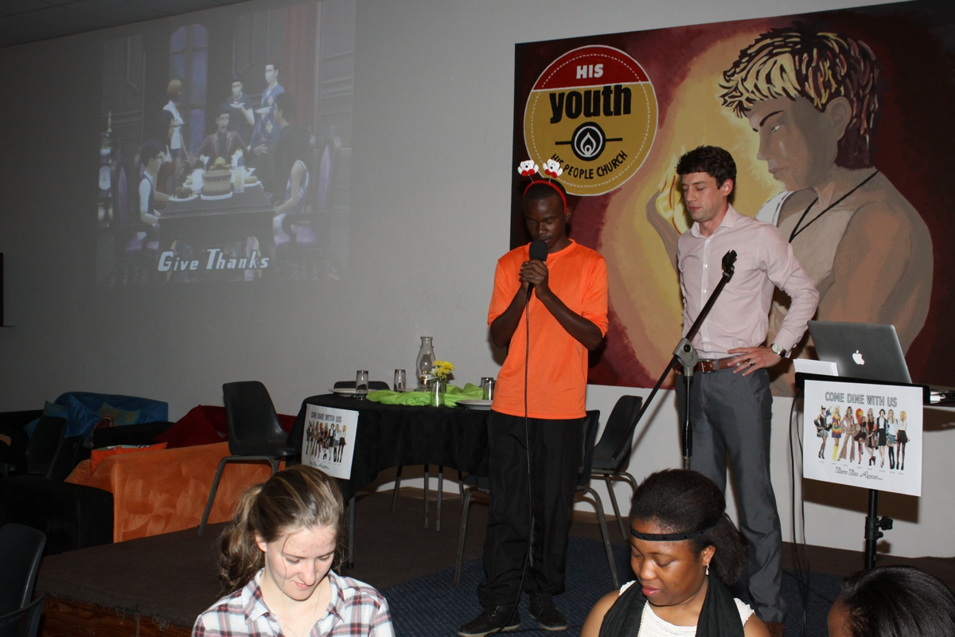
Notes:
Saying grace

Slide 21
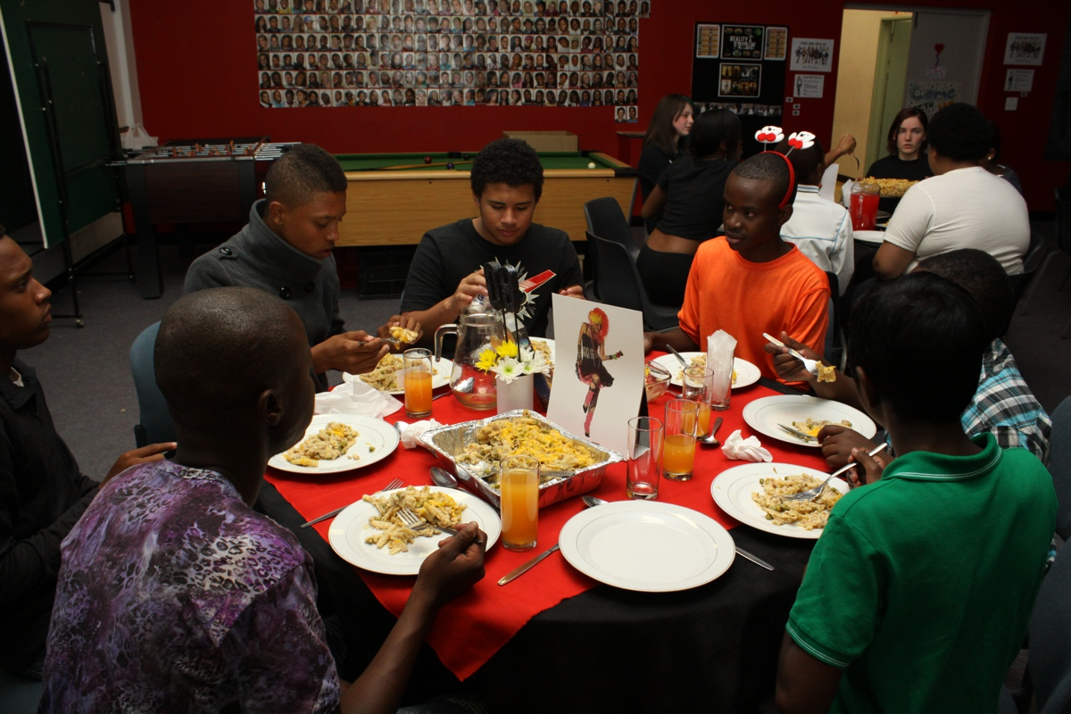
Notes:
The main course

Slide 22
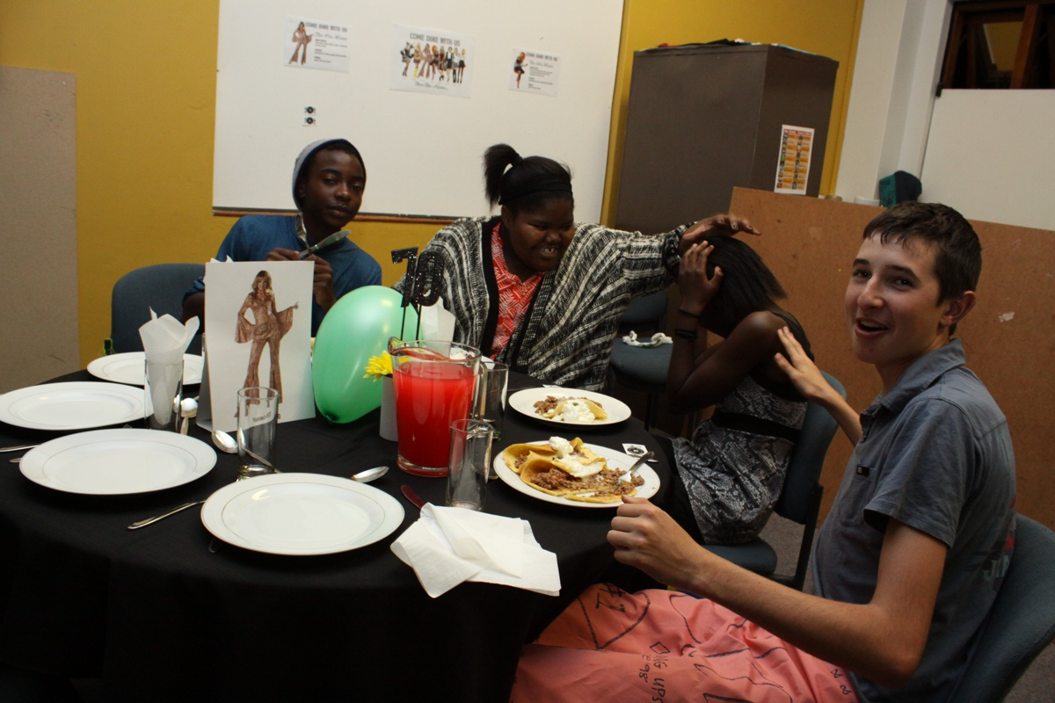
Notes:
The main course

Slide 23
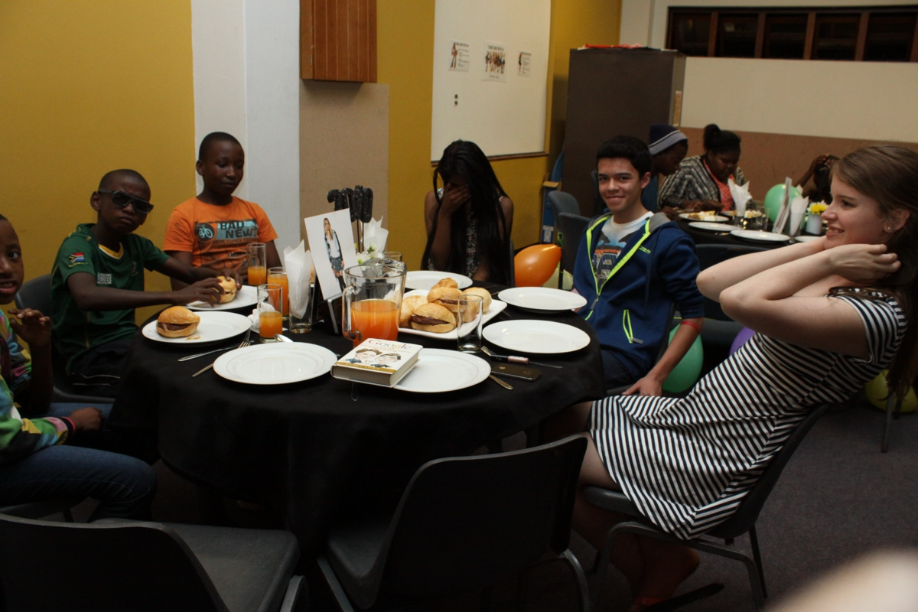
Notes:
The main course

Slide 24
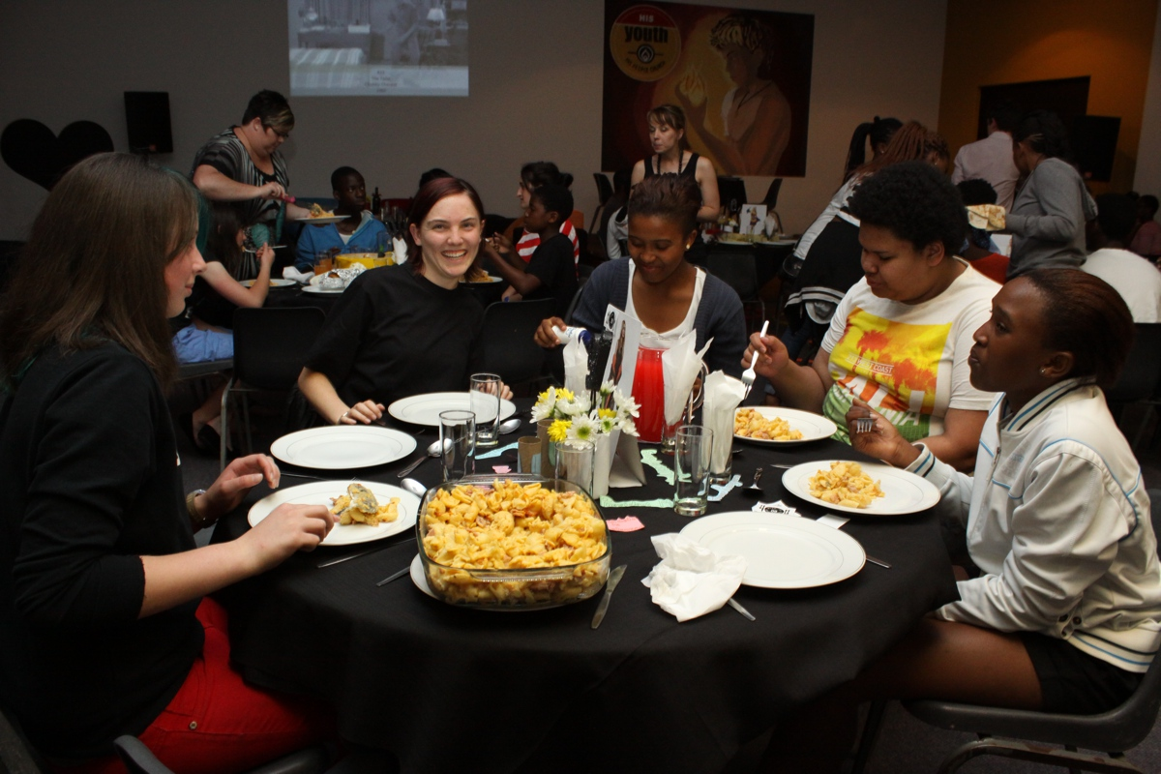
Notes:
The main course

Slide 25
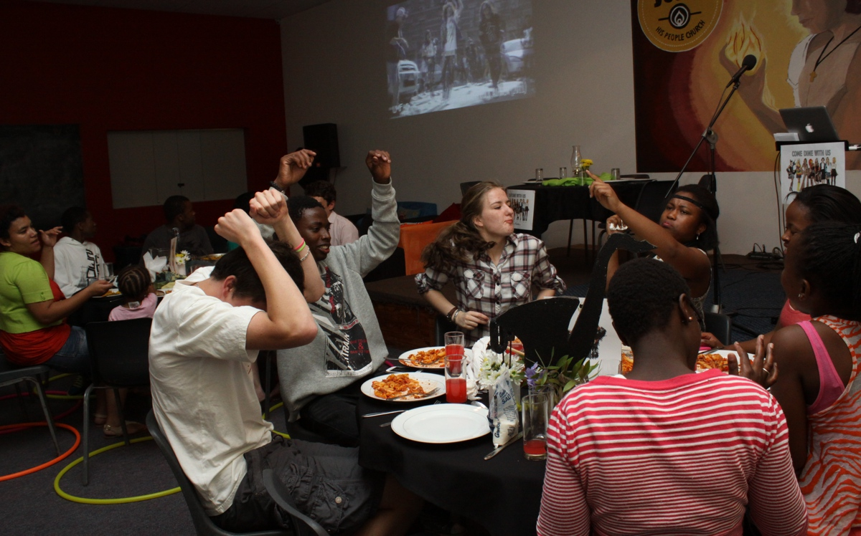

Slide 26
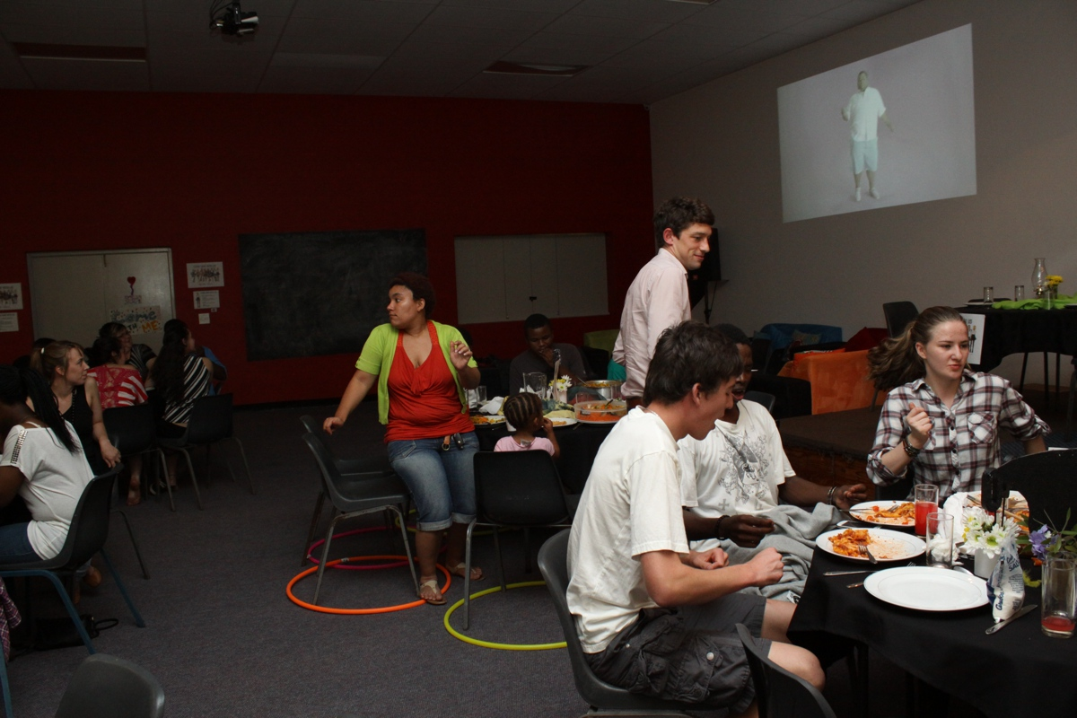

Slide 27
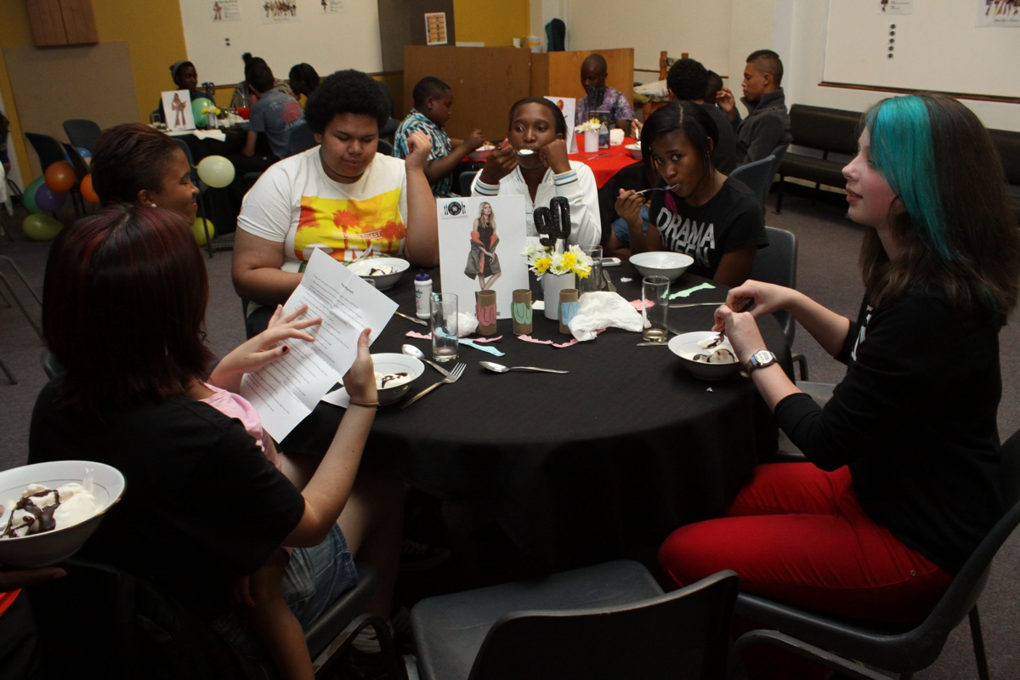
Notes:
Trivial pursuit game of questions about events from the past term.

Slide 28
Notes:
Trivial pursuit game of questions about events from the past term.

Slide 29
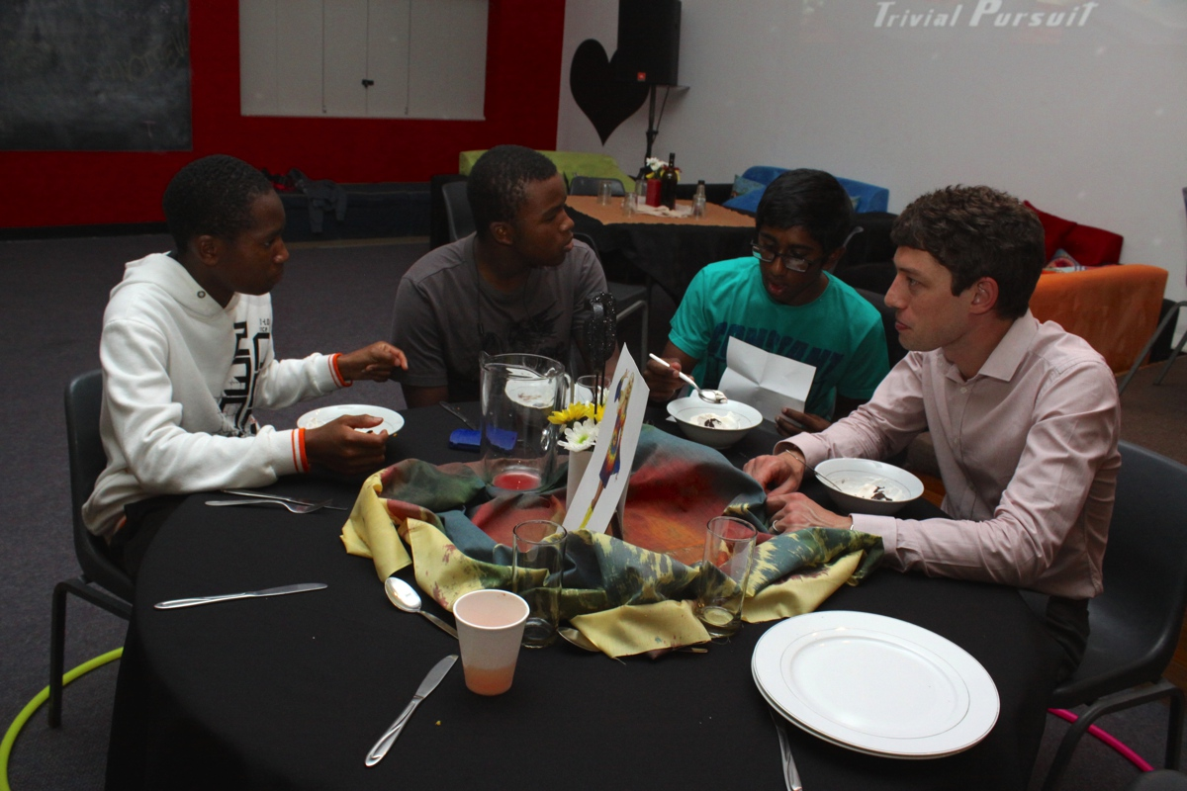
Notes:
Trivial pursuit game of questions about events from the past term.

Slide 30
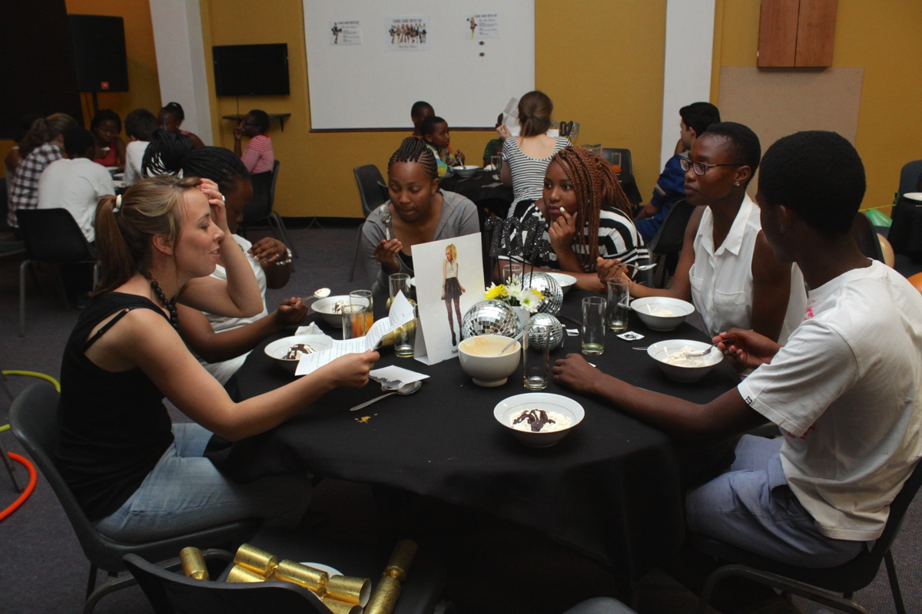
Notes:
Trivial pursuit game of questions about events from the past term.

Slide 31
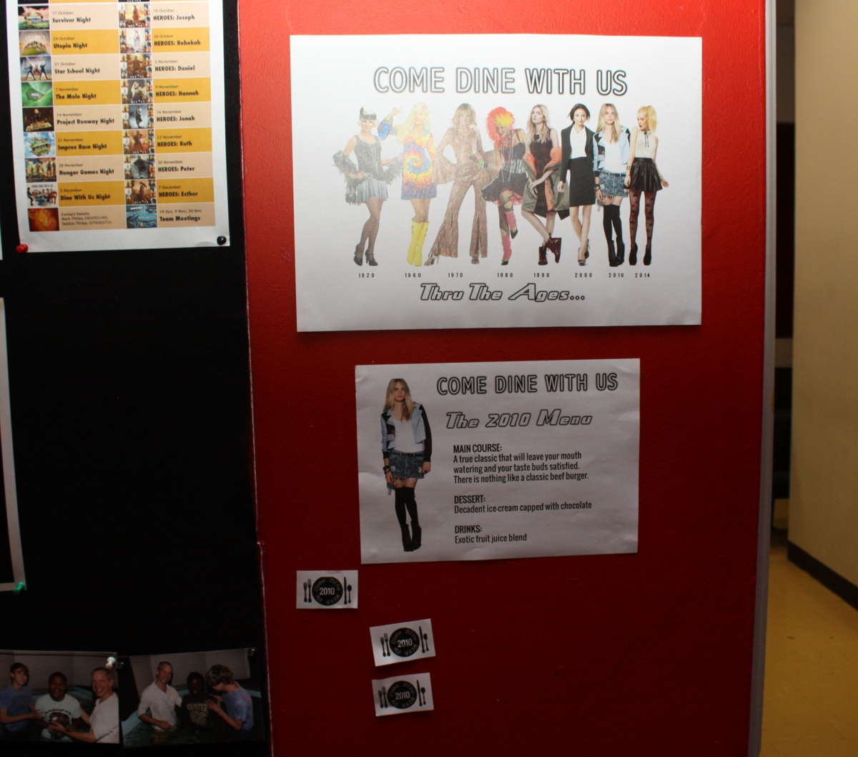
Notes:
Some of the room décor.

Slide 32
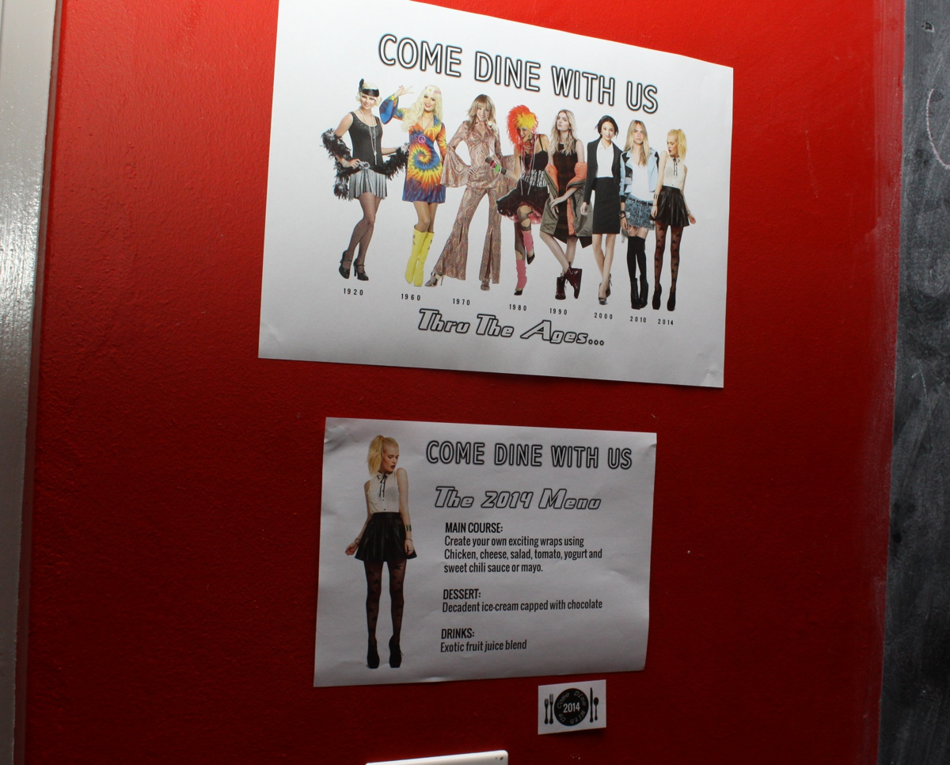
Notes:
Some of the room décor.

Slide 33
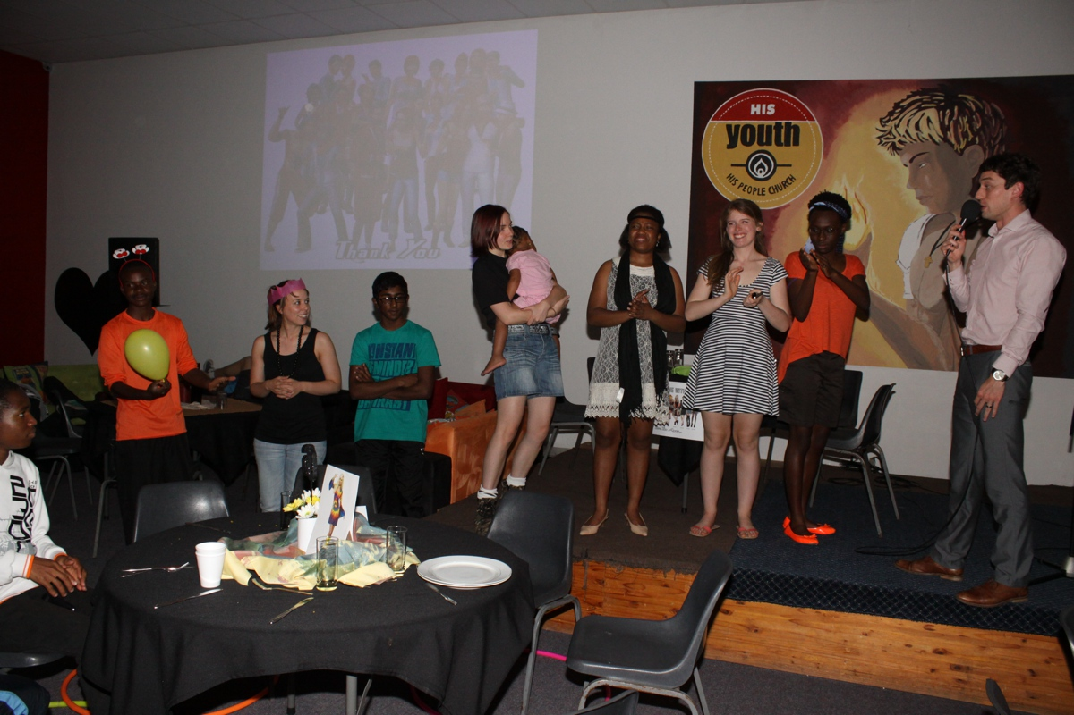
Notes:
The hosts are thanked

Slide 34
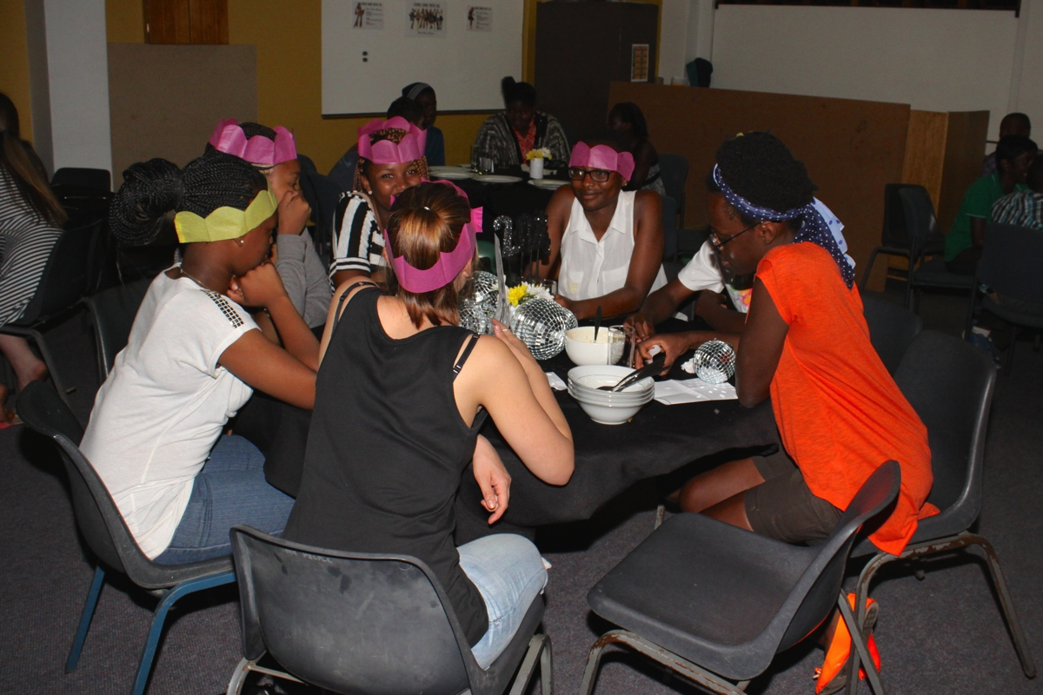
Notes:
Small group time.

Slide 35
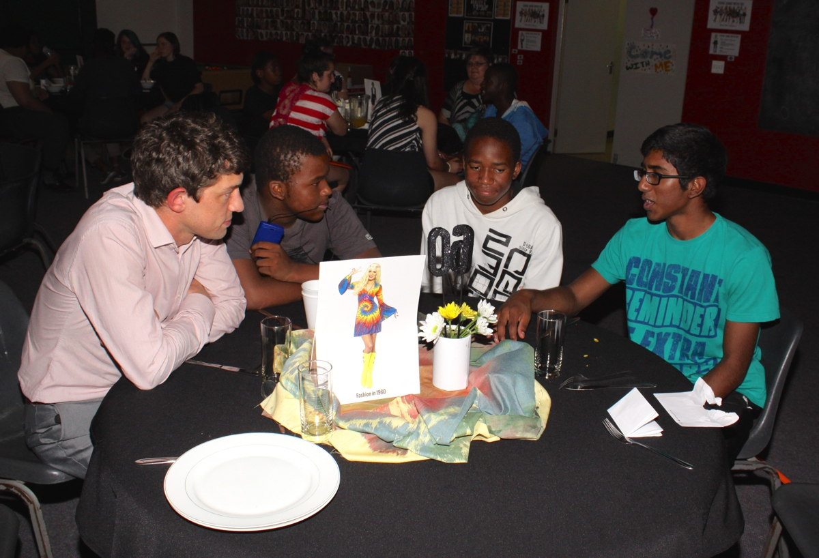
Notes:
Small group time.

Slide 36
Notes:
Small group time.

