Slide 1

Notes:
This week is Comedy Club Night.

Slide 2

Notes:
Welcome to Escape Friday.

Slide 3

Notes:
On Sunday morning in our Breakout Series we are dealing with Depression.

Slide 4

Notes:
Next Friday is our Escape Room Night.

Slide 5
Notes:
Tonight is our Comedy Club Night.

Slide 6
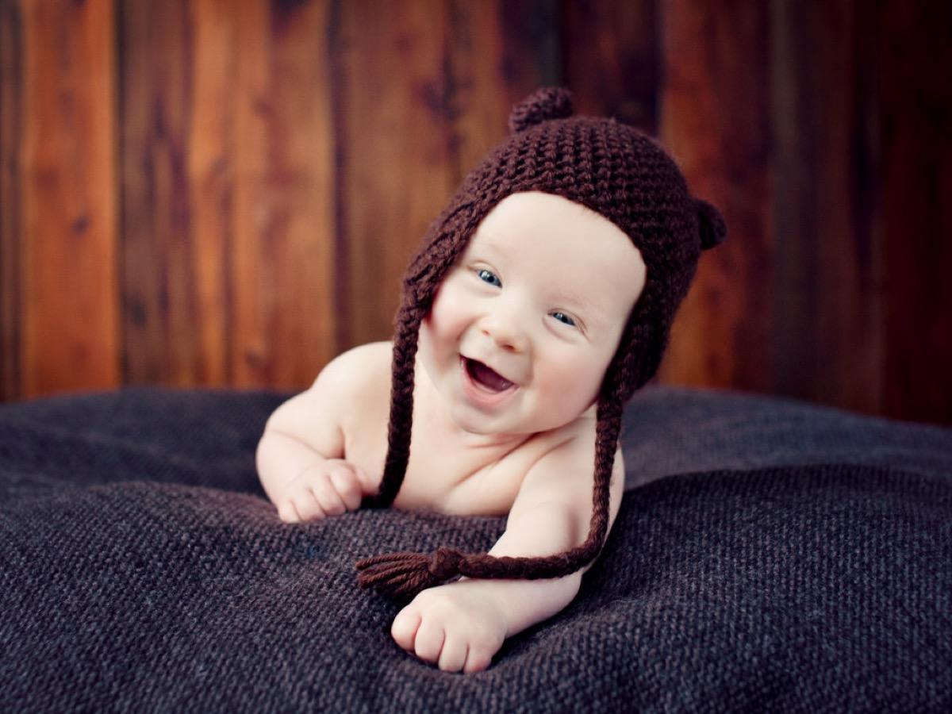
Notes:
Audio Playing Over Slides: The Best Baby Laugh Song Very Funny. Get it on YouTube at: https://www.youtube.com/watch?v=3BBvKkw1RH0

Slide 7
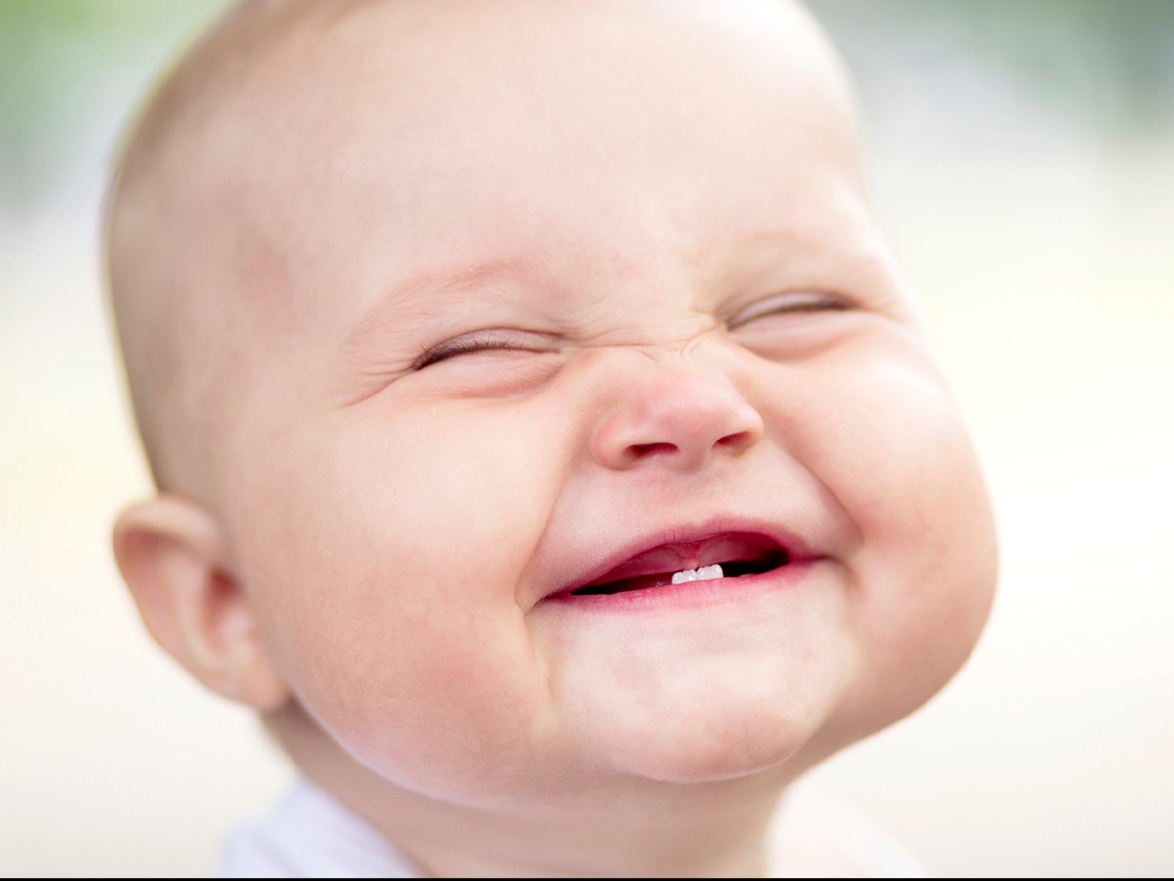

Slide 8
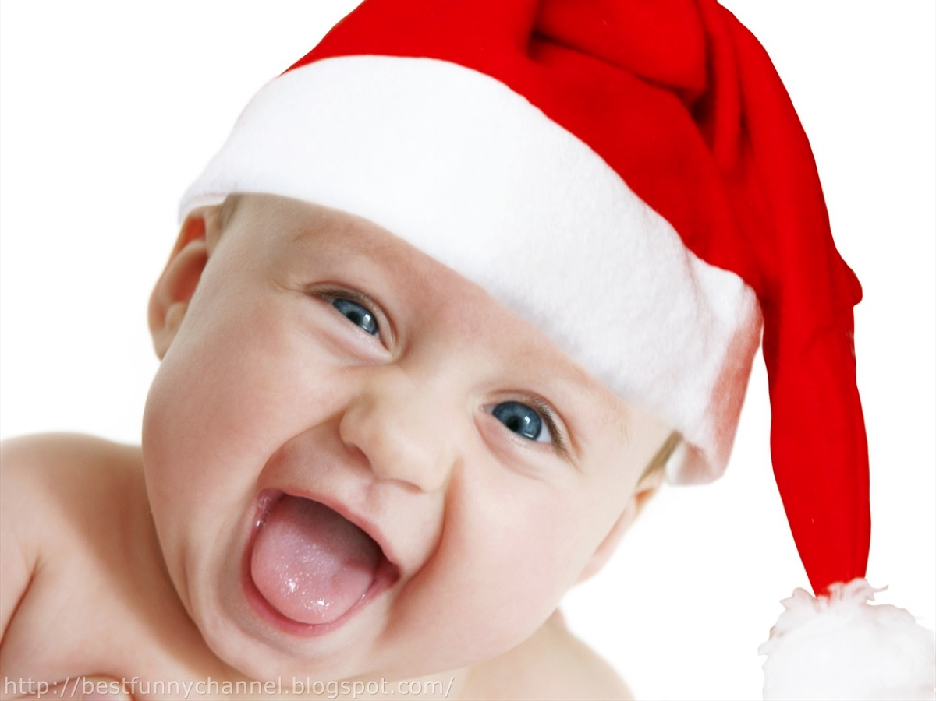

Slide 9
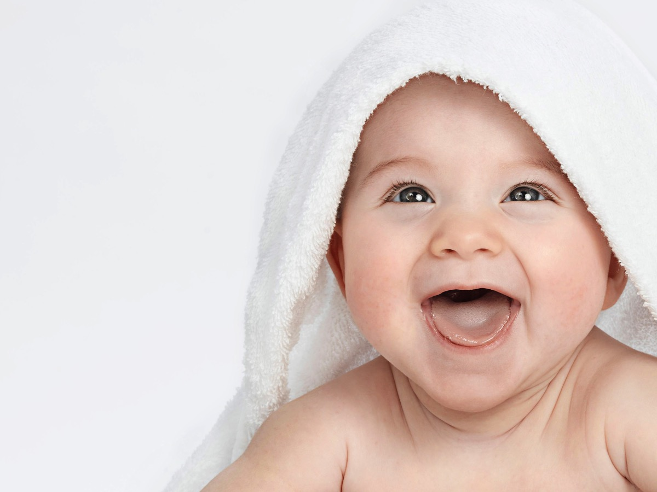

Slide 10
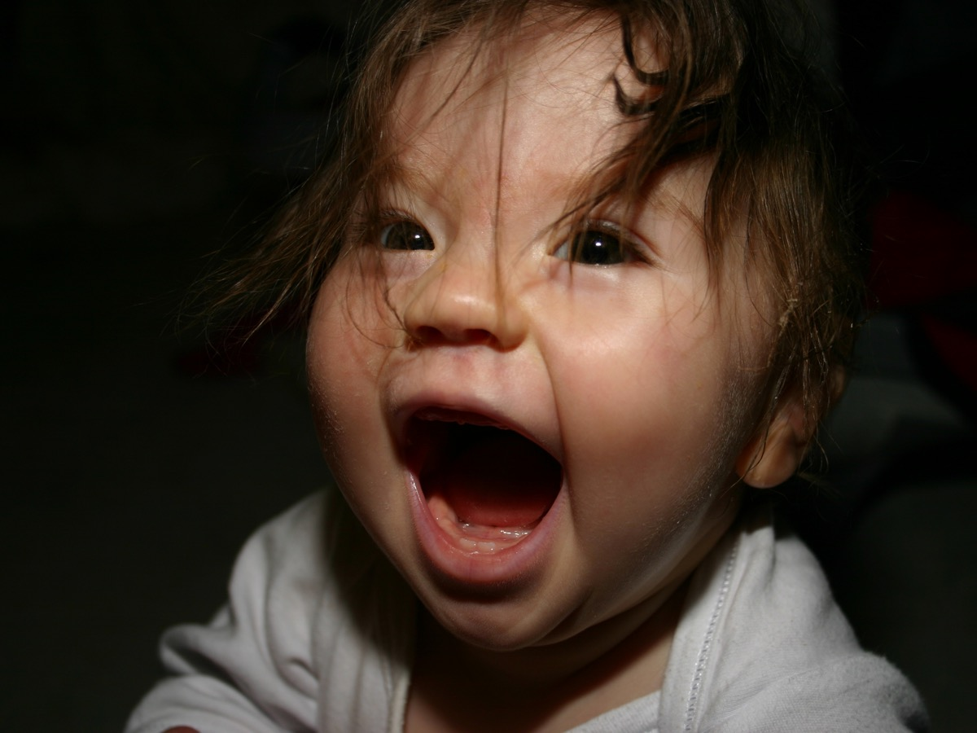

Slide 11
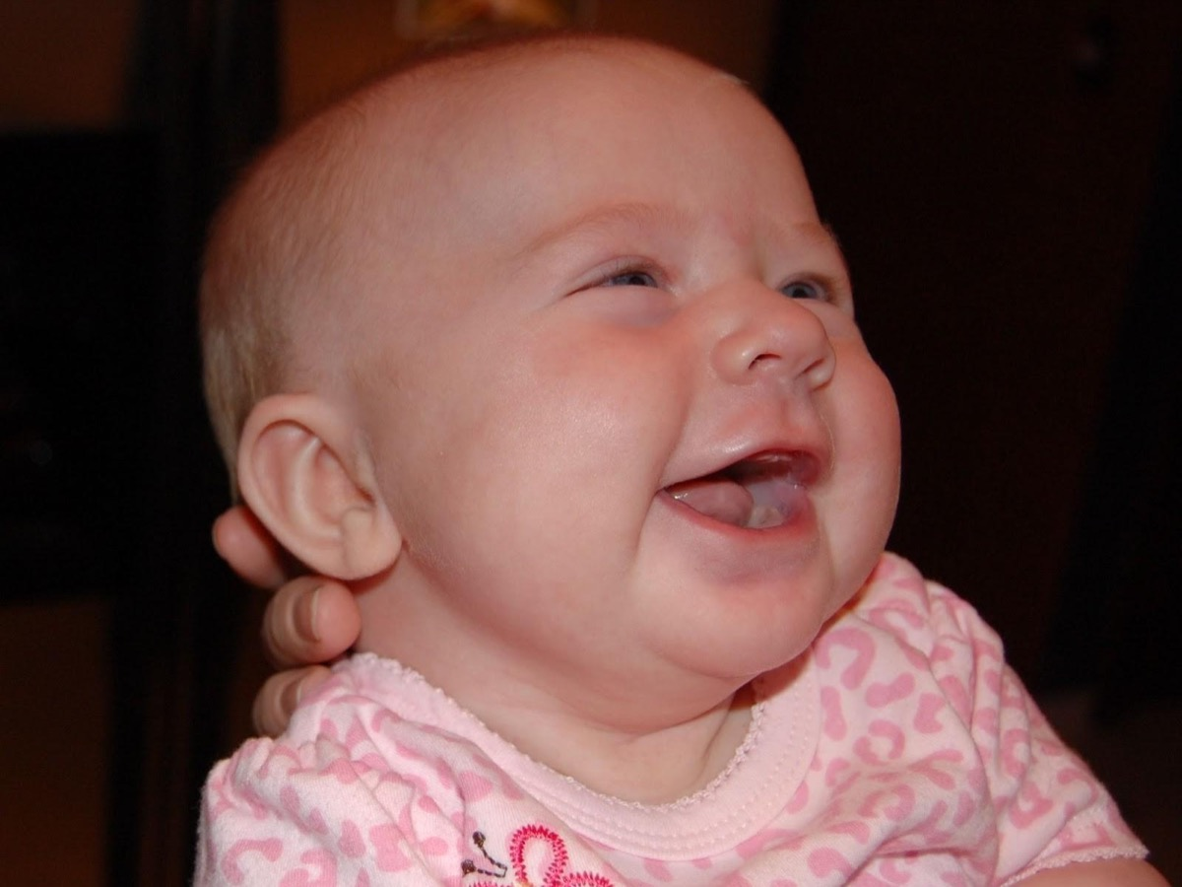

Slide 12
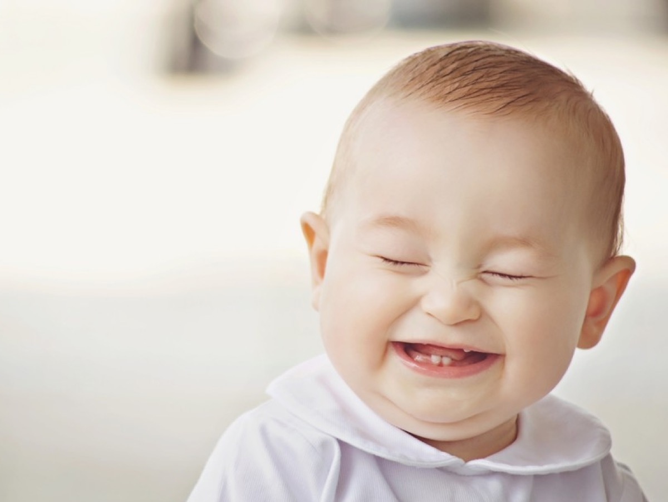

Slide 13
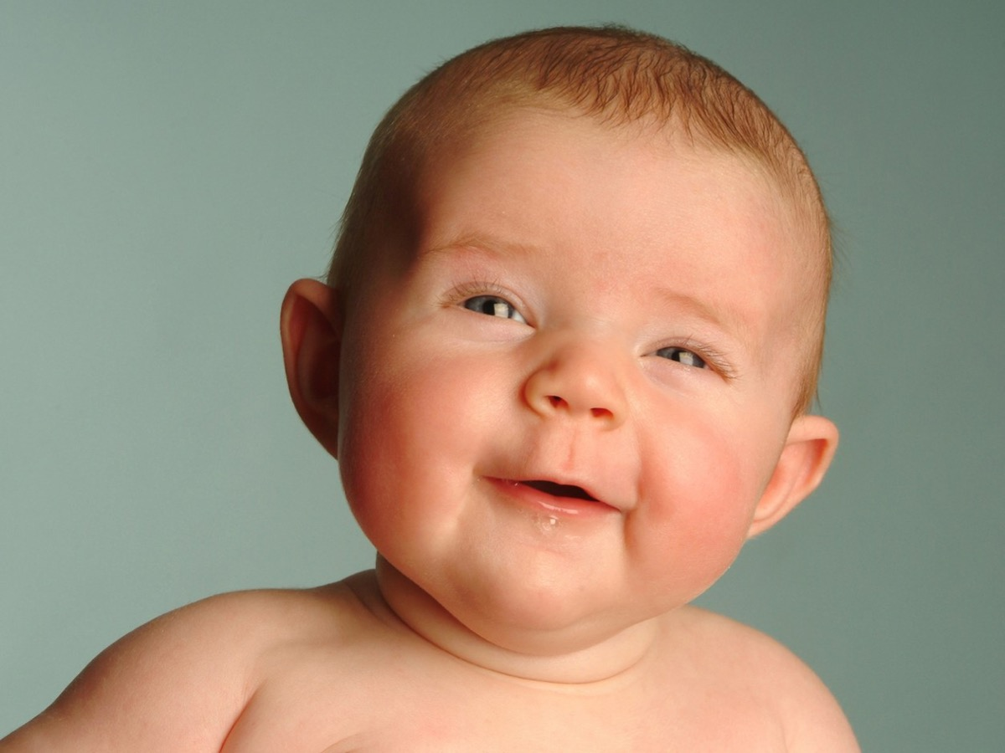

Slide 14
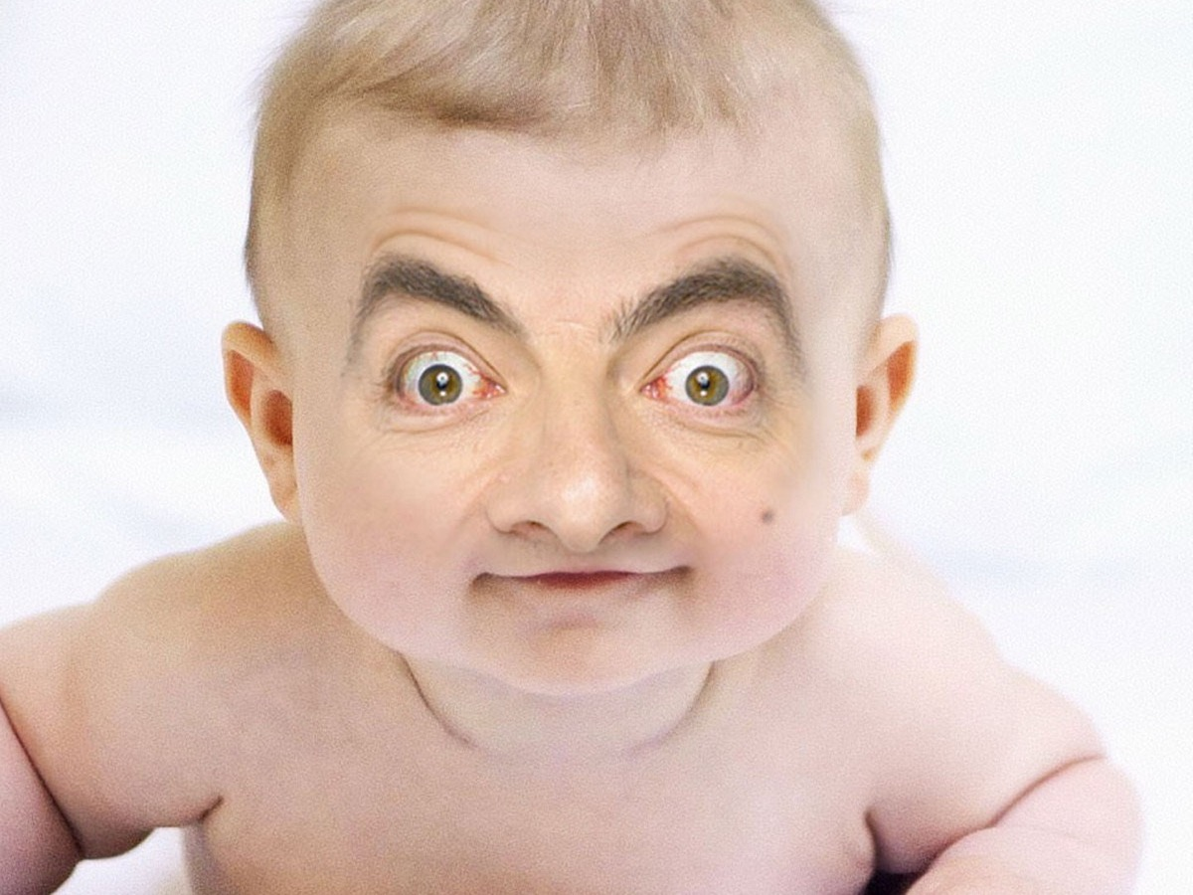

Slide 15
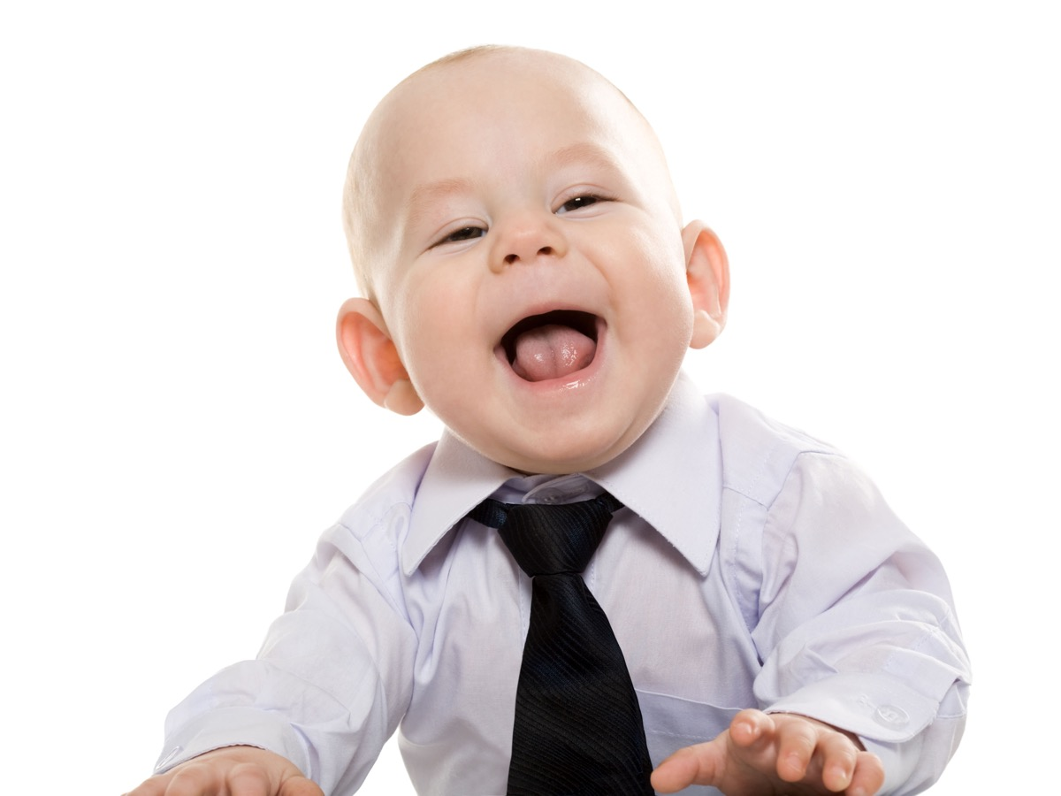

Slide 16
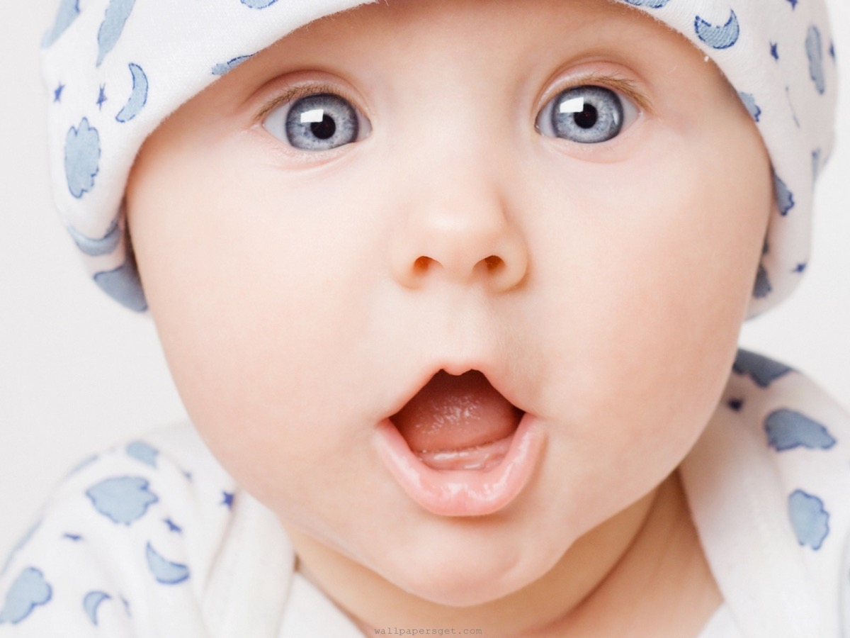

Slide 17


Slide 18
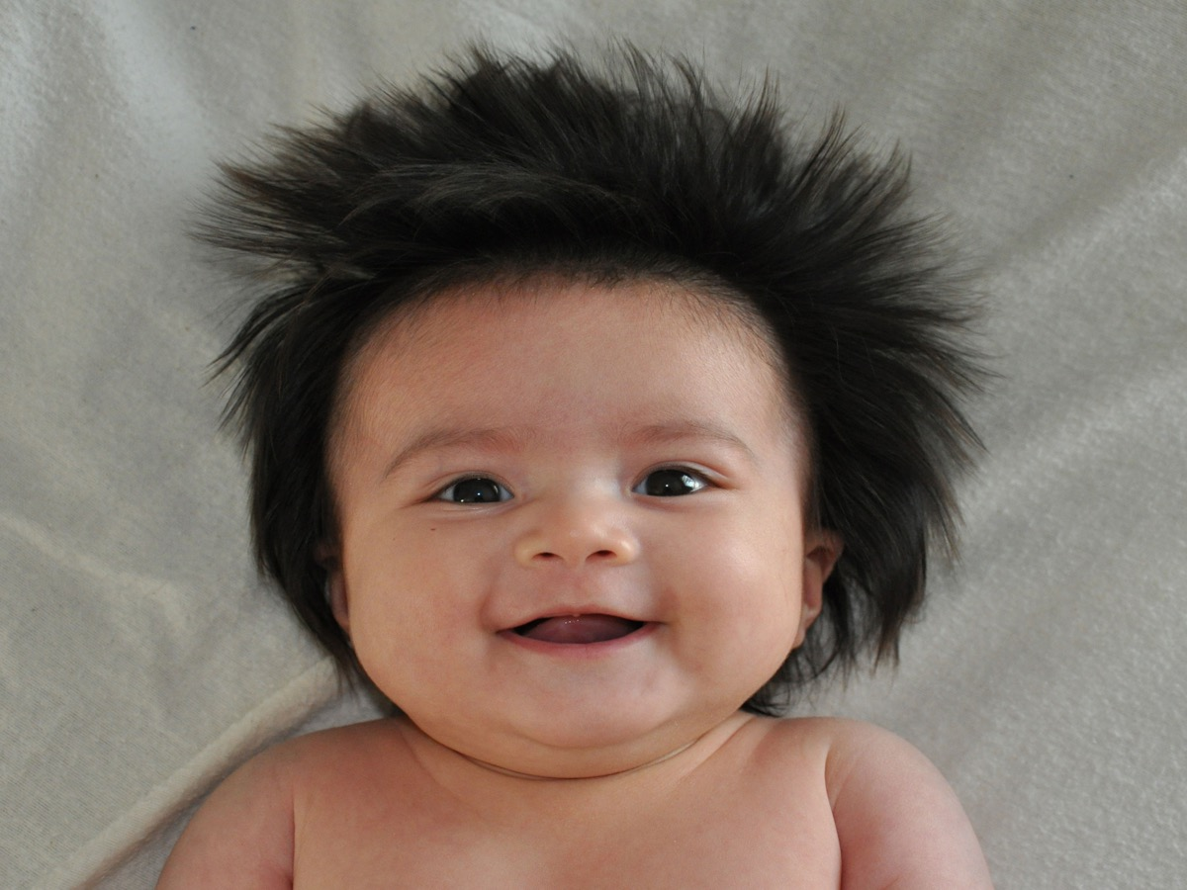

Slide 19
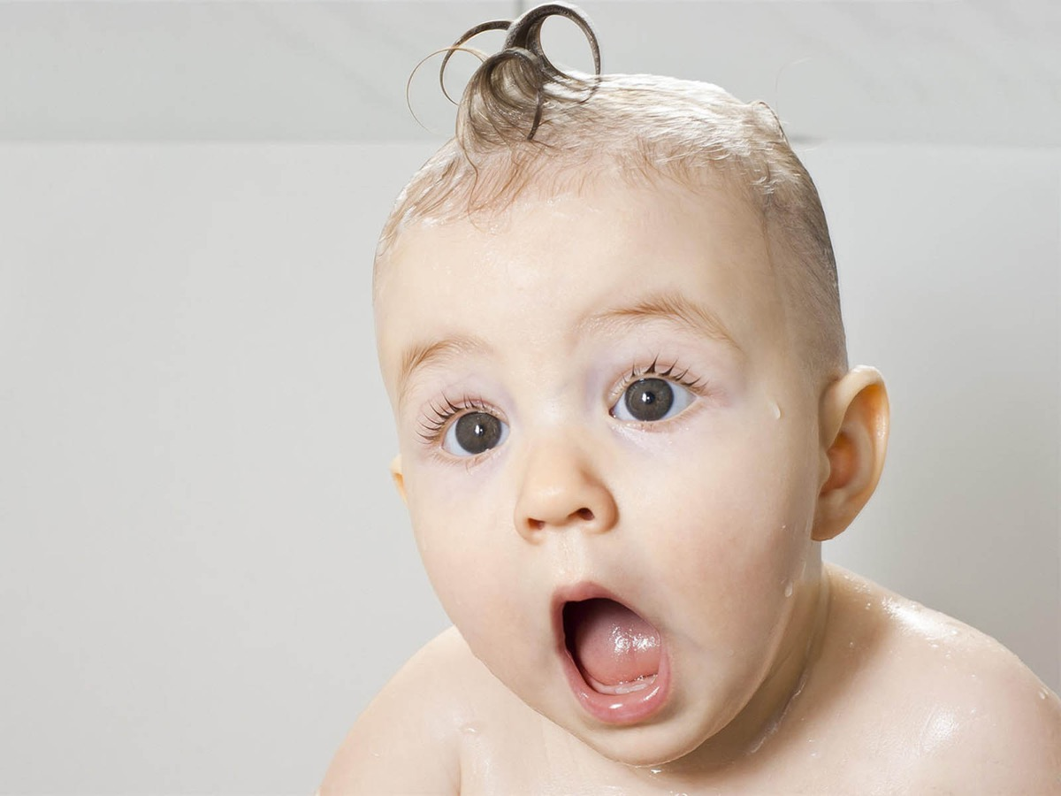

Slide 20
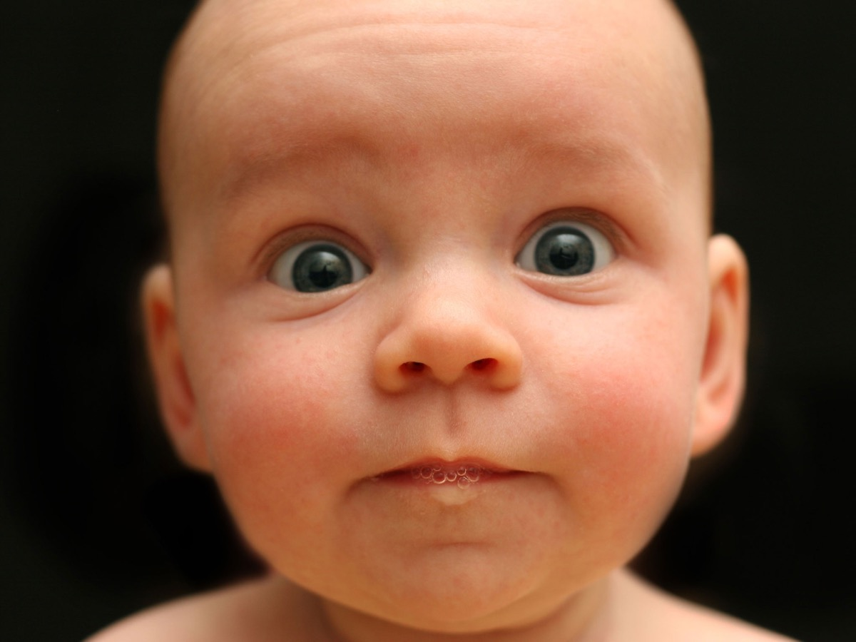

Slide 21
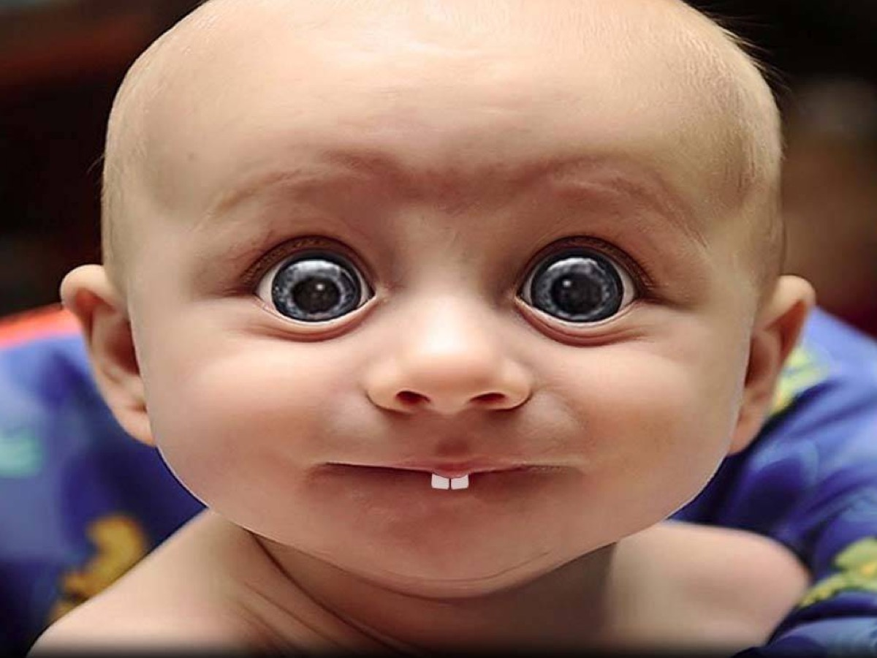

Slide 22
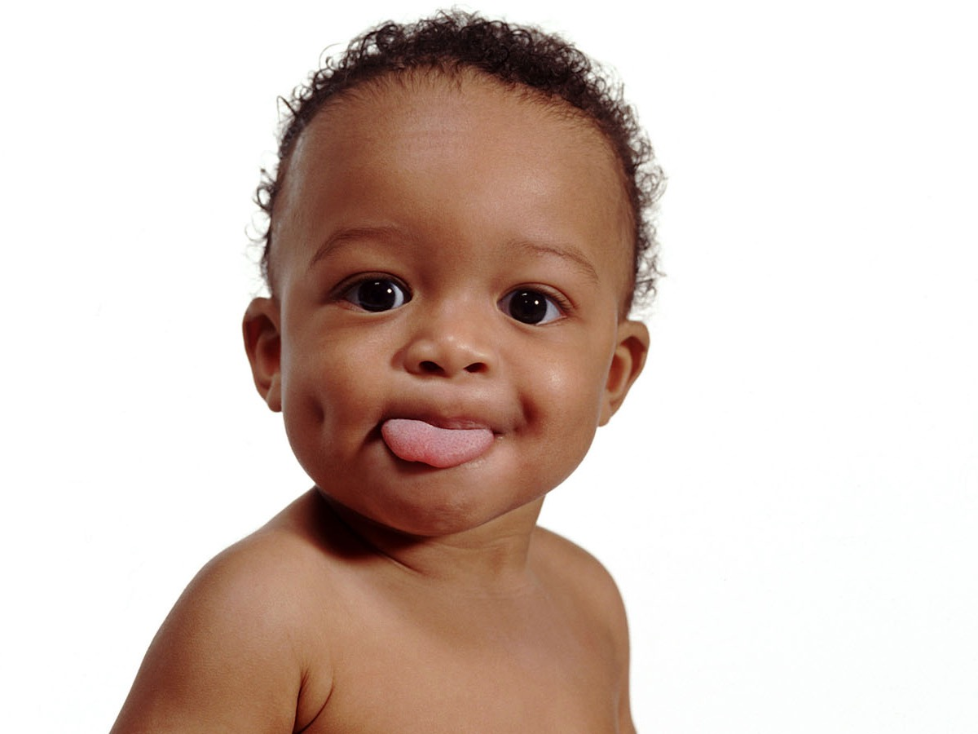

Slide 23
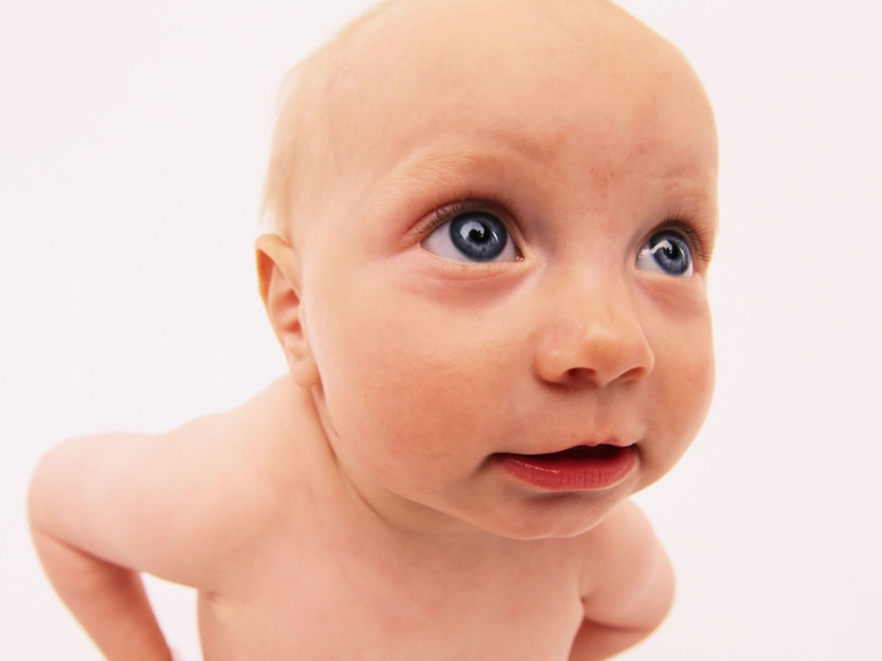

Slide 24


Slide 25
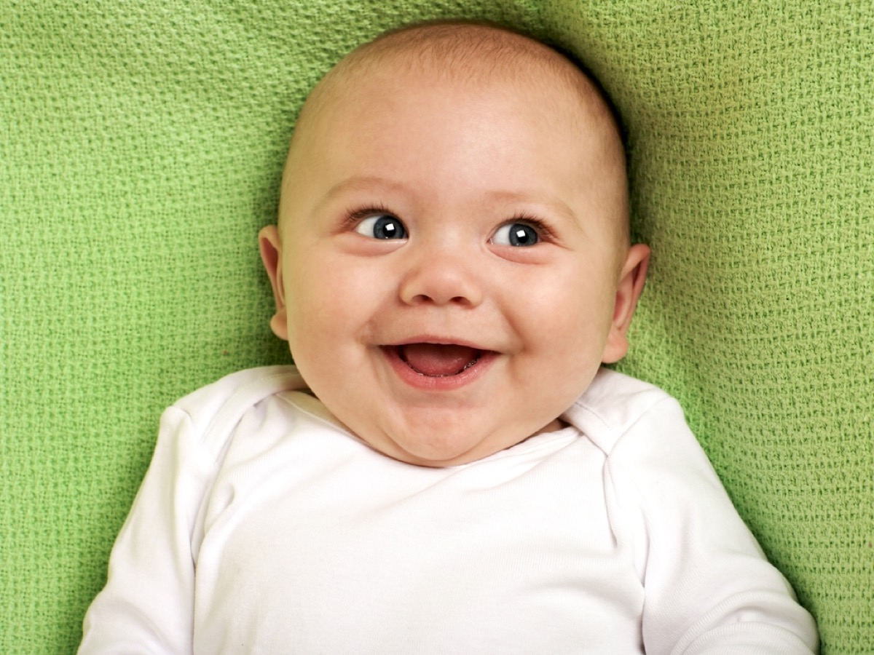

Slide 26
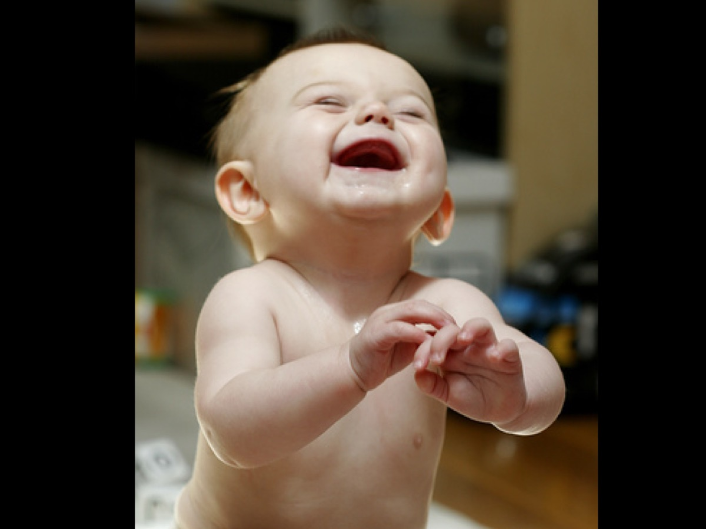

Slide 27
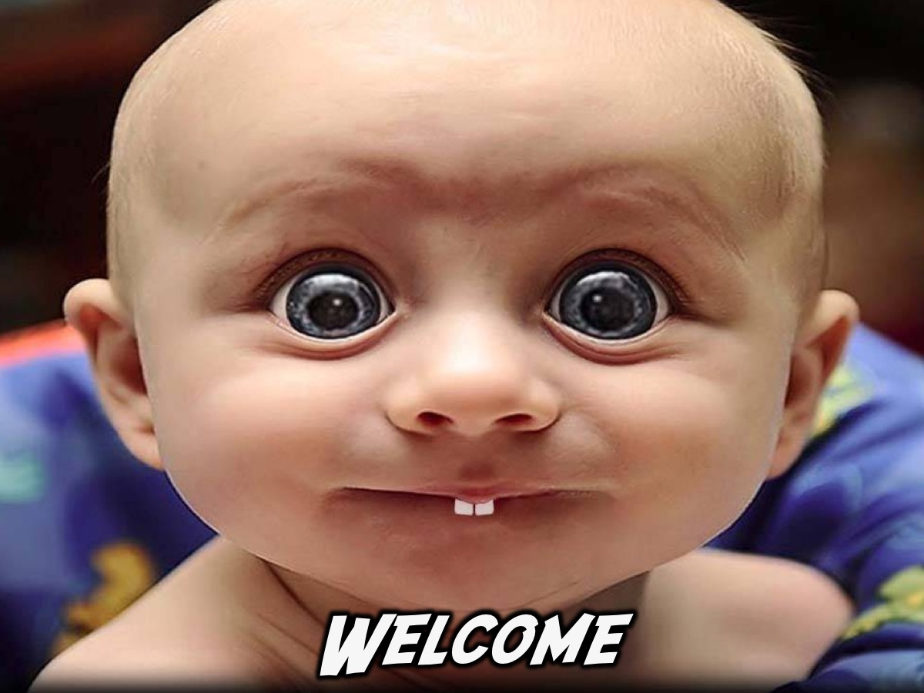
Notes:
Welcome to any newcomers and regulars.

Slide 28

Notes:
Let the Fun Begin

Slide 29
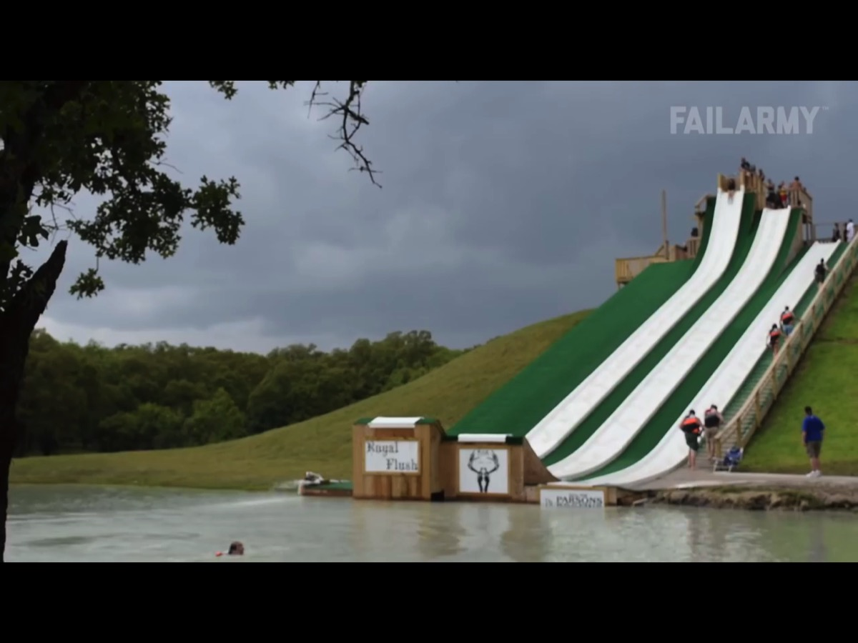
Notes:
Video: Ultimate Fails Compilation 2015 FailArmy Best Fails of the Year (Part 2). Get it on YouTube at: https://www.youtube.com/watch?v=UuRIfwpYRg8

Slide 30
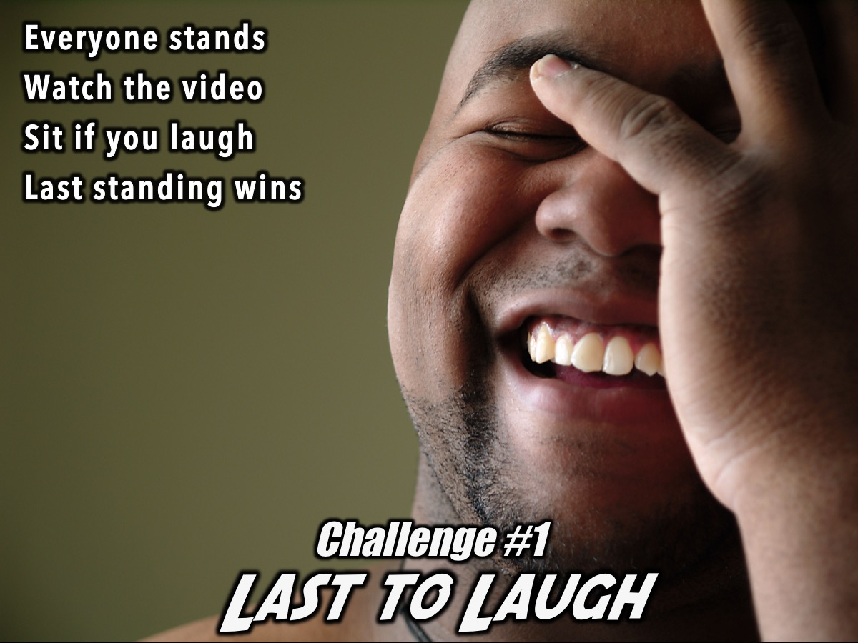
Notes:
Challenge #1: Last to Laugh: Everyone stands up and watches a video clip designed to make people laugh. If you laugh you have to sit down. The last person standing who has not laughed will win a prize. Leaders will monitor the audience to ensure that those who laugh sit down.

Slide 31
Notes:
Video: Ultimate Fails Compilation 2015 FailArmy Best Fails of the Year (Part 1). Get it on YouTube at: https://www.youtube.com/watch?v=JZipyUGgK3g

Slide 32

Notes:
Challenge #2: Seconds to Laugh: Teens are invited to compete individually. They have 10 (or 20?) seconds to get onto the stage and get a laugh from the audience. If they are successful they get a prize. At least 10 people will get a chance to compete.

Slide 33

Notes:
Challenge #3: First to Laugh: Divide into four teams. Each team has to prepare a skit/comedy routine to perform on stage. As each team competes a time keeper will record how long it takes for them to make the audience laugh. The team who gets the audience laughing in the least amount of time wins a prize.

Slide 34

Notes:
Small Groups. Here is the the heart behind the small group time - our goal is that your group members will go away challenged to not be boring but fun to be around and known to laugh and love life. Here are the questions: (1) What made you laugh tonight? (2) What normally makes you laugh? (3) How is laughter good for us (according to these Scriptures)? "Do not be sad, for the joy you have in the Lord is your strength." (Neh 8:10). "A glad heart makes a cheerful face, but by sorrow of heart the spirit is crushed." (Prov 15:13). "Rejoice in the Lord always." (Phil 4). (4) Pray for each other to laugh more.

Slide 35

Notes:
Next Friday night is Escape Room Night.

Slide 36
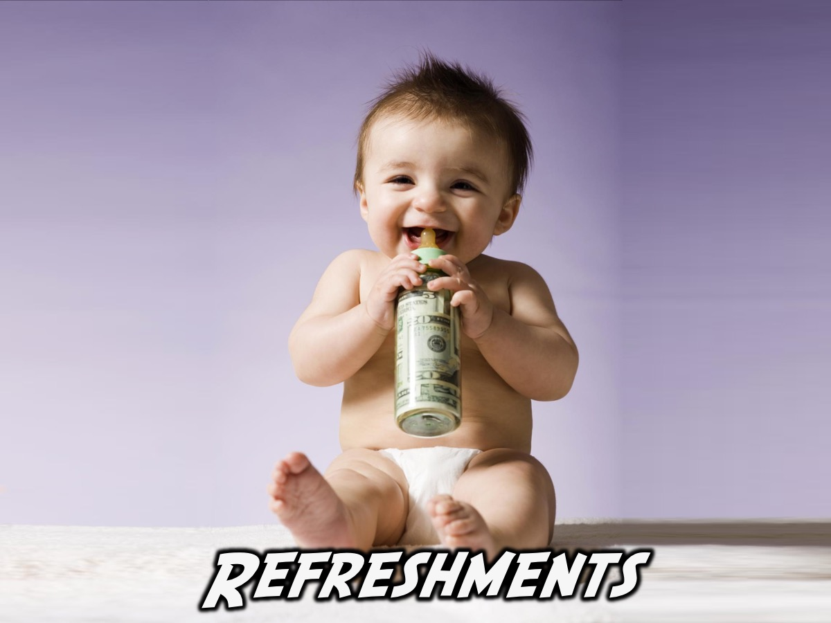
Notes:
Refreshments are served.

