Slide 1
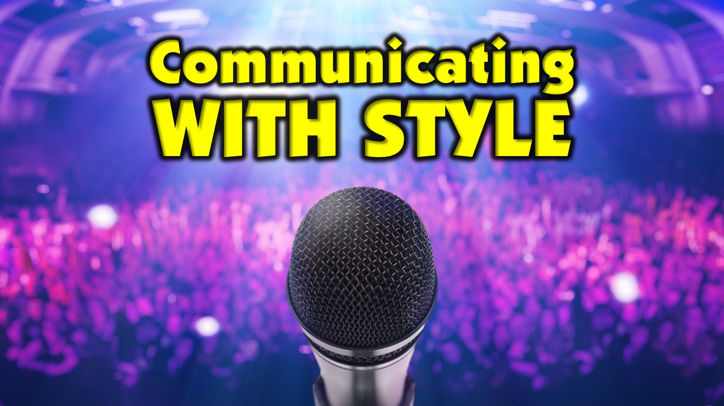
Notes:
Welcome to Communicating with Style. Let’s pray and ask God to help time together radically impact how we communitate with people.

Slide 2

Notes:
Maybe you are a confident speaker and you are here today because the other option did not look that attractive - maybe this is the lesser of two evils. Or at least you are helping to get a few points to go from good to great.

Slide 3

Notes:
Or maybe you have a fear of public speaking and hope this morning will help you conquer some of the speaking demons.

Slide 4
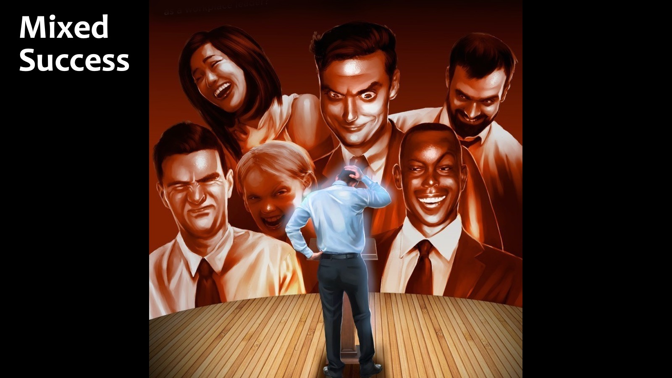
Notes:
Maybe you have had mixed success at public speaking and could learn a thing of two

Slide 5
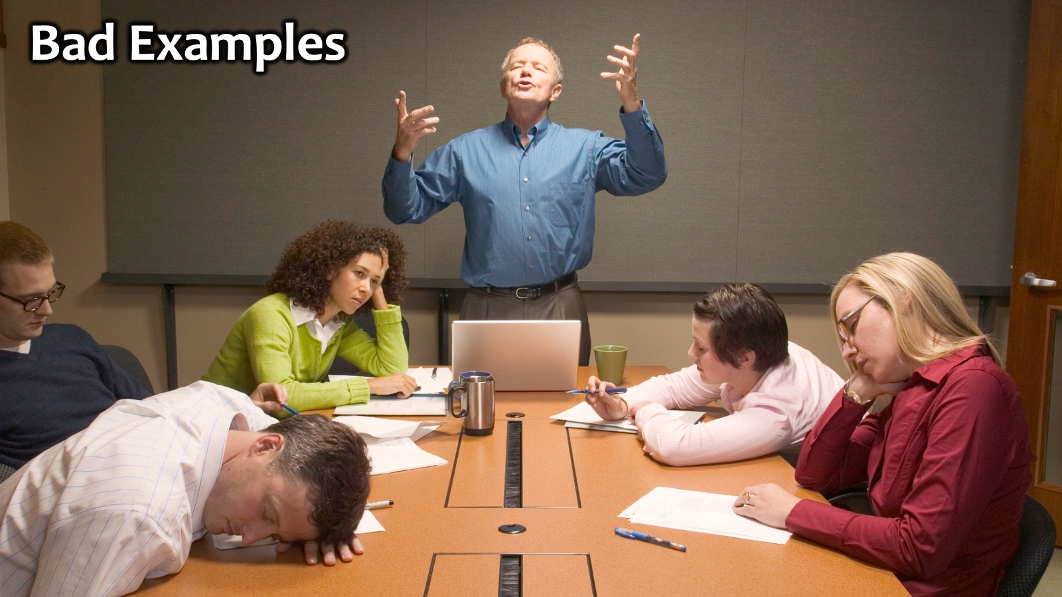
Notes:
Or maybe you have watched really really bad speakers bore the life out of their audience and you never want to be that guy!

Slide 6
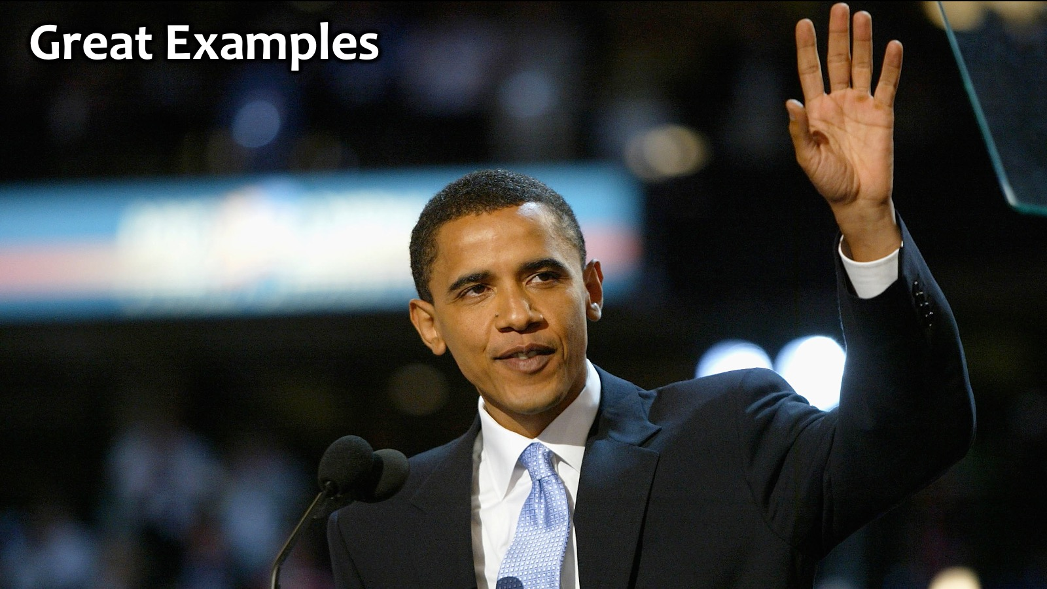
Notes:
Someone who never bores his audience is Barak Obama. Arguably, one of the greatest speeches ever delivered was by Barak Obama in 20014 at the Democratic National Convention in Boston:

Slide 7
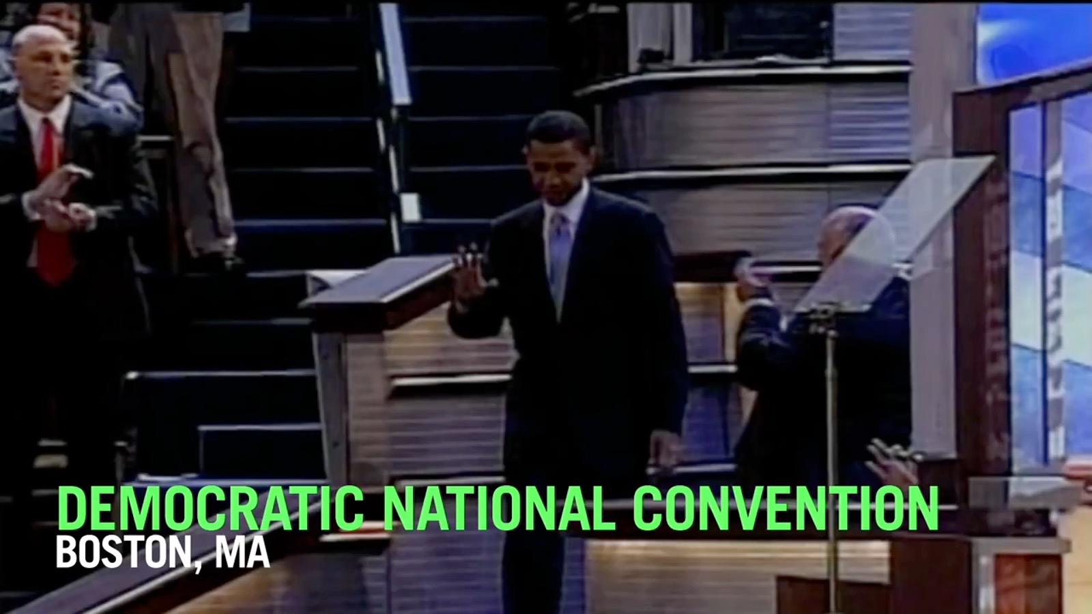
Notes:
Video: The Speech That Made Obama President. In 2004, a one-term senator from Illinois took the stage to deliver the keynote speech at the Democratic National Convention in Boston. By the time Barack Obama had finished speaking, Democrats across the country knew they had seen the future of their party. Get it on https://www.youtube.com/watch?v=OFPwDe22CoY

Slide 8
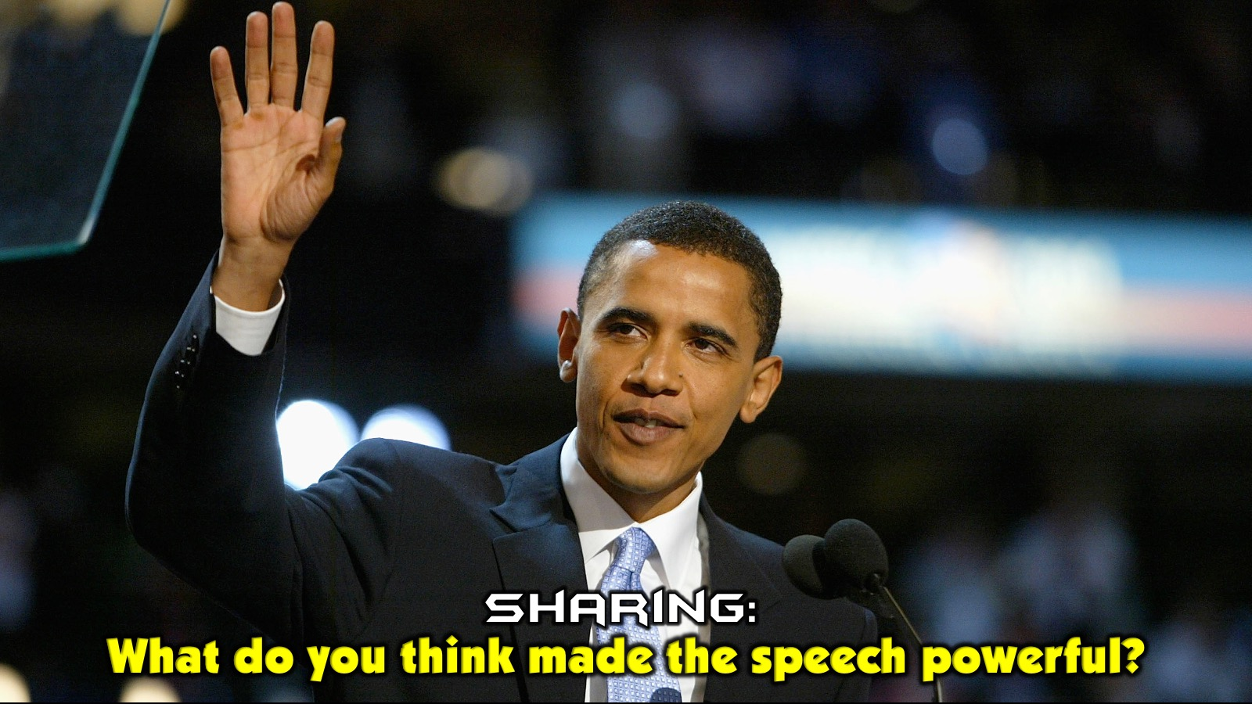
Notes:
Sharing: What do you think made the speech powerful?
Feedback: Each table is going to share their best idea about what made the speech great.

Slide 9

Notes:
Learning from God: God is an incredible communicator - he always gets people’s attention and communicates with style.

Slide 10
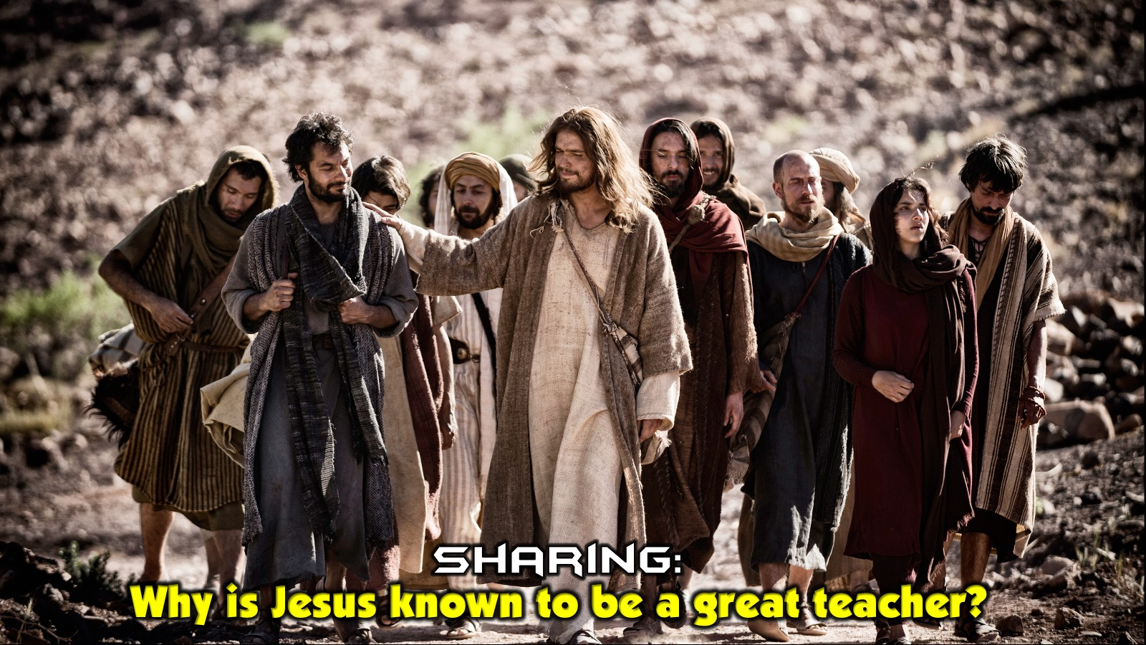
Notes:
Activity: Jesus is acknowledged to be one of the greatest teachers who ever lived. Why is Jesus known as such a great teacher?

Slide 11
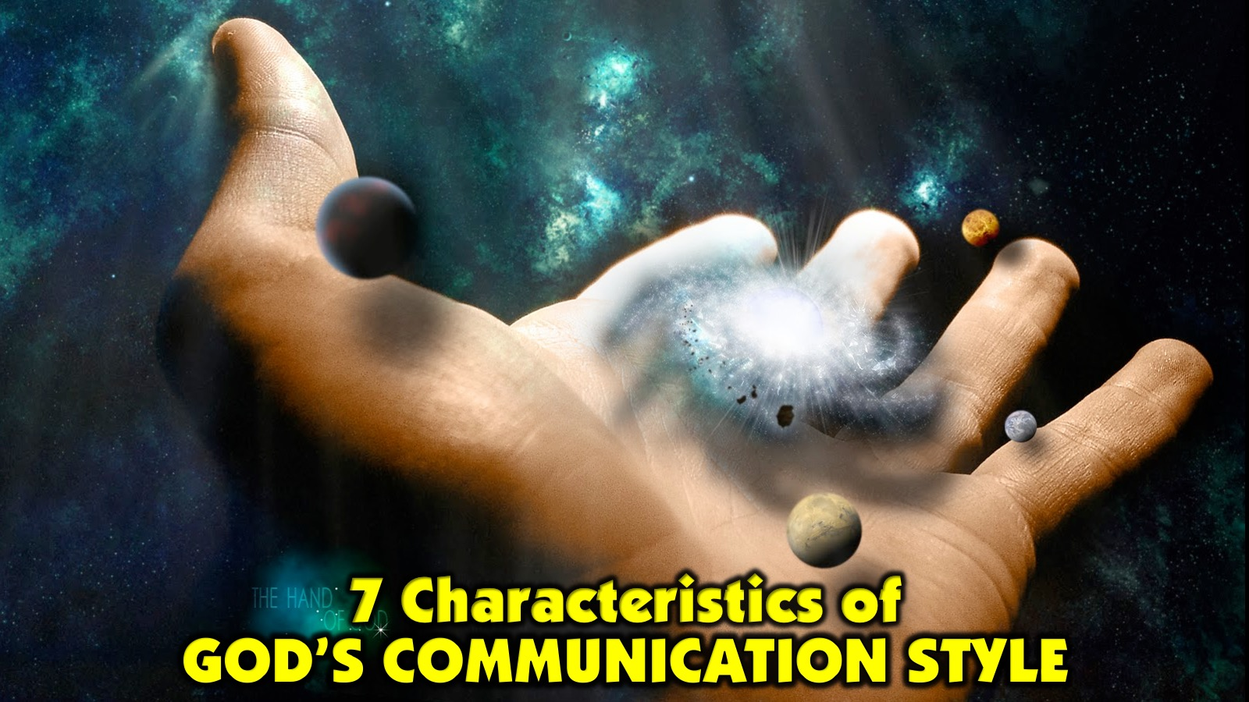
Notes:
Here are 7 Characteristics of God’s Communication Style:

Slide 12
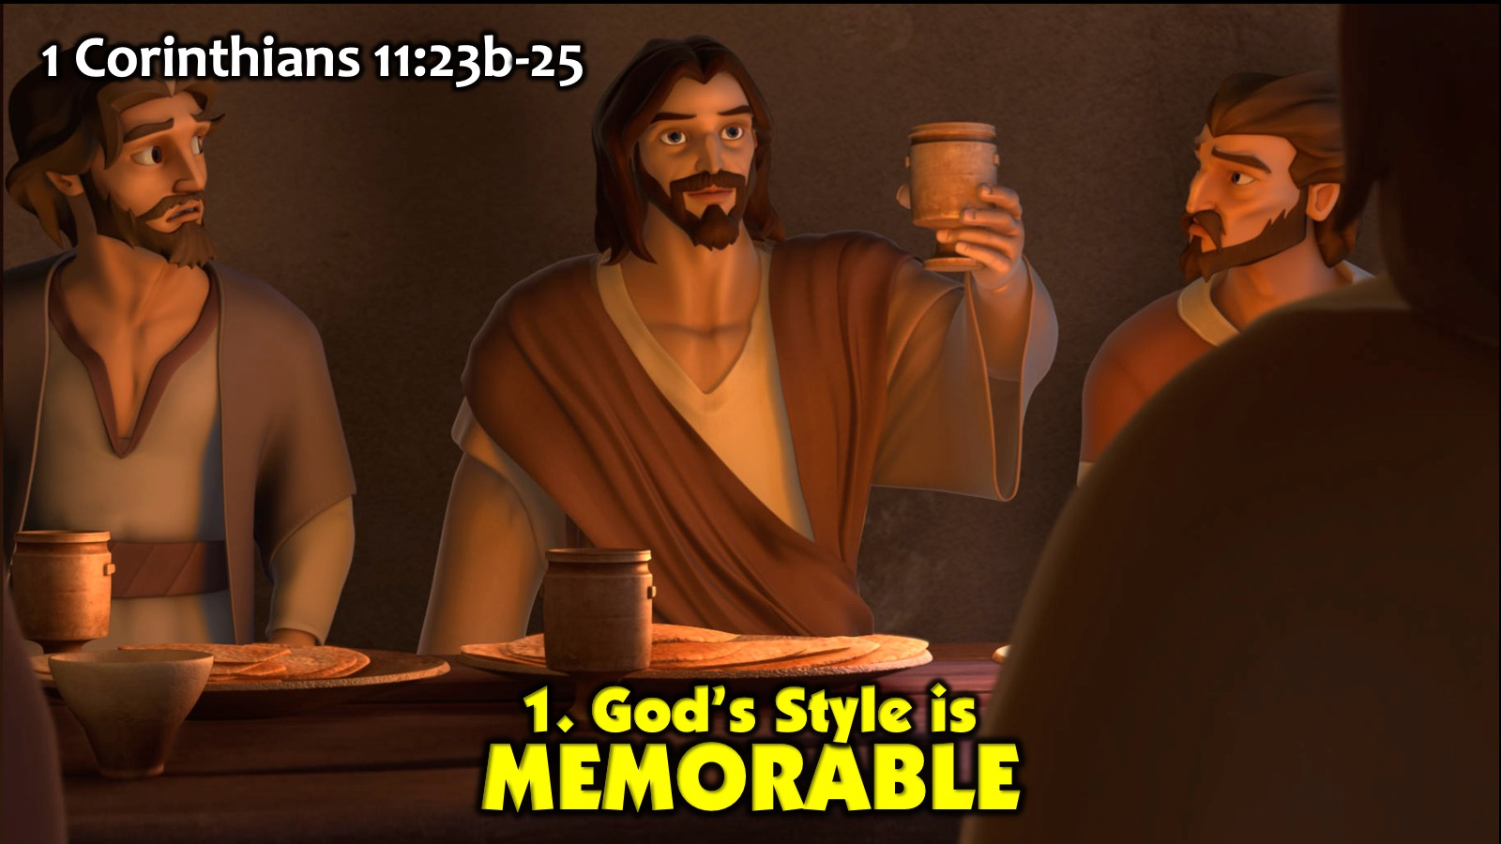
Notes:
1. God’s Style is Memorable: 1 Corinthians 11:23b-25. Jesus breaks bread and shares the cup. We still use the bread and the cup 2000 years later to remember Him.

Slide 13
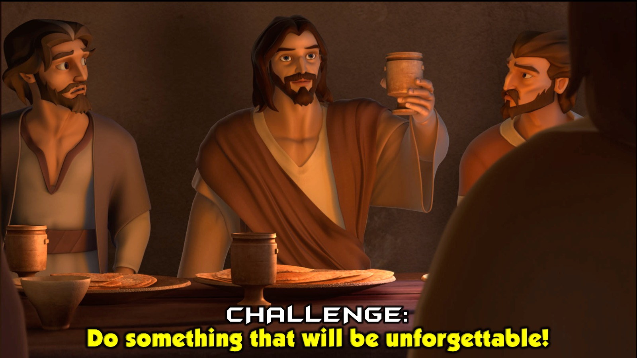
Notes:
Challenge: Do something that will be truly unforgettable.

Slide 14
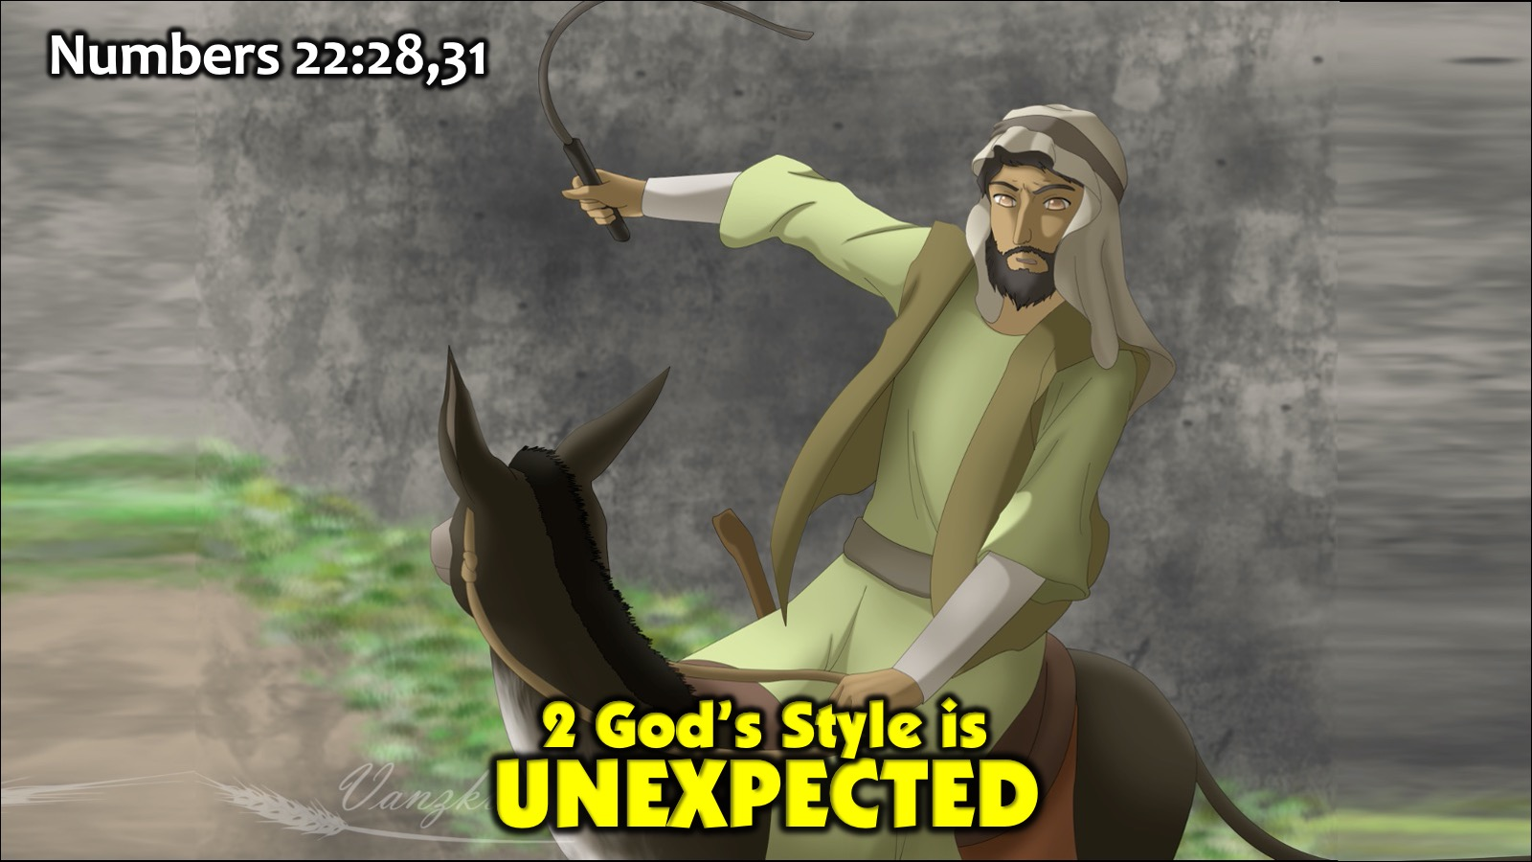
Notes:
2. God’s Style is Unexpected: Numbers 22:28,31. God speaks through a donkey and sends an angel to block Balaam’s way. Challenge:

Slide 15
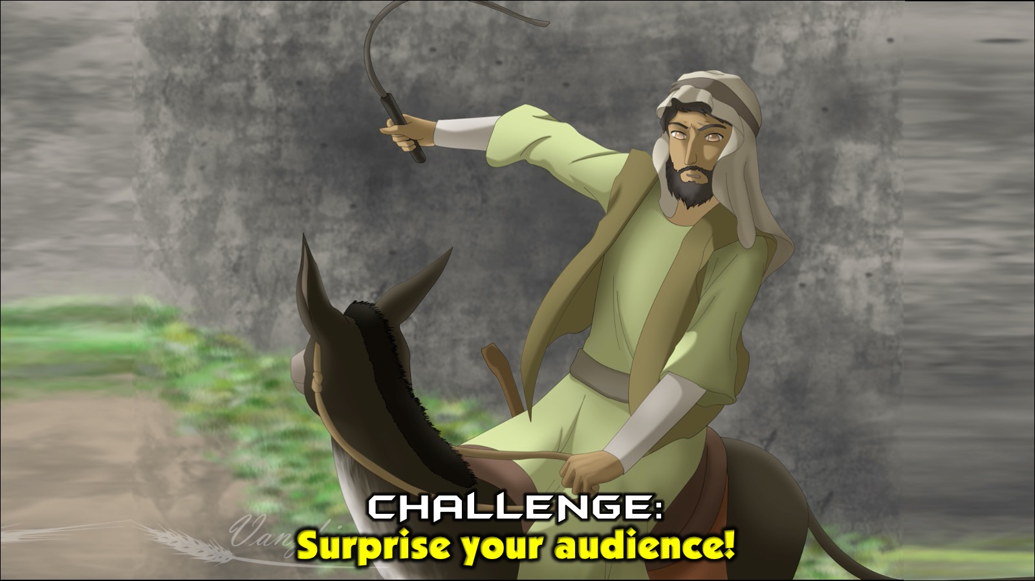
Notes:
Challenge: Communicate in a way that surprises your audience and involves their senses.

Slide 16
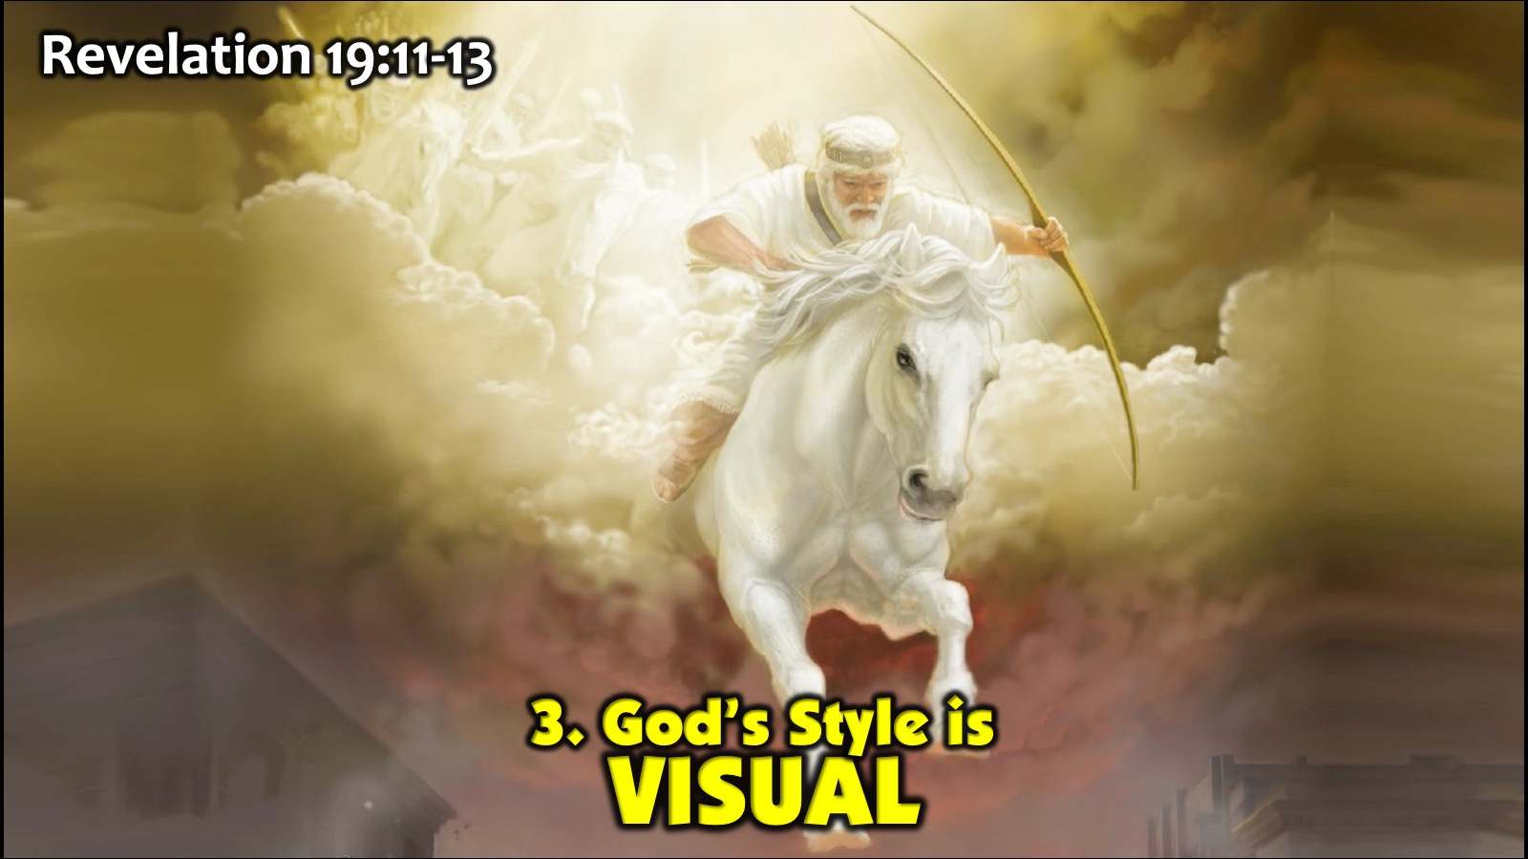
Notes:
3. God’s Style is Visual: Revelation 19:11-13. God used visual aids to show John a vision of Christ as King, riding a white horse to victory over Satan’s followers.

Slide 17
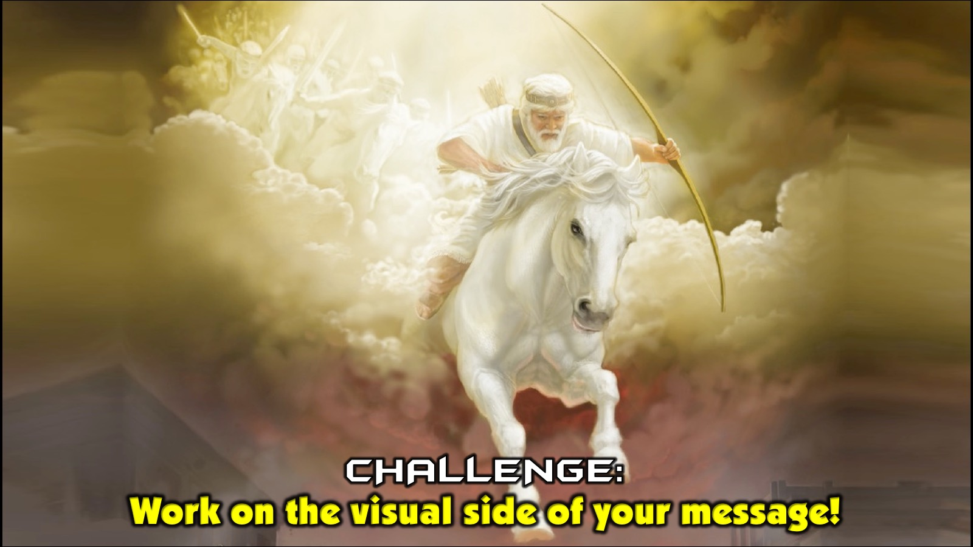
Notes:
Challenge: Include the whole visual faculties of your audience - colours, shapes, etc.

Slide 18
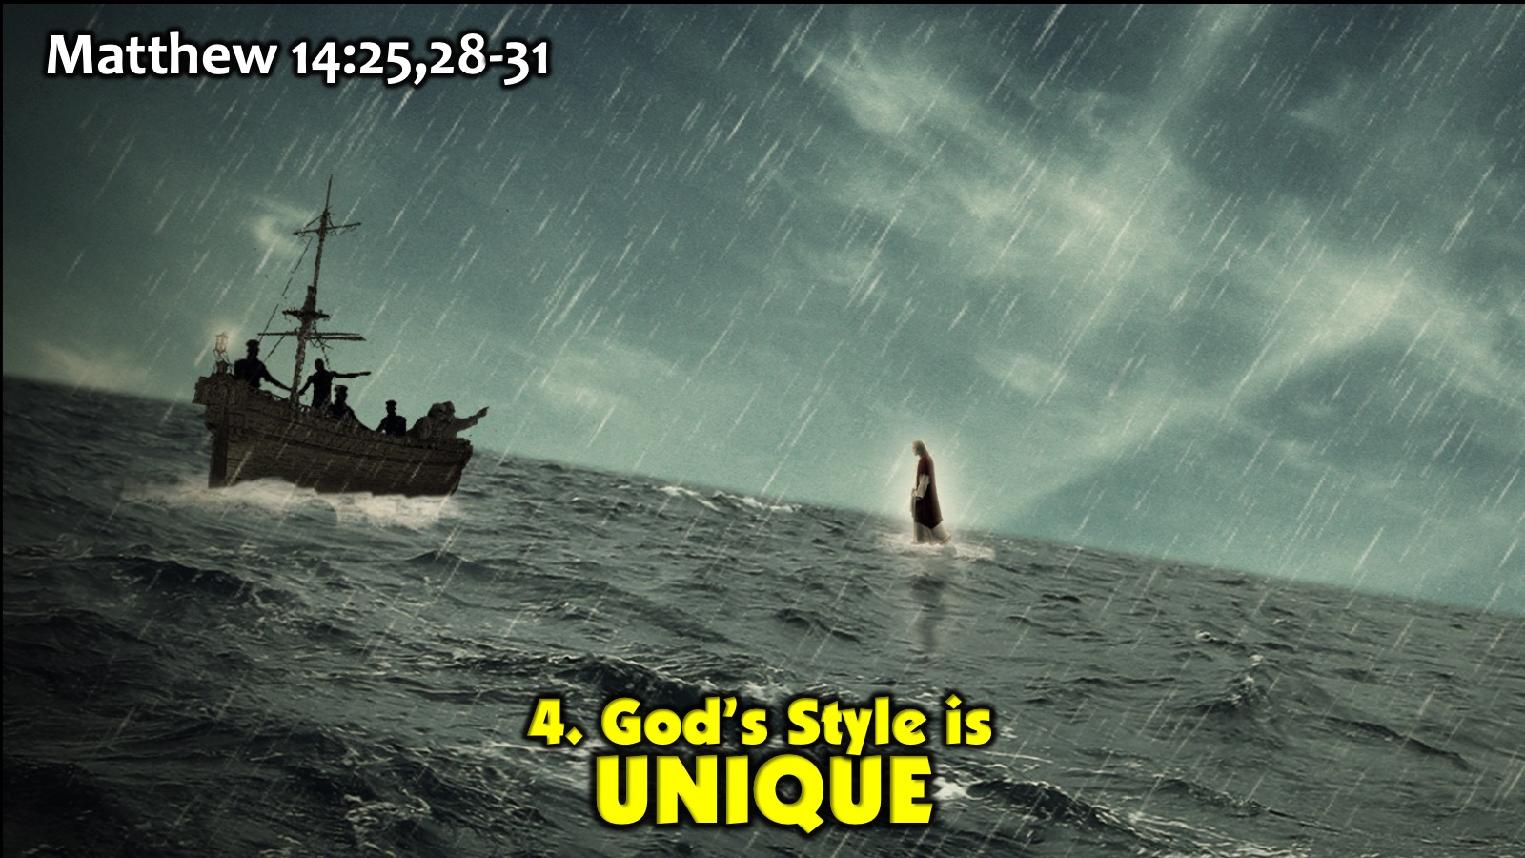
Notes:
4. God’s Style is Unique: Matthew 14:25,28-31. Jesus taught his disciples to put their faith in him by walking on the water.

Slide 19
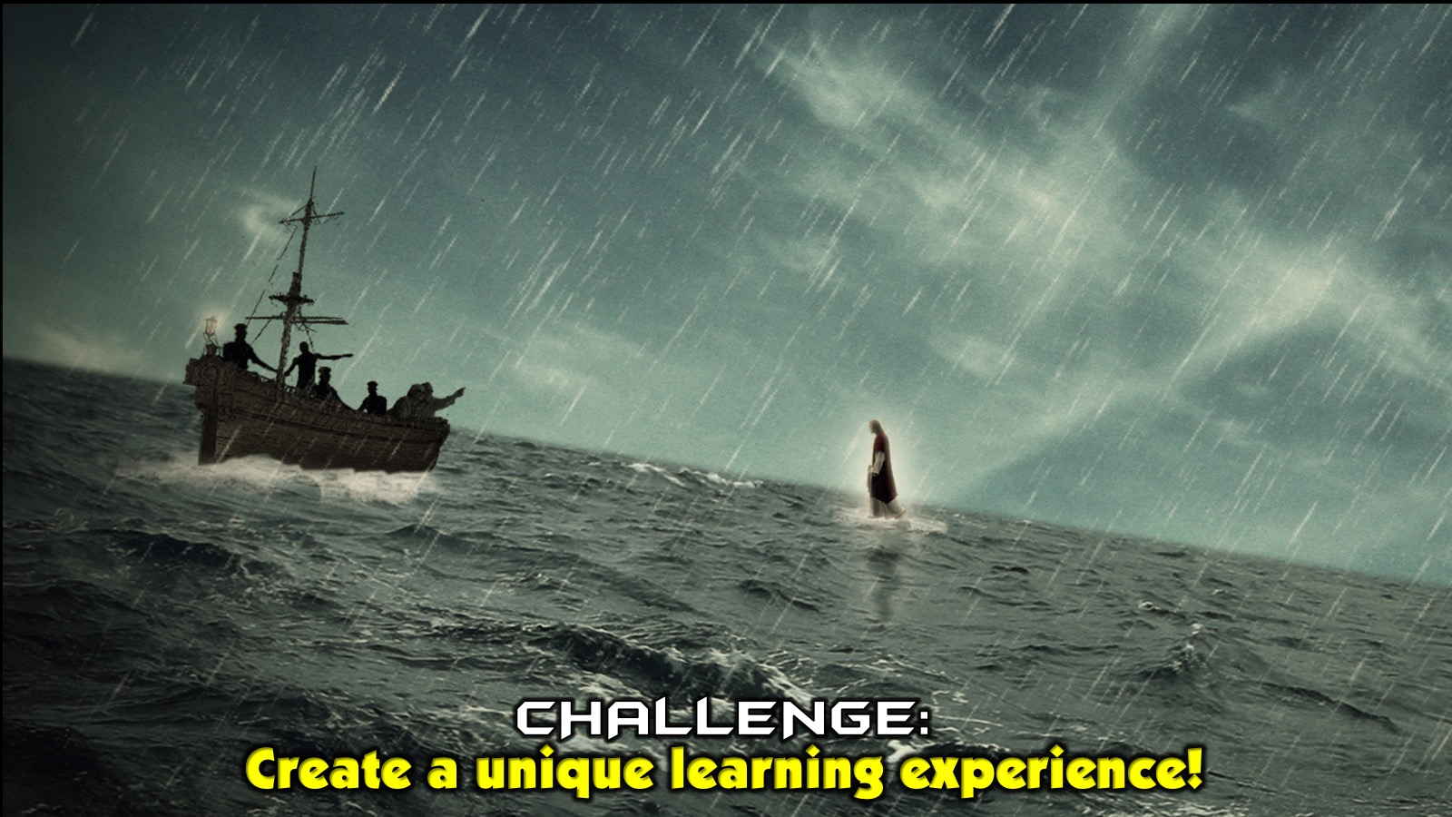
Notes:
Challenge: Create a unique event for your audience, one they will never be able to forget - a learning experience!

Slide 20
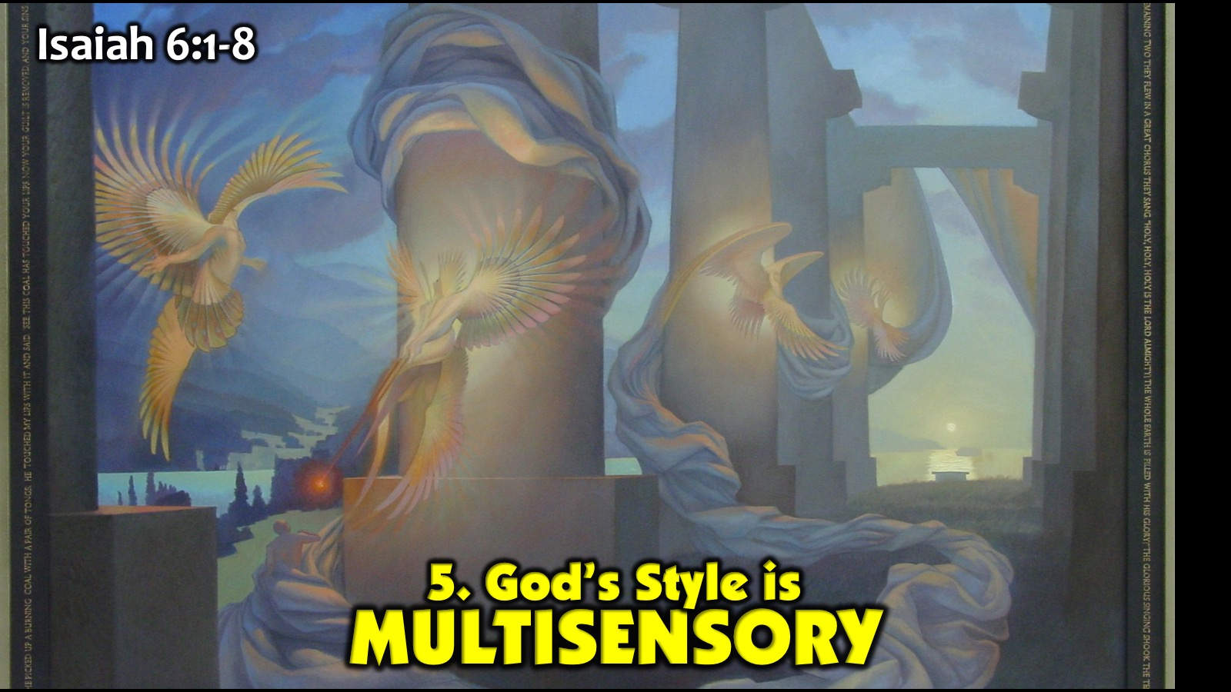
Notes:
5. God’s Style is Multisensory: Isaiah 6:1-8. God gave Isaiah a multisensory, life changing experience with sight, sound, aroma and touch. Jesus used everything around him to teach his disciples - all their senses were involved.

Slide 21
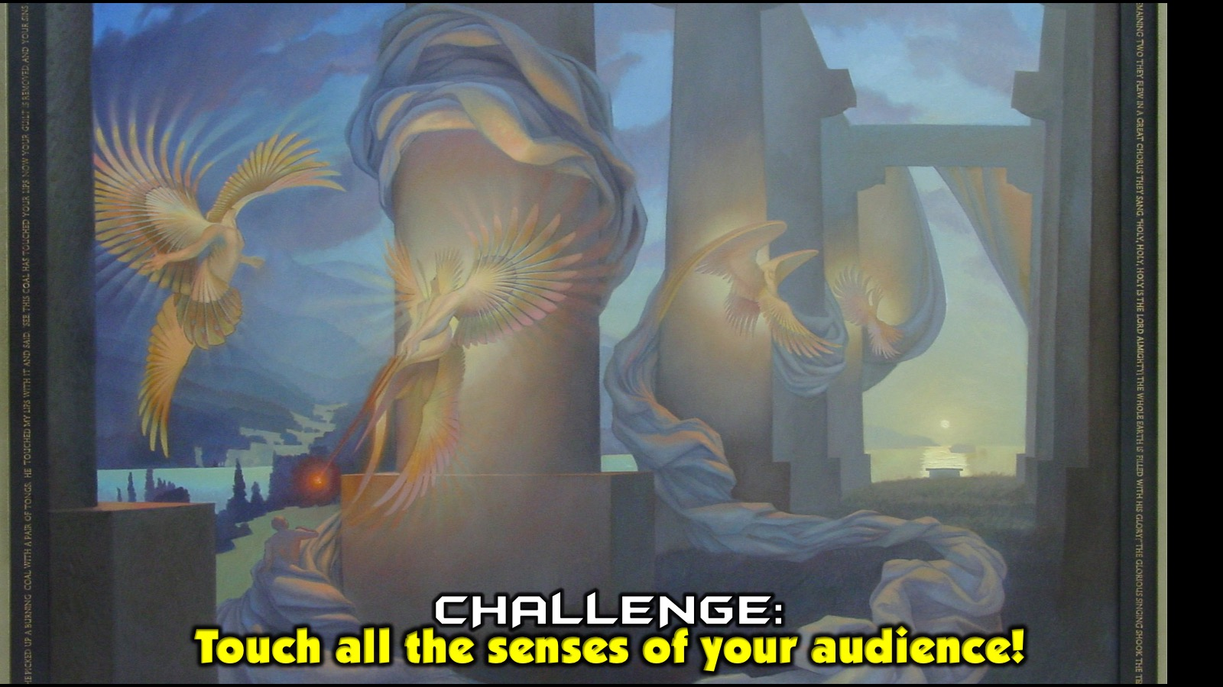
Notes:
Challenge: Bring the world into your speaking environment as much as possible to touch all the senses of your audience.

Slide 22
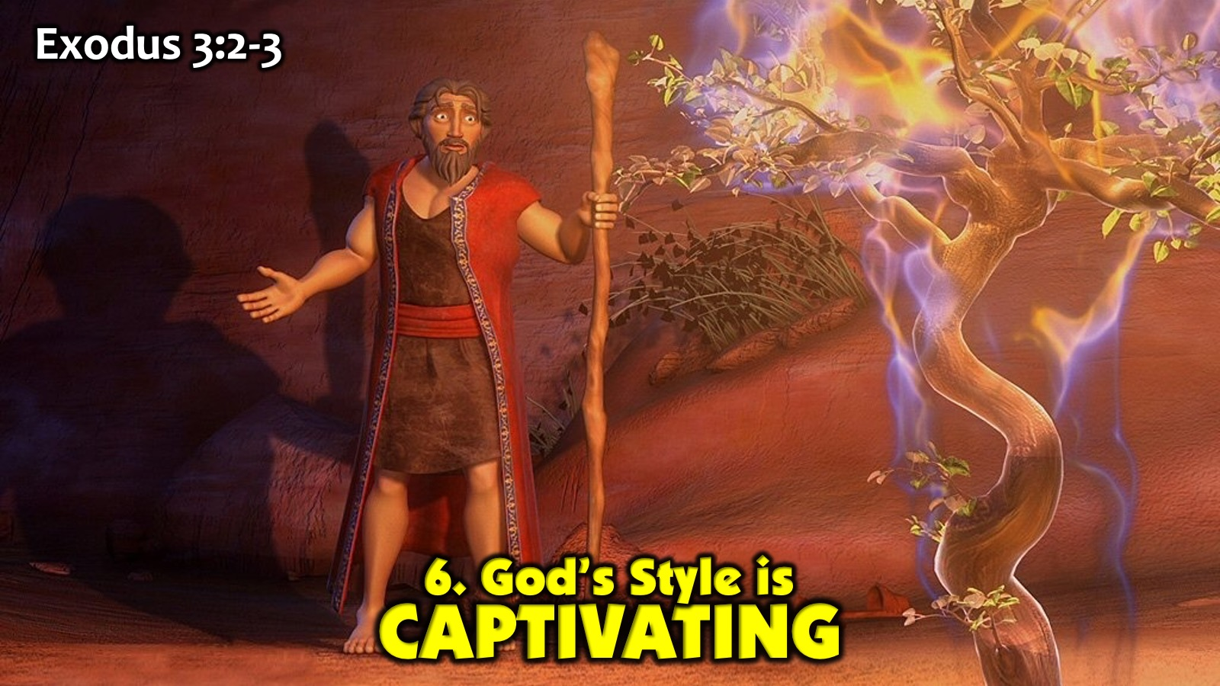
Notes:
6. God’s Style is Captivating: Exodus 3:2-3. God got and held Moses’ attention by setting a green bush on fire and then speaking to him.

Slide 23
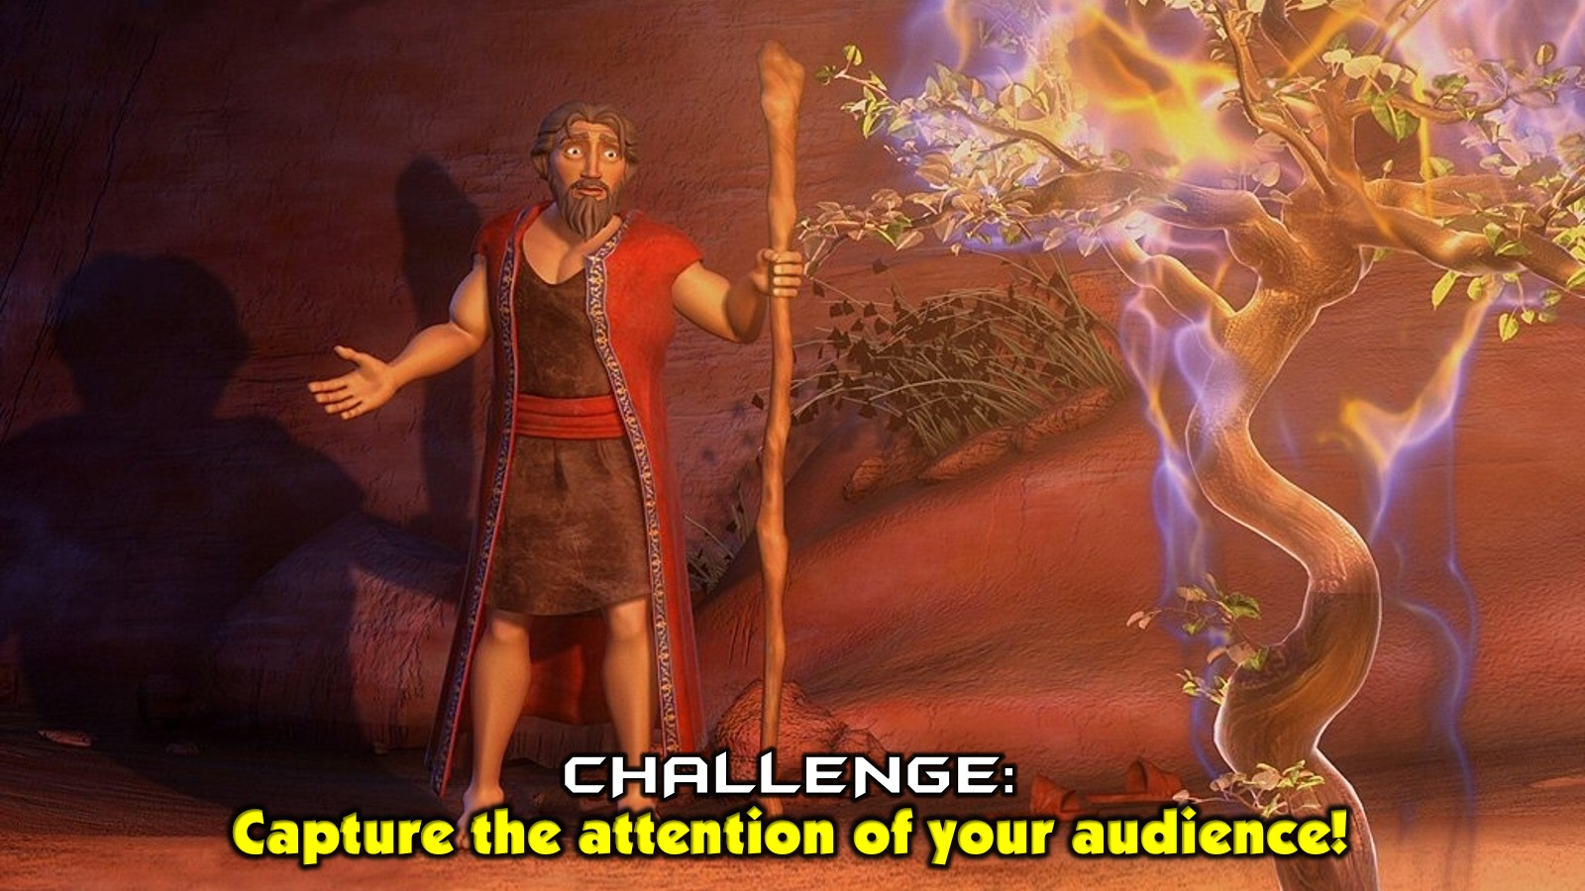
Notes:
Challenge: Capture your audience by everything you say and do in your message.

Slide 24
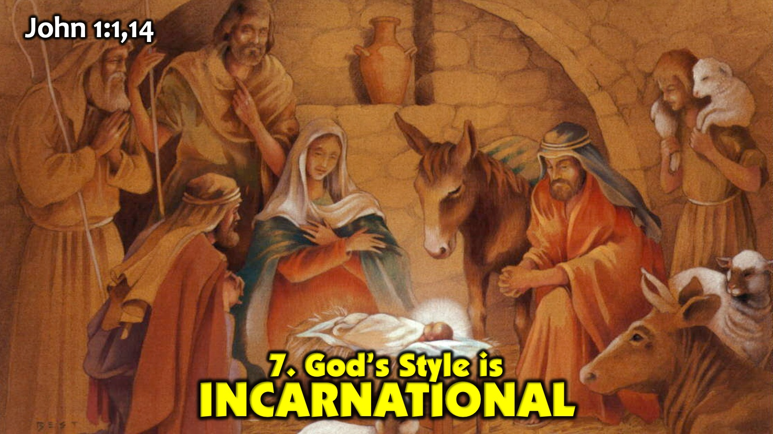
Notes:
7. God’s Style is Incarnational: John 1:1,14. God came to teach us about his love and salvation and he did this by becoming one of us. Jesus did not just bring a word from God, he became the word from God! Challenge: As we model what we teach and share examples from our own lives there will be power behind what we say.

Slide 25
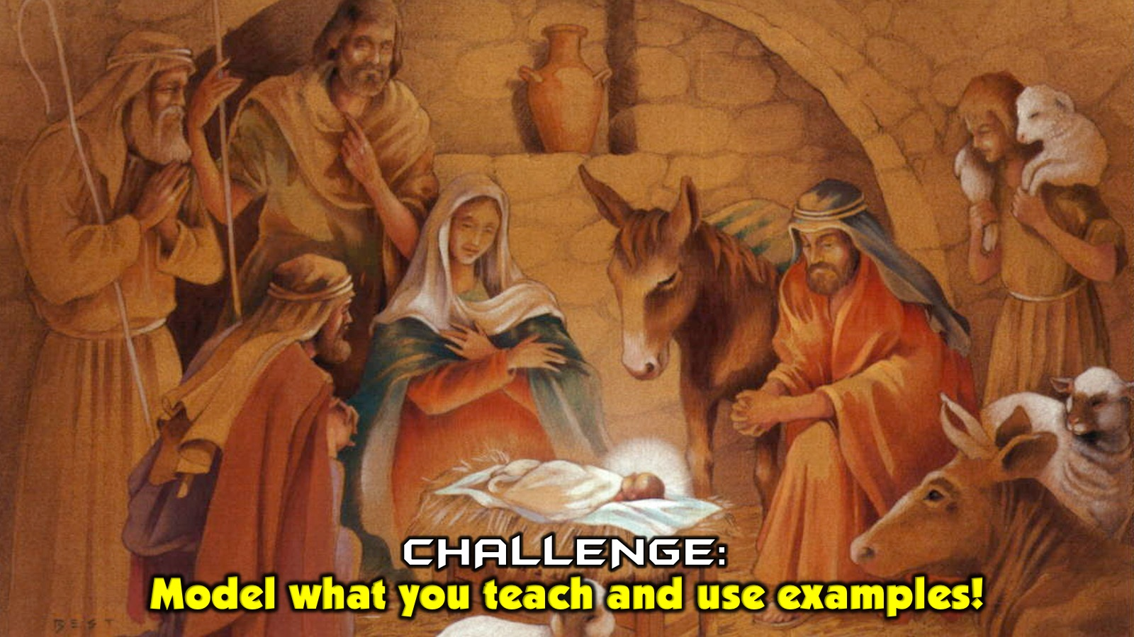
Notes:
Challenge: As we model what we teach and share examples from our own lives there will be power behind what we say.

Slide 26
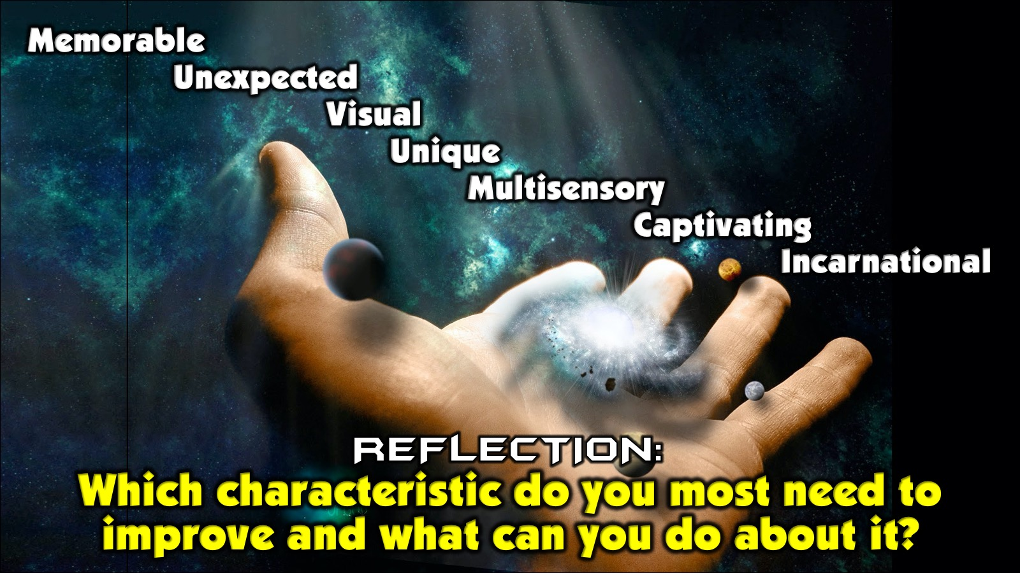
Notes:
Reflection: Which characteristic do you most need to improve and what can you do about it?

Slide 27

Notes:
Most of you have probably heard of Toastmasters - an organisation that trains people in public speaking. They have a world championship of public speaking each year and we are going to watch the winner of 2014 in action:

Slide 28
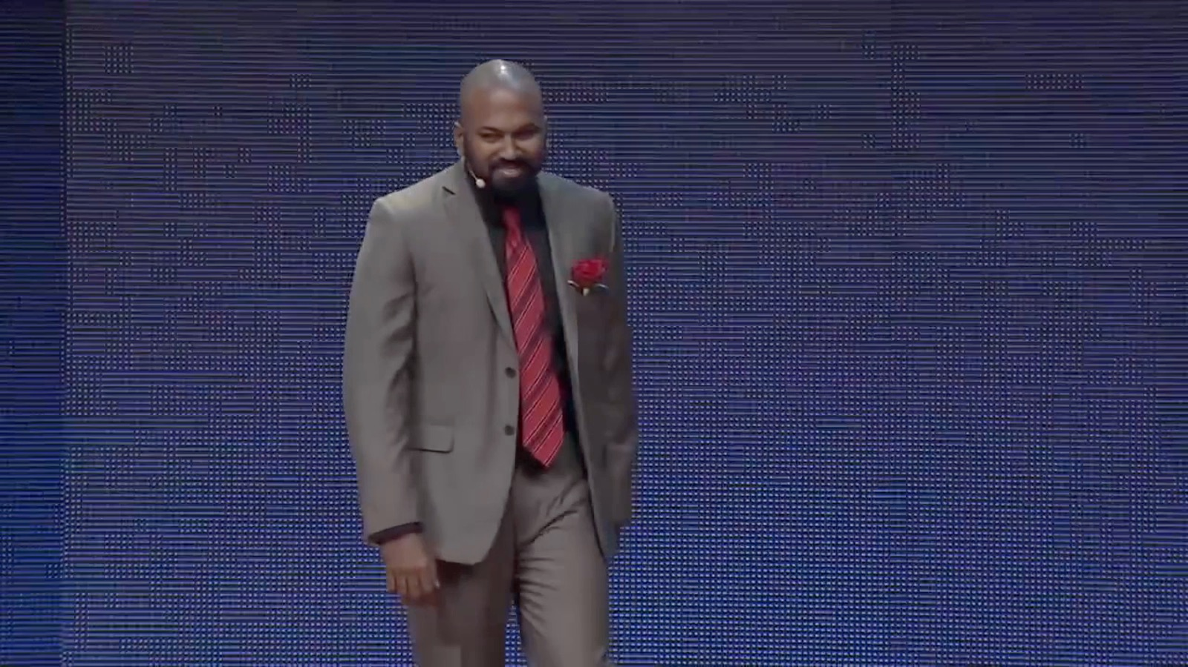
Notes:
Video: Dananjaya Hettiarachchi World Champion of Public Speaking 2014 FULL SPEECH. Get it on YouTube at: https://www.youtube.com/watch?v=bbz2boNSeL0

Slide 29

Notes:
Guidelines for Communicating with Style: What can we do about raising the quality and the impact of our communication? How do we communicate with style? Here are some guidelines that will definitely help:

Slide 30
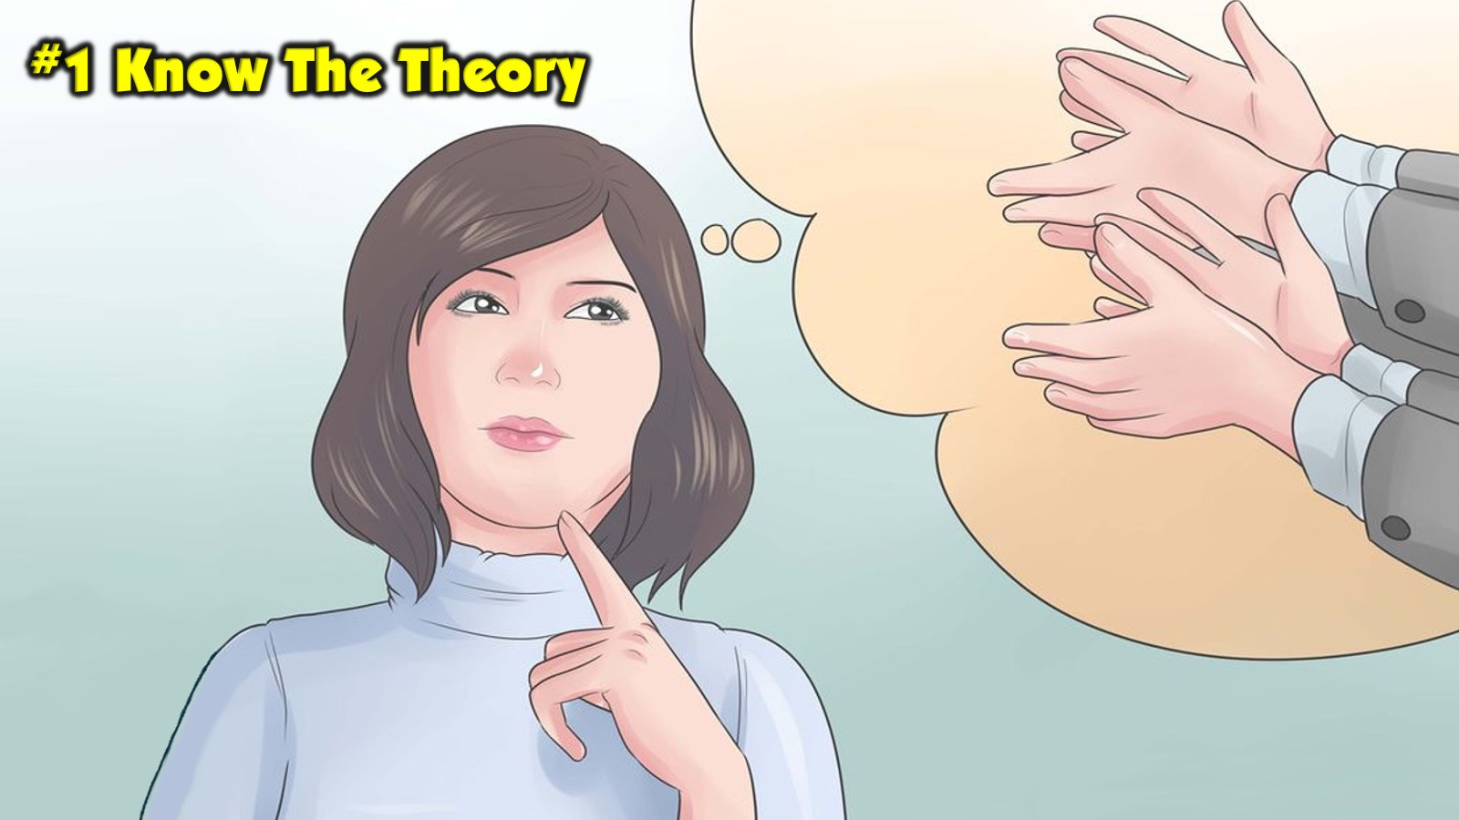
Notes:
1. Know The Theory: It will help if you study about communication and learning as they are a vital part of communicating with style. Here are two aspects that are critical:

Slide 31
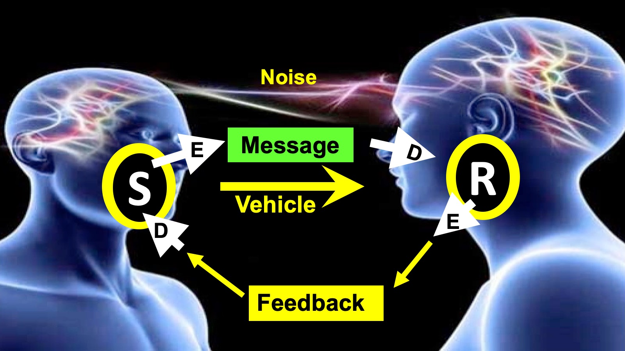
Notes:
A. The Communication Model: There is a Sender and a Receiver who each have to encode and decode the message being transferred between them, then there is Noise which can hinder the message being received and there is Feedback that the receiver returns that needs to be reacted on by the Sender.

Slide 32
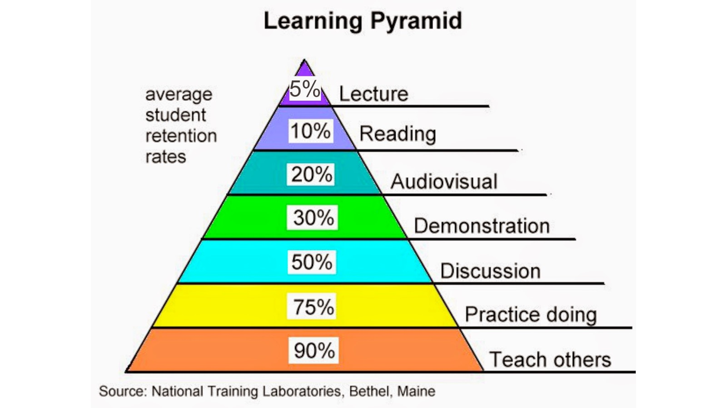
Notes:
B. The Learning Cone: The Edgar Dale Cone of Learning teaches us that there are different kinds of communication methods and that we must use more active learning tool than passive ones to ensure people actually learn.

Slide 33
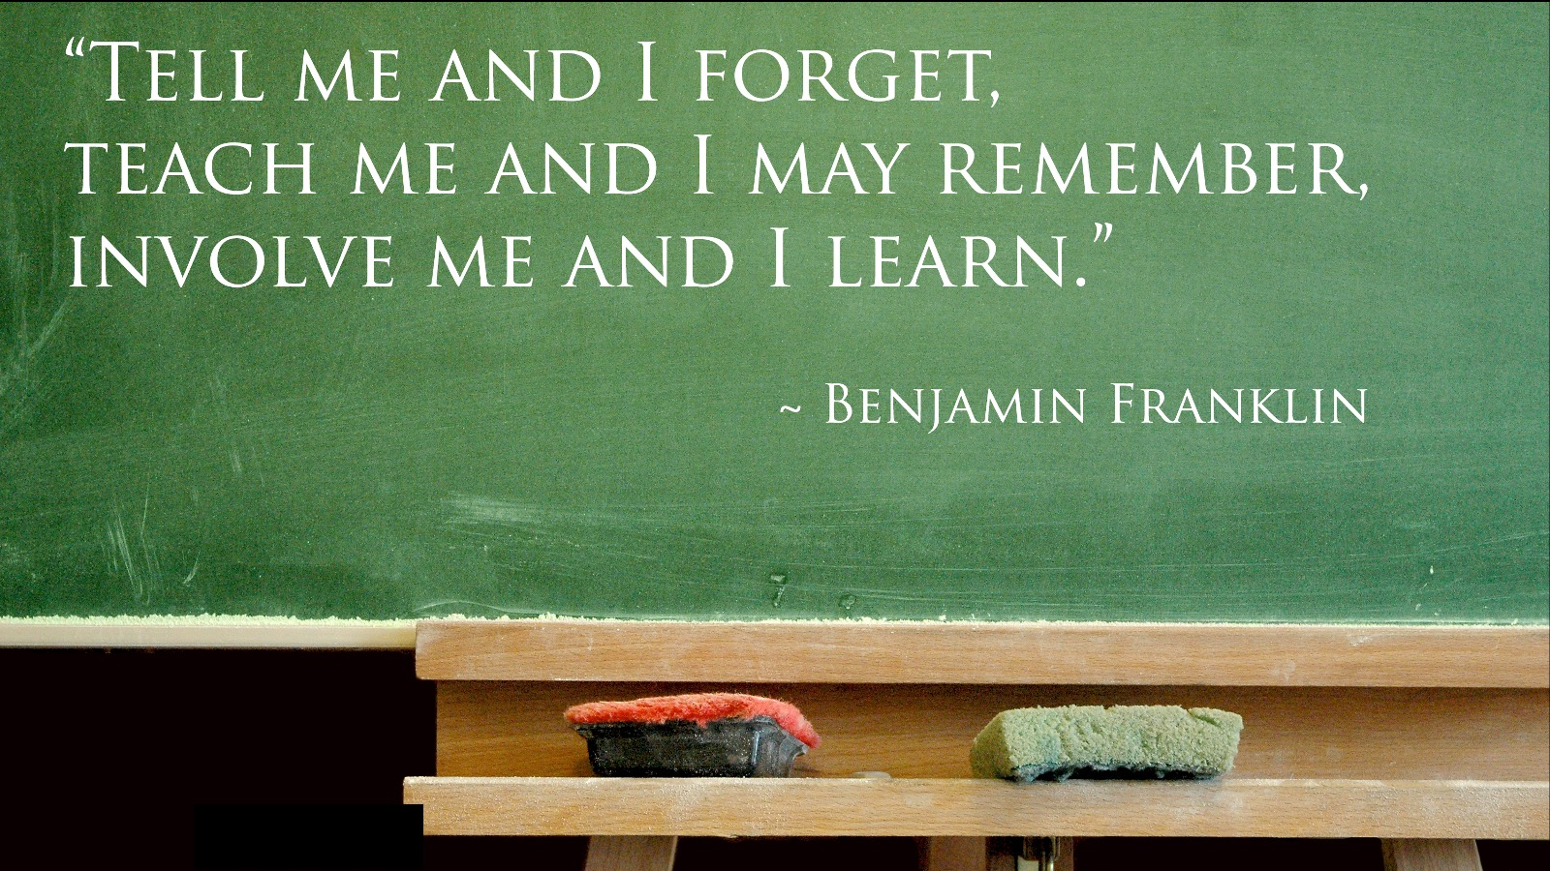
Notes:
Benjamin Franklin said: “Tell me and I forget, teach me and I may remember, involve me and I learn.”

Slide 34
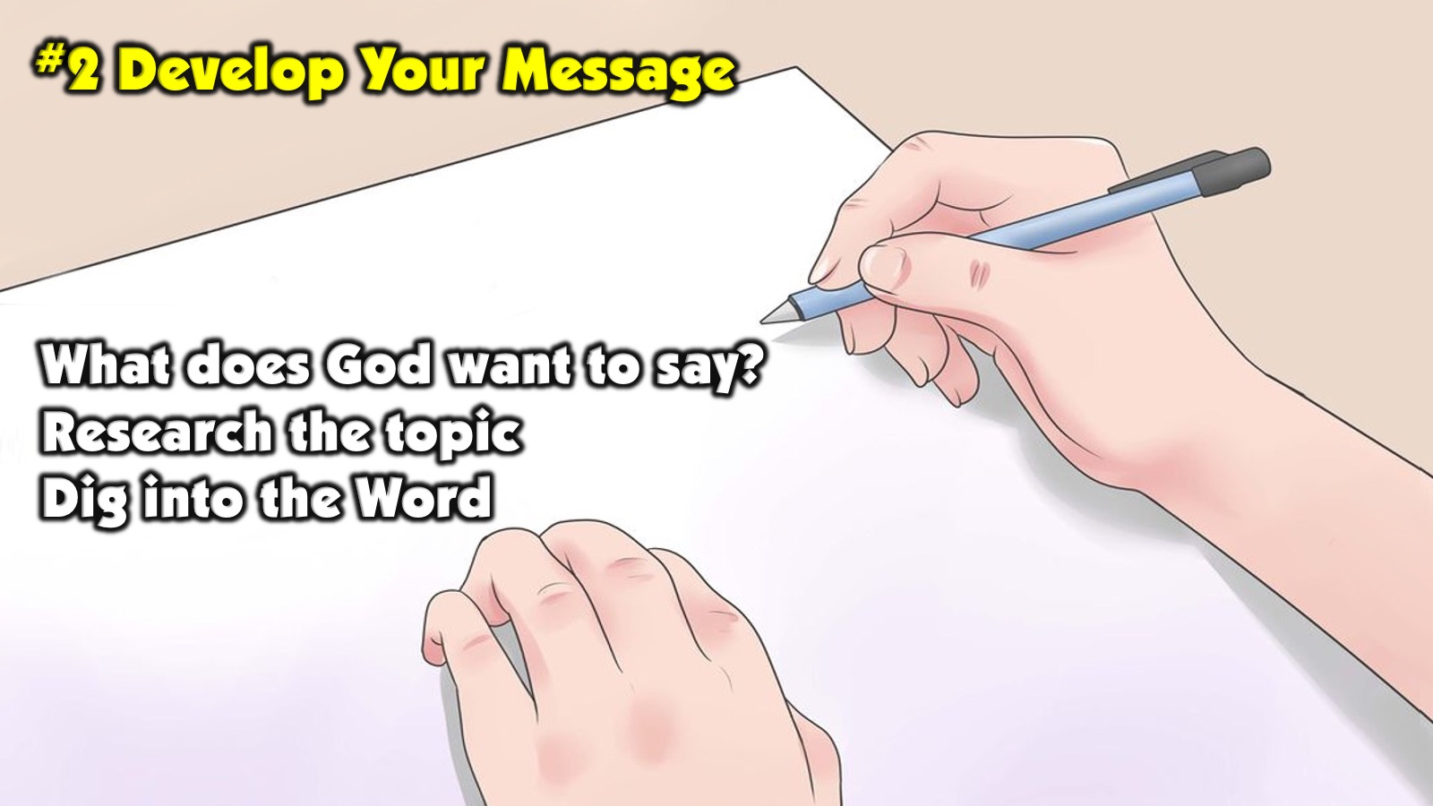
Notes:
2. Develop Your Message: We should start by asking: “God, what do You want to say to Your people?” Sometimes a topic is assigned for us but it is still essential to check what God wants to say to his people. Then we have to flesh it out by doing the hard work of researching the topic, digging into the Word and reading what others have said - but all along the way, checking in with what God’s passion is about the message that we will deliver. This is not a session on homiletics so that is sadly all we can say about developing the message for now.

Slide 35

Notes:
3. Live Your Message: Before we speak we HAVE to live it out in our own lives. If we stand up and read someone else’s speech people will know that it has not been birthed in our lives - and sometimes a message has to be forged in the fires of our lives for it to be powerful!

Slide 36
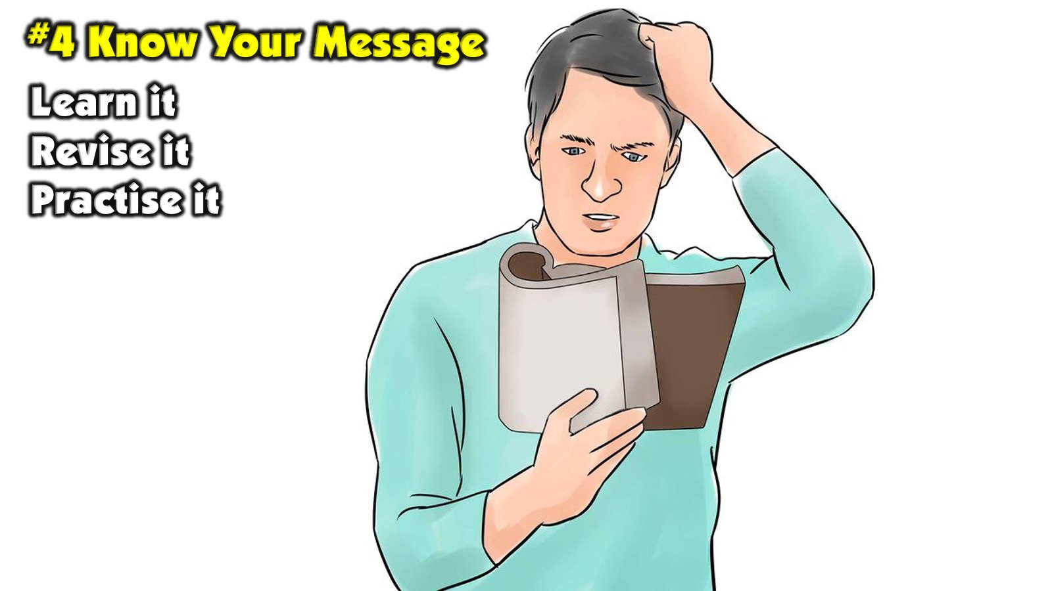
Notes:
4. Know Your Message: Before you get up to share your message in front of people make sure that you know your message inside and out - every aspect – and are completely familiar with every sentence, quote, story, Bible passage, etc.

Slide 37

Notes:
5. Create Your Notes: Develop a cue card system - Phone, PPT Slides, Notes, etc. I use PowerPoint as my notes and seldom have another page of notes with me as I don’t want to create a barrier between the audience and me. Scriptures can be read from the Bible or off a screen or the projection on the wall.

Slide 38
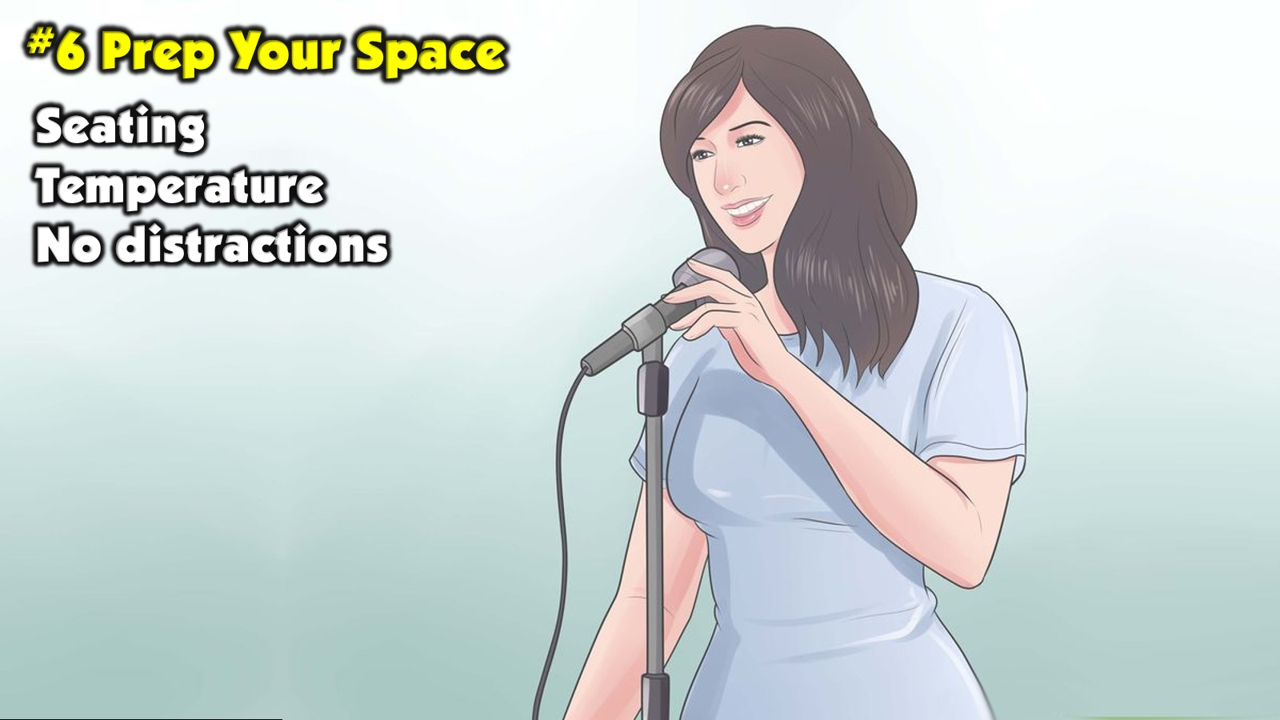
Notes:
6. Prep Your Space: Long before people arrive you should be in the venue making sure that every aspect is right - from the seating to the temperature to the space itself - ensuring that every possible distraction has been removed and anything that will help you communicate with style has been moved into place. Think through how you are going to use the space you have.

Slide 39
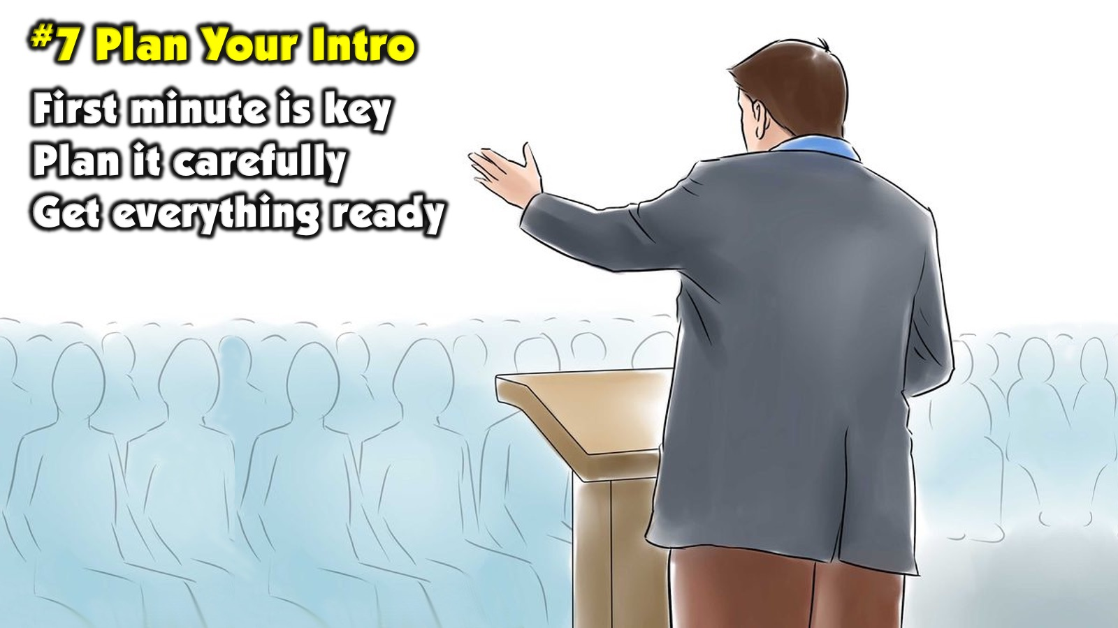
Notes:
7. Plan Your Intro: The first minute of your message is critical - in that time people will decide whether you are worth listening to or whether they end up checking what is happening in their social media world on Facebook or on WhatsApp, etc. Think through exactly what you are going to say and do in the first few minutes - making sure everything is ready for the launch.

Slide 40
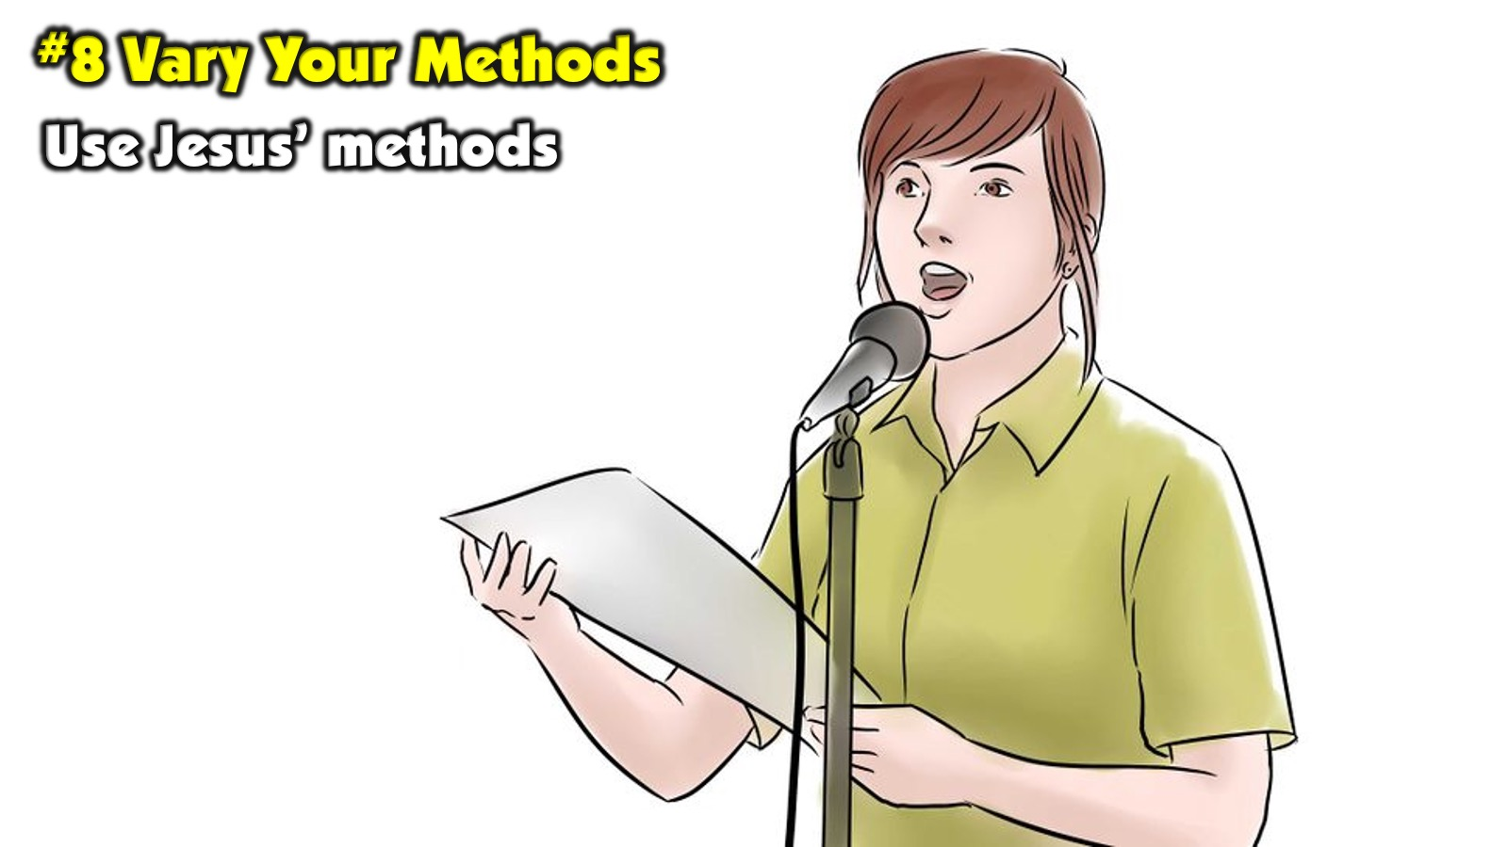
Notes:
8. Vary Your Methods: Let’s go back to the master teacher, Jesus, and learn from some of the methods that he used:

Slide 41
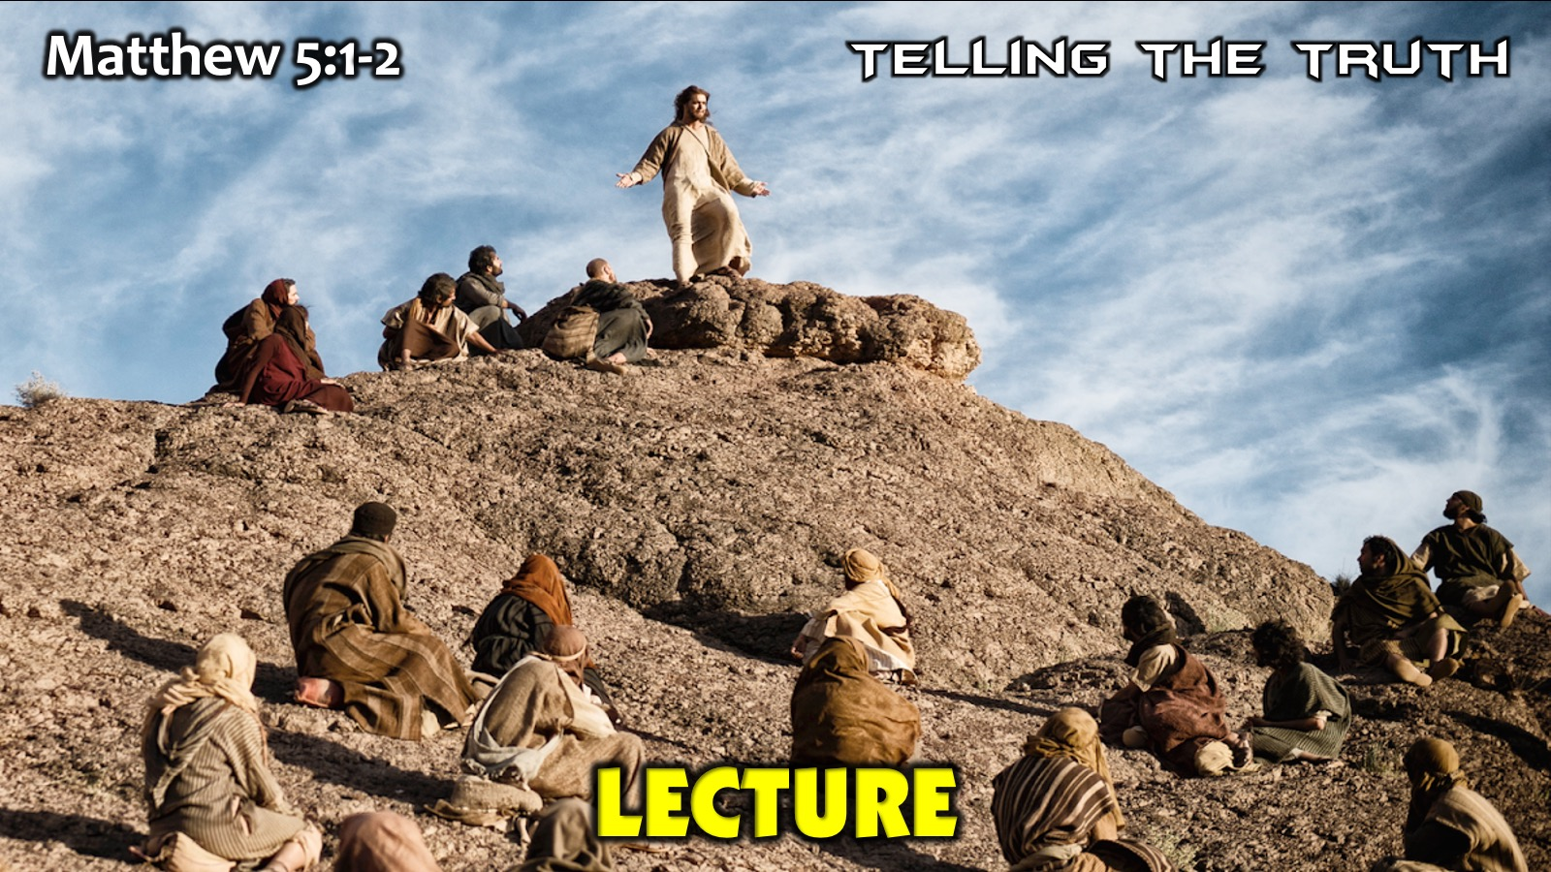
Notes:
A. Lecture: Telling the Truth. Matthew 5:1-2. Jesus’ sermon on the Mount runs for several pages - it was not a short pep talk but I am convinced you could have heard a pin drop throughout the message - he held their attention throughout the message - in face it was so memorable that Matthew was able to remember it word for word when he came to write the gospel. Challenge: Use the lecture method when you speak but make sure you engage the audience with powerful illustrations and relevant truth and use variety.

Slide 42
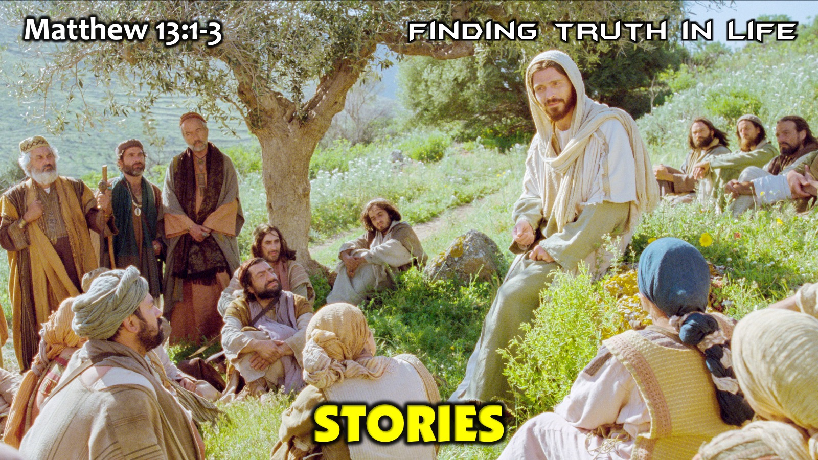
Notes:
B. Stories: Finding Truth in Life. Matthew 13:1-3. Jesus often used parables when he spoke to communicate heavenly truths through earthly examples (we used to call parables earthly stories with heavenly meanings) and also to allow people to connect on different levels of his message. Challenge: Use the little word: Like (i.e. The kingdom of heaven is like…) to take an abstract truth and make it concrete or real for your listeners. Tell a personal story when you speak to illustrate what you are saying.

Slide 43
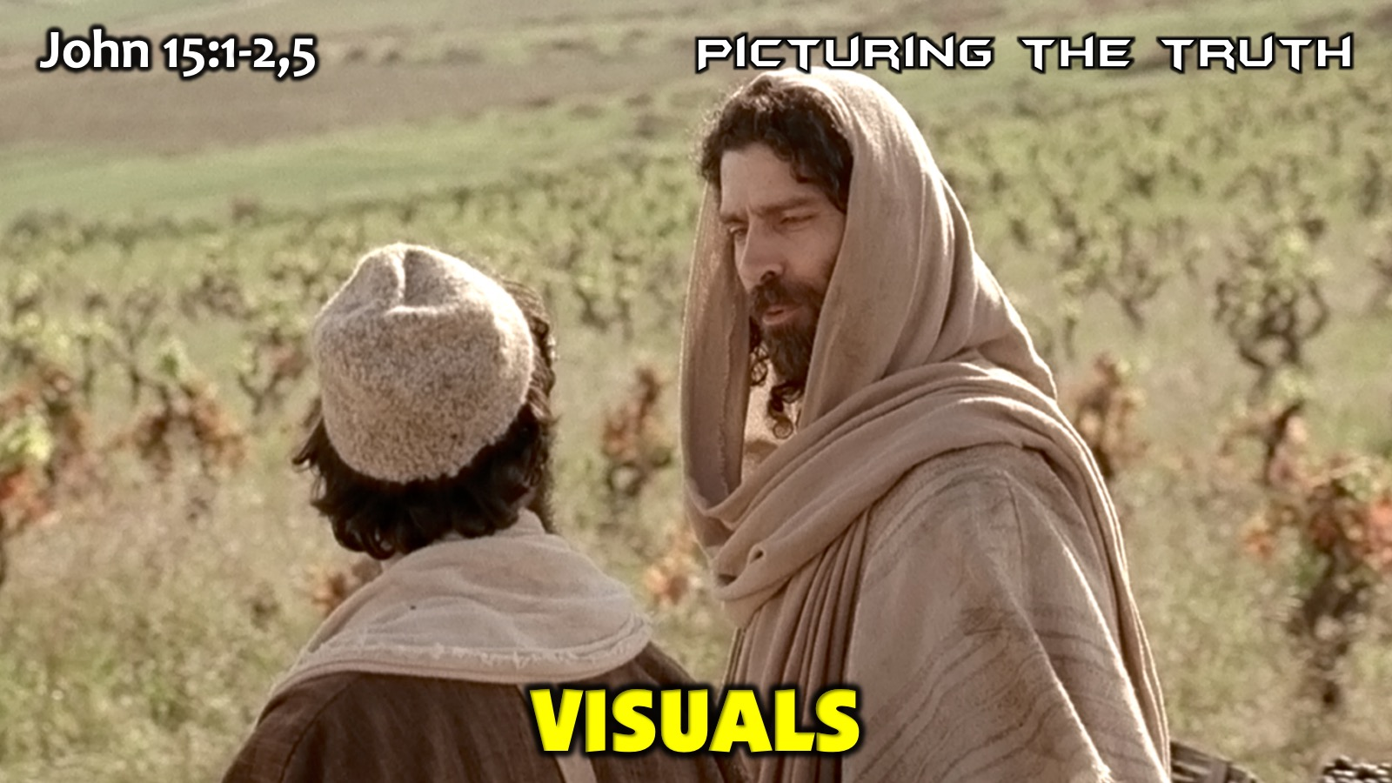
Notes:
C. Visuals: Picturing the Truth. John 15:1-2,5. Jesus passed through vineyards after leaving the upper room on the way to the Mount of Olives and he used them to paint a word picture of how he is the vine and they are the branches. Challenge: Use a visual object to illustrate what you are saying - it can be digital or a real life object that you bring along.

Slide 44
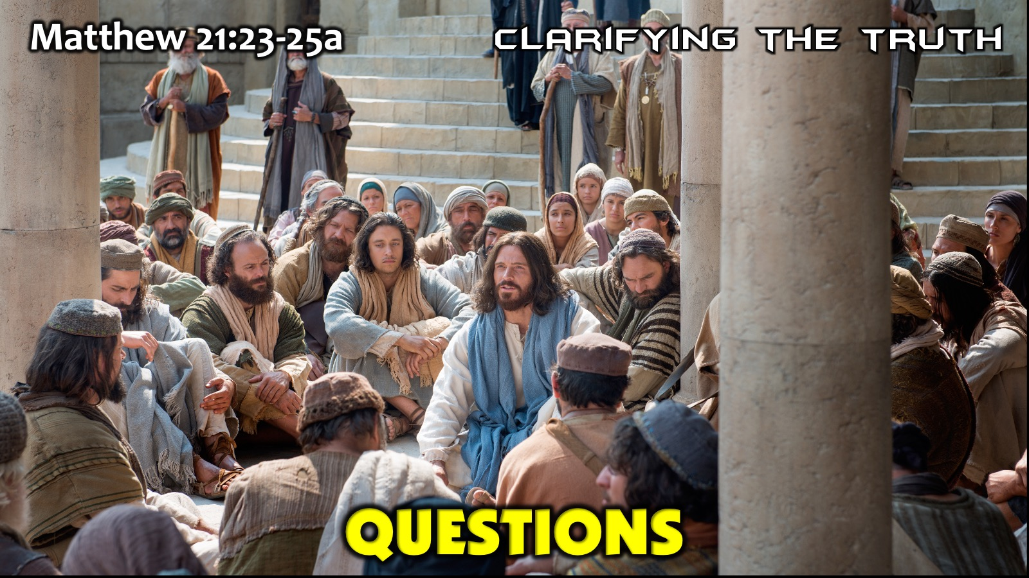
Notes:
D. Questions: Clarifying the Truth. Matthew 21:23-25a. Jesus used questions all the time to interact with people to make them think and come up with insights for themselves or see where their thinking needed to change. Challenge: Make sure your questions cannot be answered with a YES or a NO answer. Start with words like: Who, What, Why, When, Where and How. And give time for people to think and then answer and also have people answer in their own mind, or among themselves, or in group setting with feedback.

Slide 45
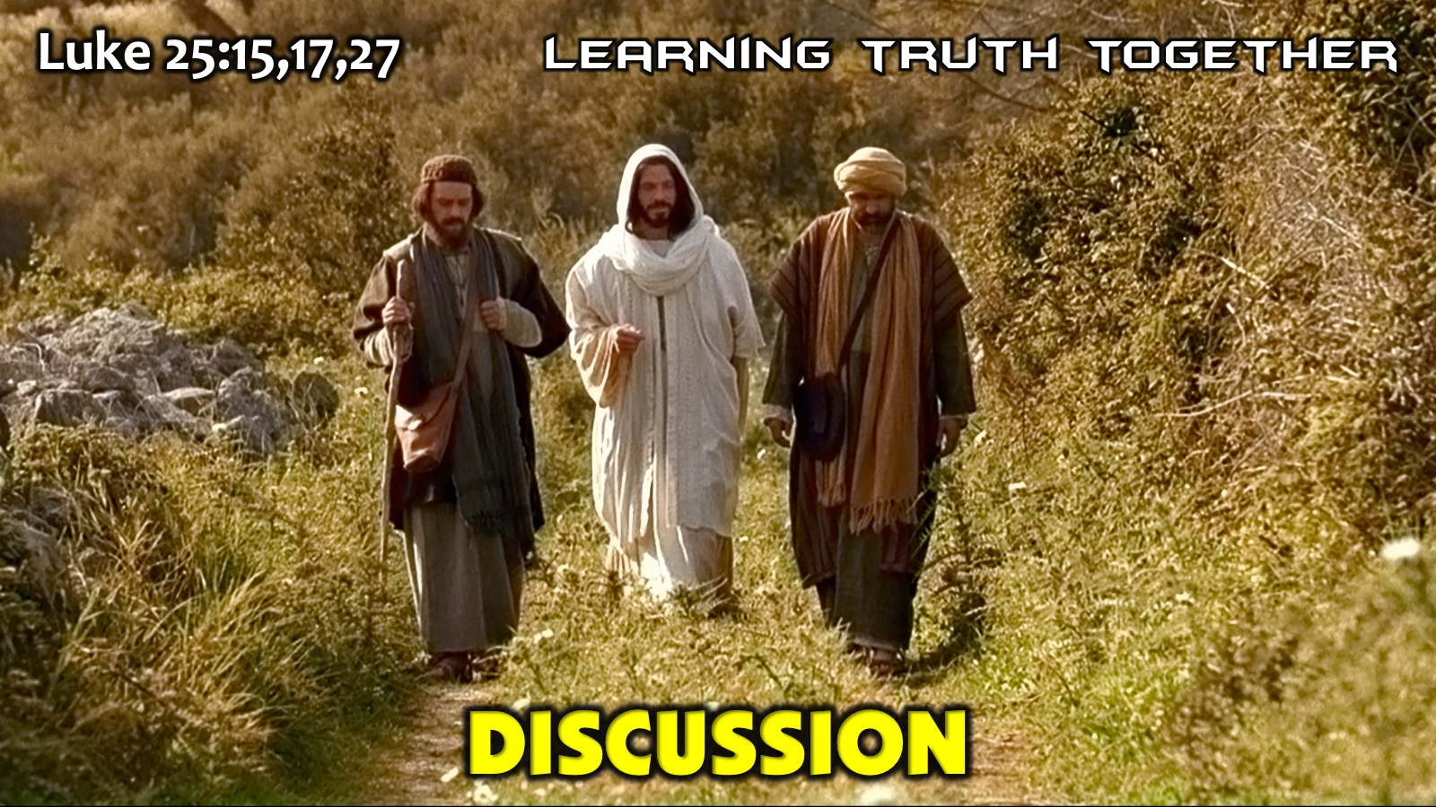
Notes:
E. Discussion: Learning the Truth Together. Luke 25:15,17,27. Jesus joined in a discussion his disciples were having on the road to Emmaus and entered into the conversation rather than immediately giving the answers. He spent time listening to what they were speaking about, then he asked them questions, he ate a meal with them and revealed himself/the truth to them. Challenge: Create an opportunity where people can talk together, share their perspectives and through questions and input learn together. Make sure there are no loose ends at the end of the time and pull all the thread together as best as possible.

Slide 46
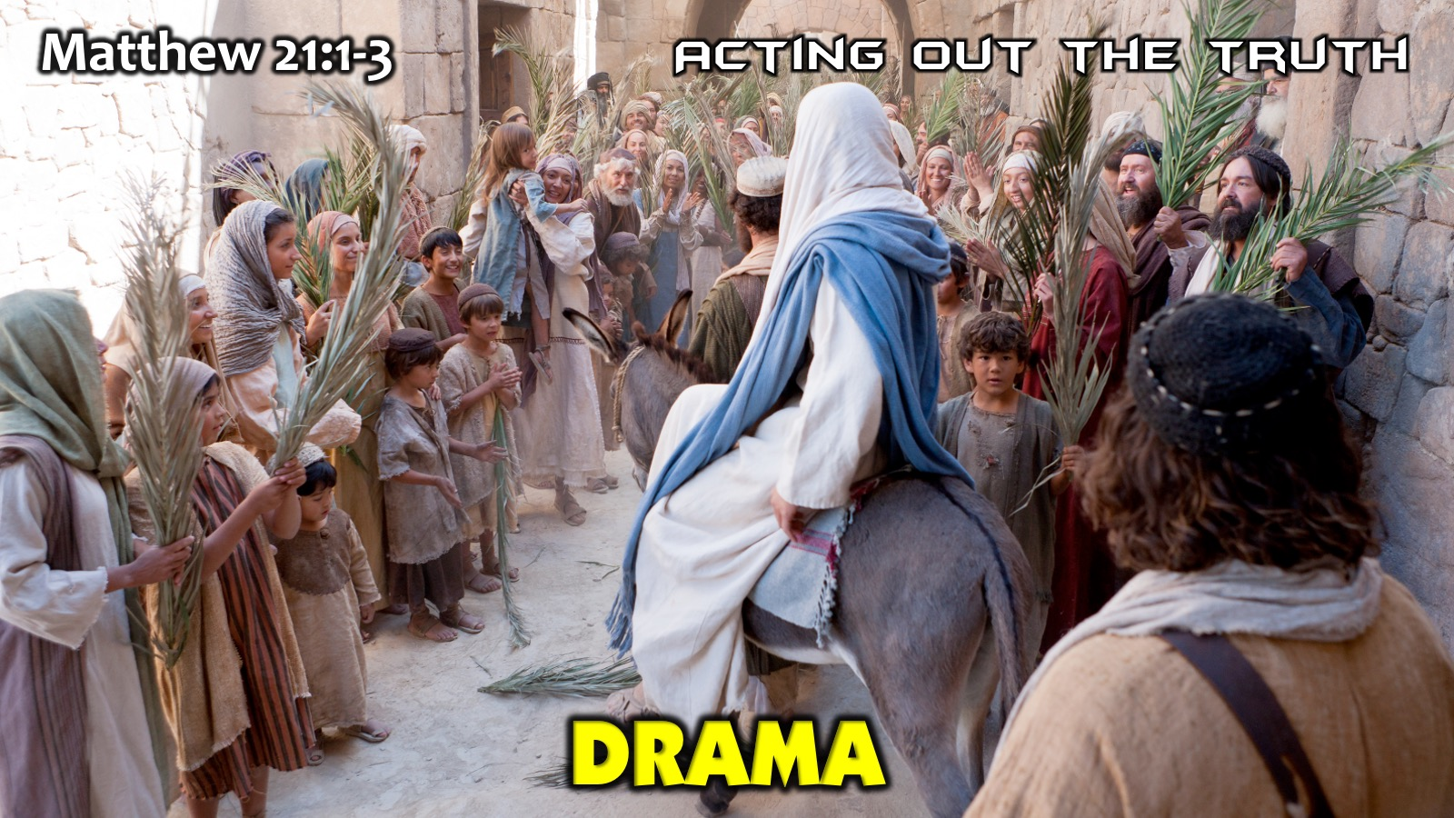
Notes:
F. Drama: Acting out the Truth. Matthew 21:1-3. Jesus used dramatic methods to teach important truth like sending his disciples to get a donkey for him to ride into Jerusalem - this fulfilled Old Testament prophecies, involved people and made people think about his identity. Challenge: Create a simple way in which people can enact a situation that will help them learn a deep truth.

Slide 47
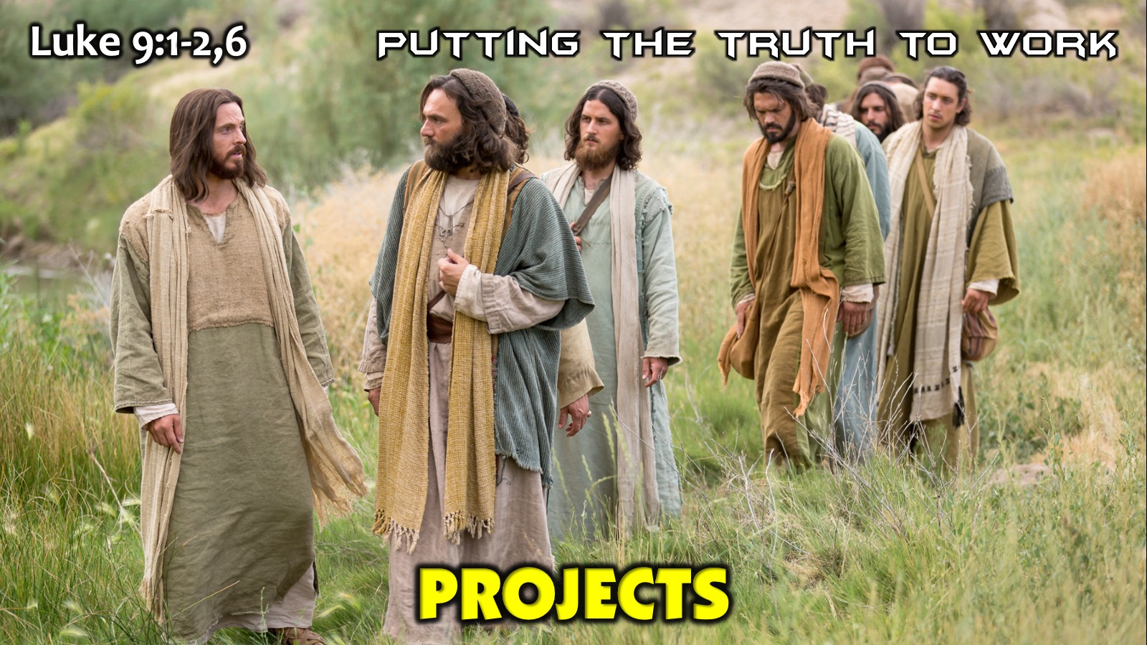
Notes:
G. Projects: Putting the Truth to Work. Luke 9:1-2,6. Jesus sent his disciples out to practise what he had taught them and when they returned he talked about what they had learned. Challenge: Give people something to do once you have delivered your message - at youth this week we spoke about the media and we sent youth out with a way to evaluate they media consumption using the traffic safety idea of: Stop, Look and Listen. Challenge: Think of what your audience can do in the next week with what you have said to them.

Slide 48
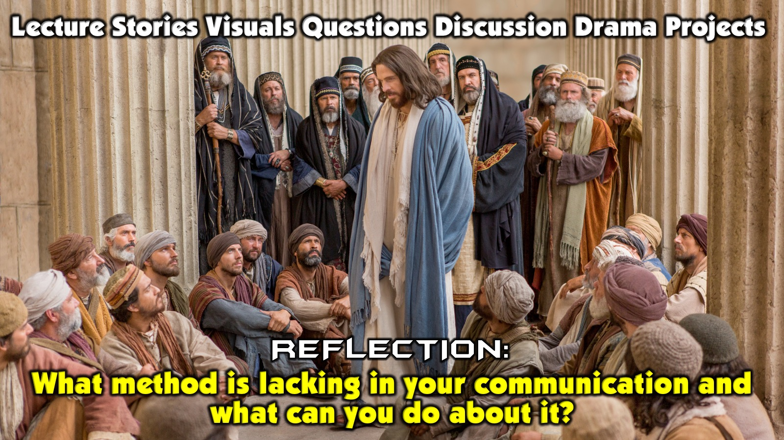
Notes:
Reflection: What method is lacking in your communication and what can you do about it?

Slide 49
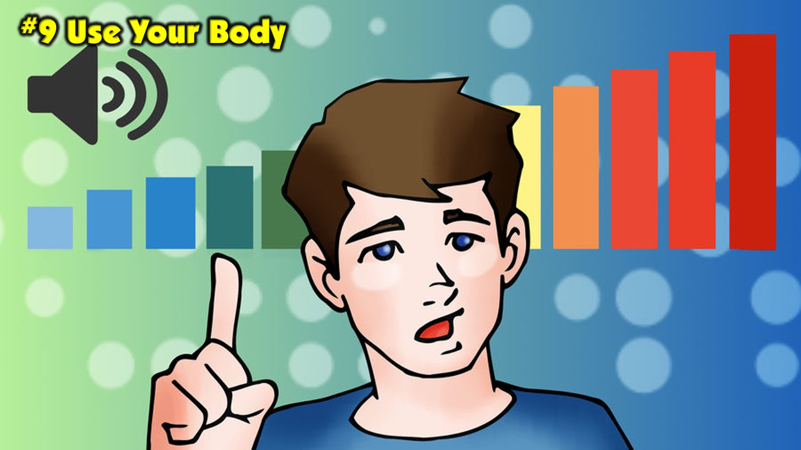
Notes:
10. Use Your Body. Effective communicators make good use of their whole bodies to ensure effective communication takes place:

Slide 50

Notes:
A. Eyes: Look at people not over their heads, make genuine eye contact, avoid looking at your notes or screen too much.

Slide 51

Notes:
Eyes Evaluation Chart - avoid the two ineffective zones of communication: (a) Looking above the audience and (b) Looking down at your notes. Make sure you make eye contact with everyone in the audience - those in the front all the way from the left to the right and those at the back all the way from left to right.

Slide 52
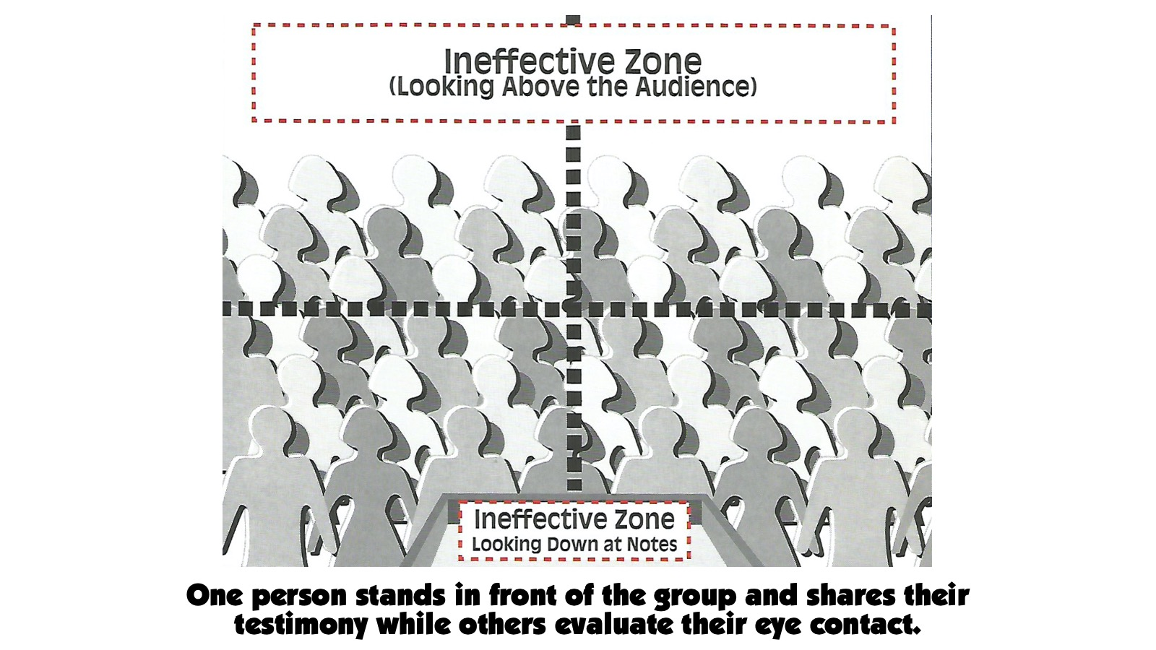
Notes:
Exercise: One person stands in front of the group and shares their testimony while others evaluate their eye contact.

Slide 53
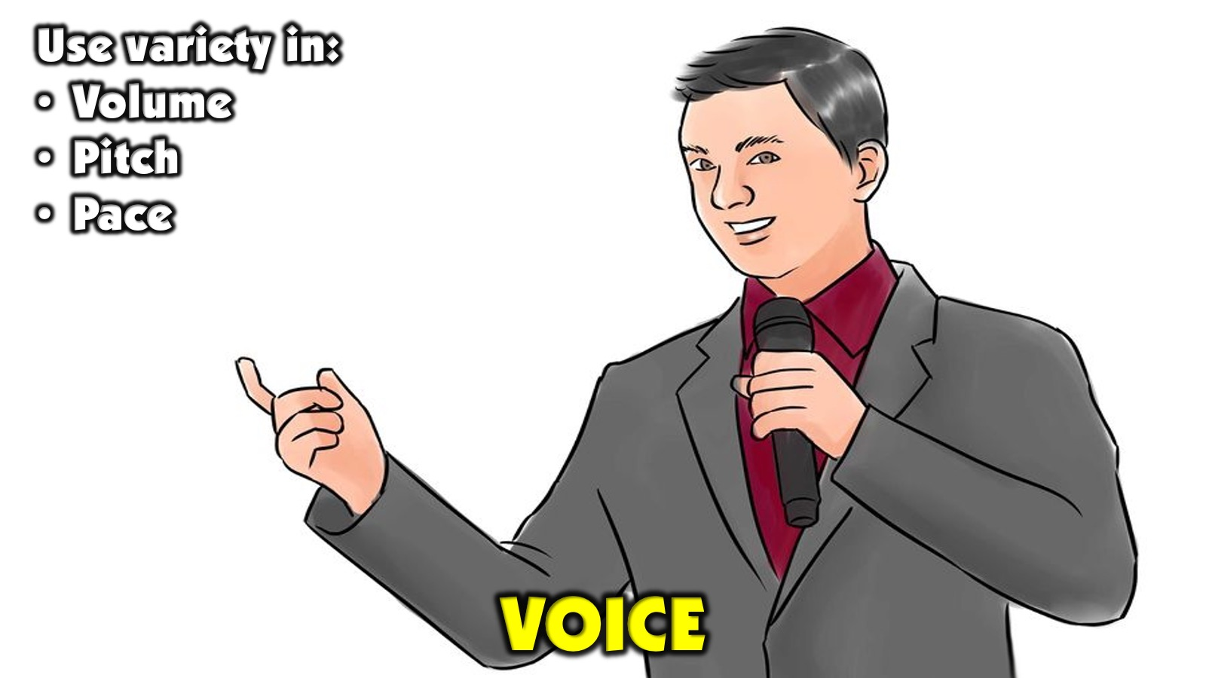
Notes:
B. Voice: Work on variety in the Volume (Loud or Soft), Pitch (High or Low) and Rate (Fast or Slow) of your speech. The more variety there is the better - but work on appropriate variation.

Slide 54
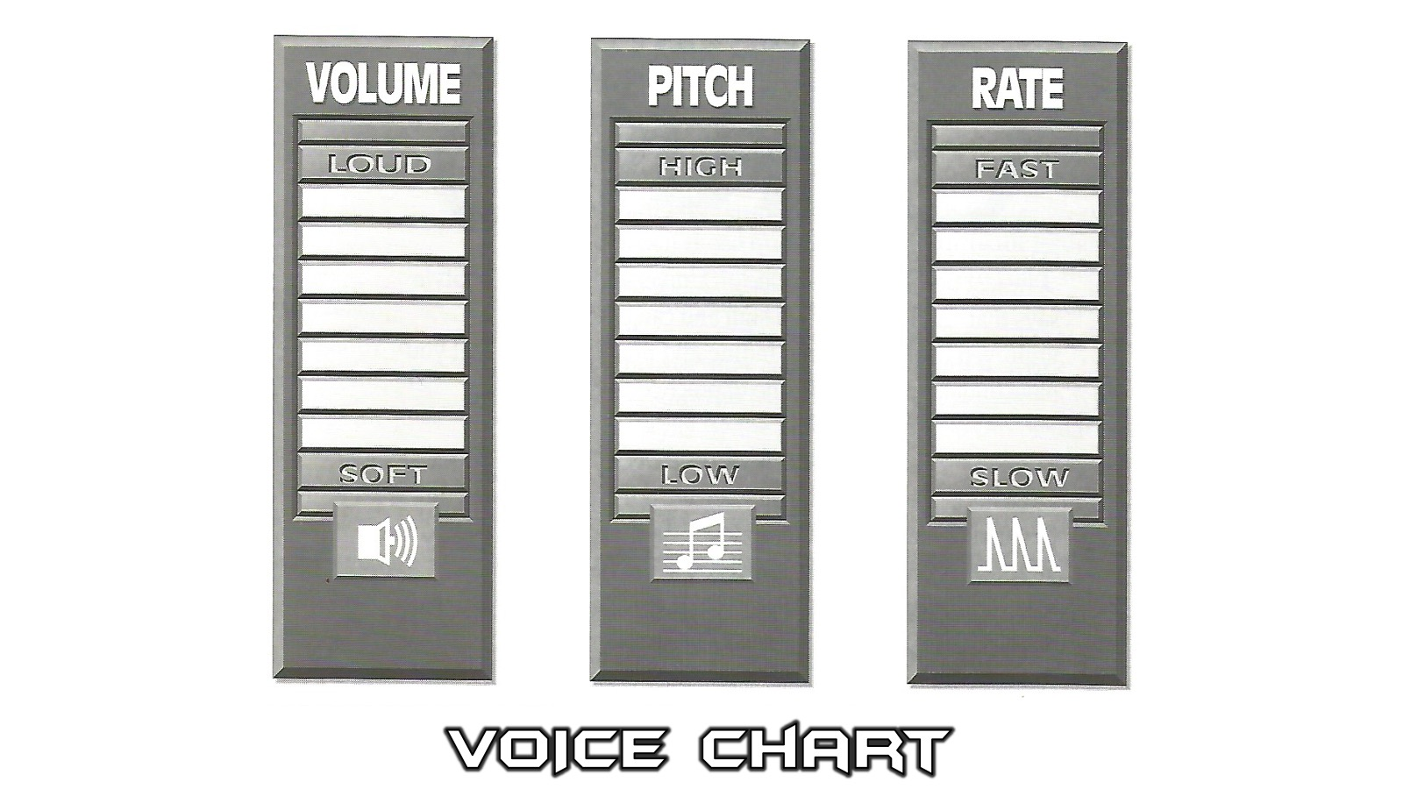
Notes:
Voice Evaluation Chart - Watch your Volume (you can go all the way from a Soft voice to a Loud voice), vary your Pitch (you can go from high to low) and Rate (you can go from Fast or Slow). Make sure you are not stuck at one place on the scale for extended periods of time but vary each level appropriately.

Slide 55
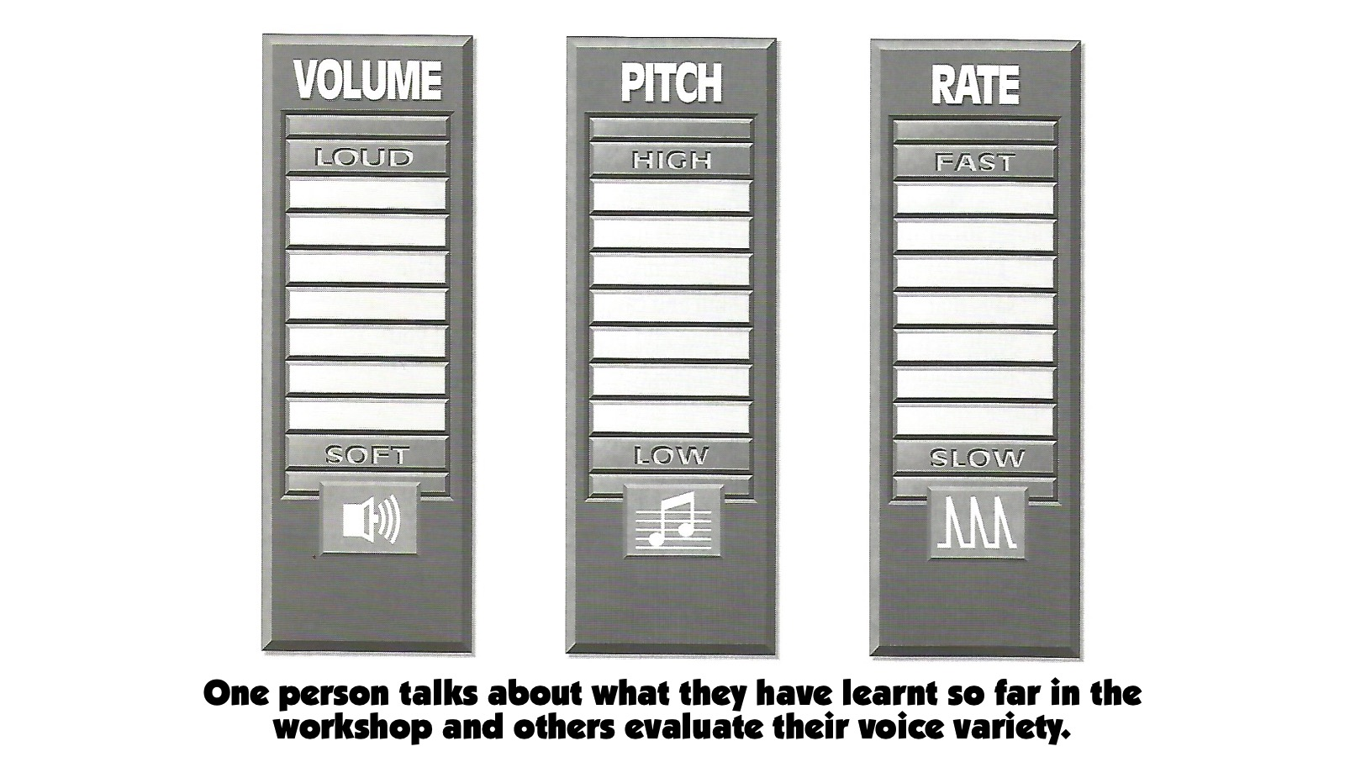
Notes:
Exercise: One person stands in front of the group and talks about what they have learnt so far in the workshop and others evaluate their voice variety.

Slide 56
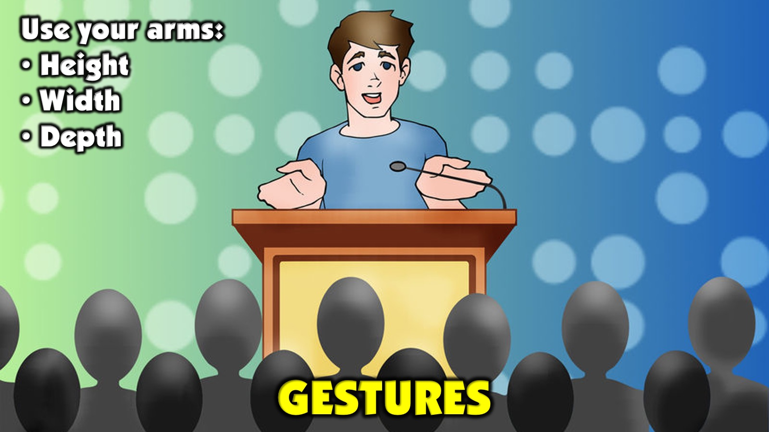
Notes:
C. Gestures: Work on using your hands and arms in three space dimensions: Height, Width and Depth.

Slide 57

Notes:
Gestures Evaluation Chart: Your gestures should where extend to all three spatial dimensions - up high, out wide and towards your audience.

Slide 58
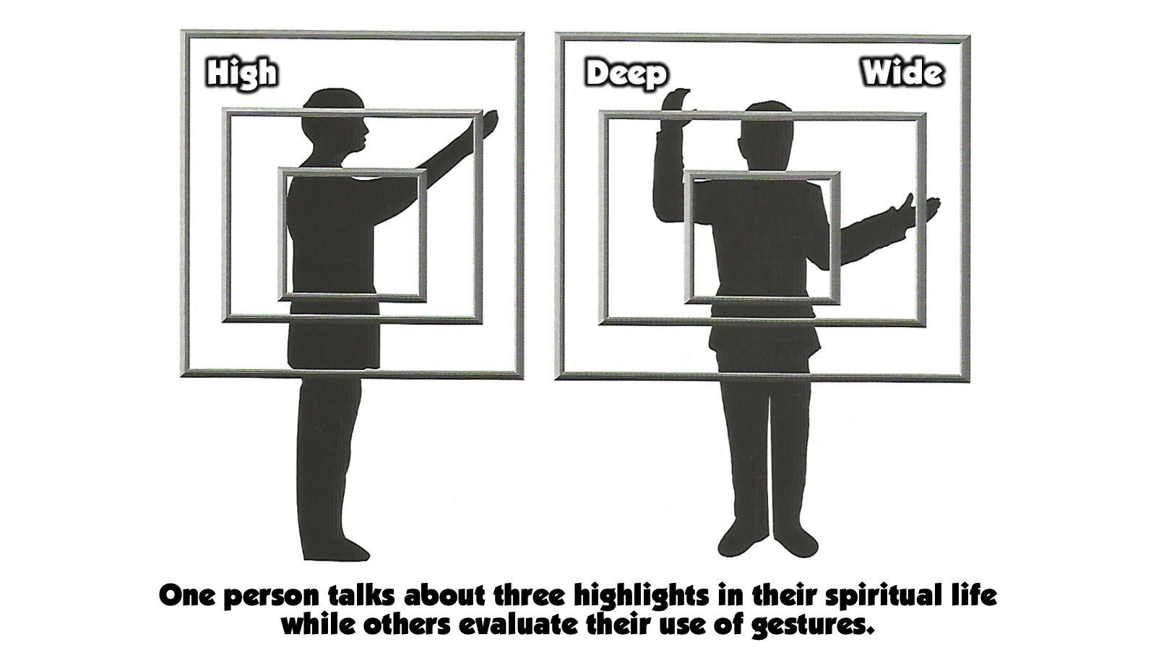
Notes:
Exercise: One person talks about three highlights in their spiritual life while others evaluate their use of gestures.

Slide 59
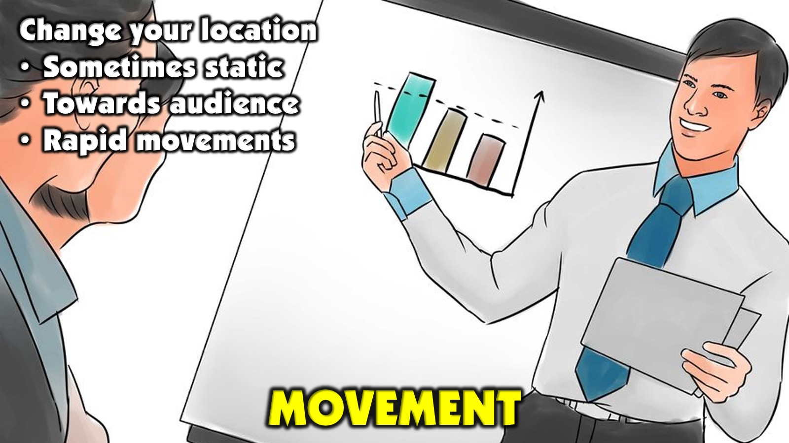
Notes:
D. Movement: Change your location in front of your audience to match what you are communicating - maybe static when you read a scripture to avoid distraction, maybe moving towards your audience to show emotions or use humour, or make rapid movements for exciting content, etc.

Slide 60

Notes:
Movement Evaluation Chart: Evaluate your movements from the pulpit or your speaking location to ensure that you are not stuck in one place.

Slide 61
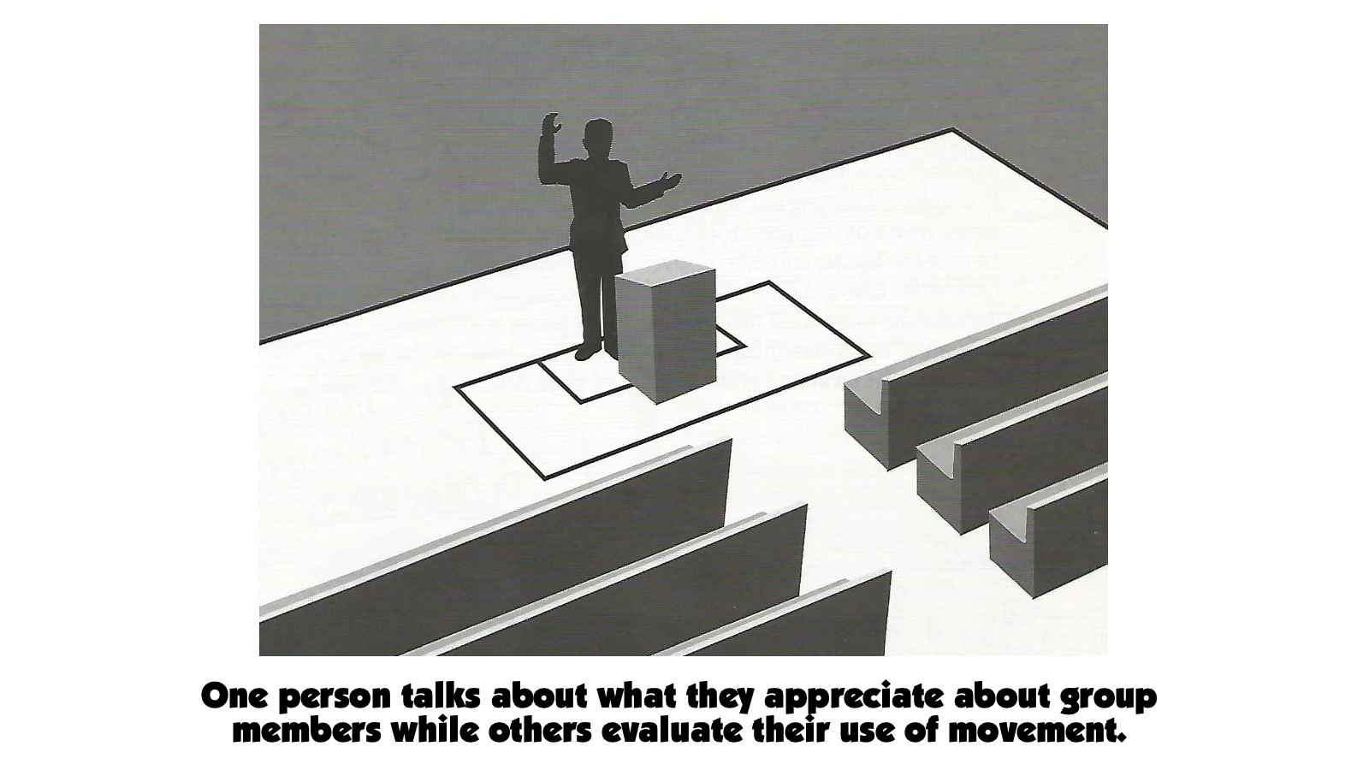
Notes:
Exercise: One person talks about what they appreciate about group members while others evaluate their use of movement.

Slide 62

Notes:
9. Engage Your Audience. This point is huge and it just could be one of the most important areas that we cover today!

Slide 63

Notes:
Do you remember the quote I mentioned earlier by Benjamin Franklin who said: “Tell me and I forget, teach me and I may remember, involve me and I learn.”

Slide 64

Notes:
Here are ten practical ways to engage your audience taken from a high school preaching context:
A. Speak with them - not just at them. Use ideas they relate to.

Slide 65

Notes:
B. Involve them. - ask questions and build on their answers. Do activities with people by calling them forward.
Youth trying to open my bible to a page that is not marked in yellow highlighter - passages that refer to the presence of God. They would earn a slab of chocolate if they were successful.

Slide 66

Notes:
C. Have them talk together - when people interact with each other they are more engaged.

Slide 67

Notes:
D. Have them feedback - people will stay connected if they know they may share with others.

Slide 68

Notes:
E. Use humour - people relate to speakers who are warm and who use appropriate humour along the way.

Slide 69

Notes:
F. Use media they relate to - make reference to their world in the images you use - mental or digital. Make it dramatic, relevant and captivating!

Slide 70

Notes:
H. Make it practical not just theoretical: So what? Now What? What can I do with this?

Slide 71

Notes:
I. Ask great questions - make sure they are open ended and lead to deep reflection.

Slide 72

Notes:
J. Summarise main points - end your message, before closing in prayer, with a concise summary of what you have taught by reviewing the main points. This will help people remember what you have taught them in the session.

Slide 73

Notes:
11. Call for Response - Challenge people to respond to what your are speaking about but also create space for ministry during and after your message: through quite reflection, personal prayer or opportunities for people to come forward for prayer from leaders.

Slide 74

Notes:
Wrap Up: We have learnt from the master communicator today! I trust you have been inspired. Be sure to walk away with some practical things that you can do to improve your next message and make it your aim to always communicate with style!
Prayer: Help us, O God to become gifted communicators who teach for life change and see people being edified and equipped through our messages.

