Slide 1
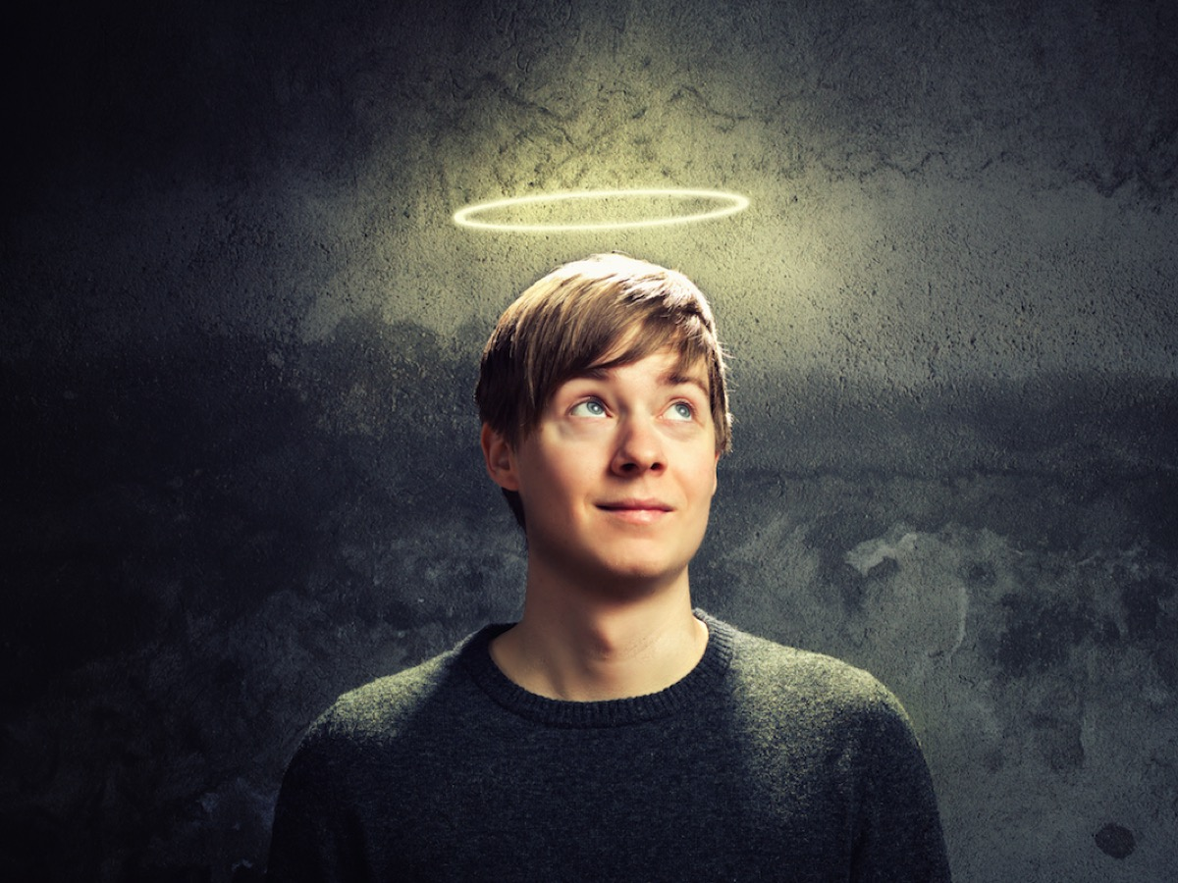
Notes:
What a privilege it is for me to be the one asked to bring the Word this morning. This very pulpit was the place where I preached my first ever pulpit at age 15. Three of us were invited by Uncle John Gardner to share the preaching slot among us on Sunday morning: It was Titch, Stretch and Tits - Titch was Andrew Baird, Stretch was Steven O’Hara and Tits - well that would have been me given my unique surname. I was petrified - my knees were knocking so hard together that I doubt that anyone heard what I was saying. But by the grace of God, I made it through and it confirmed in me even at that young age that I was called to full-time ministry.

Slide 2
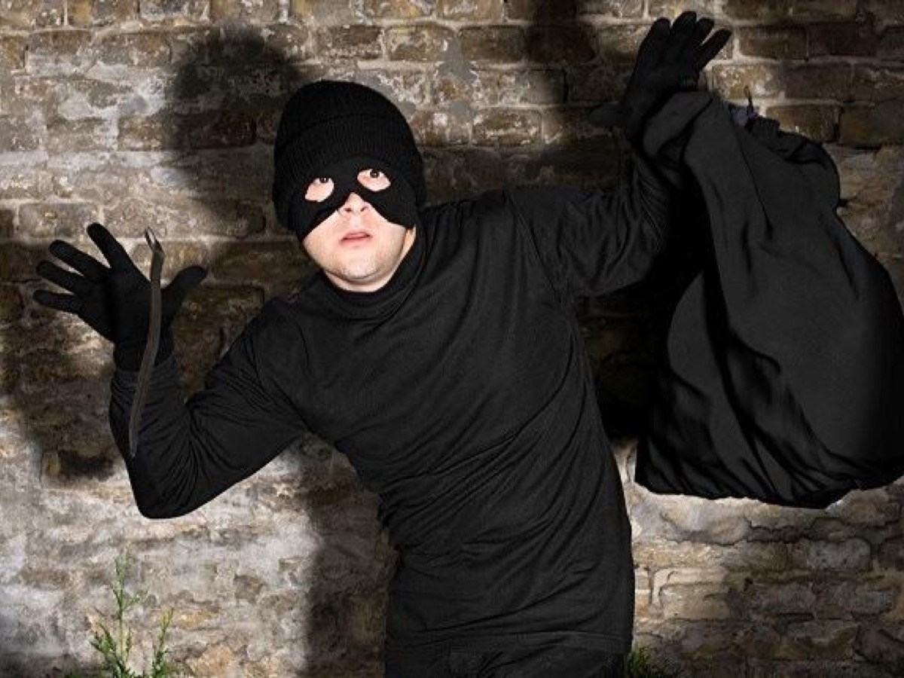
Notes:
But honestly, if you only knew the secret that I have carried for the past 42 years from growing up at Fynnlands Baptist Church in the 60s and the 70s the deacons and elders might just decide to reconsider whether I will be the preacher this morning. I will never forget the night that Uncle Johan Potgieter stumbled across the scene of a crime in one of the Sunday School classrooms on the ground floor. My best friend, Arnold Karstens, and I and some other mates had gone off to the corner cafe with our offering money and we had returned to the classroom with our stolen goods are were busy sharing it out among the 5 of us on a table when in burst Uncle Johan. Pandemonia broke out, sweets went flying (precious few landing in our pockets) as we ran for the exit and not a few of us got bruises that night from jumping out of the window. We had to face the music later with the deacons and I suspect punishment was administered by our parents too. So well done, deacons and elders for inviting a convicted thief to share the Word this morning.

Slide 3
Notes:
And that brings me to my theme this morning - which is all about Creating a Legacy - a Kingdom Legacy. The power of investing in a life or in the next generation that can multiply into the lives of millions and even affect the course of a whole generation. Personally it is my aim that each one of you will leave this place this morning after this incredible 70th year celebration of the ministry of the Sunday School knowing that God wants you to Create a Kingdom Legacy with your life.

Slide 4
Notes:
We will tell the next generation the praiseworthy deeds of the Lord, his power, and the wonders he has done… so the next generation would know them, even the children yet to be born, and they in turn would tell their children. Then they would put their trust in God and would not forget his deeds but would keep his commands. (Psalm 78:4-7)

Slide 5
Notes:
Activity 1: Think of 3 Sermons that changed your life.

Slide 6
Notes:
Activity 2: Think of 3 People who changed your life.
Reflect: I am sure you were able to think of the 3 people a lot quicker than you could the 3 sermons.

Slide 7
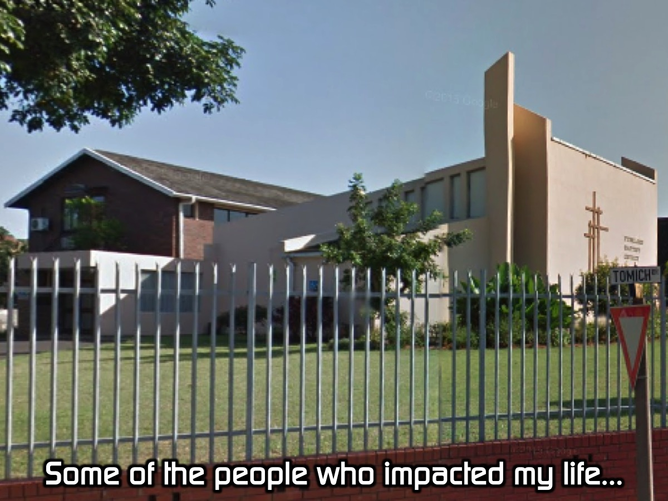
Notes:
Let me talk about some of the people who impacted my life at Fynnlands when I was growing up:

Slide 8
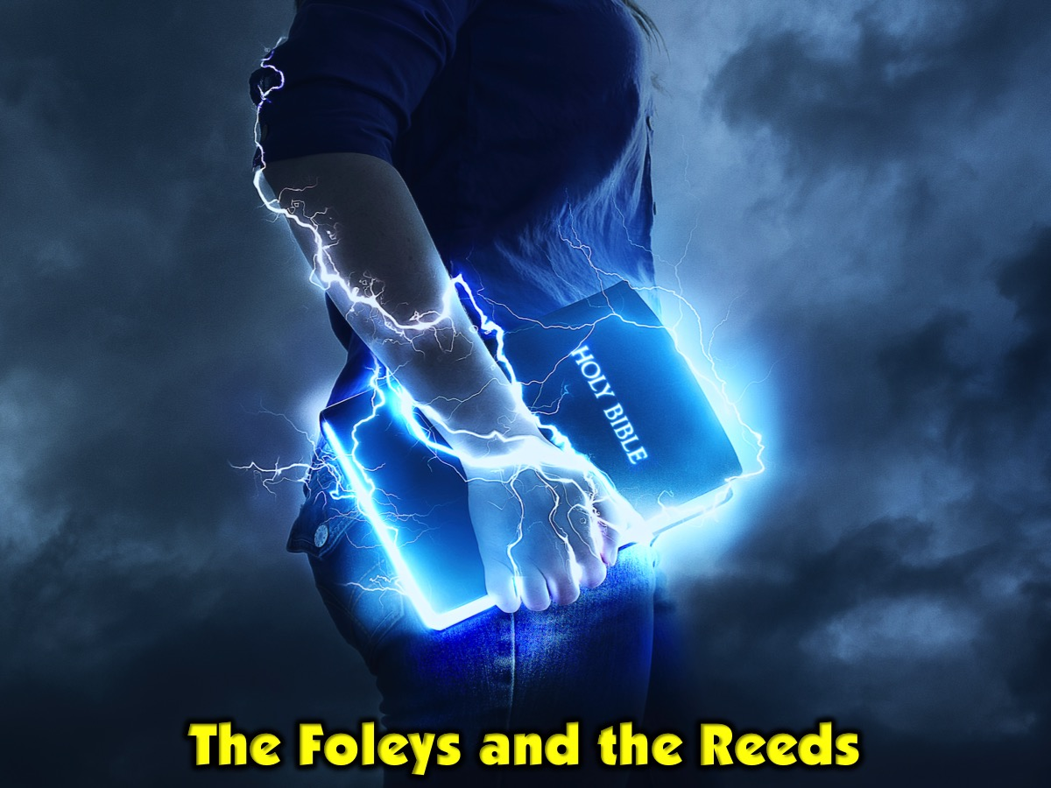
Notes:
1. The Foley’s and the Reeds with BMA (Bible Memory Association). They gave me a deep love for the Word and taught me how to commit scripture to memory.

Slide 9
Notes:
2. Johnny and Mona May. They were the prayer warriors of the church when I was growing up. Aunty Mona would begin the prayer time and at least 20 minutes later she would finally end her prayer and then Uncle Johnny would start for the next 20 minutes or more. Everyone else would pray in the remaining 20 minutes. But you know what, I learnt so much about prayer from them and there was an intimacy with Father God that you just knew that God was real and that he loves it when his children speak to him.

Slide 10
Notes:
3. Grant Rayner. Each time he saw me he would ask me questions like: What did you read in the Bible this week? What did you pray about? Did you share the gospel with your friends this week?

Slide 11
Notes:
4. John and Rose Gardner. The Gardners opened their home to teenagers, Uncle John organised got us to lead the youth ministry even when we were in our early teens - he equipped and empowered us for ministry. Here are some tributes that were shared on Facebook in tribute to Uncle John a few weeks back: “Many of us are Christians today because of his input into our lives”. (Laura Noakes). “So many of us were so privileged to be under John's leadership at Fynnland Baptist YP back in the 70's. We give God all the glory for a life lived in dedication to our Saviour. (Beth Skeen)

Slide 12
Notes:
One generation commends your works to another; They tell of your mighty acts. They speak of the glorious splendor of your majesty. They tell of the power of your awesome works. They celebrate your abundant goodness. They joyfully sing of your righteousness. (Psalm 145:3-7)

Slide 13
Notes:
This is my 30th year in full time ministry - and as I was preparing this message for today on kingdom impact I realised that I have had 3 different decades of ministries that illustrate how due to the impact of my upbringing at Fynnland Baptist Church, I have been able to have an impact on thousands of lives:

Slide 14
Notes:
1. Baptist College. I had the privilege to training dozens of youth pastors in my first decade of ministry at Baptist Theological College in Randburg. Each of guys and girls have gone on to impact lives in contexts throughout the country and even the world.

Slide 15
Notes:
2. Sonlife Africa. In the second decade of my ministry I had the privilege of training leaders in countries across the continent of Africa.

Slide 17
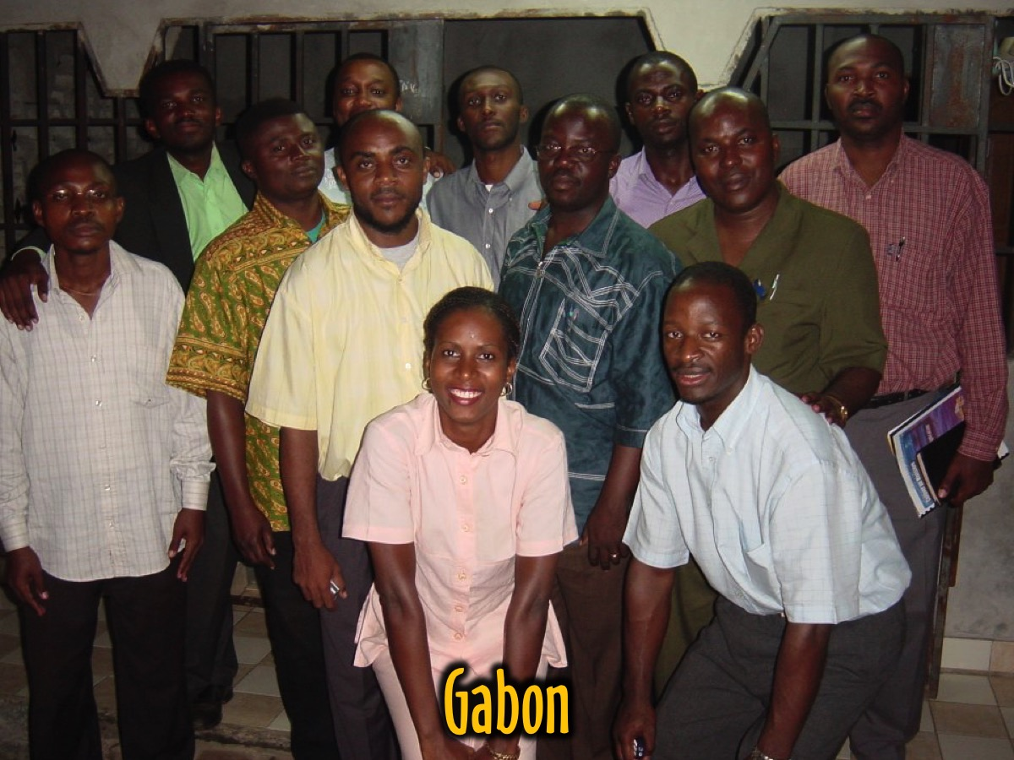

Slide 18
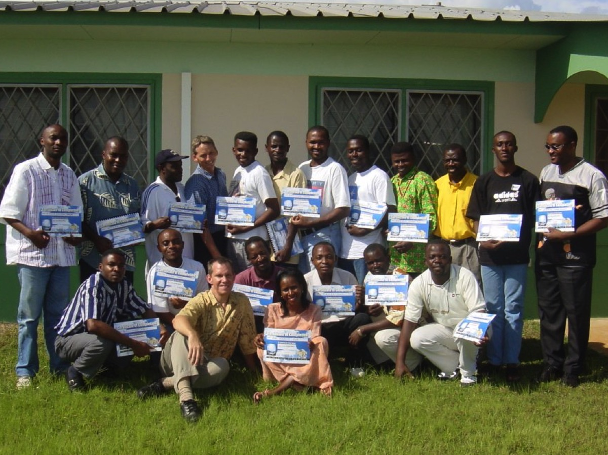

Slide 19
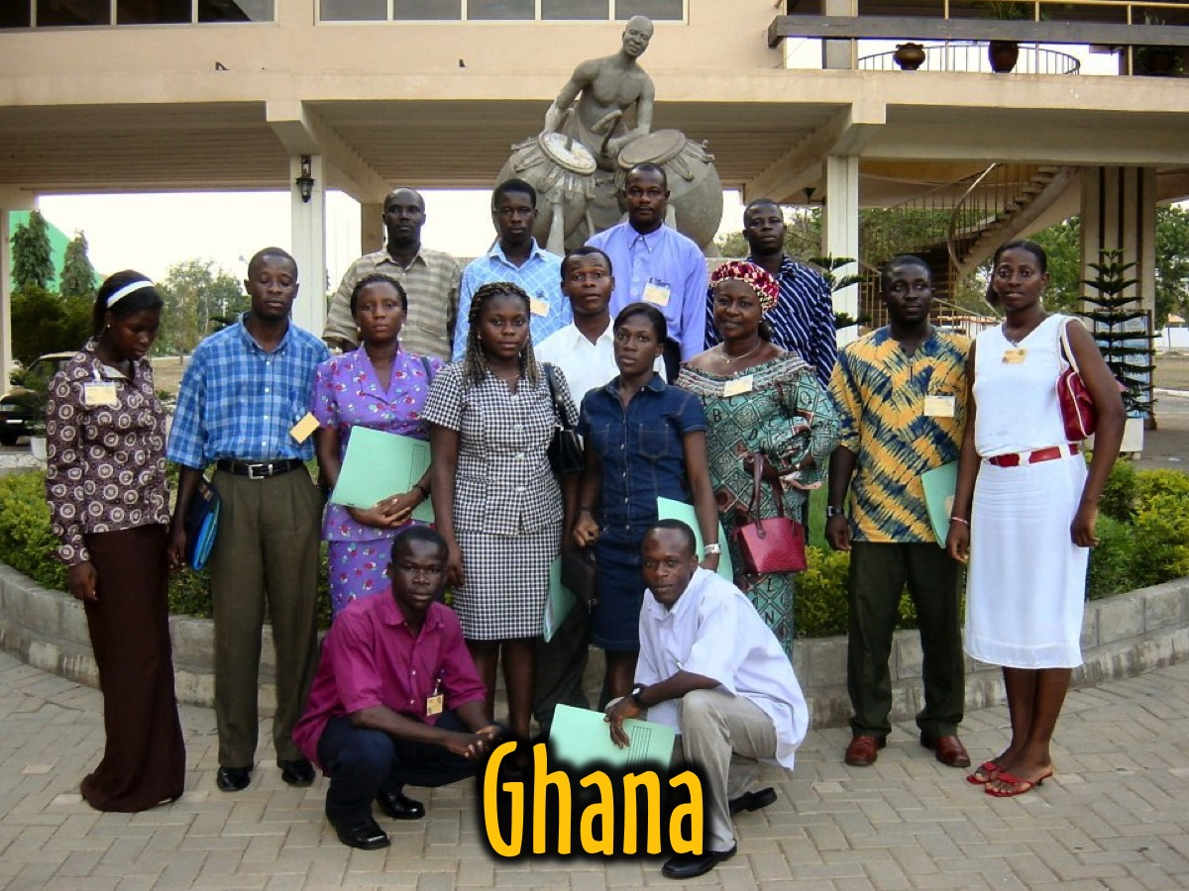

Slide 20
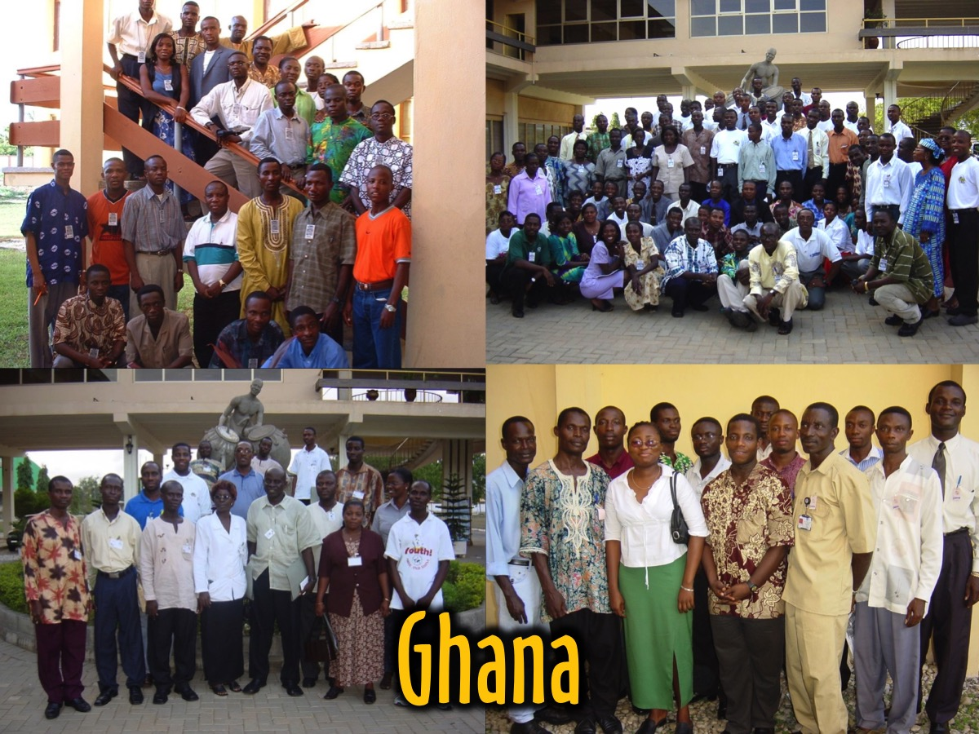

Slide 21
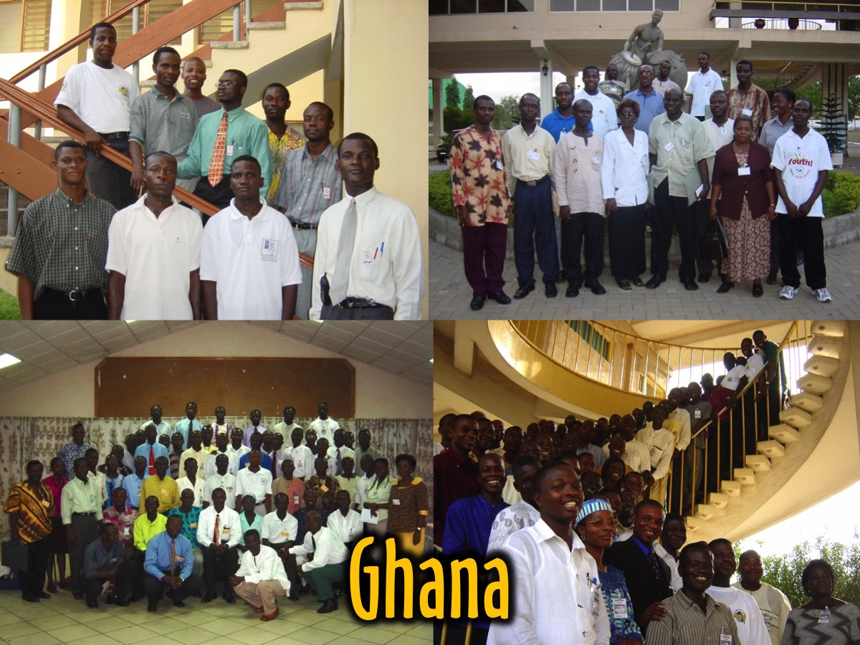

Slide 22
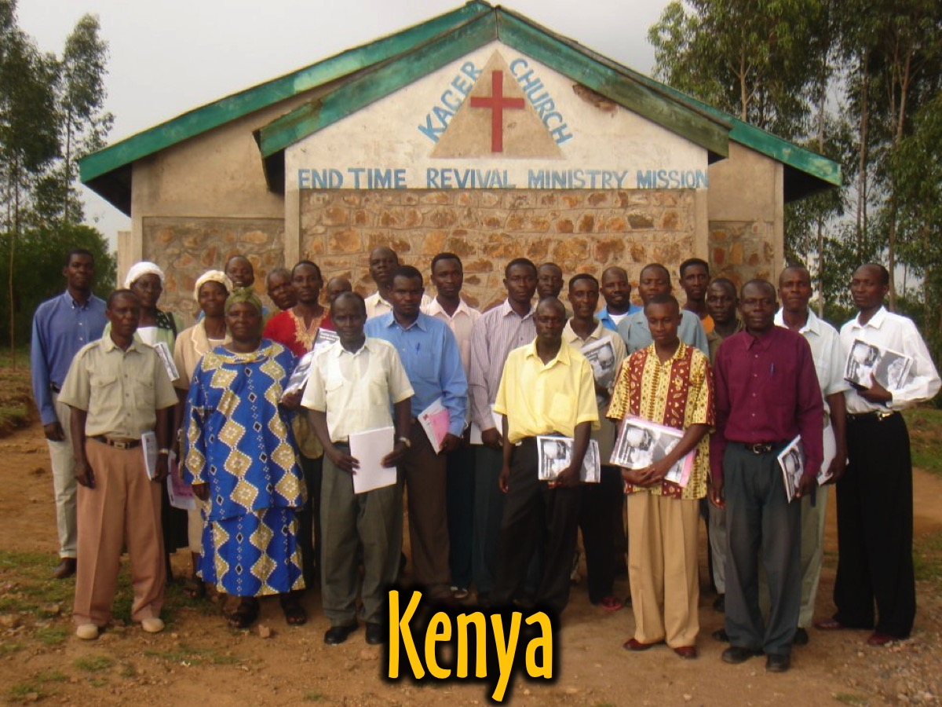

Slide 23
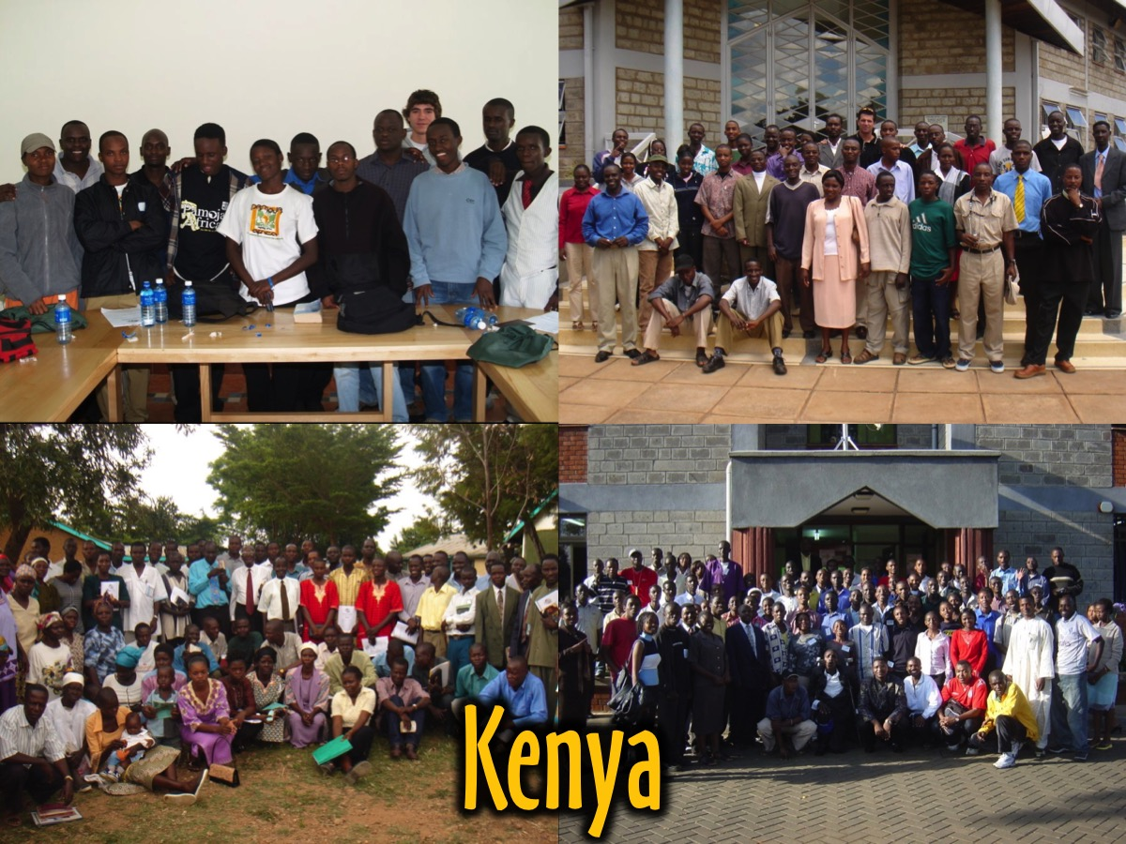

Slide 24
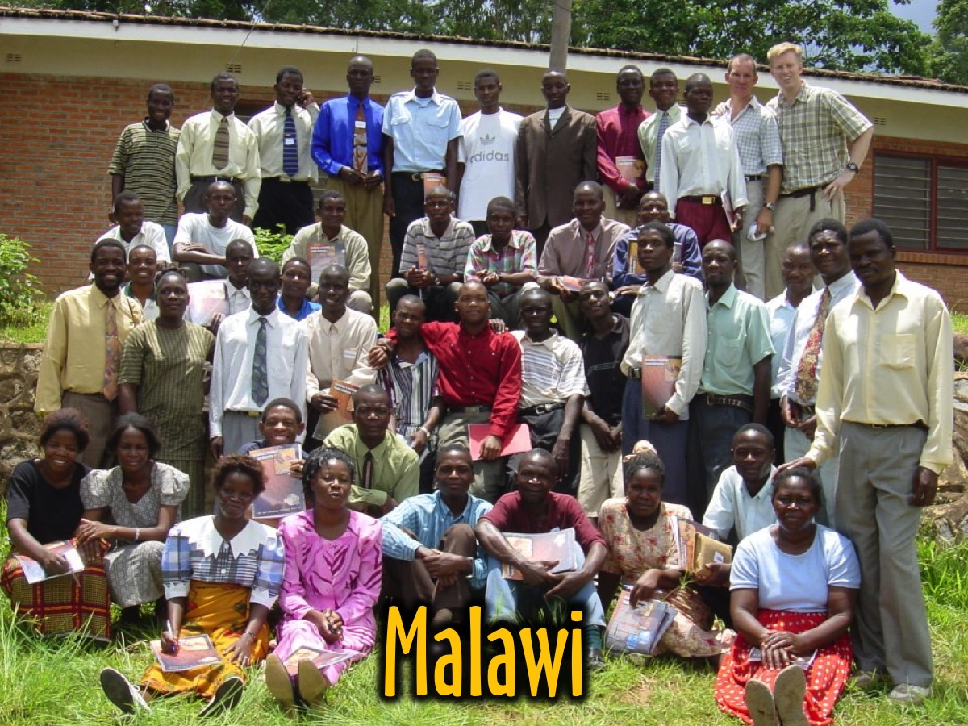

Slide 25
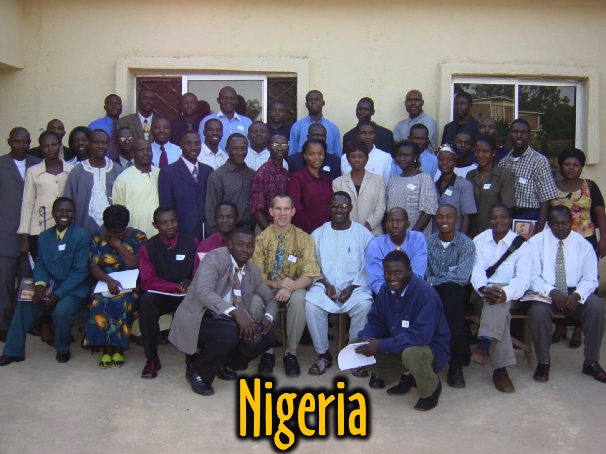

Slide 26
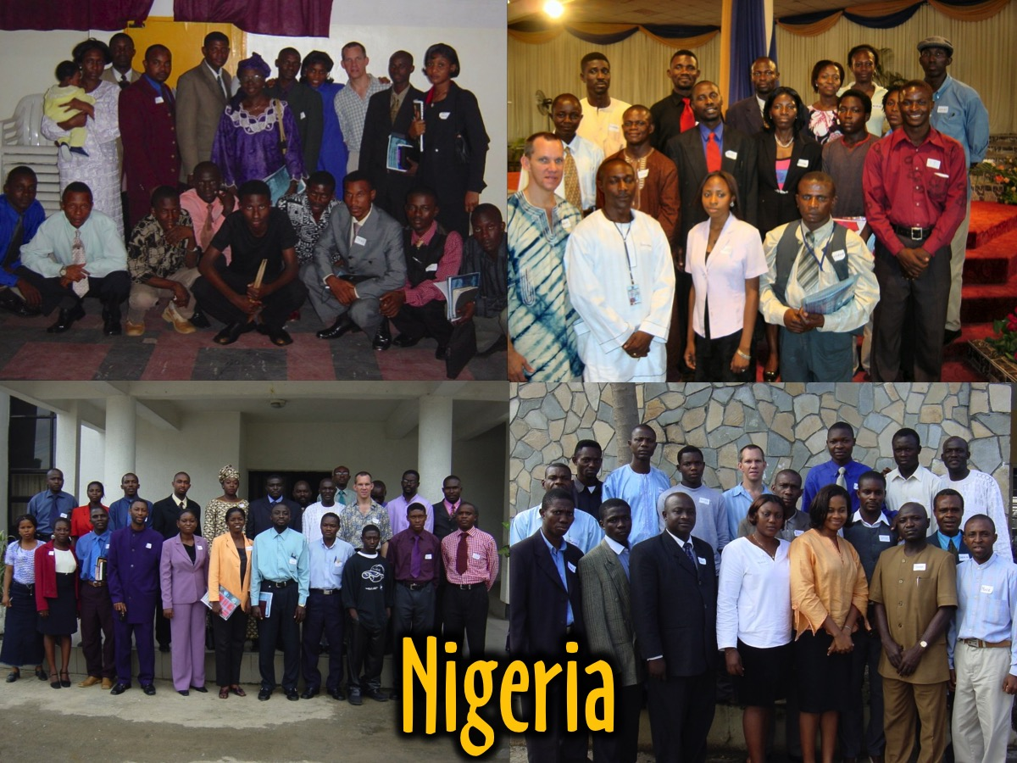

Slide 27
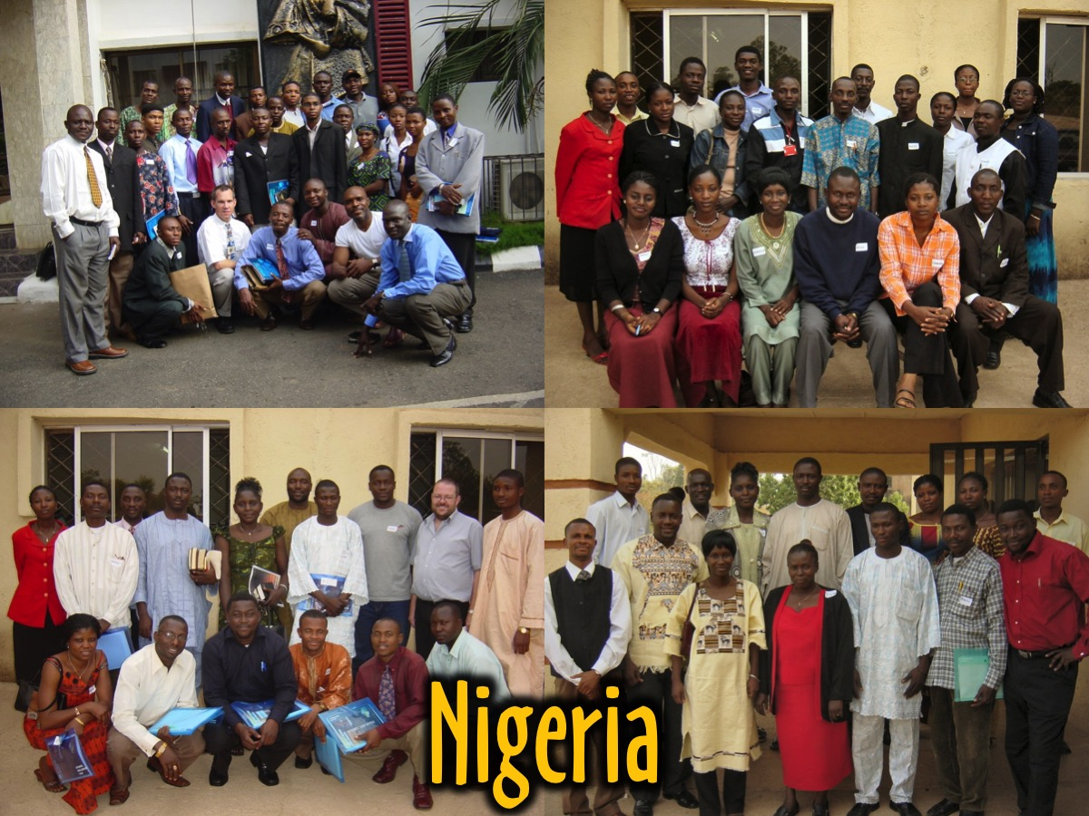

Slide 31
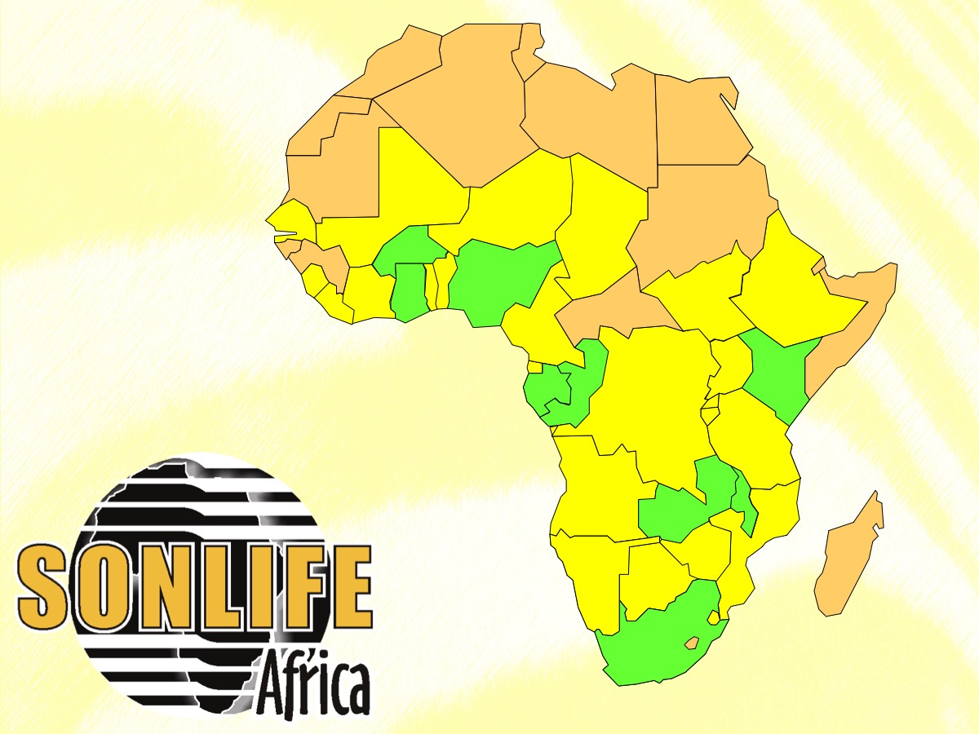
Notes:
Here is an overview of the countries that I was able to multiply into (the 9 countries shown in green). I visited each country 4 times to train leaders in building a disciplemaking movement in their local church and then released a country leader to continue the movement in their context. Since I handed the movement over to leaders that I had developed, now known as J-Life Africa, they are now working in over 30 African countries (shown in green).

Slide 32
Notes:
3. His People Church. In the third decade of ministry so far, God called Debbie and I and our family to join His People Christian Church in Rosebank.

Slide 33
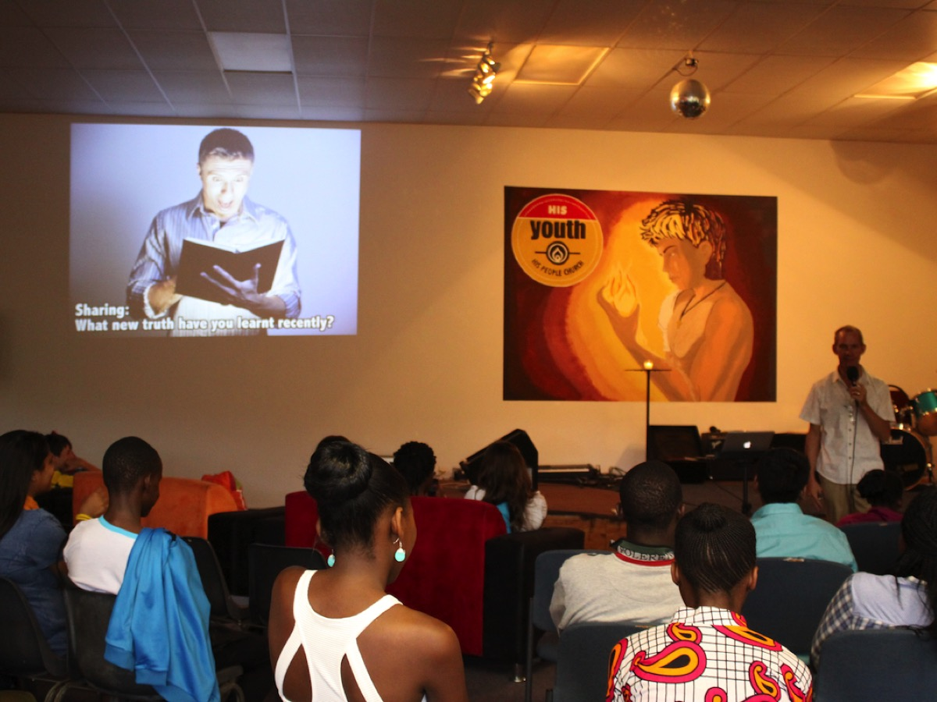
Notes:
Not long after I joined I was invited to become a youth pastor at the church and three years ago, Debbie joined me on staff as well.

Slide 34
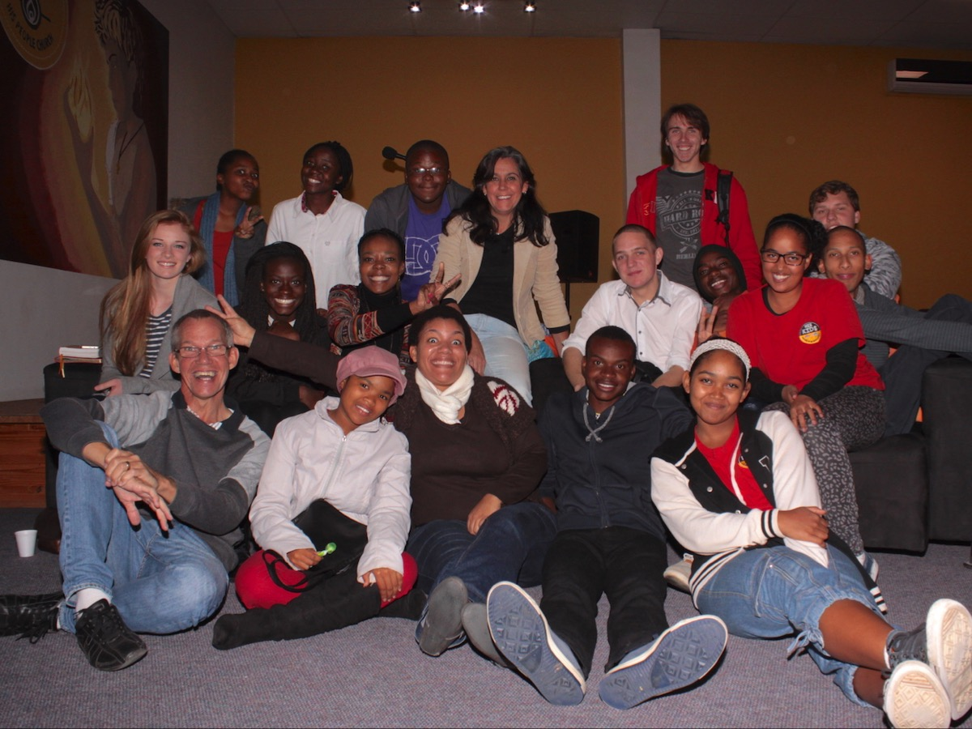
Notes:
Here are some of the current adult and teen leaders that we work with at His Youth.

Slide 35
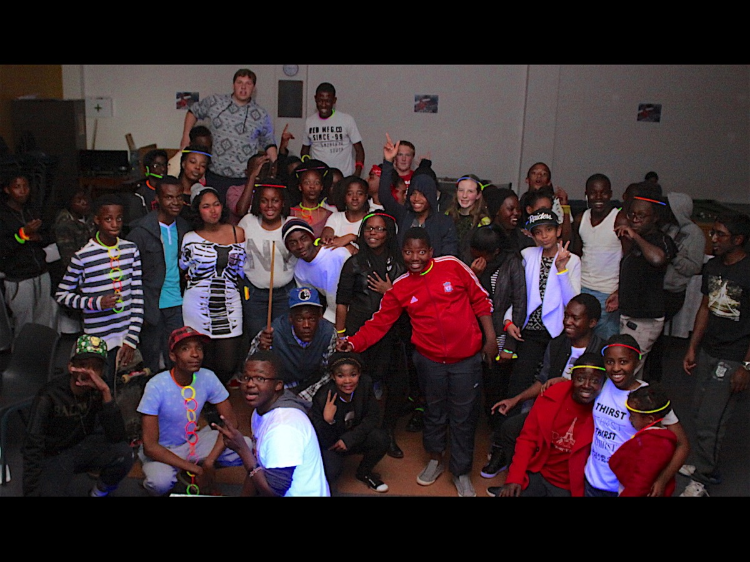
Notes:
Here are some of the teens in our youth ministry that we meet with on a regular basis.

Slide 36
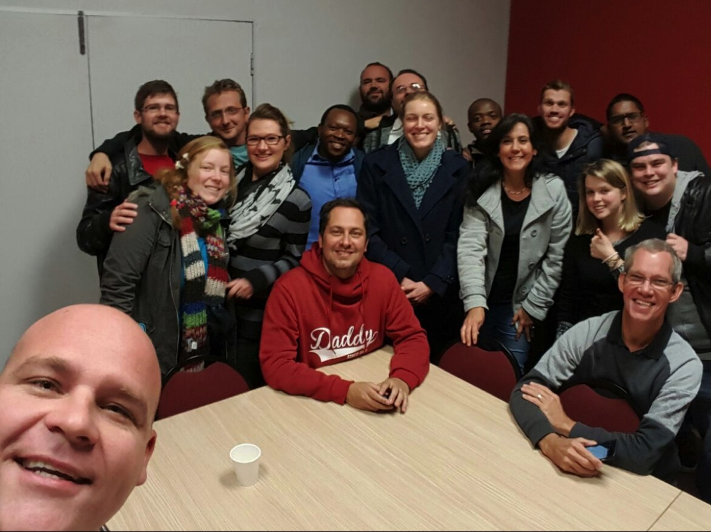
Notes:
These are some of the youth pastors in our geographic area that Debbie and I pour our lives into on a weekly basis!

Slide 37
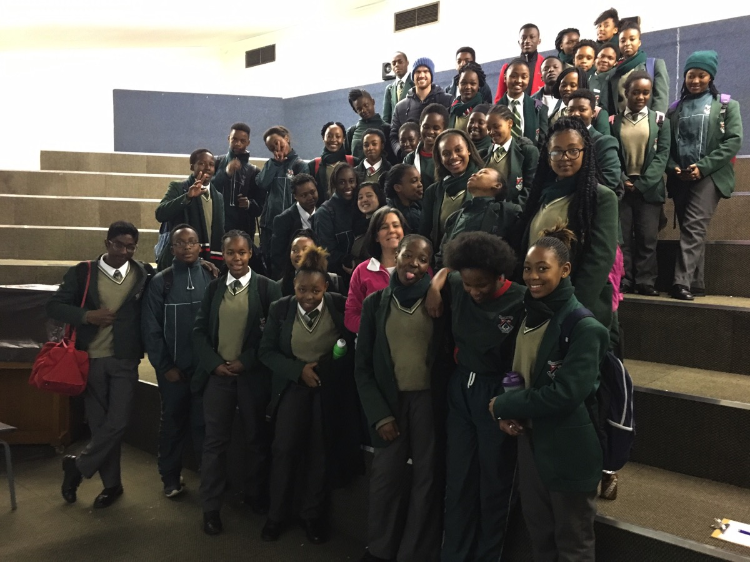
Notes:
Here are some of the learners in just one of the 3 high schools that we work in that we meet with on a weekly basis.

Slide 38
Notes:
Here are some of the boys who live in single parents homes that we meet with every Saturday afternoon in a suburb where our church is located. Every one of the lives and families that we are touching and represented by the photos that I am showing are in some way a result of the impact that Sunday School and people at Fynnlands Baptist Church had on my life while I was growing up!

Slide 39
Notes:
So as you celebrate 70 years of Sunday School at Flynnlands you should probably ask yourselves, is running Sunday School here every Sunday worth the effort?

Slide 40
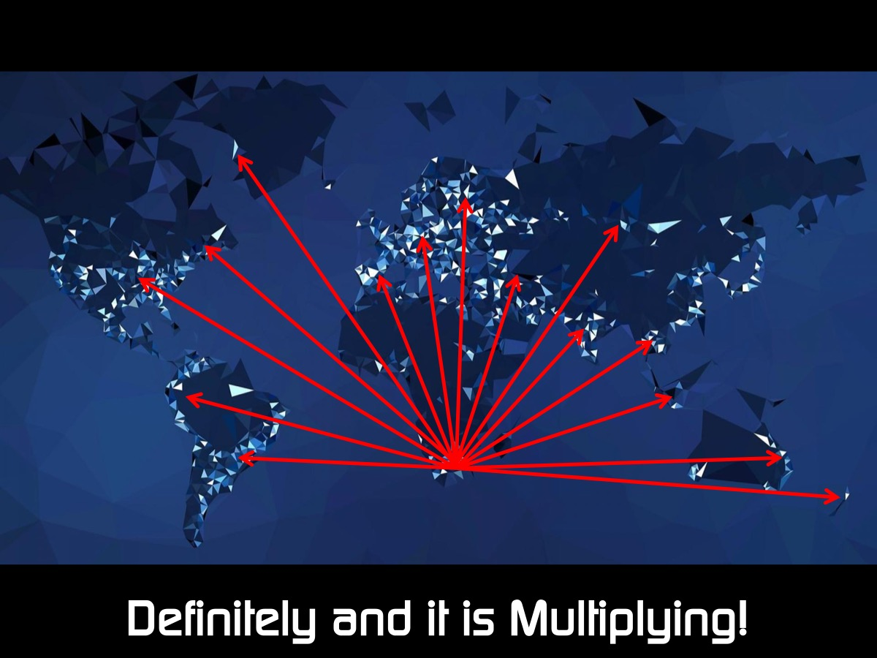
Notes:
I believe so - I could spend endless time talking about the impact of what others who were a product of this church are doing around the world for the sake of the kingdom - but I think by now you get the message - what we do in one place multiplies around the globe! You are not adding people into the kingdom - you engaged in multiplication. Let me illustrate the difference with an activity:

Slide 41
Notes:
Activity: The Difference Between Addition and Multiplication: (1) To demonstrate Addition I am going to touch someone in the front and ask them to stand. Then I will touch another person and then another and so on. So I have led 3 to 5 people to Jesus so far. But it is taking a while and I don’t really have time to follow them up properly or help them become disciples who make disciples. If I keep going like this we will never make disciples of all nations. (2) To demonstrate Multiplication I am going to touch a few people, but before I am done touching them I am going to equip them to do what I did to them and send them out to lead others to Jesus who will lead others, and so on. Let’s see how many people I need to touch before the whole congregation is standing!

Slide 42
Notes:
Someone said: Legacy is not leaving something for people, it’s leaving something in people.

Slide 43
Notes:
Go and make disciples of all nations, baptizing them in the name of the Father and of the Son and of the Holy Spirit, and teaching them to obey everything I have commanded you. And surely I am with you always, to the very end of the age. (Matthew 28:19-20)

Slide 44
Notes:
Kingdom legacy is all about making disciples who will make disciples who will make disciples.

Slide 45
Notes:
What did Jesus leave behind? You can often tell what mattered most to a person by what they leave behind when they depart this world. What Jesus left behind is more astonishing when you think of what he didn’t leave: No wife or child. No house. No clothes. No money. No business. No writings. No hymns. No portrait. No buildings. No cross remnant. No confirmed gravesite.

Slide 46
Notes:
What Was His Legacy? No wonder some people think that Jesus was a myth - there are no concrete signs that he lived. So scant a corporeal trace did Jesus leave that some have claimed he was a myth. The only things he left behind were people who believed his gospel. Jesus left his Word (teaching) and his church (a few hundred people). And these two legacies changed the course of history. They are, in fact, what history is all about. Everything passes away: rulers, nations, professions, species, industries, families, possessions, political movements, houses, IRAs, 401Ks, heirlooms, photos, books, cars, schools, degrees, careers—every earthly thing we cherish. Except for Jesus’ Word and his church.

Slide 47
Notes:
What will you leave behind? What will your legacy be?

Slide 48
Notes:
There is an amazing poem by CT Studd, a missionary and a cricketer from many years back, called Only One Life and this line ends everyone of the verses: “Only one life, ’twill soon be past, Only what’s done for Christ will last.”
Only One Life by CT Studd
Two little lines I heard one day,
Traveling along life’s busy way;
Bringing conviction to my heart,
And from my mind would not depart;
Only one life, ’twill soon be past,
Only what’s done for Christ will last.
Only one life, yes only one,
Soon will its fleeting hours be done;
Then, in ‘that day’ my Lord to meet,
And stand before His Judgement seat;
Only one life, ’twill soon be past,
Only what’s done for Christ will last.
Only one life, the still small voice,
Gently pleads for a better choice
Bidding me selfish aims to leave,
And to God’s holy will to cleave;
Only one life, ’twill soon be past,
Only what’s done for Christ will last.
Only one life, a few brief years,
Each with its burdens, hopes, and fears;
Each with its clays I must fulfill,
living for self or in His will;
Only one life, ’twill soon be past,
Only what’s done for Christ will last.
When this bright world would tempt me sore,
When Satan would a victory score;
When self would seek to have its way,
Then help me Lord with joy to say;
Only one life, ’twill soon be past,
Only what’s done for Christ will last.
Give me Father, a purpose deep,
In joy or sorrow Thy word to keep;
Faithful and true what e’er the strife,
Pleasing Thee in my daily life;
Only one life, ’twill soon be past,
Only what’s done for Christ will last.
Oh let my love with fervor burn,
And from the world now let me turn;
Living for Thee, and Thee alone,
Bringing Thee pleasure on Thy throne;
Only one life, ’twill soon be past,
Only what’s done for Christ will last.
Only one life, yes only one,
Now let me say, ”Thy will be done”;
And when at last I’ll hear the call,
I know I’ll say “twas worth it all”;
Only one life, ’twill soon be past,
Only what’s done for Christ will last.

Slide 49
Notes:
So don’t waste your life.
Activity: The Rope Illustration - show a long rope and say that it represents our lives - then show an end that is marked and speak about how that short piece represents our lives on earth while the rest of the rope is our life in eternity - on the others side of death).

Slide 50
Notes:
Chuck Palahniuk said: “We all die. The goal isn't to live forever, the goal is to create something that will.”

Slide 51
Notes:
So how do we create a kingdom legacy?

Slide 52
Notes:
1. As Parents: bring your children up in the ways of the Lord.

Slide 53
Notes:
These commandments that I give you today are to be on your hearts. Impress them on your children. Talk about them when you sit at home and when you walk along the road, when you lie down and when you get up. (Deuteronomy 6:6-7)

Slide 54
Notes:
George Barna said: “In the race to a Child’s heart, the first one there wins.”

Slide 55
Notes:
Leigh Robinson in a seminar in Johannesburg last week said: “The role you play with kids is passing on to them the very words of God. We have a tiny window of time to do this. They will be able to draw from that in critical moments for the rest of their life.”

Slide 56
Notes:
2. As Individuals: Invest in the next generation by teaching and guiding them in the paths of righteousness.

Slide 57
Notes:
A hundred years from now it will not matter what my bank account was, the sort of house I lived in, or the kind of car I drove, but the world may be different because I was important in the life of a child. (Forest Witcraft)

Slide 58
Notes:
The Apostle Paul said: And the things you have heard me say in the presence of many witnesses entrust to reliable people who will also be qualified to teach others. (2 Timothy 2:2)

Slide 59
Notes:
3. As a Church: keep your passion for reaching, discipling and equipping the next generation.

Slide 60
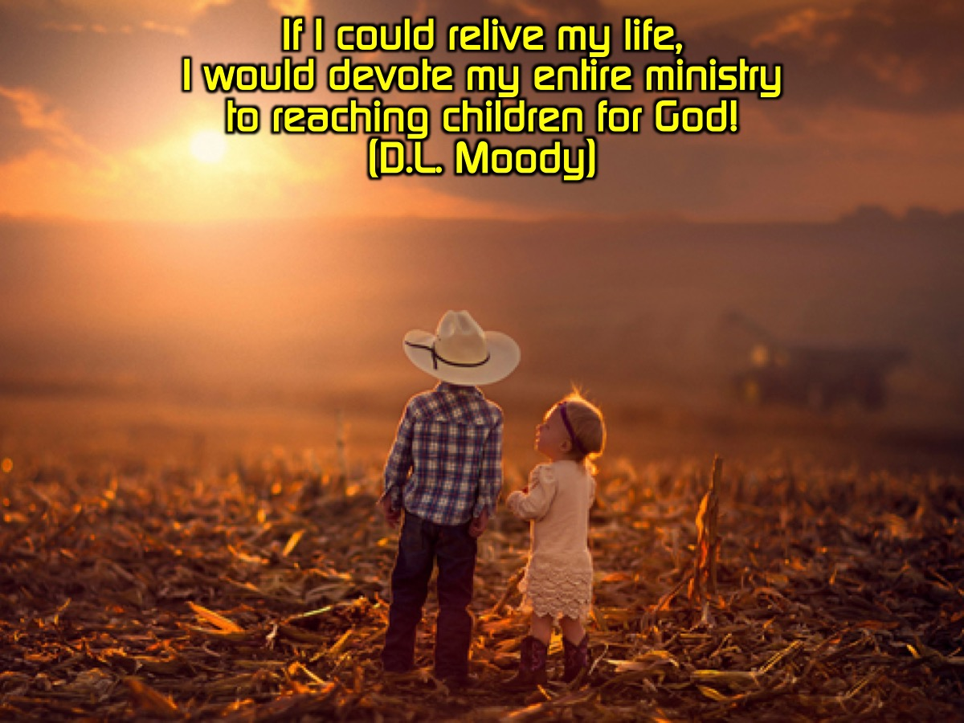
Notes:
D.L.Moody said: If I could relive my life, I would devote my entire ministry to reaching children for God!

Slide 61
Notes:
What if we don’t do this? The alternative is unthinkable! The people served the Lord throughout the lifetime of Joshua and of the elders who outlived him and who had seen all the great things the Lord had done for Israel. After that whole generation had been gathered to their ancestors, another generation grew up who knew neither the LORD nor what he had done for Israel. Then the Israelites did evil in the eyes of the Lord and served the Baals. (Judges 2:6,7,10,11)

Slide 62
Notes:
Prayer

