Slide 1

Notes:
Welcome to the David Series. Over the next ten weeks we will be exploring the life of David and learning valuable life lessons for our own lives. Here is a preview of the next ten weeks…

Slide 2

Notes:
Week 1: Destiny (1 Samuel 16)

Slide 3
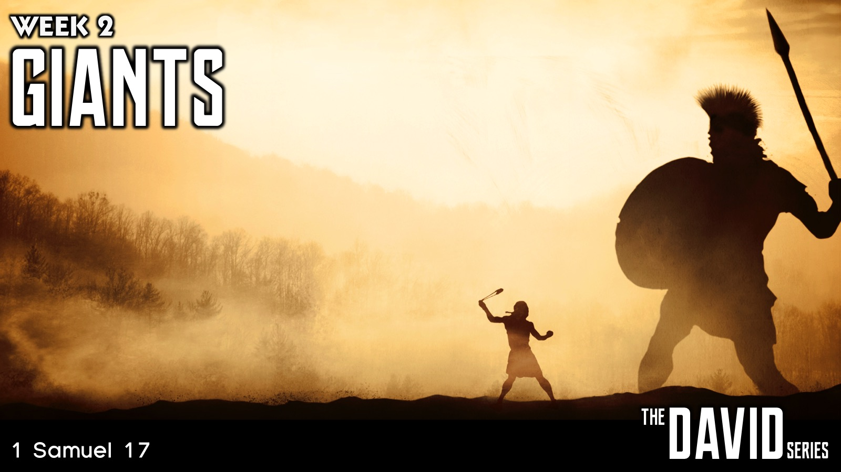
Notes:
Week 2: Giants (1 Samuel 17)

Slide 4

Notes:
Week 3: Friends (1 Samuel 18-20)

Slide 5

Notes:
Week 4: Betrayal (1 Samuel 21-23)

Slide 6

Notes:
Week 5: Revenge (1 Samuel 24)

Slide 7

Notes:
Week 6: Trials (1 Samuel 25-31)

Slide 8

Notes:
Week 7: Power (2 Samuel 1-10)

Slide 9

Notes:
Week 8: Lust (2 Samuel 11-12)

Slide 10

Notes:
Week 9: Tragedy (2 Samuel 13-18)

Slide 11

Notes:
Week 10: Legacy (2 Samuel 19-23; 1 Kings 1-2)

Slide 12

Notes:
Today we are going to learn about Destiny (1 Samuel 16).

Slide 13
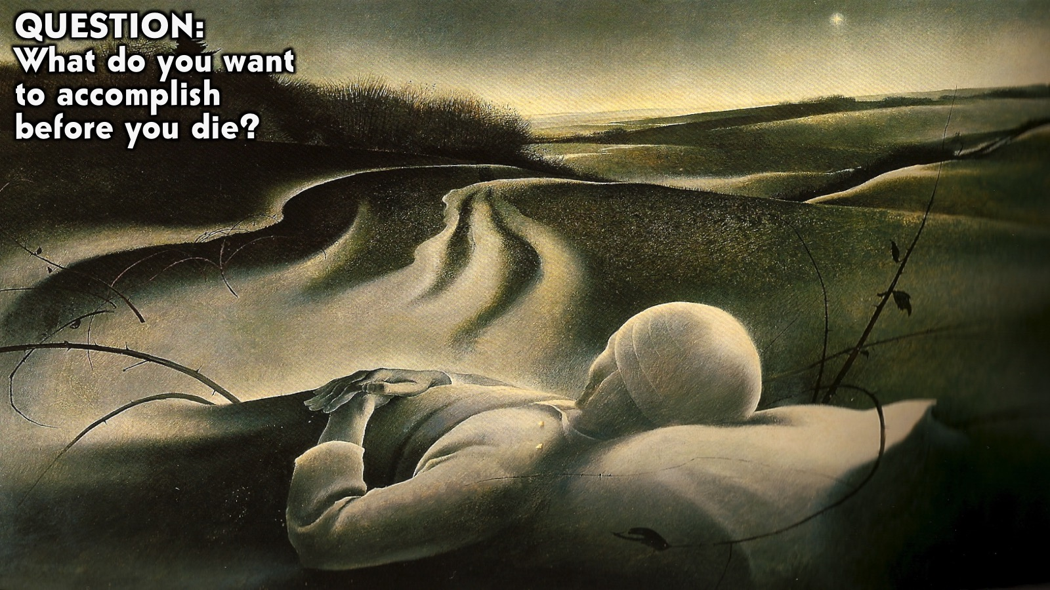
Notes:
Question: What do you want to accomplish before you die?

Slide 14

Notes:
Destiny is the specific task that God wants you to accomplish on earth!

Slide 15

Notes:
“To each there comes in their lifetime a special moment when they are figuratively tapped on the shoulder and offered the chance to do a very special thing, unique to them and fitted to their talents. What a tragedy if that moment finds them unprepared or unqualified for that which could have been their finest hour.” (Sir Winston Churchill)

Slide 16

Notes:
God has a destiny for each one of us and he will work for us, in us and through us to make it happen.

Slide 17
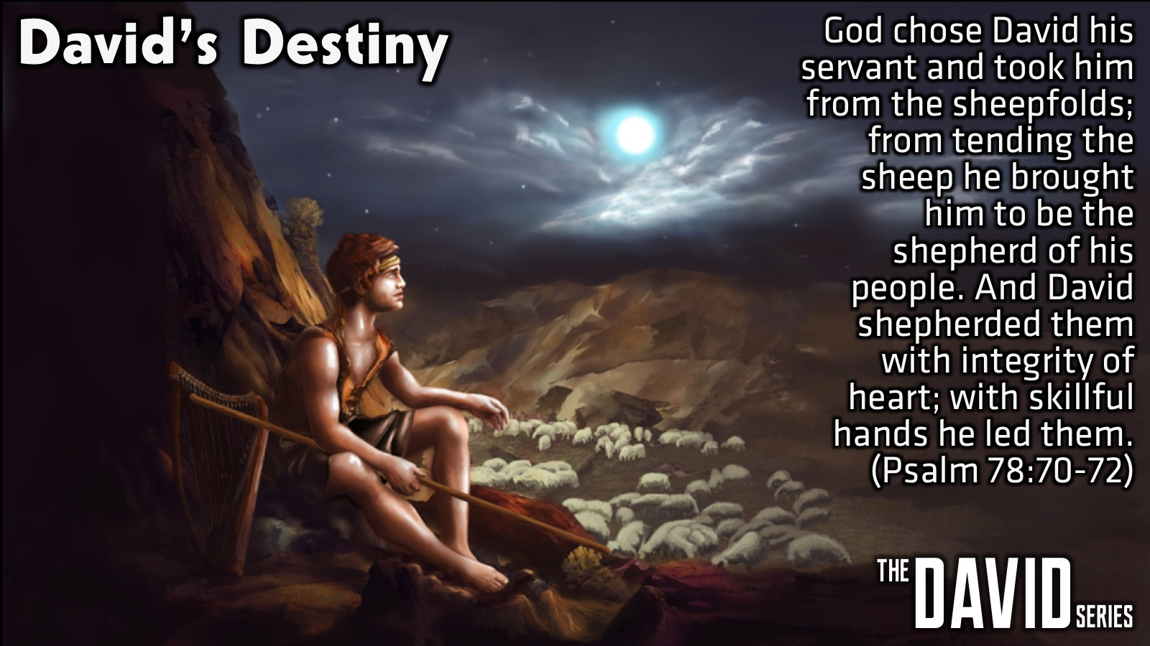
Notes:
David’s Destiny: God chose David his servant and took him from the sheepfolds; from tending the sheep he brought him to be the shepherd of his people. And David shepherded them with integrity of heart; with skillful hands he led them. (Psalm 78:70-72)

Slide 18
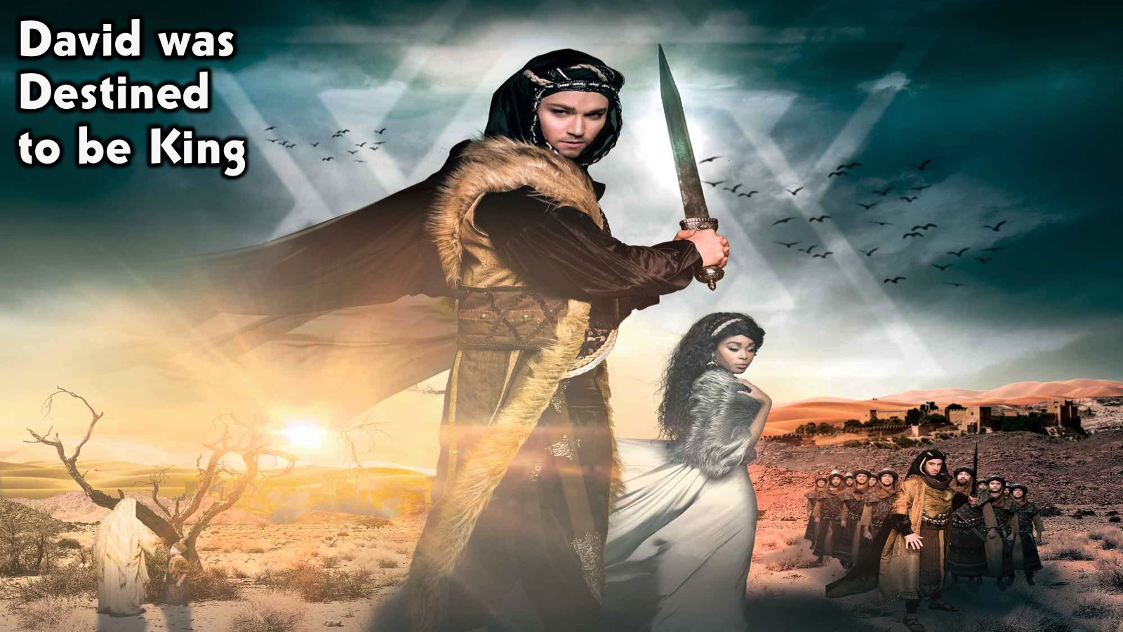
Notes:
David was Destined to be King.

Slide 19
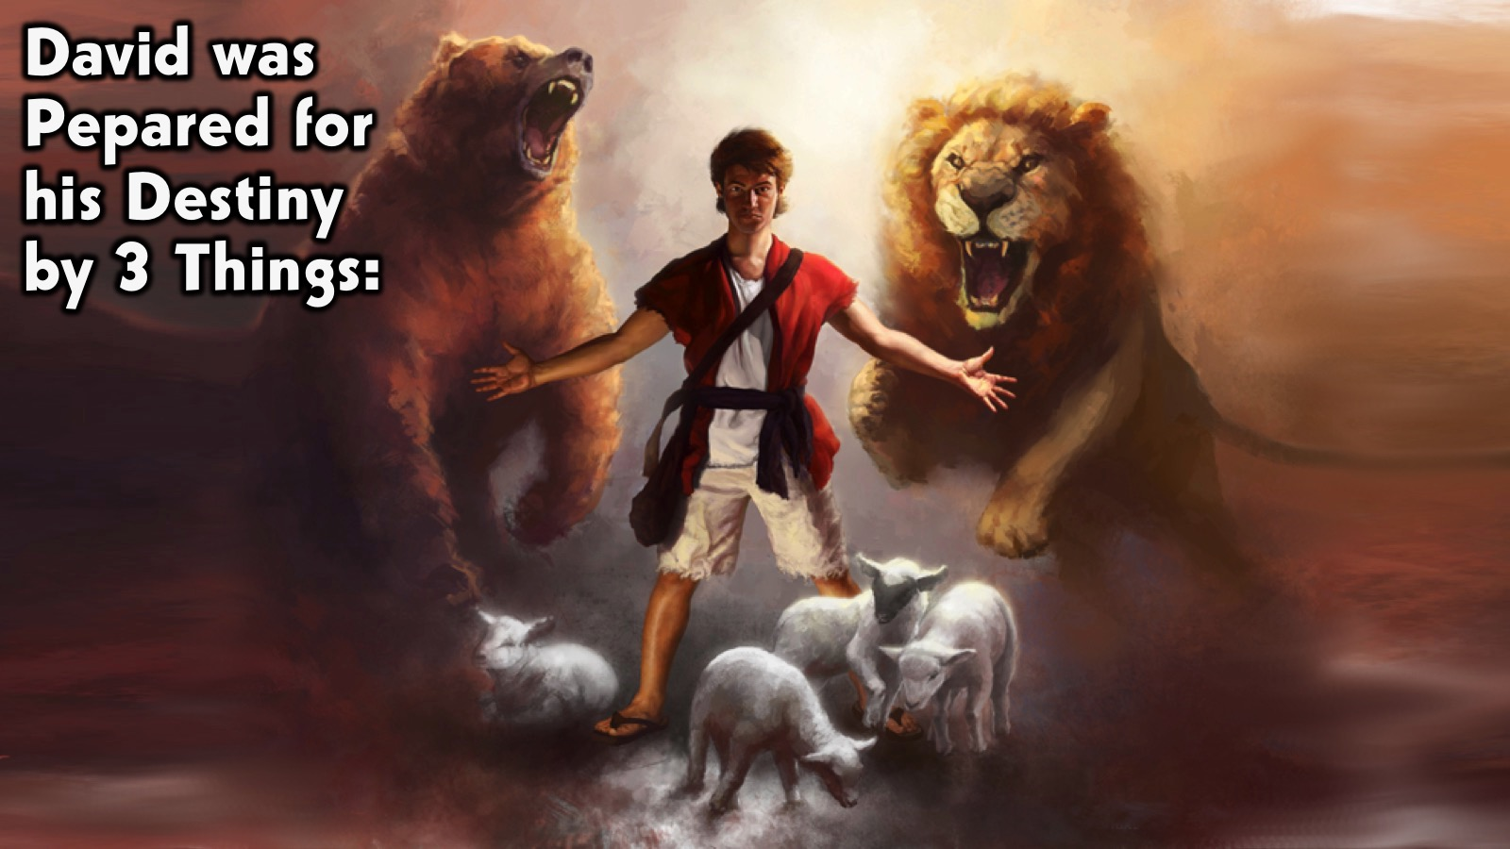
Notes:
David was Pepared for his Destiny by 3 Things:

Slide 20
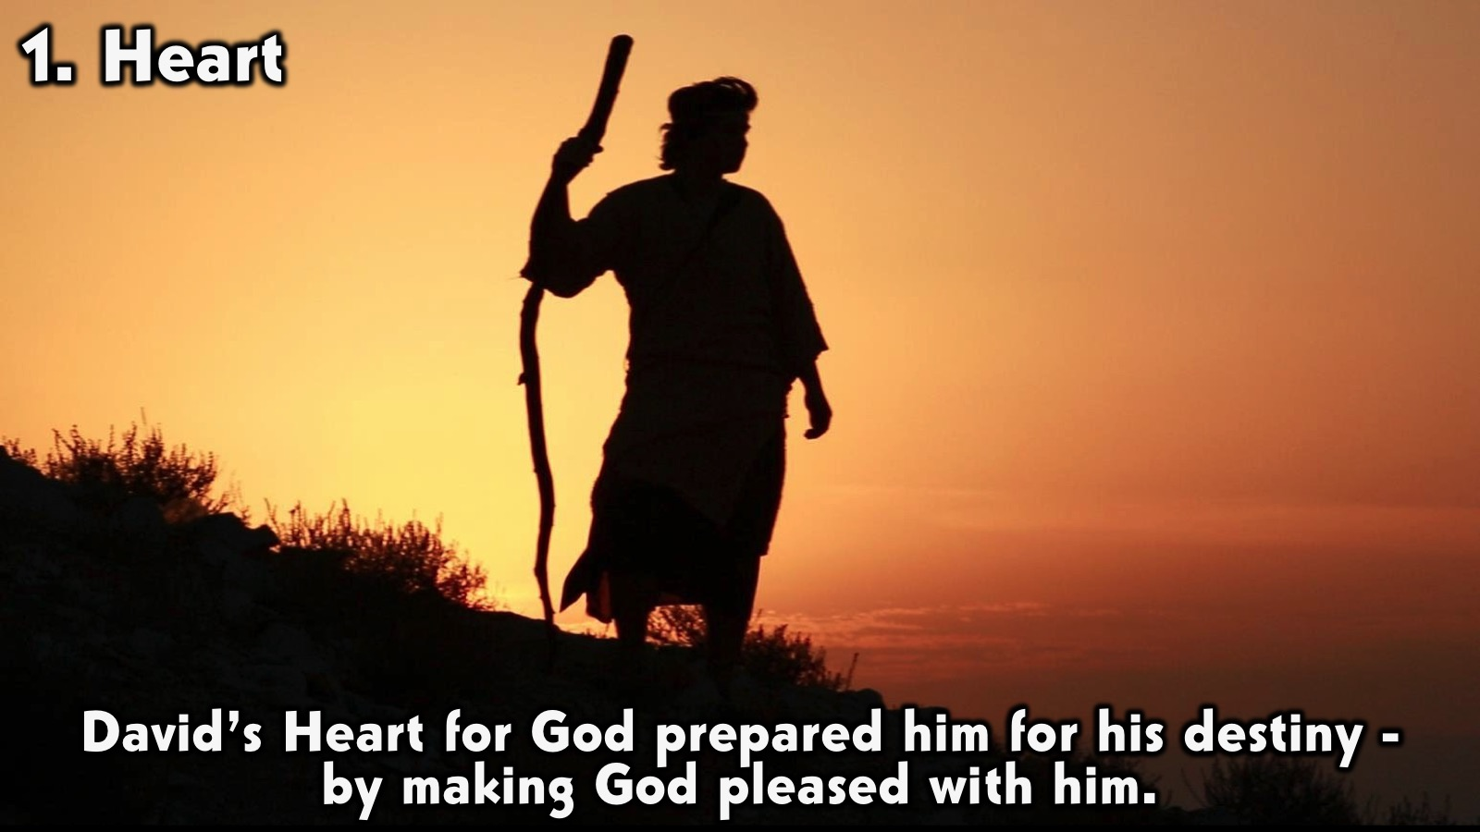
Notes:
1. Heart: David’s Heart for God prepared him for his destiny - by making God pleased with him.

Slide 21
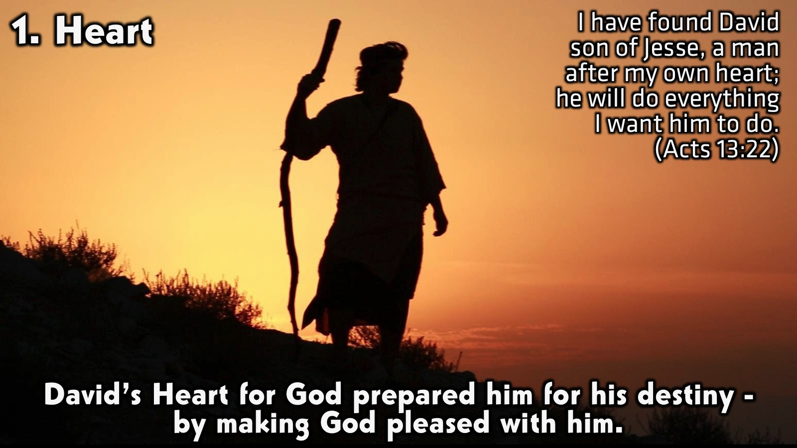
Notes:
When Samuel was looking for someone to anoint as king the Lord spoke through him: “Do not consider his appearance or his height, for I have rejected him. The Lord does not look at the things people look at. People look at the outward appearance, but the Lord looks at the heart.” (1 Samuel 16:7). After removing Saul, he made David their king. God testified concerning him: “I have found David son of Jesse, a man after my own heart; he will do everything I want him to do.” (Acts 13:22). David was a man after God’s heart: Who we are is more important that what we do!

Slide 22
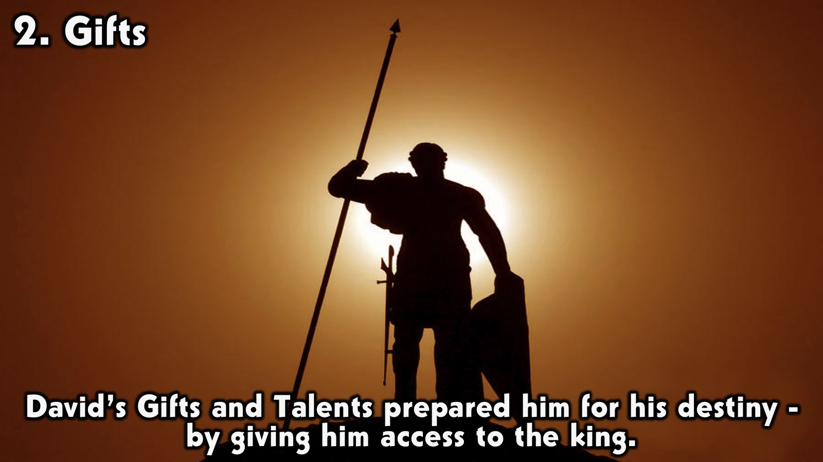
Notes:
2. Gifts: David’s Gifts and Talents prepared him for his destiny - by giving him access to the king.

Slide 23
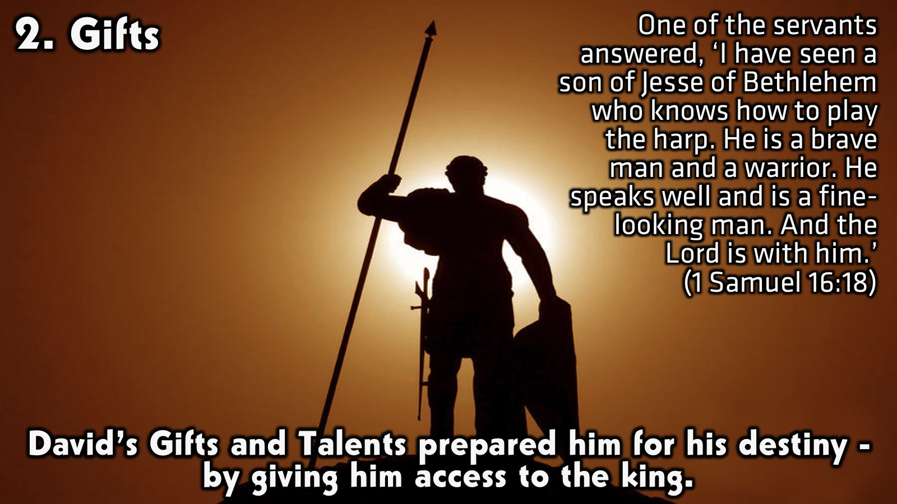
Notes:
Now the Spirit of the Lord had departed from Saul, and an evil spirit from the Lord tormented him. Saul’s attendants said to him, ‘See, an evil spirit from God is tormenting you. Let our lord command his servants here to search for someone who can play the lyre. He will play when the evil spirit from God comes on you, and you will feel better.’ So Saul said to his attendants, ‘Find someone who plays well and bring him to me.’ One of the servants answered, ‘I have seen a son of Jesse of Bethlehem who knows how to play the lyre. He is a brave man and a warrior. He speaks well and is a fine-looking man. And the Lord is with him.’ Then Saul sent messengers to Jesse and said, ‘Send me your son David, who is with the sheep.’ So Jesse took a donkey loaded with bread, a skin of wine and a young goat and sent them with his son David to Saul. David came to Saul and entered his service. Saul liked him very much, and David became one of his armour-bearers. Then Saul sent word to Jesse, saying, ‘Allow David to remain in my service, for I am pleased with him.’ Whenever the spirit from God came on Saul, David would take up his lyre and play. Then relief would come to Saul; he would feel better, and the evil spirit would leave him. (1 Samuel 16:14-23). Key Verse: One of the servants answered, ‘I have seen a son of Jesse of Bethlehem who knows how to play the harp. He is a brave man and a warrior. He speaks well and is a fine-looking man. And the Lord is with him.’ (1 Samuel 16:18). David developed a good reputation so that a servant recommended him to the king.

Slide 24
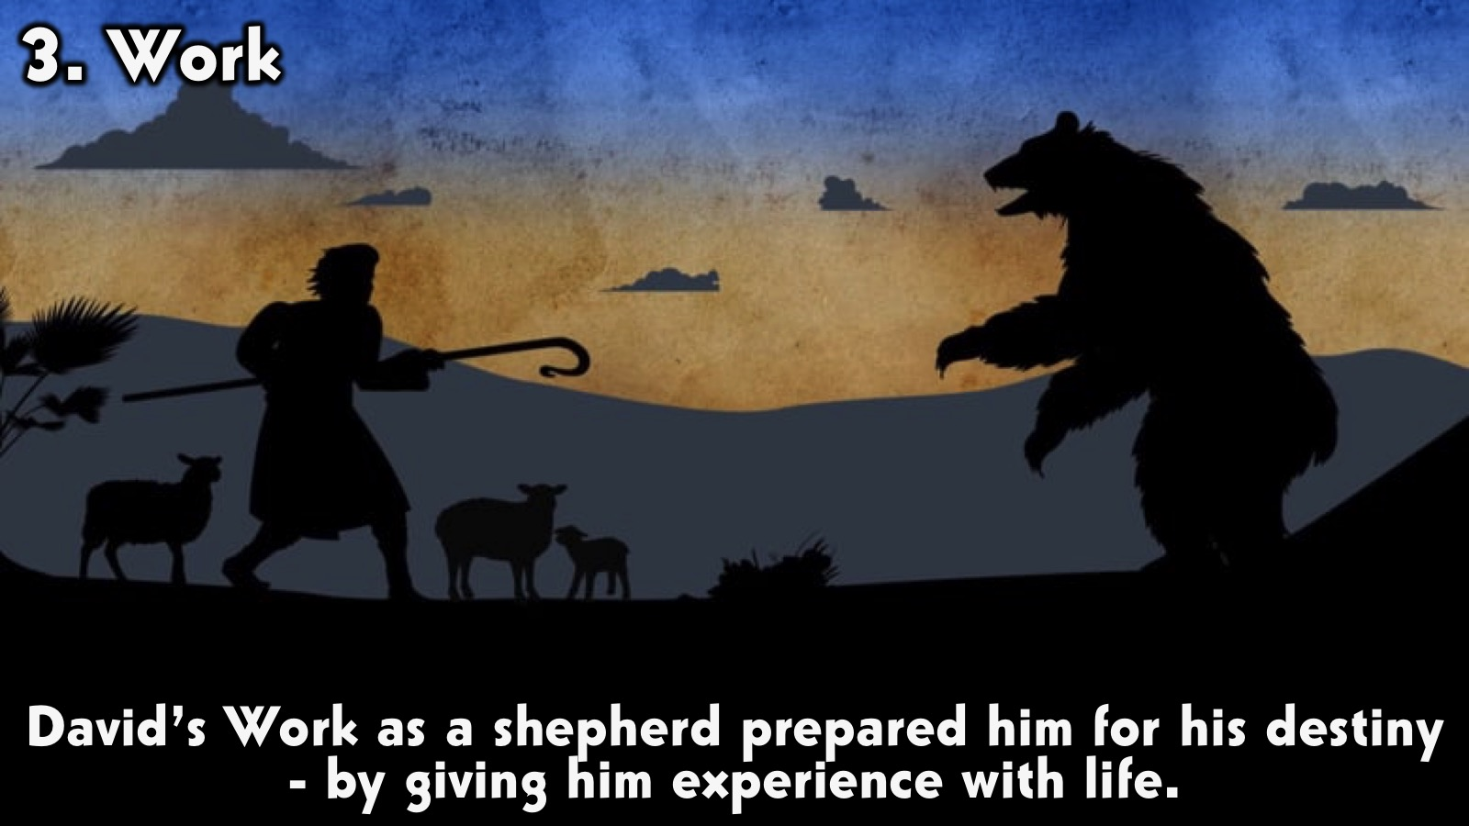
Notes:
3. His Work: David’s Work as a shepherd prepared him for his destiny - by giving him experience with life.

Slide 25
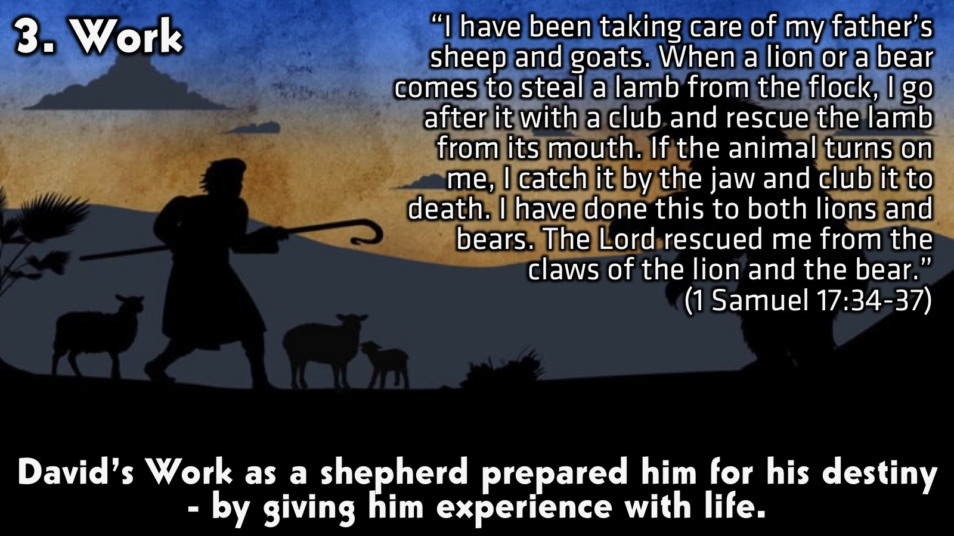
Notes:
“I have been taking care of my father’s sheep and goats. When a lion or a bear comes to steal a lamb from the flock, I go after it with a club and rescue the lamb from its mouth. If the animal turns on me, I catch it by the jaw and club it to death. I have done this to both lions and bears. The Lord rescued me from the claws of the lion and the bear.” (1 Samuel 17:34-37). His background as a shepherd gave him confidence that he could go up against any obstacle that he faced and win; and it also taught him how to care for people. He spent lots of time alone and was able to think about God and speak to God in prayer.

Slide 26
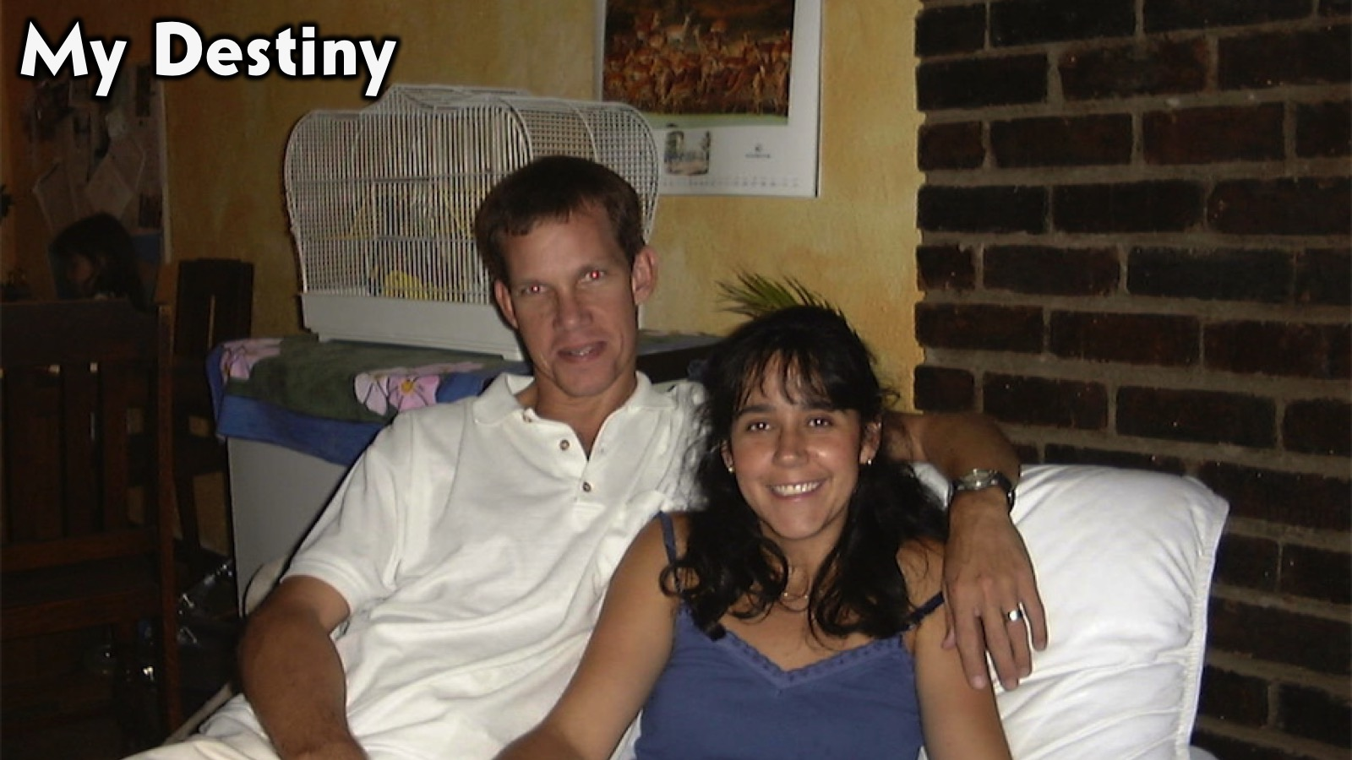
Notes:
My Destiny: Before I get you to think about your destiny, let me share briefly about what I believe my destiny has been and will be.

Slide 27
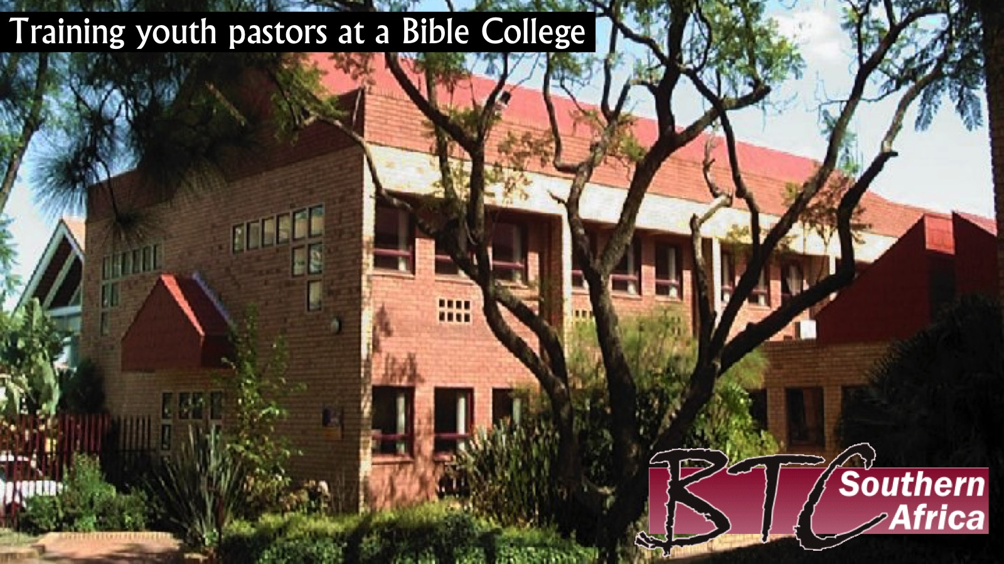
Notes:
1. God called me to spend a decade of my life training youth pastors at a Bible College in Randburg.

Slide 28
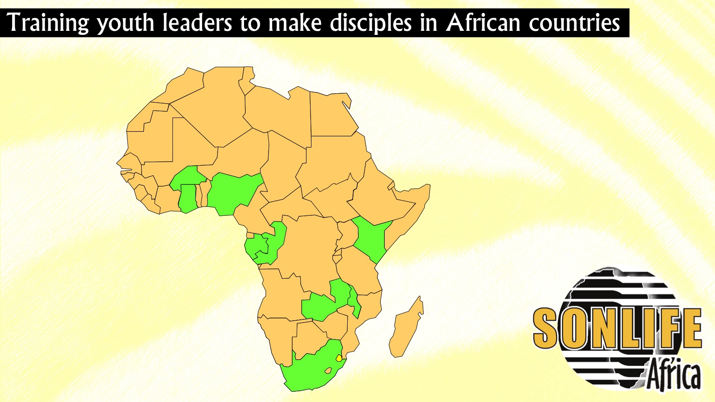
Notes:
2. God called me to spend a decade of my life training leaders to build disciplemaking youth ministries in countries across the continent of Africa. Here are some photos that were taken at the end of each of the three day training sessions…

Slide 29
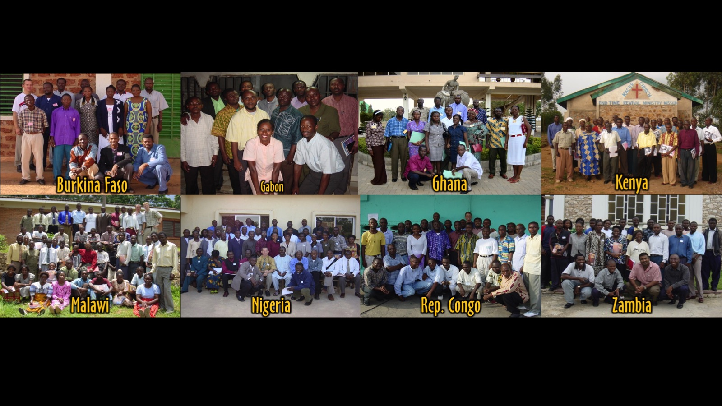
Notes:
Here are some pics of the countries in Africa (apart from South Africa) that I had the privilege to work in.

Slide 30
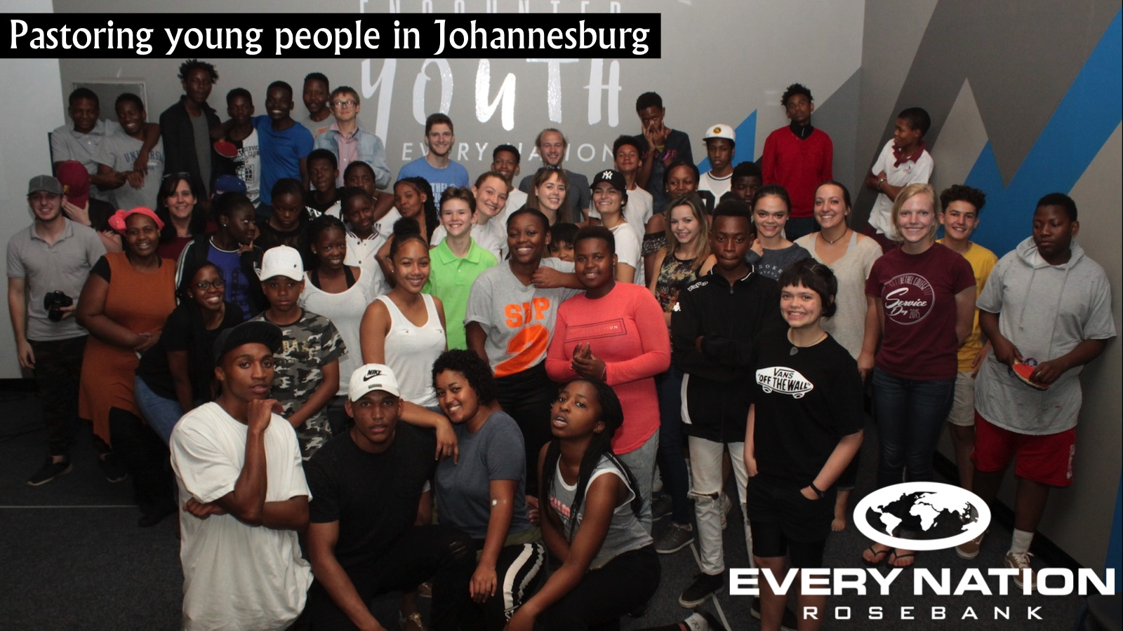
Notes:
3. God called me to spend a decade of my life pastoring young people in Johannesburg.

Slide 31

Notes:
4. God has called me to spend the next decade of my life building a national youth movement in the Every Nation church in Southern Africa. Thankfully it looks like I won’t have to leave my pastoring role at Every Nation Rosebank.

Slide 32

Notes:
Your Destiny: What about your destiny?

Slide 33
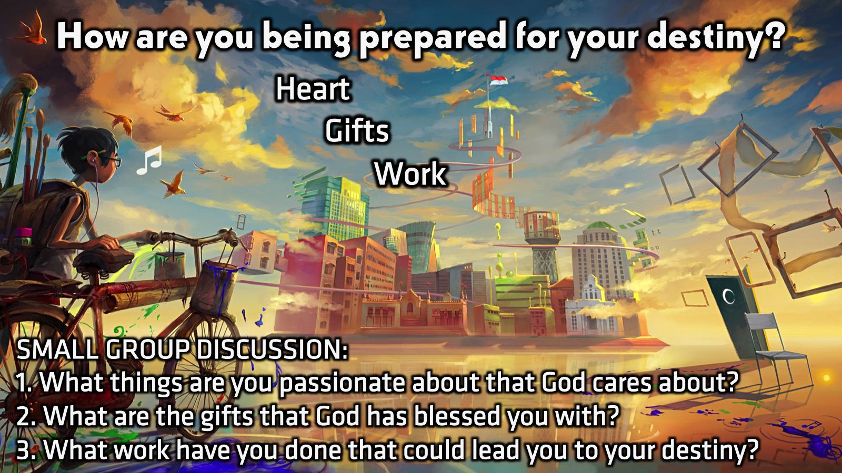
Notes:
Small Group Discussion: How are you being prepared for your destiny?
1. Heart: What things are you passionate about that God cares about?
2. Gifts: What are the gifts and talents that God has blessed you with?
3. Work: What work have you done that could lead you to your destiny?

Slide 34

Notes:
Daily Devotions: We will post devotions on the Sunday WhatsApp group every night of the week throughout this series. Do everything you can to be a part of the daily journey in the life of David. Here is link to the devotions: http://bit.ly/DavidDevotionsWeek1

Slide 35

Notes:
Prayer: We have leaders standing by who would love to pray with you that God will prepare you for your destiny and lead you to it!

Slide 36

Notes:
Next Week: Next week we will look at the next chapter in David’s Life: Giants (1 Samuel 17)

