Slide 1
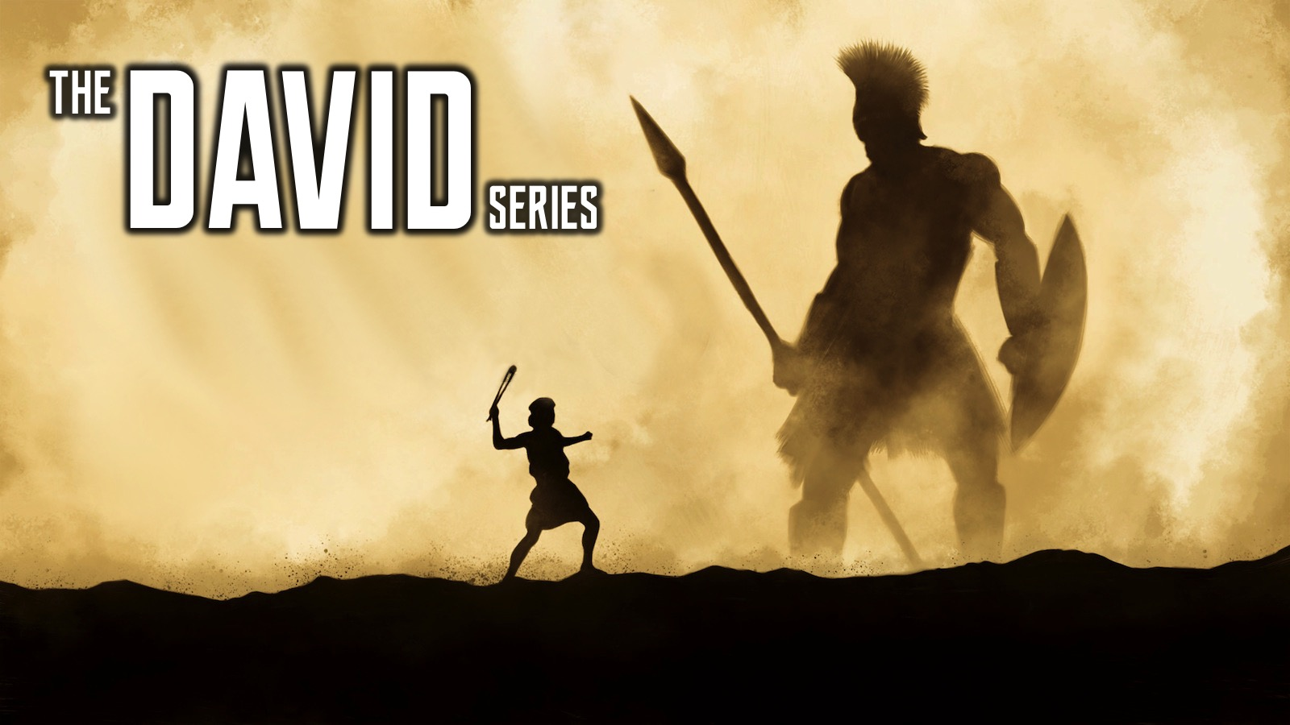
Notes:
Welcome to the David Series.

Slide 2
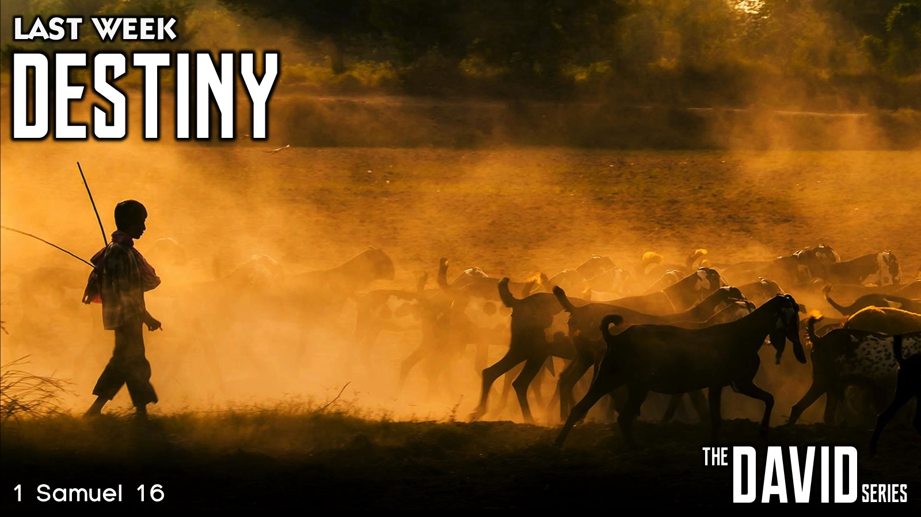
Notes:
Last week we learnt about Destiny.

Slide 3
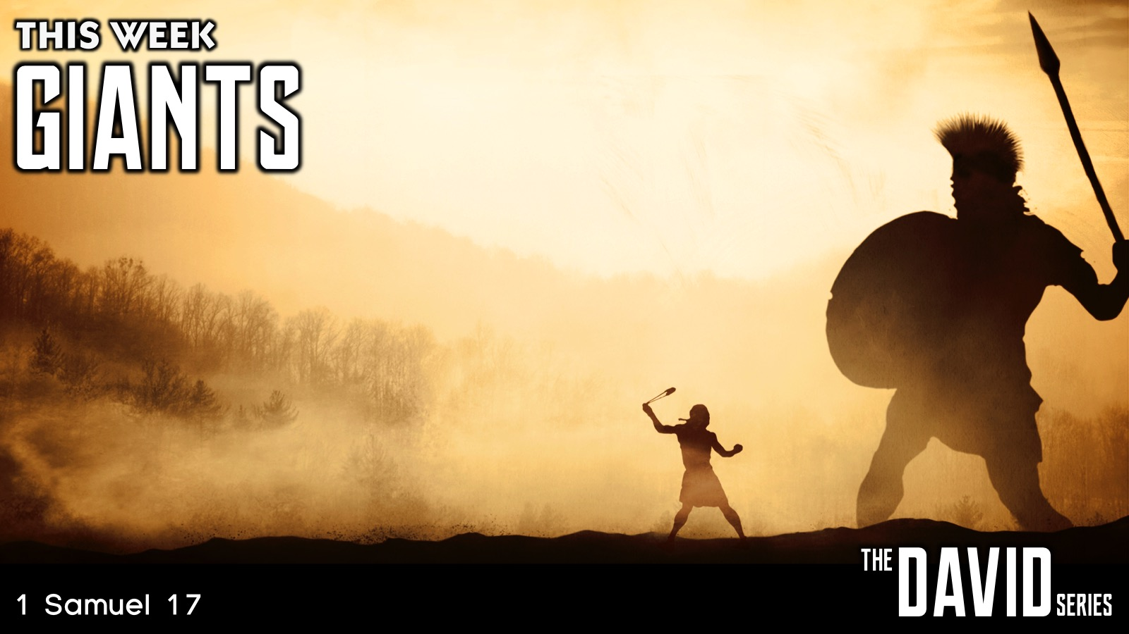
Notes:
This week we are going to learn about handing Giants.

Slide 4
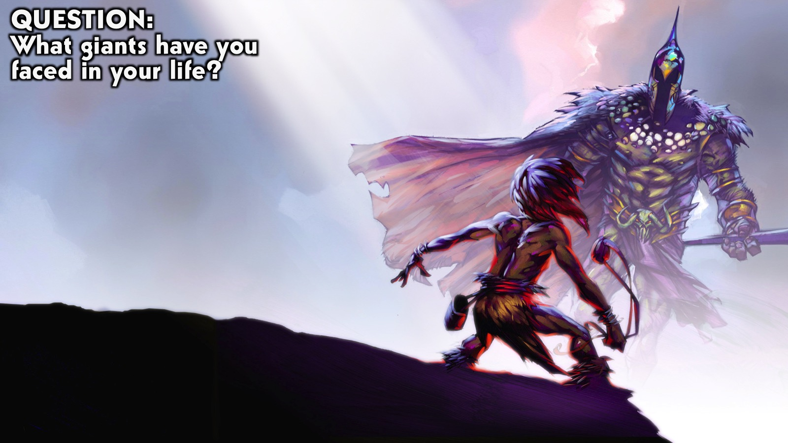
Notes:
Question: What giants have you faced in your life?

Slide 5

Notes:
Giants in My Life: I have fought some giants in my life…

Slide 6
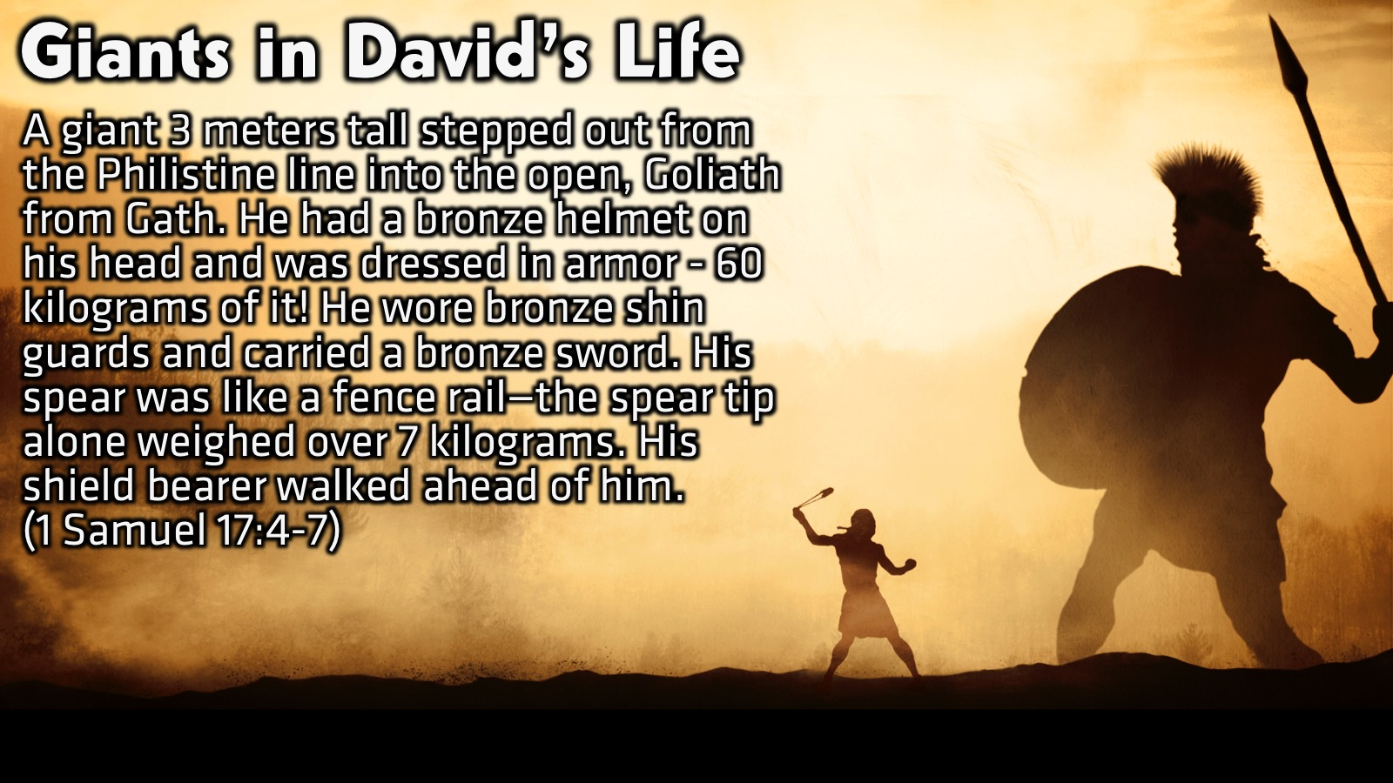
Notes:
Giants in David’s Life: In 1 Samuel 17 we read how David faced a giant in his life.

Slide 7
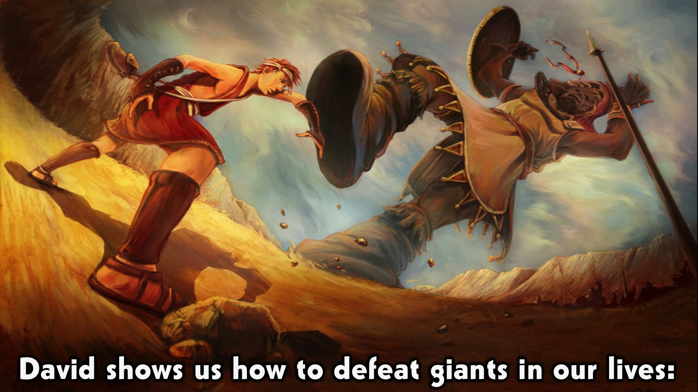
Notes:
David shows us how to defeat giants in our lives:

Slide 8
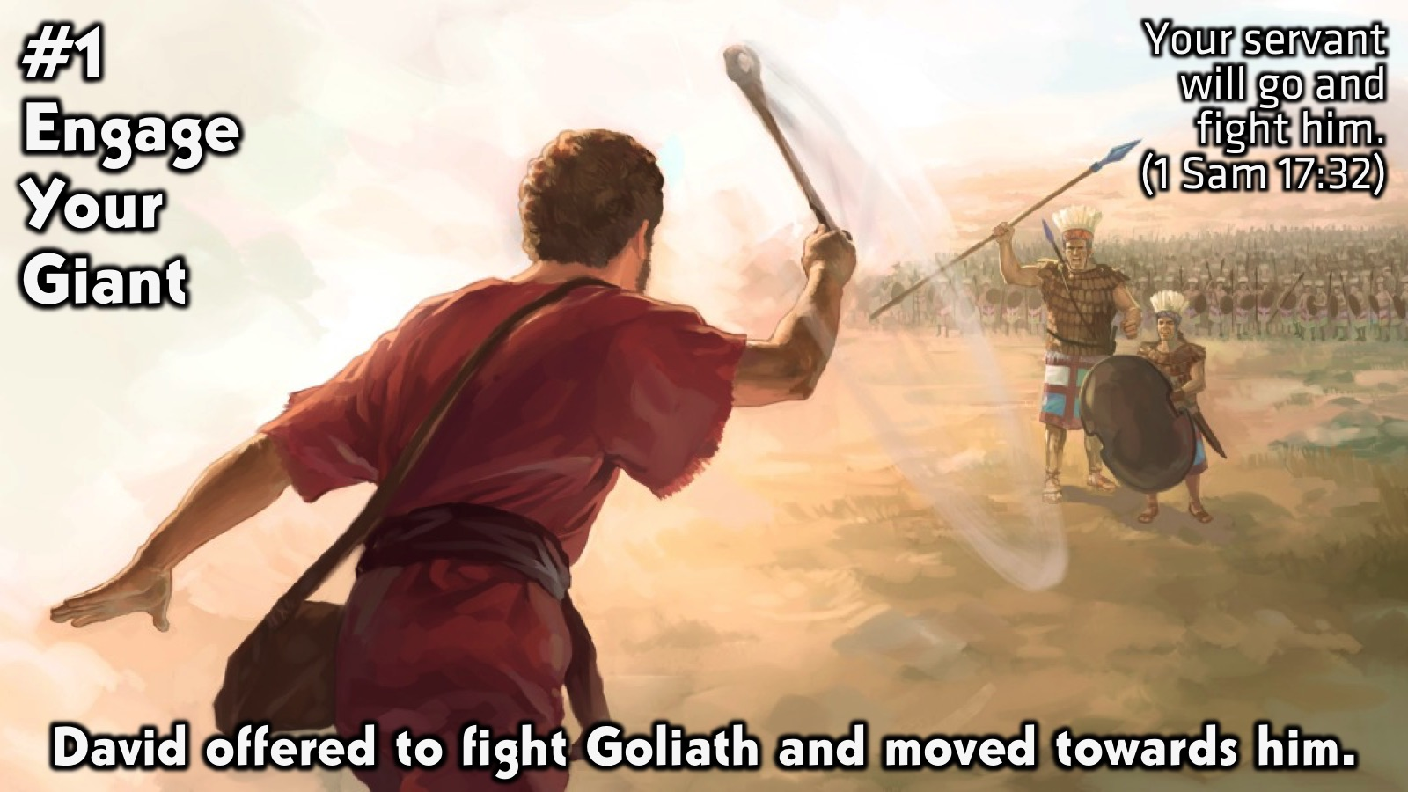
Notes:
1. Engage Your Giant: David offered to fight Goliath and moved towards him. David said to Saul, “Let no one lose heart on account of this Philistine; your servant will go and fight him.” (1 Samuel 17:32)

Slide 9
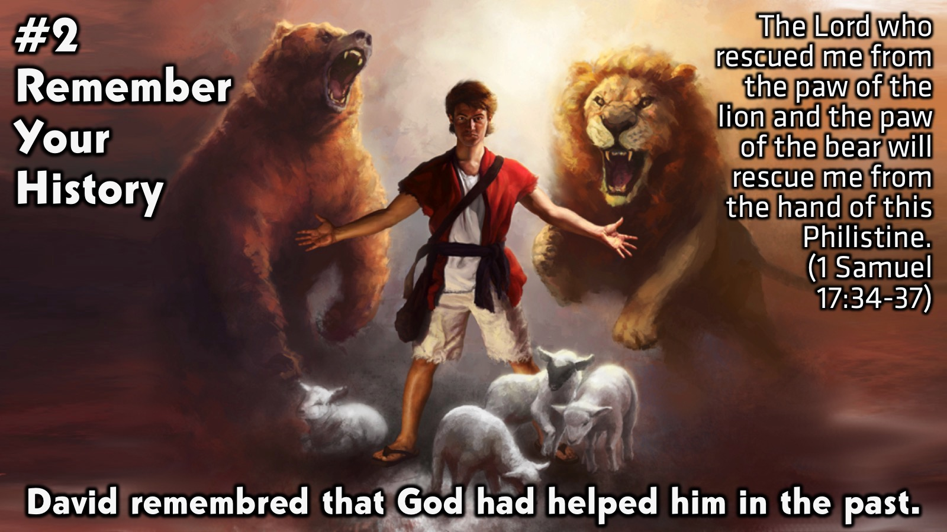
Notes:
2. Remember Your History: David remembred that God had helped him in the past. “David said to Saul, ‘Your servant has been keeping his father’s sheep. When a lion or a bear came and carried off a sheep from the flock, I went after it, struck it and rescued the sheep from its mouth. When it turned on me, I seized it by its hair, struck it and killed it. Your servant has killed both the lion and the bear; this uncircumcised Philistine will be like one of them, because he has defied the armies of the living God. The Lord who rescued me from the paw of the lion and the paw of the bear will rescue me from the hand of this Philistine.’ (1 Samuel 17:34-37)

Slide 10
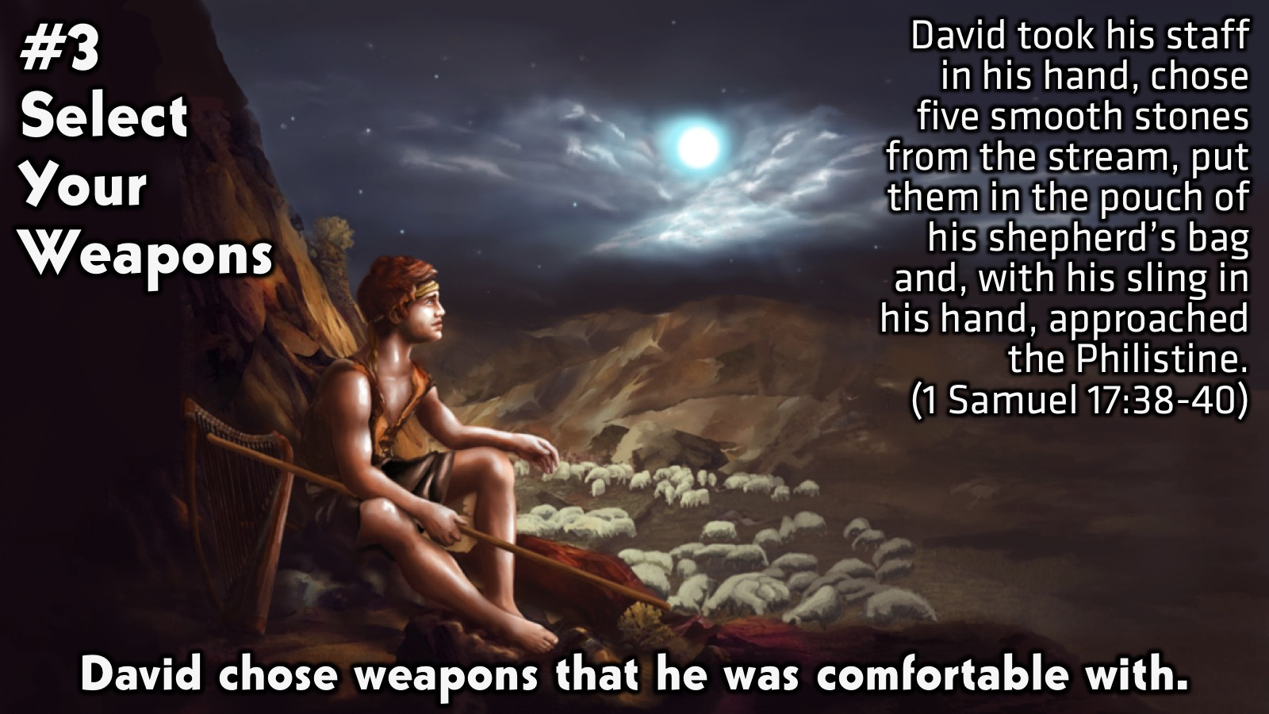
Notes:
3. Select Your Weapon: David chose weapons that he was comfortable with. “Then Saul dressed David in his own tunic. He put a coat of armour on him and a bronze helmet on his head. David fastened on his sword over the tunic and tried walking around, because he was not used to them. ‘I cannot go in these,’ he said to Saul, ‘because I am not used to them.’ So he took them off. Then he took his staff in his hand, chose five smooth stones from the stream, put them in the pouch of his shepherd’s bag and, with his sling in his hand, approached the Philistine. (1 Samuel 17:32)

Slide 11
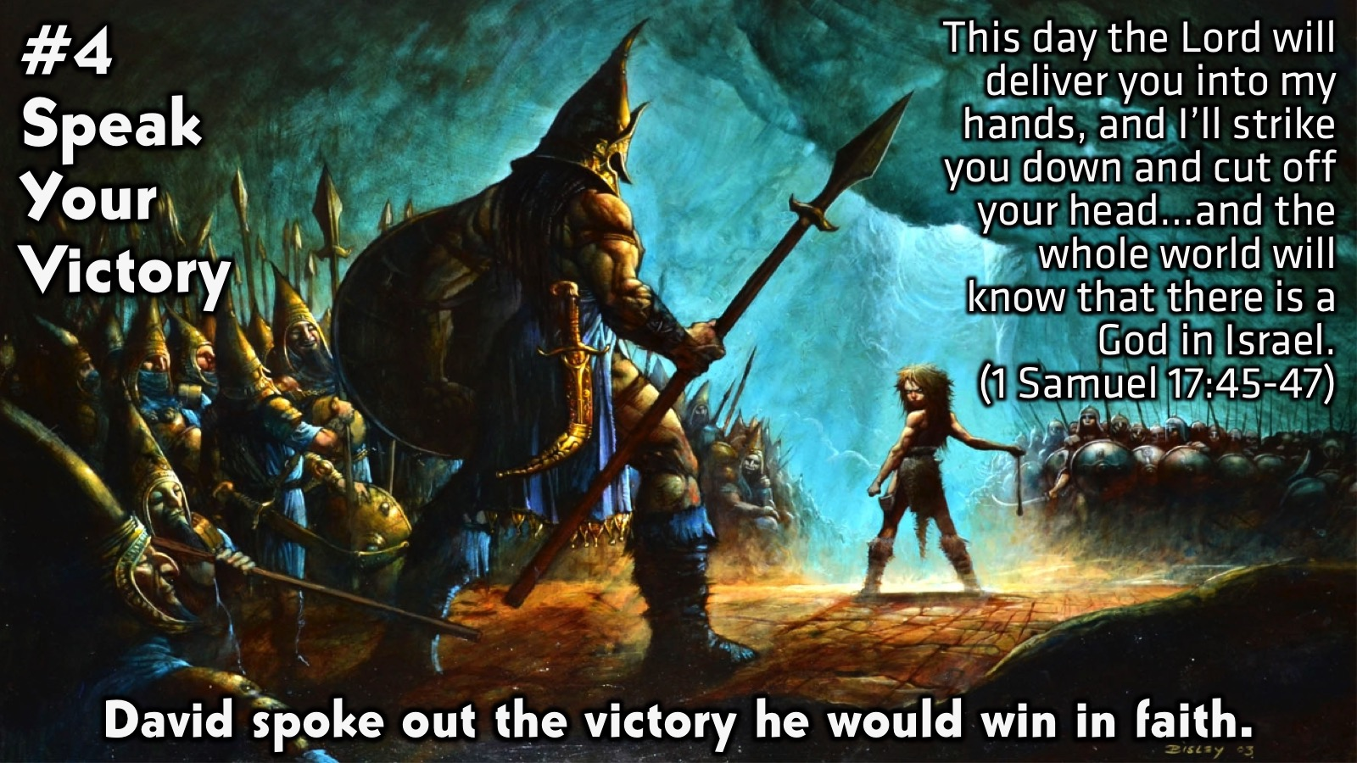
Notes:
4. Speak Your Victory: David spoke out the victory he would win in faith. David said to the Philistine, ‘You come against me with sword and spear and javelin, but I come against you in the name of the Lord Almighty, the God of the armies of Israel, whom you have defied. 46 This day the Lord will deliver you into my hands, and I’ll strike you down and cut off your head. This very day I will give the carcasses of the Philistine army to the birds and the wild animals, and the whole world will know that there is a God in Israel. 47 All those gathered here will know that it is not by sword or spear that the Lord saves; for the battle is the Lord’s, and he will give all of you into our hands.’. (1 Samuel 17:45-47)

Slide 12
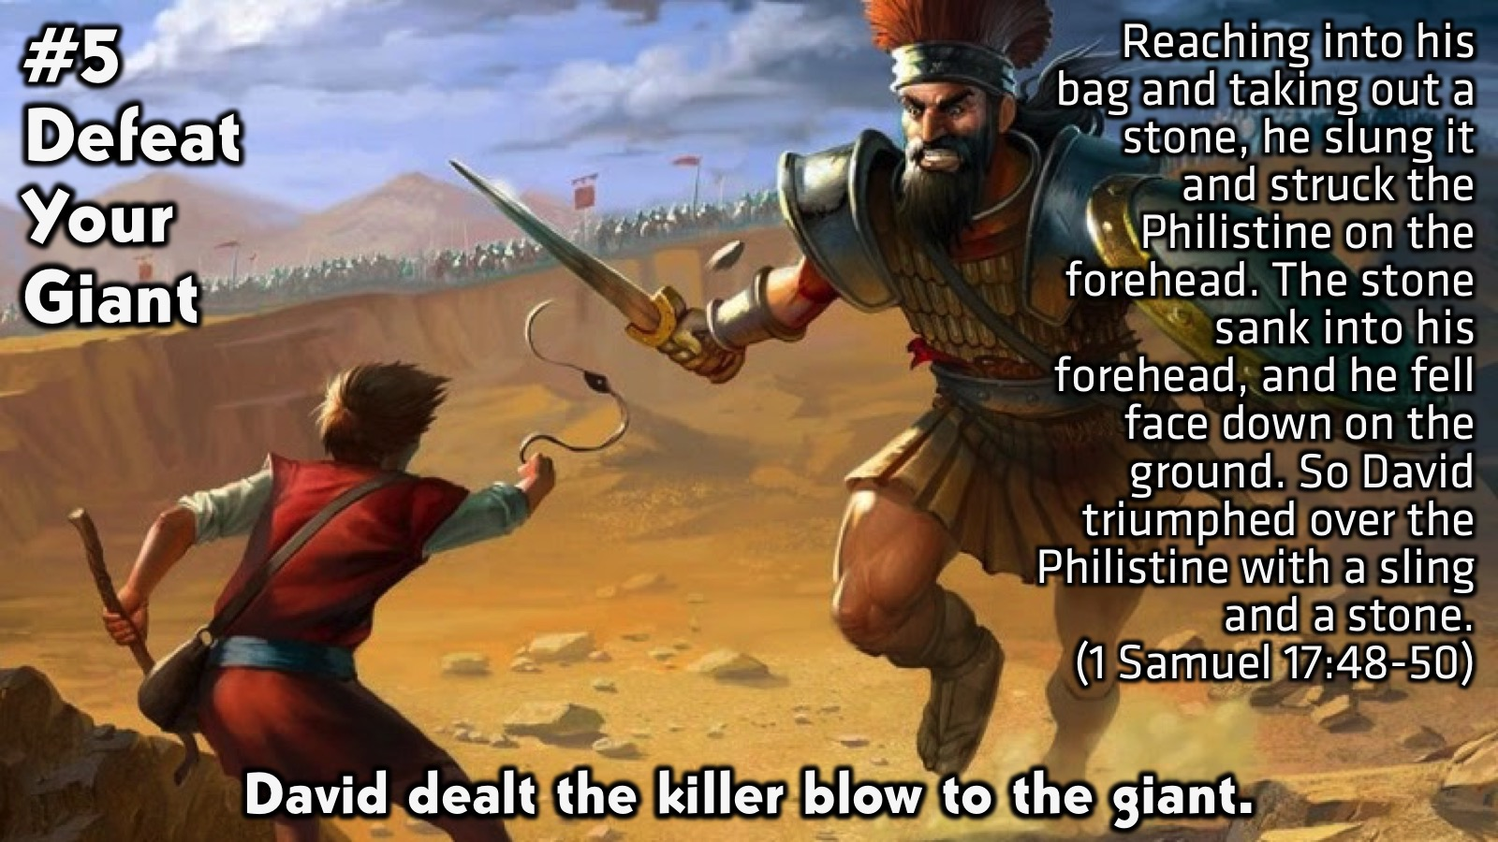
Notes:
5. Defeat Your Giant: David dealt the killer blow to the giant. “As the Philistine moved closer to attack him, David ran quickly towards the battle line to meet him. Reaching into his bag and taking out a stone, he slung it and struck the Philistine on the forehead. The stone sank into his forehead, and he fell face down on the ground. So David triumphed over the Philistine with a sling and a stone; without a sword in his hand he struck down the Philistine and killed him.” (1 Samuel 17:48-50)

Slide 13
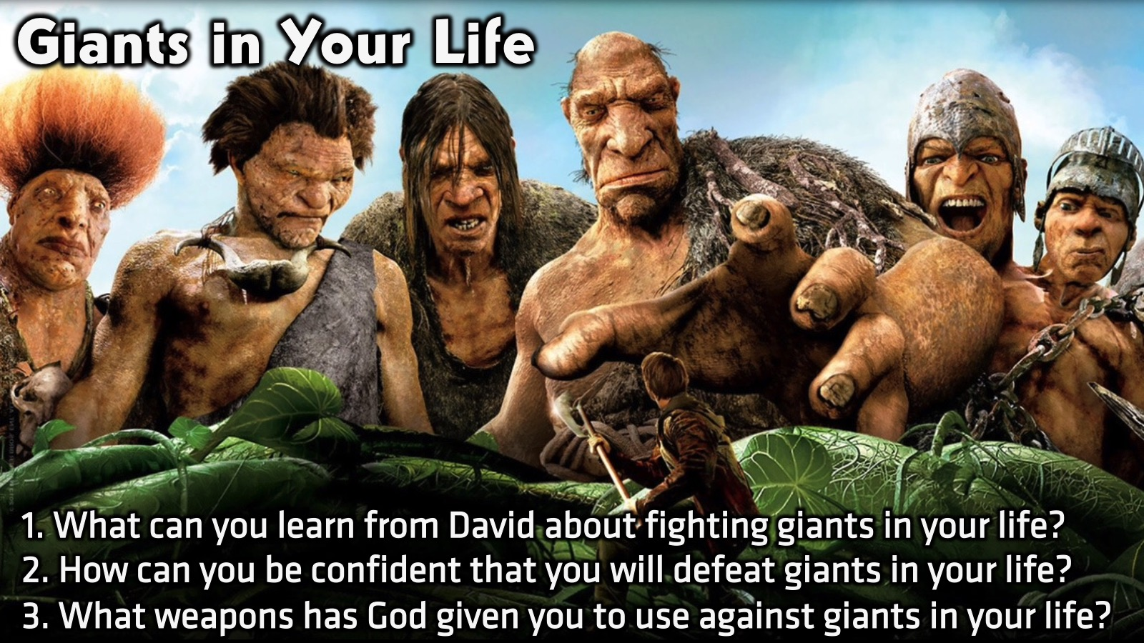
Notes:
Small Group Discussion: You have ten minutes to apply the message to your life in small groups using these 3 questions: (1) What can you learn from David about fighting giants in your life? (2) How can you be confident that you will defeat giants in your life? (3) What weapons has God given you to use against giants in your life?

Slide 14
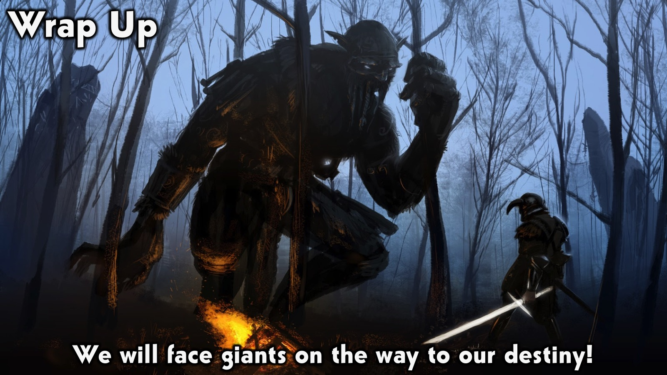
Notes:
Wrap Up: We will face giants on the way to our destiny!

Slide 15
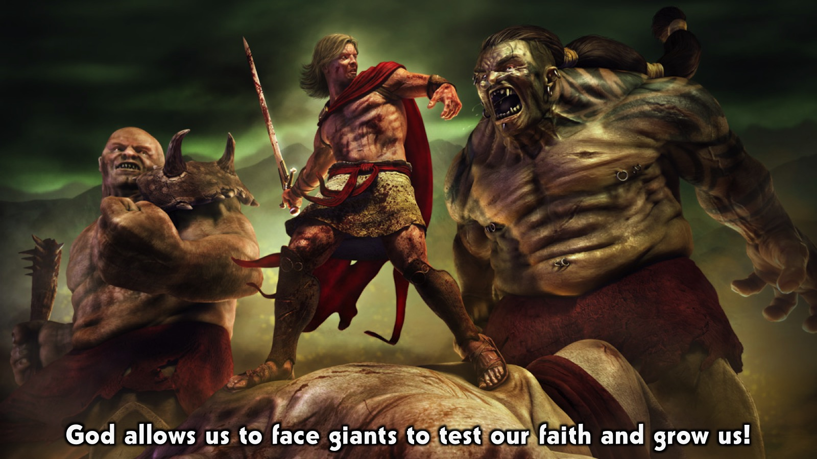
Notes:
God allows us to face giants to test our faith and grow us!

Slide 16
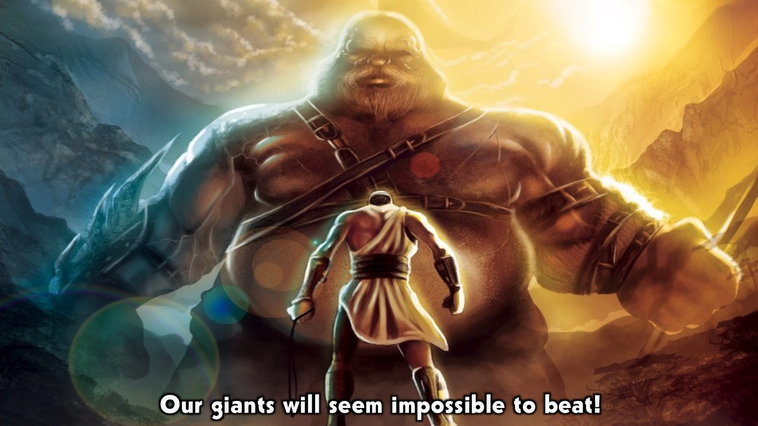
Notes:
Our giant will seem impossible to beat!

Slide 17
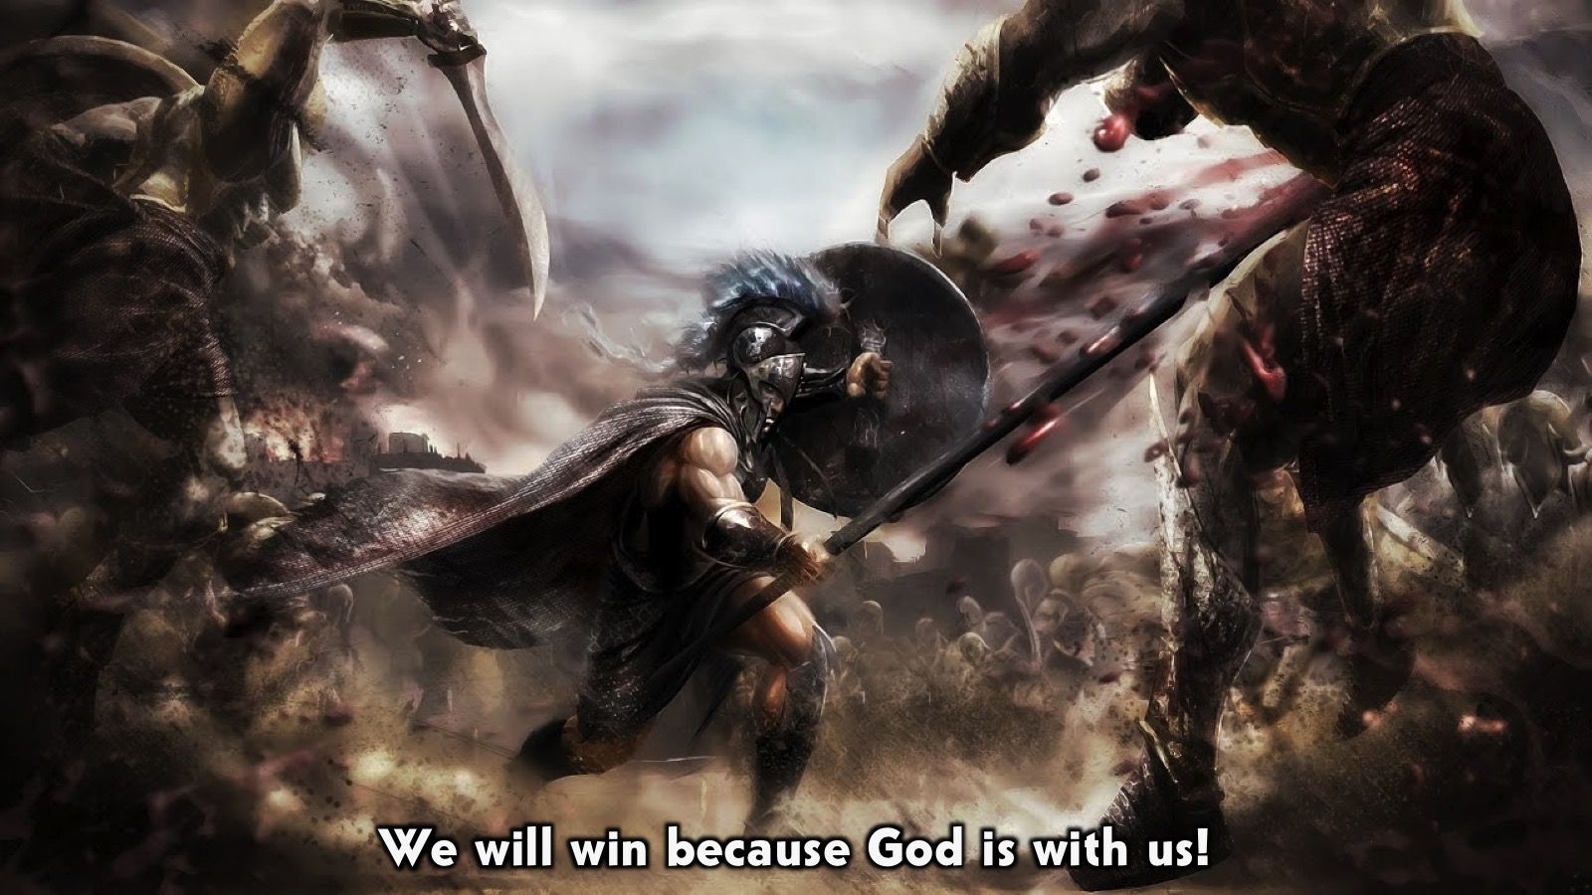
Notes:
We will win because God is with us!

Slide 18
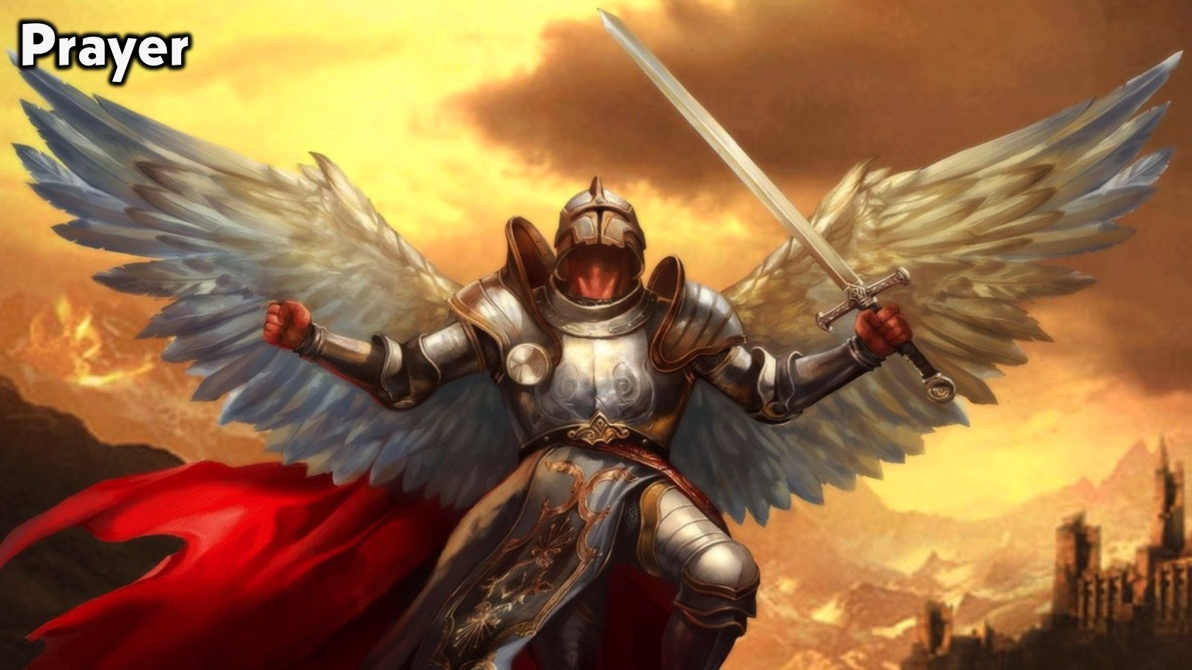
Notes:
Prayer: If you are facing giants that seem impossible to defeat, please stand so we can pray with you!

Slide 19

Notes:
Daily Devotions: We will post devotions on the Sunday WhatsApp group every night of the week throughout this series. Do everything you can to be a part of the daily journey in the life of David.

Slide 20

Notes:
Next Week: Next week we will look at the next chapter in David’s Life: Friends (1 Samuel 18-20)

