Slide 1
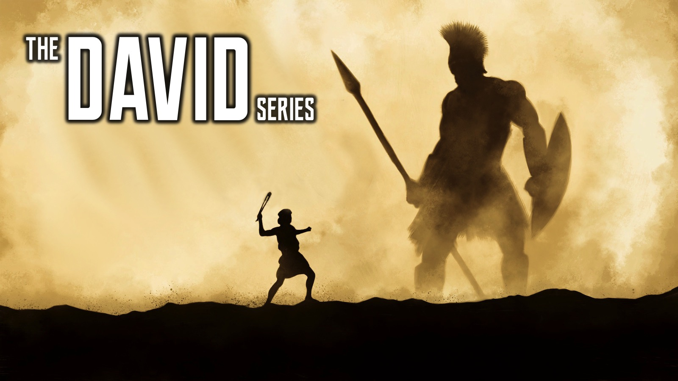
Notes:
Welcome to the David Series.

Slide 2
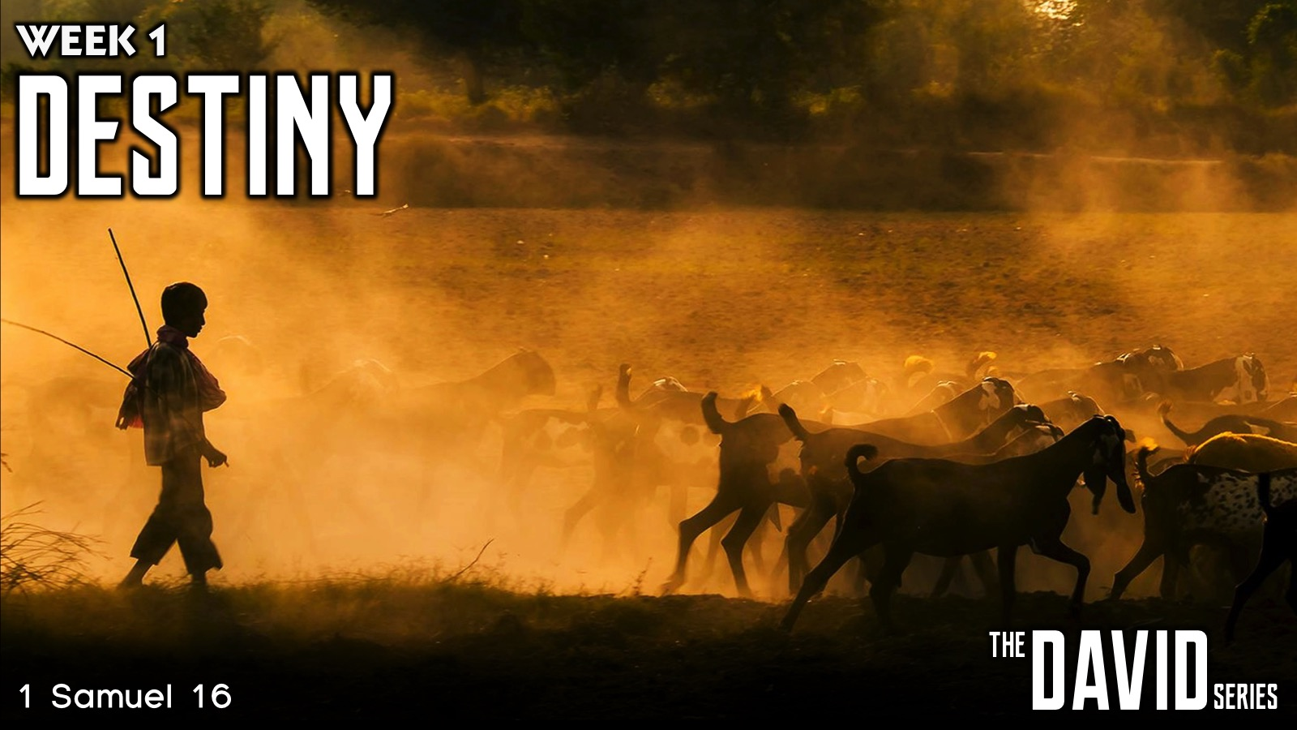
Notes:
In week 1 we learnt about Destiny.

Slide 3
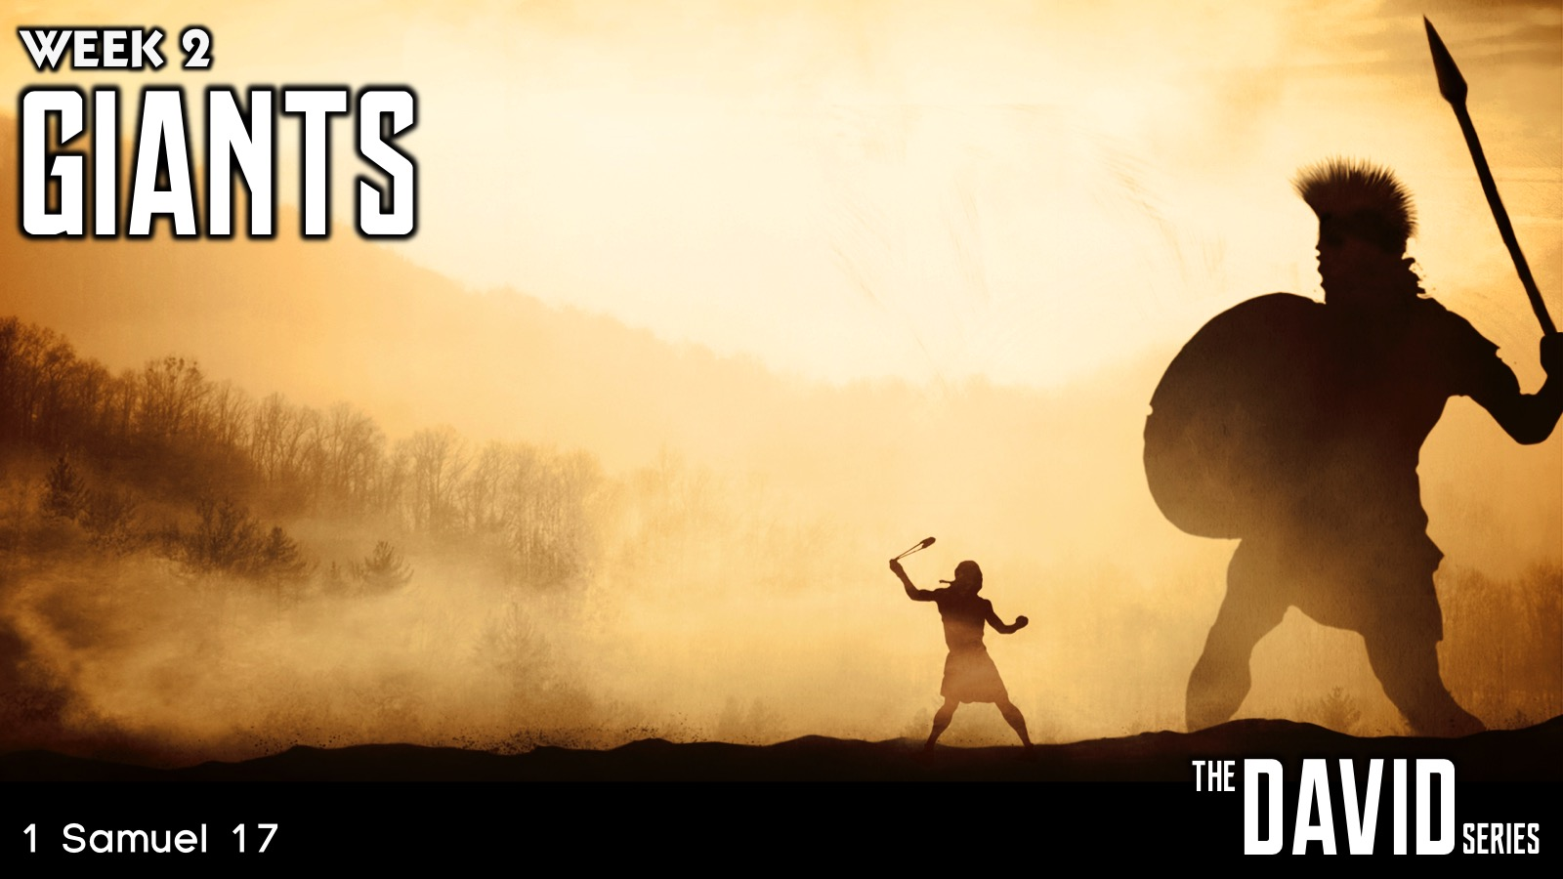
Notes:
Last week we learnt about handing Giants.

Slide 4
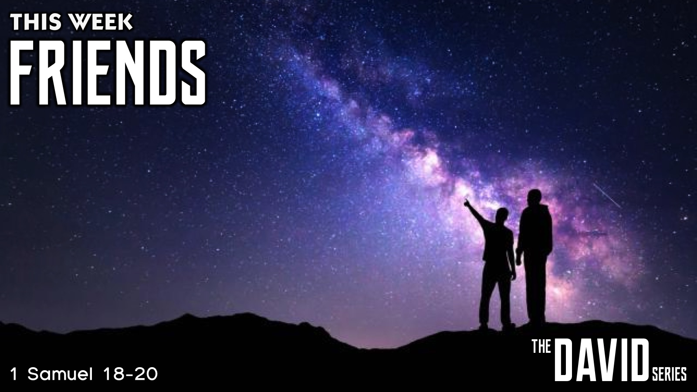
Notes:
This week we are going to learn about Friends.

Slide 5
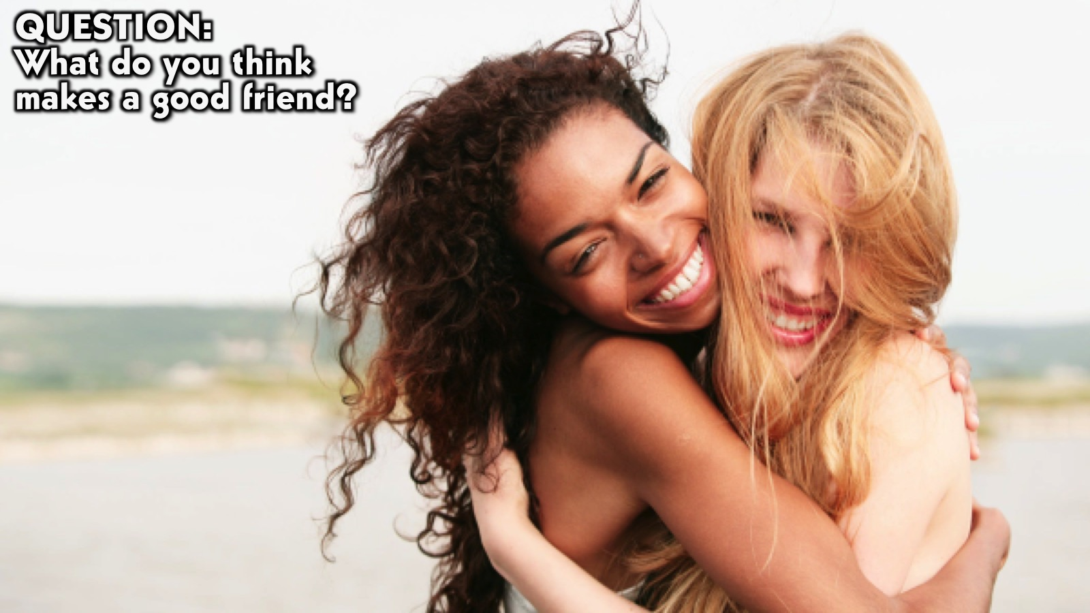
Notes:
Question: What do you think makes a good friend?

Slide 6
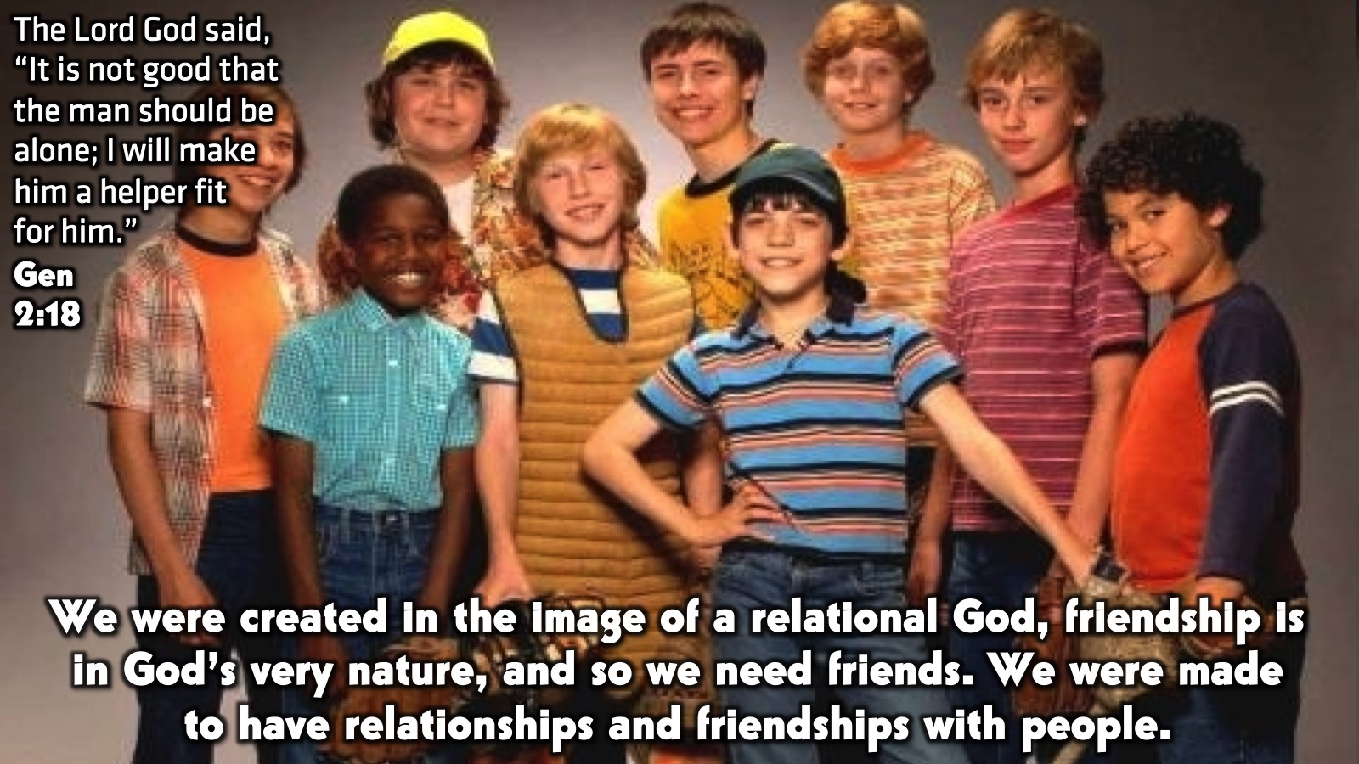
Notes:
The Lord God said, “It is not good that the man should be alone; I will make him a helper fit for him.” (Genesis 2:8). We were created in the image of a relational God, friendship is in God’s very nature, and so we need friends. We were made to have relationships and friendships with people

Slide 7

Notes:
Friends in David’s Life: The Friendship of Jonathan and David. Jonathon was a Prince and heir to the Kingdom of Israel. David grew up a shepherd boy, fighting off bear and lions, until he defeated Goliath, where after he worked for King Saul. From the beginning Jonathan and David had a connection and made a covenant of friendship both men stuck to, even long after death had separated them. It kind of didn’t make sense that they would be friends, an heir and a shepherd boy, but God knitted their hearts and they had a connection and a covenant they stuck to.

Slide 8
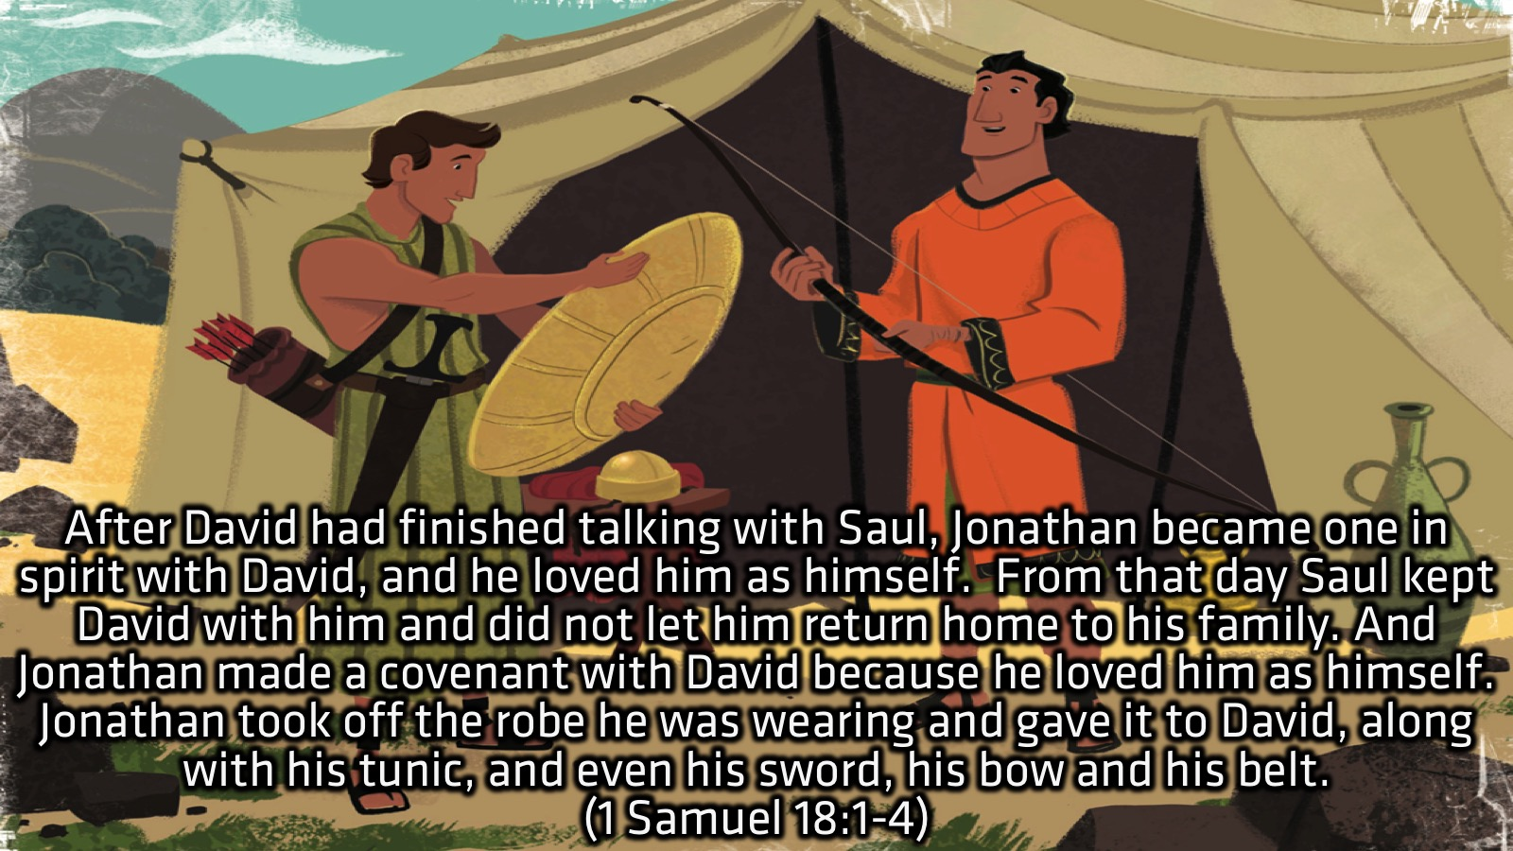
Notes:
Their friendship started with a heart connection and a love for each other as great as the love they had for themselves. They were not only friends, but out of this love and connection they made a covenant of friendship, a commitment to stick with each other and be in relationship with each other. Just being friends or being in relationship with each other is different, and they chose to commit to journey together, not just know each other.

Slide 9
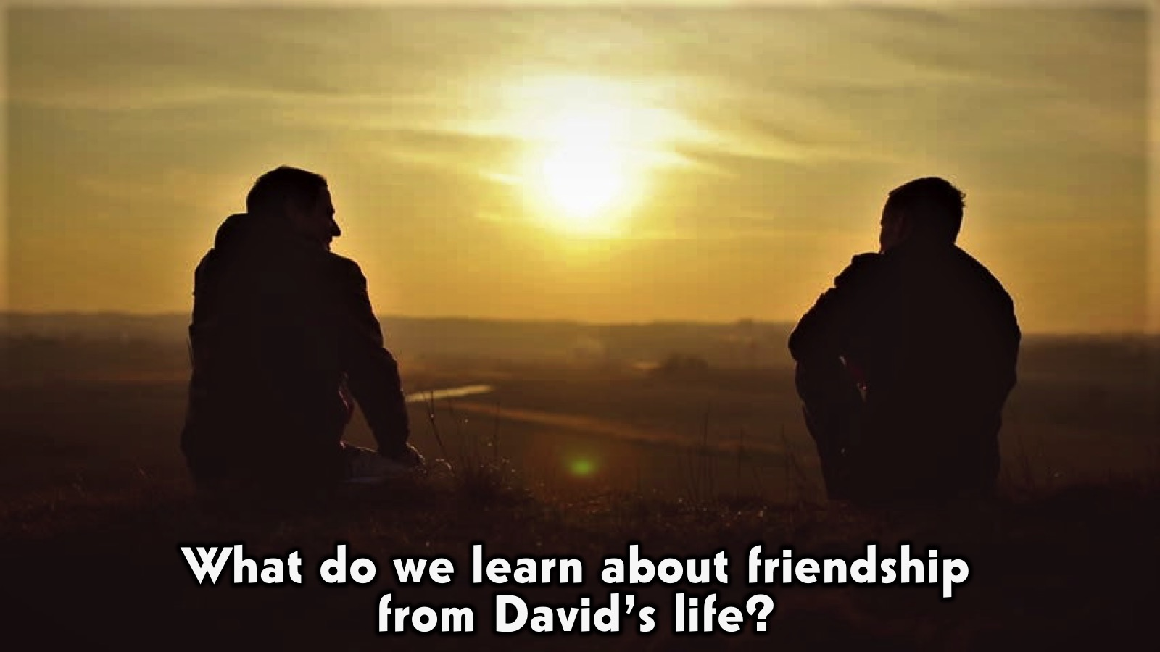
Notes:
What do we learn about friendship from David’s life? Although this series is about David, it is important to look at the support system and team he had around him, that helped to encourage him and push him forward in his God-given destiny. What kind of friendship did Jonathan offer David that helped to make him all he became?

Slide 10
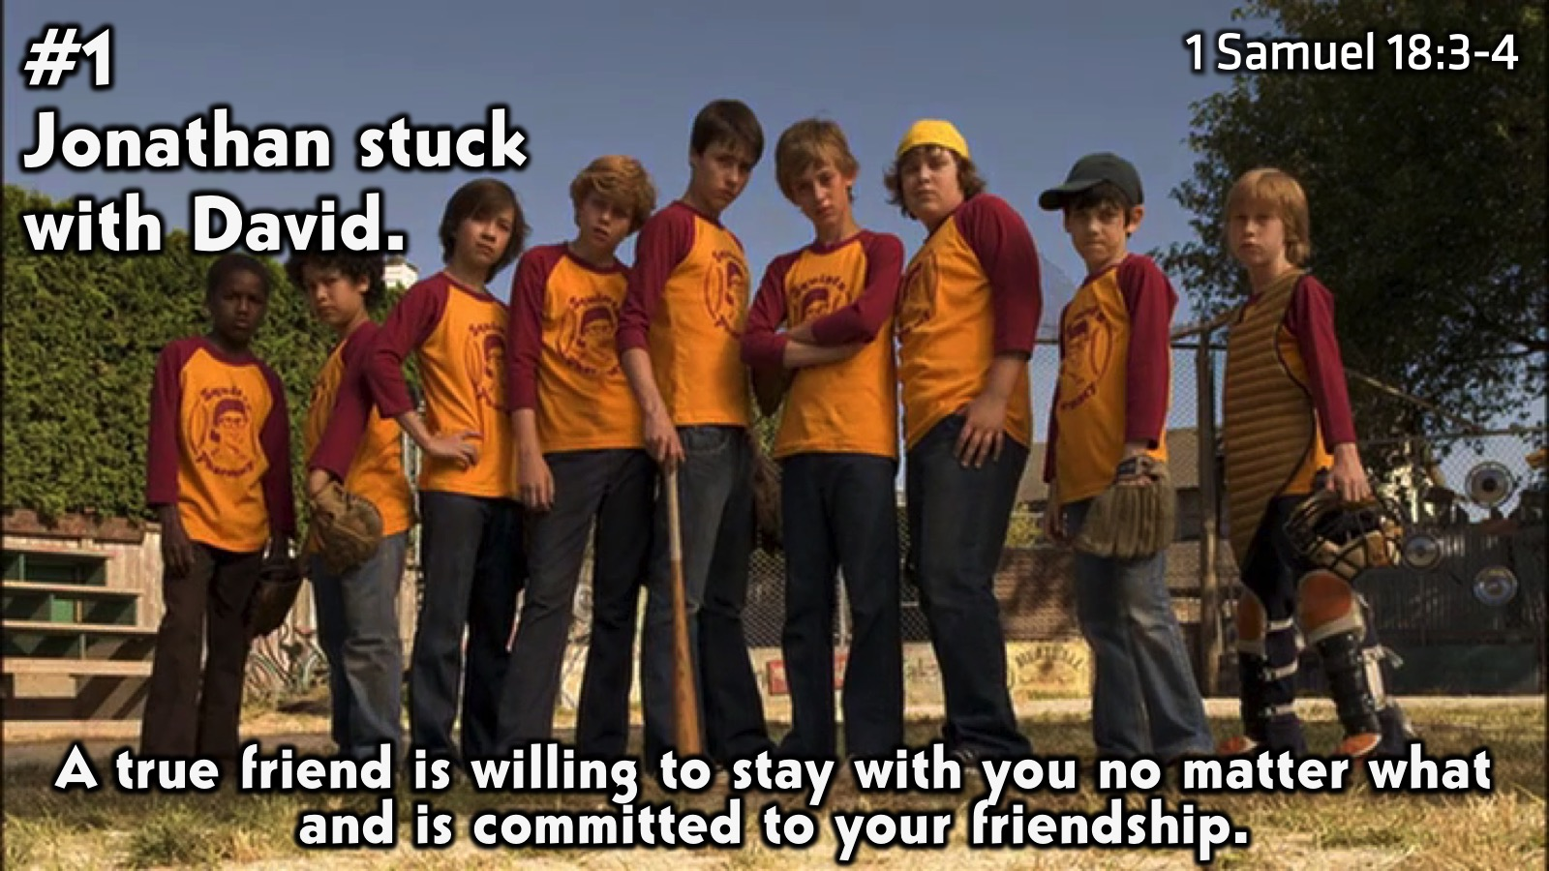
Notes:
#1 Jonathan Stuck with David: A friend sticks with you. A lot of friendships these days are not with ‘stick with you’ kind of people. There are often ulterior motives involved and the goal is what you can get. However, a friend should be loyal and devoted, willing to endure and stay even if it’s just to benefit you. Jonathan made a lot of sacrifices for David, and in the end had to give up his right to the throne. However, he was not in it for what he could get, and stuck with David through it all, anyway.

Slide 11
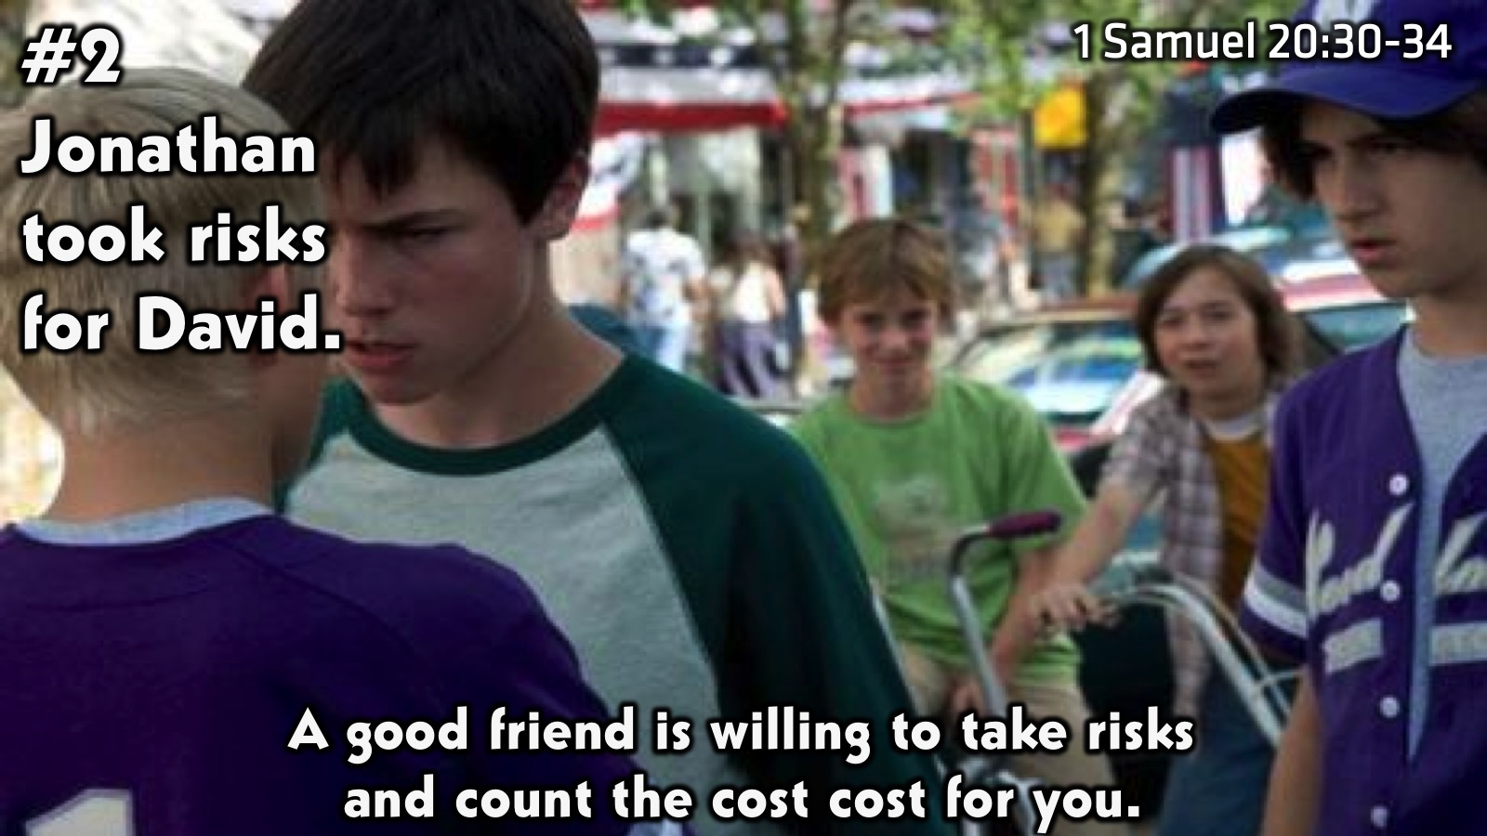
Notes:
#2 Jonathan took risks for David: A friend takes risks for you. In 1 Samuel 20:30-34 Prince Jonathon is nearly killed by his own father as he seeks, like many times before, to defend his friend and protect him from death. David was a threat to Jonathon too, being the heir of Israel, but he was willing to take risks and protect him. A true friend should be willing to count the cost for you and take the risk for their friend.

Slide 12
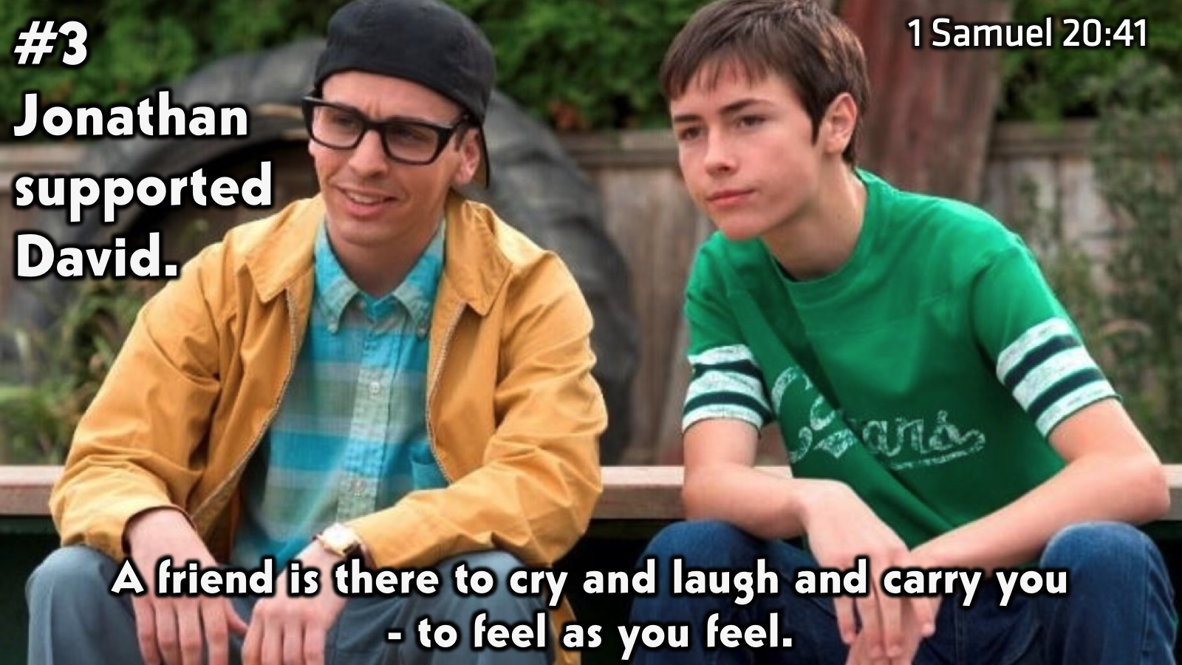
Notes:
#3 Jonathan suppoorted David: A friend is there for you. If a friend is there for what they can gain, when you need to be weak, they wont know how to handle it. But a true friend will feel what you are feeling, and be ready to support you as you need them. When Jonathan brought word to David that he had to flee King Saul he understood what David was feeling and they wept together. Even though it was a dark time for David and their friendship, Jonathon still sought to encourage David and remind him of their commitment to friendship.

Slide 13
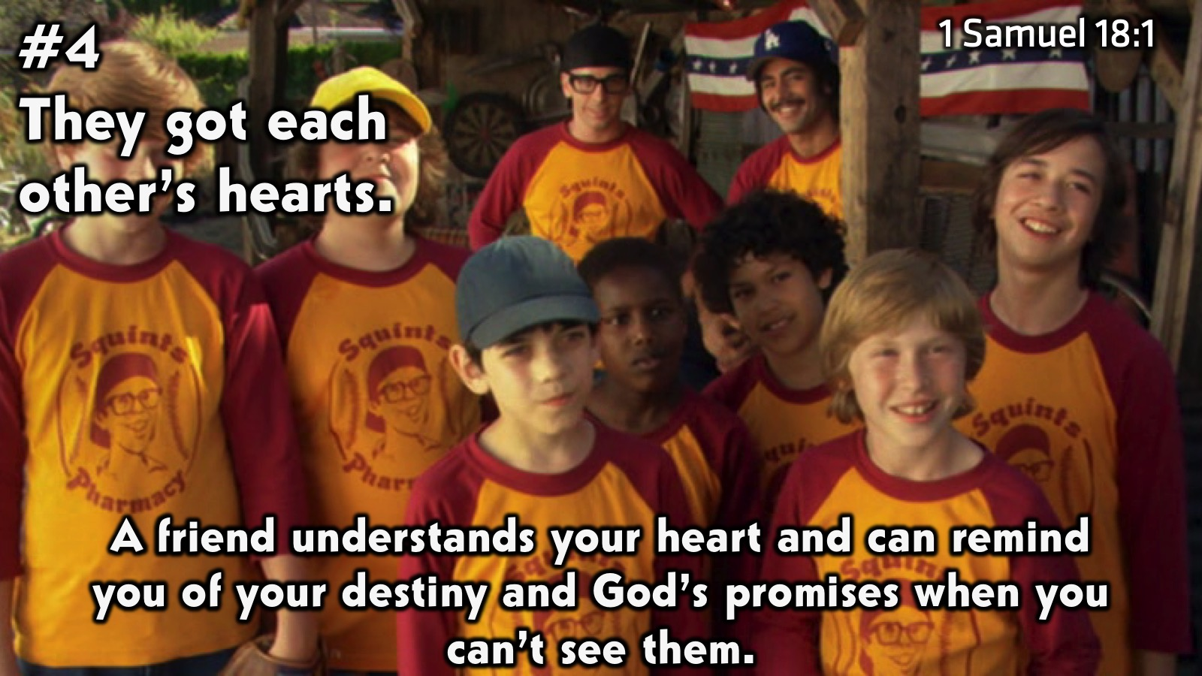
Notes:
#4 They got each other’s hearts: A friend gets you. From the very beginning Jonathon and David’s hearts were knit, they got each other, and so when David was going through some dark and scary times Jonathon was able to remind him of God’s promises and the destiny he was pushing for. When a friend gets you and understands your heart then they can remind you of what’s important and what you’re pushing for when life clouds your vision. You can’t always see clearly on your own but with a friend, we are able to walk with them until we can.

Slide 14
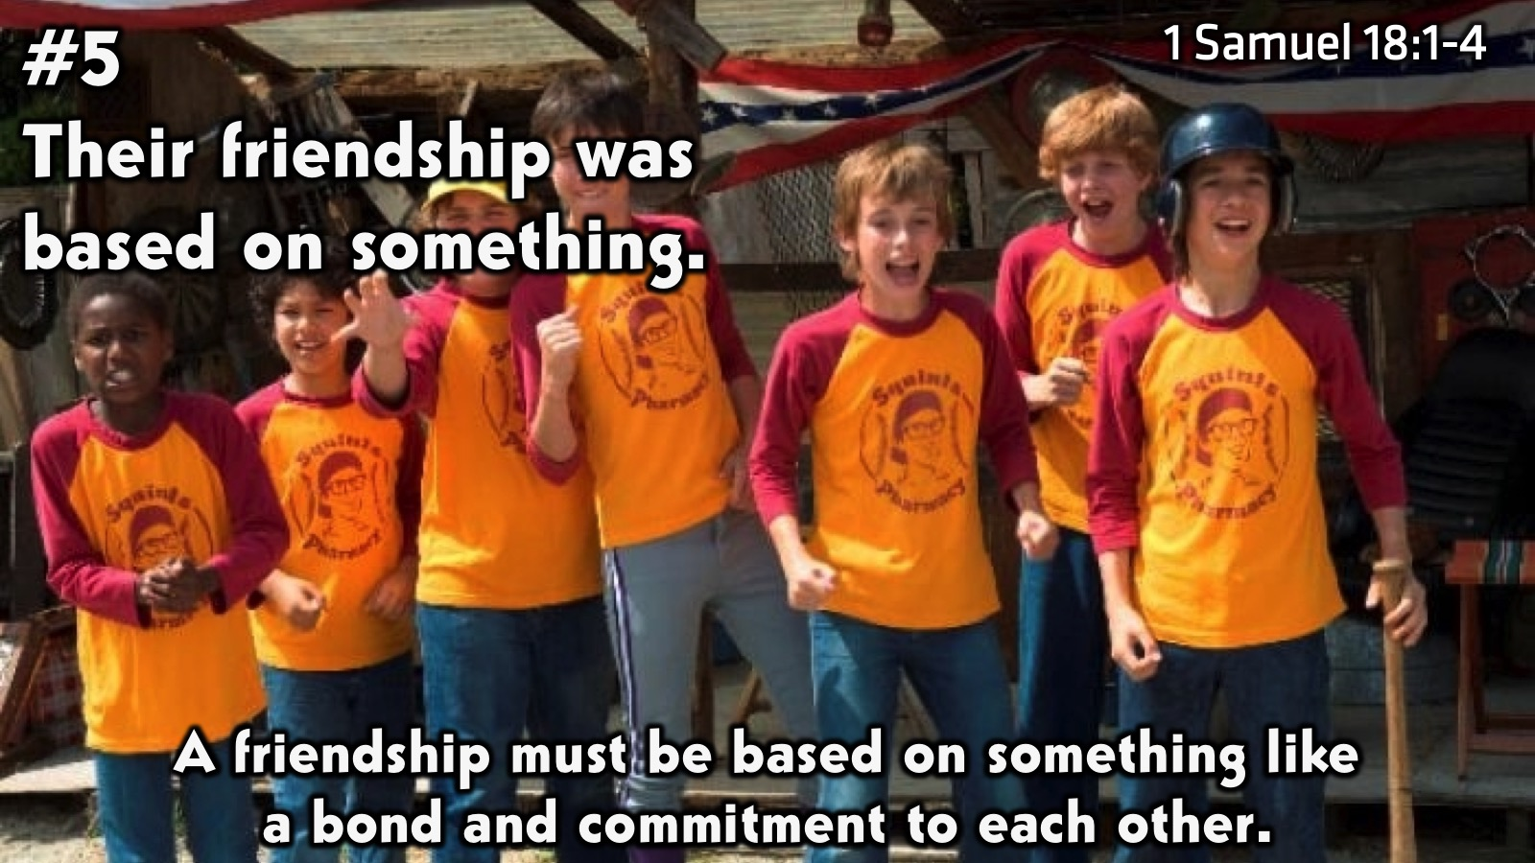
Notes:
#5 Their friendship was based on something: a friendship is based on committed hearts. Jonathon made a covenant of friendship with David that, as I mentioned earlier, they stuck to long after death had separated them. This commitment was something they held to even during the dark times, a security that their friend was there and on their side. So many friendship have no basis other than having a good time or getting something out of it. But if a friendship is based on committed hearts that get each other then it is something strong you can cling to when life pushes you down.

Slide 15
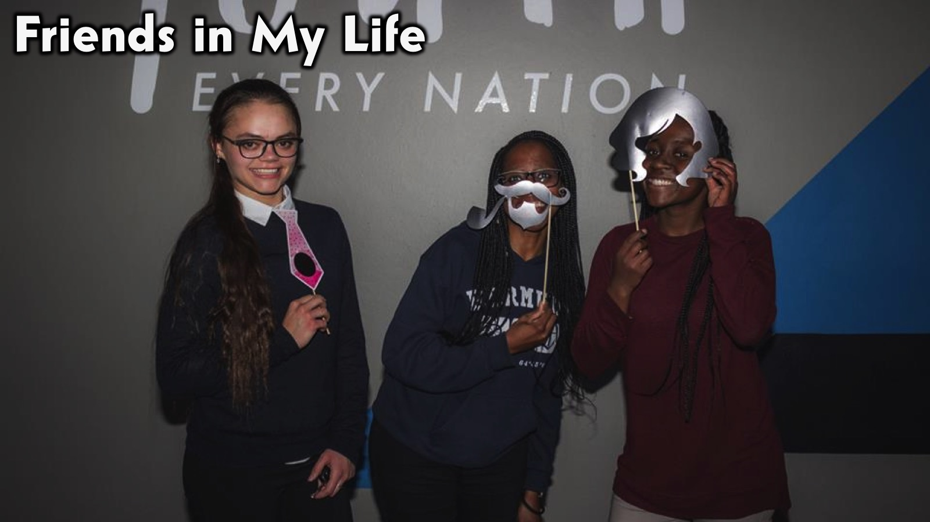
Notes:
Friends in My Life: I have a lot of friends, who I love to spend time with and get to know deeper…

Slide 16
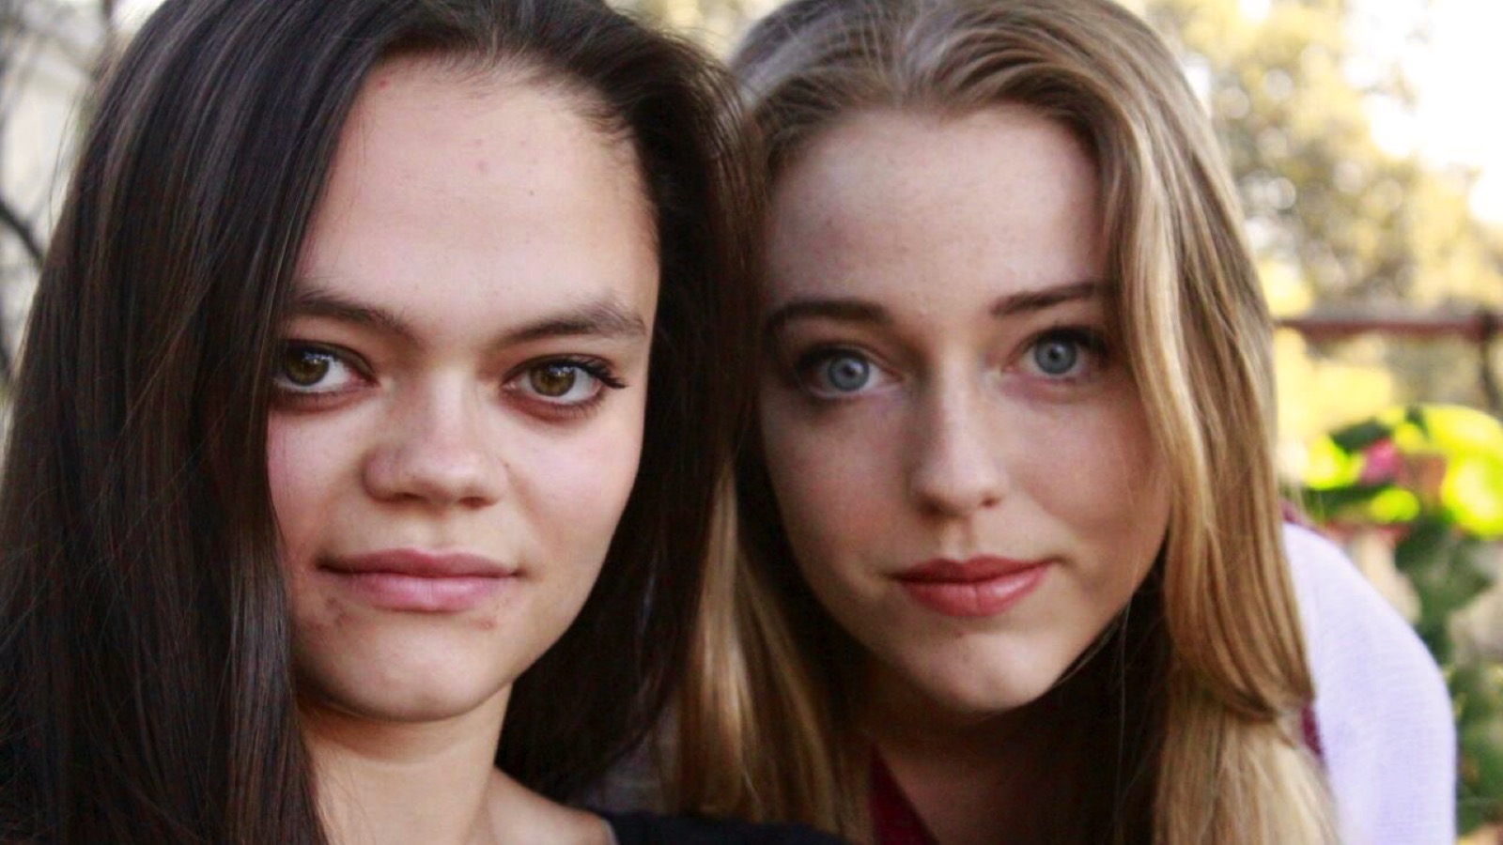

Slide 17
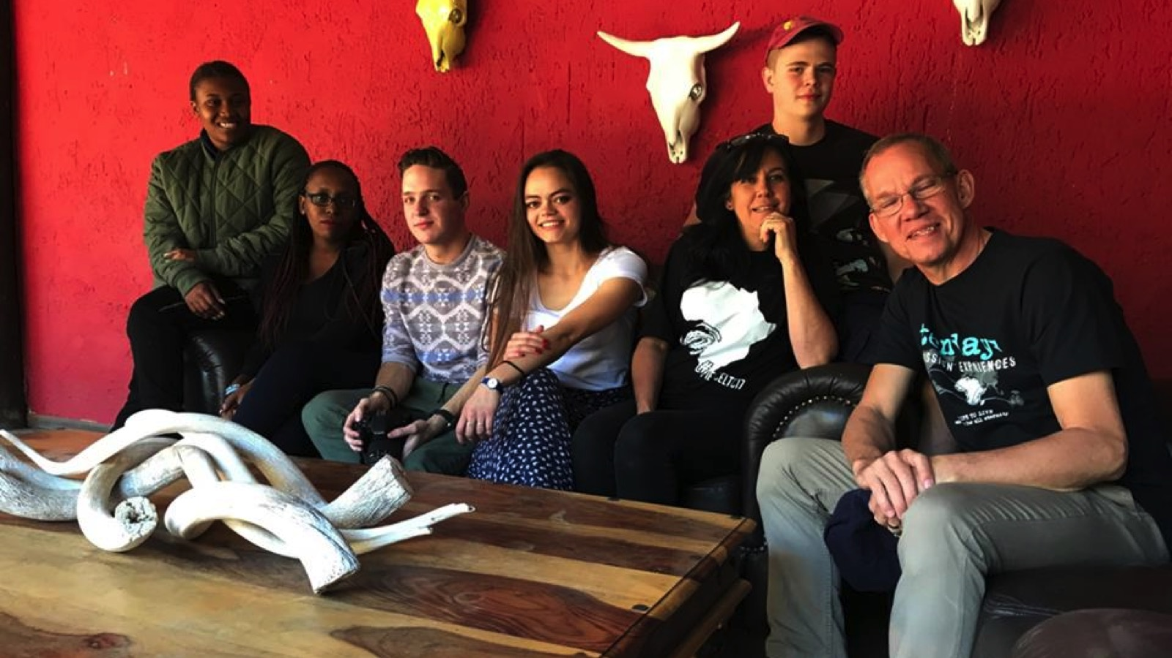

Slide 18
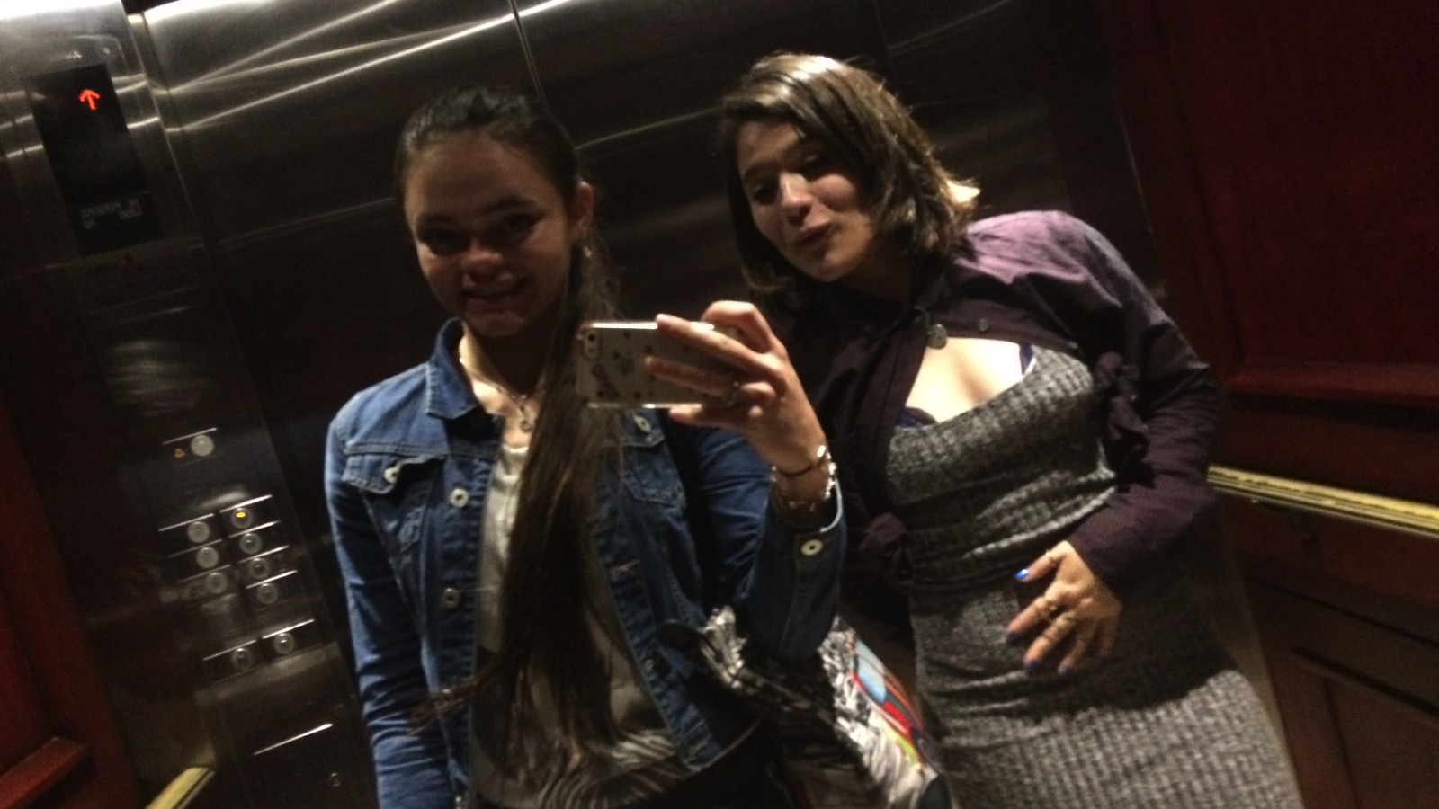

Slide 19
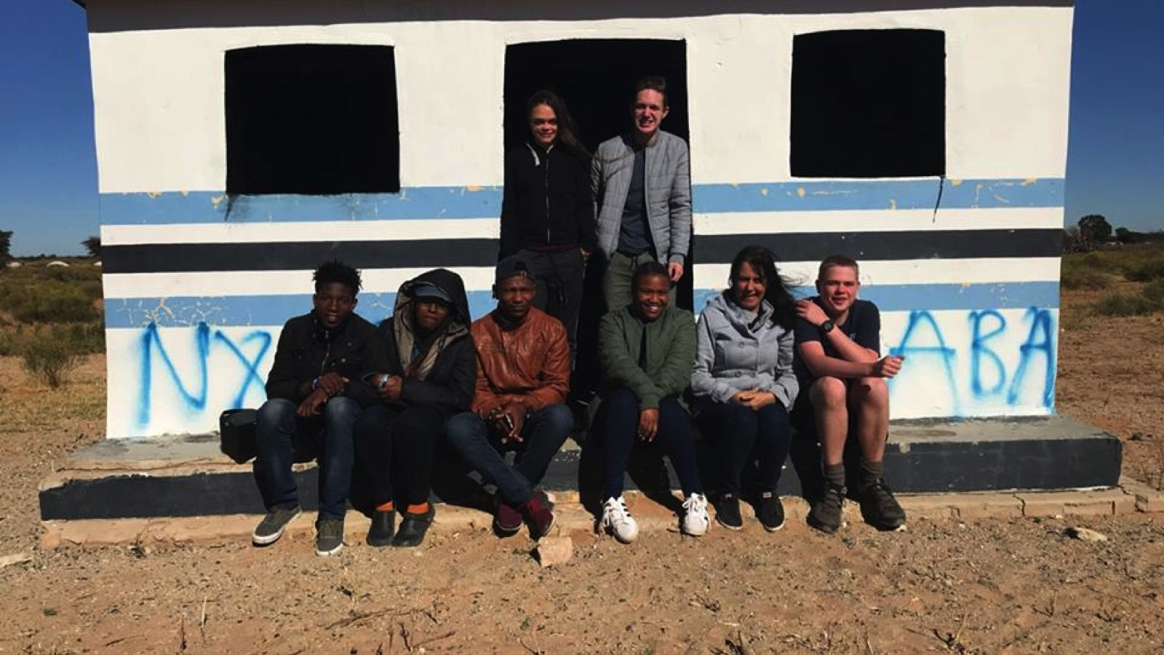

Slide 20
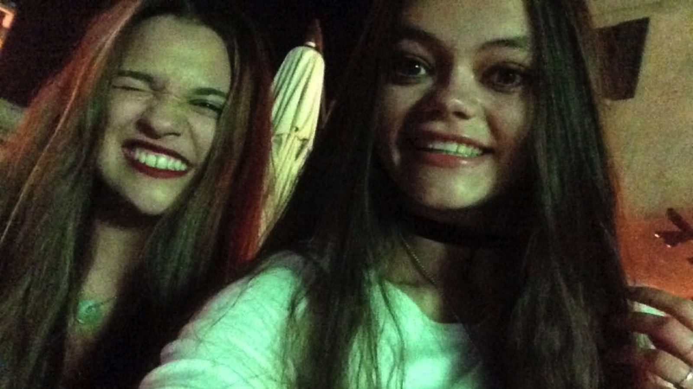

Slide 21
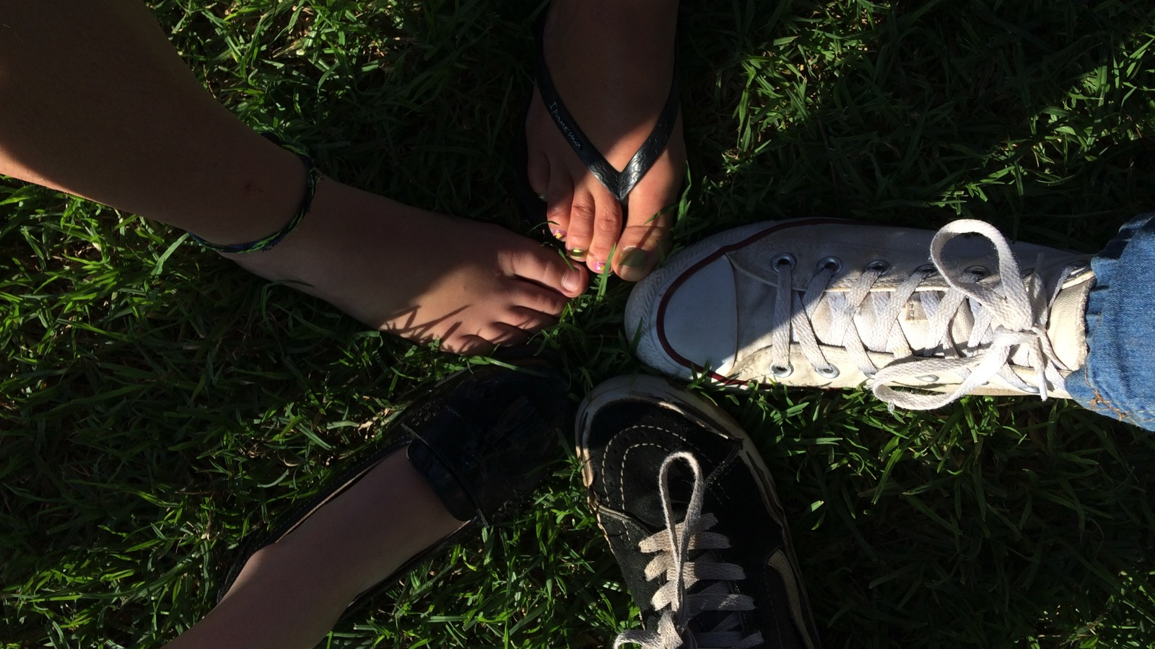

Slide 22
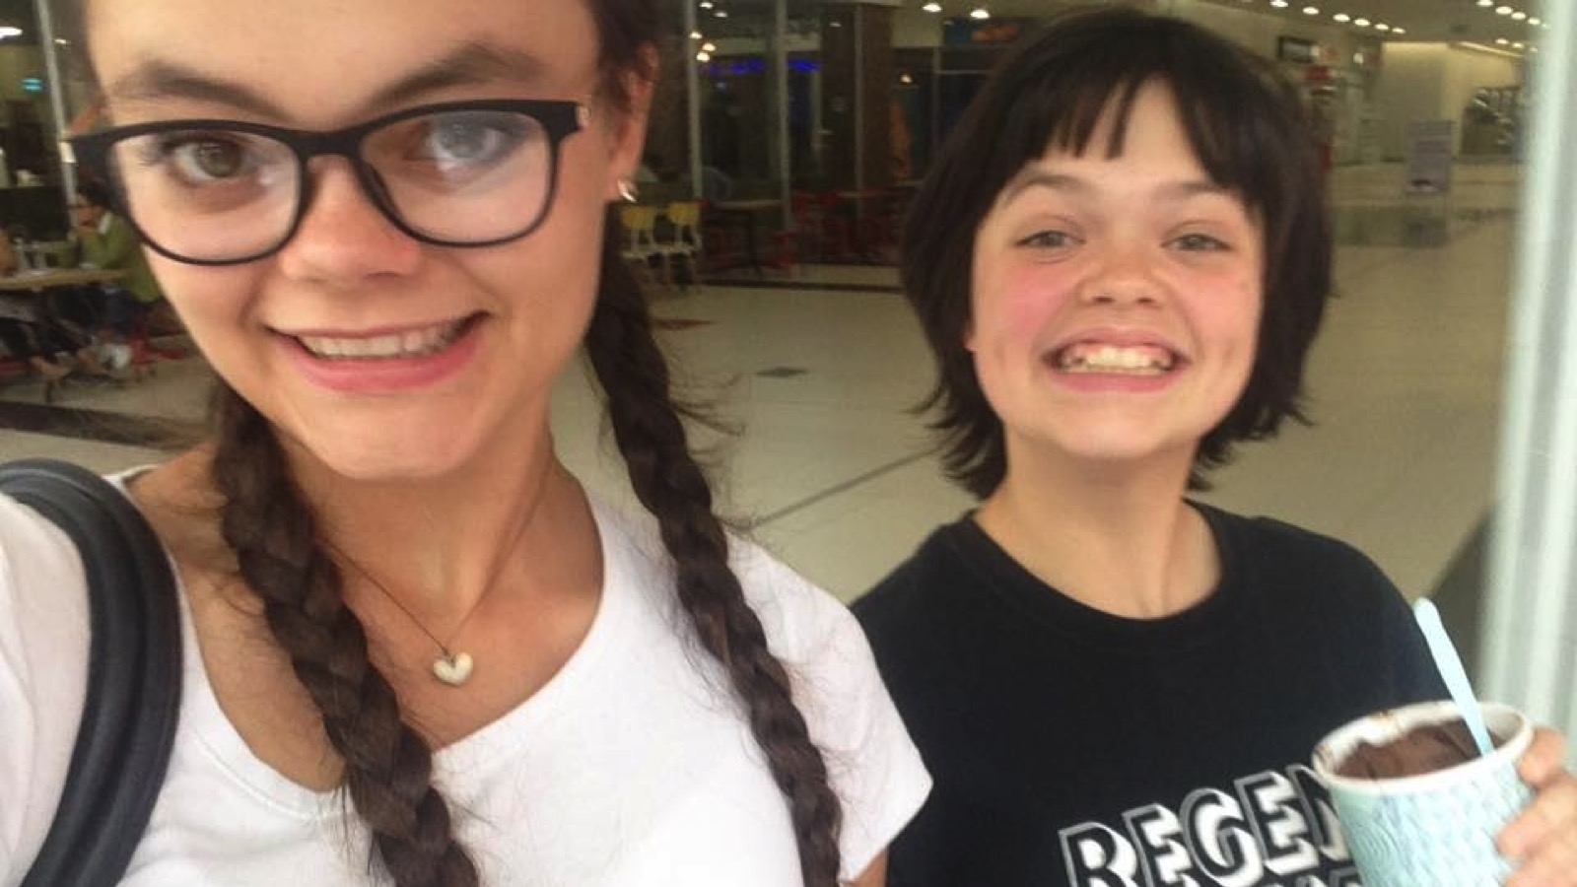

Slide 23
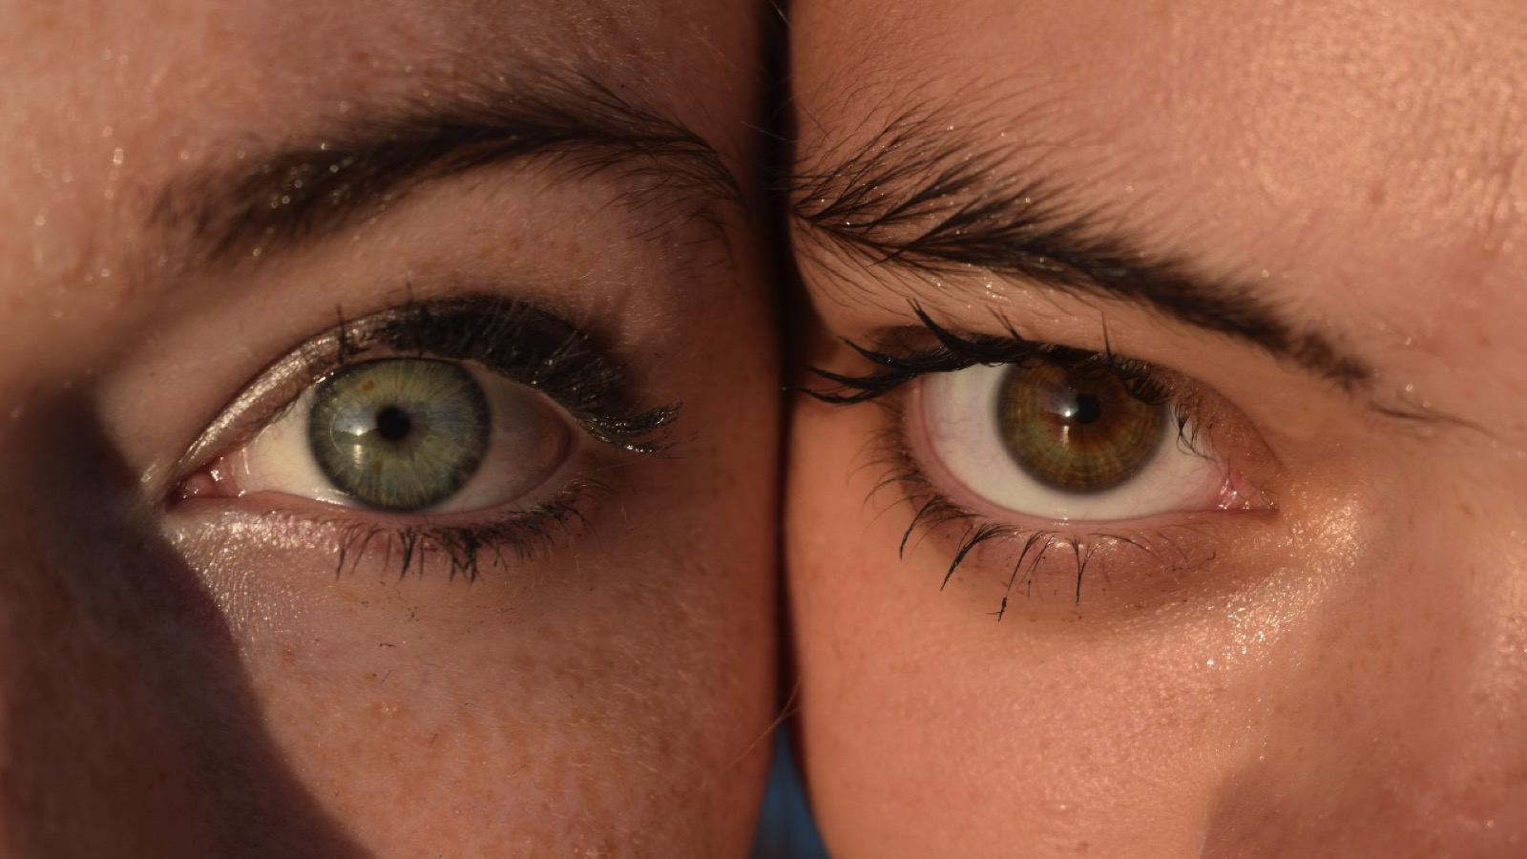

Slide 24
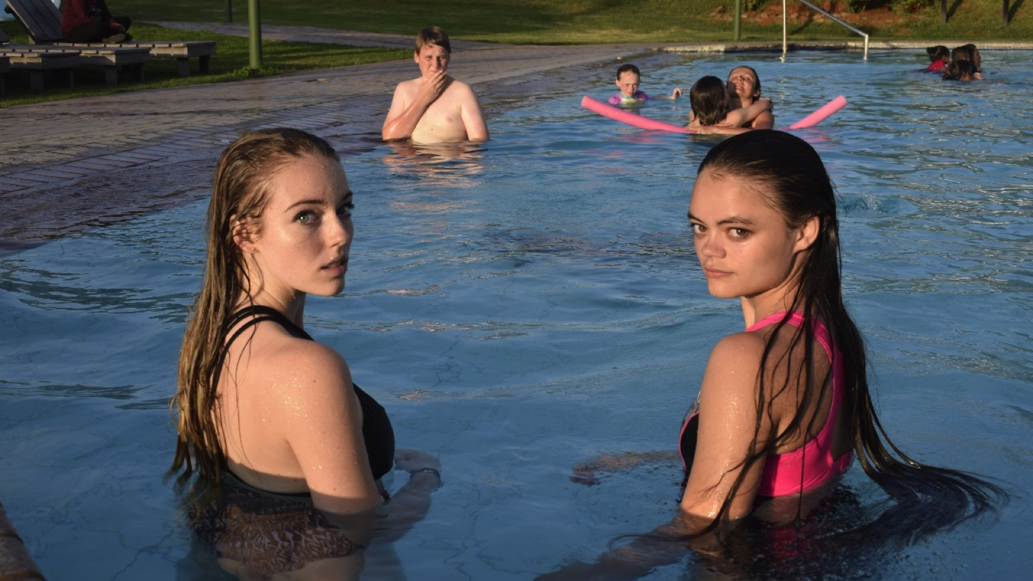

Slide 25
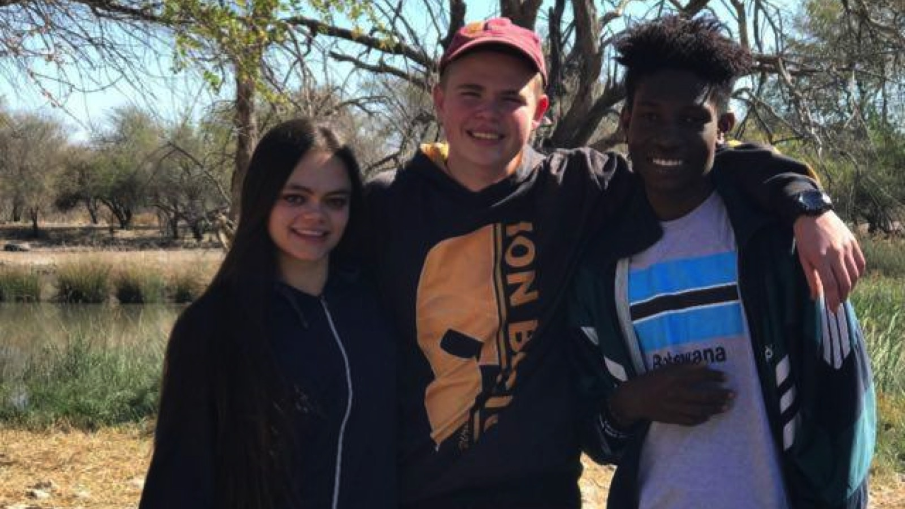

Slide 26
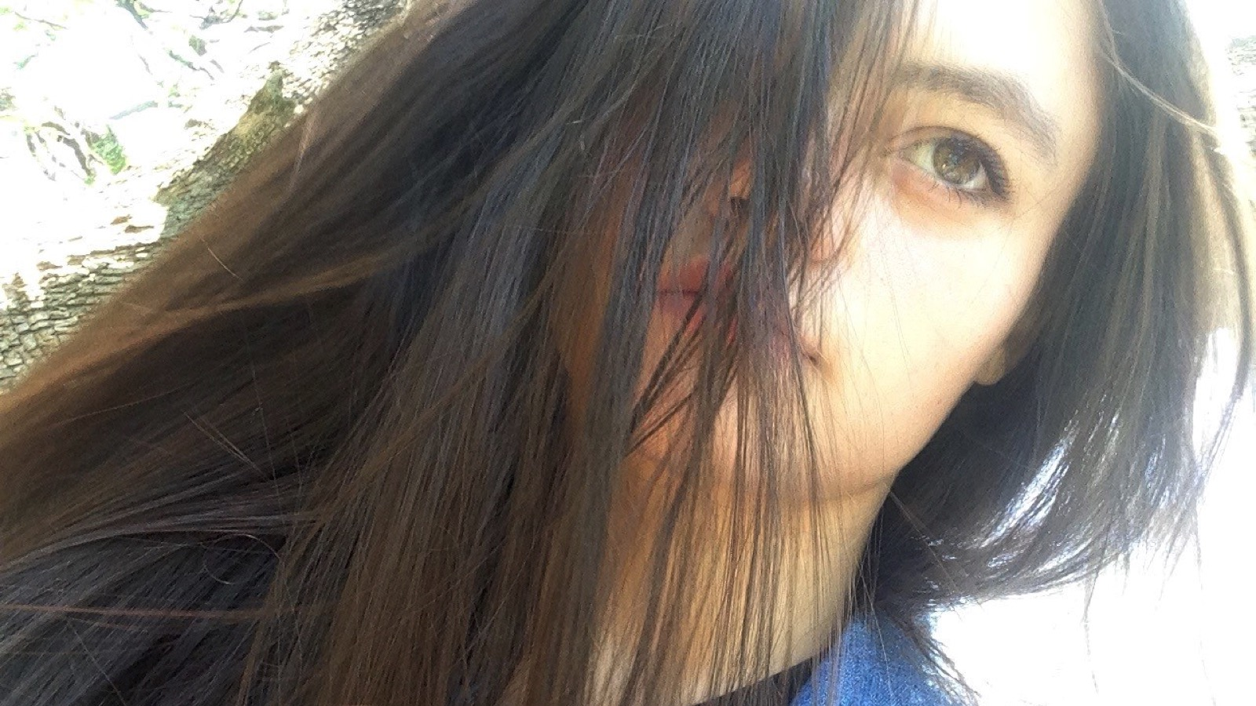
Notes:
But that wasn’t always the case… For a couple of years I found myself in a space with no one my age around me, and no one I could relate to. I love conversing with people and spending time with them and so I had plenty of younger children and teens to encourage and teach and look after, and plenty of adults to talk to and watch, but I didn’t have friends, and it wasn’t quite the same…

Slide 27

Notes:
Although I could feel something was missing and I longed to have a friend that would get my heart and walk life with me, it ended up being a beautiful season in my life. I got to know the friend I have in Jesus. Every morning or late at night, where I could’ve been texting or spending time with friends I journaled and spent time with THE friend…

Slide 28
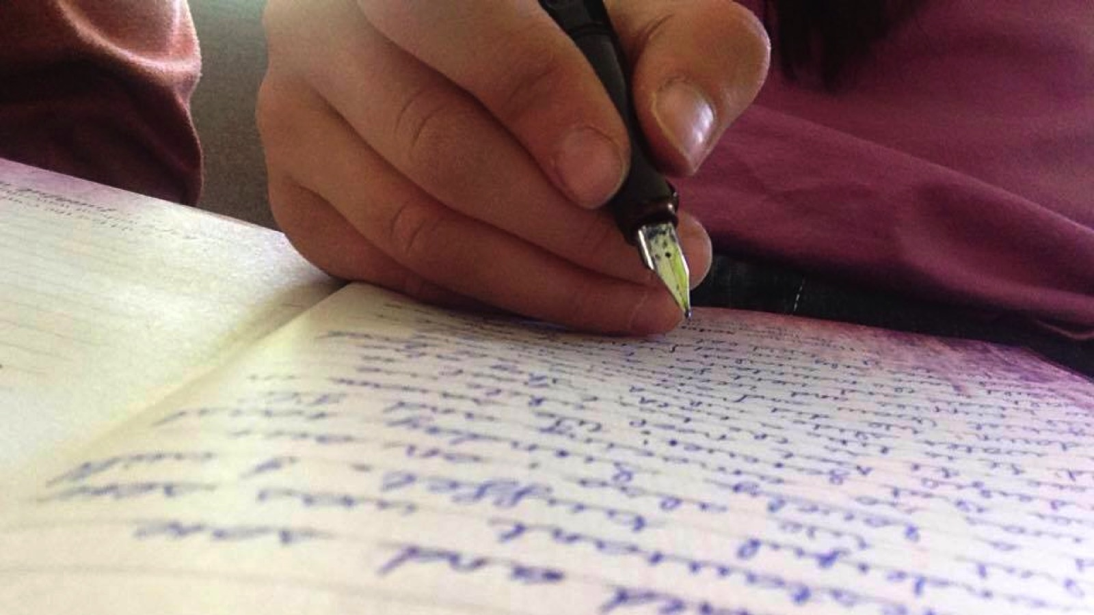
Notes:
I would pour out my heart on the pages and not pray, but talk to Jesus. Being seemingly ‘friendless’ is hard, it feels lonely and there were a lot of things I wished I could do with a bestie. However, I wouldn’t change it for anything, because I got to experience my Jesus as my Friend.

Slide 29
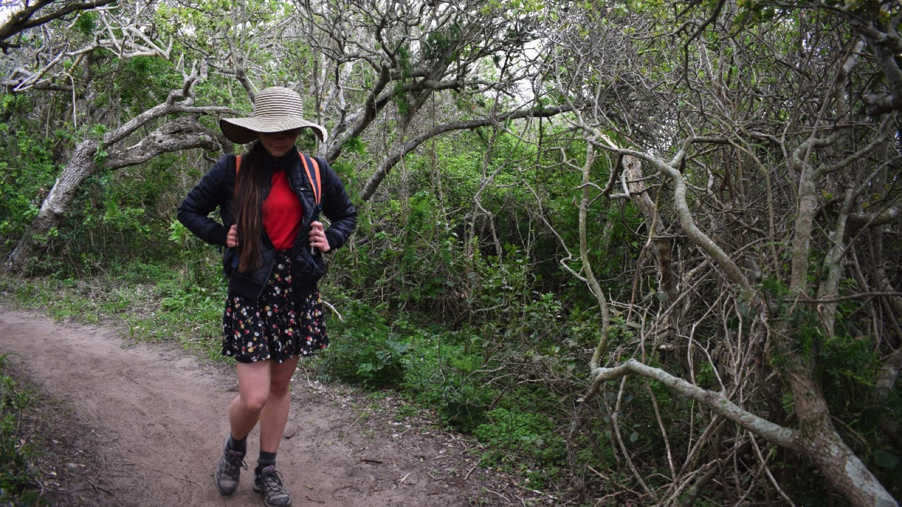
Notes:
I always prayed for friends, but was not discontent to walk my life path with Jesus. He taught and showed me so much, He knitted my heart to His, and when friends my age came my way I was able to step into a new season with so many riches from the last. Jesus rooted me in Him and with that rooting I no longer depend on friends to feel accepted, because I know that my best friend is always there, ready to listen, give advice, accept me, and walks my path with me every day with wisdom, and kindness, endurance, love, and care. He is an amazing journey partner!

Slide 30
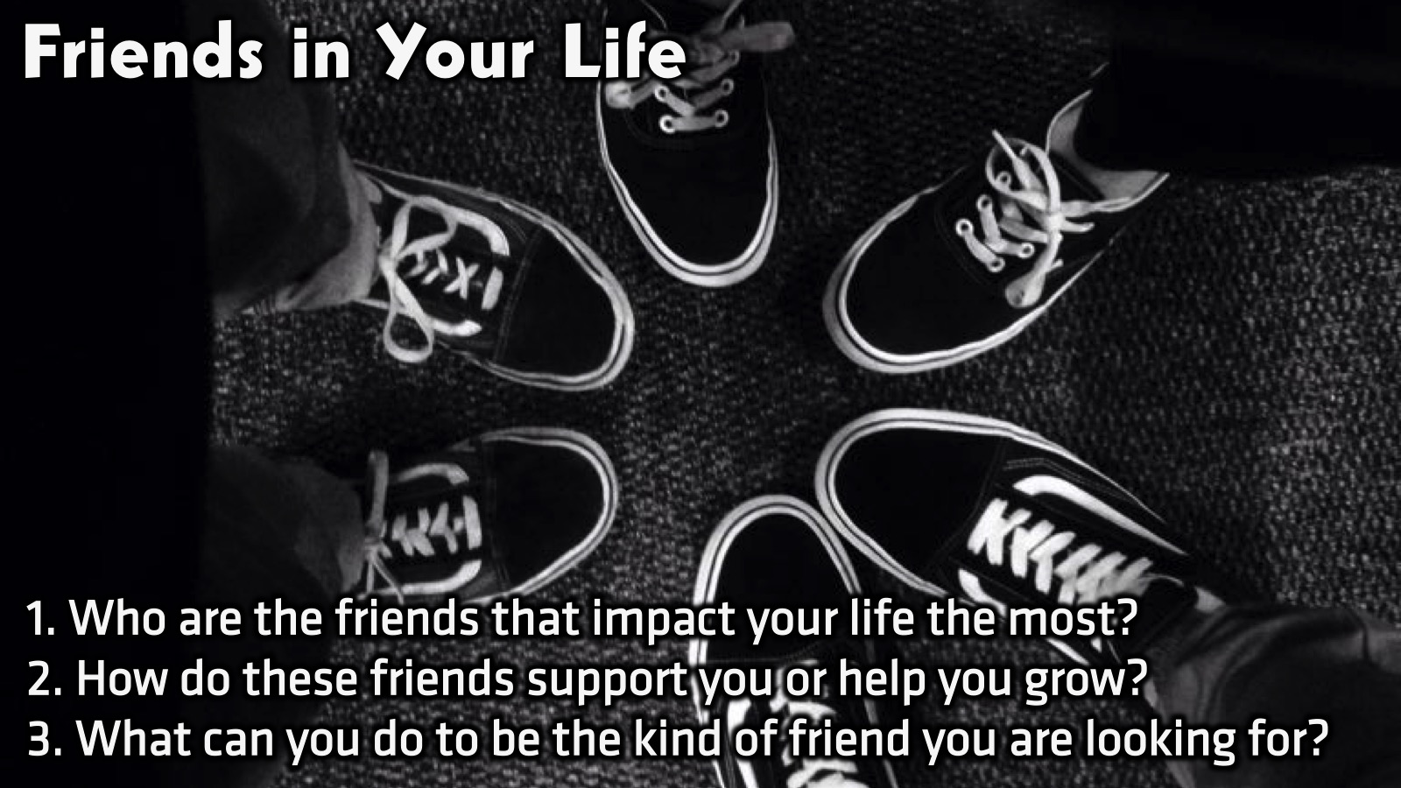
Notes:
Small Group Discussion: You have ten minutes to apply the message to your life in small groups using these 3 questions: (1) Who are the friends that impact your life the most? (2) How do these friends support you or help you grow? (3) What can you do to be the kind of friend you are looking for?

Slide 31
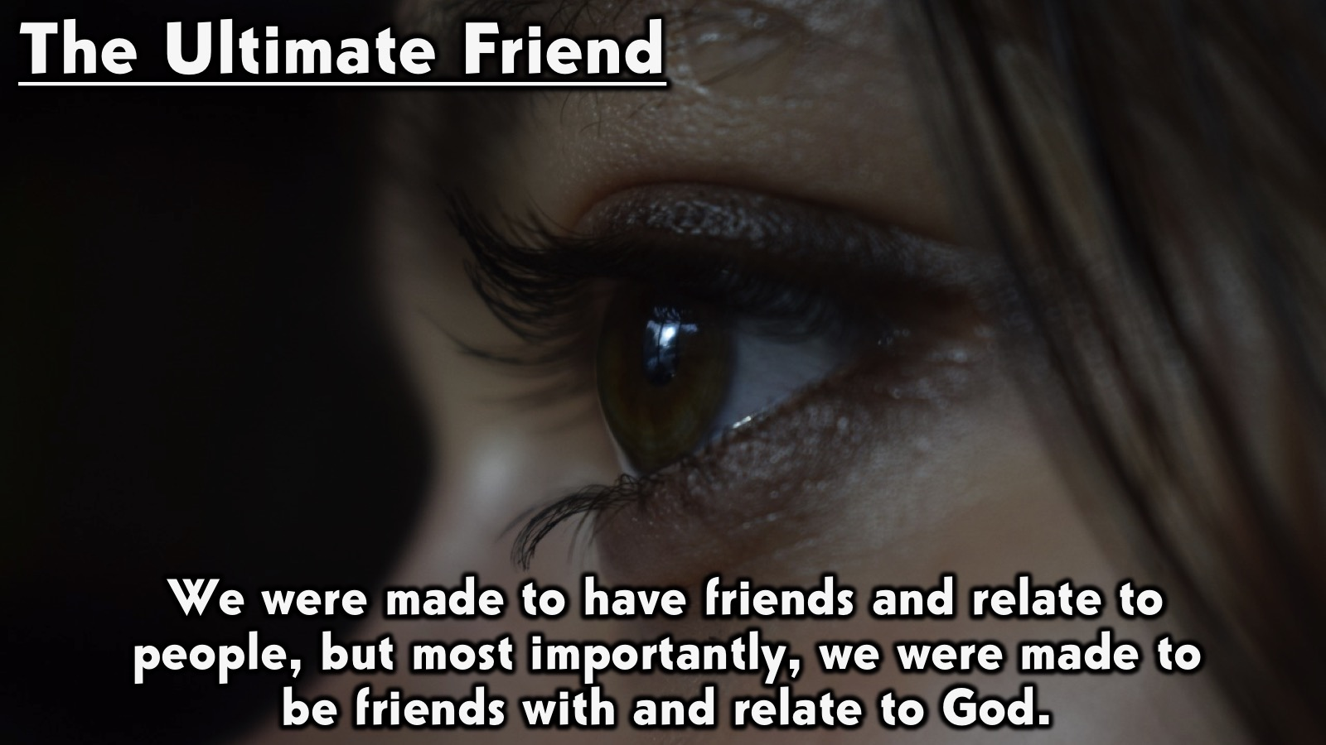
Notes:
Wrap Up: Friends will come and go. They might be what we need some of the time, but they will also let us down. However there is an ever faithful friend, one who sticks closer than a brother and so in our journey of finding our team and becoming this friend to those around us, let us not forget the friend that walks with us daily. God placed in us a heart that longs for connection, that we might long to connect to Him, and so as He walks with us, let us walk with Him, the one who encompasses all of what friendship should be.

Slide 32
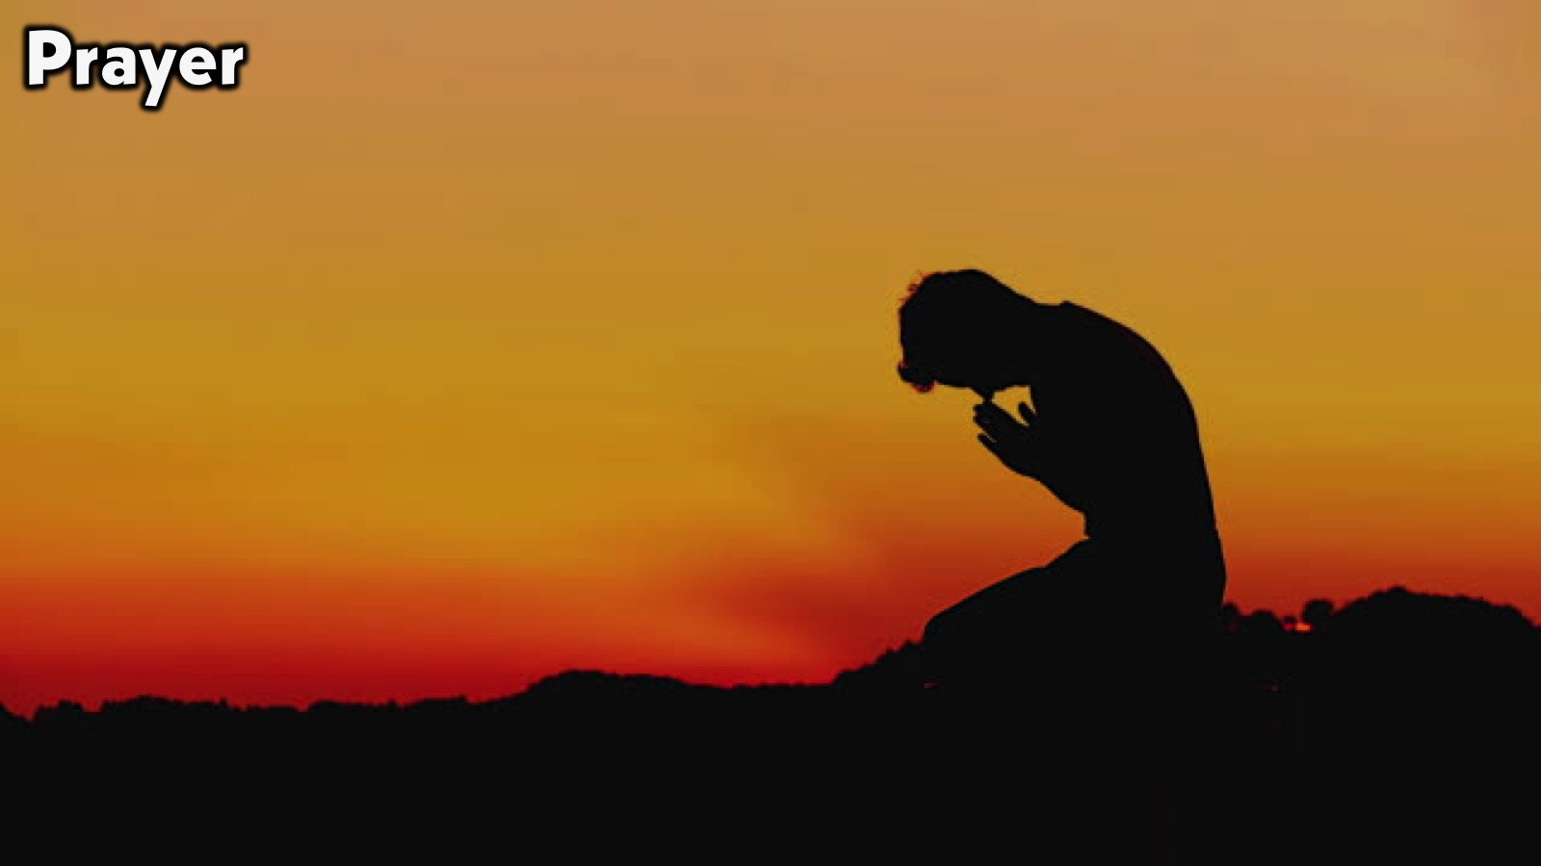
Notes:
Prayer:

Slide 33

Notes:
Daily Devotions: We will post devotions on the Sunday WhatsApp group every night of the week throughout this series. Do everything you can to be a part of the daily journey in the life of David.

Slide 34
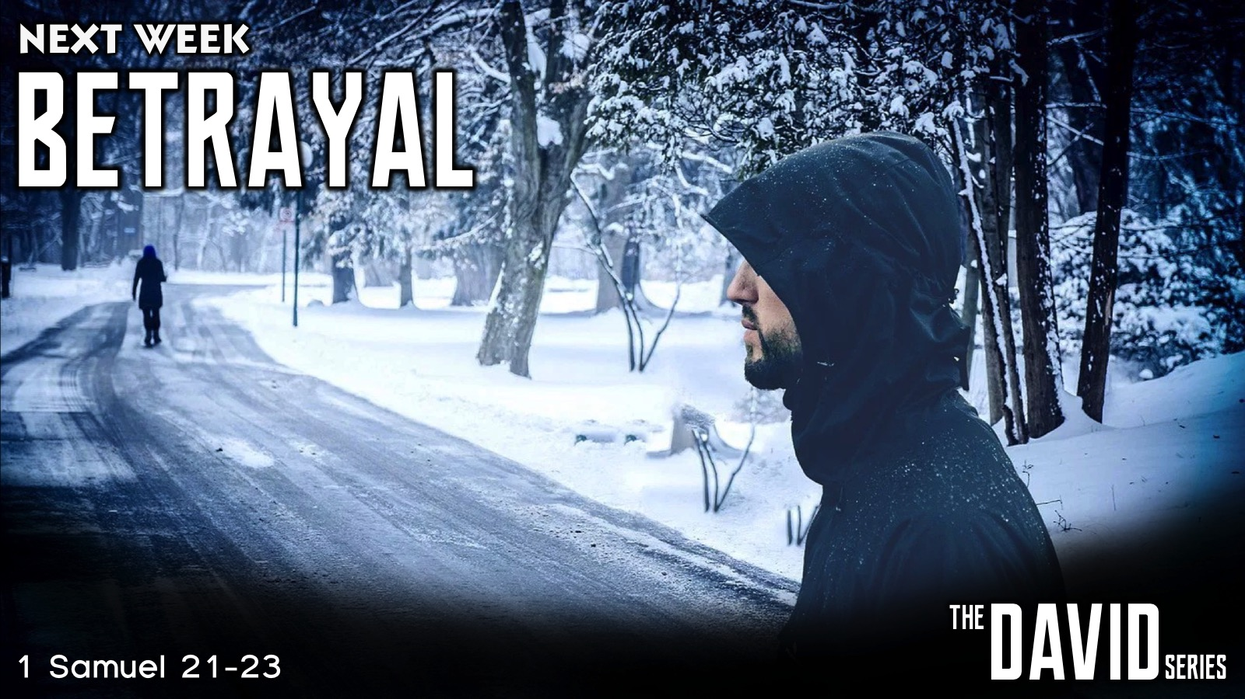
Notes:
Next Week: Next week we will look at the next chapter in David’s Life: Betrayal (1 Samuel 21-23)

