Slide 1

Notes:
Welcome to the David Series.

Slide 2

Notes:
In week 1 we learnt about Destiny.

Slide 3

Notes:
In week 2 we learnt about handing Giants.

Slide 4

Notes:
Last week we learnt about dealing with Friends.

Slide 5
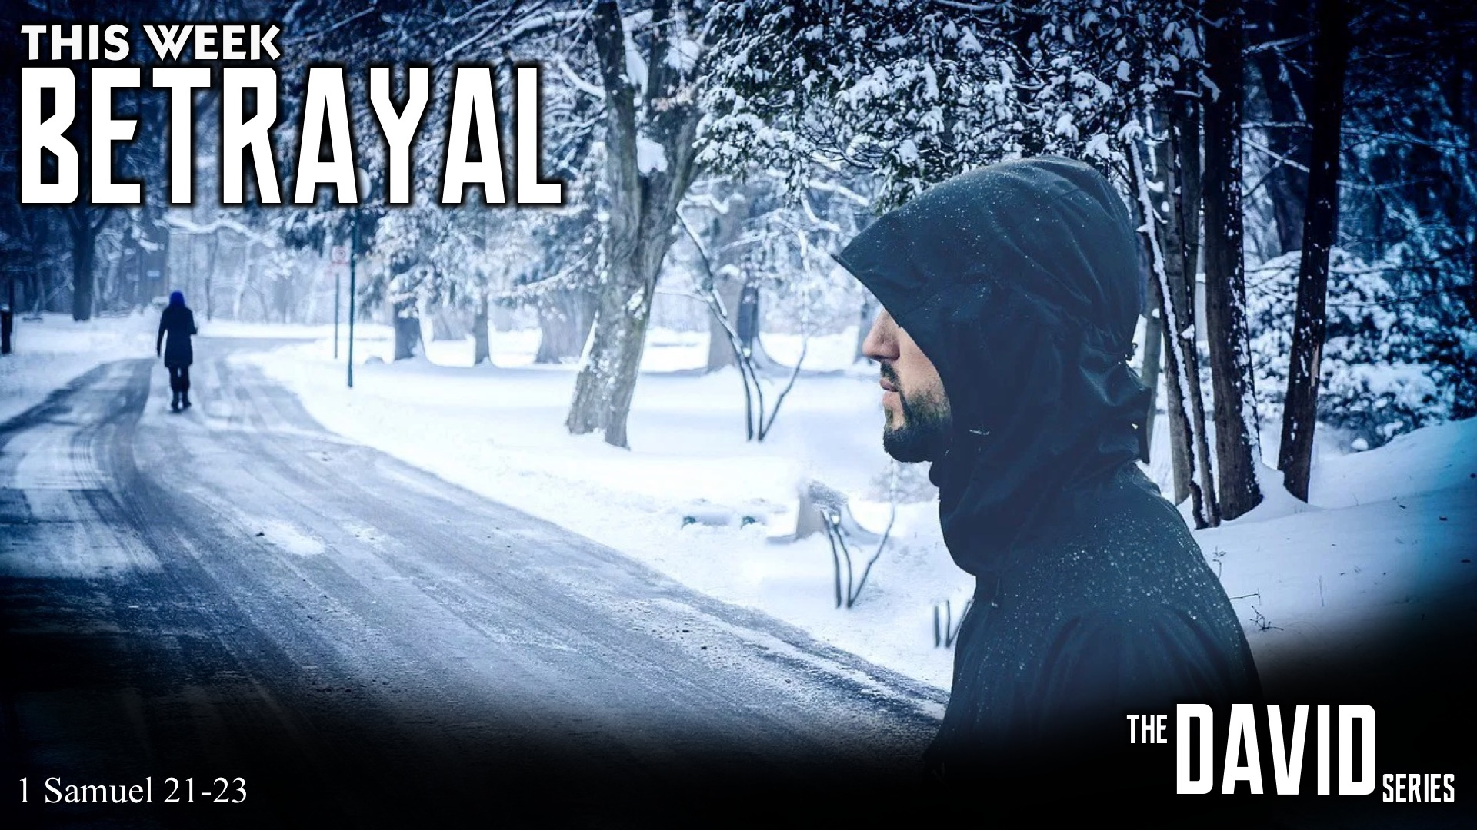
Notes:
This week are are going to learn about Betrayal.

Slide 6
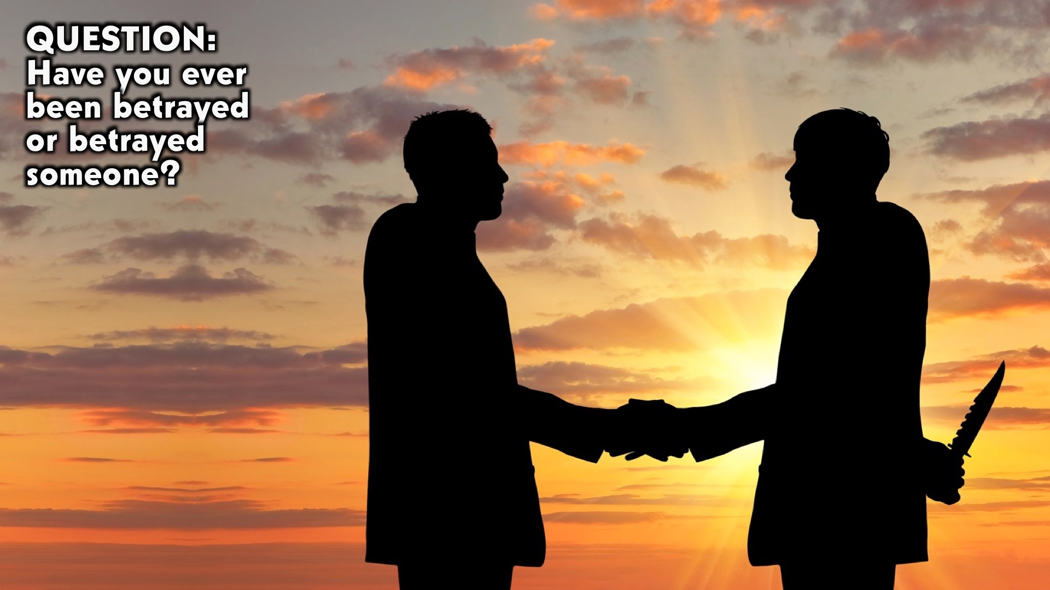
Notes:
Question: Have you ever been betrayed or betrayed someone?

Slide 7
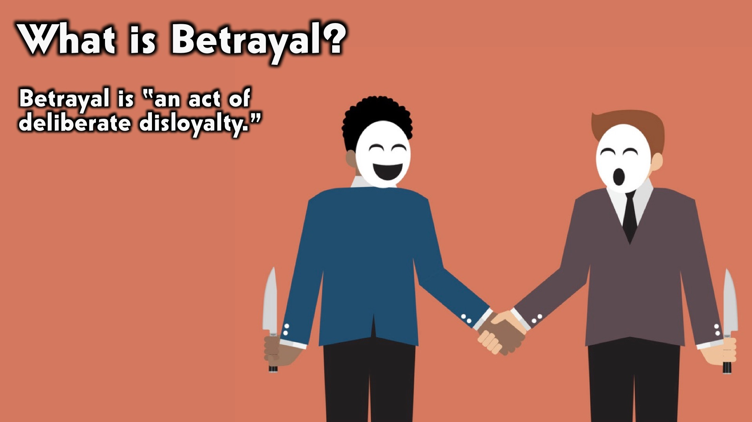
Notes:
What is Betrayal: Betrayal is “an act of deliberate disloyalty.”

Slide 8

Notes:
Betrayal in My Life: Some insights from my life…

Slide 9
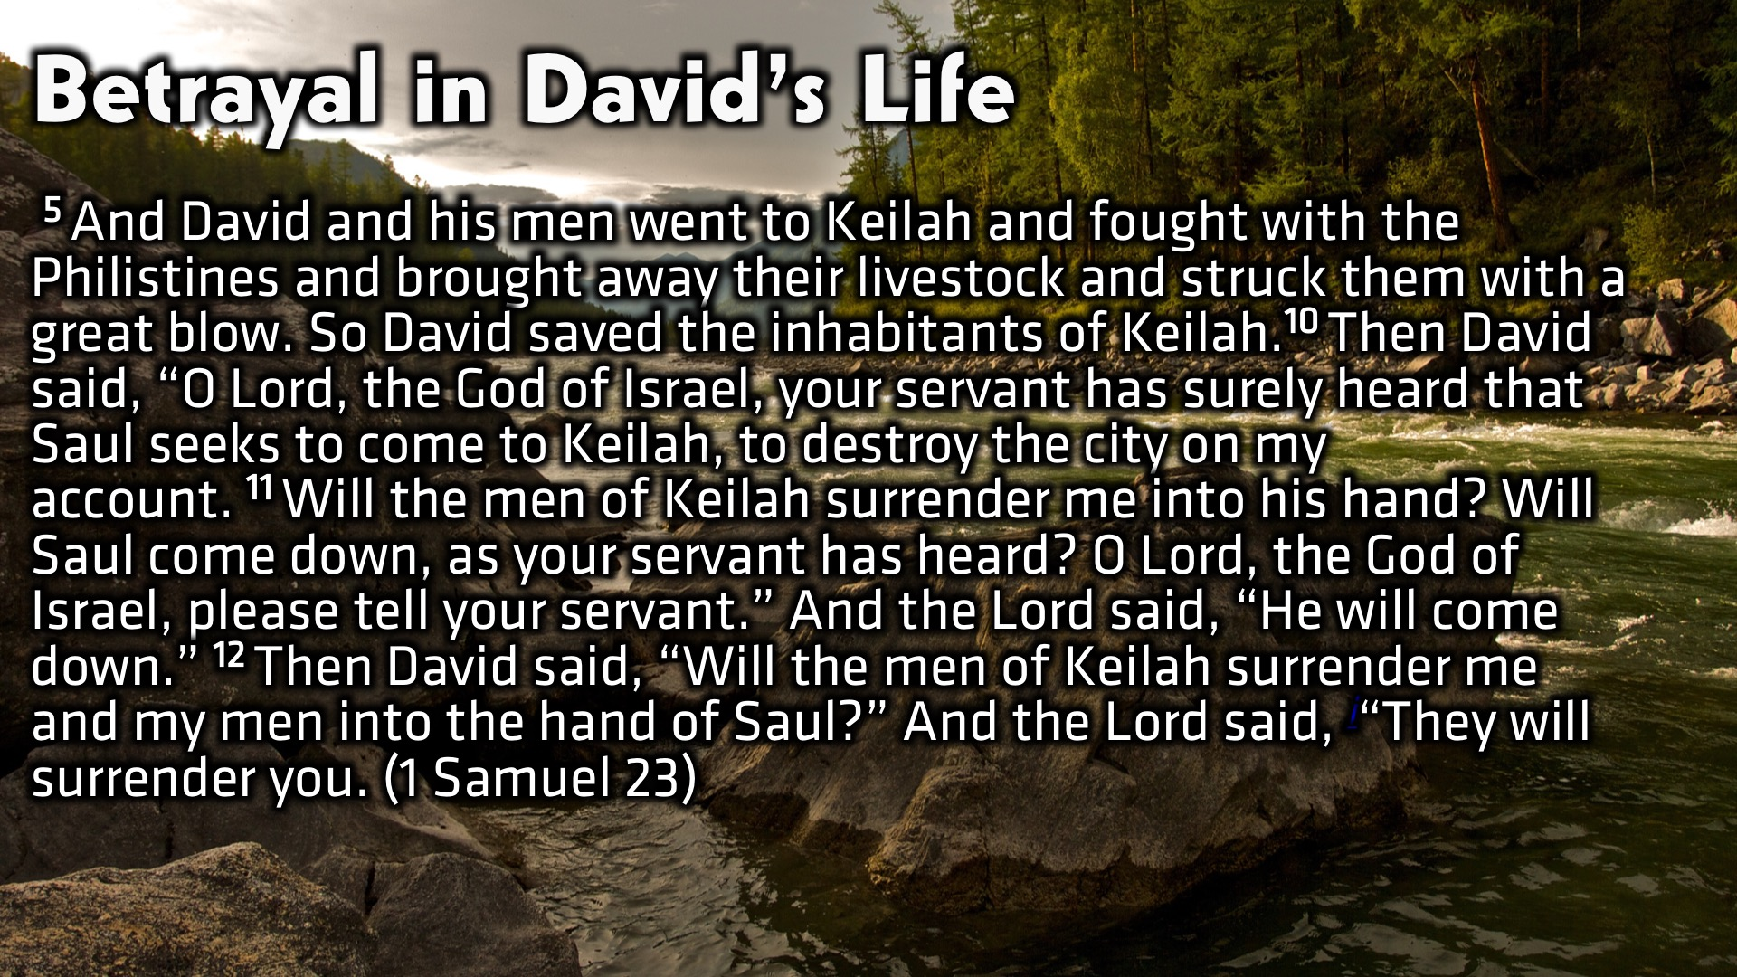
Notes:
Betrayal in David’s Life: (1 Samuel 23)

Slide 10
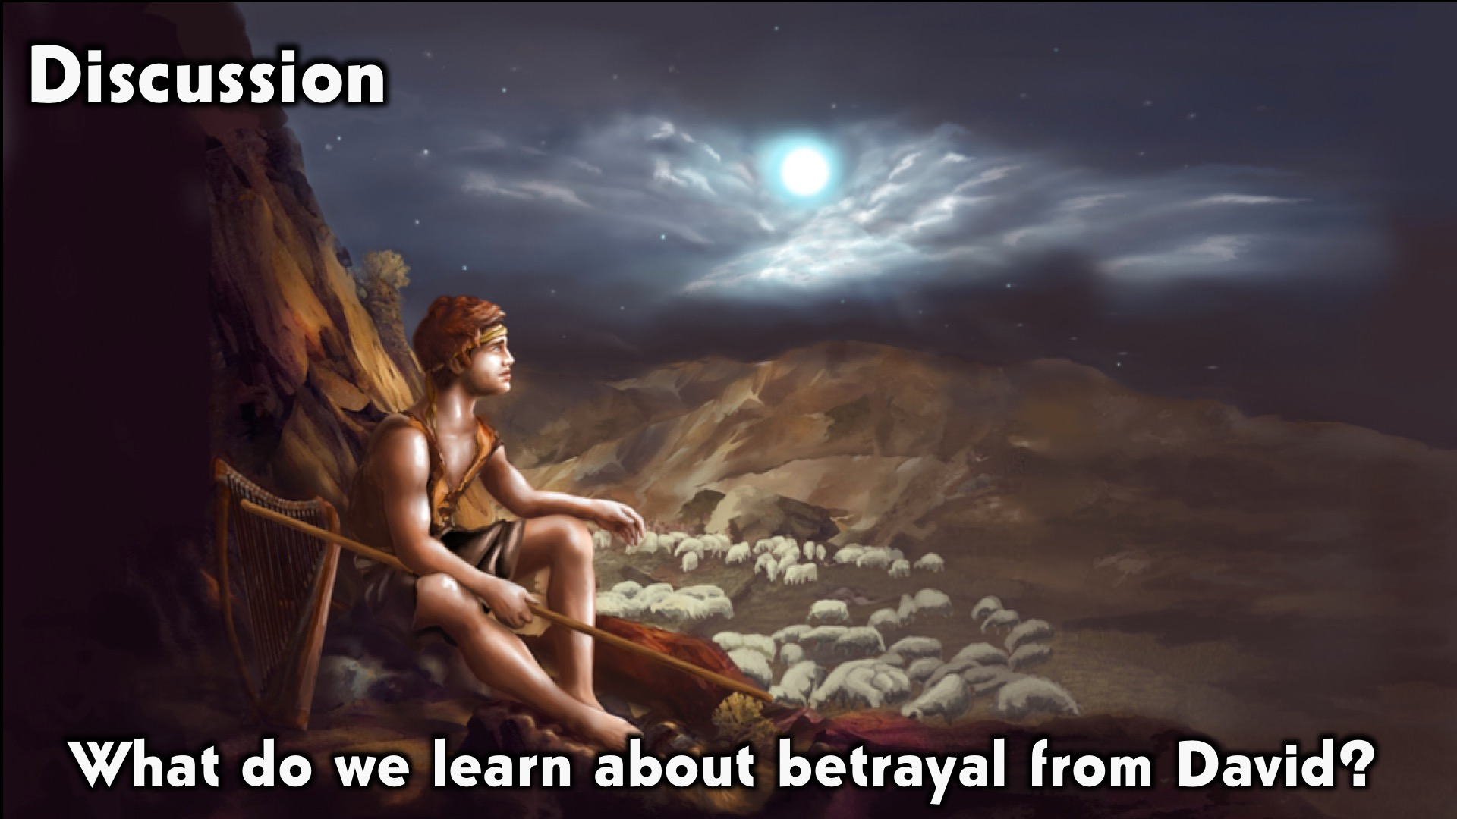
Notes:
Discussion: What do we learn about betrayal from David?

Slide 11
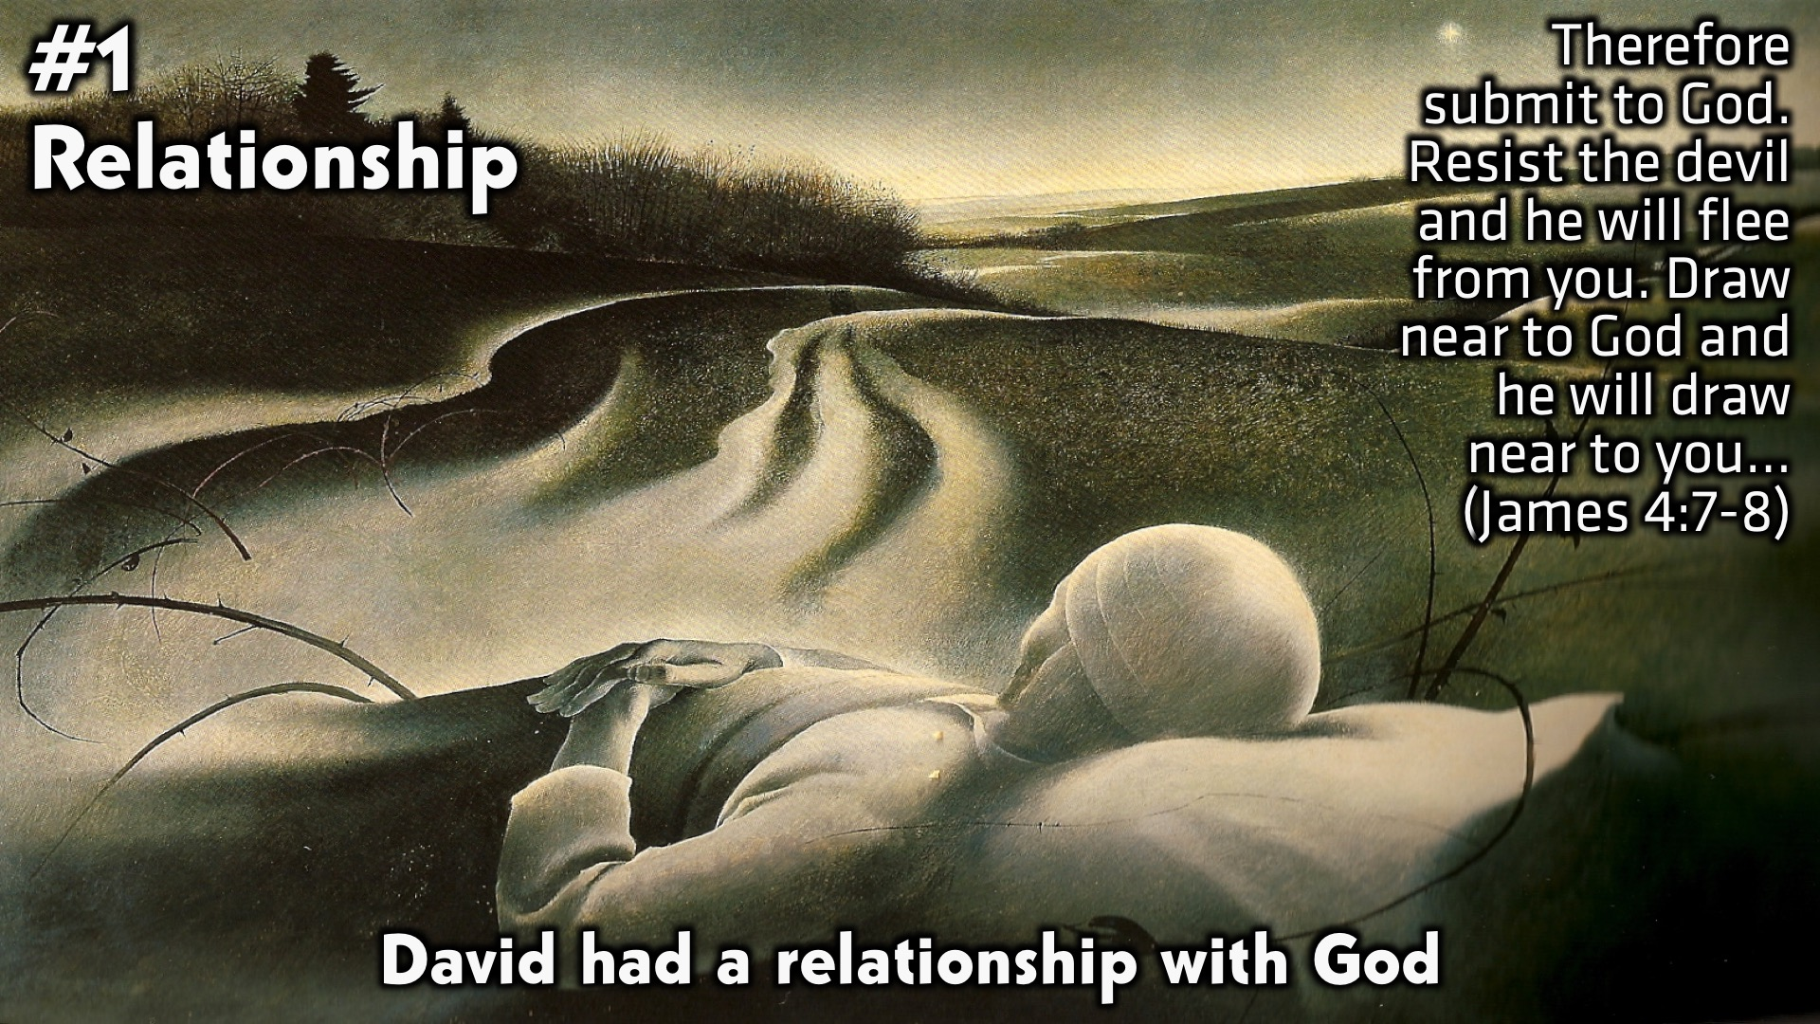
Notes:
1. Relationship: David had a relationship with God. (James 4:7-8)

Slide 12
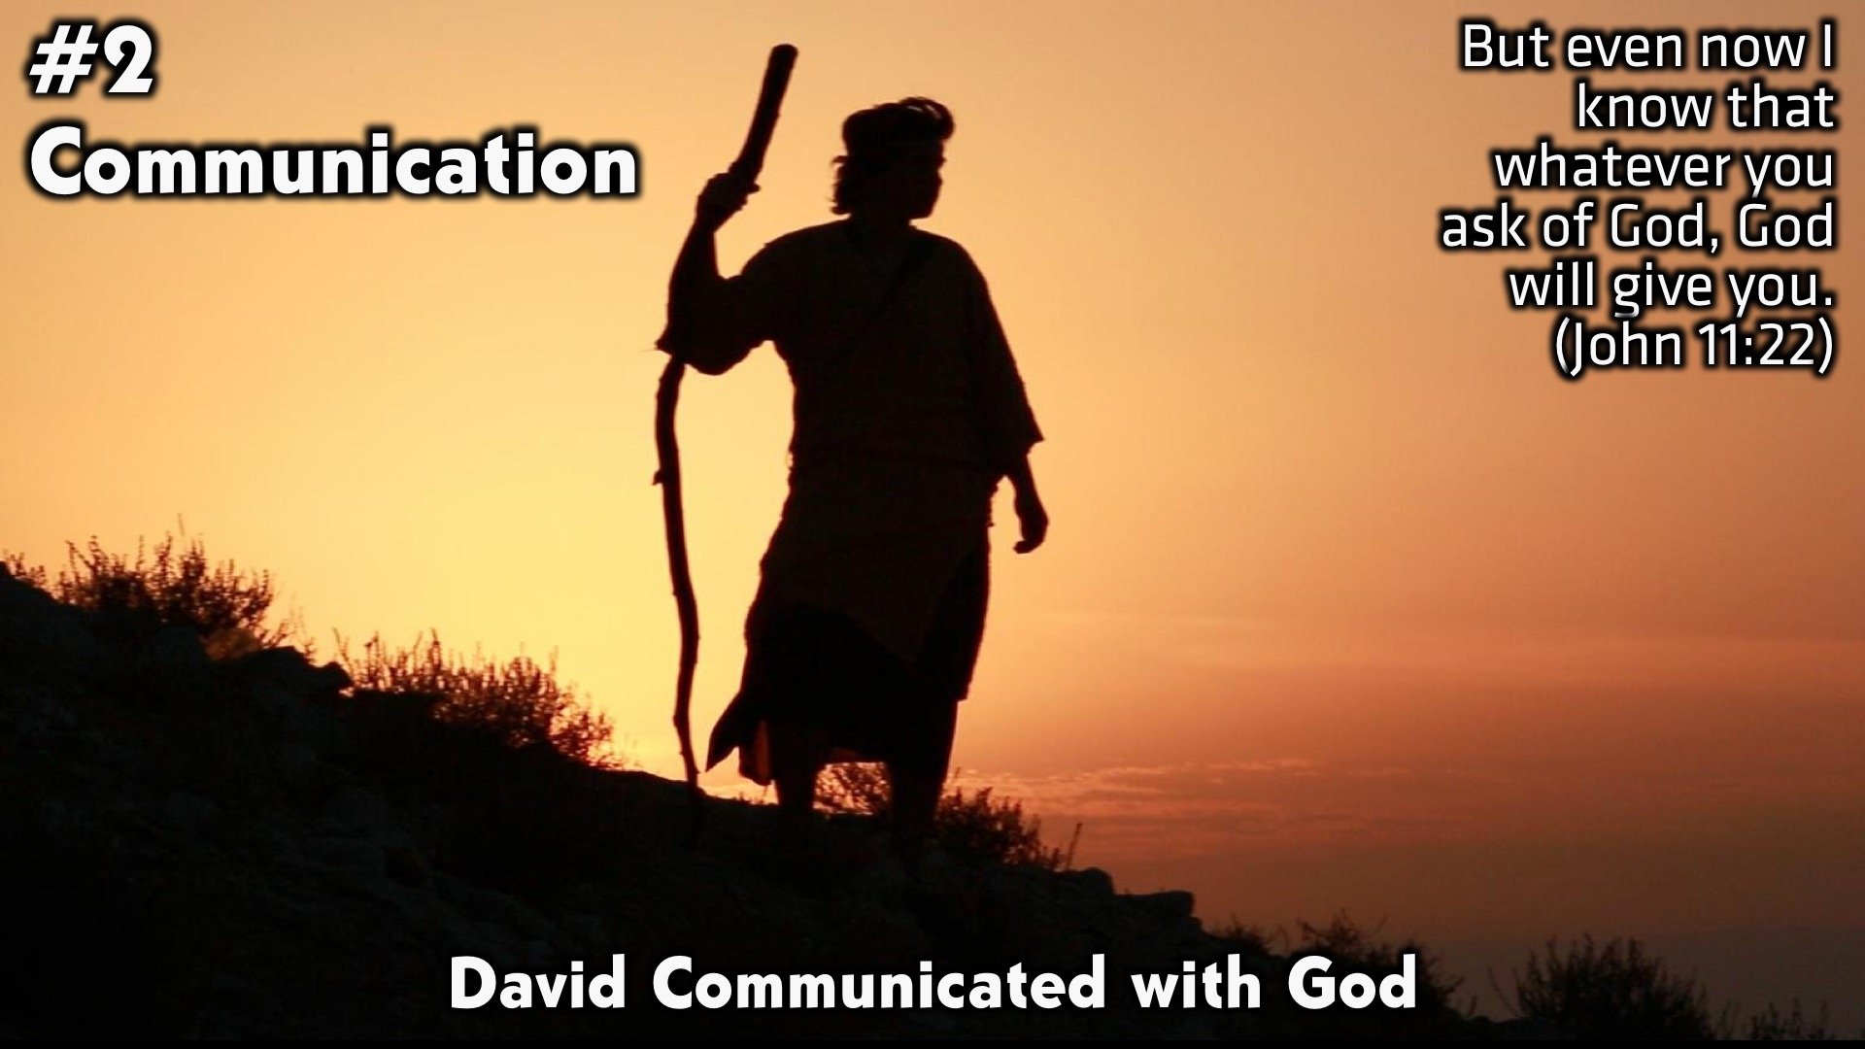
Notes:
2. Communication: David Communicated with God. (John 11:22)

Slide 13
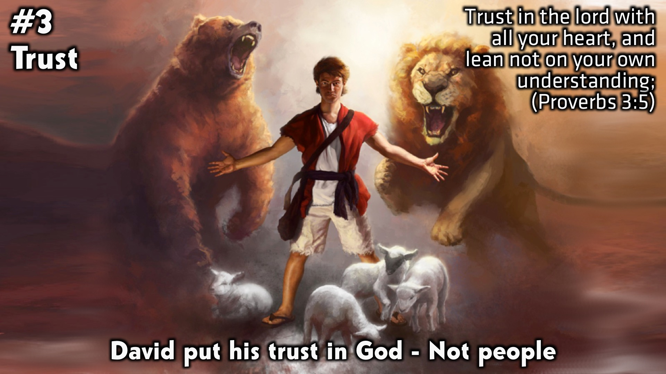
Notes:
3. Trust: David put his trust in God – Not people. (Proverbs 3:5)

Slide 14
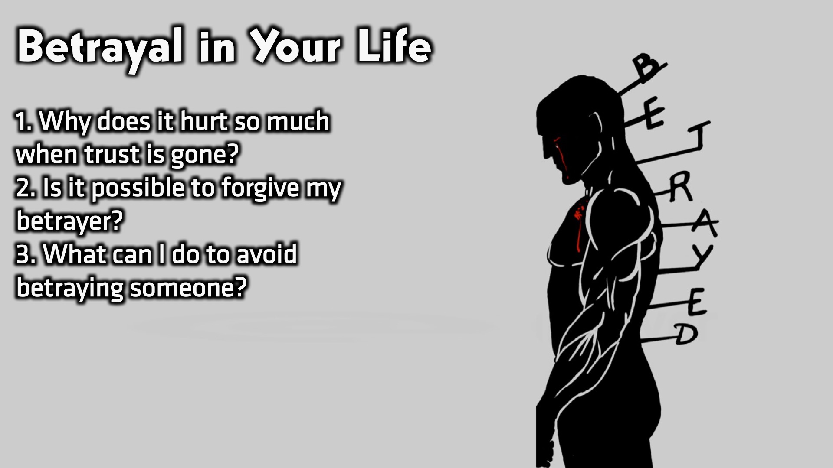
Notes:
Small Group Discussion: You have ten minutes to apply the message to your life in small groups using these 3 questions: (1) Why does it hurt so much when trust is gone? (2) Is it possible to forgive my betrayer? (3) What can I do to avoid betraying someone?

Slide 15
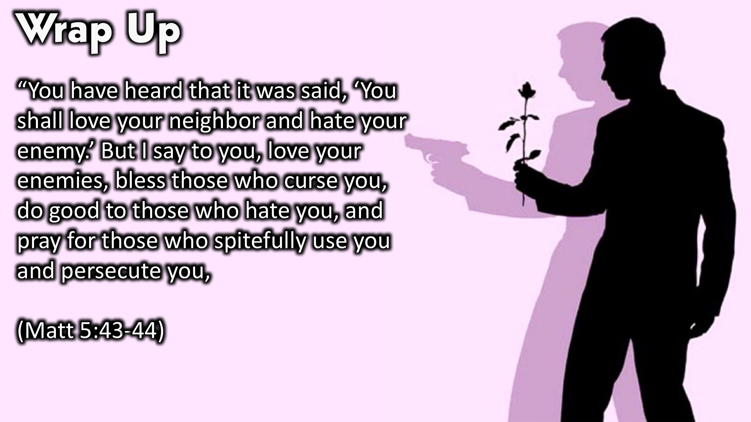
Notes:
Wrap Up: “You have heard that it was said, ‘You shall love your neighbor and hate your enemy.’ But I say to you, love your enemies, bless those who curse you, do good to those who hate you, and pray for those who spitefully use you and persecute you. (Matt 5:43-44)

Slide 16

Notes:
Wrap Up: God heals all wounds and erases every sin. God is all powerful!! As you go about your week, remember to: (1) Have a RELATIONSHIP with God. (2) Have constant COMMUNICATION with God. (3) TRUST God completely.

Slide 17
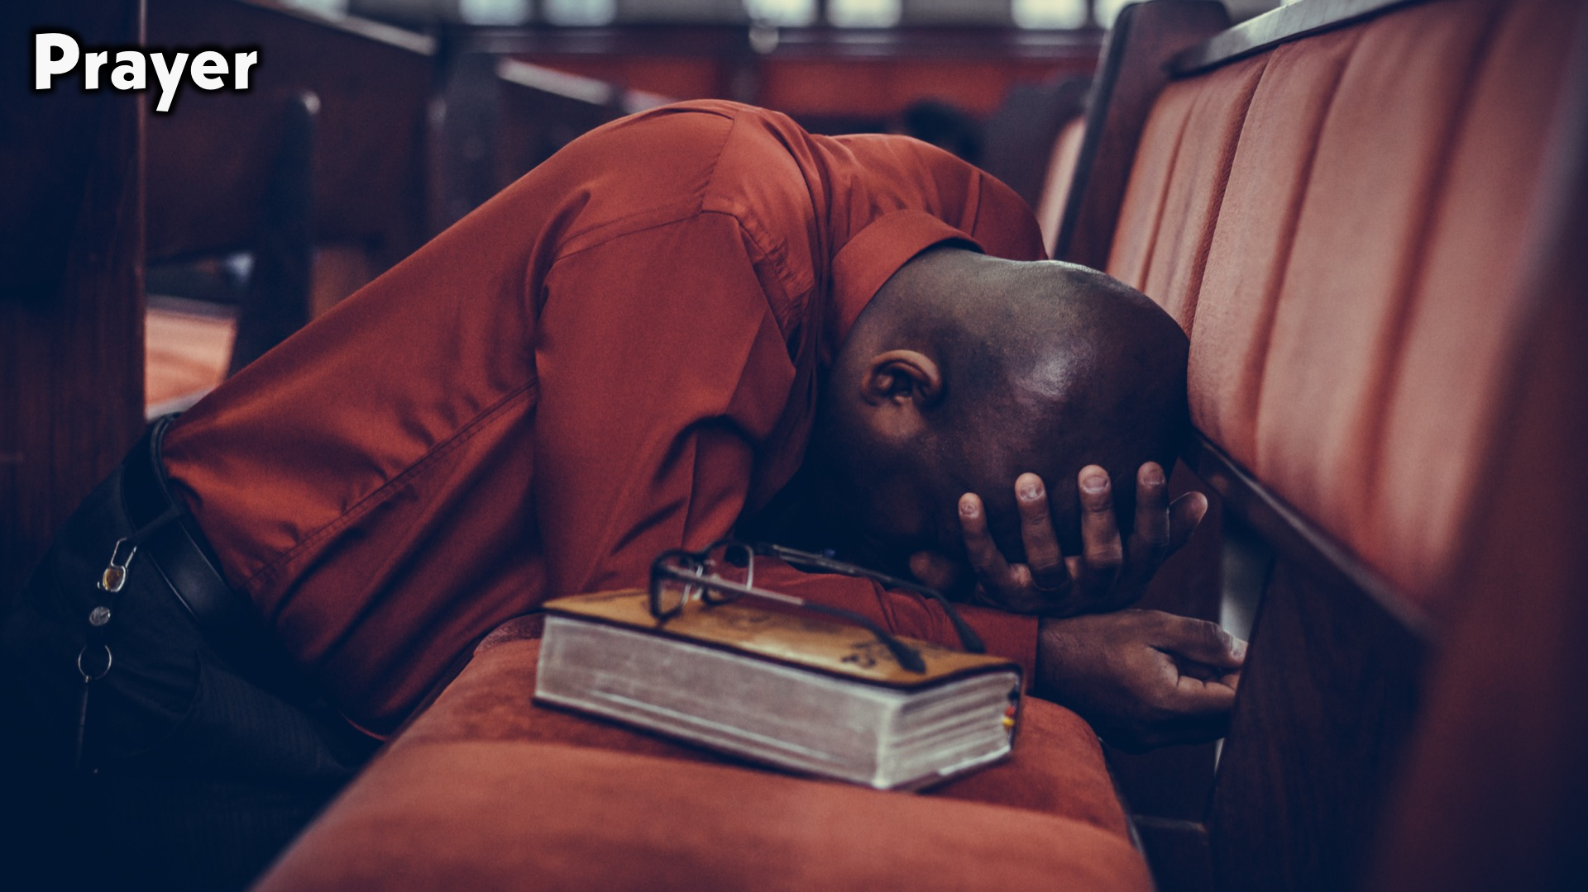
Notes:
Prayer.

Slide 18

Notes:
Daily Devotions: We will post devotions on the Sunday WhatsApp group every night of the week throughout this series. Do everything you can to be a part of the daily journey in the life of David.

Slide 19

Notes:
Next Week: Next week we will look at the next chapter in David’s Life: Revenge (1 Samuel 24)

