Slide 1
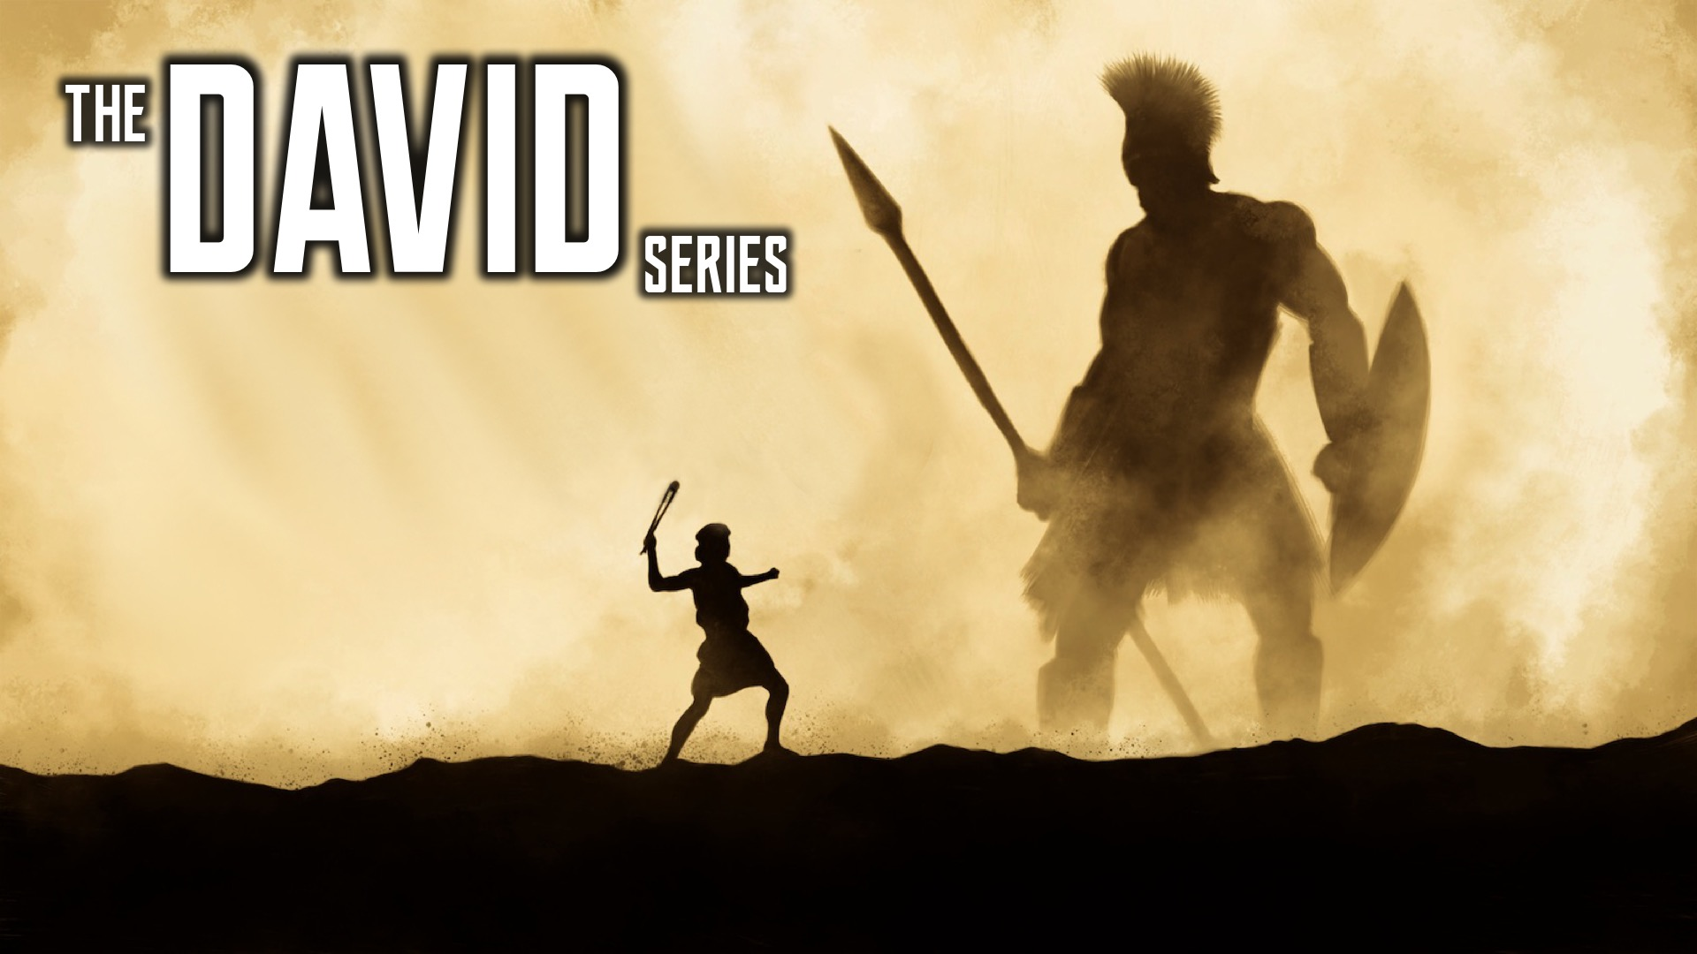
Notes:
Welcome to the David Series.

Slide 2
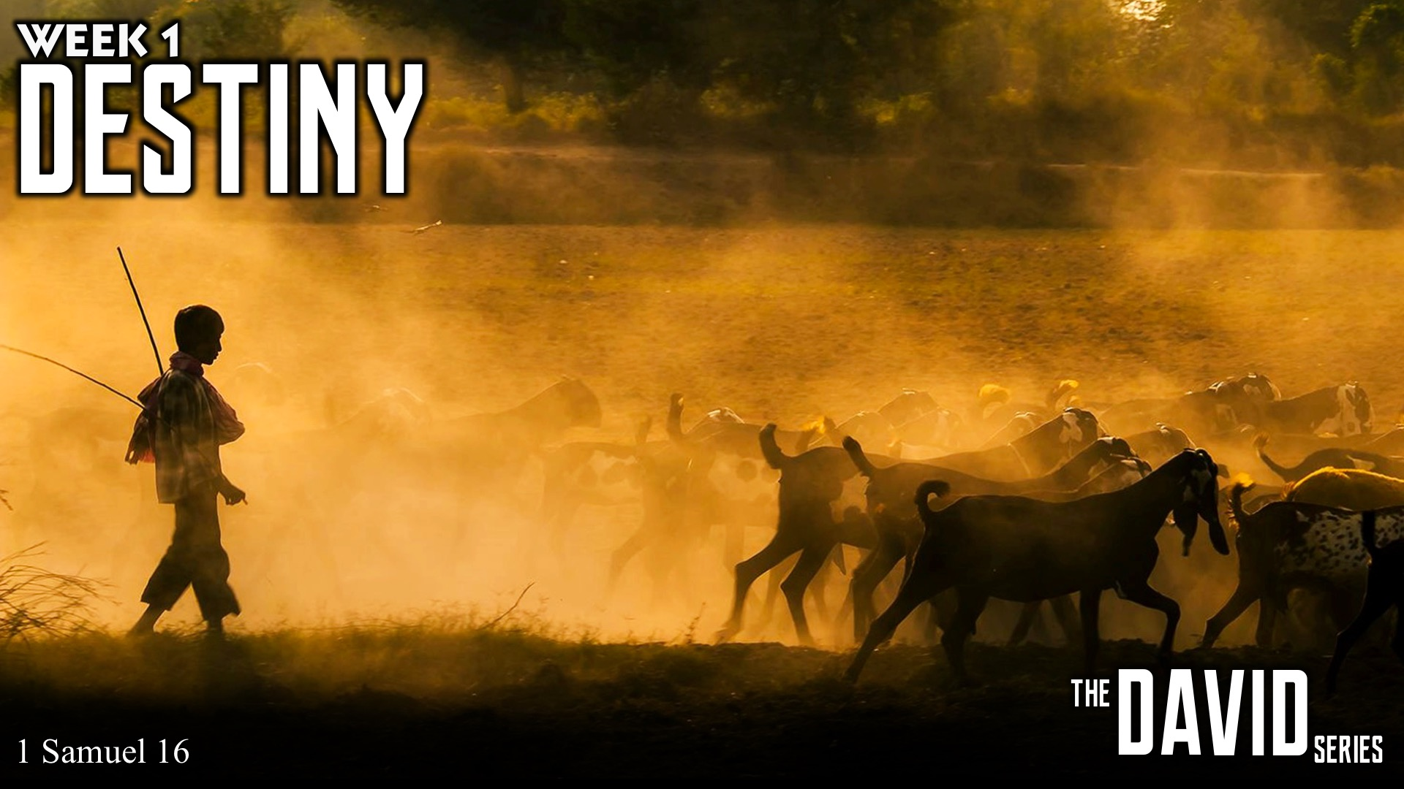
Notes:
In week 1 we learnt about Destiny.

Slide 3
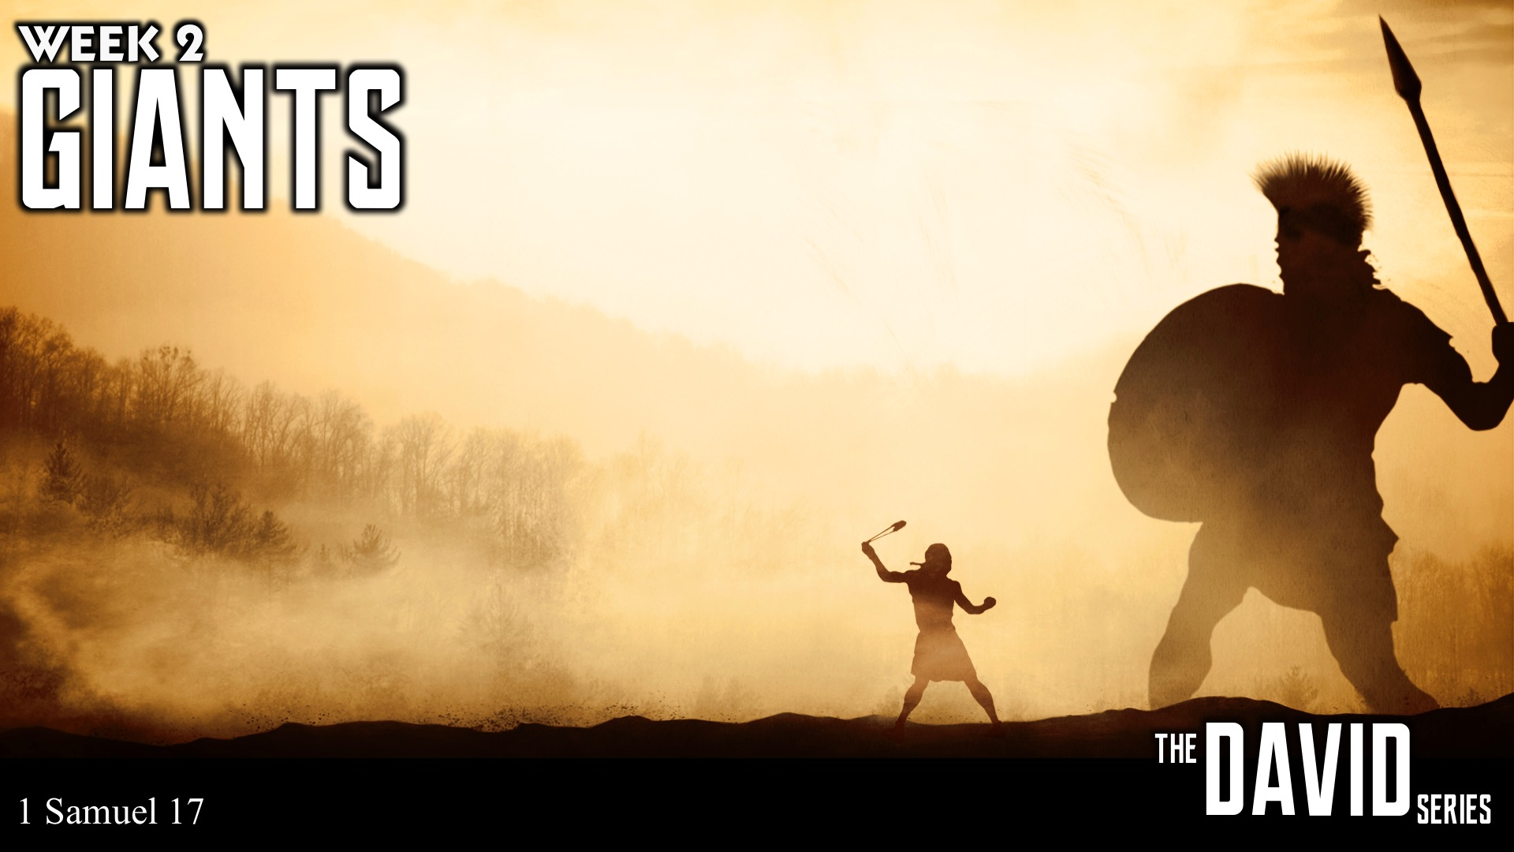
Notes:
In week 2 we learnt about handing Giants.

Slide 4

Notes:
In week 3 we learnt about dealing with Friends.

Slide 5
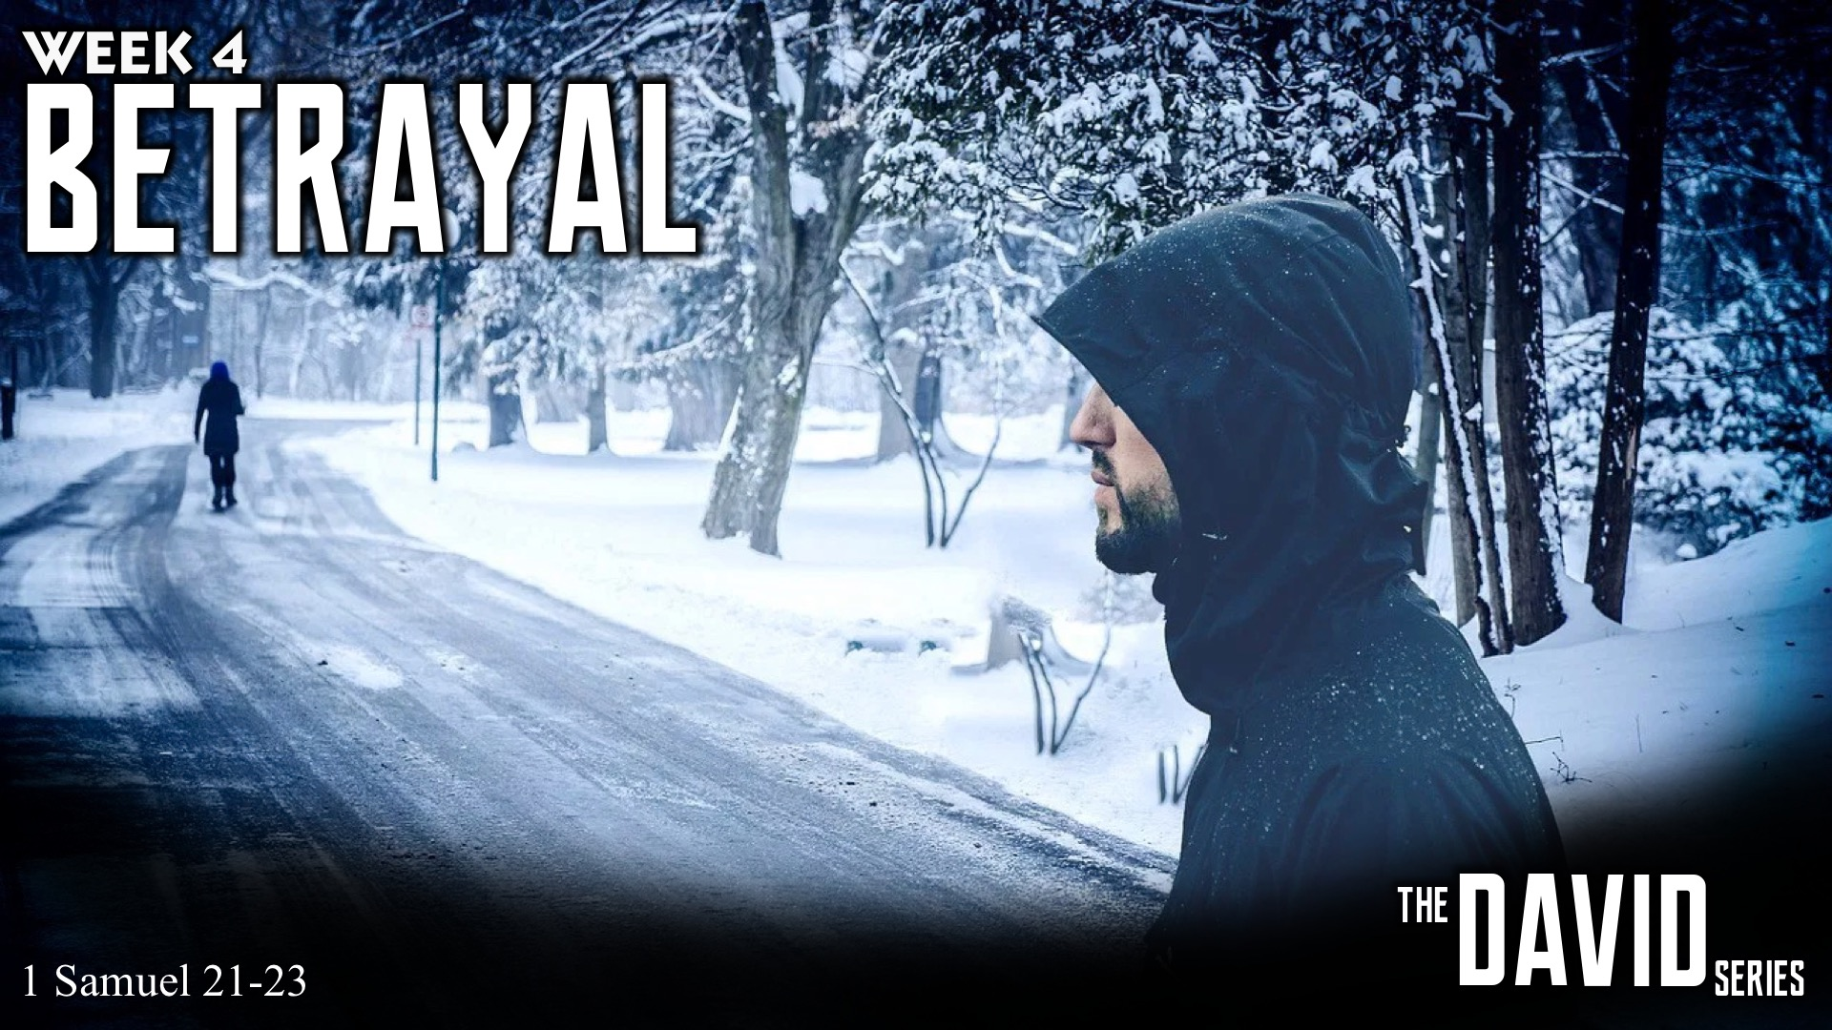
Notes:
In week 4 we learnt about dealing with Betrayal.

Slide 6

Notes:
Last week we learnt about dealing with Revenge.

Slide 7
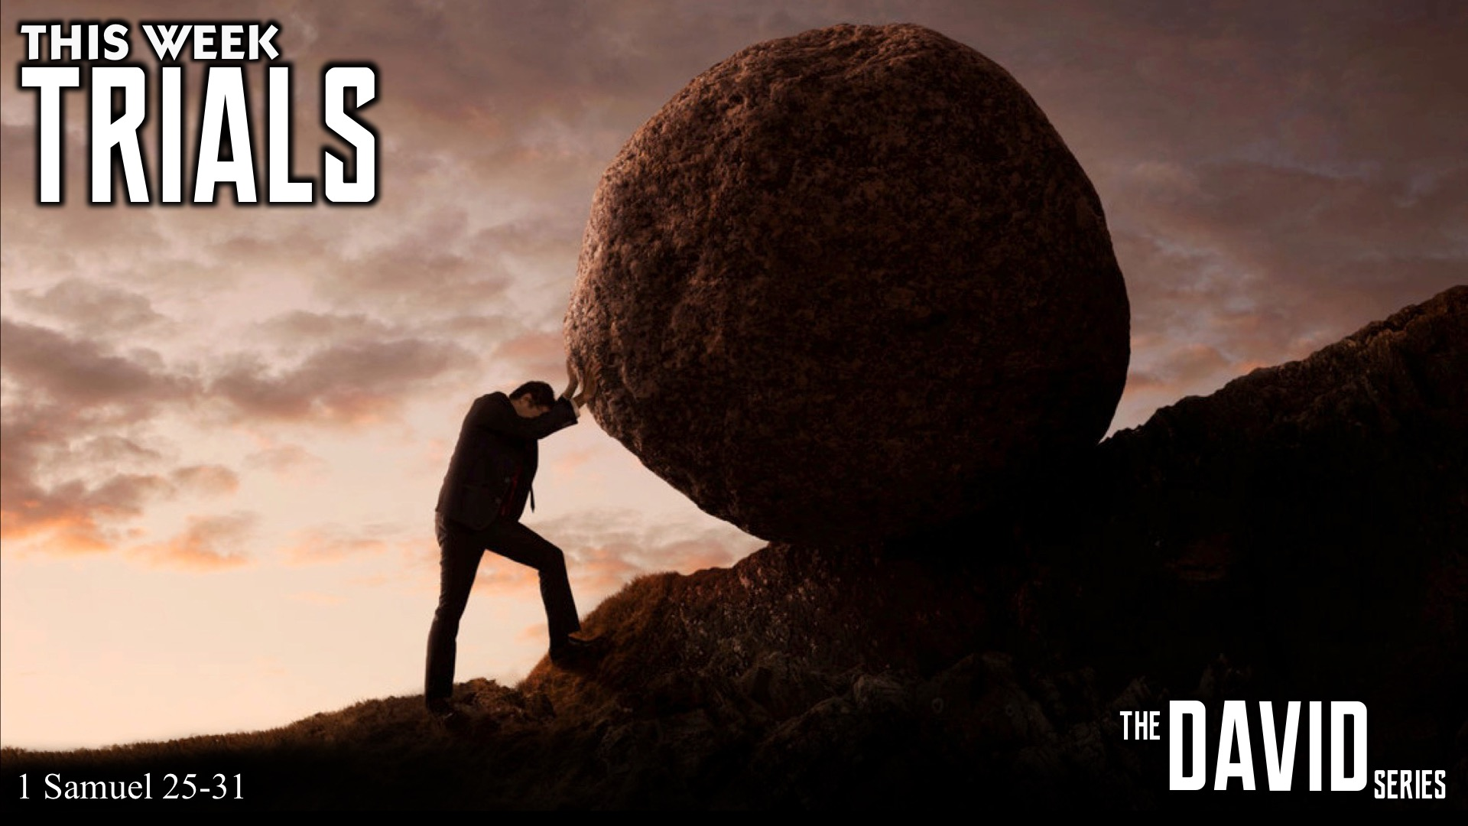
Notes:
This week we are going to learn about Trials.

Slide 8
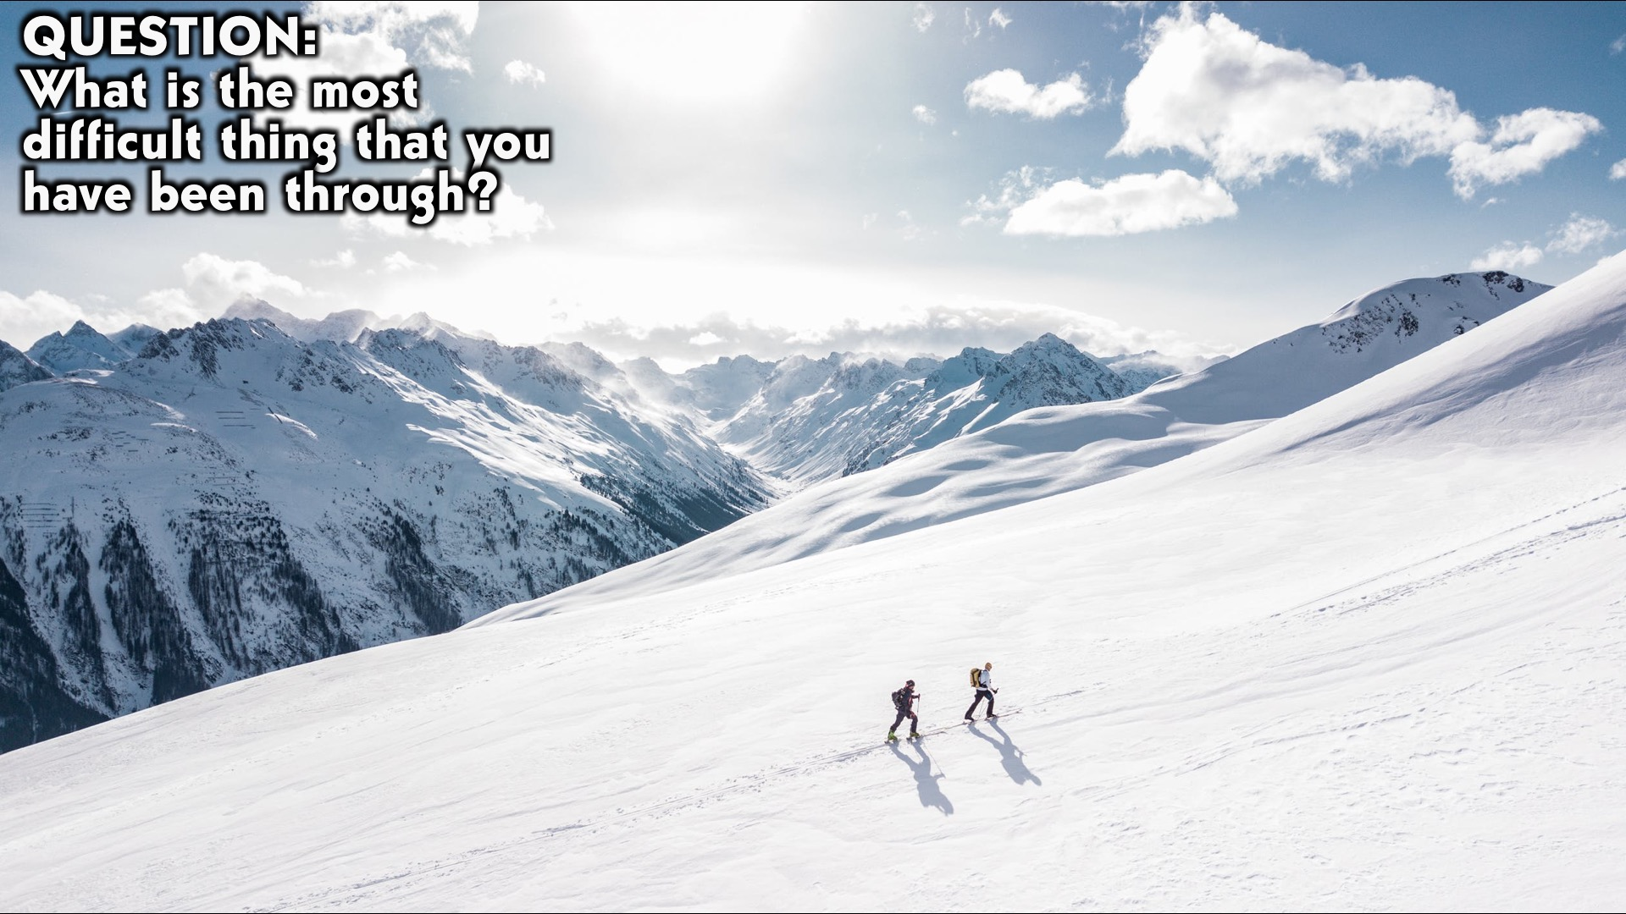
Notes:
Question: What is the most difficult thing that you have been through?

Slide 9
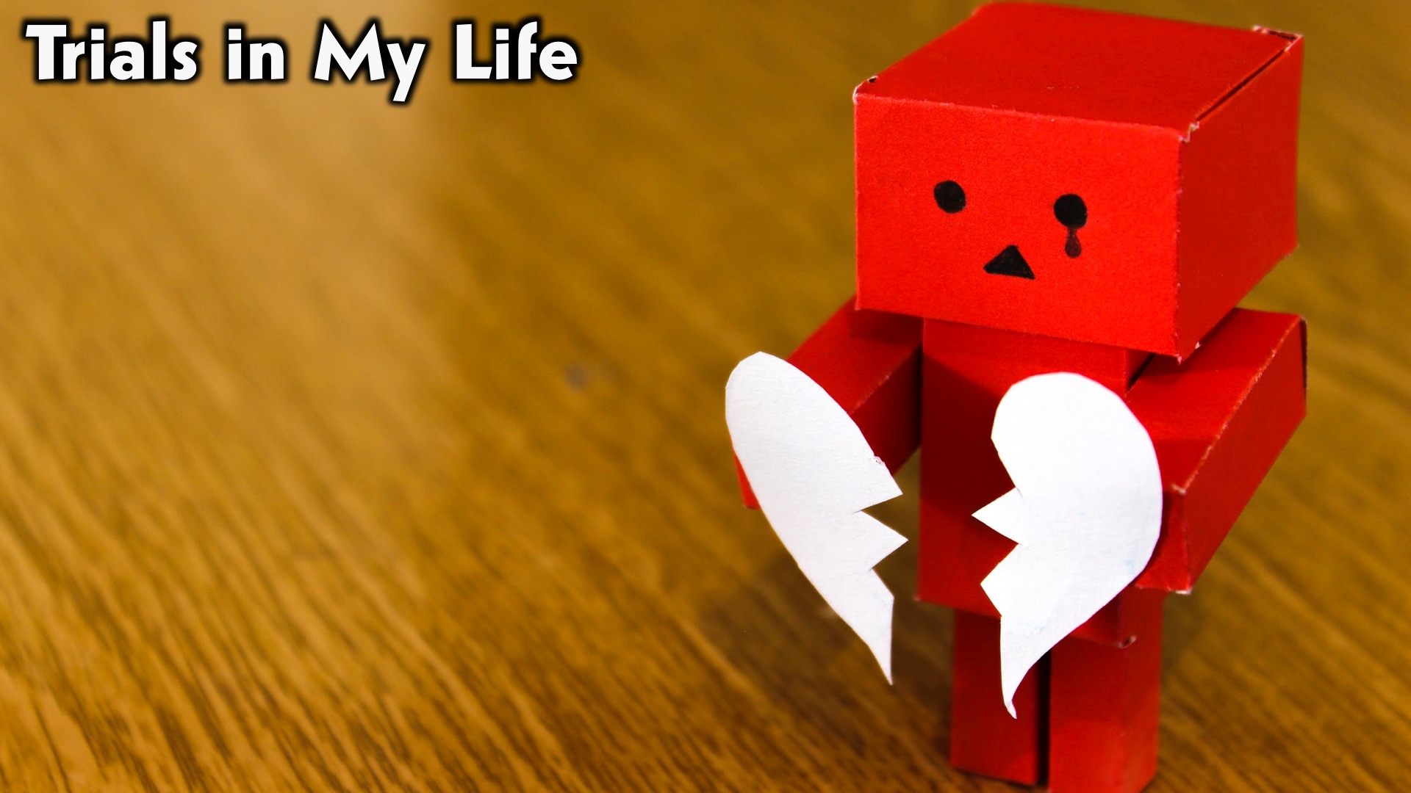
Notes:
Trials in My Life: Some insights from my life…

Slide 10
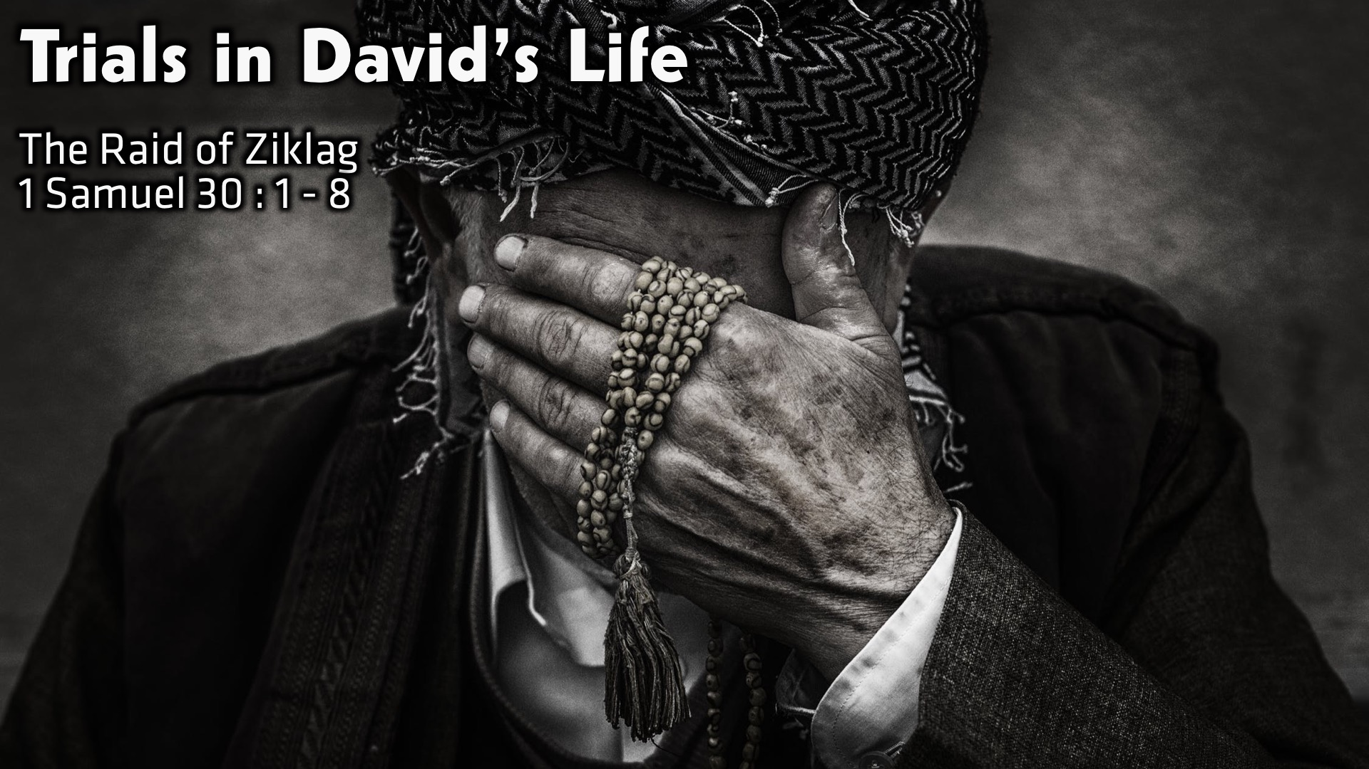
Notes:
Trials in David’s Life:
The Raid of Ziklag
1 Samuel 30 : 1 - 8

Slide 11
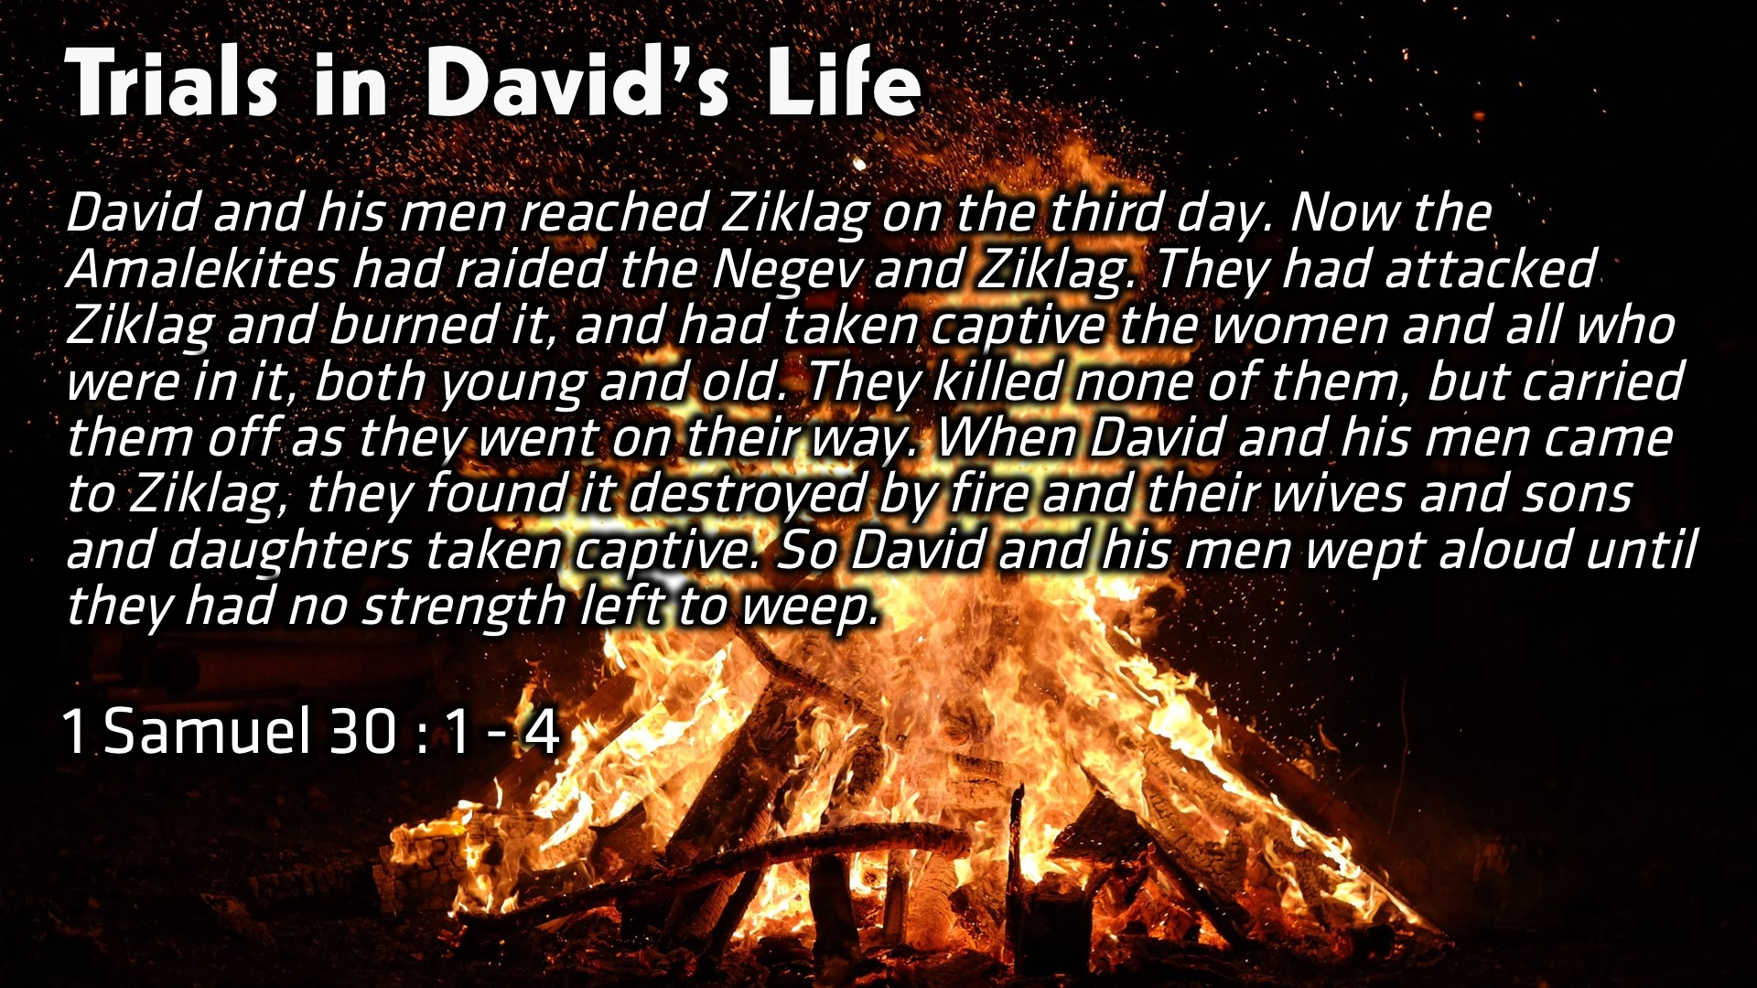
Notes:
Trials in David’s Life: David and his men reached Ziklag on the third day. Now the Amalekites had raided the Negev and Ziklag. They had attacked Ziklag and burned it, and had taken captive the women and all who were in it, both young and old. They killed none of them, but carried them off as they went on their way. When David and his men came to Ziklag, they found it destroyed by fire and their wives and sons and daughters taken captive. So David and his men wept aloud until they had no strength left to weep. (1 Samuel 30 : 1 – 4)

Slide 12
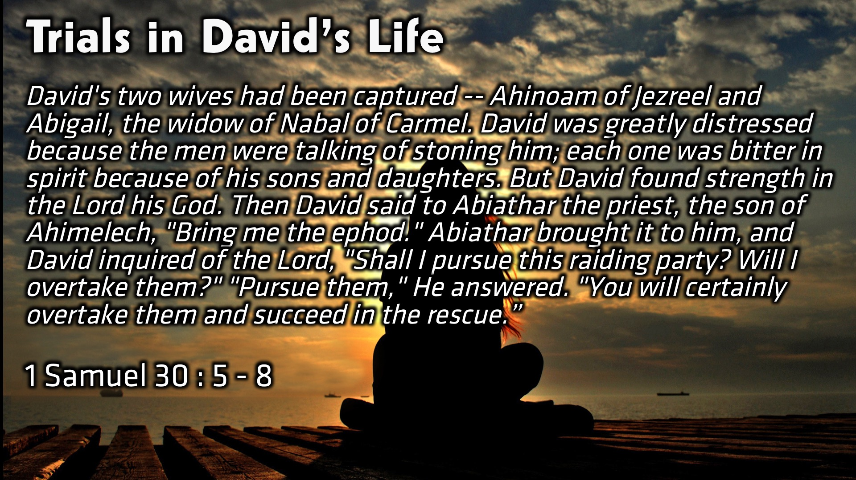
Notes:
Trials in David’s Life: David's two wives had been captured -- Ahinoam of Jezreel and Abigail, the widow of Nabal of Carmel. David was greatly distressed because the men were talking of stoning him; each one was bitter in spirit because of his sons and daughters. But David found strength in the Lord his God. Then David said to Abiathar the priest, the son of Ahimelech, "Bring me the ephod." Abiathar brought it to him, and David inquired of the Lord, "Shall I pursue this raiding party? Will I overtake them?" "Pursue them," He answered. "You will certainly overtake them and succeed in the rescue.” (1 Samuel 30 : 5 – 8)

Slide 13
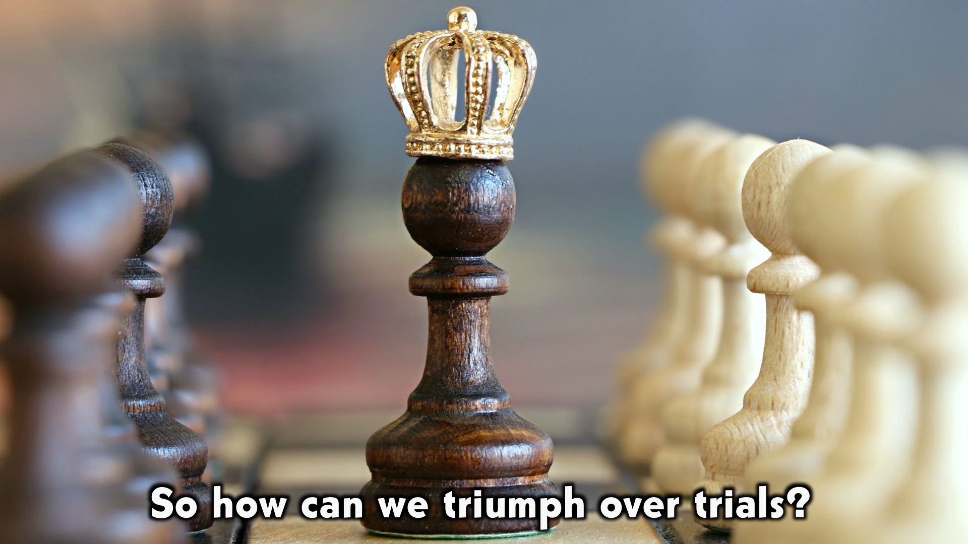
Notes:
So how can we triumph over trials?

Slide 14
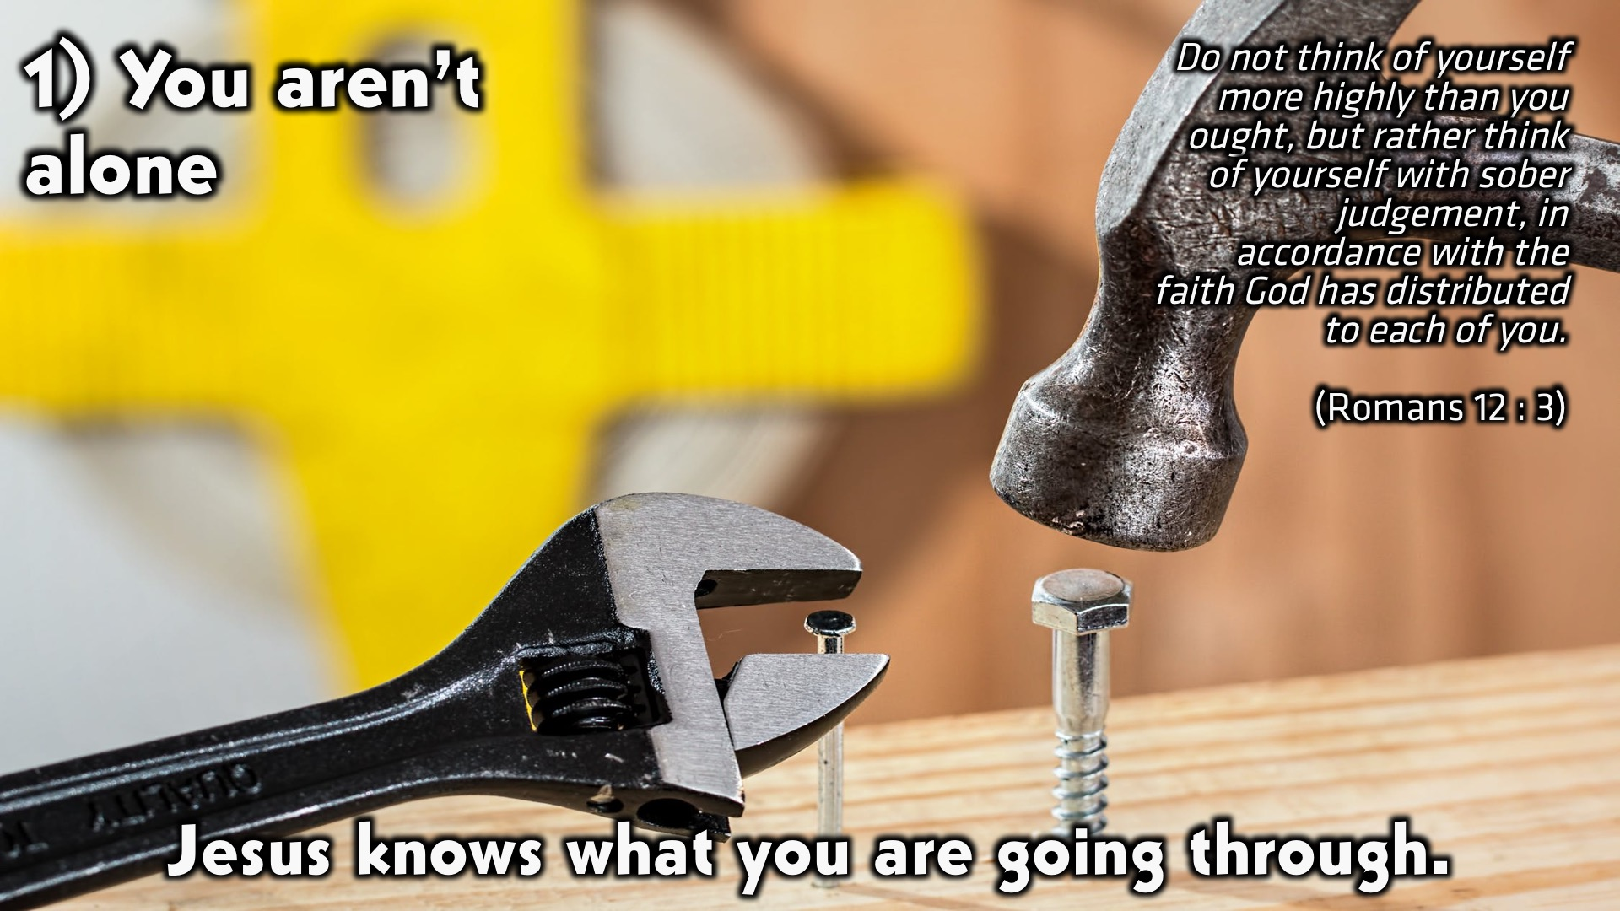
Notes:
1. You aren’t alone: Jesus knows what you are going through. Do not think of yourself more highly than you ought, but rather think of yourself with sober judgement, in accordance with the faith God has distributed to each of you. (Romans 12 : 3)

Slide 15
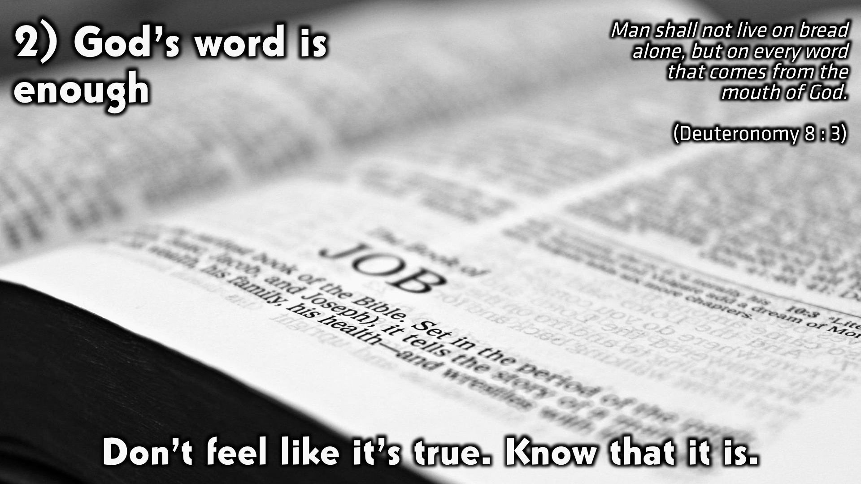
Notes:
1. God’s word is enough: Don’t feel like it’s true. Know that it is. Man shall not live on bread alone, but on every word that comes from the mouth of God. (Deuteronomy 8 : 3)

Slide 16
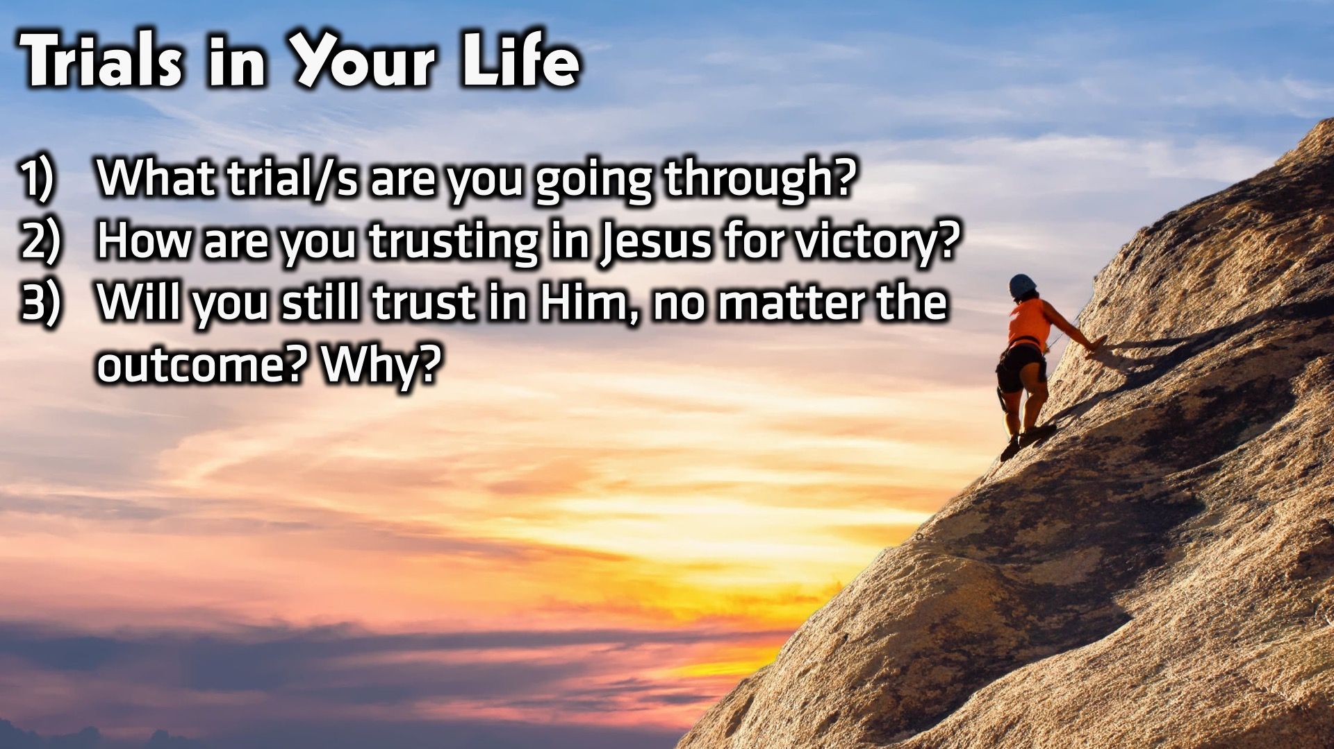
Notes:
Small Group Discussion: You have ten minutes to apply the message to your life in small groups using these 3 questions: (1) What trial/s are you going through? (2) How are you trusting in Jesus for victory? (3) Will you still trust in Him, no matter the outcome? Why?

Slide 17
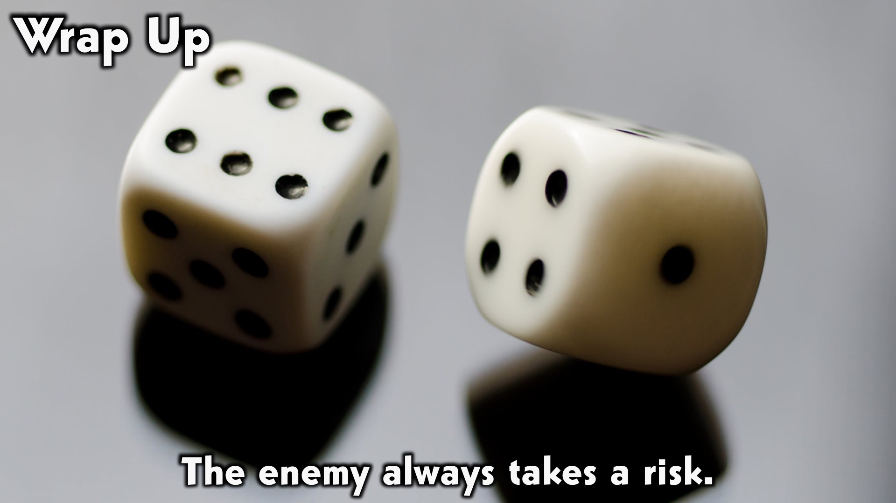
Notes:
Wrap Up: The enemy always takes a risk.

Slide 18
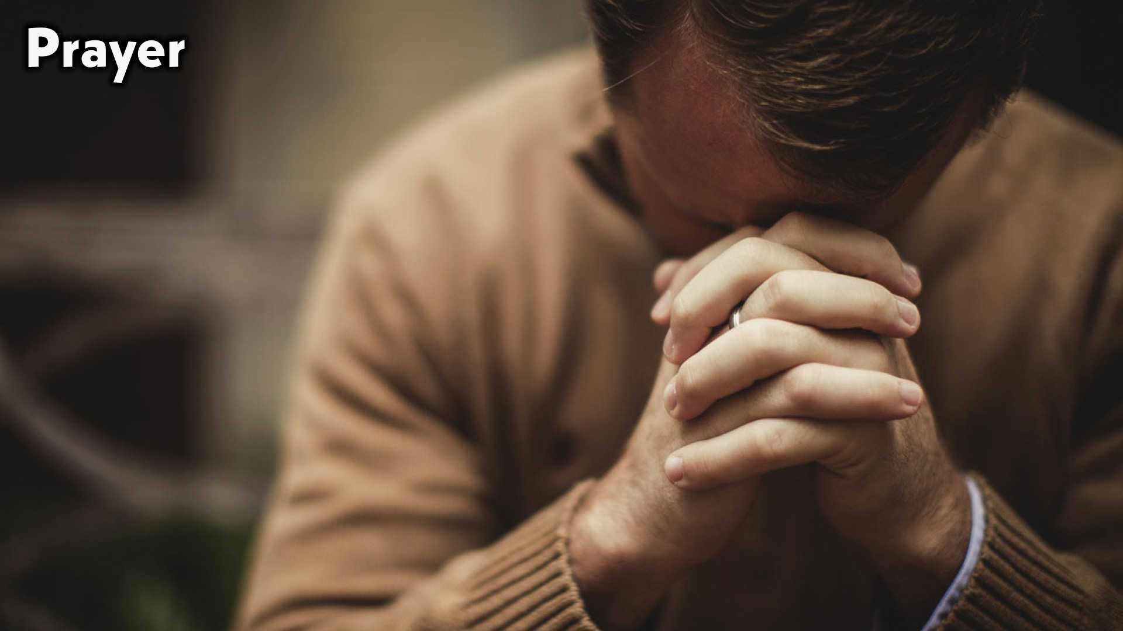
Notes:
Prayer:

Slide 19

Notes:
Daily Devotions: We will post devotions on the Sunday WhatsApp group every night of the week throughout this series. Do everything you can to be a part of the daily journey in the life of David.

Slide 20

Notes:
Next Week: Next week we will look at the next chapter in David’s Life: Power (2 Samuel 1-10)

