Slide 1
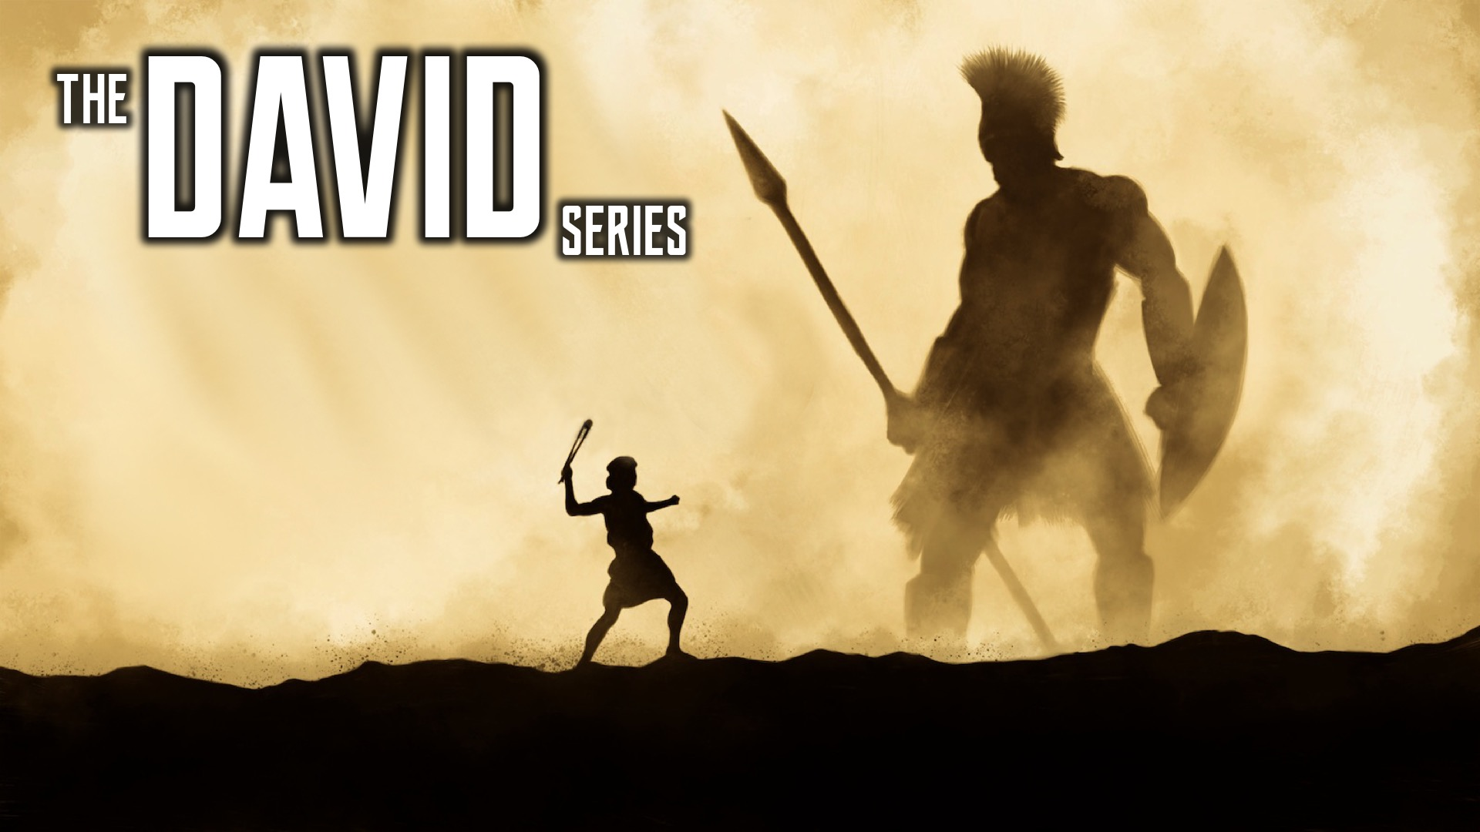
Notes:
Welcome to the David Series.

Slide 2
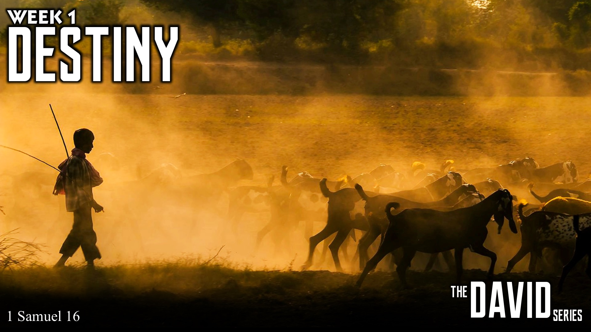
Notes:
In week 1 we learnt about Destiny.

Slide 3
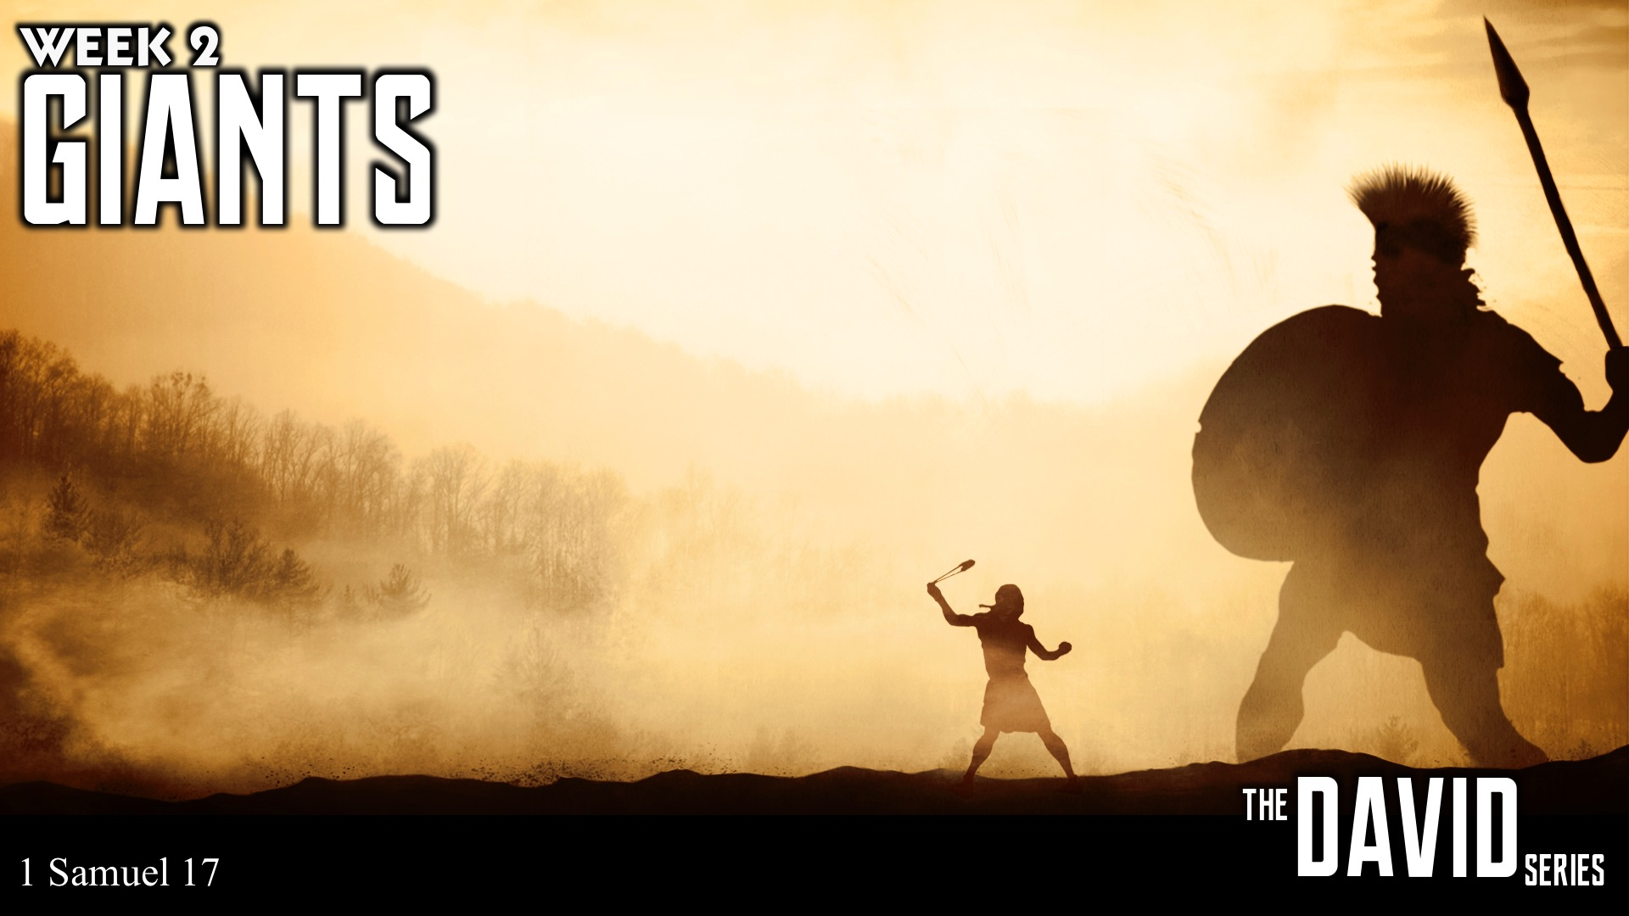
Notes:
In week 2 we learnt about handing Giants.

Slide 4
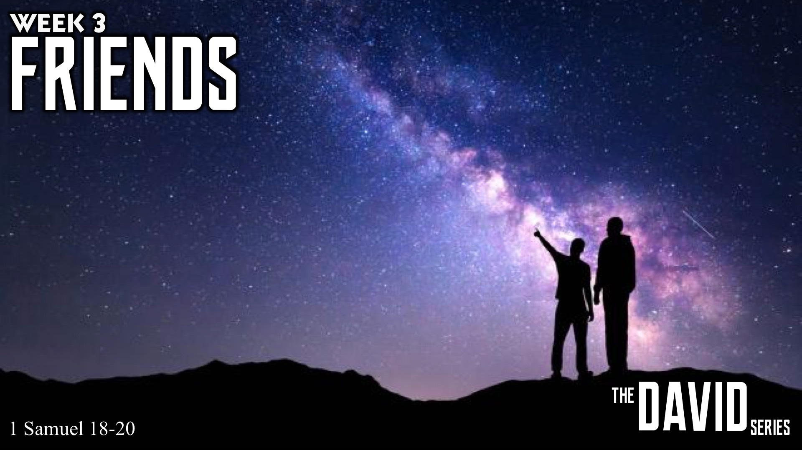
Notes:
In Week 3 of the David Series, Grace preached on the value of good friendships, and the importance of being in connection with the ultimate friend, Jesus.

Slide 5
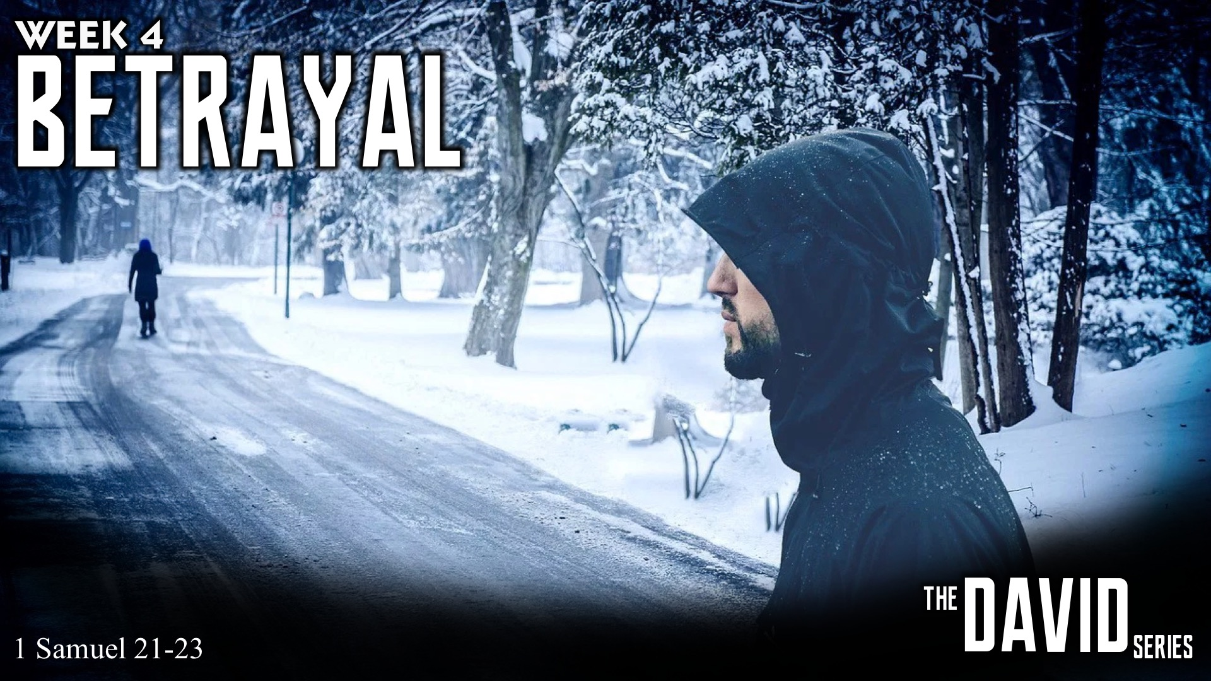
Notes:
In week 4 of the David Series, Thabile spoke about betrayal, and explained how we need to be in relationship with God, where there is constant communication, and trust.

Slide 6
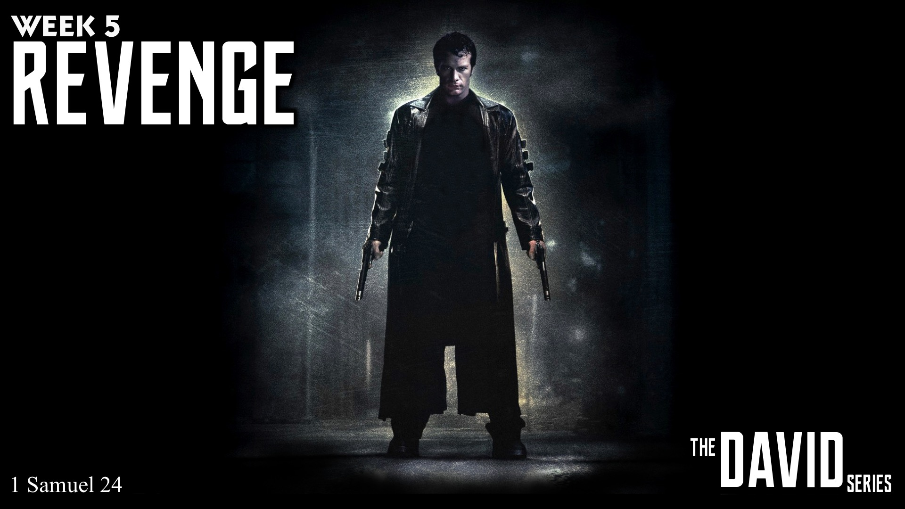
Notes:
In week 5 of the David Series, Grace spoke about Revenge.
Taken Trailer

Slide 7
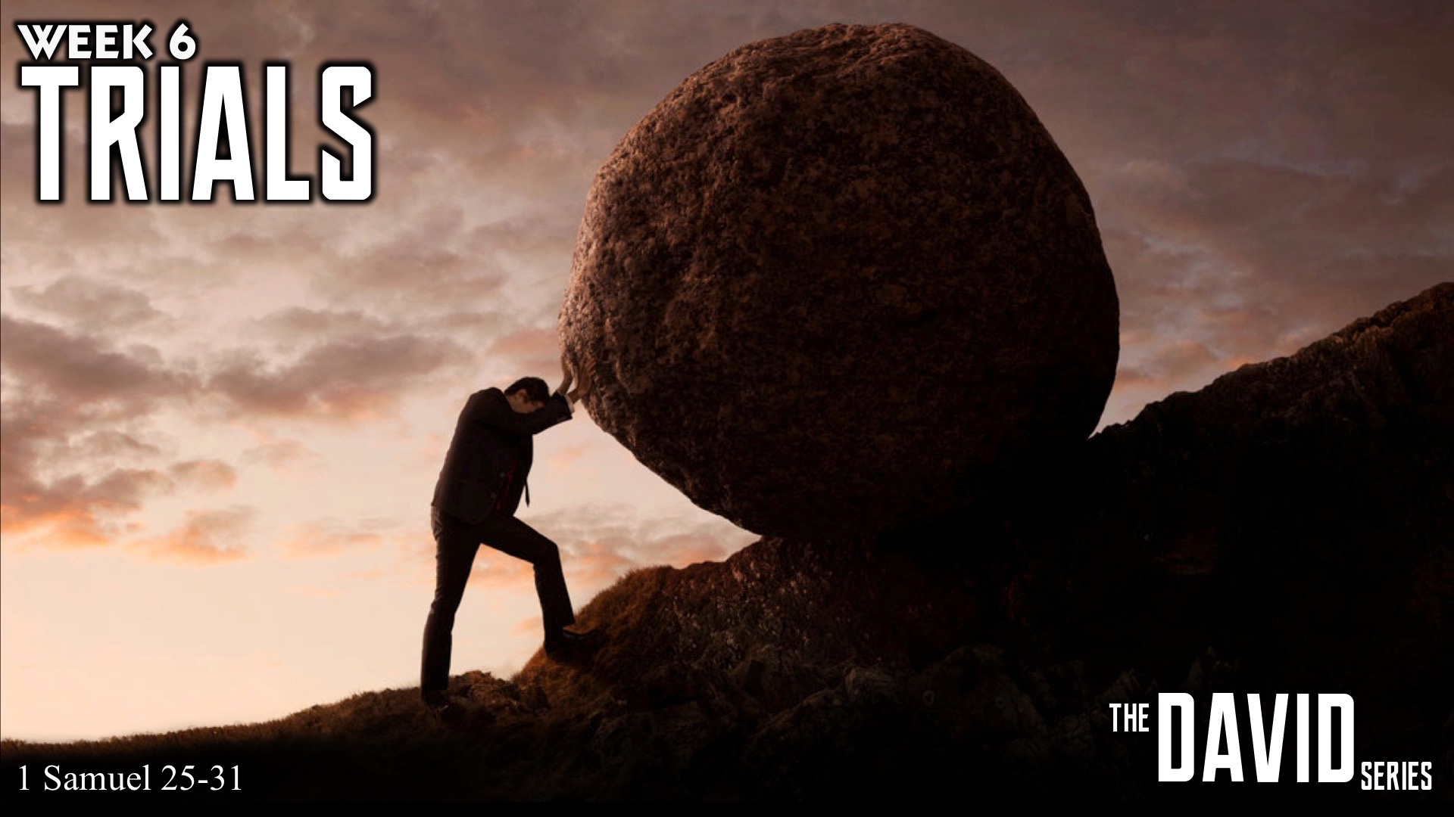
Notes:
In week 6 of the David Series, Micah spoke about Trials, and explained how in everything God is with us.

Slide 8
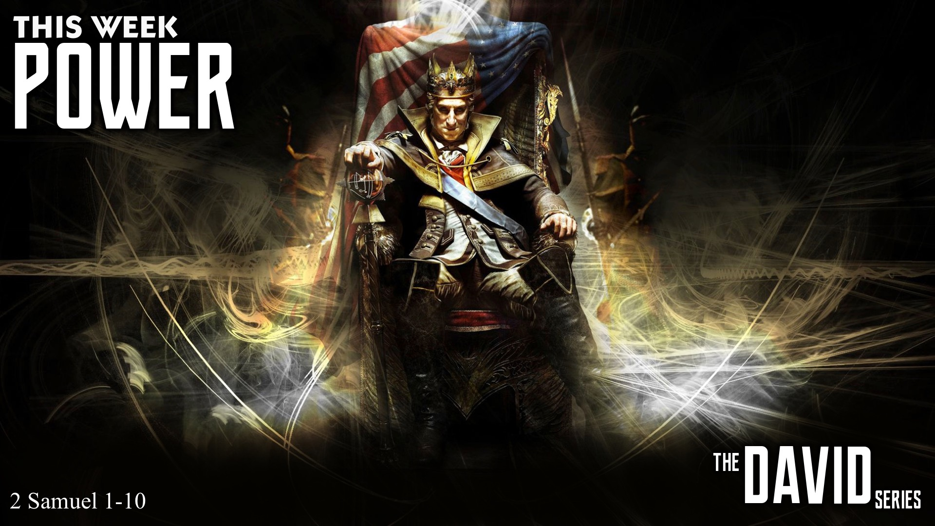
Notes:
This week are are going to learn about Power.

Slide 9
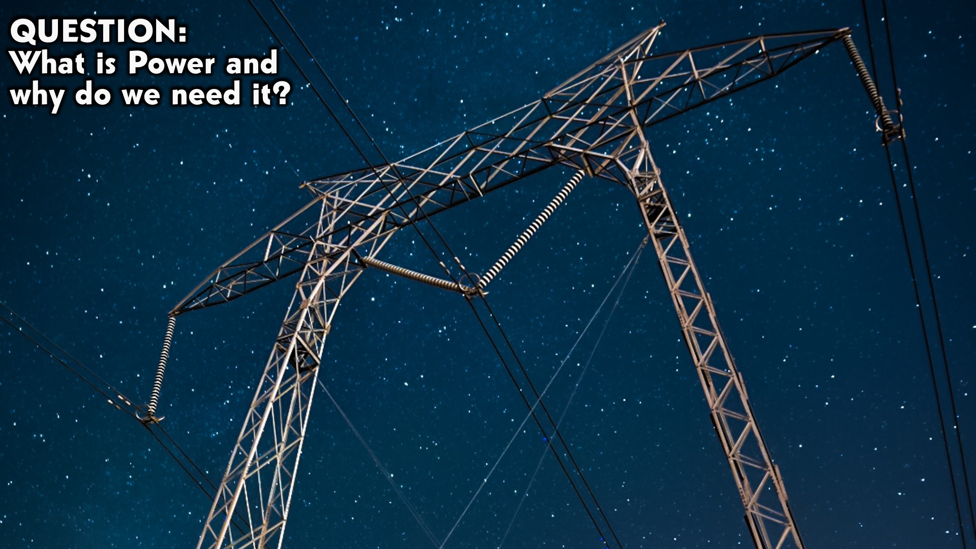
Notes:
Question: What is Power and why do we need it?

Slide 10
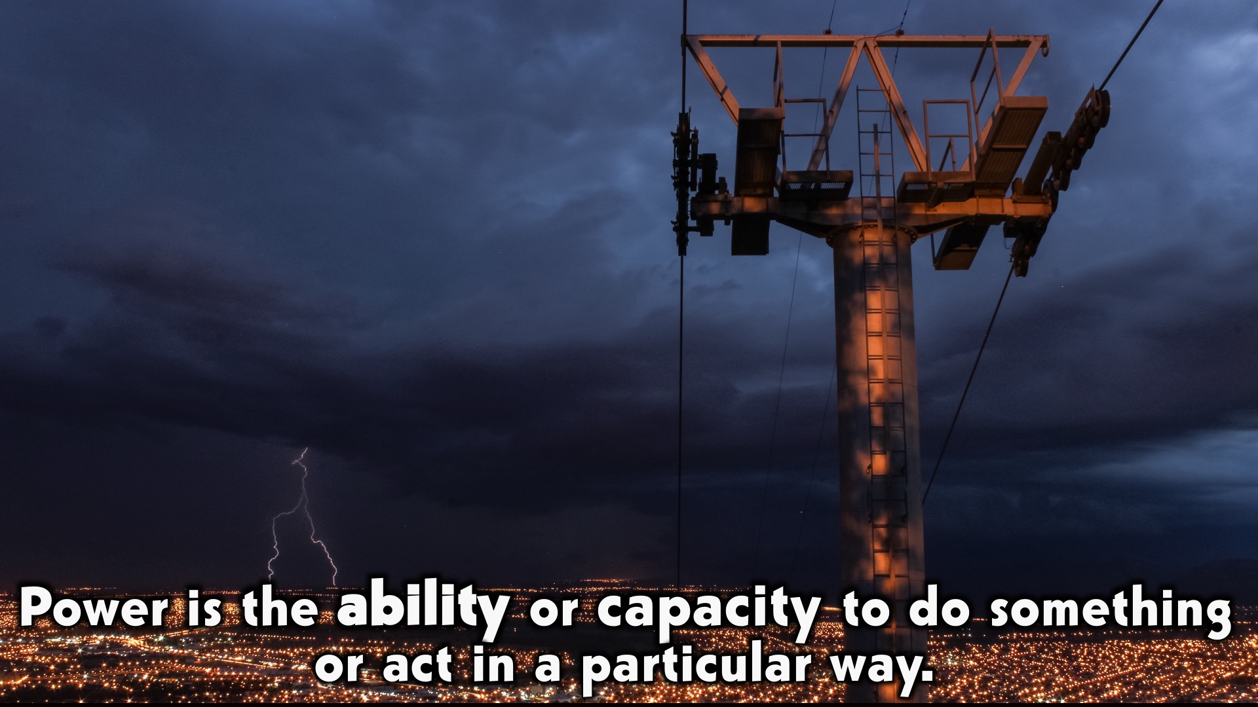
Notes:
What is Power? Power is the ability or capacity to do something or act in a particular way.

Slide 11
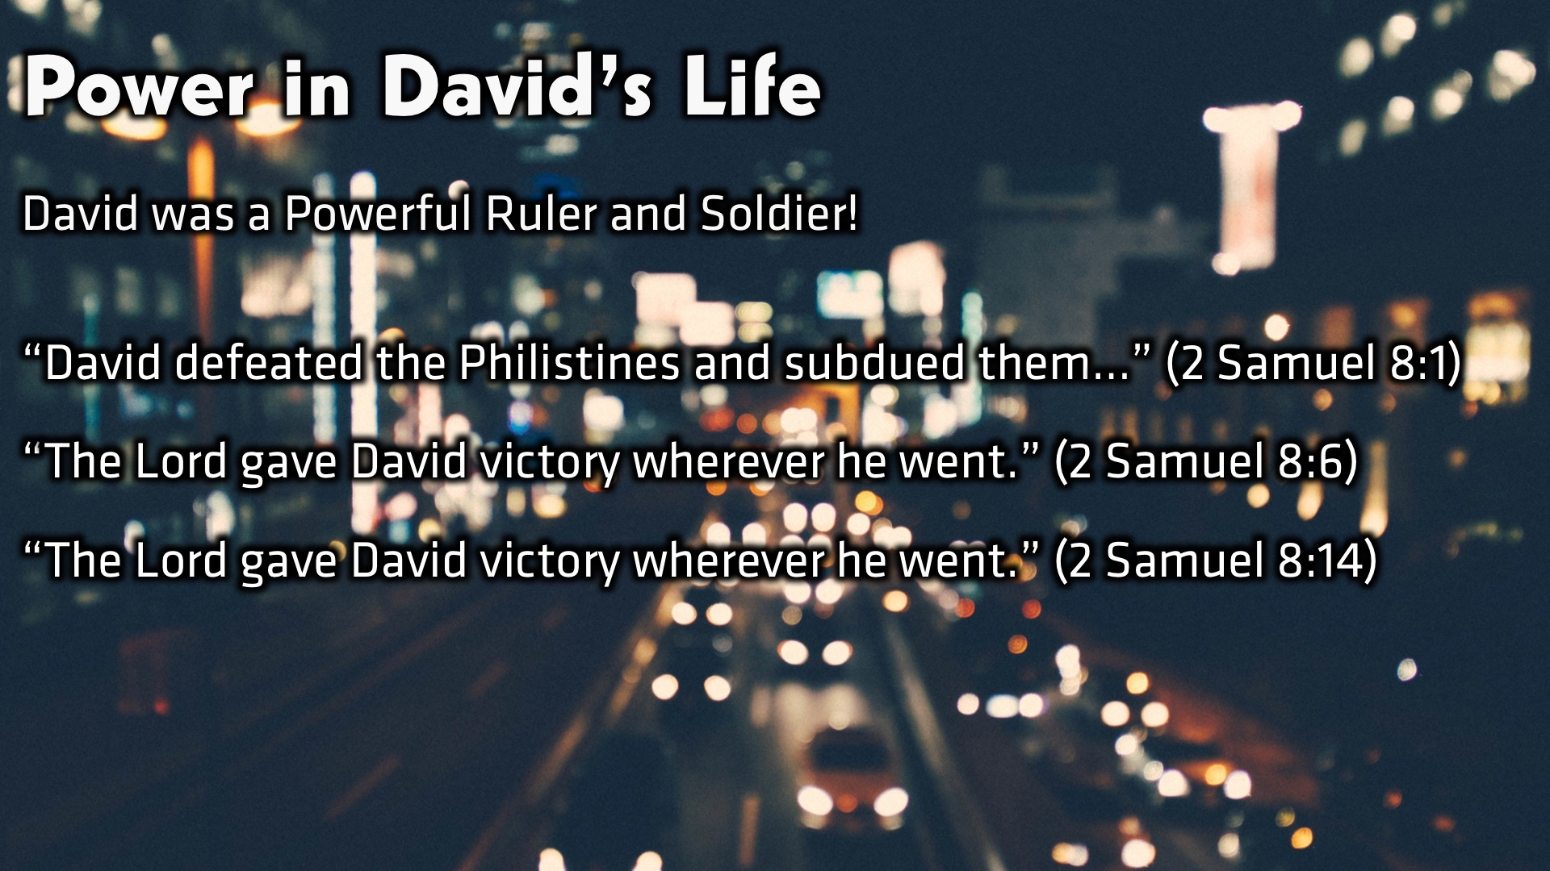
Notes:
Power in David’s Life
David was extremely Powerful – Game of thrones, hercules, hulk – He killed many people.
He conquered many armies and nations: Philistines, Moabites, Family of Haddezer
Thousands of deaths
BUT because he was operating for God, and in connection with him.

Slide 12
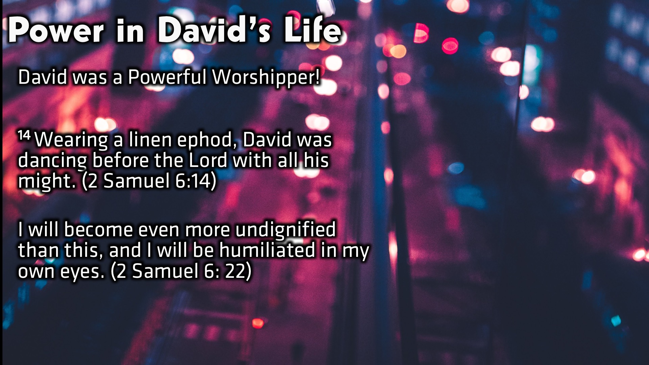
Notes:
Power in David’s Life
David spent time in worship, singing, writing and dancing.
David was a Powerful Worshipper! “¹⁴ Wearing a linen ephod, David was dancing before the Lord with all his might.” (2 Samuel 6:14) “I will become even more undignified than this, and I will be humiliated in my own eyes.” (2 Samuel 6: 22)

Slide 13
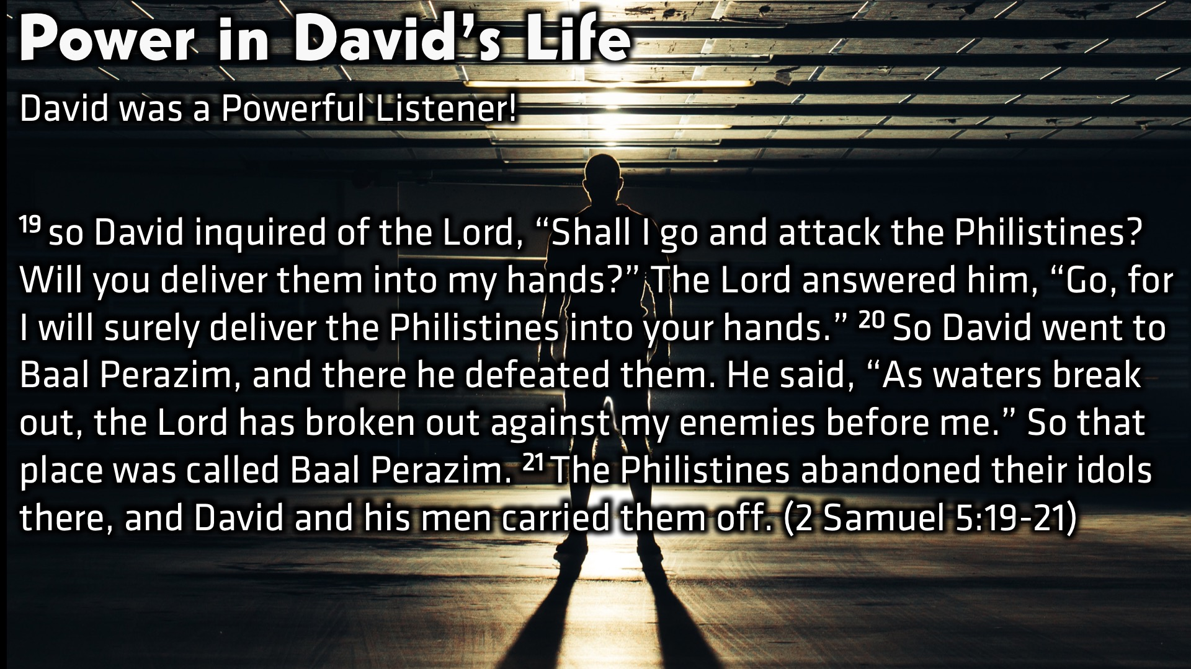
Notes:
Power in David’s Life
David was a powerful listener, he listened to God, acted according to his will, and therefore succeeded, he was given the ability to do something through God. “¹⁹ so David inquired of the Lord, “Shall I go and attack the Philistines? Will you deliver them into my hands?” The Lord answered him, “Go, for I will surely deliver the Philistines into your hands.” ²⁰ So David went to Baal Perazim, and there he defeated them. He said, “As waters break out, the Lord has broken out against my enemies before me.” So that place was called Baal Perazim. ²¹ The Philistines abandoned their idols there, and David and his men carried them off.” (2 Samuel 5:19-21)

Slide 14

Notes:
Power in My Life: Writing this sermon… I was stuck for what to write… with the topic power. I decided to put on a worship song, “A thousand Hallelujahs” and just worshipped. I listened to what God was telling me, and knew immediately that I should speak on worship, and how when we worship, we are powerful. I then acted on it.

Slide 15
Notes:
Power in My Life: I Came Up with a formula, very scientific! We are powerful when we Worship, Listen and Act.

Slide 16
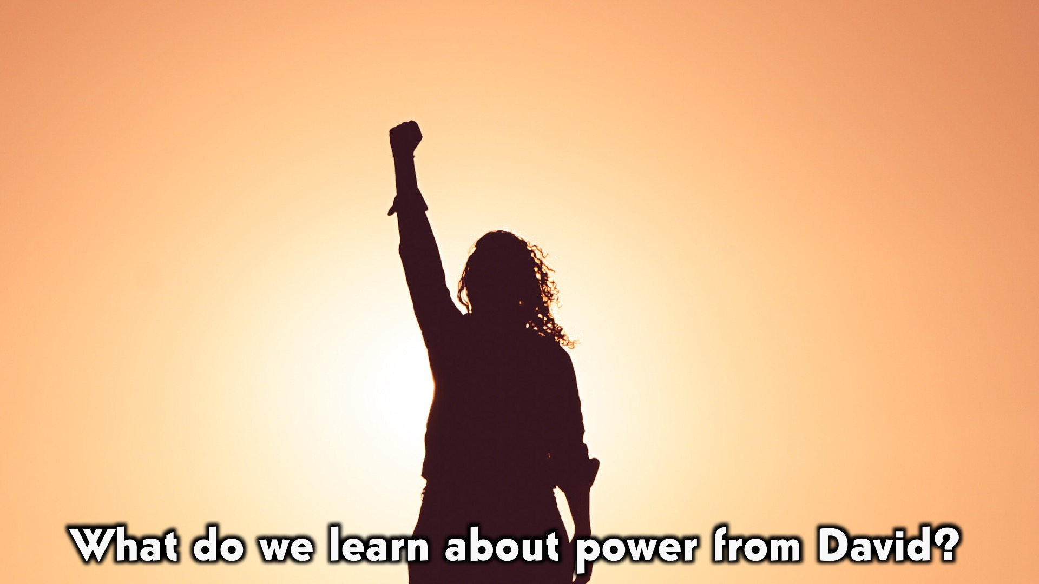
Notes:
What do we learn about power from David?

Slide 17
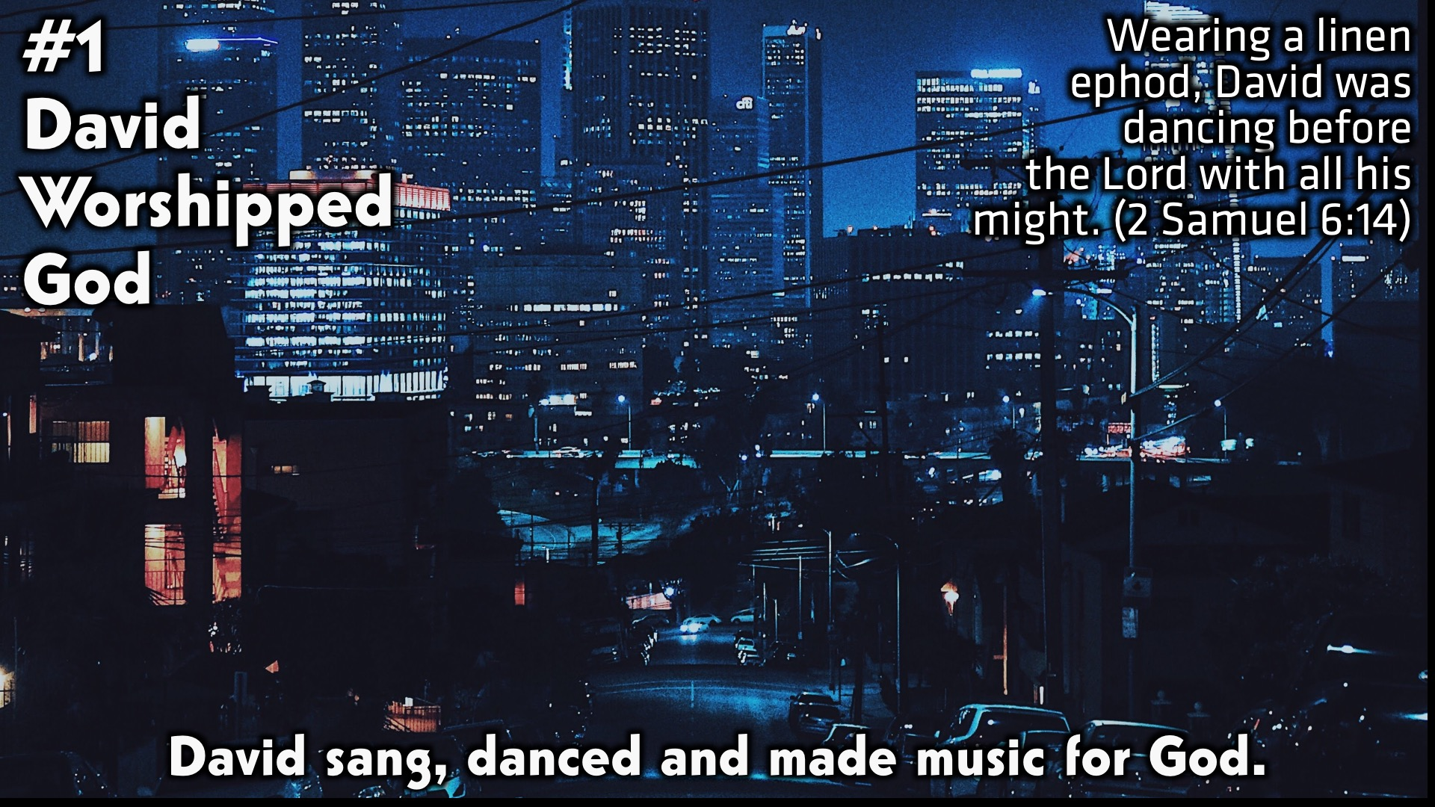
Notes:
1. David Worshipped God: David sang, danced and made music for God.

Slide 18
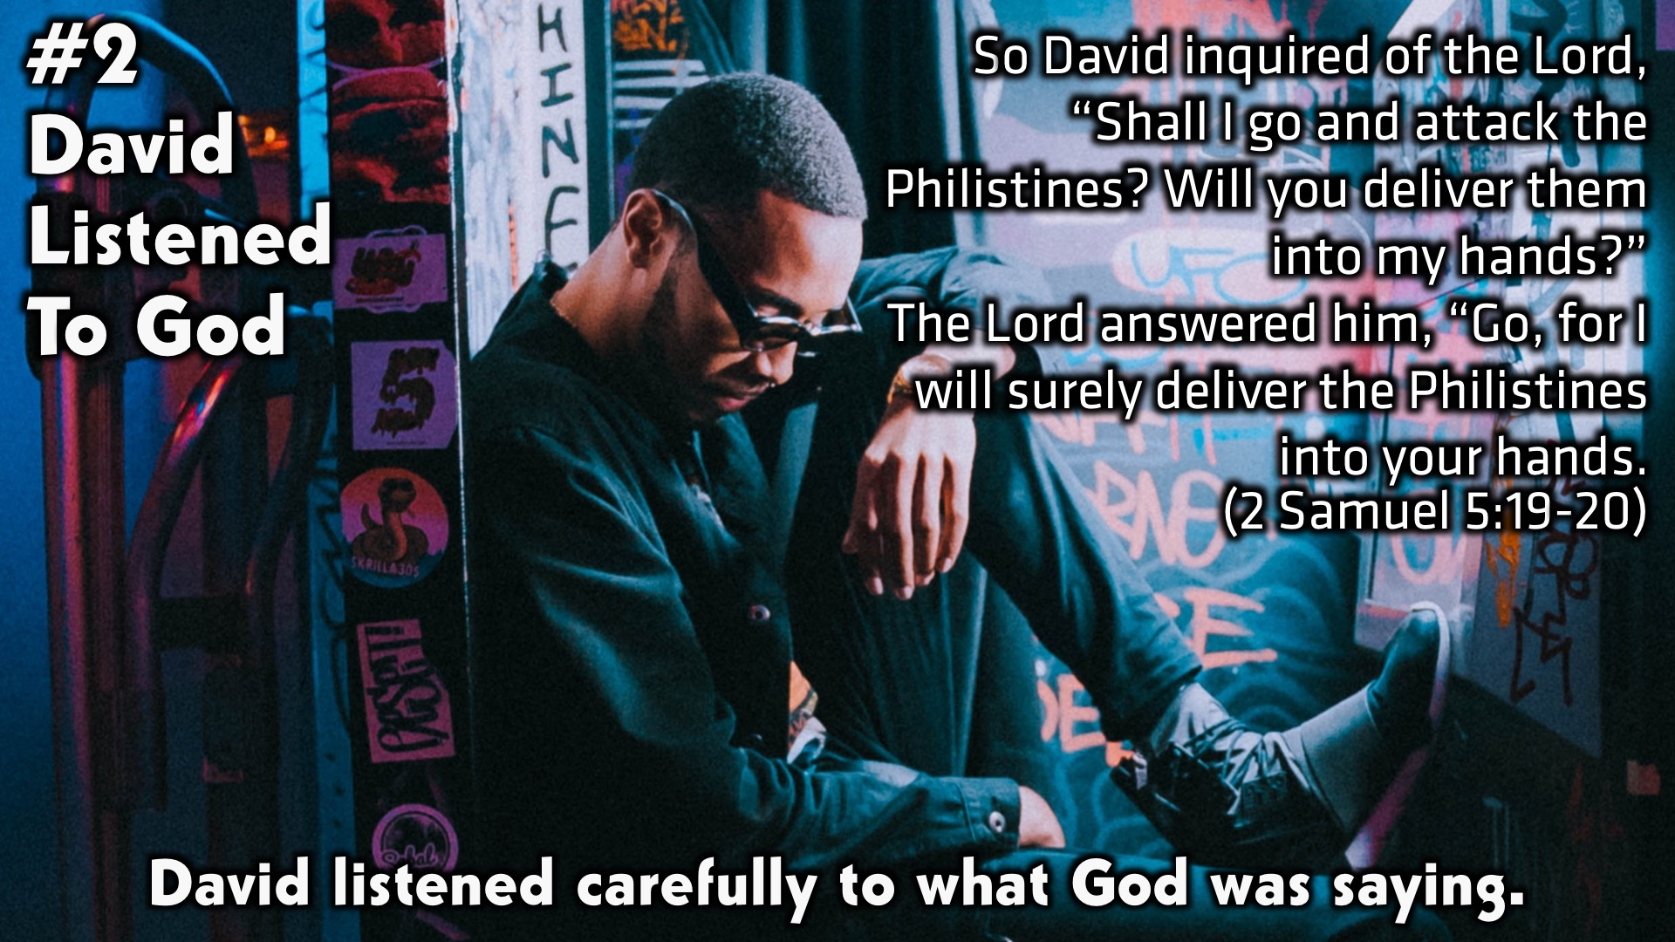
Notes:
#2David Listened To God: David listened carefully to what God was saying.

Slide 19
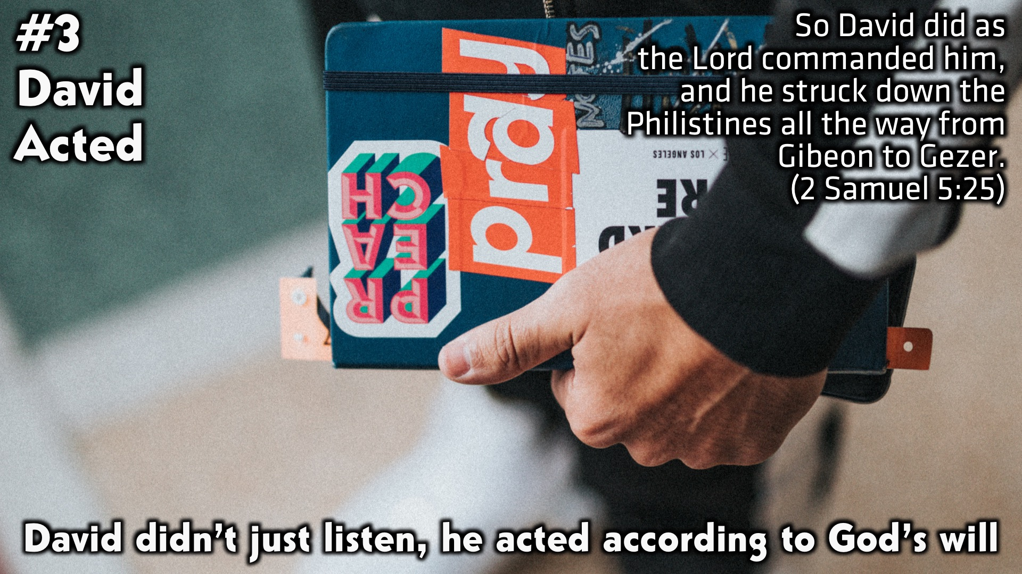
Notes:
1. David Acted: David didn’t just listen, he acted according to God’s will.

Slide 20
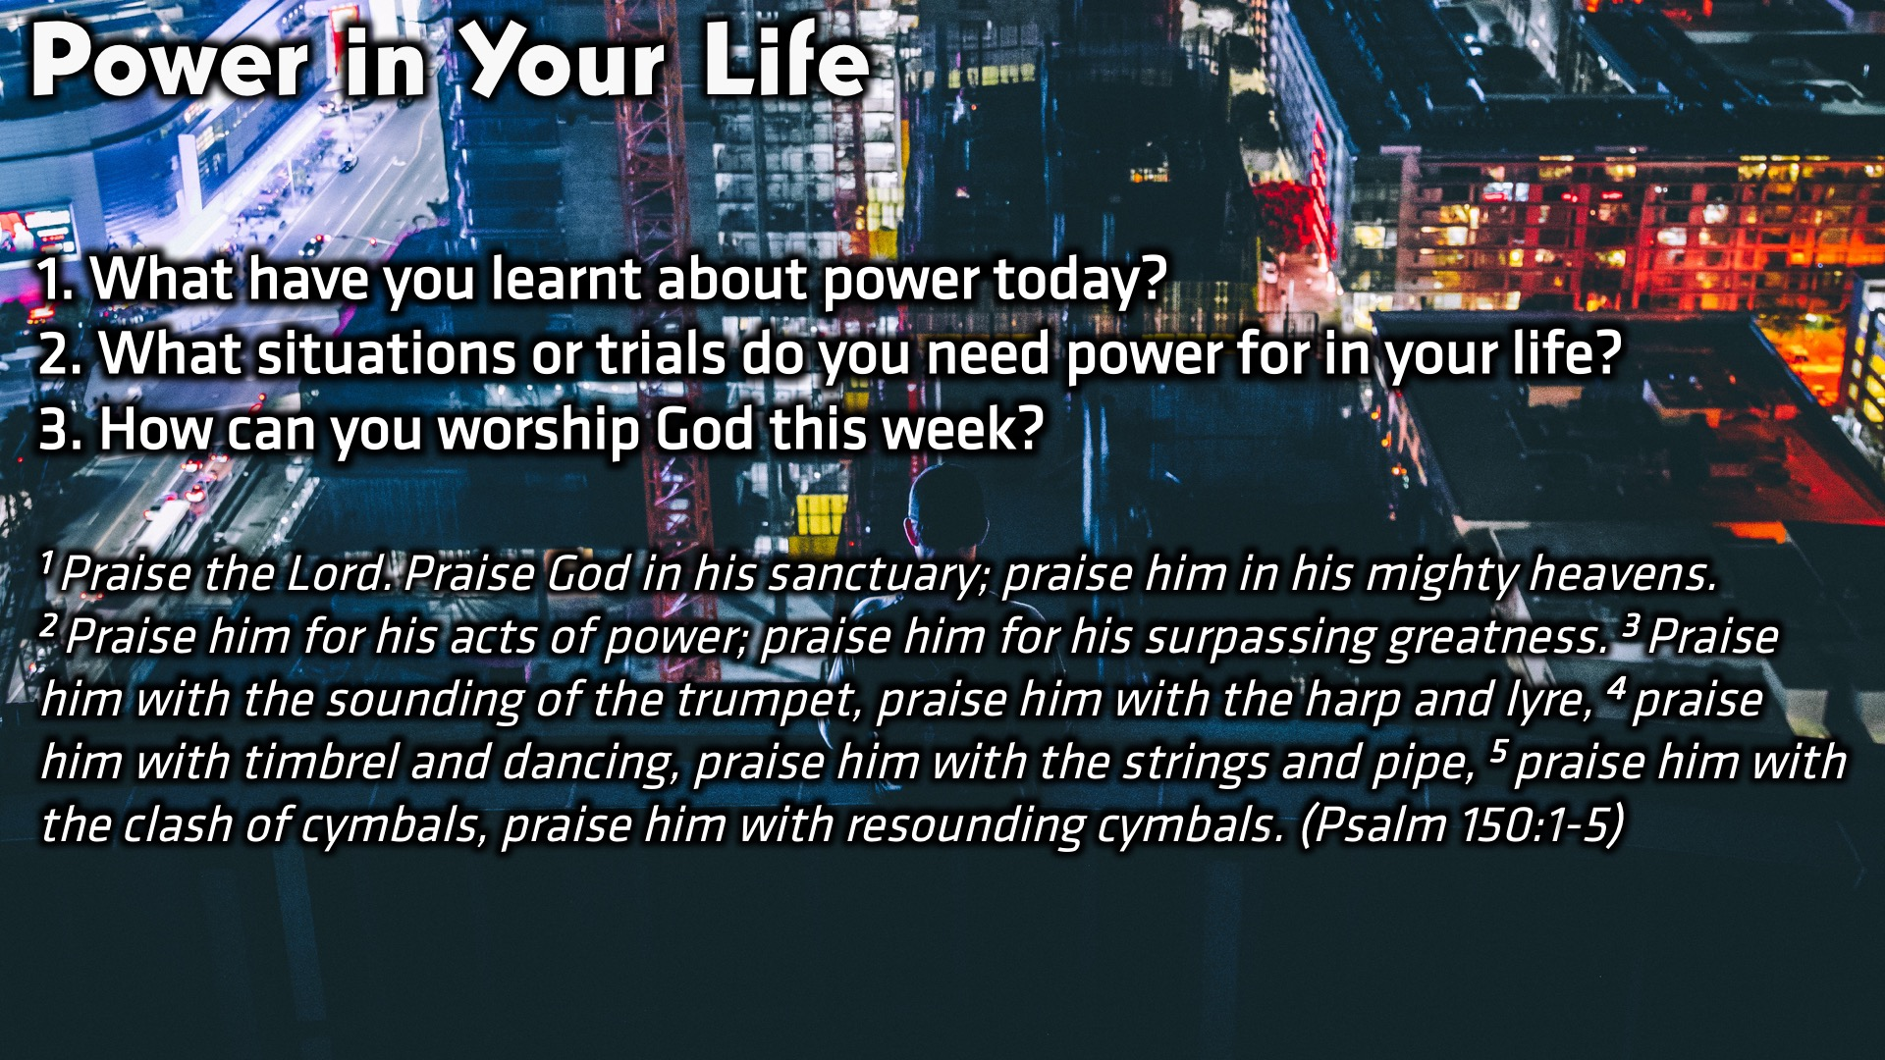
Notes:
Small Group Discussion: You have ten minutes to apply the message to your life in small groups using these 3 questions: (1) What have you learnt about power today? (2) What situations or trials do you need power for in your life? (3) How can you worship God this week?

Slide 21
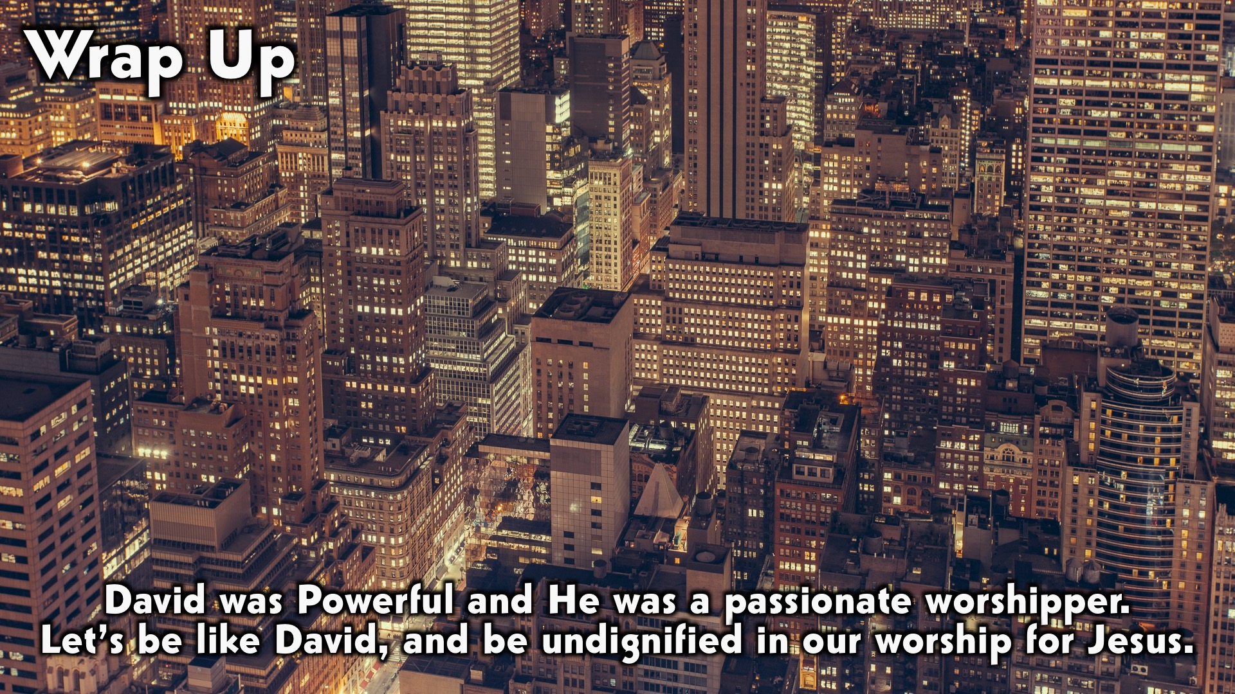
Notes:
Wrap Up: David was Powerful and He was a passionate worshipper. Let’s be like David, and be undignified in our worship for Jesus.

Slide 22
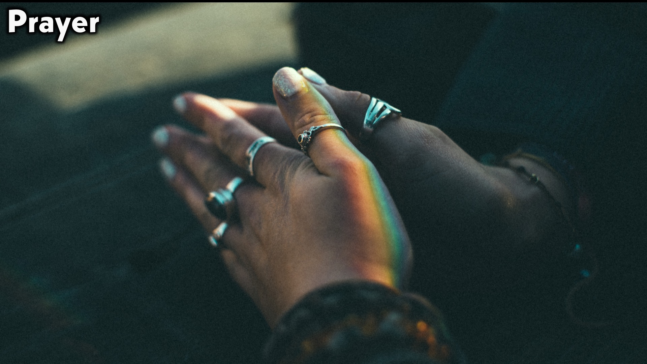
Notes:
Prayer and Ministry Moment: Play song, “A Thousand Hallelujahs” by Wholehearted Worship.

Slide 23

Notes:
Daily Devotions: We will post devotions on the Sunday WhatsApp group every night of the week throughout this series. Do everything you can to be a part of the daily journey in the life of David.

Slide 24

Notes:
Next Week: Next week we will look at the next chapter in David’s Life: Lust (2 Samuel 11-12)

