Slide 1

Notes:
Welcome to the David Series.

Slide 2

Notes:
In week 1 we learnt about Destiny.

Slide 3

Notes:
In week 2 we learnt about handing Giants.

Slide 4

Notes:
In week 3 we learnt about dealing with Friends.

Slide 5

Notes:
In week 4 we learnt about dealing with Betrayal.

Slide 6

Notes:
In week 5 we learnt about dealing with Revenge.

Slide 7

Notes:
In week 6 we learnt about dealing with Trials.

Slide 8

Notes:
Last week we learnt about dealing with Power.

Slide 9

Notes:
This week we are going to learn about Lust.

Slide 10

Notes:
Small Group Discussion: (1) What is your understanding of lust? (2) What do think the following scripture says about lust? Oh, let me warn you, sisters in Jerusalem: Don’t excite love, don’t stir it up, until the time is ripe - and you’re ready. ~ Song of Solomon 8:4

Slide 11
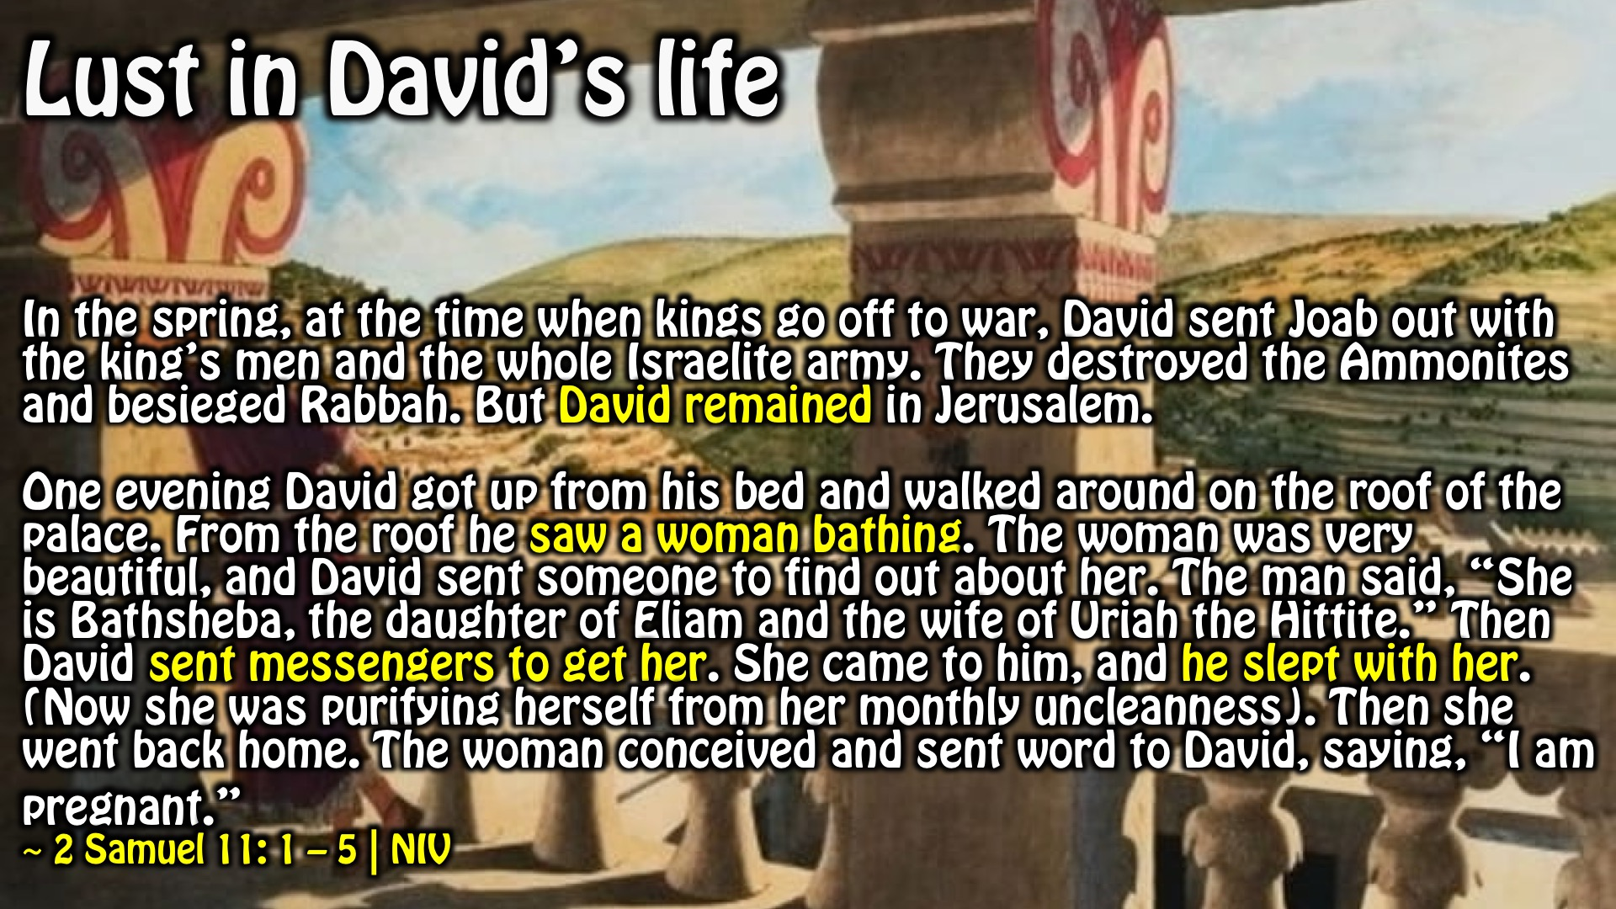
Notes:
Lust in David’s Life: In the spring, at the time when kings go off to war, David sent Joab out with the king’s men and the whole Israelite army. They destroyed the Ammonites and besieged Rabbah. But David remained in Jerusalem.
One evening David got up from his bed and walked around on the roof of the palace. From the roof he saw a woman bathing. The woman was very beautiful, and David sent someone to find out about her. The man said, “She is Bathsheba, the daughter of Eliam and the wife of Uriah the Hittite.” Then David sent messengers to get her. She came to him, and he slept with her. (Now she was purifying herself from her monthly uncleanness). Then she went back home. The woman conceived and sent word to David, saying, “I am pregnant.”
~ 2 Samuel 11: 1 – 5 | NIV

Slide 12

Notes:
Lust in David’s Life: (1) David abandoned his purpose (2) David focused on his own desires (3) David looked into instead of turning away from sin – 1 Corinthians 6:18 (4) David sinned deliberately (5) David tried to cover up his sin (6) David murdered to continue to cover up his sin (7) David experienced far-reaching consequences to his sin

Slide 13
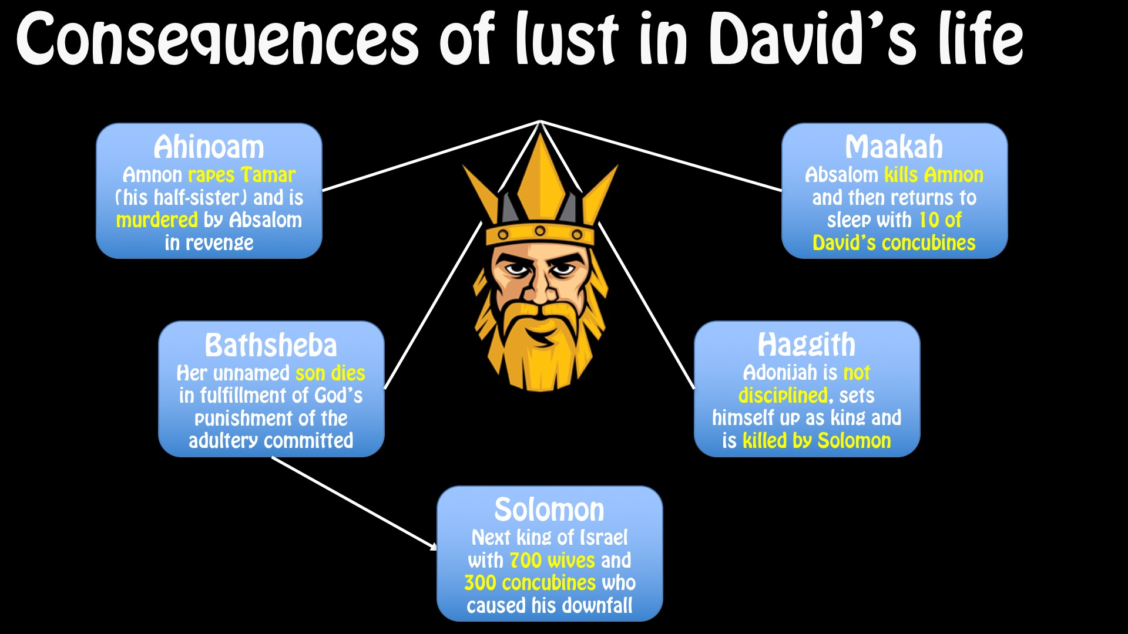
Notes:
Consequences of lust in David’s life: (1) Ahinoam - Amnon rapes Tamar (his half-sister) and is murdered by Absalom in revenge (2) Bathsheba - Her unnamed son dies in fulfillment of God’s punishment of the adultery committed (3) Solomon - Next king of Israel with 700 wives and 300 concubines who caused his downfall (4) Maakah - Absalom kills Amnon and then returns to sleep with 10 of David’s concubines (5) Haggith - Adonijah is not disciplined, sets himself up as king and is killed by Solomon

Slide 14
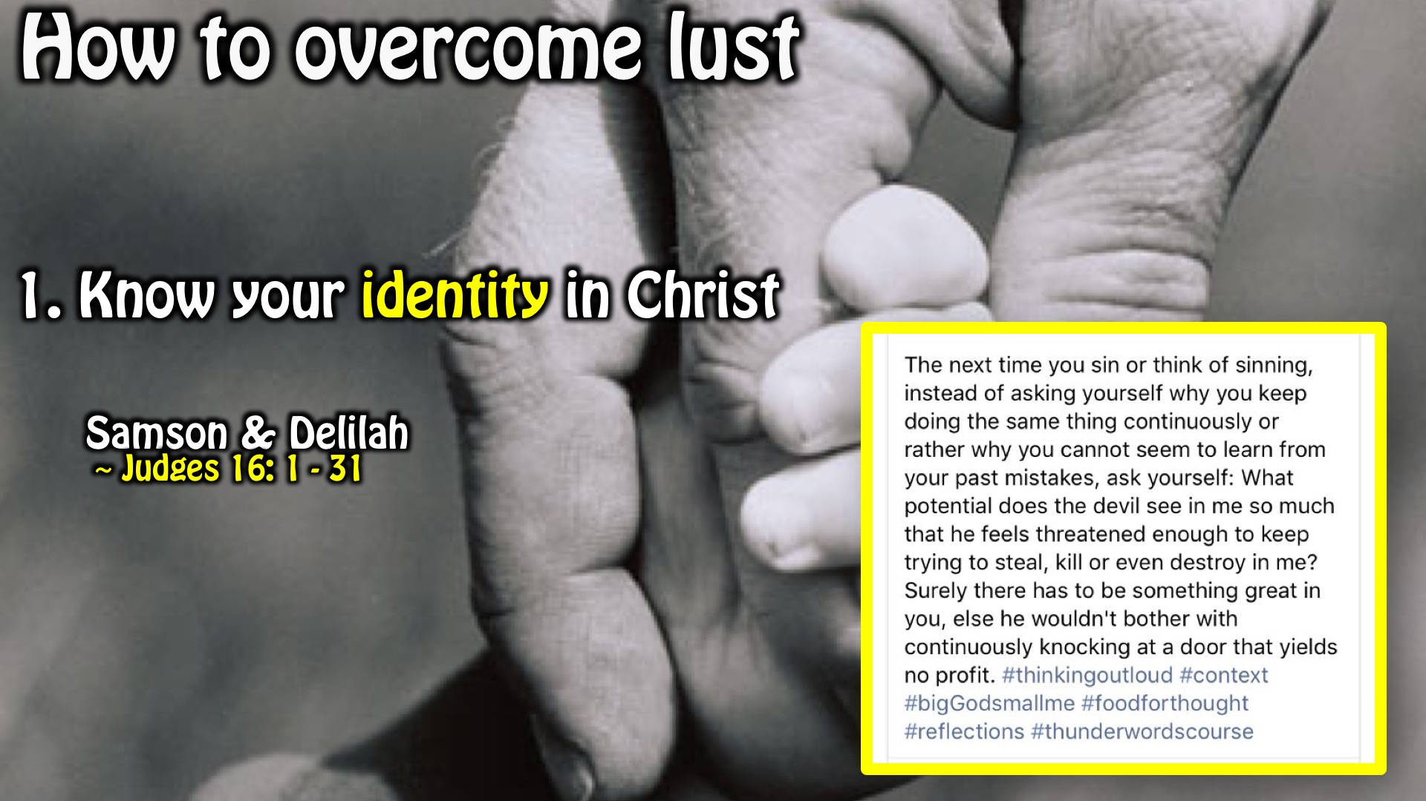
Notes:
How to overcome lust: Know your identity in Christ. Samson and Delilah (Judges 16: 1-31)

Slide 15
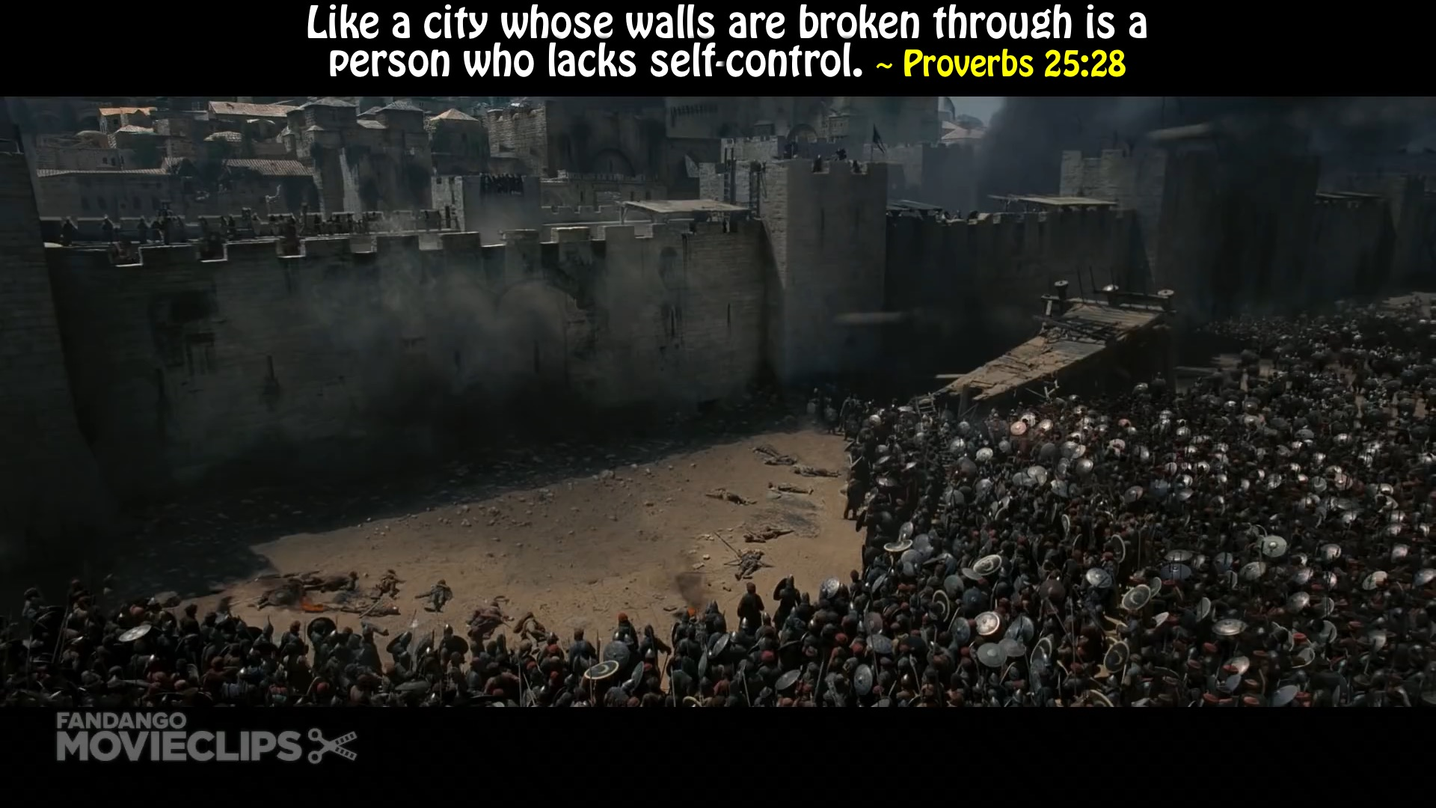
Notes:
Video: Find this clip on YouTube at https://www.youtube.com/watch?v=qG8YoqrNMEA (Kingdom of Heaven)

Slide 16
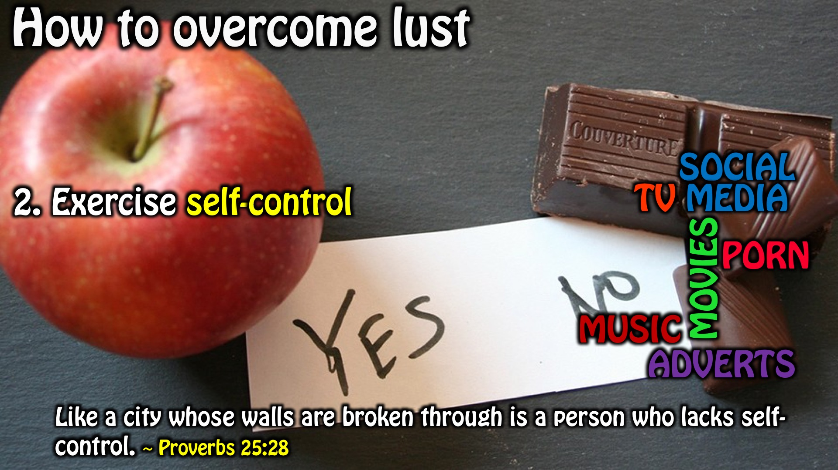
Notes:
How to overcome lust: Exercise self control. Like a city whose walls are broken through is a person who lacks self-control. (Proverbs 25:28)

Slide 17
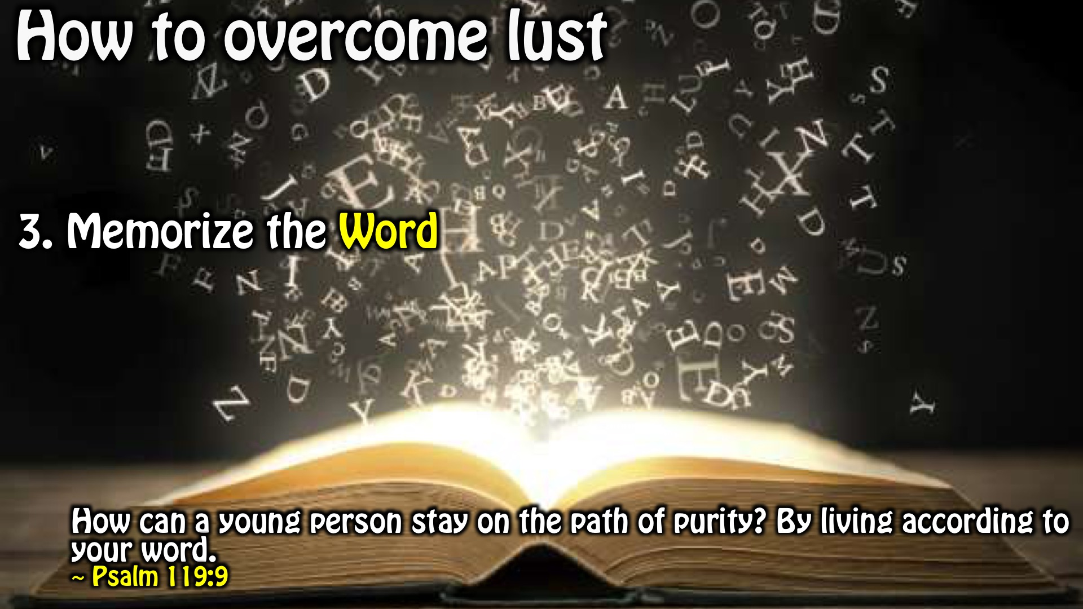
Notes:
How to overcome lust: Memorize the word. How can a young person stay on the path of purity? By living according to your word. (Psalm 119:9)

Slide 18
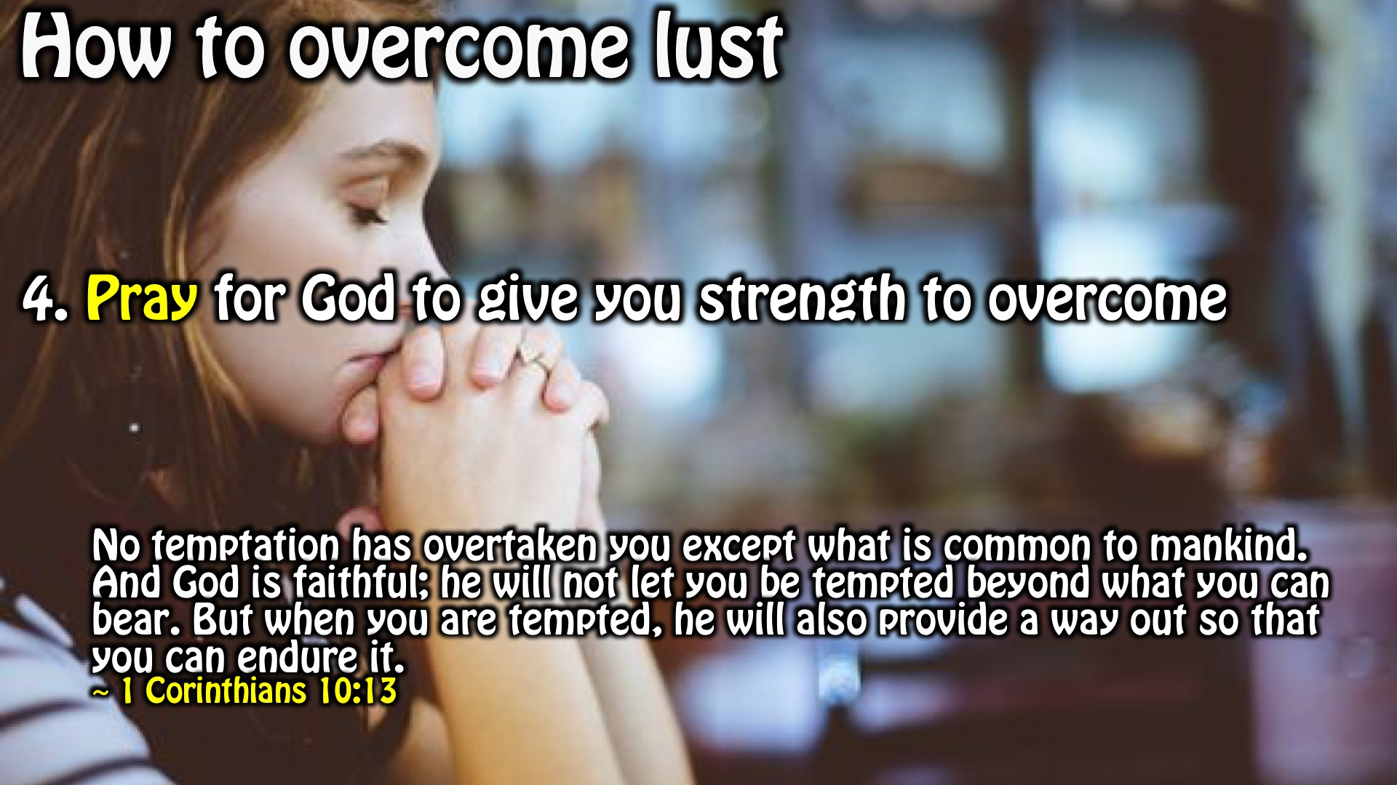
Notes:
How to overcome lust: Pray for God to give you strength to overcome. No temptation has overtaken you except what is common to mankind. And God is faithful; he will not let you be tempted beyond what you can bear. But when you are tempted, he will also provide a way out so that you can endure it. (1 Corinthians 10:13)

Slide 19
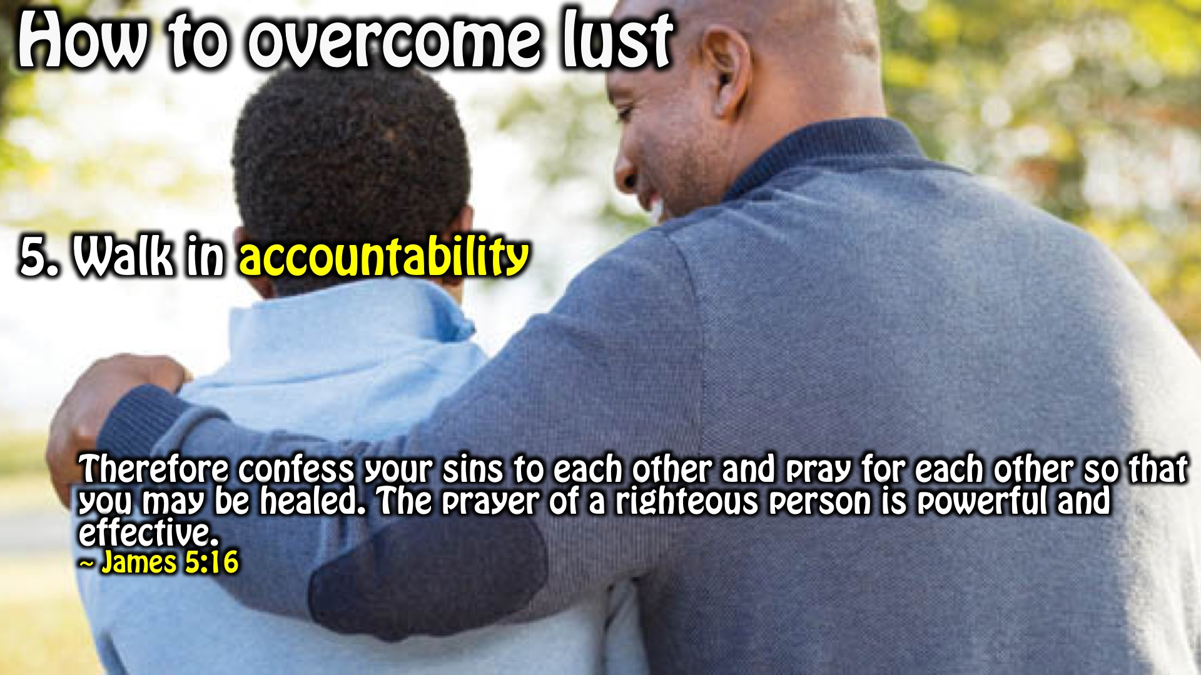
Notes:
How to overcome lust: Walk in accountability. Therefore confess your sins to each other and pray for each other so that you may be healed. The prayer of a righteous person is powerful and effective. (James 5:16)

Slide 20
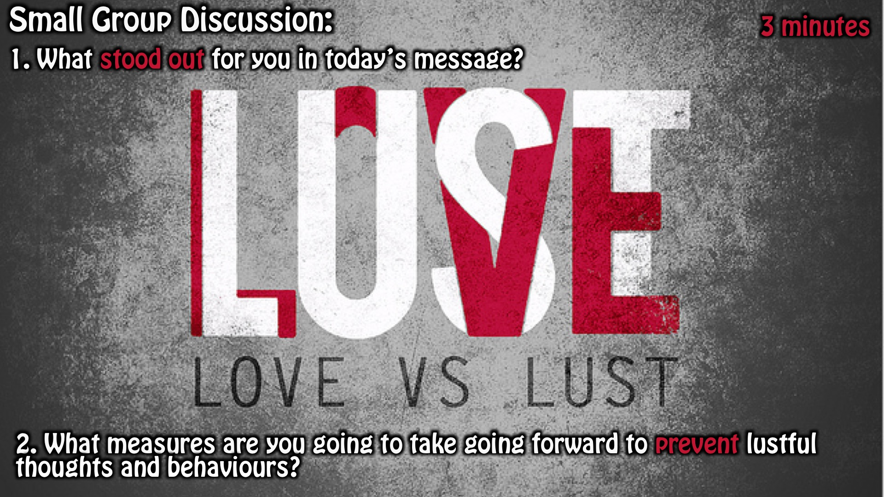
Notes:
Small Group Discussion: (1) What stood out for you in today’s message? (2) What measures are you going to take going forward to prevent lustful thoughts and behaviors?

Slide 21

Notes:
Summary of today’s sermon.

Slide 22
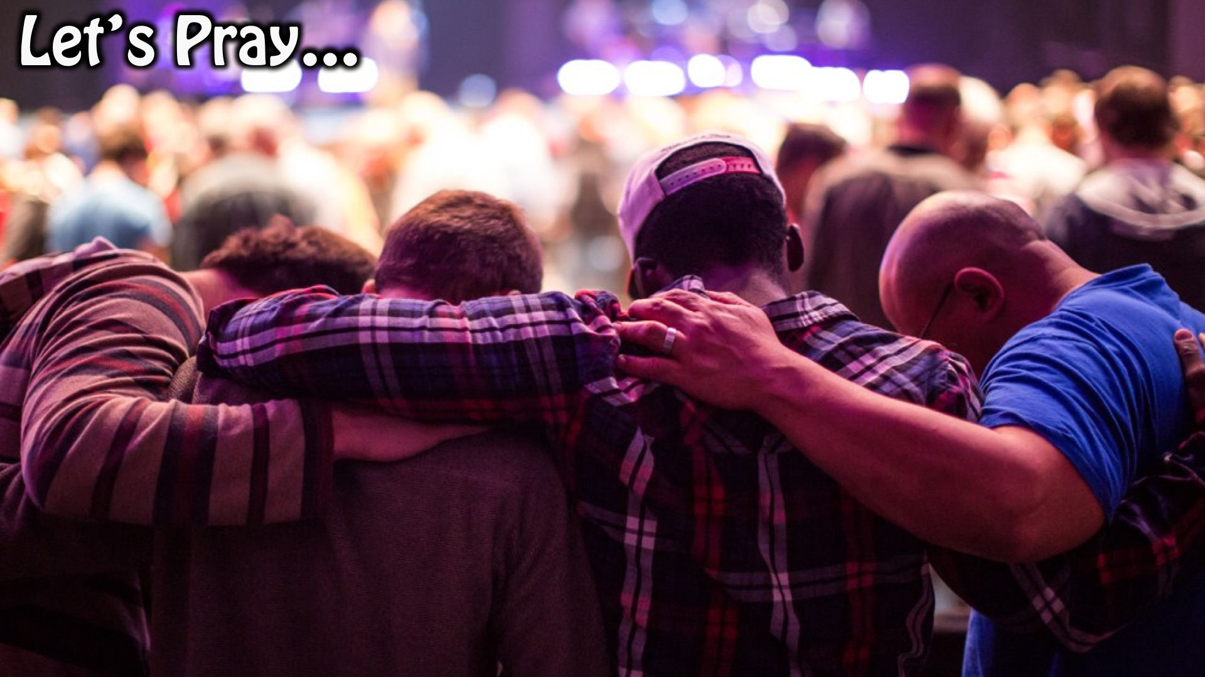
Notes:
Prayer.

Slide 23

Notes:
Daily Devotions: We will post devotions on the Sunday WhatsApp group every night of the week throughout this series. Do everything you can to be a part of the daily journey in the life of David.

Slide 24

Notes:
Next Week: Next week we will look at the next chapter in David’s Life: Tragedy (2 Samuel 13-18)

