Slide 1
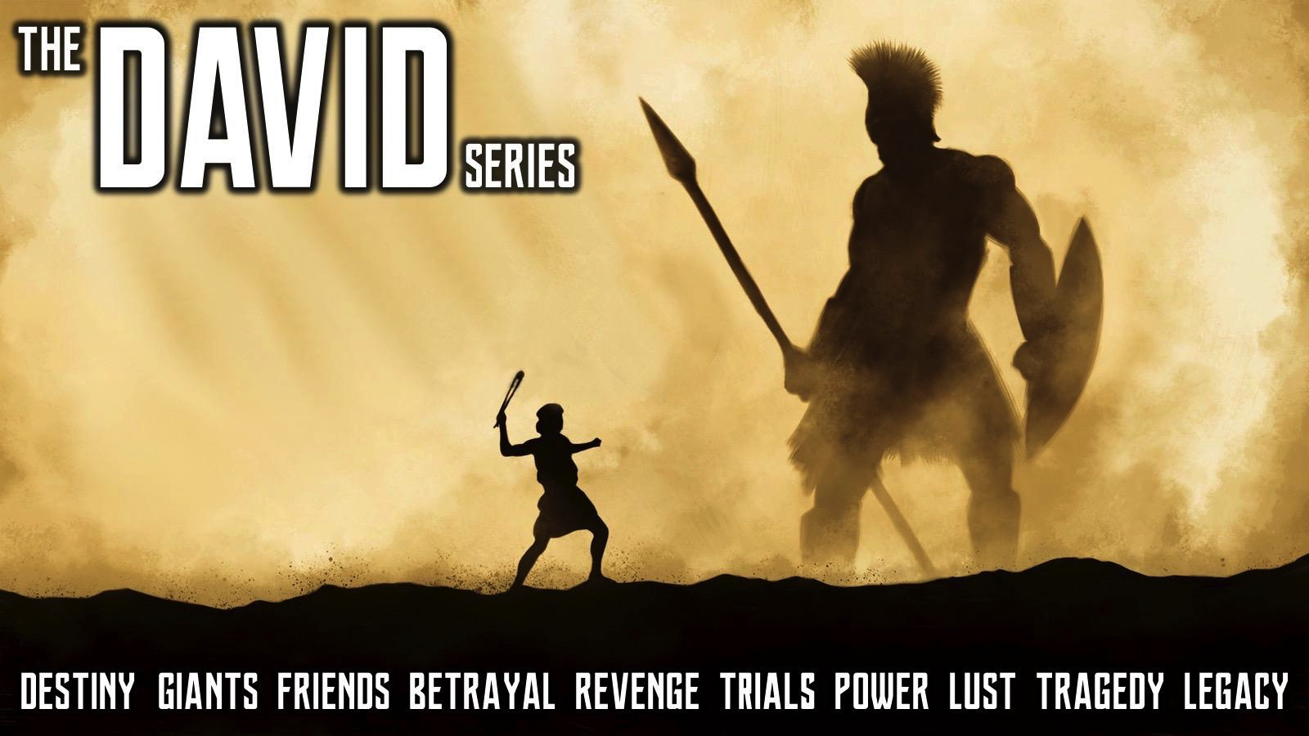
Notes:
Welcome to the David Series.

Slide 2

Notes:
Week 1: Destiny (1 Samuel 16)

Slide 3
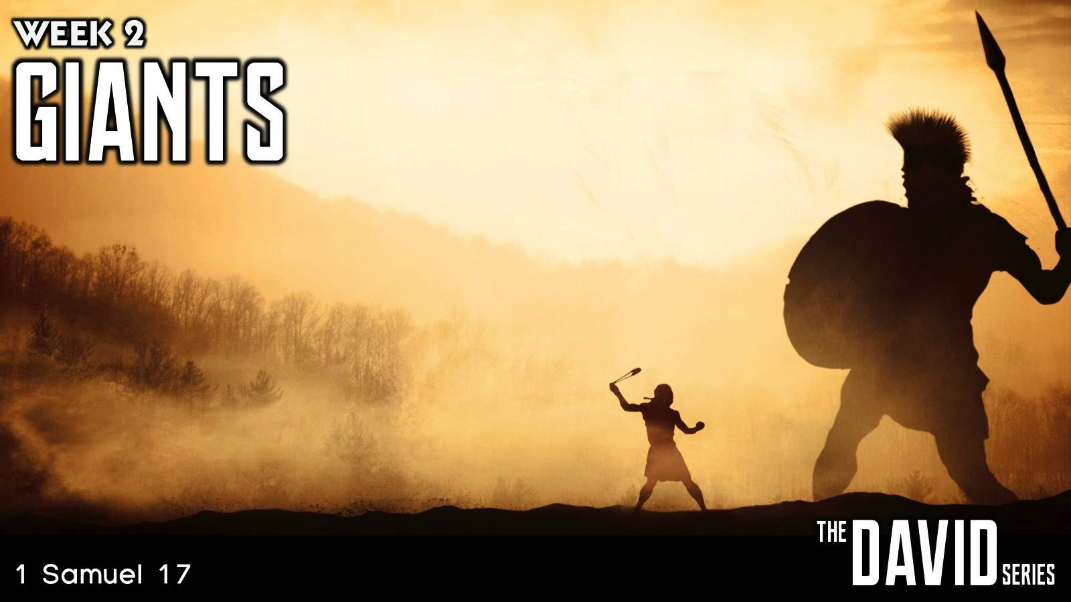
Notes:
Week 2: Giants (1 Samuel 17)

Slide 4

Notes:
Week 3: Friends (1 Samuel 18-20)

Slide 5
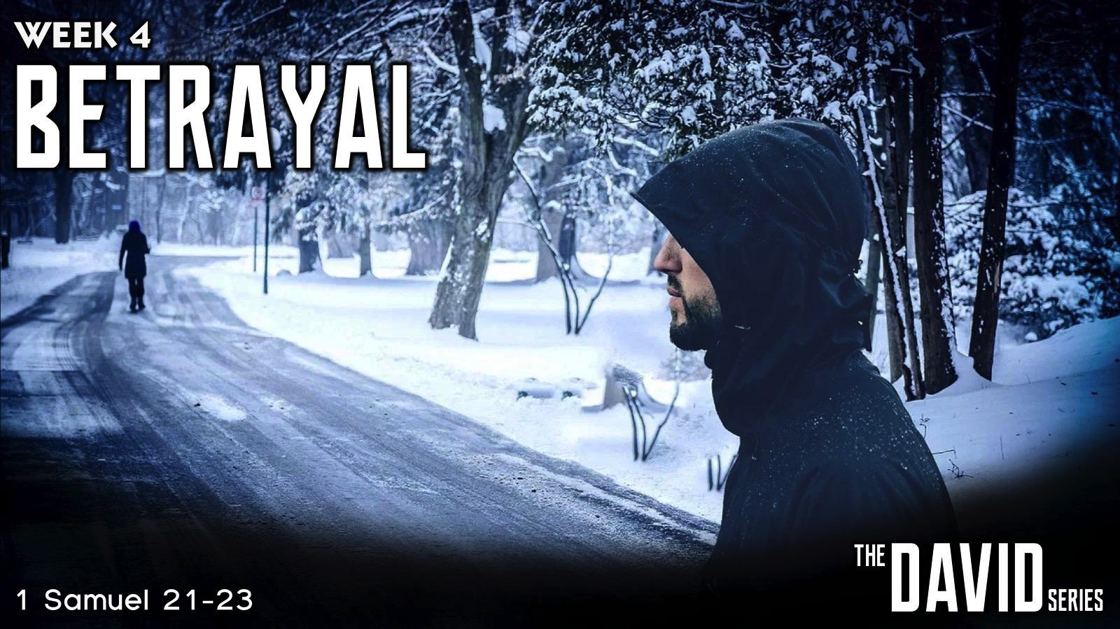
Notes:
Week 4: Betrayal (1 Samuel 21-23)

Slide 6
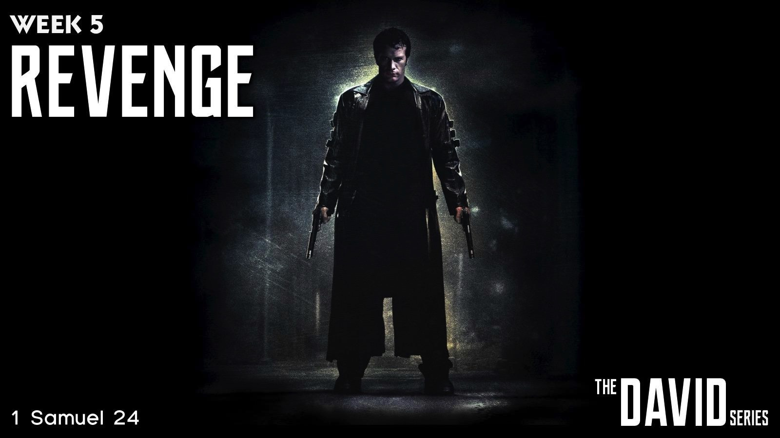
Notes:
Week 5: Revenge (1 Samuel 24)

Slide 7

Notes:
Week 6: Trials (1 Samuel 25-31)

Slide 8
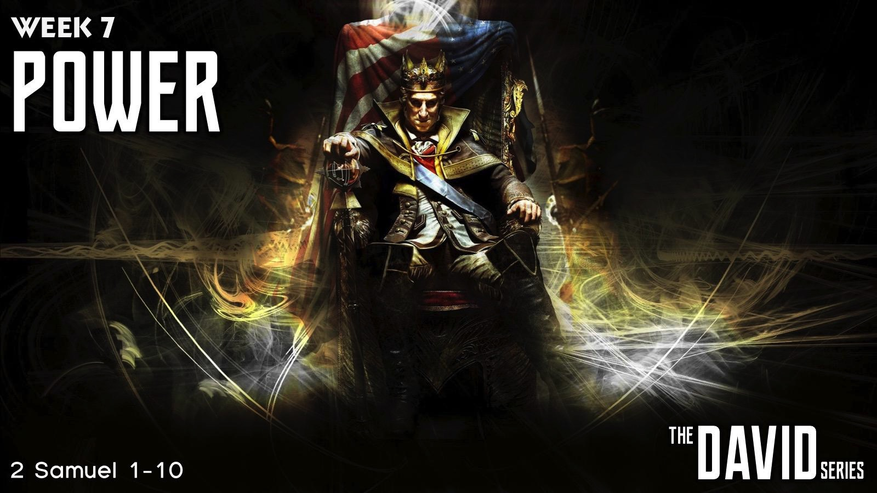
Notes:
Week 7: Power (2 Samuel 1-10)

Slide 9

Notes:
Last Week we explored Lust (2 Samuel 11-12)

Slide 10

Notes:
This week are are going to learn about Tragedy.

Slide 11
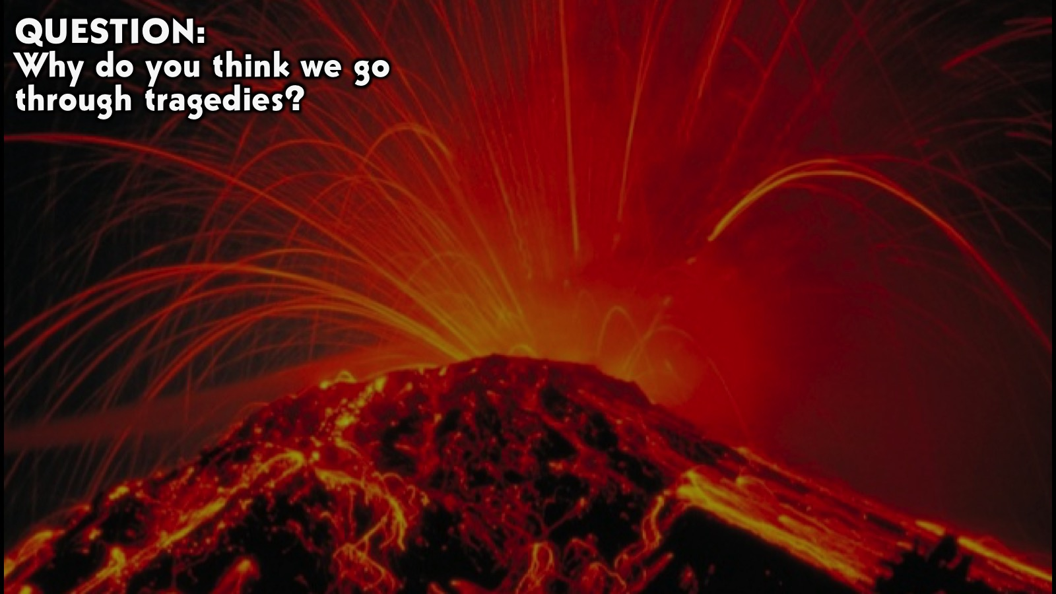
Notes:
Question: Why do you think we go through tragedies?

Slide 12
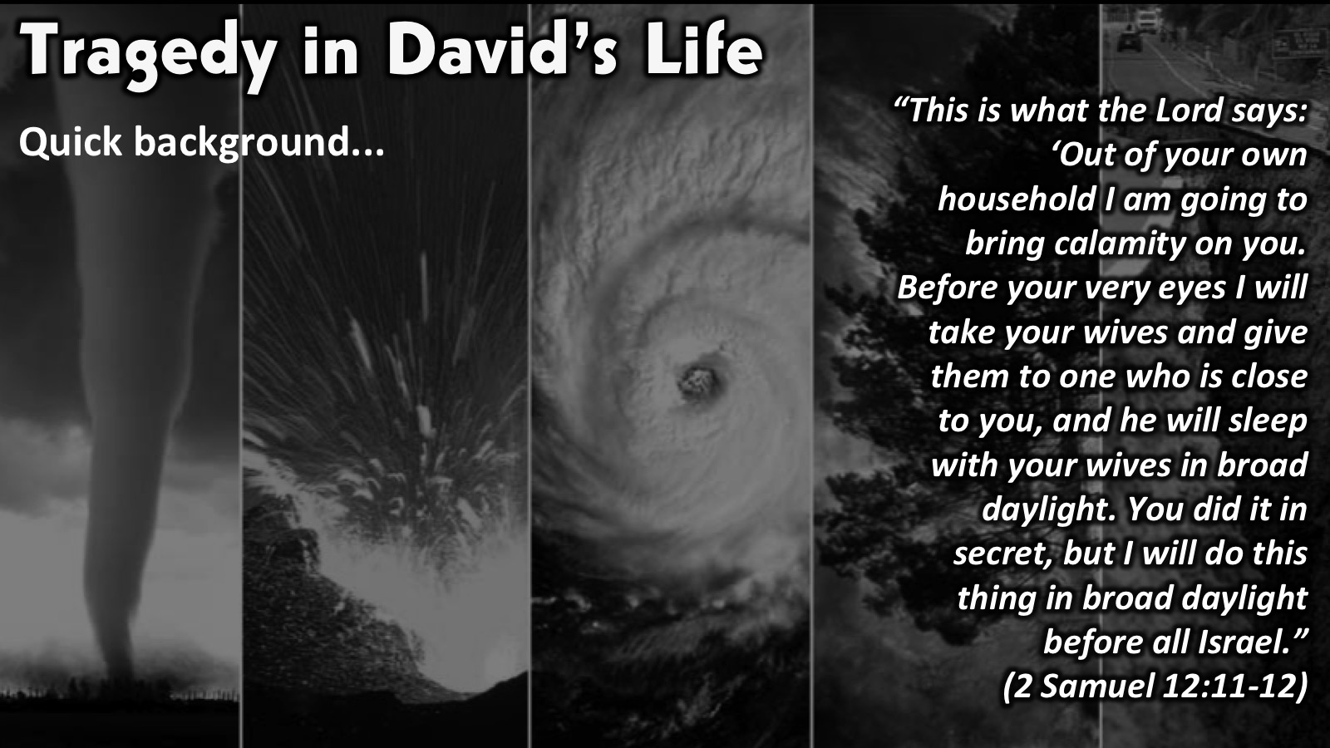
Notes:
Tragedy in David’s Life: Quick background…….. things started falling apart in David’s life when he disobeyed God by committing murder and adultery, based on selfish reasons. “This is what the Lord says: ‘Out of your own household I am going to bring calamity on you. Before your very eyes I will take your wives and give them to one who is close to you, and he will sleep with your wives in broad daylight. You did it in secret, but I will do this thing in broad daylight before all Israel.” (2 Samuel 12:11-12).

Slide 13
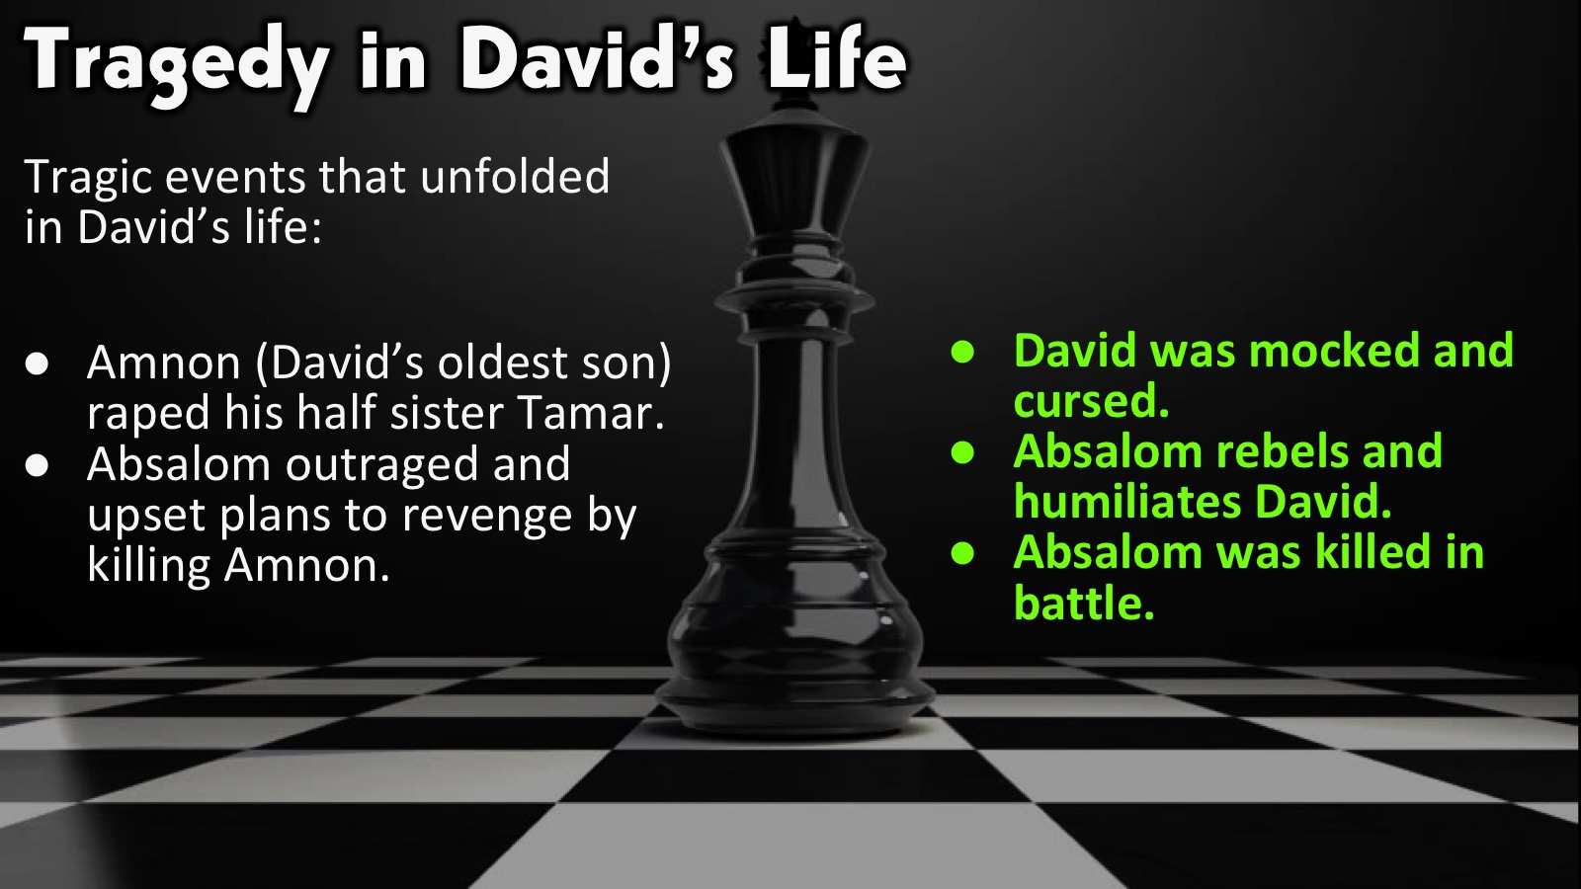
Notes:
Tragedy in David’s Life: Tragic events that unfolded in David’s life. (1) Amnon (David’s oldest son) raped his half sister Tamar. (2 Samuel 13:12-14). (2) Absalom outraged and upset plans to revenge by killing Amnon. (2 Samuel 13:23-29). The three points i am going to focus on are: (1) David was mocked and cursed. (2) Samuel 16:5-8). (2) Absalom devises a clever plan to overthrow his father David. (2 Samuel 15 vs 1-12). (3) Absalom was killed in battle. (2 Samuel 18:14-15)

Slide 14
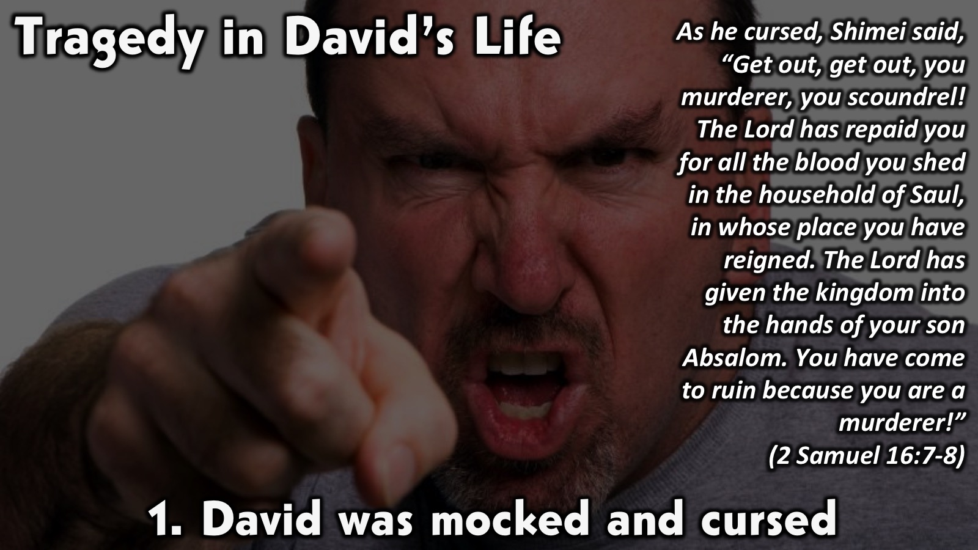
Notes:
1. David was mocked and cursed. As he cursed, Shimei said, “Get out, get out, you murderer, you scoundrel! The Lord has repaid you for all the blood you shed in the household of Saul, in whose place you have reigned. The Lord has given the kingdom into the hands of your son Absalom. You have come to ruin because you are a murderer!” (2 Samuel 16:7-8). David had already lost a lot at this point , now Shimei comes and starts to mock him making him feel worse. But David just carried on and ignored the insults. He was already down what more ….

Slide 15
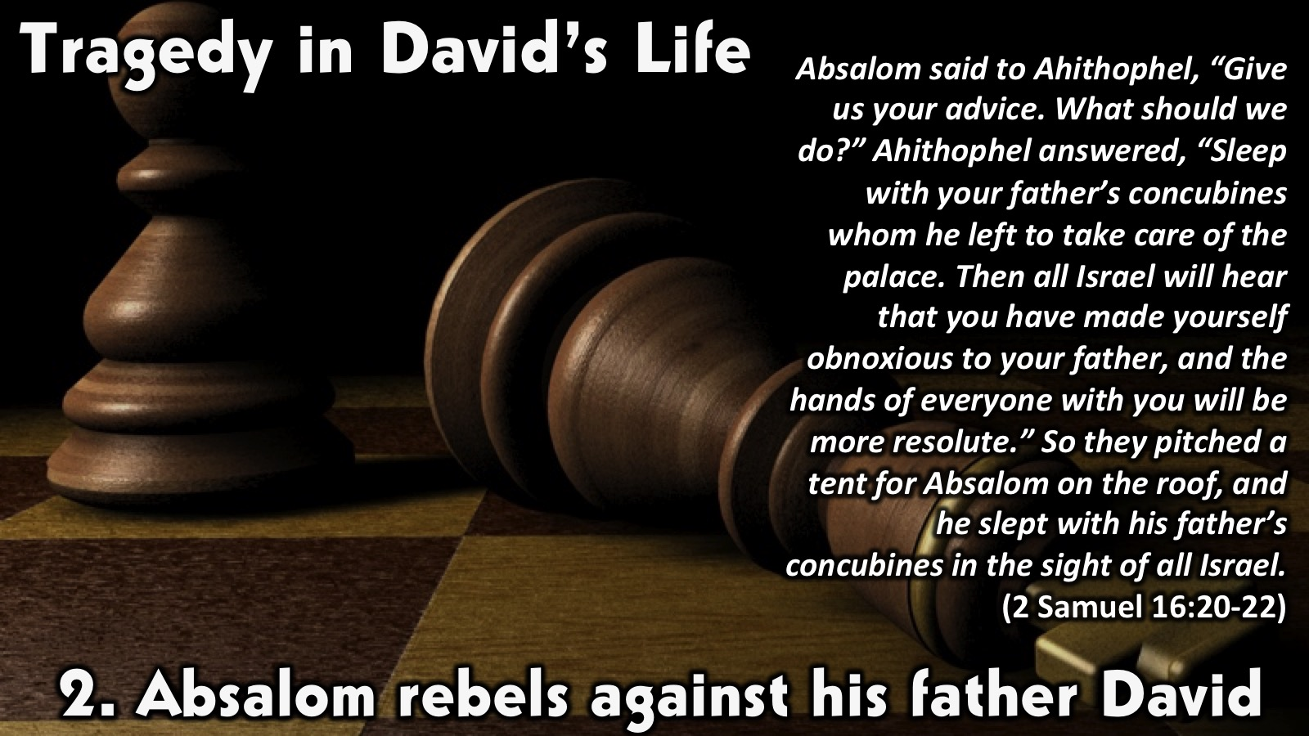
Notes:
2. Absalom rebels against his father David. Absalom said to Ahithophel, “Give us your advice. What should we do?” Ahithophel answered, “Sleep with your father’s concubines whom he left to take care of the palace. Then all Israel will hear that you have made yourself obnoxious to your father, and the hands of everyone with you will be more resolute.” So they pitched a tent for Absalom on the roof, and he slept with his father’s concubines in the sight of all Israel. (2 Samuel 16 vs 20-22). David was humiliated and disrespected in front of the whole of Israel. David’s own flesh and blood turned against him. It hurts when the people we love turn against us , it's difficult to understand it and process it. David was a powerful man but at this point in his life he wasn't seen as powerful or worthy king. You will feel powerless and not know what to do.

Slide 16
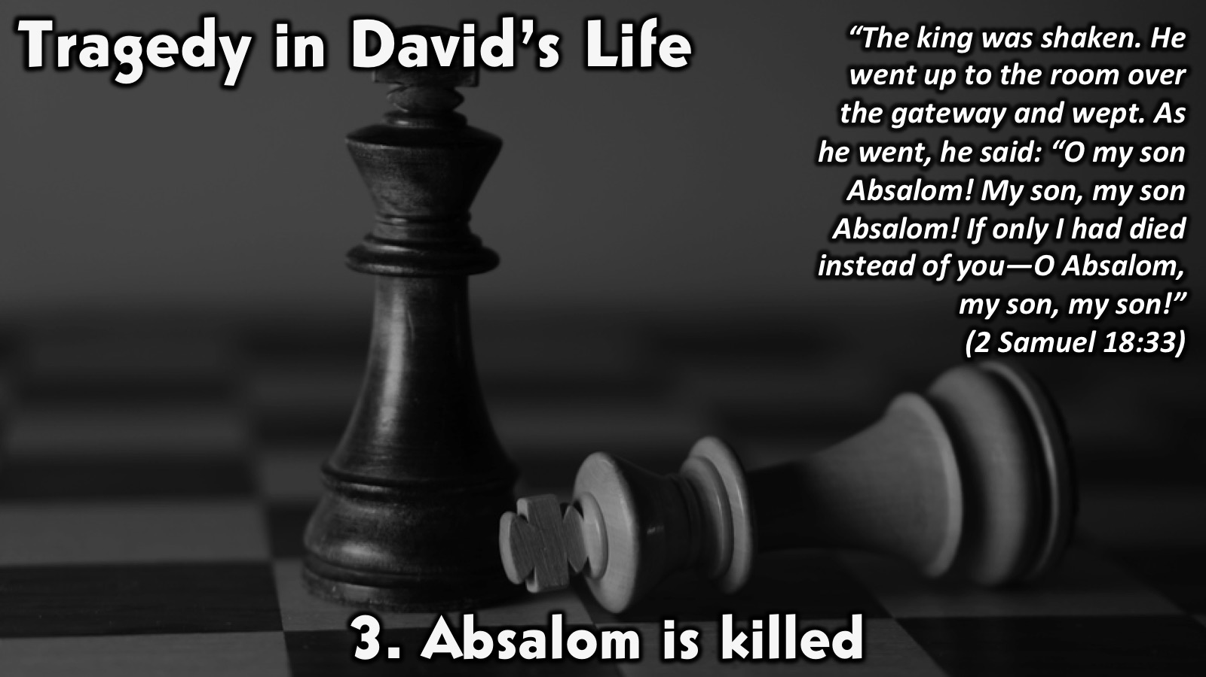
Notes:
3. Absalom is killed. “The king was shaken. He went up to the room over the gateway and wept. As he went, he said: “O my son Absalom! My son, my son Absalom! If only I had died instead of you—O Absalom, my son, my son!” (2 Samuel 18:33). When David got the word that Absalom was killed it broke his heart. At this point David had lost so much now to hear another son of his is dead, was another rock pushing down on him. When you go through a tragedy you might feel like thats it i cant take take another low. It will hurt but you have to carry on.

Slide 17
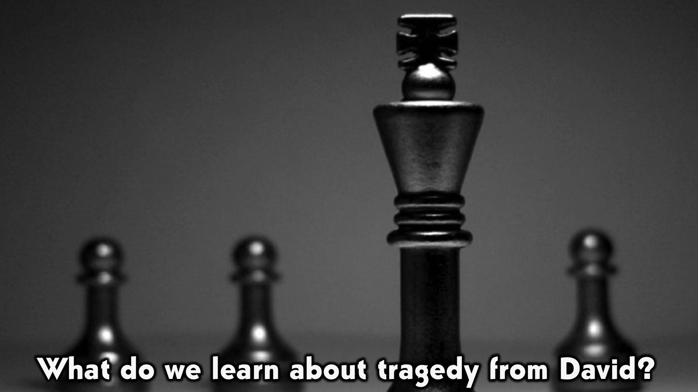
Notes:
What do we learn about tragedy from David?

Slide 18
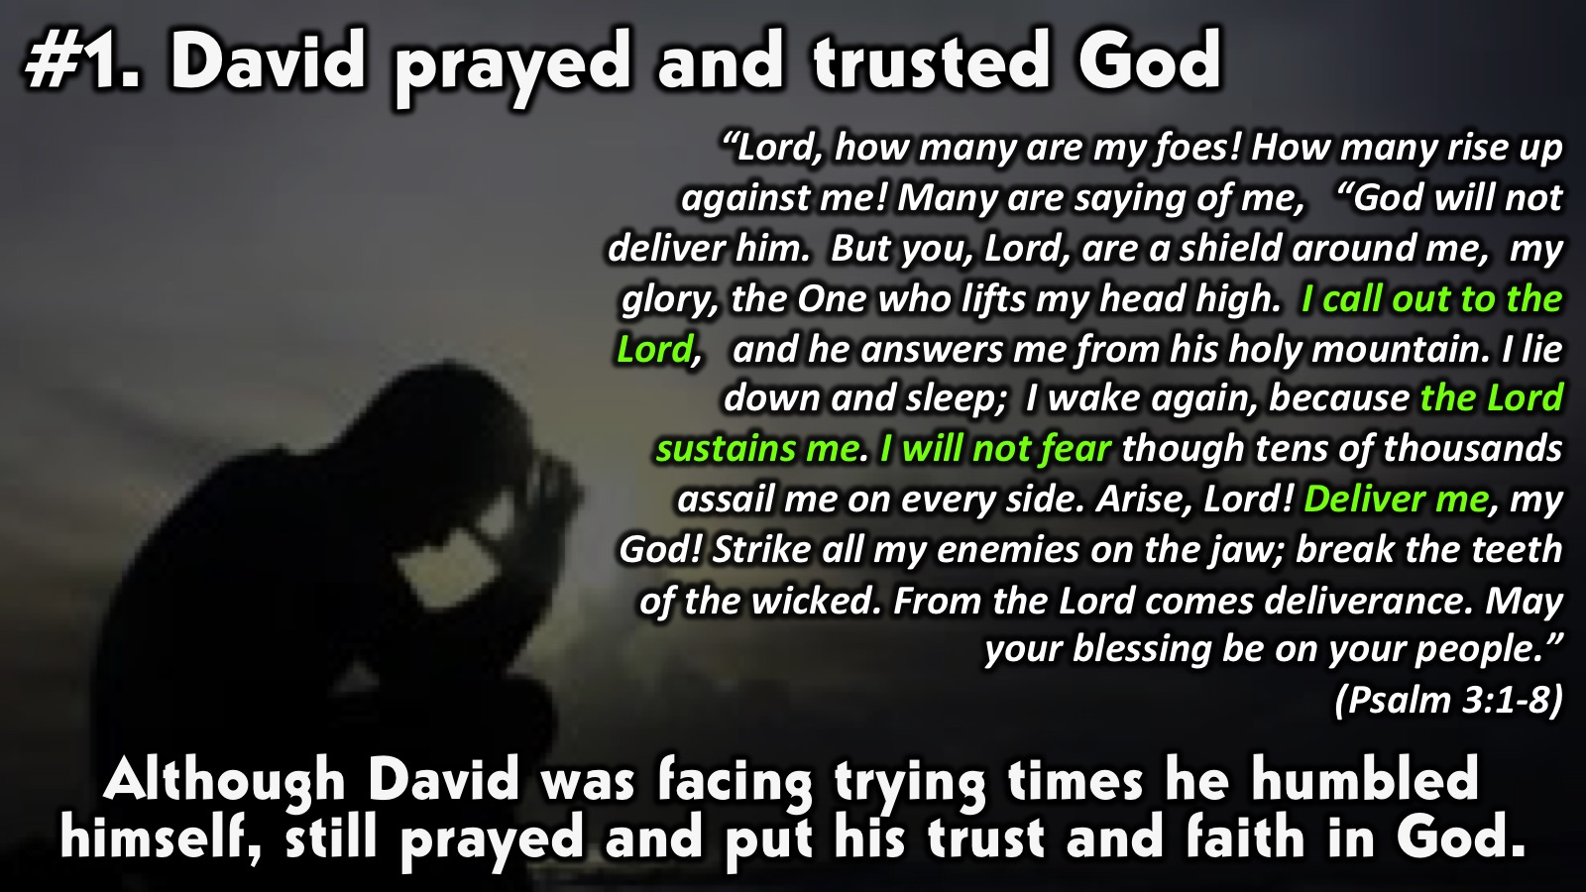
Notes:
1. David prayed and trusted God. This Psalm David wrote when he fled from Absalom. This psalm showed me that i need to encourage and uplift myself using the word of God and speaking life into my situation. At this point David didn't know how the situation was going to play out so he opted to take the matter to the Lord and asked Him for help. The situation might not turn out the way you wanted but God always shows up. When we go through tragedies we need to stay keep our eyes on God. God knows and understands what you go through it's nothing new to Him. Let Him help you. You might feel like he abandoned you but He is always with you and is waiting for you to call on Him.

Slide 19
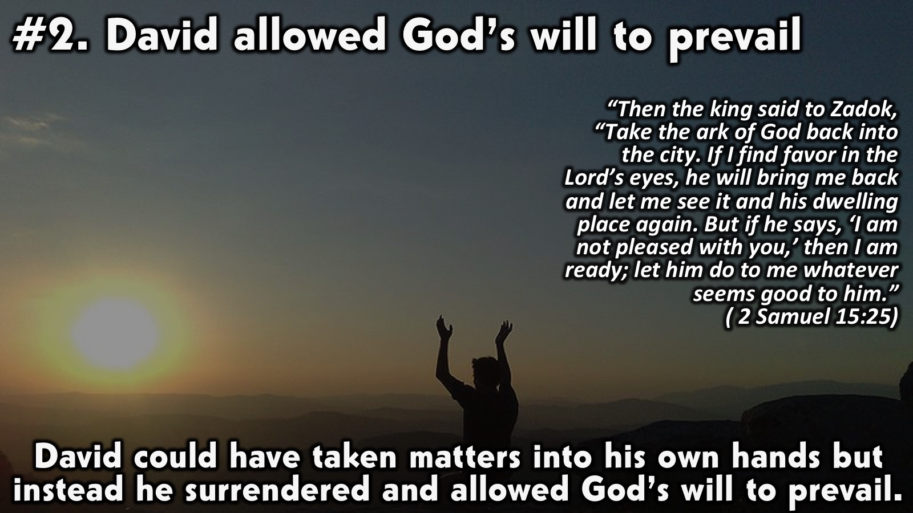
Notes:
2. David allowed God’s will to prevail. David was a powerful man he could have taken matters into his own hands and killed all the men who had plotted against him and at the same time put Absalom in his place. But instead he put his feelings aside and allowed God’s will to prevail. We see David’s humility accepting that he was wrong and accepting the consequences of his actions. When we surrender it means giving up control over our situation or any ideas of how we want the situation to straighten out. You are saying to God let Your Will be done and not mine. Through all this mess that David was going through he still worshipped God.

Slide 20
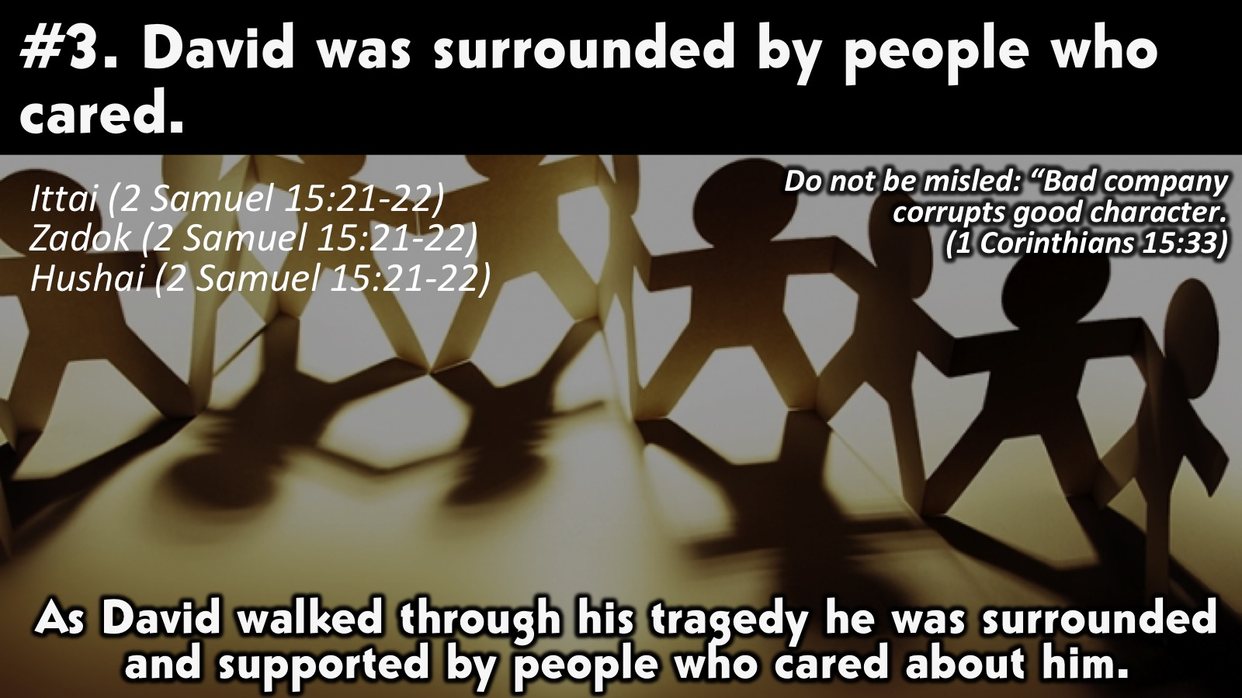
Notes:
3. David was surrounded by people who cared. He had: Ittai (2 Samuel 15:21-22); Zadok (2 Samuel 15:21-22) and Hushai (2 Samuel 15:21-22). It’s important to have a healthy support system. When we go through tragedies, we are not in a good space. Many thoughts go through our minds so its important to be around positive people that feed you positive words, especially encouraging words, from the Word of God.

Slide 21
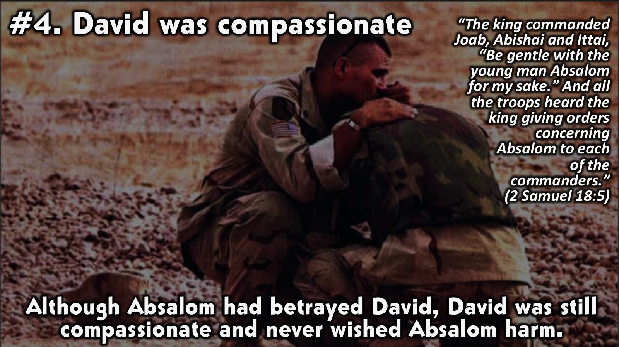
Notes:
4. David was compassionate. Even though Absalom betrayed David and hurt him, David still wanted him to be ok, he wished him no harm. He forgave him. Sometimes when when we go through tragedies they are caused by the people we love and closest to us. But we need to find it in ourselves to forgive and let God deal with them. It will be hard but what makes it easy for me is when i think about the number of times i hurt God or sin and how every time I go to him and ask for forgiveness He washes me clean. If God can do that for me, i should be able to forgive others too. Romans 12:17-19 says: "Do not repay anyone evil for evil. Be careful to do what is right in the eyes of everybody. If it is possible, as far as it depends on you, live at peace with everyone. Do not take revenge, my friends, but leave room for God's wrath, for it is written: 'It is mine to avenge; I will repay,' says the Lord.”

Slide 22
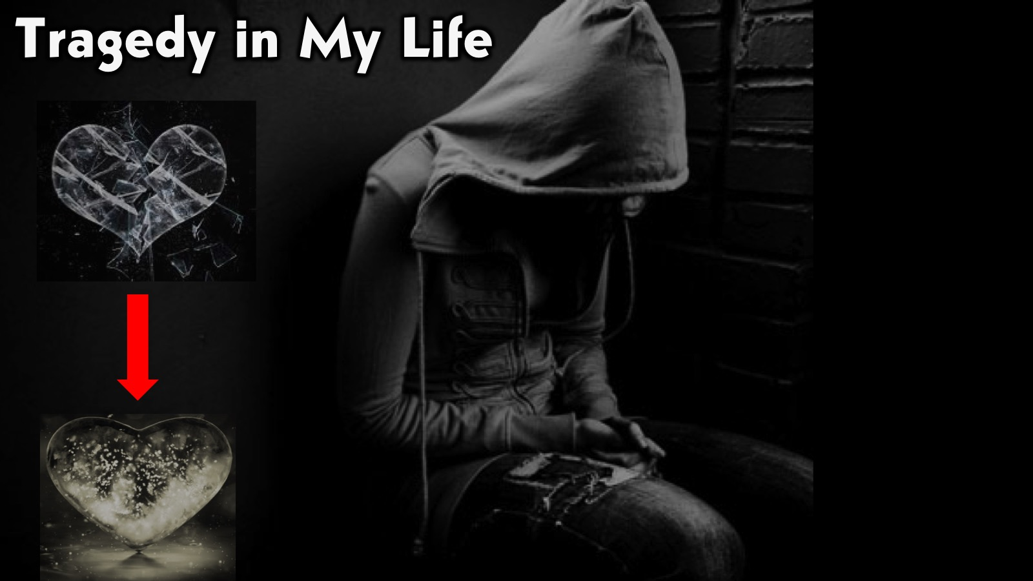
Notes:
Tragedy in My Life: How did i apply the four points to my tragedy? (1) I had to pray to stay sane. (2) I had to trust God was in control even though i couldn’t see the light. (3) I had no other choice but to surrender, i was so weak i didn't even have the strength to control my situation anymore. (4) I worshipped God , that's where i got my comfort. (5) I surrounded myself with positive and supportive people. (6) I had to forgive my dad as hard as it was, I did it. It took me 3 years. But God never gave up on me He kept working on my heart. (7) I waited on the Lord. The Result: (1) I was healed. (2) God kept putting people in my life that helped me deal with the issues i had, he never abandoned me. (3) He gave me peace. (4) What I thought was broken and ruined, He mended and turned it into something beautiful and whole (my heart).

Slide 23
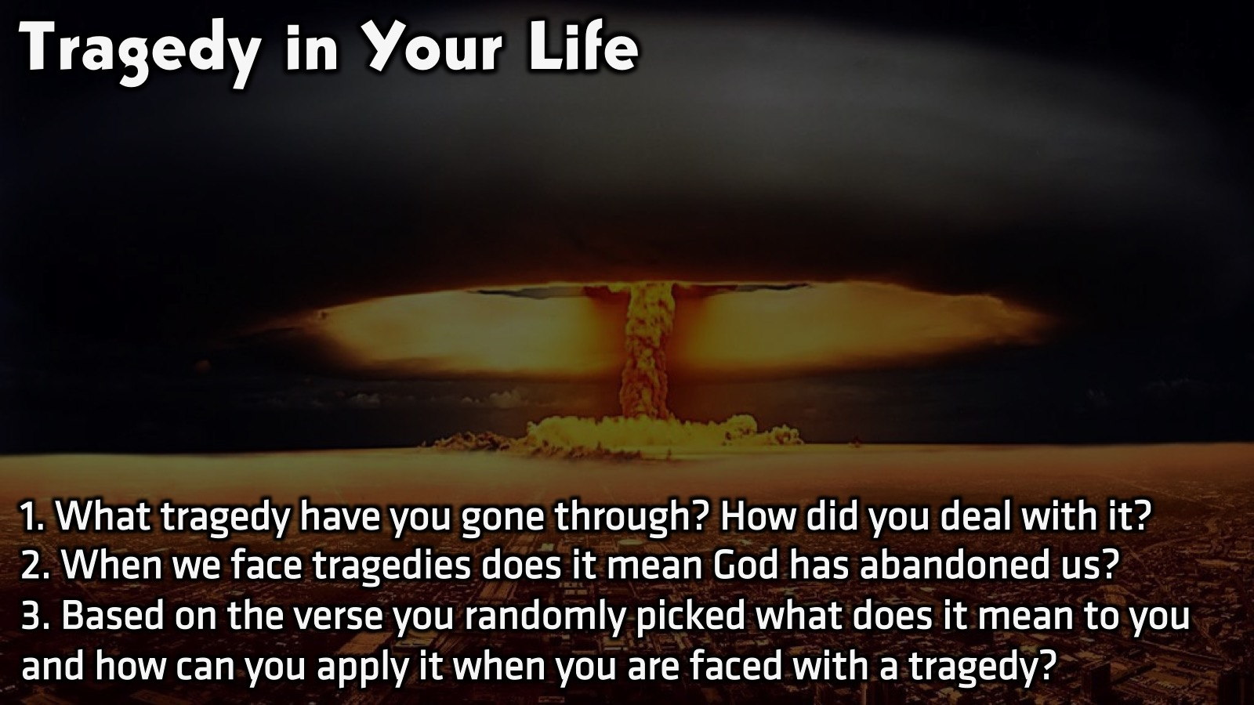
Notes:
Small Group Discussion: You have ten minutes to apply the message to your life in small groups using these 3 questions: (1) What tragedy have you gone through? How did you deal with it? (2) When we face tragedies does it mean God has abandoned us? If yes why do feel or think so? (3) Based on the verse you randomly picked from the envelop what does it mean to you and how can you apply it when you are faced with a tragedy? (Facilitators Notes: This is the chance for them to see how God is always there for them and its a good time for leaders to minister, please be sensitive and ask God to lead you about what you should say to the teens.)
No one will be able to stand against you all the days of your life. As I was with Moses, so I will be with you; I will never leave you nor forsake you. (Joshua 1:5)
"Peace I leave with you; my peace I give you. I do not give to you as the world gives. Do not let your hearts be troubled and do not be afraid.” (John 14:27)
“Cast your cares on the Lord and he will sustain you; he will never let the righteous be shaken.” (Psalm 55:22)
"Be strong and courageous. Do not be afraid or terrified because of them, for the Lord your God goes with you; he will never leave you nor forsake you.” (Deuteronomy 31:6)
"He heals the brokenhearted and binds up their wounds.” (Psalm 147:3)
"I called on your name, O Lord, from the depths of the pit. You heard my plea: "Do not close your ears to my cry for relief." You came near when I called you, and you said, "Do not fear.” (Lamentations 3:55-57)
"So do not fear, for I am with you; do not be dismayed, for I am your God. I will strengthen you and help you; I will uphold you with my righteous right hand.” (Isaiah 41:10)
“Trust in the Lord with all your heart and lean not on your own understanding; in all your ways submit to him, and he will make your paths straight.“ (Proverbs 3:5)
“Come to me, all you who are weary and burdened, and I will give you rest. Take my yoke upon you and learn from me, for I am gentle and humble in heart, and you will find rest for your souls. For my yoke is easy and my burden is light.” (Matthew 11:28-30)
“I sought the Lord, and he answered me; he delivered me from all my fears.” (Psalm 34:4)

Slide 24
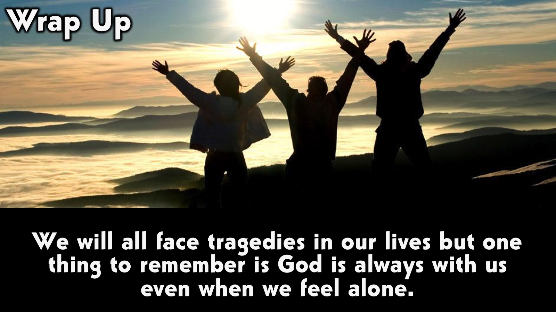
Notes:
Wrap Up: We will all face tragedies in our lives but one thing to remember is God is always with us even when we feel alone.

Slide 25
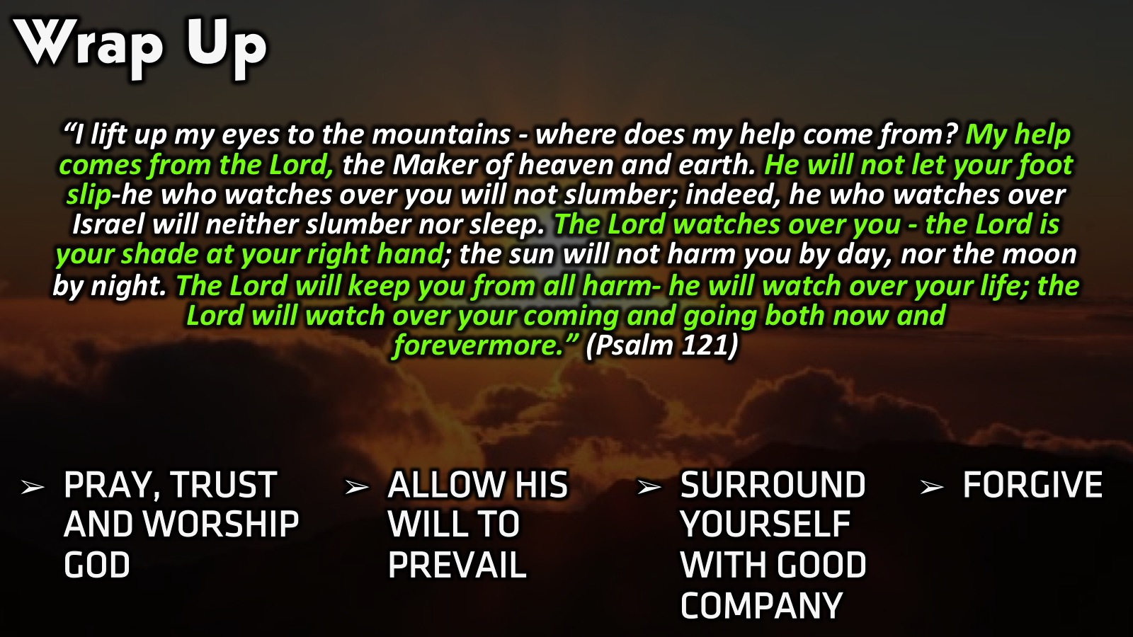
Notes:
Wrap Up: “I lift up my eyes to the mountains - where does my help come from? My help comes from the Lord, the Maker of heaven and earth. He will not let your foot slip-he who watches over you will not slumber; indeed, he who watches over Israel will neither slumber nor sleep. The Lord watches over you - the Lord is your shade at your right hand; the sun will not harm you by day, nor the moon by night. The Lord will keep you from all harm - he will watch over your life; the Lord will watch over your coming and going both now and forevermore.” (Psalm 121) When you face a tragedy you should (1) pray, trust and worship God. (2) Allow God’s will to prevail. (3) Surround yourself with good company. (4) Forgive.

Slide 26
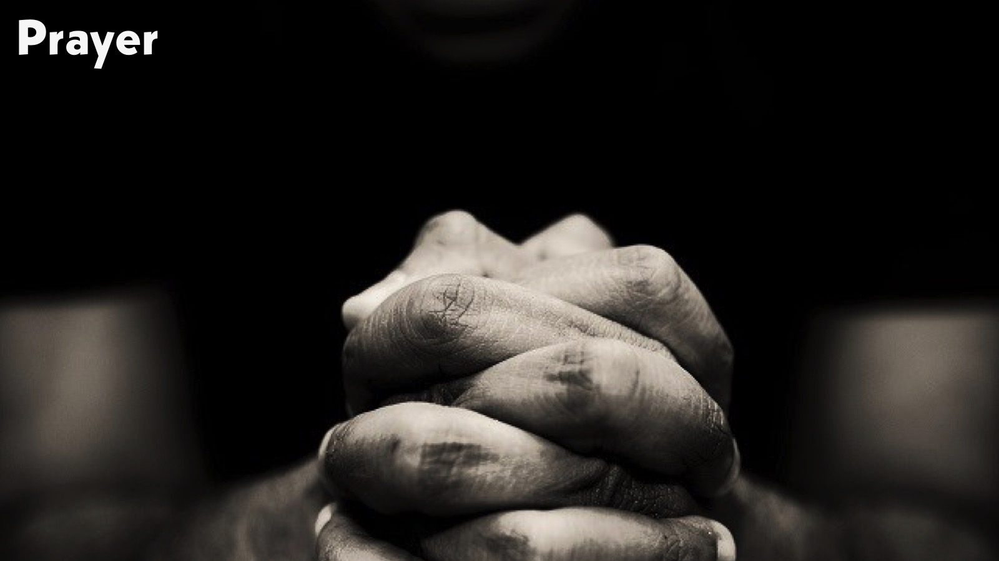
Notes:
Prayer:

Slide 27

Notes:
Daily Devotions: We will post devotions on the Sunday WhatsApp group every night of the week throughout this series. Do everything you can to be a part of the daily journey in the life of David.

Slide 28

Notes:
Next Week: Next week we will look at the final chapter in David’s Life: Legacy (2 Samuel 19-23)

