Slide 1

Notes:
Welcome to the David Series.

Slide 2

Notes:
In week 1 we learnt about Destiny.

Slide 3

Notes:
In week 2 we learnt about handing Giants.

Slide 4
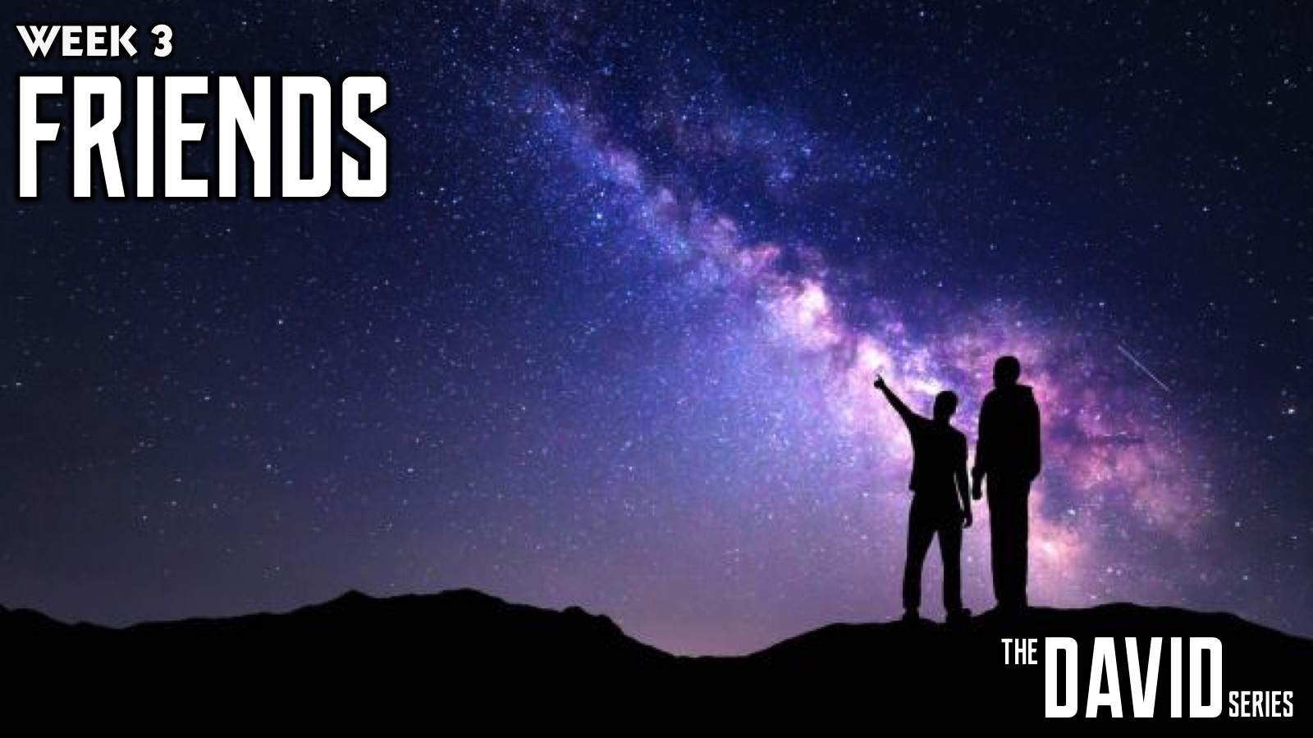
Notes:
In week 3 we learnt about dealing with Friends.

Slide 5

Notes:
In week 4 we learnt about dealing with Betrayal.

Slide 6

Notes:
In week 5 we learnt about dealing with Revenge.

Slide 7

Notes:
In week 6 we learnt about dealing with Trials.

Slide 8

Notes:
In week 7 we learnt about dealing with Power.

Slide 9

Notes:
In week 8 we learnt about dealing with Lust.

Slide 10

Notes:
Last week are learnt about dealing with Tragedy.

Slide 11

Notes:
This week we are going to learn about Legacy.

Slide 12
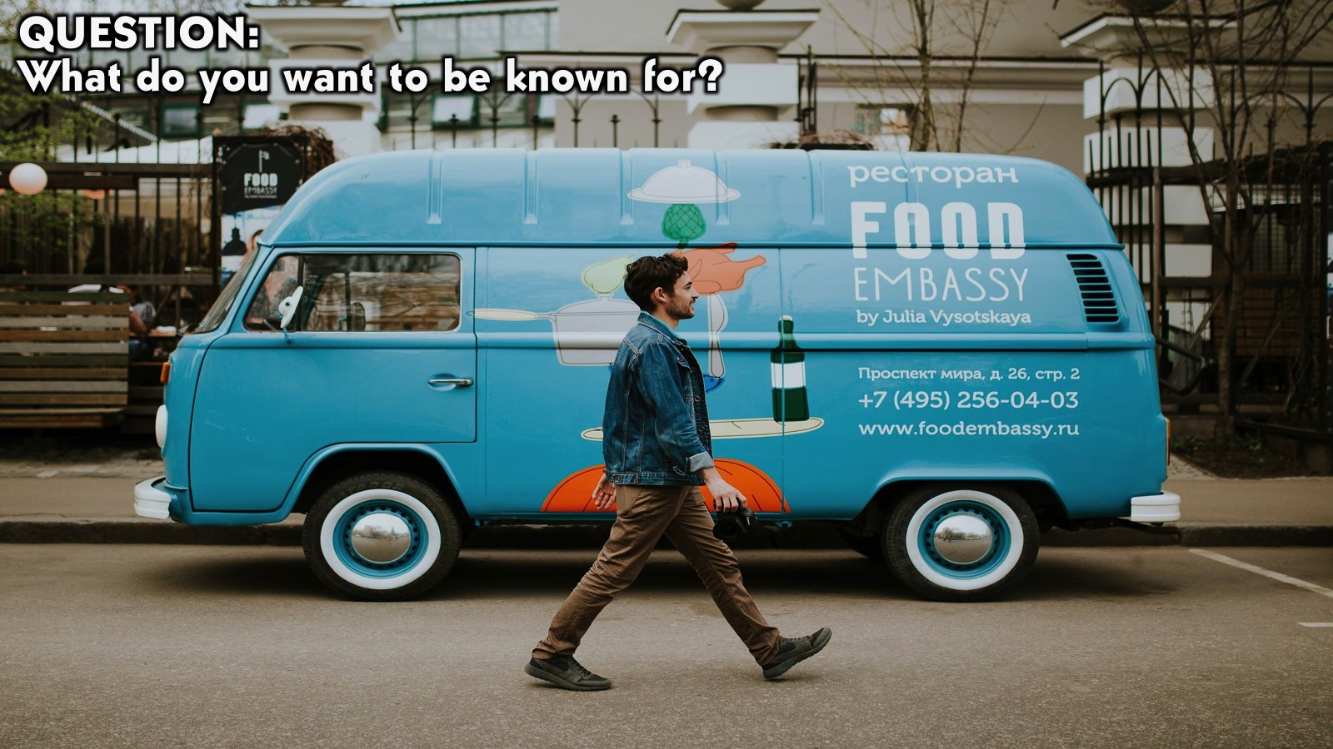
Notes:
Question: What do you want to be known for?

Slide 13

Notes:
Every GODLY PURPOSE fulfilled on earth leaves a great legacy to inspire many generations to come.

Slide 14
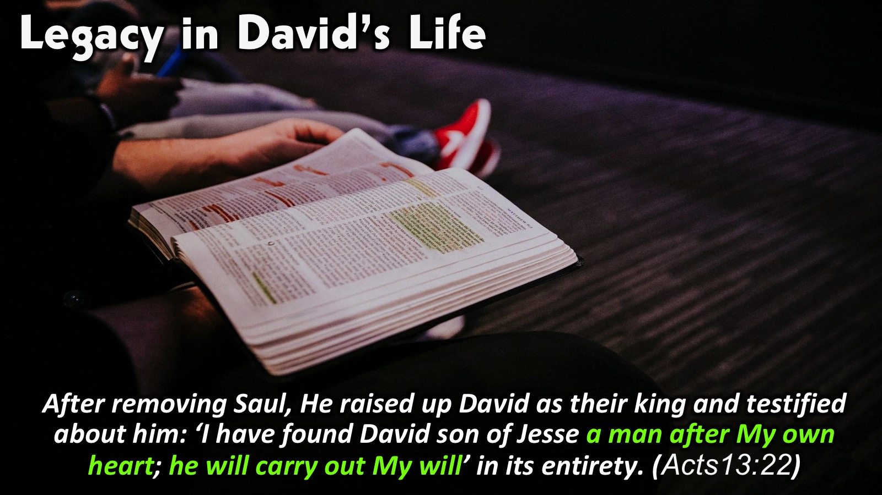
Notes:
Legacy in David’s Life: David’s purpose on earth was to do the will of God. God Himself saw David’s heart and testified about him as the man after God’s own heart. David’s Legacy was for the will of God and not for selfish ambitions to accumulate worldly riches and fame that most view as a great legacy. Although David had all these worldly positions, his Legacy is not defined by them.

Slide 15
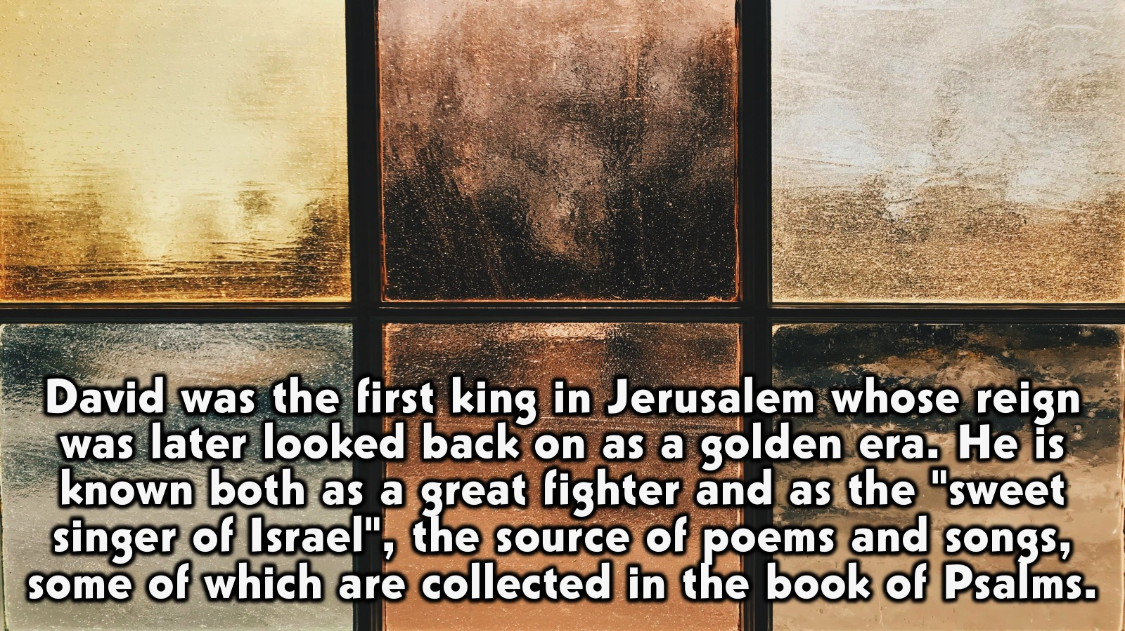
Notes:
David was the first king in Jerusalem whose reign was later looked back on as a golden era. He is known both as a great fighter and as the "sweet singer of Israel", the source of poems and songs, some of which are collected in the book of Psalms.

Slide 16
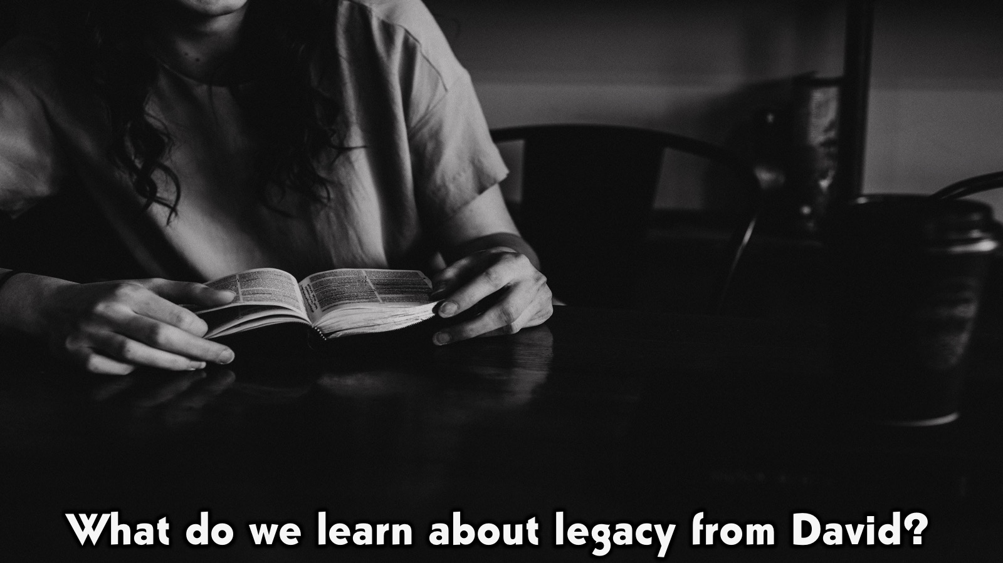
Notes:
What do we learn about legacy from David?

Slide 17
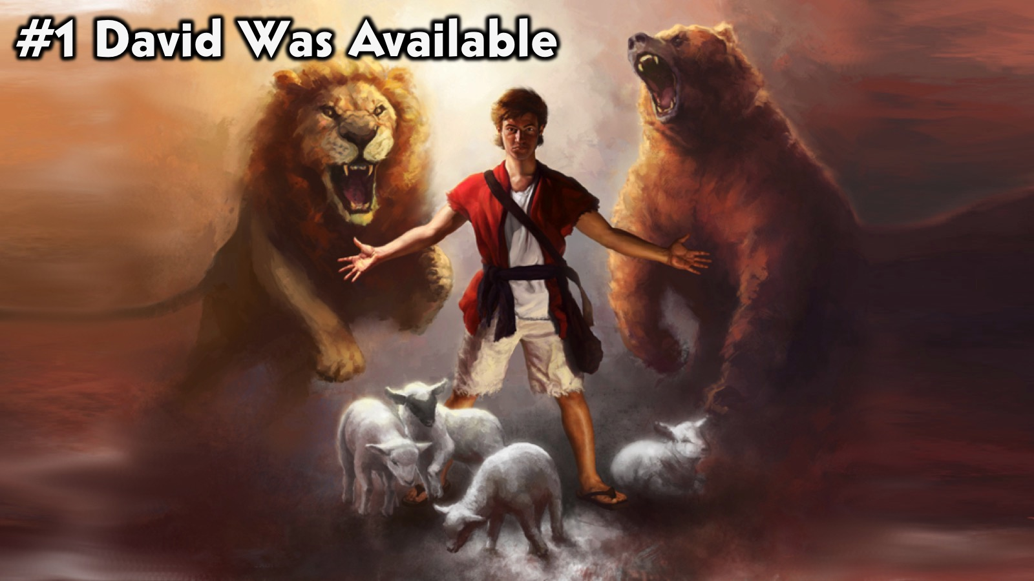
Notes:
#1. David Was Available. David was available to God (from a young age). He did not run away from what God wanted him to do even though he was young.

Slide 18
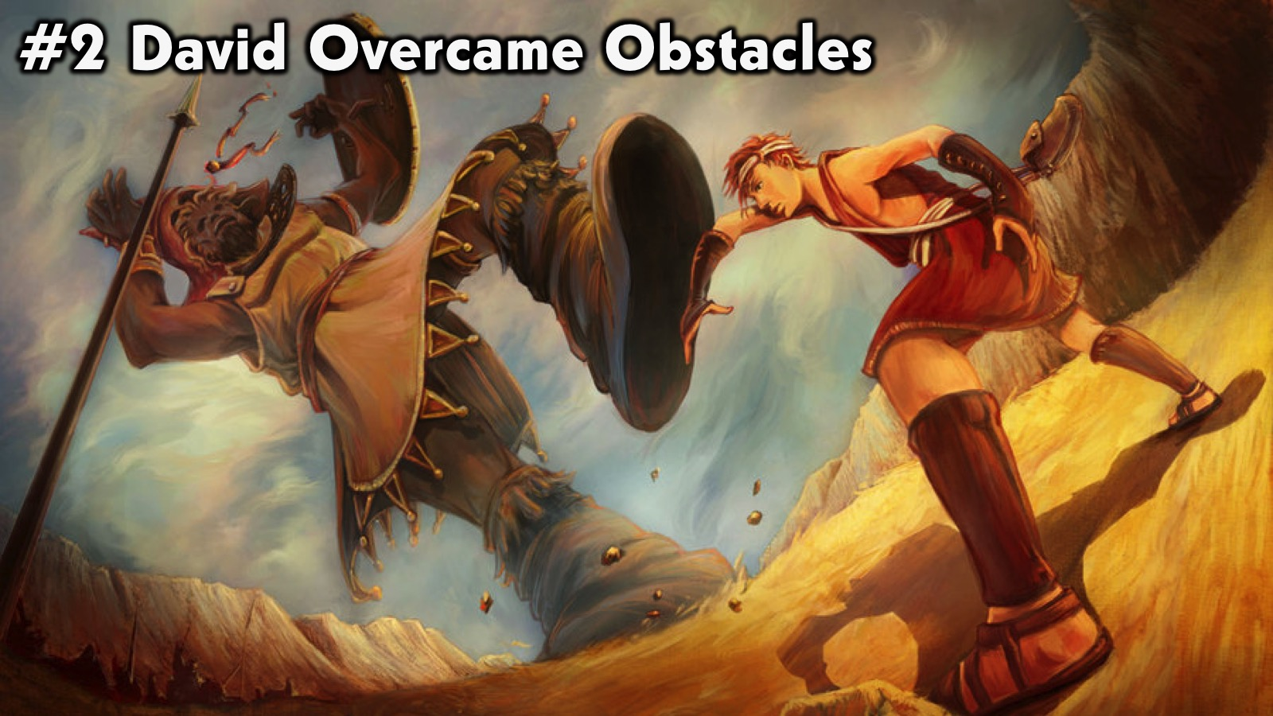
Notes:
#2. David Overcame Obstacles. Many things stood in the way of David fulfilling his destiny (including Goliath and king Saul) by the did not let them stop him.

Slide 19
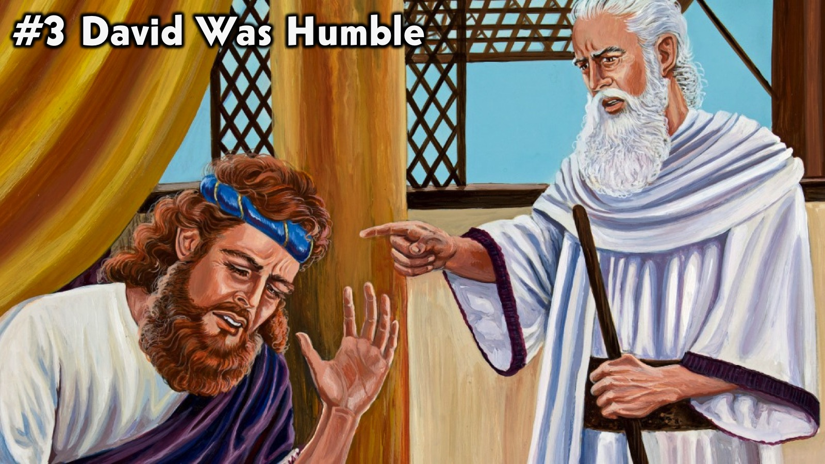
Notes:
#3. David Was Humble. David did not give up when he messed up (when he sinned with Bathsheba) - he confessed his sin and moved forward.

Slide 20
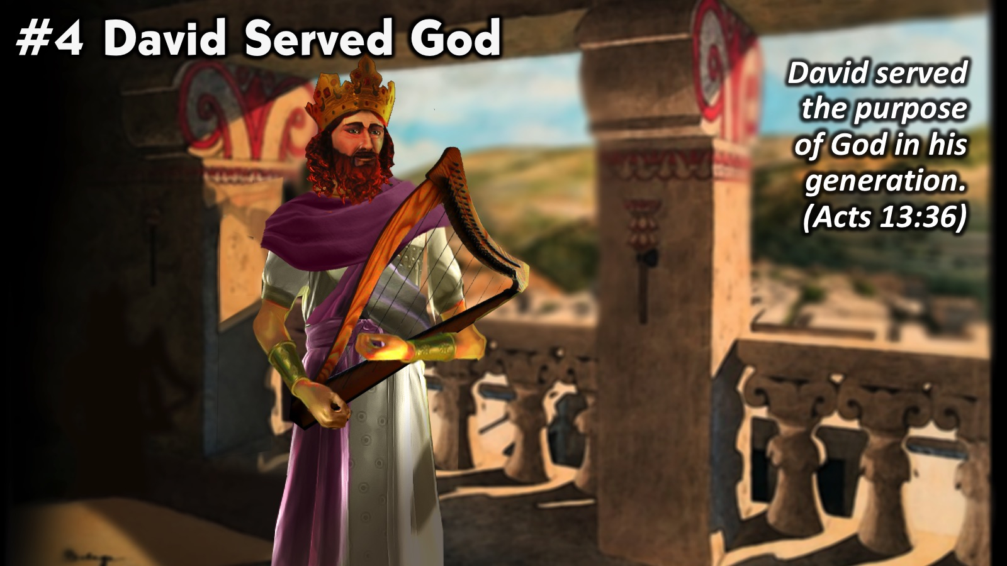
Notes:
#4. David Served God. David served the purposes of God in his generation. David served the purpose of God in his own generation. (Acts 13:36)

Slide 21
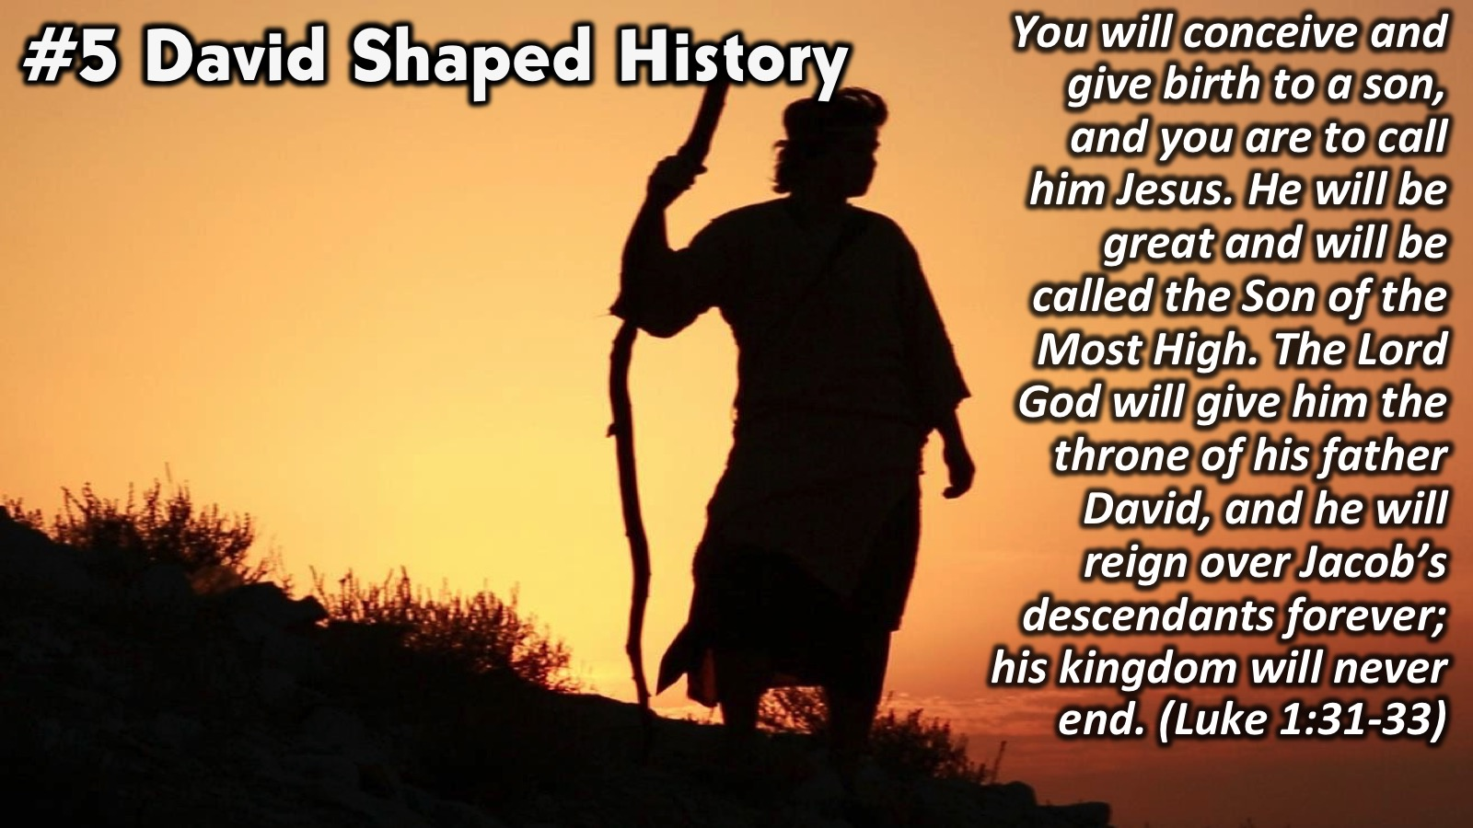
Notes:
#5. David Shaped History. Ultimately David produced the saviour of the world (Jesus was his great great great ... grandson). You will conceive and give birth to a son, and you are to call him Jesus. He will be great and will be called the Son of the Most High. The Lord God will give him the throne of his father David, and he will reign over Jacob’s descendants forever; his kingdom will never end. (Luke 1:31-33)

Slide 22
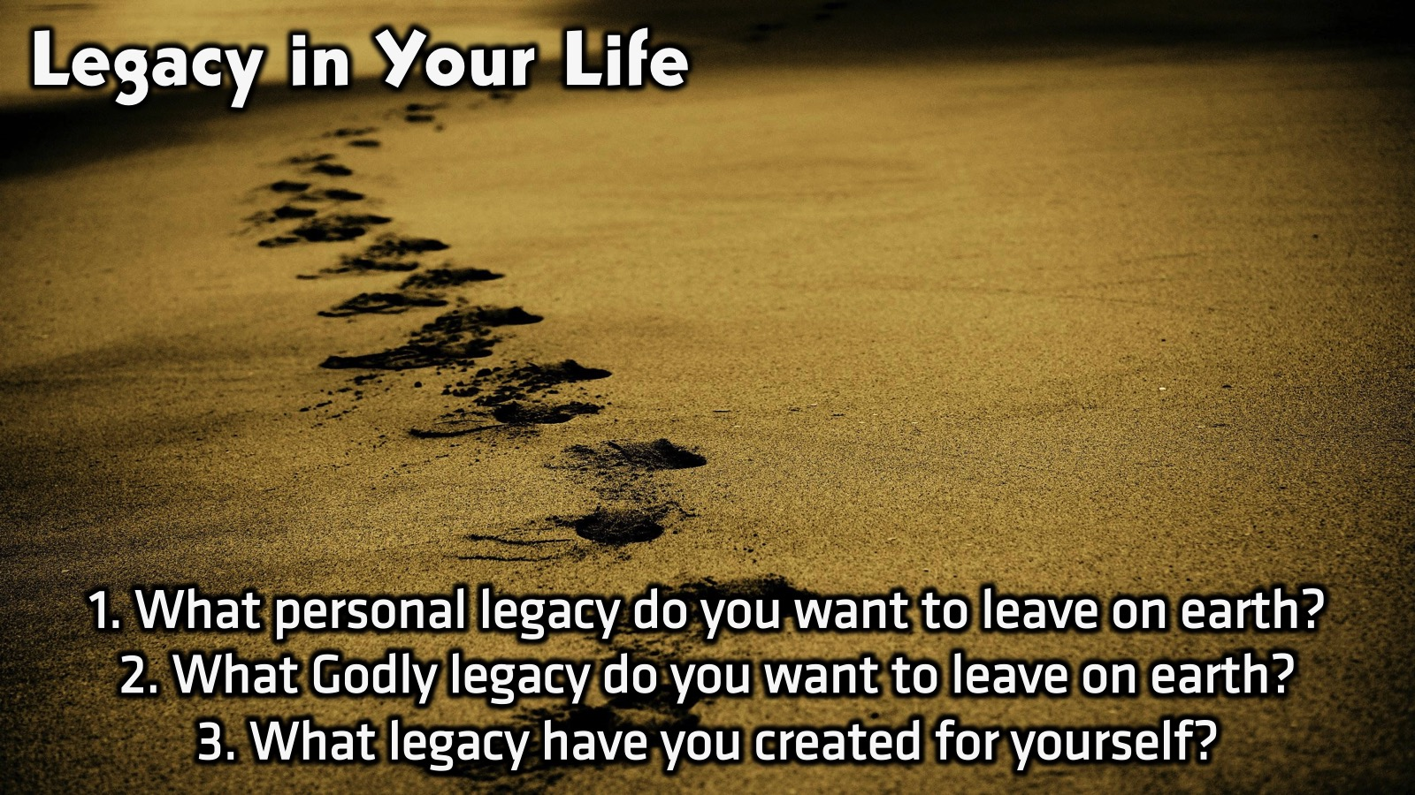
Notes:
Small Group Discussion: You have ten minutes to apply the message to your life in small groups using these 3 questions: (1) What personal legacy do you want to leave on earth? (2) What Godly legacy do you want to leave on earth? (3) What legacy have you created for yourself?

Slide 23

Notes:
Wrap Up: Your Godly Legacy will please God and inspire many generations to come.

Slide 24

Notes:
Prayer:

Slide 25

Notes:
Daily Devotions: We will post devotions on the Sunday WhatsApp group every night of the week throughout this series. Do everything you can to be a part of the daily journey in the life of David.

Slide 26

Notes:
Next Week: Next week we will be taking a break for the school holidays.

