Slide 1

Notes:
Deal Or No Deal Night
We will split our teens into 4 groups. Each group has 10 cases to open (it will work in rounds and each team will wait for their turn to do something).
We have a spreadsheet which will calculate how much money each team is offered by the banker to try and get them to take the deal after round 3 and 6 and 8.
We will use these 10 values: R1, R5, R10, R100, R500, R1,000, R10,000, R100,000, R500,000, R1,000,000.
The "cases" are A3 printed images of cases and when "opened" reveal the amount they contain - like in the show.
Each team will end up "winning" a certain amount of money depending on the deal they take or what is in their final case at the end of the game. The team in first place gets a big slab of chocolate for each person, in fact all teams win a prize but the last team gets something like a sucker each.
We will set up four stations around the room - there will be a heading stuck on the wall (the Deal or No Deal logo from the game) and then the ten briefcases and a list of the values which will be crossed off as each case is opened.
Along the way someone will mark off the values that are chosen by each team in a spreadsheet which will calculate how much the banker offers the teams after round 3, 6 and 8.
In round 9 each team has the option to switch the case they chose from the wall in the beginning with the last remaining case on the wall - or they can stick with their original choice and open their case to see what they have won! They are playing to see how much money they win but actually get prizes based on whether they come first or second or third or fourth.
If at the end of the show we have a situation where more than one team share the same winnings - we have a tie breaker lined up where we have up to 4 briefcases that can be chosen and the team with the highest value is the winner. This could settle a first place tie or even third/fourth if necessary.
Small Groups. Here are the questions for our small group time: (1) What did you like about Deal or No Deal? (2) What didn't you like about this game? (3) How does this verse challenge the idea that life is just a" game of chance”? "Like an open book, you watched me grow from conception to birth; all the stages of my life were spread out before you. The days of my life all prepared before I'd even lived one day." (Psalm 139:16). (4) What can you do to live a life of faith? (5) Pray for each other to trust God more in their everyday life.

Slide 2

Notes:
Welcome: Welcome to Cash Friday - welcome to our regulars and if there are any newcomers please come up onto stage so we can welcome you!

Slide 3
Notes:
Tonight is Deal or No Deal Night.

Slide 4
Notes:
Video: Deal or No Deal Saturday Night Live Spoof. Get it on YouTube at: https://www.youtube.com/watch?v=byogJgXG0GM

Slide 5

Notes:
Choose Your Team - there are 4 Deal Or No Deal stations around the room - go and sit by one of them.

Slide 6
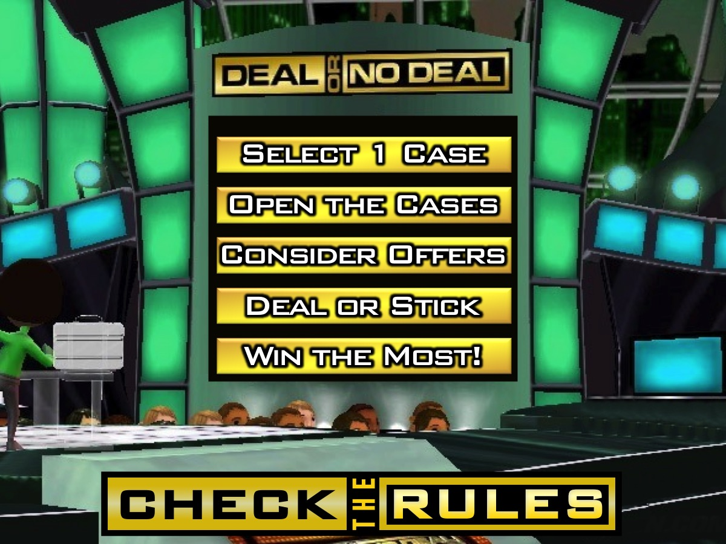
Notes:
Check The Rules - There are 10 briefcases on the wall - when we start you will select one of them and place it in front of your team. You will open the other cases in rounds when it is your turn. You will consider offers from our banker that you can take or reject. You will try and win the most amount of money to win the best prizes for your team at the end of the show.
(Note: Each team will compete in each round)

Slide 7
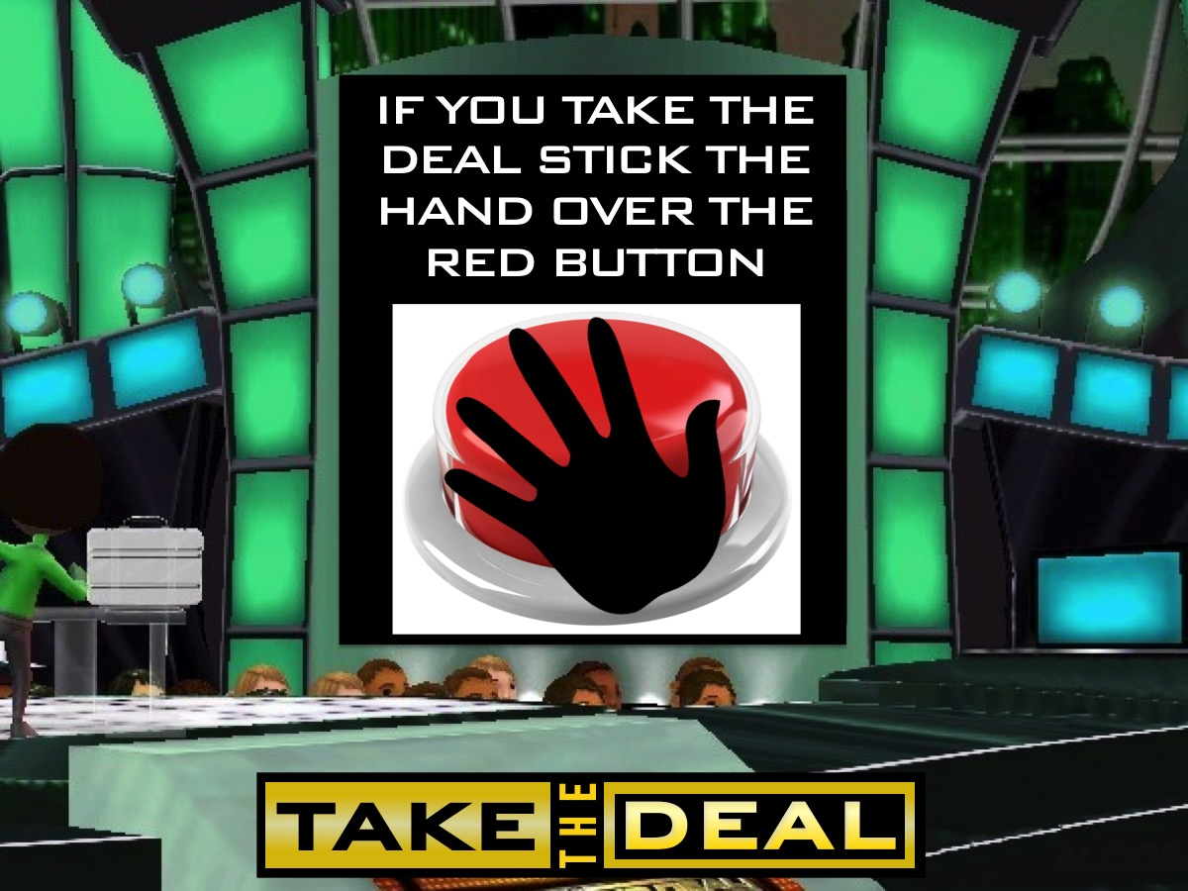
Notes:
Take The Deal - If your team decides to take the deal offered by the banker at any stage - then you should stick the black hand over the red button on your wall. Then sit back and wait until the other teams finish competing!

Slide 8
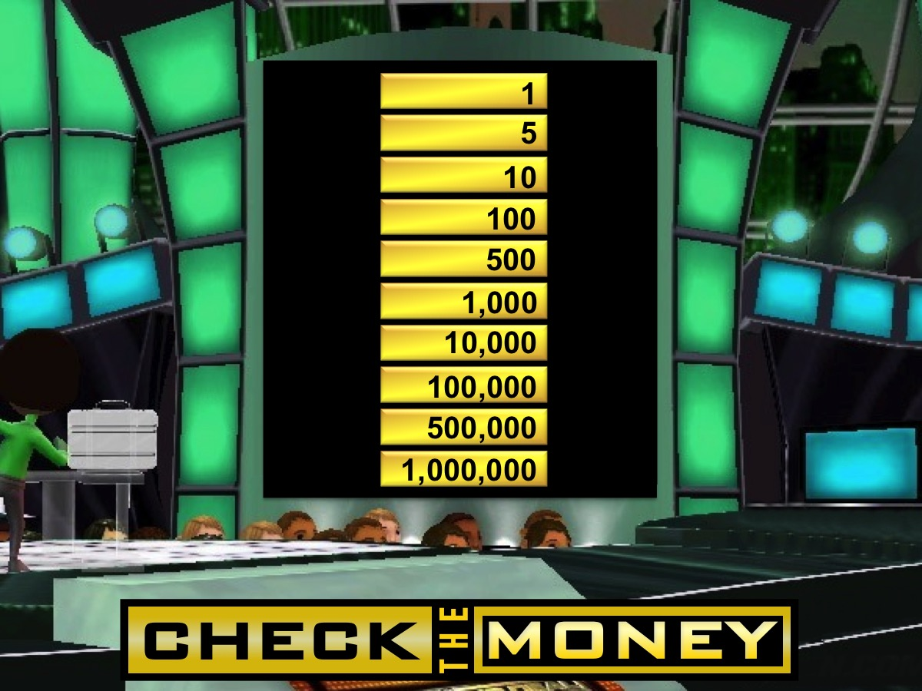
Notes:
Check The Money - Here are the ten values that we have placed into the 10 briefcases: R1, R5, R10, R100, R500, R1,000, R10,000, R100,000, R500,000, R1,000,000

Slide 9

Notes:
Are you ready to play: Deal or No Deal!
Sound: Deal_or_No_Deal_Night_Opening.mp3
[Game show tunes will play all along on the night]

Slide 10
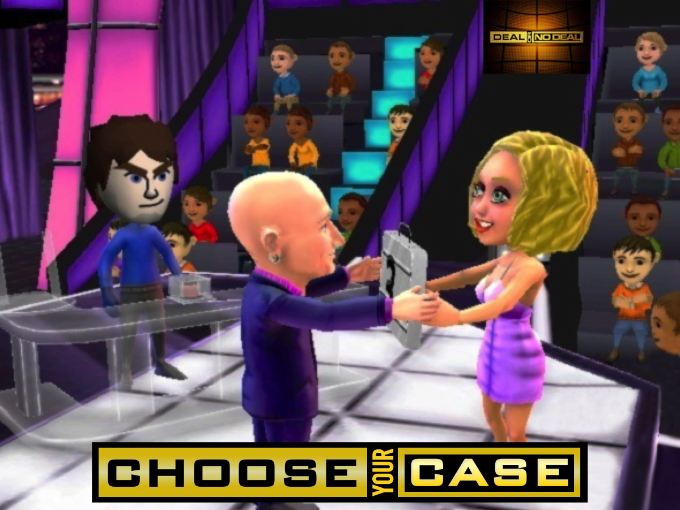
Notes:
Choose Your Case - There are 10 briefcases on the wall - choose one of them and place it in front of your team
Sound: Deal_or_No_Deal_Night_Choose_Case.mp3
(Note: Each team will compete in each round)

Slide 11
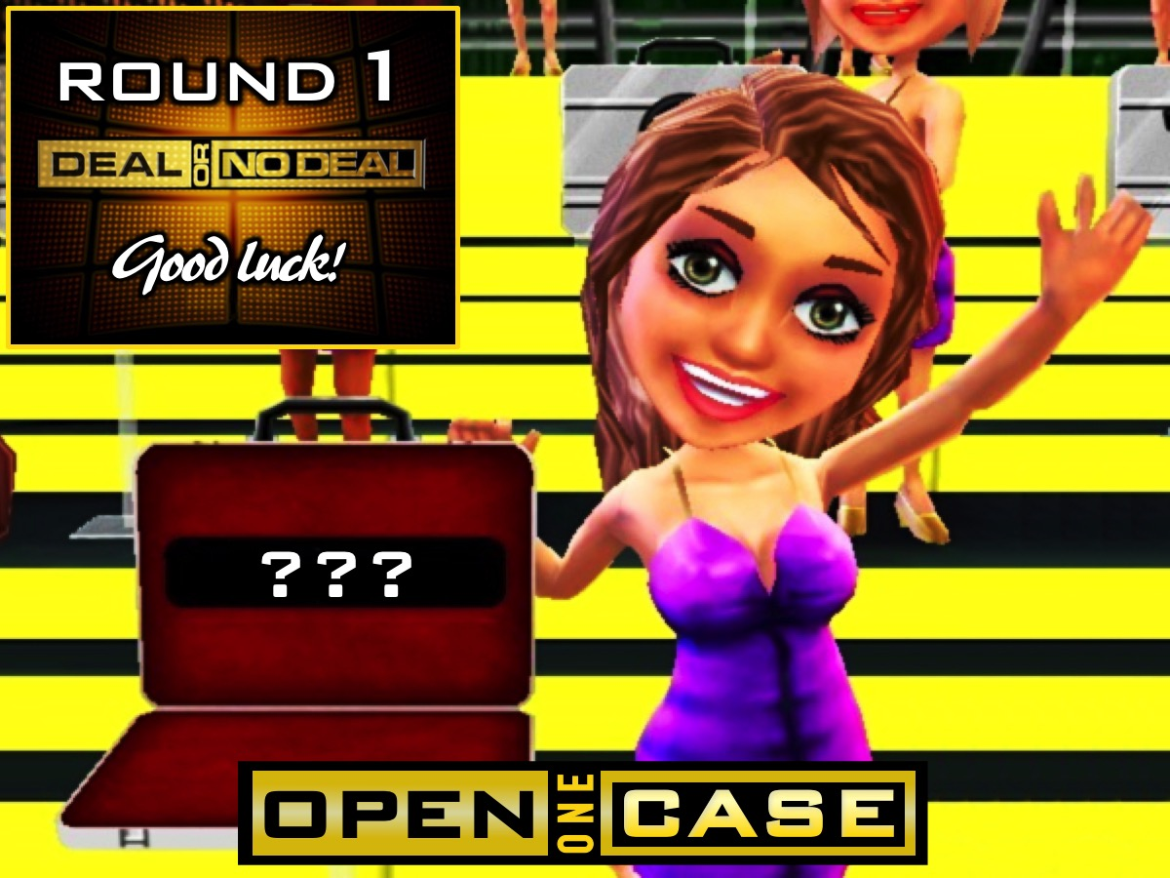
Notes:
Round 1 - Open One Case - each team will select one case to open and cross that value off the list of the wall in front of them.
Sound: Deal_or_No_Deal_Night_Round_1.mp3
(Note: Someone will cross the values off on a spreadsheet for all the teams as they open cases)

Slide 12
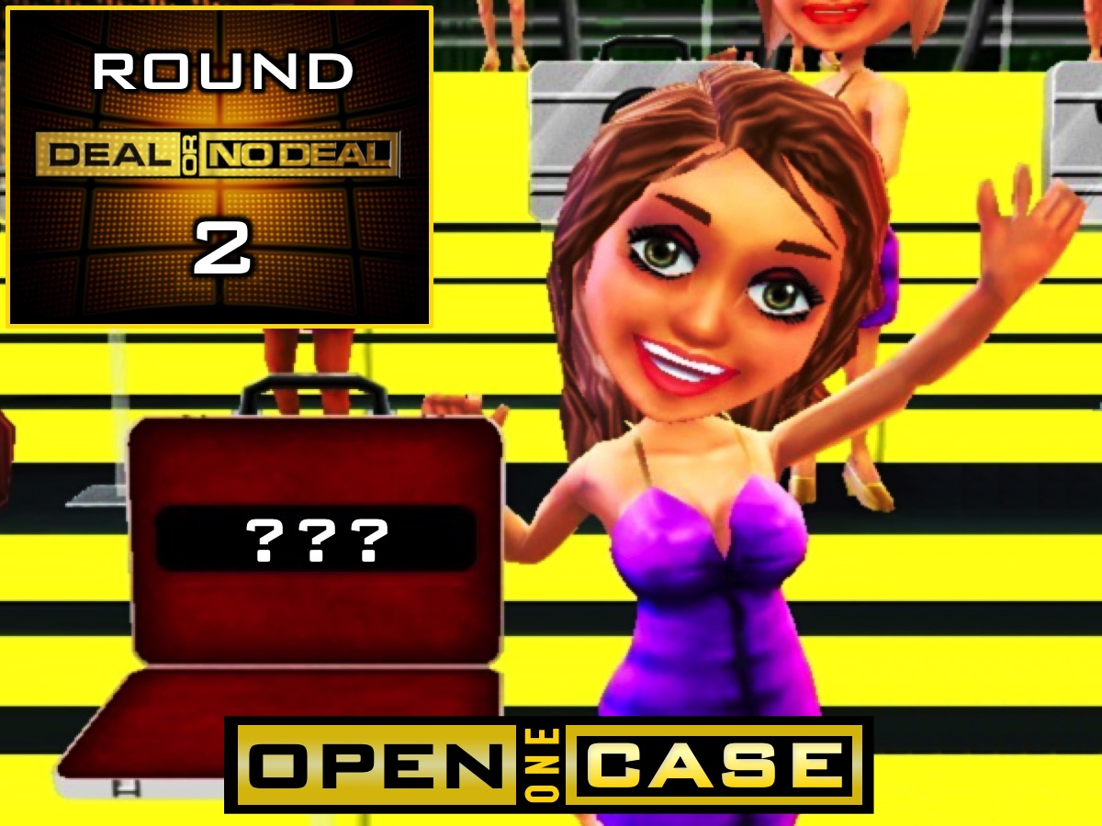
Notes:
Round 2 - Open One Case - each team will select one case to open and cross off that value.
Sound: Deal_or_No_Deal_Night_Round_2.mp3

Slide 13

Notes:
Round 3 - Open One Case - each team will select one case to open and cross off that value.
Sound: Deal_or_No_Deal_Night_Round_3.mp3

Slide 14
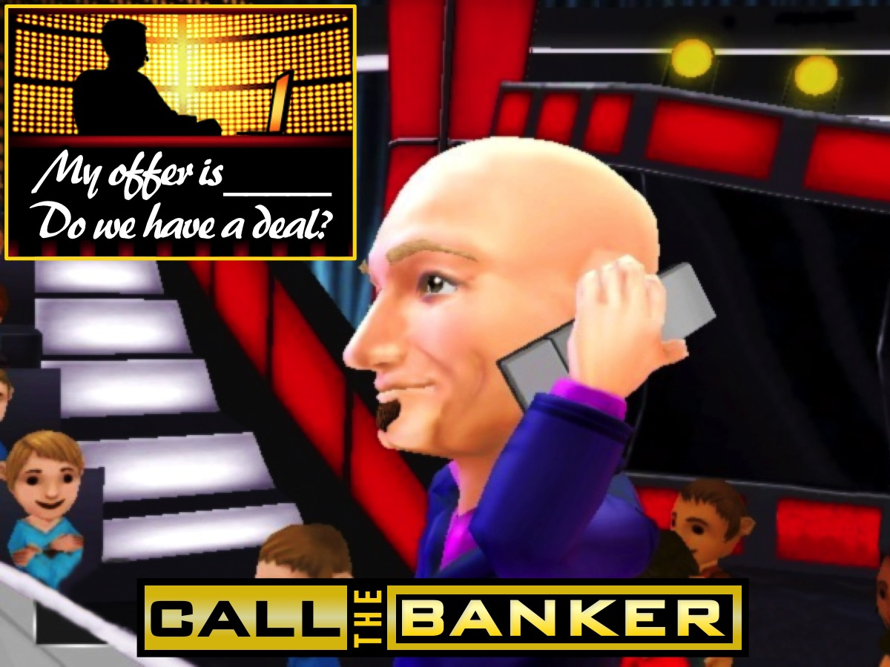
Notes:
Call the Banker: The banker will give each team an amount they can walk away with or they can choose to continue playing.
Sound: Deal_or_No_Deal_Night_Banker_Calling.mp3

Slide 15

Notes:
Round 4 - Open One Case - each team will select one case to open.
Sound: Deal_or_No_Deal_Night_Round_1.mp3

Slide 16

Notes:
Round 5 - Open One Case - each team will select one case to open.
Sound: Deal_or_No_Deal_Night_Round_2.mp3

Slide 17

Notes:
Round 6 - Open One Case - each team will select one case to open.
Sound: Deal_or_No_Deal_Night_Round_3.mp3

Slide 18
Notes:
Call the Banker: The banker will give each team an amount they can walk away with or they can choose to continue playing.
Sound: Deal_or_No_Deal_Night_Banker_Long.mp3

Slide 19

Notes:
Round 7 - Open One Case - each team will select one case to open.
Sound: Deal_or_No_Deal_Night_Round_1.mp3

Slide 20

Notes:
Round 8 - Open One Case - each team will select one case to open.
Sound: Deal_or_No_Deal_Night_Round_2.mp3

Slide 21
Notes:
Call the Banker: The banker will give each team an amount they can walk away with or they can choose to continue playing. This will be the final offer!
Sound: Deal_or_No_Deal_Night_Banker_Calling.mp3

Slide 22
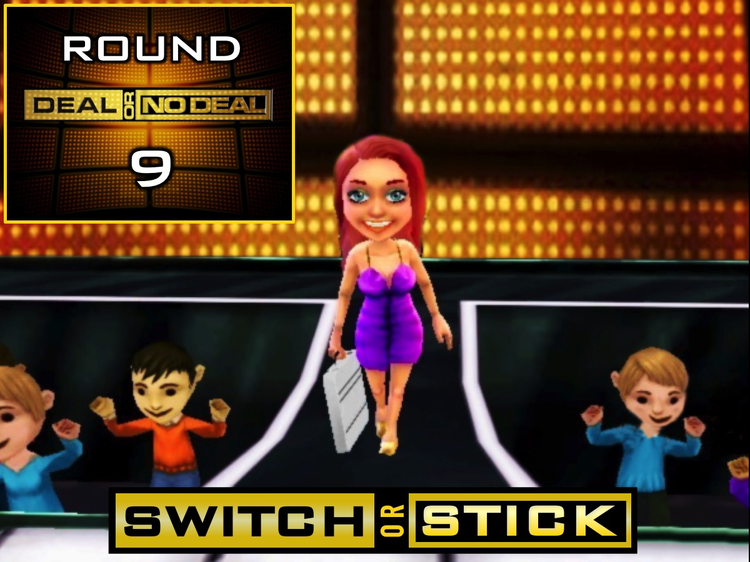
Notes:
Round 9 - Switch or Stick - each team can choose to switch their case with the one on the wall or stick.
Sound: Deal_or_No_Deal_Night_Switch.mp3

Slide 23
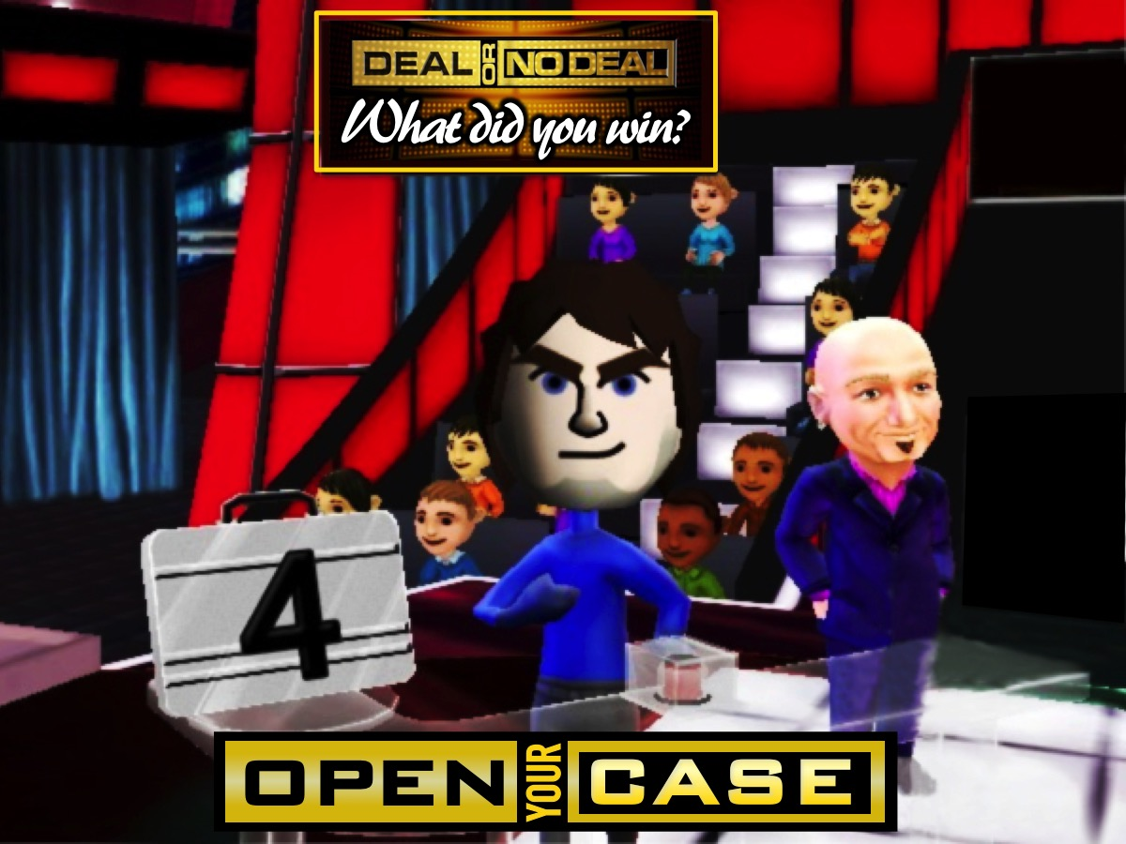
Notes:
Open the Case: Each team in turn will open the case in front of them (not the case on the wall).
Sound: Deal_or_No_Deal_Night_Reveal.mp3

Slide 24

Notes:
Collect Your Prizes: Each team is given a prize based on where they came in the game - from 4th to 1st Place.
Sound: Deal_or_No_Deal_Night_Main.mp3

Slide 25

Notes:
Small Groups. Here are the questions for our small group time: (1) What did you like about Deal or No Deal? (2) What didn't you like about this game? (3) How does this verse challenge the idea that life is just a" game of chance”? "Like an open book, you watched me grow from conception to birth; all the stages of my life were spread out before you. The days of my life all prepared before I'd even lived one day." (Psalm 139:16). (4) What can you do to live a life of faith? (5) Pray for each other to trust God more in their everyday life.

Slide 26

Notes:
There will be no youth next Friday (or on Sunday) - we meet again the following Friday!

Slide 27
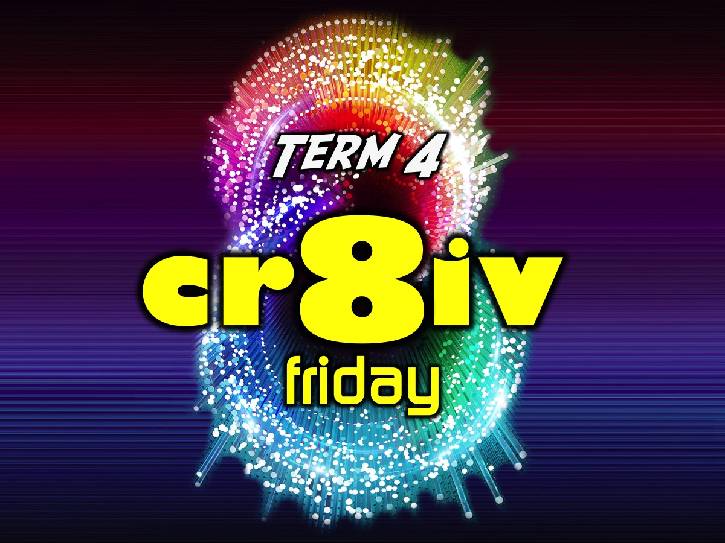
Notes:
Next term we have a brand new series called: cr8iv Friday.

