Slide 1
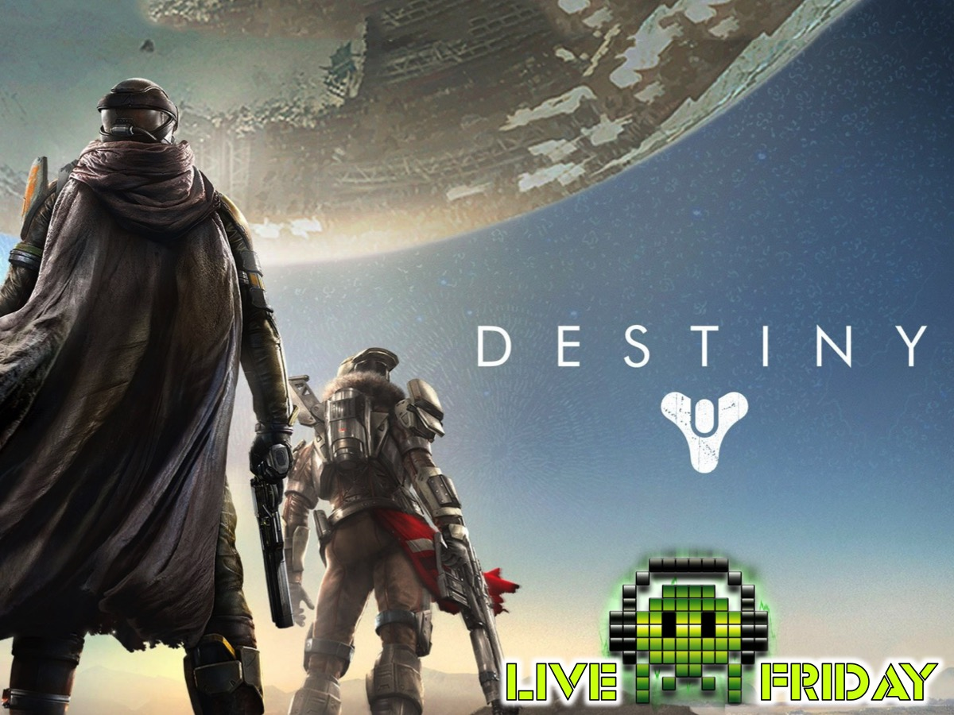
Notes:
Destiny Night

Slide 2
Notes:
Pre-Event Video: Official Destiny Live Action Trailer Become Legend. Get it on YouTube at: https://www.youtube.com/watch?v=9ZyQK6kUdWQ

Slide 3

Notes:
Welcome to Live Friday

Slide 4
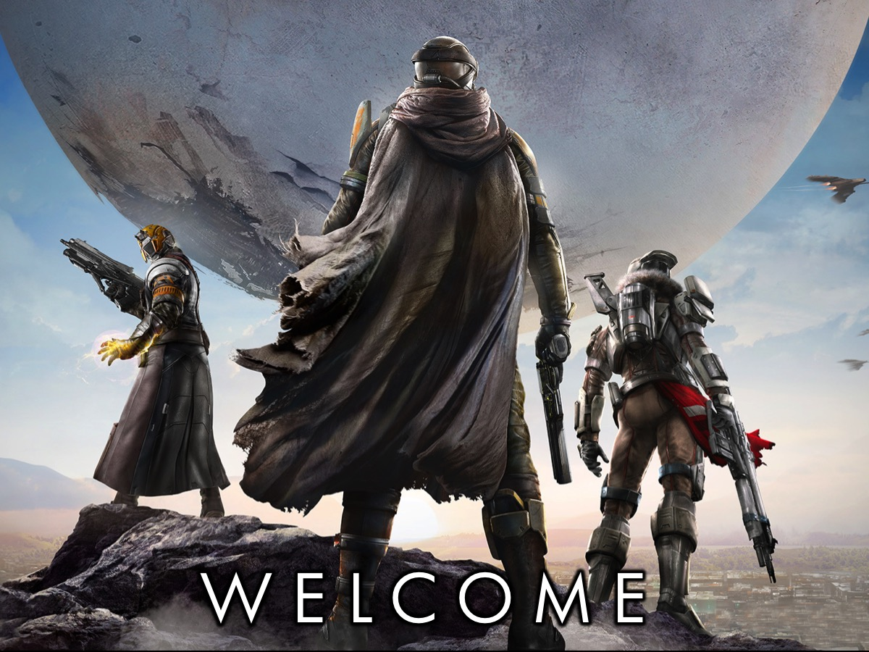
Notes:
Welcome to our regulars and any newcomers.

Slide 5

Notes:
Announcements: On Sunday morning we continue with our Revolution Series. And next Friday night it is our Tombraider Night.

Slide 6
Notes:
Tonight is Destiny Night.

Slide 7
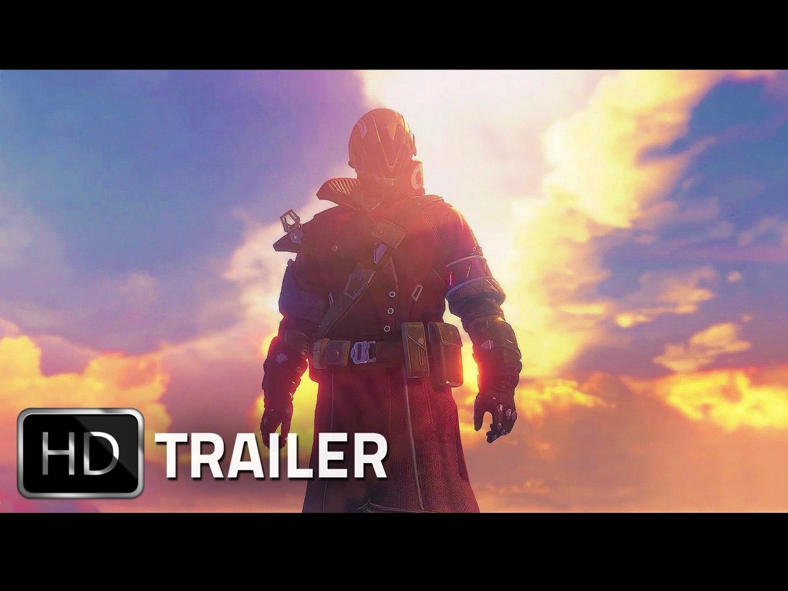
Notes:
Let’s start off with a video to help us understand what the game, Destiny, is all about.

Slide 8
Notes:
Video: Official Destiny E3 Gameplay Trailer. Get it on YouTube at: https://www.youtube.com/watch?v=y2Jx5__c1lY

Slide 9

Notes:
The Traveller arrived on earth to help humanity recover from catastrophe and defeat it’s enemies.

Slide 10

Notes:
The Guardians are soldiers able to wield the Travellers power to save the city. If they can find a way to save The City -- to reclaim all that was lost – they will become legend. If they fail, the last light of civilization will go out.

Slide 11
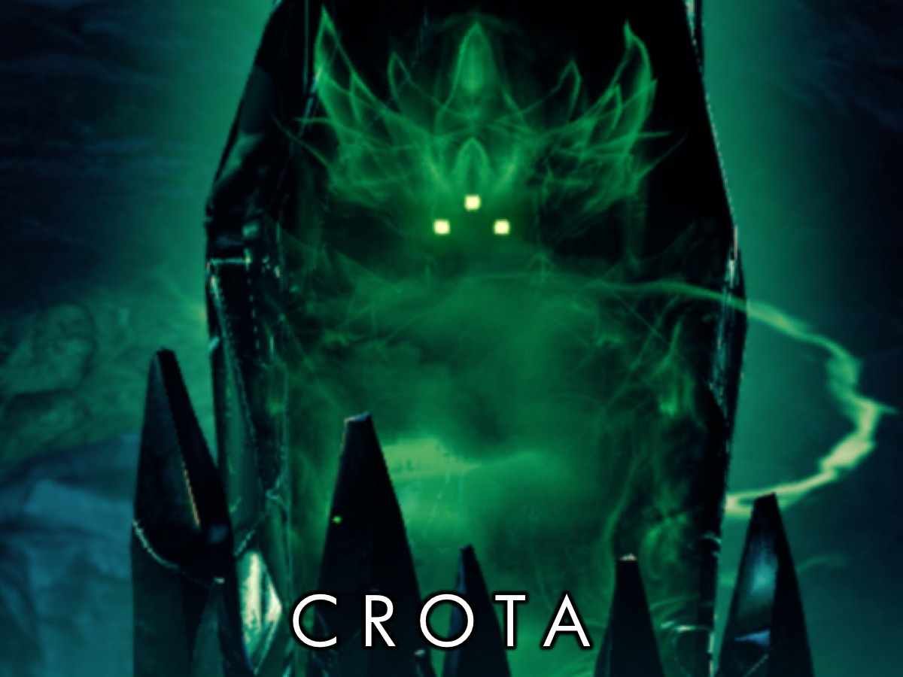
Notes:
Crota is a force of Darkness and must be defeated if the human race has any hope of survival.

Slide 12
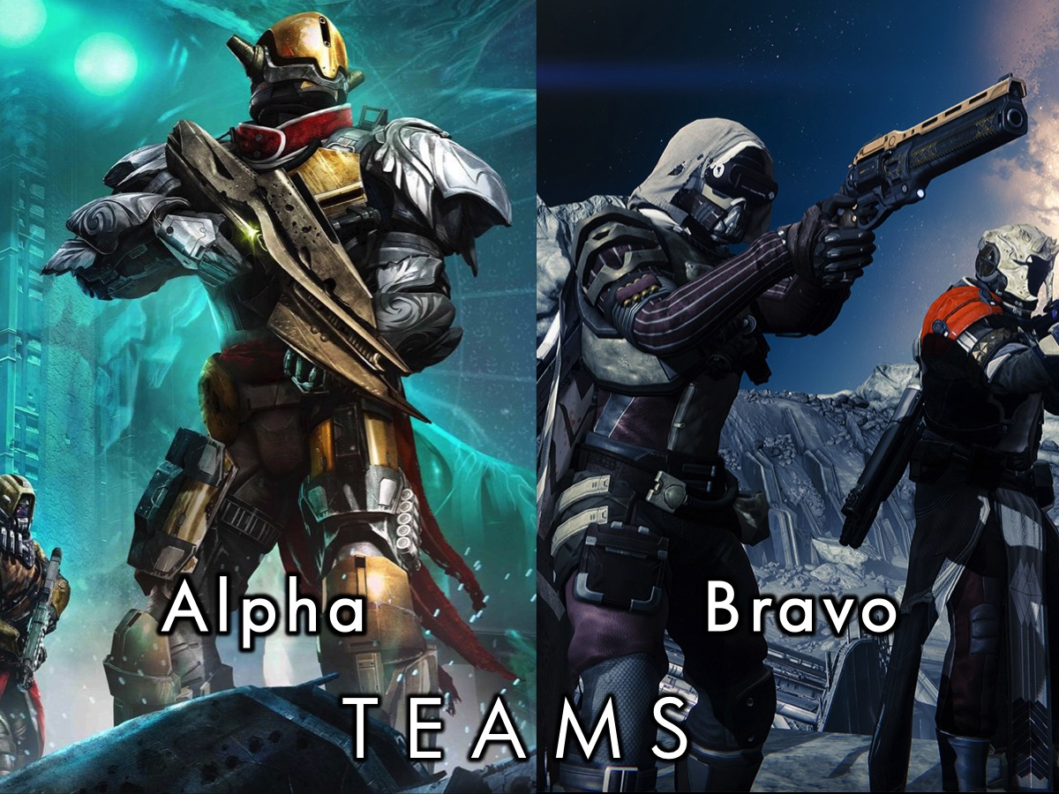
Notes:
Teams: You are going to divide you into two equal groups of Guardians: Alpha Guardians and Bravo Guardians.

Slide 13
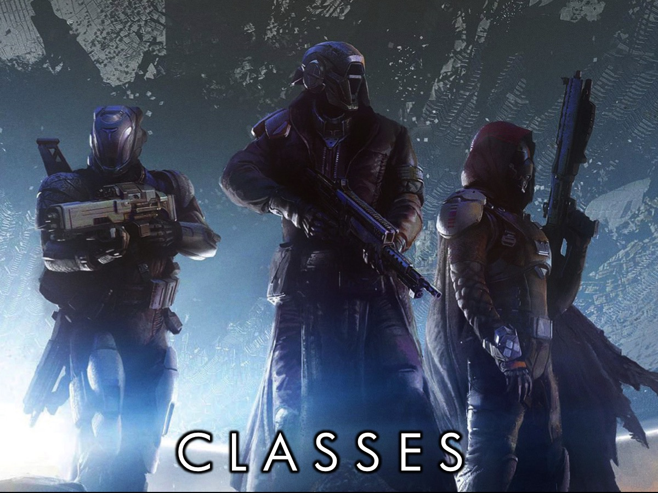
Notes:
Classes: You are now going to divide into three classes (in each group of Guardians): Hunters, Titans and Warlocks. You choose a class based on your personal skills - but the teams must be equal in size at the end of your choosing.

Slide 14
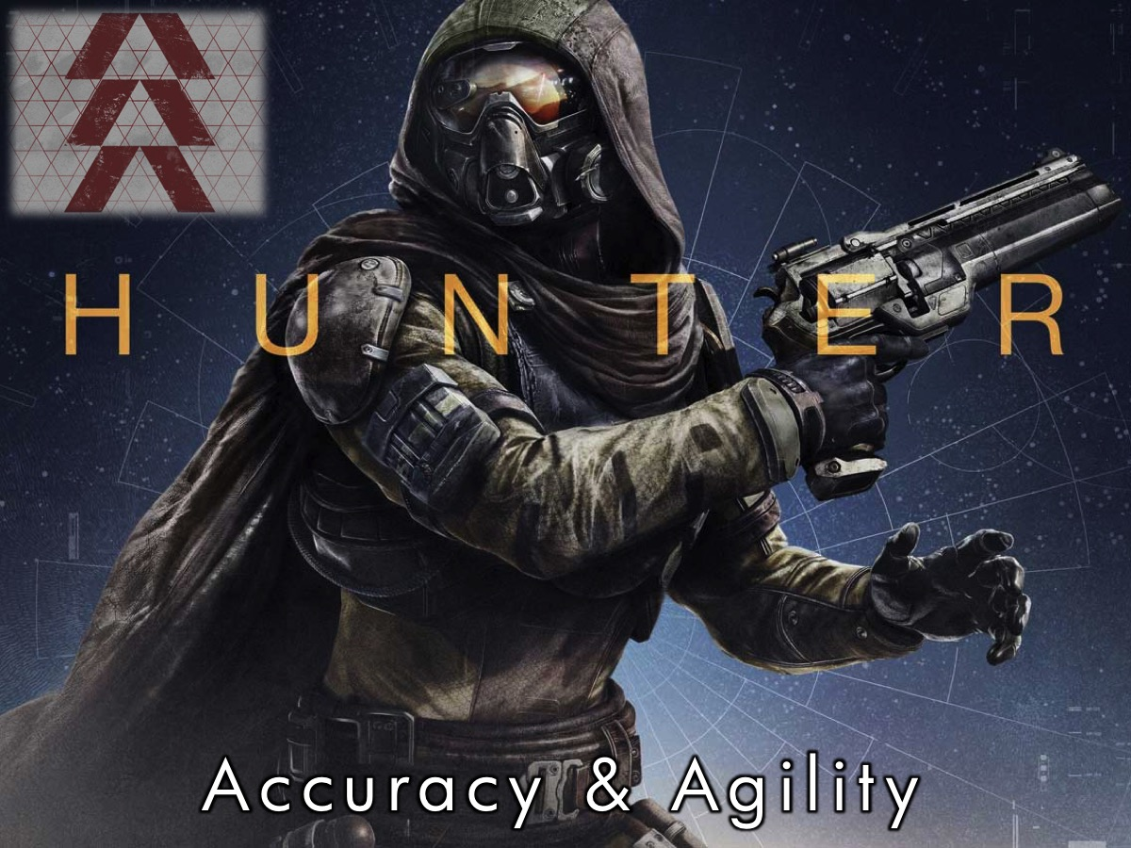
Notes:
Hunter Class – Guardians who are known for their Accuracy and Agility.

Slide 15
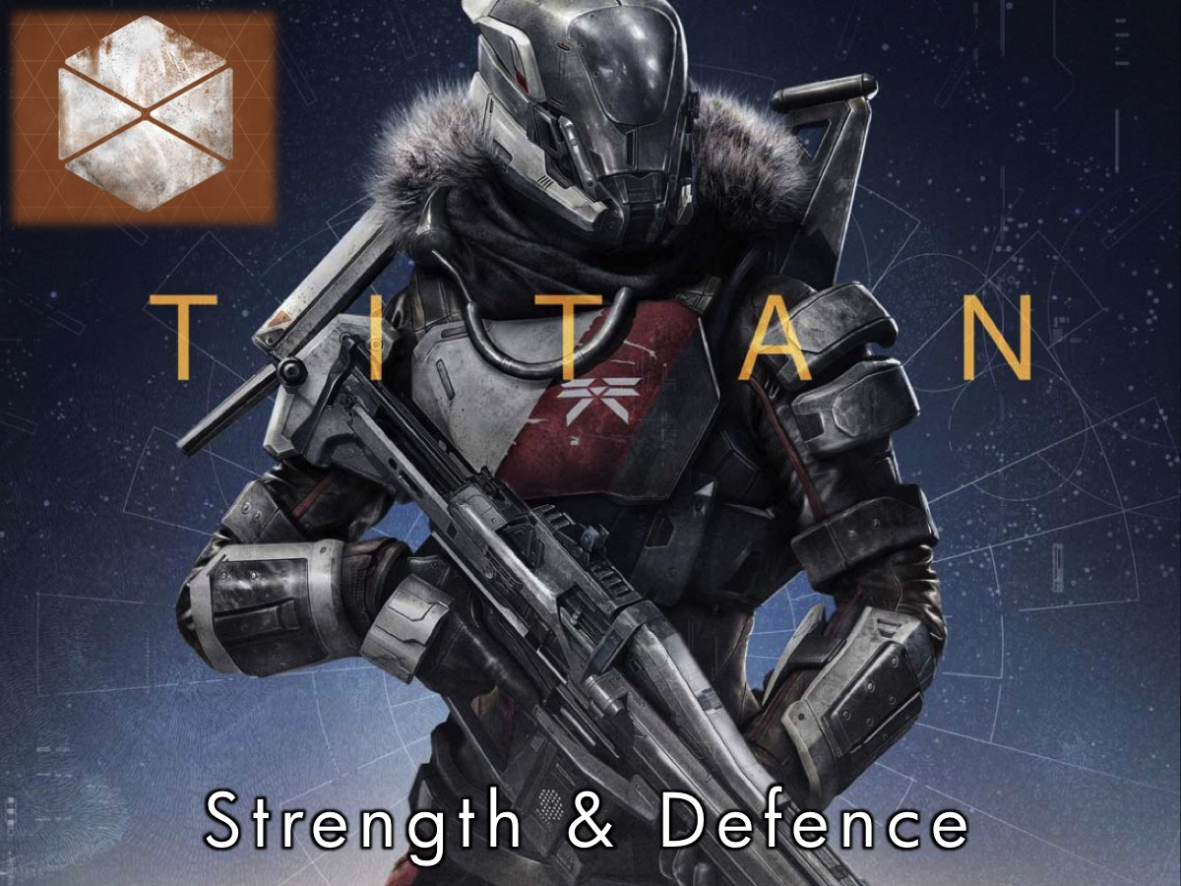
Notes:
Titan Class – Guardians who are known for their Strength and Defence.

Slide 16

Notes:
Warlock Class – Guardians who are known for their Intellect and Strategy.

Slide 17
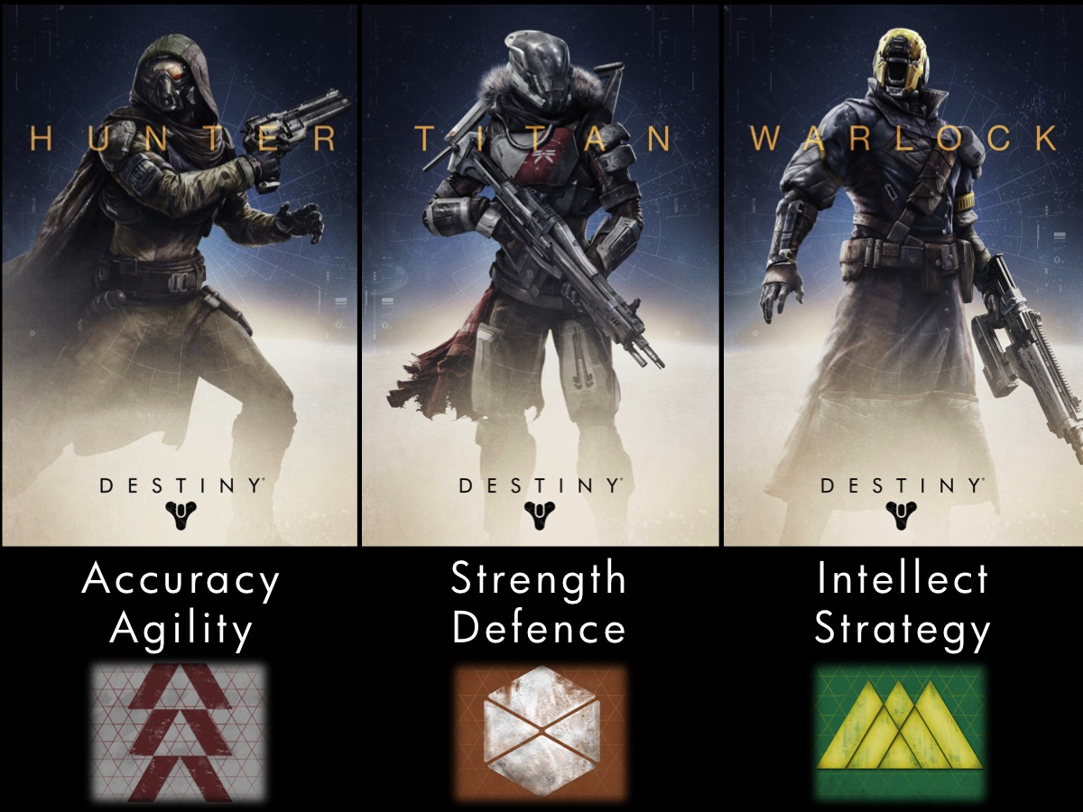
Notes:
Okay, do divide yourselves in your Guardian group into three different classes.

Slide 18
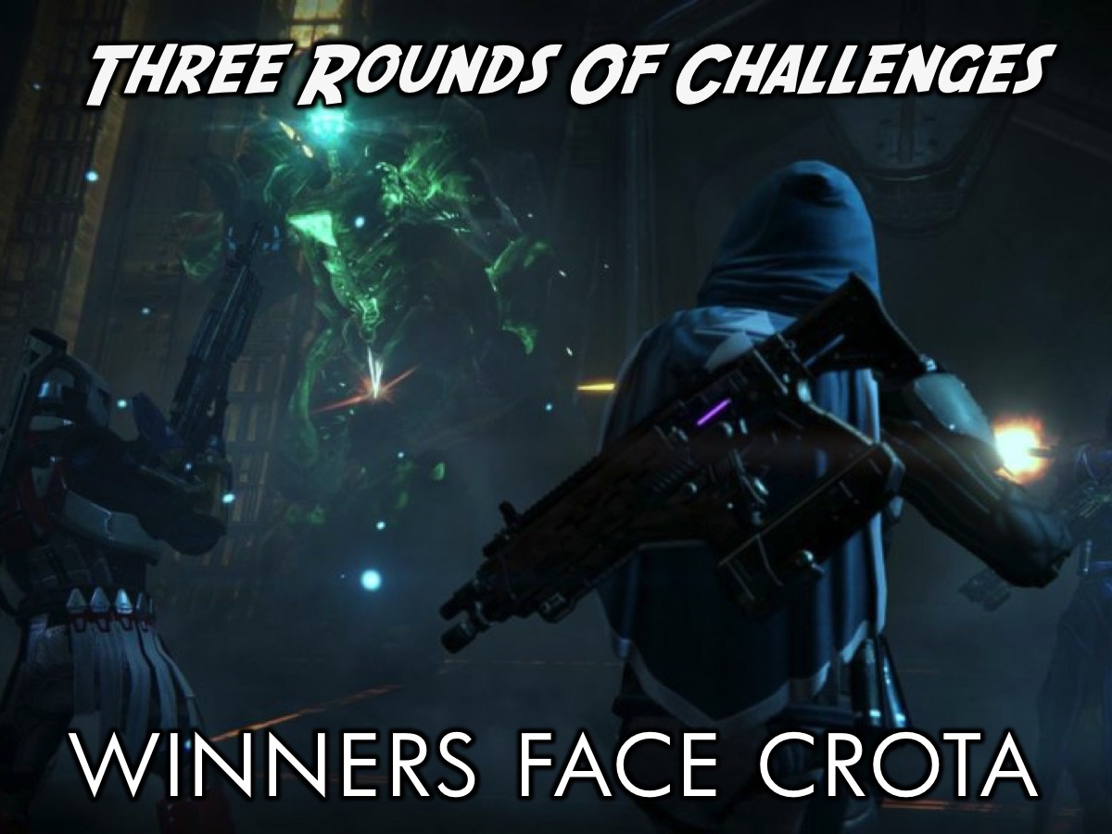
Notes:
We are going to have three rounds of games and the group of guardians with the highest combined score will go up against Crota!

Slide 19
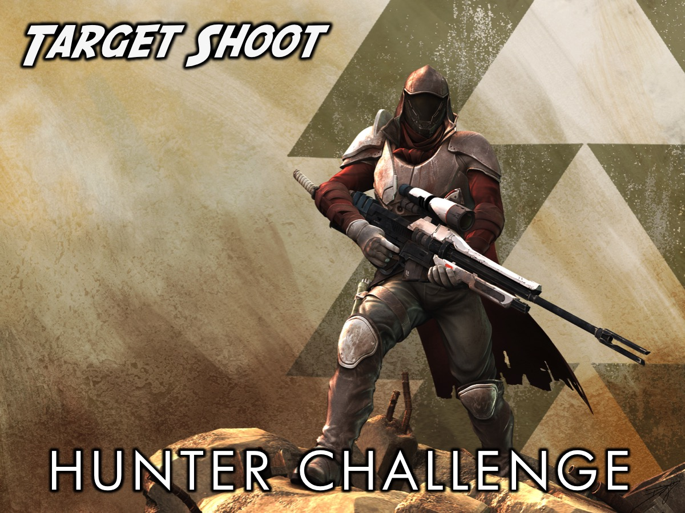
Notes:
Hunter Class Challenge: The Hunters will compete in Target Shooting using a spoon and a ping pong ball.

Slide 20
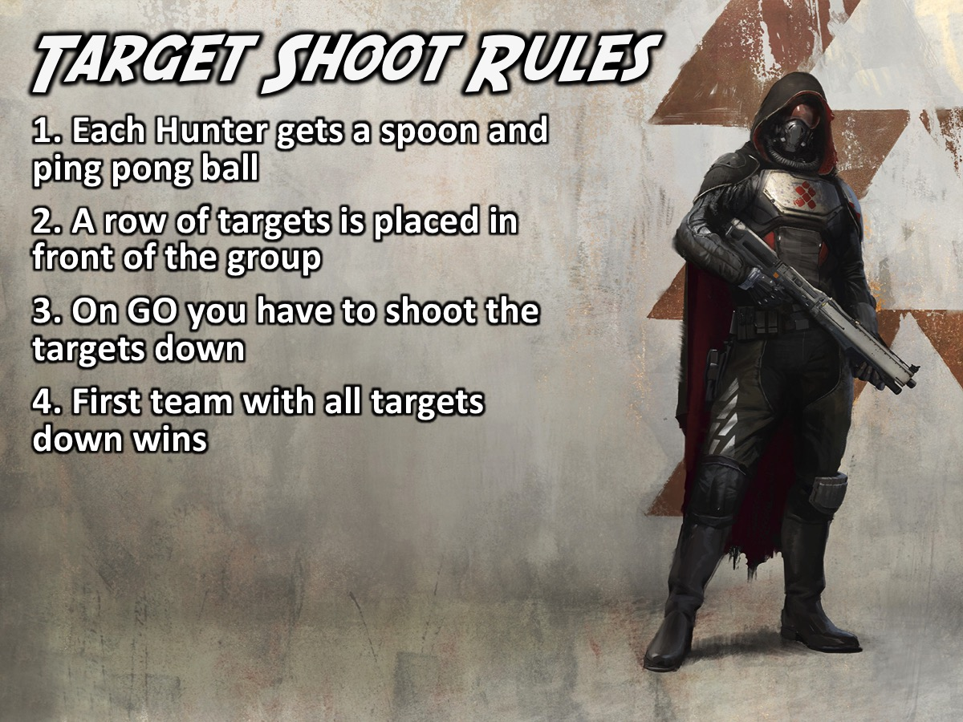
Notes:
Target Shooting Rules:
1. Each Hunter is given a spoon and ping pong ball
2. A row of targets is placed in front of the group
3. On go you have to knock the cups down
4. First team with all cups down wins

Slide 21
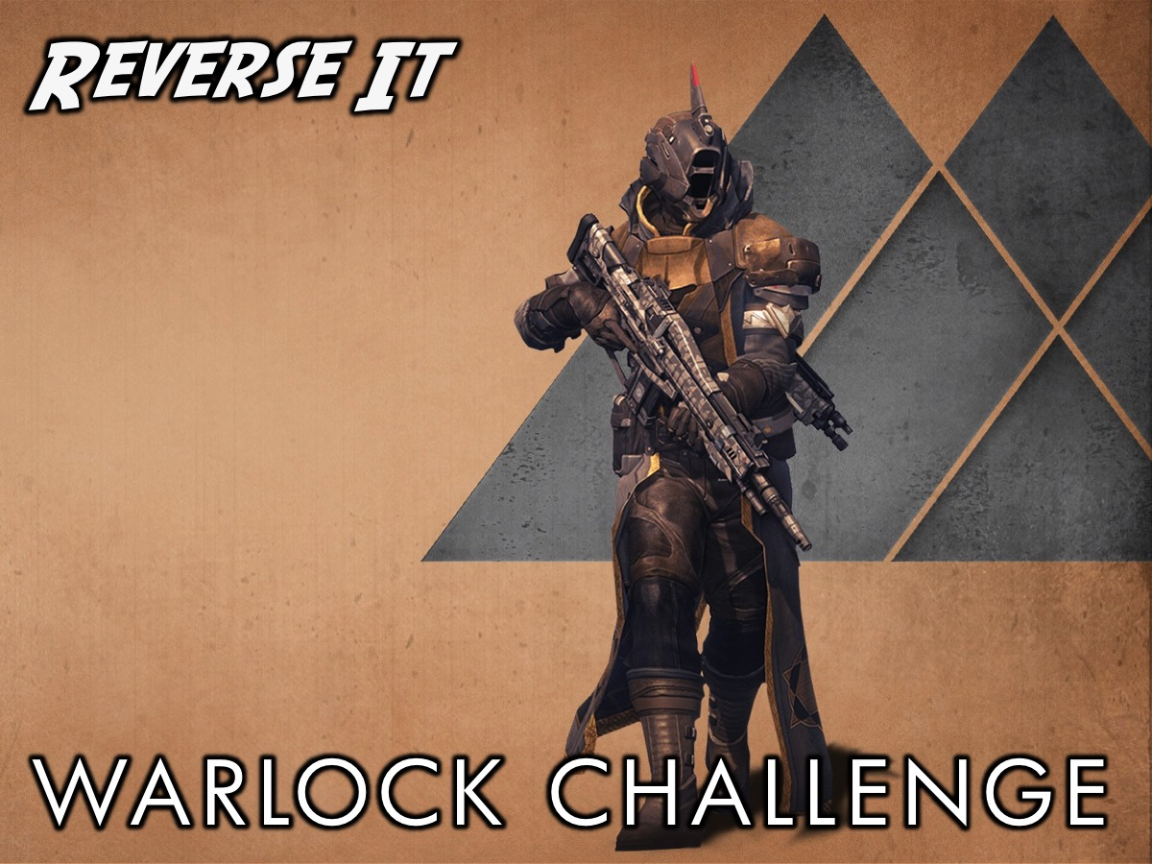
Notes:
Warlock Class Challenge: The Warlocks will compete in a game called Reverse It. Each group is given a sheet and everyone has to stand on it and at all times have both their feet on the sheet. The first team to turn the sheet over - without stepping on the ground - wins the game. Give the teams a few minutes to strategise before starting.

Slide 22
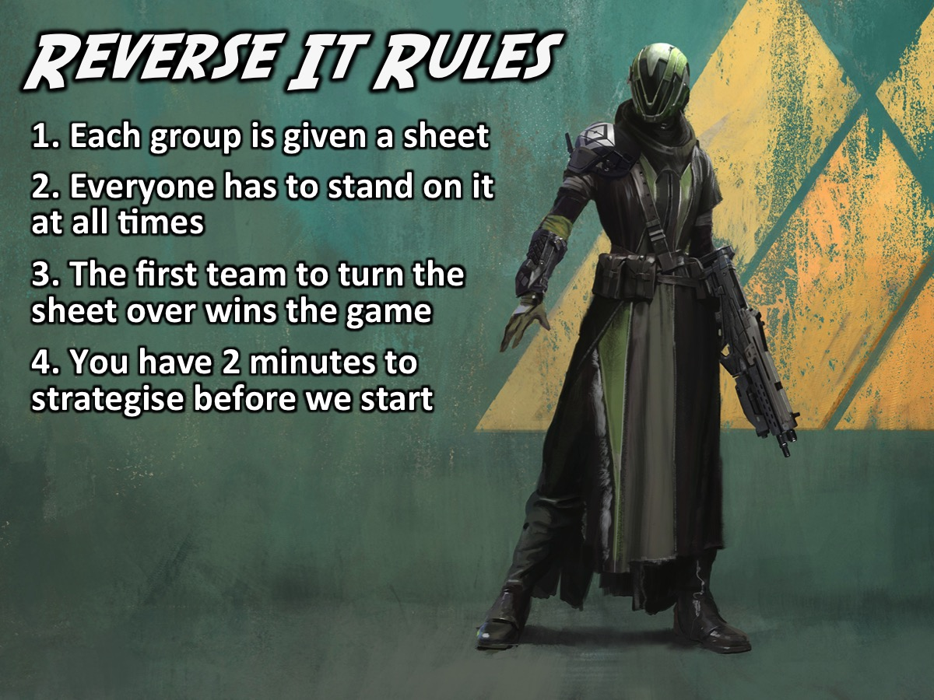
Notes:
Reverse It Rules:
1. Each group is given a sheet
2. Everyone has to stand on it at all times
3. The first team to turn the sheet over wins the game
4. You have 2 minutes to strategise before we start

Slide 23
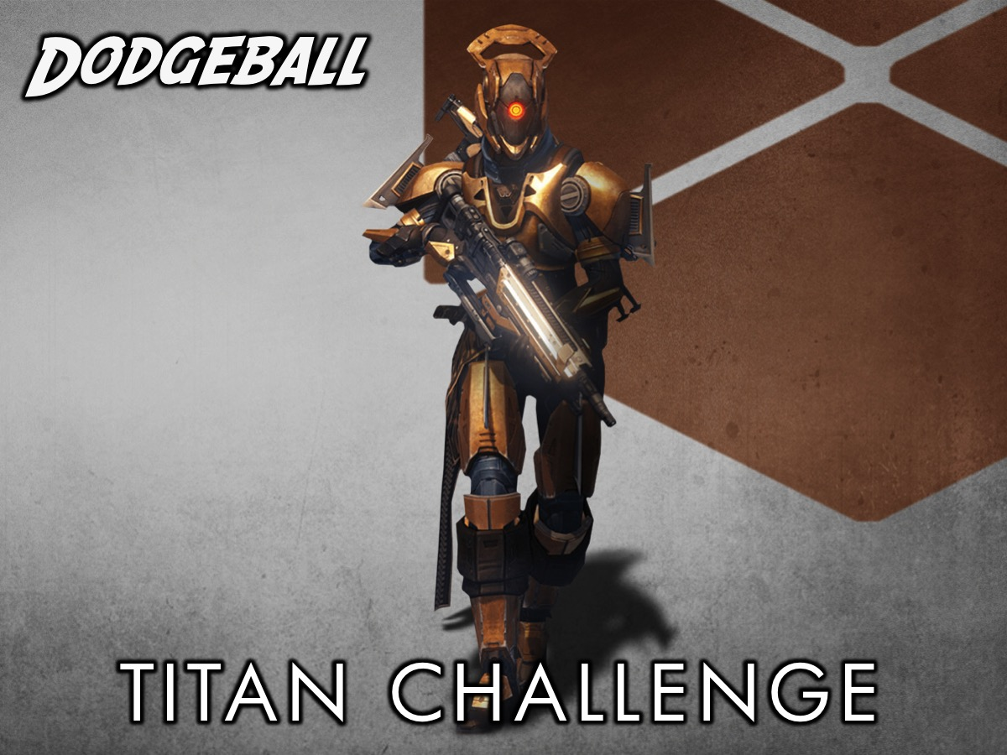
Notes:
Titan Class Challenge: The Titans will compete in a game of Dodge Ball. There will be a measured out court with two sides and each team will be given 5 balls to start with.

Slide 24
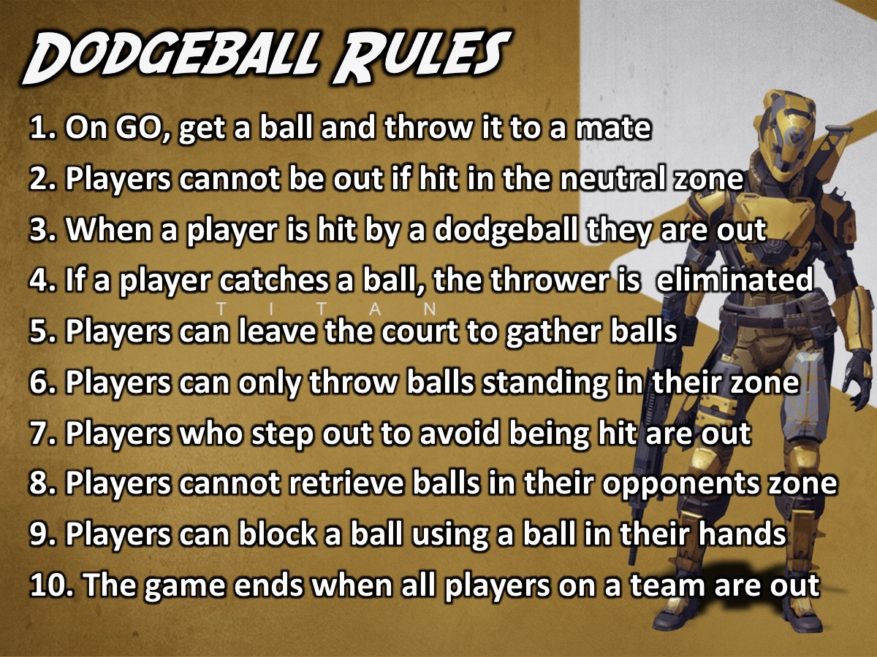
Notes:
Dodgeball Rules:
1. On GO, get a ball and throw it to a mate
2. Players cannot be out if hit in the neutral zone
3. When a player is hit by a dodgeball they are out
4. If a player catches a ball, the thrower is eliminated
5. Players can leave the court to gather balls
6. Players can only throw balls standing in their zone
7. Players who step out to avoid being hit are out
8. Players cannot retrieve balls in their opponents zone
9. Players can block a ball using a ball in their hands
10. The game ends when all players on a team are out

Slide 25
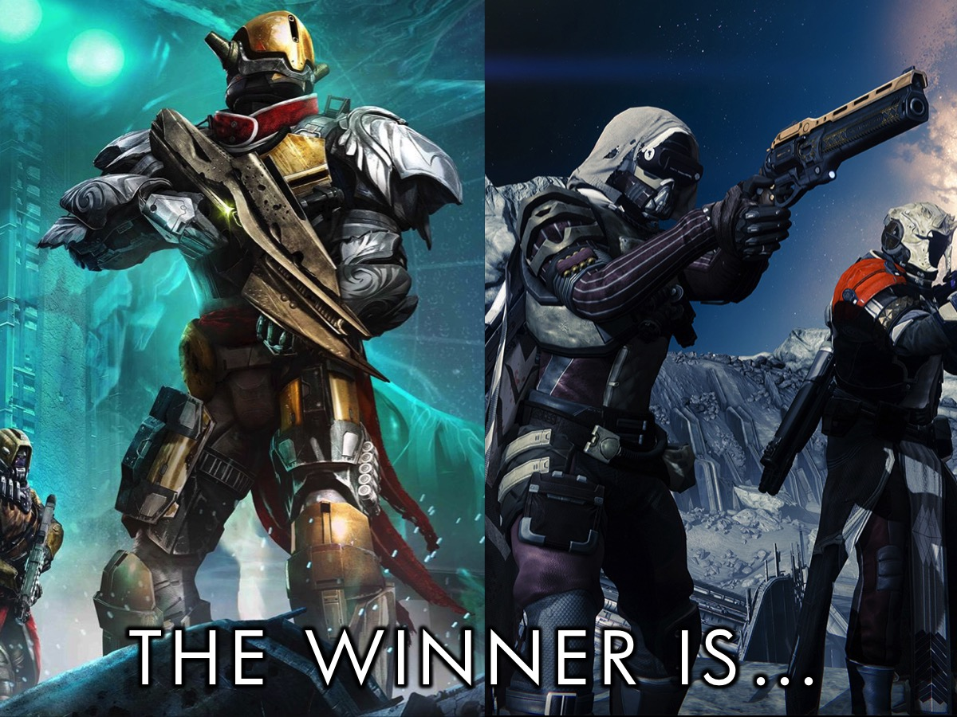
Notes:
And the Winning Guardians are… (They receive a prize)

Slide 26
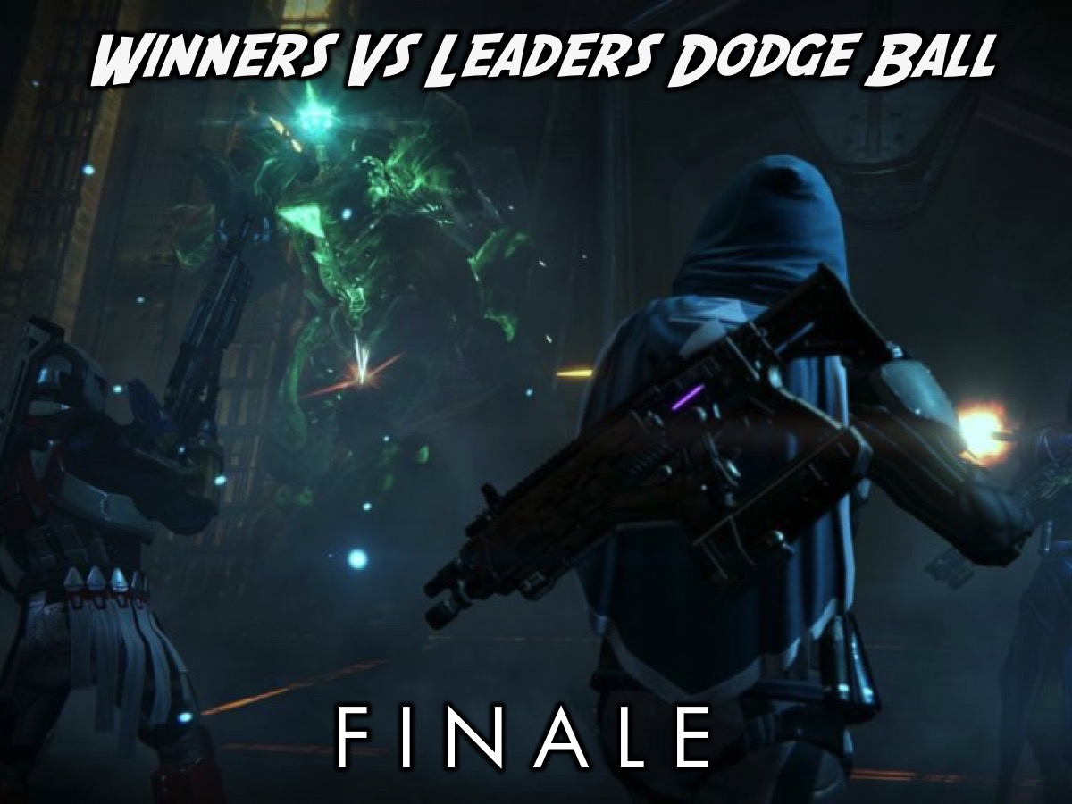
Notes:
Finale: The winning team of Guardians will compete against Crota – represented by the teen leaders - in a game of Dodge Ball.

Slide 27

Notes:
Before we move into our small groups – let’s take a look at what a gamer has come up with showing the parallels between the life of Jesus and the Traveller in Destiny.

Slide 28
Notes:
Video: An edited version of: “Destiny Secrets - The Religious Paradigm”. Get it on YouTube at: https://www.youtube.com/watch?v=_or6xoQGWLQ

Slide 29
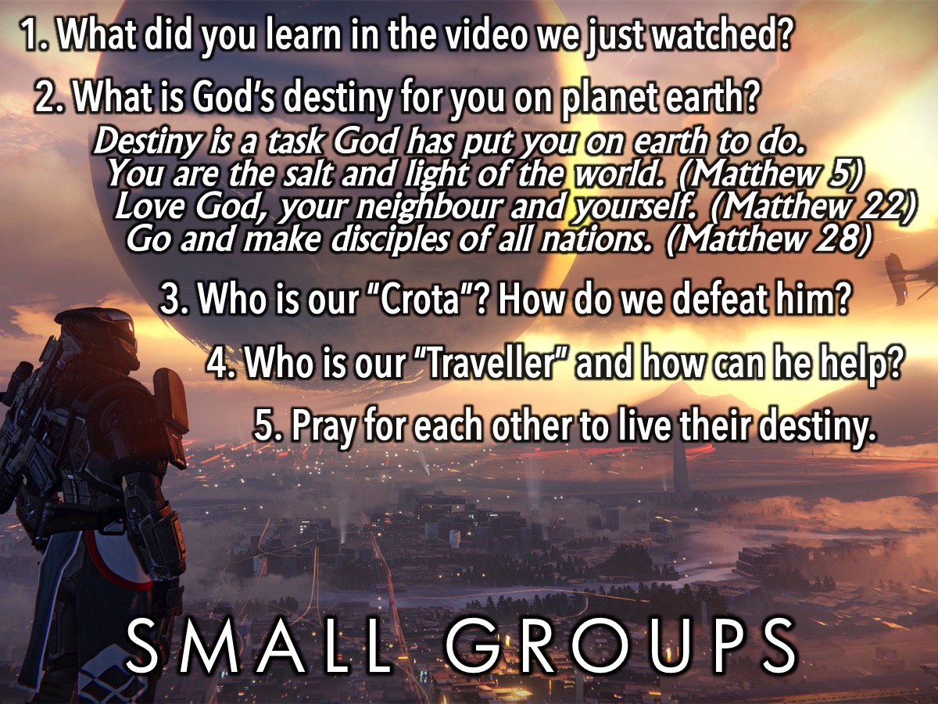
Notes:
Small Groups: Here are the questions: (1) What did you learn in the video we just watched? (the video shows how that the Traveller in the game called Destiny is like Jesus in many ways). (2) What is God’s destiny for you on planet earth? Here is a definition of Destiny: “Destiny is the task God has put us on earth to do”. Here are some questions to help us shape our destiny: “You are the salt and light of the world”. (Matthew 5). “Love God, your neighbour and yourself”. (Matthew 22). “Go and make disciples of all nations. (Matthew 28). (3) Who is our Crota? How do we defeat him? (In Destiny, Crota is the main enemy of the Guardians who is destroying the world). (4) Who is our “Traveller” and how can he help? (Here you will focus on the role that Jesus and the Holy Spirit - and maybe even the Bible - play in our lives). (5) Pray for each other to discover and live their destiny.

Slide 30
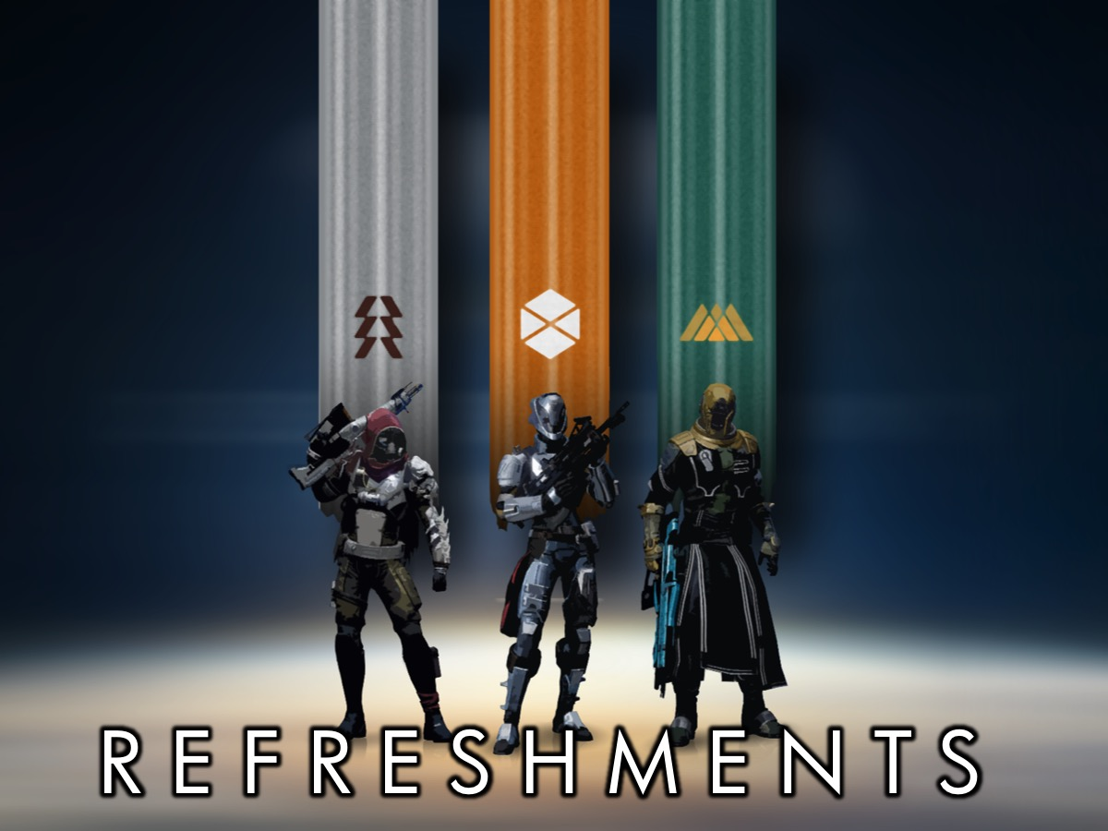
Notes:
Refreshments: It is time for refreshments!

