Slide 1
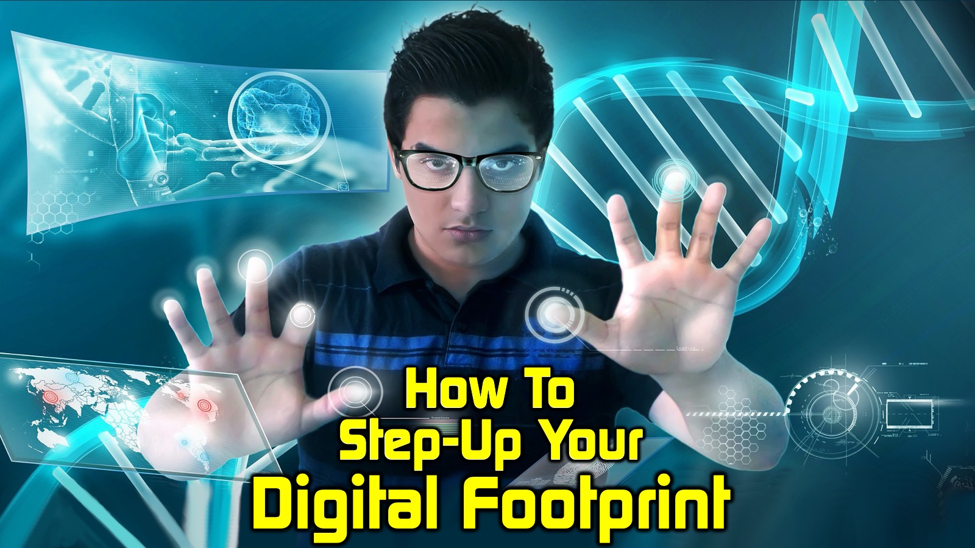
Notes:
Thanks to each of you, over 170 online this morning on this cold Johannesburg morning or wherever you connecting in from. What an opportunity we have to do something fresh at this time and to be alive and well. And to be making sure that we are taking everything God has given us and we still being effective. This is not a time to hold back or to shrink back or to say, "We can't do any more what we used to do, so we're going to give up." We are not those who shrink back! We are going to make sure that we immediately begin to say: "We have a digital footprint and we want to step up our digital footprint. We want to go beyond anything that we have ever done before.

Slide 2
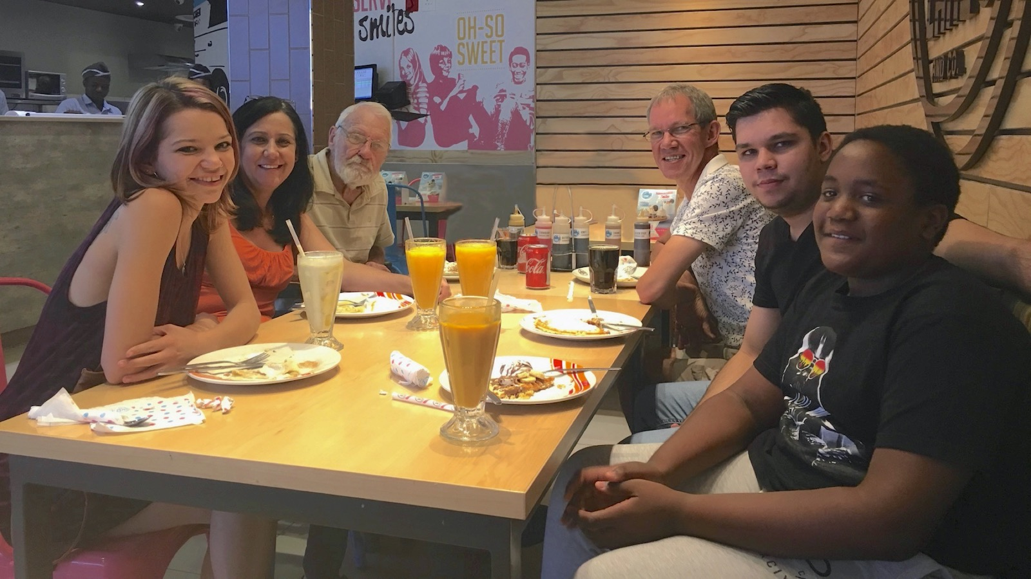
Notes:
But before I get to start preaching too much, they may just introduce myself. I'm fortunately not the oldest person in this picture. That's my dad in the background there, who's actually holding on for dear life in the last days of his life. We've been in and out of hospital during lockdown with him. But there's my wife, Debbie, next to my dad, my daughter Ashley, my youngest son in the foreground, Drew Nguvu and just behind him is my oldest son, Keegan Wayne, who's probably hacking into this right now seeing that that's his chosen profession. Yes, as Shannon said, I'm from Every Nation Rosebank where I have been on staff for the last 15 years or so. For about 13 of those years I was a full time youth pastor. If you cut me I will bleed youth ministry. And I actually saw on my side screen just now one of the delegates, Stuart Fisher, who happen to have stepped into my shoes and is knocking the ball out the park. Stewart, big ups to you, bro and if you guys want to connect with someone who is a trailblazer then check him out.

Slide 3
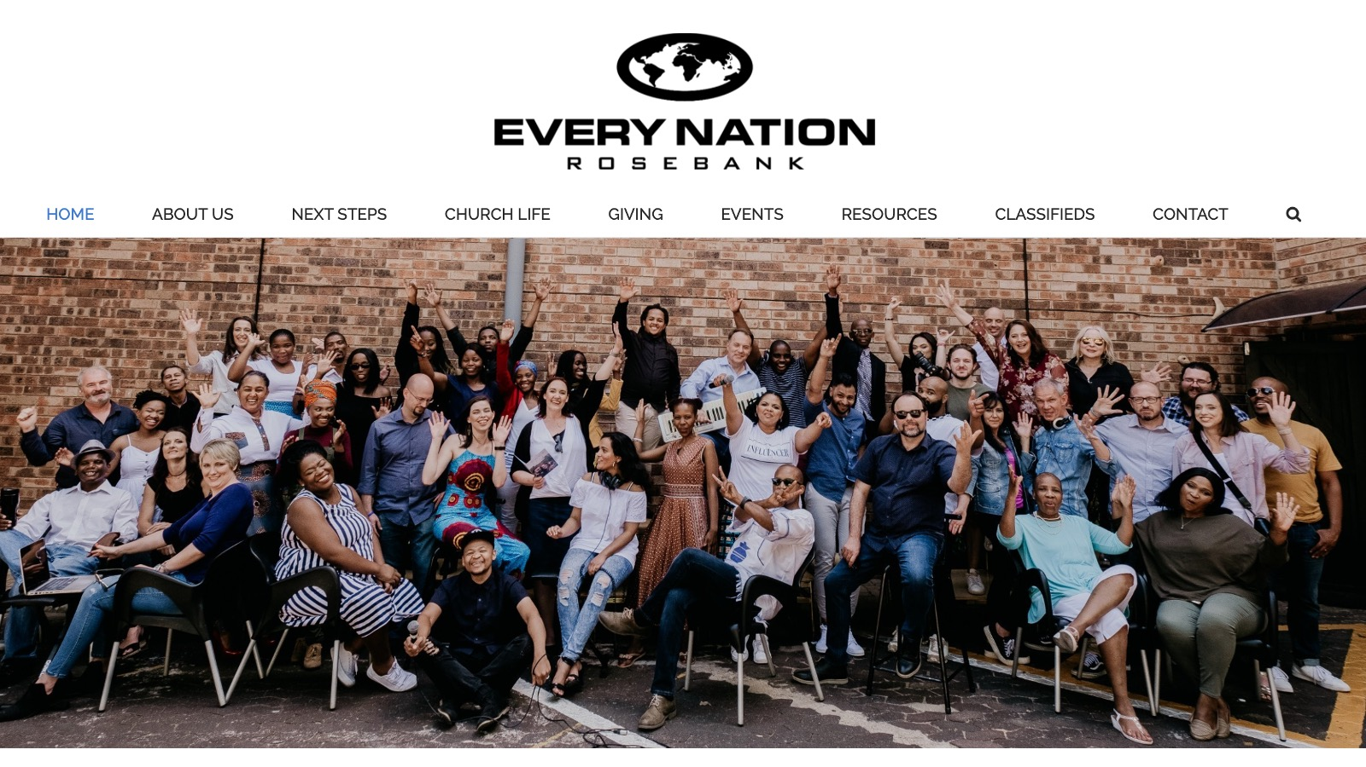
Notes:
And so this is our staff at Every Nation Rosebank where I'm tasked with the responsibility of ensuring there's a leadership development pipeline. I'm going to be speaking out of that context this morning. But my heart is still very much for youth.

Slide 4
Notes:
If you want to see what I've done in the last three decades of my life, then simply pop across to the website that I ran called the Youth Ministry Resourcer

Slide 5
Notes:
and before you drown in all the resources you may want to begin on the Program's page and you'll see the strategy we use at Encounter Youth: Engage, Establish, Equip and Empower. I guess this website is my life's work and it will always be free to access.

Slide 6
Notes:
Here is the link to The Youth Ministry Resourcer: website www.ymresourcer.com

Slide 7
Notes:
You will also find for the rest of this session that loads of extra resource have been put into a Google Drive folder for you. Just jump across to: www.bit.ly/GenC2020.

Slide 8
Notes:
The very first file in that folder is a presentation entitled: Digital Footprint, which is what I'll be walking you through this morning in between three breakaway groups. There are lots of other resources in there that I've created or stolen from others and they are there for your use.

Slide 9
Notes:
And so my challenge to you is firstly, is to Embrace the Digital Revolution.

Slide 10
Notes:
There's been a number of revolutions down through the ages and we're in the fourth industrial revolution. If you don't know we had the printing press and we are well into the digital era. And it's our time now to really knock it out the park.

Slide 11
Notes:
We weren't doing such a good job, but lockdown has forced us to go on another level.

Slide 12
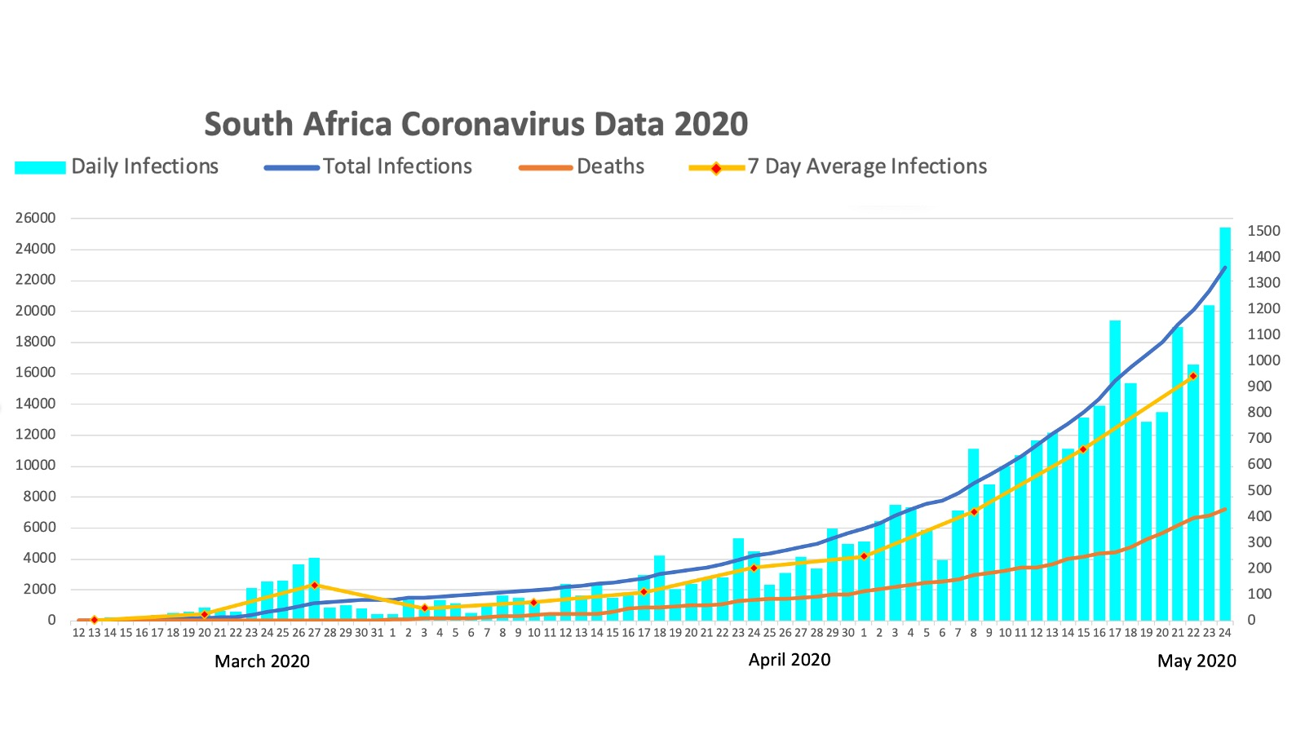
Notes:
This is the chart that I've been keeping with all the stats about impact of the Coronavirus in South Africa from the start in March and brought about the need to social distance ourselves.

Slide 13
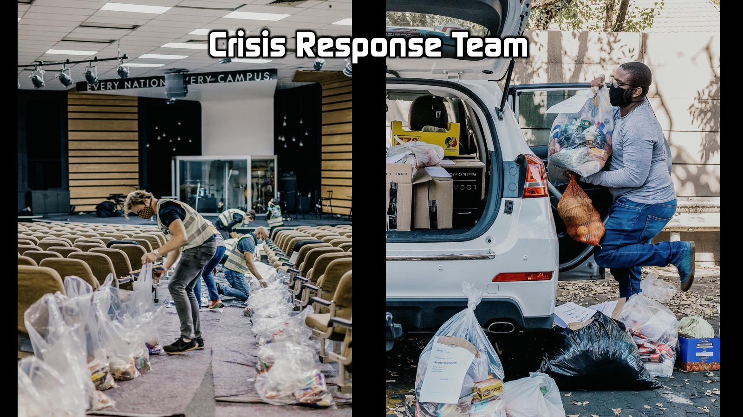
Notes:
You know that almost overnight our churches went into crisis response where our sanctuaries were used for little more than reaching out to the poor.

Slide 14
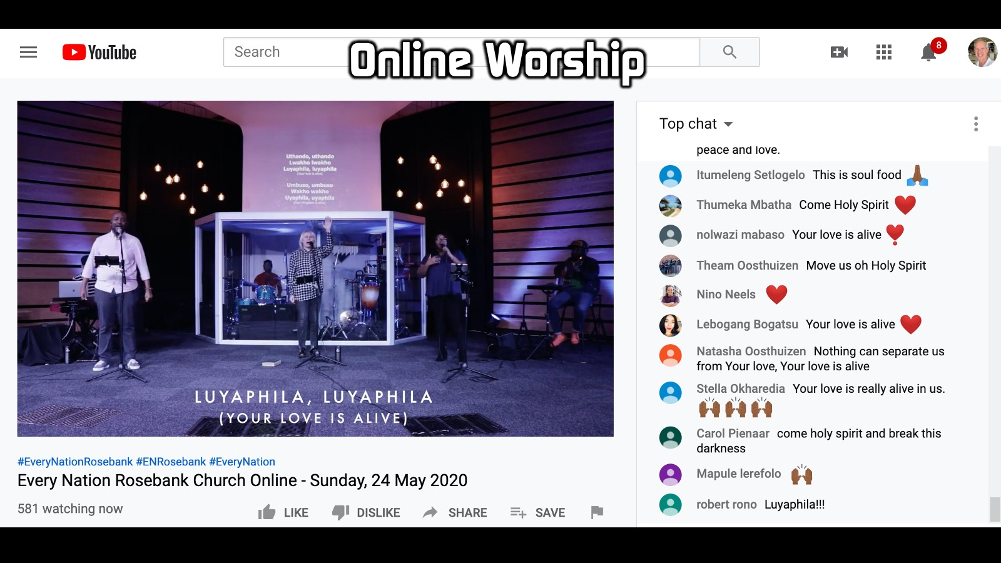

Slide 15
Notes:
You're probably doing online search online sermons.

Slide 16
Notes:
I'm sure you are facilitating online prayer,

Slide 17
Notes:
online small groups,

Slide 18
Notes:
online conferences like this one we having next weekend as an Every Nation family of churches - on the 30th and the 31st of May.

Slide 19
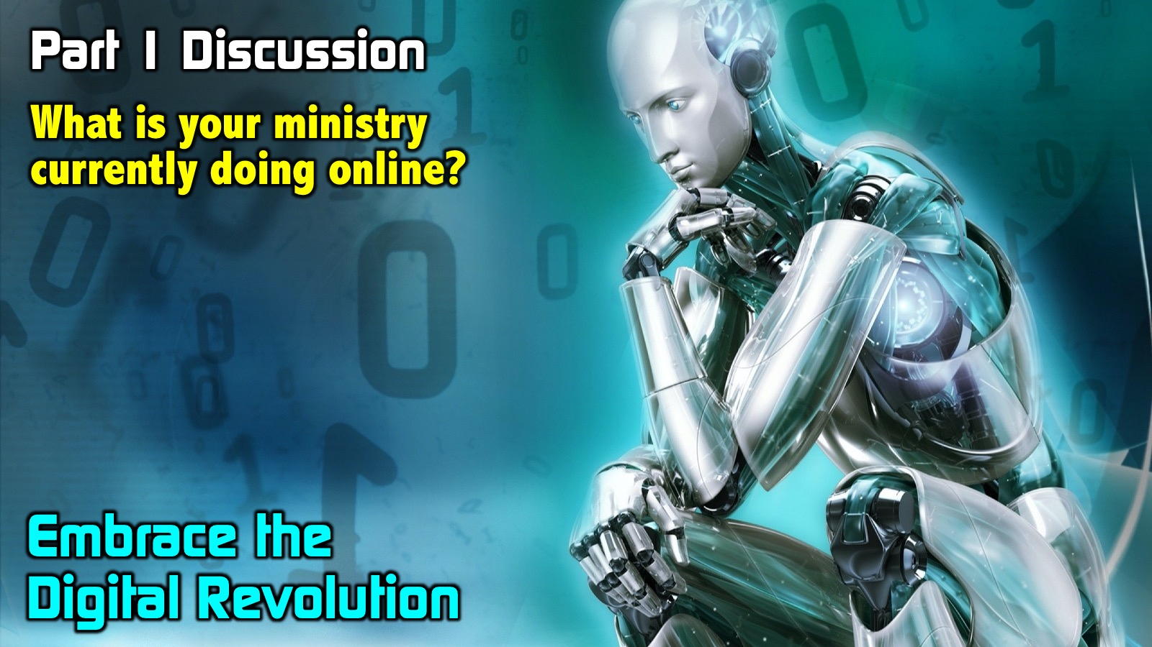
Notes:
And so I'm going to pause it right there. And I'm going to throw you into your discussion groups for the next five minutes as you answer this question: What is your ministry currently doing online? So confront the brutal facts to look at what you're doing. And then you'll come back and we'll take it further.
I see you are all coming back from your small groups, and I trust that that was a really awesome time. You began to think through what is it that you have been doing online during this season. Some of this could have been stuff that you've done for a long time in the past. Some of it could be stuff that you've that you've begun to do. And we want to make sure that whatever we're doing that we are using the tools that we have at our disposal. It's no good being part of this digital revolution, and then not actually making the most of it.

Slide 20
Notes:
So I want to encourage you, secondly, to Expand your Digital Presence. So far I've had you look at where you at, what you are currently doing? I want to challenge you now that that it's time to go beyond...

Slide 21
Notes:
Firstly, it's time to Do Old Things Even Better. It's time to look at everything you do. I don't know what your list of things were that you're doing. It could have included: Worship, Sermons, Prayer, Team meetings, Givings/Caring, I was the host of our lead pastors birthday that took place on a Zoom call the other day with 40 people and it was about a two hour engagement of prophetic words shared with him and people speaking into his life. And it was new, it was different, and it worked. How are our small groups doing? Are we being creative? Are we doing all things better? So that's the first point here.

Slide 22
Notes:
But secondly, in this section, I want to challenge you to start Doing New Things. Maybe things you haven't done before. I want to push you in two areas and do a little bit of show and tell of some things I've been doing over the last year or two.

Slide 23
Notes:
I want to talk about Training for understanding and Coaching for implementation. When we equip people remember that Edgar in the session ended by saying as he referenced Ephesians 4:11, that it is our job as leaders, as pastors, to equip people. So I want to talk about training. Maybe in the church, we would call it more disciplemaking, or equipping for leadership. But it's this idea that I want to help someone move to the next level.

Slide 24
Notes:
Leadership 215 is one of the leadership levels that I'm responsible for at Every Nation Rosebank where we have a four step leadership process. One one of those levels is called Leadership 215 and it is actually based on 2 Timothy 2:15.

Slide 25
Notes:
In this course there are 12 modules that are studied. And every one of these modules has 12 sections in it. Actually the students enrolled in Leadership 215 this year did not miss a beat when lockdown happened because we have already transitioned to a digital learning platform. It's called Pathwright. And here's what happens in their studies for each of the sections:

Slide 26
Notes:
Firstly, they Read.

Slide 27
Notes:
They have a student manual for every one of the modules (I've have actually put this module into the Google Drive folder). So they download and they read.

Slide 28
Notes:
Secondly, they Watch or Listen to a teaching depending on their bandwidth, depending on the amount of data they have.

Slide 29
Notes:
And so they would click on a video for that module or they would listen to the audio.

Slide 30
Notes:
Thirdly there are a number of Questions that they need to answer questions

Slide 31
Notes:
like for example: Which of the following are unbiblical teachings? There was a time when only the Father existed! The Son and the Spirit are less divine than the Father! The Spirit is no less divine than the Son or the Father! The Son became divine at his baptism! There are about four or five questions like this that refers back to what they have read or have watched or listened to in the teaching.

Slide 32
Notes:
Fourthly, they begin to Reflect, it will be three questions.

Slide 33
Notes:
And like this, this one's about analogies of the trinity - how they adequate or inadequate with shortcomings.

Slide 34
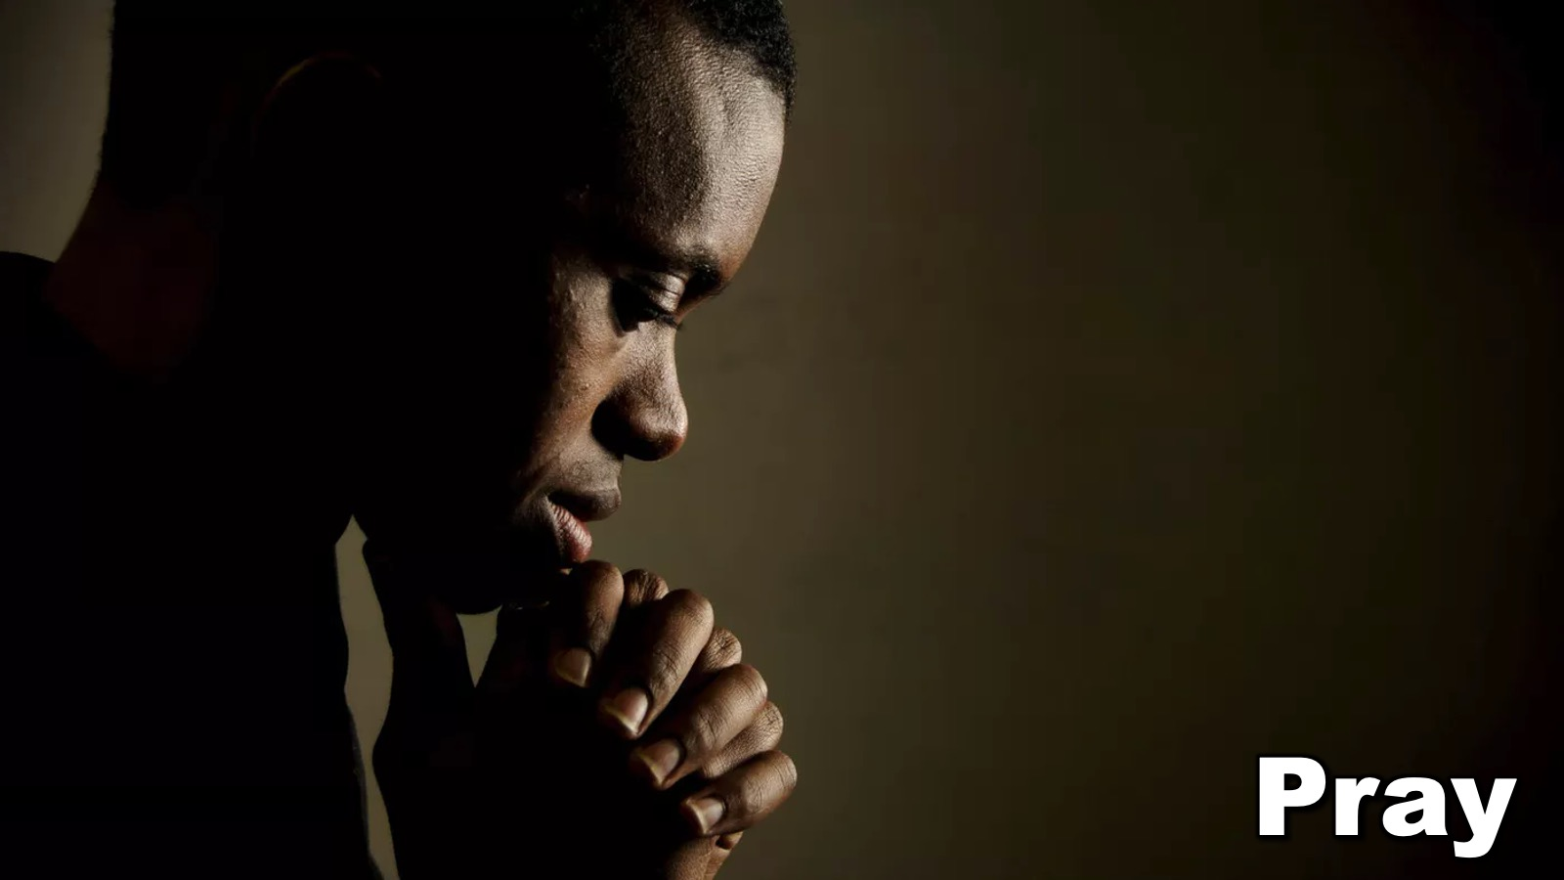
Notes:
Fifthly, they are guided in a Prayer.

Slide 35
Notes:
Here is a sample…

Slide 36
Notes:
Sixthly, they have to an opportunity to provide Feedback and this is where it gets really exciting.

Slide 37
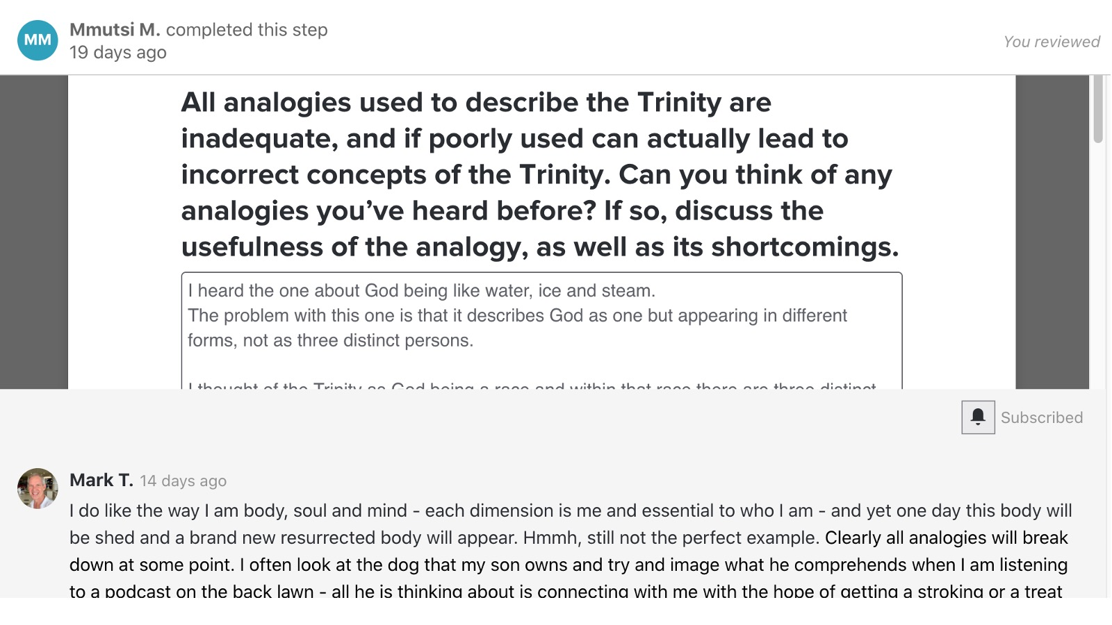
Notes:
As the administrator of this course I read through their work, and I comment on what they have shared. They sometimes get more back for me than what they send me.

Slide 38
Notes:
But it's this idea that we need to be interactive with people as they are learning. We must take training beyond just dumping information onto people.

Slide 39
Notes:
Secondly, I spoke about Coaching for implementation - this is where we need to help people take something they have been given and engage with them so they can use it.

Slide 40
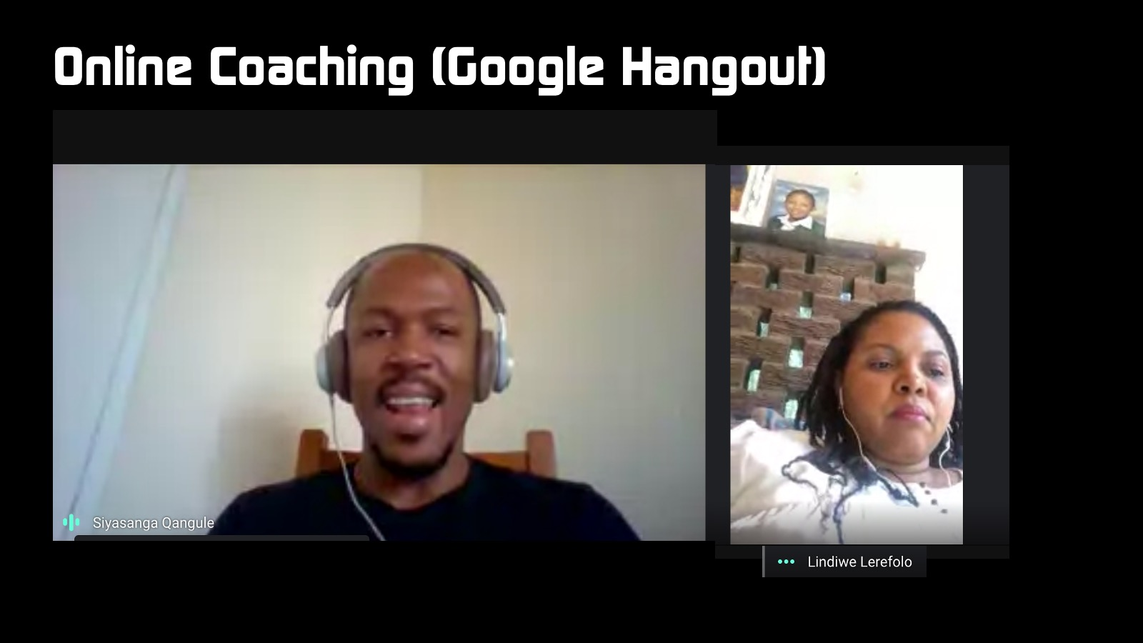
Notes:
I do a lot of coaching via Google Hangout - here as our administrator and our lead pastor's wife on a Google Hangouts call recently.

Slide 41
Notes:
I have 10 staff members at the moment that I'm coaching and we have a coaching group set up on WhatsApp, and I can share information with them, I can ask questions to engage with them.

Slide 42
Notes:
And then finally, what I do in terms of coaching is I've made use of Google Classroom. I don't know if you've smudged into that recently.

Slide 43
Notes:
I'm going to give you a very short heads up in terms of what I do to mirror what I do in my book called The Productive Life, and you will actually get the whole book in this online journey on Google Classroom. So they're happens to be seven keys that I have explored. For every section, there's an Overview with a video to preview. There's the Text from the book from that chapter. There is Content that they will engage with - whatever the sub points are in the heart of that chapter. Then there's a PowerPoint Presentation for them to view. Then there are some Questions and activities that they reflect on. And finally, I'll link them to a Podcast.

Slide 44
Notes:
So this is what the engagement looks like. In this section they are defining their mission. What are they want to be, their lifetime Noun, what can they do to engage with people, and then who do they want to impact, etc. So they submit that they get the email version of that back to themselves,

Slide 45
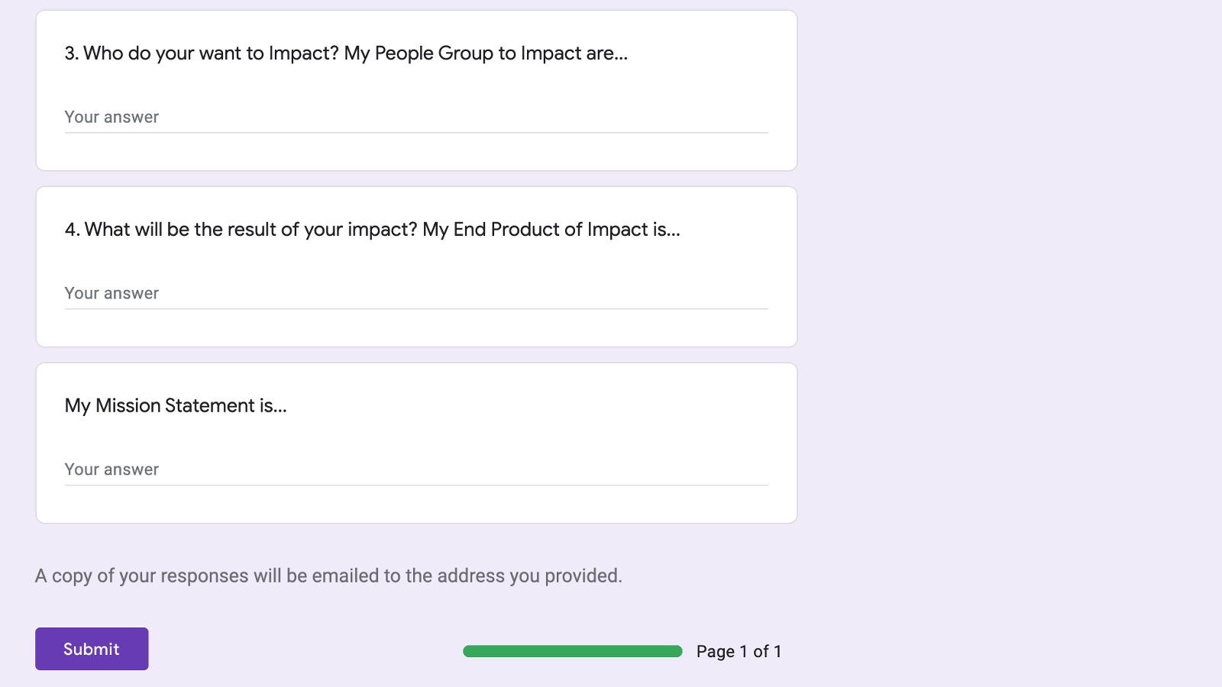

Slide 46
Notes:
and there's the reflection questions that they need to answer along the way as well.

Slide 47
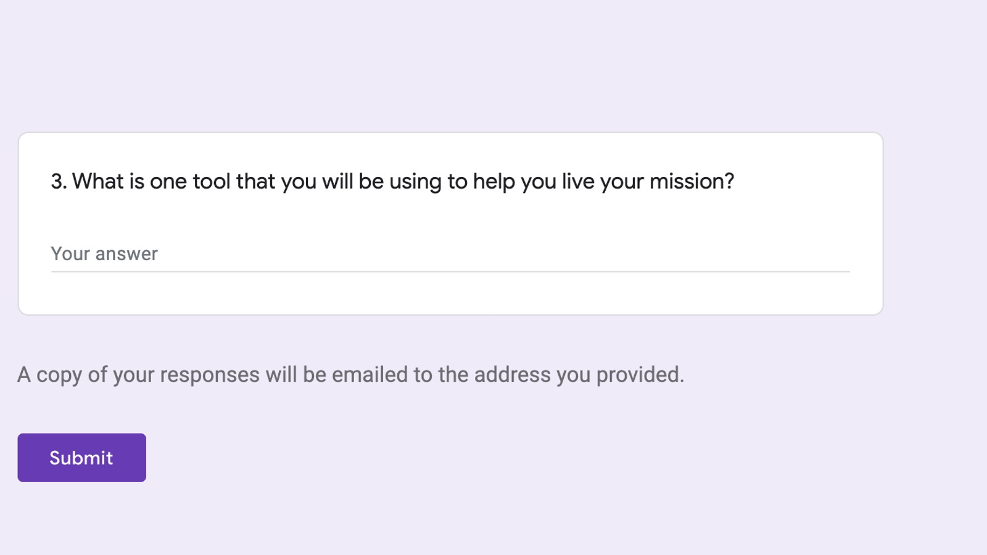

Slide 48
Notes:
So I want to give you free access to that it's a self-guided class, don't feel like it's going to have to happen in the next month or something like that. You will get the whole book in that as well. That's the code you need to join the Class: ejrdc4d and the website is: classroom.google.com

Slide 49
Notes:
There's also my book, which is online on Amazon. I've set it to 99 cents, that is less than $1, just for the next few days, if you want to grab that. You don't have to buy it, because you can cut and paste the contents of the book in that Google Classroom. Here is the link to the book on Amazon: http://bit.ly/TPLBOOK

Slide 50
Notes:
And so that is what you can do to coach people online.

Slide 51
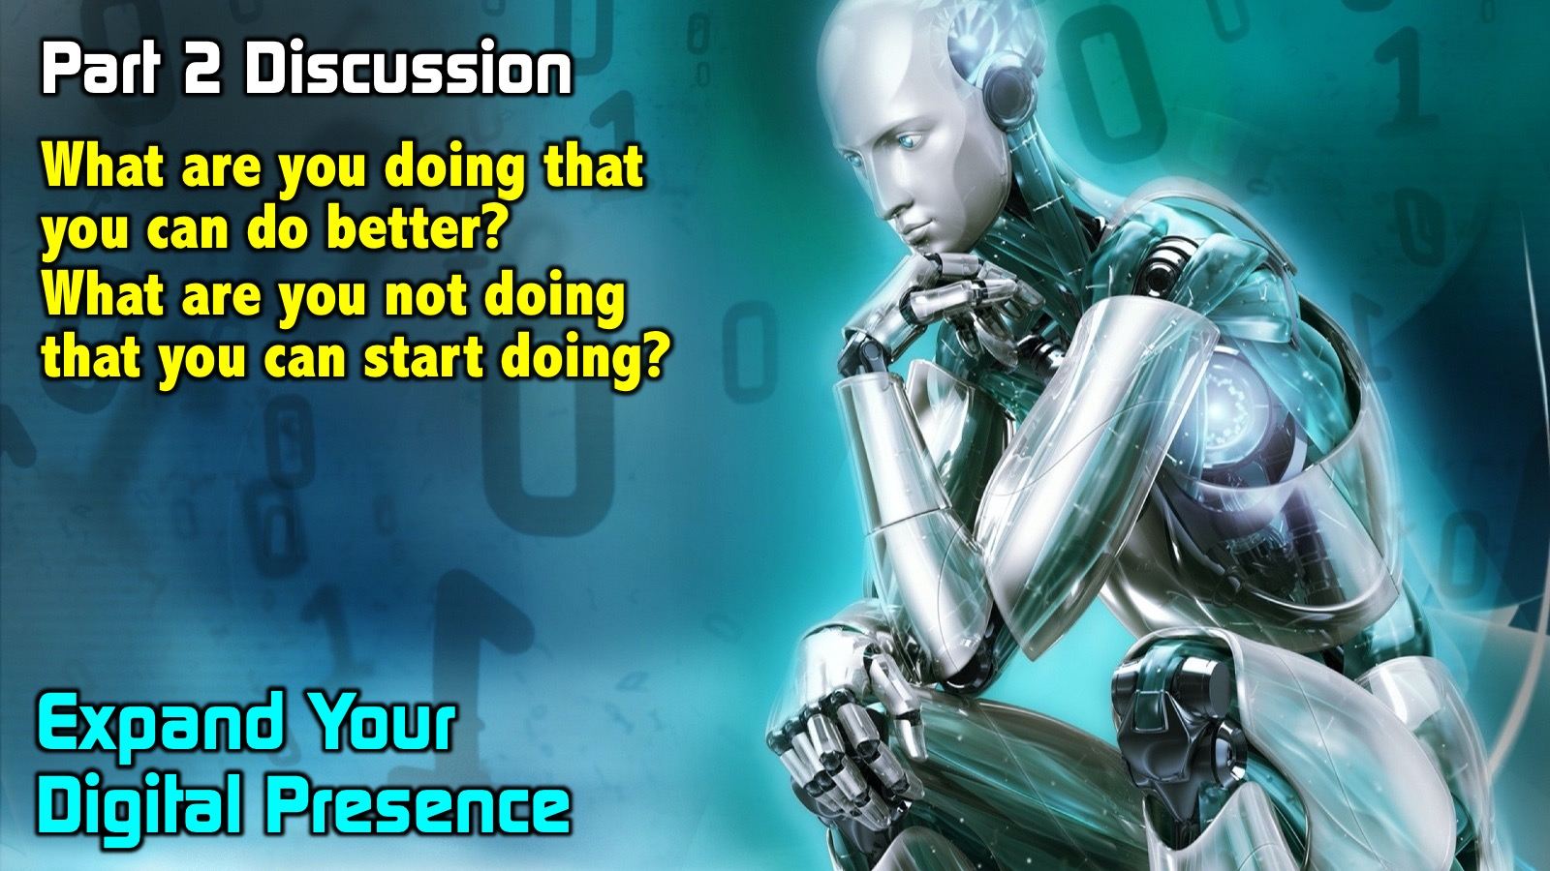
Notes:
So what are you doing that you can do better? And particularly, what are you not doing among the next generation that you can start doing in the online digital place - beyond just using WhatsApp and social media? So I'm going to release you back into your small groups now, and I'll see you five minutes.
So guys, I trust that was a really significant time and trust that you began to think about, Firstly, what you're doing that can be done better. And you know we're merely starting the discussion today. This is by no means the end of the discussion. And then Secondly, What are you not doing that you can start doing? But let me remind you about two things: One, this conference is being recorded so you'll have access to that and don't worry if you missed something. Don't forget that all of the resources for this session are available at: bit.ly/GenC2020. And know that the leaders are here to answer any questions. If you've missed something, please just shout.

Slide 52
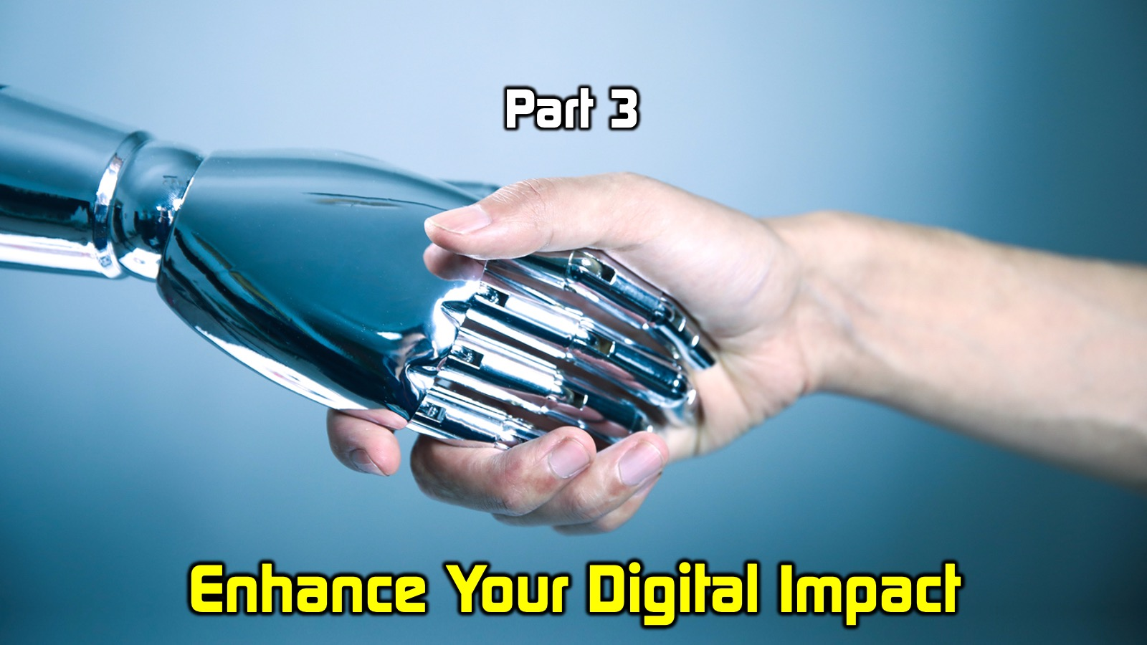
Notes:
The third and final part of the session that I'm leading on How to Sep-Up Your Digital Footprint is to Enhance your Digital impact. It's one thing to have a presence online, but you know that if that's meaningless and not significant, or not available to people, then it's going to count for nothing.

Slide 53
Notes:
And I want to just say three things called us it the AAA of online digital learning: Firstly, make it Accessible. We learned very quickly when lockdown hit that data is unequally distributed across our audience. Not everyone has the kind of fibre connection I have in my home or maybe what you have in your home. And we have to make allowances for that. This echoes what Paul says back in 1 Corinthians 9 where he said that we are to become all things to all people. It's no good only making something available to one group of people. And I'll be showing you an example of how we've pushed WhatsApp to it's nth degree to be able to deliver stuff to as vast an audience as possible to make it accessible. So whatever you do online, make sure everyone can access it.

Slide 54
Notes:
Secondly, make it Attractive. Aesthetics do count when it comes to learning - what I see what I engage with. And remember when it spoke about digital narratives, there's a lot that they are doing when you engage with them at the same time and you have to pull them in and you need to keep their attention and focus. If it doesn't look great then it's not going to make for good learning, and people are going to click elsewhere.

Slide 55
Notes:
Thirdly, make it Active. Ensure that it's active/interactive. It's not enough to just send out a 20 minute video and think that is going to transform lives - we need to engage with people.

Slide 56
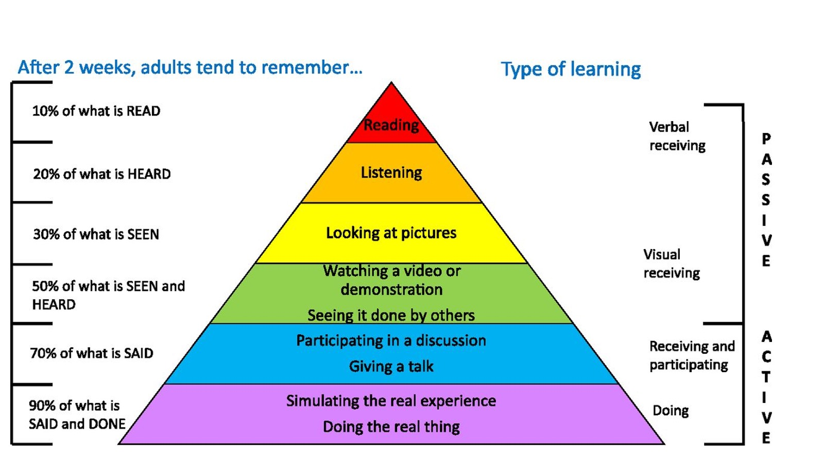
Notes:
You've probably heard about the Edgar Dale Cone of Experience that has become known as the Cone of Learning. It mirrors a little Bloom's Taxonomy as well. The heart of this from from Edgar Dale in 1946 was the triangle itself, because the tip of the triangle is in terms of effectiveness is to read something, then to listen or hear, then to see pictures, then to watch a video and then to see something done by others - in other words, watching it's still passive, and then participating in a discussion, which you've been doing along the way. Then also getting out and giving a talk, you know that when you speak, you learn so much and then simulating the real experience and doing the real thing. And obviously, you remember different amounts on each of those.

Slide 57
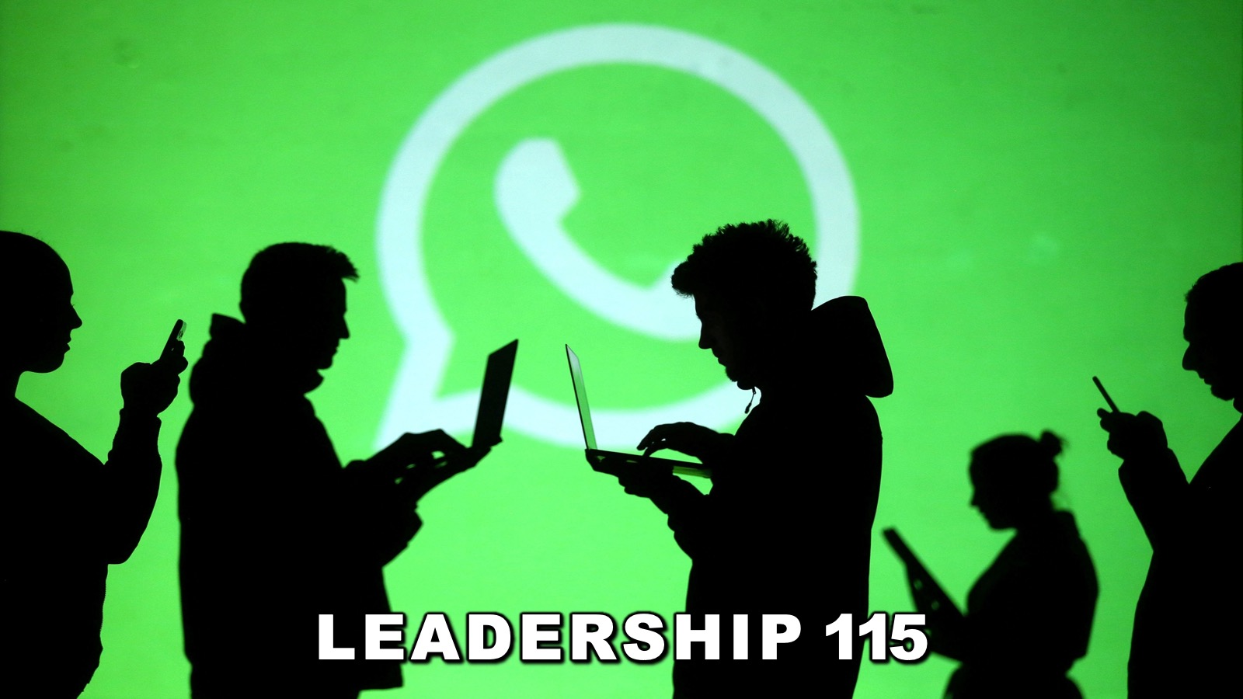
Notes:
So let me give you an example of something that we've done for the first of our four leadership modules that of Leadership 115. Let me say it's all about character development and it's a year programme. We have 40 leaders enrolled in it at the moment. And we would have a live session once a month on a Thursday and the moment locked down happened we began to brainstorm how we could move move it to a digital platform, realising that many people don't have bandwidth so to record a high definition video might be great, but let's begin to rethink it.

Slide 58
Notes:
And so I'm going to walk you through each step, but here is an overview: it starts with a Welcome, then Instructions, Prayer, an Intro message (that is either listened to watched or read depending on the bandwidth students have), then there comes another Teaching, then an Activation where journaling takes place, then a Question and Answer section (I'll show you what that looks like just now) and then an Activation again with journaling, a Prayer and some Homework which we follow up throughout the week.

Slide 59
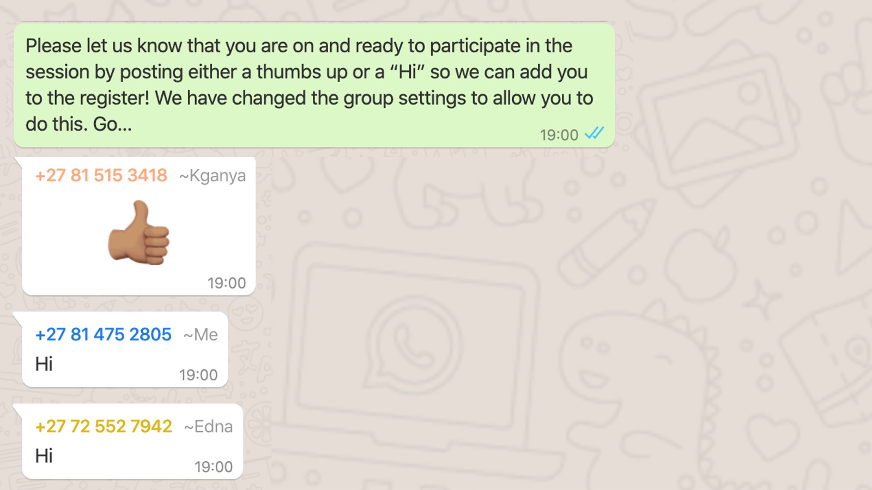
Notes:
So this is what you would have experienced if you were on the WhatsApp session - everyone had the chance to send a thumbs up.

Slide 60
Notes:
Then we gave announcements we actually started the announcements early that afternoon, but we reminded them at this point.

Slide 61
Notes:
We opened in prayer.

Slide 62
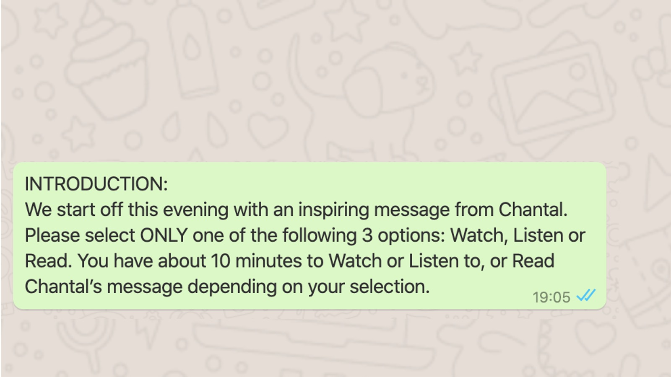
Notes:
We gave an overview for the evening, which was shared with them in a Video (in WhatsApp you are limited to a 64 megabyte video) or an Audio or Text.

Slide 63
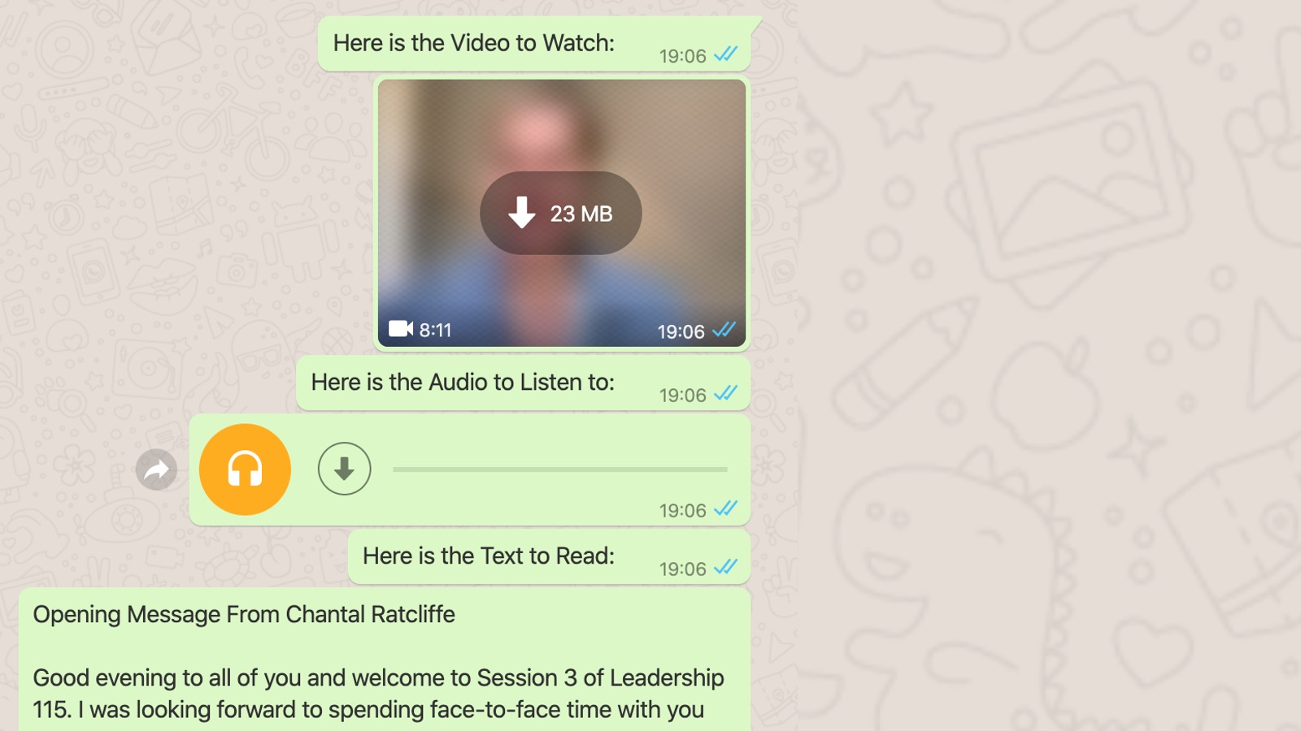
Notes:
They were asked to choose one format to use.

Slide 64
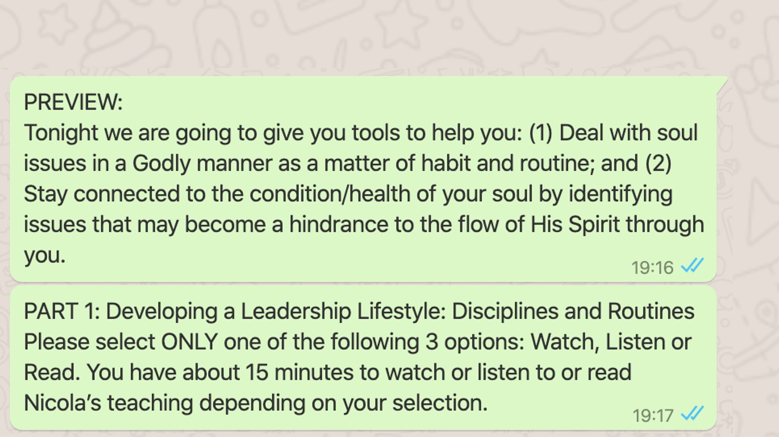
Notes:
Then we previewed the session. We told them that it's about dealing with soul issues and godliness as they're related.

Slide 65
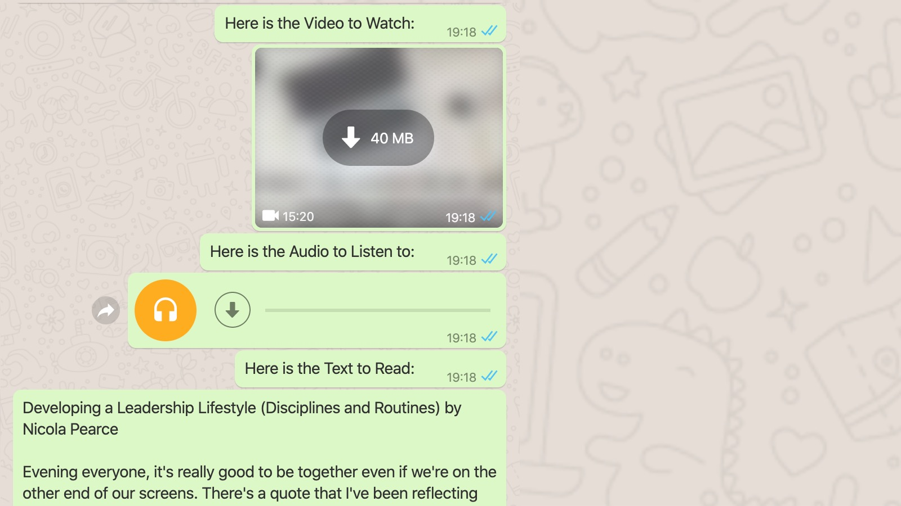
Notes:
There was another teaching that students could watch, listen to or read.

Slide 66
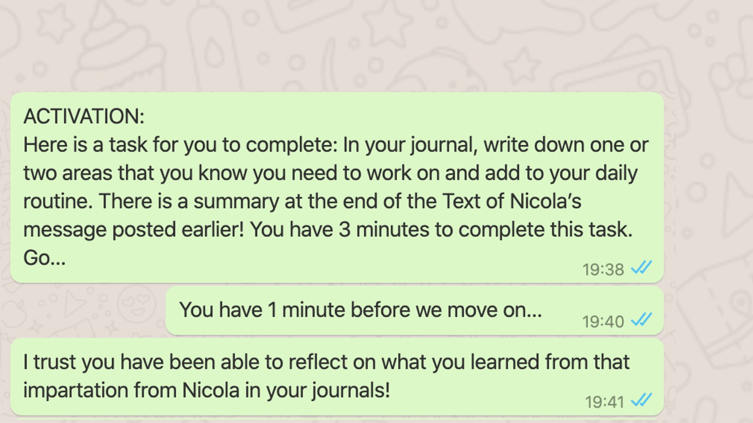
Notes:
Then came an activation time - three minutes to complete a task based on a question that had been asked.

Slide 67
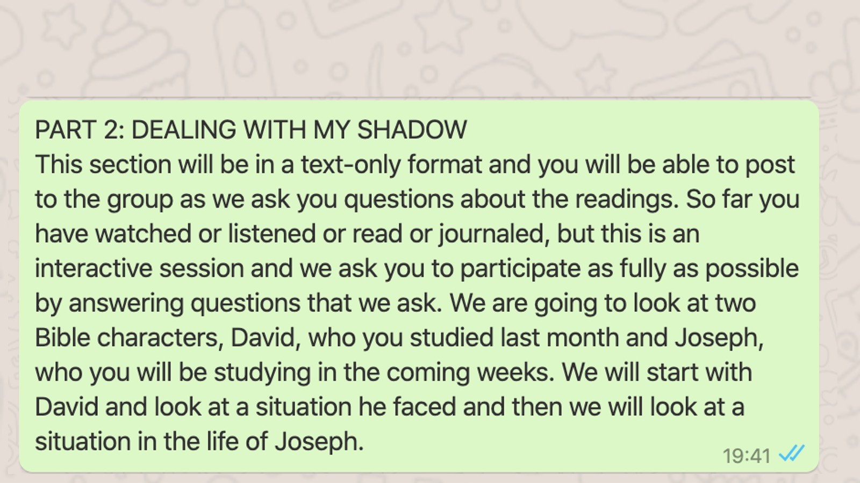

Slide 68
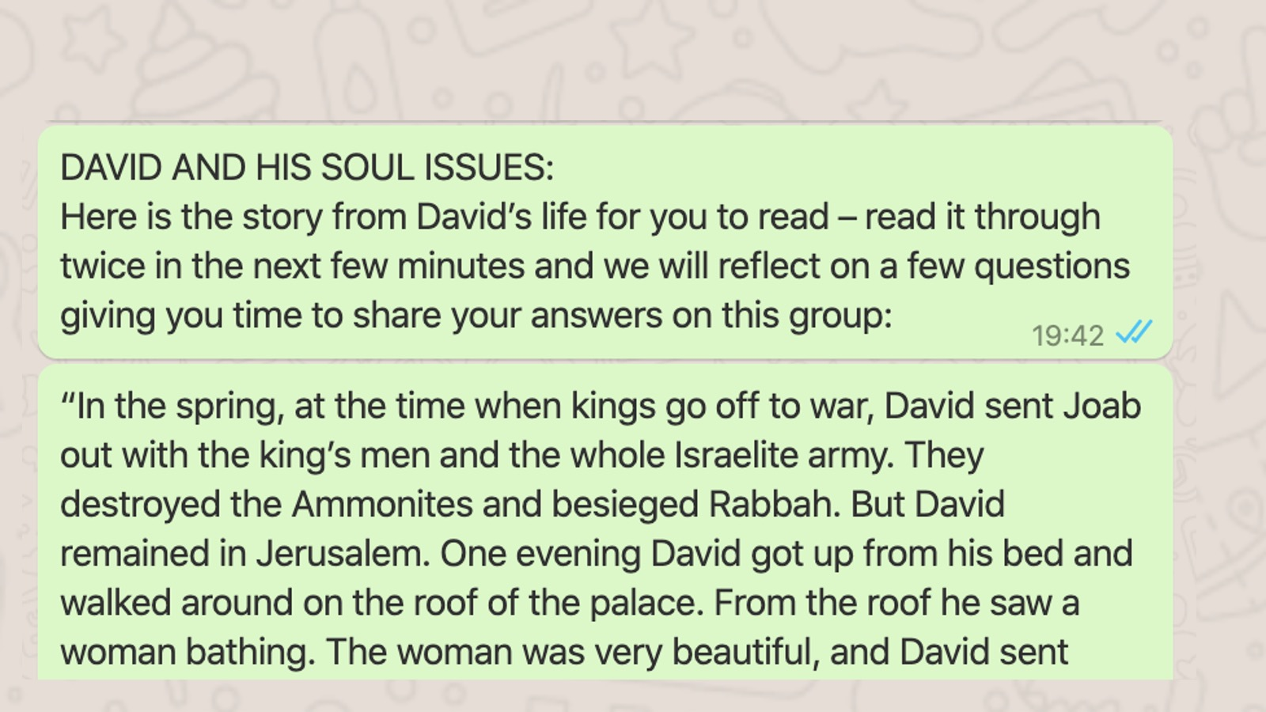
Notes:
Then we moved into the interactive, engaging part of the night dealing with my shadow. And we looked at David first and the Joseph (we set up a juxtaposition between David and Joseph that you will see rolled out now). After they had read the passage we provided we asked them questions about David and students could post their responses - and it was overwhelming.

Slide 69
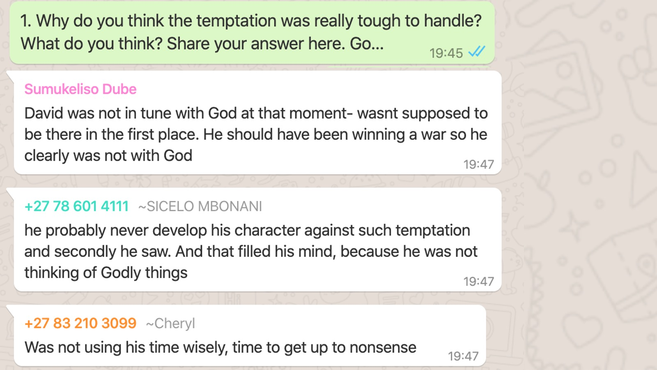
Notes:
Question 1 was: Why do you think the temptation was tough?

Slide 70
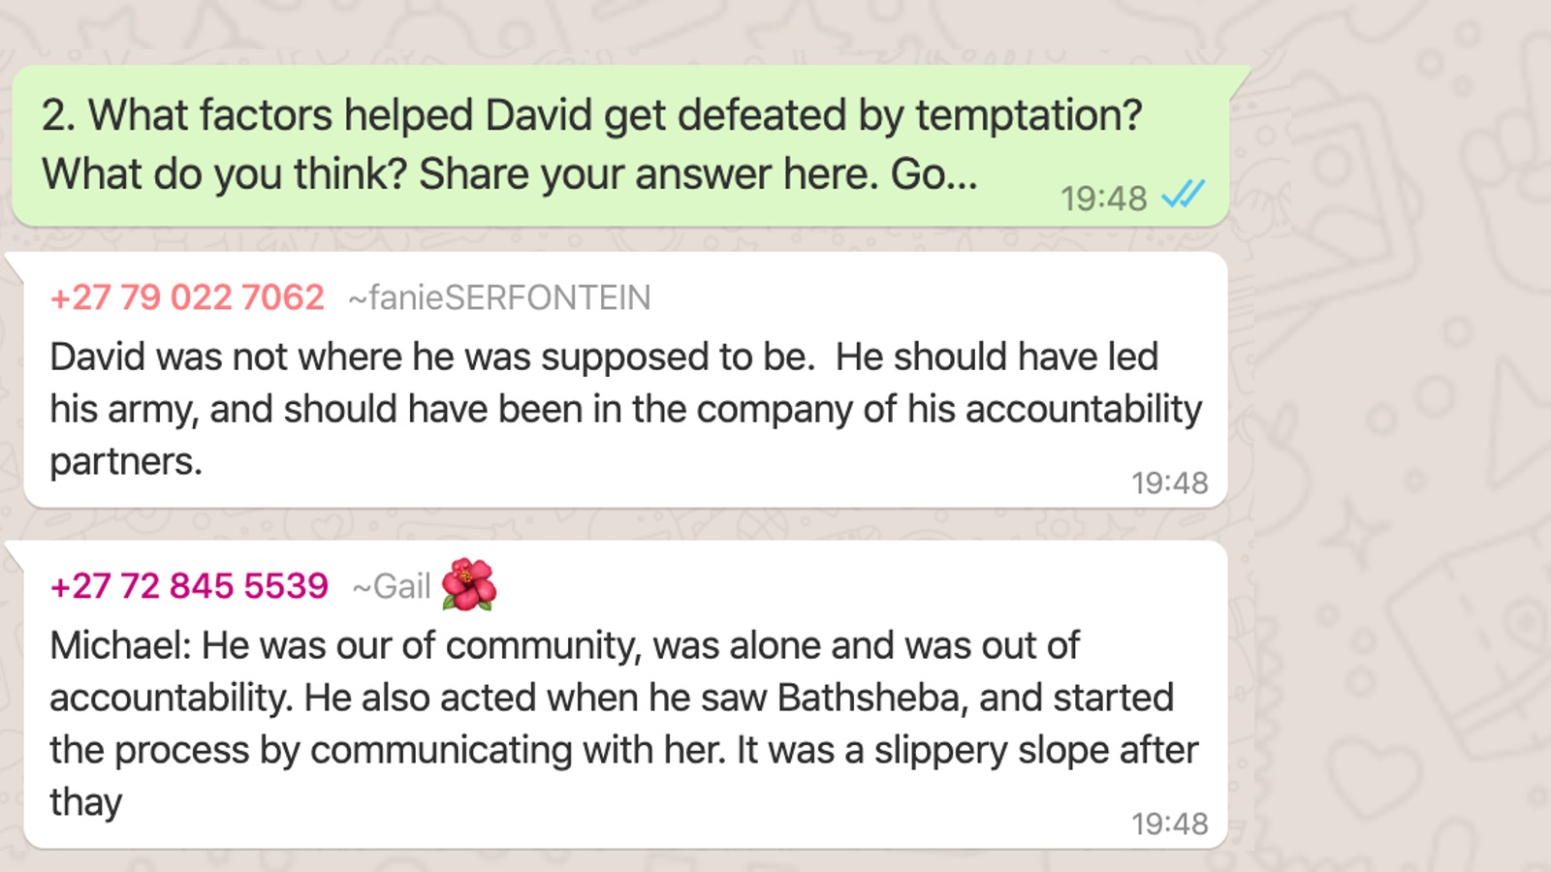
Notes:
Question 2 was: What factors help David get defeated by temptation?

Slide 71
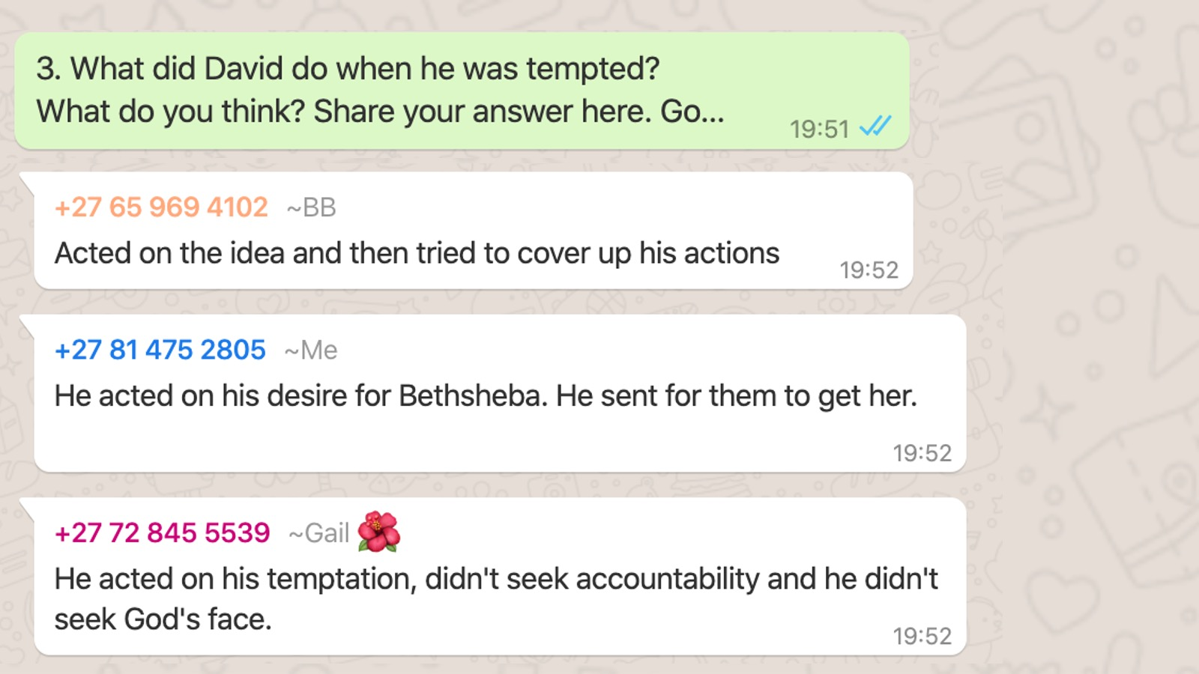
Notes:
Question 3 was: What did David do when he was tempted?

Slide 72
Notes:
We then moved on to Joseph - they read the story like they had done with David. We used the same questions:

Slide 73
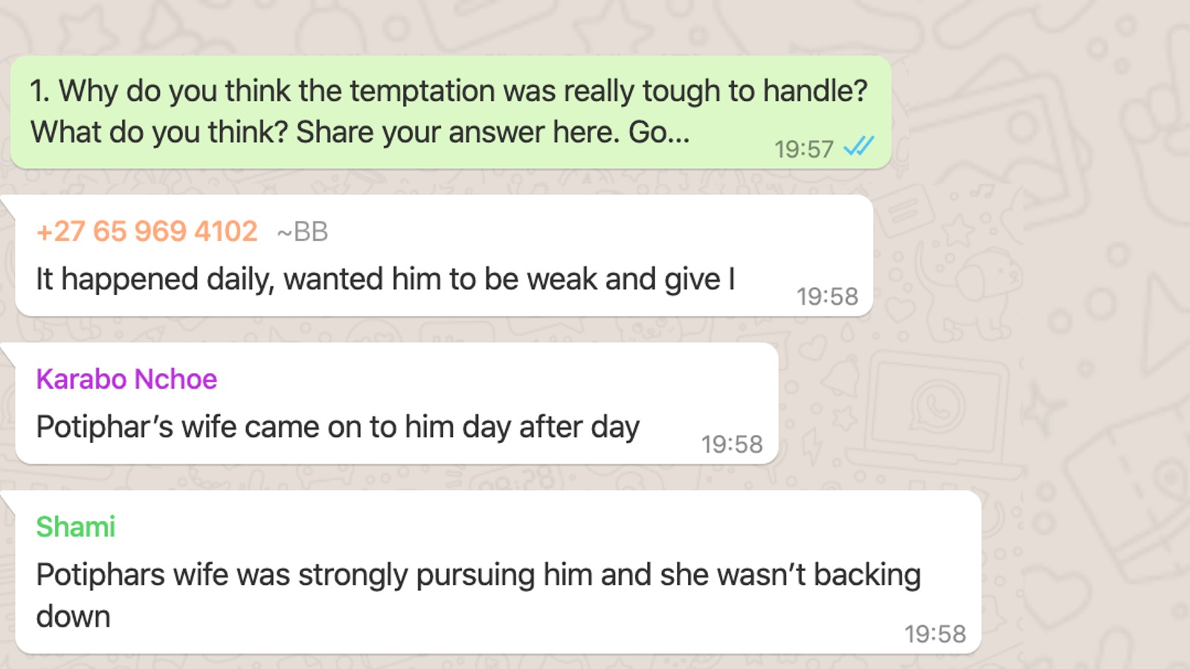
Notes:
Question 1 was: Why do you think the temptation was tough?

Slide 74
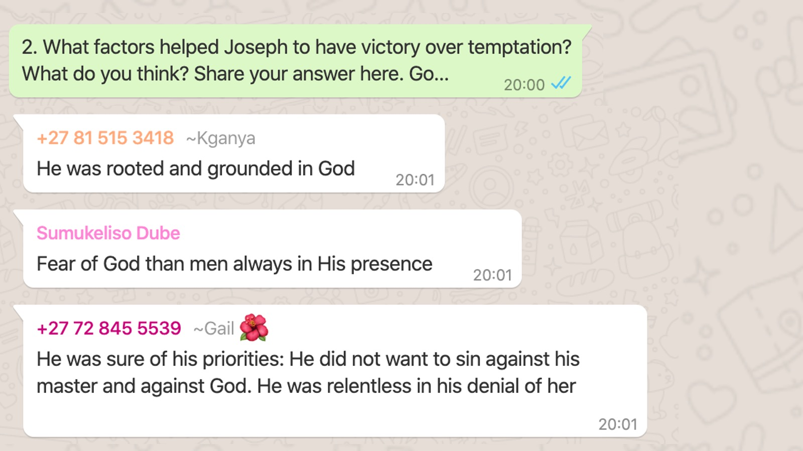
Notes:
Question 2 was: What factors helped Joseph have victory?

Slide 75
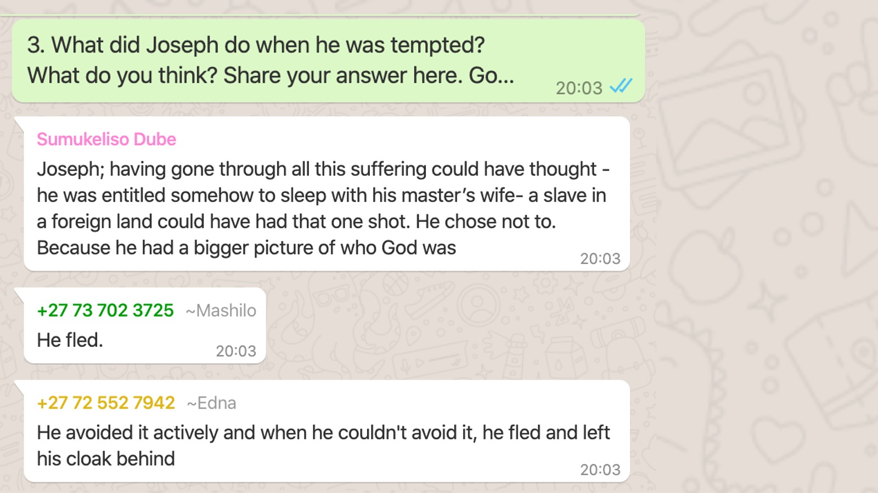
Notes:
Question 3 was: What did Joseph do when he was tempted?

Slide 76
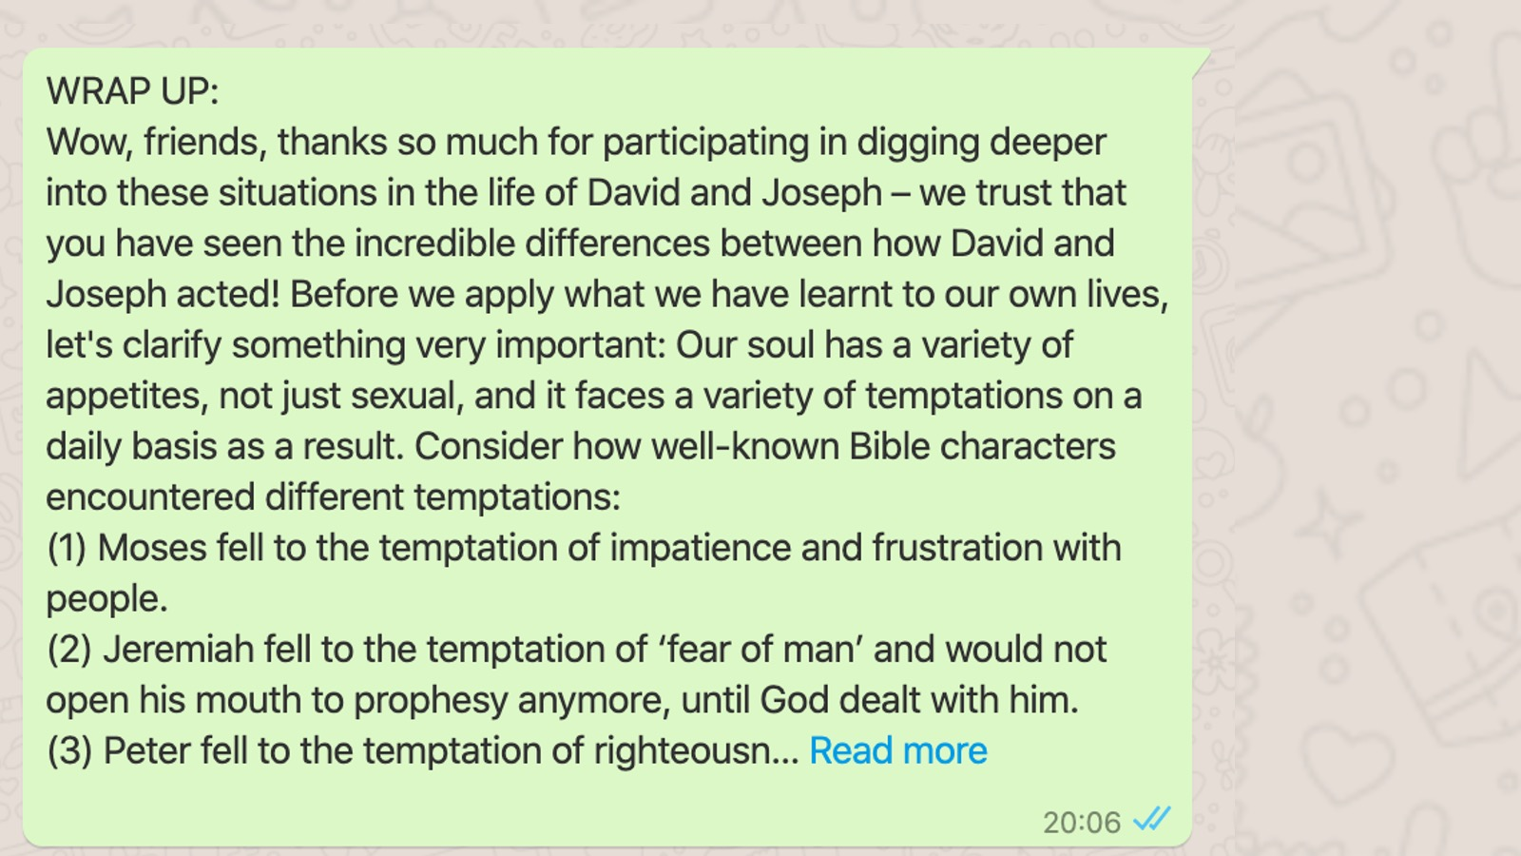
Notes:
We then shared a wrap up and reminded students that we're not just dealing with sexual temptation even those two stories though those two stories were about sexual temptations.

Slide 77
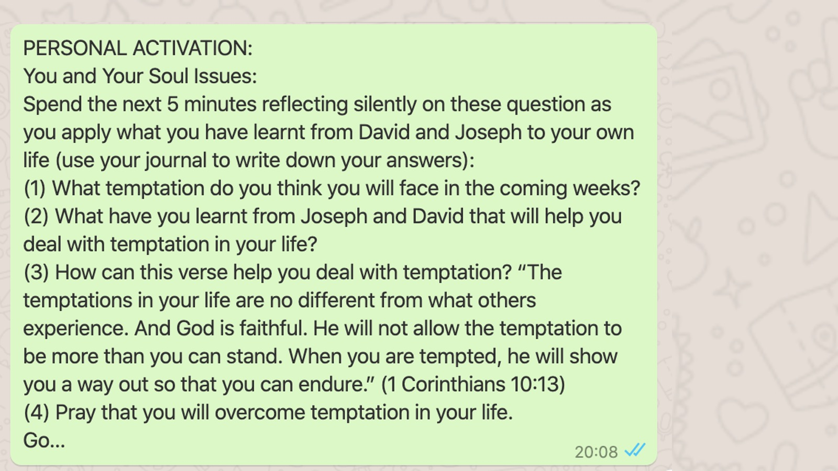
Notes:
Then they had five minutes of Personal Activation in the journals

Slide 78
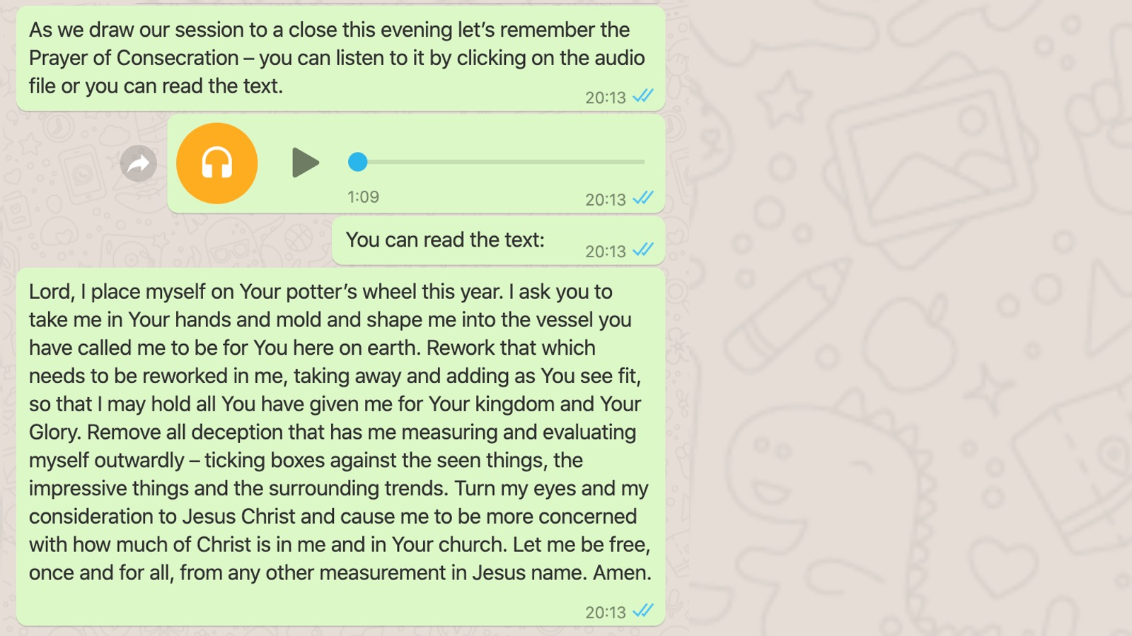
Notes:
We shared what we call the prayer of consecration, they could either listen to it, or they could read it in WhatsApp.

Slide 79
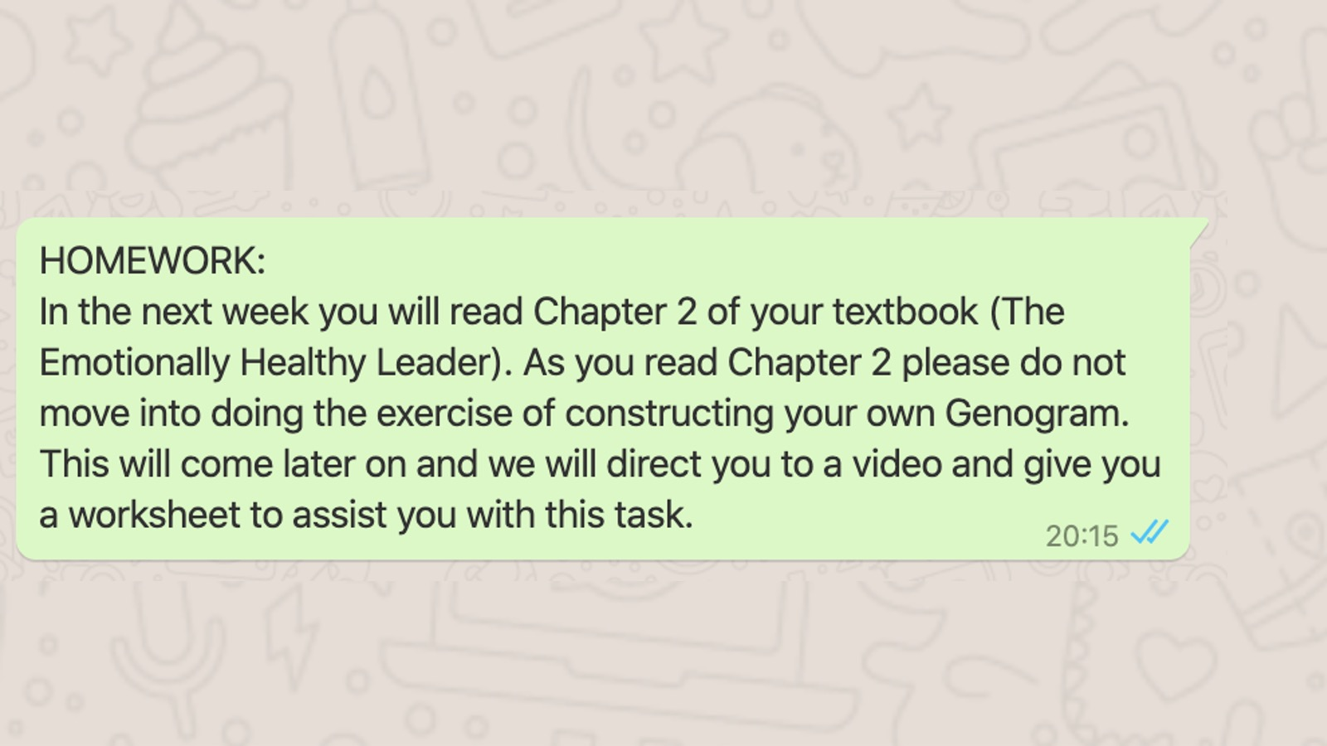
Notes:
And finally, we gave them a message about their homework for the coming week before ending the session.

Slide 80
Notes:
And finally, we closed in prayer.

Slide 81
Notes:
And so I trust that when you are engaging online with your high schoolers, that you are making it as engaged as possible. Remember it needs to be accessible, attractive, and active.

Slide 82
Notes:
May remind you not to forget to jump back into the Google Classroom because you can set up this engagement with your high schoolers, with your youth, with adults in your congregation. through Google Classroom, it's obviously totally free and it's a great opportunity. There's the code in case you missed it earlier: ejrdc4d

Slide 83
Notes:
So don't forget, make your teaching your coaching your training, make your online offerings accessible to everyone, make them attractive and make them active. So you're going to head off again into your groups and I want you to ask each other what can you do to be more interactive and more effective? How can you make sure that it's not a one way communication? I was watching one of our leaders, Asher, who is on this call who was engaging with people this weekend, I watched Drew, my son, in a Connect group, with Stuart being asked questions and pulled into interaction, and they were doing puzzles at one point, they were looking at Scriptures, they were engaging, and as a dad, of a high schooler, I put my thumb in the air and I thought you know what, that's incredible active learning. So good ups to all you guys doing amazing stuff. There you go, Zooms is gonna to take you back into your small groups.

Slide 84
Notes:
Welcome as you are starting to make your way back from the small group time. Yep, that was a ridiculously short amount of time to engage today. But there's some news, we hatching a plan - in two weeks time we will be together again. I'll be able to engage more relaxed and more fully, and you'll have more time to engage. We're going to be working on stuff together. So in that discussion time you began to say, "Can we do everything we do digitally, more effectively, and more interactively? Can we make sure that what we're doing is as live and as engaging and as interactive as possible? And even for us as conference presenters, organisers today, we want to get better at what we do and I know the organisers are going to ask you, hey, make sure that you share feedback so we can all grow and learn.

Slide 85
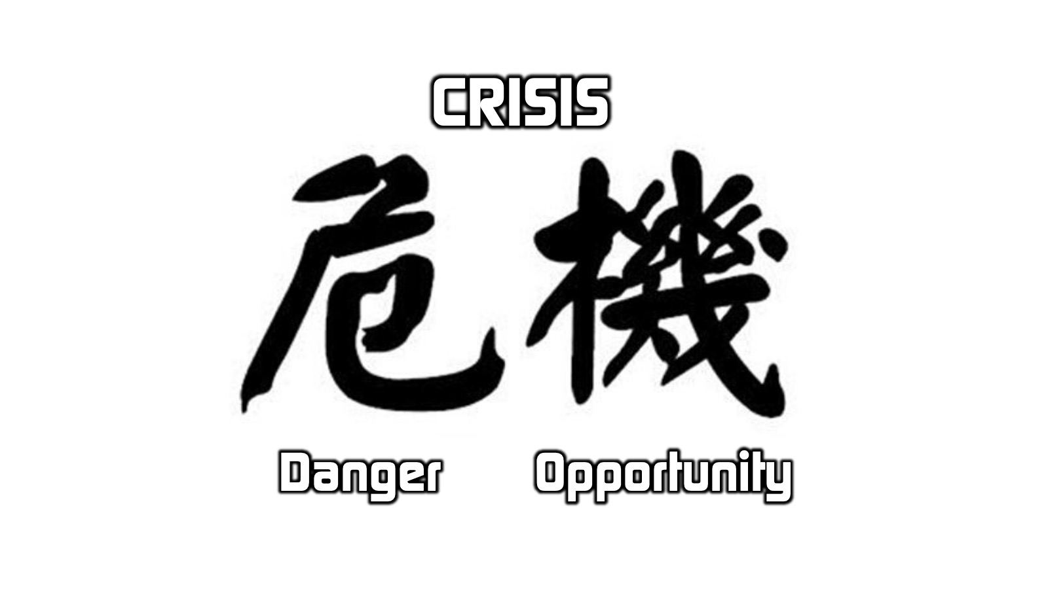
Notes:
I want to just close by saying that you probably know that in the Chinese word Crisis, there's a combination of two symbols, Danger and Opportunity. And yes, this pandemic is dangerous. I started with that chart that's going in the wrong direction. But there's opportunity here and I think God is nudging us to begin to engage more deeply with ourselves more deeply with others in brand new ways. There are huge opportunities, not just for lockdown, but for the future to make sure that what we do is going to reach more and more people. I've had WhatsApp messages during this session from a pastor in Cape Town who has been online with us, from a leader in another suburb not far away from here, and I know that this is going to ultimately go around the world. Let's begin to think more broadly of our church community, our congregation, our parish and make sure that we are stepping up our digital footprint.

Slide 86
Notes:
So guys, huge thank you that I've been able to share with you today.

