Slide 1

Notes:
Welcome to the second session that I am privileged to lead for Generate Conference 2020! Today I want to explore with you How To Step-Up Your Digital Teaching.

Slide 2
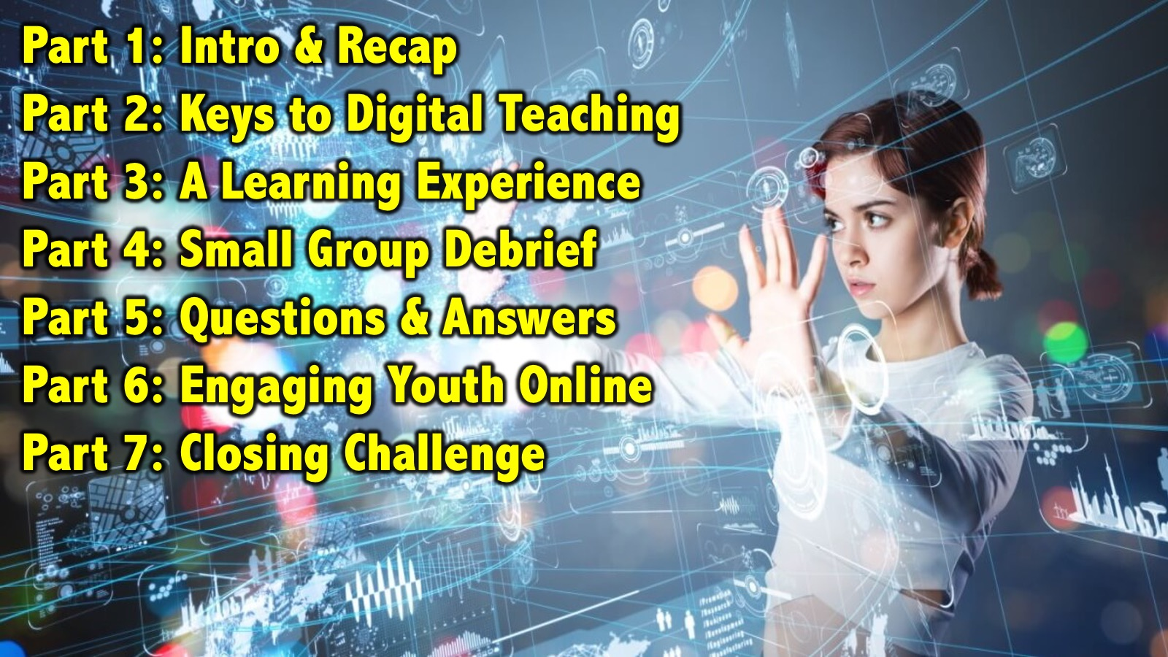
Notes:
Here is the outline for our session over the next 90 minutes:
Part 1: Intro & Recap (3)
Part 2: Keys to Digital Teaching (15)
Part 3: A Learning Experience (15)
Part 4: Small Group Debrief (15)
Part 5: Questions & Answers (10)
Part 6: Engaging Youth Online (20)
Part 7: Closing Challenge (3)

Slide 3
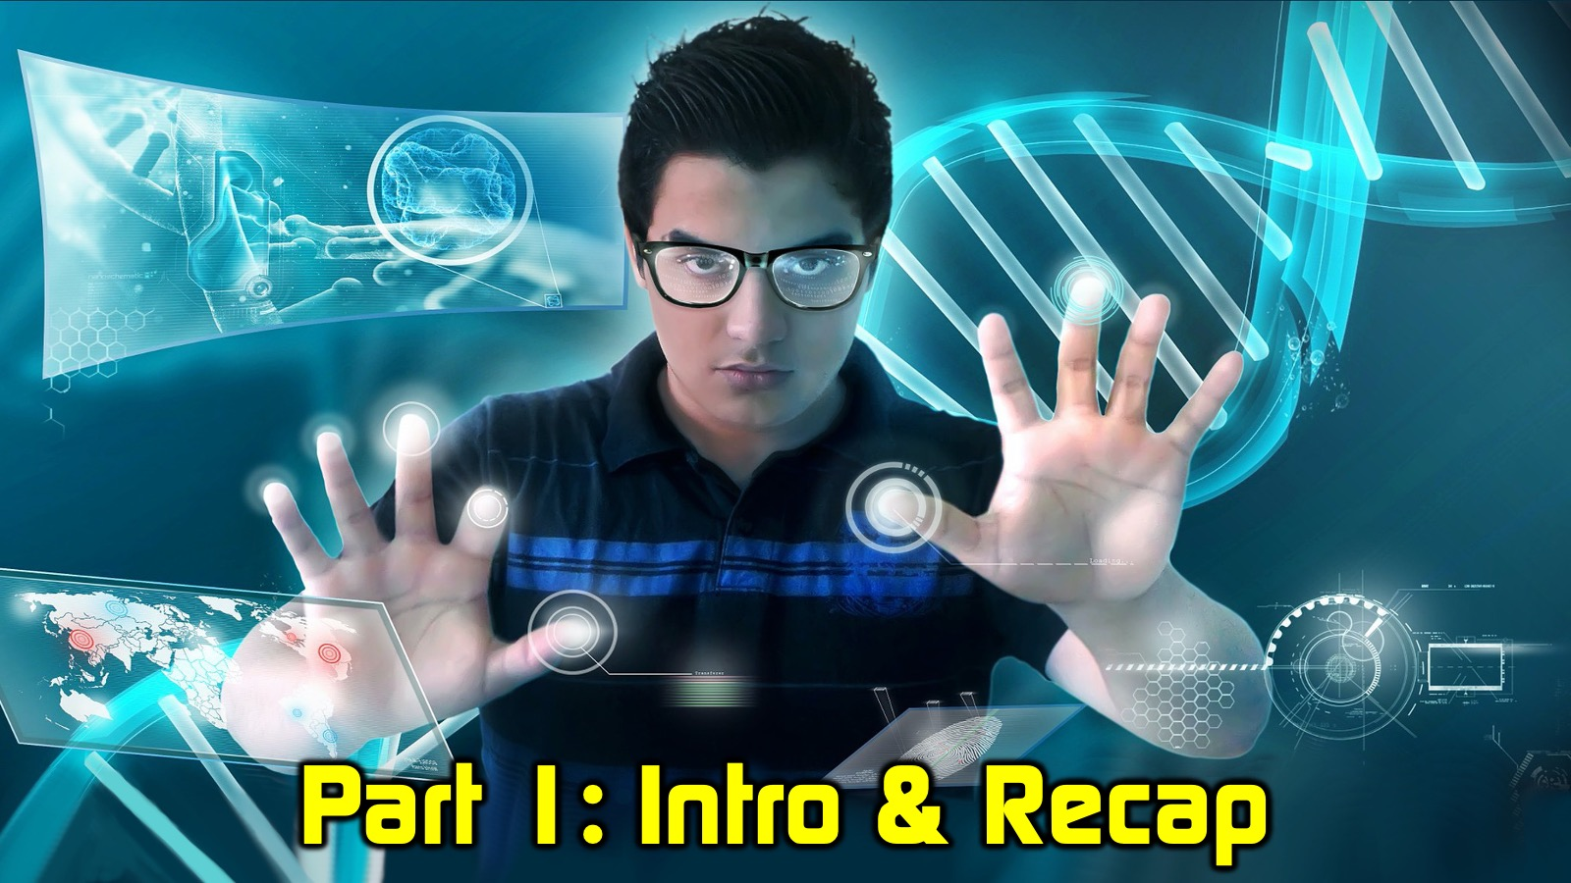
Notes:
Part 1: Intro & Recap (3 mins)
I am going to briefly Introduce myself and recap our previous session.

Slide 4
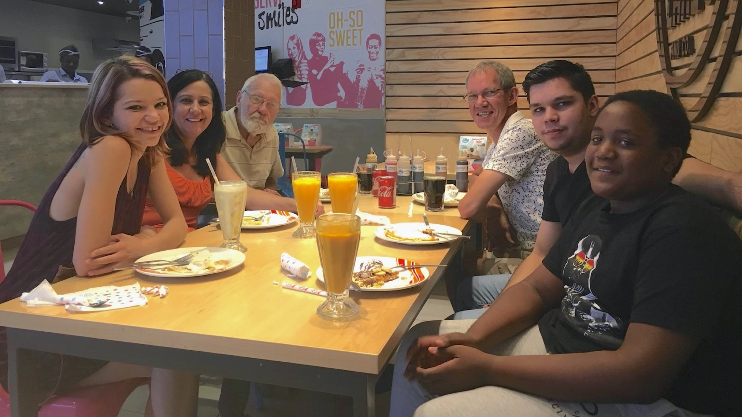
Notes:
Let me begin by introducing myself. I am married to Debbie and am the proud father of three “kids”: Keegan, Ashley and Drew.

Slide 5

Notes:
This is staff at Every Nation Rosebank where I'm tasked with the responsibility of ensuring there's a leadership development pipeline. I'm going to be speaking out of that context this morning. But my heart is still very much for youth.

Slide 6
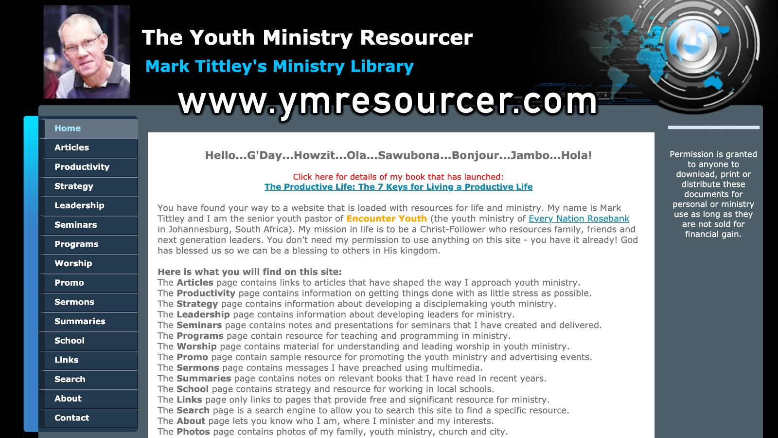
Notes:
If you want to see what I've done in the last three decades of my life, then simply pop across to the website that I ran called the Youth Ministry Resourcer. Before you drown in all the resources you may want to begin on the Program's page and you'll see the strategy we use at Encounter Youth: Engage, Establish, Equip and Empower. I guess this website is my life's work and it will always be free to access. Here is the link to The Youth Ministry Resourcer website: http://www.ymresourcer.com

Slide 7
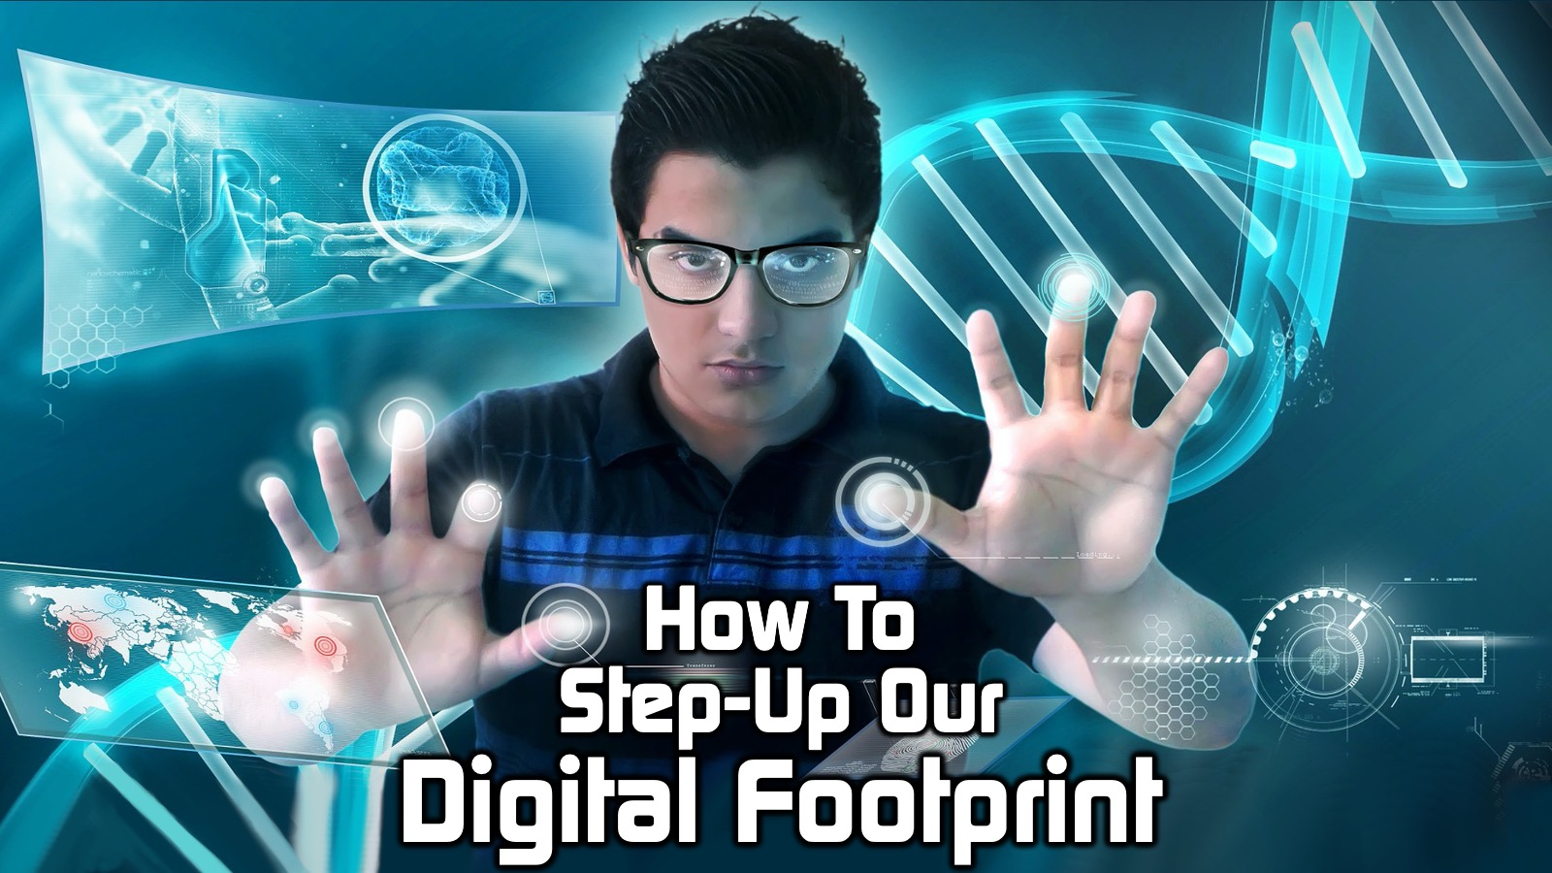
Notes:
In our session two weeks ago we look at how to step up our digital footprint.

Slide 8
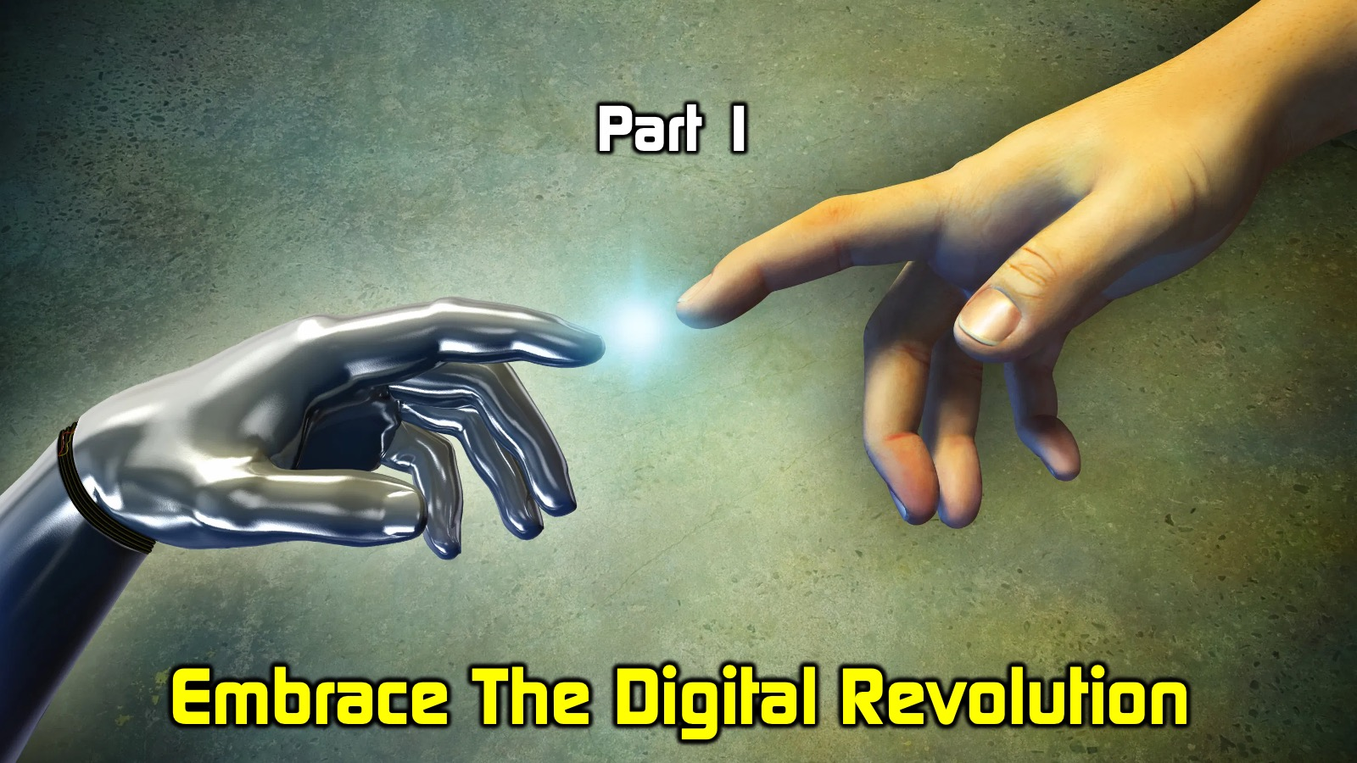
Notes:
In Part I challenged you to Embrace the Digital Revolution and not miss the opportunity we have to engage people online.

Slide 9
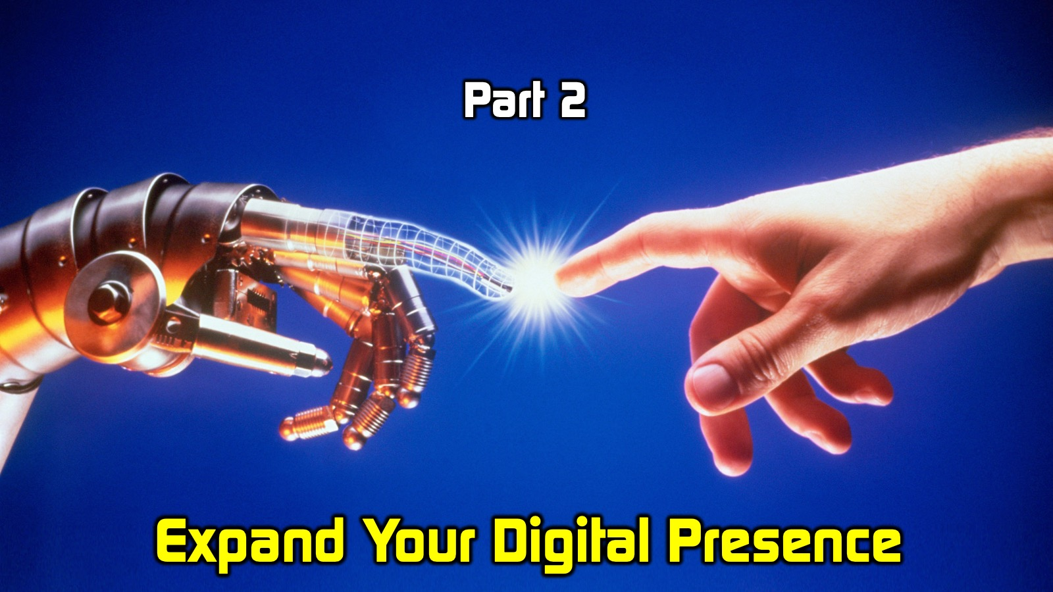
Notes:
In Part 2 I encouraged you to Expand your Digital Presence. The challenge was to do old things better and to attempt new things!

Slide 10
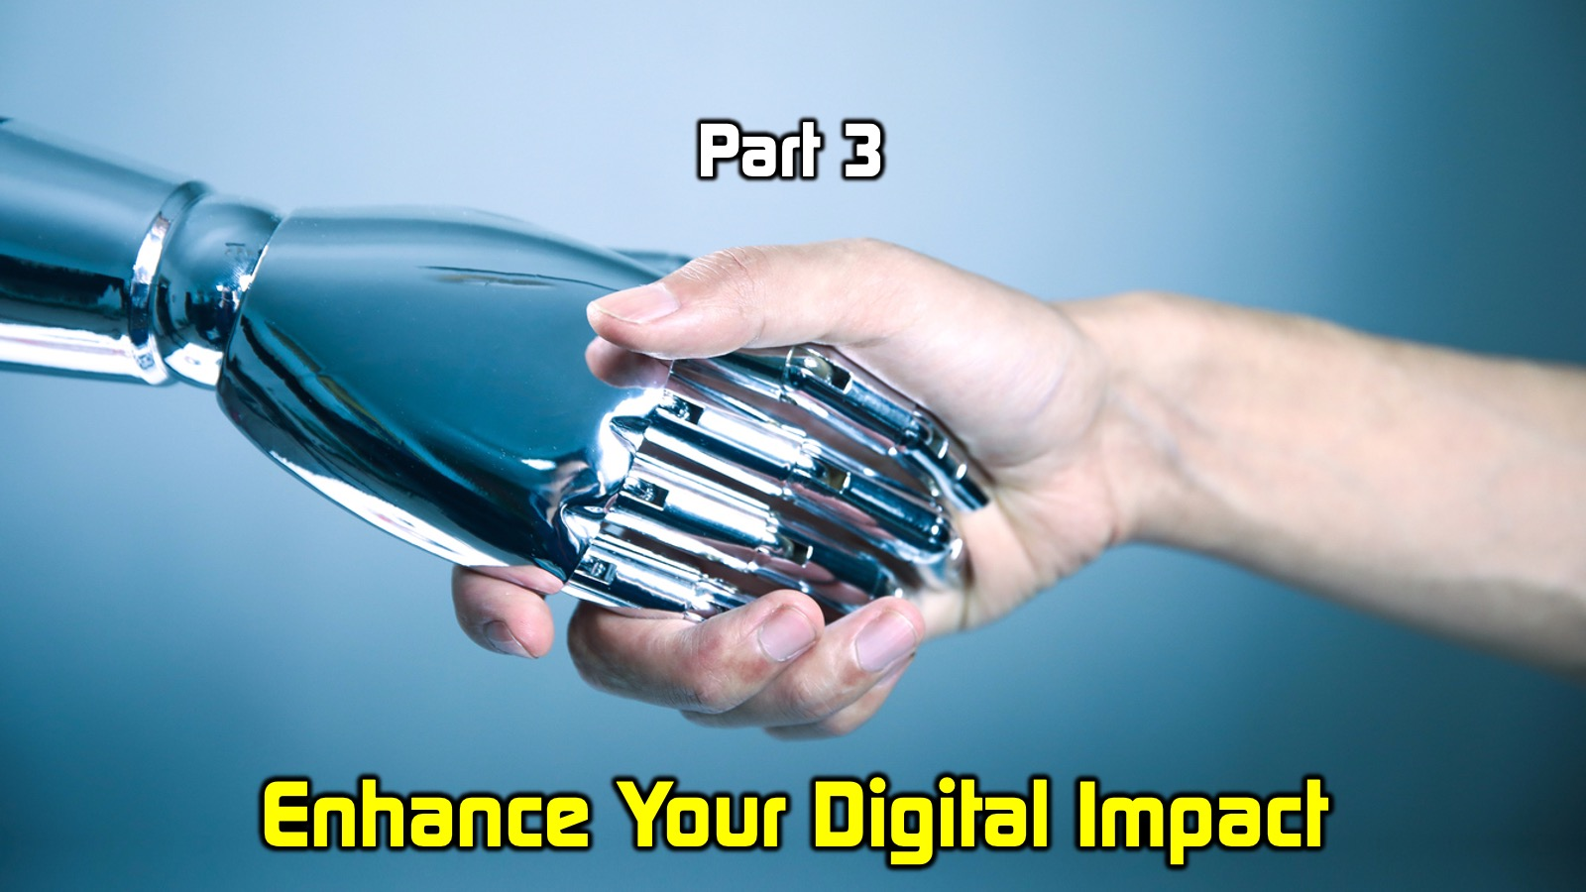
Notes:
In Part 3 I challenged you to Enhance your Digital impact. This is the theme that we are going to explore in depth today.

Slide 11

Notes:
If you missed the presentation you will find the presentation with loads of extra resource in a Google Drive folder. Here is the link: www.bit.ly/GenC2020

Slide 12
Notes:
Today our focus is on How To Step-Up Your Digital Teaching

Slide 13

Notes:
There is a Google Drive Folder of resources, including this presentation, at: bit.ly/GenC2

Slide 14

Notes:
Part 2: Keys to Digital Teaching (15 mins)
In this session I am going explore key principles for online teaching that will help to ensure learning and life change takes place. These are my best practices for facilitating digital learning and each one is based on a principles of learning (which I will share first before introducing the key):

Slide 15
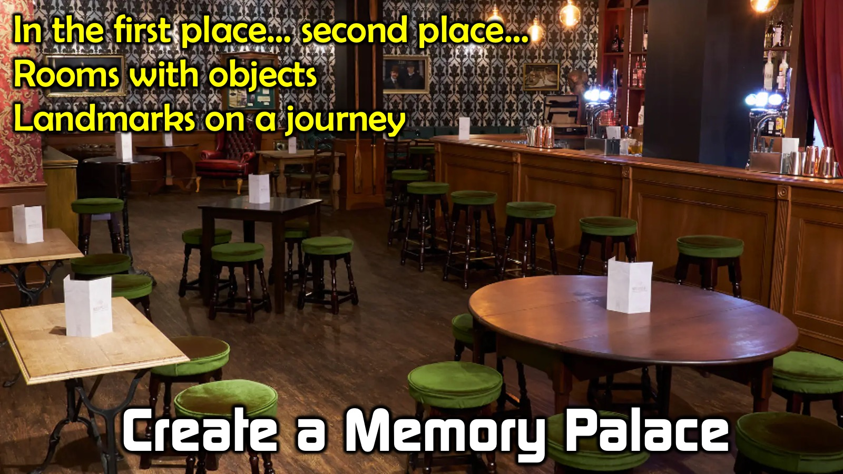
Notes:
Arguably the best way to remember things like the 7 keys I am about to explore with you is by using a Memory Palace. You may have heard of memory competitions that happen around the world and if you have heard the expression: “In the first place” or “In the second place” then you know about memory palaces. It is an ancient tool used to remember items. Let’s say you wanted to remember the 7 Keys to Digital Learning – you would create a 7 stage memory palace which could be a journey through 7 different rooms in a house, or 7 different items in the room in front of you or 7 stops on a journey that you take regularly – and you create something memorable in each place that reminds you of the point that you need to remember. Why not try it as I unpack the 7 Keys – look around you, from the left to the right, and see if you can identify 7 items or objects and then you can connect a principle to each place.

Slide 16
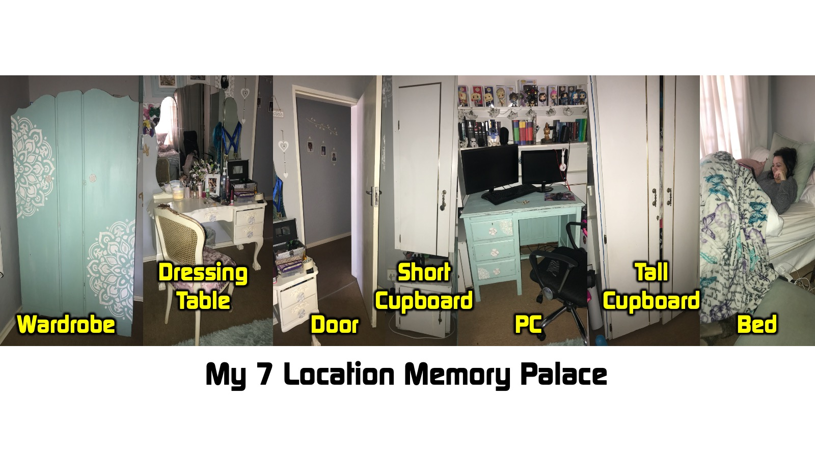
Notes:
I have chosen 7 locations around me in the room that I am using for this session – my Daughter’s room actually – I will use them to remember the 7 keys later. The secret is for you to identify you own seven locations in your room from left to right! It helps to place a unique object in each location that connects with what you are trying to remember!

Slide 17

Notes:
Learning Principle #1: People learn best when they can access the material.
It makes sense that anyone who cannot be a part of a learning experience, no matter how excellent it is, will not be able to learn from it.

Slide 18

Notes:
Digital Teaching Key #1: Make it ACCESSIBLE
Cater for People with Different Data Limits.
We learned very quickly when Lockdown started that data is unequally distributed across our audience. Not everyone has the kind of fibre connection I have in my home or maybe what you have in your home. And we have to make allowances for that. This echoes the challenge Paul gives in 1 Corinthians 9 about the need to become all things to all people. It's no good only making something available to one group of people. Later I will show you an example of how we are using WhatsApp to deliver teaching to people with vastly different data allowances. So, whatever you do online, make sure everyone can access it - otherwise no matter how good your teaching is, it won’t be effective.

Slide 19

Notes:
Key #1: People learn best when they can access the material so we make teaching ACCESSIBLE!

Slide 20
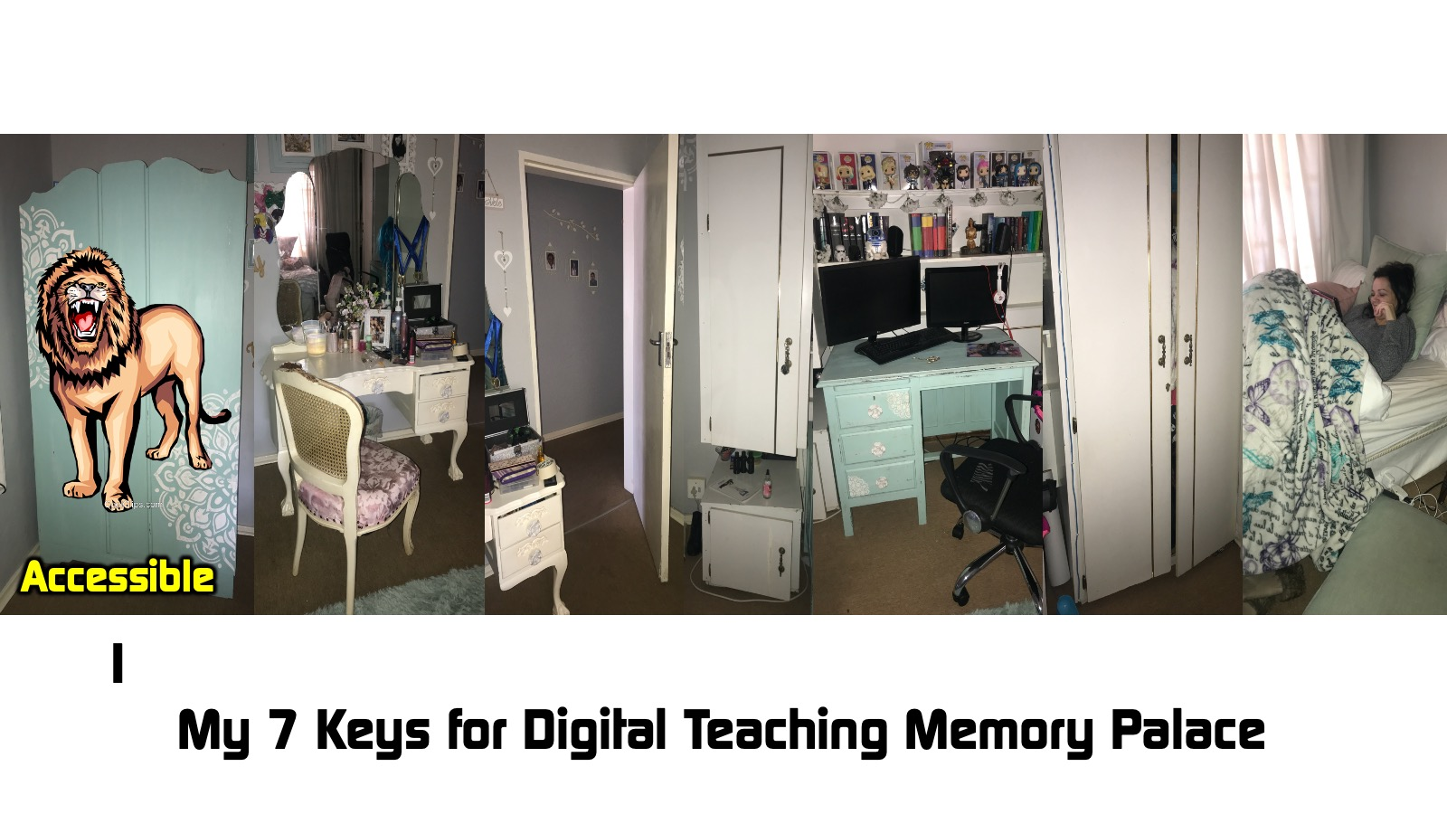
Notes:
Memory: The Wardrobe: I hear a roar and the door of the wardrobe flies open and Aslan the Lion is standing there – he has found the access code to escape Narnia. This reminds me that the first key to digital teaching is ACCESSIBLE.

Slide 21

Notes:
Learning Principle #2: People learn best when many of their senses are involved.
Learners will be more engaged with the material touches more than one of their senses - they need to see and hear as well as feel emotions and touch something wherever possible.

Slide 22

Notes:
Digital Teaching Key #2: Make it CREATIVE
Share the Material in Different Ways
Gone are the days when someone standing in front of an audience speaking for an hour will hold attention. For a generation raised in a digital world conditioned to multitask we must work really hard at getting and keeping attention. In our youth group context for live teaching session we taught our presenters to do something different every 7 minutes and make sure that each slide is different to the one before it. Online teachers should consider sharing their material in many different ways – for example: (1) ask a question linked to the learners context, (2) show a video clip to add new insights, (3) give an interactive assignment, (4) debrief what has been learned, and (5) give a task to be completed as homework. Teachers should be ready to bring in statistics, quotes, real problems and authentic solutions to problems to drive their point home. To promote interaction and keep attention, it helps to use video, images and audio content rather than just one medium.

Slide 23
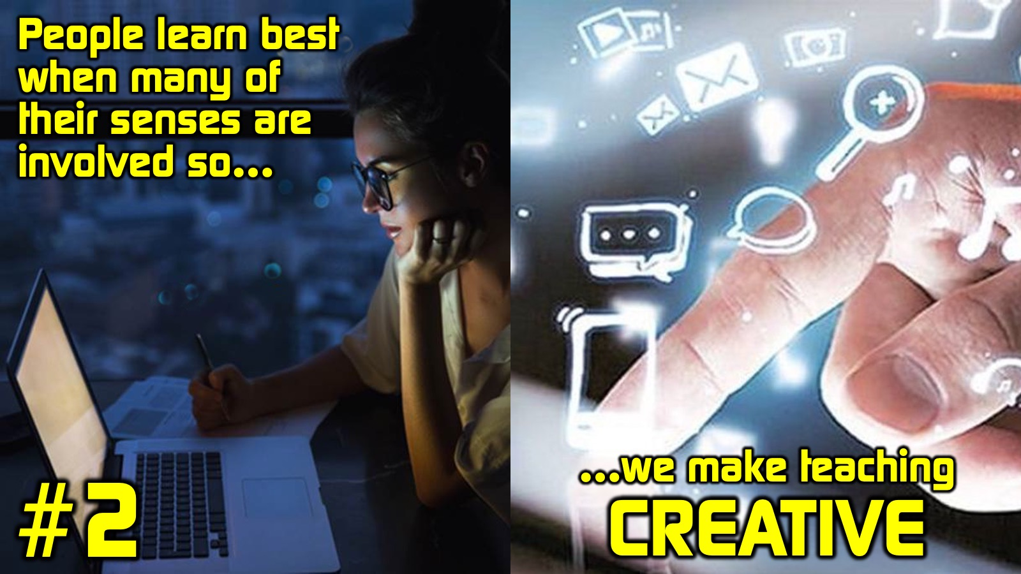
Notes:
Key #2: People learn best when many of their senses are involved so we make teaching CREATIVE!

Slide 24
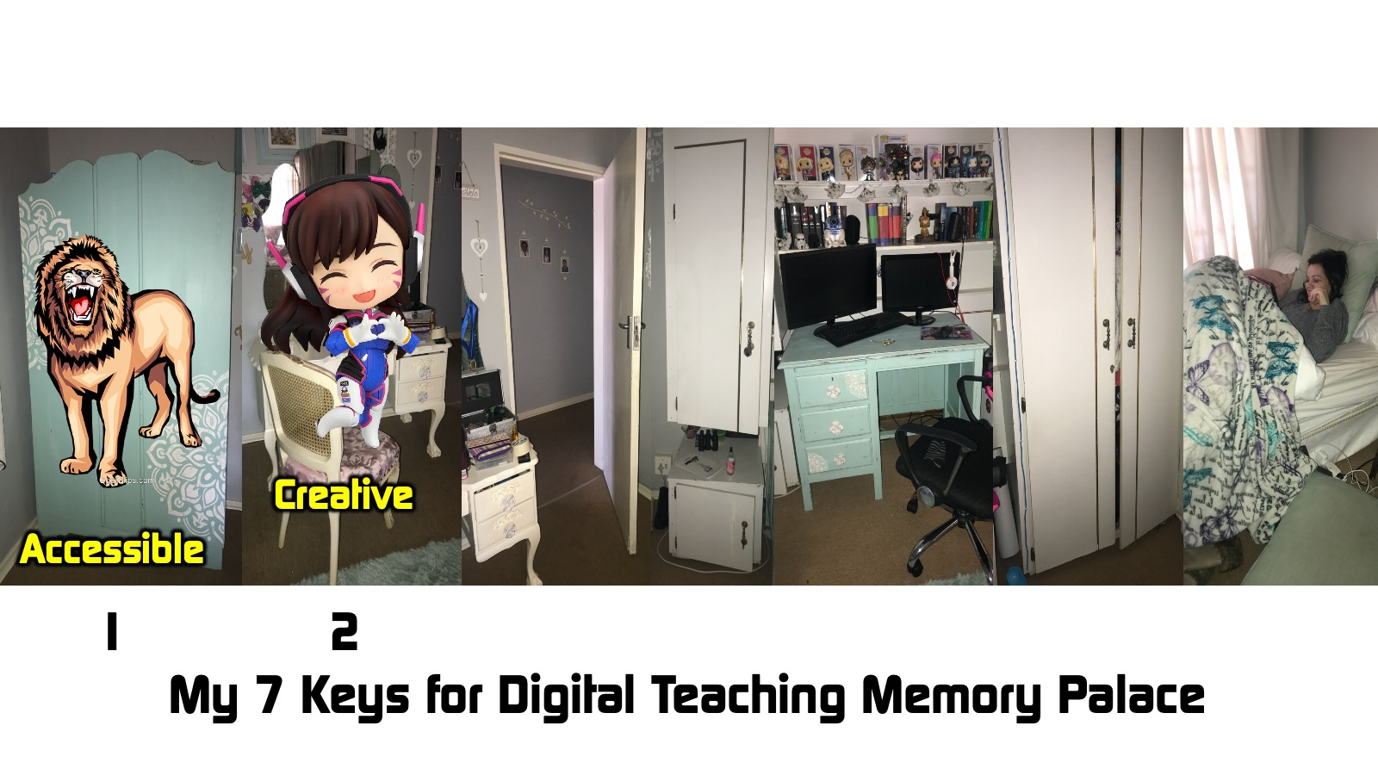
Notes:
Memory: The Dressing Table: Ashley my cosplaying daughter creatively transforms herself into D.Va from Overwatch at her dressing table. This reminds me that the second key to digital teaching is CREATIVE.

Slide 25
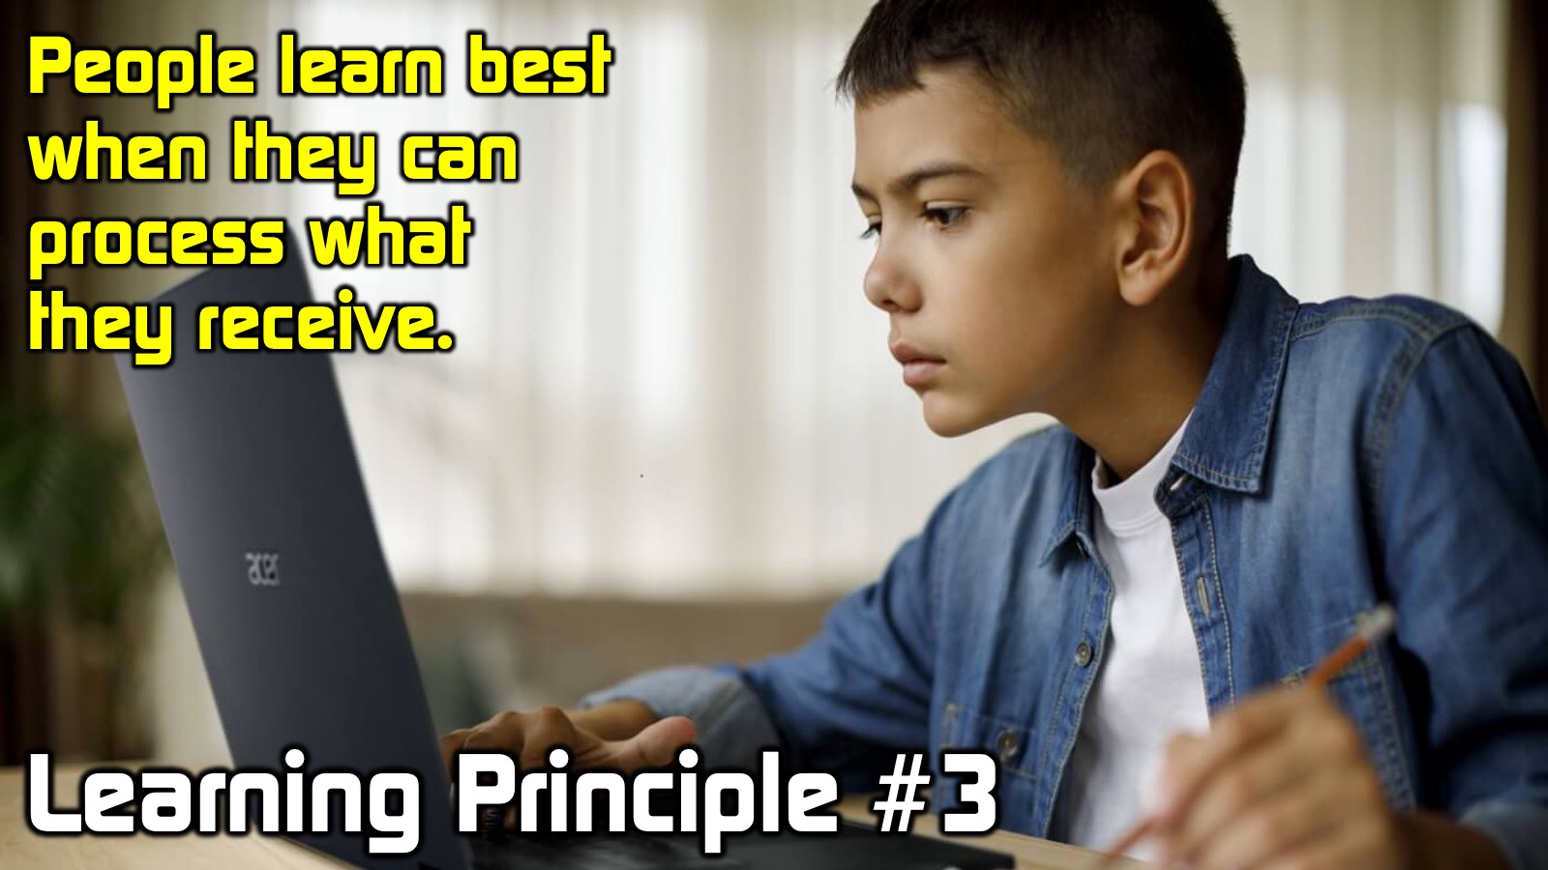
Notes:
Learning Principle #3: People learn best when they can process what they receive.
Learners can quickly become overwhelmed by the material and need to feel like they are able to understand and think through what they are receiving. It is okay to stretch people in the learning environment but they must still be able to process what they are receiving. Never forget that people have limited attention spans and will loose interest easily.

Slide 26

Notes:
Digital Teaching Key 3: Make it Manageable
Share the Material in Bite-Sized Chunks
It is critical that teachers do not overwhelm the learner. Everything they share needs to be narrowly focused on the topic and shared in bite-sized chunks that are manageable. Rather than giving a 30-minute talk, a wise teacher will break the session into smaller chunks that can be digested more easily. The elements you don’t include are just as important as the ones you do include. Use a less-is-more approach. It helps to let students choose whether they want to watch a video, listen to an audio or read the text. Over-explaining or including too many types of media may overwhelm the user, so get rid of whatever isn’t necessary. Adopt a less-is-more approach by eliminating irrelevant, extra or complex information. Don’t overuse media, this will distract and overwhelm your users. Microlearning breaks down course material into smaller, more digestible segments. Reduce clutter in all aspects of your teaching or students will feel frustration and irritation It helps to break up text into titles and paragraphs and if possible, display content in the form of lists. Large chunks of text overwhelm learners quickly. Use only those media elements that add to the teaching experience.

Slide 27
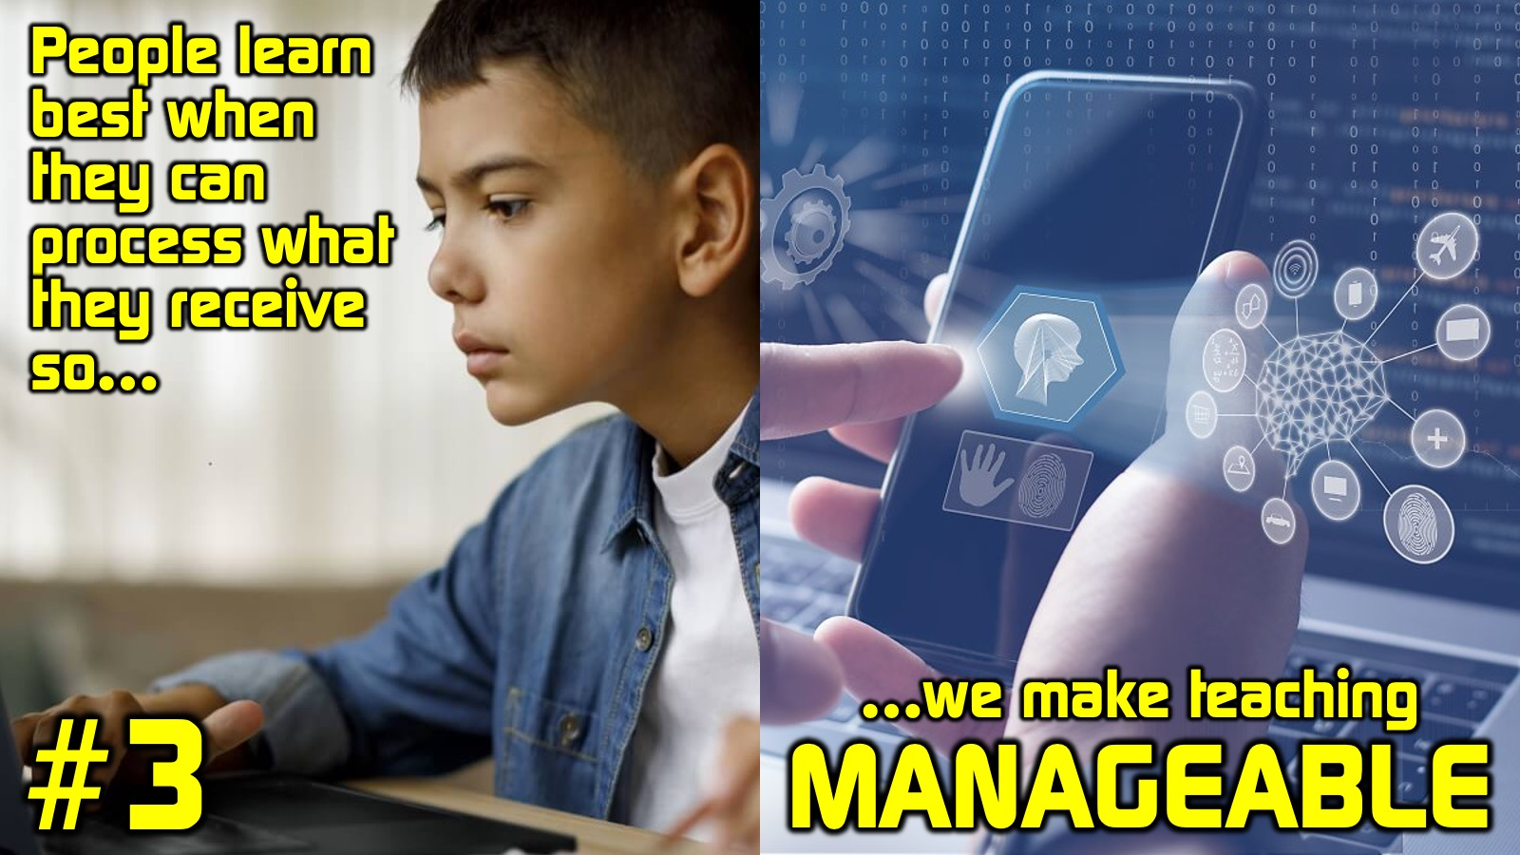
Notes:
Key #3: People learn best when can process what they receive so we make teaching MANAGEABLE!

Slide 28
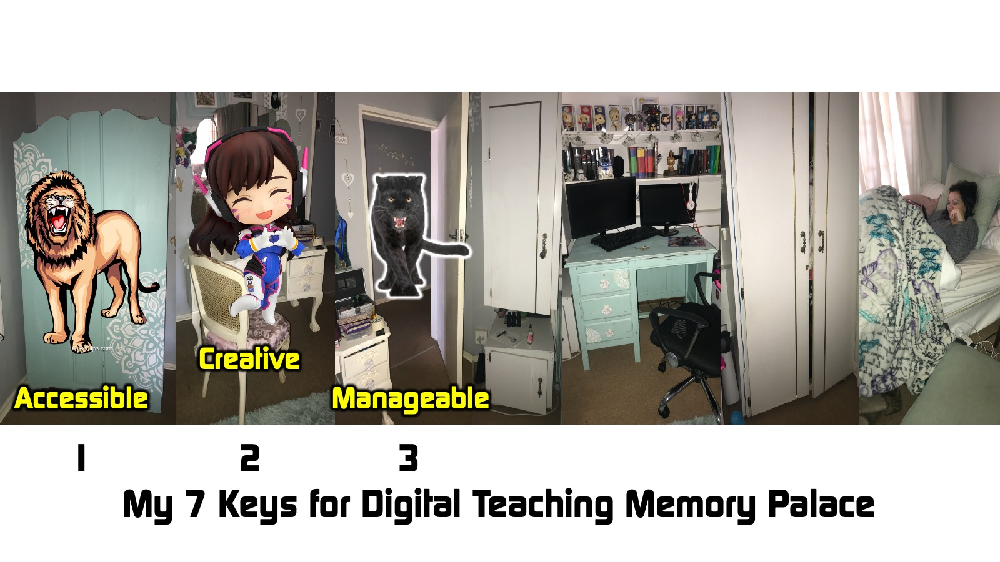
Notes:
Memory: The Door: Our black cat called Panther is super sharp as he manages to open the door with his paw. This reminds me that the third key to digital teaching is MANAGEABLE.

Slide 29

Notes:
Learning Principle #4: People learn best when they are actively involved in the process.
Active participation enhances motivation, the rate of learning and achievement of objectives. People learn best when they are given an opportunity to discuss what they are learning. Discussion enhances motivation, reinforces concepts, nurtures communication skills and fosters memorisation and understanding in learners. The greater the involvement, the greater the retention.

Slide 30

Notes:
Digital Teaching Key #4: Make it INTERACTIVE
Create a Dialogue with the Learners
It's not enough to just post a 20 minute video and think that it will transform lives - we need to engage with people for change to take place. Teachers must do whatever it takes to have a conversation with learners. It helps to mix discussions, collaboration, video and audio clips, and hands-on exercises with text and brief video lectures – this will create an online active learning classroom. After learners view a video or some other form of digital content, they should be encouraged to interact with the material to apply it to their lives. You can make this happen by asking questions about what they have just learnt.

Slide 31
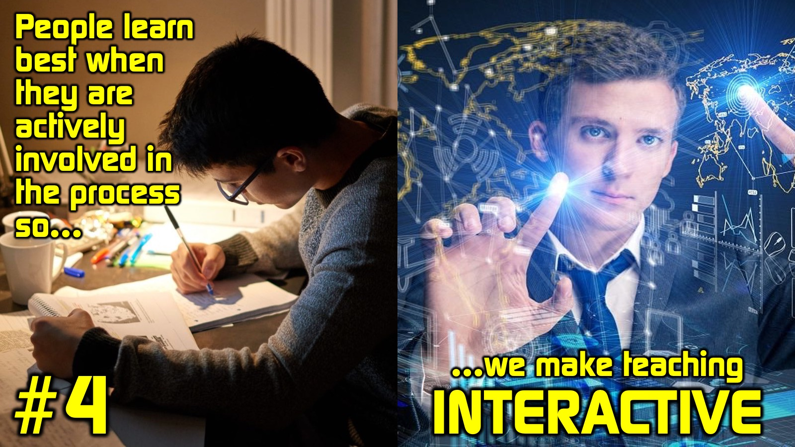
Notes:
Key #4: People learn best when they are actively involved in the process so we make teaching INTERACTIVE!

Slide 32
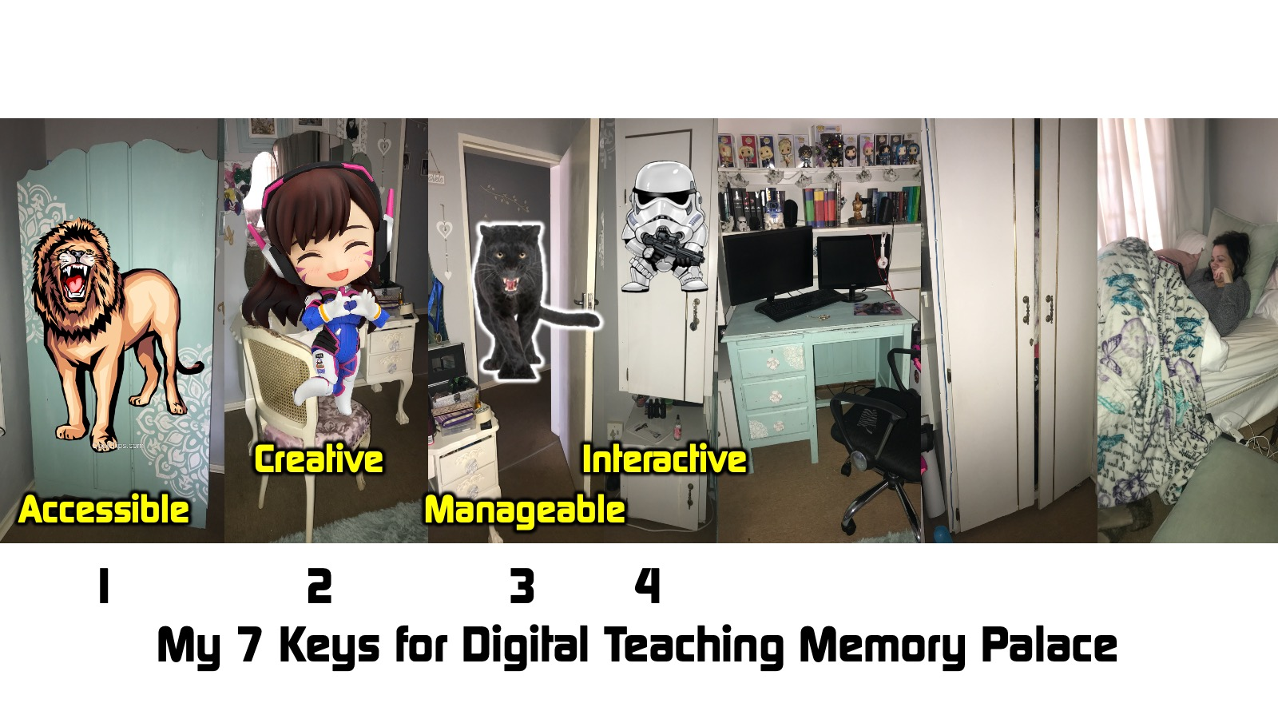
Notes:
Memory: The Short Cupboard: The door of the cupboard flies open and my daughters Star Wars shirts become active and stormtroopers are firing at me. This reminds me that the fourth key to digital teaching is INTERACTIVE.

Slide 33

Notes:
Learning Principle #5: People learn best when they are guided by a caring teacher.
Teachers who show personal and individual attention to their student enhance learning. It is critical that teachers know the names of their students, learn about their lives, listen well, are there for them and expect change to happen. Teacher need to care enough about their learners that they engage in online mentoring by investing their life into people to assist in their personal development and spiritual growth.

Slide 34

Notes:
Digital Teaching Key #5: Make it GUIDED
Walk with Learners Along the Way
No matter where teaching take place, the importance of the teacher being present with the learner in the learning experience is critical. That is more than just answering questions that students post online! Teachers need to have a “social presence” during the session by sharing personal information about themselves, such as what they are reading and what they are learning as well as any challenges they are facing. People generally absorb information more effectively when they feel like there’s a human” element involved and when content is personalized, conversational and informal. It is best to use a conversational voice and tone - rather than a formal, authoritative tone - this will help to put the learner at ease and it gives the content a more approachable, intimate feel so learners can process the content more easily with increased attention and engagement.

Slide 35

Notes:
Key #5: People learn best when they are guided by a caring teacher so we make teaching GUIDED!

Slide 36
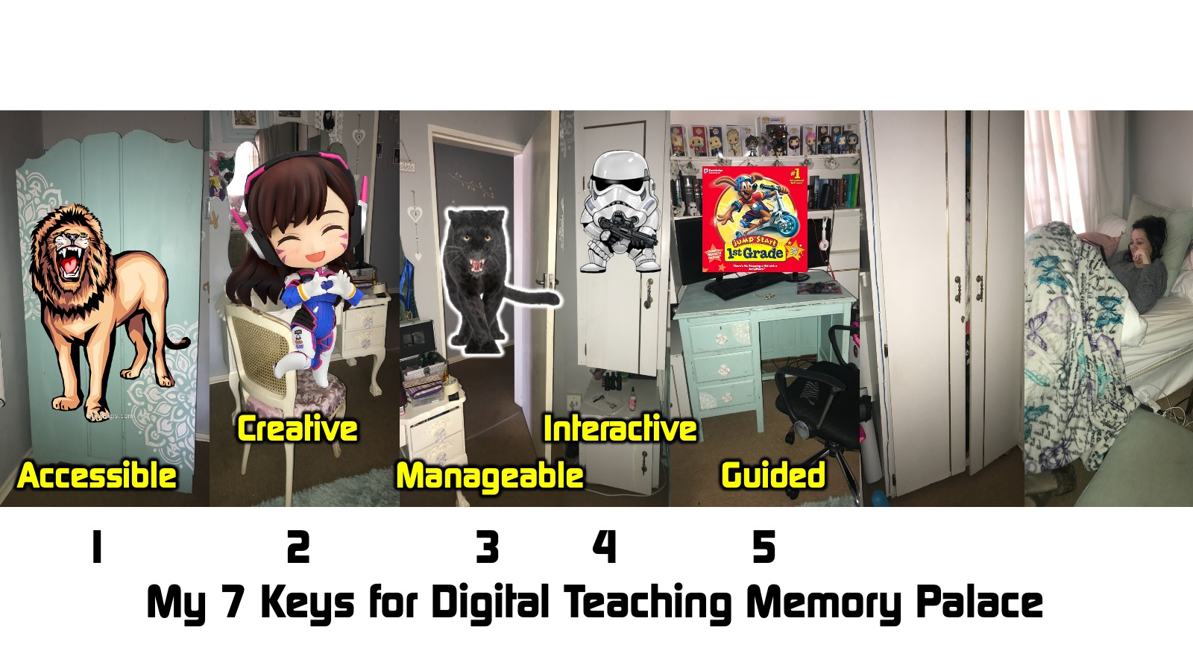
Notes:
Memory: The PC: My daughter is sitting at the PC but she is 6 (it is 20 years ago) and I am guiding her as she plays Jumpstart - one of the first educational computer learning and gaming system ever invented. This reminds me that the third key to digital teaching is GUIDED.

Slide 37
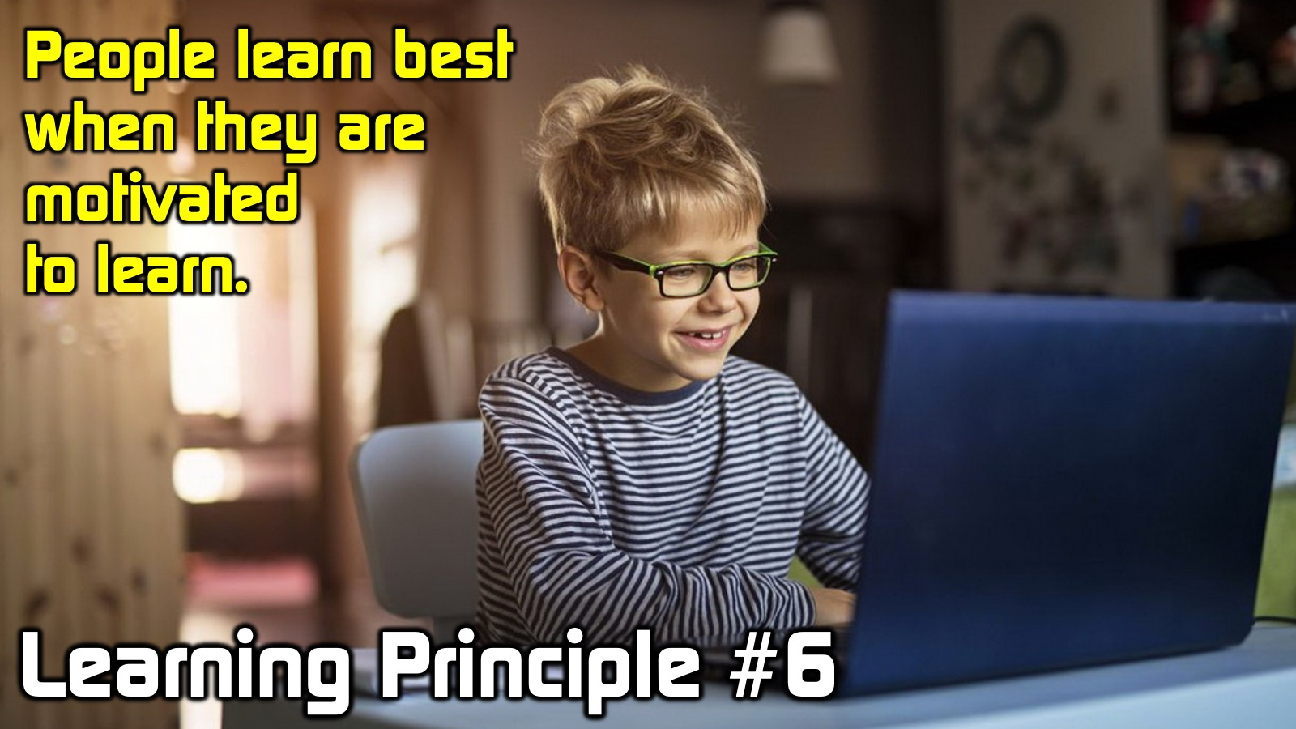
Notes:
Learning Principle #6: People learn best when they are motivated to learn
You cannot force someone to learn. They need to want to listen to what you have to say and they will be motivated to do that if they believe it will meet a need they have and help them grow!

Slide 38

Notes:
Digital Teaching Key #6: Make it ATTRACTIVE
Share Material That Looks Good
Aesthetics are important when it comes to learning because what people see and appreciate they engage with. If we are continually needing to pull learners in so they are not distracted then we must make sure that everything we share is attractive! If it doesn't look great and is not relevant, people will just click elsewhere. Be sure to use well created images and videos with learners.

Slide 39
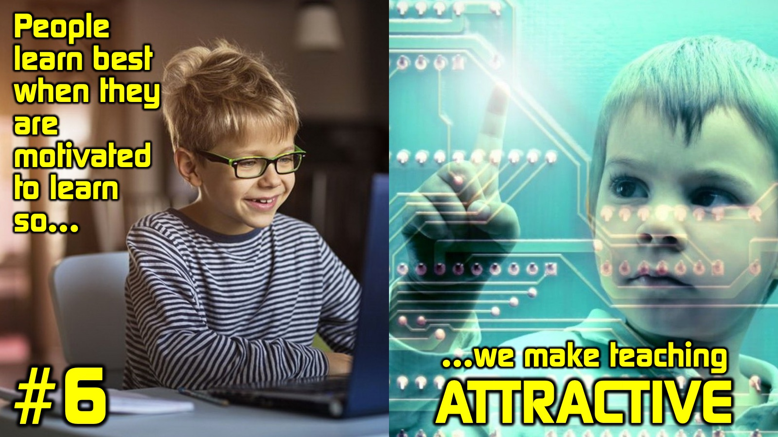
Notes:
Key #6: People learn best when they are motivated to learn so we make teaching ATTRACTIVE!

Slide 40
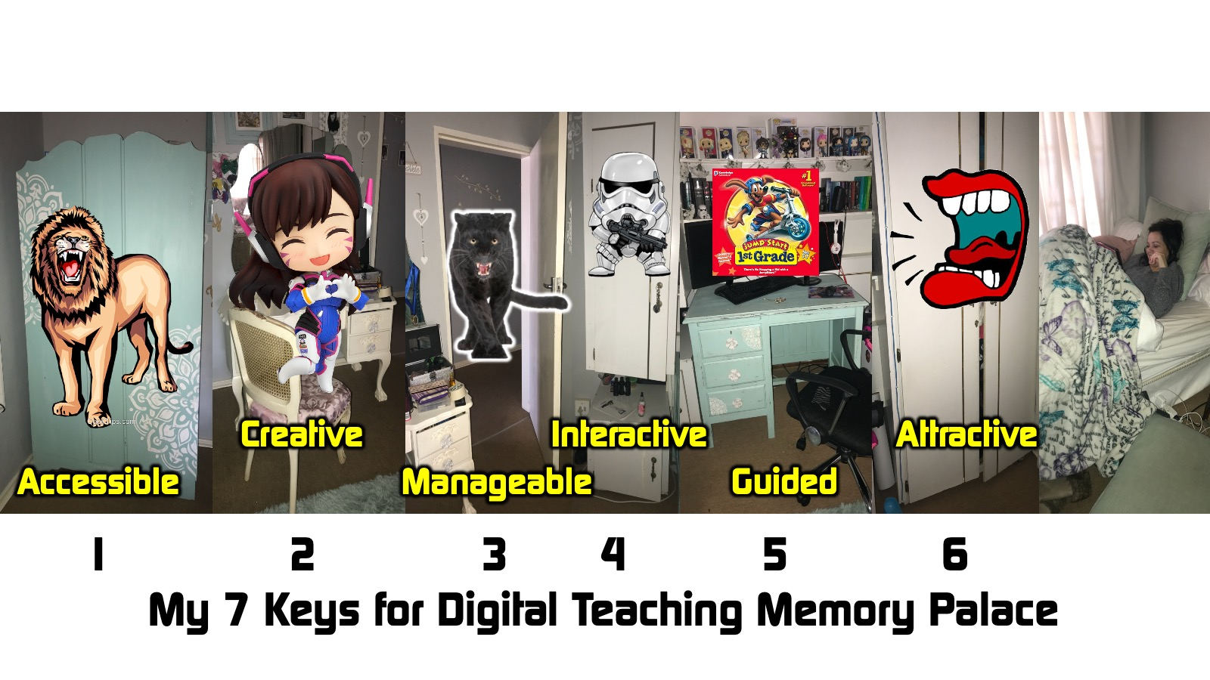
Notes:
Memory: The Tall Cupboard: The door of the tall cupboard is closed but I hear a voice calling softly that attracts me to take a closer look - I open the door and find nothing but dresses and jackets. This reminds me that the sixth key to digital teaching is ATTRACTIVE.

Slide 41

Notes:
Learning Principle #7: People learn best when they have time to process what they hear.
Each learner has their own learning speed, ability and power of comprehension so it is best to design some white-space into the learning experience so people can process what they are learning. Where possible, self-pacing is effective because it enables different individuals to respond at a tempo that enables them to assimilate information.

Slide 42

Notes:
Digital Teaching Key #7: Make it RELAXED
Allow Time for Learning to happen
You need to create digital “white space” in your teaching. People have low attention spans. According to one study, people tend to shift focus from one task to another as many as 20 times in an hour. A screen that is filled with elements is not easy to focus on. When every element screams for your attention your eyes wander and your mind cannot rest on any one element properly. Just as we need “white space” to reduce clutter in printed material so too, in the digital experience, we need to build in some downtime. You can pause and invite learners to reflect on what they have learnt so far. Get learners to take out a journal or note book and write down one thing that they have learnt or can do after the session. Whatever happens, do not let learners feel that you are rushing to get through material. Create breathing room in all your teaching!

Slide 43

Notes:
Key #7: People learn best when they are have time to process what they hear so we make teaching RELAXED!

Slide 44
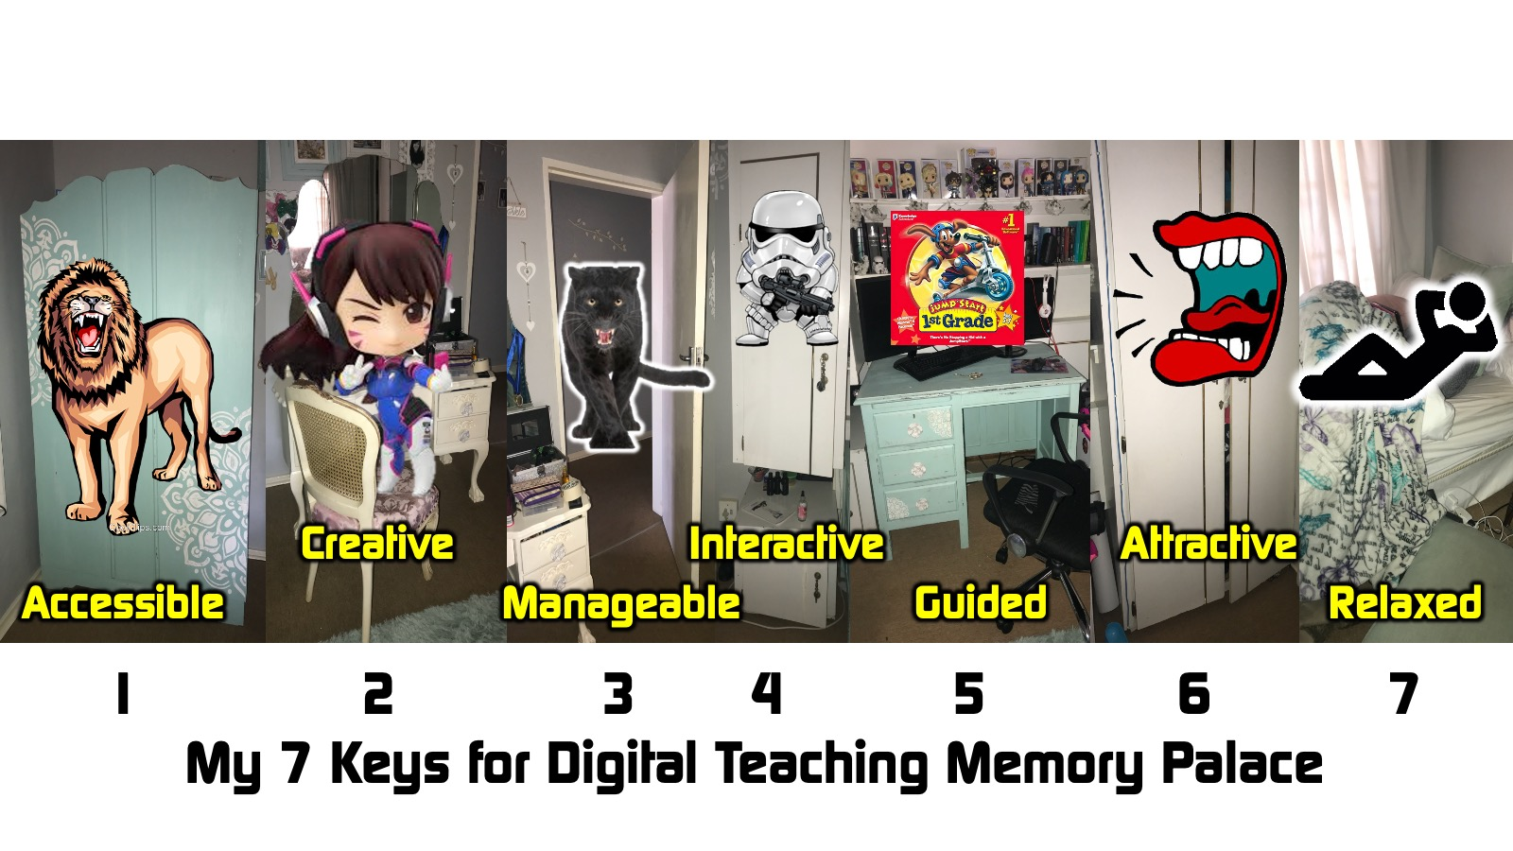
Notes:
Memory: The Bed: it is eleven o’clock and my daughter is still relaxing in bed after being up all night watching and drawing anime on her tablet. This reminds me that the seventh key to digital teaching is RELAXED.

Slide 45

Notes:
SUMMARY: Here is a summary of my 7 Keys to Digital Teaching: Make it: (1) Accessible; (2) Creative, (3) Manageable, (4) Interactive, (5) Guided, (6) Attractive and (7) Relaxed.

Slide 46

Notes:
Evaluating Digital Teaching: Here are questions we can use to evaluate our teaching based on the 7 keys:
1. How did we make it Accessible?
2. How did we make it Creative?
3. How did we make it Manageable?
4. How did we make it Interactive?
5. How did we make it Guided?
6. How did we make it Attractive?
7. How did we make it Relaxed?

Slide 47
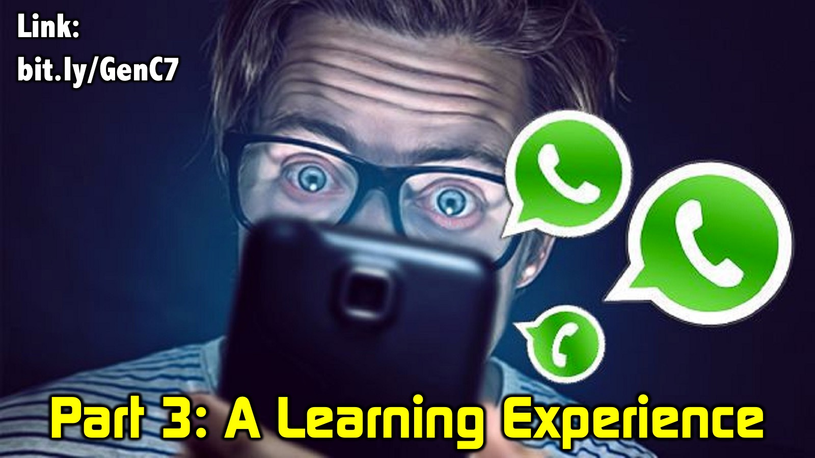
Notes:
Part 3: A Learning Experience (15 min)
I am going to facilitate a live teaching experience using WhatsApp so you can experience interactive learning first-hand. If you have not already joined the Digital Learning WhatsApp group then you need to click the link (if you have joined the group then open WhatsApp on your phone or tablet). The link is: bit.ly/GenC7
—
Welcome to our session on Building Good Habits and Breaking Bad Habits!
—
Habits seems to be a real hot topic today, but have you ever wondered what a habit is?
Here is a simple definition: A habit is an action that is repeated enough times to become automatic - it has moved from the conscious to the sub-conscious part of our minds where it is done without much awareness or effort.
You may want to read that paragraph one more time to take it all in!
—
Read the following passage and look out for one godly habit that jumps out at you?
“Be strong and very courageous. Be careful to obey all the law my servant Moses gave you; do not turn from it to the right or to the left, that you may be successful wherever you go. Keep this Book of the Law always on your lips; meditate on it day and night, so that you may be careful to do everything written in it. Then you will be prosperous and successful. Have I not commanded you? Be strong and courageous. Do not be afraid; do not be discouraged, for the Lord your God will be with you wherever you go.” (Joshua 1:7-9 NIV)
—
Type the habit that jumped out at you and post it here. Go…
—
I have created a short video about habits. Depending on how much data you have, you can watch the video (it is 50MB) or you can listen to the audio (it is 2MB) or you can read the text (it is 0MB).
—
Here is the Video you can watch…
—
SHARE: 1Habits.mp4
—
Or here is the Audio you can listen to…
—
SHARE: 2Habits.mp3
—
Or here is the Text you can read…
[The video starts with Mark caught biting his nails] What is your worst habit - that thing you just can't stop doing, no matter what you do? I developed a bad habit of biting my nails when I was a kid and my dad used to shout at me whenever he caught me snacking on my nails. He even used to paint this horrible tasting stuff all over my nails to help me break what was really a bad habit. I can actually taste it now from the bad memories that still linger. Sadly, I grew up thinking that habits were something to be avoided. And yet when it comes to productivity, habits are a massive game changer, because they help turn goals into reality. For example, I have a Priority in my life to engage with God, and a Goal of spending quality time in devotions every day. What helped this goal become a consistent reality in my life was creating the Habit of getting up at 5am every day, and spending an hour in devotions - where I Meditate, Read Scripture, Pray and record the spontaneous flow of thoughts that come to mind. I don't hope I will do this, it has become a habit and it happens.
—
I trust that inspired you and prepared you for what is to come. I am going to ask each of you to post a short answer to a question on this group right now. Here is the question: What one Good Habit have you struggled to develop in the past weeks? Identify a habit and post it here now. Go…
—
Thanks for sharing so openly and participating so eagerly.
—
Clearly the secret is to figure out how to get that habit established in your life!
—
SHARE: 3HabitsAtomic.jpg
—
According to James Clear in his book, “Atomic Habits”, there are 4 things you can do to make a habit stick: You need to make the habit…
1. OBVIOUS
You must build a reminder into your environment so you remember to do the habit - like a “Cue”.
Example: Let me use the example of reading my Bible as a daily habit: The action will be OBVIOUS if I put an actual Bible next to my bedside as a reminder or if I set an alarm on my phone to remind me to open the YouVersion app when I wake up!
2. ATTRACTIVE
You need to make sure that the activity is something you want to do - almost like a “Craving”.
Example: My daily Bible reading will be ATTRACTIVE if I remind myself that when I open my Bible Jesus actually meets with me, I get closer to him and I become more like Him! Using a fresh translation of the Bible, like the Passion Translation, will also makes the reading attractive.
3. EASY
You must make sure that the activity can be easily repeated each time you do it - almost like a natural “Response”.
Example: My daily Bible reading will be EASY if I put a bookmark in my bedside Bible so I can easily find where I need to read from, or if I use a Daily Reading Plan in my YouVersion app to automatically find the next chapter to read.
4. SATISFYING
You must design habits that you enjoy doing - that give you a “Reward”.
Example: My daily Bible reading will be SATISFYING if I make a note of what Jesus has said to me in my devotions so that I can share it with others and multiply the impact of my devotions.
So, to build a good habit you need to make it Obvious, Attractive, Easy and Satisfying!
—
Don’t forget to click on Read more…
—
As a summary, here is an image that shows the 4 secrets to building a good habit…
—
SHARE: 4HabitsGood.jpg
—
What one thing can you do to make your habit stick? Type up your one thing and post it here now. Go…
—
Thanks for sharing your responses.
I am going to give you 30 seconds to think about something you will do in the next week to make that good habit stick. Your 30 seconds starts now…
—
What one Bad Habit have you struggled to break in the past weeks? Identify a habit and post it here now. Go…
—
Thanks for sharing so openly.
—
How do you break a bad habit? According to James Clear, the key is to do the opposite of what it takes to create a good habit. In other words, you need to make the bad habit…
1. INVISIBLE
You must remove something from your environment that triggers you doing the bad habit.
Example: Let me use the example of breaking the habit of biting my nails: The action will be INVISIBLE if I keep my nails cut really short!
2. UNATTRACTIVE
You must do something to make the bad habit less attractive to you.
Example: My nail biting habit will be UNATTRACTIVE if I paint my nails with a bitter-flavoured varnish that tasty really nasty!
3. DIFFICULT
You must make it much harder to engage in activities that relate to the bad habit.
Example: My nail biting habit will be DIFFICULT if I keep a stress ball in my hand when my hands are idle – this will help with one of the underlying motivations of nail biting, which is stress.
4. UNSATISYING
You must diminish the rewards or satisfaction that you get from doing the bad habit.
Example: My nail biting habit will be UNSATISFYING if I print a picture of a badly bitten finger and put it up somewhere where I will see if often, as a deterrent.
So, to break a bad habit you need to make it Invisible, Unattractive, Difficult and Unsatisfying!
—
Don’t forget to click on Read more…
—
As a summary, here is an image that shows the 4 secrets to breaking a bad habit…
—
SHARE: 5HabitsBad.jpg
—
What one thing can you do to break your bad habit? Type up your one thing and post it here now.
—
Thanks again for sharing so openly and positively.
I am going to give you 30 seconds to think about something you will do in the next week to break that bad habit. Your 30 seconds starts now...
—
Let’s pray: Dear God, I ask that you will help me to break bad habits in my life and to build good habits into my life. Help me to follow through on the ideas that I have had today so that I grow in my relationship with you and people around me. In Jesus name, Amen!
——
There are two tasks for you to complete before we get together for our session next week:
Task #1: Go deeper into the fascinating subject of habits by reading a free chapter from my book, The Productive Life, using this link: http://bit.ly/TPL_Chapter
Task #2: Read an article that I wrote to describe my devotional habits so you can get some fresh ideas for growing your relationship with Jesus.
—
SHARE: 6Habits.pdf
—
Okay, join me back on the Zoom call…

Slide 48

Notes:
Part 4: Small Group Debrief (15 mins)
You will be placed into groups of 3 to reflect on what you learnt and walk through the 7 keys you experienced and explore implications for your future online teaching. Here are the questions:
1. On a scale of 1-10 (where 10 is excellent) how would you rate the effectiveness of the learning experience? Why?
2. Which of the keys did you notice in the experience? Accessible, Creative, Manageable, Interactive, Guided, Attractive, Relaxed.
3. What one thing do you need to do differently in your online teaching?

Slide 49
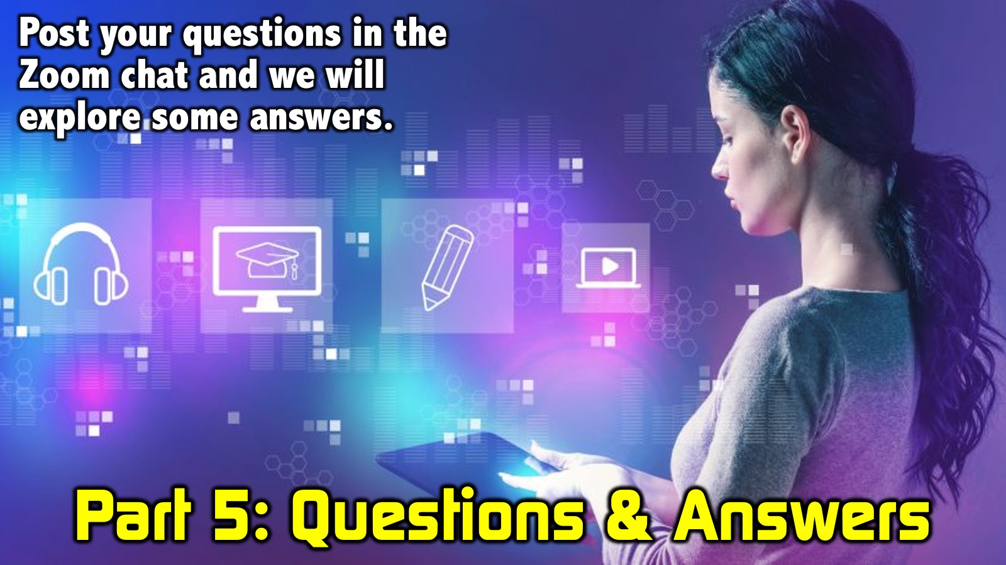
Notes:
Part 5: Questions & Answers (10 mins)
I am going to facilitate a Q&A session using questions posted in the chat.

Slide 50

Notes:
Part 6: Engaging Youth Online (15 mins)
Stuart Fisher will explore ways in which he and his team are facilitating learning among Youth. Stuart is the Youth Director at Encounter Youth – the youth ministry of Every Nation Rosebank. He is also the music director at the church and a long-standing guitarist for the band We Will Worship. He is also studying law at UNISA. Clearly Stuart is a busy chap and we appreciate the time you have given to share with us some of the ways in which you are communicating online with high schoolers.

Slide 51


Slide 52
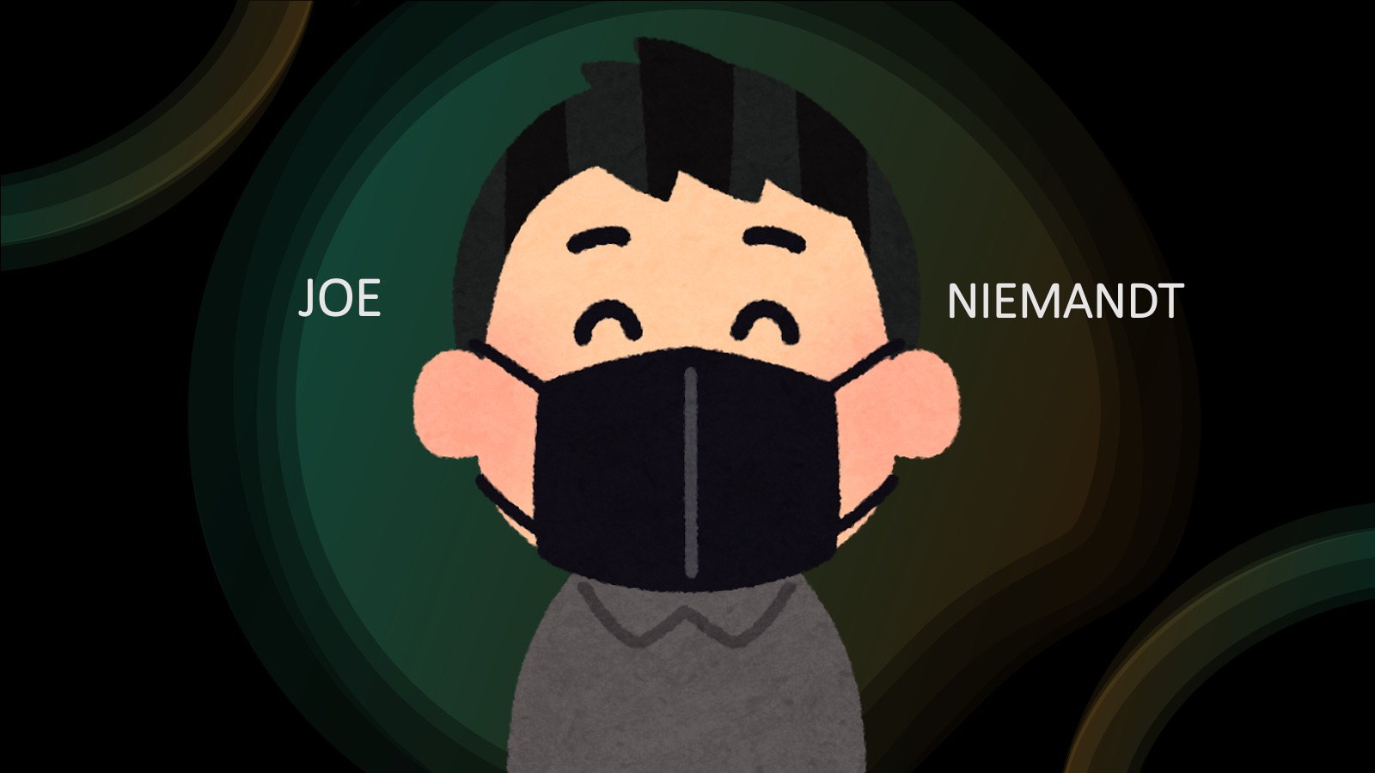

Slide 53
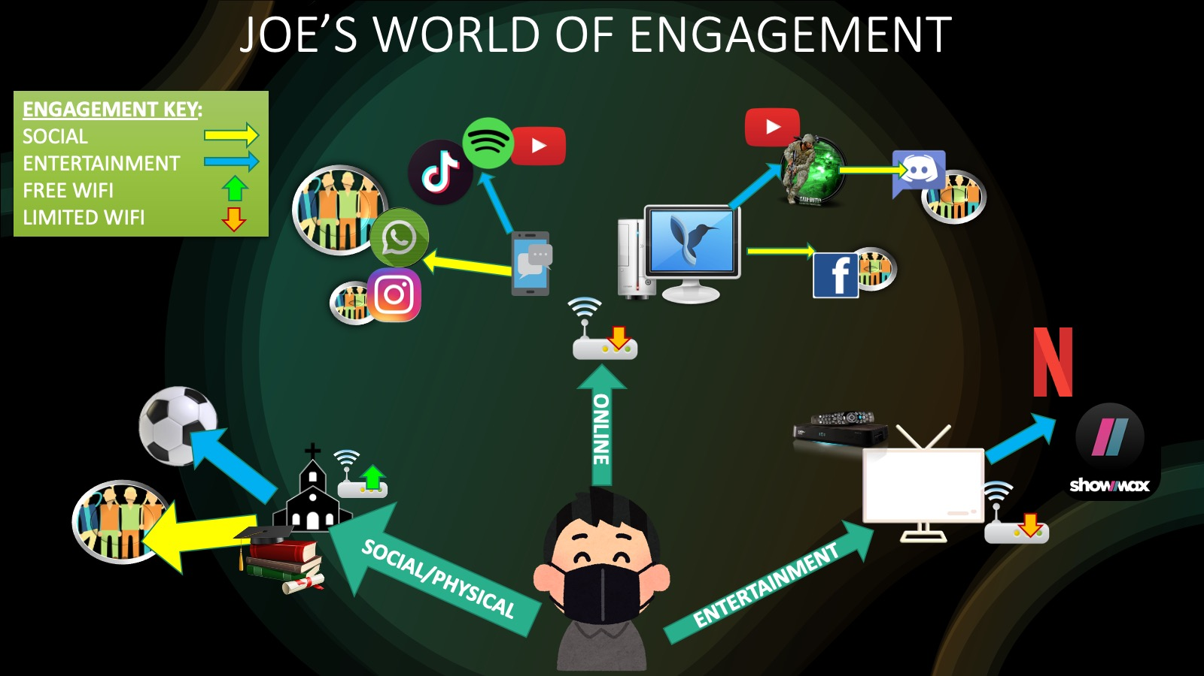

Slide 54
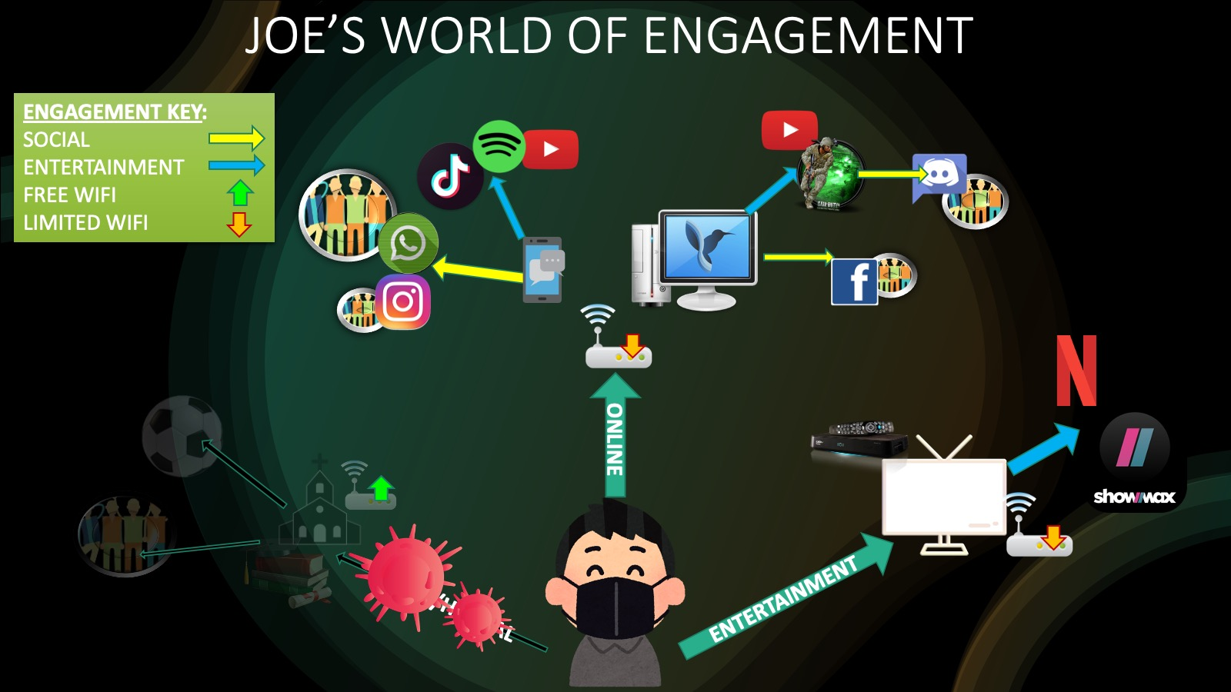

Slide 55
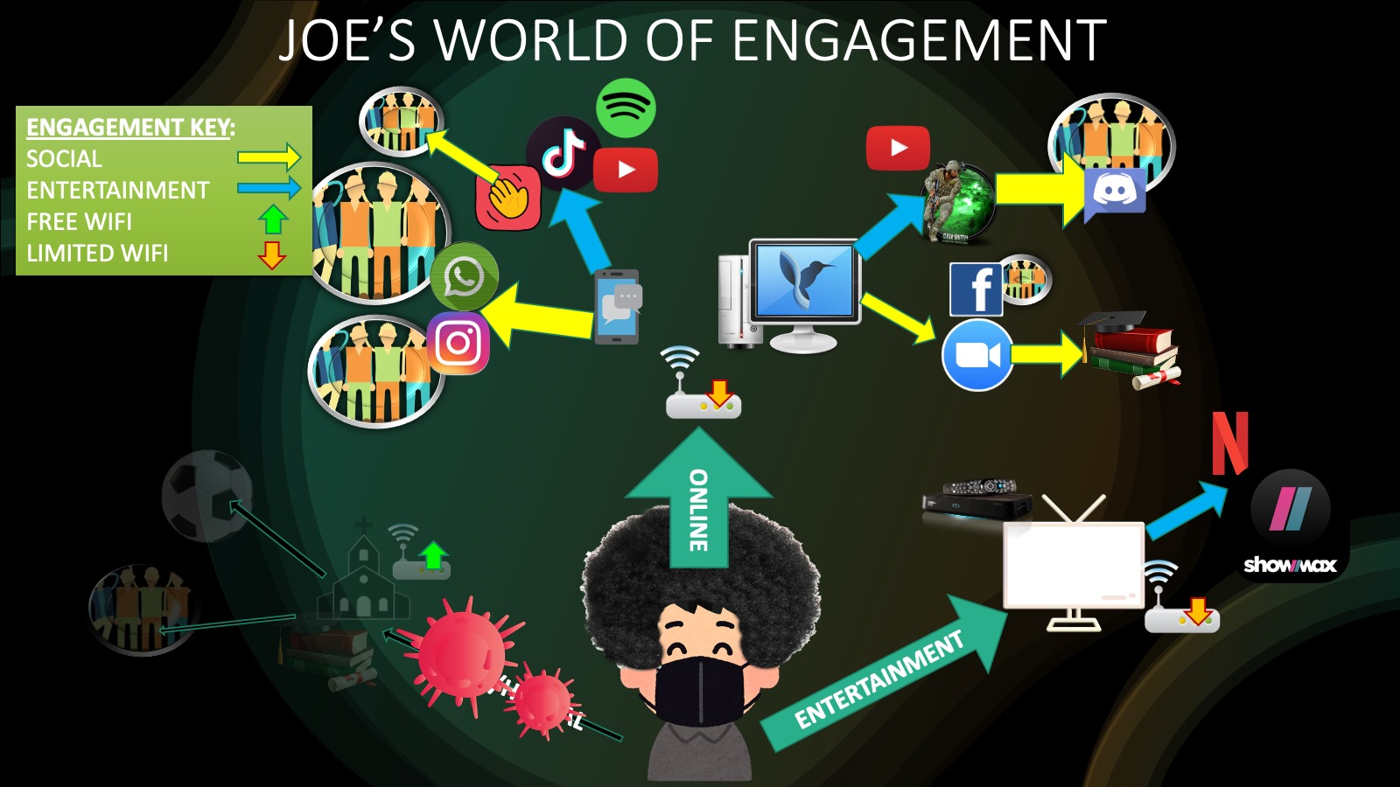

Slide 56
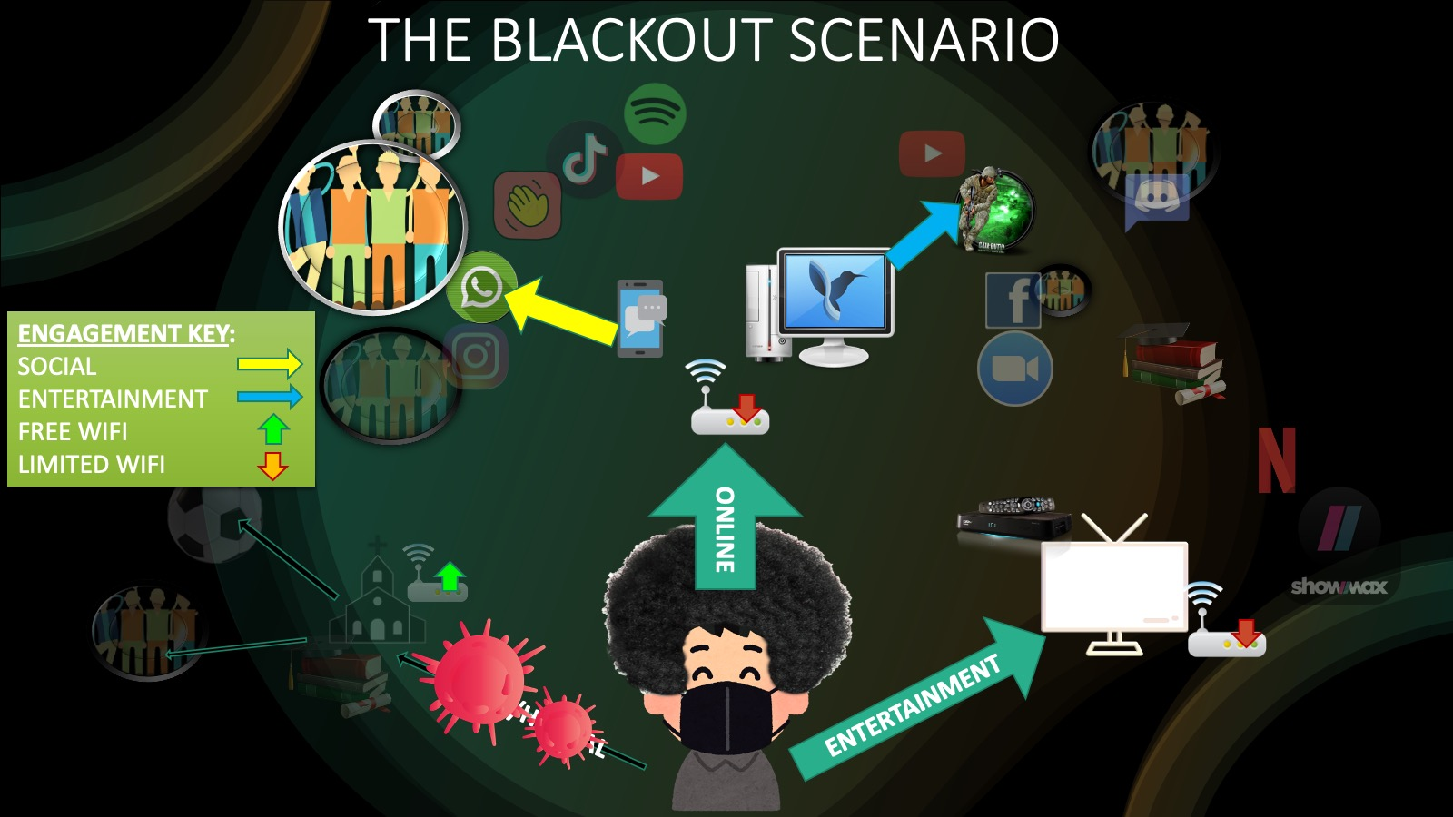

Slide 57


Slide 58


Slide 59
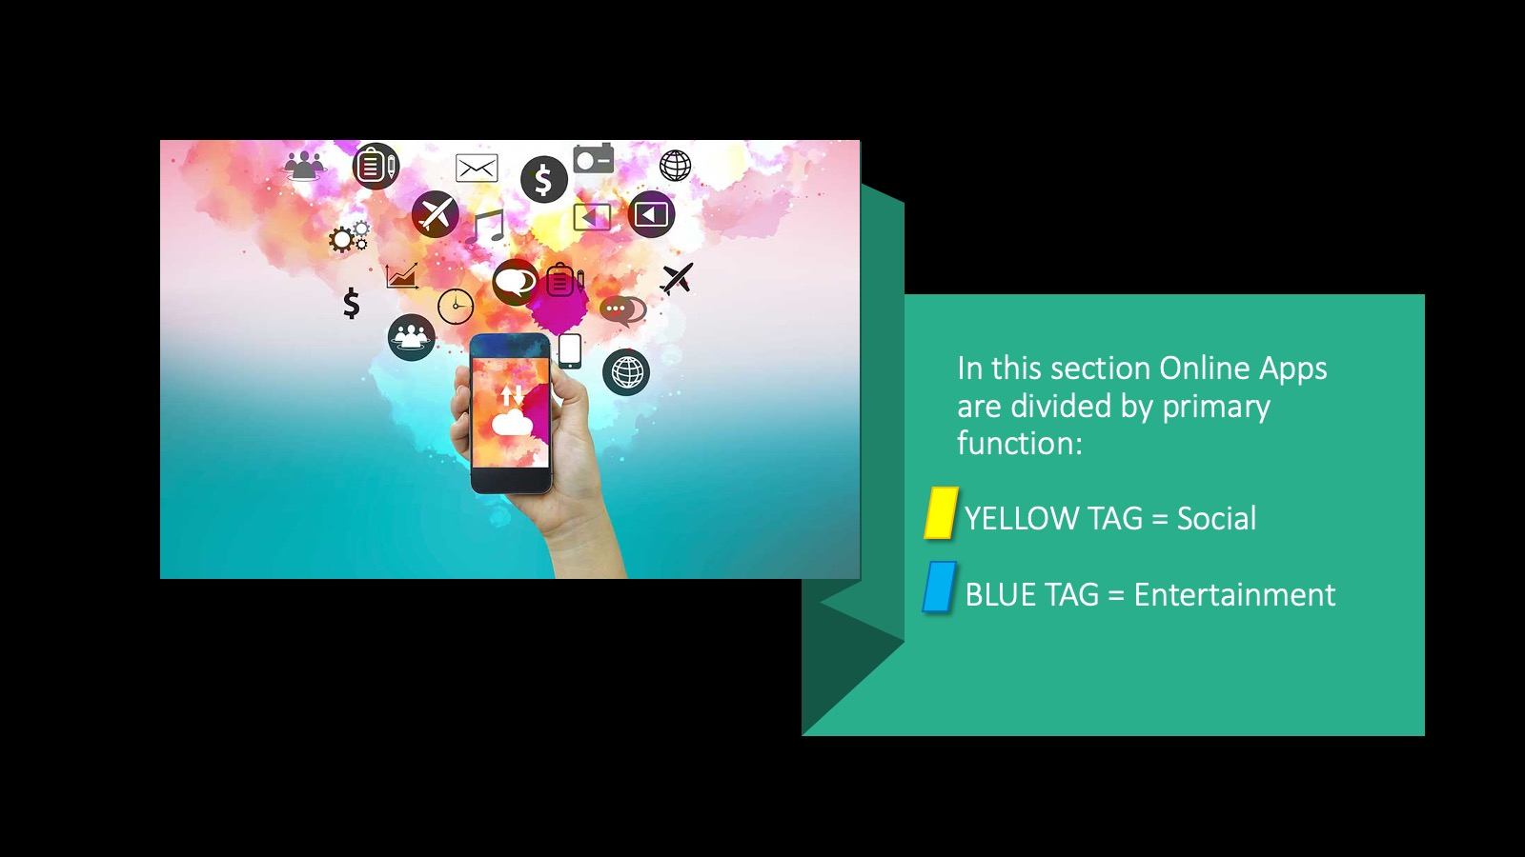

Slide 60


Slide 61
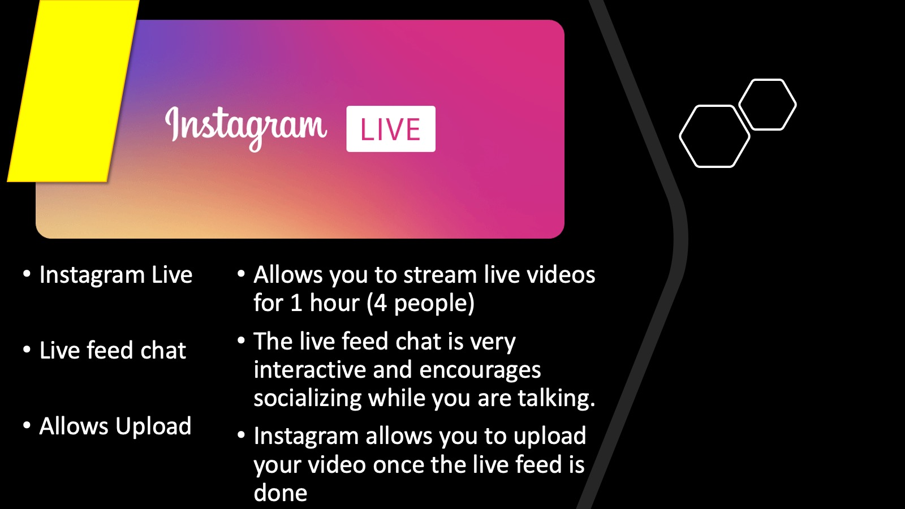

Slide 62
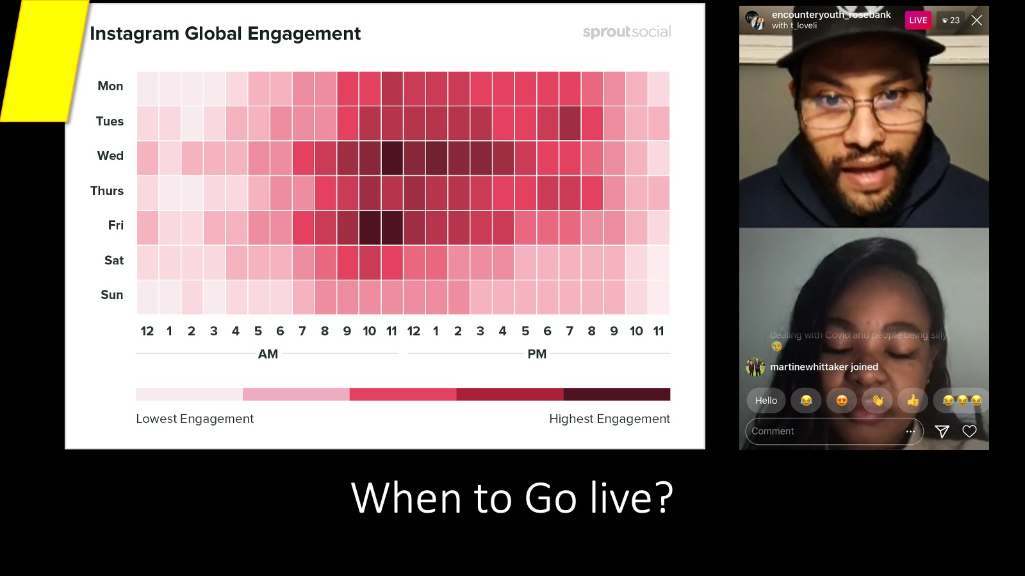

Slide 63
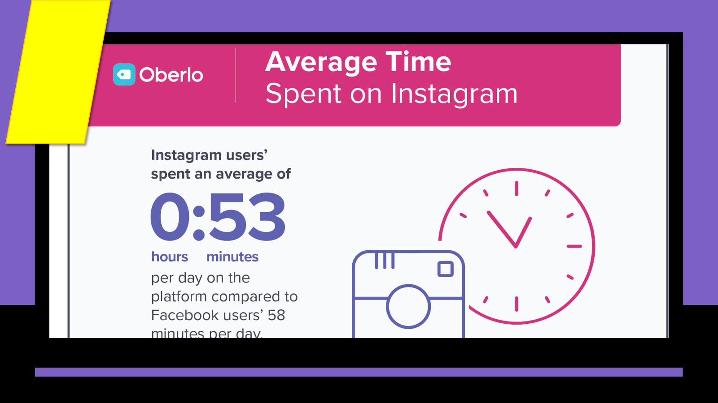

Slide 64
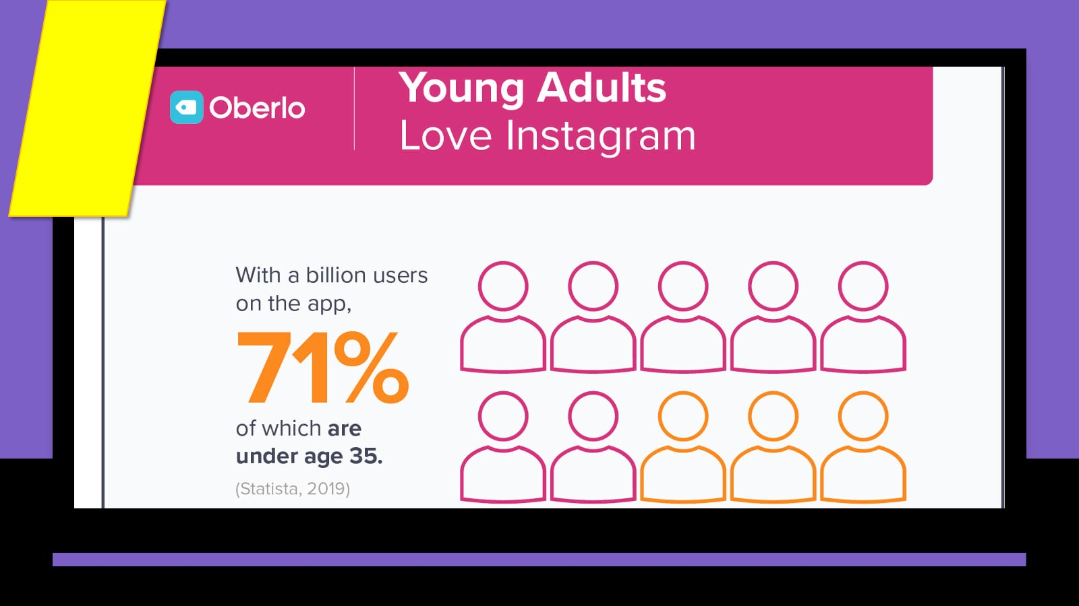

Slide 65


Slide 66
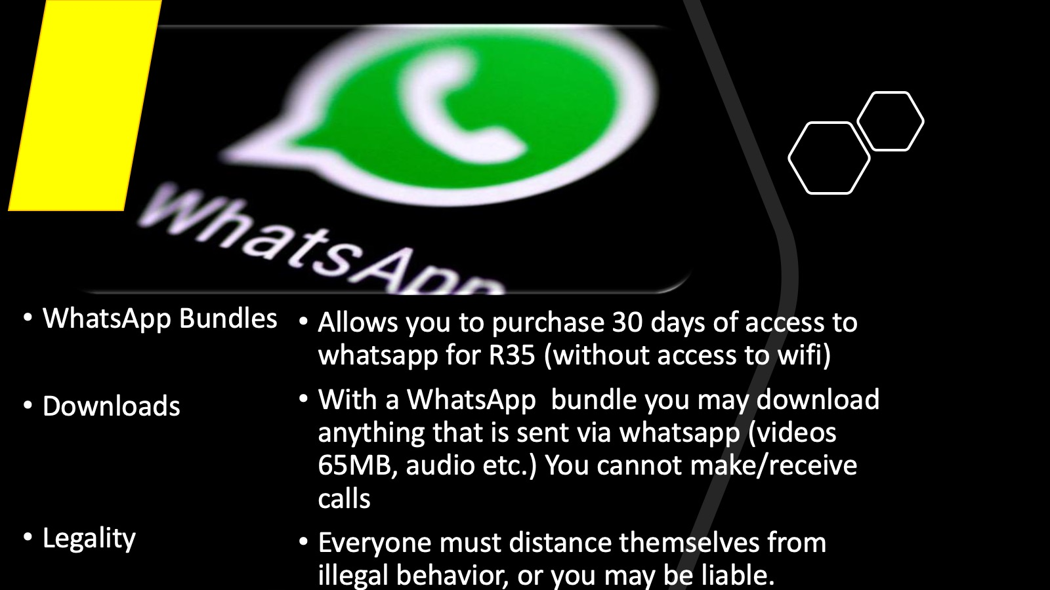

Slide 67
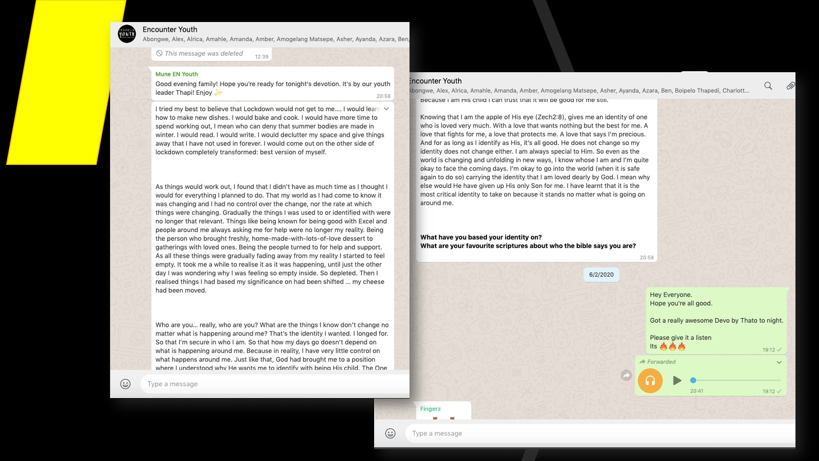

Slide 68


Slide 69
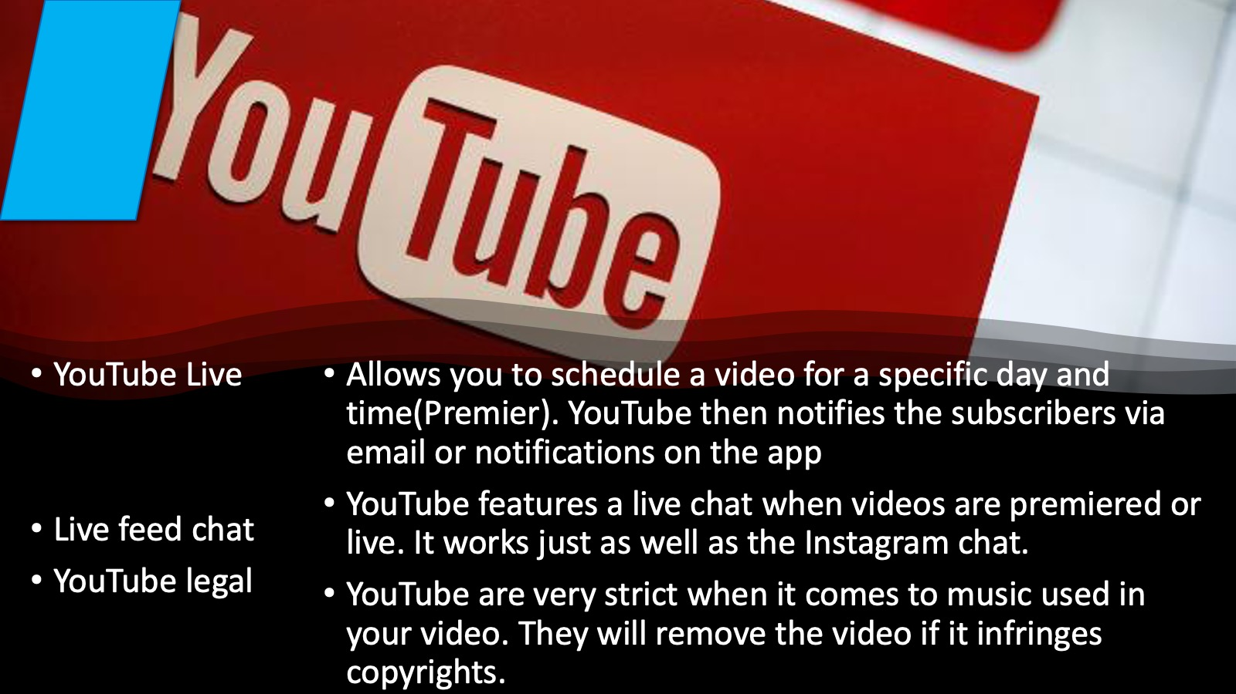

Slide 70
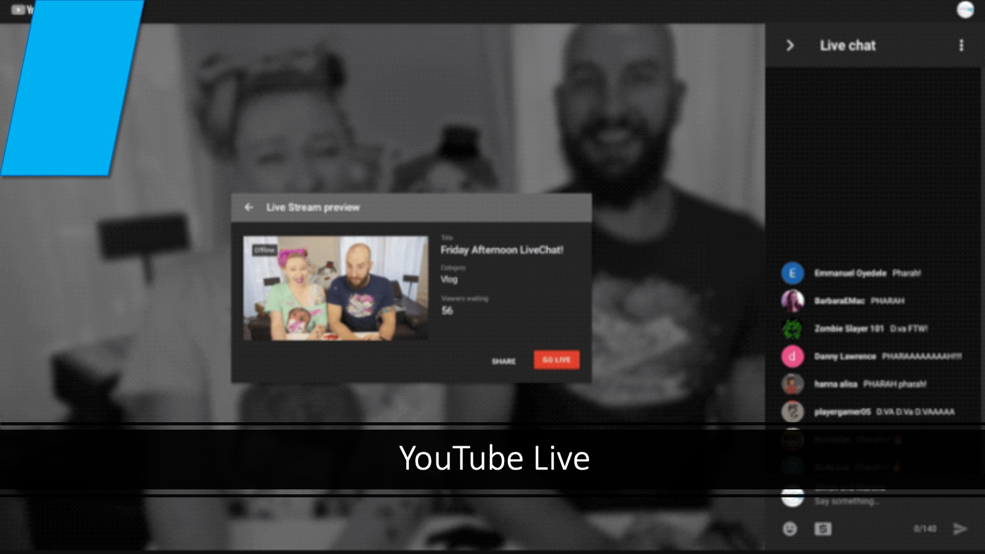

Slide 71
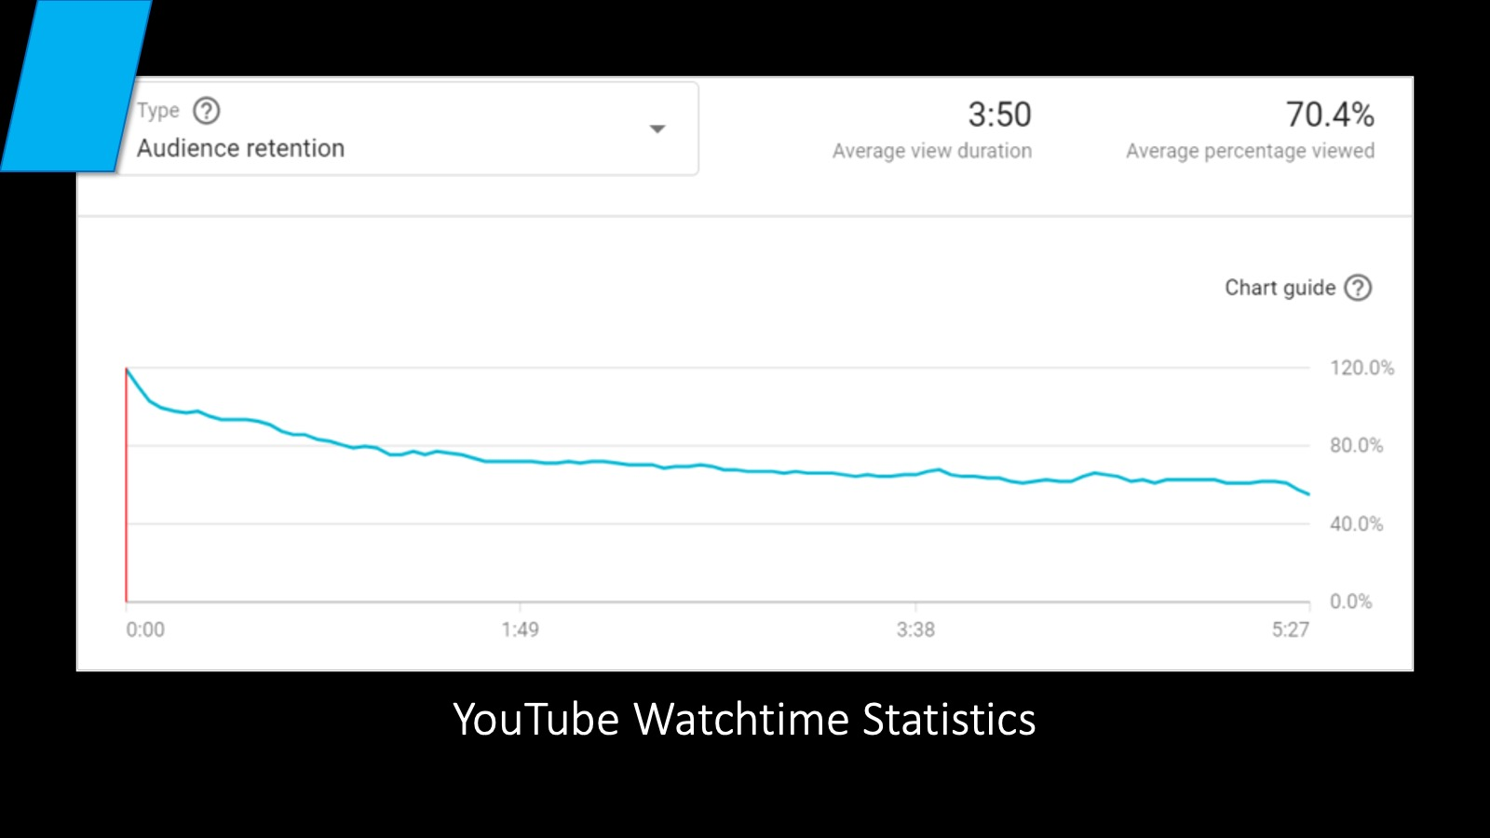

Slide 72
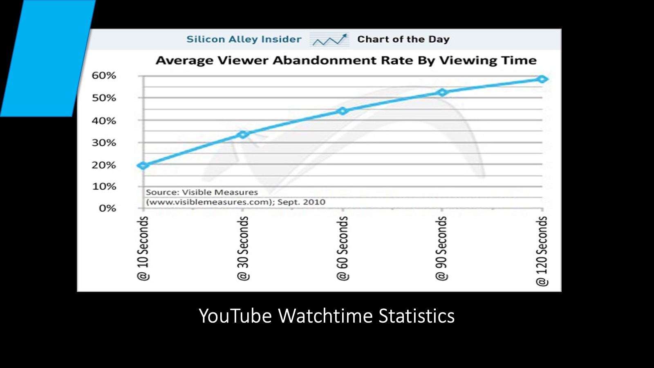

Slide 73
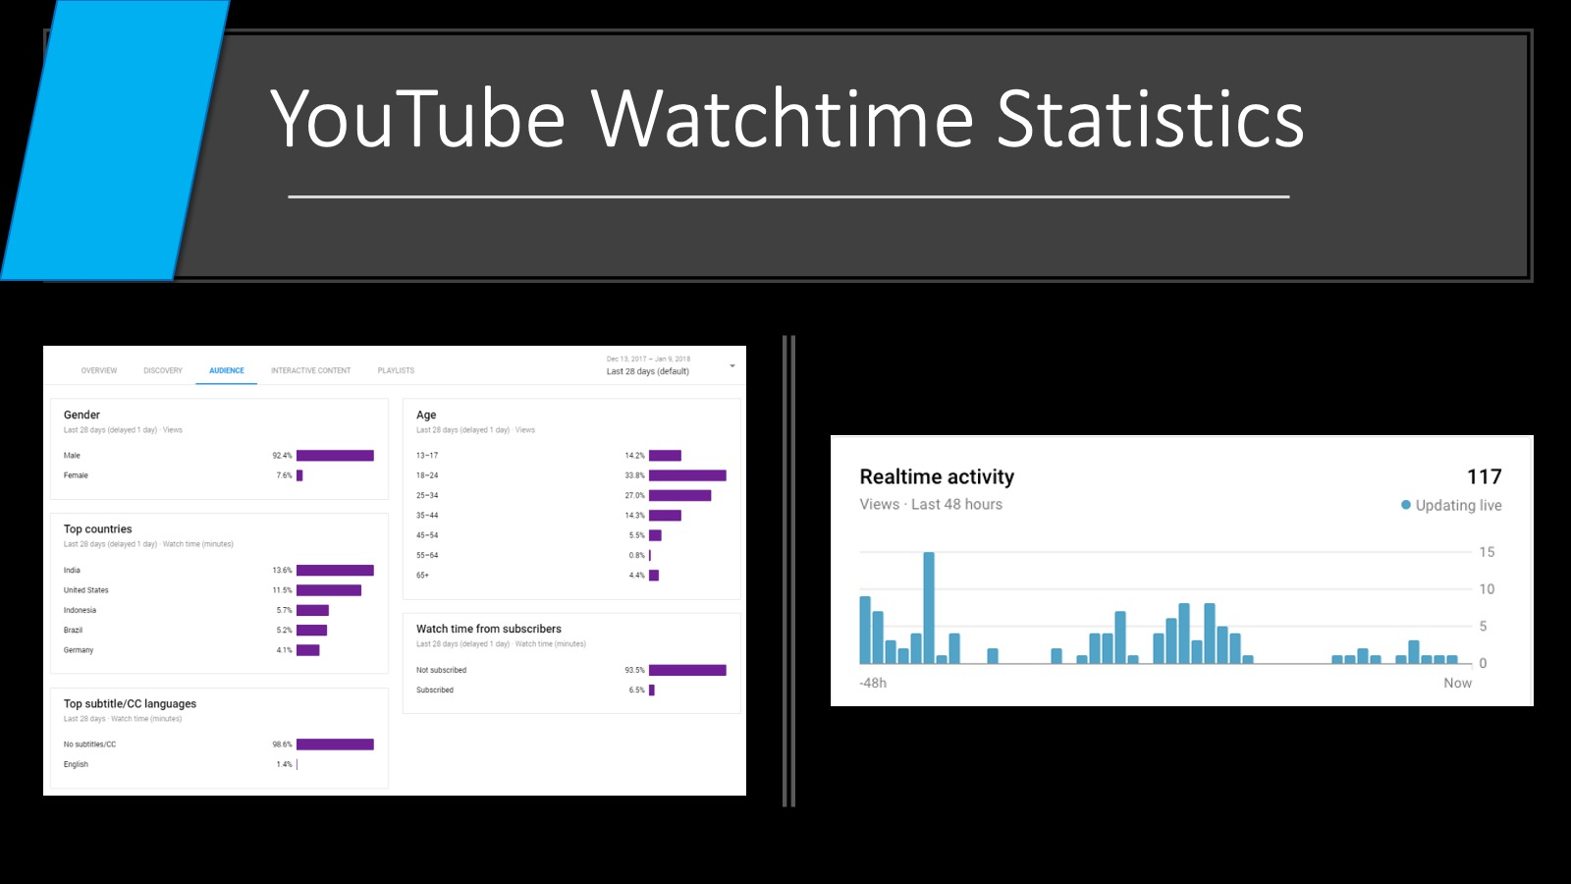

Slide 74
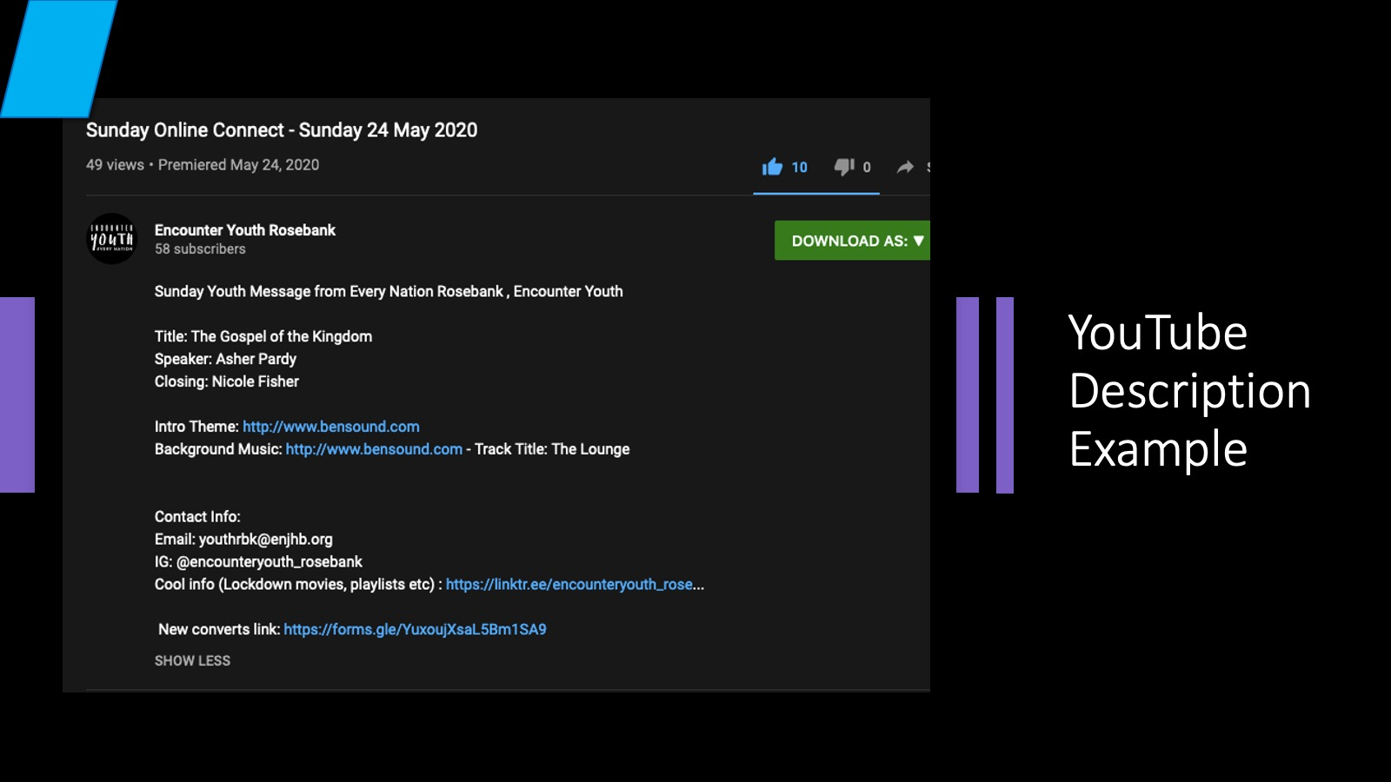

Slide 75
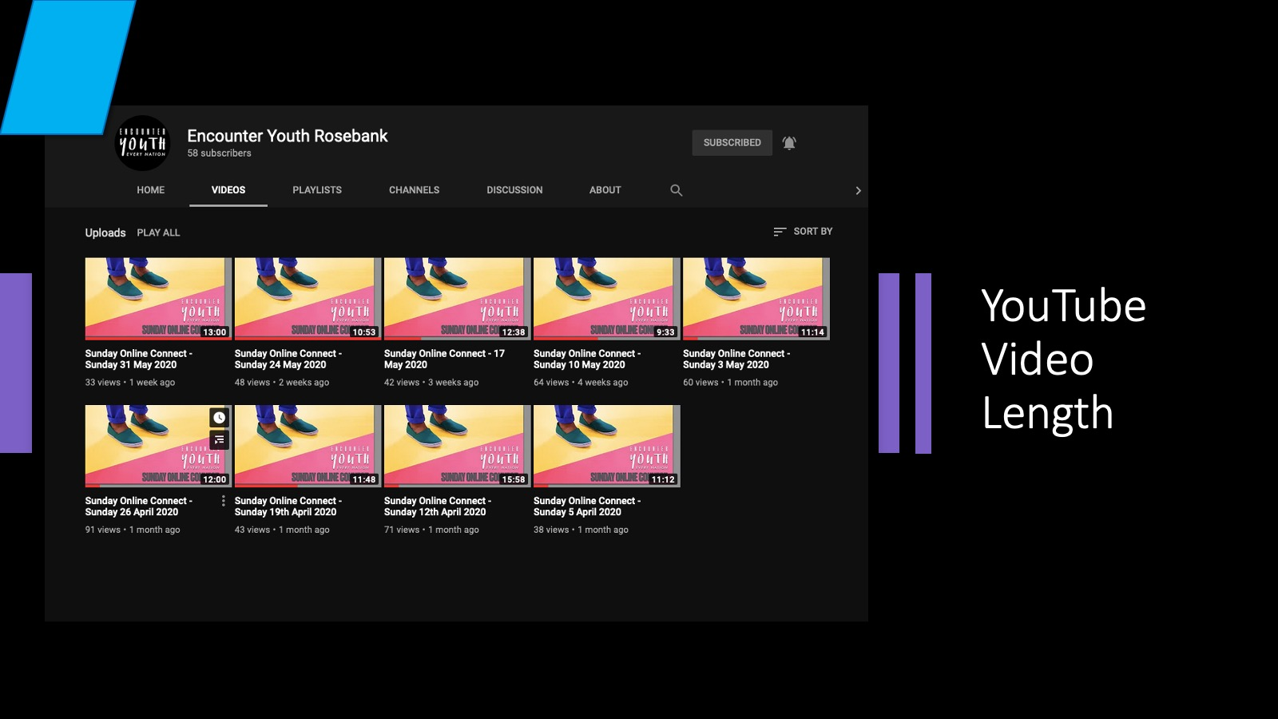

Slide 76


Slide 77
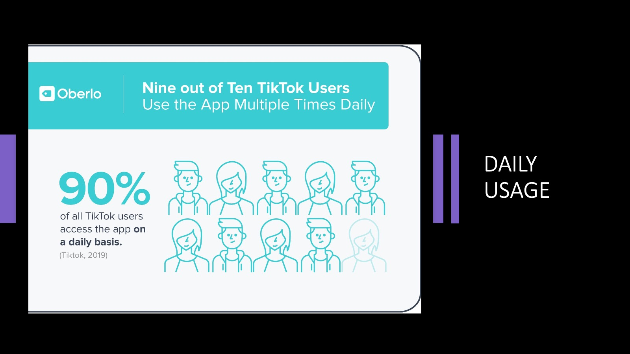

Slide 78
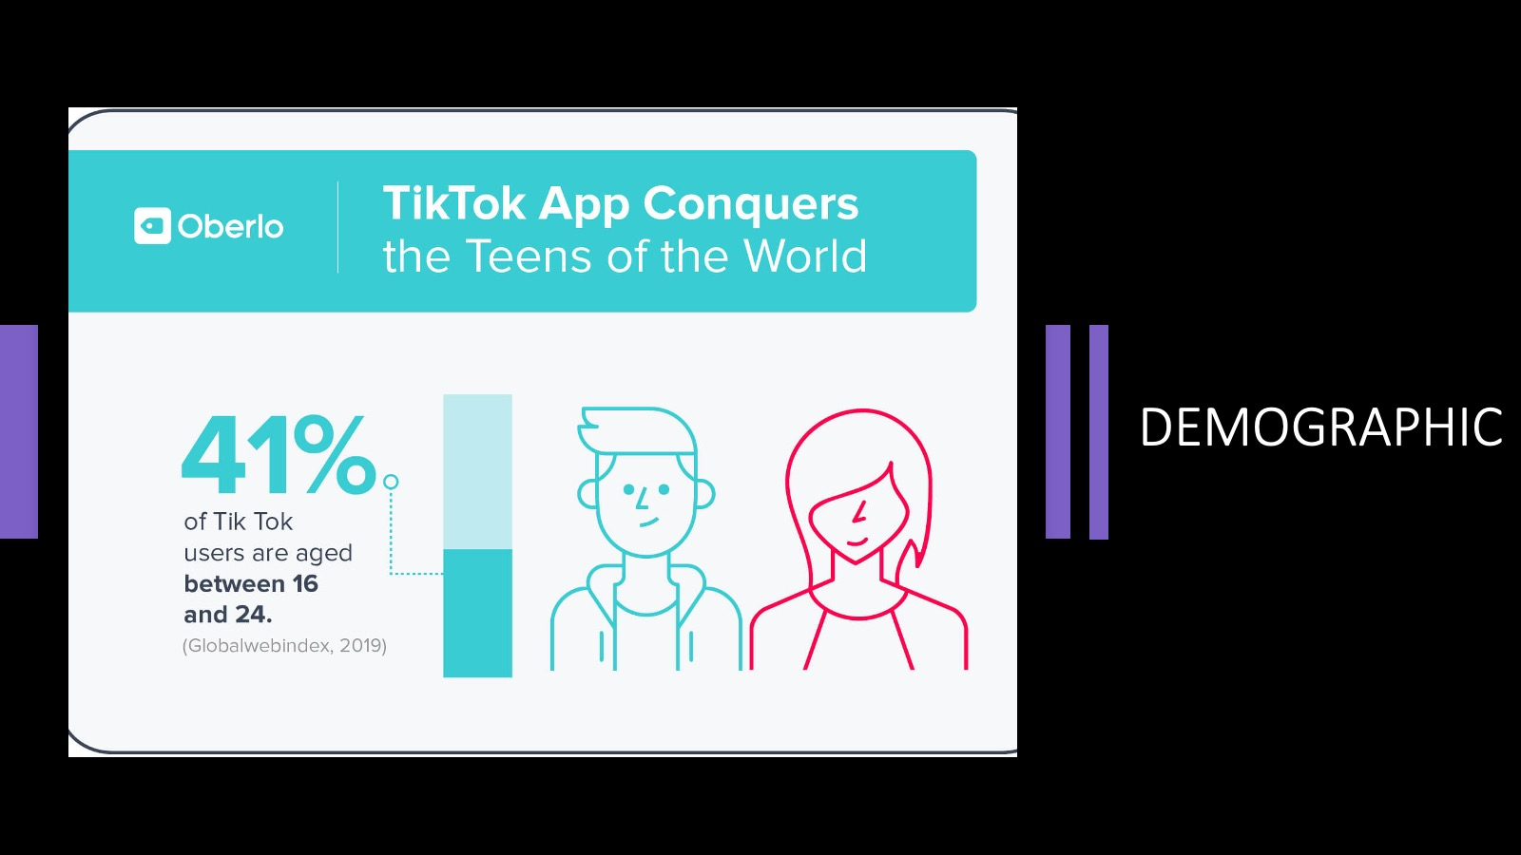

Slide 79


Slide 80
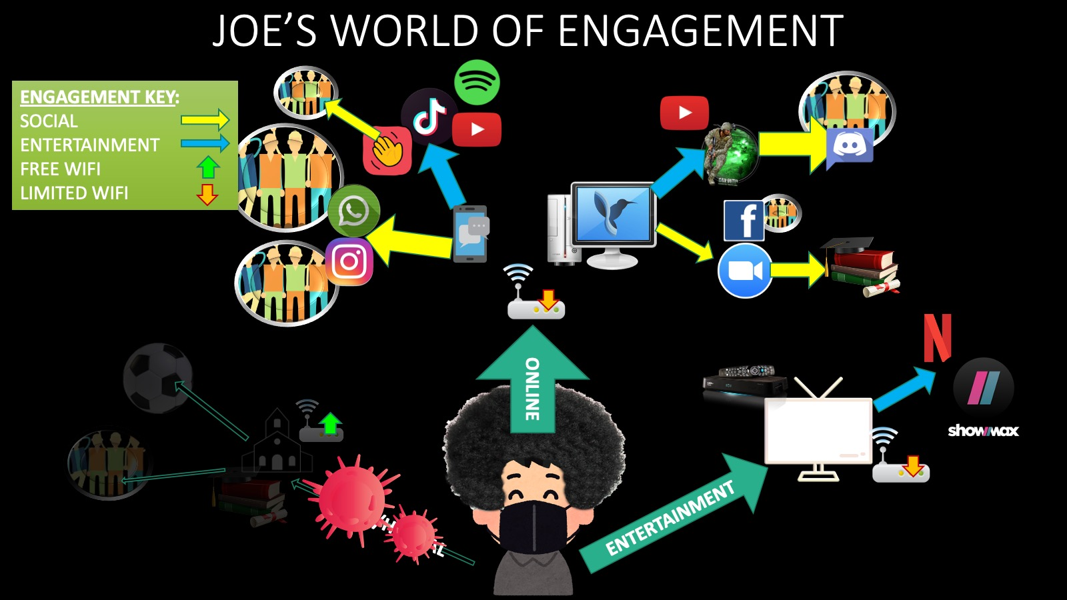

Slide 81
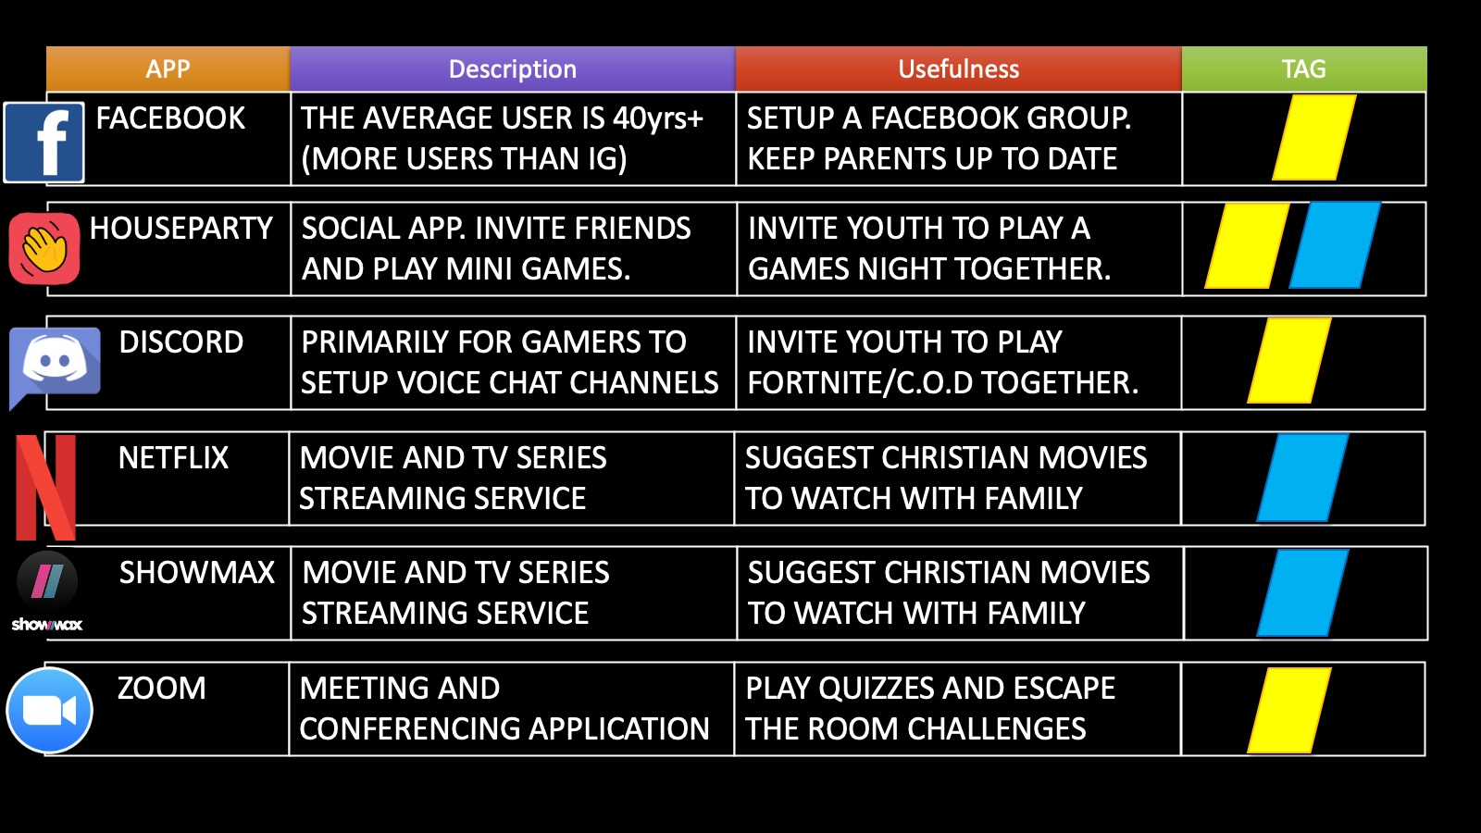

Slide 82


Slide 83
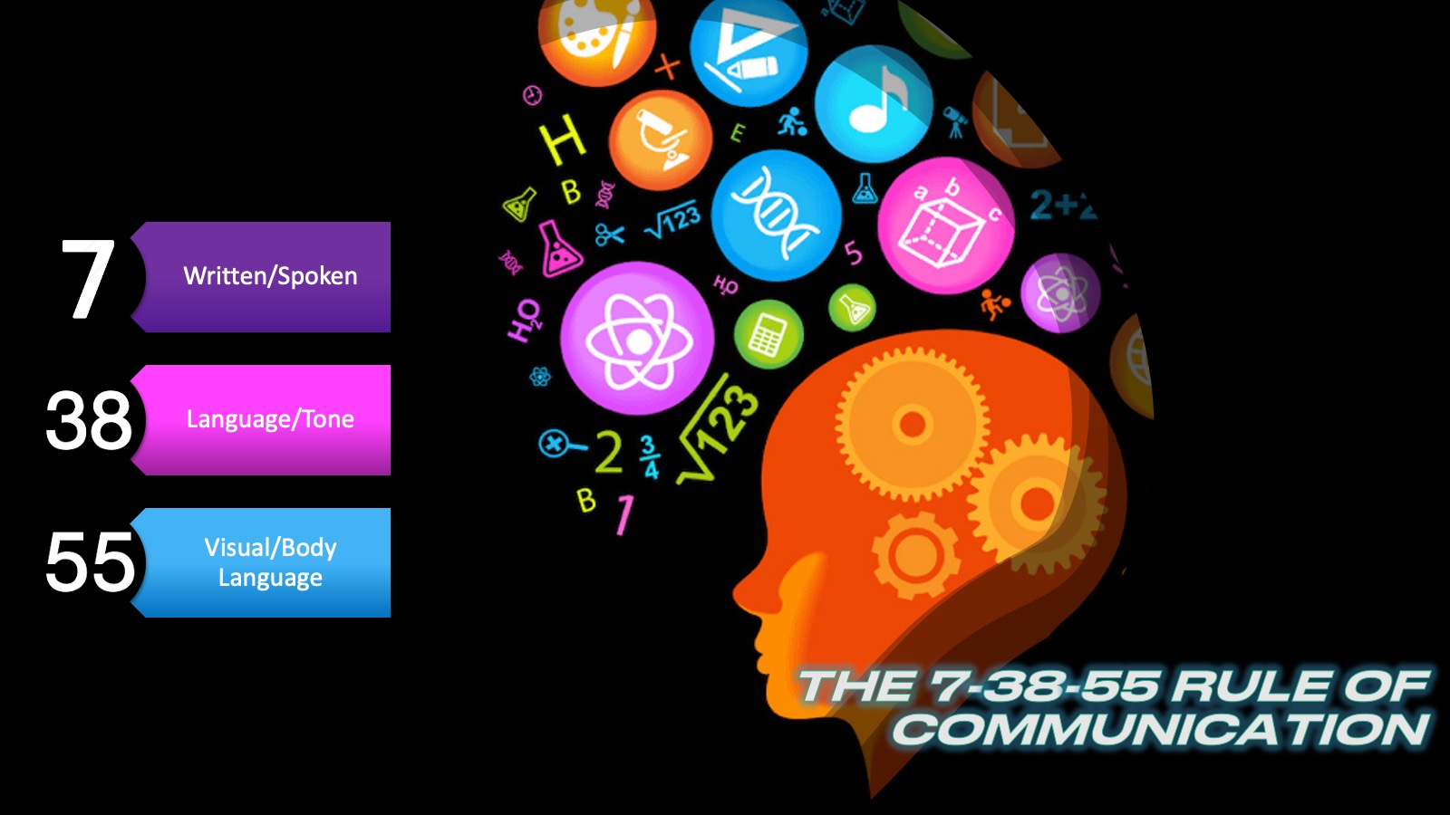

Slide 84
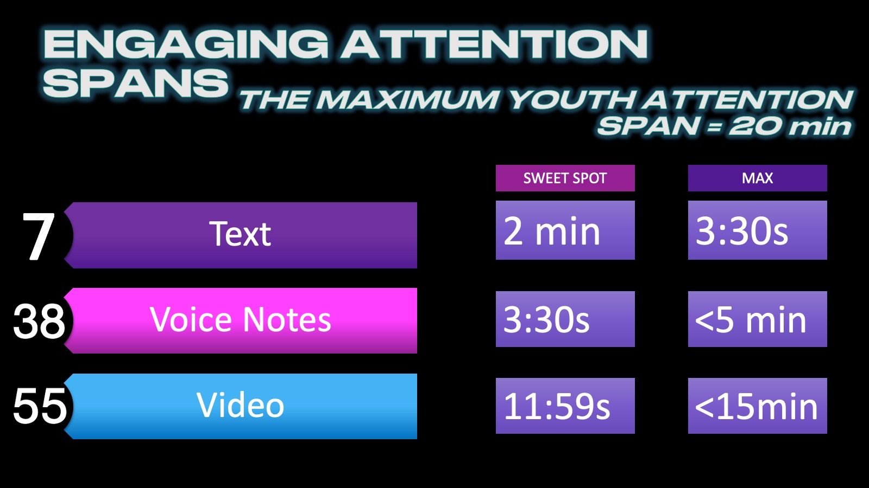

Slide 85


Slide 86


Slide 87

Notes:
Part 7: Closing Challenge (3 mins)
I am going to wrap up the session and share a final challenge with the delegates.
“Tell me and I forget, teach me and I may remember, involve me and I learn.”
This quote is attributed to Benjamin Franklin but was actually said by Xun Kuang who was a Chinese Confucian philosopher that lived from 312-230 BC.
The truth here is that being told something is fleeting, being taught something is more memorable, but learning something is unforgettable!
Make it your goal with all your teaching to ensure that life changing learning takes place!

