Slide 1
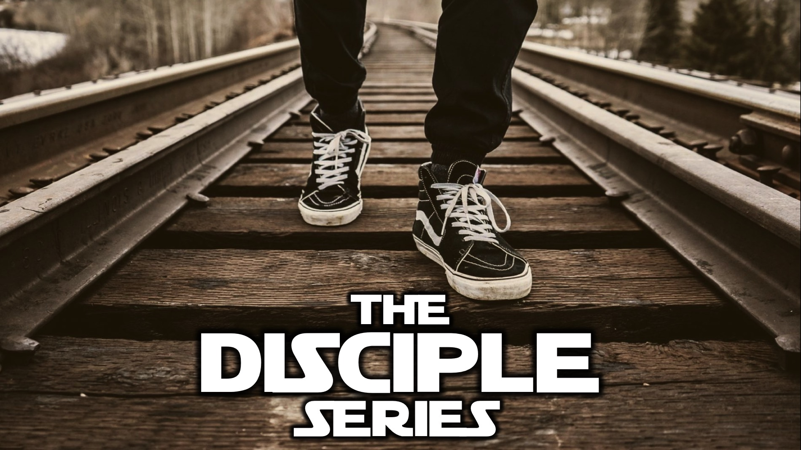
Notes:
Welcome to the Disciple Series. Here is a preview of the sessions in this series:

Slide 2
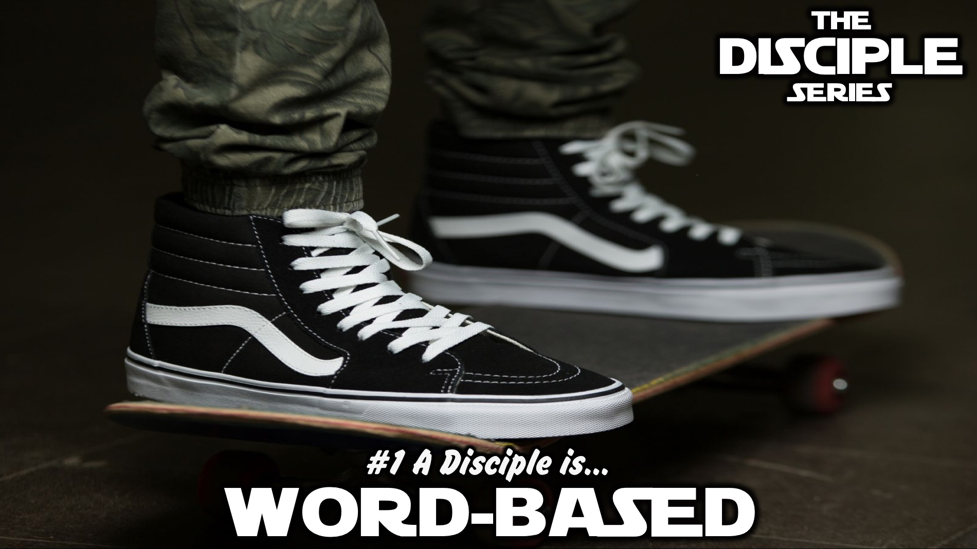
Notes:
In week 1 we will learn that a disciple is Word-based.

Slide 3
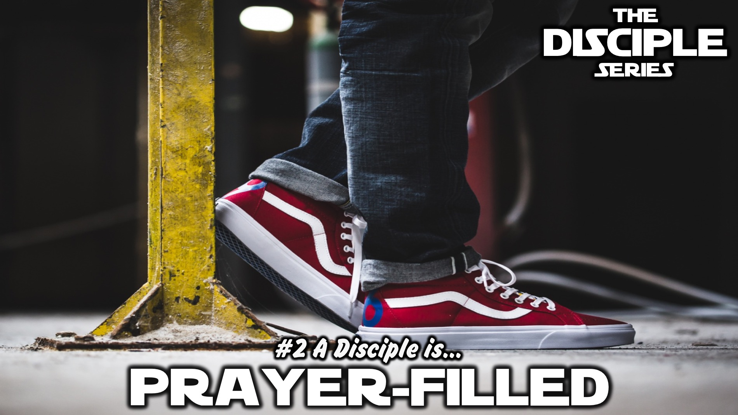
Notes:
In week 2 we will learn that a disciple is Prayer-filled.

Slide 4
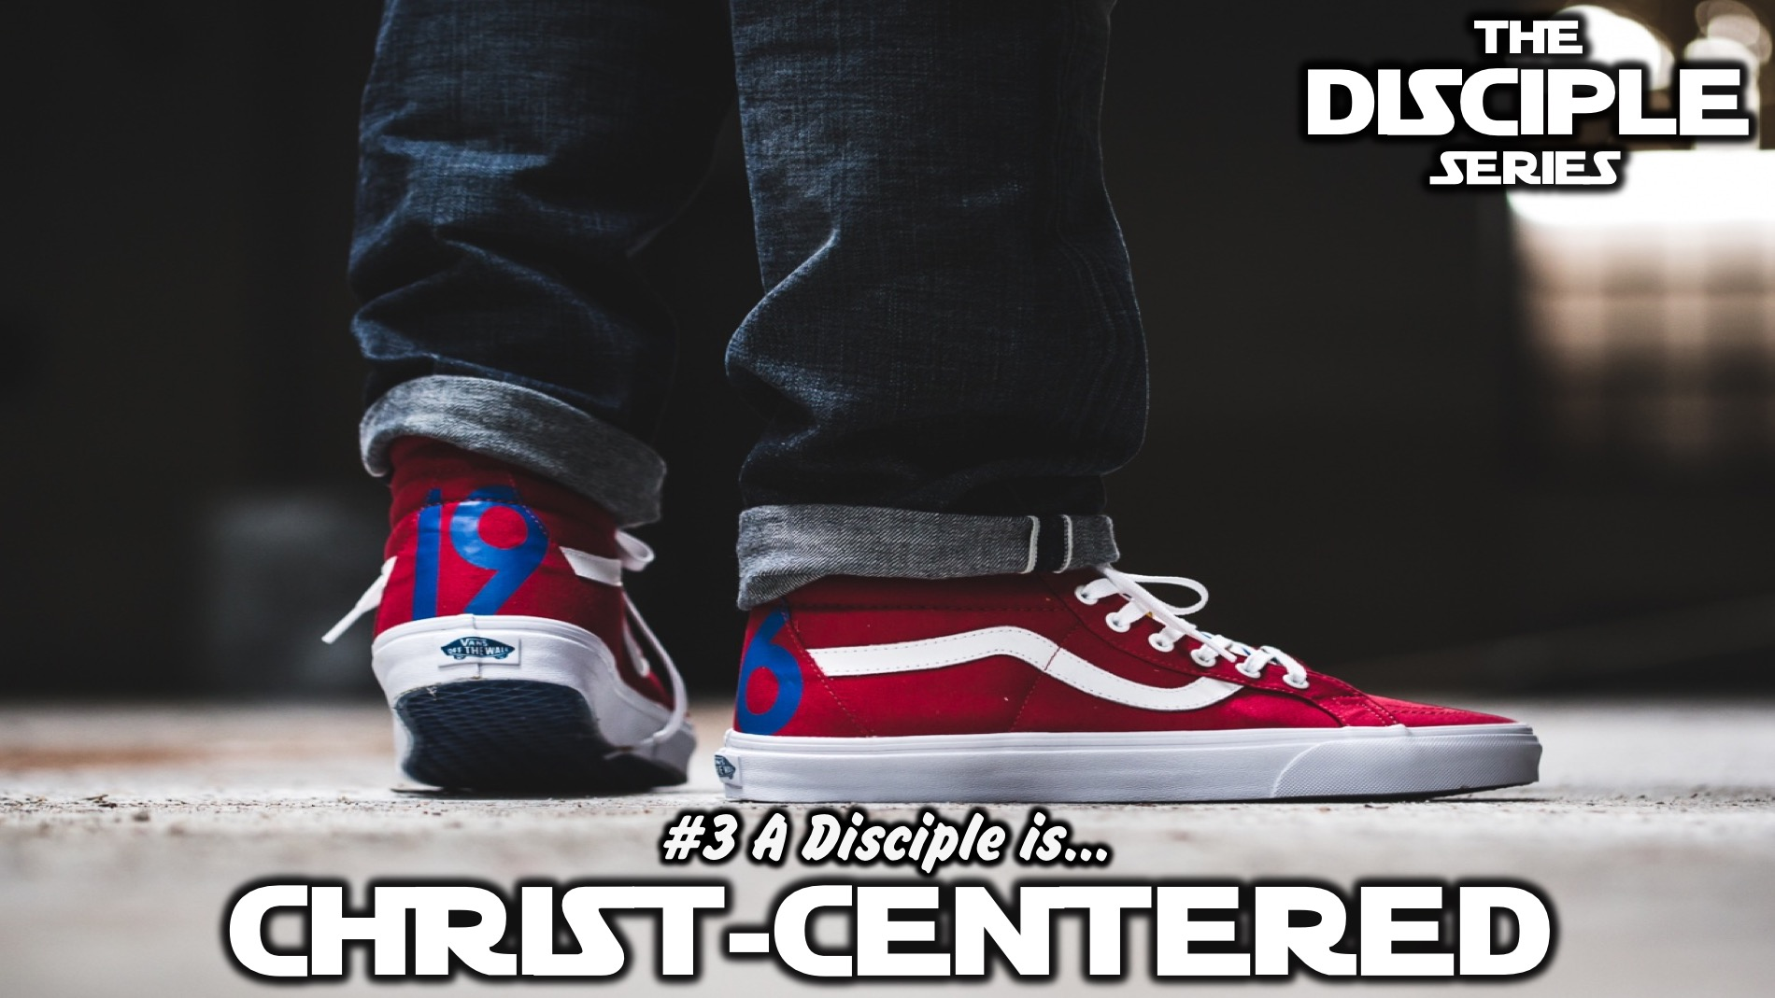
Notes:
In week 3 we will learn that a disciple is Christ-centered.

Slide 5
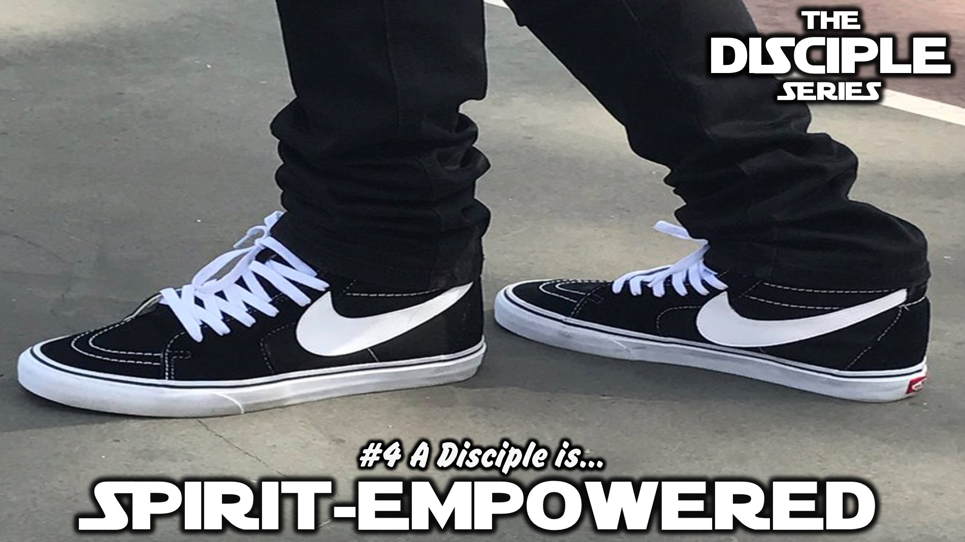
Notes:
In week 4 we will learn that a disciple is Spirit-empowered.

Slide 6
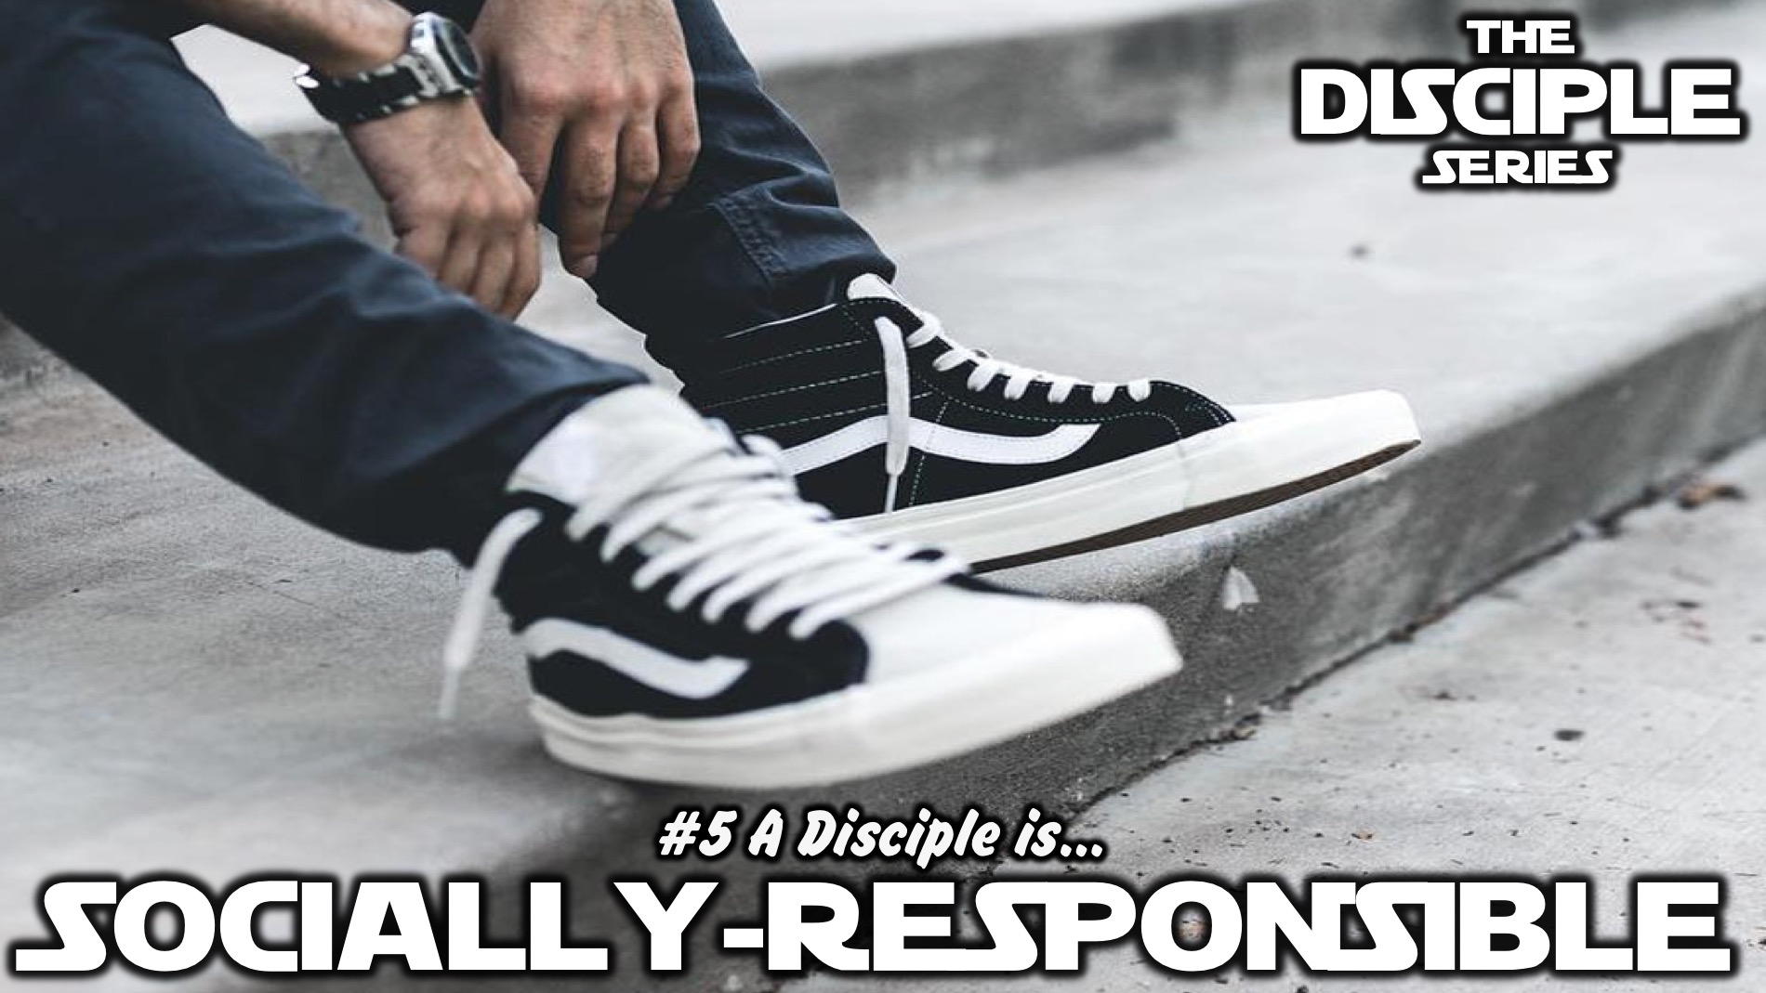
Notes:
In week 5 we will learn that a disciple is Socially-responsible.

Slide 7
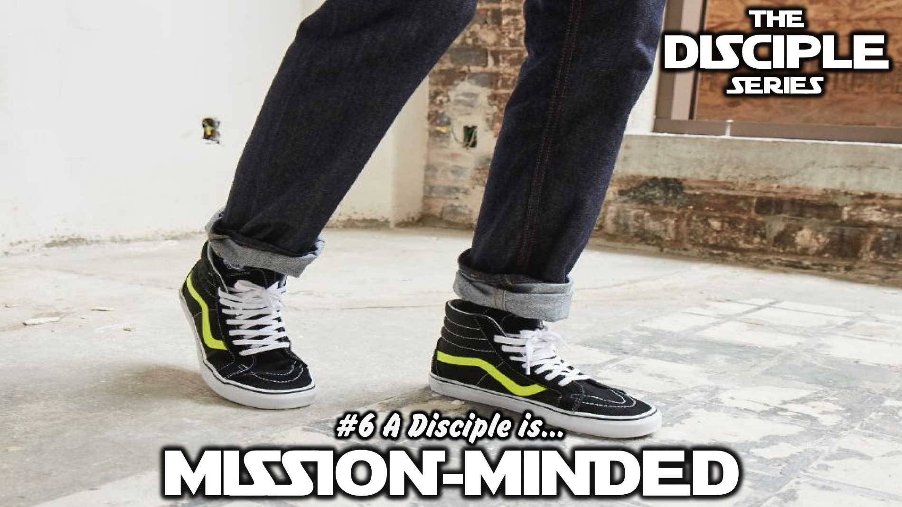
Notes:
In week 6 we will learn that a disciple is Mission-minded.

Slide 8
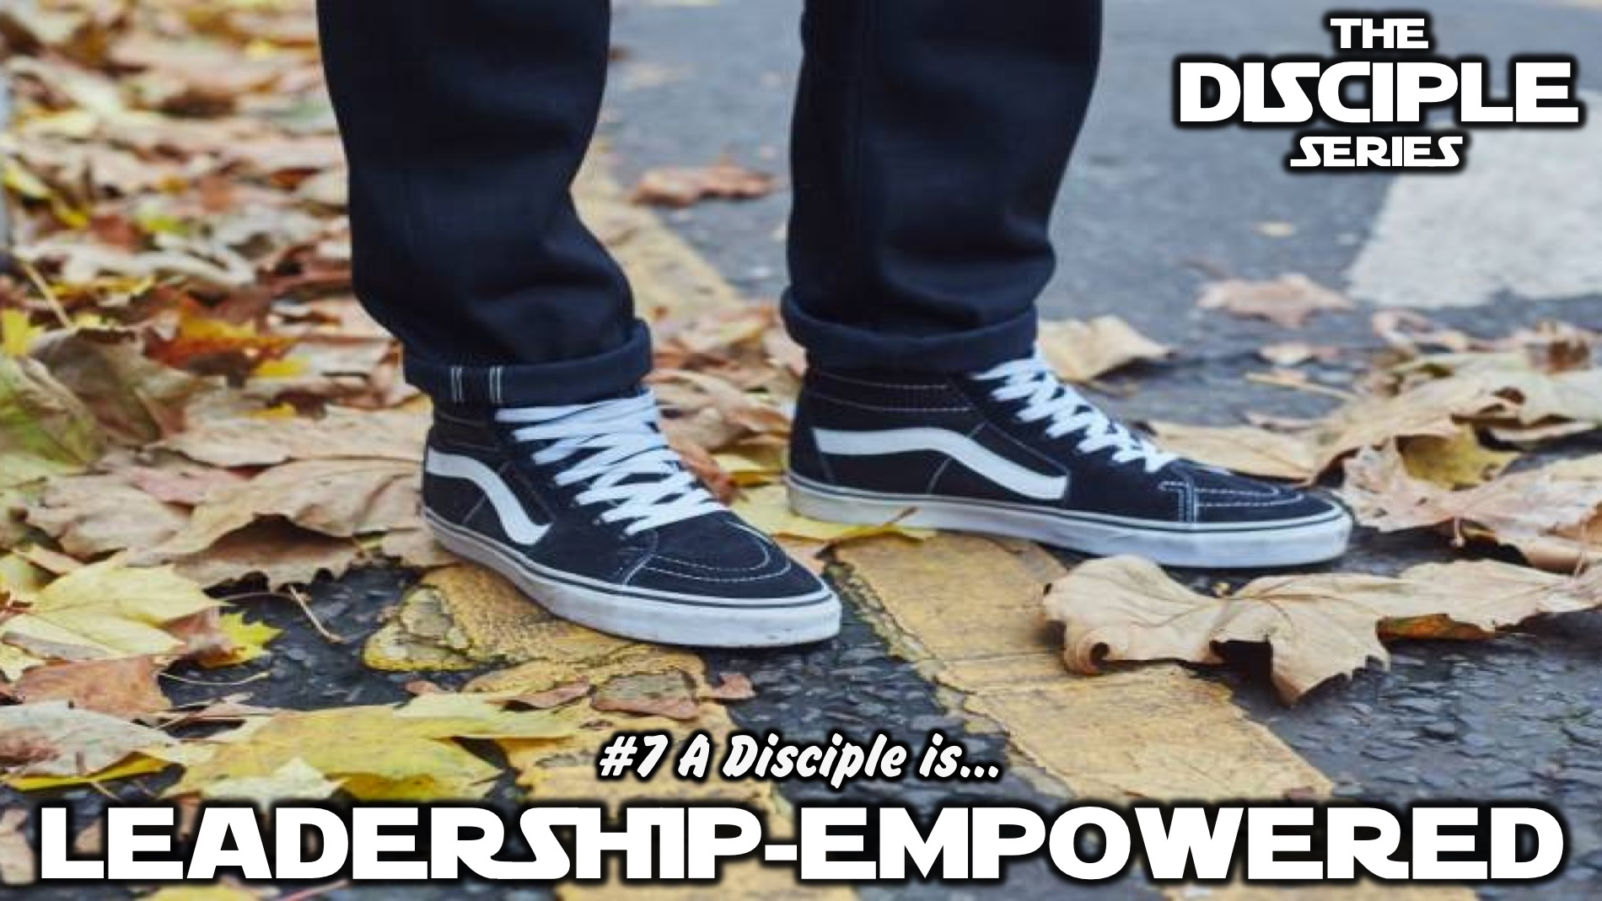
Notes:
In week 7 we will learn that a disciple is Leadership-empowered.

Slide 9
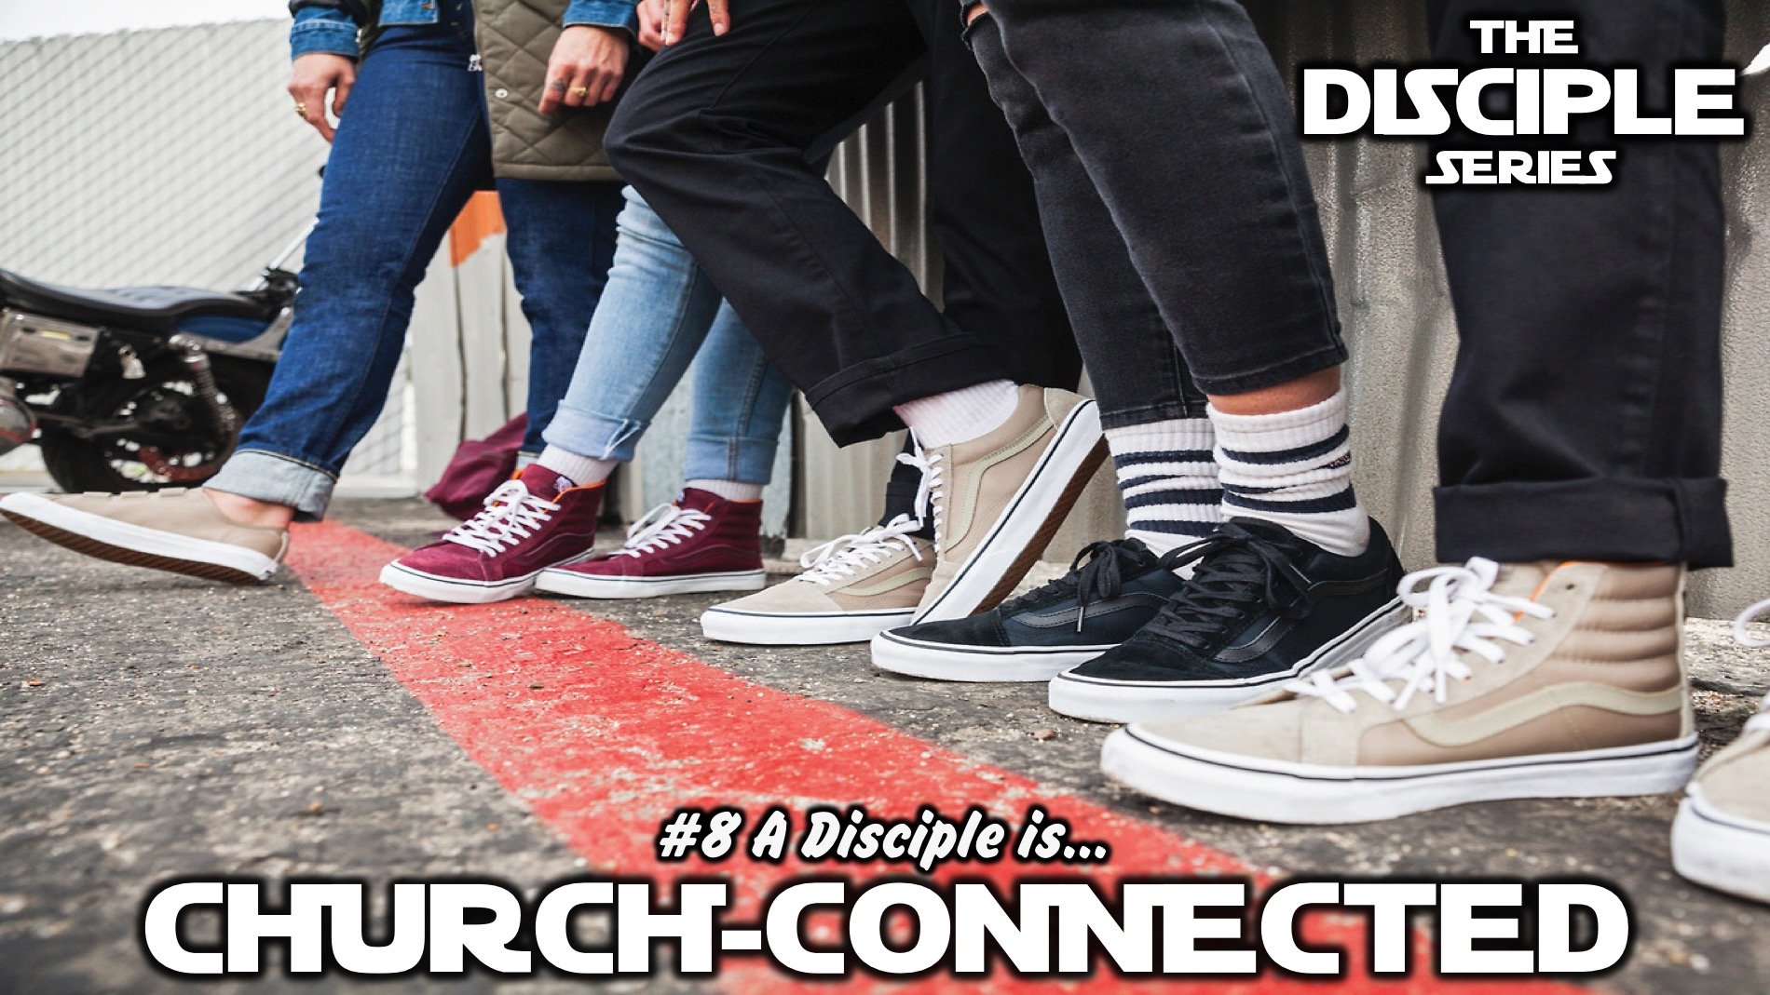
Notes:
In week 8 we will learn that a disciple is Church-connected.

Slide 10
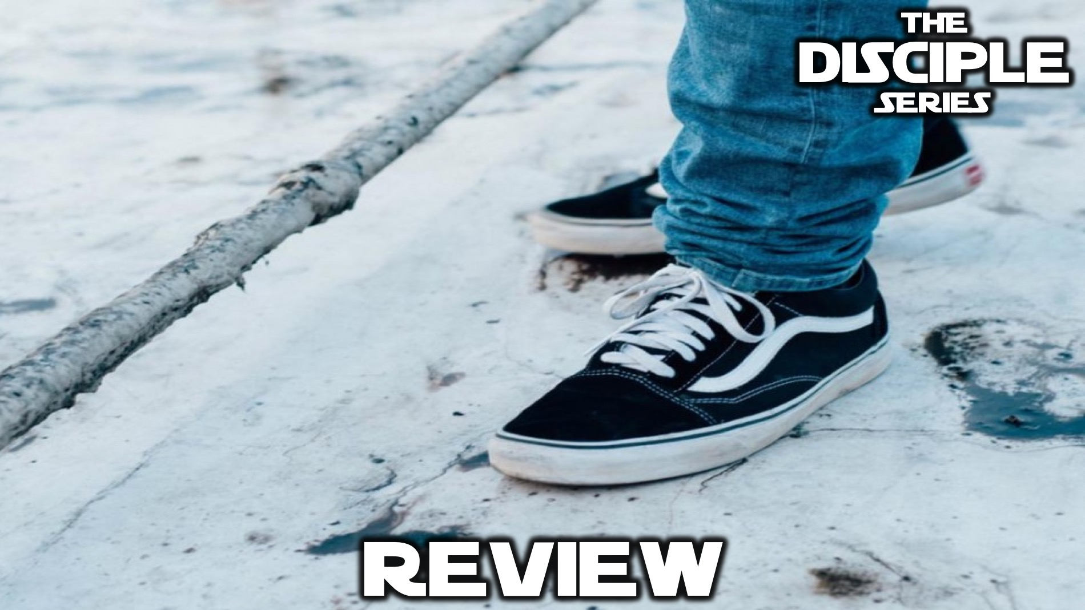
Notes:
In the final week we will review all that we have learnt.

Slide 11

Notes:
So fasten your seatbelts - this is the Disciple Series!

Slide 12
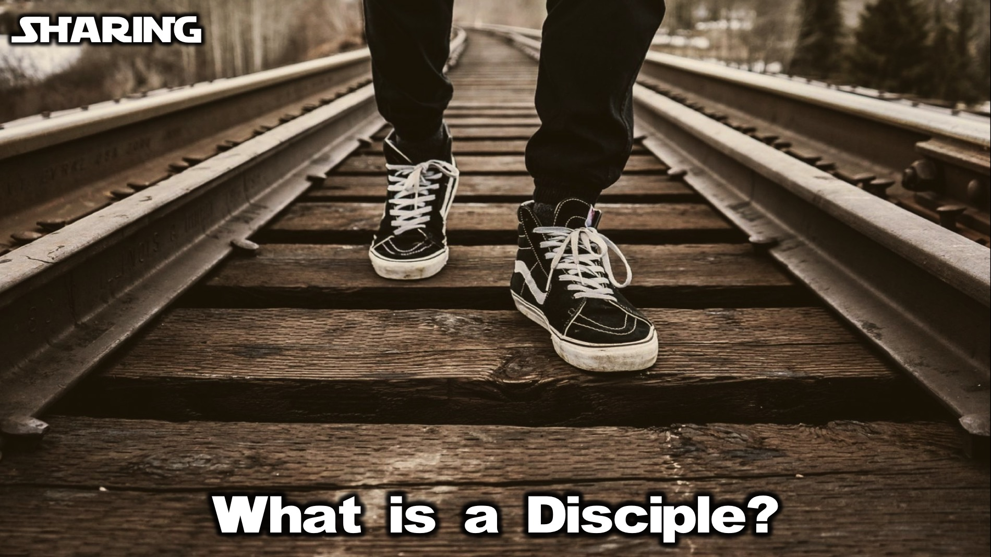
Notes:
But first, we need to answer this question: What is a Disciple? Turn to the person next to you and ask them to answer the question.

Slide 13
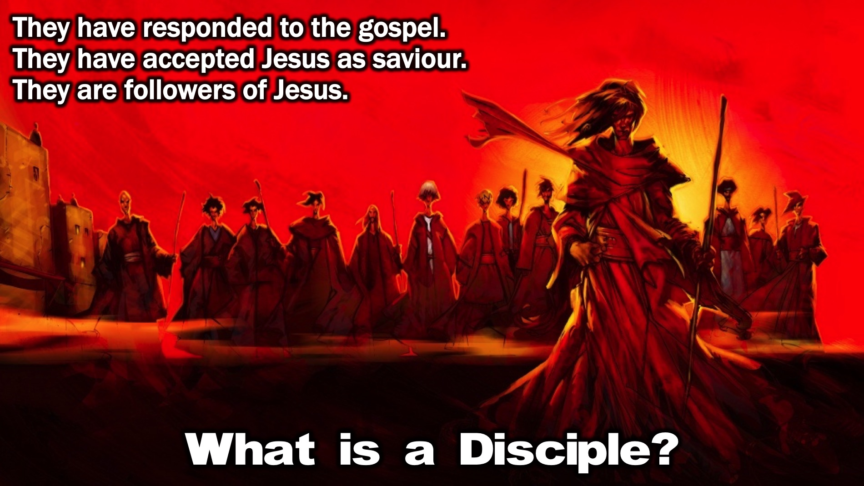
Notes:
A disciple is a follower of Jesus. They have responded to the Gospel message and have accepted Jesus as their Saviour and Lord and they have commited their lives to following Jesus!

Slide 14
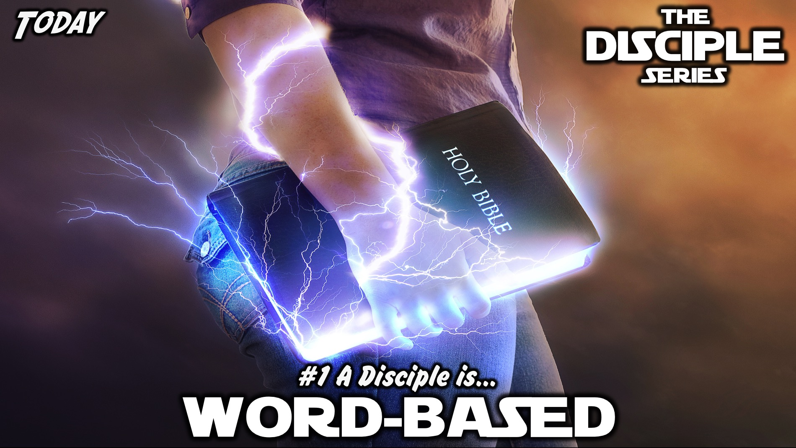
Notes:
Today we are going to learn how a disciple is Word-based.

Slide 15
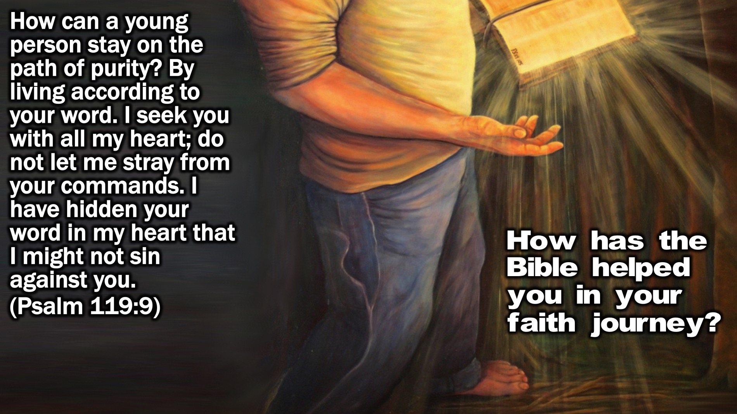
Notes:
Bible Passage: “How can a young person keep their way pure? By living according to your Word?” (Psalm 119:9)
Small Group Discussion: How has the Bible helped you in your faith journey?

Slide 16
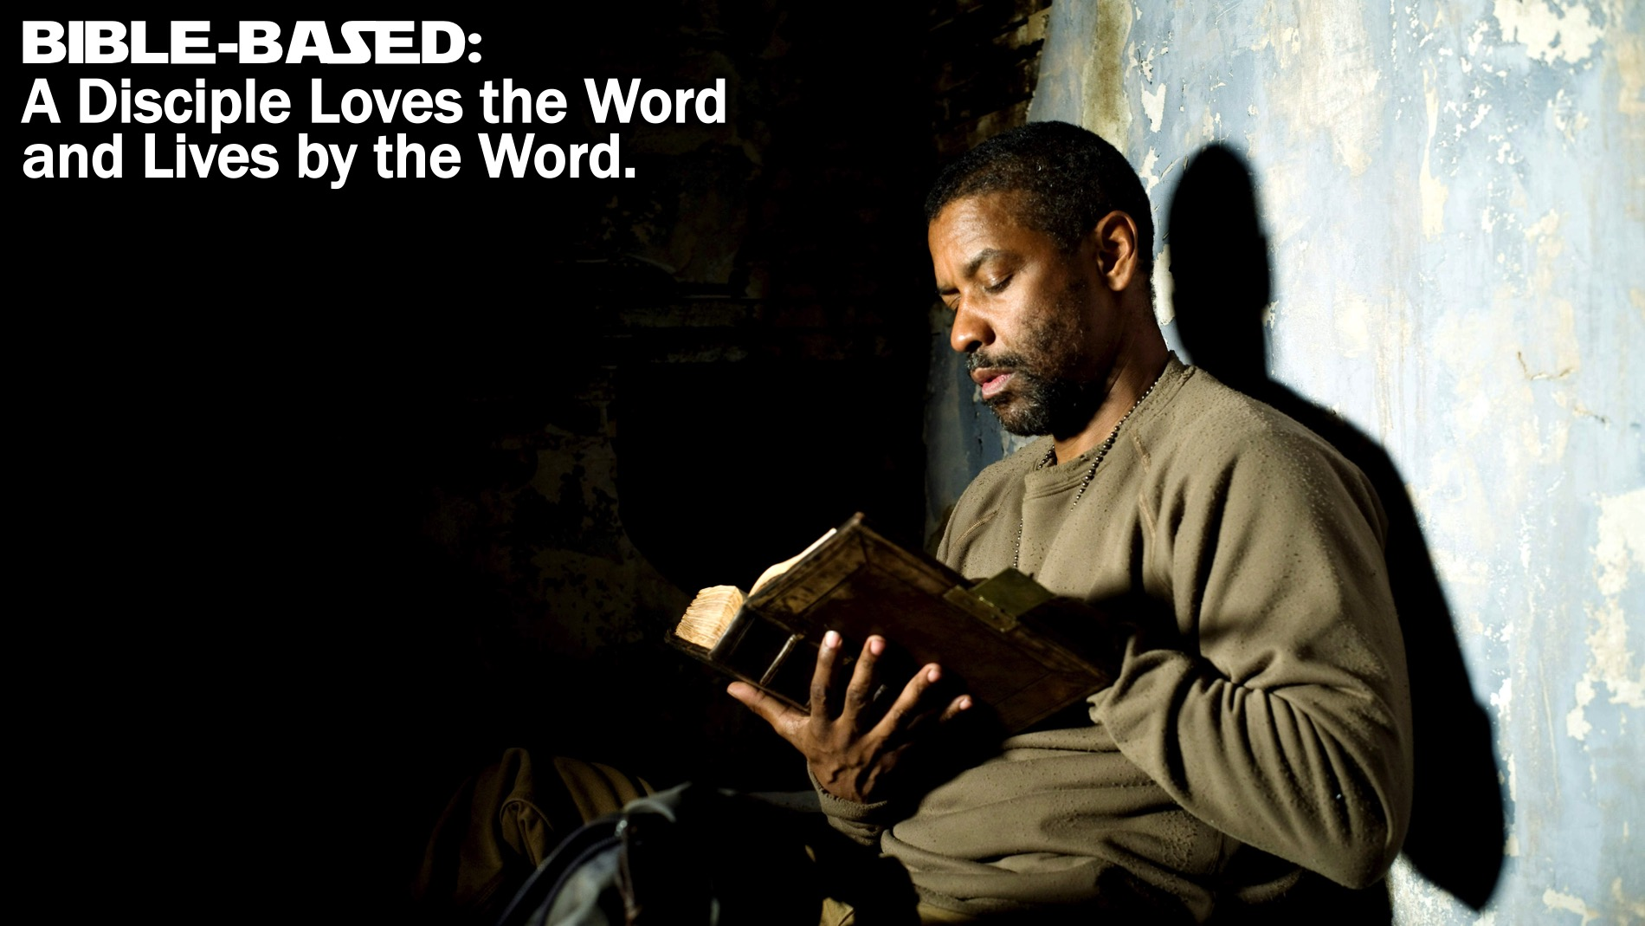
Notes:
Definition: Bible-based: A Disciple Loves the Word and Lives by the Word.

Slide 17
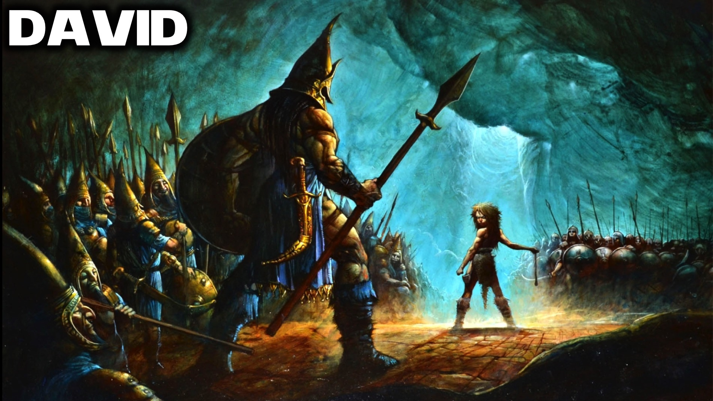
Notes:
Biblical Character: David

Slide 18
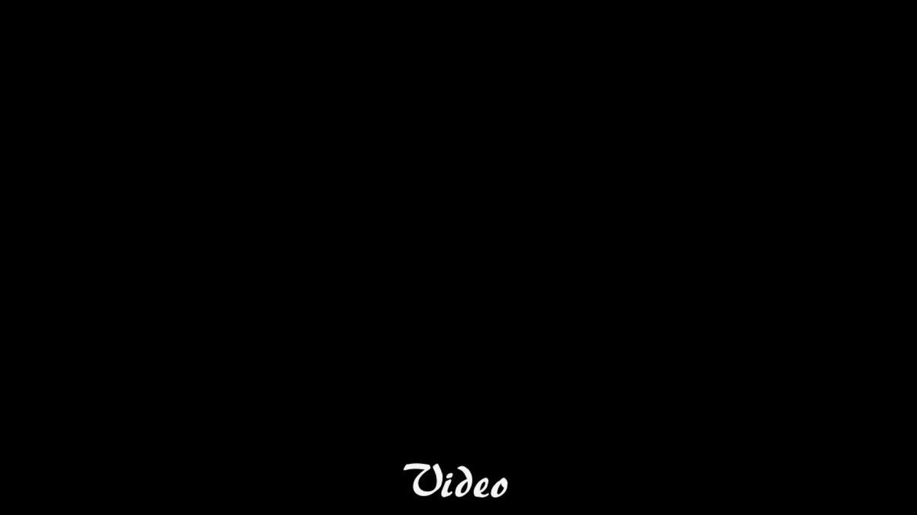
Notes:
Video: The Story of David and Goliath from The Bible Series on DVD, Disk 2, Episode 4 from 8:08 to 12:08.

Slide 19
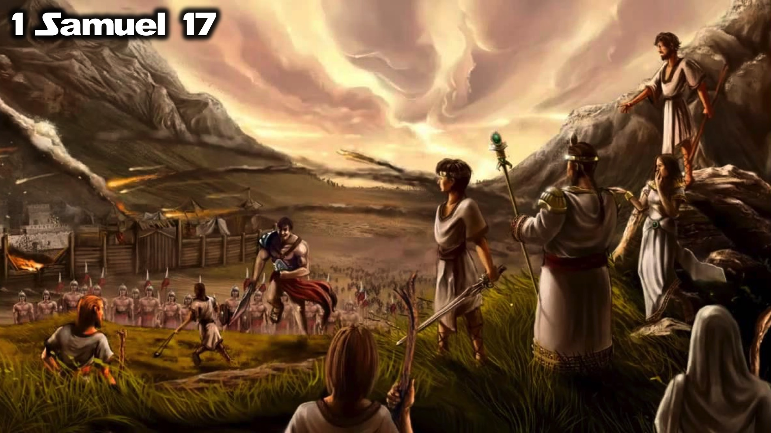
Notes:
The story of David volunteering to fight against a giant, Goliath, is found in 1 Samuel 17 - the Israelites are under attack from the Philistines and the two armies are facing each other with a valley between them.

Slide 20
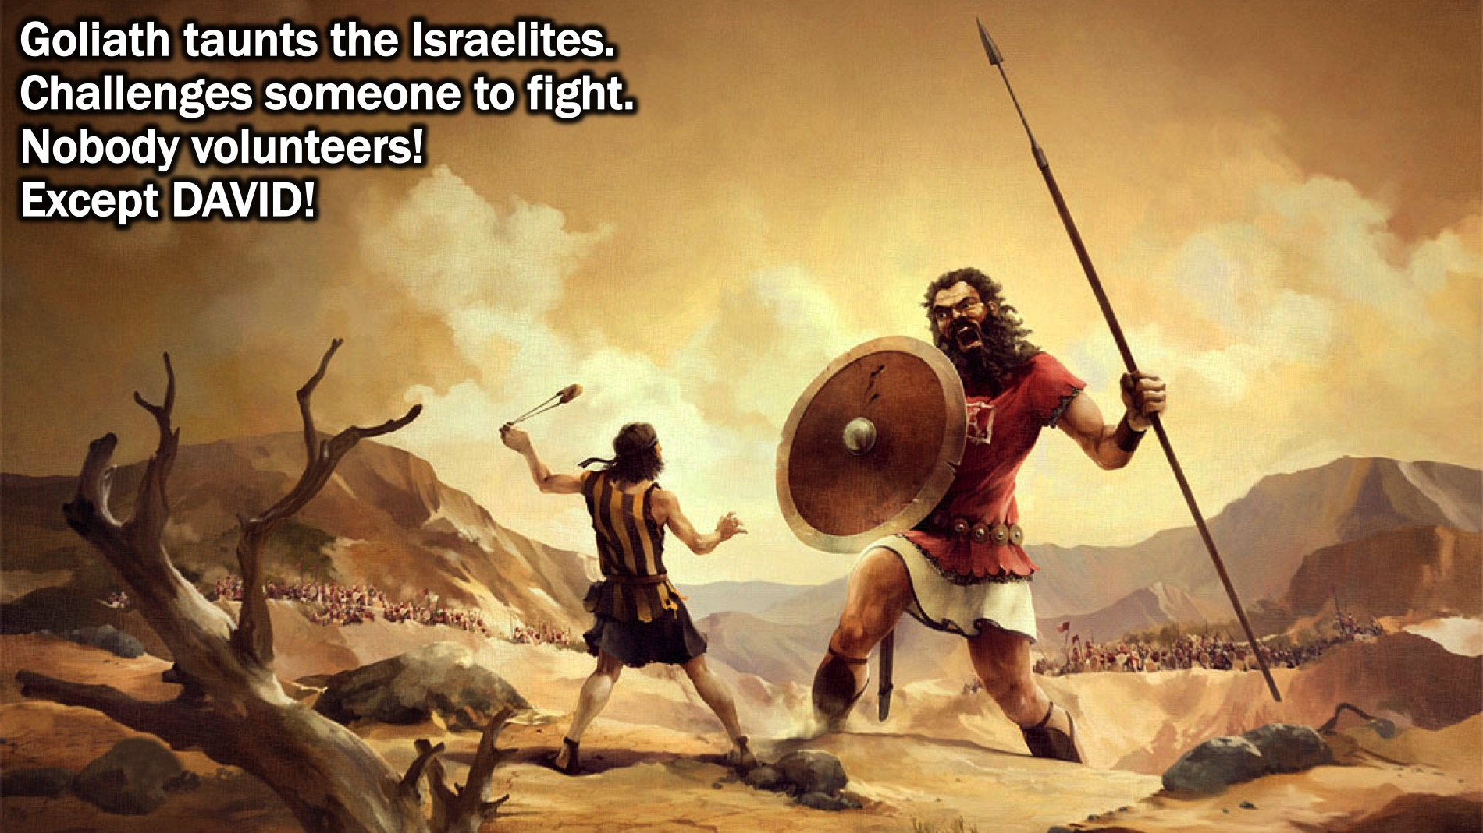
Notes:
Their top fighter, Goliath - a giant of a man - steps forward and taunts the Israelites to send someone out to fight him but they are too scared - until a young guy, David, steps forward and volunteers to fight against the giant.

Slide 21
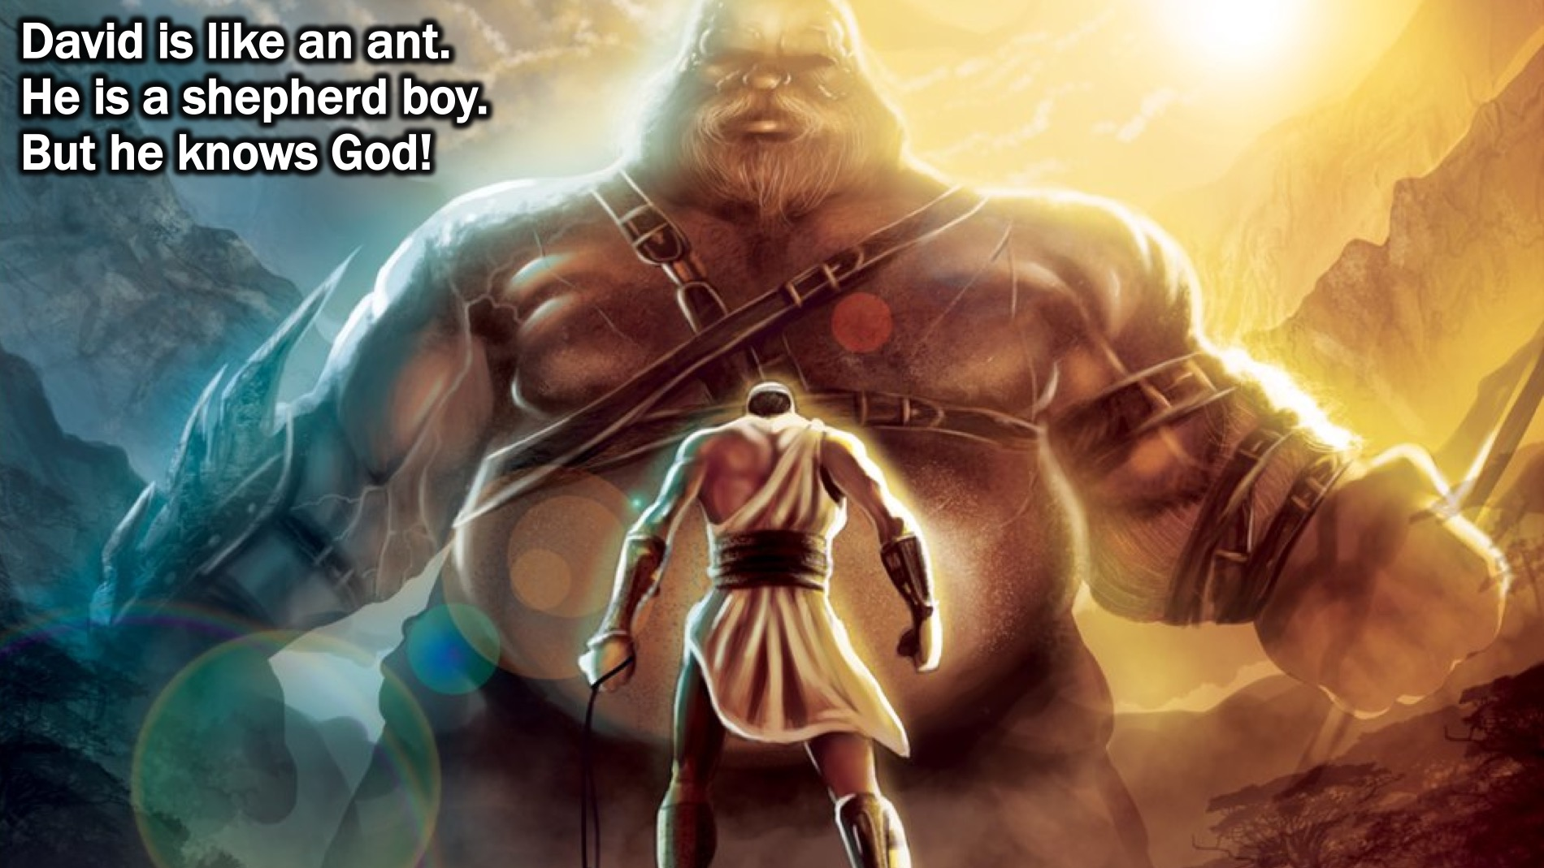
Notes:
David is like an ant next to Goliath - it looks crazy for David to do this - but David is a shepherd boy who has spent his life defending his sheep - he even killed a bear and a lion! And more than that - David is a man after God’s own heart - he has a personal replationship with God - he spends all his spare time talking to God and listening to God’s word and recording them in songs for future generations to know God’s Word! And God’s Word has given him courage to face even impossible odds!

Slide 22
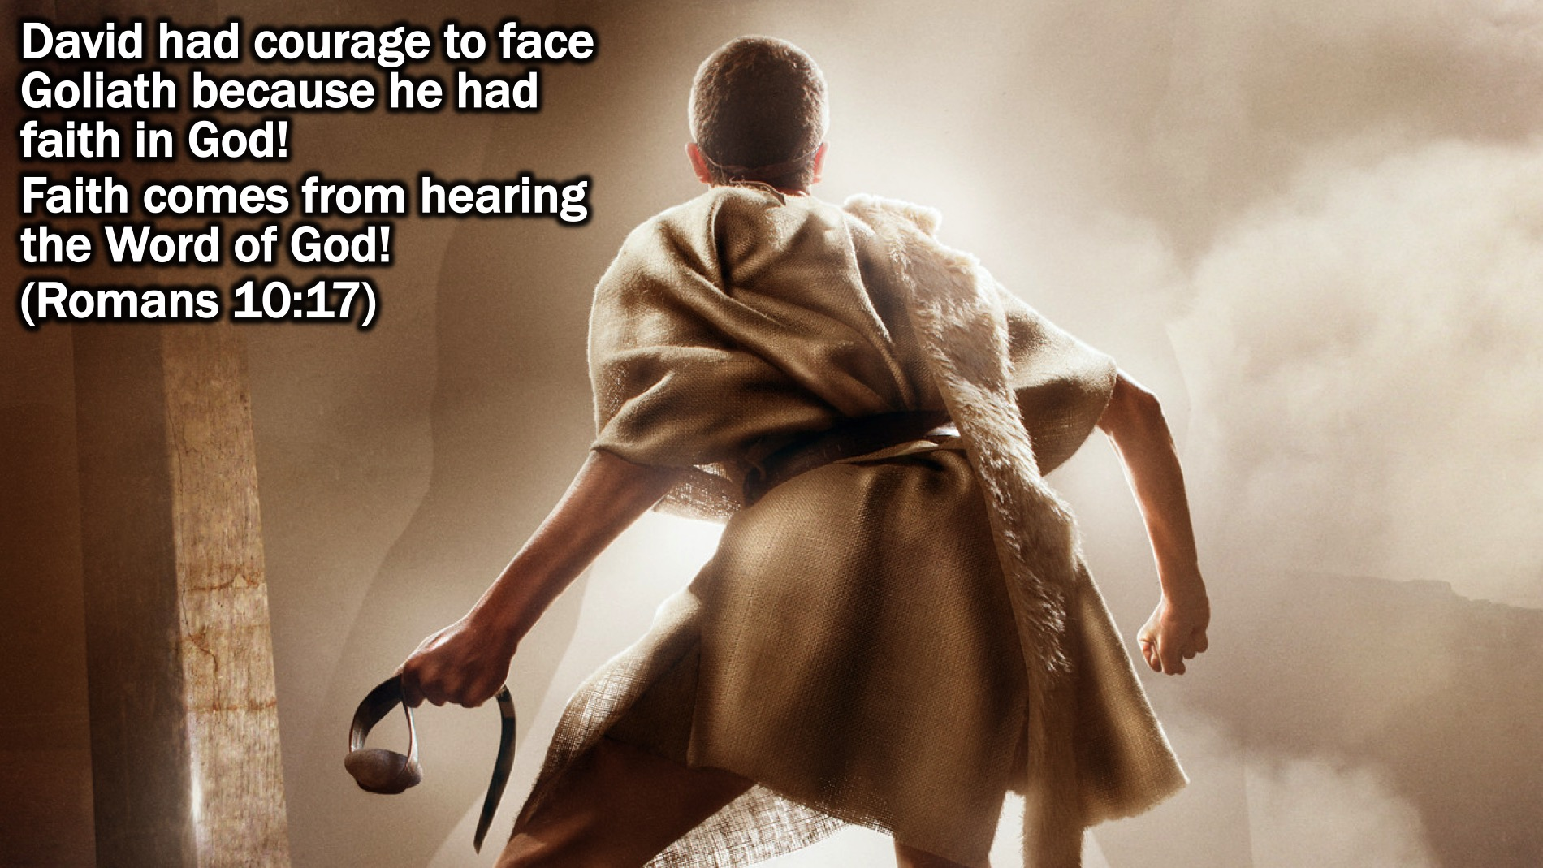
Notes:
David had courage to face Goliath because he had faith in God! Faith comes from hearing the Word of God! Romans 10:17)

Slide 23
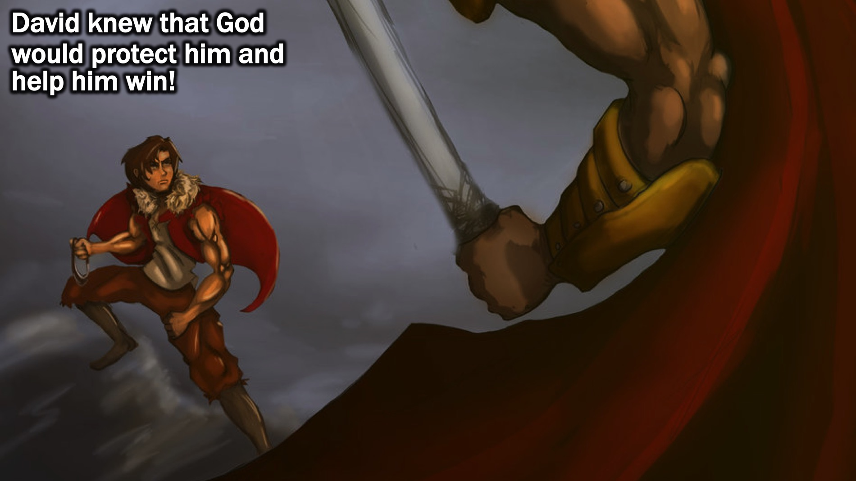
Notes:
David knew that God would protect him and help him win!

Slide 24
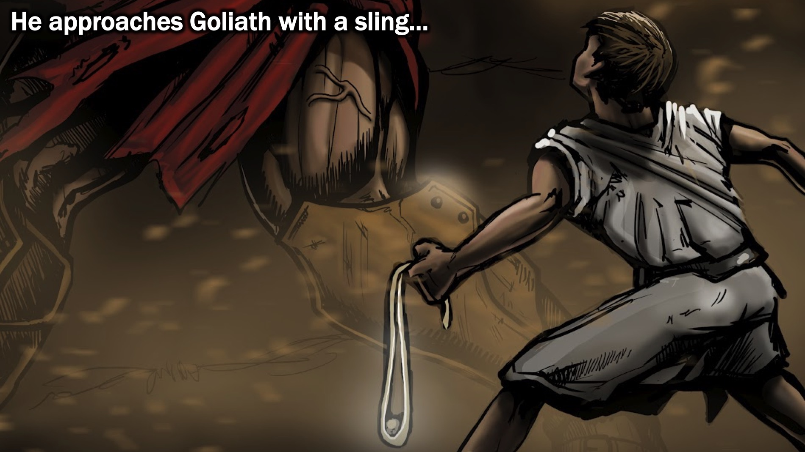
Notes:
He approaches Goliath with a sling…

Slide 25
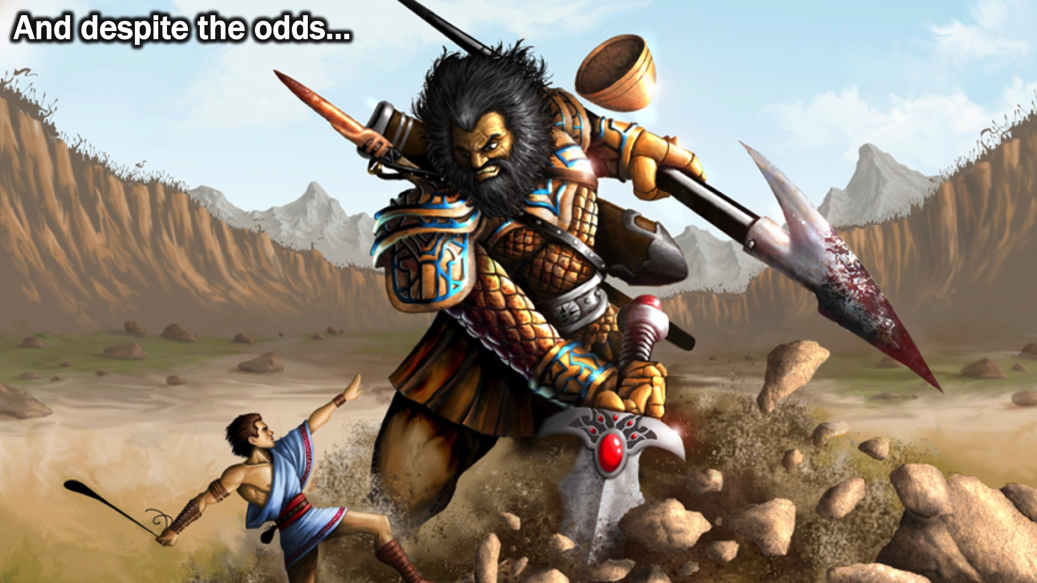
Notes:
And despite the odds…

Slide 26
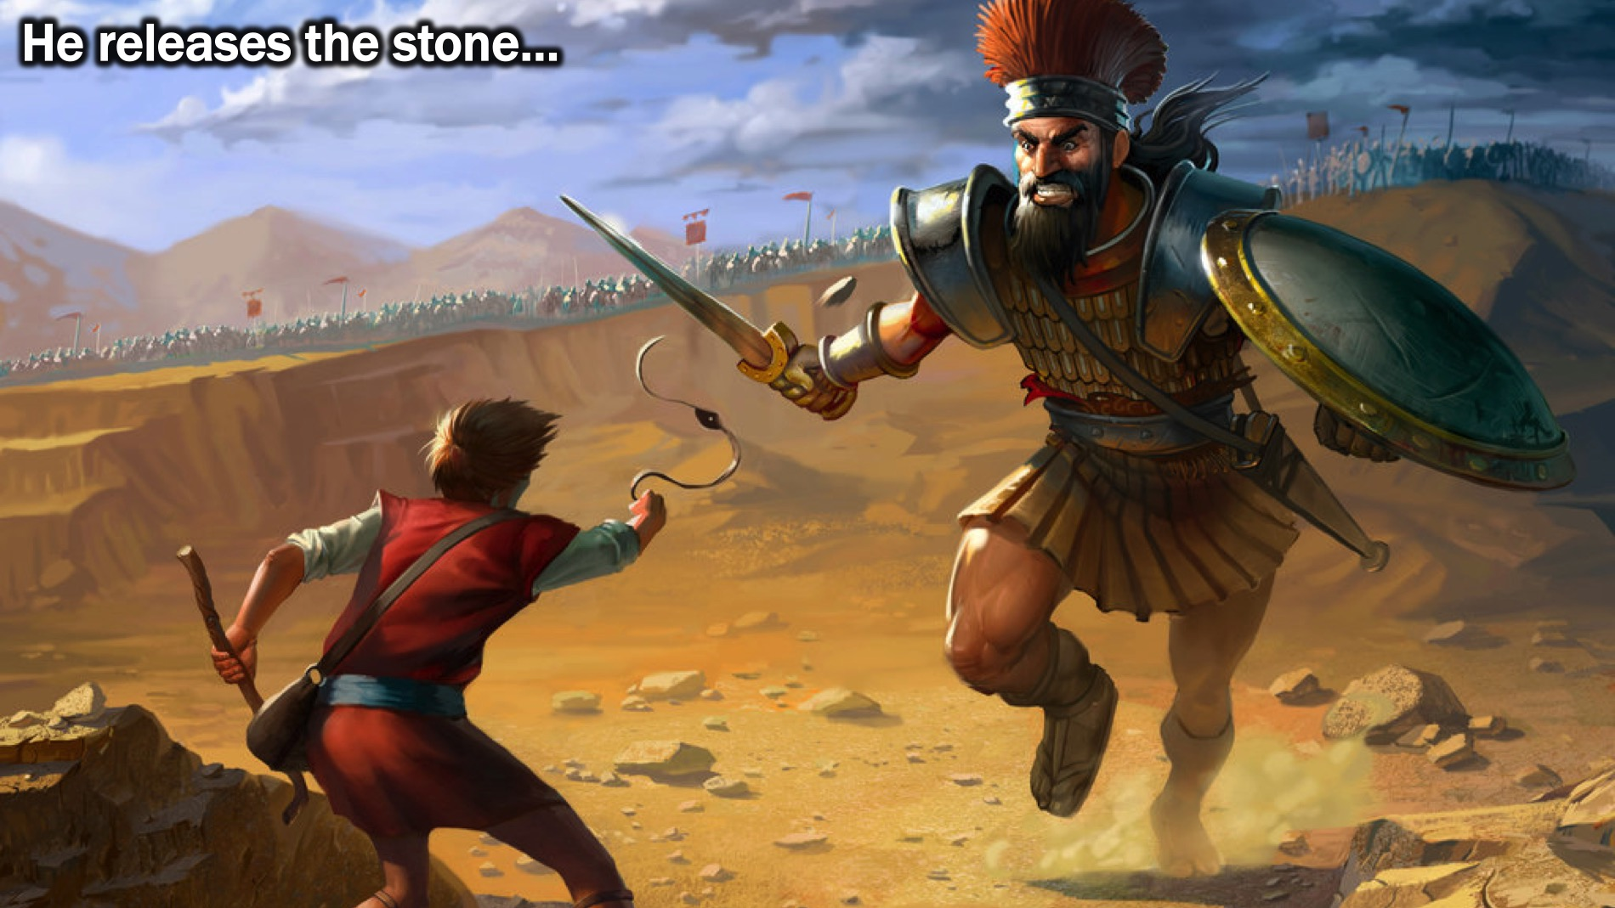
Notes:
He releases the stone…

Slide 27
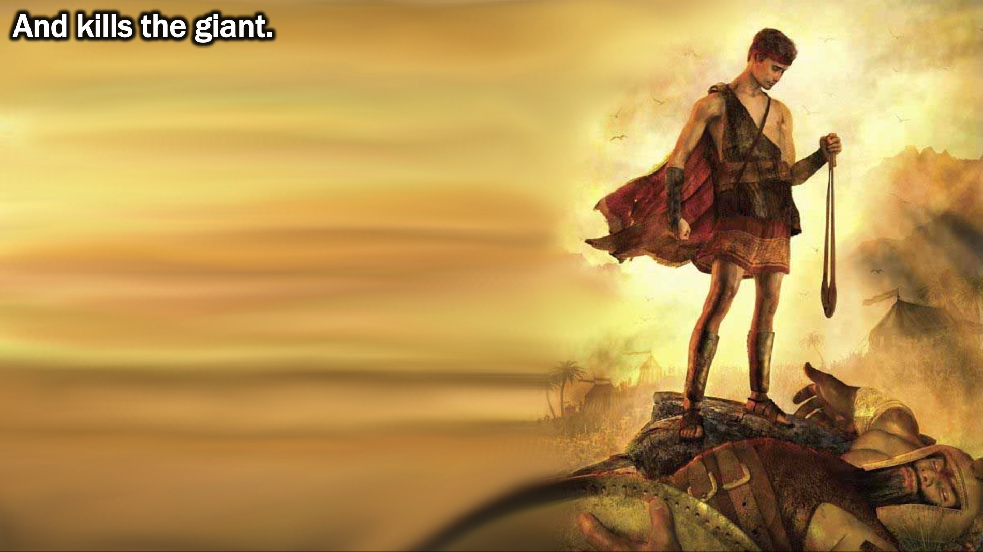
Notes:
And kills the giant.

Slide 28
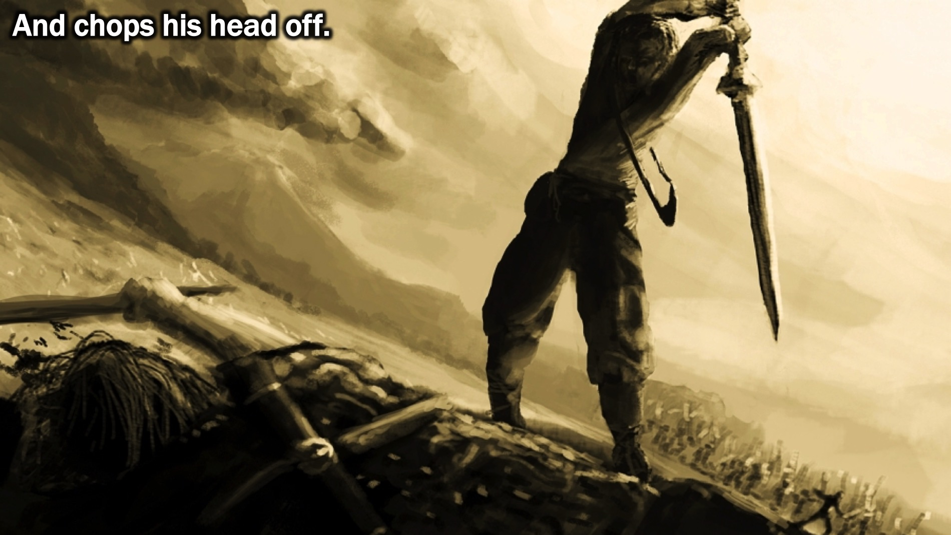
Notes:
And chops his head off!

Slide 29
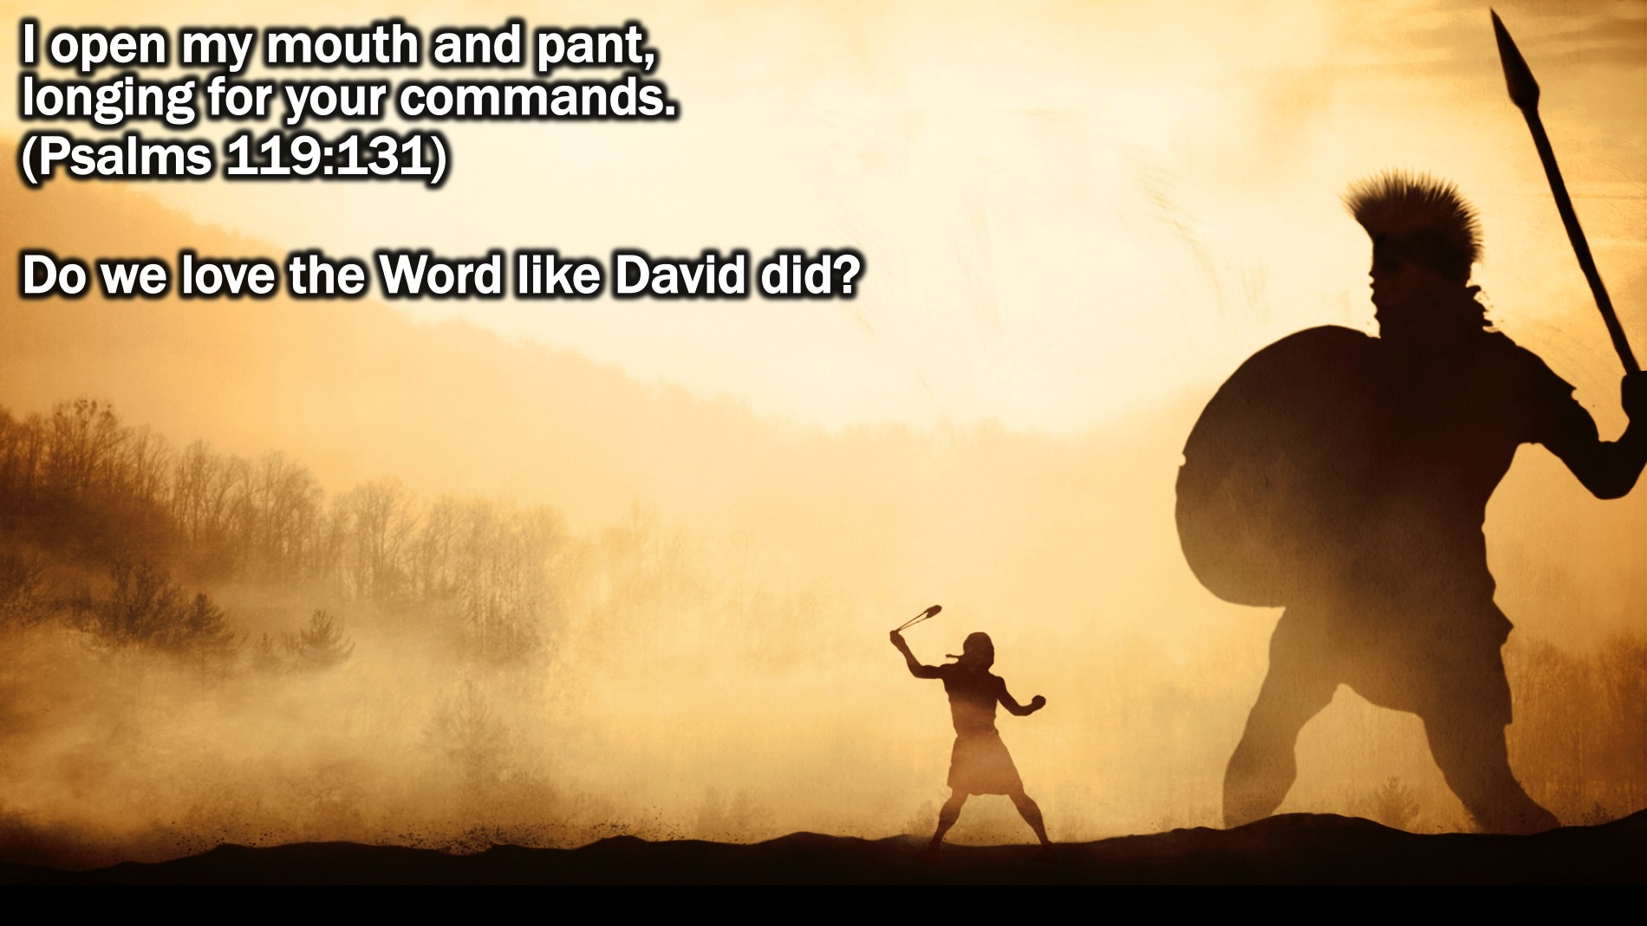
Notes:
Do we love the word like David? It wasn’t that David was some religious fanatic. He was a sinner like all of us. He was an adulterer, a murderer, one who trusted in armies rather than God - and yet God considered him a man after God’s own heart. Why? Because He followed hard after God’s heart, and that is the word of God. David panted for the word of God as the most precious food. David sought after the word of God as the most priceless treasure. David’s greatest love was for the word of God, the heart of God. David said: “I open my mouth and pant, longing for your commands.” (Psalms 119:131)

Slide 30
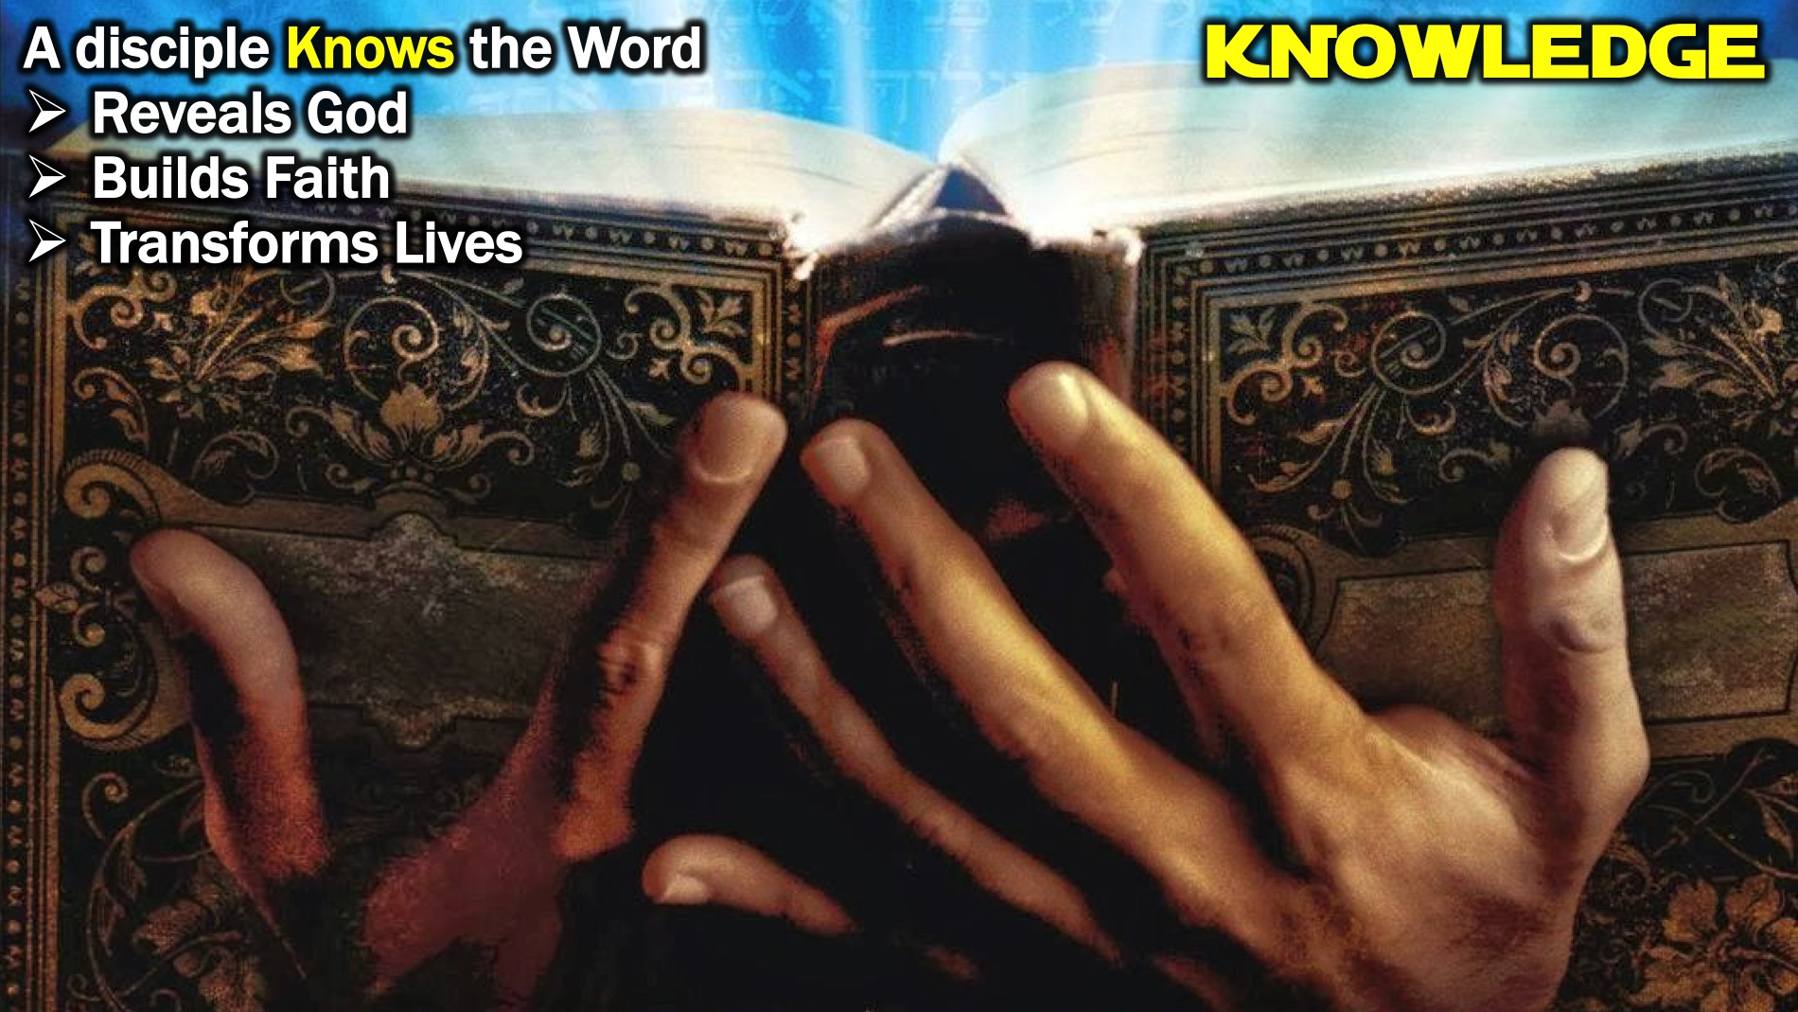
Notes:
Knowledge: A disciple knows the Word reveals God, builds faith and transforms lives.

Slide 31
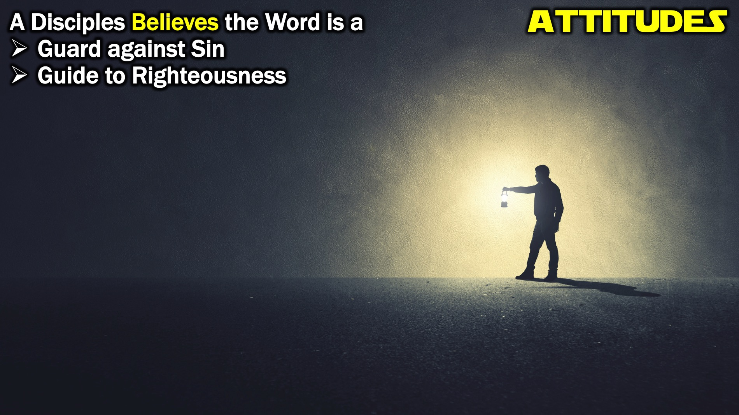
Notes:
Attitudes: A disciple believes the Word is a guard against sin and a guide to righteousness.

Slide 32
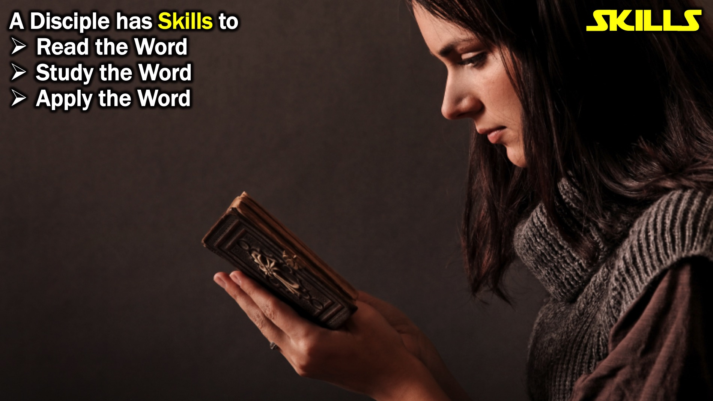
Notes:
Skills: A disciple has skills to read, study and apply the Word.

Slide 33
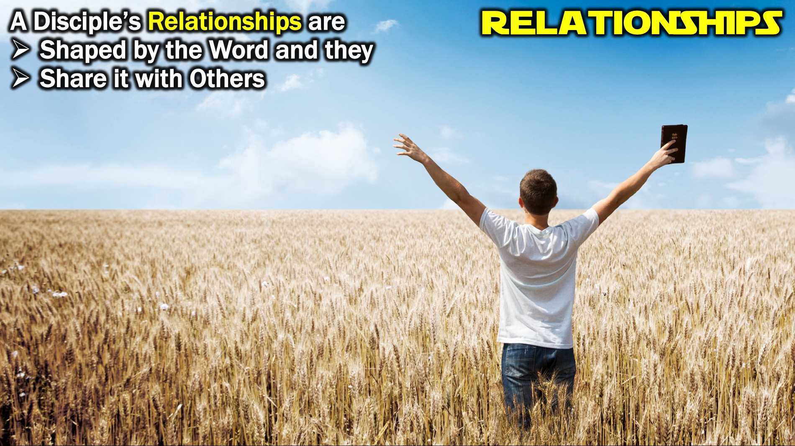
Notes:
Relationships: A disciple’s relationships are shaped by the Word and they share it with others.

Slide 34
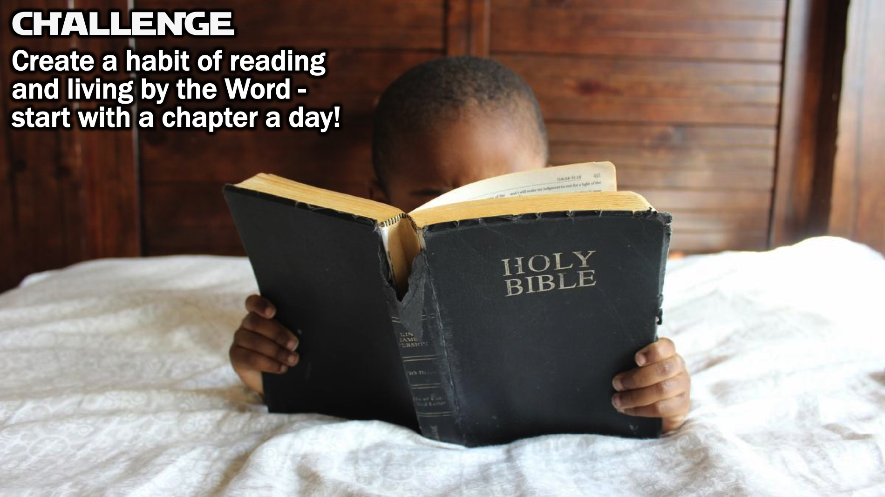
Notes:
Challenge: Create a habit in your life of reading and living by the Word! Start reading the Bible each day - just a chapter a day would be a great start!

Slide 35
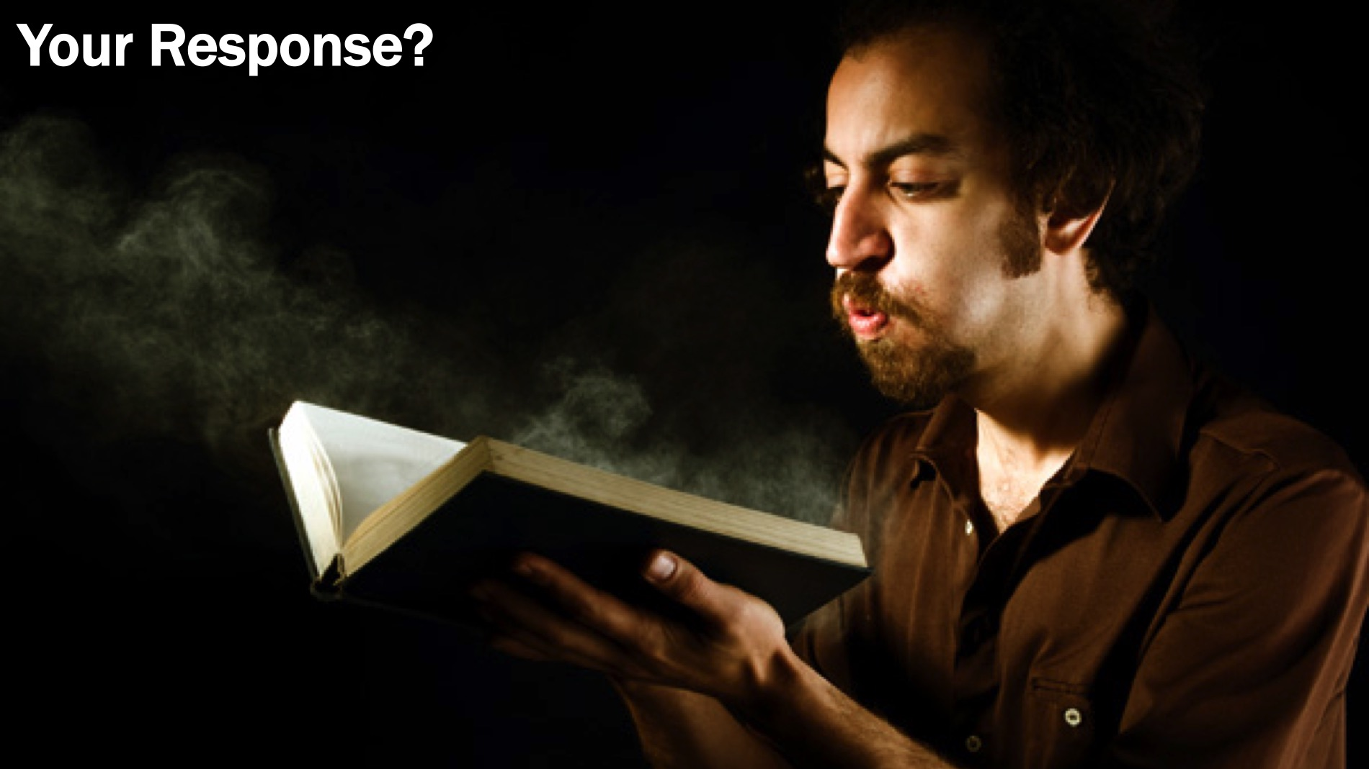
Notes:
So what will your response be to the message you have heard today?

Slide 36
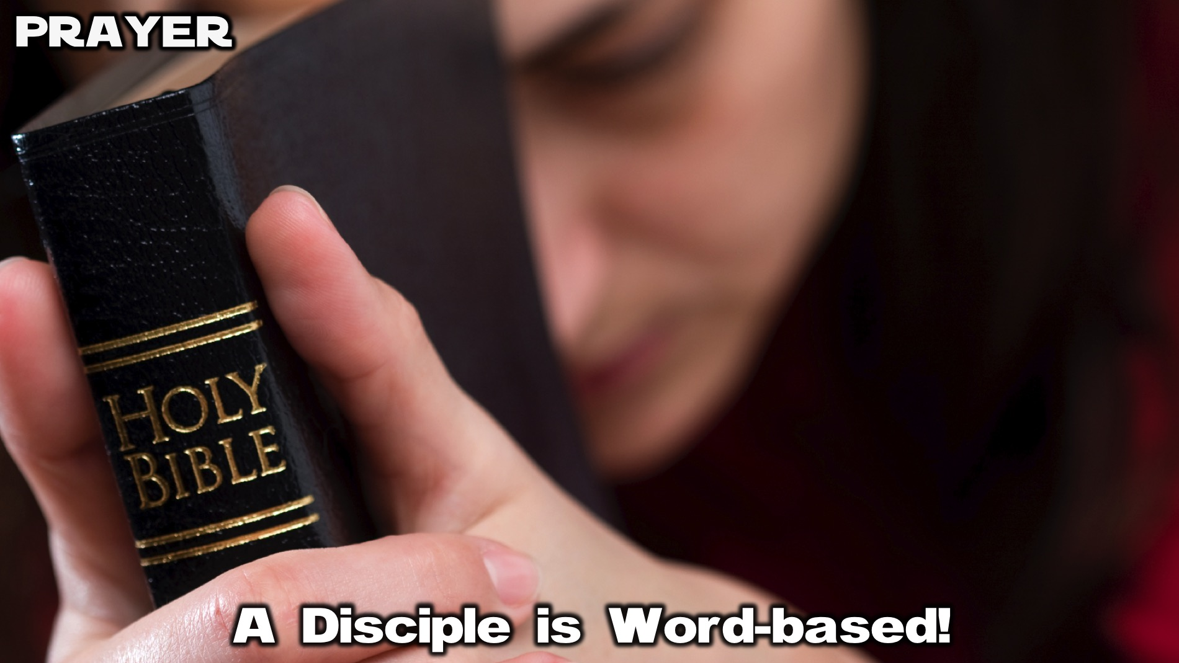
Notes:
Prayer: Let’s ask God to help us become Word-based.

Slide 37
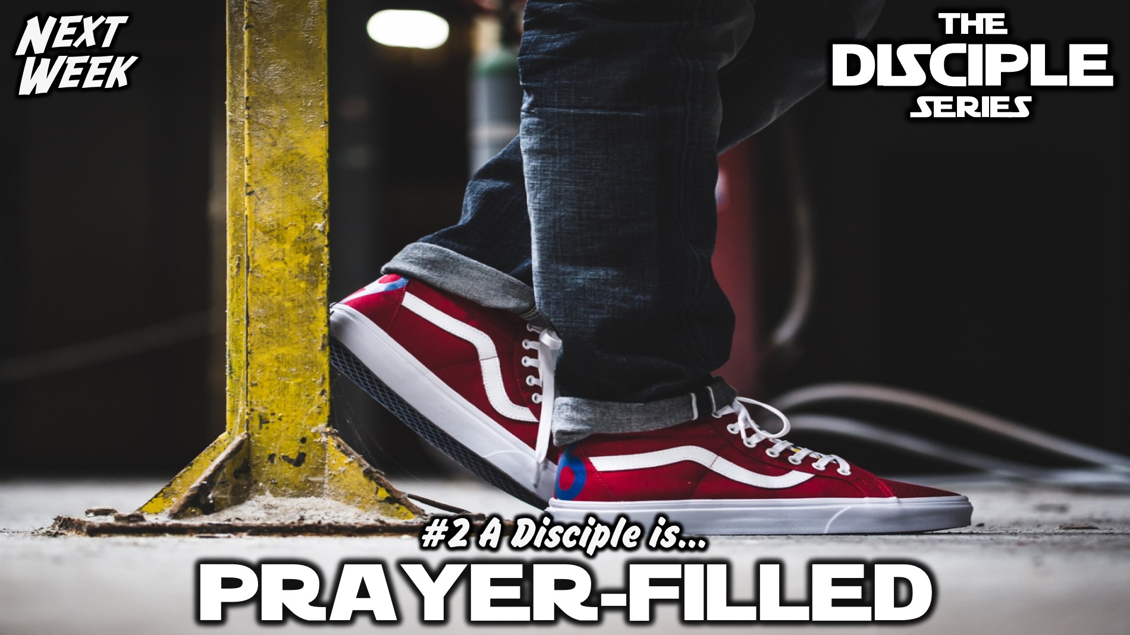
Notes:
Next week we will explore quality #2: A Disciple is Prayer-filled.

