Slide 1

Notes:
Welcome to the Disciple Series.

Slide 2
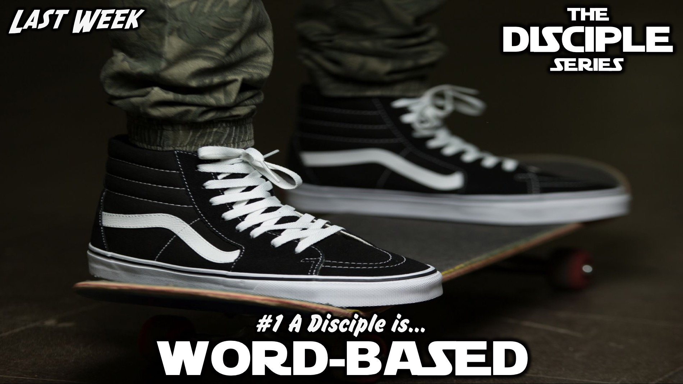
Notes:
Last week we learnt that a disciple is Word-based.

Slide 3
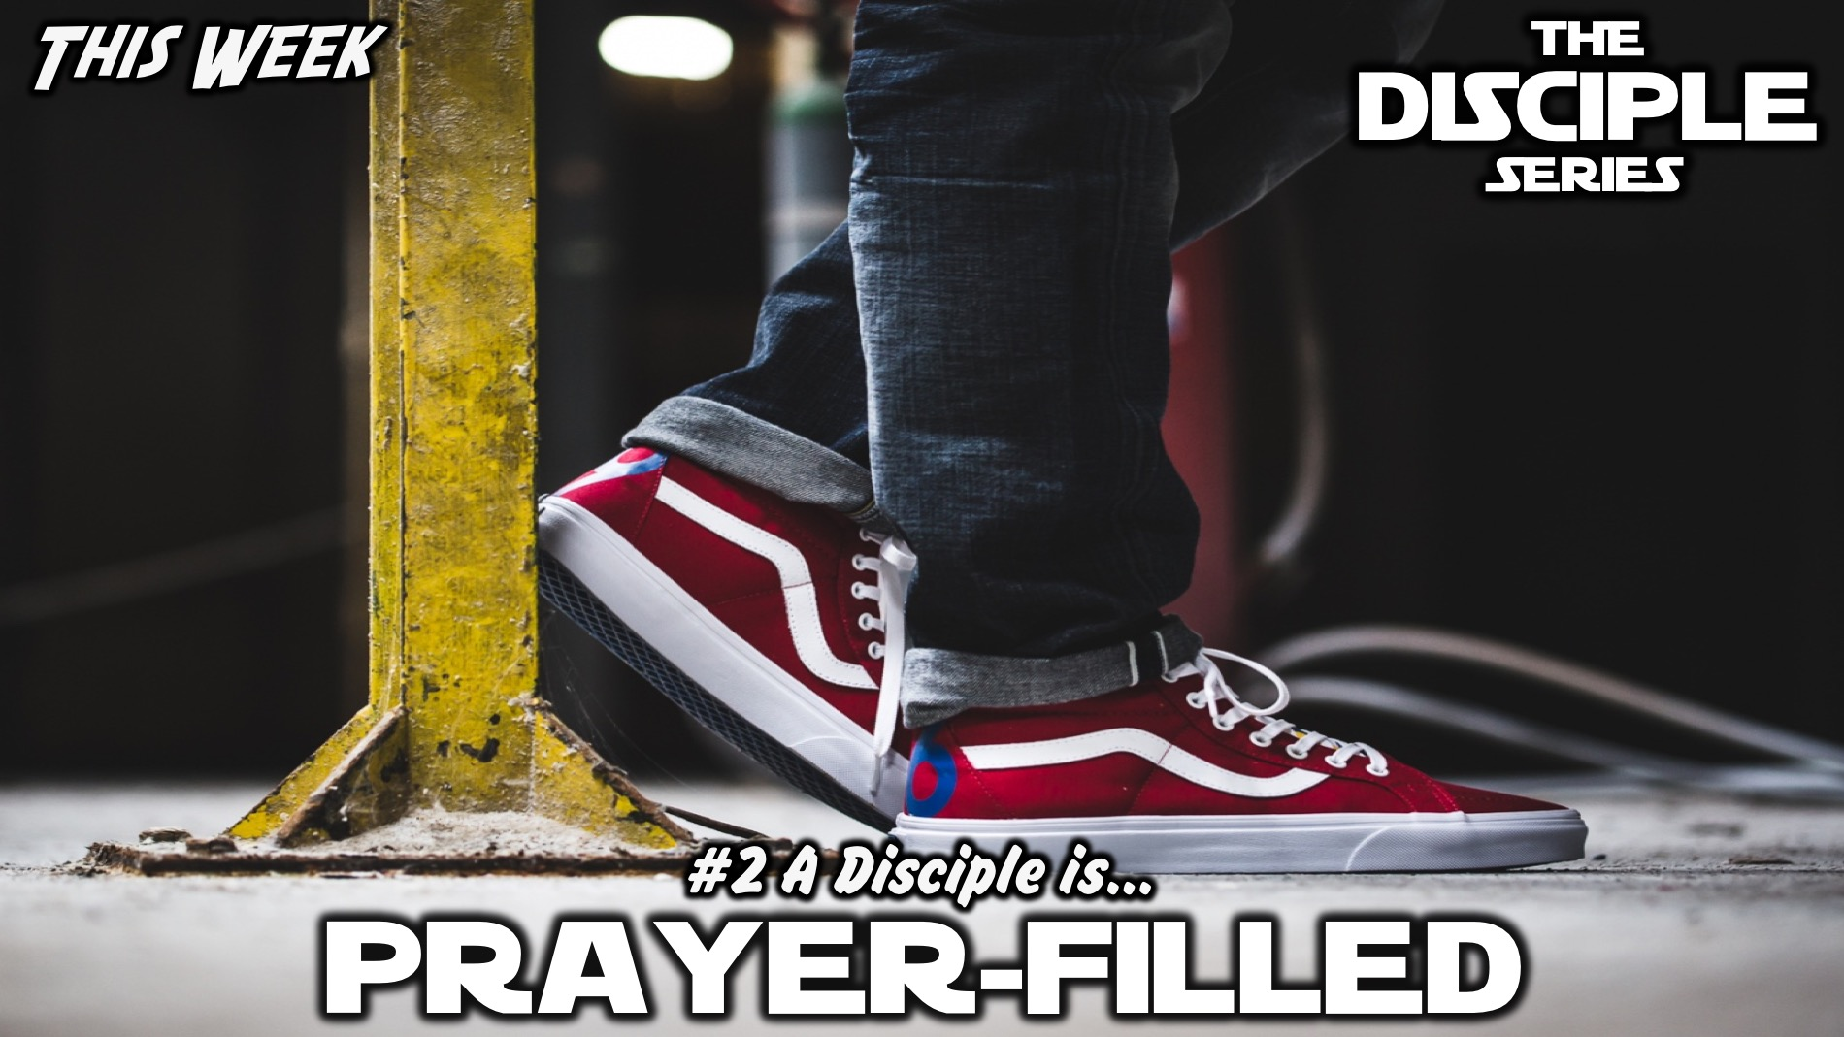
Notes:
This week we will learn that a disciple is Prayer-filled.

Slide 4
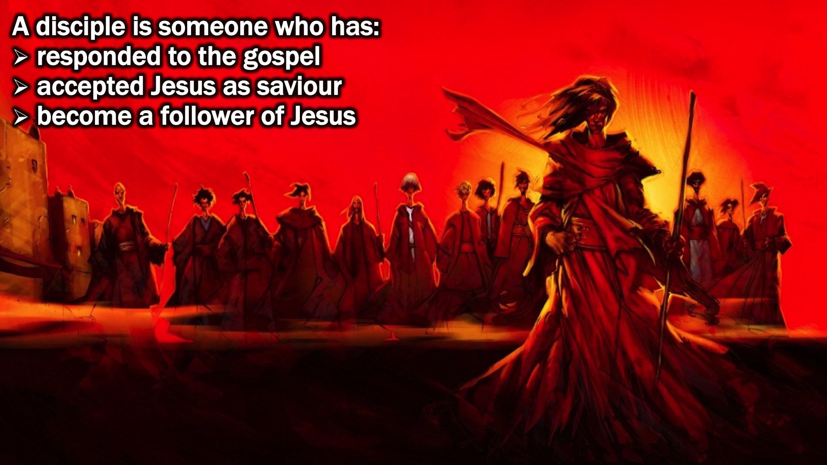
Notes:
But first a reminder. Last week we said that a disciple is someone who has responded to the Gospel message, they have accepted Jesus as their Saviour they have become a follower of Jesus!

Slide 5
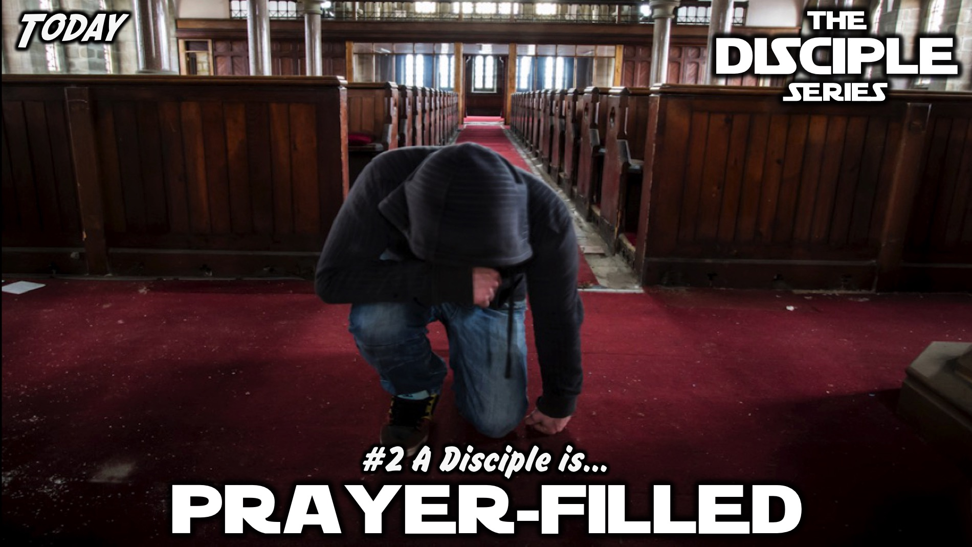
Notes:
Today we are going to learn how a disciple is Prayer-filled.

Slide 6
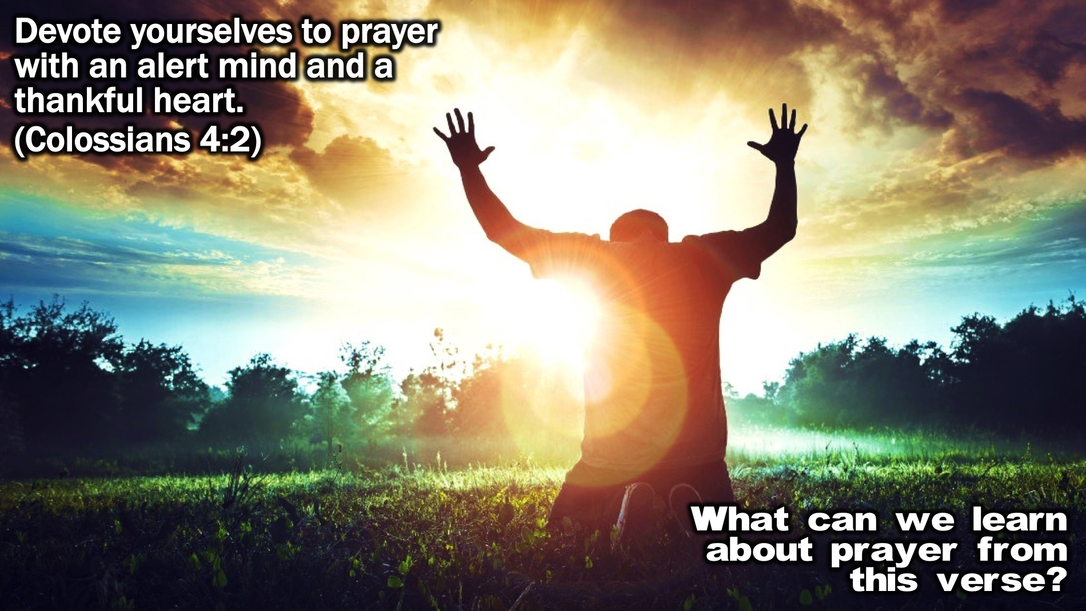
Notes:
Bible Passage: “Devote yourselves to prayer with an alert mind and a thankful heart.” (Colossians 4:2)
Small Group Discussion: What can we learn about prayer from this verse?

Slide 7
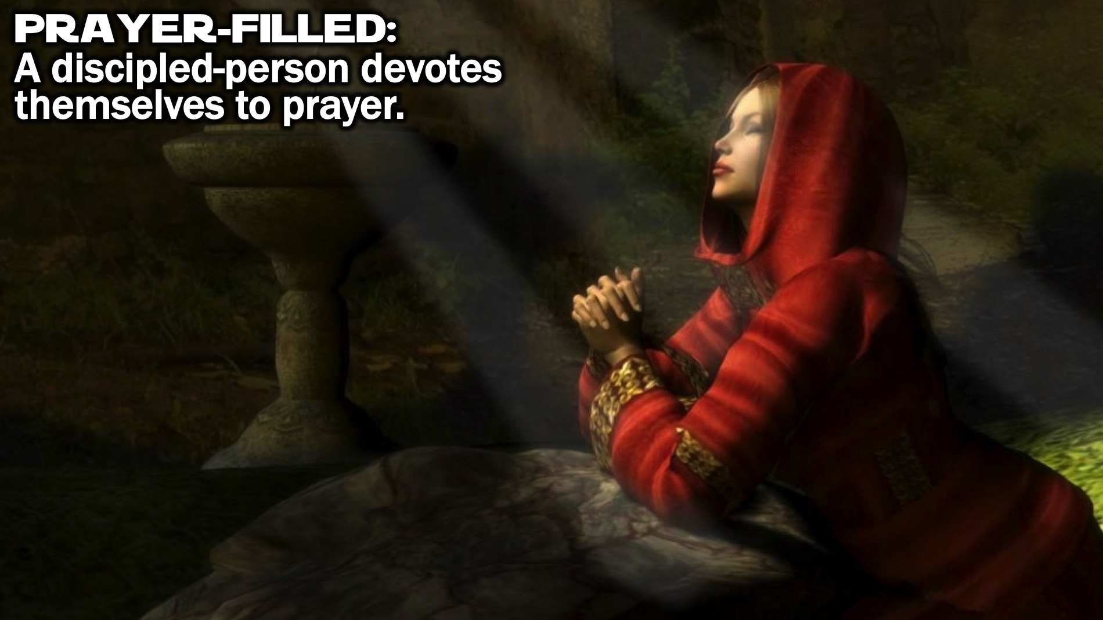
Notes:
Definition: Payer-filled: A discipled-person devotes themselves to prayer.

Slide 8
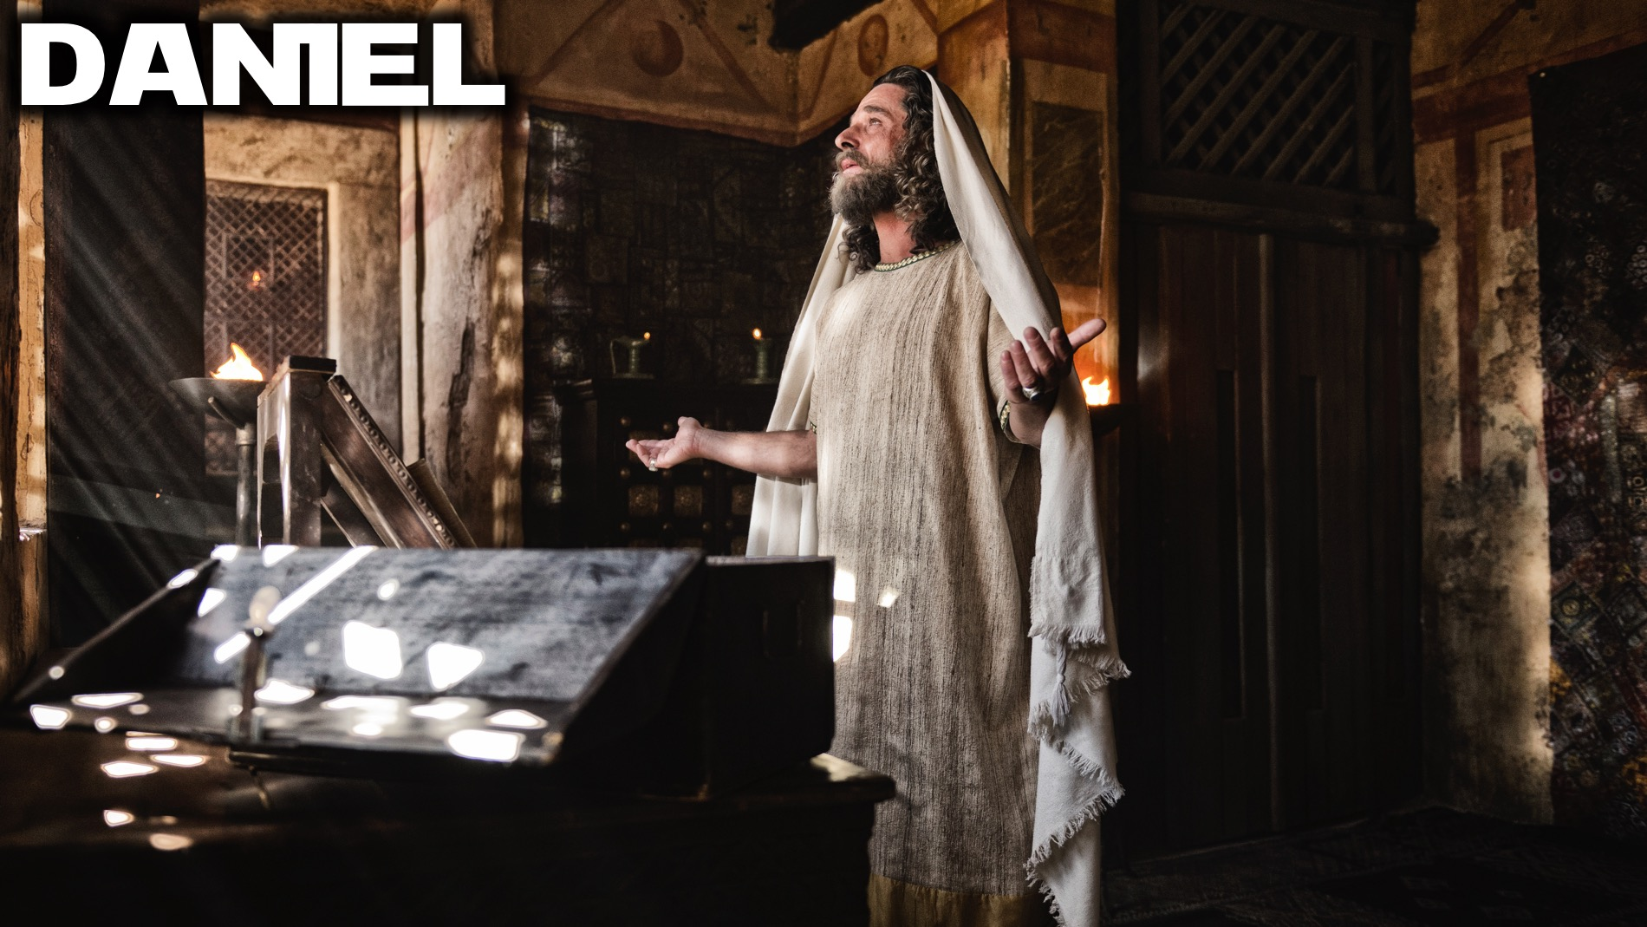
Notes:
Biblical Character: Daniel

Slide 9

Notes:
Video: The Story of Daniel from The Bible Series on DVD, Disk 2, Episode 5.

Slide 10
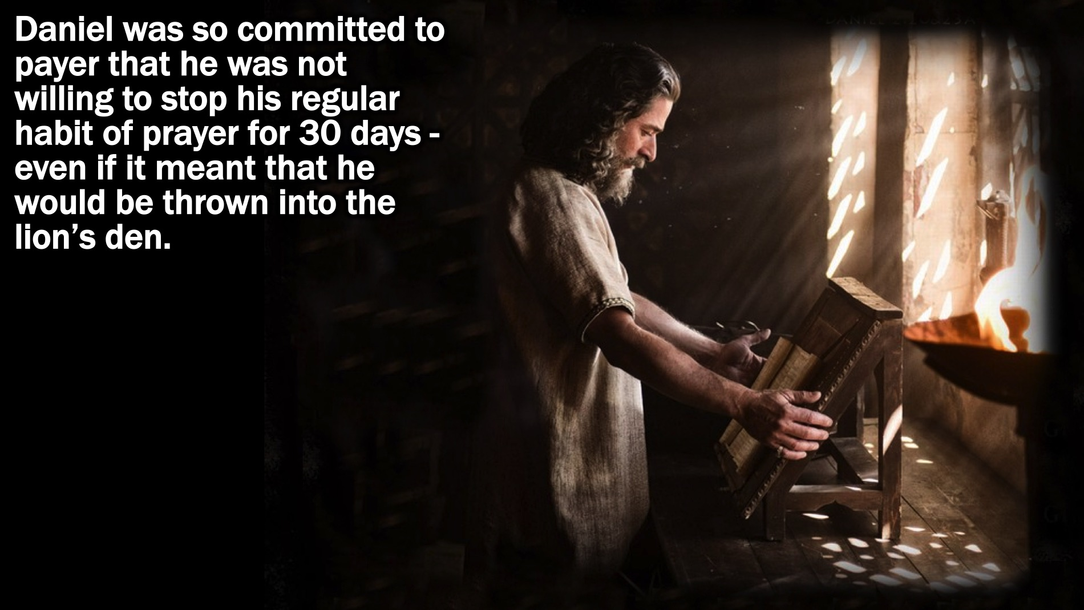
Notes:
In Daniel 6 we learn that Daniel was so committed to payer that he was not willing to stop his regular habit of prayer for 30 days - even if it meant that he would be thrown into the lion’s den.

Slide 11
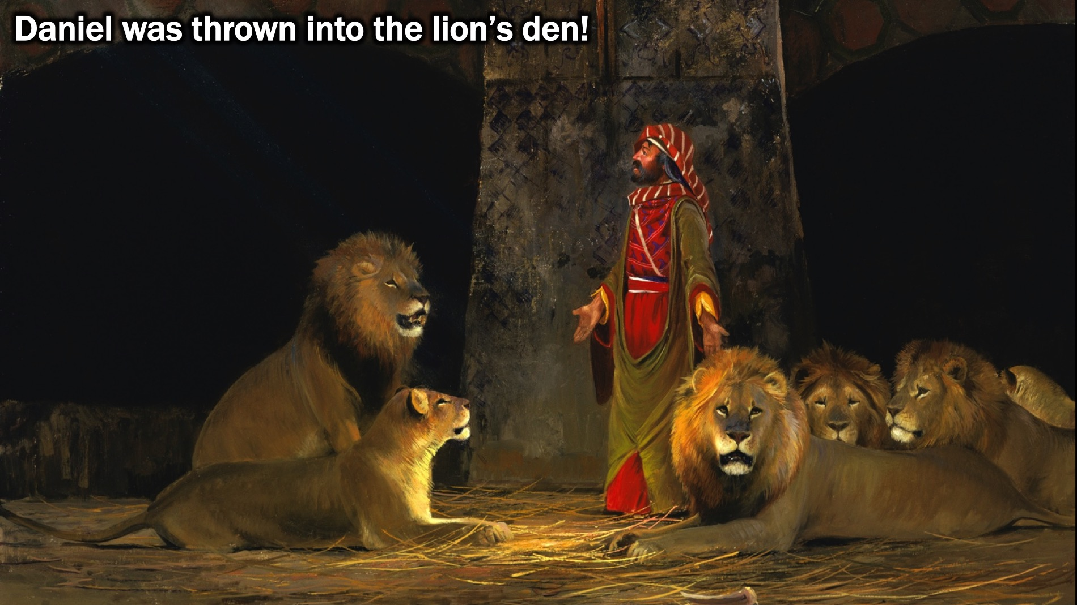
Notes:
Daniel was thrown into the lion’s den!

Slide 12
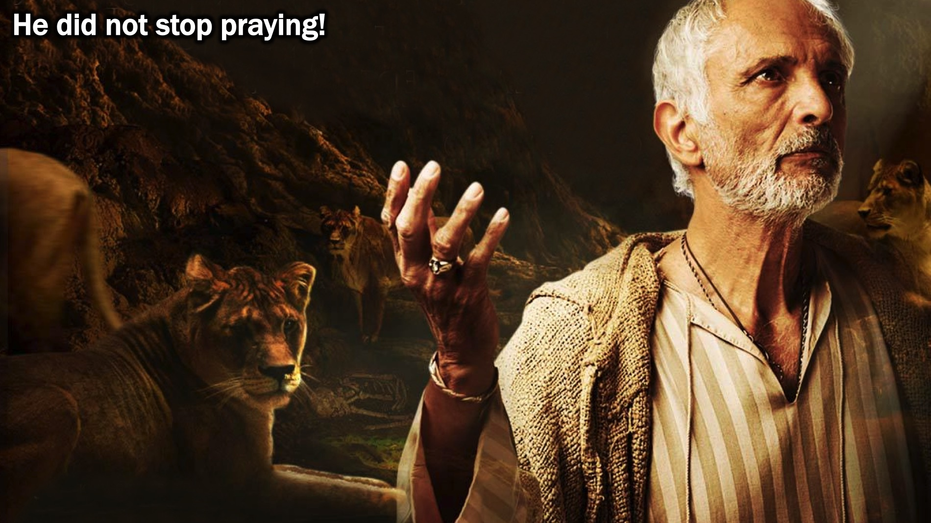
Notes:
He did not stop praying!

Slide 13
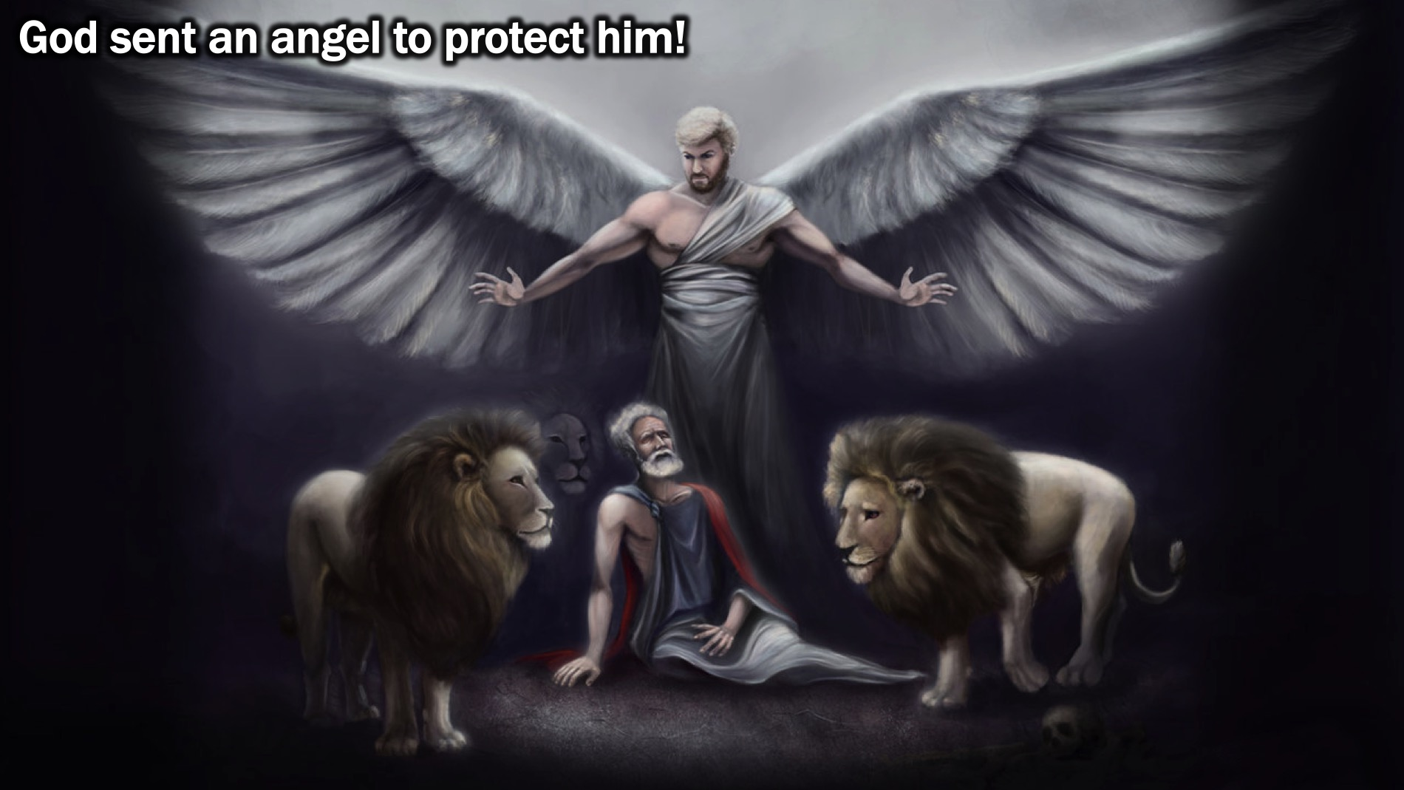
Notes:
God sent an angel to protect Daniel!

Slide 14
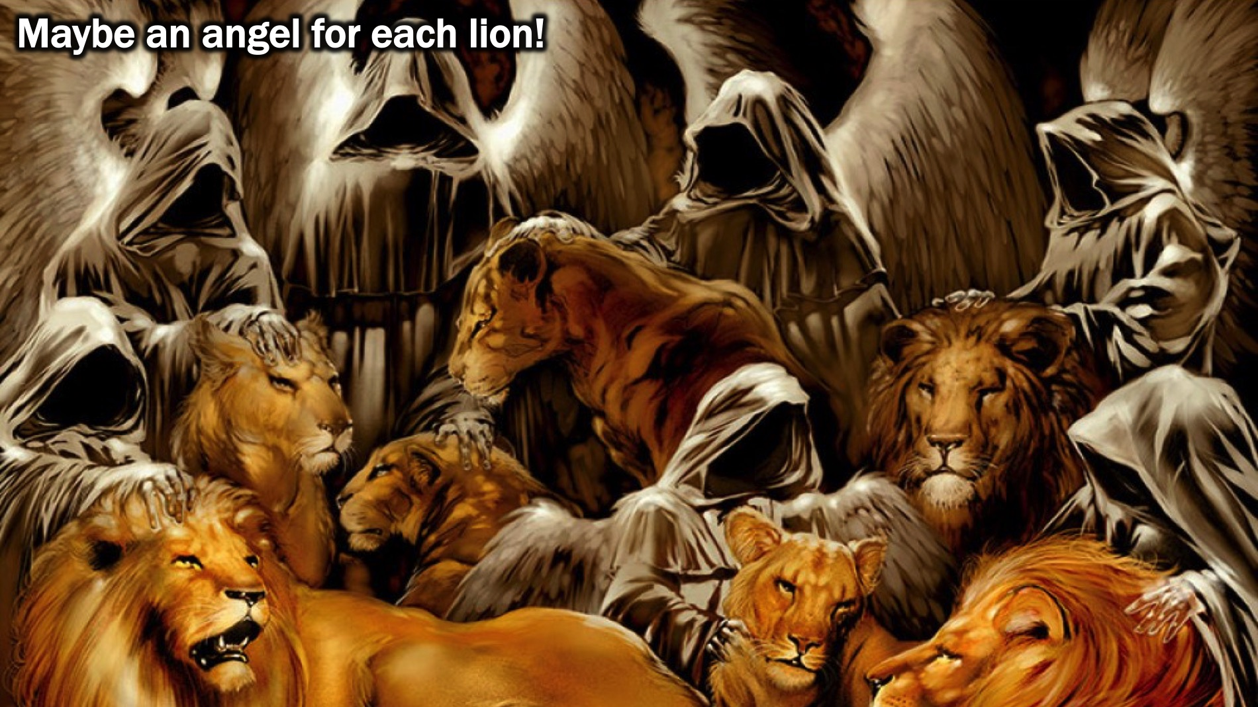
Notes:
Maybe an angel for each lion!

Slide 15
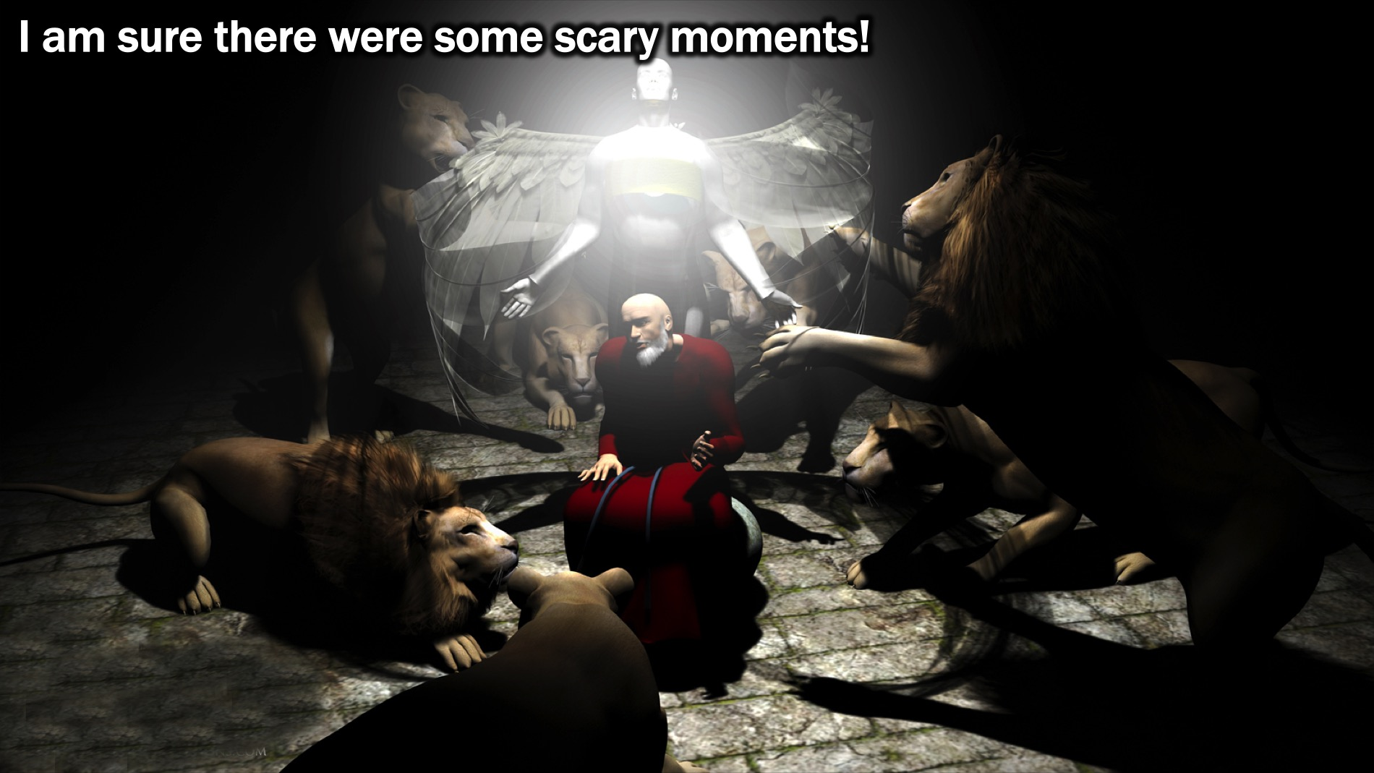
Notes:
I am sure there were some scary moments!

Slide 16
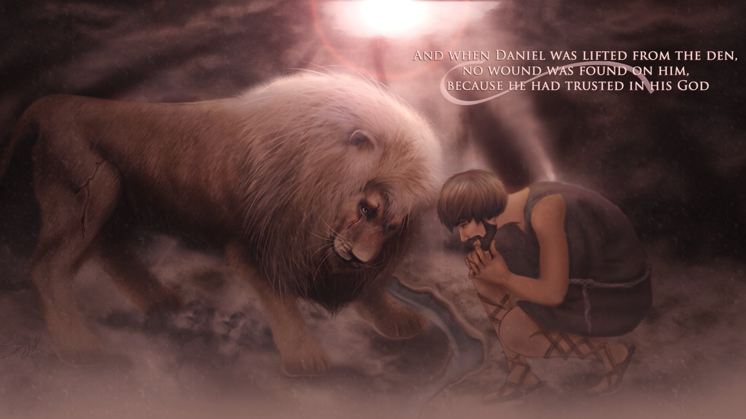
Notes:
But when Daniel was lifted from the den, no wound was found on him because he had trusted in his God!

Slide 17
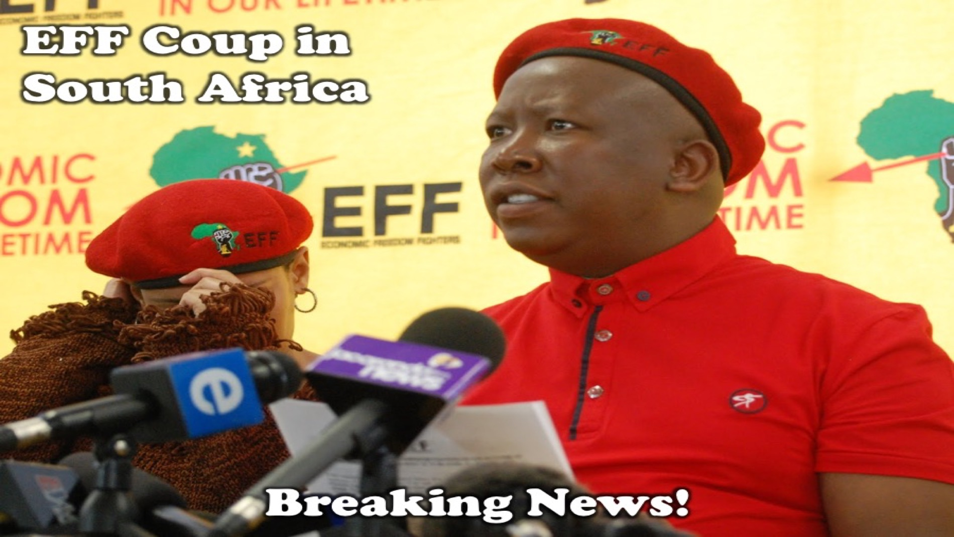
Notes:
Breaking News! Have you heard the news – early this morning the EFF (Economic Freedom Fighters) staged a coup in South Africa…

Slide 18
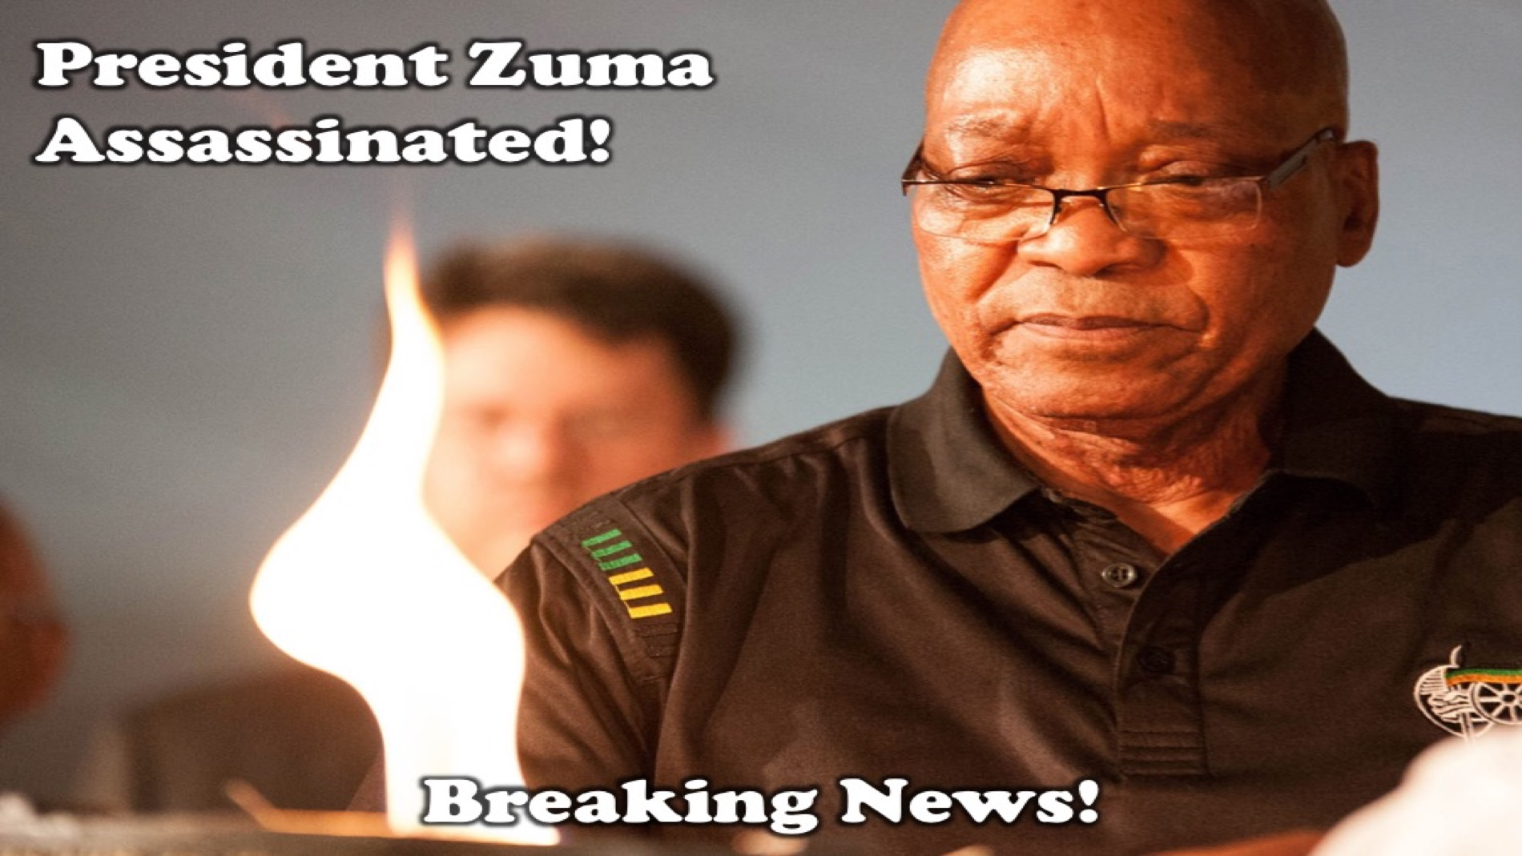
Notes:
President Jacob Zuma has been assassinated.

Slide 19
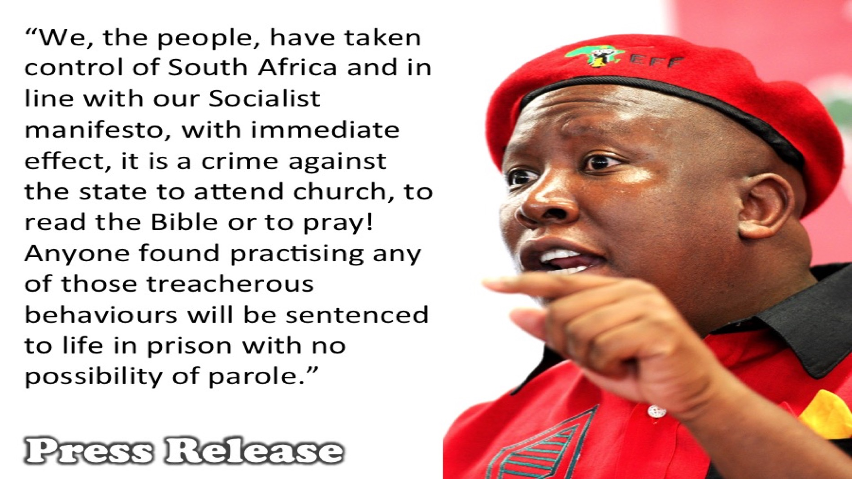
Notes:
The leader of the EFF, Julius Malema, appeared on SABC3 at 7am and issued the following statement: “We, the people, have taken control of the country and because of our Socialist manifesto, with immediate effect, it is a crime against the state to attend church, to read your Bible or to pray! Anyone found practising any of those treacherous behaviours will be sentenced to life in prison with no possibility of parole.”

Slide 20
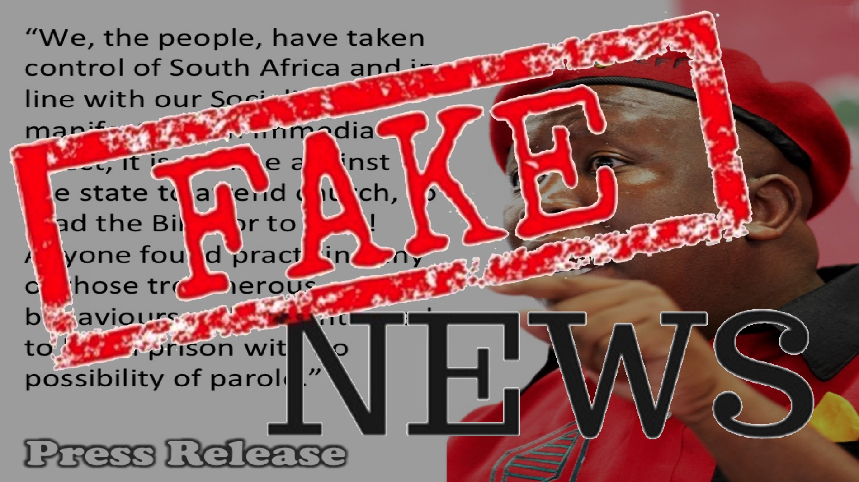
Notes:
Okay, so I made that up - but what if something like that happened?

Slide 21
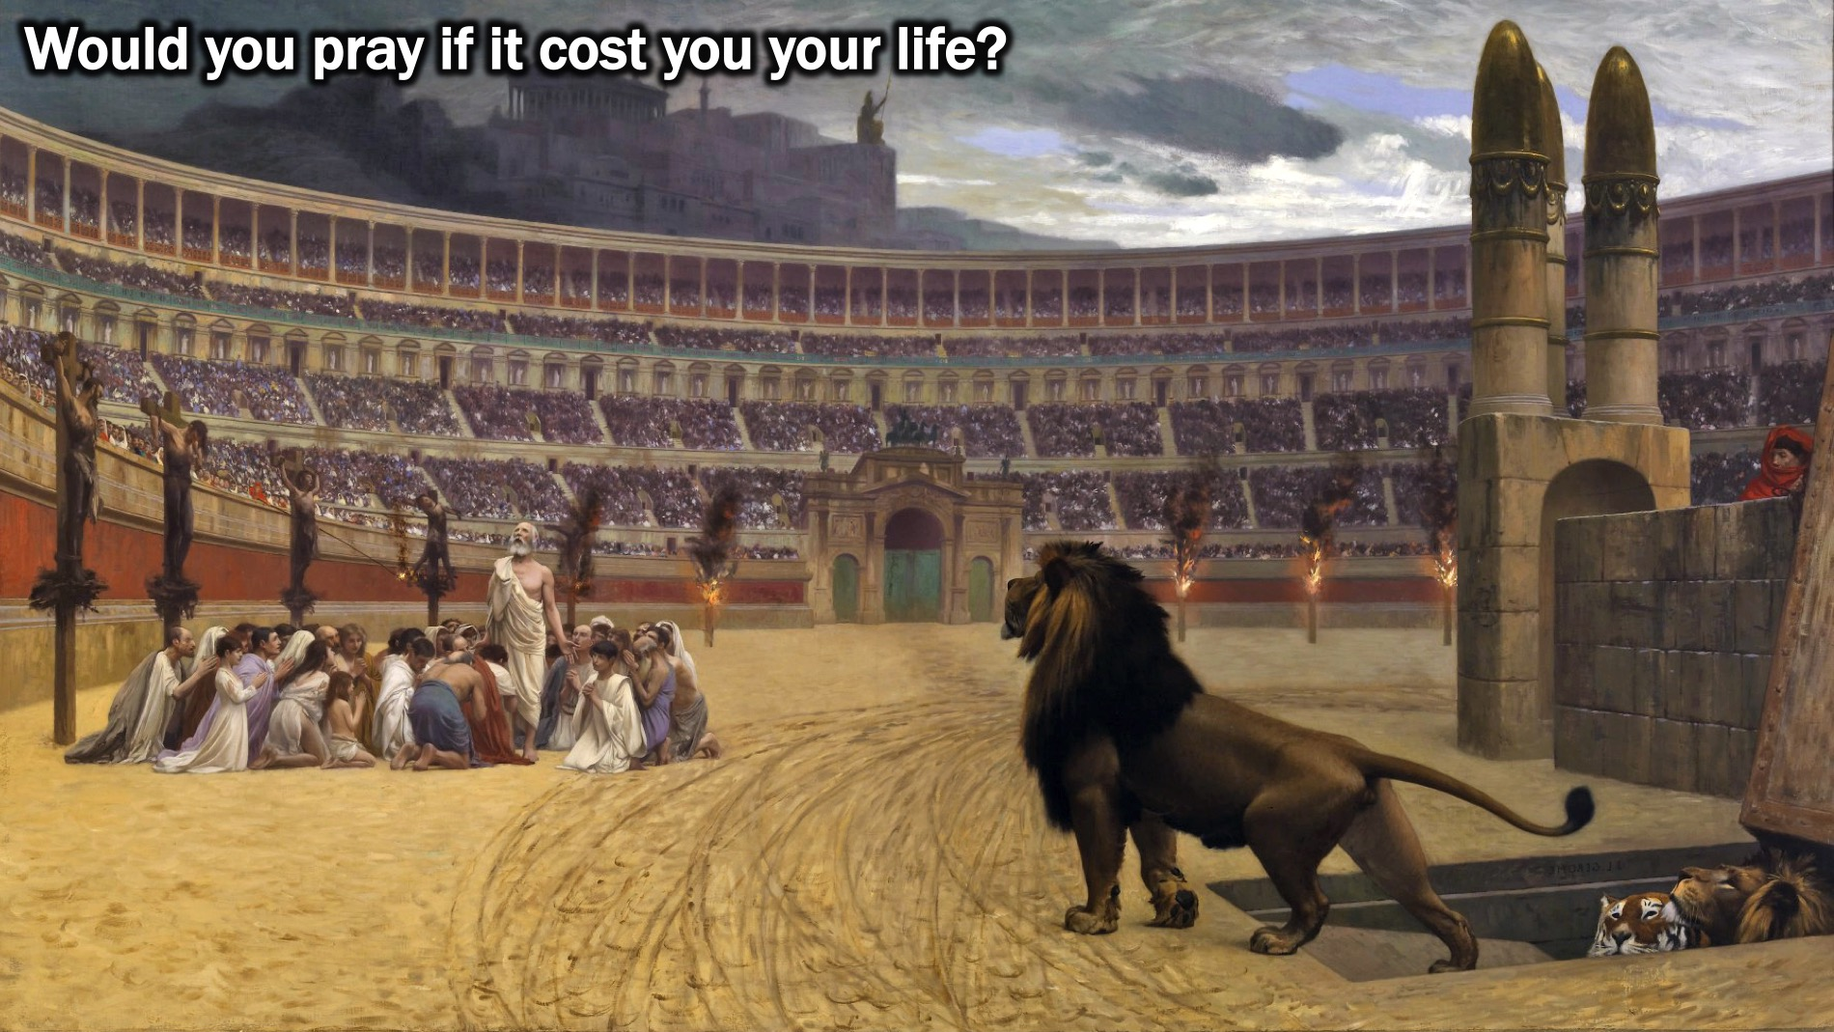
Notes:
Would you pray if it cost you your life?

Slide 22

Notes:
Maybe you are not there yet…

Slide 23
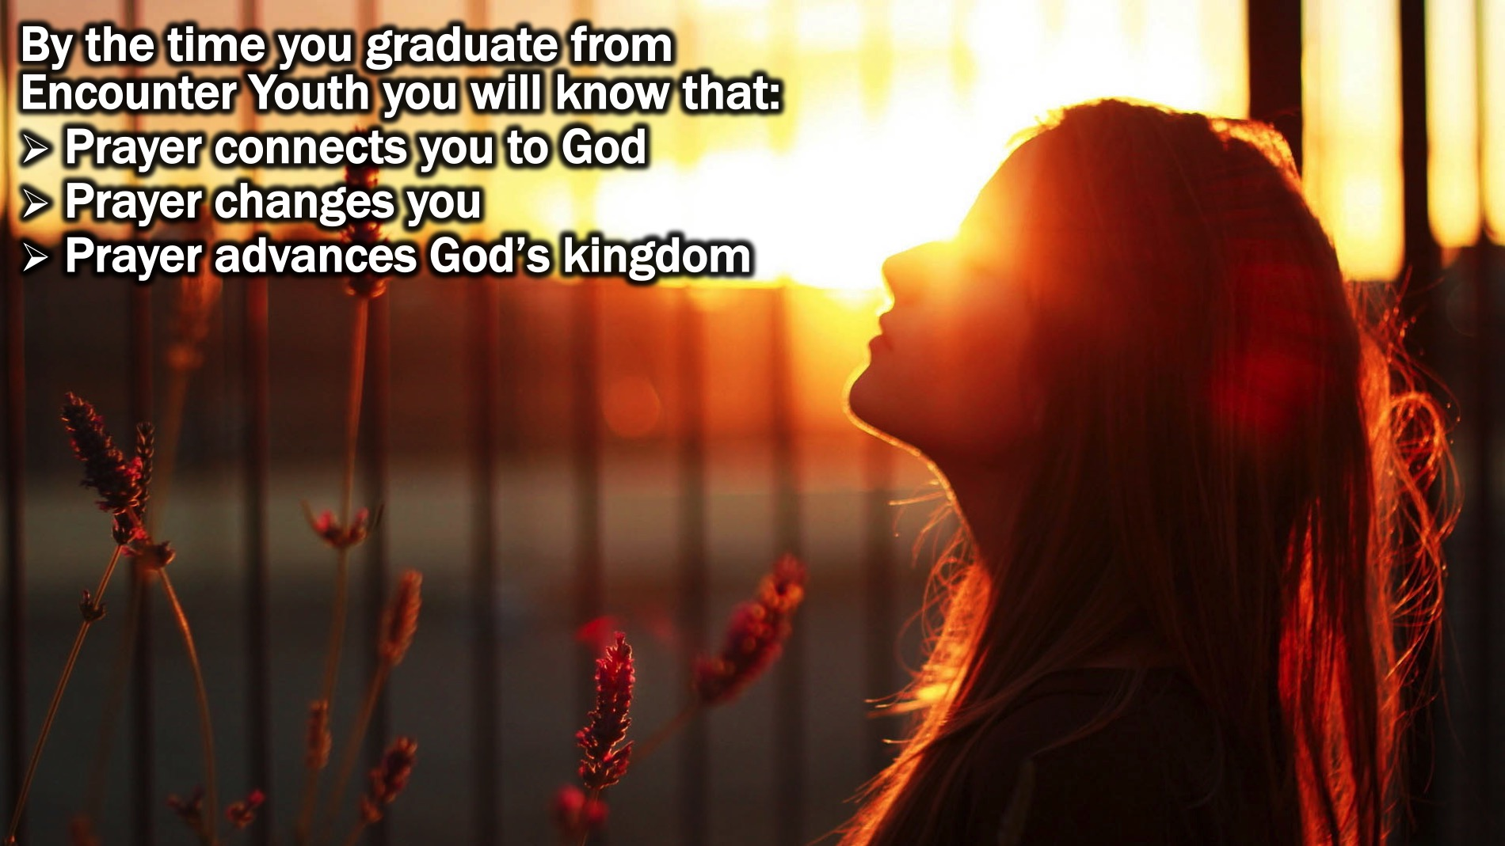
Notes:
By the time you graduate from Encounter Youth you will know that: (1) Prayer connects you to God. (2) Prayer changes you and (3) Prayer advanced God’s kingdom.

Slide 24
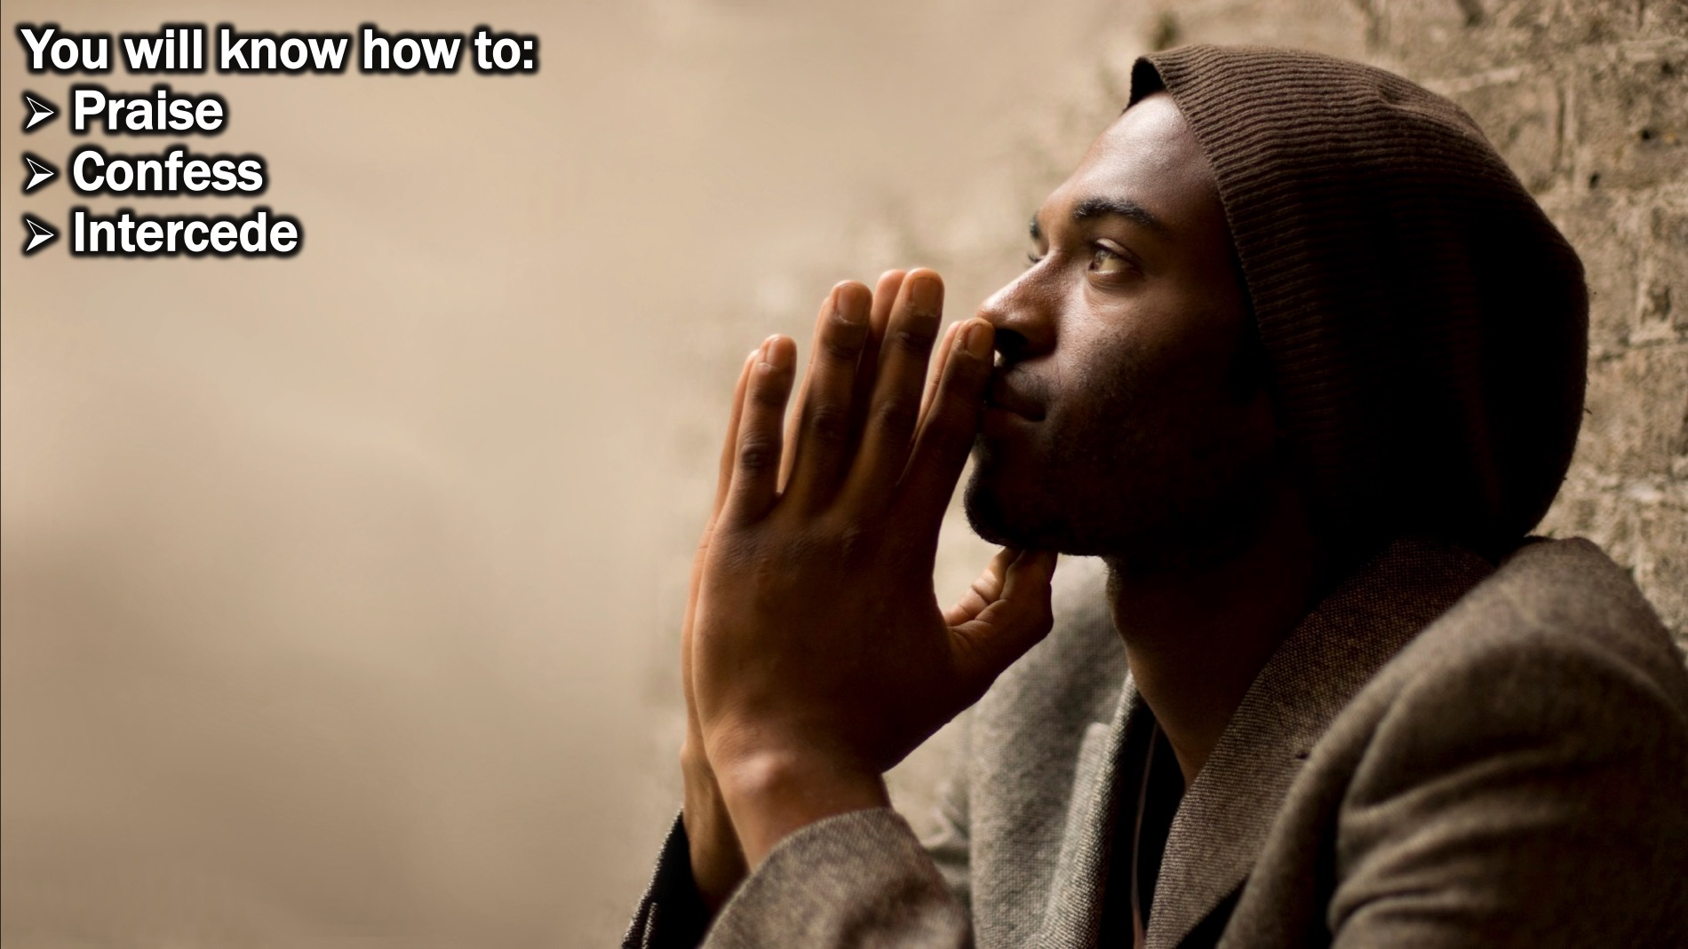
Notes:
You will know how to (1) Praise; (2) Confess and (3) Intercede through prayer.

Slide 25
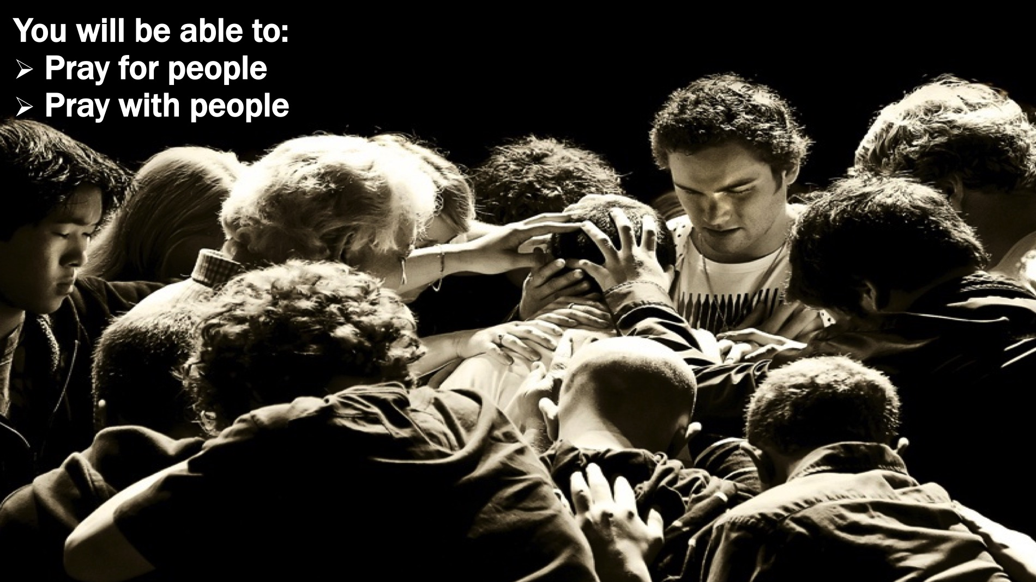
Notes:
You will be able to pray for people and pray with people.

Slide 26
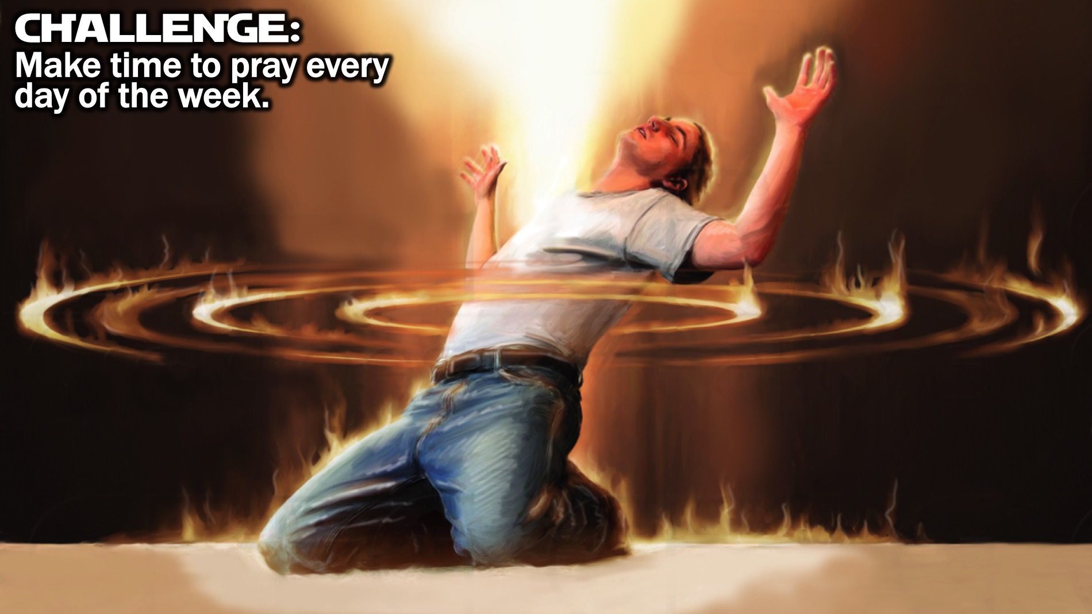
Notes:
Challenge: Make time to pray every day of the week.

Slide 27
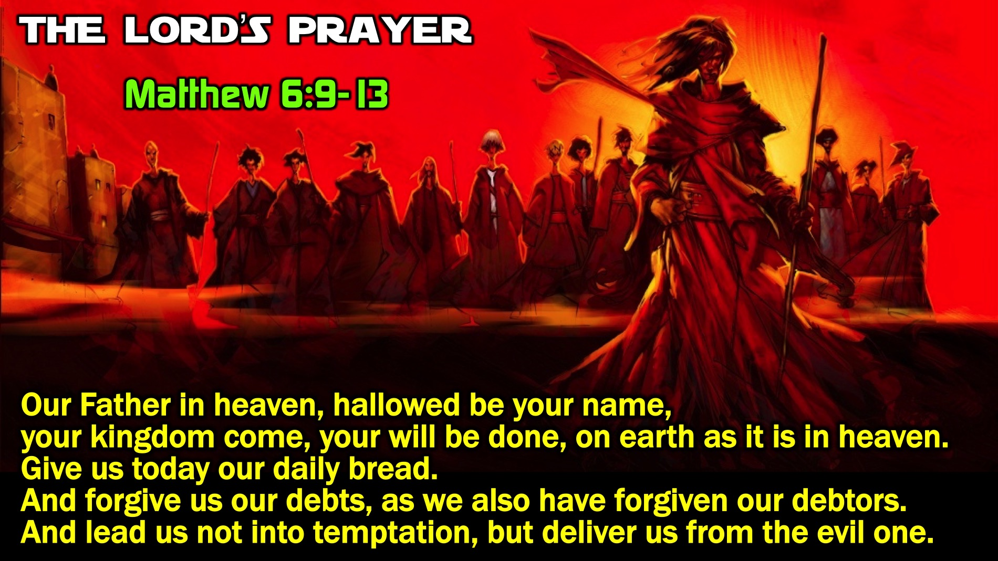
Notes:
When the disciples asked Jesus to teach them how to pray he gave them The Lord’s Prayer: “Our Father in heaven, Hallowed be your name. Your kingdom come, Your will be done, on earth as it is in heaven. Give us this day our daily bread, and forgive us our debts, as we also have forgiven our debtors. And lead us not into temptation, but deliver us from evil.” (Matthew 6:9-13). This model prayar gives us an outline to use when we pray based on the word PRAY: Praise, Request, Admit and Yield.

Slide 28

Notes:
“Our Father in heaven, hallowed be your name...” Praise: Praise God for who He is and all He has done.

Slide 29
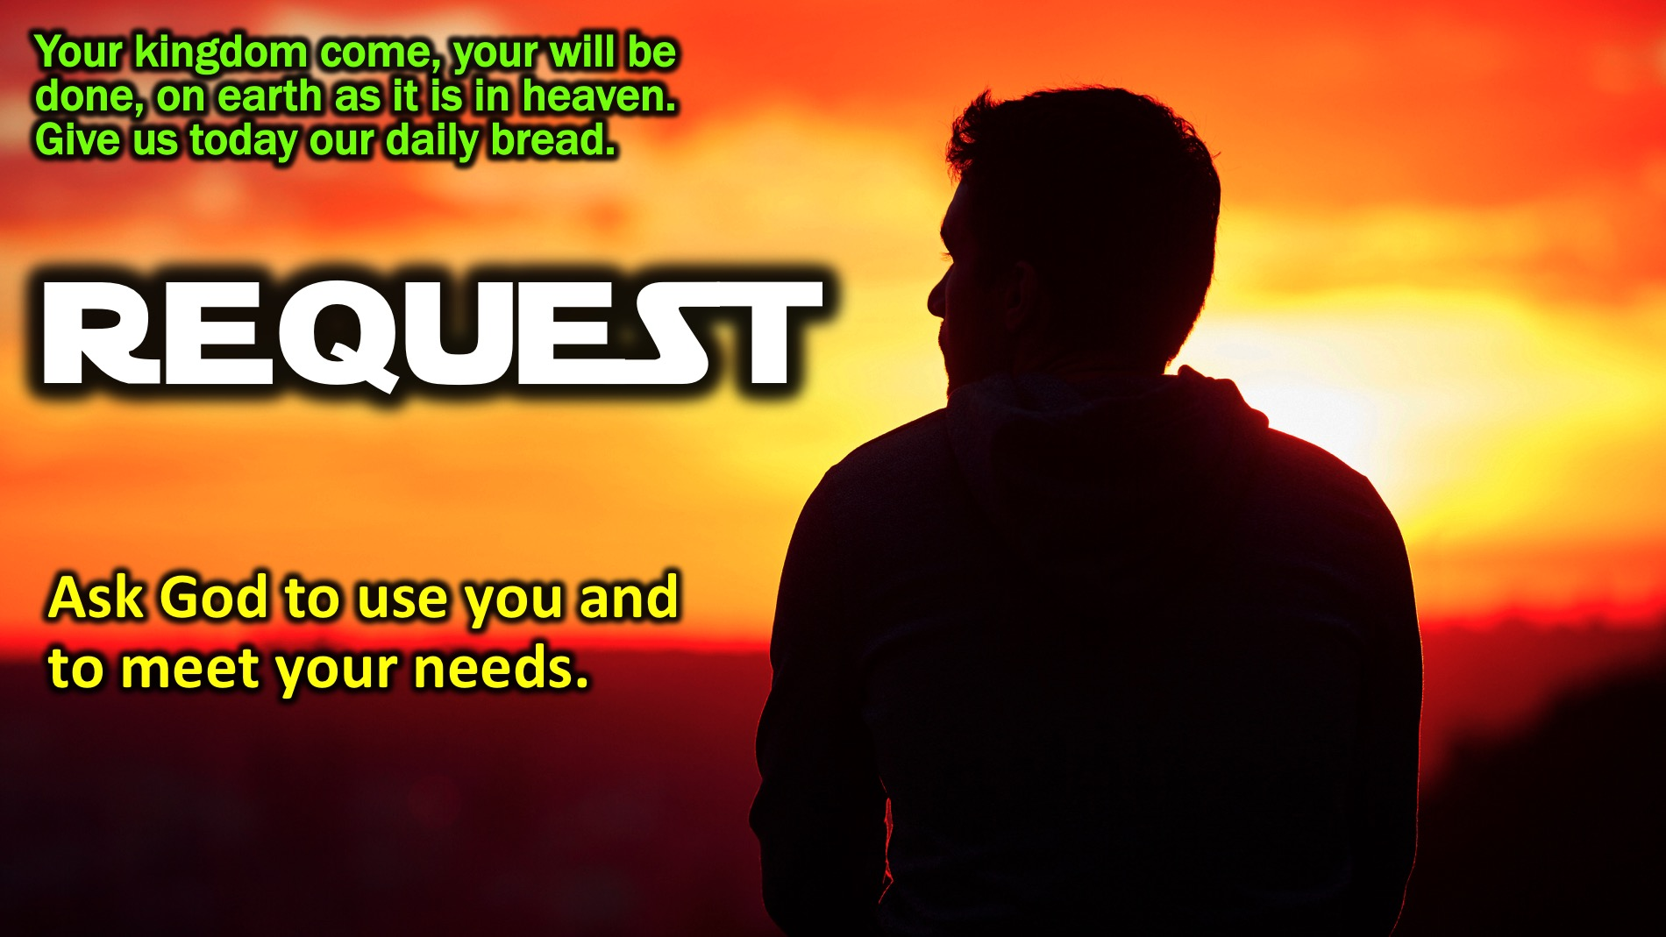
Notes:
“Your kingdom come, your will be done, on earth as it is in heaven. Give us today our daily bread.” Request: Ask God to use you and to meet your needs.

Slide 30
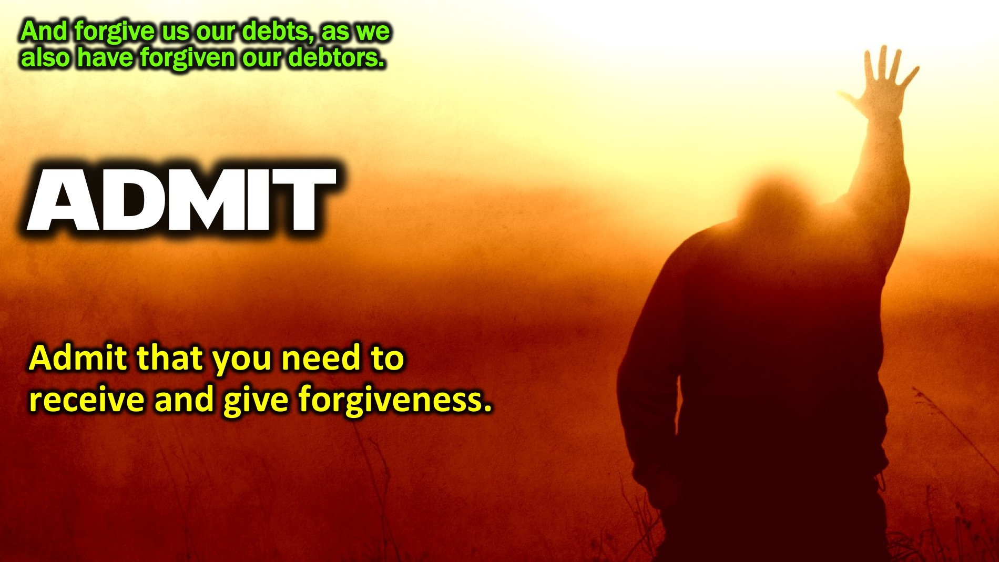
Notes:
“And forgive us our debts, as we also have forgiven our debtors.” Admit: Admit that you need to receive and give forgiveness.

Slide 31
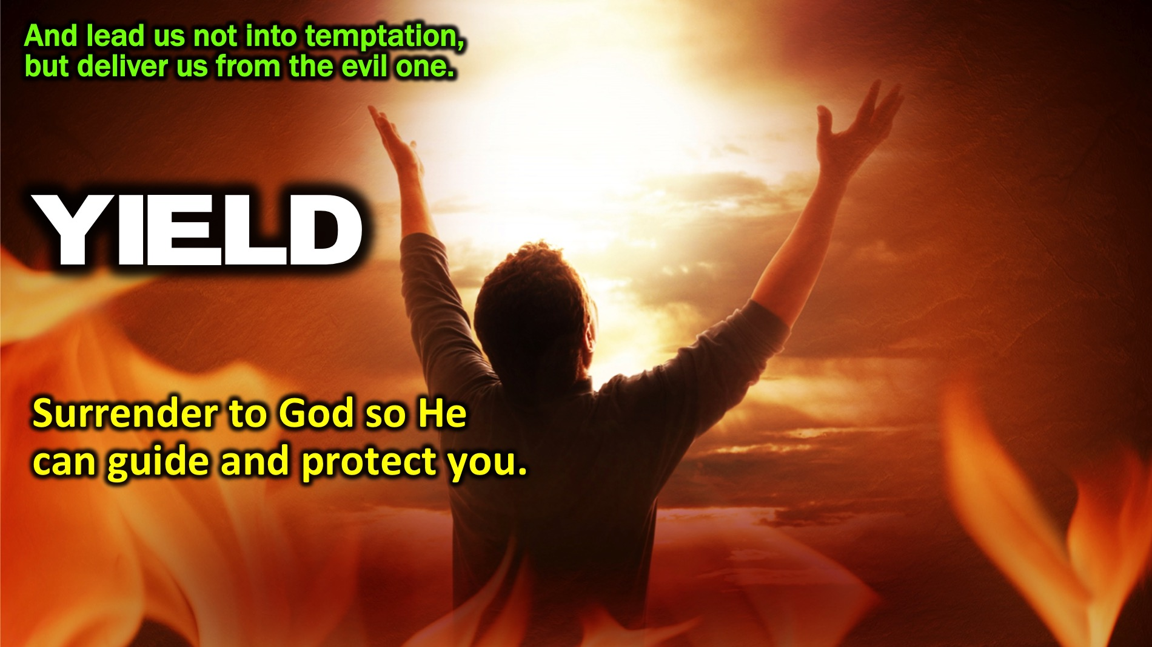
Notes:
“And lead us not into temptation, but deliver us from the evil one.” Yield: Surrender to God so He can guide and protect you.

Slide 32
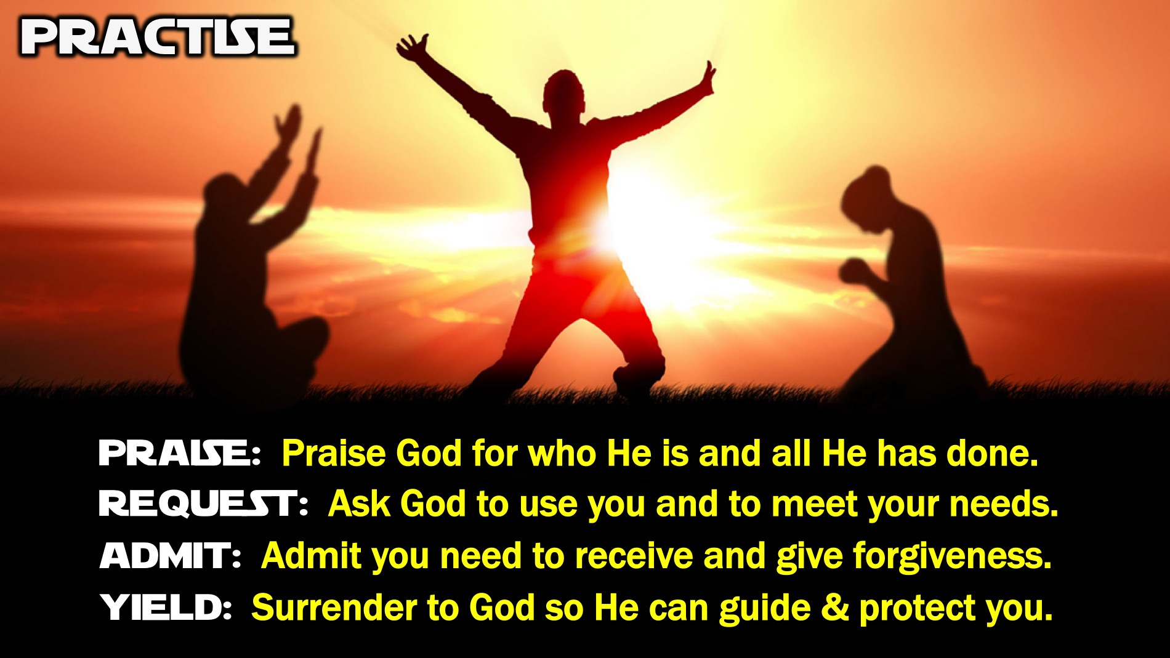
Notes:
Practise: Turn to the person next to you and spend a few minutes praying using the PRAY outline (have each person share one item for each of the four parts to the prayer: (1) Praise: Praise God for who He is and all He has done. (2) Request: Ask God to use you and to meet your needs. (3) Admit: Admit you need to receive and give forgiveness. (4) Yield: Surrender to God so He can guide & protect you.

Slide 33
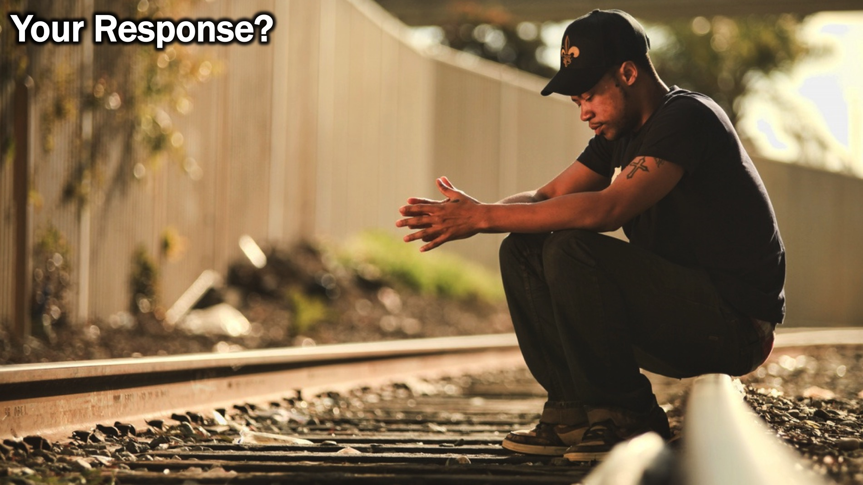
Notes:
So what will your response be to the message you have heard today?

Slide 34
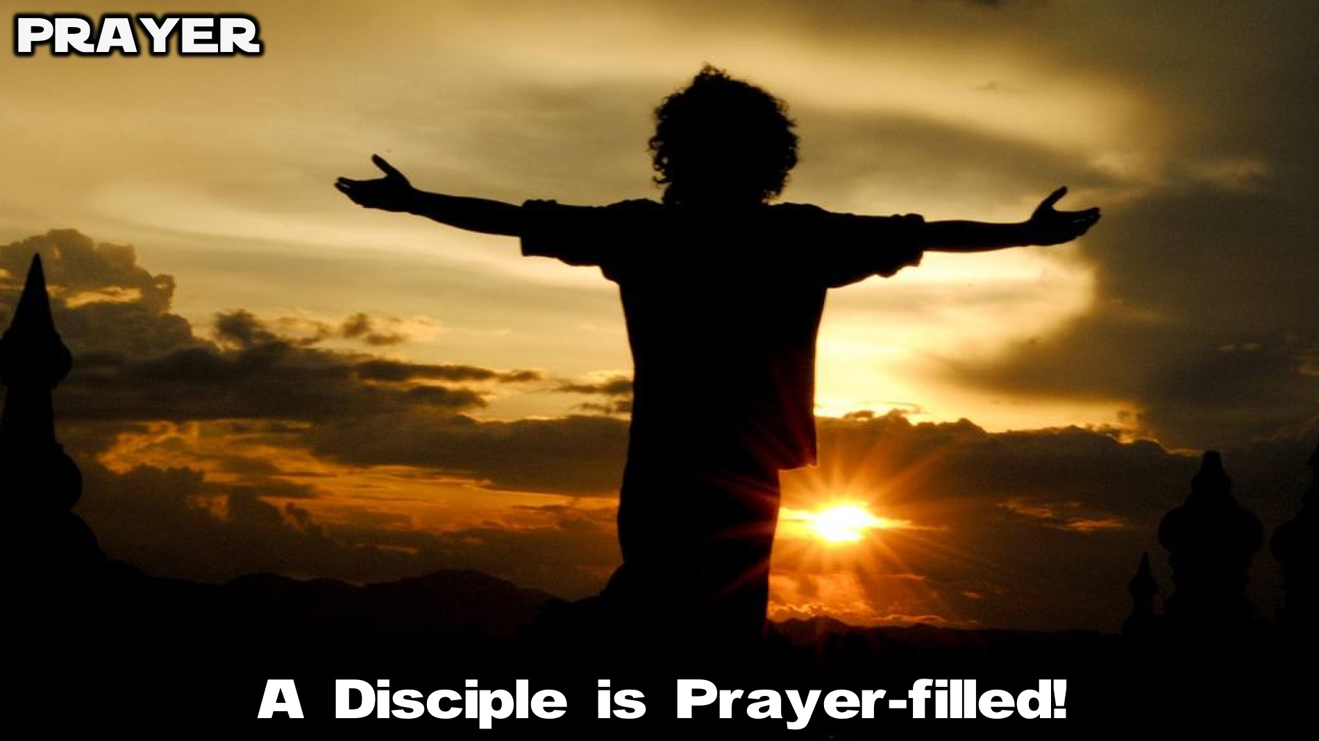
Notes:
Prayer: Let’s ask God to help us become Prayer-filled disciples.

Slide 35

Notes:
Next week we will learn that a disciple is Christ-centered.

