Slide 1

Notes:
Welcome to the Disciple Series.

Slide 2

Notes:
In week 1 we learnt that a disciple is Word-based.

Slide 3
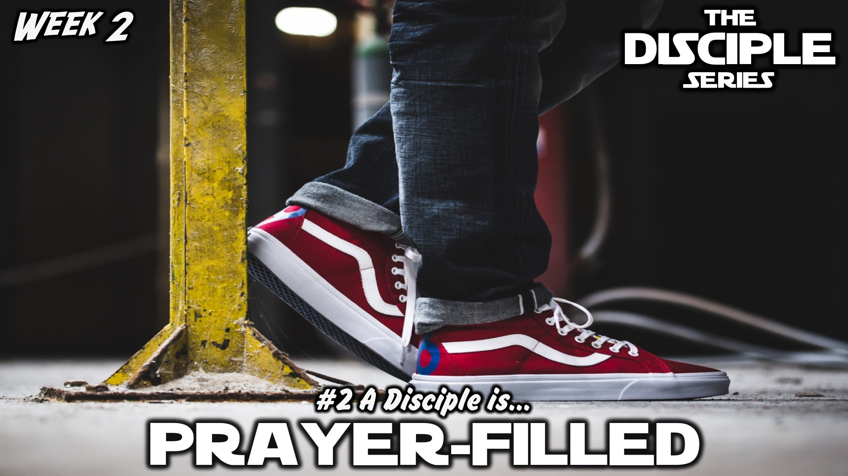
Notes:
In week 2 we learnt that a disciple is Prayer-filled.

Slide 4
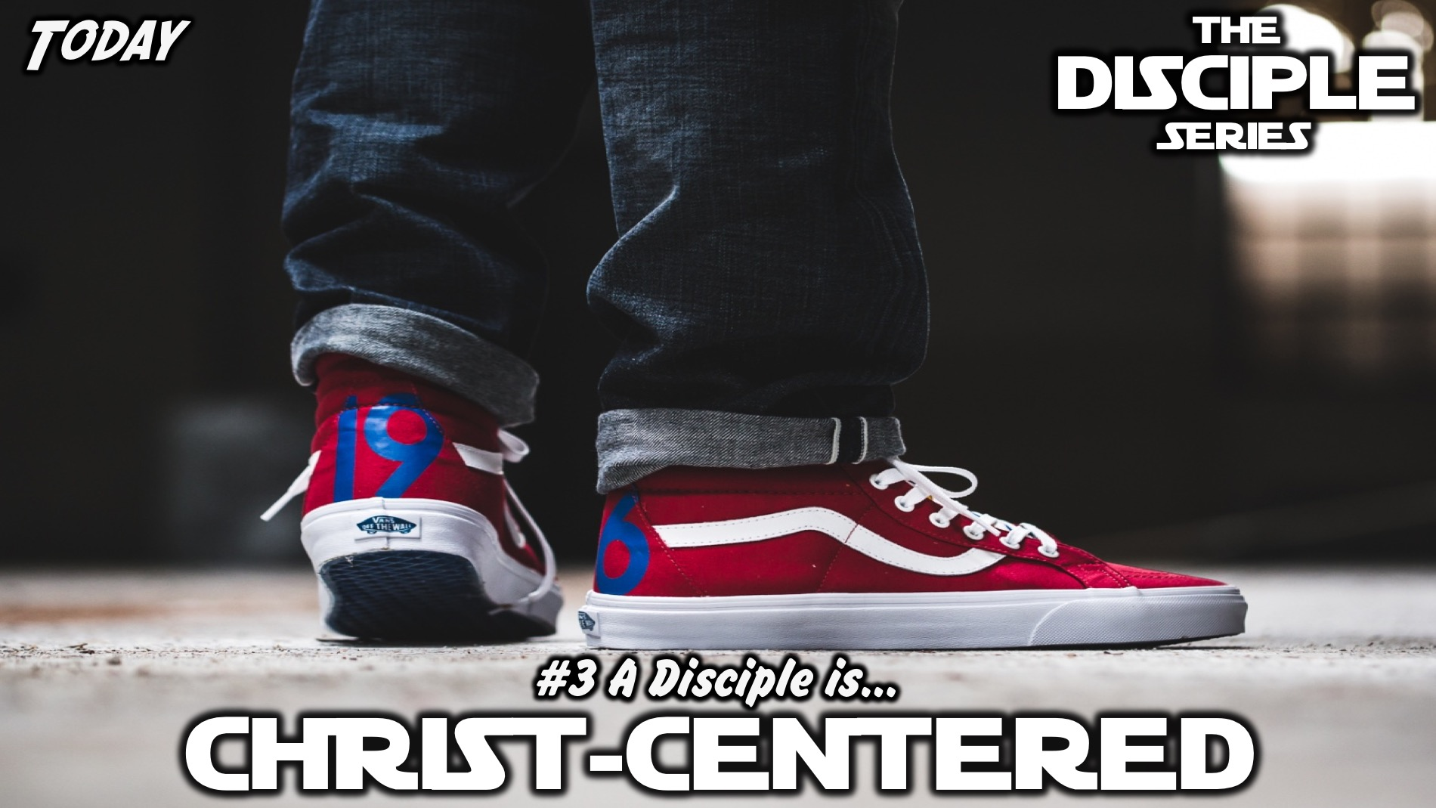
Notes:
Today we are going to discover that a disciple is Christ-centered.

Slide 5
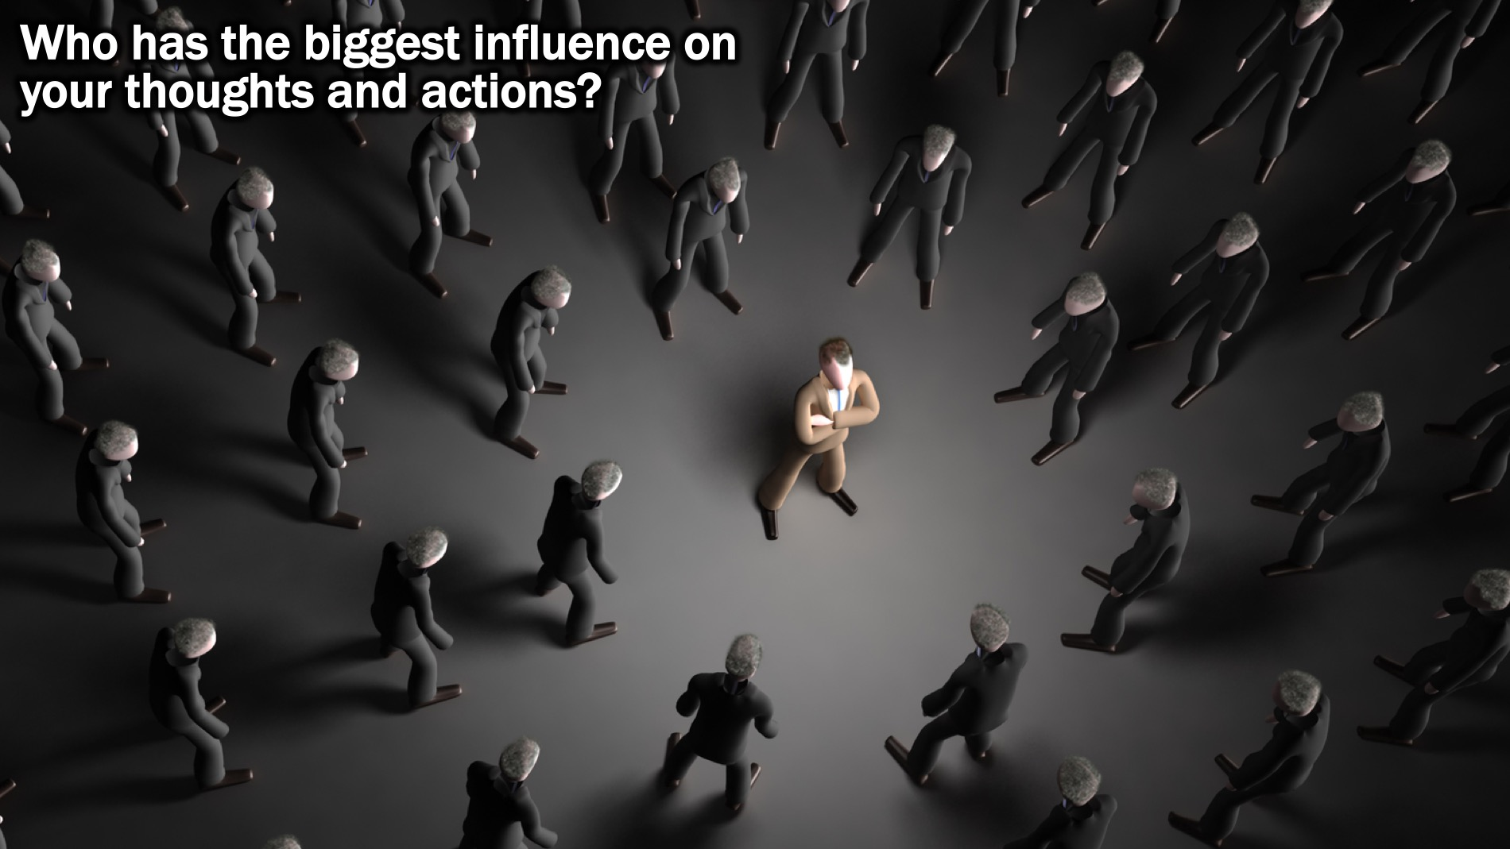
Notes:
Small Group Question: Who has the biggest influence on your thoughts and actions?

Slide 6
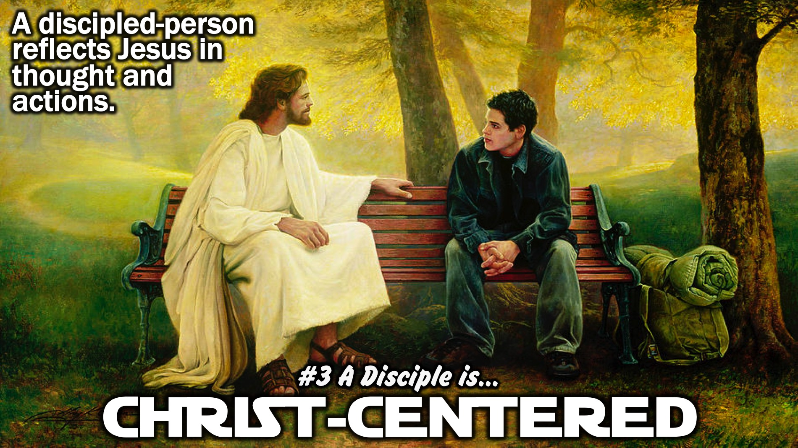
Notes:
So as disciples we are called to be Christ-centered. A discipled-person reflects Jesus in thought and actions.

Slide 7
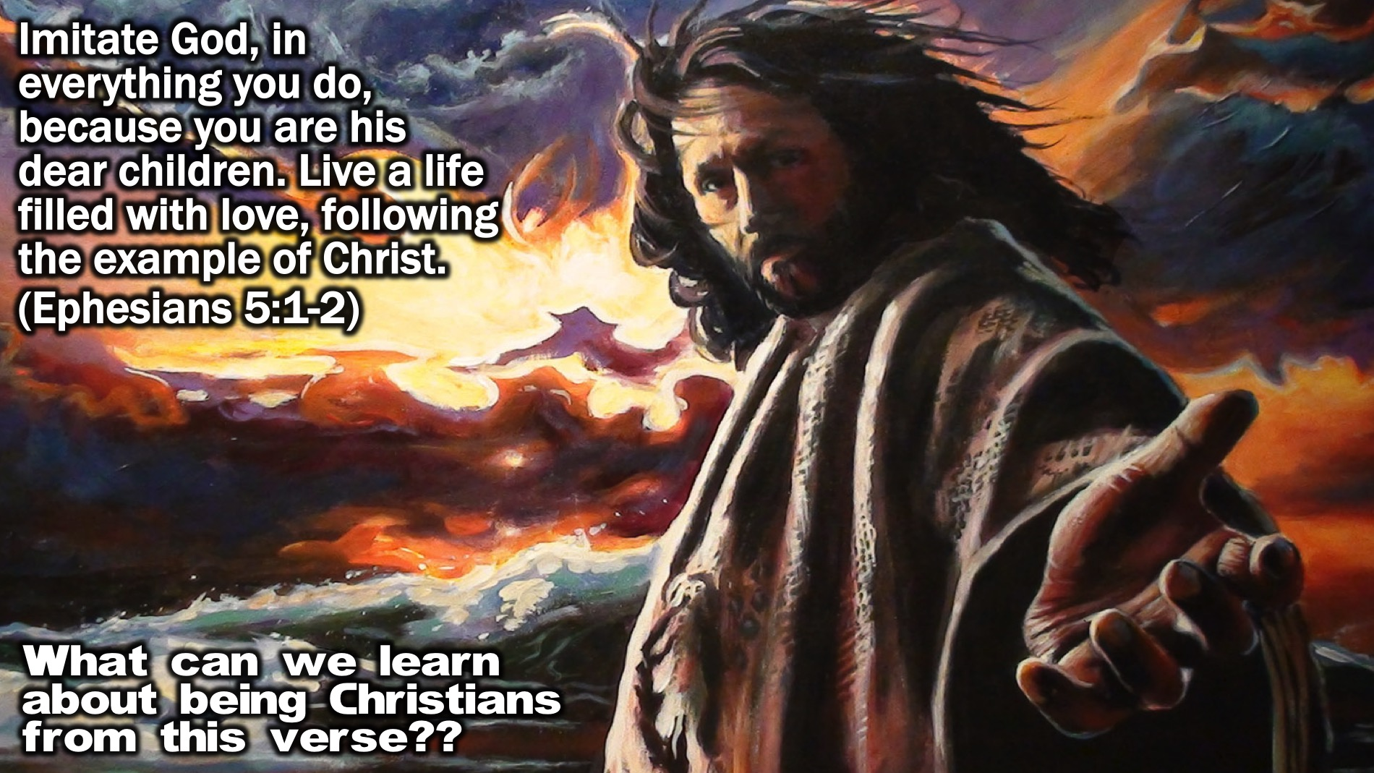
Notes:
Bible Passage: Imitate God, in everything you do, because you are his dear children. Live a life filled with love, following the example of Christ. (Ephesians 5:1-2)
Small Group Question: What can we learn about being Christians from this verse??

Slide 8
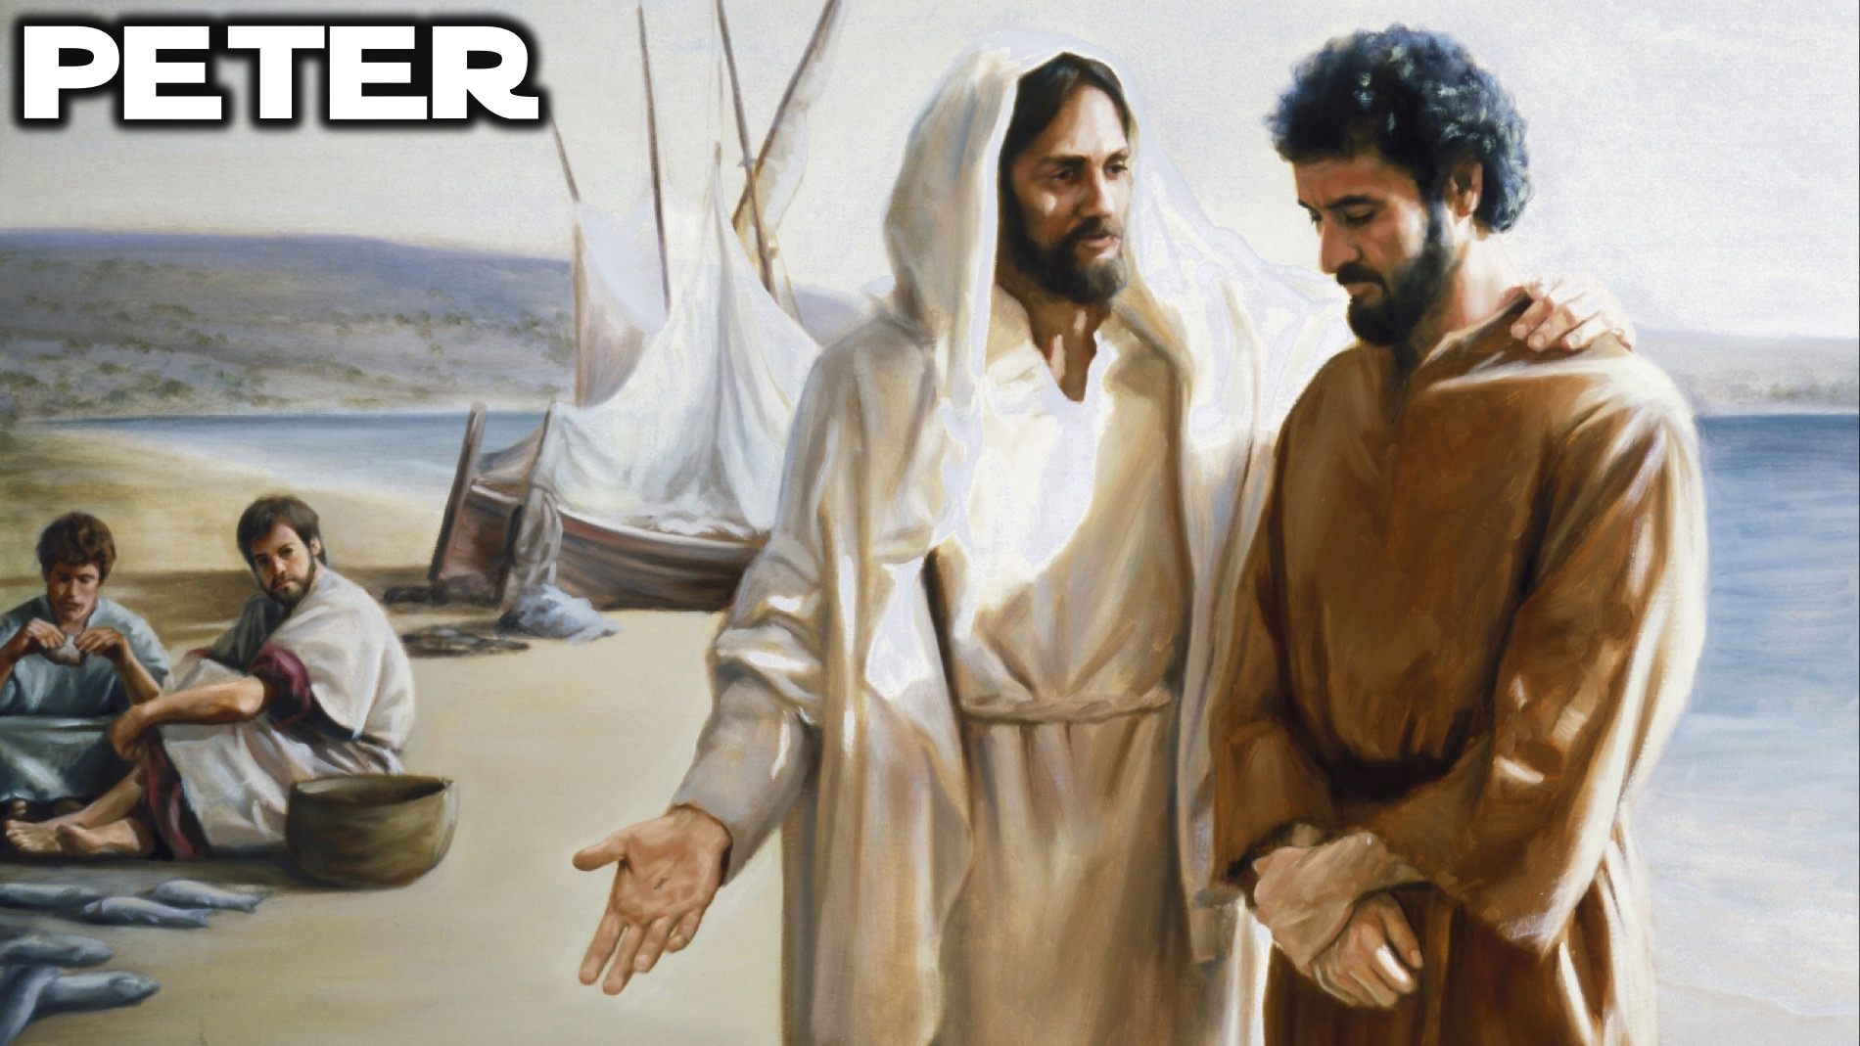
Notes:
Biblical Character: Peter

Slide 9

Notes:
Video: The Call of Peter from The Bible Series on DVD, Disk 2, Episode 6.

Slide 10
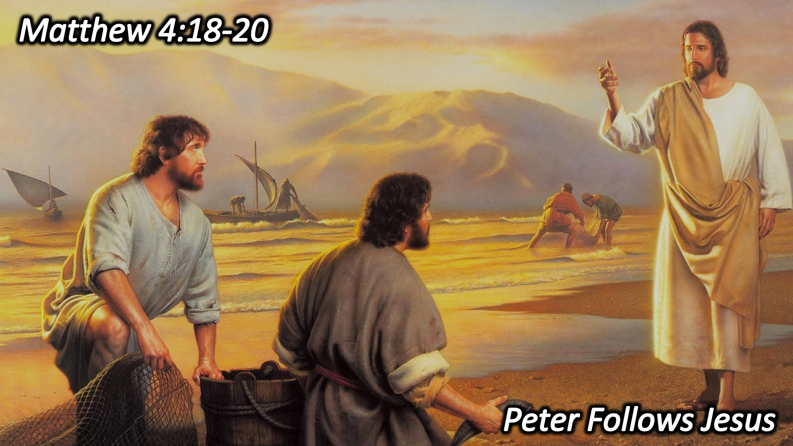
Notes:
Here are a few examples from the life of Peter that reflect how he was Christ-centered:
1. Peter Follow Jesus. When Jesus called Peter to follow him - he literally left everything and started following Jesus. His whole life was changed because he had met Jesus. . As Jesus was walking beside the Sea of Galilee, he saw two brothers, Simon called Peter and his brother Andrew. They were casting a net into the lake, for they were fishermen." "Come, follow me," Jesus said, "and I will make you fishers of men." At once they left their nets and followed him. (Matthew 4:18-20)

Slide 11
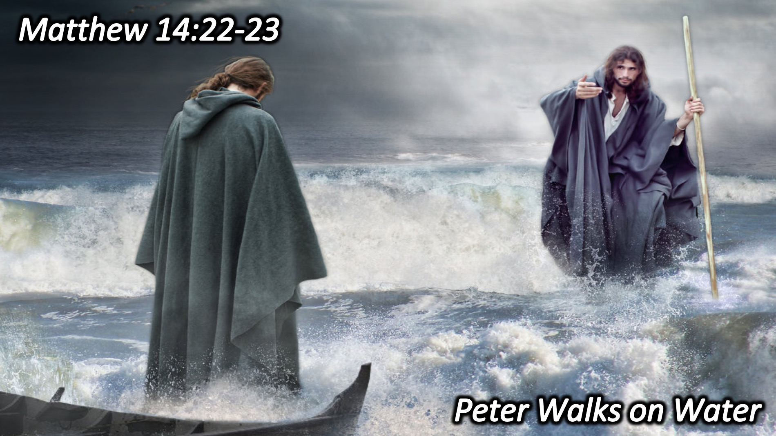
Notes:
2. Peter Walks on Water. During the fourth watch of the night Jesus went out to them, walking on the lake. When the disciples saw him walking on the lake, they were terrified. "It's a ghost," they said, and cried out in fear. But Jesus immediately said to them: "Take courage! It is I. Don't be afraid." "Lord, if it's you," Peter replied, "tell me to come to you on the water." "Come," he said. Then Peter got down out of the boat, walked on the water and came toward Jesus. But when he saw the wind, he was afraid and, beginning to sink, cried out, "Lord, save me!" Immediately Jesus reached out his hand and caught him. "You of little faith," he said, "why did you doubt?" And when they climbed into the boat, the wind died down. Then those who were in the boat worshiped him, saying, "Truly you are the Son of God.“ (Matthew 14:22‑33)

Slide 12
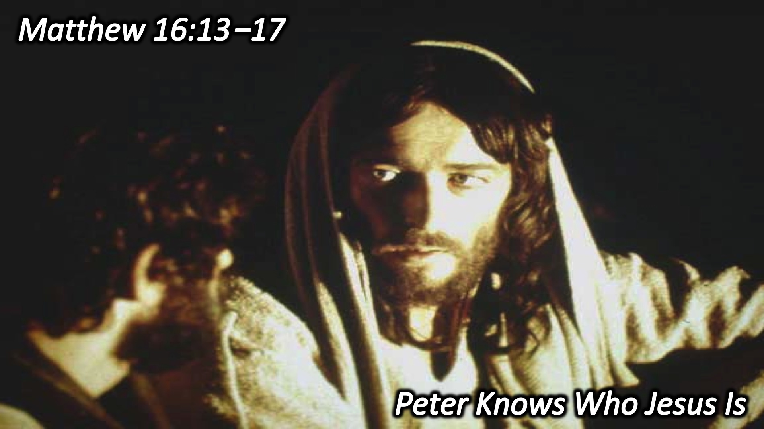
Notes:
3. Peter Knows Who Jesus Is. When Jesus came to the region of Caesarea Philippi, he asked his disciples, "Who do people say the Son of Man is?" They replied, "Some say John the Baptist; others say Elijah; and still others, Jeremiah or one of the prophets." "But what about you?" he asked. "Who do you say I am?" Simon Peter answered, "You are the Christ, the Son of the living God." Jesus replied, "Blessed are you, Simon son of Jonah, for this was not revealed to you by man, but by my Father in heaven." (Matthew 16:13‑17)

Slide 13
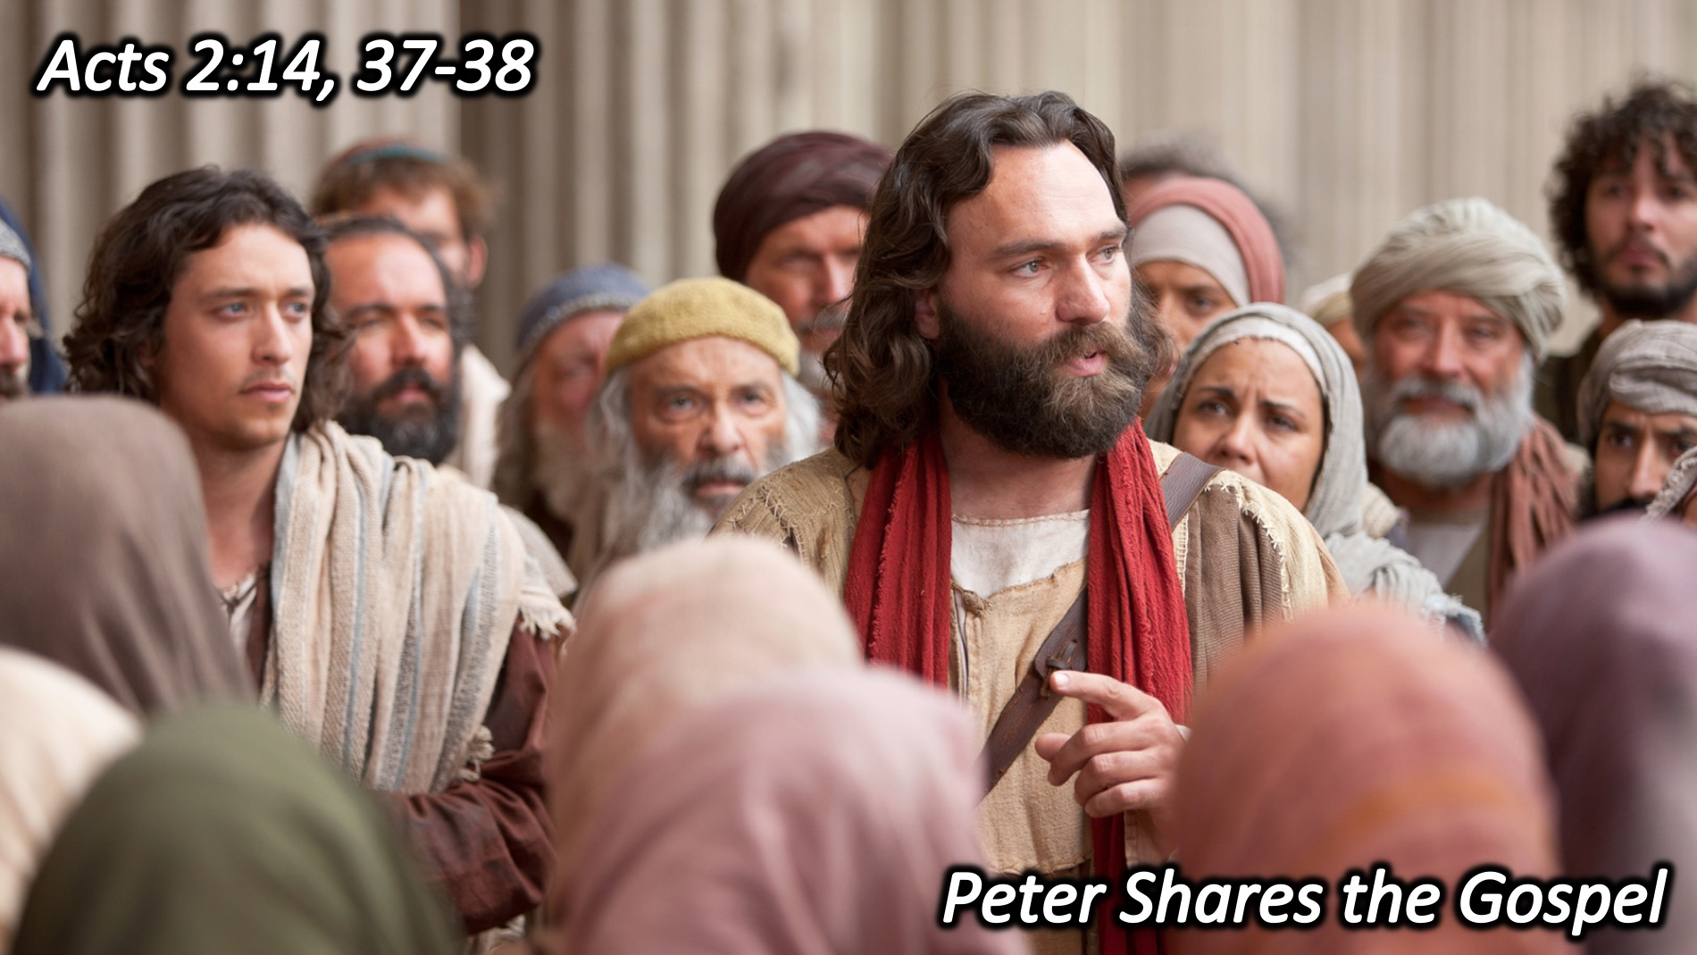
Notes:
4. Peter Shares the Gospel. Then Peter stood up with the Eleven, raised his voice and addressed the crowd: "Fellow Jews and all of you who live in Jerusalem, let me explain this to you; listen carefully to what I say."..."When the people heard this, they were cut to the heart and said to Peter and the other apostles, "Brothers, what shall we do?" Peter replied, "Repent and be baptized, every one of you, in the name of Jesus Christ for the forgiveness of your sins. And you will receive the gift of the Holy Spirit." (Acts 2:14, 37-38)

Slide 14
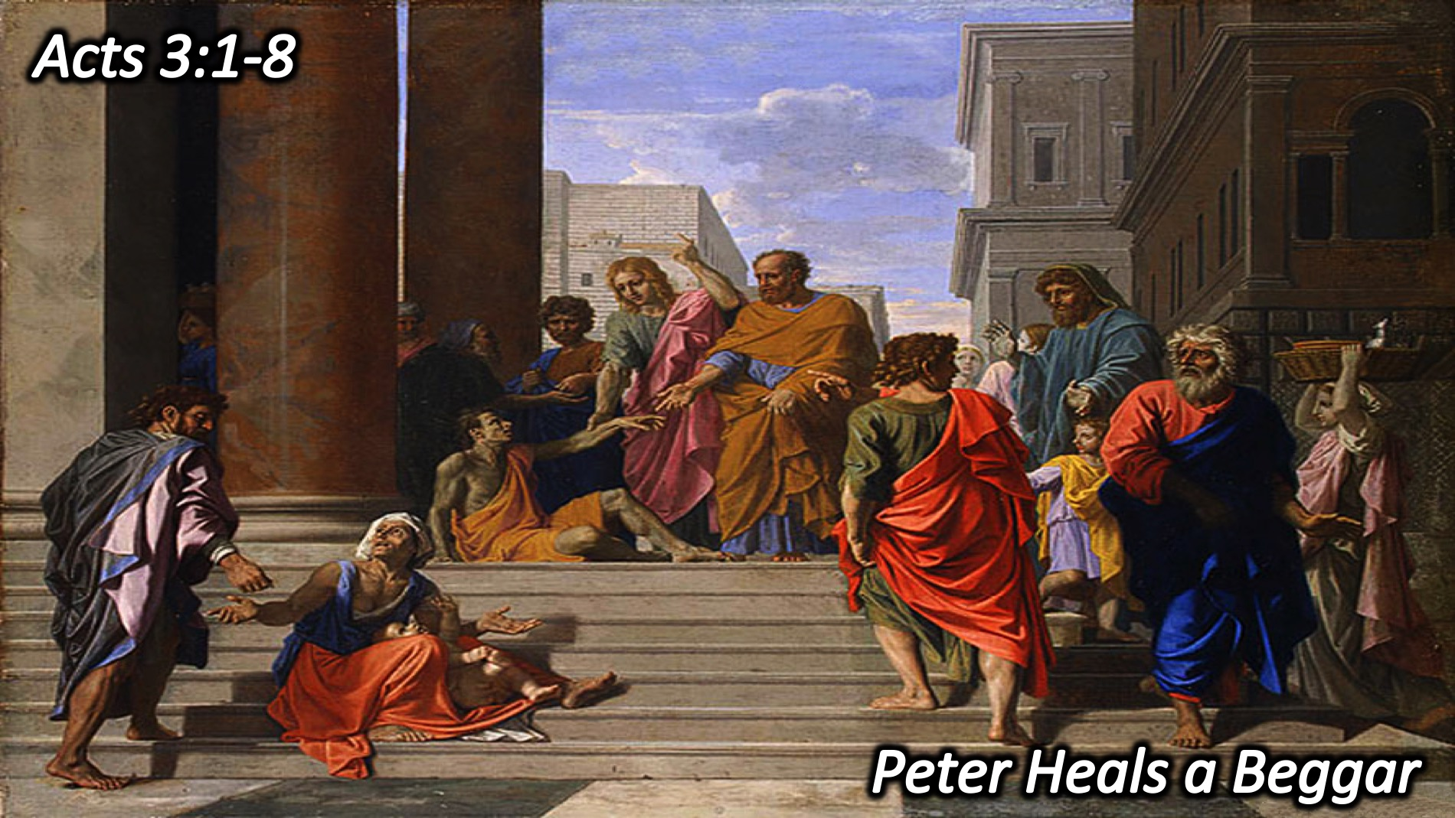
Notes:
5. Peter Heals a Beggar. One day Peter and John were going up to the temple at the time of prayer at three in the afternoon. Now a man crippled from birth was being carried to the temple gate called Beautiful, where he was put every day to beg from those going into the temple courts. When he saw Peter and John about to enter, he asked them for money. Peter looked straight at him, as did John. Then Peter said, "Look at us!" So the man gave them his attention, expecting to get something from them. Then Peter said, "Silver or gold I do not have, but what I have I give you. In the name of Jesus Christ of Nazareth, walk." Taking him by the right hand, he helped him up, and instantly the man's feet and ankles became strong. He jumped to his feet and began to walk. Then he went with them into the temple courts, walking and jumping, and praising God. (Acts 3:1-8)

Slide 15
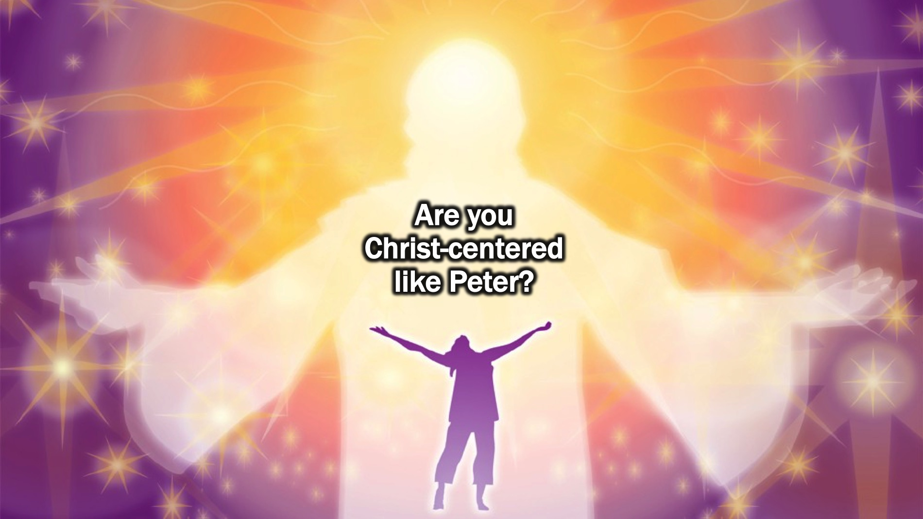
Notes:
Are you Christ-centered like Peter?

Slide 16
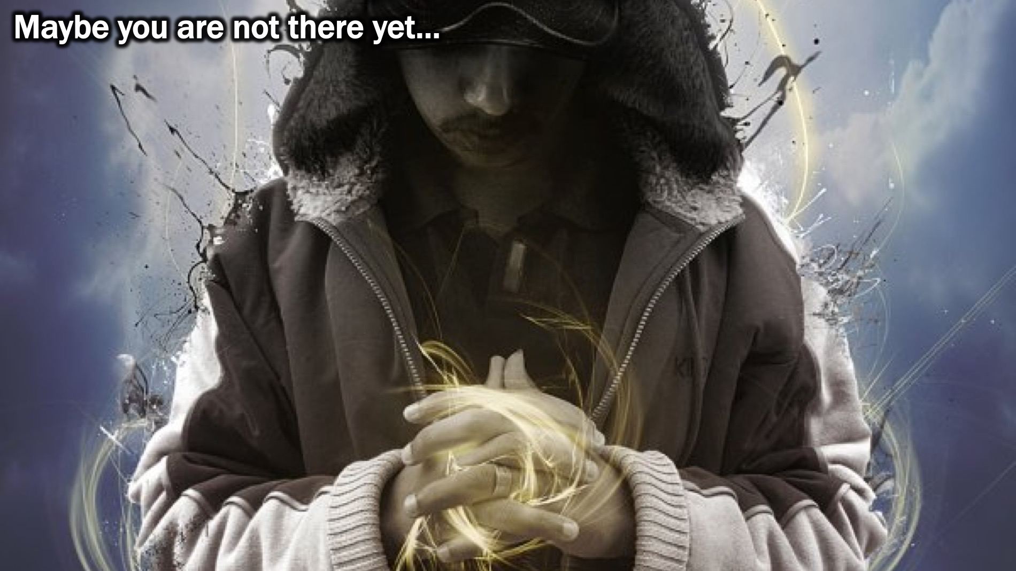
Notes:
Maybe you are not there yet…

Slide 17
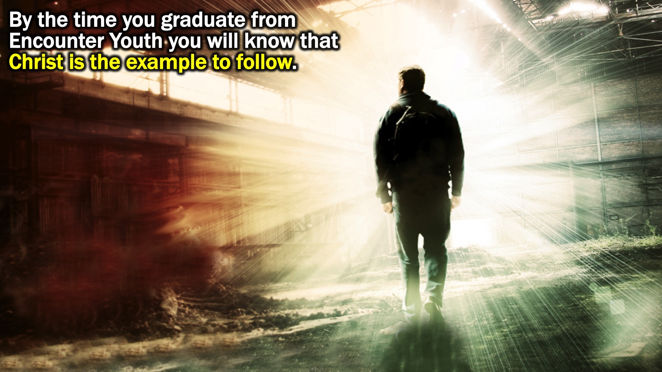
Notes:
By the time you graduate from Encounter Youth you will know that Christ is the example to follow.

Slide 18
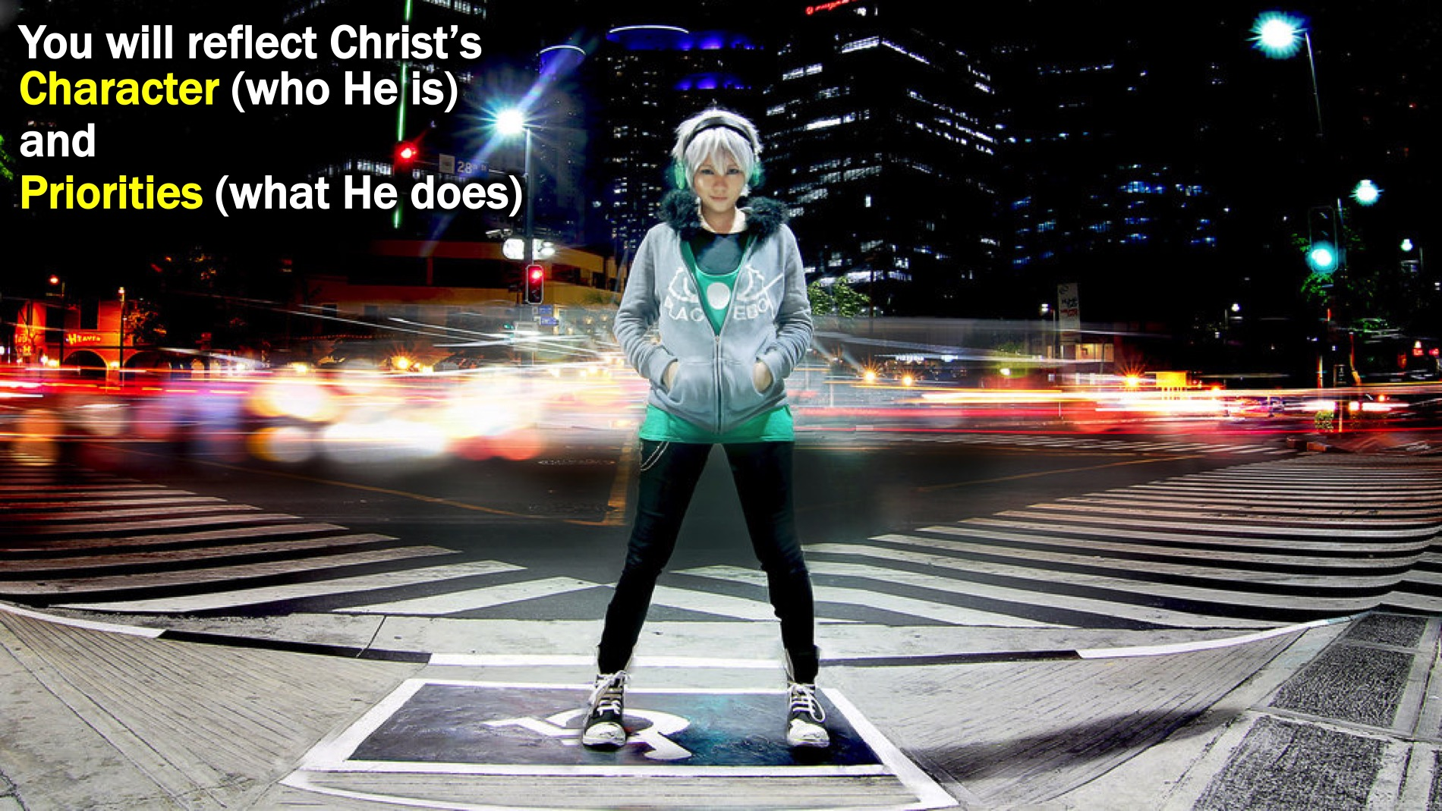
Notes:
You will reflect Jesus’ Character (who He is) and Priorities (what He does).

Slide 19
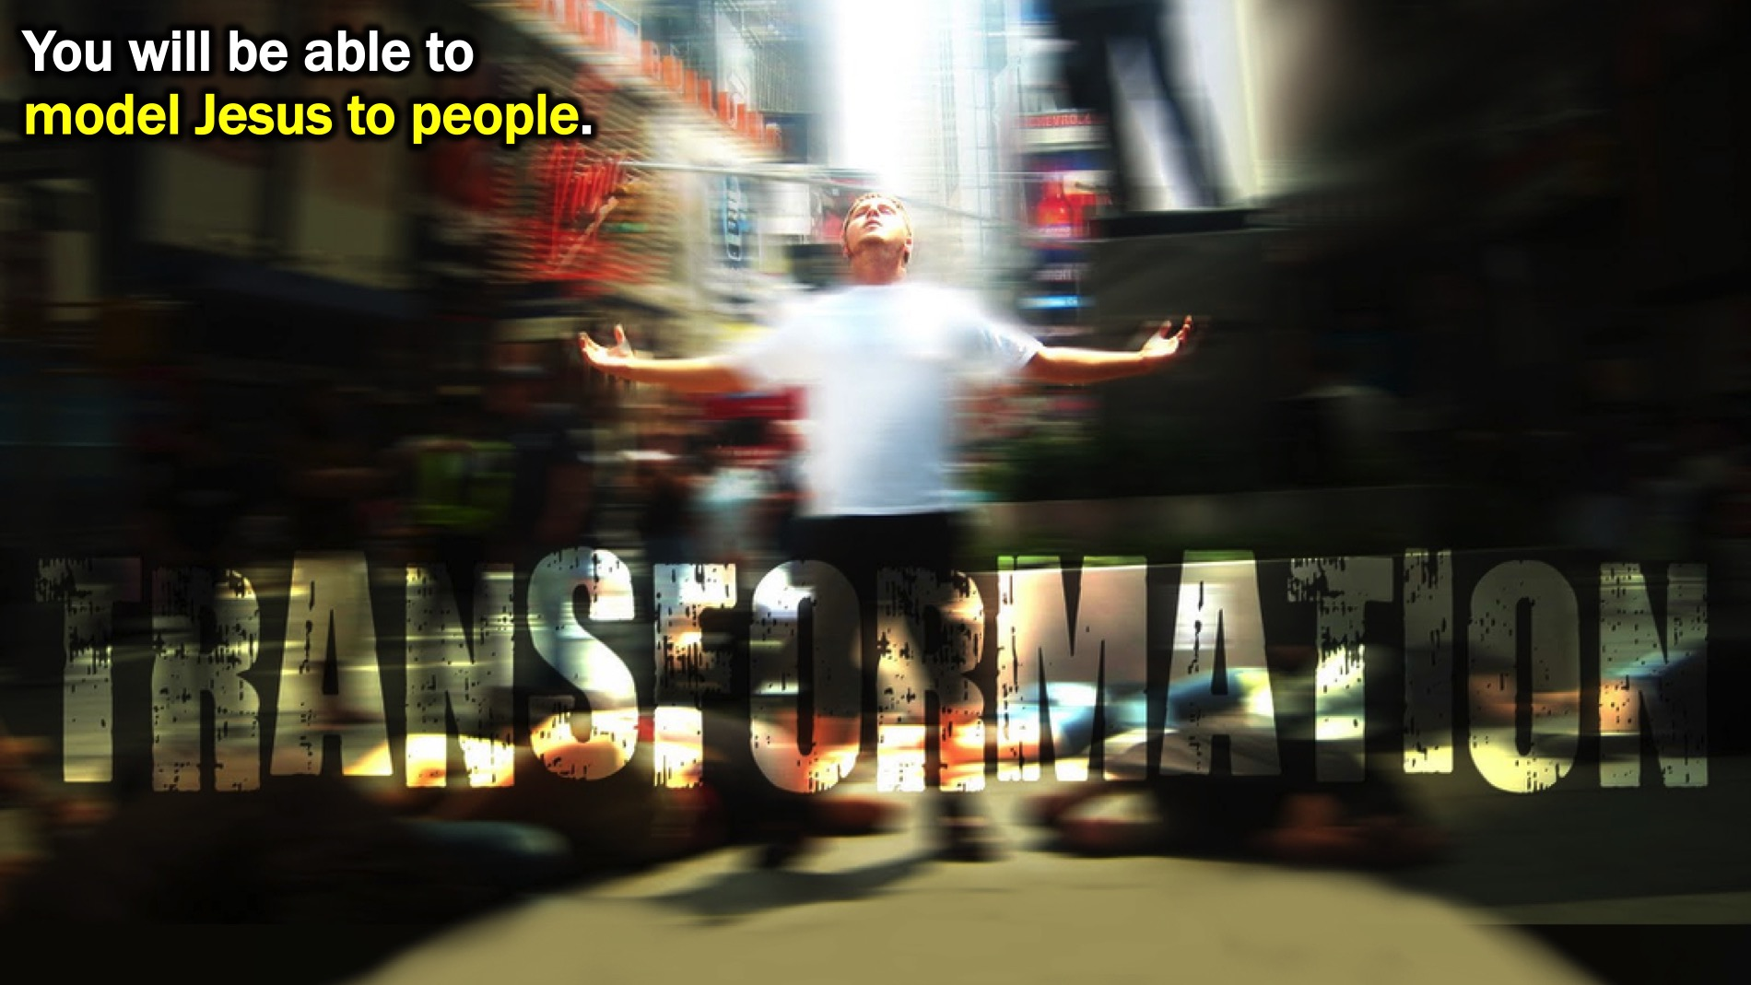
Notes:
You will be able to model Jesus to people. “Follow my example, as I follow the example of Christ..” (1 Corinthians 11:1)

Slide 20
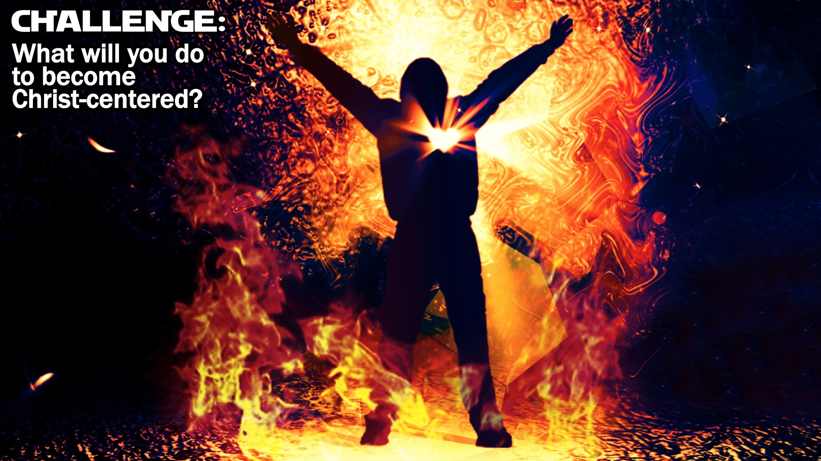
Notes:
Challenge: What will you do to become Christ-centered?

Slide 21
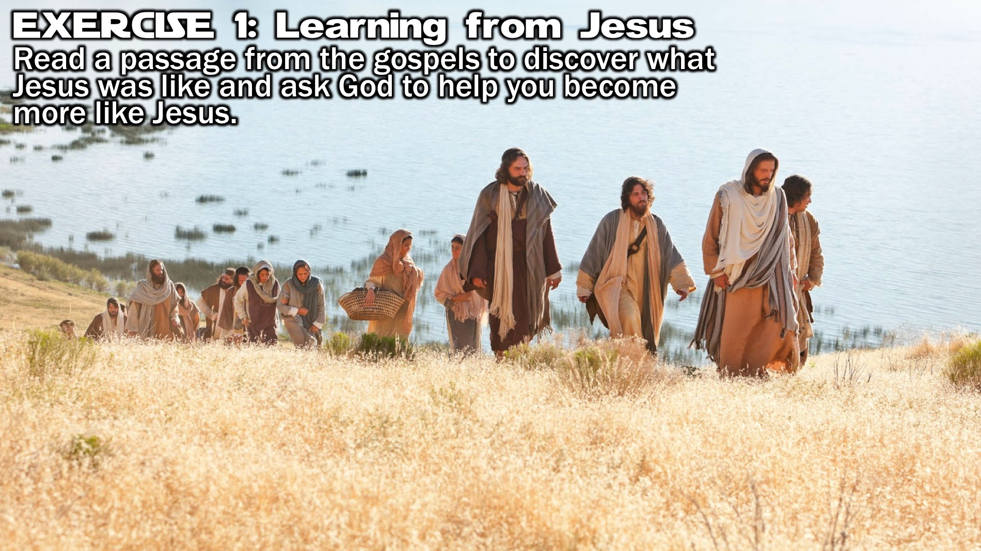
Notes:
Exercise 1: Read a passage from the gospels to discover what Jesus was like and ask God to help you become more like Jesus.

Slide 22
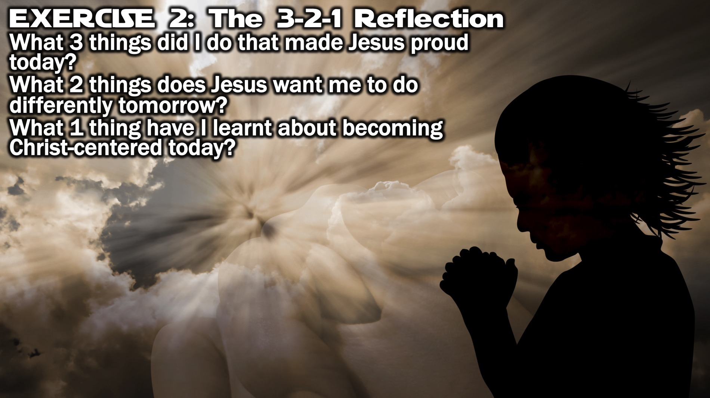
Notes:
Exercise 2: The 3-2-1 Reflection Exercise. Answer these questions at the end of each day: (1) What 3 things did I do that made Jesus proud today? (2) What 2 things does Jesus want me to do differently tomorrow? (3) What 1 thing have I learnt about becoming Christ-centered today?

Slide 23
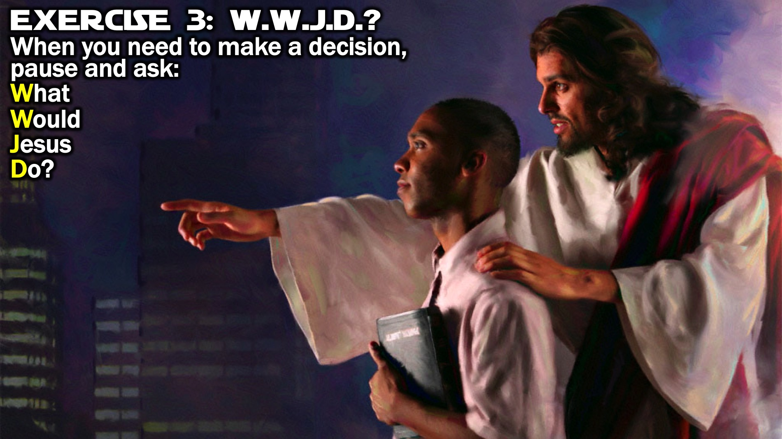
Notes:
Exercise 3: WWJD? Pause each time you need to make a decision and ask What Would Jesus Do?

Slide 24
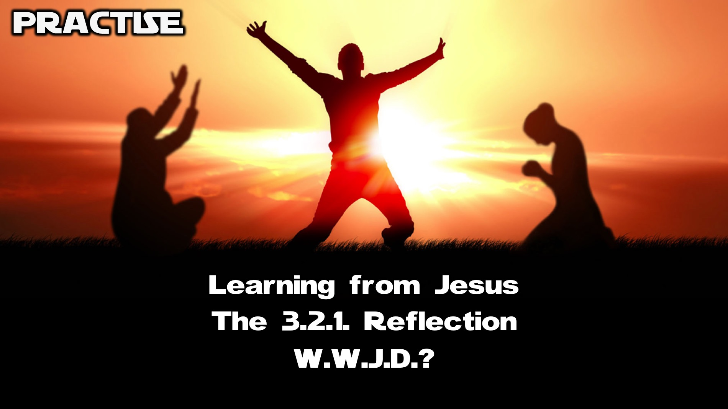
Notes:
Practise: On your table there are pieces of paper with the 3 exercises - choose one of them and do the exercise.

Slide 25
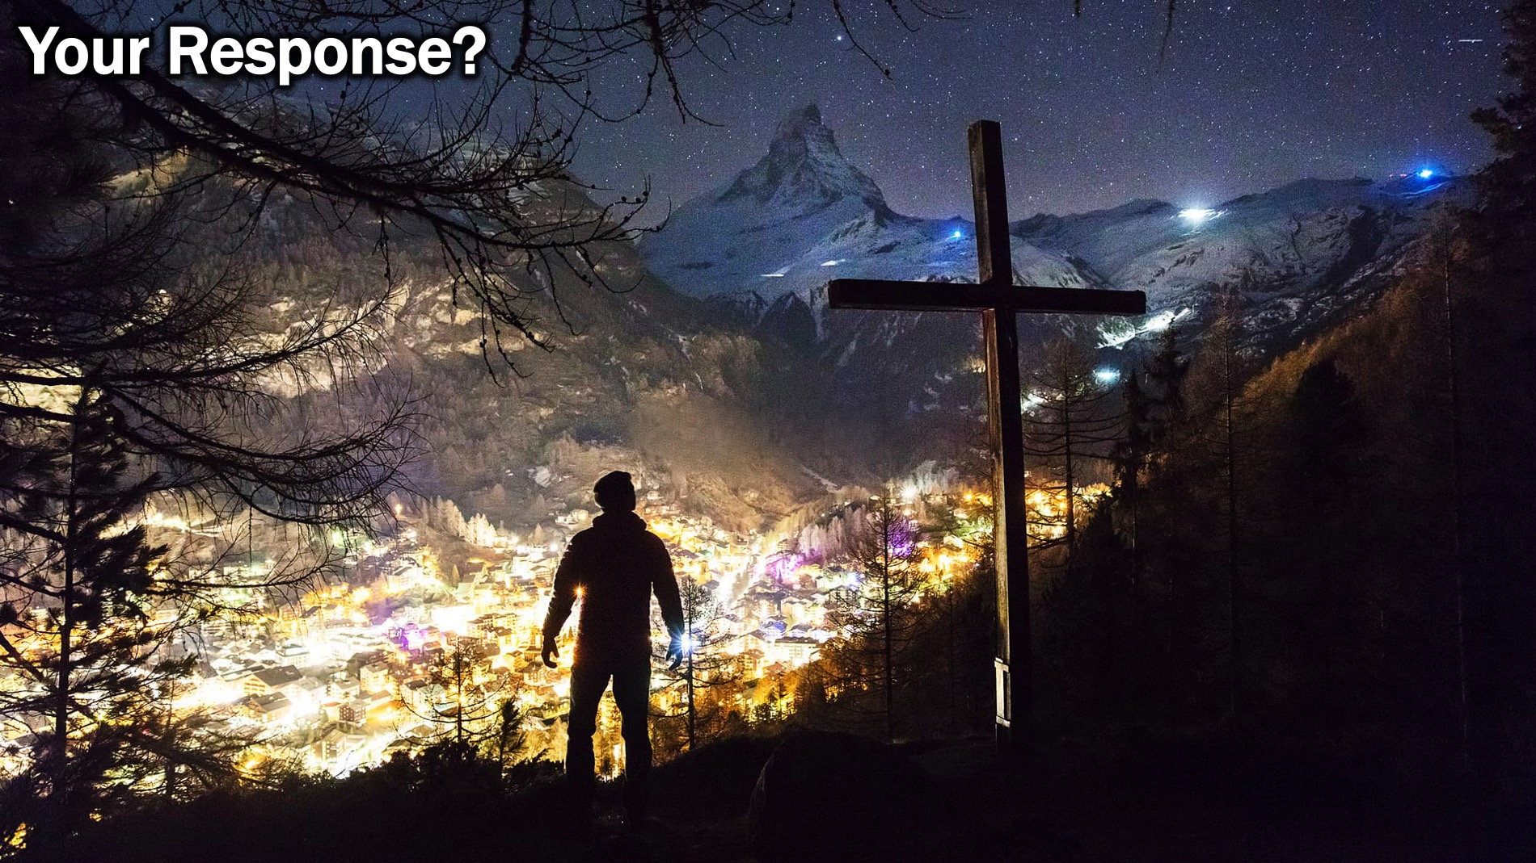
Notes:
So what will your response be to the message you have heard today? Will you work on becoming Christ-centered?

Slide 26
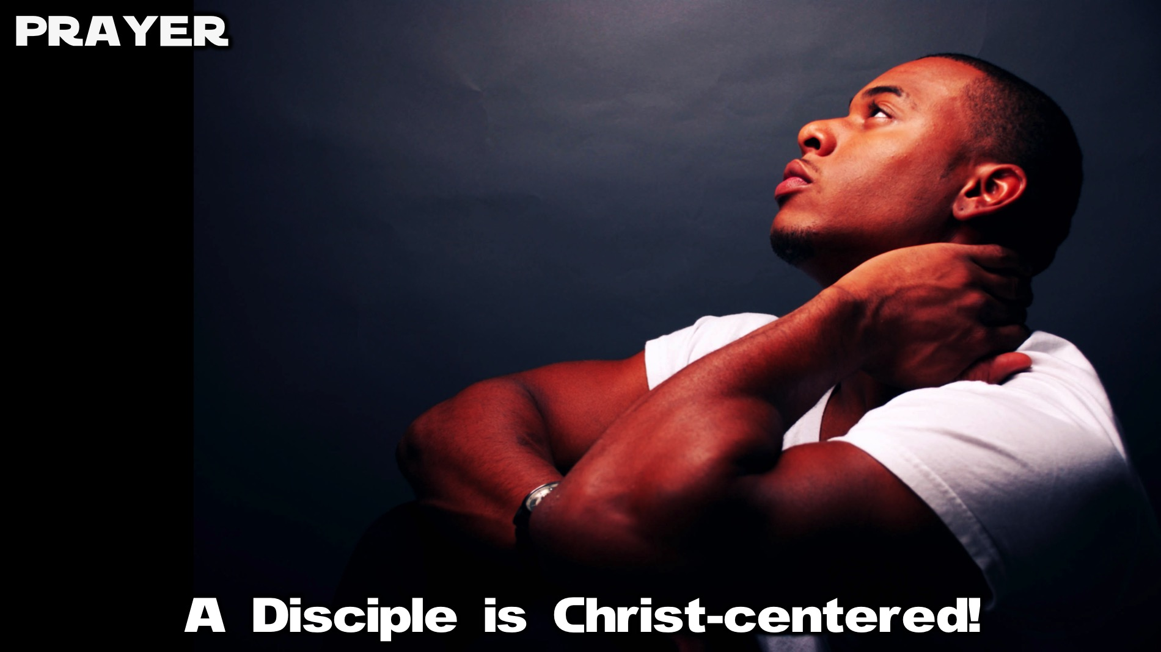
Notes:
Prayer: Let’s ask God to help us become Christ-centered.

Slide 27

Notes:
Next week we will learn that a disciple is Spirit-empowered.

