Slide 1

Notes:
Welcome to the Disciple Series.

Slide 2

Notes:
In Week 1 we learnt that a disciple is Word-based.

Slide 3
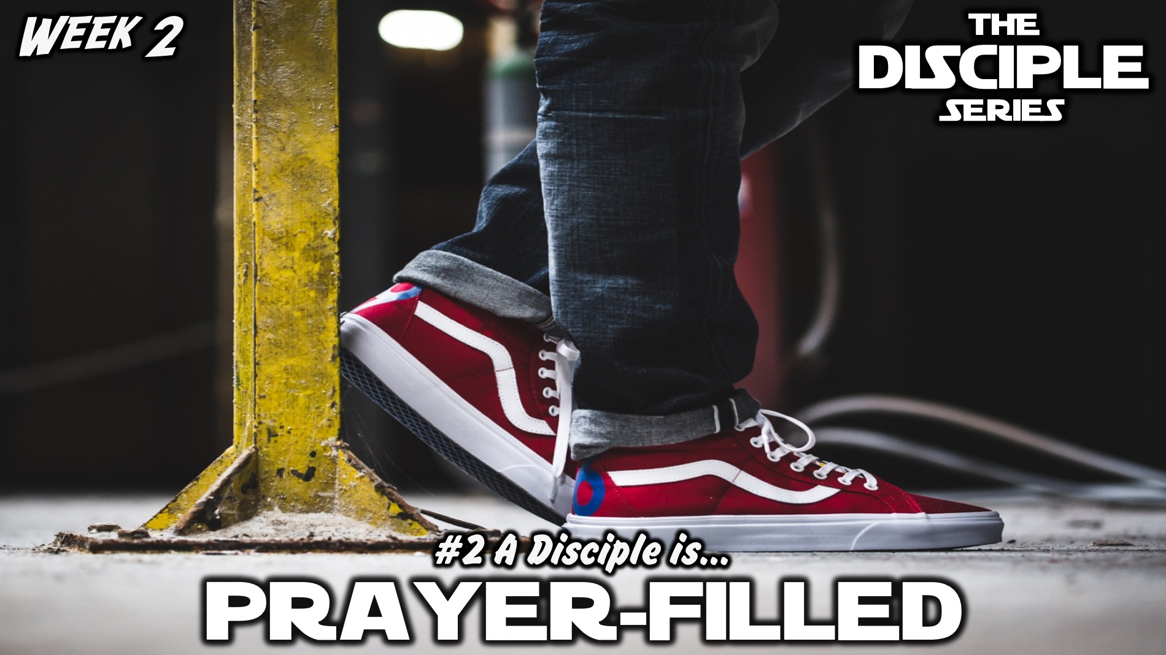
Notes:
In Week 2 we learnt that a disciple is Prayer-filled.

Slide 4
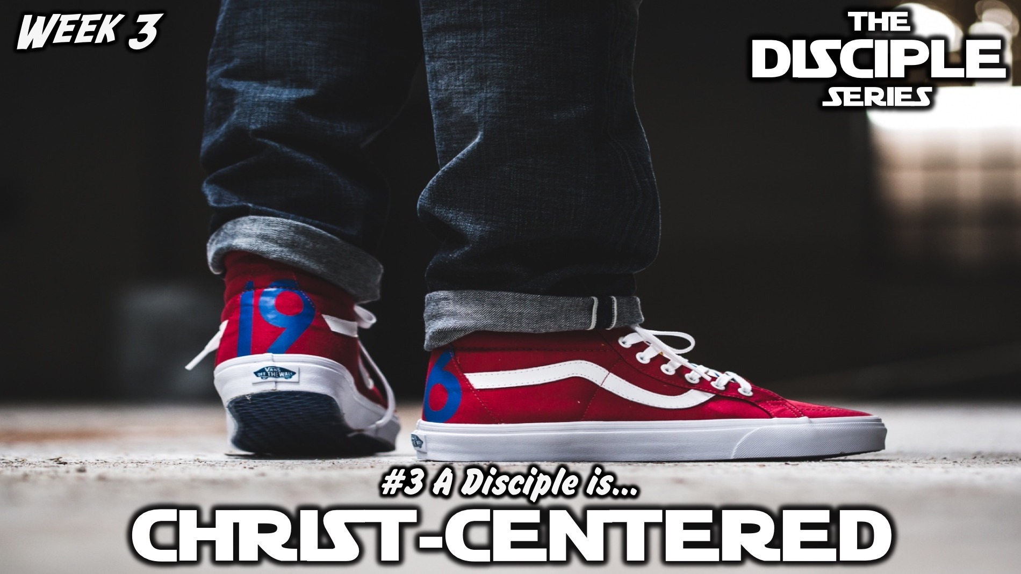
Notes:
Last week we learnt that a disciple is Christ-centered.

Slide 5
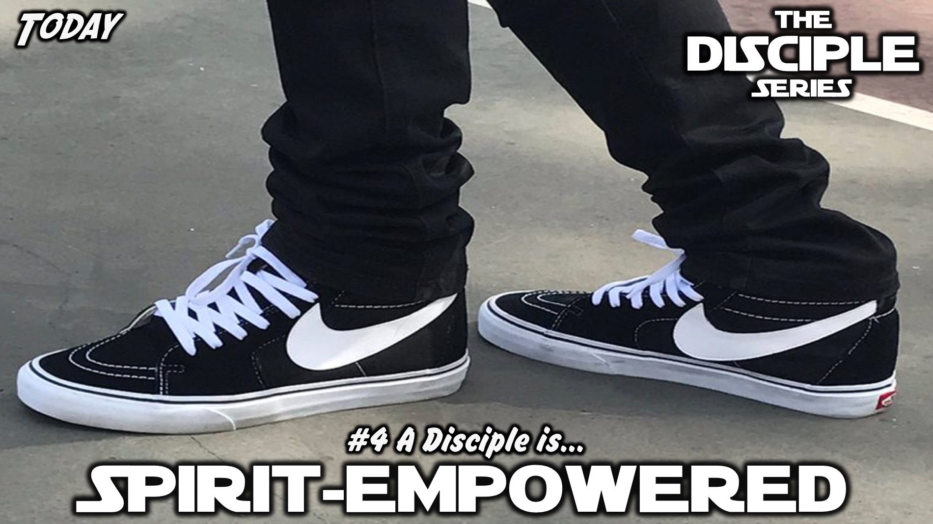
Notes:
Today we are going to discover that a disciple is spirit-empowered.

Slide 6
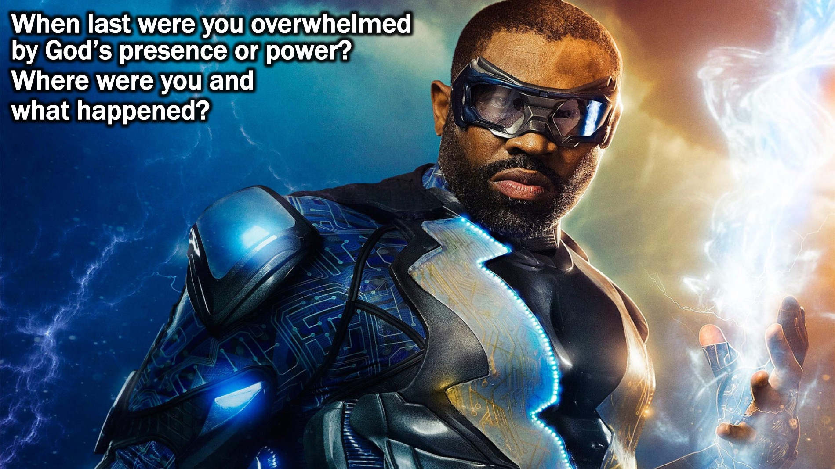
Notes:
Small Group Question: When last were you overwhelmed by God’s presence or power? Where were you and what happened?

Slide 7
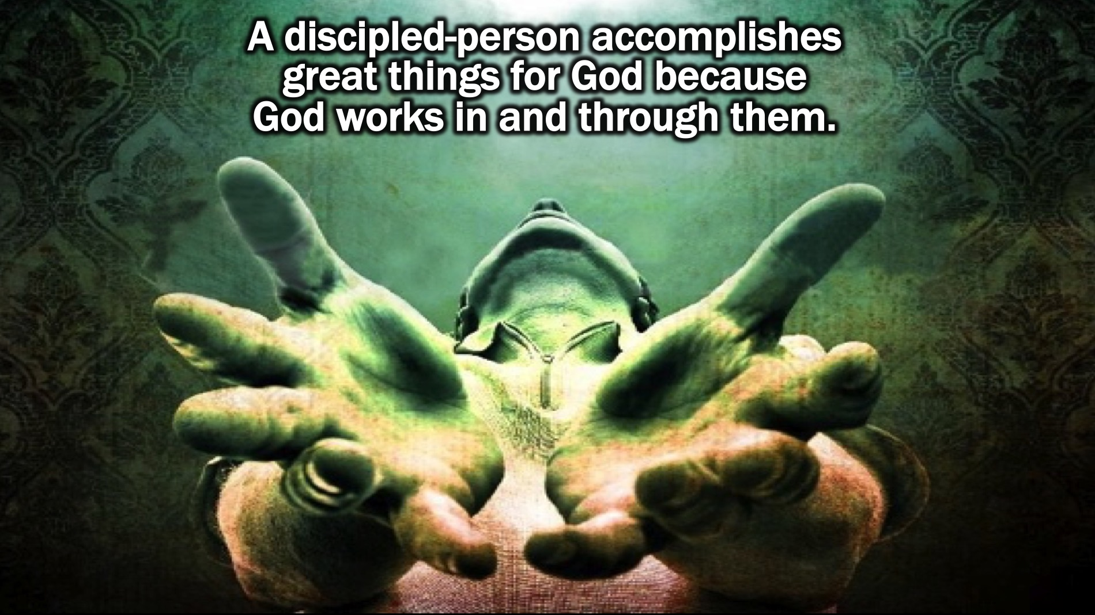
Notes:
So as disciples we are called to be Spirit-empowered. A discipled-person accomplishes great things for God because God works in and through them.

Slide 8
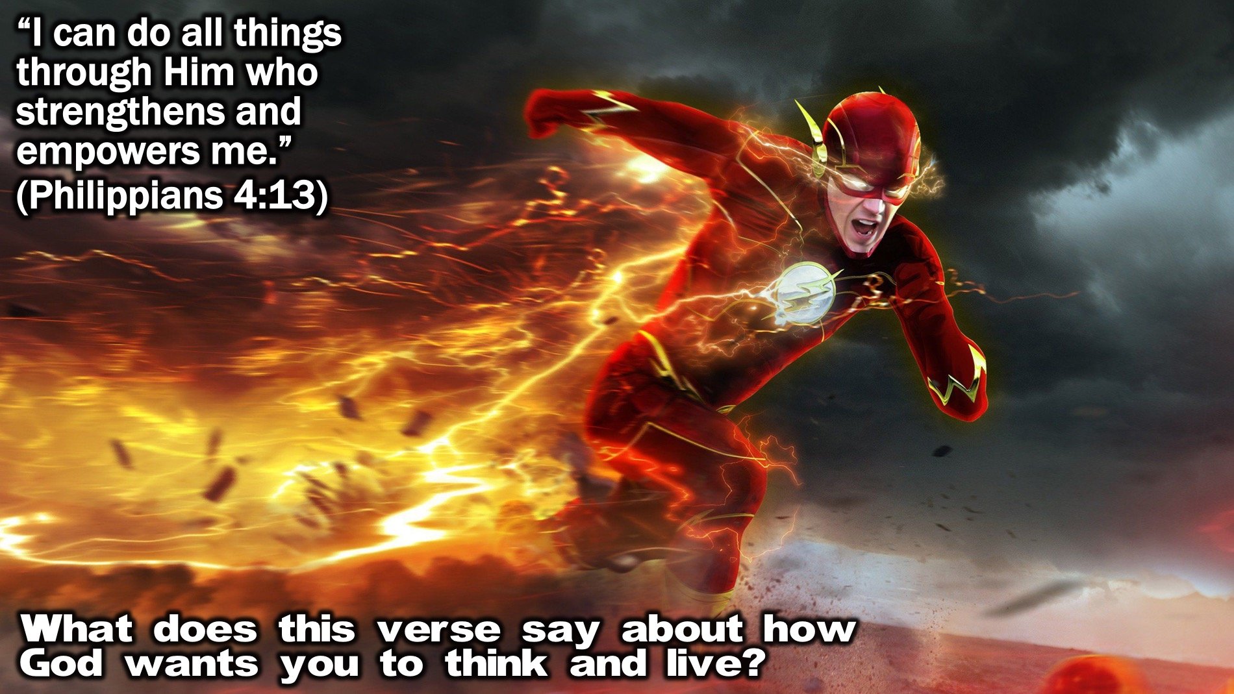
Notes:
Bible Passage: “I can do all things through Him who strengthens and empowers me.” (Philippians 4:13)
Small Group Question: What does this verse say about how God wants you to think and live?

Slide 9

Notes:
Biblical Character: Samson

Slide 10
Notes:
Video: The Story of Samson merged from 2 Samson movie trailers. Get them on YouTube at: https://www.youtube.com/watch?v=mSolF3QBVBY and https://www.youtube.com/watch?v=mSolF3QBVBY.

Slide 11
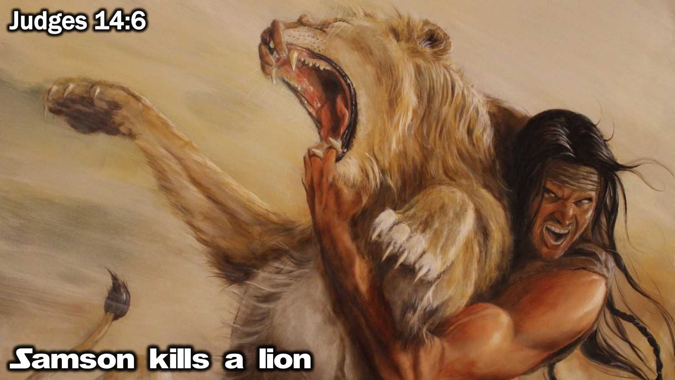
Notes:
Here are three stories from the life of Samson that show how he was filled with the Holy Spirit to do extraordinary things:
1. Samson Kills a Lion: “As Samson and his parents were going down to Timnah, a young lion suddenly attacked Samson near the vineyards of Timnah. At that moment the Spirit of the Lord came powerfully upon him, and he ripped the lion’s jaws apart with his bare hands. He did it as easily as if it were a young goat.” (Judges 14:6)

Slide 12
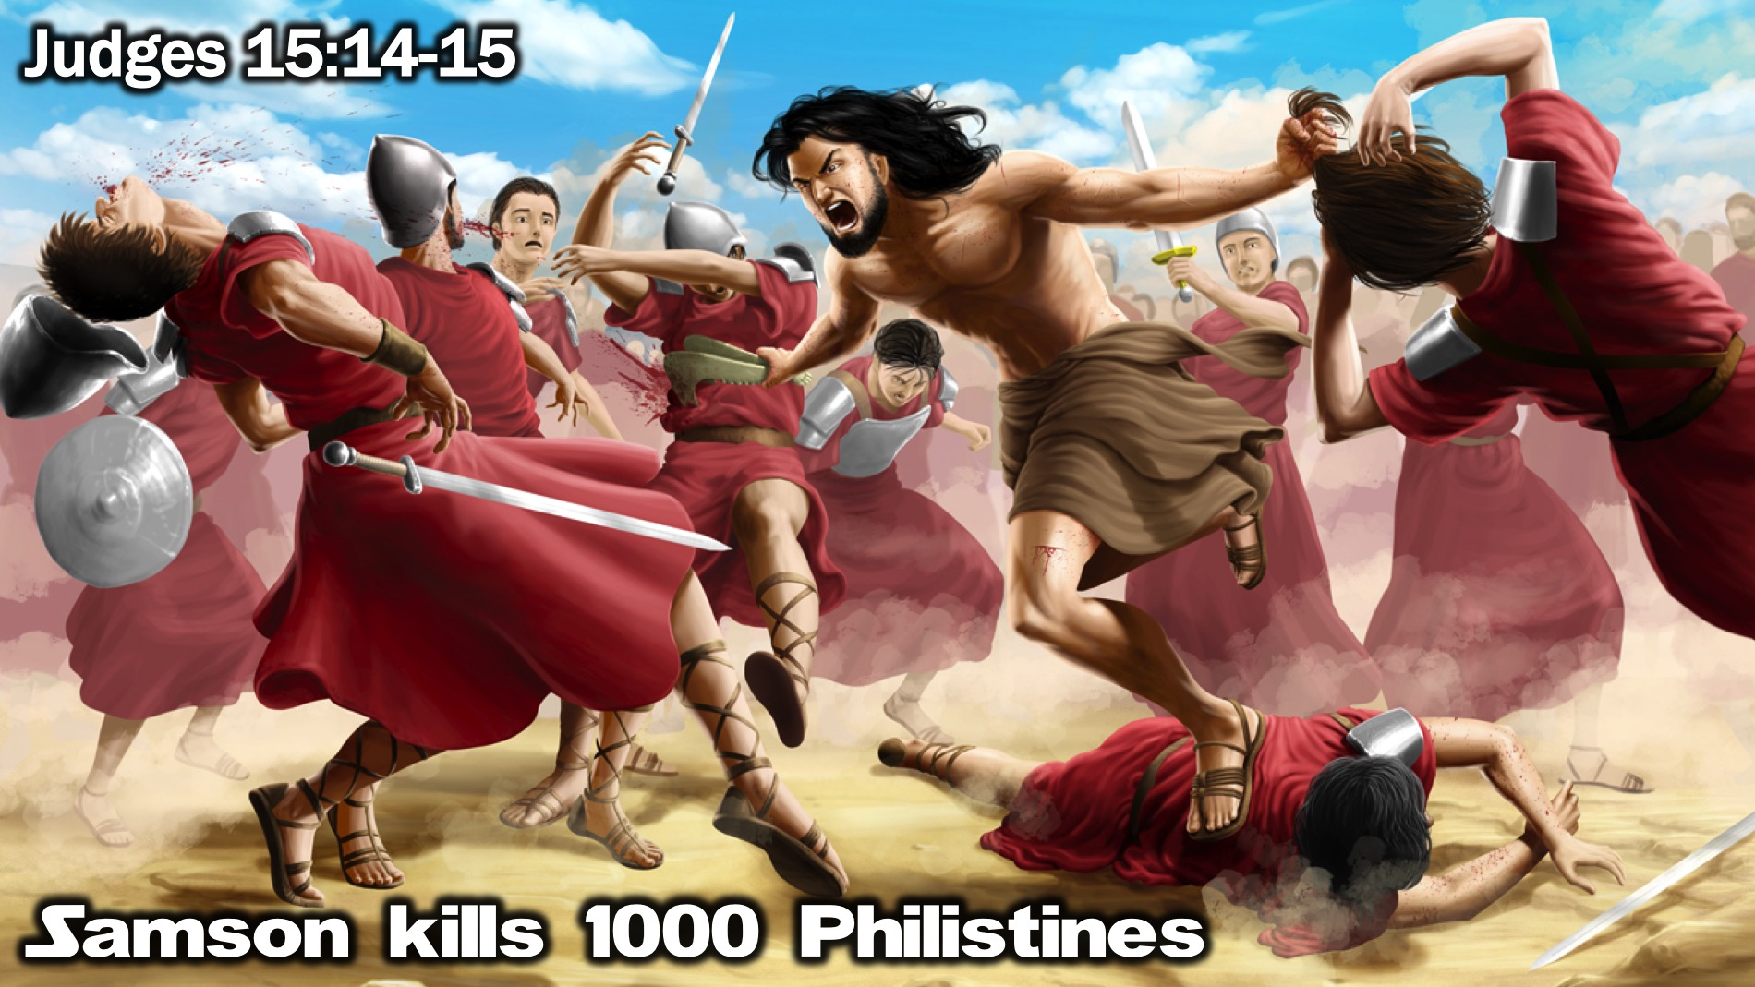
Notes:
2. Samson Kills 1000 Philistines: “As Samson arrived at Lehi, the Philistines came shouting in triumph. But the Spirit of the Lord came powerfully upon Samson, and he snapped the ropes on his arms as if they were burnt strands of flax, and they fell from his wrists. Then he found the jawbone of a recently killed donkey. He picked it up and killed 1,000 Philistines with it.” (Judges 15:14-15)

Slide 13
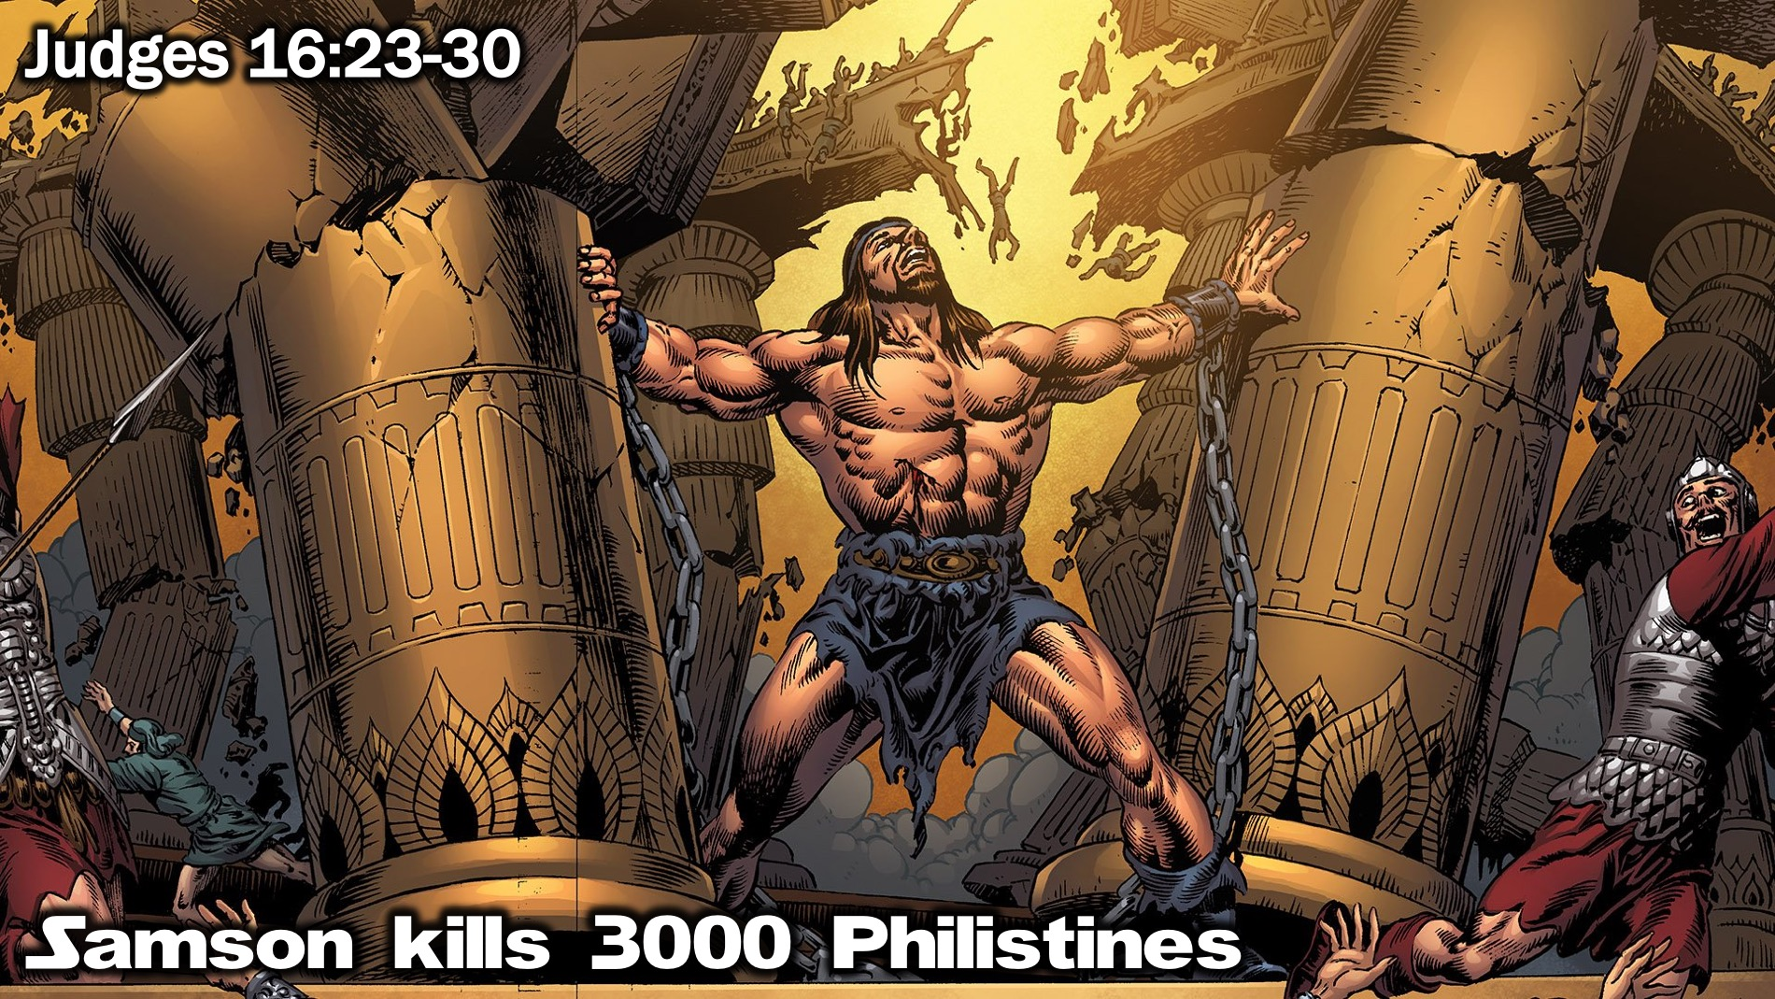
Notes:
3. Samson Kills 3000 Philistines: “The Philistine rulers held a great festival, offering sacrifices and praising their god, Dagon. They said, “Our god has given us victory over our enemy Samson!” When the people saw him, they praised their god, saying, “Our god has delivered our enemy to us! The one who killed so many of us is now in our power!” Half drunk by now, the people demanded, “Bring out Samson so he can amuse us!” So he was brought from the prison to amuse them, and they had him stand between the pillars supporting the roof. Samson said to the young servant who was leading him by the hand, “Place my hands against the pillars that hold up the temple. I want to rest against them.” Now the temple was completely filled with people. All the Philistine rulers were there, and there were about 3,000 men and women on the roof who were watching as Samson amused them. Then Samson prayed to the Lord, “Sovereign Lord, remember me again. O God, please strengthen me just one more time. With one blow let me pay back the Philistines for the loss of my two eyes.” Then Samson put his hands on the two center pillars that held up the temple. Pushing against them with both hands, he prayed, “Let me die with the Philistines.” And the temple crashed down on the Philistine rulers and all the people. So he killed more people when he died than he had during his entire lifetime.” (Judges 16:23-30)

Slide 14
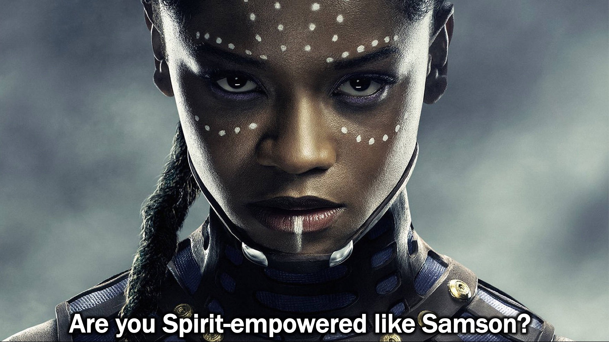
Notes:
Question: Are you Spirit-empowered like Samson?

Slide 15
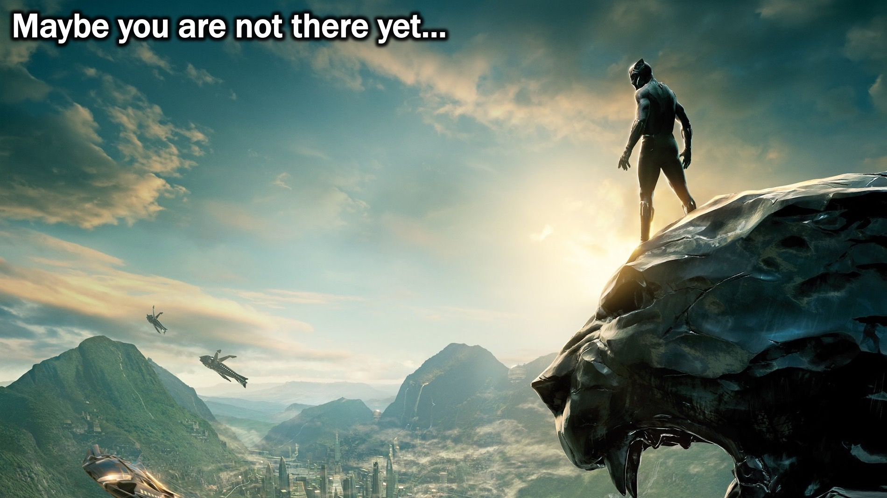
Notes:
Maybe you are not there yet…

Slide 16

Notes:
By the time you graduate from Encounter Youth you will know that the Spirit empowers you to do what you can’t do in you own strength.

Slide 17
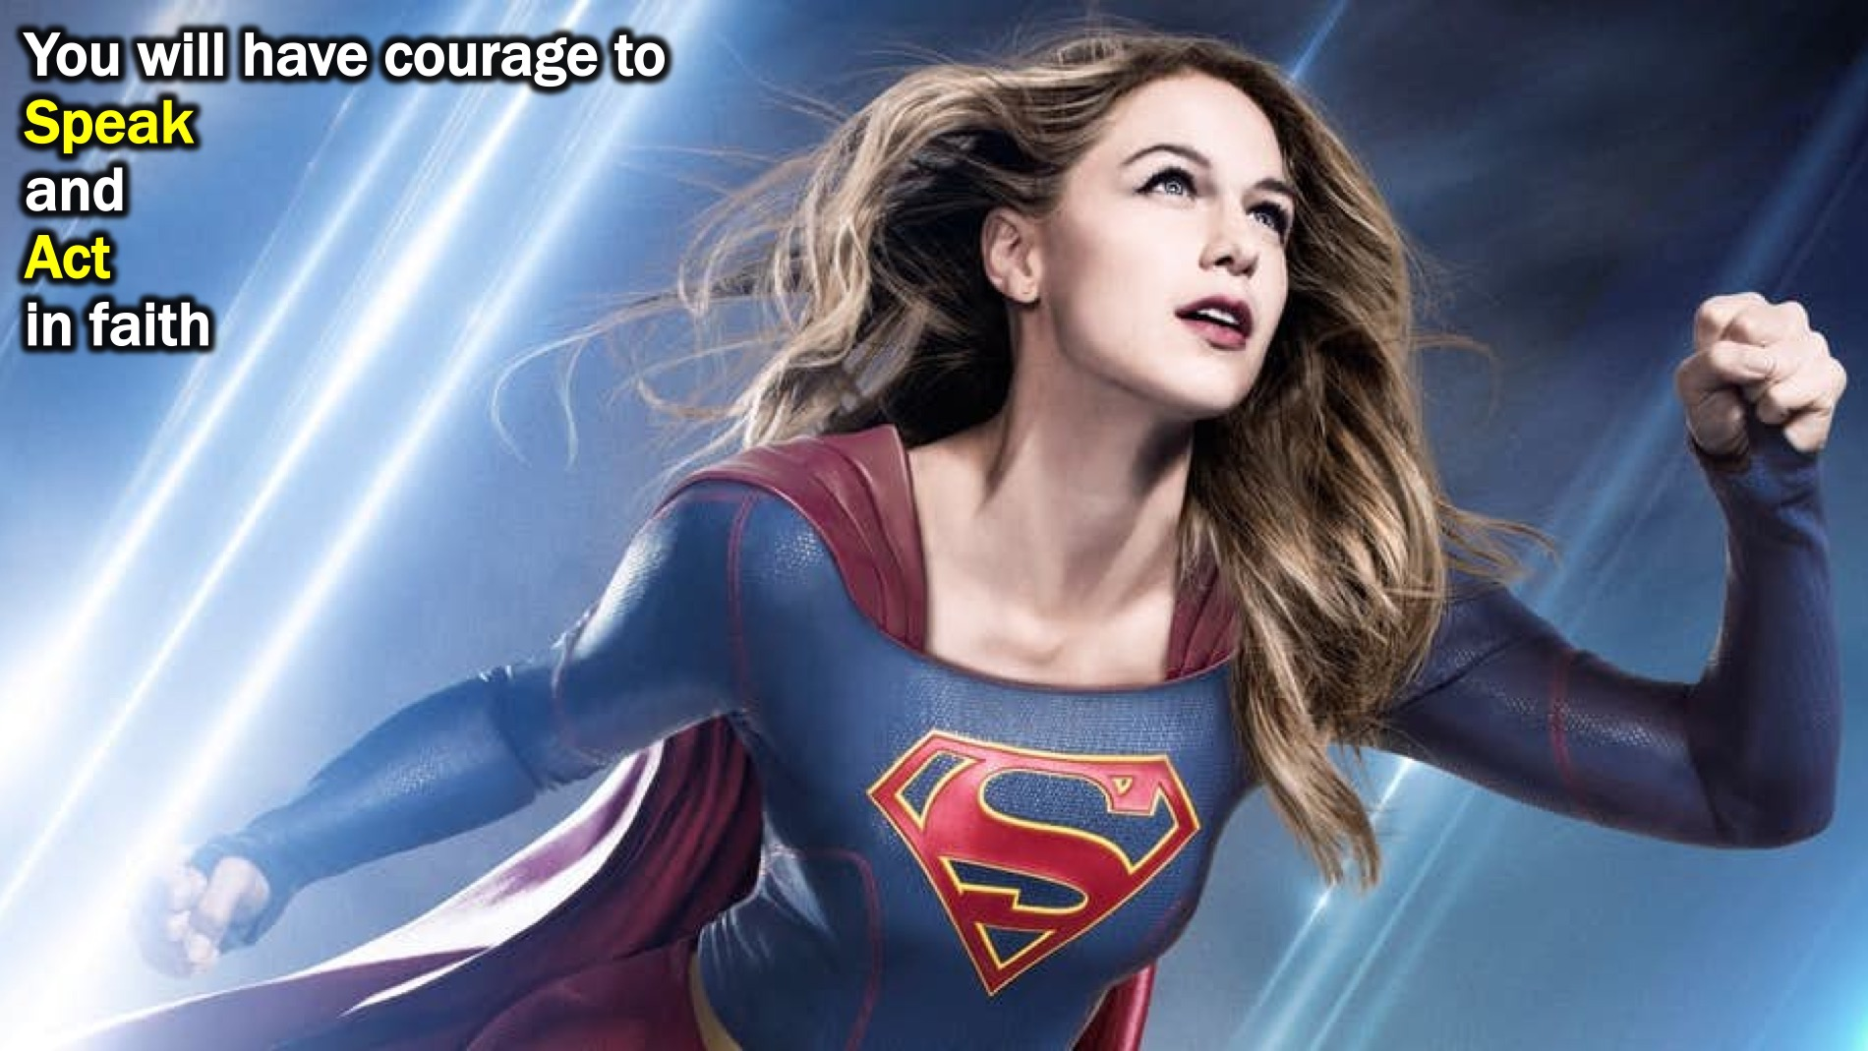
Notes:
You will have courage to Speak and Act in faith.

Slide 18
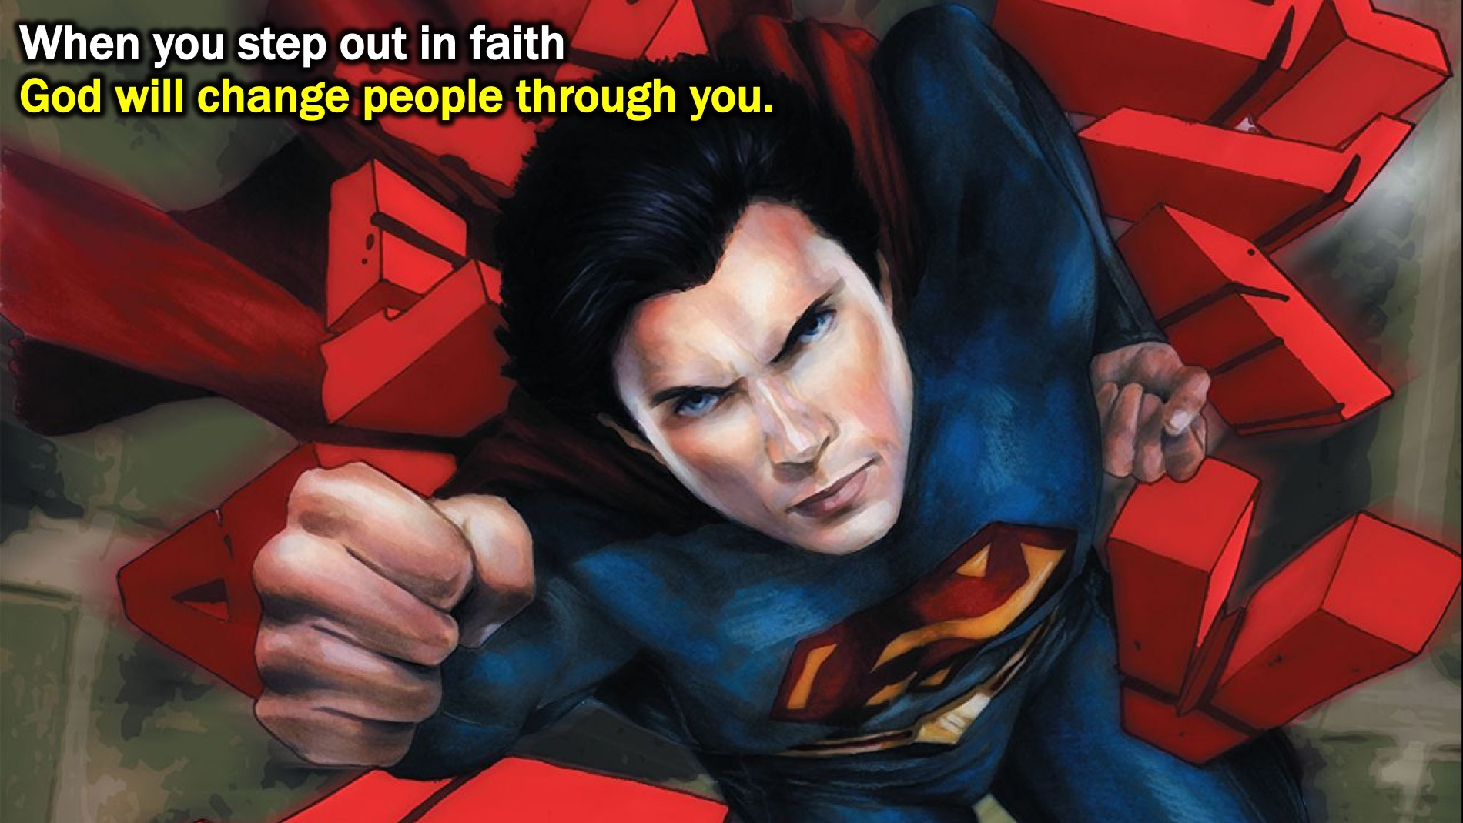
Notes:
When you step out in faith, God will change people through you.

Slide 19

Notes:
Challenge: Do you want to be Spirit-filled?

Slide 20
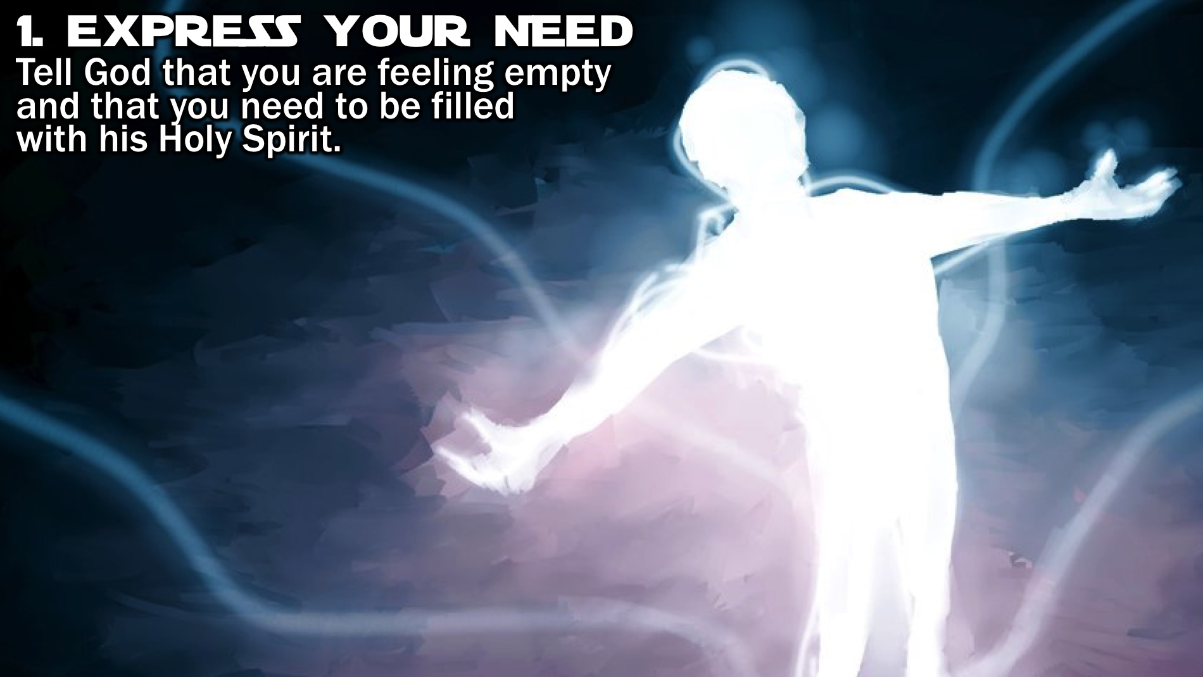
Notes:
Step #1: Express Your Need. Tell God that you are feeling empty and that you need to be filled with his Holy Spirit.

Slide 21
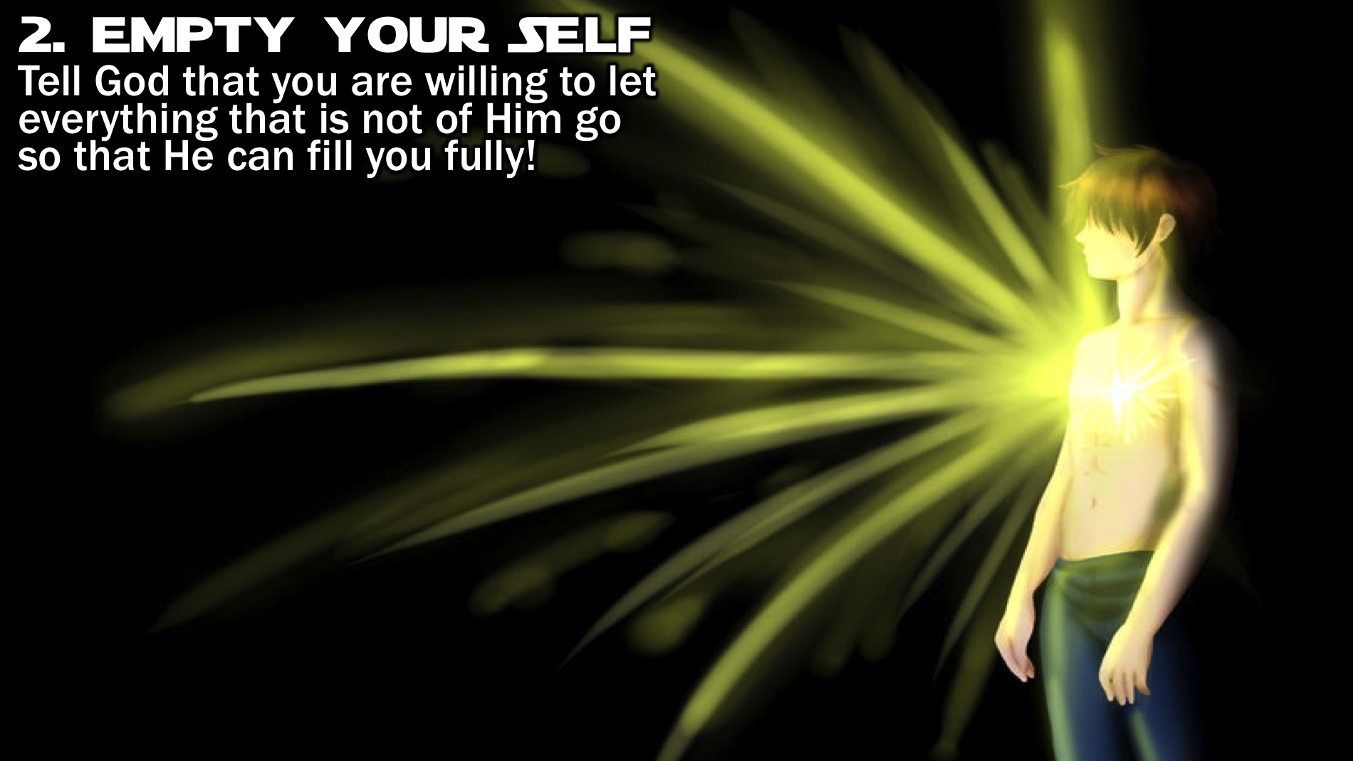
Notes:
Step #2: Empty Your Self. Tell God that you are willing to let everything that is not of Him go so that He can fill you fully!

Slide 22
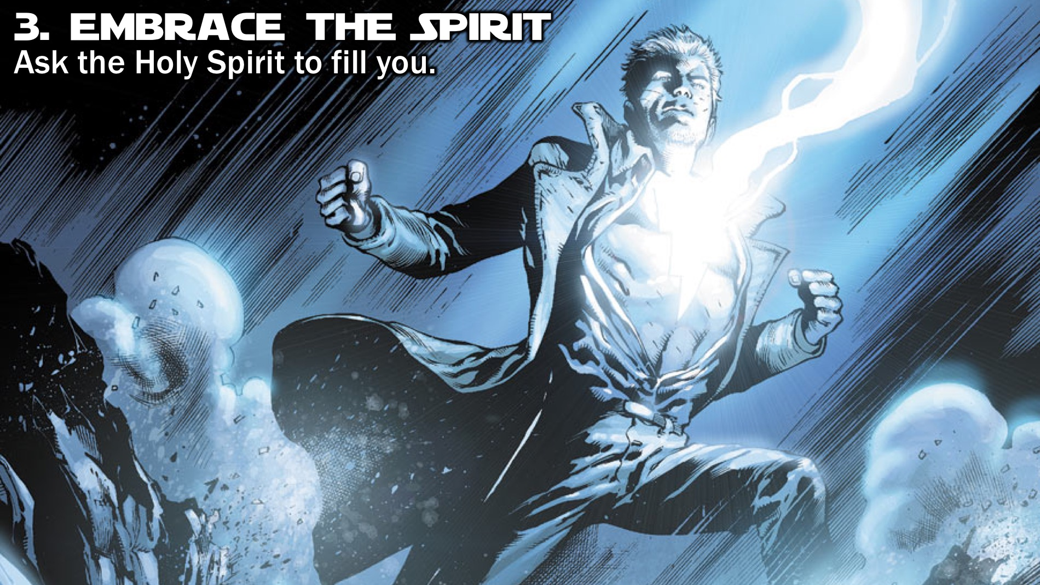
Notes:
Step #3: Embrace The Spirit. Ask the Holy Spirit to fill you and believe that he will do it!

Slide 23
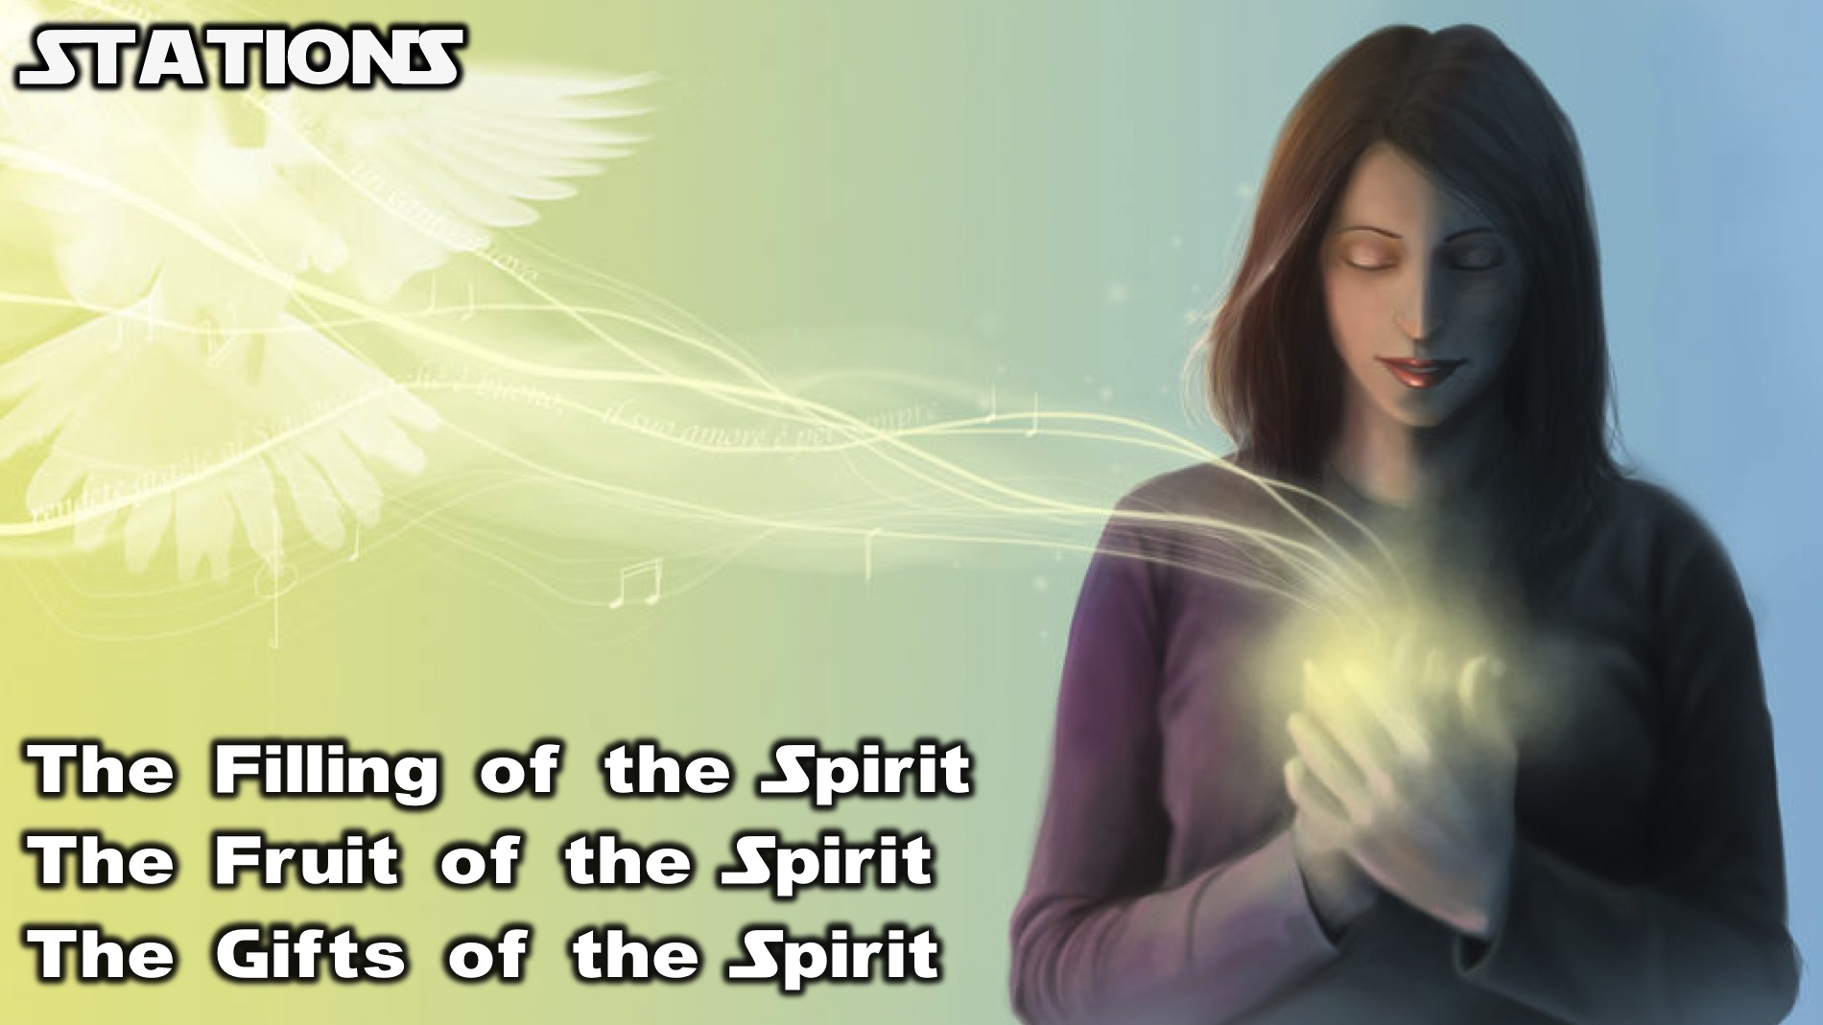
Notes:
Stations: We have 3 stations around the room that you can visit to encounter the Holy Spirit. (1) The Filling of the Spirit where someone will pray for you to be filled with the Holy Spirit. (2) The Fruit of the Spirit where you can ask the Holy Spirit to produce His fruit in your life. (3) The Gifts of the Spirit where you can pray that the Holy Spirit will give you a spiritual gifts so you can do his work.

Slide 24
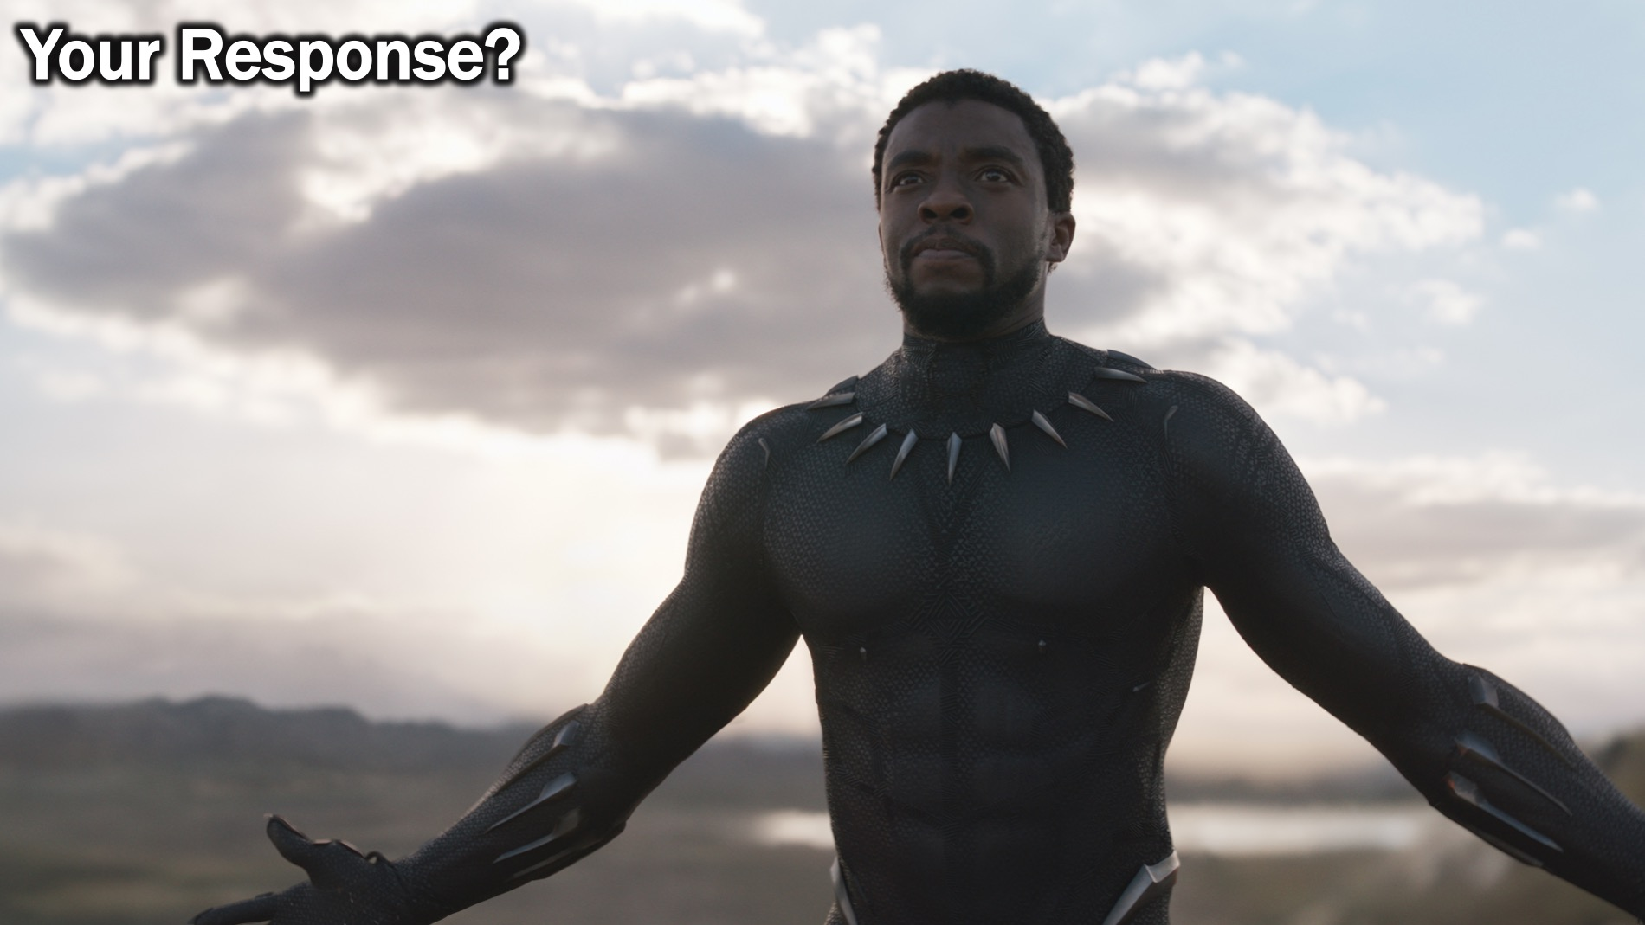
Notes:
What will your response be to the message you have heard today? Will you work on becoming Spirit-empowered?

Slide 25
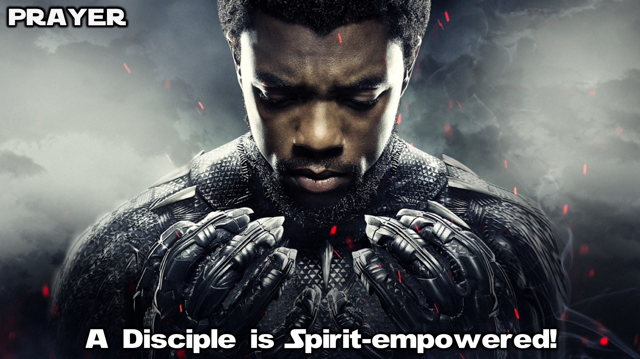
Notes:
Prayer: Let’s ask God to help us become Spirit-empowered.

Slide 26
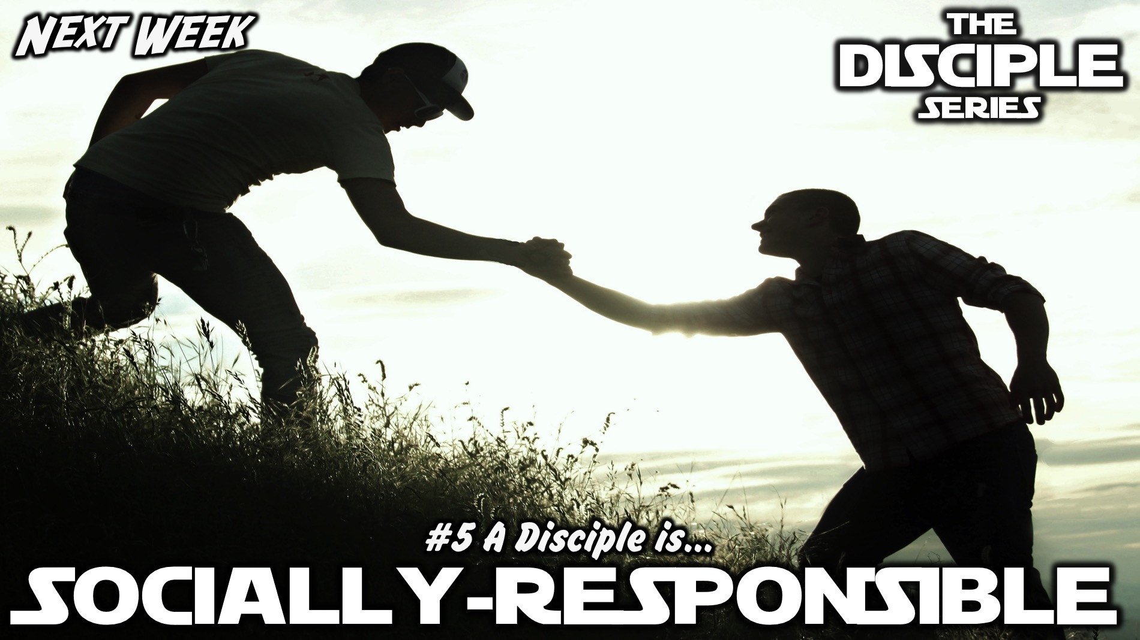
Notes:
Next week we will learn that a disciple is Socially-responsible.

