Slide 1

Notes:
Welcome to the Disciple Series.

Slide 2

Notes:
In week 1 we learnt that a disciple is Word-based.

Slide 3

Notes:
In week 2 we learnt that a disciple is Prayer-filled.

Slide 4
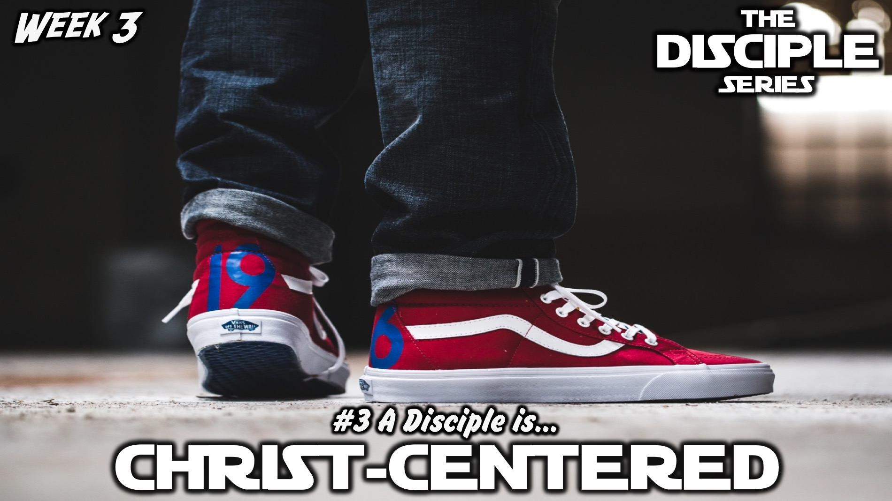
Notes:
In week 3 we learnt that a disciple is Christ-centered.

Slide 5
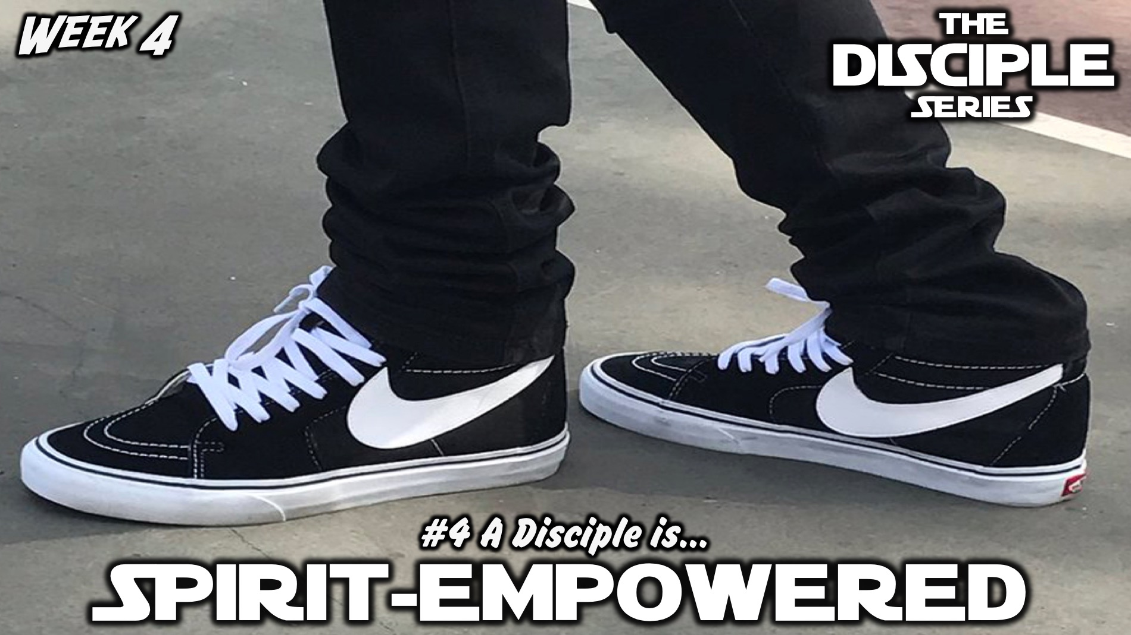
Notes:
In week 4 we learnt that a disciple is Spirit-empowered.

Slide 6

Notes:
Last week we learnt that a disciple is Socially-responsible.

Slide 7
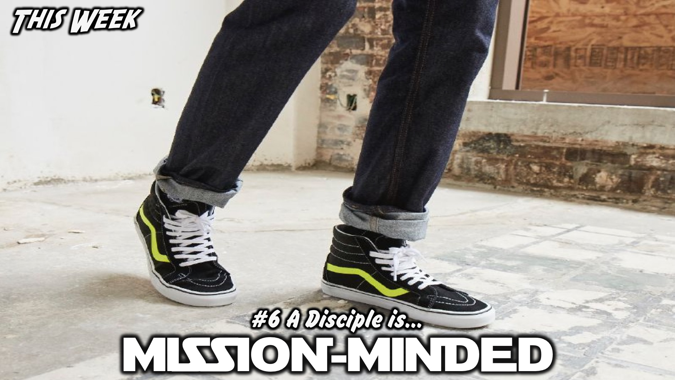
Notes:
This week we will learn that a disciple is Mission-minded.

Slide 8
Notes:
Video: Baywatch 2017 Trailer. Get it on YouTube at: https://www.youtube.com/watch?v=gM6Yg6ZVIL8

Slide 9
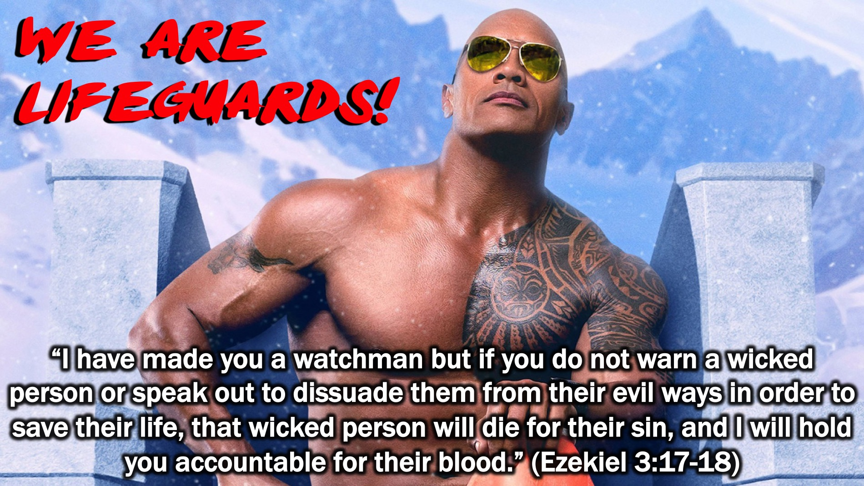
Notes:
We are Life Guards! “I have made you a watchman but if you do not warn a wicked person or speak out to dissuade them from their evil ways in order to save their life, that wicked person will die for their sin, and I will hold you accountable for their blood.” (Ezekiel 3:17-18)

Slide 10
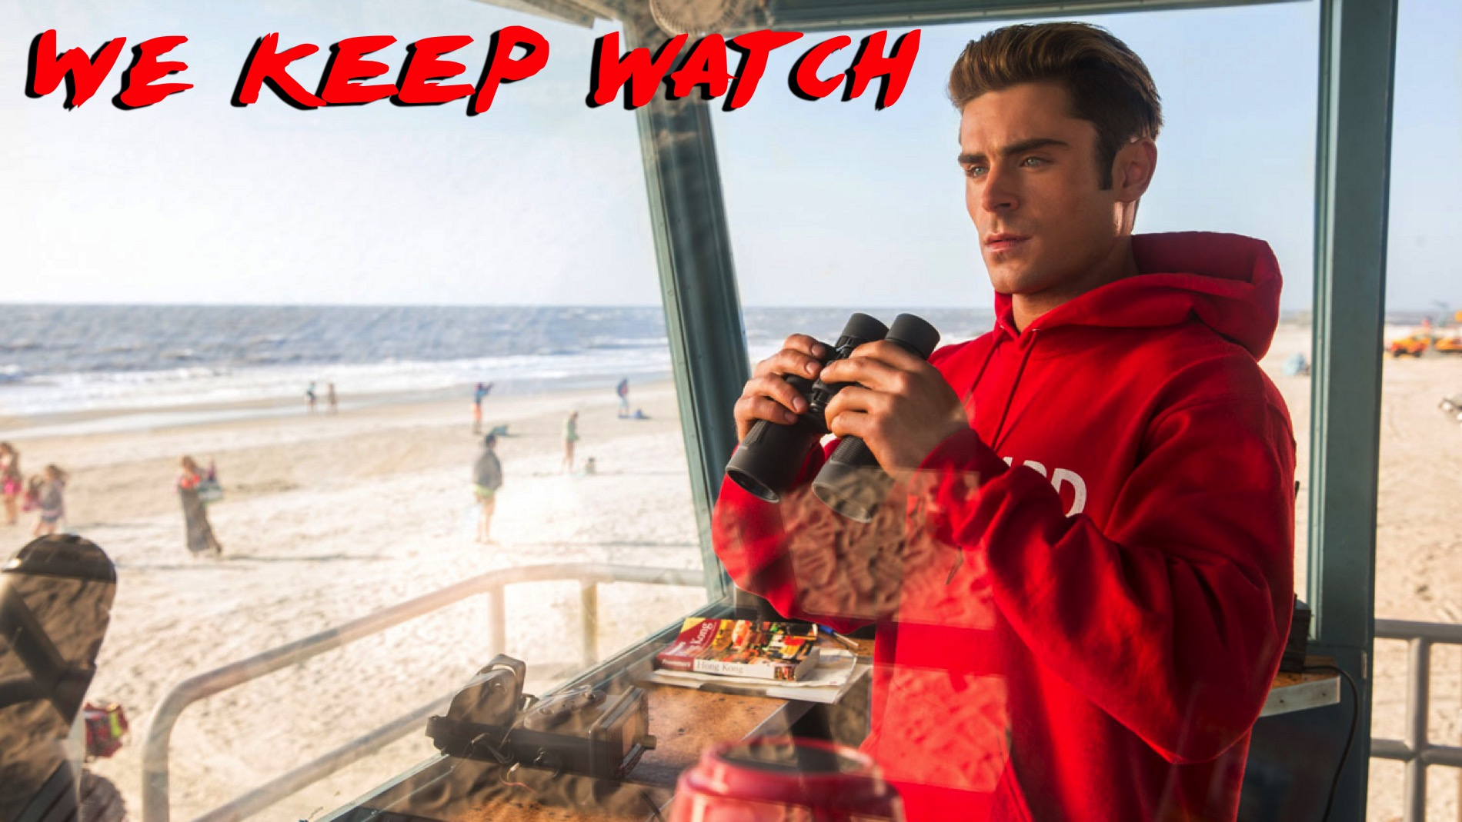
Notes:
(1) We keep watch to see if anyone is in trouble.

Slide 11

Notes:
(2) We take risks even if it costs us!

Slide 12
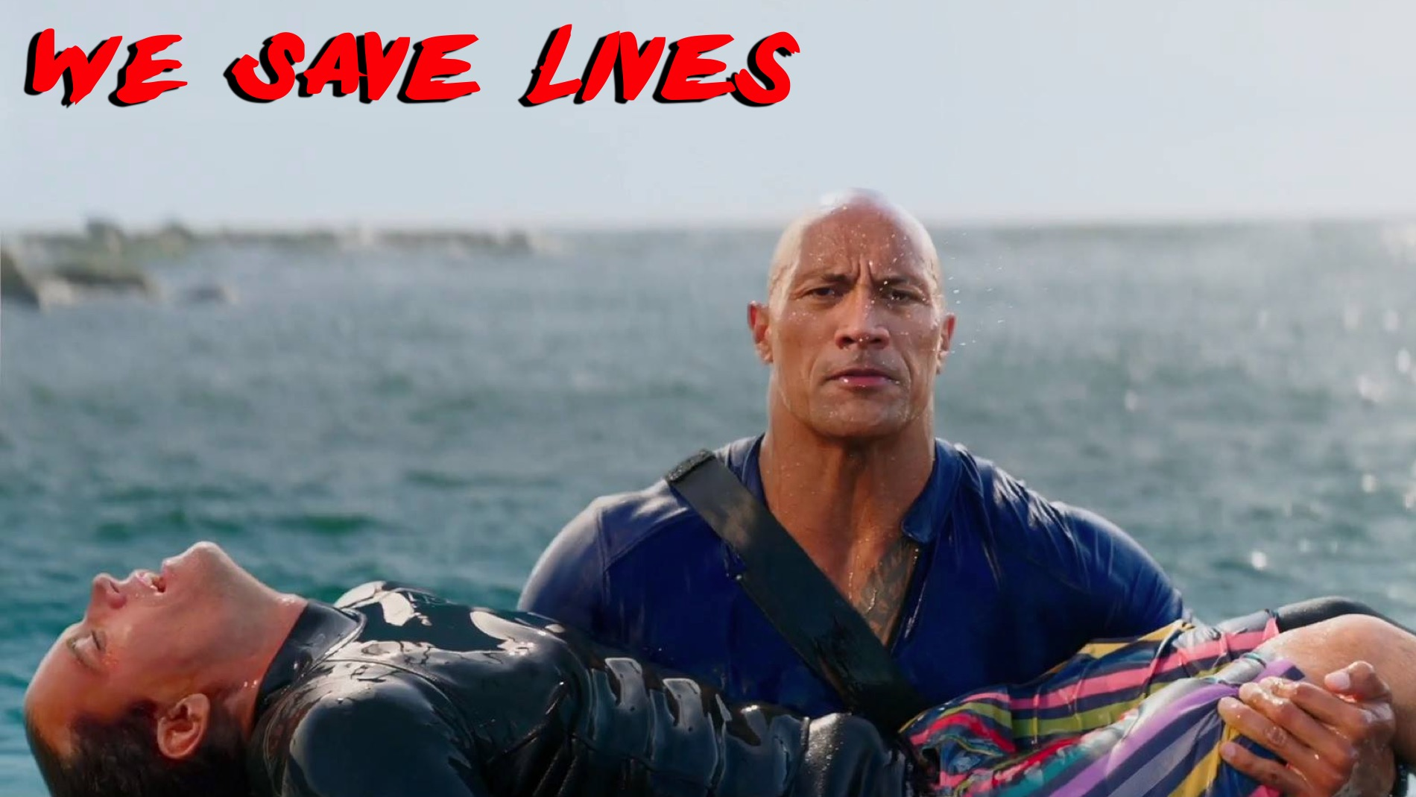
Notes:
(3) We save lives!

Slide 13
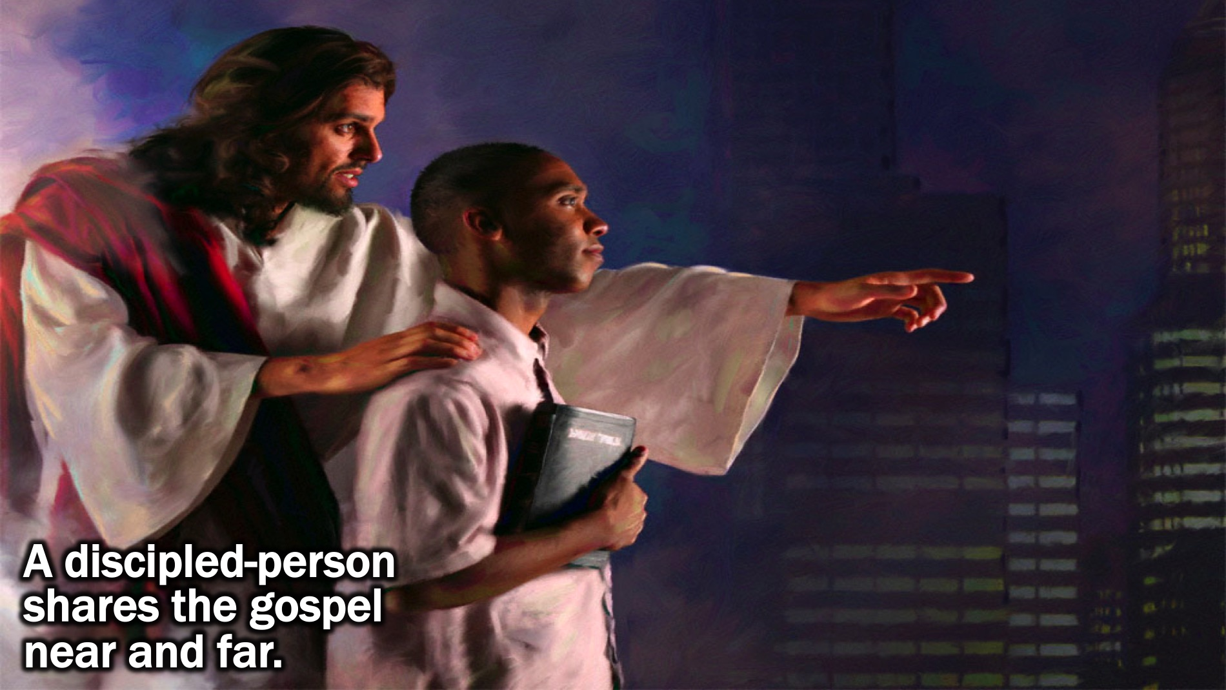
Notes:
Definition: A discipled-person shares the gospel near and far.

Slide 14
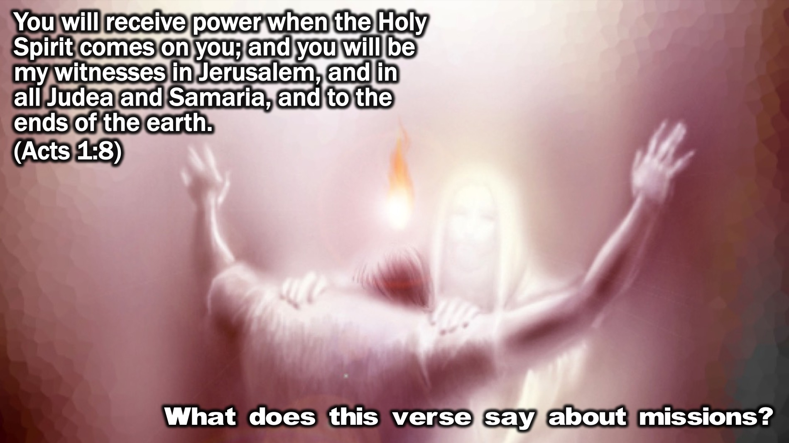
Notes:
Bible Passage: “You will receive power when the Holy Spirit comes on you; and you will be my witnesses in Jerusalem, and in all Judea and Samaria, and to the ends of the earth.” (Acts 1:8)
Small Group Question: What does this verse say about missions?

Slide 15
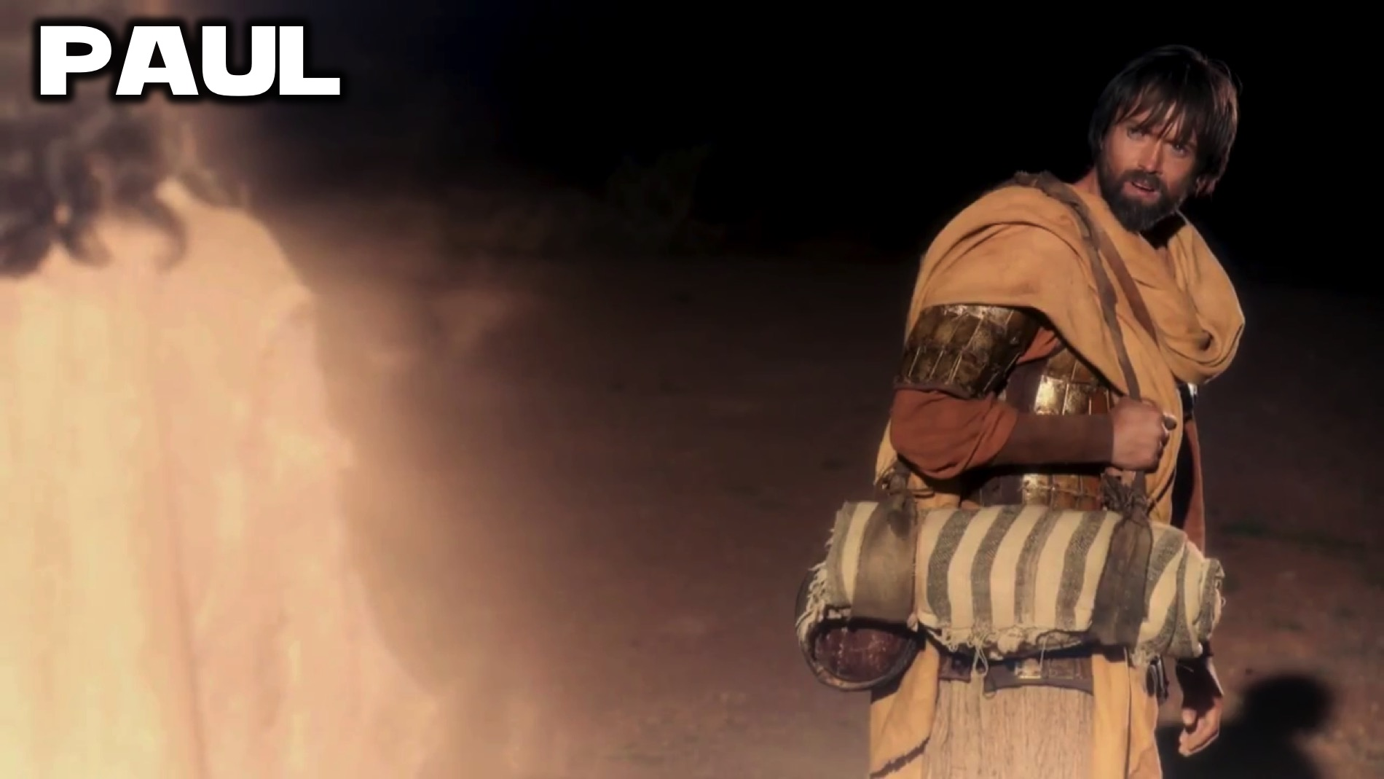
Notes:
Biblical Character: Paul

Slide 16
Notes:
Video: Paul, Apostle of Christ: Official Trailer. Get it on YouTube at: https://www.youtube.com/watch?v=LyOqQZUDdO4

Slide 17
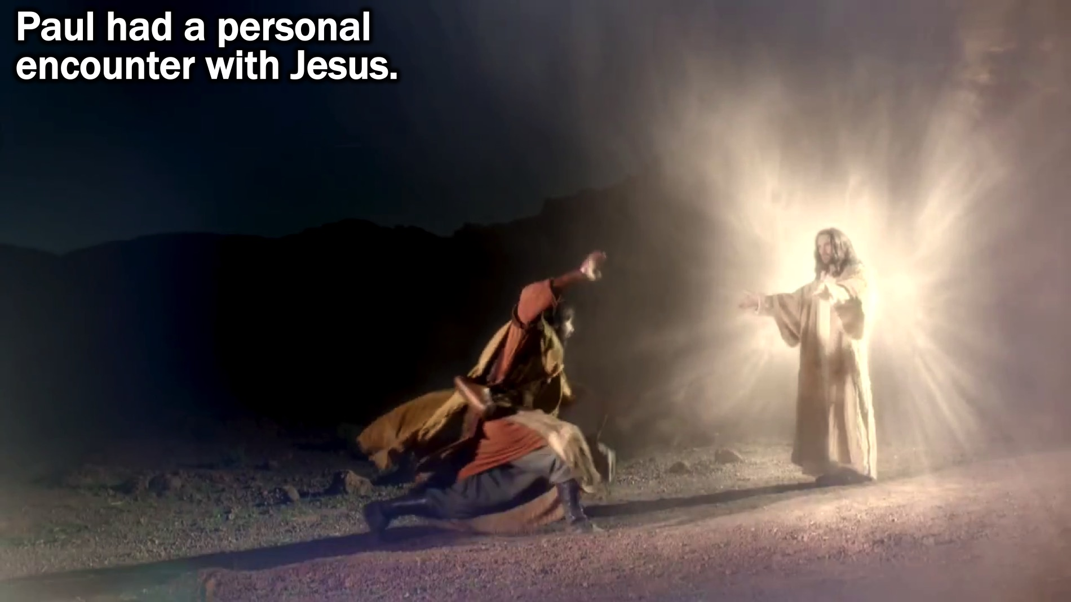
Notes:
(1) Paul had a personal encounter with Jesus.

Slide 18
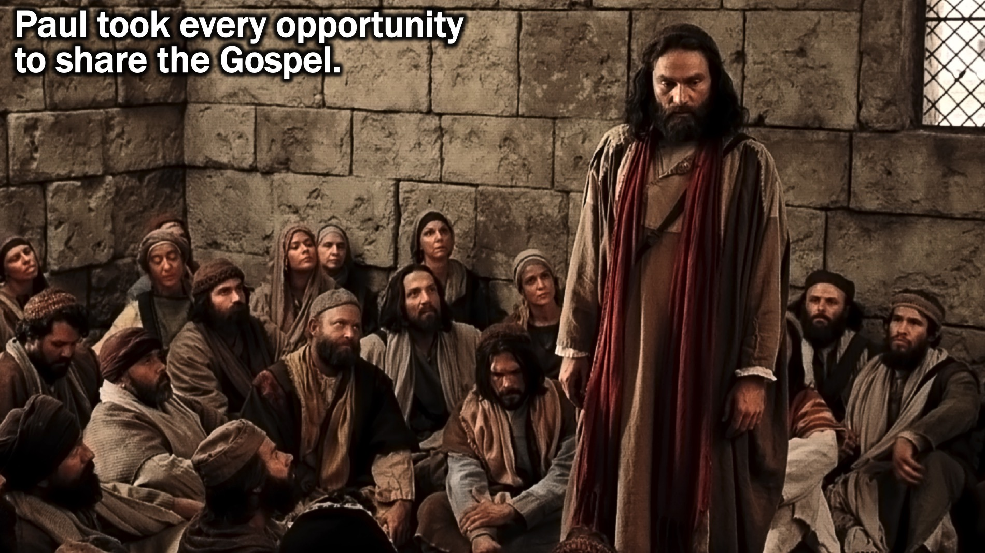
Notes:
(2) Paul took every opportunity to share the Gospel.

Slide 19
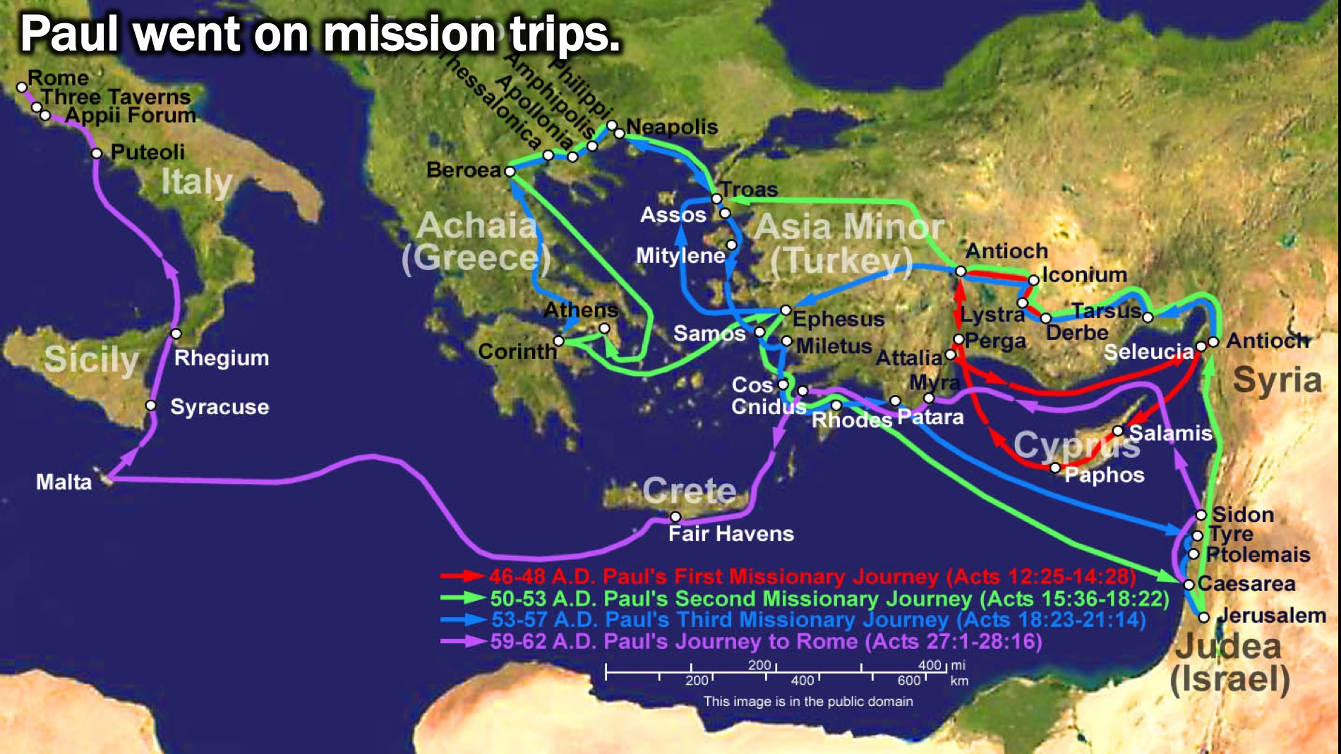
Notes:
(3) Paul went on mission trips.

Slide 20
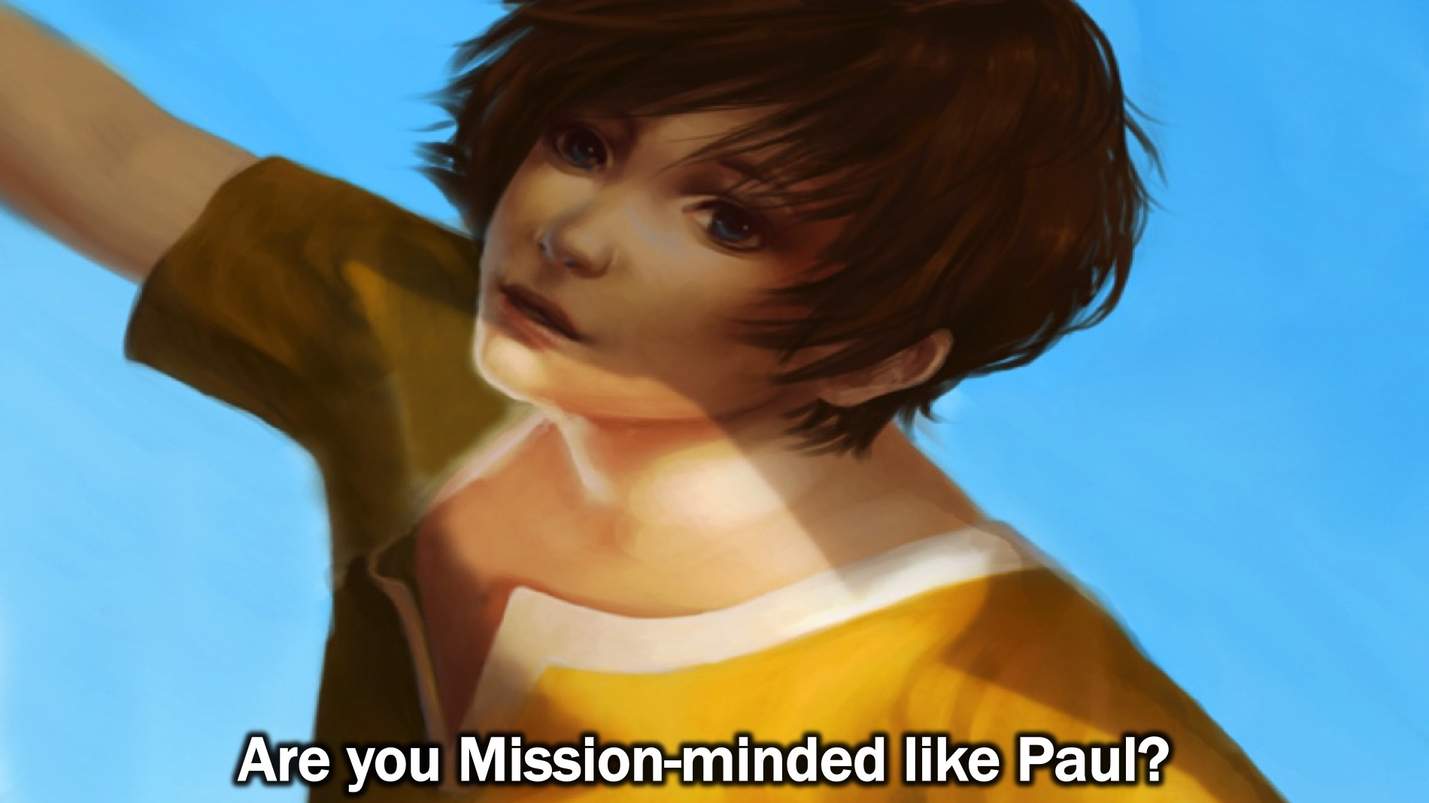
Notes:
Question: Are you Mission-minded like Paul?

Slide 21

Notes:
Maybe you are not there yet…

Slide 22
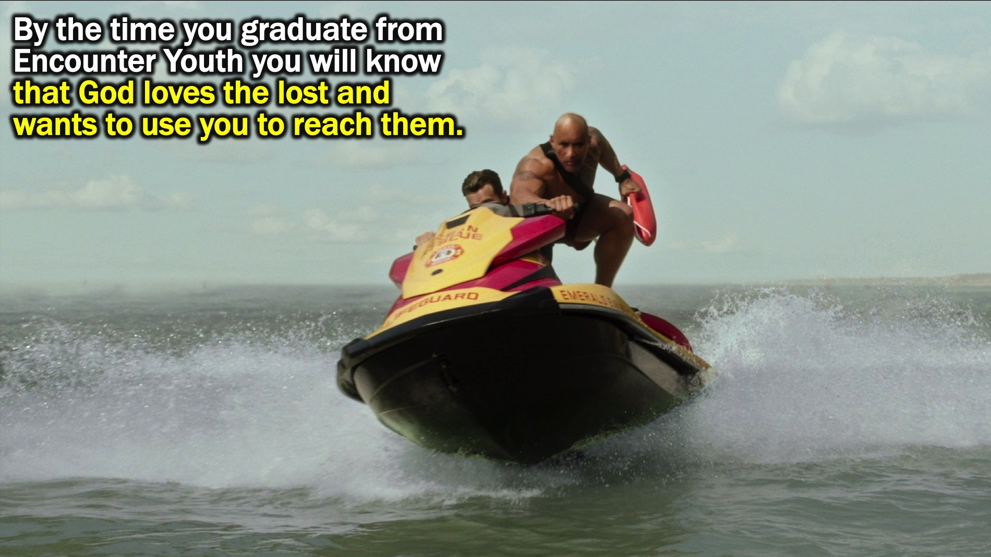
Notes:
By the time you graduate from Encounter Youth you will that God loves the lost and wants to use them to reach them.

Slide 23
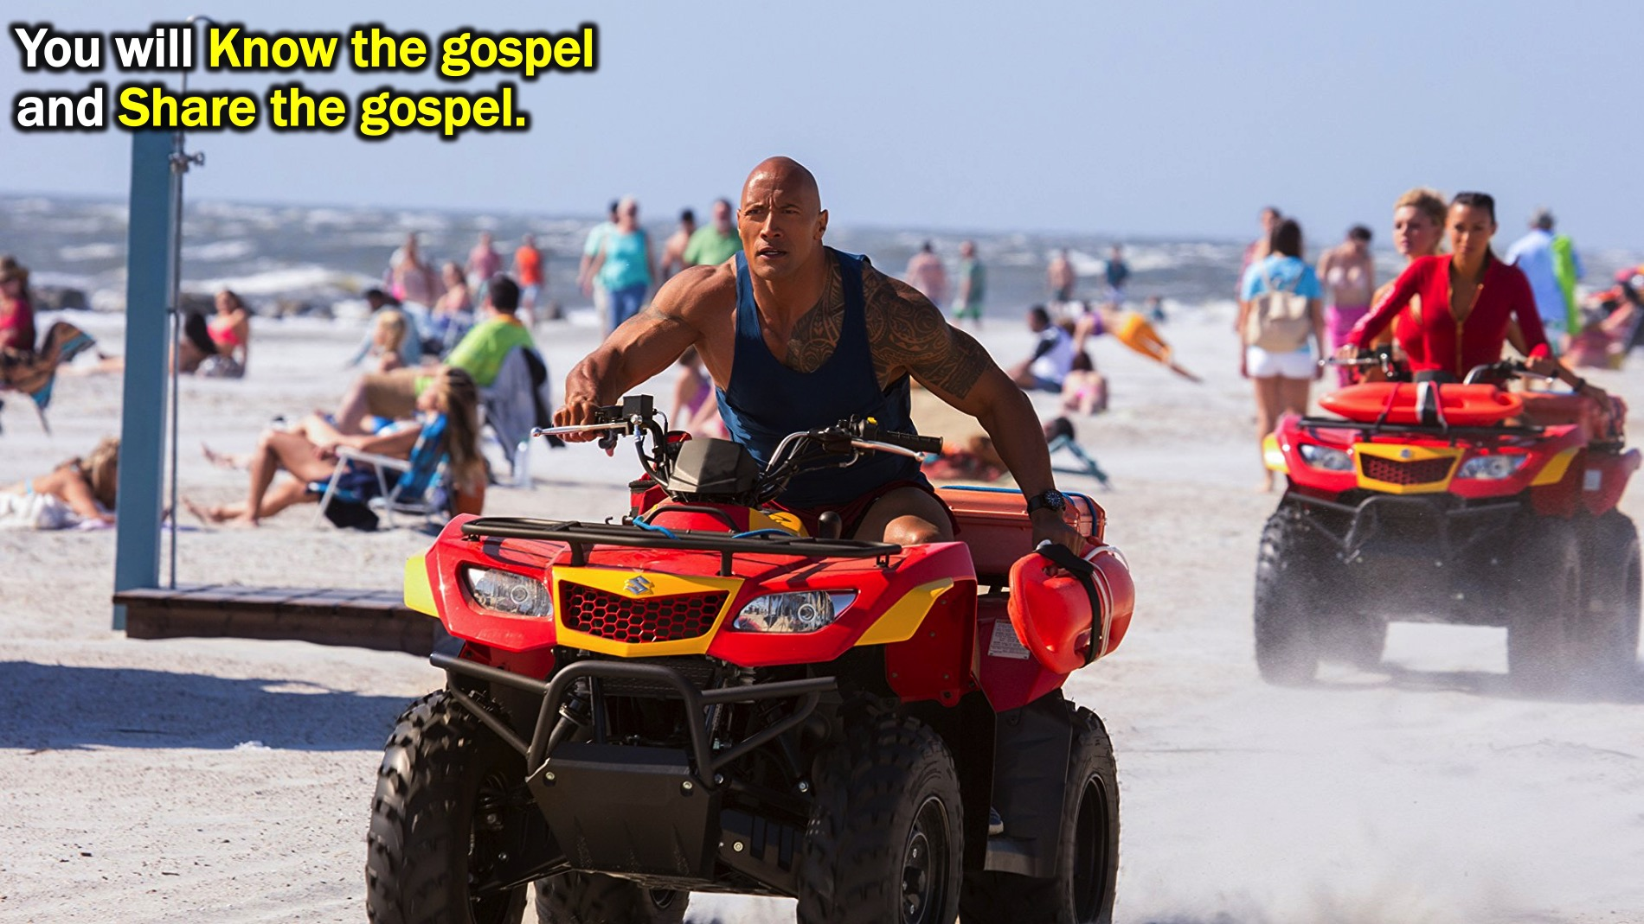
Notes:
You will know the gospel and share the Gospel.

Slide 24
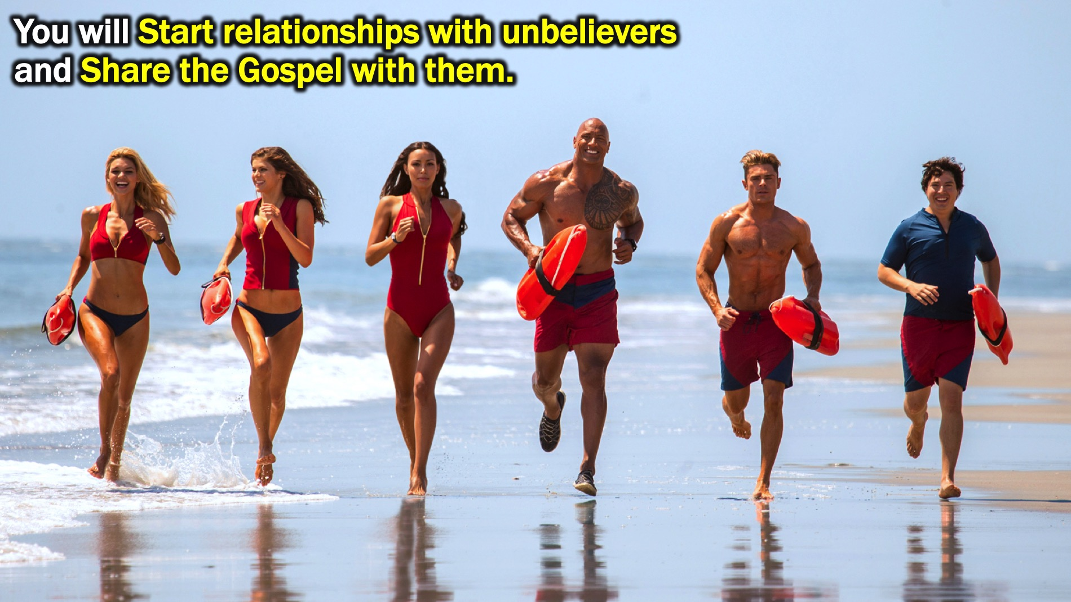
Notes:
You will start relationships with unbelievers and share the Gospel with them.

Slide 25

Notes:
Challenge: Will you be Mission-minded?

Slide 26

Notes:
Step #1: REACH JUST ONE. As a church we have been challenged to reach just one person for Jesus.

Slide 27

Notes:
Bring your Just One to our Zoo Lake Youth Outing on Wednesday the 21st March from 9am to 12.

Slide 28

Notes:
Bring your Just One to our Friday night Engage series in Term 2!

Slide 29
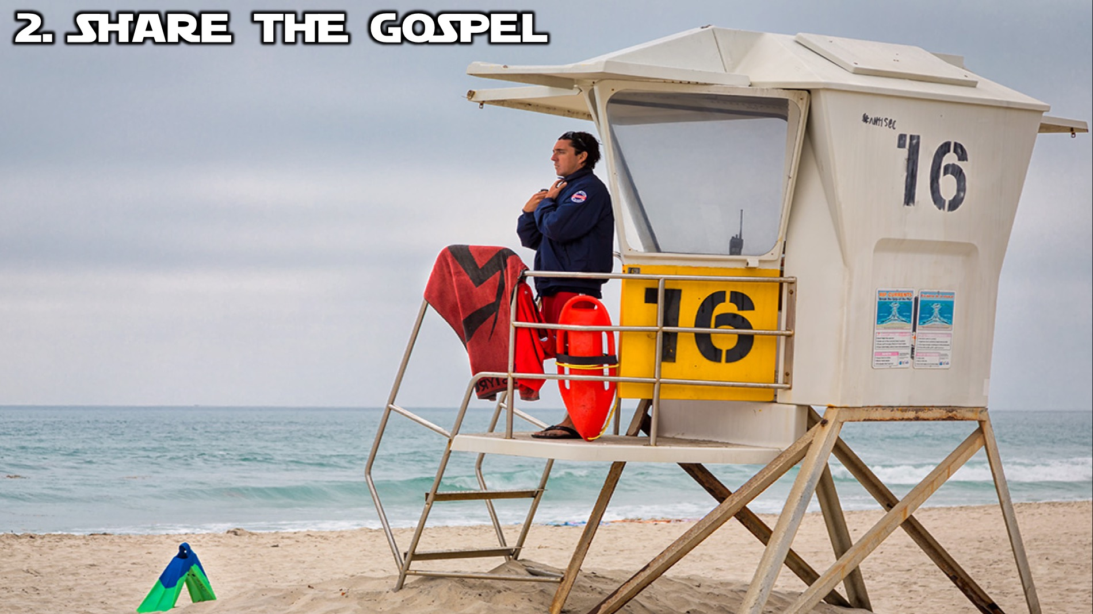
Notes:
Step #2: Share The GOSPEL.

Slide 30
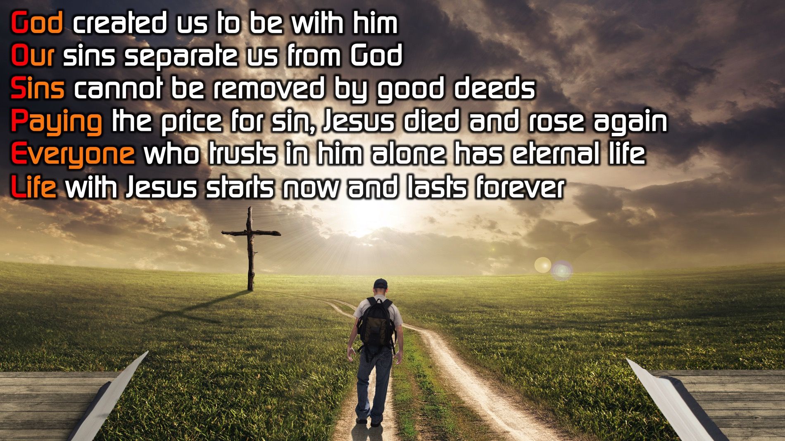
Notes:
You will know the 6 words and 6 sentences backwards by the time you graduate high school!
God created us to be with him
Our sins separate us from God
Sins cannot be removed by good deeds
Paying the price for sin, Jesus died and rose again
Everyone who trusts in him alone has eternal life
Life with Jesus starts now and lasts forever

Slide 31
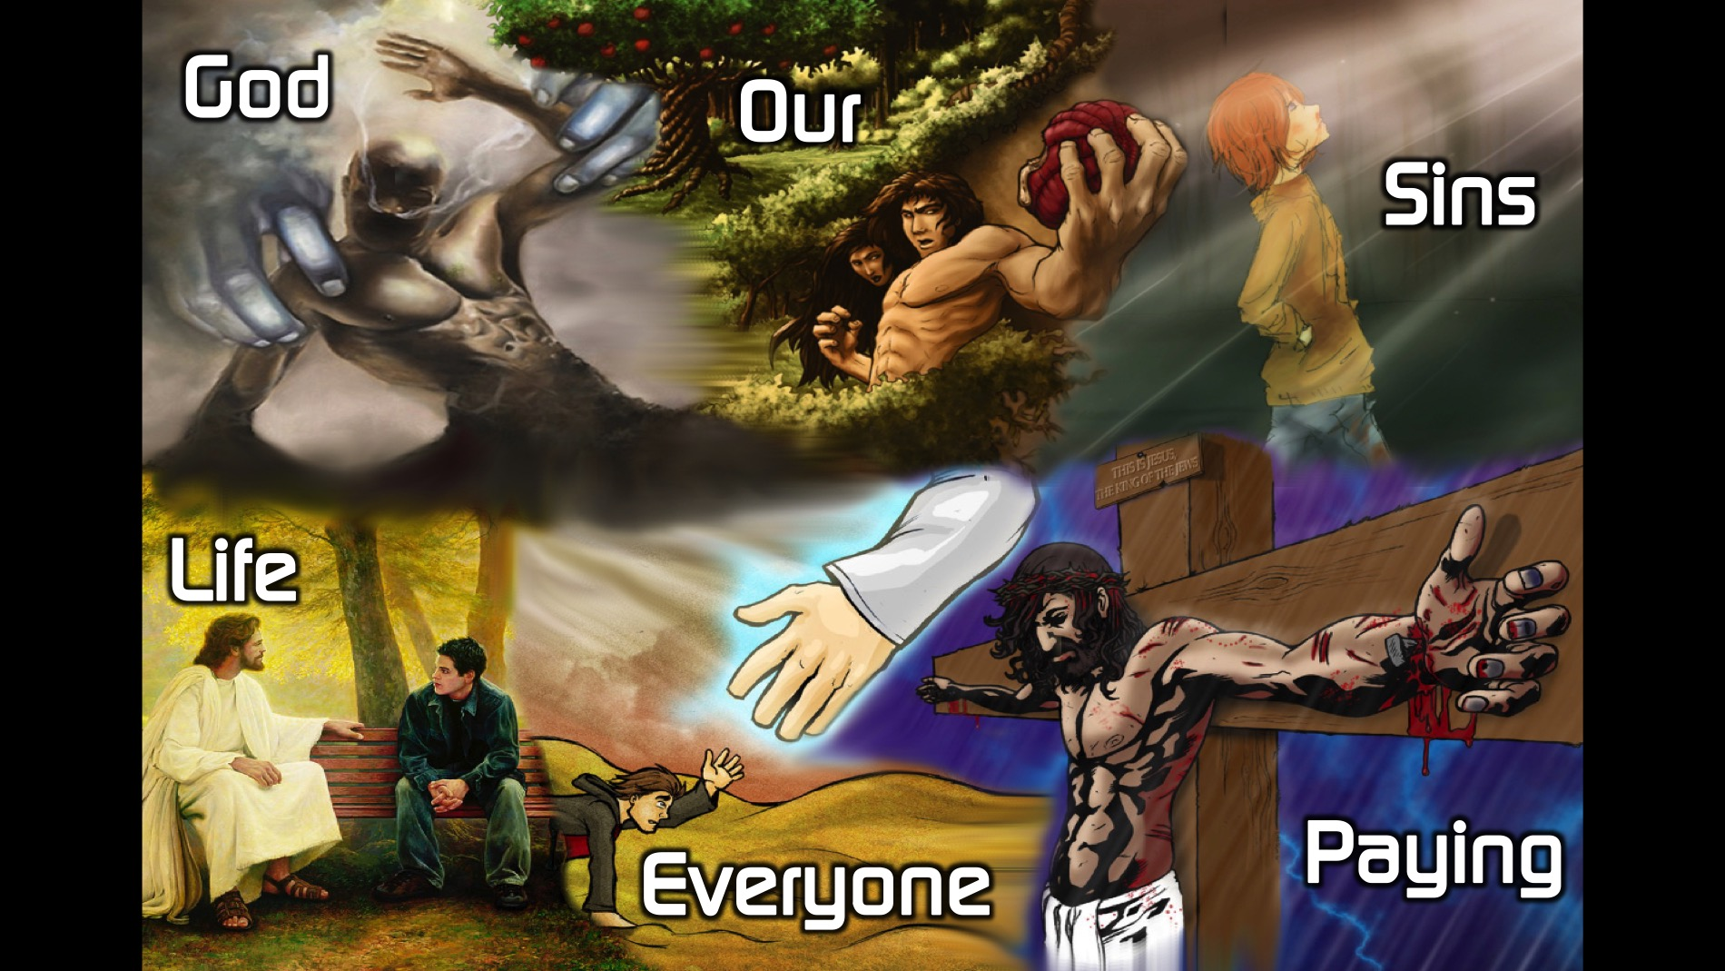
Notes:
Here are the 6 words to memorise: God Our Sins Paying Everyone Life.

Slide 32
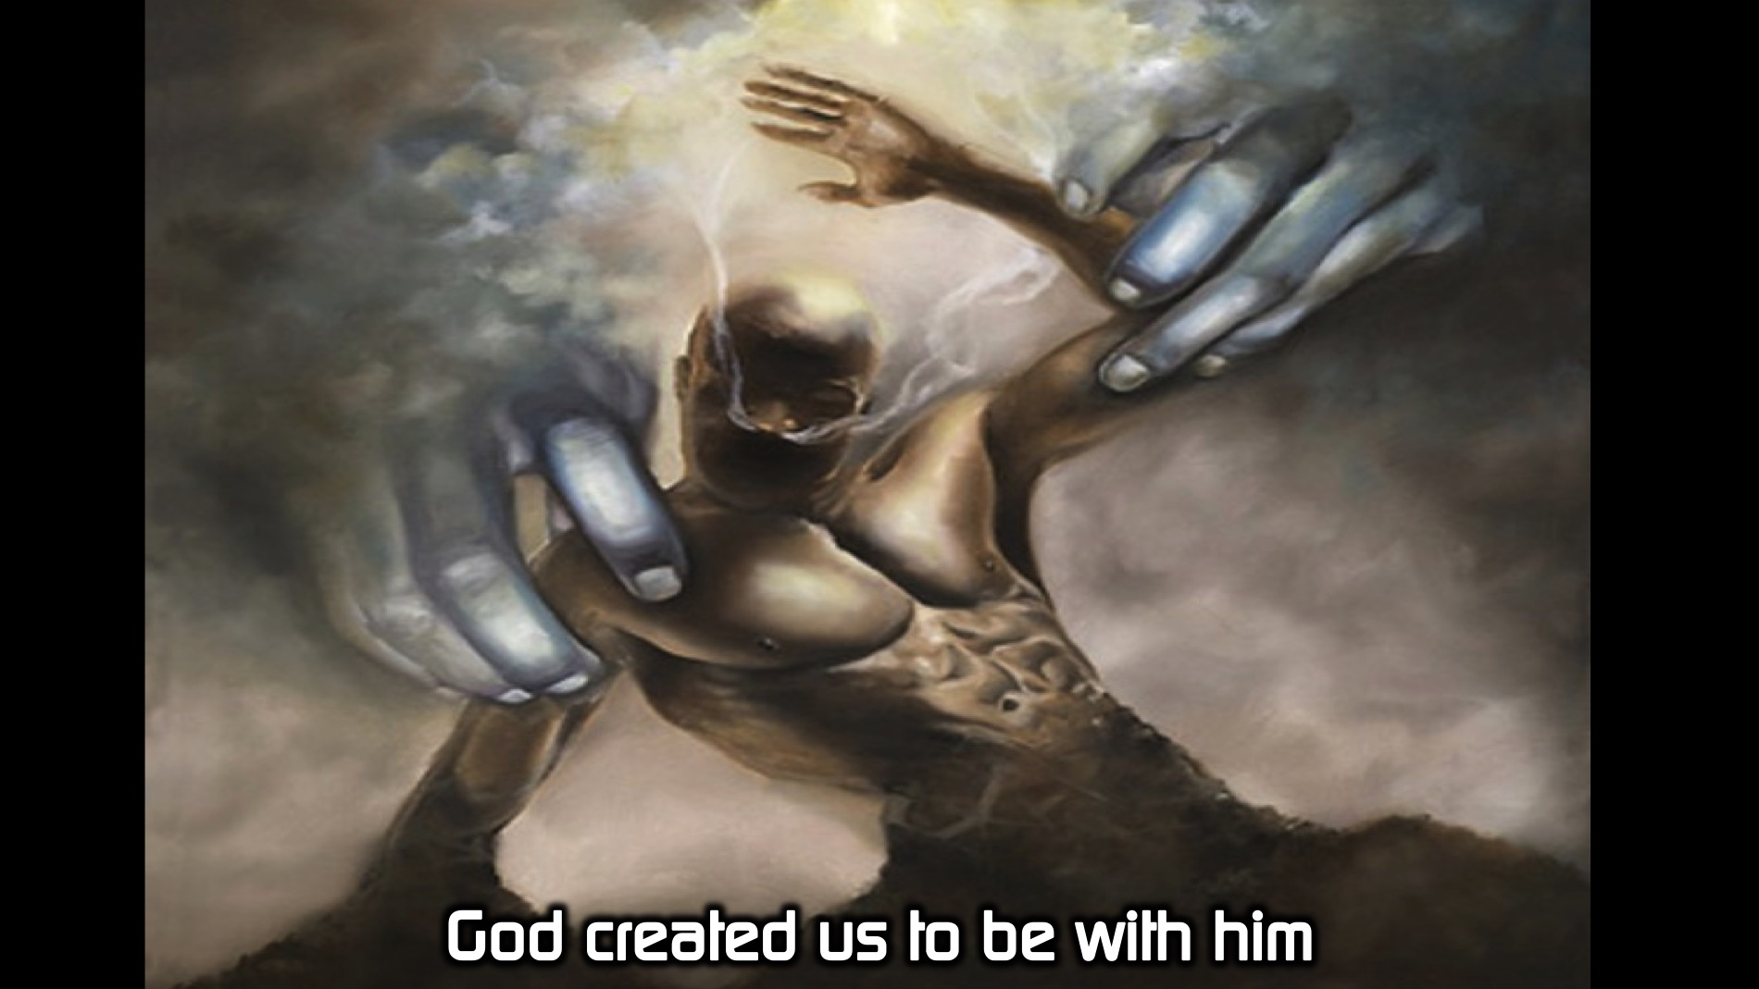
Notes:
Here are the 6 sentences to memorise:
God created us to be with him.

Slide 33
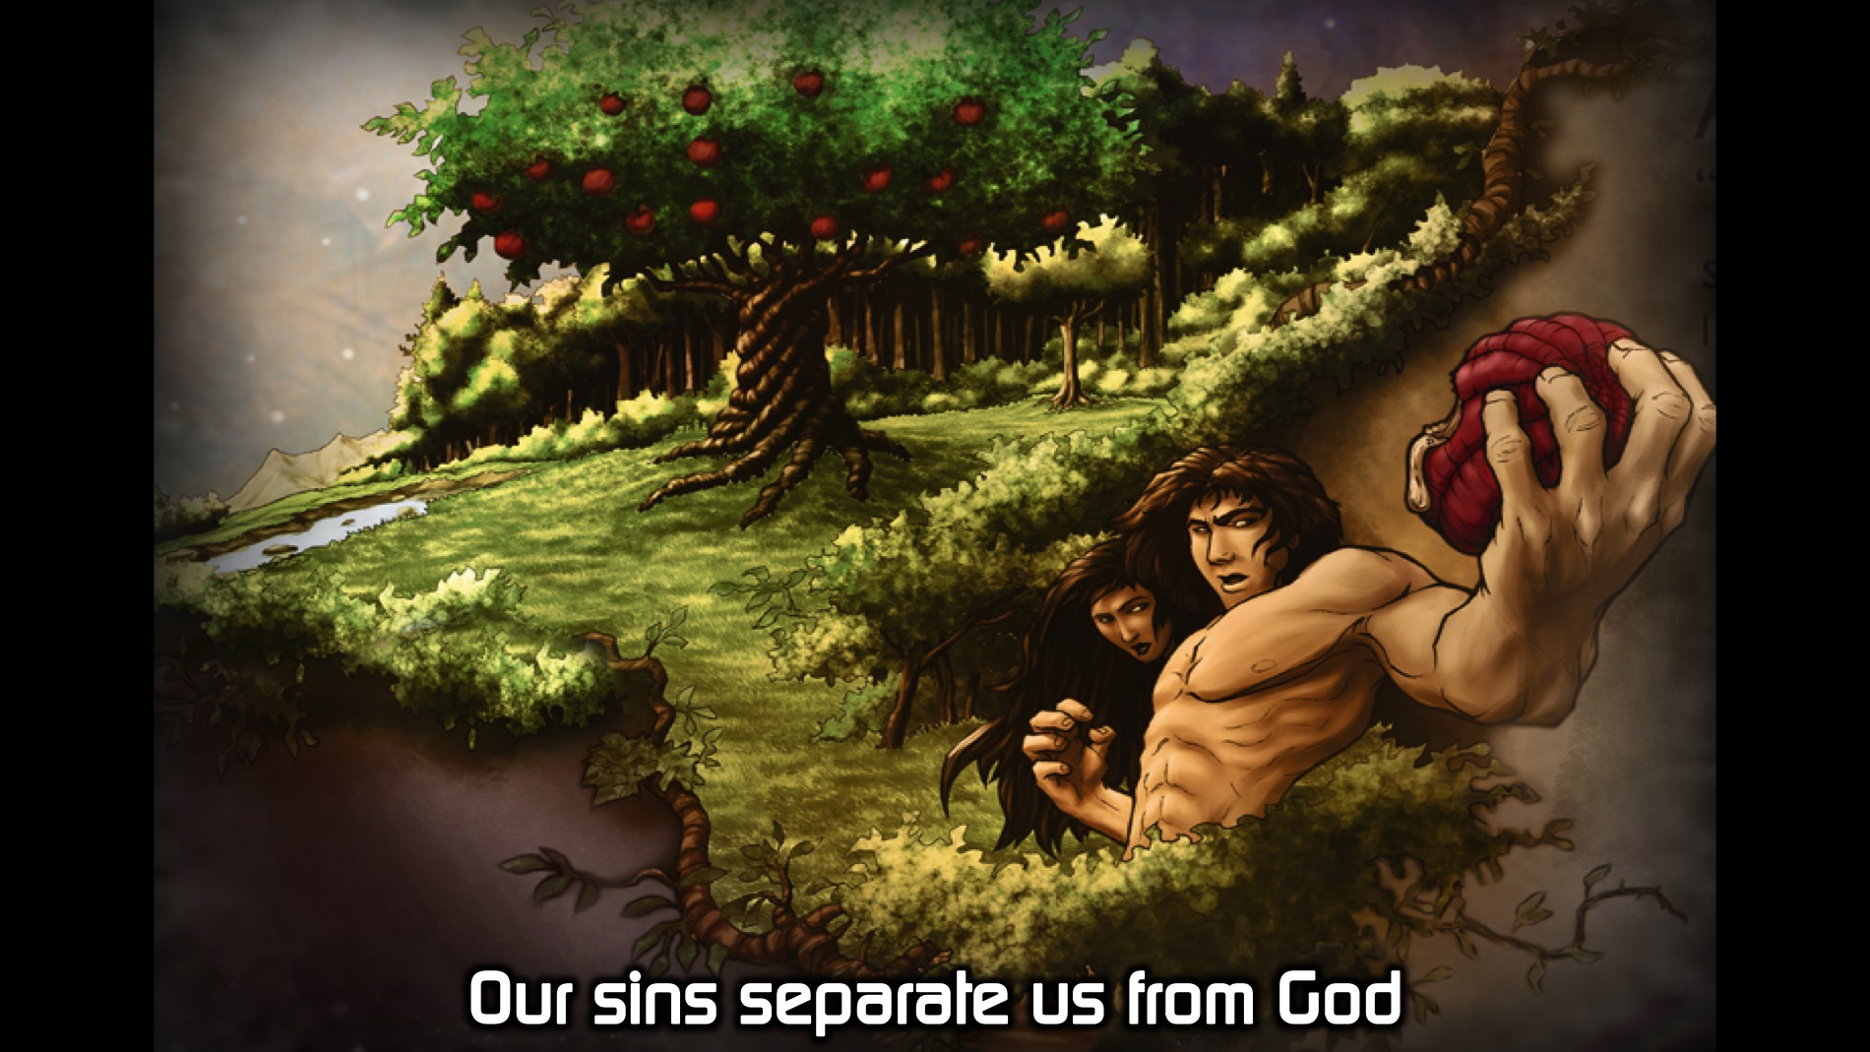
Notes:
Our sins separate us from God.

Slide 34
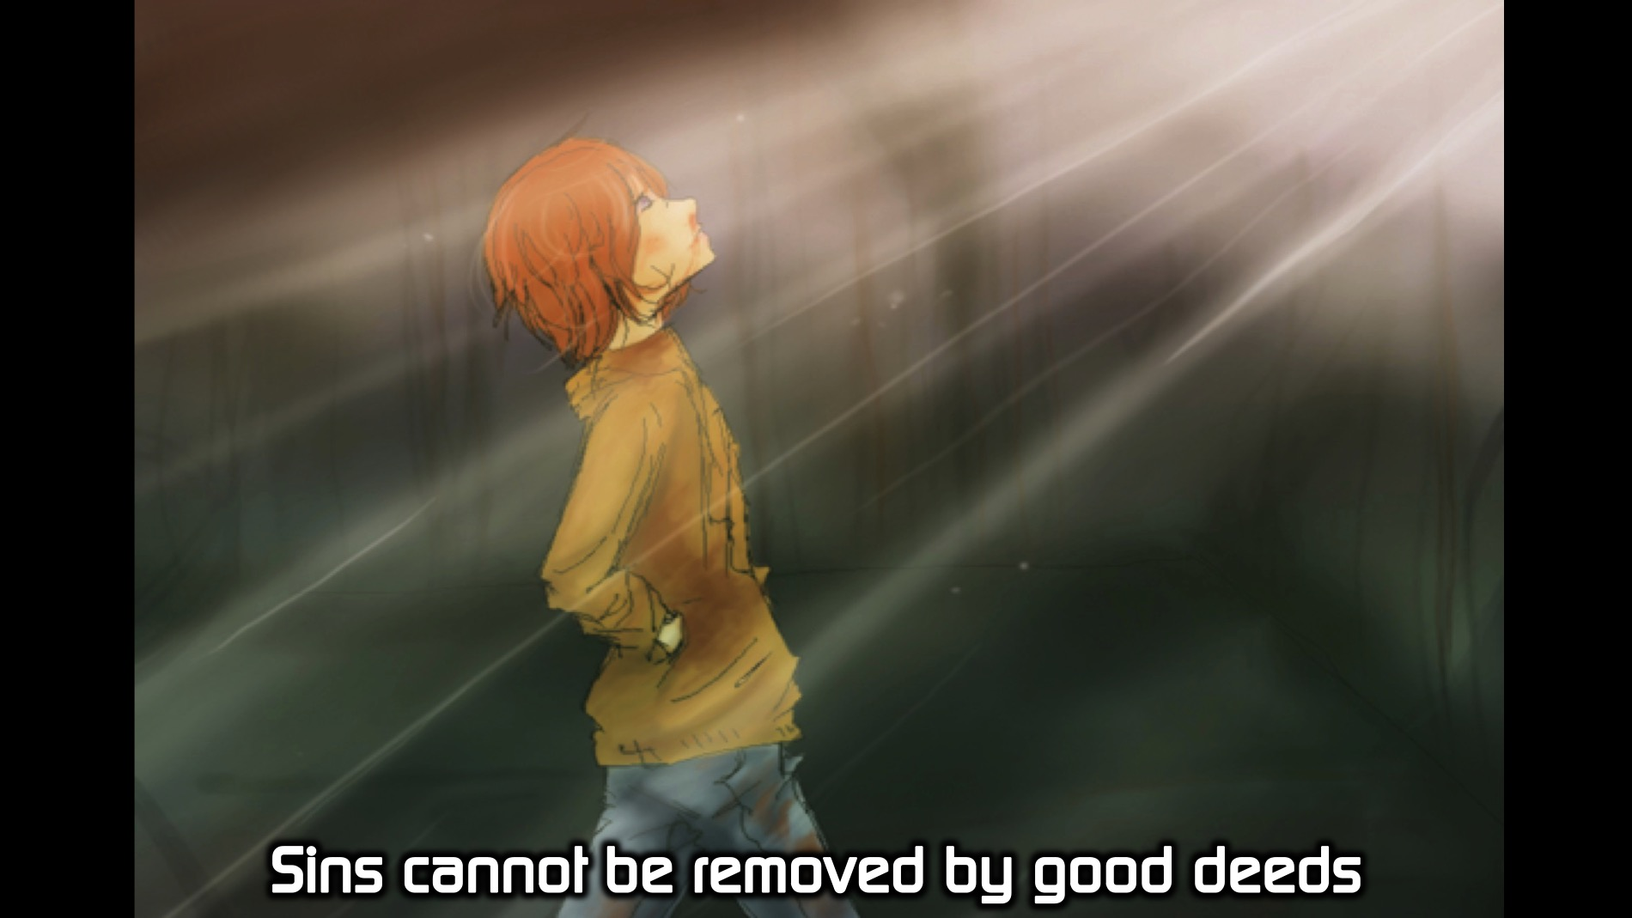
Notes:
Sins cannot be removed by good deeds.

Slide 35
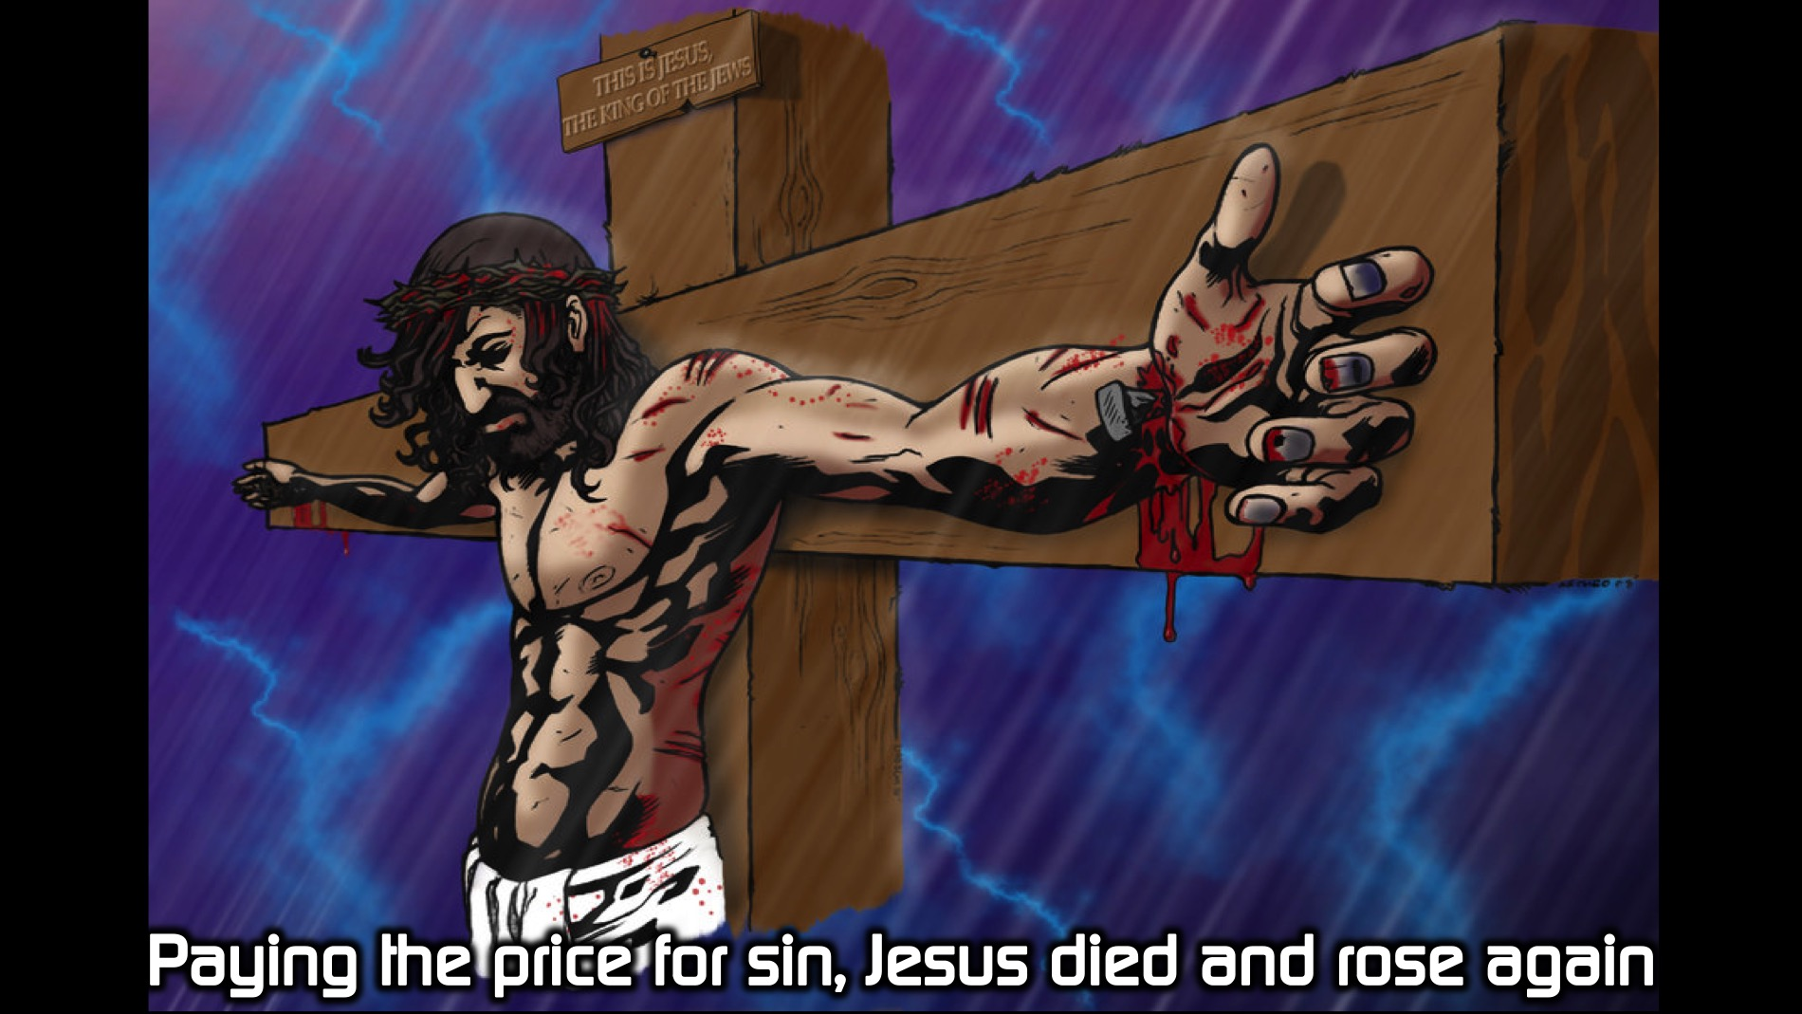
Notes:
Paying the price for sin, Jesus died and rose again.

Slide 36
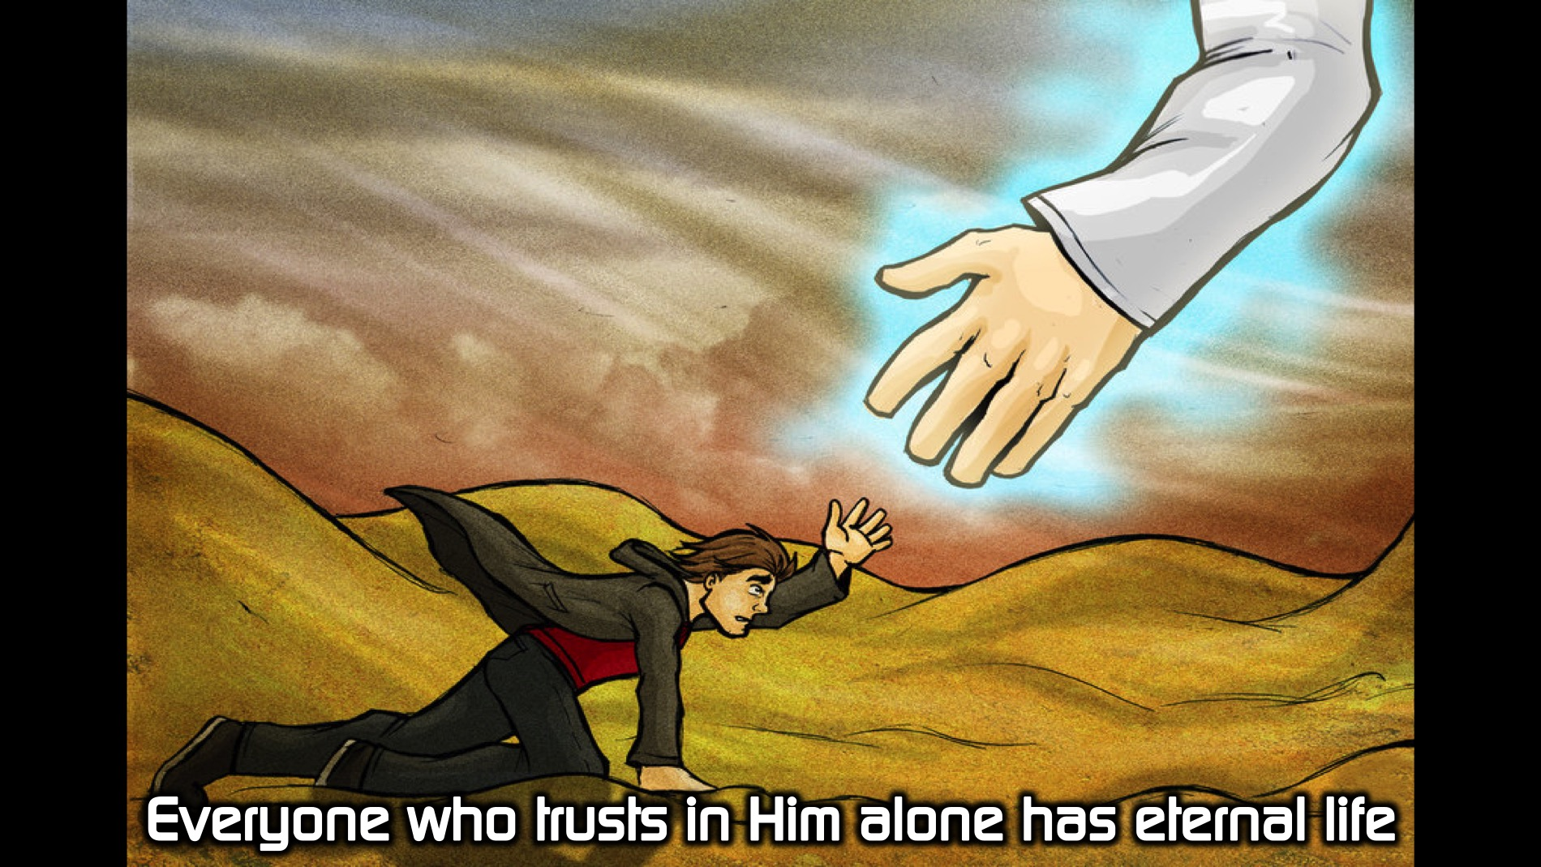
Notes:
Everyone who trusts in Him alone has eternal life.

Slide 37
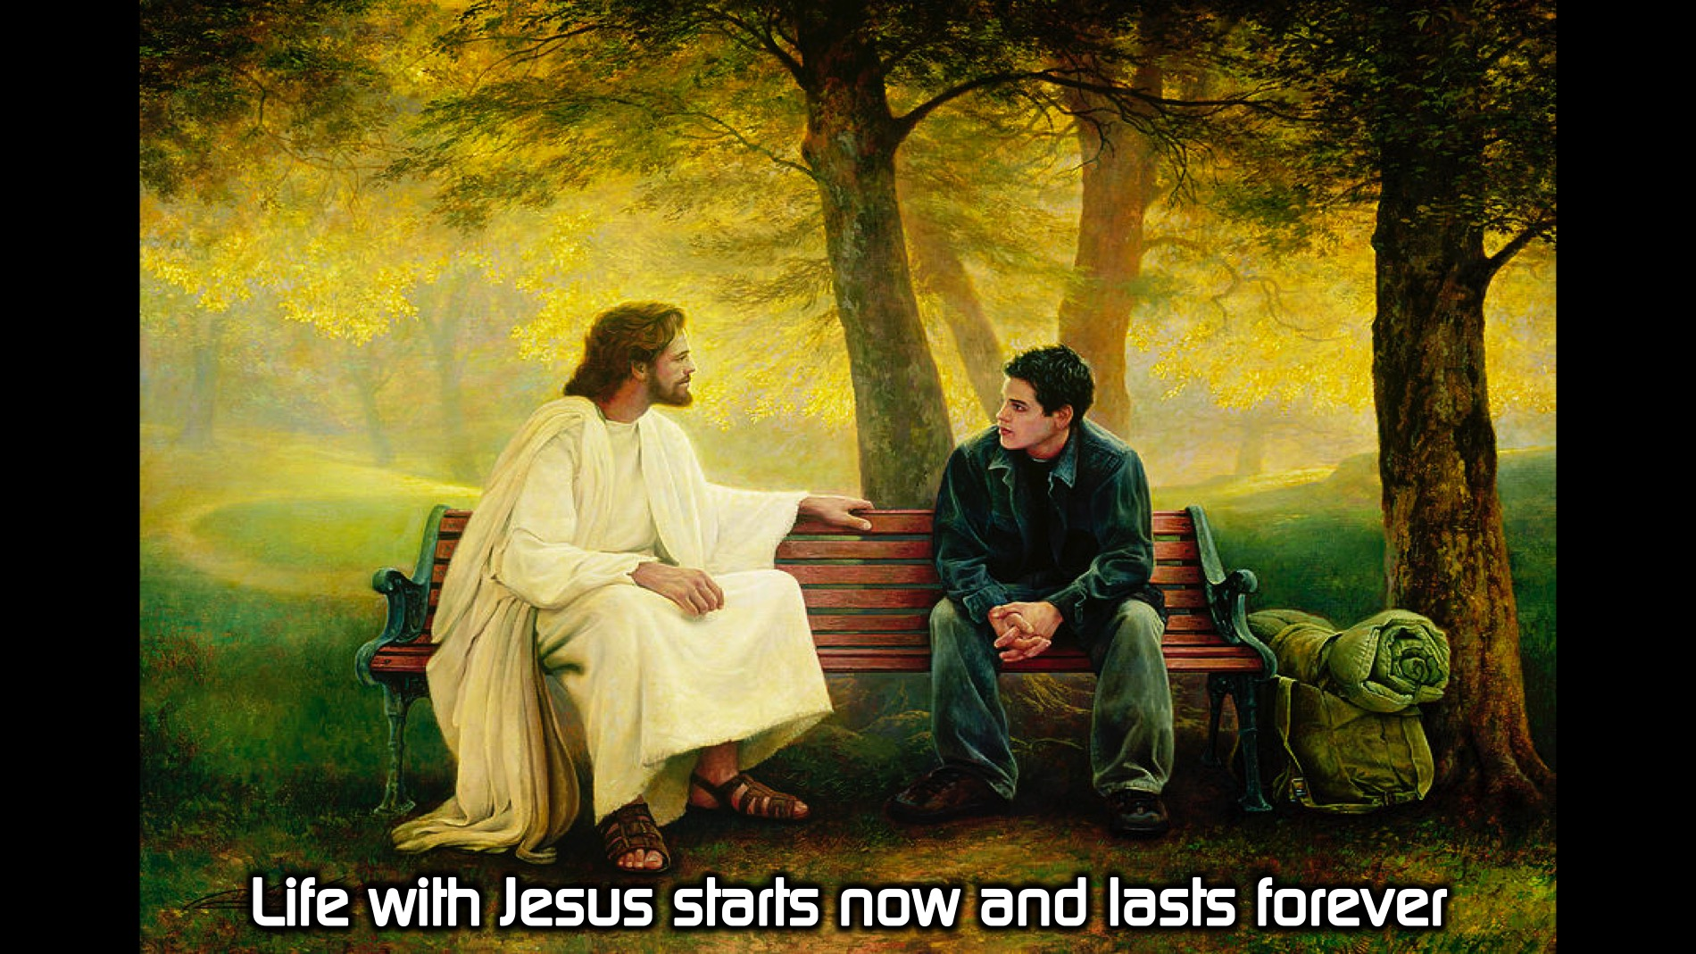
Notes:
Life with Jesus starts now and lasts forever.

Slide 38
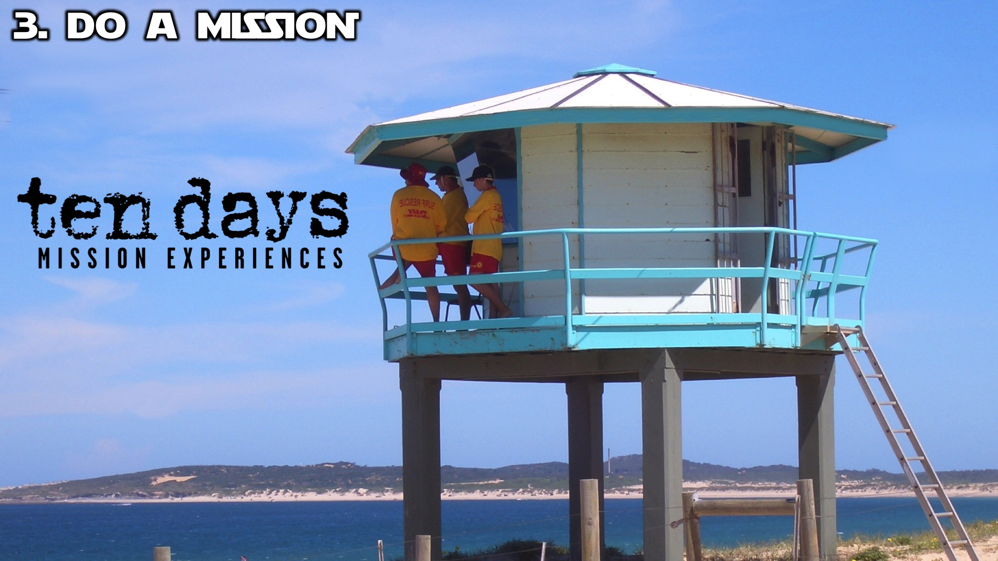
Notes:
Step #3: DO A MISSION: Before you graduate from high school make sure you are part of a Ten Days Mission trip.

Slide 39
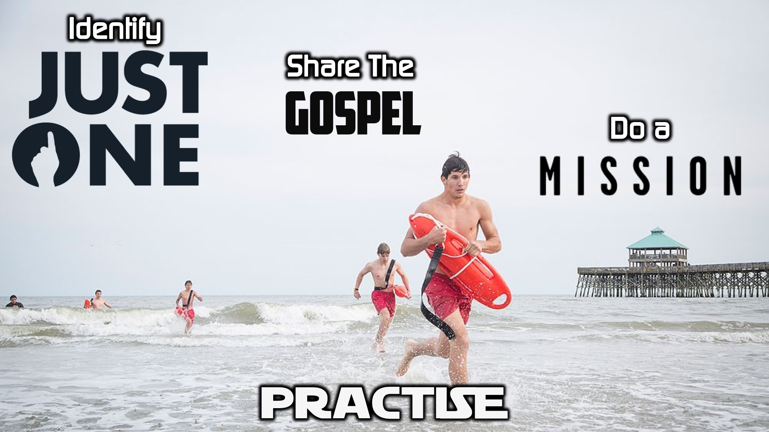
Notes:
Practise: You have 3 tasks to achieve to earn a prize: (1) Identify Your Just One: Write down the name of one of your friends that you believe God is calling you to reach. (2) Share the GOSPEL: Find a leader in the room and share the gospel with them and get them to sign your paper. (3) Pledge to do a Ten Days Mission: Get a pledge form and sign your name to pledge to go on a Ten Days Mission Trip before you graduate from high school.

Slide 40
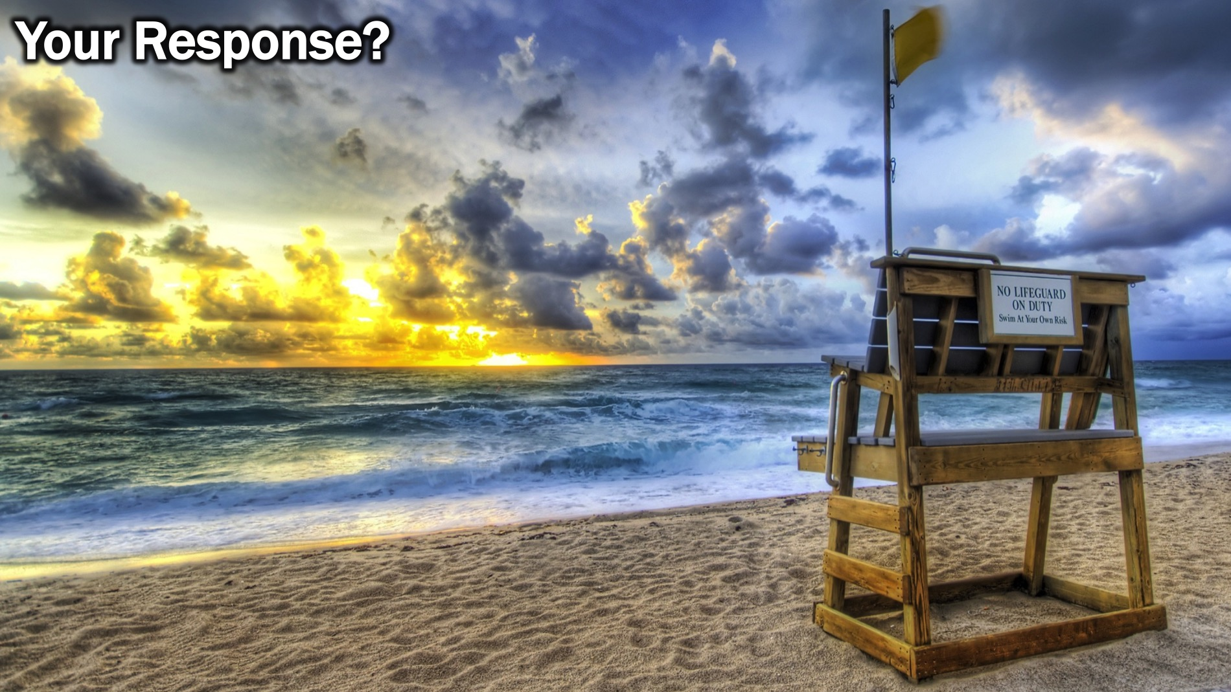
Notes:
What will your response be to the message you have heard today? Will you work on becoming Mission-minded? Don’t leave your beach unguarded!!!

Slide 41

Notes:
Be sure to join the Encounter Sunday WhatsApp group if you have not done so already. This week we will receive daily devotions based on the life of Paul each day at 8pm.

Slide 42
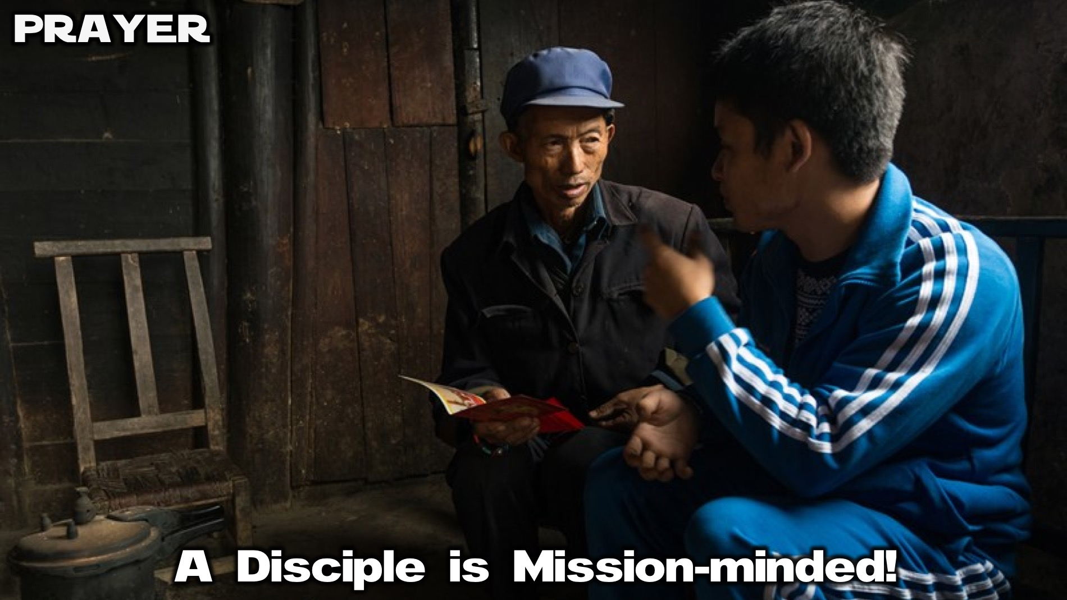
Notes:
Prayer: Let’s ask God to help us become Mission-minded.

Slide 43

Notes:
Next week we will learn that a disciple is Leadership-empowered.
Definition: A discipled-person uses their gifts to lead others.
Bible Passage: “God has given each you gifts … use them well to serve one another.” (1 Pet 4:10)
Biblical Character: Nehemiah
Knowledge: They know that God uses them to lead his people.
Attitudes: They believe they are called to be servant leaders.
Skills: They can use their gifts to serve people.
Relationships: They serve people in the world around them.

