Slide 1

Notes:
Welcome to the Disciple Series.

Slide 2
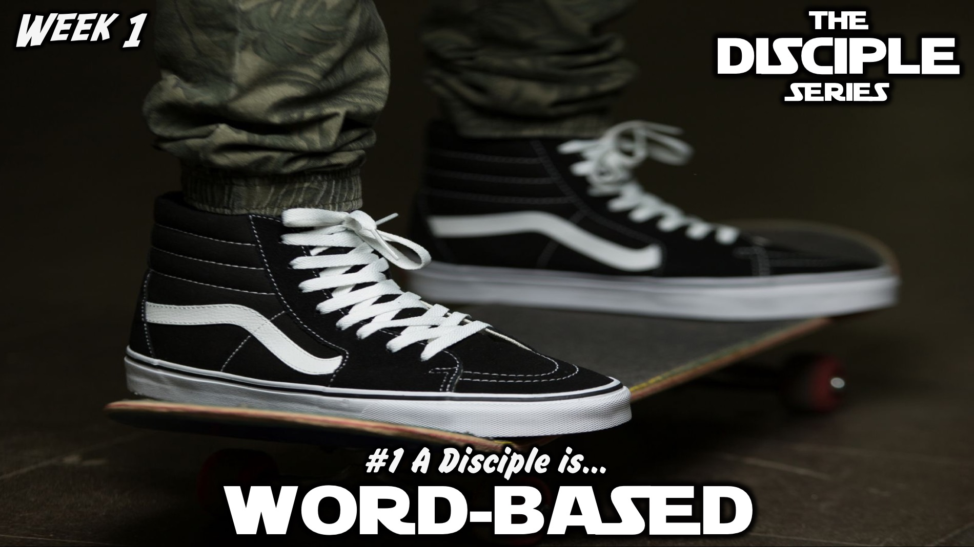
Notes:
In week 1 we learnt that a disciple is Word-based.

Slide 3

Notes:
In week 2 we learnt that a disciple is Prayer-filled.

Slide 4
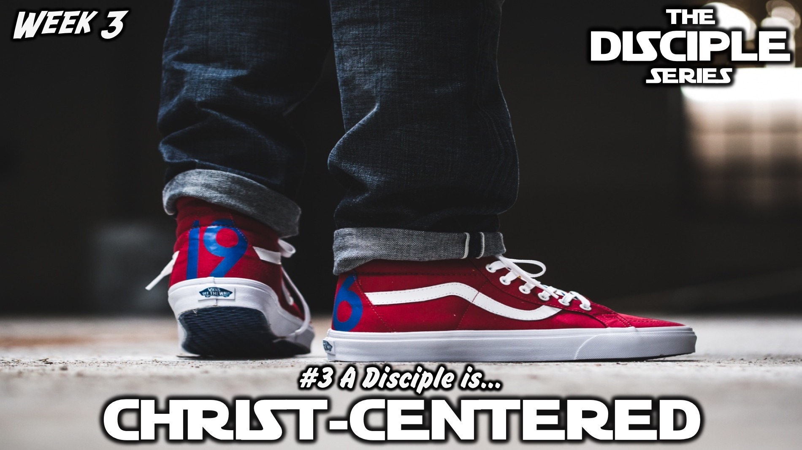
Notes:
In week 3 we learnt that a disciple is Christ-centered.

Slide 5
Notes:
In week 4 we learnt that a disciple is Spirit-empowered.

Slide 6

Notes:
In week 5 we learnt that a disciple is Socially-responsible.

Slide 7
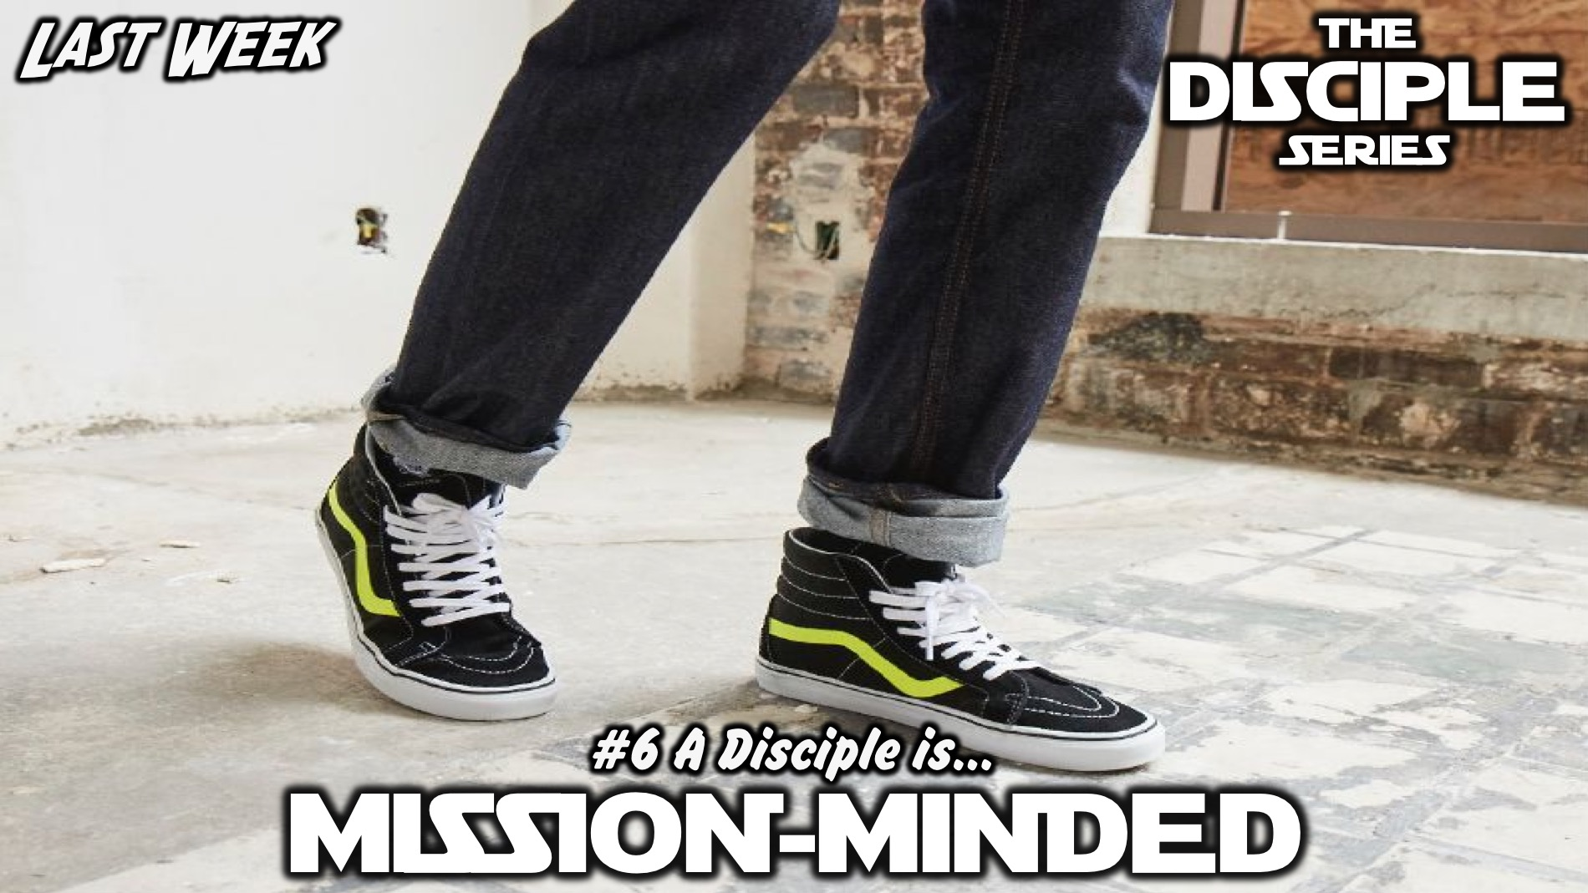
Notes:
Last week we learnt that a disciple is Mission-minded.

Slide 8
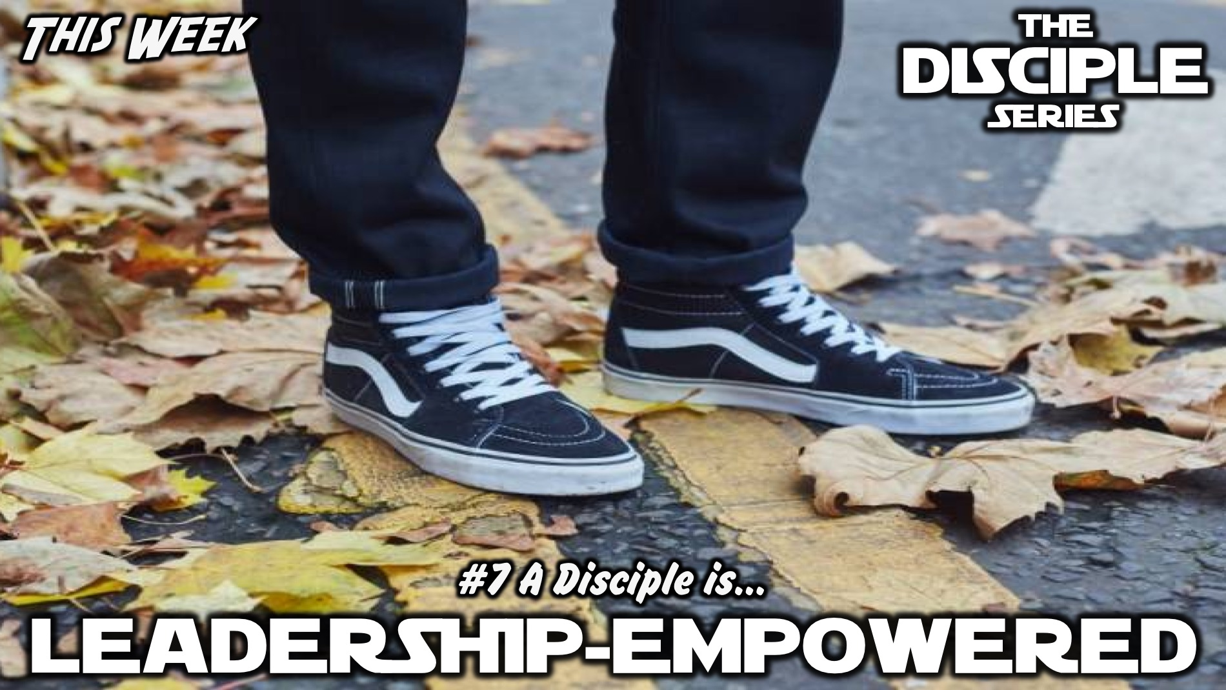
Notes:
This week we will learn that a disciple is Leadership-empowered.

Slide 9
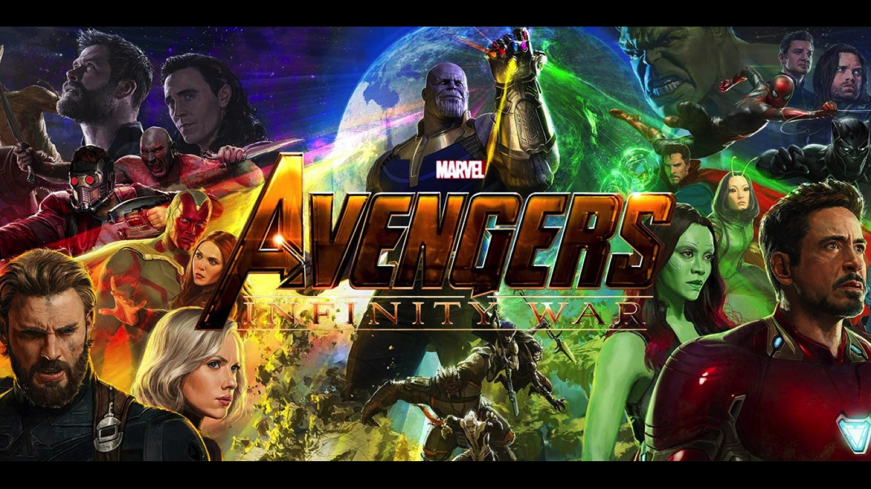
Notes:
The new Avengers movie is due out soon - it is called Infinity War. Here is the trailer…

Slide 10
Notes:
Video: Infinity War Trailer. Get it on YouTube at: https://www.youtube.com/watch?v=6ZfuNTqbHE8&t

Slide 11
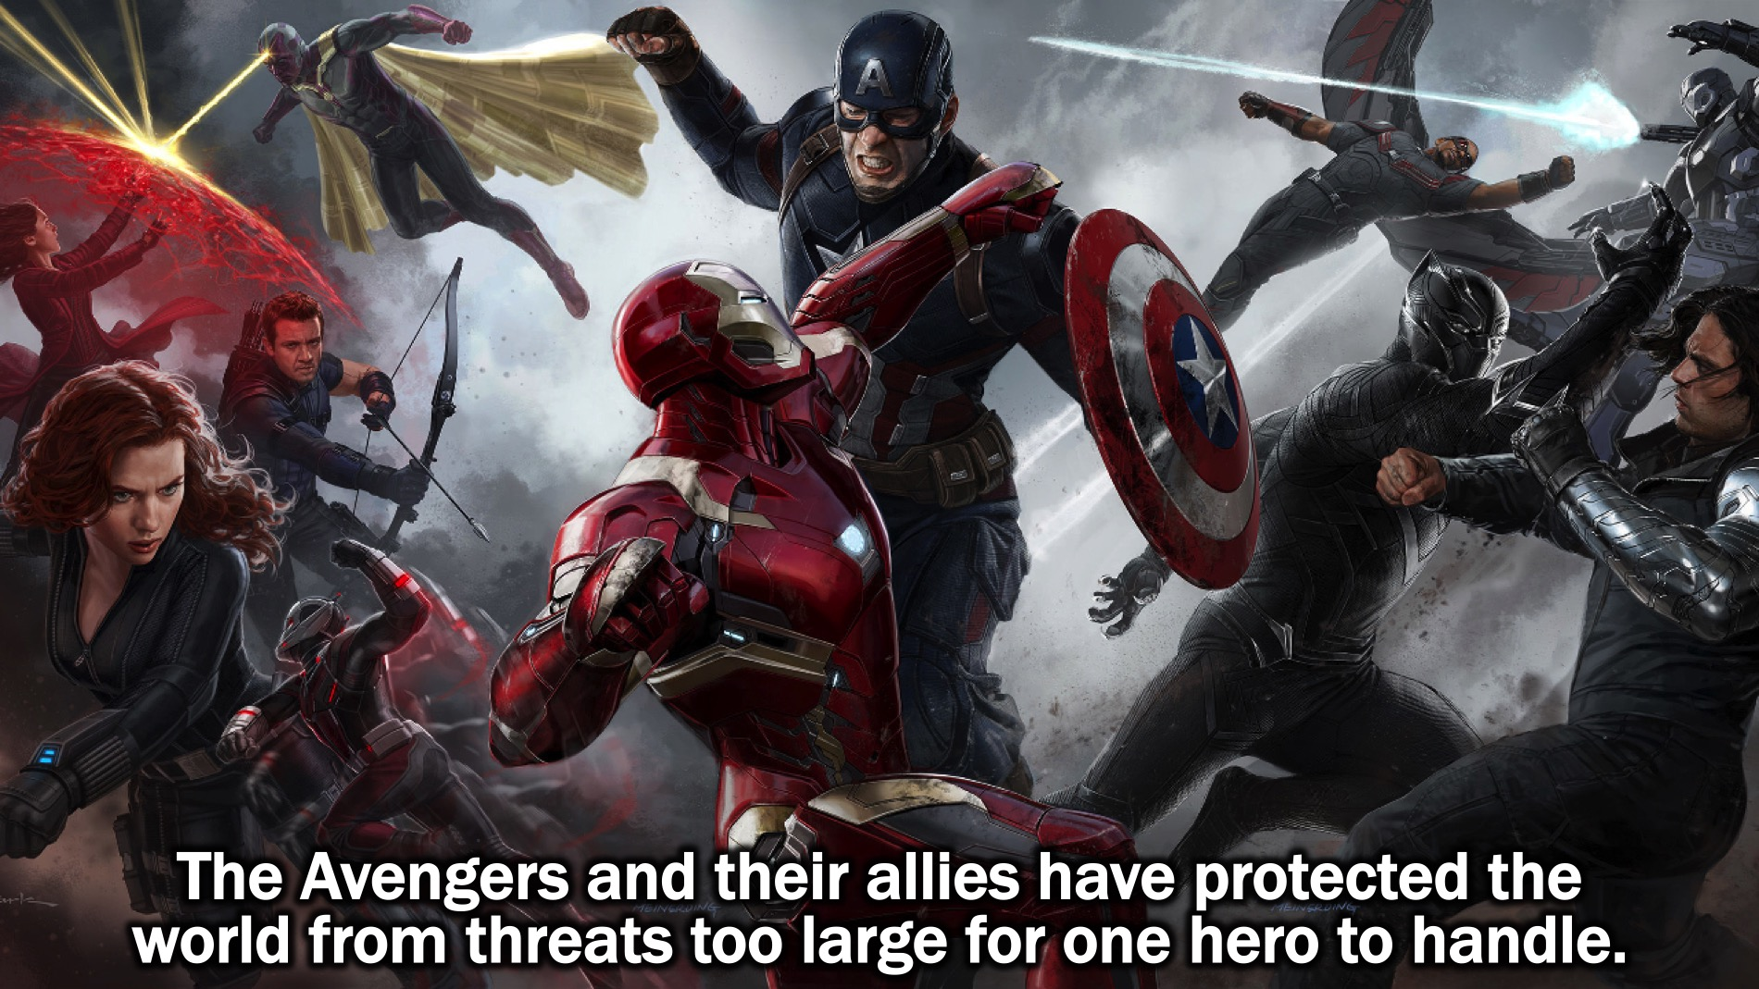
Notes:
(1) The Avengers and their allies have protected the world from threats too large for one hero to handle.

Slide 12
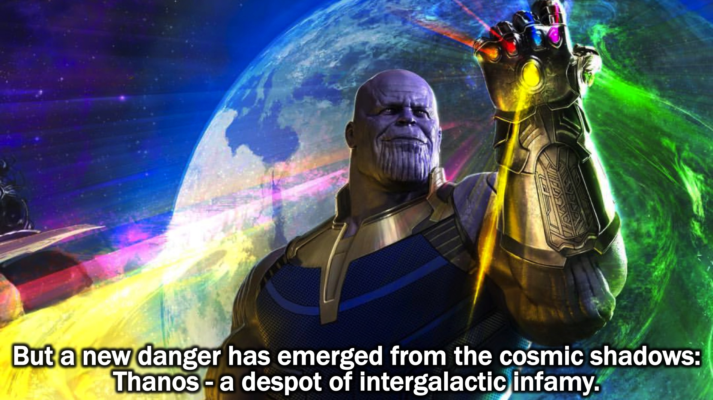
Notes:
(2) But a new danger has emerged from the cosmic shadows: Thanos - a despot of intergalactic infamy.

Slide 13
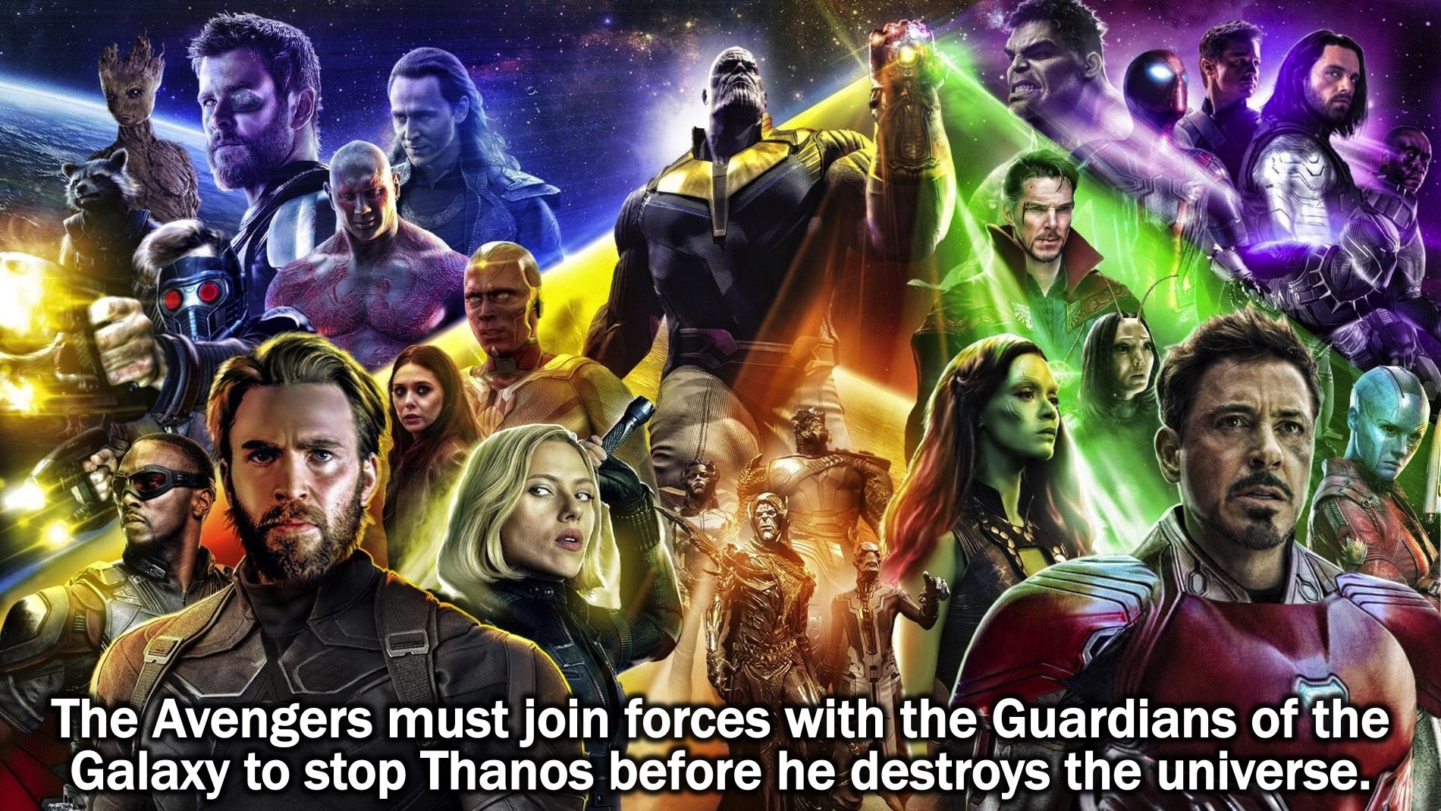
Notes:
(3) The Avengers must join forces with the Guardians of the Galaxy to stop Thanos before he destroys the universe.

Slide 14
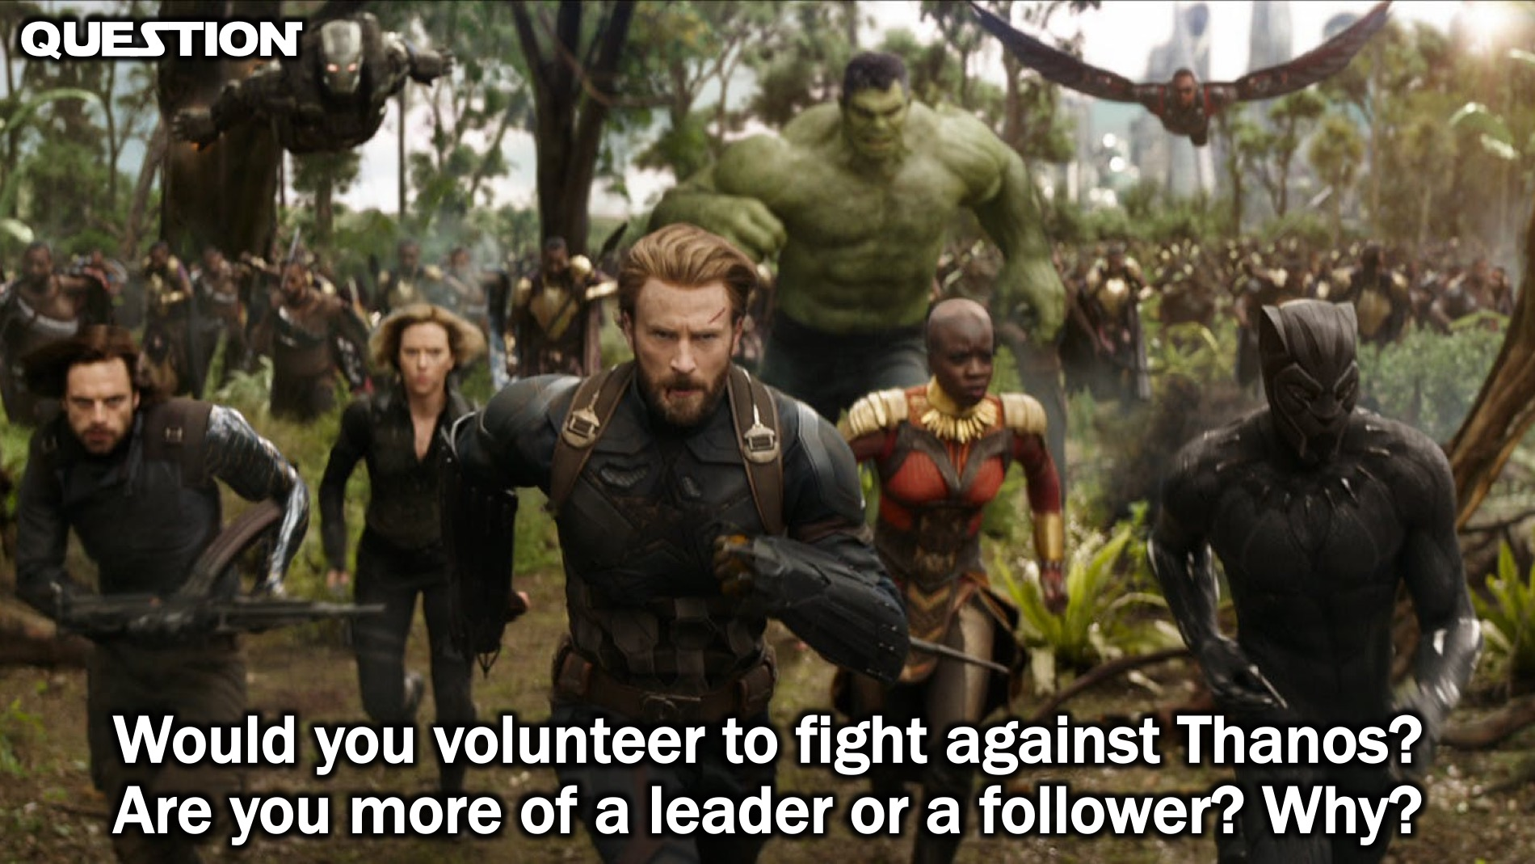
Notes:
Question: Would you volunteer to fight against Thanos? Are you more of a leader or a follower? Why?

Slide 15
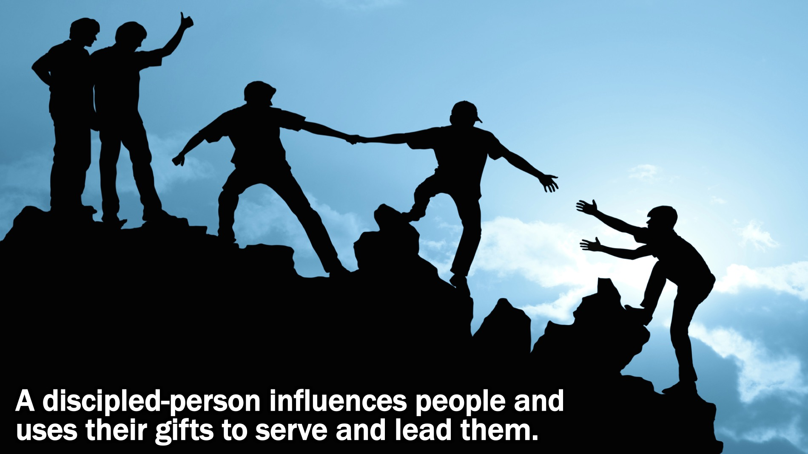
Notes:
Definition: A discipled-person influences people and uses their gifts to serve and lead them. We influence people through who we are, what we say and by what we do!

Slide 16
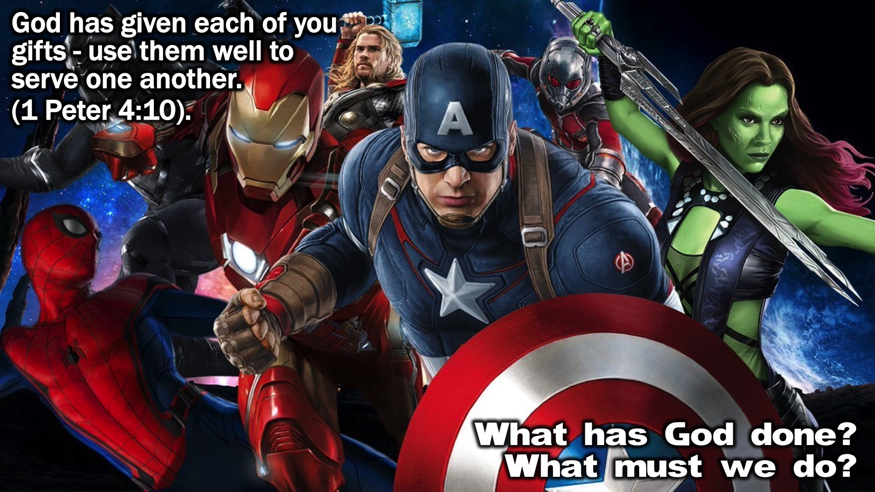
Notes:
Bible Passage: “God has given each of you gifts - use them well to serve one another.” (1 Peter 4:10).
Small Group Question: What has God done? What must we do?

Slide 17
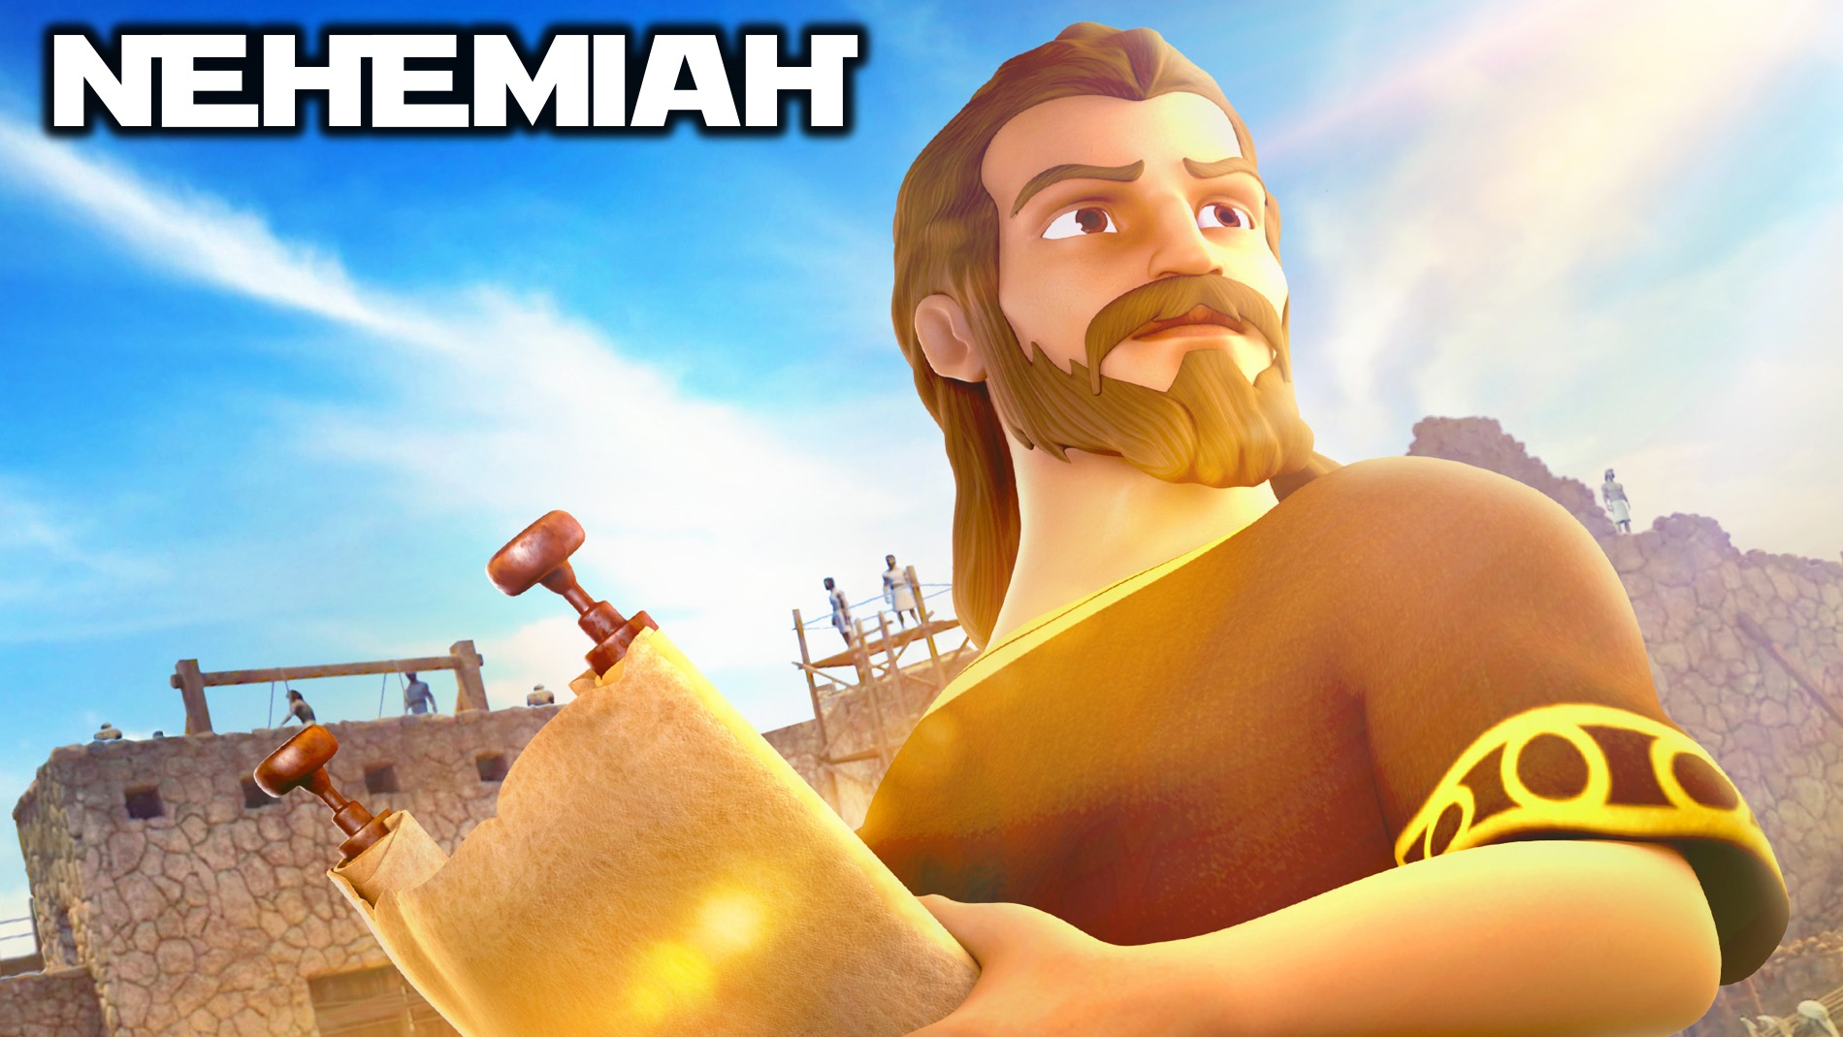
Notes:
Biblical Character: Nehemiah – Nehemiah lived during the time that the nation of Israel were in exile and he had become a cupbearer for the king of Babylon.

Slide 18
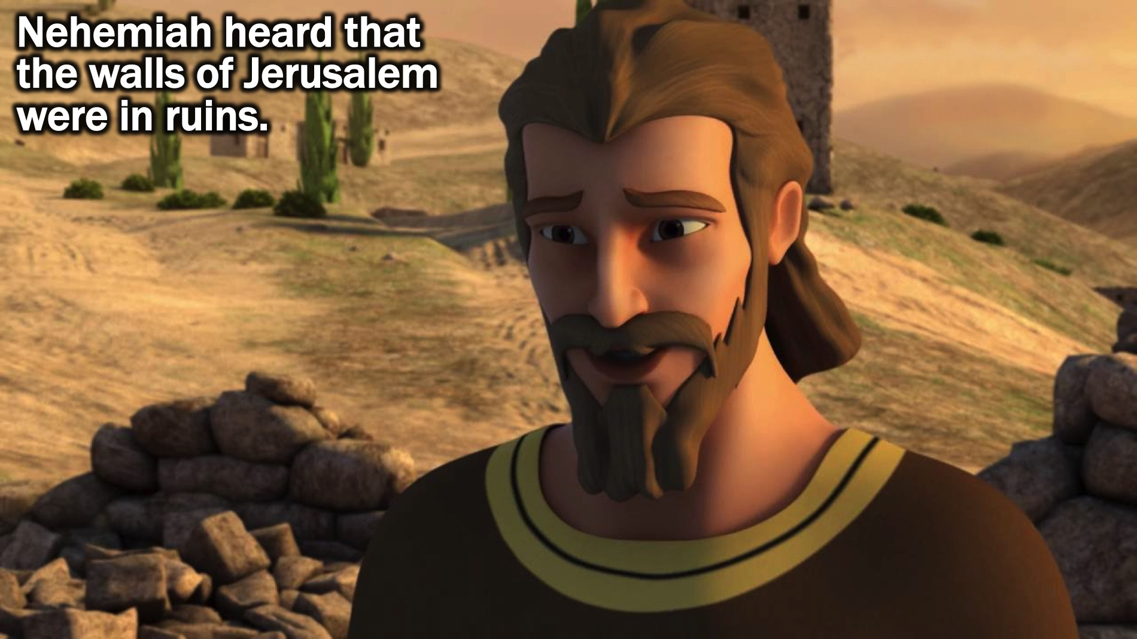
Notes:
(1) Nehemiah heard that the walls of Jerusalem were in ruins.

Slide 19
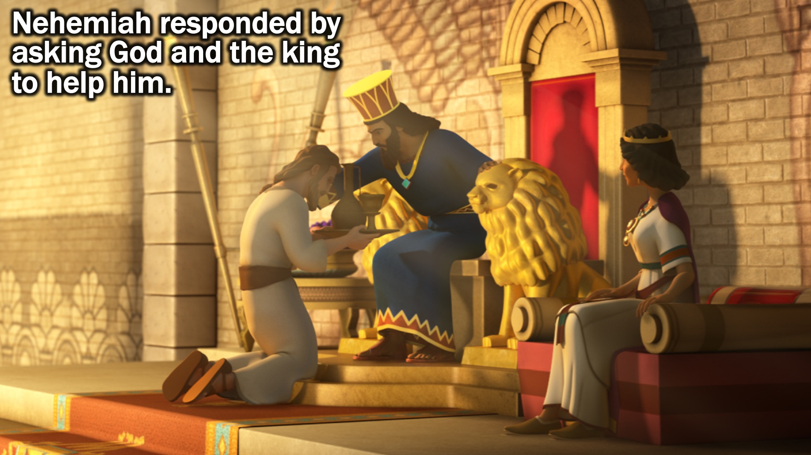
Notes:
(2) Nehemiah responded by asking God and the king to help him.

Slide 20
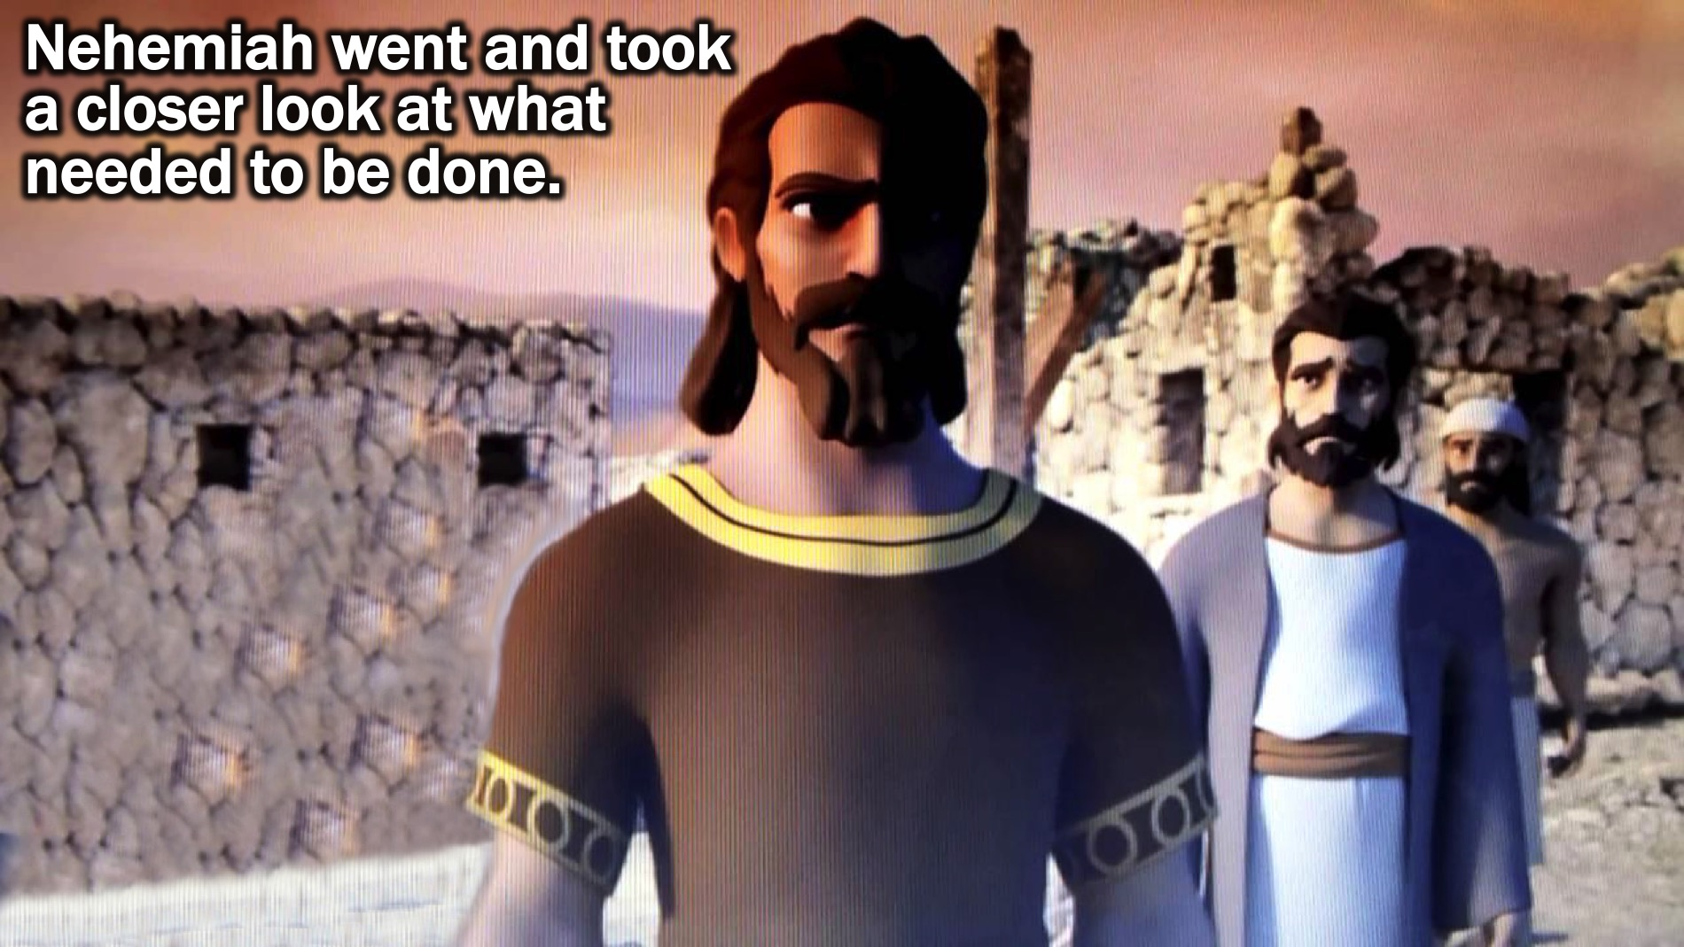
Notes:
(3) Nehemiah went and took a closer look at what needed to be done.

Slide 21
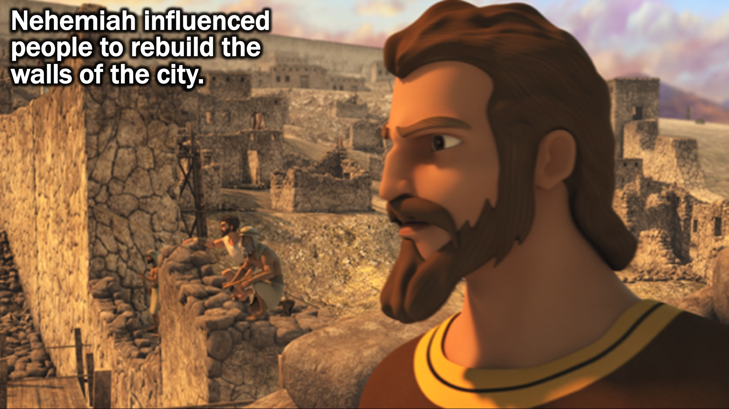
Notes:
(4) Nehemiah influenced people to rebuild the walls of the city.

Slide 22
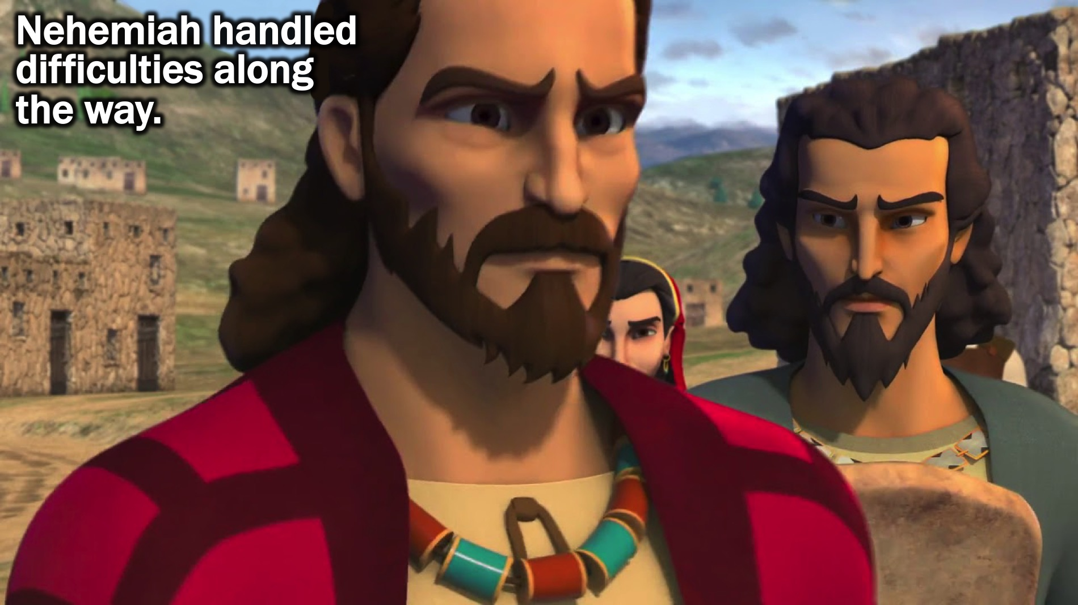
Notes:
(5) Nehemiah handled difficulties along the way.

Slide 23
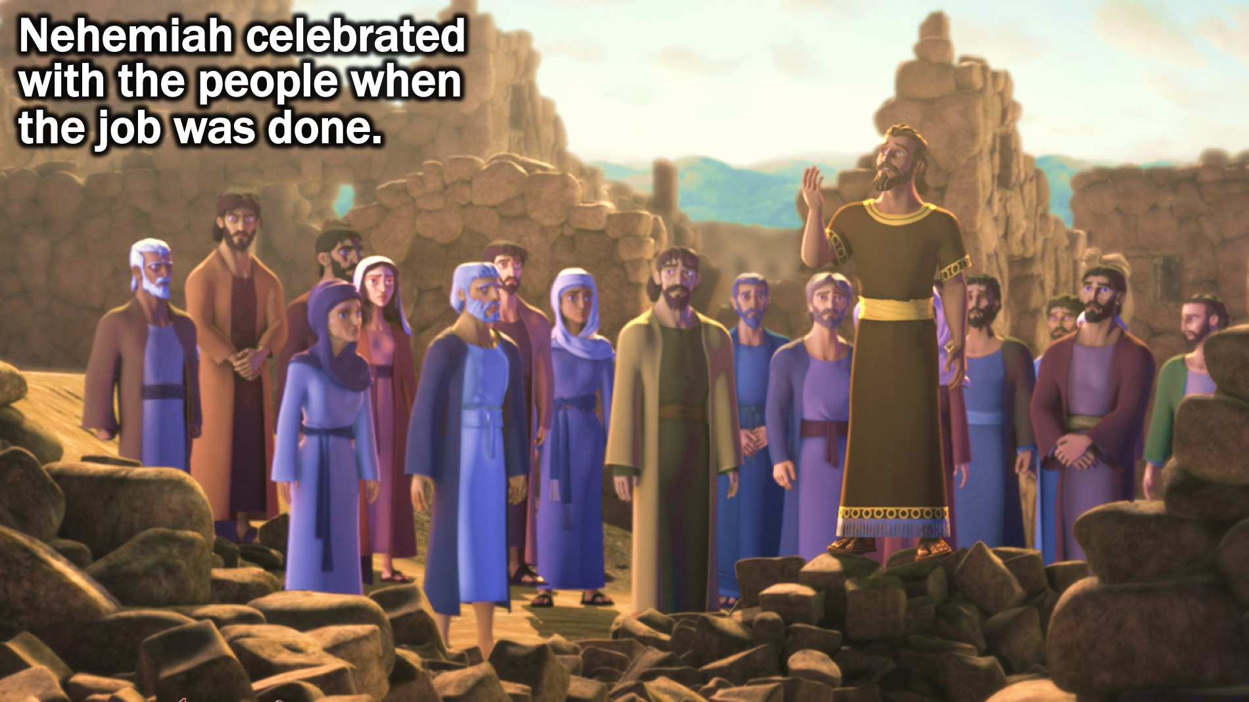
Notes:
(6) Nehemiah celebrated with the people when the job was done.

Slide 24
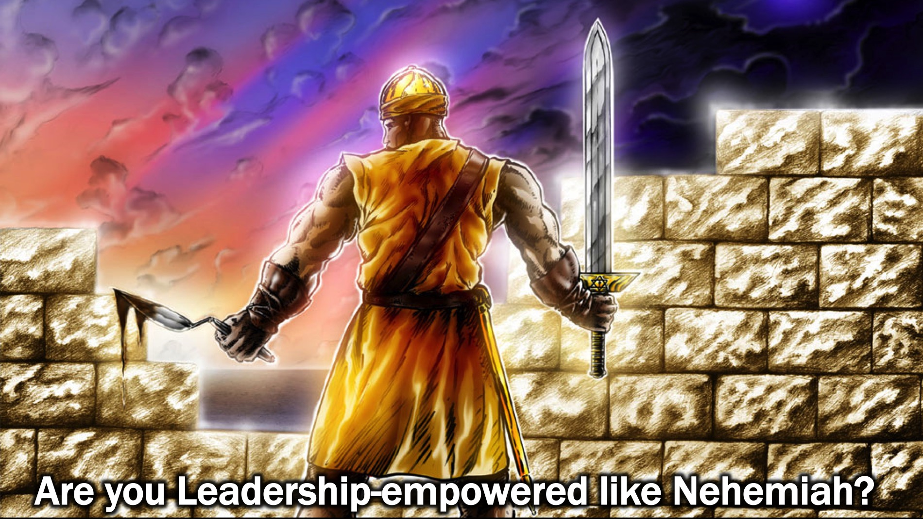
Notes:
Question: Are you Leadership-empowered like Nehemiah?

Slide 25
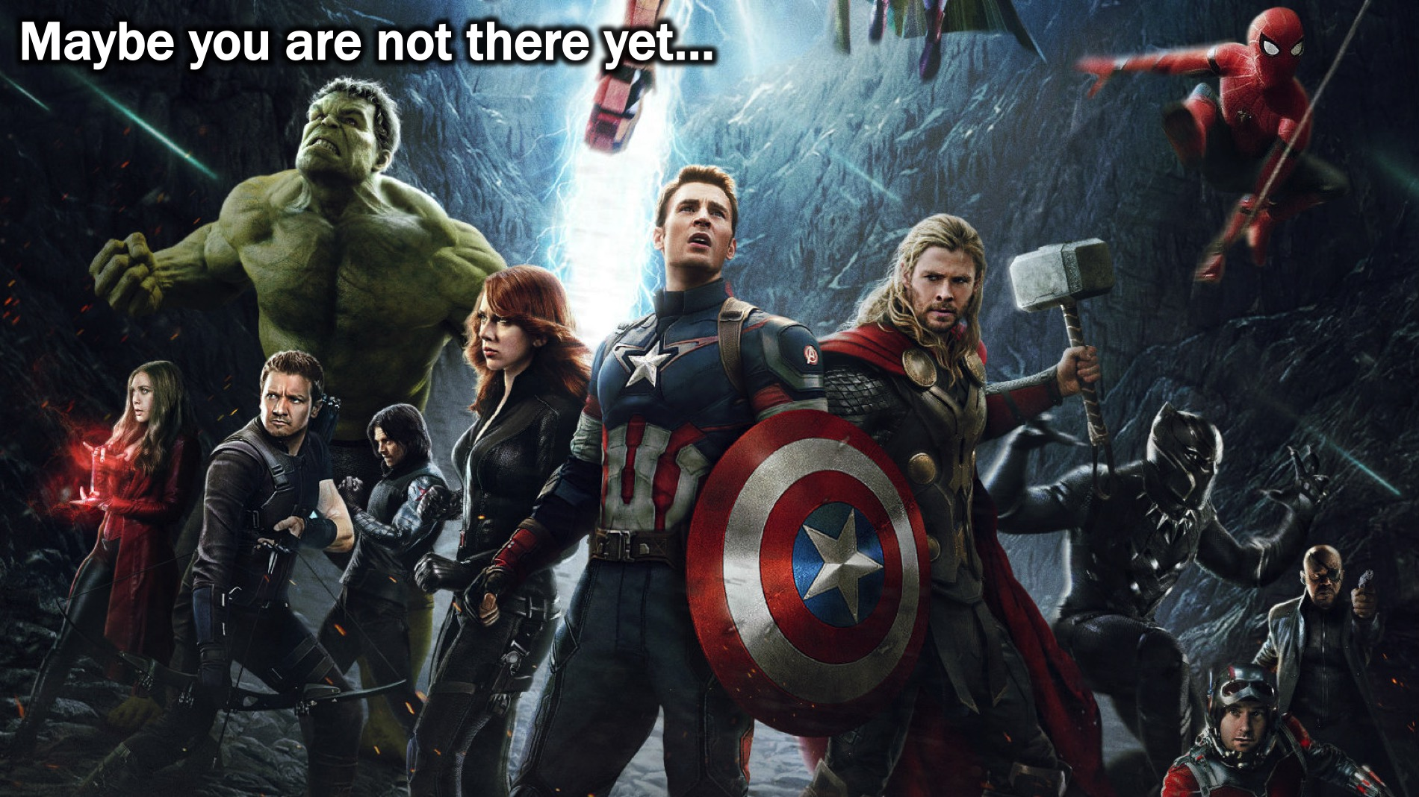
Notes:
Maybe you are not there yet…

Slide 26
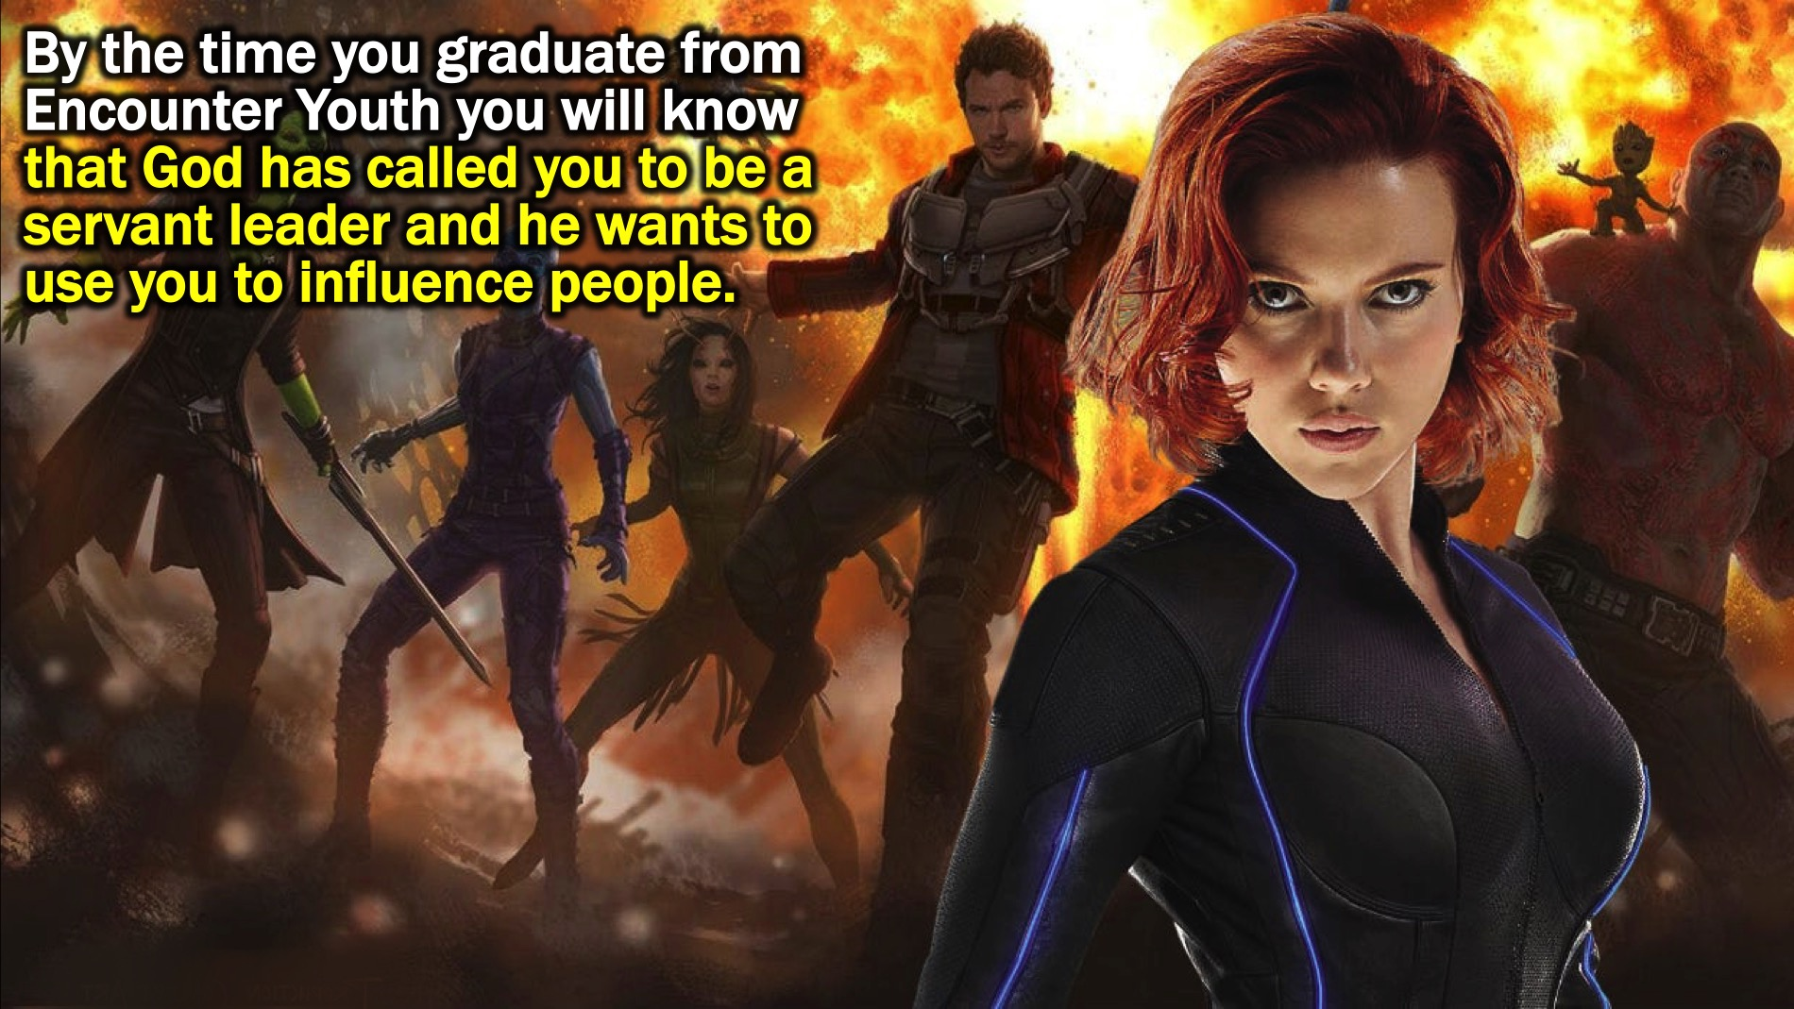
Notes:
By the time you graduate from Encounter Youth you will know that God has called you to be a servant leader and he wants to use you to influence people.

Slide 27
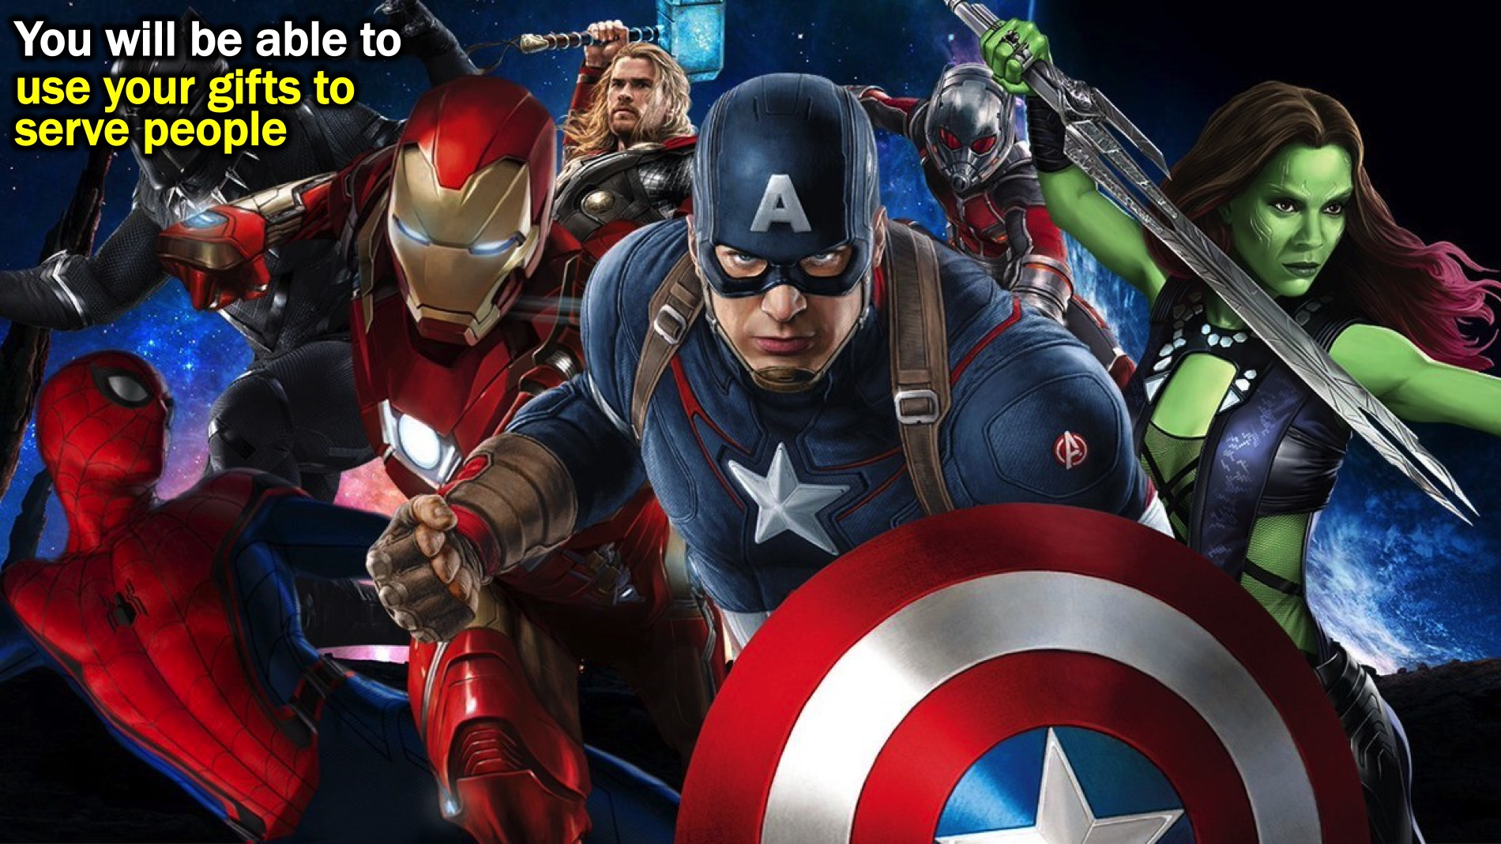
Notes:
You will be able to use your gifts to serve people

Slide 28
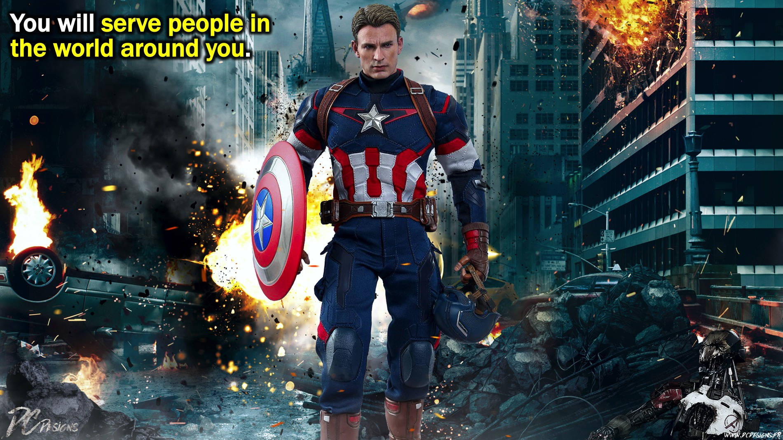
Notes:
You will serve people in the world around you.

Slide 29
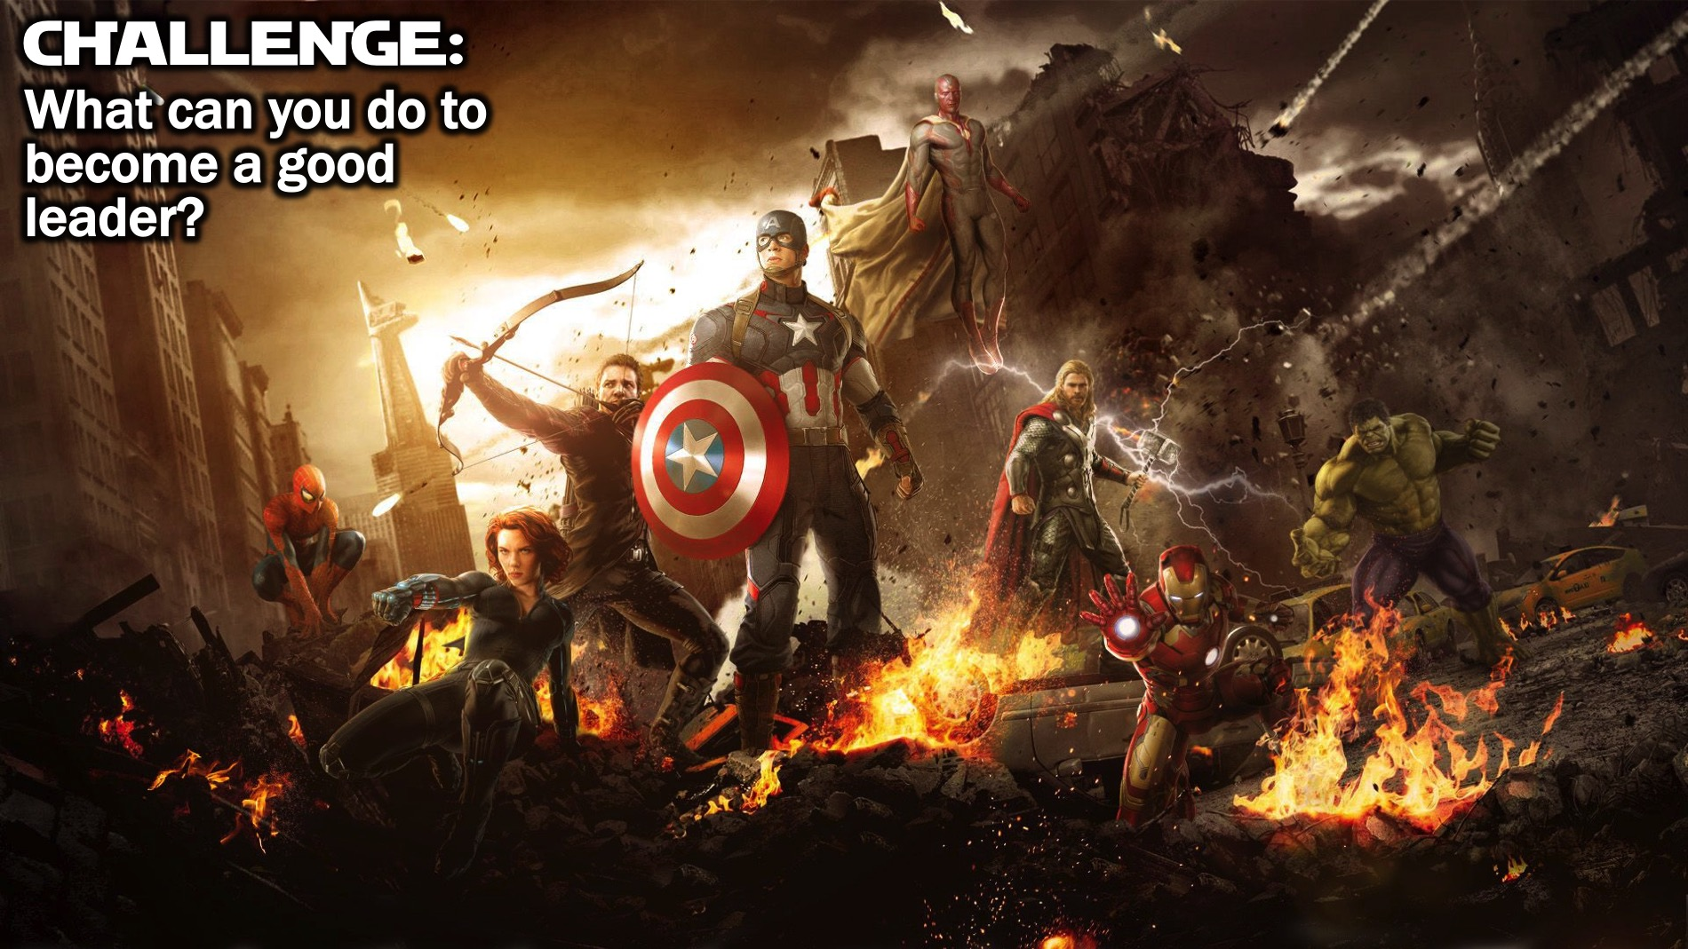
Notes:
Challenge: What can you do to become a good leader?

Slide 30
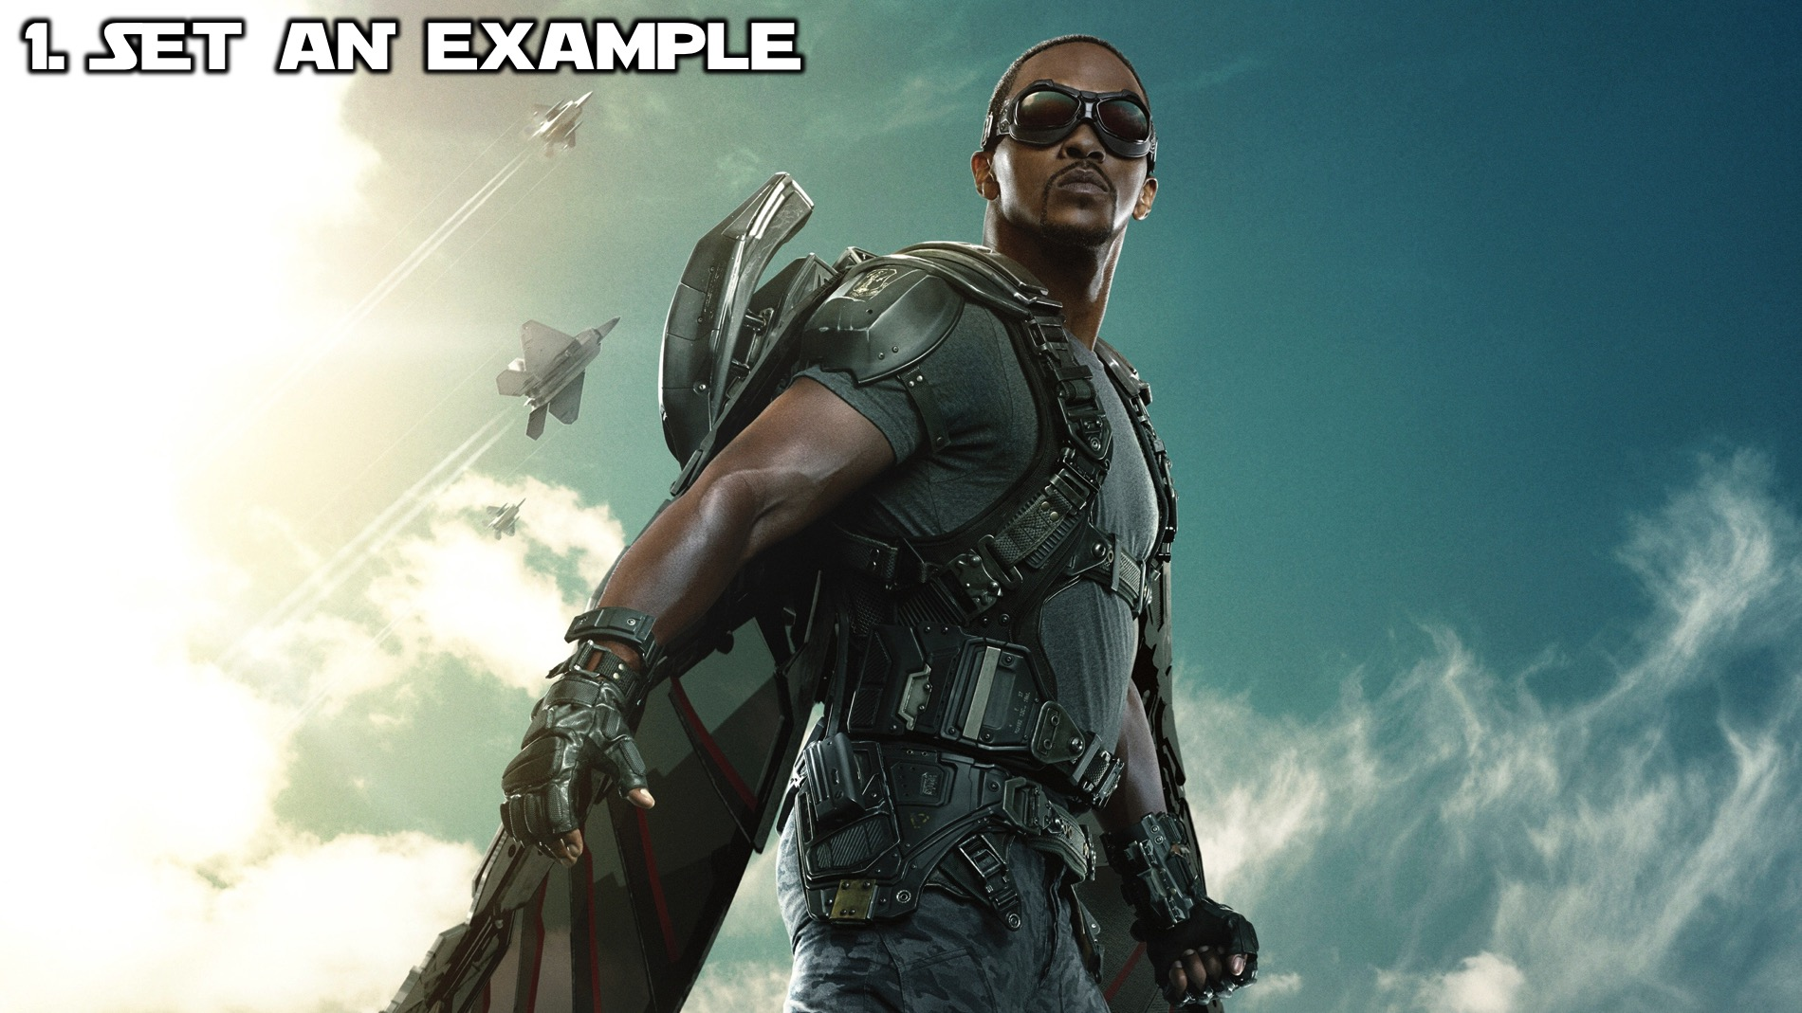
Notes:
Step #1: Set An Example: Work on becoming the kind of person that God can use and that other people want to follow!

Slide 31

Notes:
Step #2: Offer to Help: Look for opportunities where help is needed and make yourself available to help.

Slide 32
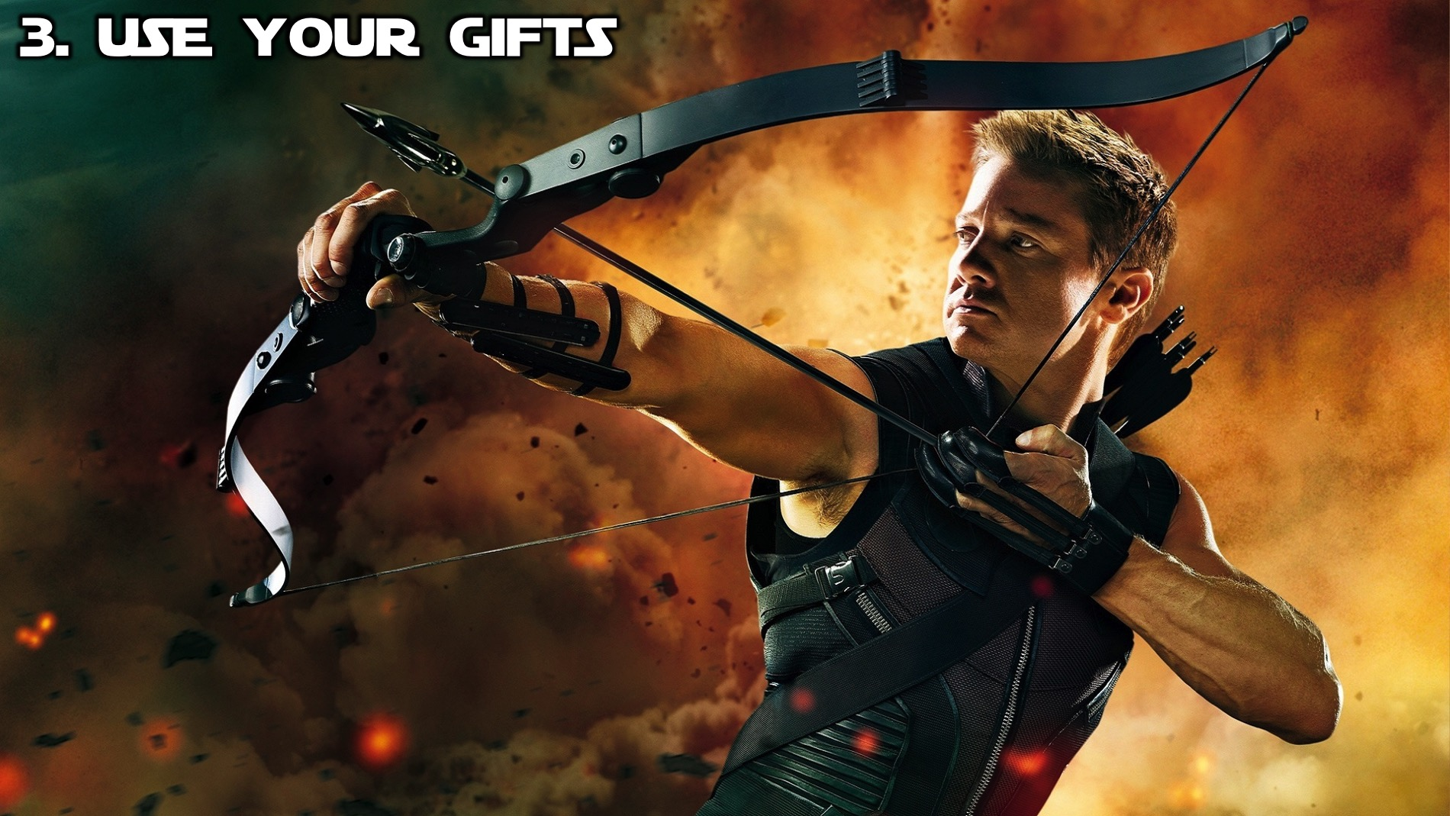
Notes:
Step #3: Use Your Gifts: Find out what you can do and use your gifts to serve others.

Slide 33
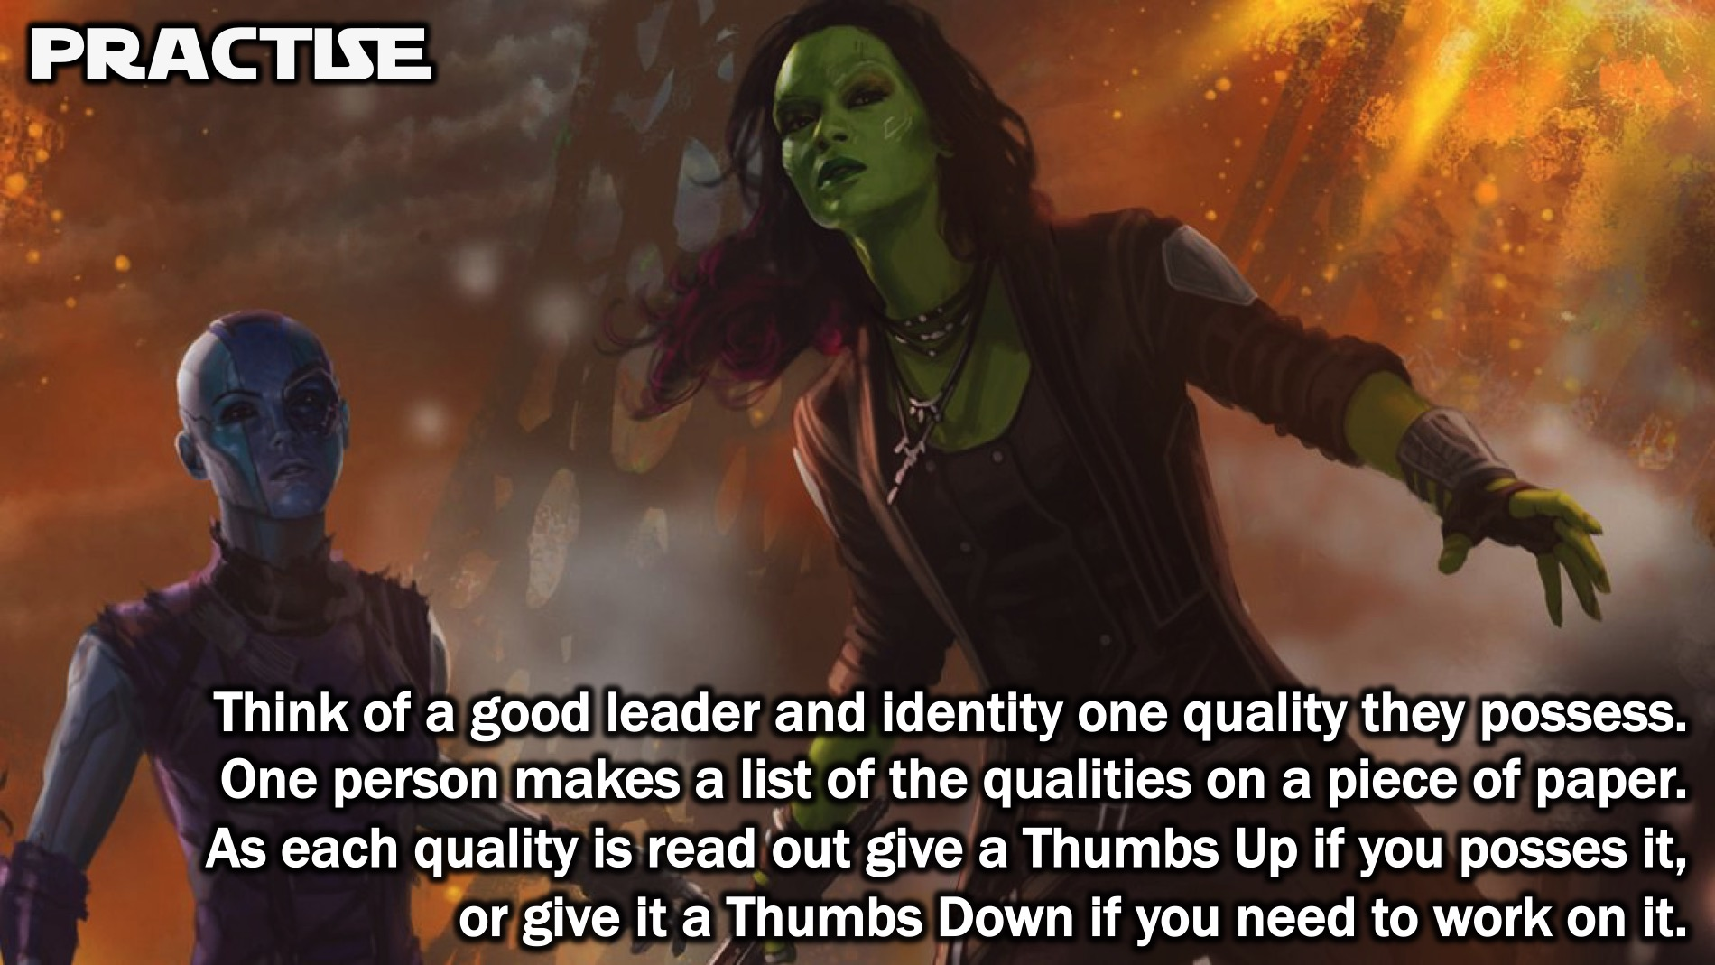
Notes:
Practise: Thumbs Up/Down. At your tables, each person thinks of a good leader and identifies one quality that makes them a good leader. One person writes all the qualities on a piece of A4 paper. There could be as many as 6 to 8 qualities mentioned depending on the number of people at the table. The person who writes down the leadership qualities - possibly the leader at the table - says: “I am going to read out the list of leadership qualities. If you feel you possess the quality, then hold your thumbs up in front of you, if you feel like you need to work on that quality, then hold your thumbs down.”

Slide 34
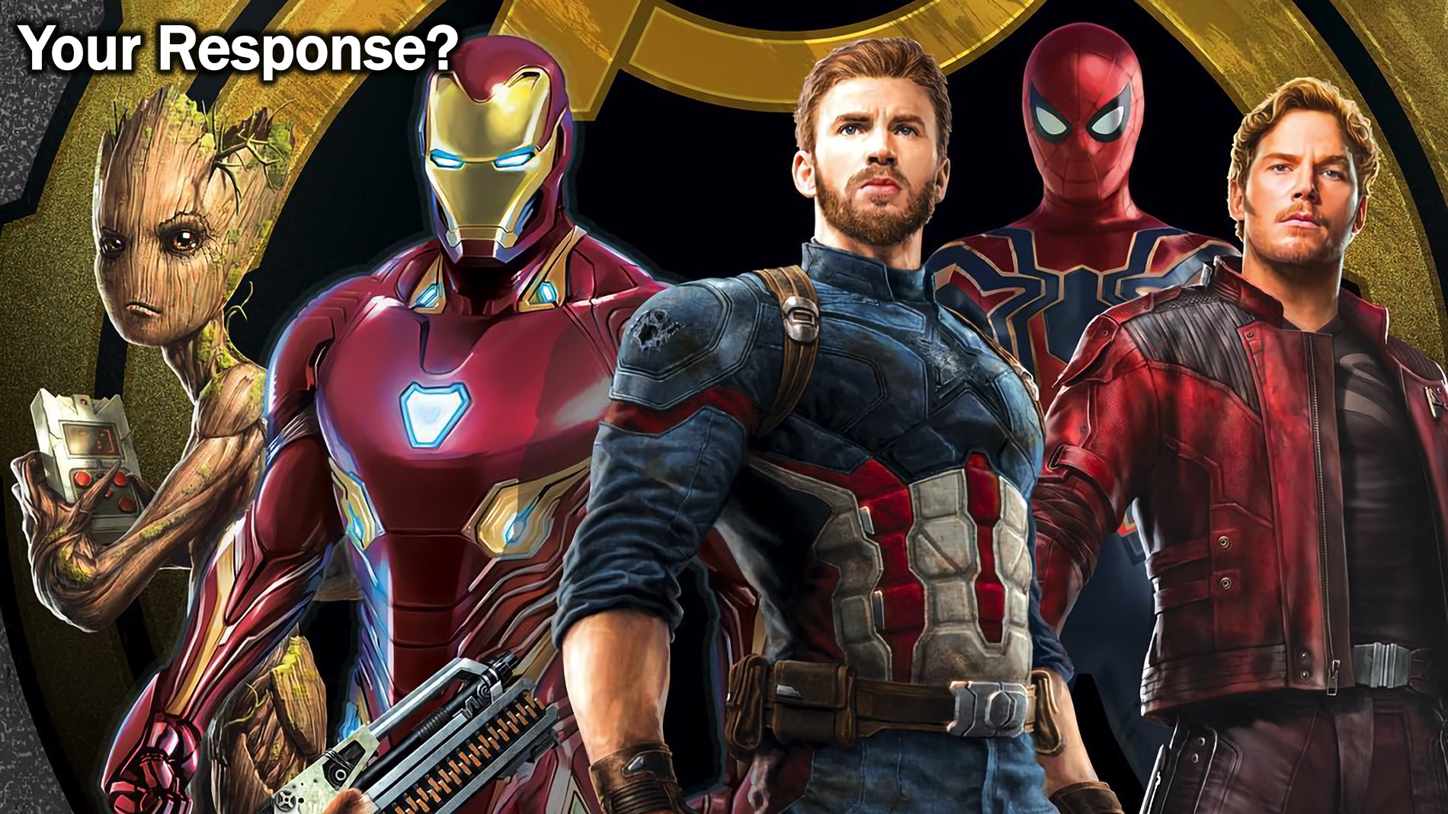
Notes:
Your Response? What will your response be to the message you have heard today? Will you work on becoming Leadership-empowered?

Slide 35
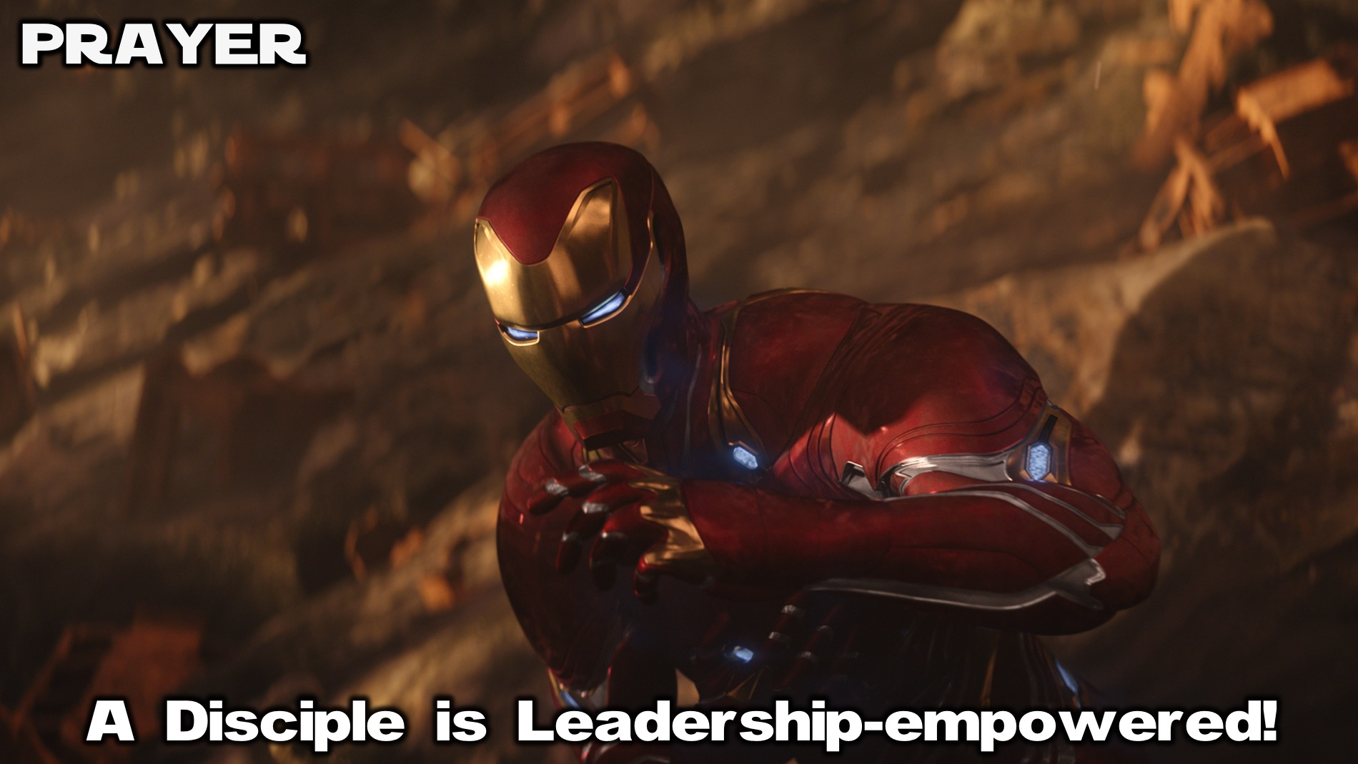
Notes:
Prayer: Let’s ask God to help us become Leadership-empowered.

Slide 36
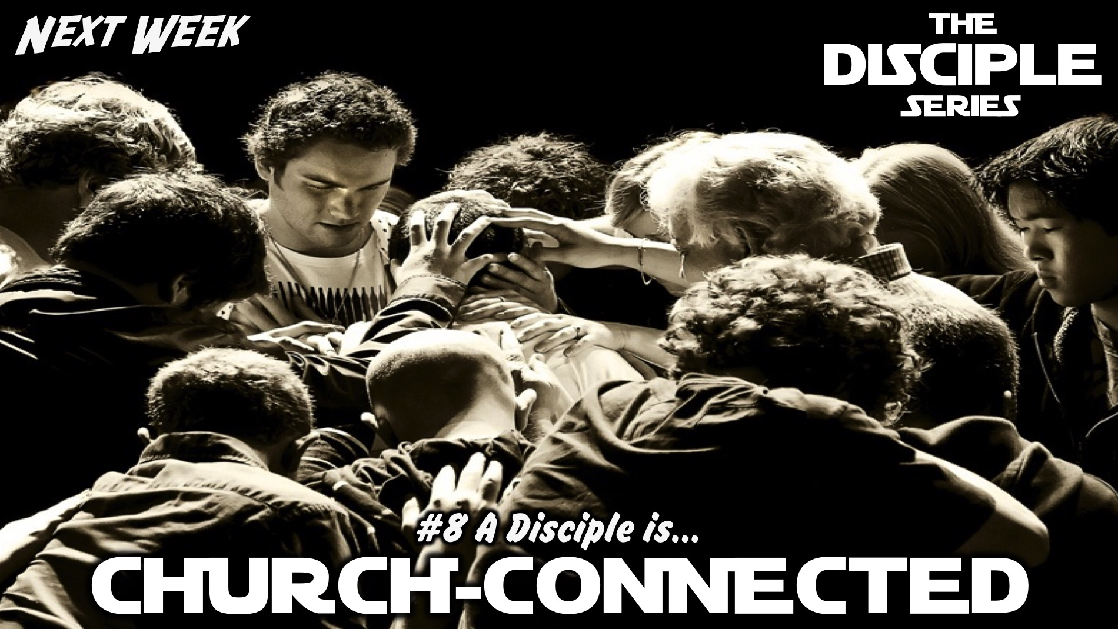
Notes:
Next week we will learn that a disciple is Church-connected.

