Slide 1

Notes:
Welcome to the final week of our Disciple Series.

Slide 2
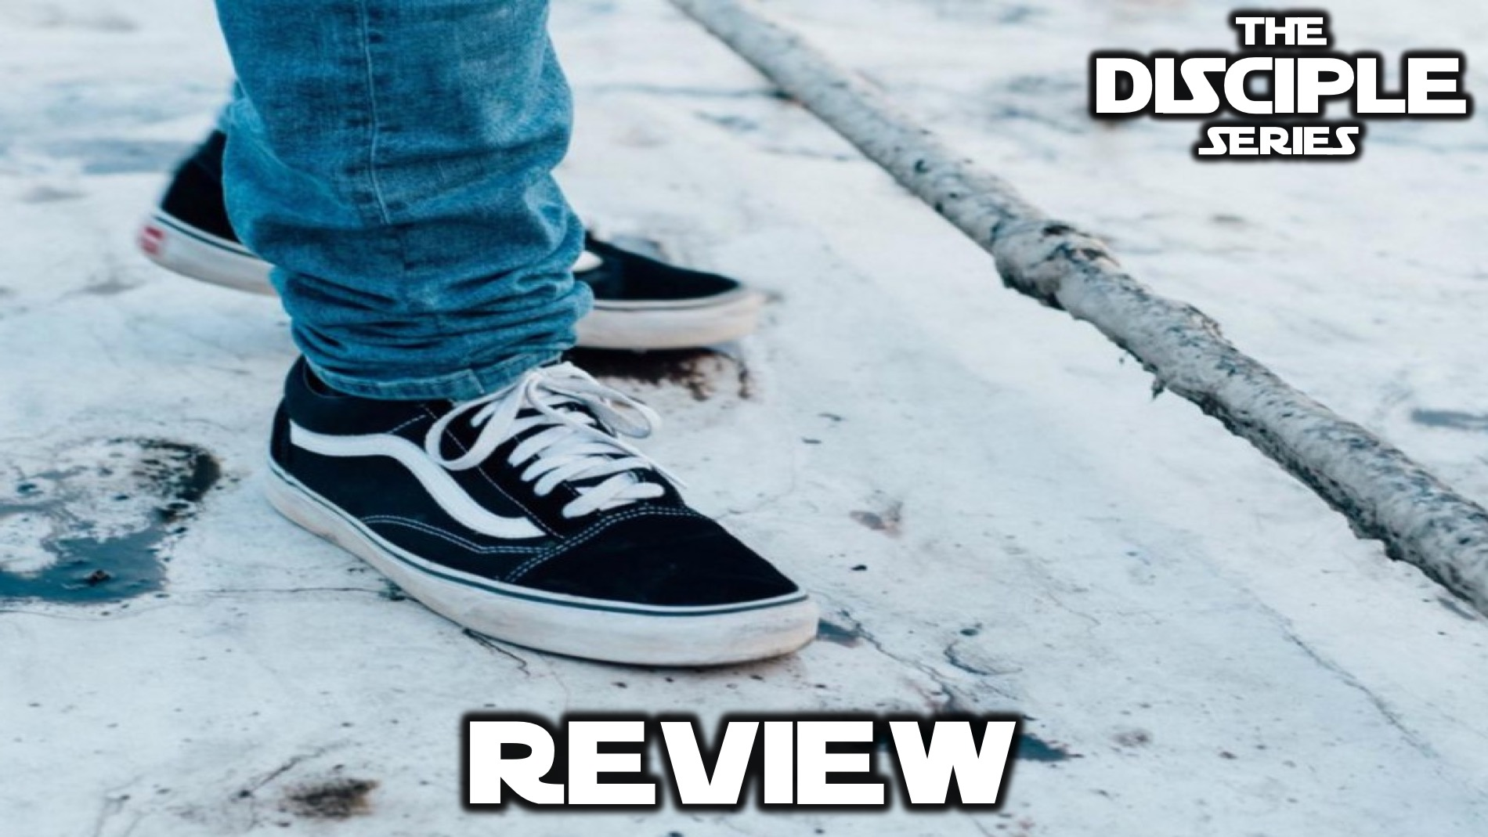
Notes:
Today we are going to review our series in two ways…

Slide 3

Notes:
Firstly, put your hands together for our special guest artist - Z_lus! You can check out his beats on SoundCloud at “Z_lus The Zeal”

Slide 4

Notes:
Secondly, you have some time to visit the Review Stations where you can connect with what we explored each week of this term in the Disciple Series.

Slide 5
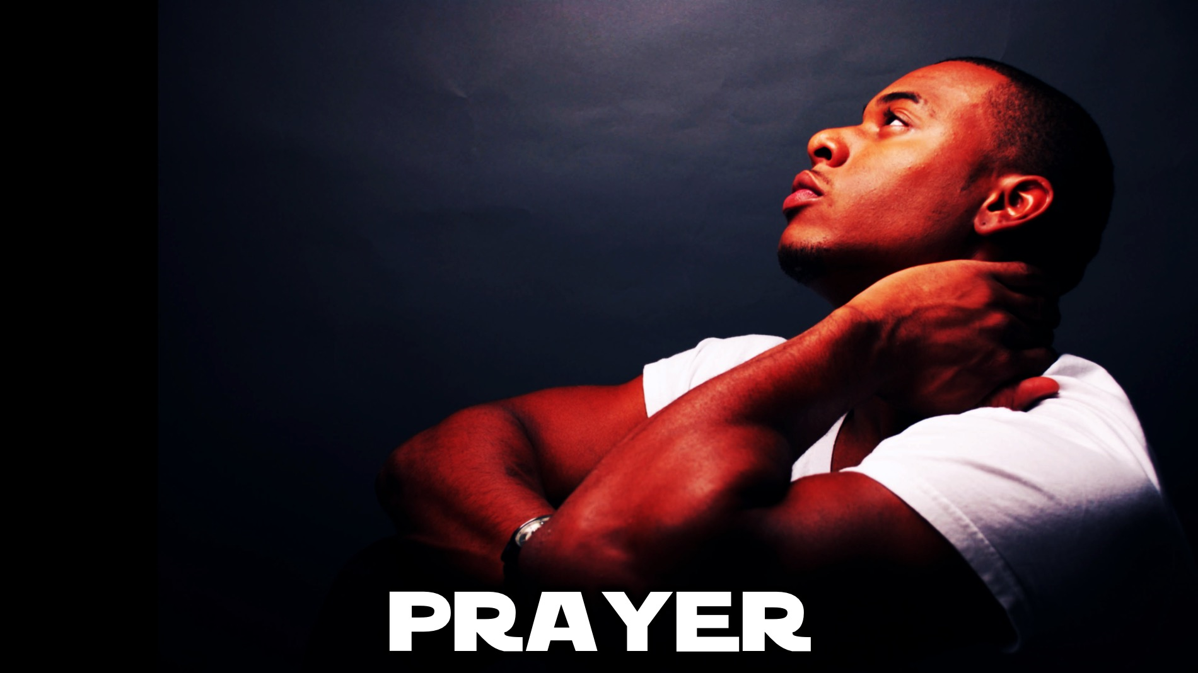
Notes:
Prayer: Let’s pray and ask God to help us become the kind of disciples who will change the world.

Slide 6

Notes:
Next term we will be presenting the Champion Series. This series is designed to teach you how to train your brain to think like a champion.

Slide 7

Notes:
Enjoy the refreshments that we have provided.

