Slide 1

Notes:
As His Youth we are a part of His People Christian Church and our global movement is Every Nation Ministries. and as such has embraced a common approach to disciplemaking with the following four phases: Engage – Establish – Equip – Empower.

Slide 2
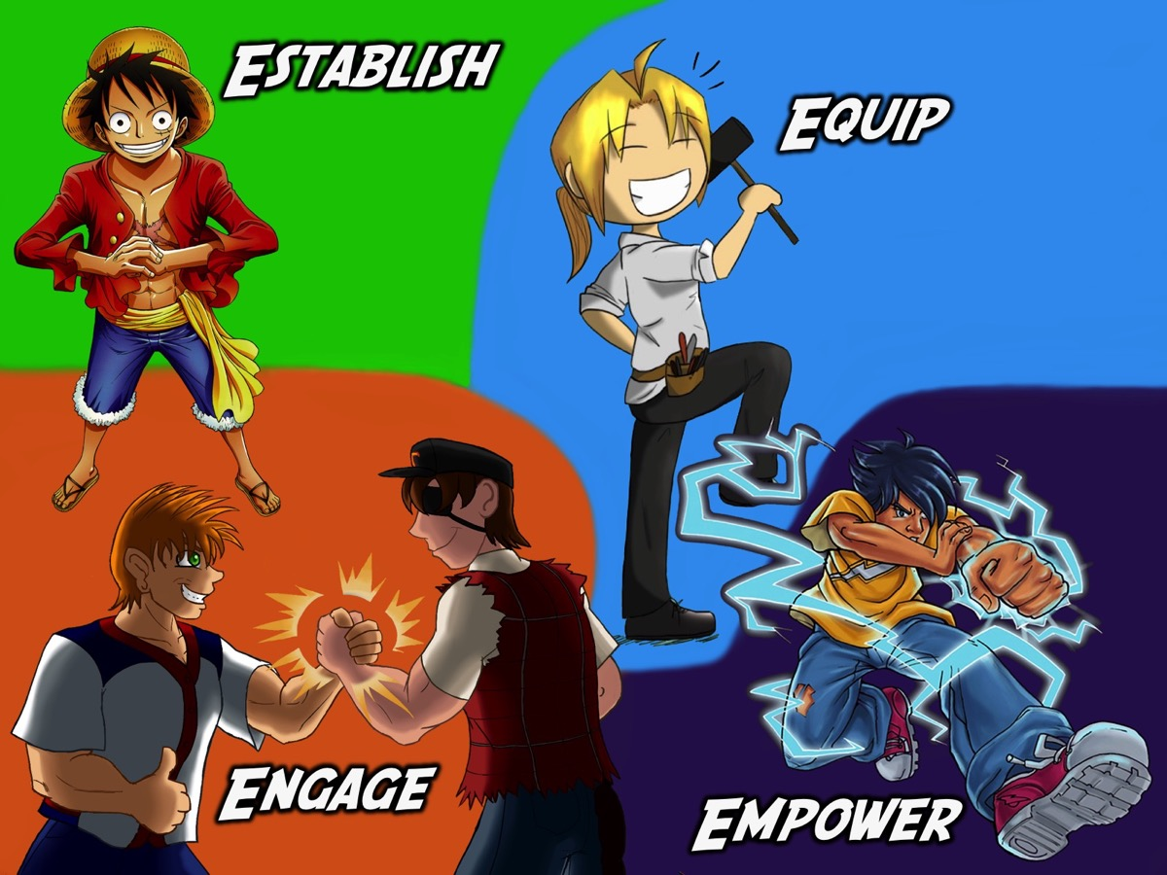
Notes:
As a youth ministry we believe it is critical to embrace the same approach for disciplemaking as the wider church so have built out youth ministry around the same four phases of ministry.

Slide 3
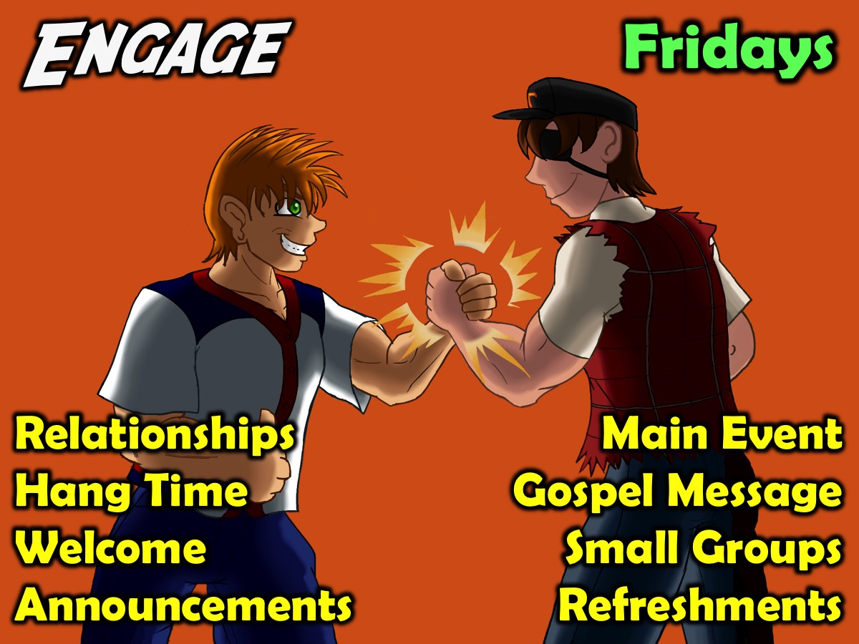
Notes:
1. Engage. Our Friday night event is an opportunity for teens to bring their friends so they can engage with other believers and with God. The key components of our Engage event are: Relationships, Hang Time, Welcome, Announcements, Main Event, Gospel Message, Small Groups & Refreshments.

Slide 4
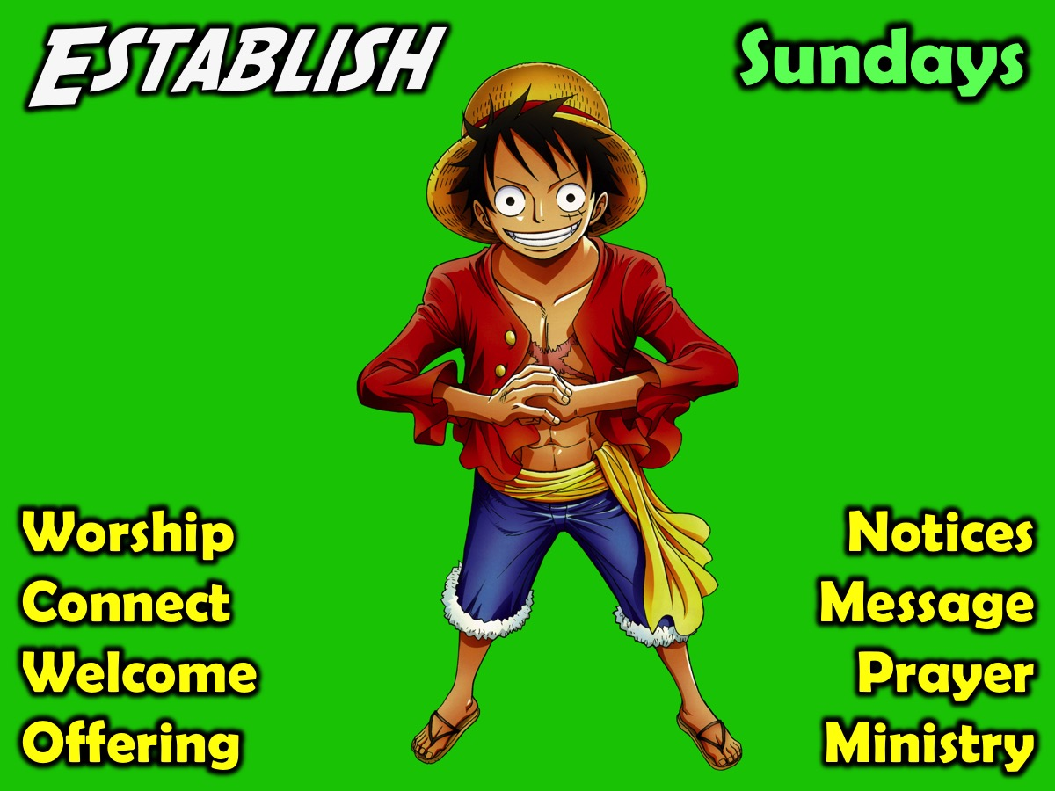
Notes:
2. Establish. Our Sunday morning event helps to establish teens in the faith. The key components are: Worship, Connect, Welcome, Offering, Notices, Messages, Prayer & Ministry.

Slide 5
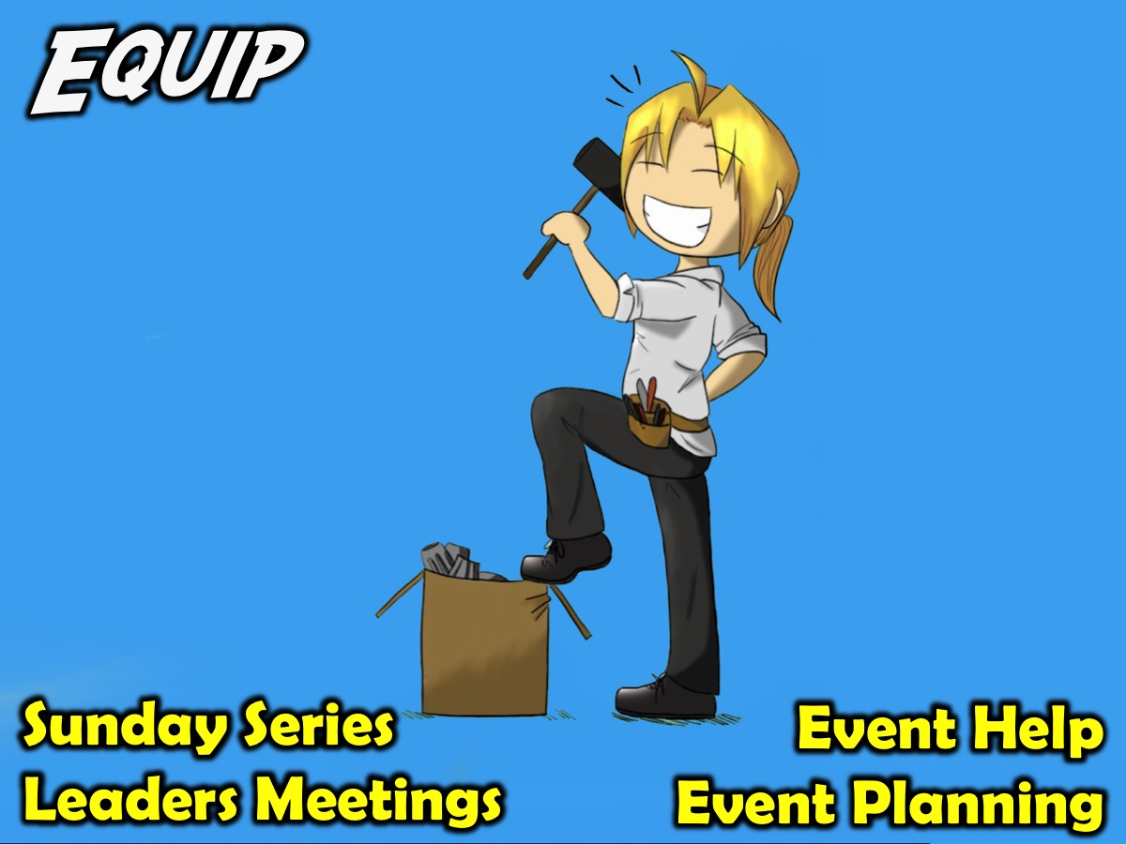
Notes:
3. Equip. We equip teens to minister among their peers in these ways: Equipping series on a Sunday morning; monthly leadership meetings and weekly prayer meetings; helping to plan and setup Friday night events or present part of a Sunday morning service (i.e. Welcome, Notices, Offering).

Slide 6
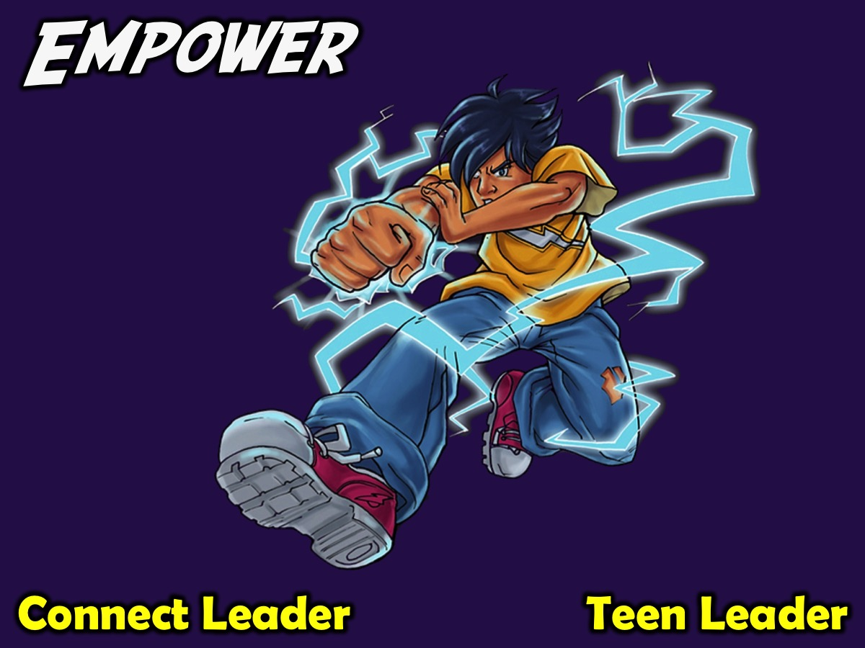
Notes:
4. Empower. We empower teens by releasing them to serve as Connect Leaders or as Teen Leaders who help plan and present weekly events.

