Slide 1

Notes:
You must have heard about the latest movie phenomenon, Divergent, that premiered in South African on the 4th of April 2014. Here is the final trailer that was released before the movie opened in cinemas.

Slide 2
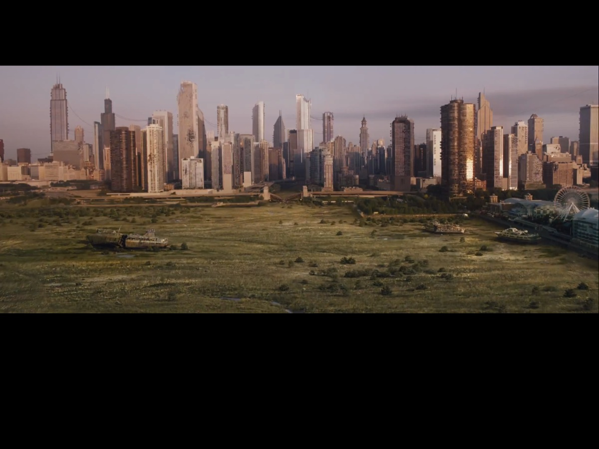
Notes:
So in this futuristic world, set in a rather run down Chicago, a disastrous war has brought about the creation of a system to ensure peace and prosperity

Slide 3
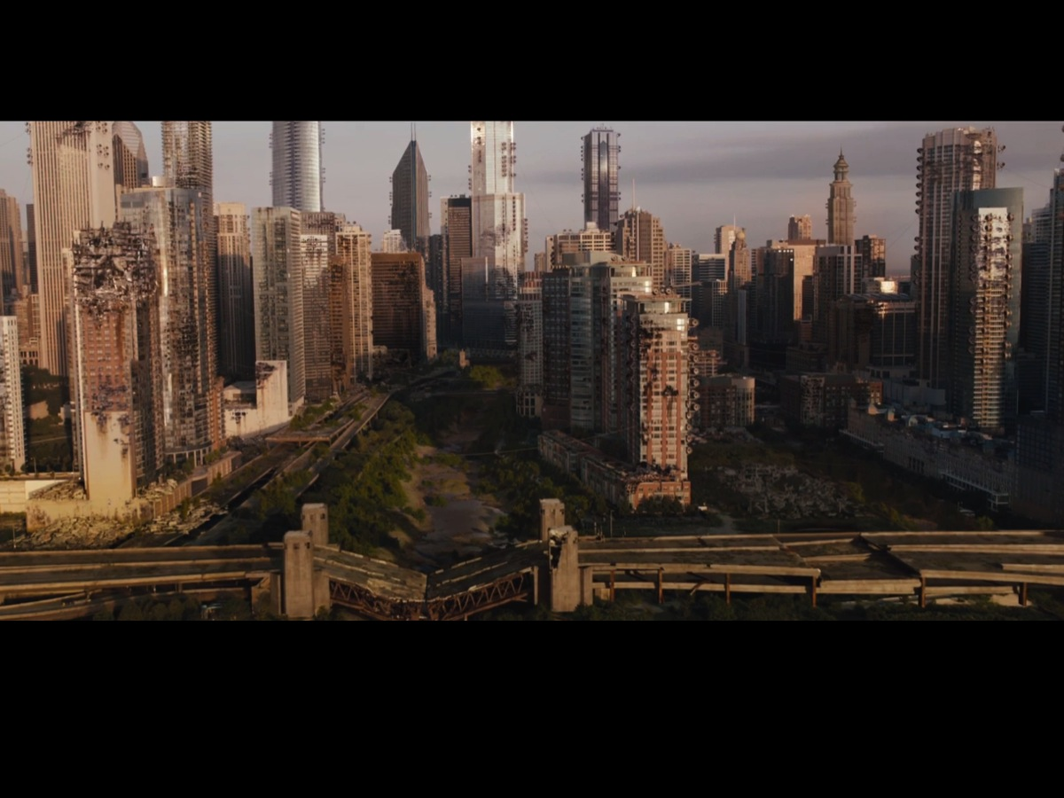
Notes:
Here is a closer view of the devastation that took place in the city of Chicago.

Slide 4
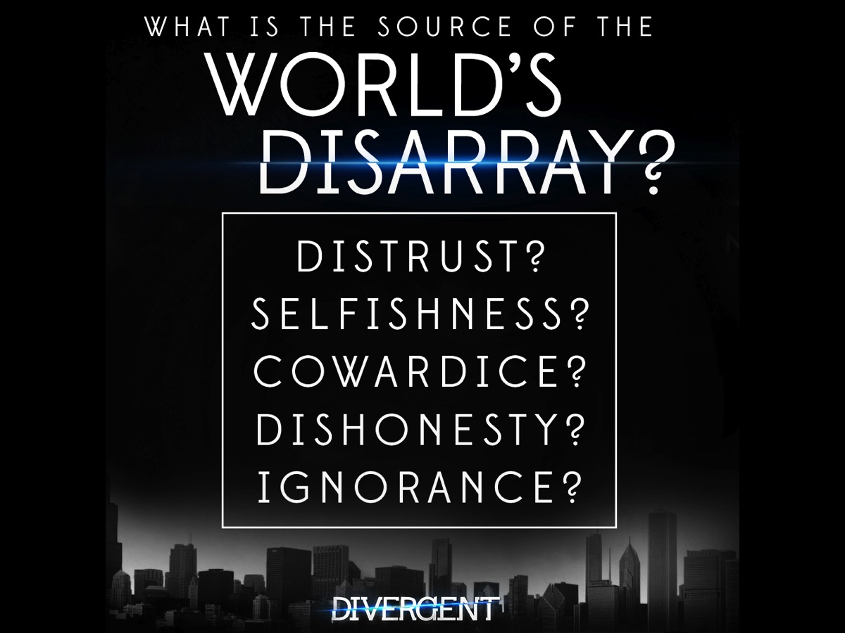
Notes:
When we look for the cause of conflict between people these negative values are options.

Slide 5
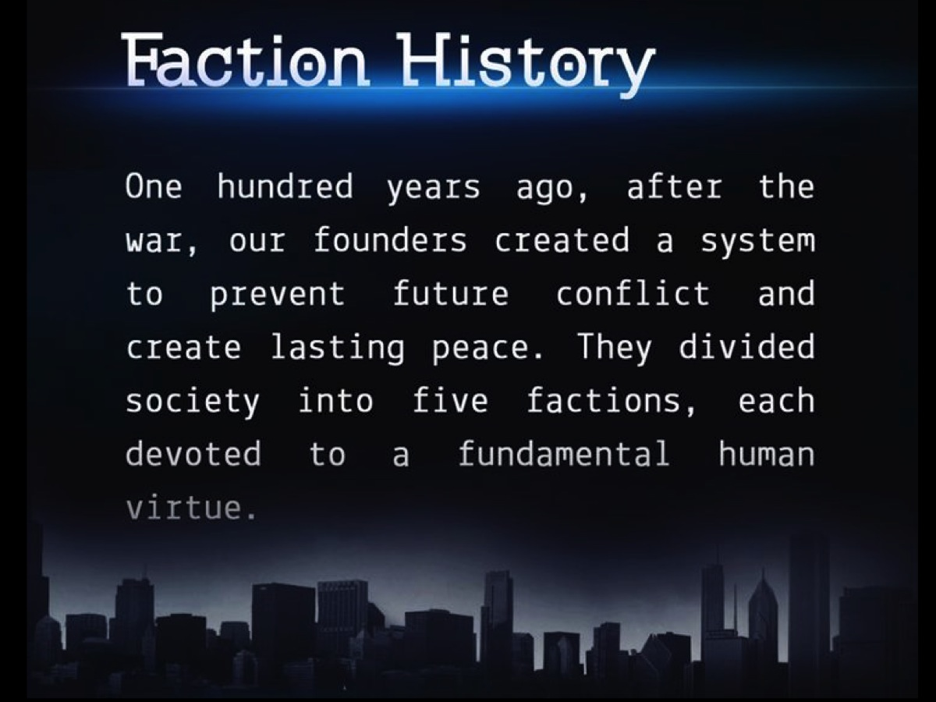
Notes:
Society has been divided into five factions – each one devoted to a different human virtue…

Slide 6
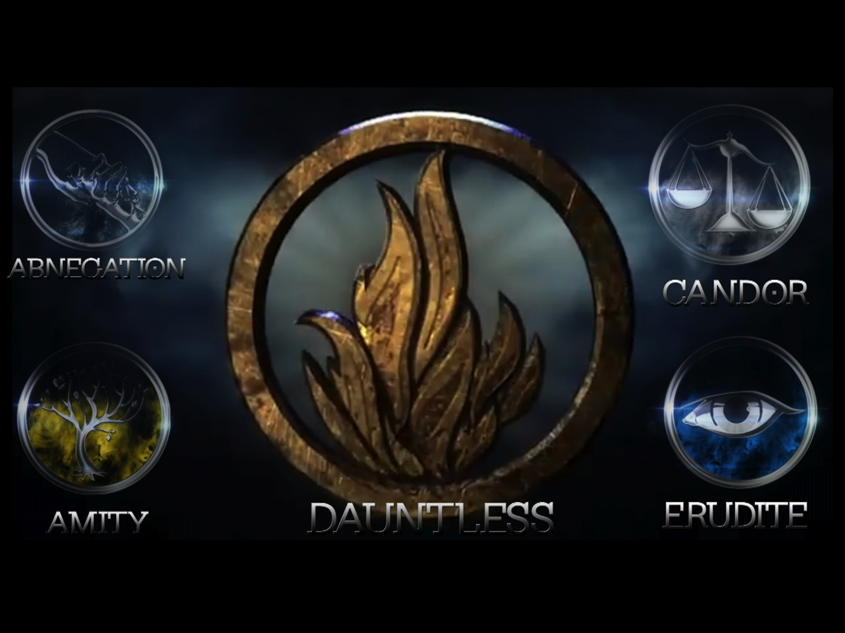
Notes:
There is Amity, Abnegation, Candor, Dauntless and Erudite.

Slide 7
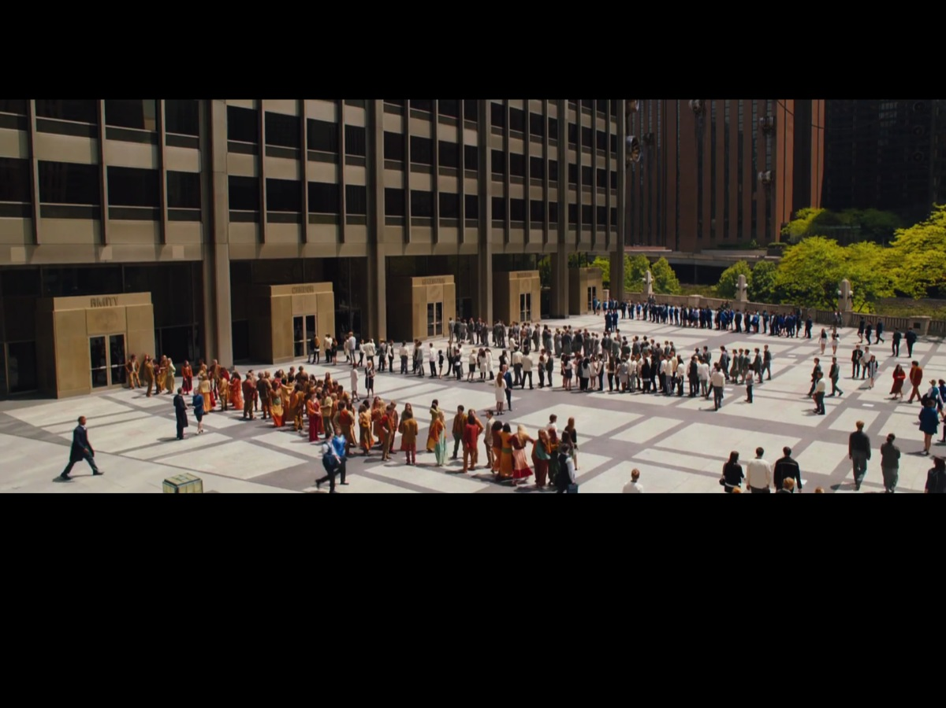
Notes:
Each member of the faction has to line up to be first tested

Slide 8
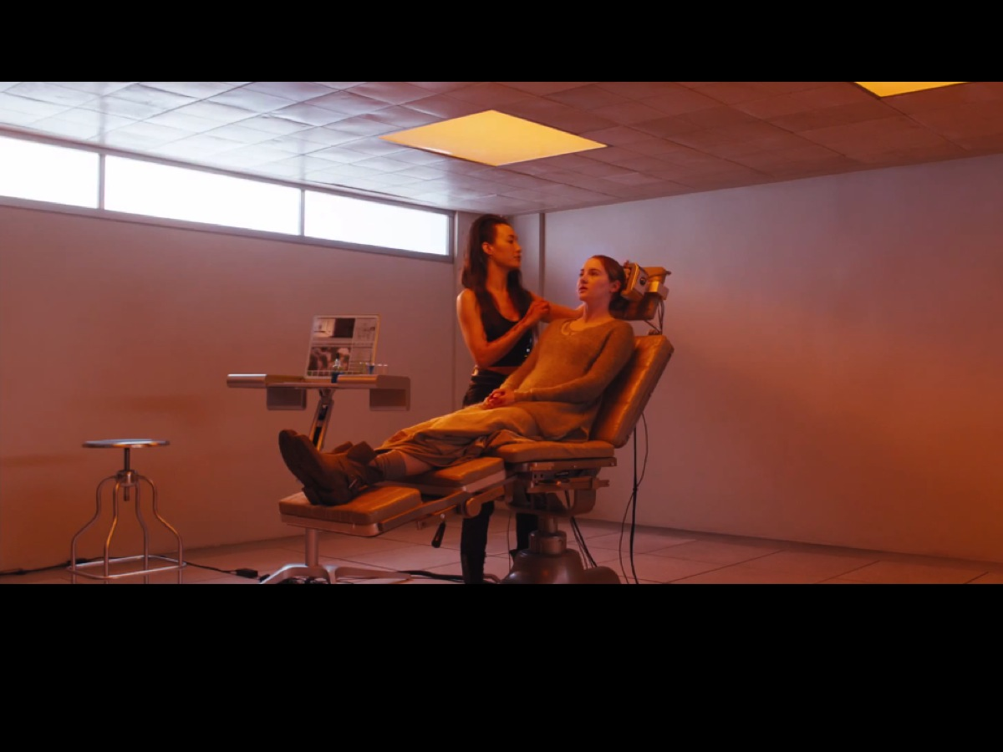
Notes:
There is an aptitude test that you go through to help you choose the faction you are going to be in.

Slide 9
Notes:
There is a Choosing Ceremony Day when each 16 year old has to choose which faction they will be a part of for the rest of their life.

Slide 10
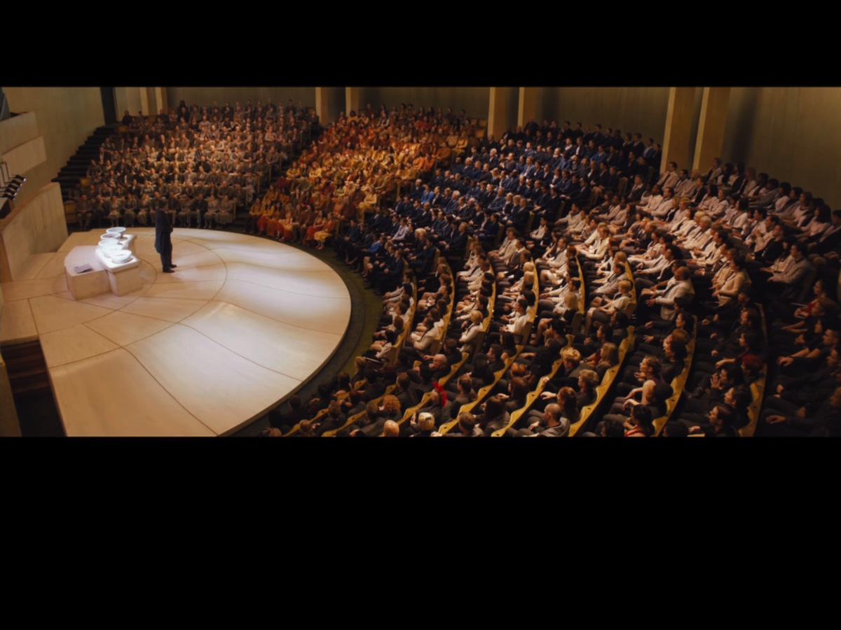
Notes:
And then they are required to sit in their current factions

Slide 11
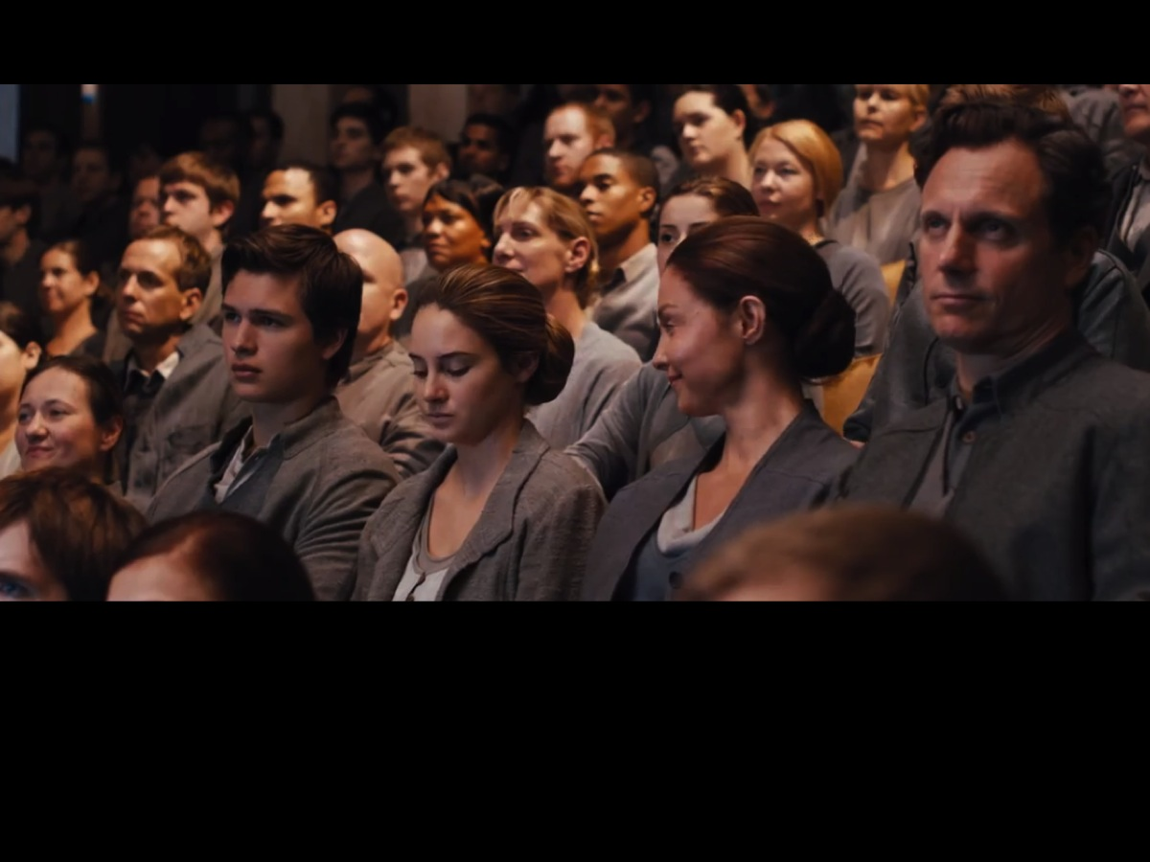
Notes:
With their parents…

Slide 12
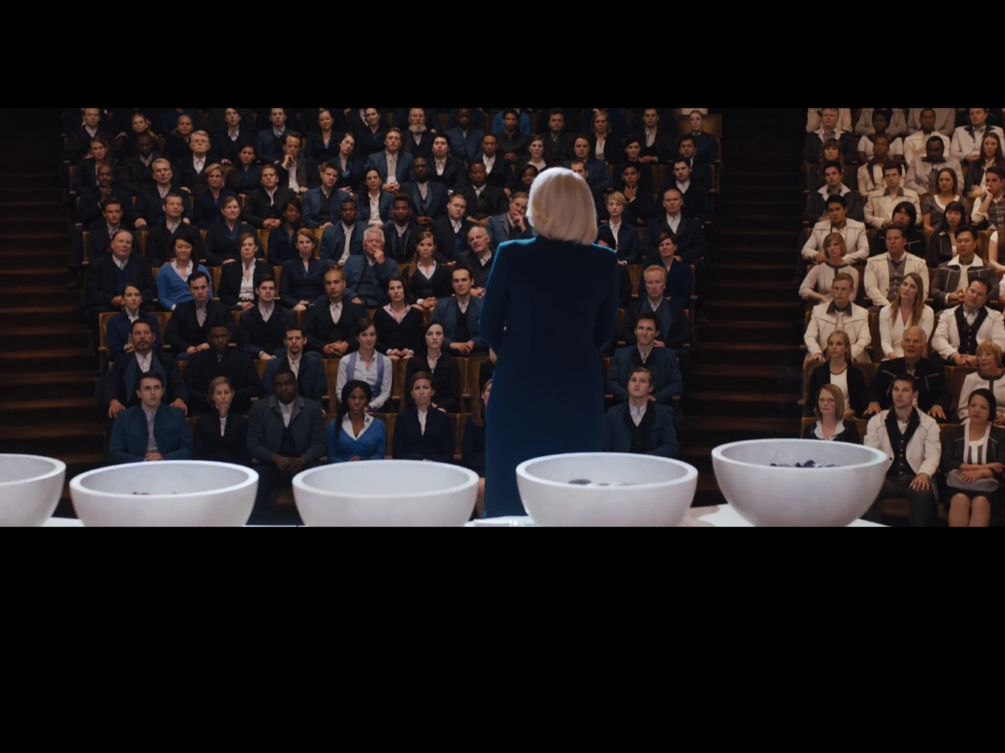
Notes:
Until the time comes when they will hear their name called out, approach the five bowls, cut their hand and drop some blood into one of the bowls.

Slide 13
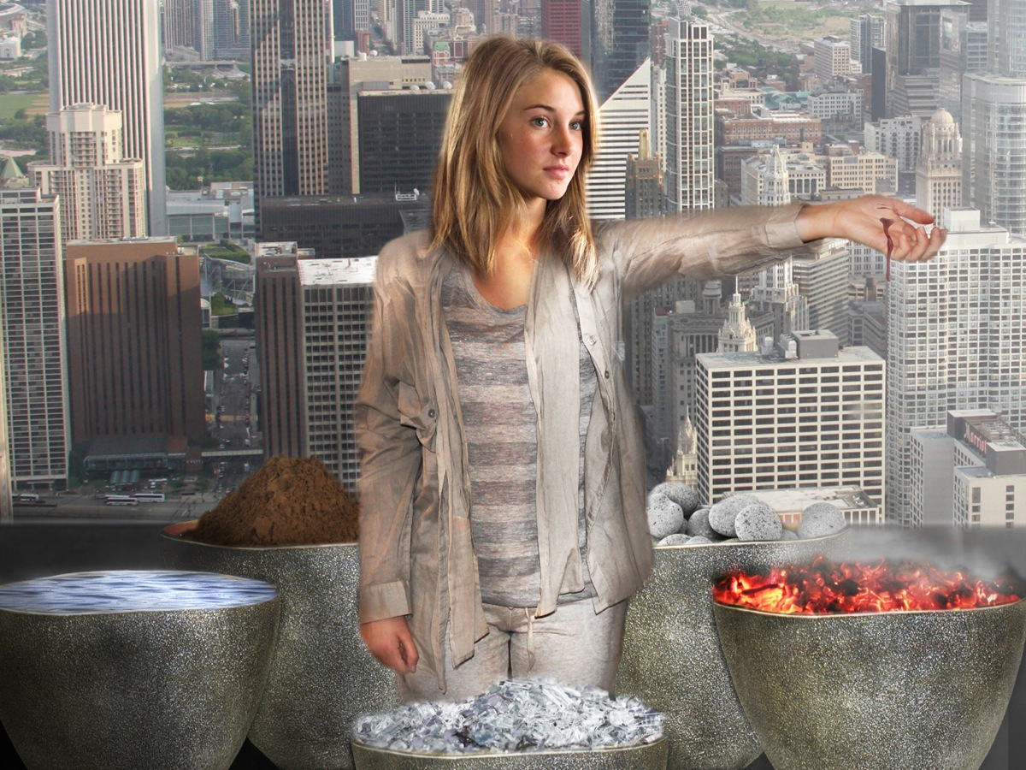
Notes:
Beatrice makes a startling choice as she steps away from the faction of her parents, Abnegation and chooses to join the Dauntless faction.

Slide 14

Notes:
She has joined the faction of Dauntless

Slide 15
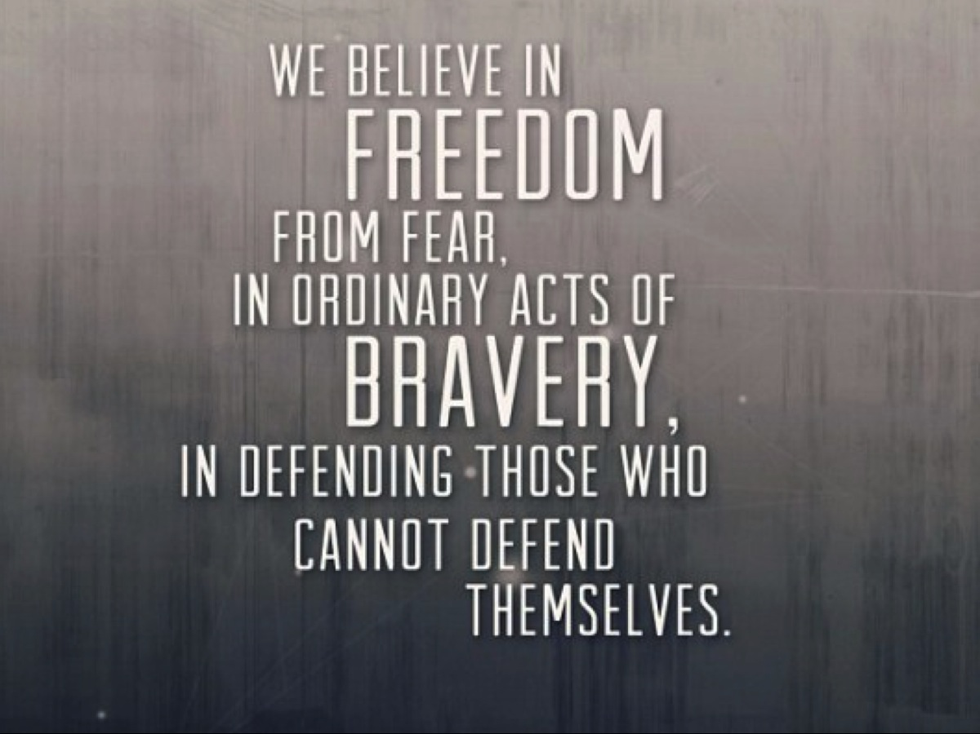
Notes:
Who believe in freedom from fear, in ordinary acts of bravery, in defending those who cannot deny themselves.

Slide 16
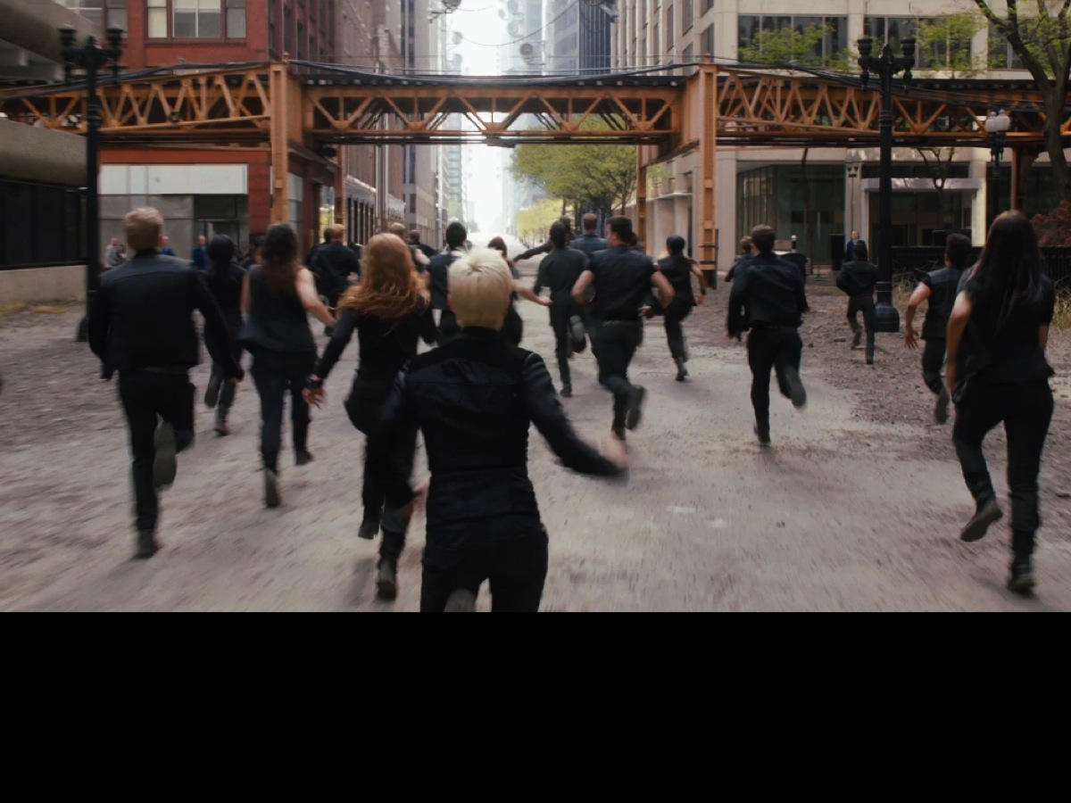
Notes:
Before long she is running through the streets with a rather wild bunch of Dauntless faction members heading towards a wild adventure and an uncertain future.

Slide 17
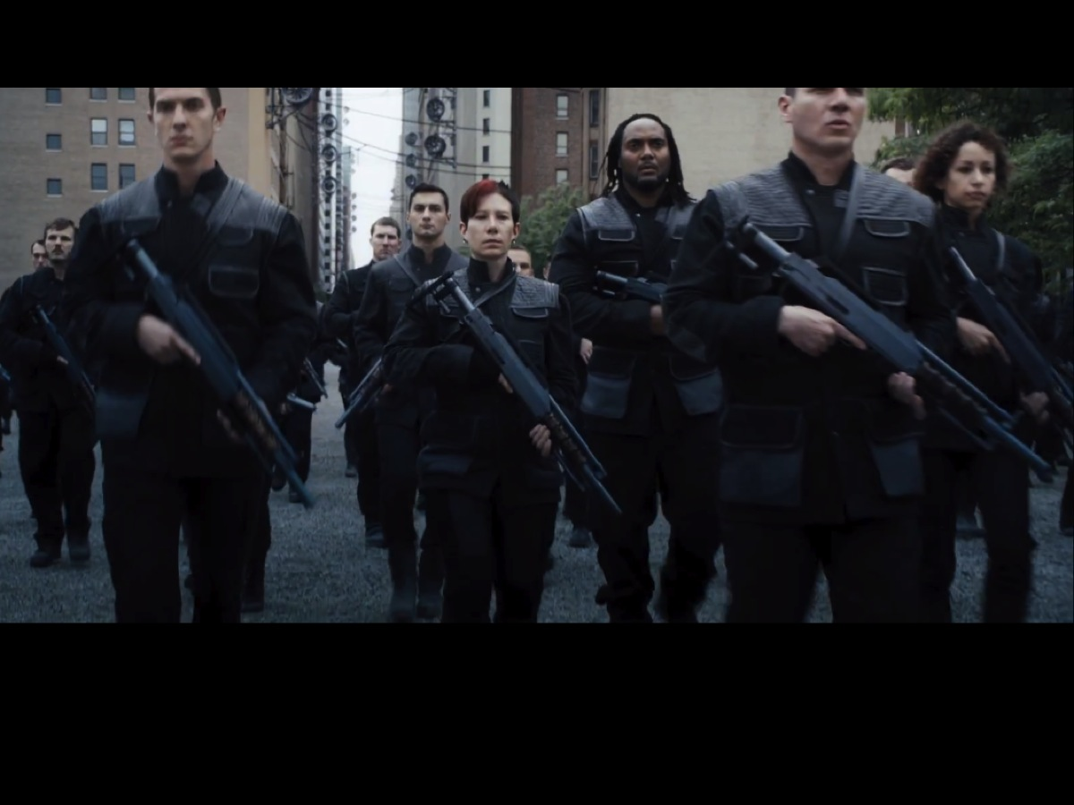
Notes:
Dauntless are the faction who keep the peace in society.

Slide 18
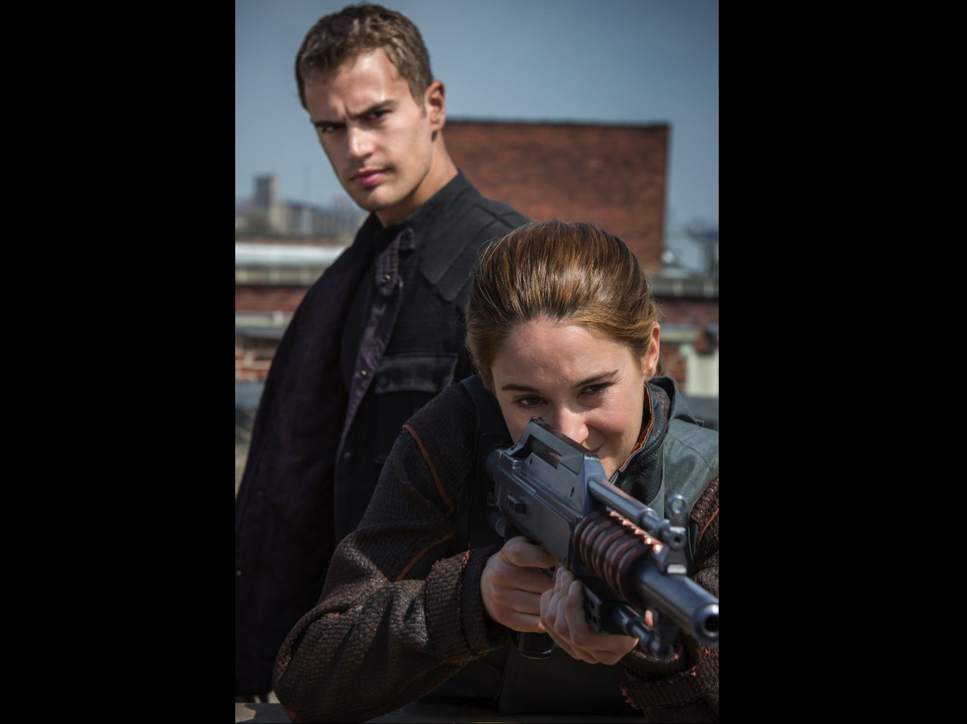
Notes:
They get to use weapons

Slide 19
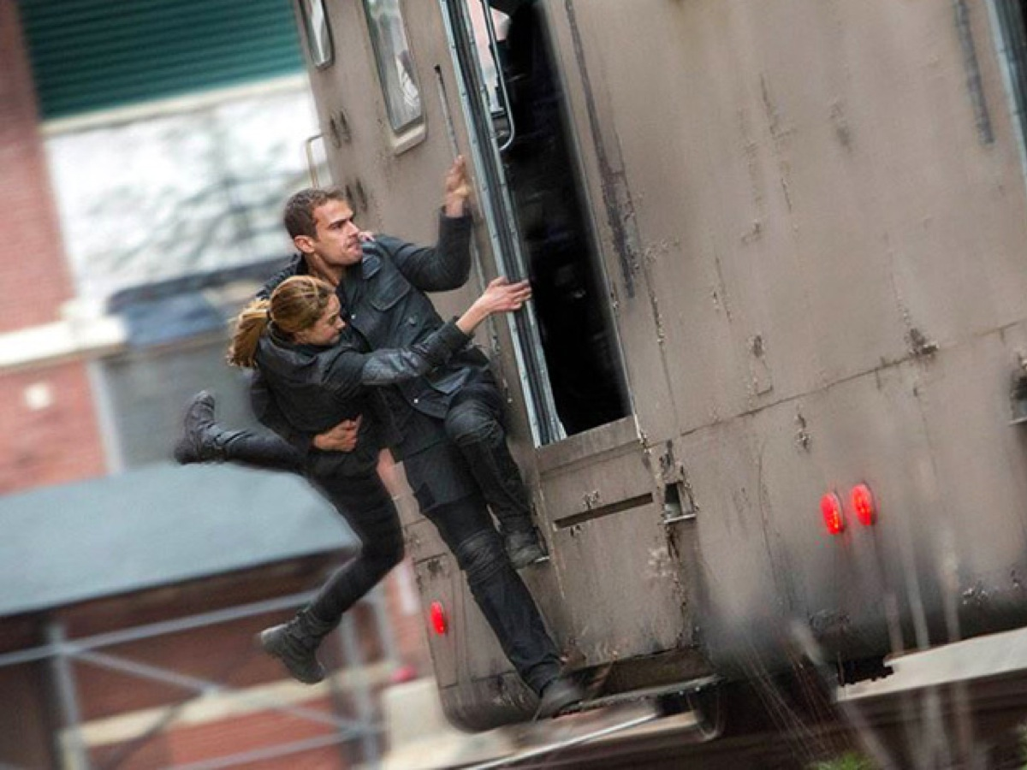
Notes:
And jump on and off moving trains

Slide 20

Notes:
Abnegation, the selfless, are the faction who run the government.

Slide 21
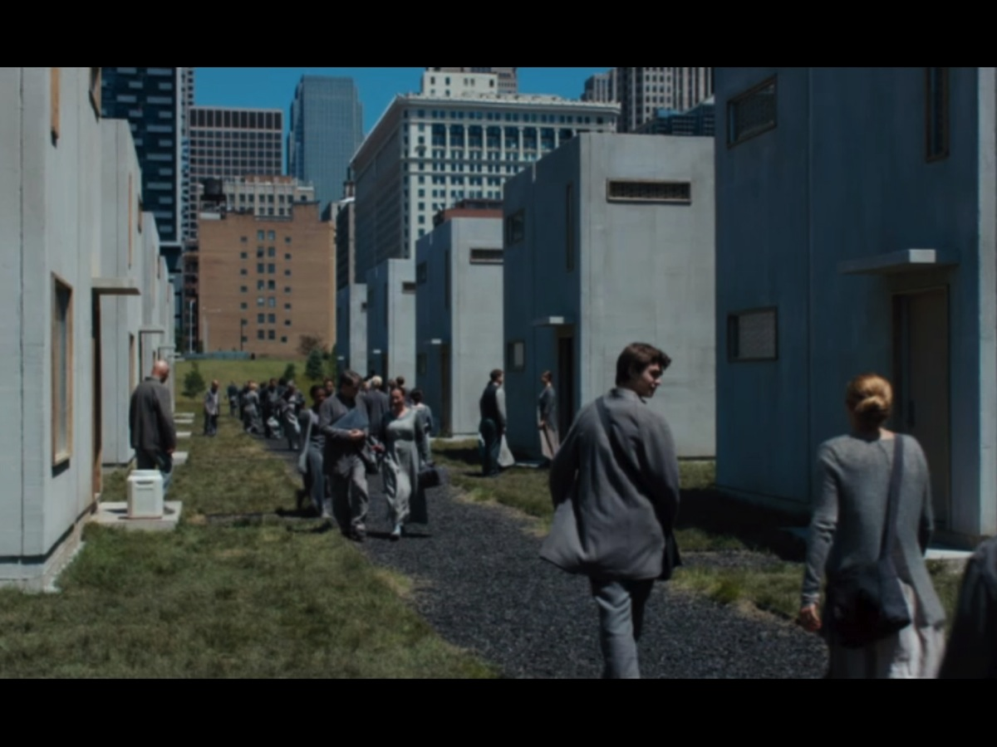
Notes:
They live in modest homes and wear a rather drab looking grey outfit.

Slide 22
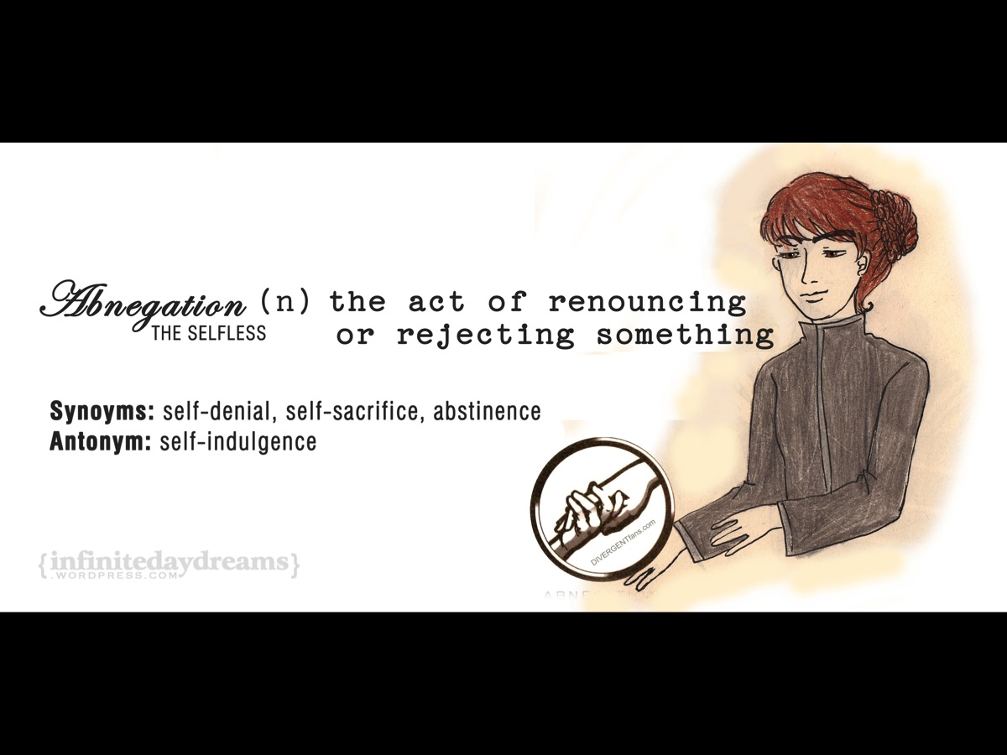
Notes:
Abnegation: the act of renouncing or rejecting something. Synonyms: Self-denial, self-sacrifice, abstinence. The Antonym is self-indulgence.

Slide 23
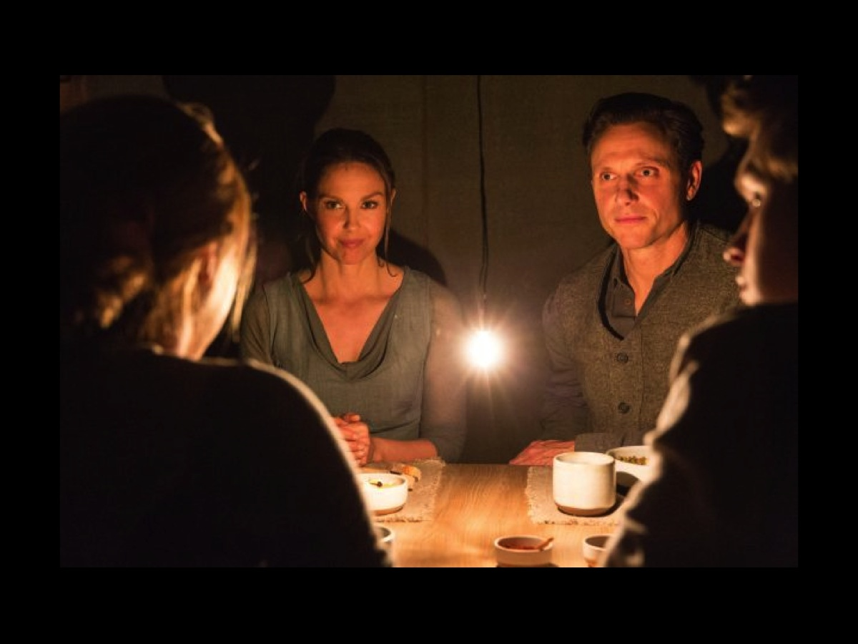
Notes:
The Abnegation live simple lives and are very family focused and put others first.

Slide 24

Notes:
The Amity faction are the peaceful. They are democratic faction (don’t have a leader but a representative – Johanna Reyes). The bread they eat contains a peace serum to keep members from fighting with each other.

Slide 25
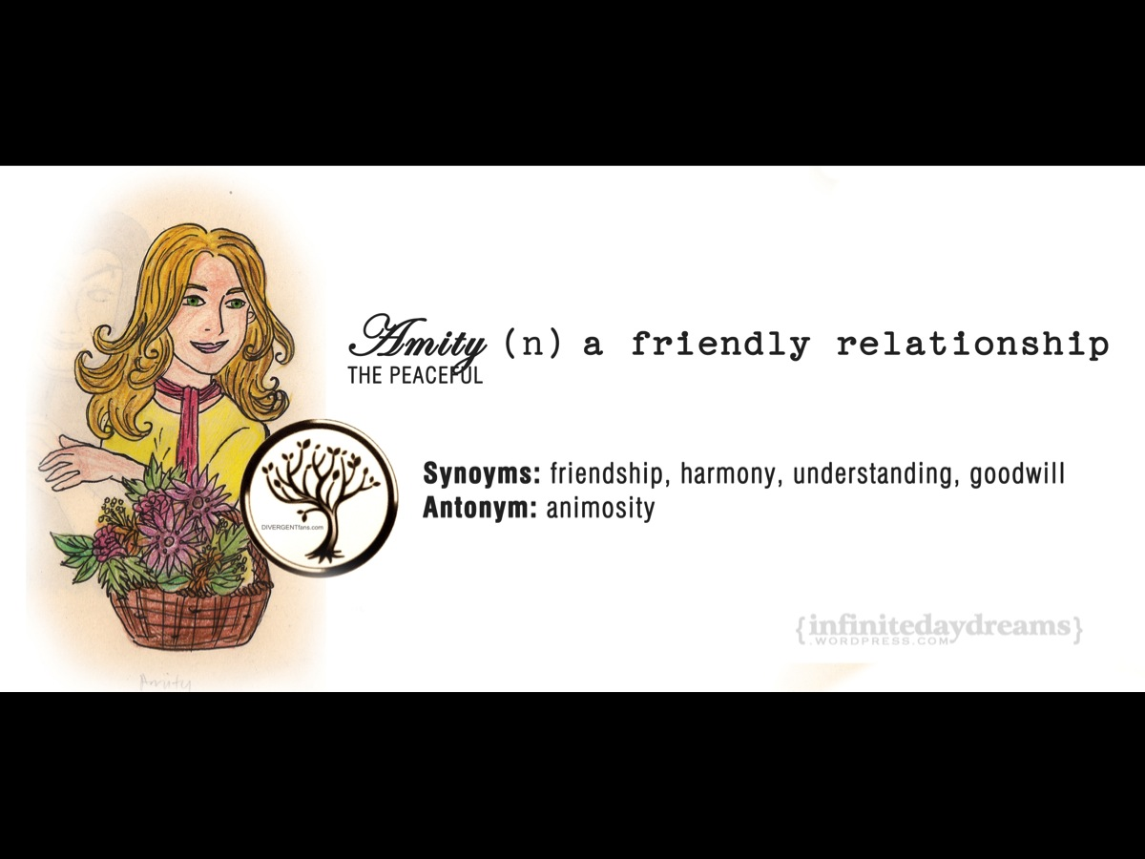
Notes:
Amity refers to a friendly relationship. Synonyms are: friendship, harmony, understanding and goodwill. The antonym is animosity.

Slide 26
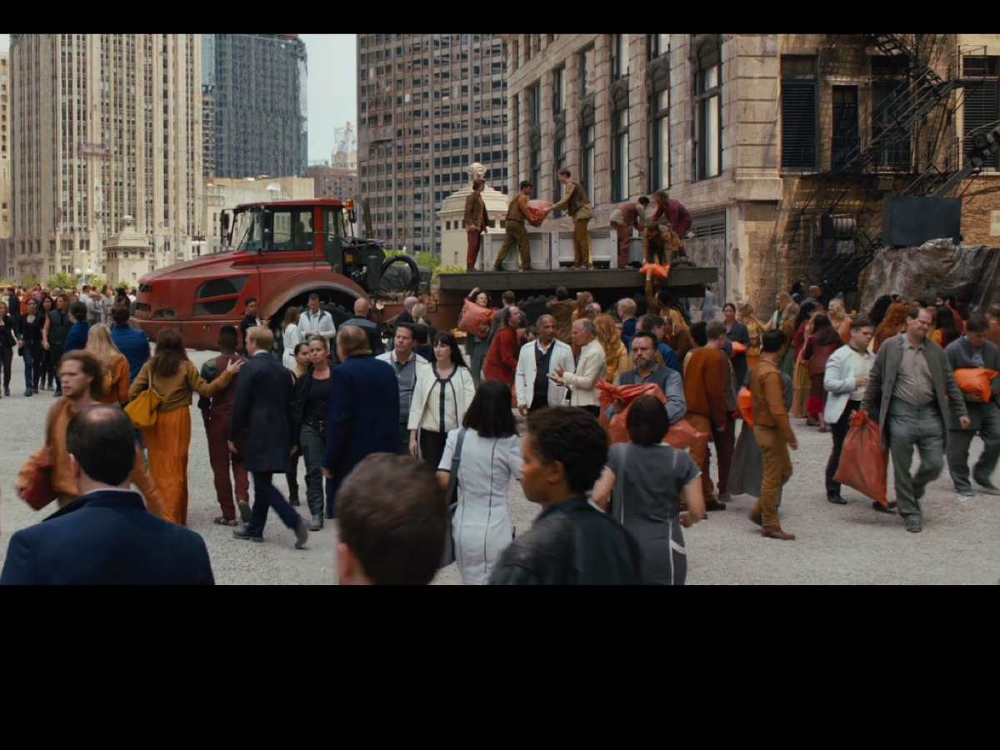
Notes:
The Amity live outside of the city on farms where they grow crops for people in the city.

Slide 27

Notes:
The Candor faction are the honest.

Slide 28
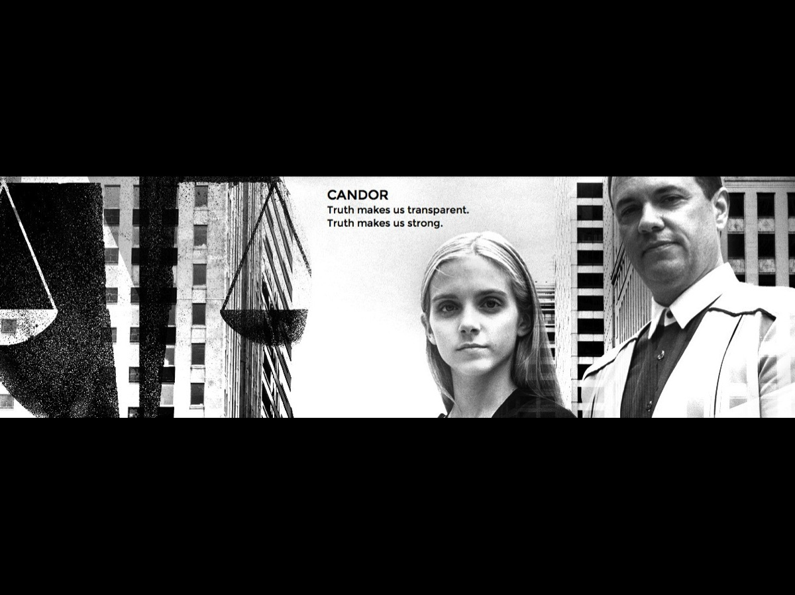
Notes:
They believe that truth makes us transparent and strong.

Slide 29
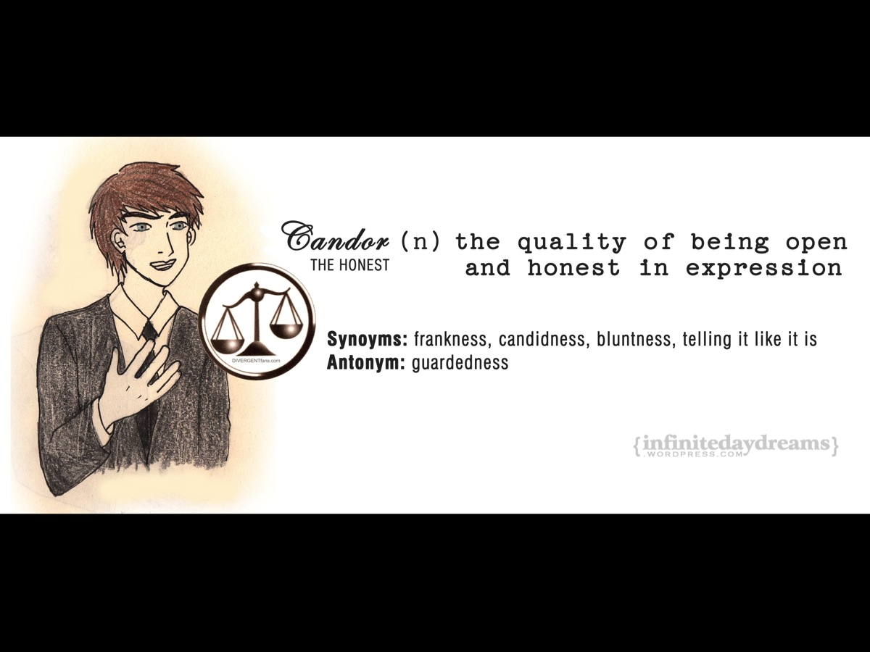
Notes:
Candor is the quality of being open and honest in expression. Synonyms are frankness, candidness, bluntness, telling it like it is. The antonym is guardedness.

Slide 30

Notes:
The Dauntless are the brave.

Slide 31
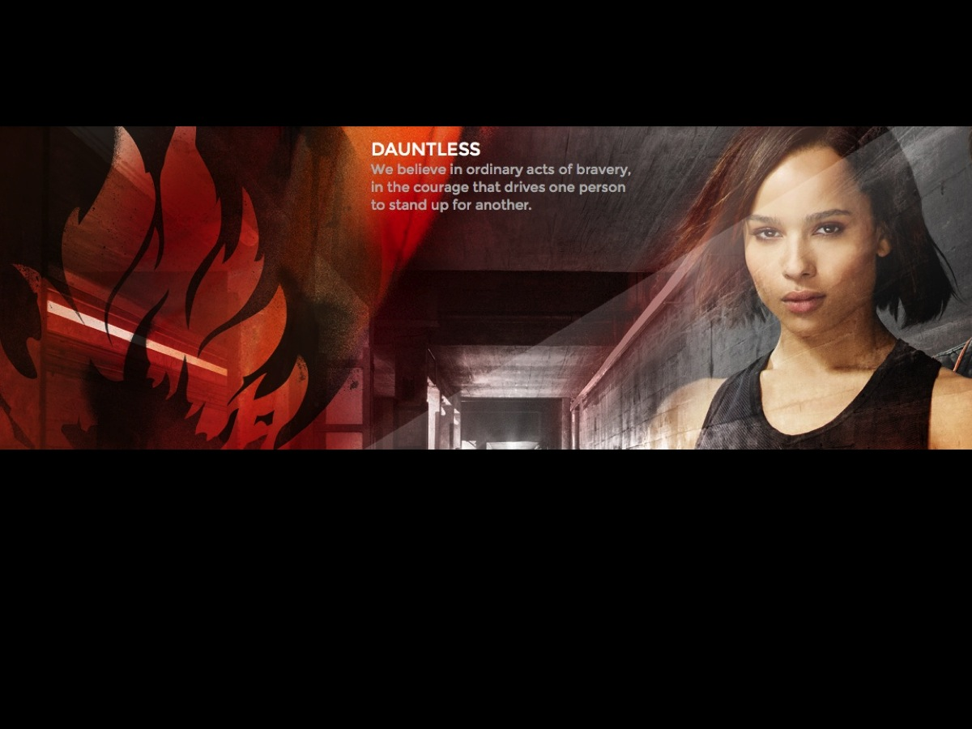
Notes:
They believe in ordinary acts of bravery, in the courage that drives one person to stand up for another.

Slide 32
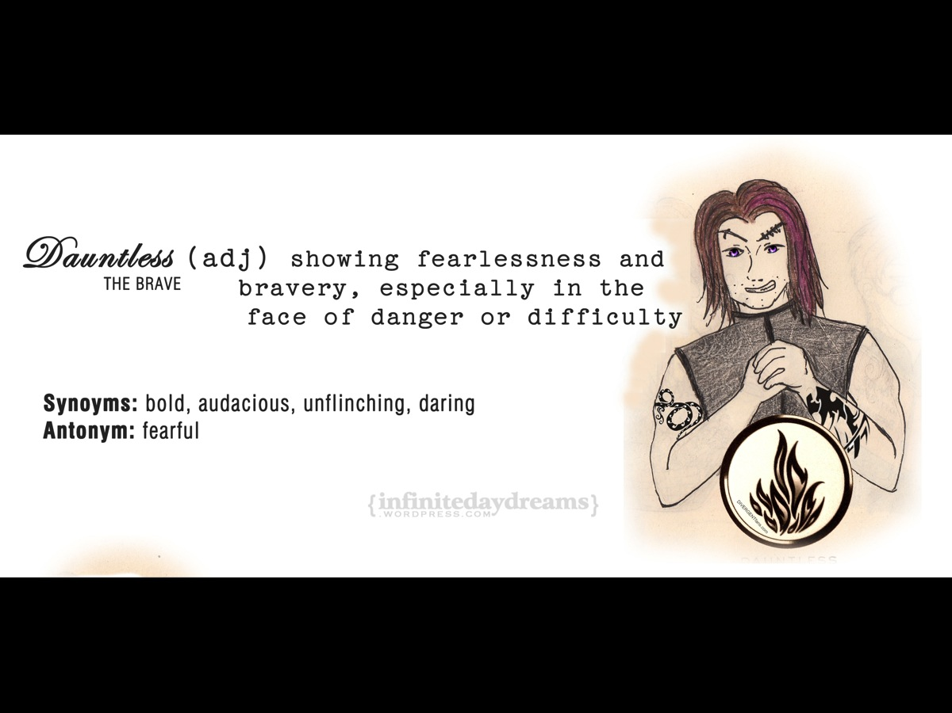
Notes:
Dauntless is showing fearlessness and bravery, especially in the face of danger or difficulty. Synonyms are bold, audacious, unflinching, daring. The antonym is fearful.

Slide 33
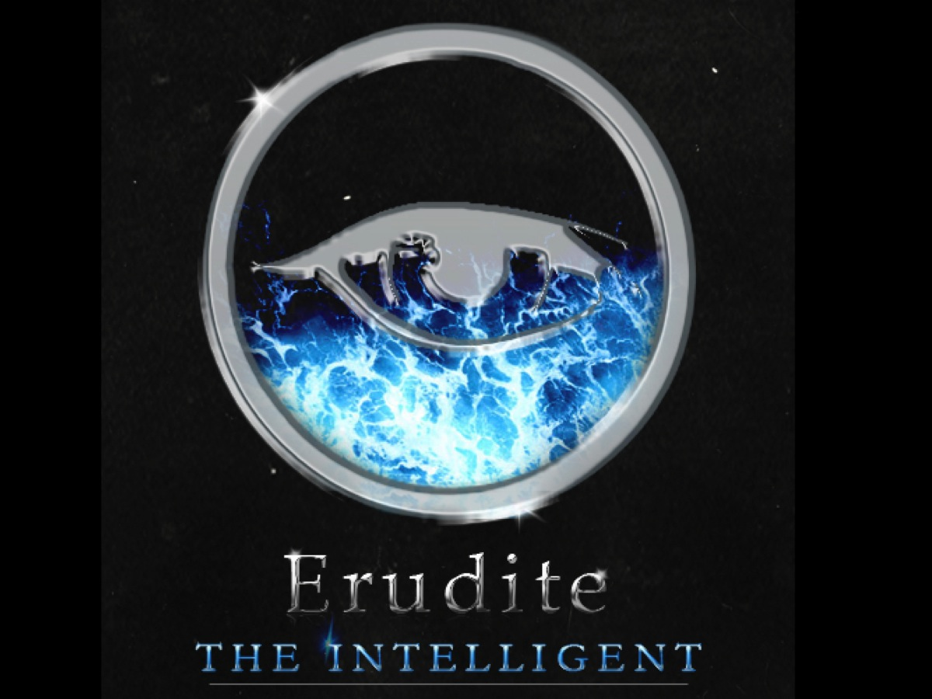
Notes:
Finally, the Erudite are the intelligent.

Slide 34
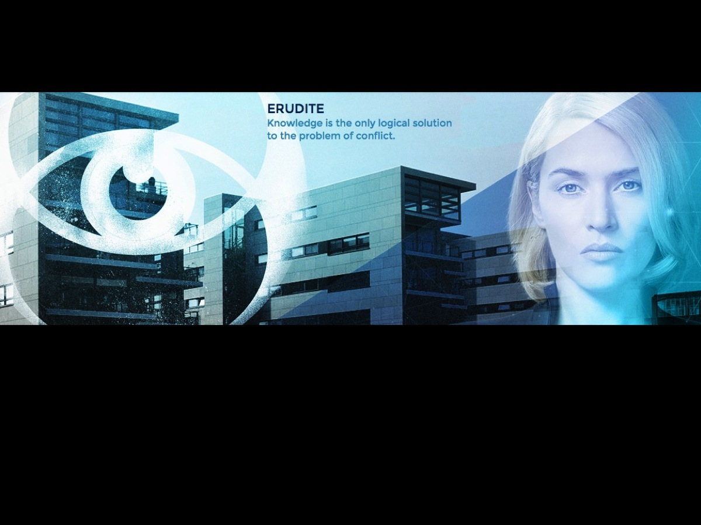
Notes:
They believe that knowledge is the only logical solution to the problem of conflict.

Slide 35
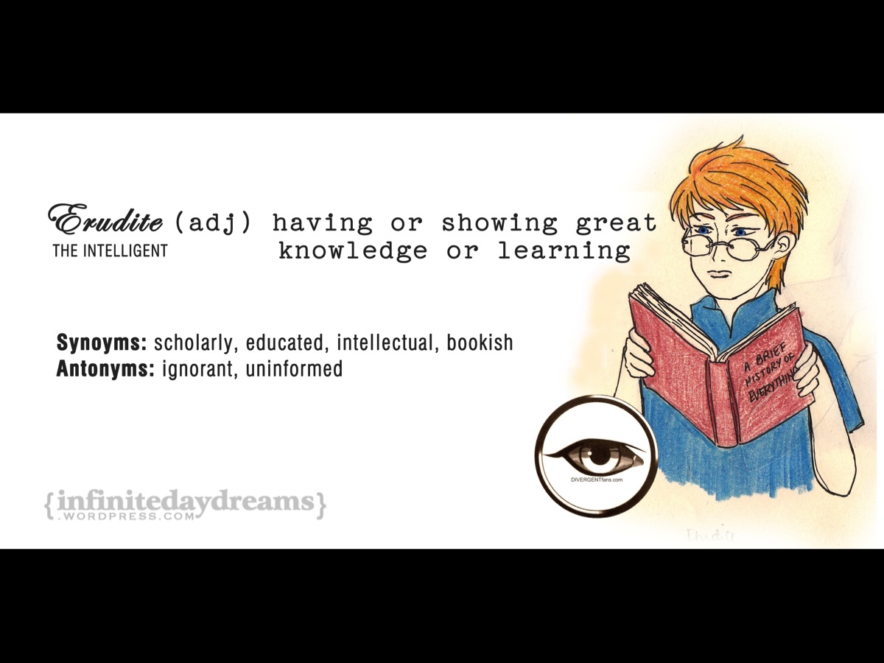
Notes:
Erudite means having or showing great knowledge or learning. Synonyms are scholarly, educated, intellectual, bookish. The antonym is ignorant or uninformed.

Slide 36
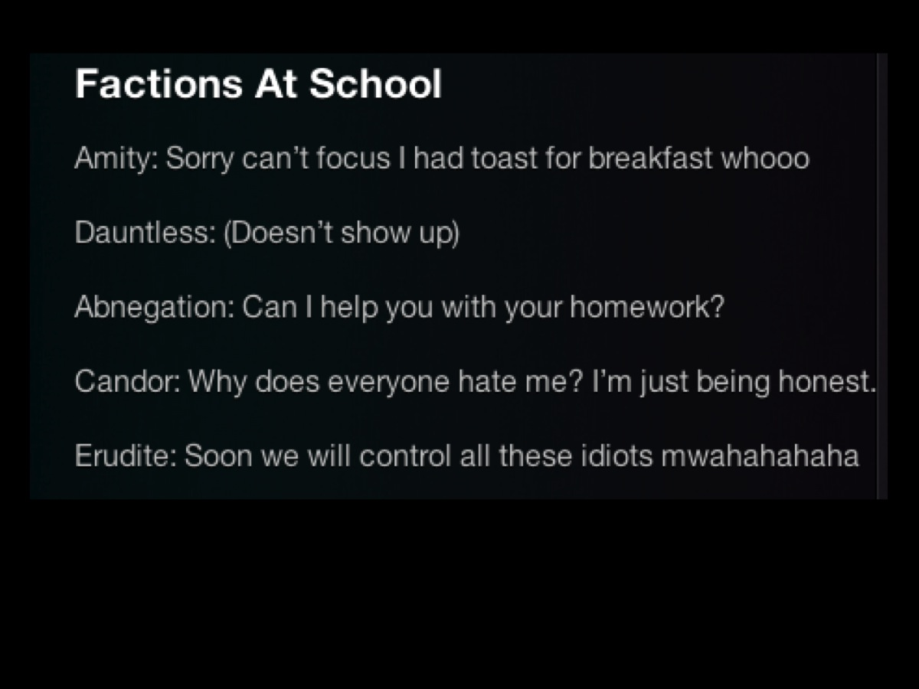
Notes:
I found this amusing piece on what it is like for the factions at school…

Slide 37

Notes:
Enter the idea of the divergent – those who are not limited to one of the factions.

Slide 38
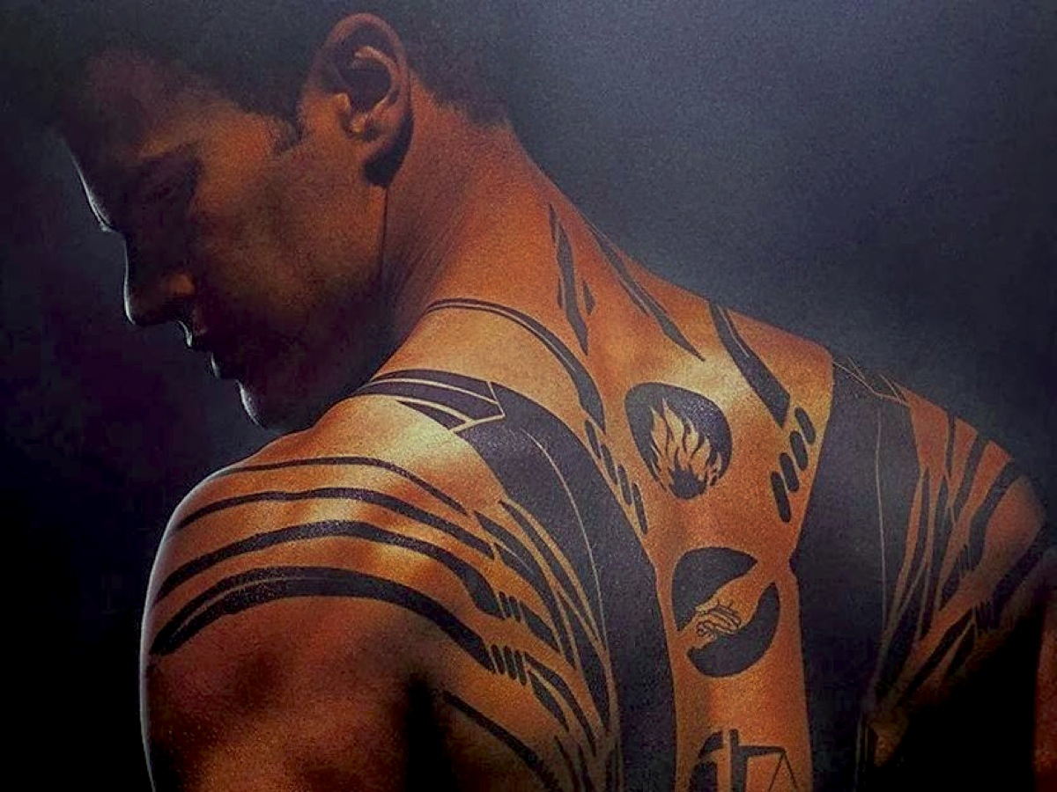
Notes:
In Divergent, an instructor, Tobias, is one of the Dauntless and is covered in tattoos.

Slide 39
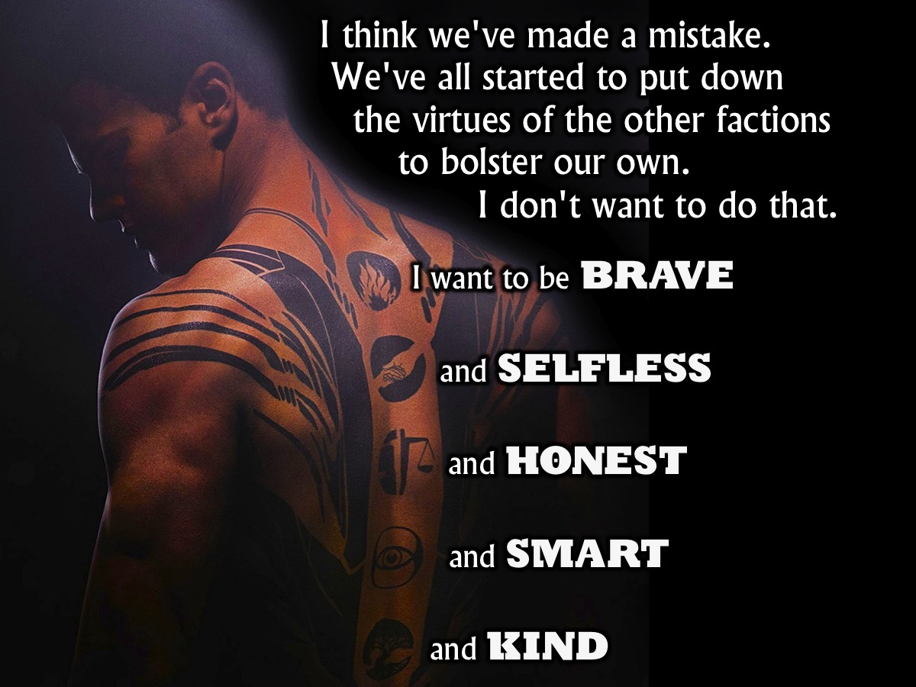
Notes:
In the first book in the trilogy, Tobias says: “I think we've made a mistake. We've all started to put down the virtues of the other factions in the process of bolstering our own. I don't want to do that. I want to be brave, and selfless and honest and smart and kind.”

Slide 40
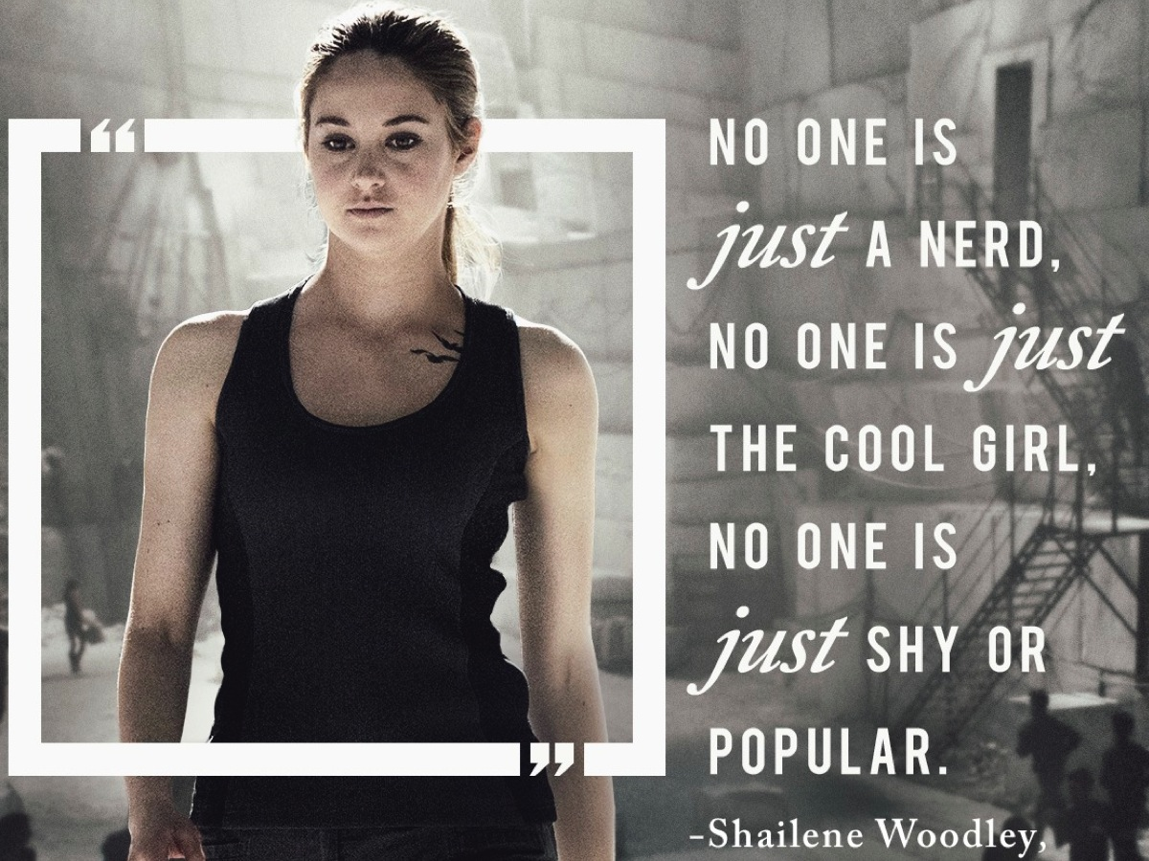
Notes:
"No one is just a nerd. No one is just the cool girl. No one is just shy or popular." (Shailene Woodley)

Slide 41
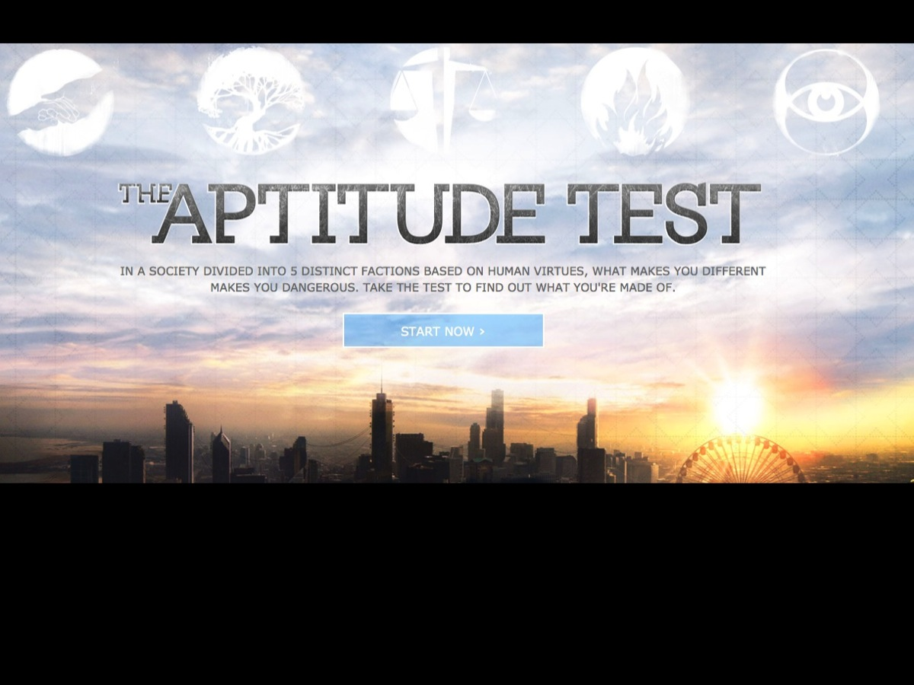
Notes:
So there is an online test that you can take at: http://divergentthemovie.com/aptitudetest

Slide 42
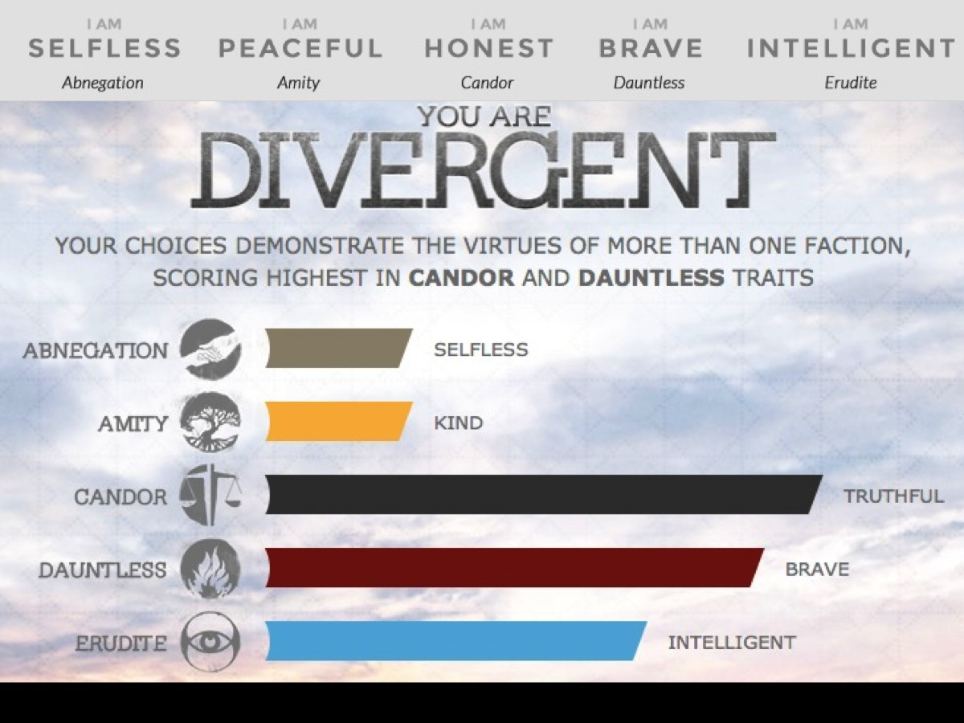
Notes:
Here is evidence that we can exhibit qualities from more than one faction – this was the result of the online aptitude test that I took last week.

Slide 43
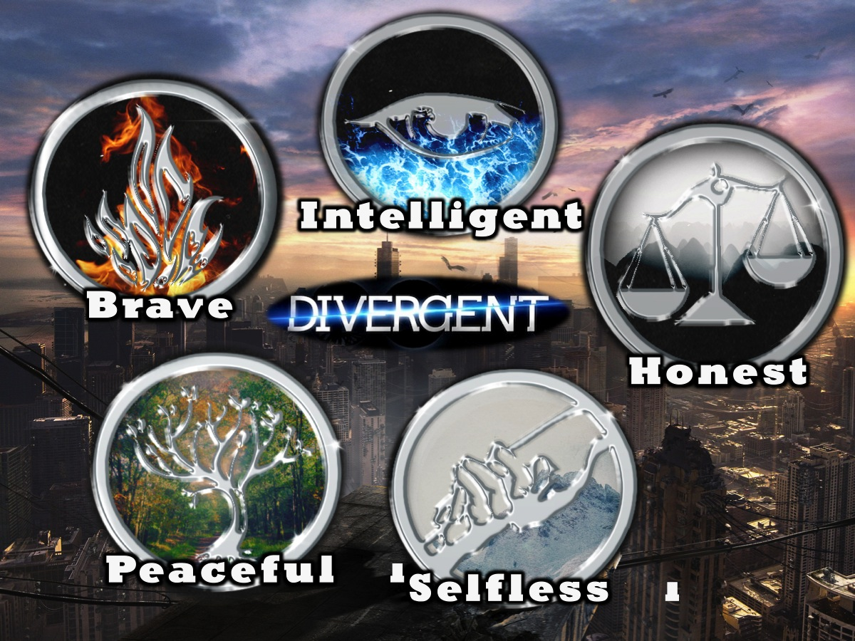
Notes:
We are meant to be Divergent – those who integrate the various values into our beliefs and practises. In the coming weeks

Slide 44
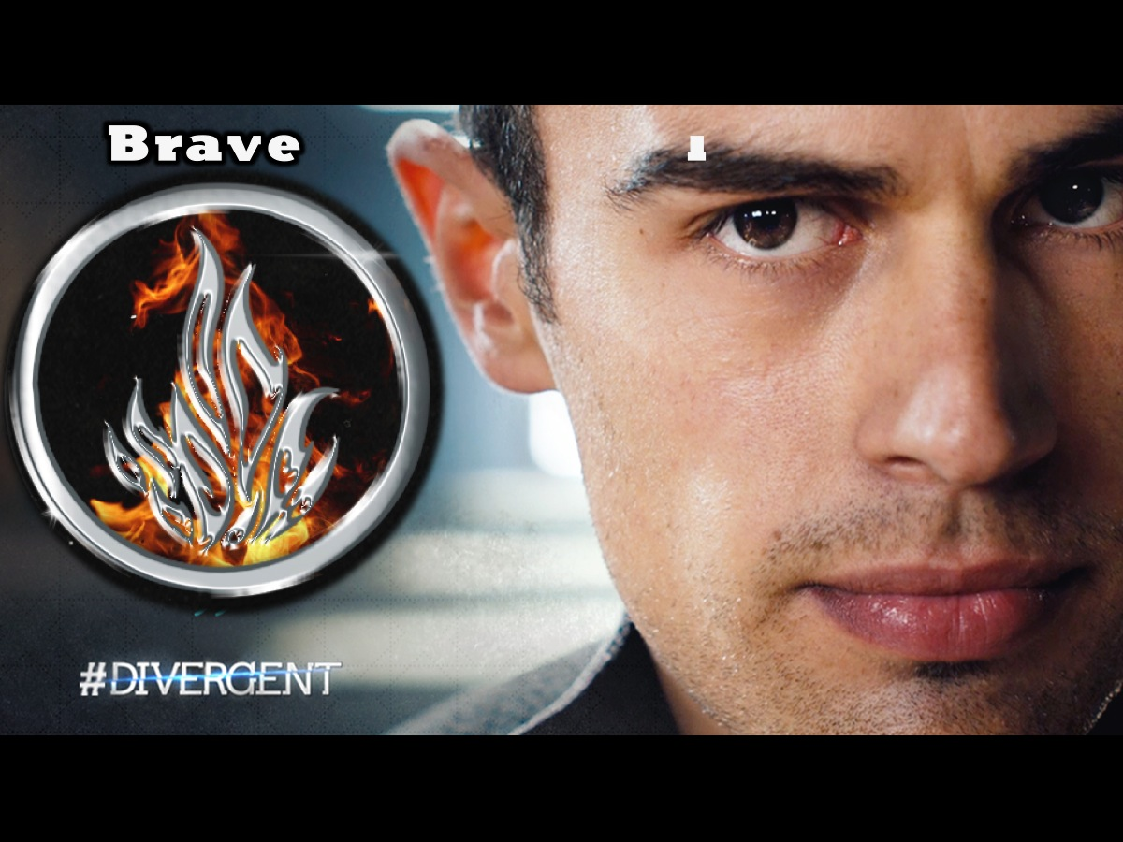
Notes:
Next week we will explore the first of the five values – Dauntless or being brave!

