Slide 1

Notes:
Last week we started our new series based on the book and movie called Divergent.

Slide 2
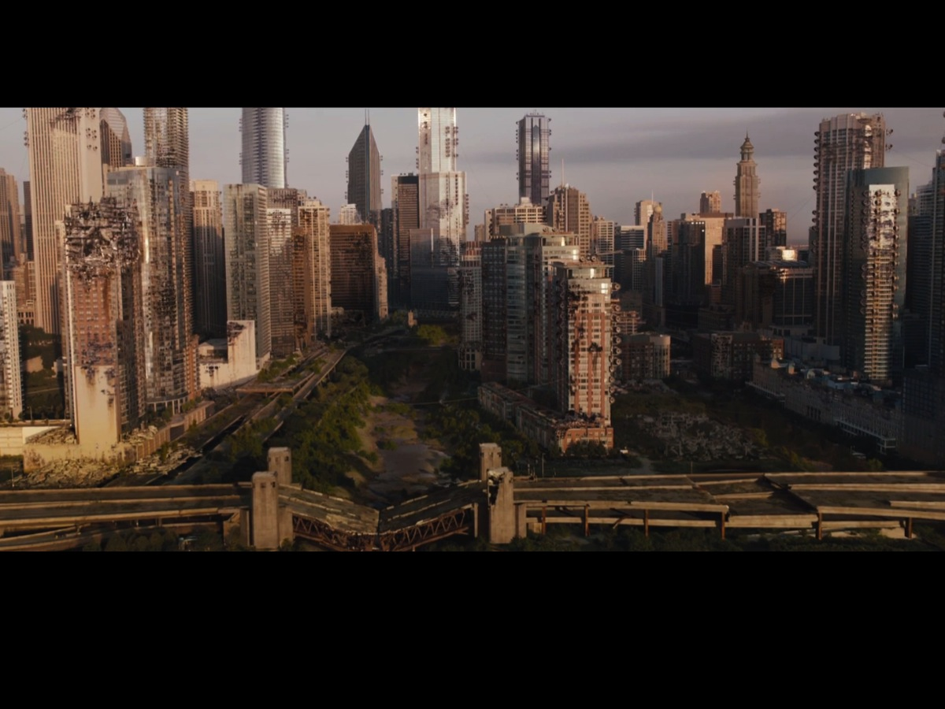
Notes:
The movie starts with the scene of a city that has experienced destruction through war and a system has been implemented to prevent it happening in the future.

Slide 3

Notes:
People have been divided into five different factions focusing on different positive values.

Slide 4

Notes:
The Amity faction are the peaceful.

Slide 5

Notes:
The Abnegation faction are the selfless.

Slide 6

Notes:
The Candor faction are the honest.

Slide 7

Notes:
The Dauntless faction are the brave.

Slide 8

Notes:
The Erudite faction are the intelligent.

Slide 9

Notes:
Today we are going to step into the world of the first of the five factions – Dauntless.

Slide 10
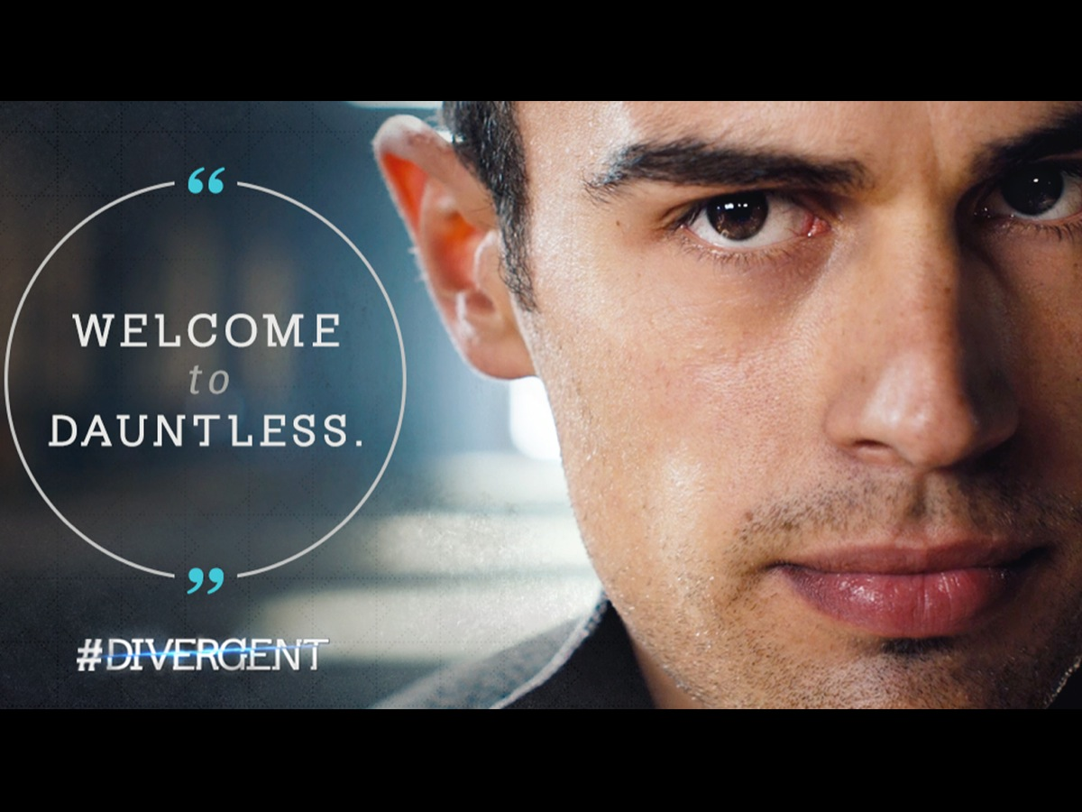
Notes:
So, welcome to Dauntless!

Slide 11

Notes:
Dauntless love eating chocolate cake!

Slide 12
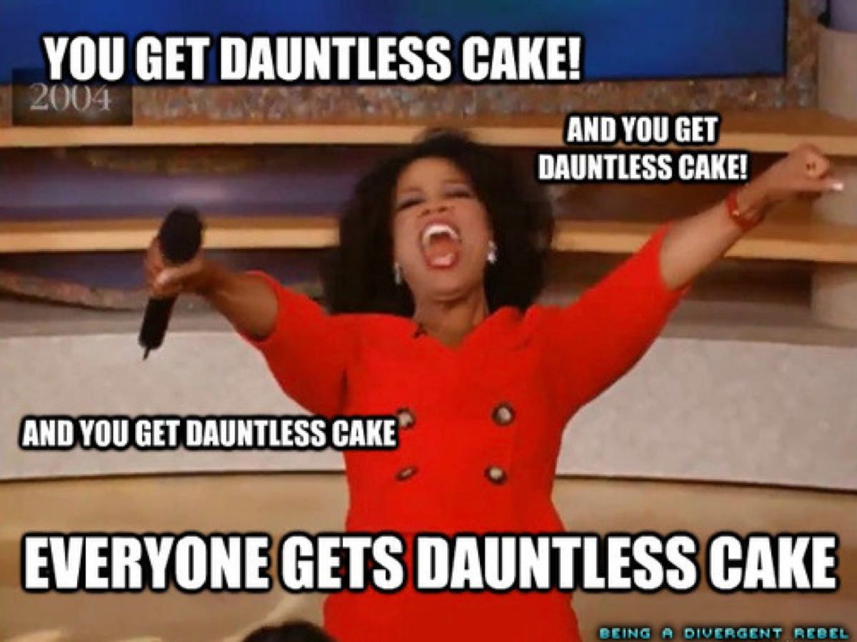
Notes:
And everybody gets Dauntless chocolate cake!

Slide 13
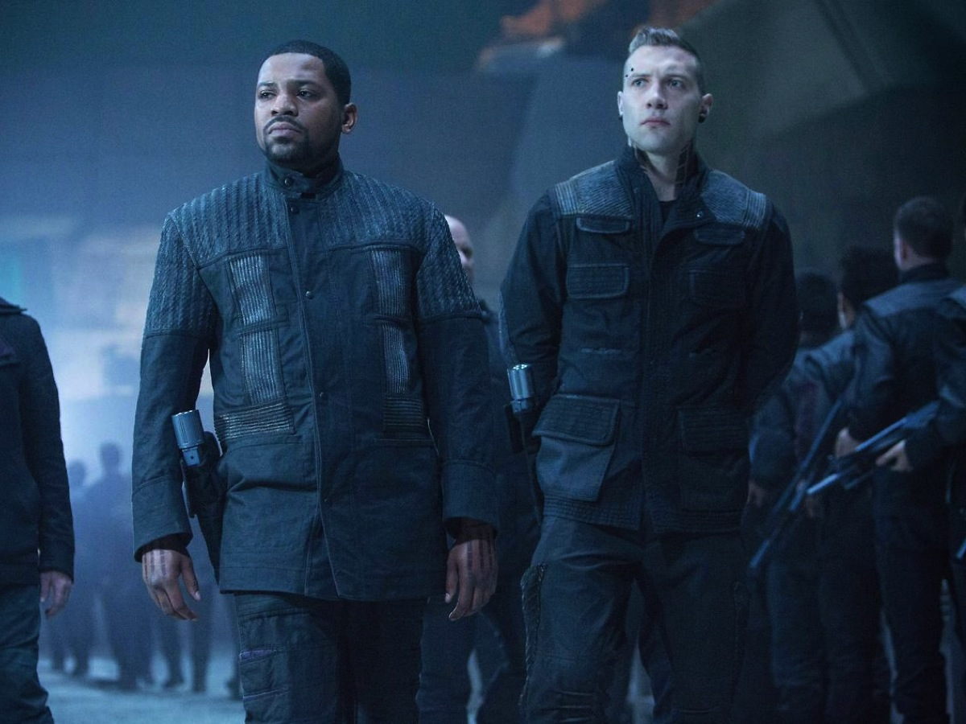
Notes:
Dauntless members are easily recognised by their black outfits with boots, tattoos and body piercings.

Slide 14
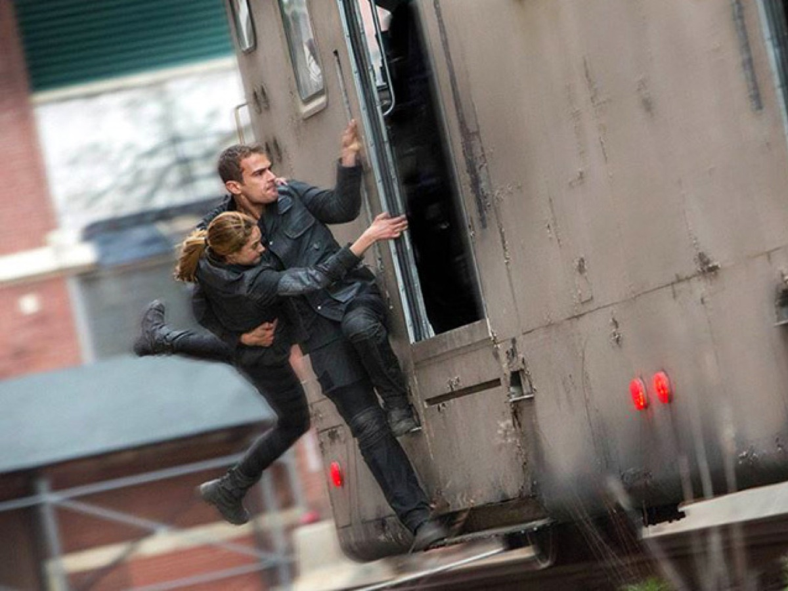
Notes:
Dauntless are always jumping onto moving trains.

Slide 15
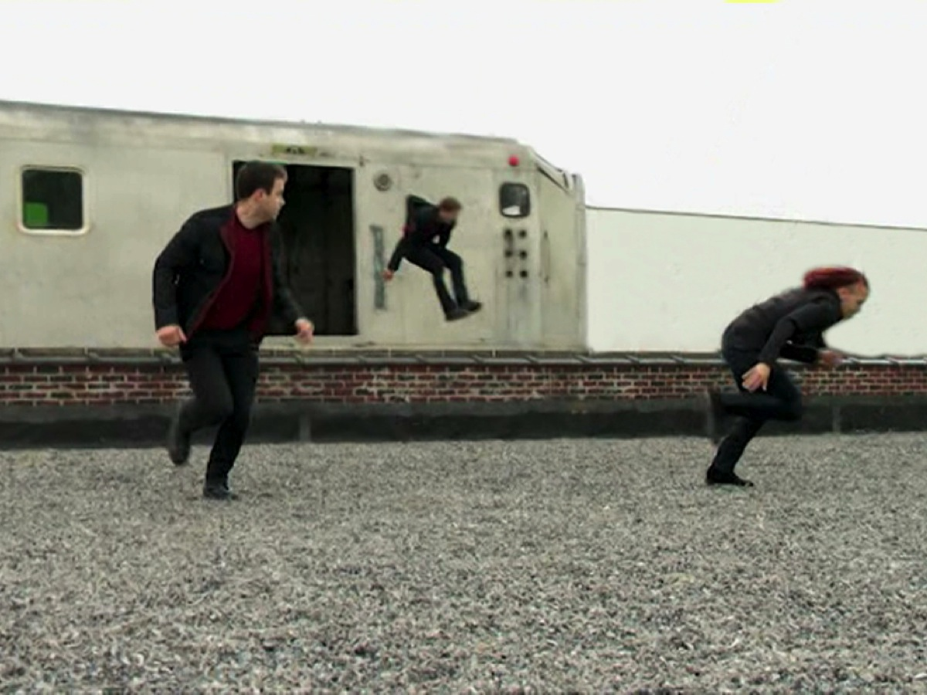
Notes:
or jumping off moving train..

Slide 16
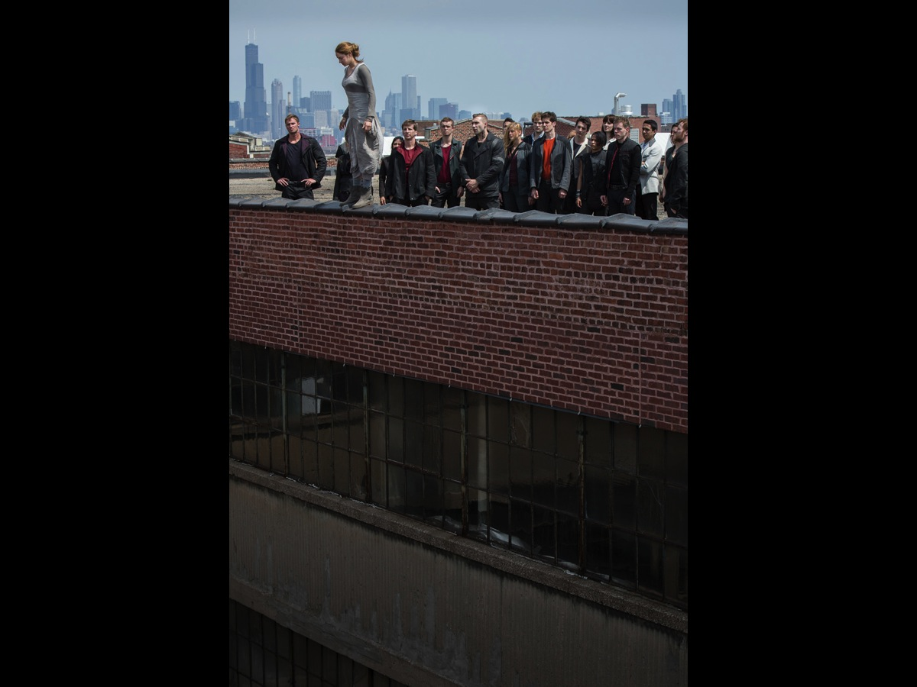
Notes:
Or jumping off buildings

Slide 17
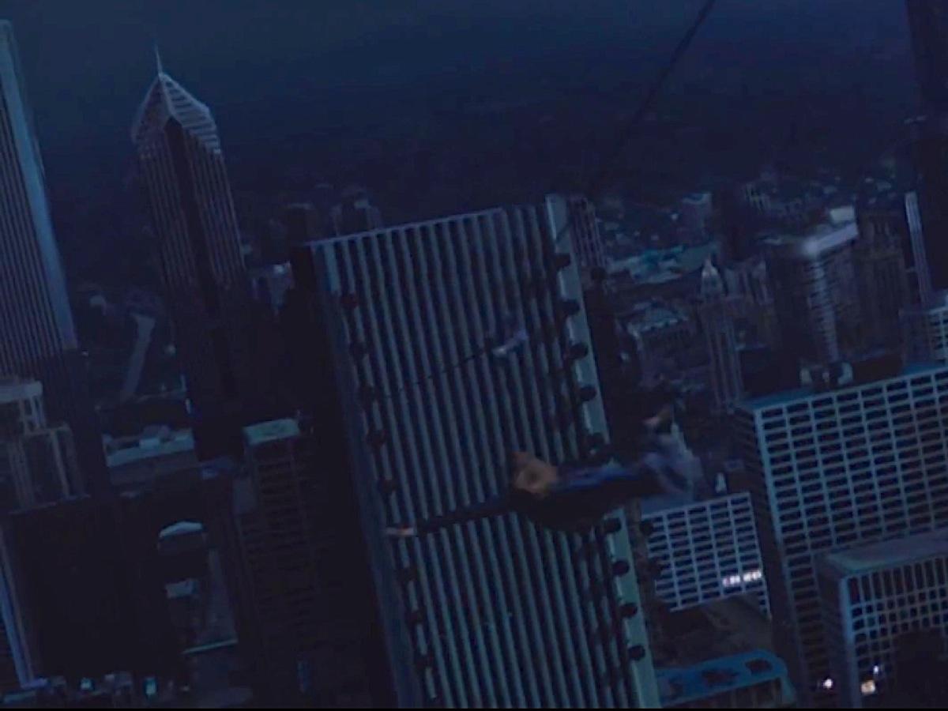
Notes:
Or zooming down ziplines from skyscrapers…

Slide 18
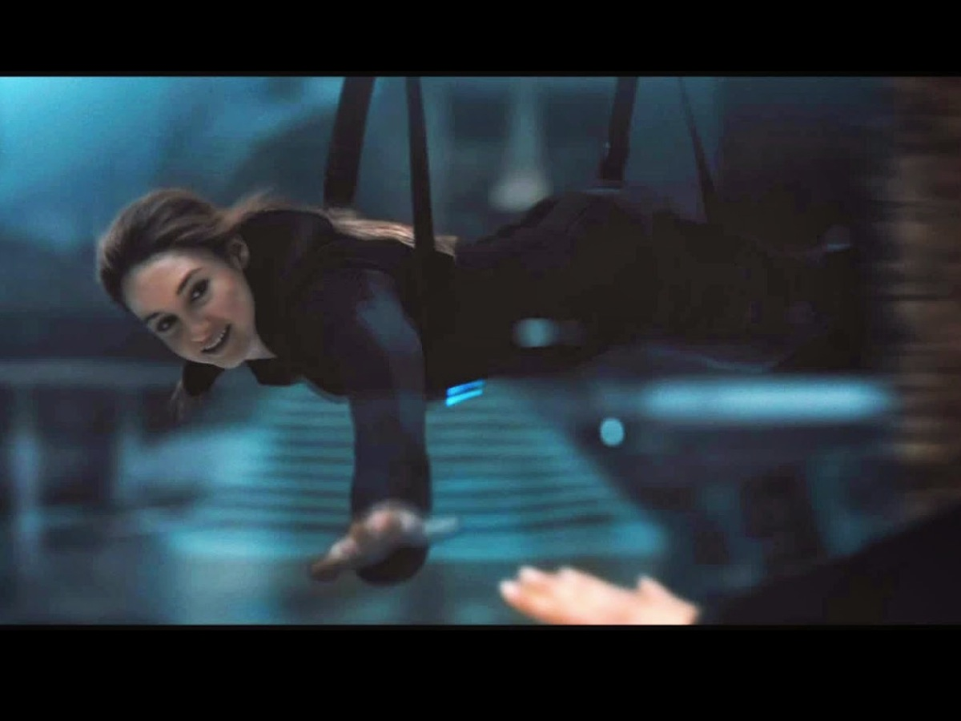
Notes:
Now that is Brave!

Slide 19
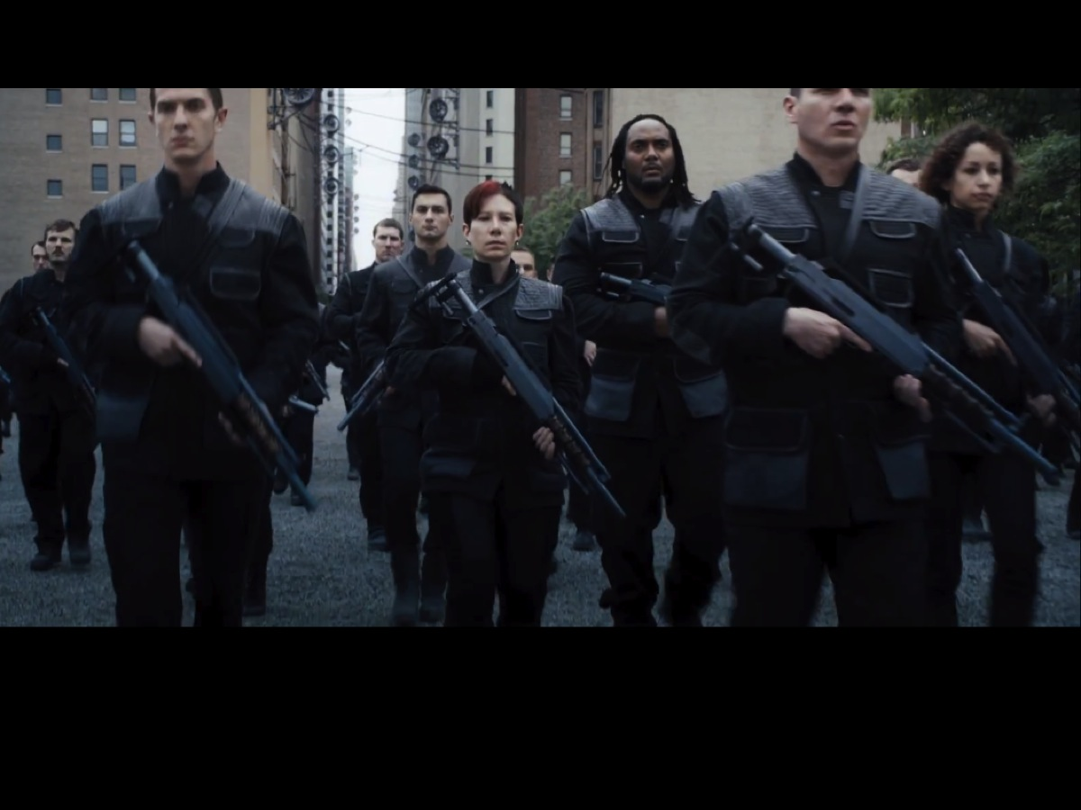
Notes:
Dauntless are the faction responsible to keep the peace in society and guard the fence around the city. They face danger at every turn and therefore have to be prepared through a vigorous training program.

Slide 20
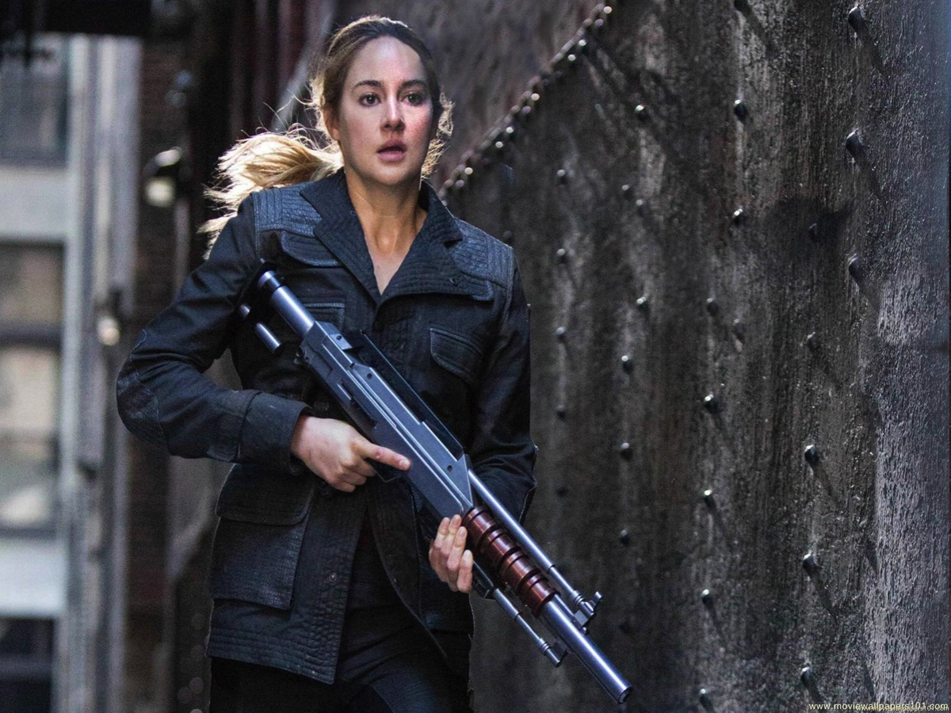
Notes:
They are trained to handle weapons like guns…

Slide 21
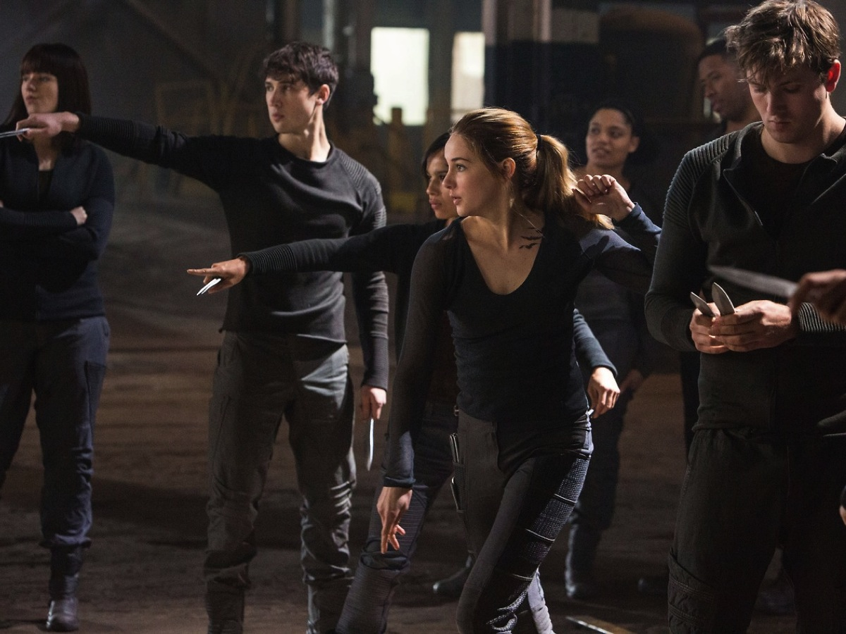
Notes:
And knives

Slide 22
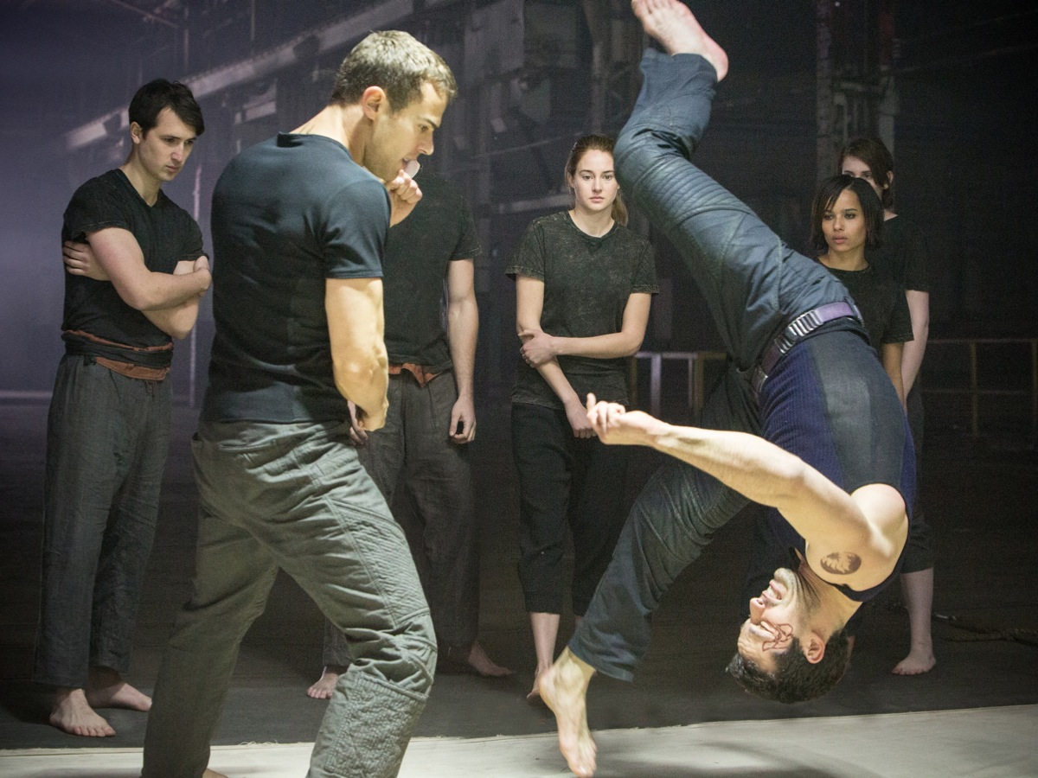
Notes:
They are trained in hand to hand combat

Slide 23
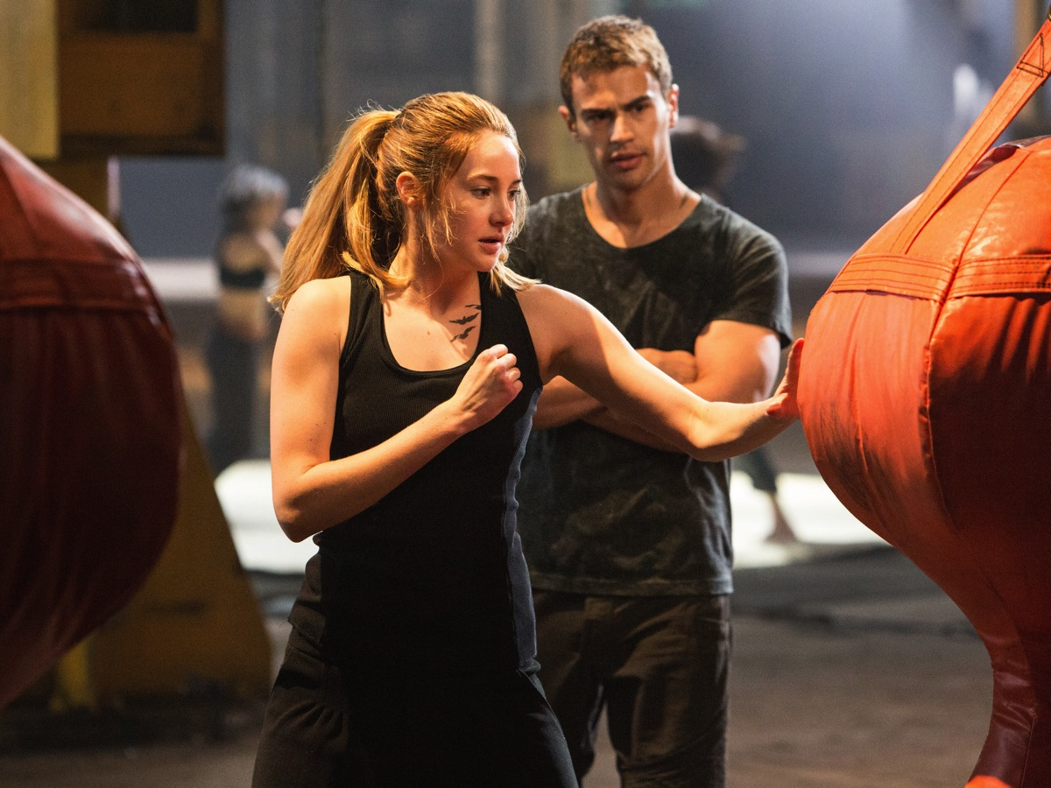
Notes:
They learn how to punch with force

Slide 24
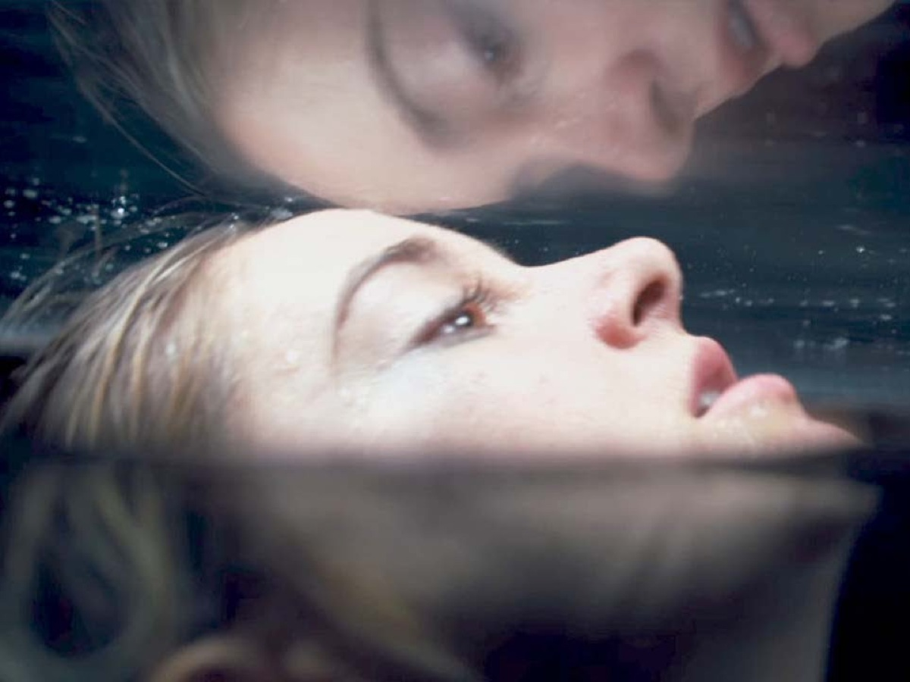
Notes:
They undergo drug-induced simulations to cause them to confront their fears

Slide 25
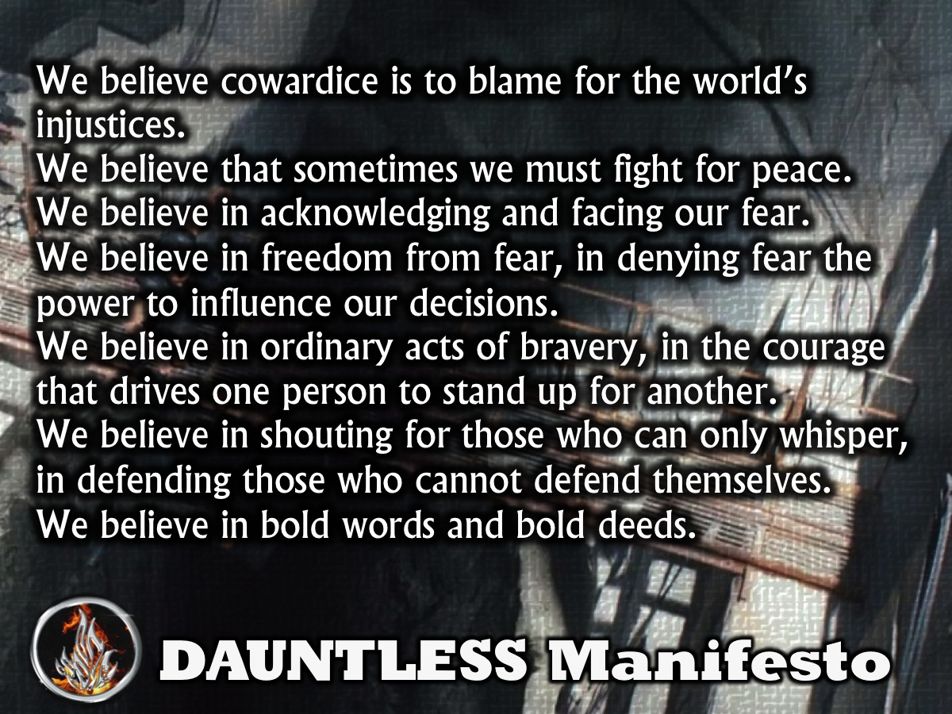
Notes:
They learn the faction manifesto:
We believe that cowardice is to blame for the world’s injustices.
We believe that sometimes we must fight for peace.
We believe in acknowledging and facing our fear.
We believe in freedom from fear, in denying fear the power to influence our decisions.
We believe in ordinary acts of bravery, in the courage that drives one person to stand up for another.
We believe in shouting for those who can only whisper, in defending those who cannot defend themselves.
We believe in bold words and bold deeds.

Slide 26
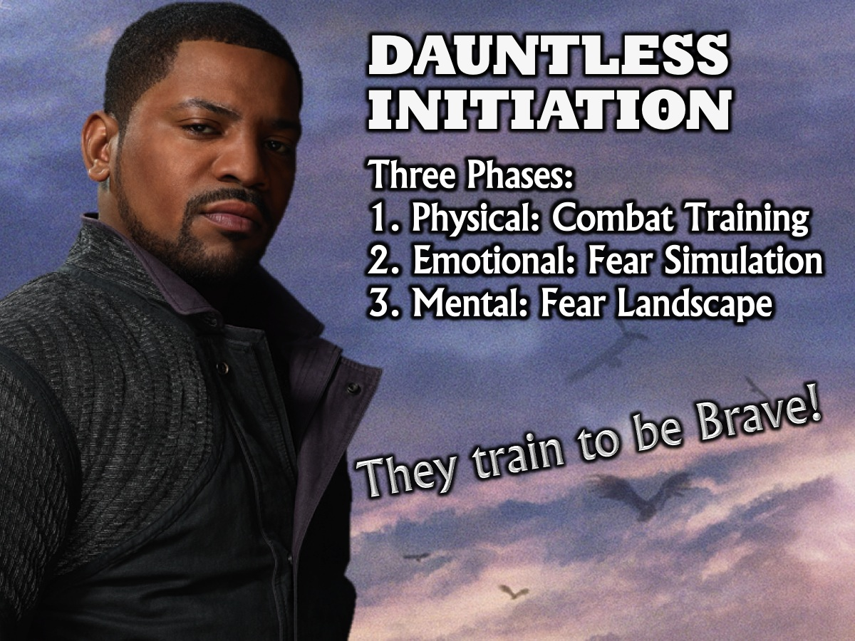
Notes:
The Dauntless Initiation has three phases: (1) Physical: Combat Training. (2) Emotional: Fear Simulation. (3) Mental: Fear Landscape. The initiates are separated during the first stage of initiation. The Dauntless born initiates are trained by Lauren, and the transfers are trained by Four and Eric. They take the initiation process very seriously. There are three stages to Dauntless initiation: The physical, the emotional, and the mental. The Dauntless born initiates and the transfers are scored separately for the first stage, which is physical combat. In the physical stage, initiates learn how to fight and are pitted against each other to prove what they have learned. They are scored based on their victories and losses. In the emotional stage, initiates are put into a simulation where they face their fears, oblivious to the fact that it is a simple simulation, and have to calm themselves to get out. The Divergent seem to have a knack for this stage, as they are aware it is not real. In the final stage, the mental, initiates are put into their fear landscapes, which reaches for every fear within the person subjected to it and creates a simulation in which they must face each one. This time, they are aware that it is not real. Those not in the top five of each initiation class typically end up as guards. It is tradition for initiates to divide into two teams and play capture the flag at the Navy Pier during initiation. Initiates are reminded not to seem too attached their families when they visit on Visiting Day since the Dauntless take the phrase ‘faction before blood’ very seriously.

Slide 27

Notes:
So what? This week we are explore the first of five values to build into our lives: Being Brave!

Slide 28
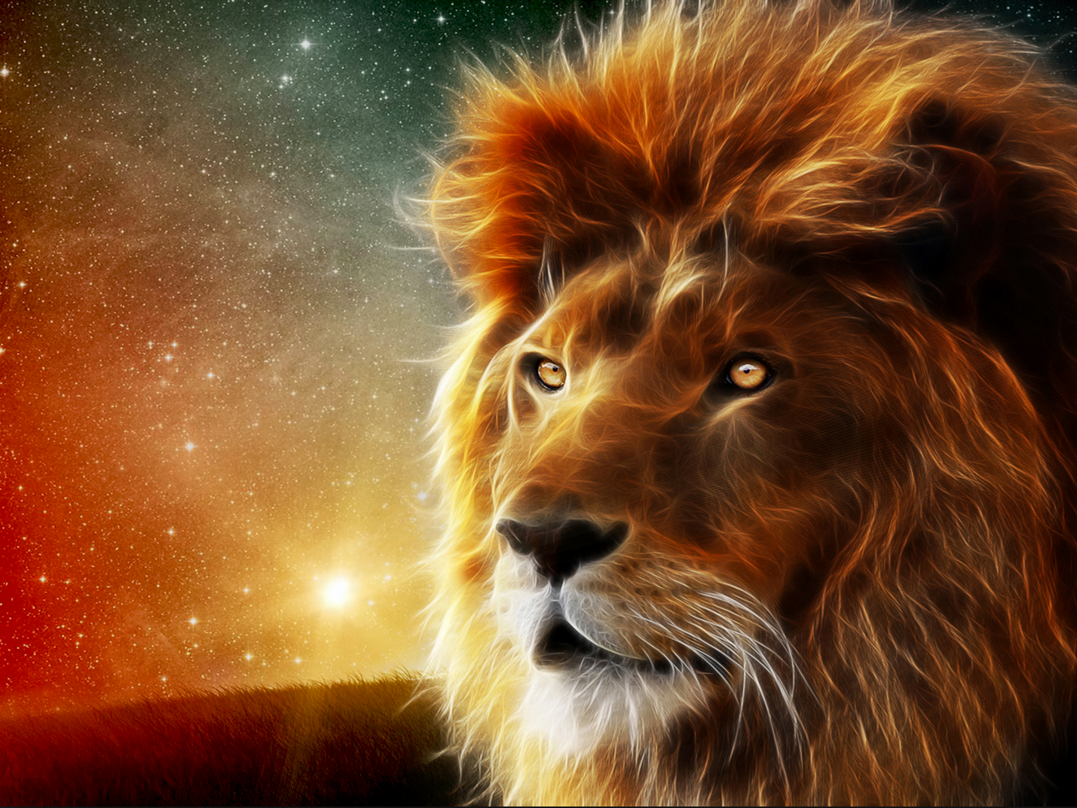
The wicked flee when no-one pursues, but the righteous are BOLD as a lion. (Proverbs 28:1)
Notes:
Proverbs 28:1 says: “The wicked flee when no-one pursues, but the righteous are BOLD as a lion.”

Slide 29

Notes:
We are often commanded in the Bible to be Strong in the Lord! How is that possible?

Slide 30
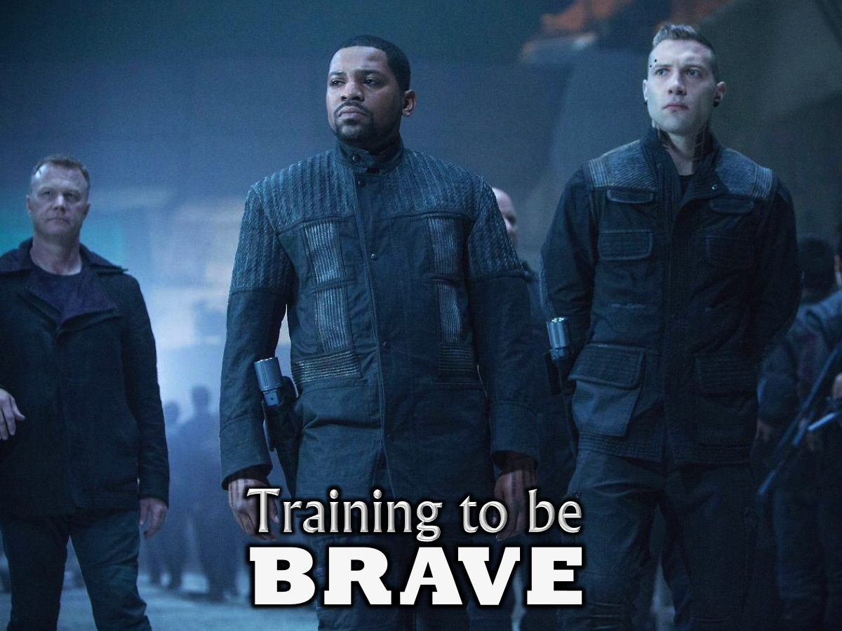
Notes:
There are three parts to your basic training as Brave initiates – if you are going to be Brave you have to…

Slide 31
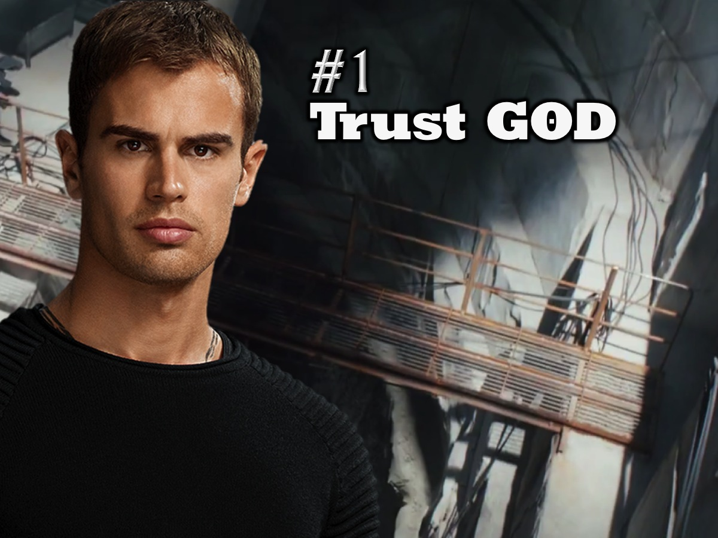
Notes:
1. Trust God

Slide 32
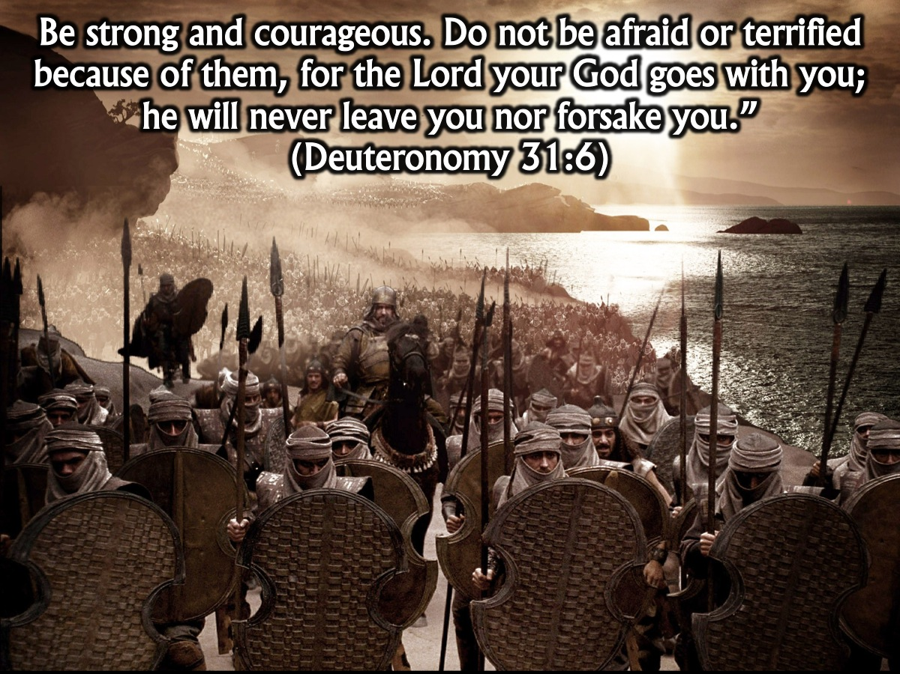
Notes:
When the Israelites were on the verge of entering into the promised land they saw how strong the occupants of the land were and I am sure they were feeling anything but brave. On more than one occasion, God said to them (through Moses or Joshua): “Be strong and courageous. Do not be afraid or terrified because of them, for the Lord your God goes with you; he will never leave you nor forsake you.” (Deuteronomy 31:6)

Slide 33
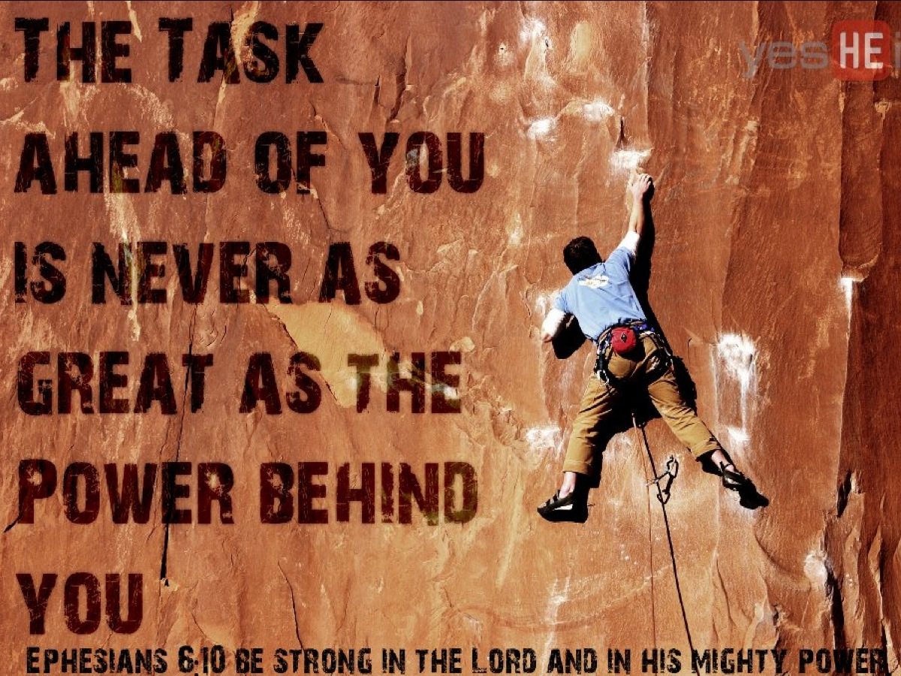
Notes:
This is why we can be Brave – because we have the power of God with us!

Slide 34

Notes:
2. Take Risks.

Slide 35
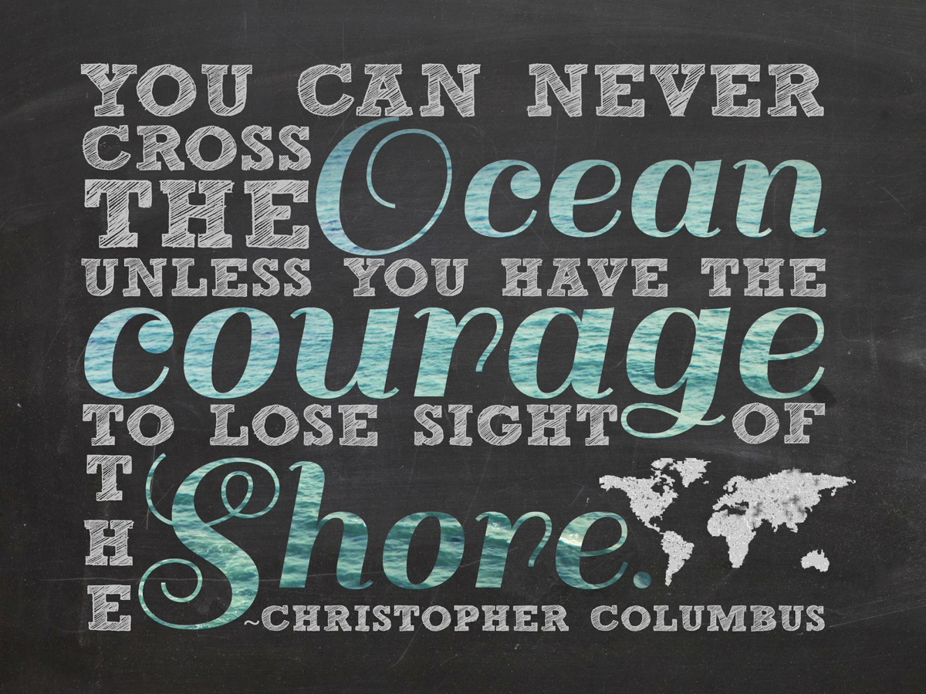
Notes:
Christopher Columbus, that great Spanish explorer would never had discovered the new world on the other side of the ocean if he did not lose sight of his own shoreline!

Slide 36
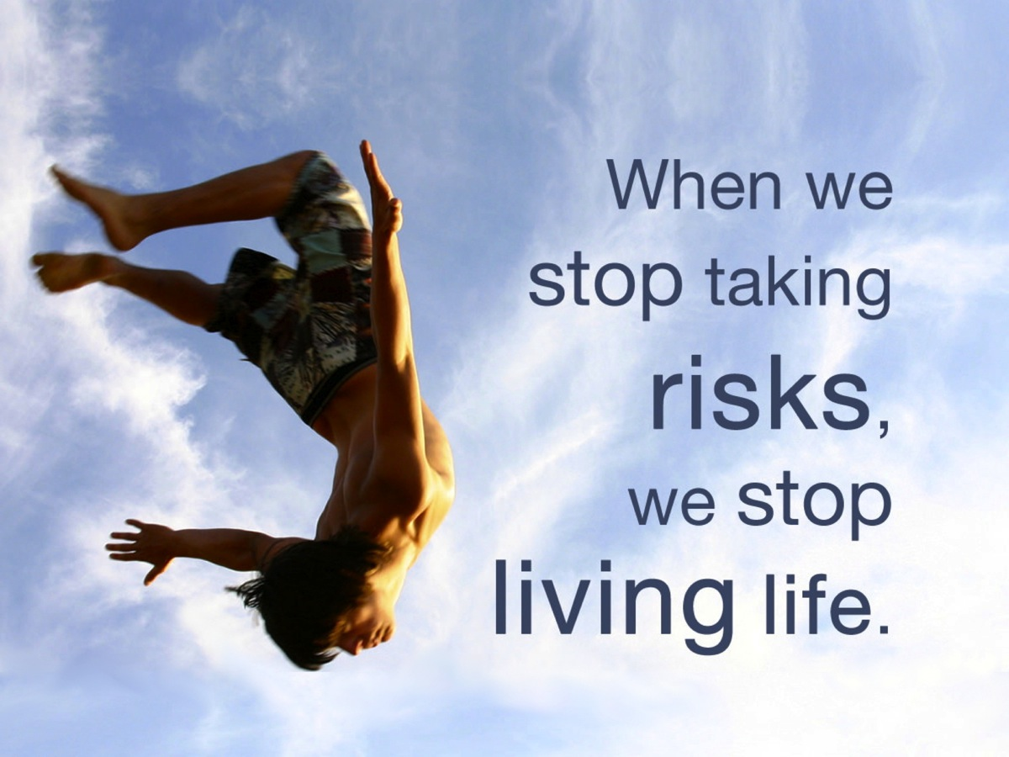
Notes:
Actually, when we stop taking risks, we stop living life!

Slide 37
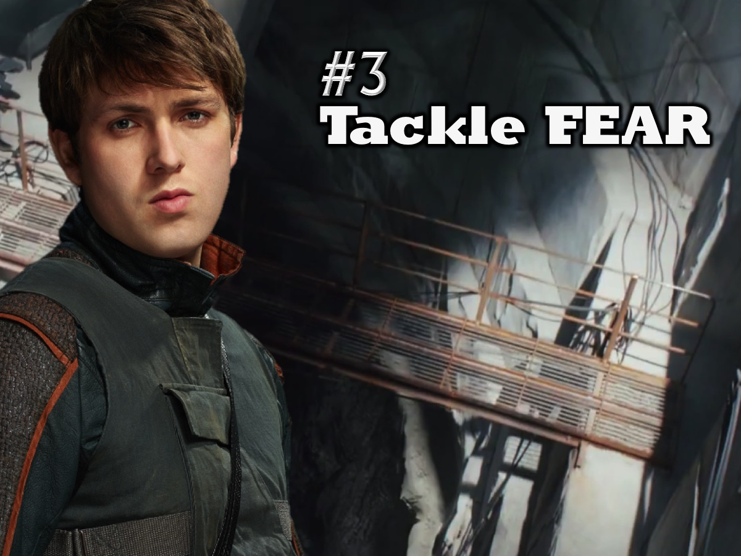
Notes:
3. Tackle Fear.

Slide 38
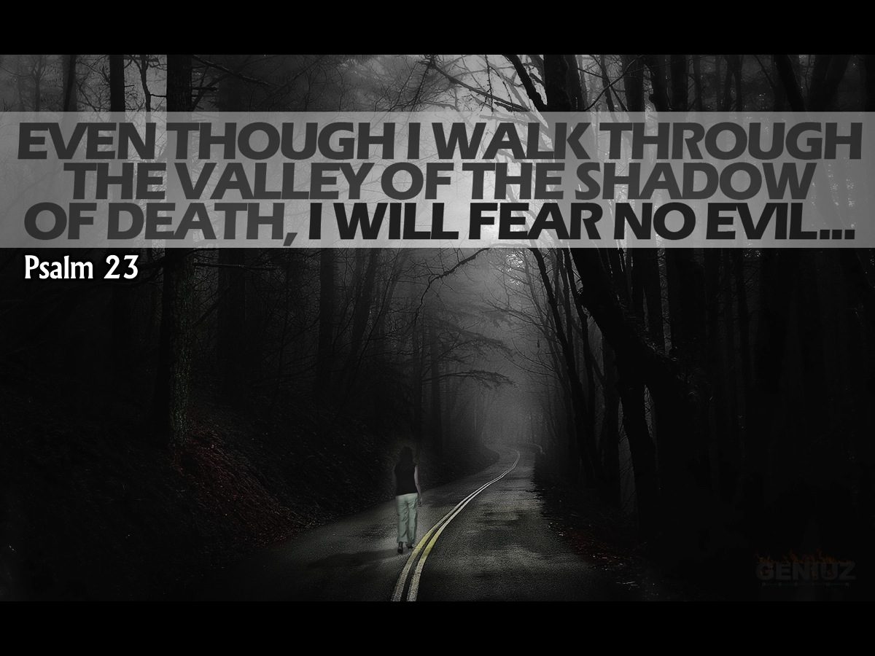
Notes:
Psalm 23 says: “Even though I walk through the valley of the shadow of death…”

Slide 39
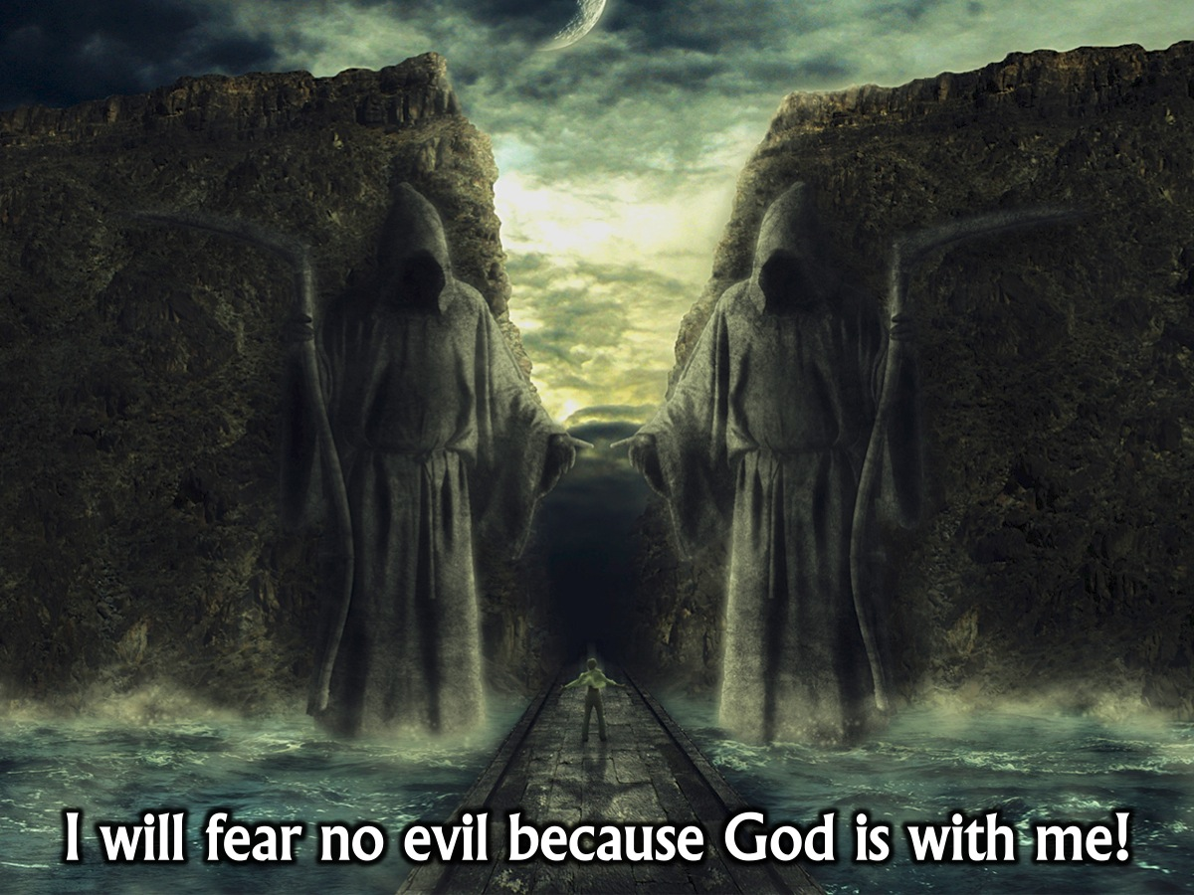
Notes:
The verse goes on to say: “I will fear no evil because God is with me!”

Slide 40
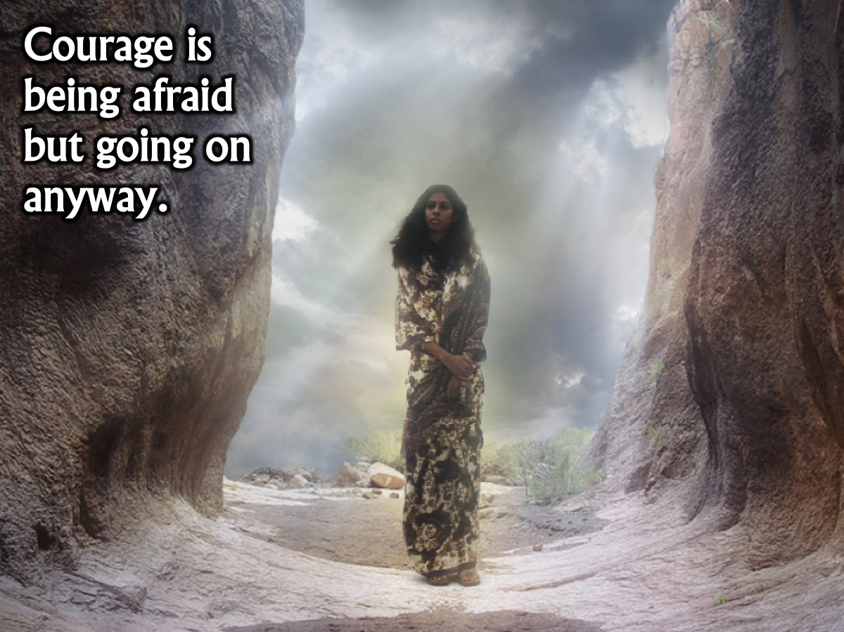
Notes:
In fact, courage is being afraid but going on anyway, knowing that God is with you and he will fight for you!

Slide 41
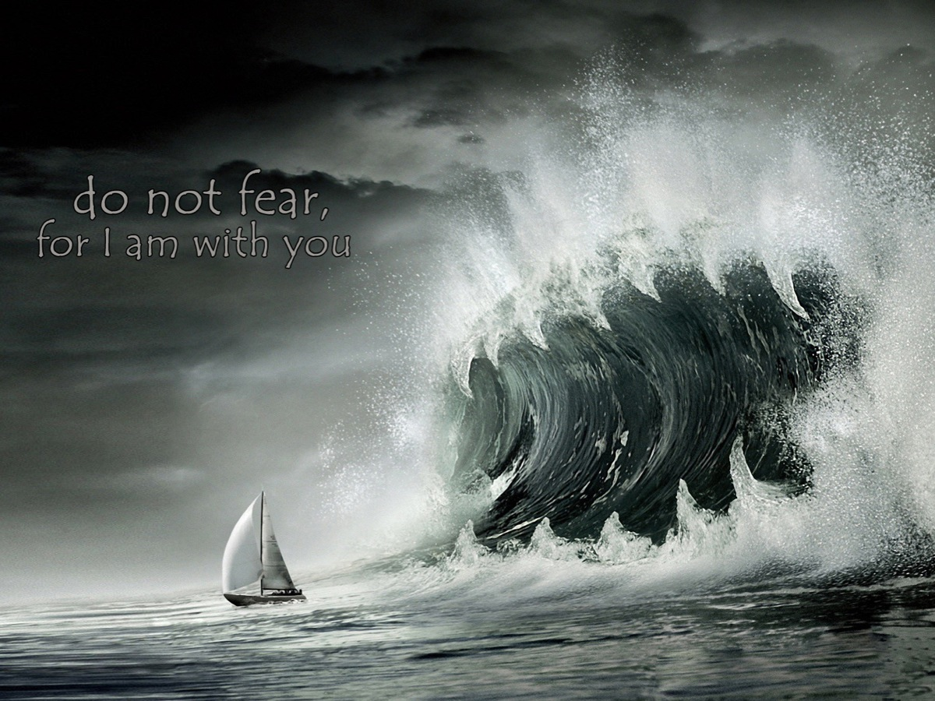
Notes:
Throughout the Bible we read this little phrase: “Do not fear, for I am with you.”

Slide 42

Notes:
Have you seen the movie, After Earth?

Slide 43
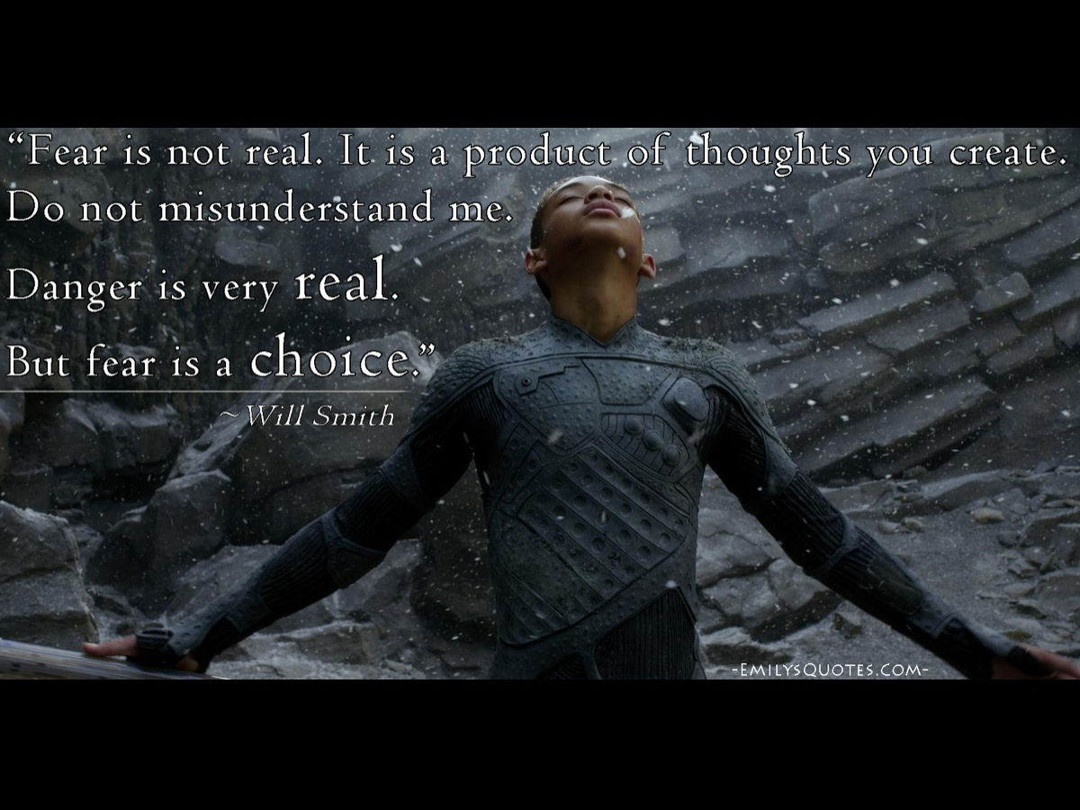
Notes:
Will Smith’s character says to his son: “Fear is not real. It is a product of thoughts you create. Now do not misunderstand me, danger is very real. But fear is a choice.” (Cypher Raige).

Slide 44
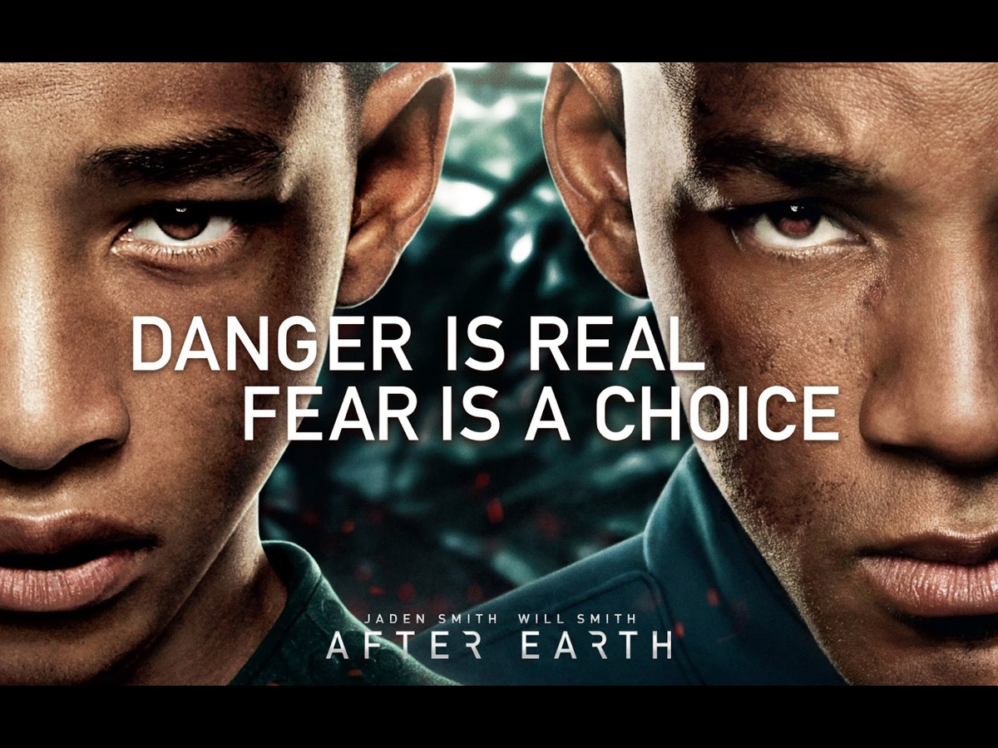
Notes:
So danger is real, but fear is a choice!

Slide 45
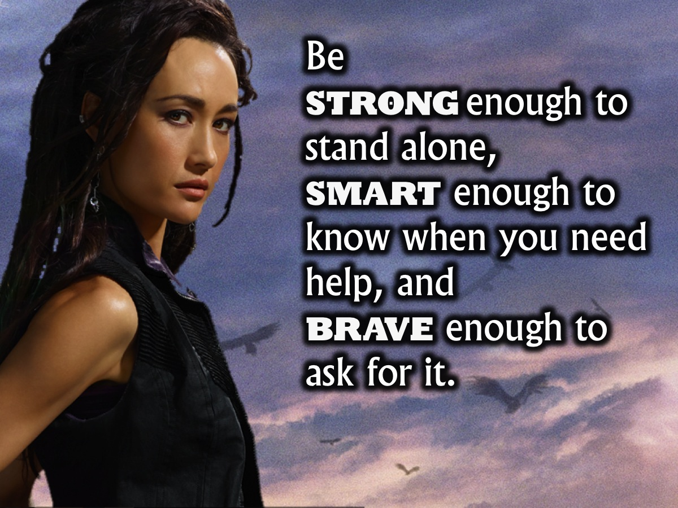
Notes:
Here are some very wise words that challenge us to be wise in our bravery! “Be strong enough to stand alone, smart enough to know when you need help, and brave enough to ask for it.”

Slide 46

Notes:
Courage does not always roar. Sometimes courage is the quiet voice at the end of the day saying: “I will try again tomorrow.”

Slide 47

Notes:
May my heart be kind, my mind fierce and my spirit brave!

Slide 48
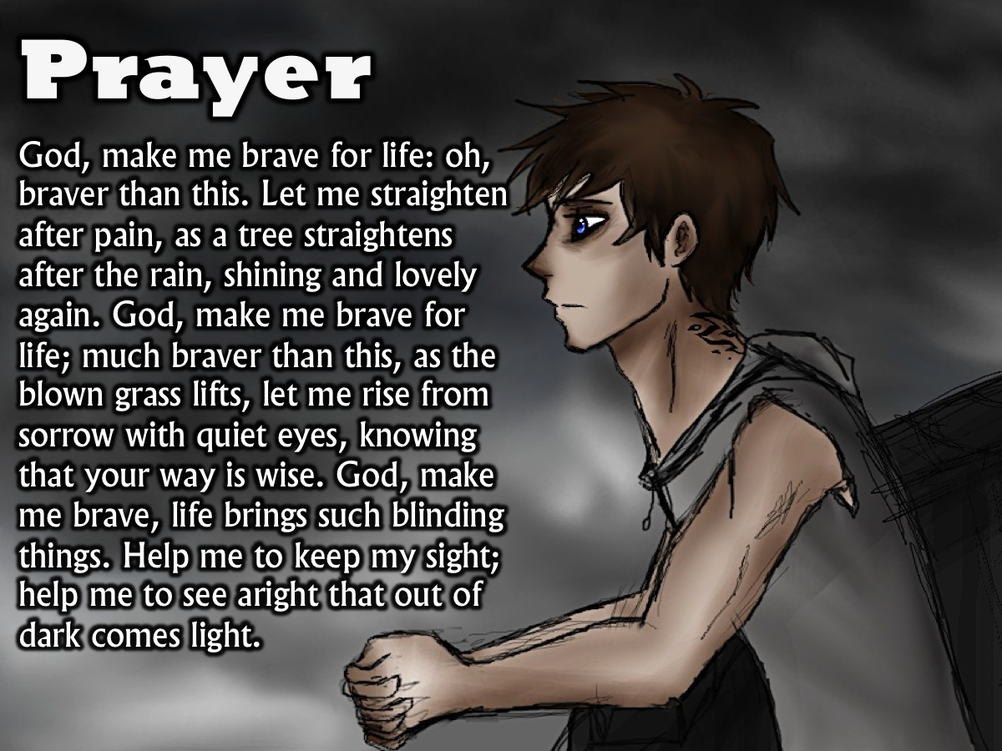
Notes:
Prayer: God, make me brave for life: oh, braver than this. Let me straighten after pain, as a tree straightens after the rain, shining and lovely again. God, make me brave for life; much braver than this, as the blown grass lifts, let me rise from sorrow with quiet eyes, knowing that your way is wise. God, make me brave, life brings such blinding things. Help me to keep my sight; help me to see aright that out of dark comes light.

Slide 49

Notes:
Next week we will look at the Erudite Faction – and explore what it means to be Wise.

