Slide 1
Notes:
Two weeks ago we started our new series based on the book and movie called Divergent.

Slide 2
Notes:
In the movie people are divided into five different factions focusing on different positive values.

Slide 3
Notes:
Last time we were together we looked into the world of Dauntless!

Slide 4
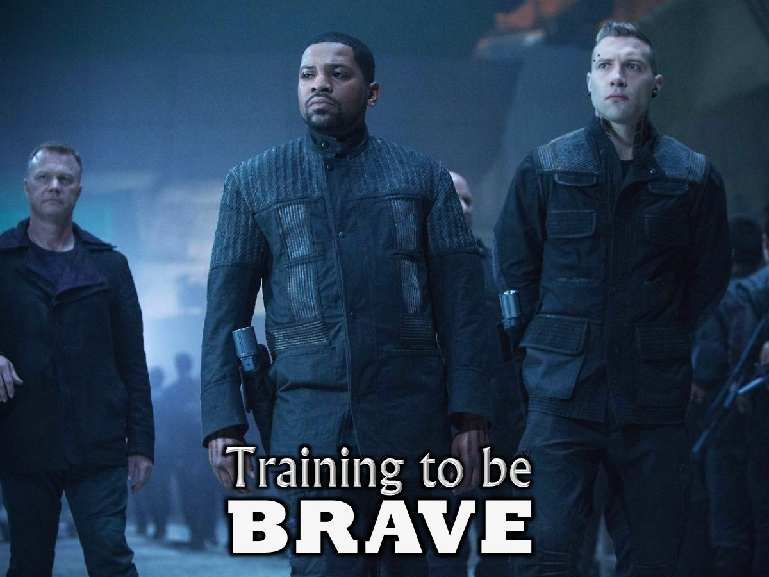
Notes:
There are three parts to your basic training as Brave initiates – if you are going to be Brave you have to…

Slide 5
Notes:
1. Trust God

Slide 6
Notes:
2. Take Risks.

Slide 7
Notes:
3. Tackle Fear.

Slide 8
Notes:
Today we are going to step into the world of the second of the five factions – Erudite.

Slide 9
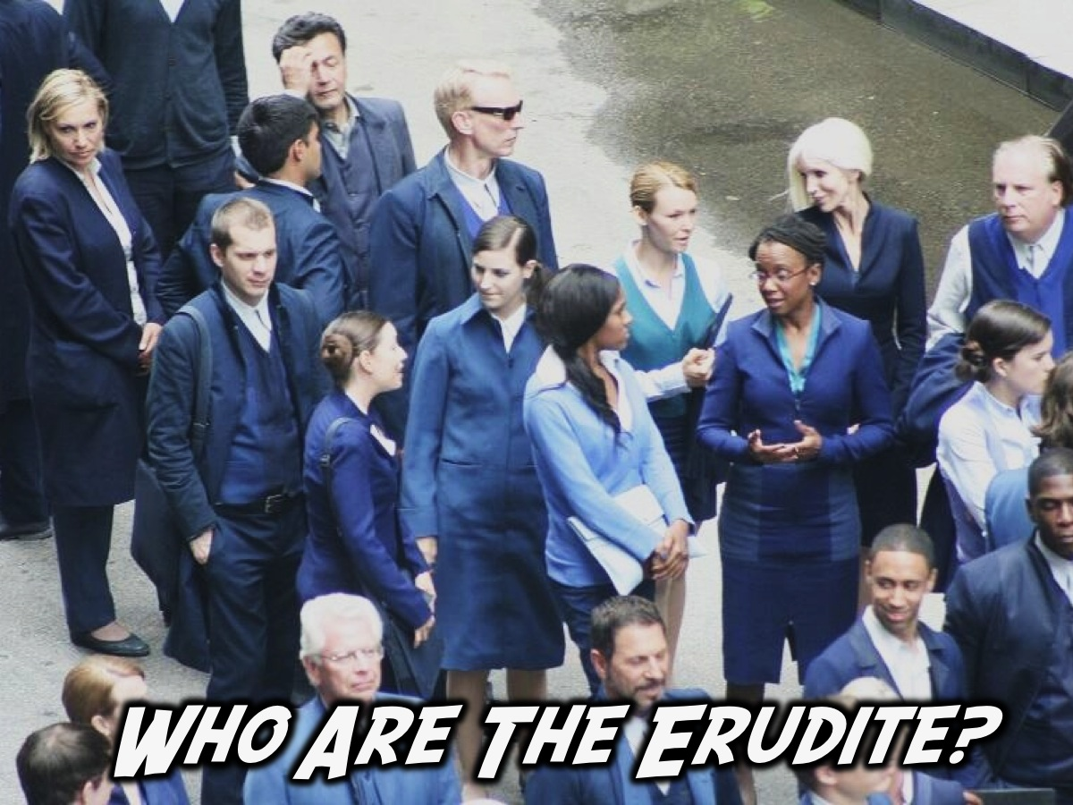
Notes:
Who are th

Slide 10
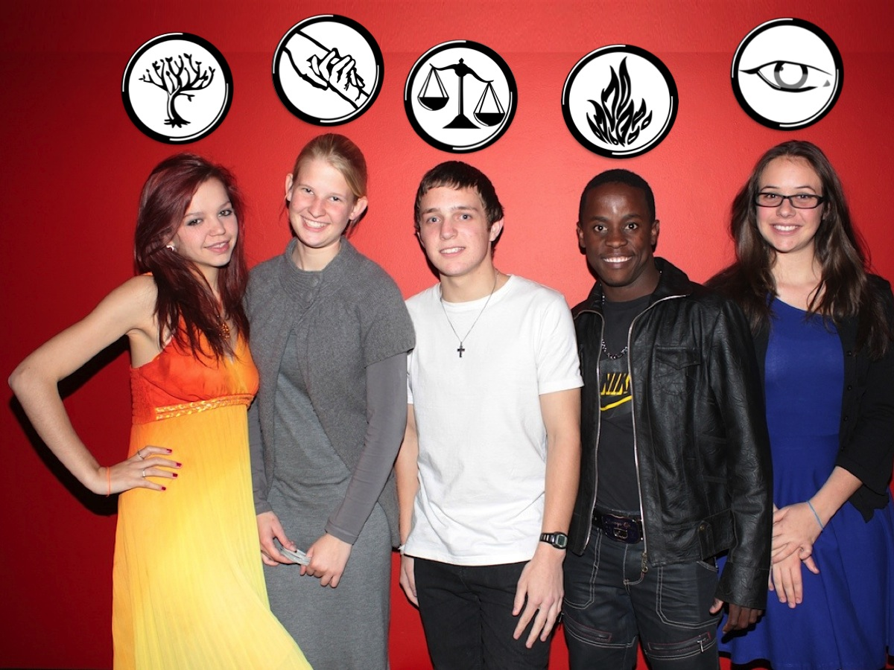
Notes:
By now you know that we are talking about one of the 5 factions in the Divergent movie.

Slide 11
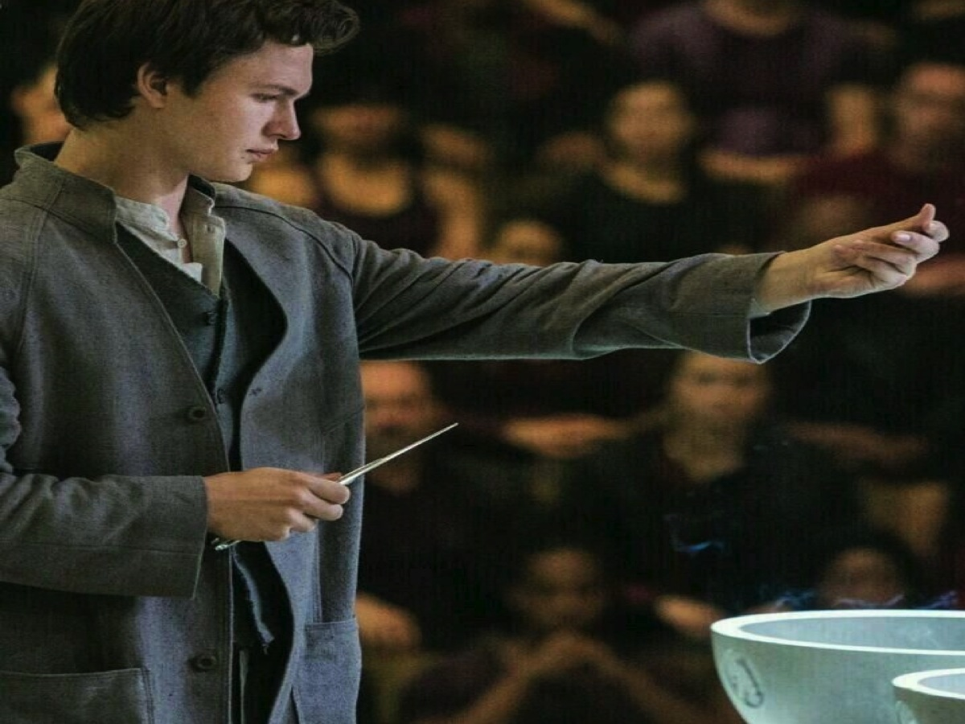
Notes:
Erudite is the faction that Beatrice’s brother, Caleb, joins at the choosing ceremony. He has secretly being interested in reading and knowledge and he takes his chance to leave his faction, Abnegation in favour of Erudite.

Slide 12
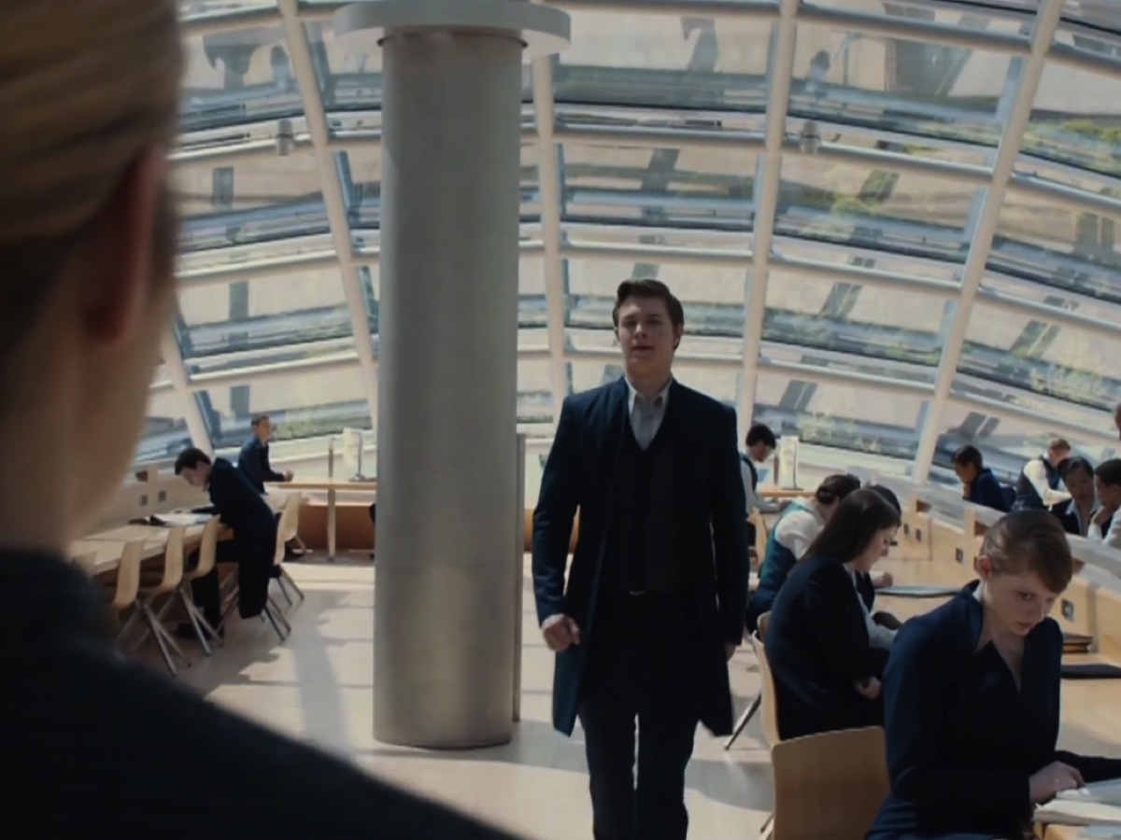
Notes:
Beatrice only visits the Erudite compound once, to see her brother Caleb, but there she learns that the main building is a library, filled completely with books.

Slide 13
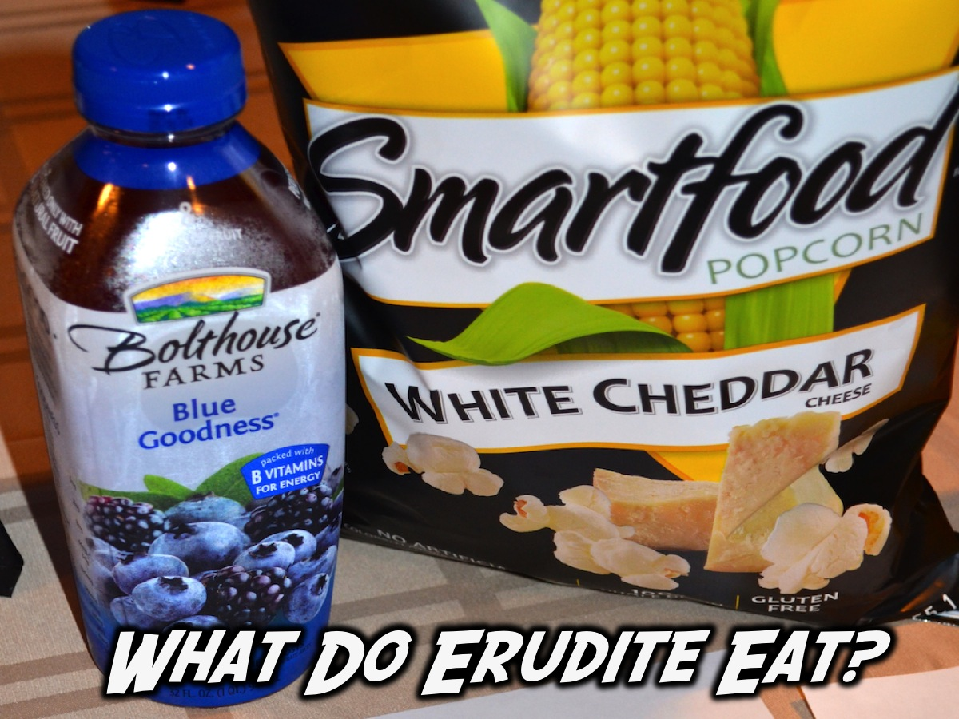
Notes:
What Do Erudite Eat? Erudite eat things that help with improving brain functioning! (Note: We chose to hand our small rolls of Super C sweets for the Erudite faction.)

Slide 14
Notes:
Why Was Erudite Established? Erudite was formed by those who blamed ignorance for the war that occurred to eliminate ignorance and darkness from human minds.

Slide 15
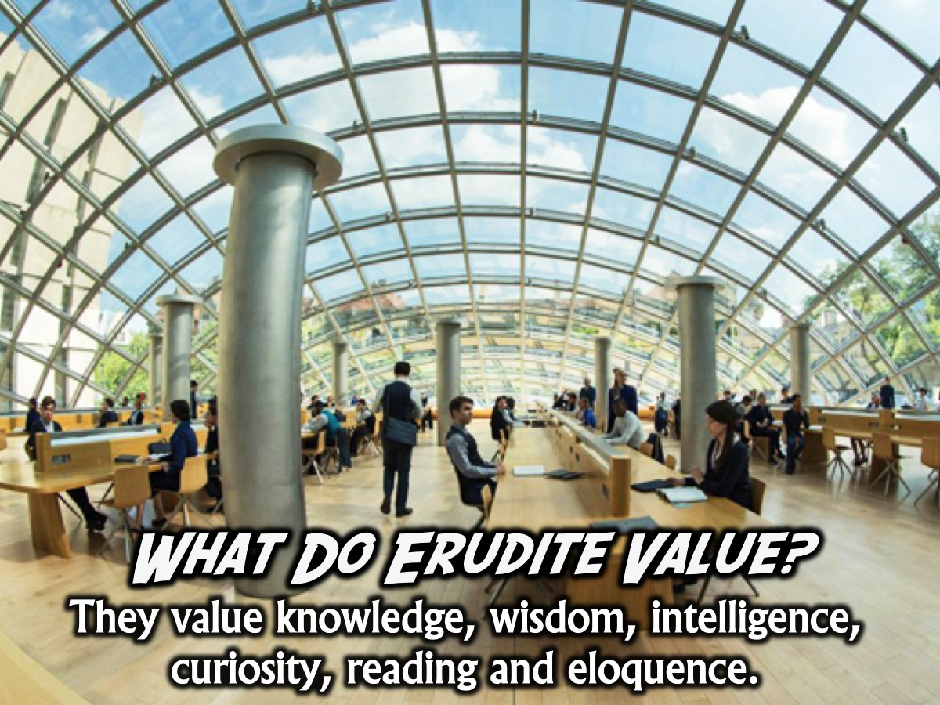
Notes:
What Do Erudite Value? They value knowledge, wisdom, intelligence, curiosity, reading and eloquence.

Slide 16
Notes:
The Erudite Manifesto: Ignorance is defined not as stupidity but as lack of knowledge. Lack of knowledge inevitably leads to lack of understanding which leads to a disconnect among people with differences which leads to conflict. Knowledge is the only logical solution to the problem of conflict. To eliminate conflict we must eliminate the disconnect among those with differences by correcting the lack of understanding that arises from ignorance with knowledge.

Slide 17
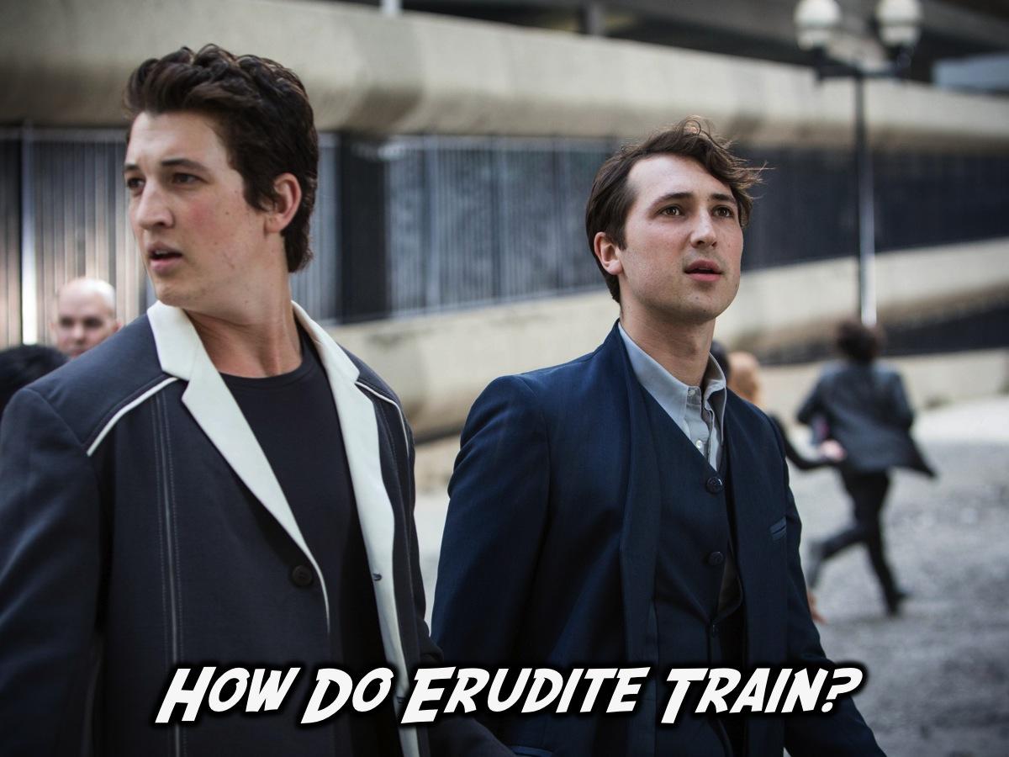
Notes:
We don’t know much about what the initiation and training looked liked for Erudite recruits but it must have involved training to be smart – including taking quizzes to find out how much initiates knew.

Slide 18
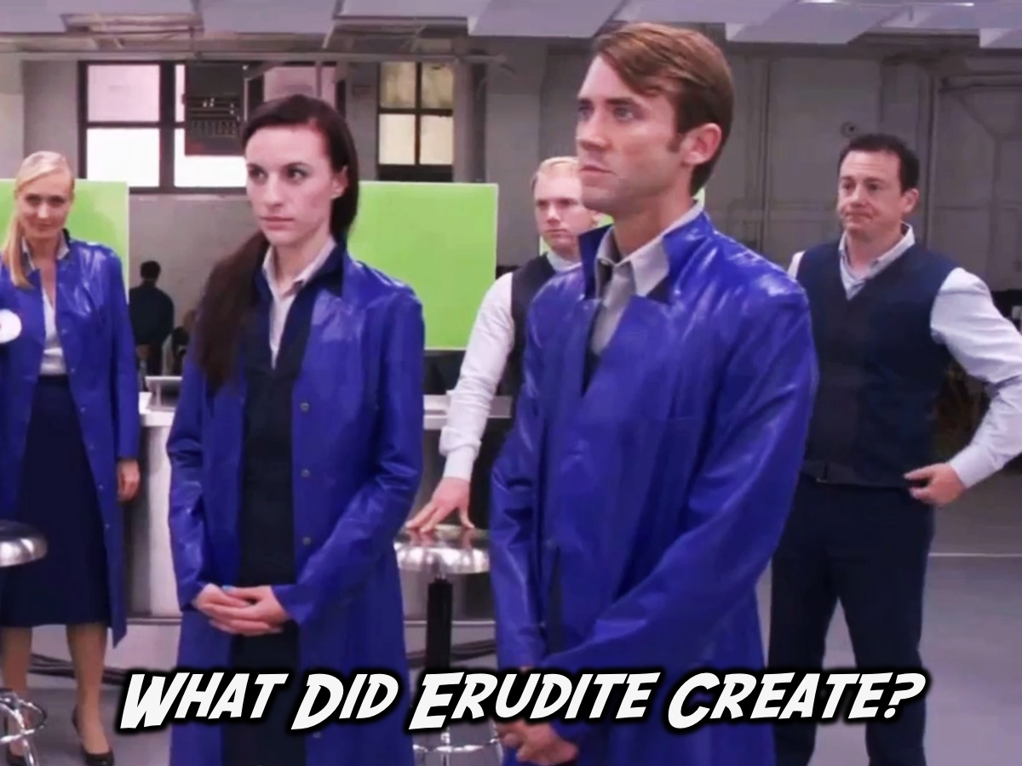
Notes:
What Did Erudite Create? Erudite were most know for the creation of five different types of serums.

Slide 19
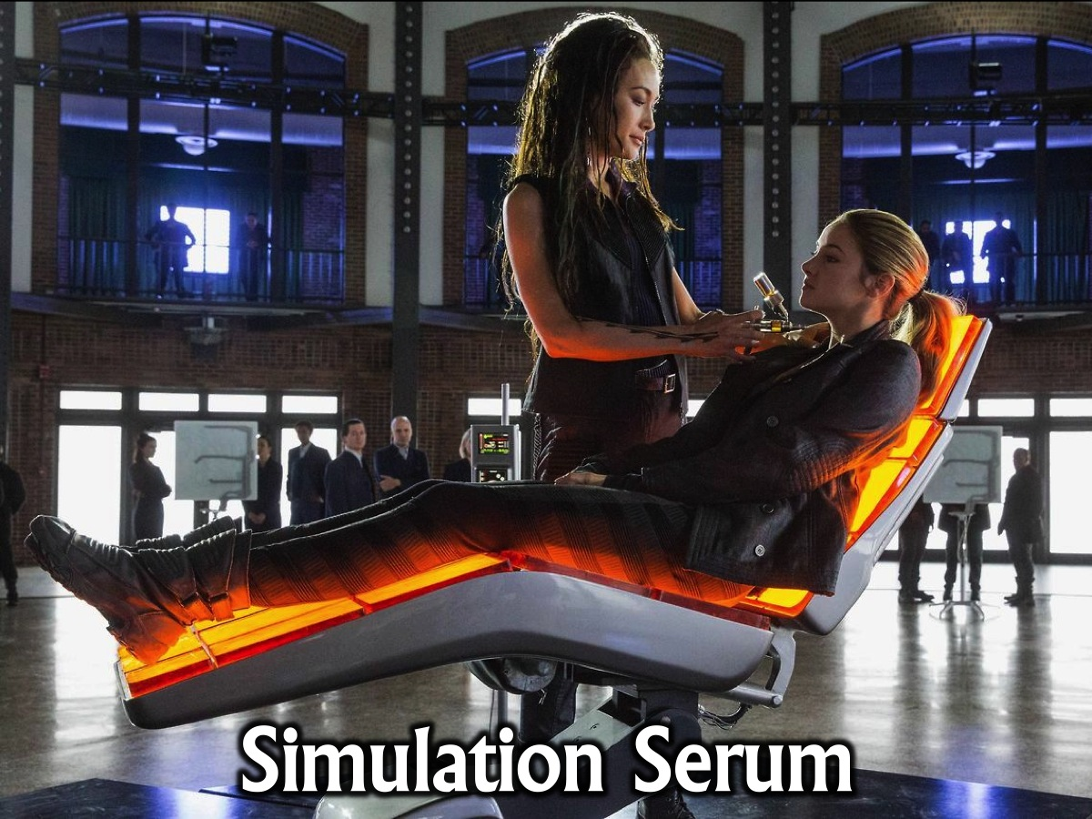
Notes:
1. Simulation Serum (orange) - The simulation serum is a drug used to induce simulations. It was designed by Jeanine Matthews and was used in aptitude test. The Dauntless use a variation in the second stage of Dauntless initiation. The Simulation Serum is usually administered orally in liquid form for the Aptitude Tests, however, it can be injected in a vaccine-like manner if need be.

Slide 20
Notes:
2. Truth Serum (blue) - The Truth Serum is a drug that is used exclusively by Candor in upholding their virtue of honesty. The serum is used mainly for Candor initiation and interrogation. The truth serum, as its name suggests, puts the person administered with it under a lethargic effect that makes them willingly answer questions without much struggle. Upon being administered the serum, Tris forgot why she was being asked questions, adding to the powerful effects of the serum. It is said by Christina that no one is able successfully deny answering any question while under the truth serum. However, due to the special nature of the Divergent, Tris was able to keep the answer from leaving her when under the serum. It can be concluded that those who are Divergent are able to, with enough effort, resist the effects of the truth serum.

Slide 21
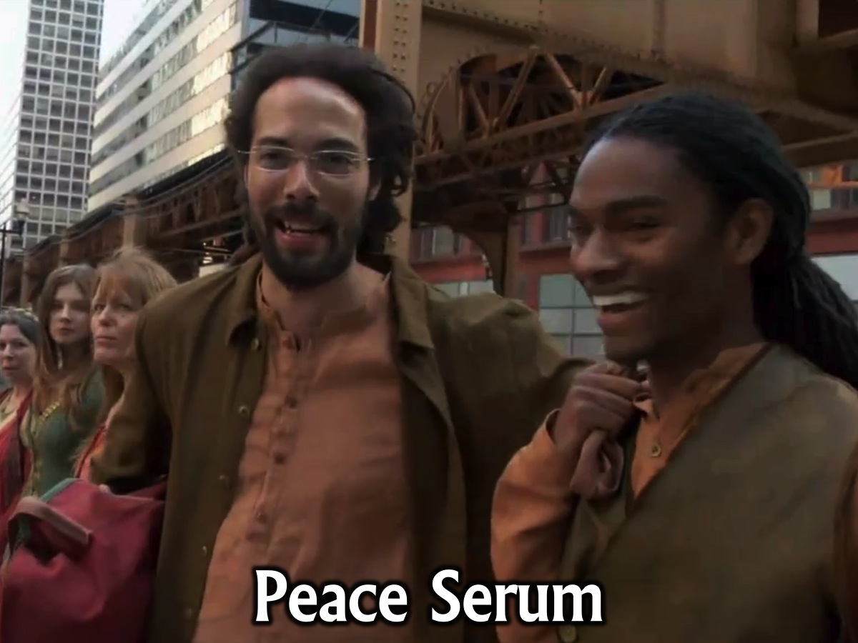
Notes:
3. Peace Serum (green) - The Peace Serum is a drug that is used by Amity in order to maintain peace in their factions. It was concocted by Erudite, like every other serum. The serum was first seen and administered in Insurgent to Tris Prior after being in a fight with Peter who tried to steal the hard drive containing the simulation program. The serum's effects can be seen immediately after administration. In small doses, it calms the mind and improves the mood of the person administered. The person may forget why he/she was angry in the first place. A feeling of calmness replaces the irateness of the administered. Dizziness is a common side-effect of the serum. Because the serum's dosage is linked to the person's height and weight, overdosage can be common had the afromentioned factors not be taken into consideration. In large doses, exaggerating effects can be evident. A euphoric and overly-elated feeling can be a common effect. Amity administers it to their faction members who have trouble keeping compliant and peaceful, characteristics that violate Amity's virtues. Johanna indirectly confesses after being confronted by Tobias that they mix the serum on some of the food, particularly their bread.

Slide 22
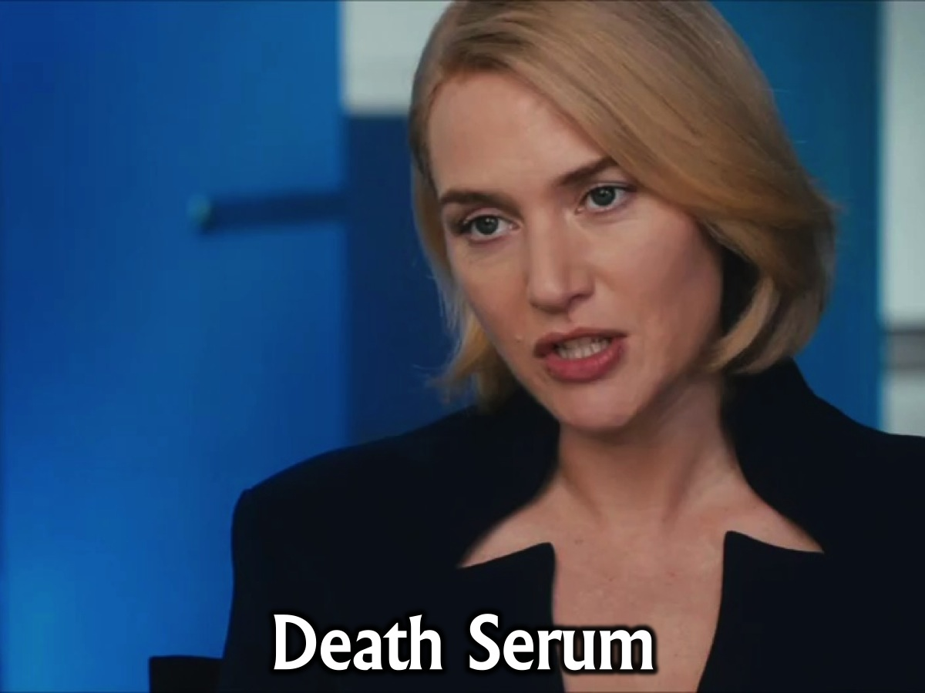
Notes:
4. Death Serum (purple) - The Death serum is a substance used by Jeanine Matthews. When Tris surrendered herself for testing, Jeanine attempted to use it, but it was actually a different, non-lethal serum dyed purple. The real serum was in Peter's hands. It is also noted that strong Divergent characters can resist the death serum when Tris resists it in Allegiant. The Death Serum is considered the serum of Erudite. In Allegiant Tris describes that the serum smells like smoke and spice, she also says that you feel the blood replaced with molasses, and the bones with lead, you also feel your body falling to the side. Tris resisted it thinking about the people she loved and the ones who died for her, The book has not a single instance of anyone actually dying as a result of ingesting Death Serum.

Slide 23
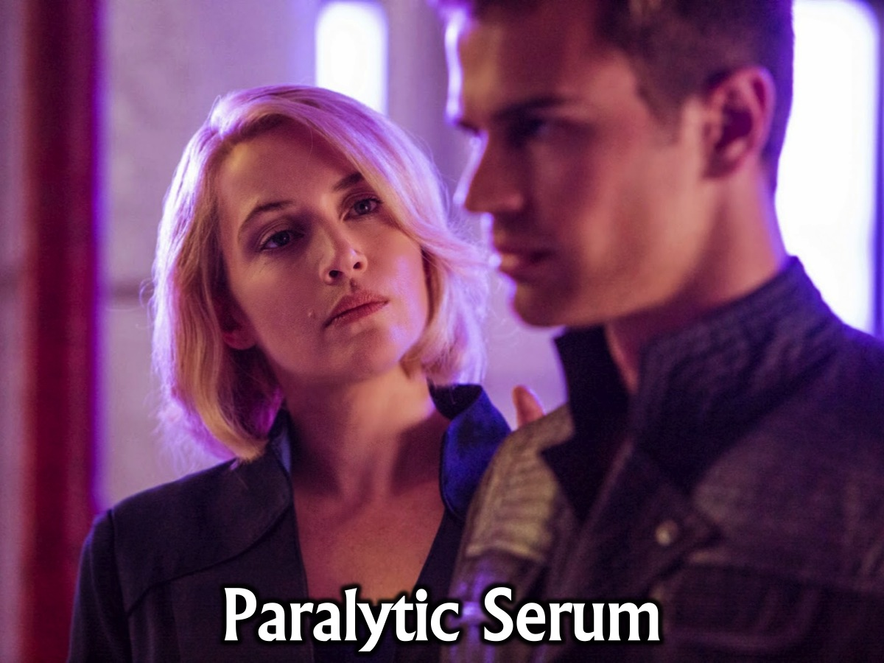
Notes:
5. Paralytic Serum (dyed purple) - The Paralytic Serum makes someone unable to move for one minute, after which they regain consciousness. In Insurgent, the Death Serum was switched for the Paralytic Serum by Peter Hayes in order to save Tris's life at her execution in the Erudite headquarters. It was dyed purple to attain the purple hue of the Death Serum. This is the only use of Paralytic Serum stated in the books. Tris described going under the serum as "All the muscles in my body relax at once. A heavy, liquid feeling fills my limbs...My eyes stay open, but my head drops to the side. I try to close my eyes, but I can’t—I can’t move." She also describes being able to breathe; not deeply and not enough to satisfy. The Paralytic Serum succeeded in making Tris look dead in front of Jeanine Matthews, as Jeanine called her a body as she told Peter to take her to the lab. The effects of the Paralytic Serum are said to only last five minutes.
There is a sixth serum – the Memory Serum - The Memory Serum is a drug used to erase the memories of a particular individual or group. It was designed by the Bureau of Genetic Welfare for use in their long-term genetic experiments. The Memory Serum can be administered by intra-venous injection, ingestion or viral contraction and subsequently erases a person's memories. It targets specific types of memories - memories that are explicit within the brain, such as names, faces, learned knowledge and sense of self. Affected individuals do not, however, have their implicit memories erased, such as how to walk, talk or ride a bike, thus allowing them to start their life anew. In the first few days after the serum is administered, the affected individual is generally disoriented and their minds are considerably more pliable than usual. This allows unaffected individuals to give them new identities, plant false memories and thus enable them to assume a new life without feelings of displacement. The memory serum comes with a counterpart inoculation serum that renders an individual immune to the memory erasing effects of the memory serum in any form, whether it by by injection, ingestion or inhalation of its aerosol. Tris, Tobias and the other conspirators inoculate themselves so they will not be affected by the serum, as are Zeke, Hana, Nita and Christina's family. The Memory Serum, also known as the Abnegation Serum, erases someone's memories, erasing the important knowledge such as their name, place of birth, etc. though leaving the basic knowledge untouched, such as how to talk, walk, tie your shoelaces, etc. It is released into the air ofthe Bureau of Genetic Welfare by Tris (Beatrice), Prior, in order to protect their home city, Chicago. According to Matthew, it can spread like a virus among people, and has been used a few generations before Tris.

Slide 24
Notes:
How Did Erudite Go Wrong? Erudite became a faction that steered away from its original belief as members became greedy for power due to their desire for knowledge. They even plotted to overthrow the government and reinstate themselves as the leaders of the city. Because of their thirst for knowledge, they are the ones easily susceptible to moral corruption as knowledge leads to a lust for power.

Slide 25
Notes:
Today we are going to talk about the biblical value of being Wise.

Slide 26
Notes:
There are four parts to your basic training to be Wise – if you are going to be Wise you have to…

Slide 27
Notes:
1. Ask

Slide 28
Notes:
James 1:5 says that if any of you lack wisdom, you should ask God who gives generously to all without finding fault and it will be given to you!

Slide 29
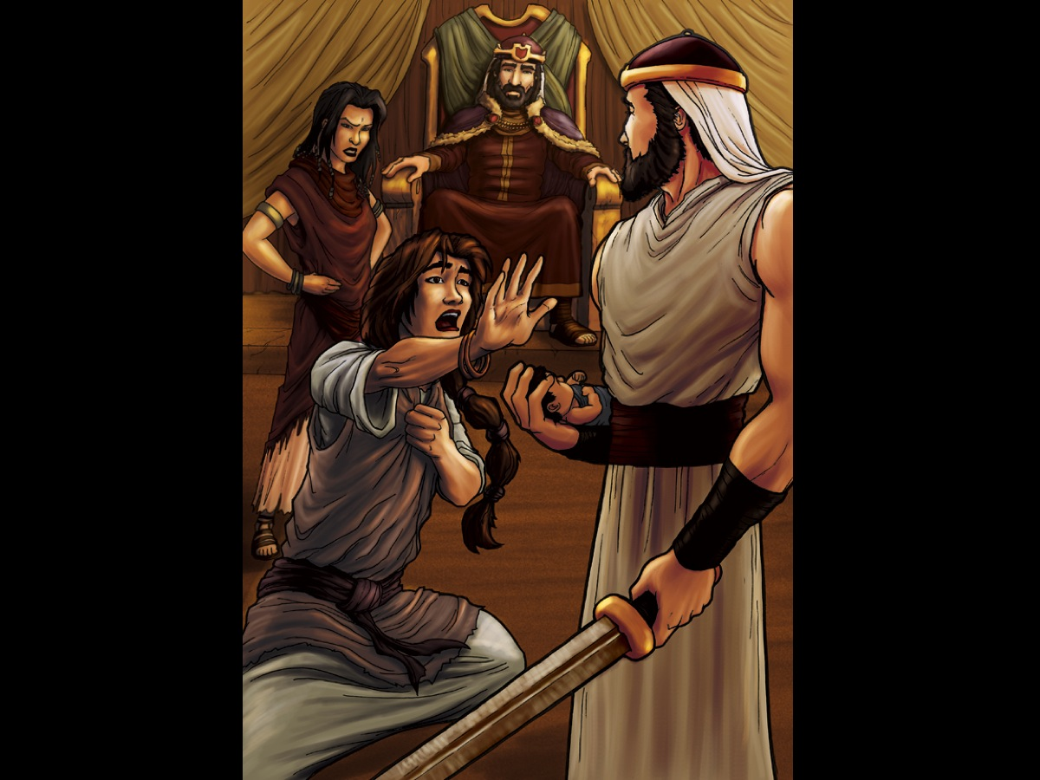
Notes:
Solomon asked God for wisdom. And in 1 Kings 3:16-28 that wisdom is seen in a situation where two young women who lived in the same house and who both had an infant son came to Solomon for a judgment. One of the women claimed that the other, after accidentally smothering her own son while sleeping, had exchanged the two children to make it appear that the living child was hers. The other woman denied this and so both women claimed to be the mother of the living son and said that the dead boy belonged to the other. After some deliberation, King Solomon called for a sword to be brought before him. He declared that there was only one fair solution: the live son must be split in two, each woman receiving half of the child. Upon hearing this terrible verdict, the boy's true mother cried out, "Oh Lord, give the baby to her, just don't kill him!" The liar, in her bitter jealousy, exclaimed, "It shall be neither mine nor yours—divide it!” The king declared the first mother as the true mother and gave her the baby. King Solomon's judgment became known throughout all of Israel and was considered an example of profound wisdom.

Slide 30
Notes:
2. Read

Slide 31
Notes:
From infancy you have known the Holy Scriptures, which are able to make you wise for salvation through faith in Christ Jesus. (2 Timothy 3:15)

Slide 32
Notes:
Read books that will make you wise.

Slide 33
Notes:
3. Listen

Slide 34
Notes:
Wise men and women are always learning, always listening for fresh insights. (Proverbs 18:15)

Slide 35
Notes:
A wise old Owl sat on an oak, the more he saw the less he spoke, the less he spoke the more he heard, Why aren't we like that wise old bird?

Slide 36
Notes:
Wise men speak because they have something to say; Fools because they have to say something. (Plato)

Slide 37
Notes:
Wisdom is the reward you get for a lifetime of listening when you'd have preferred to talk.

Slide 38
Notes:
4. Question

Slide 39
Notes:
“Why” is the fuel that powers a child’ learning engine. This questions helps us examine our assumptions, definitions, and beliefs about the world. You need to keep asking others why, and be sure also to ask yourself why on a regular basis.

Slide 40
Notes:
Asking “Why?” is all about going deeper – beyond the superficial. People who actually change the world and make an impact are those who specialise. You need to look for an area to specialise in – and dig down deep into that area.

Slide 41
Notes:
4. Share

Slide 42
Notes:
If you have knowledge, let others light their candles at it.

Slide 43
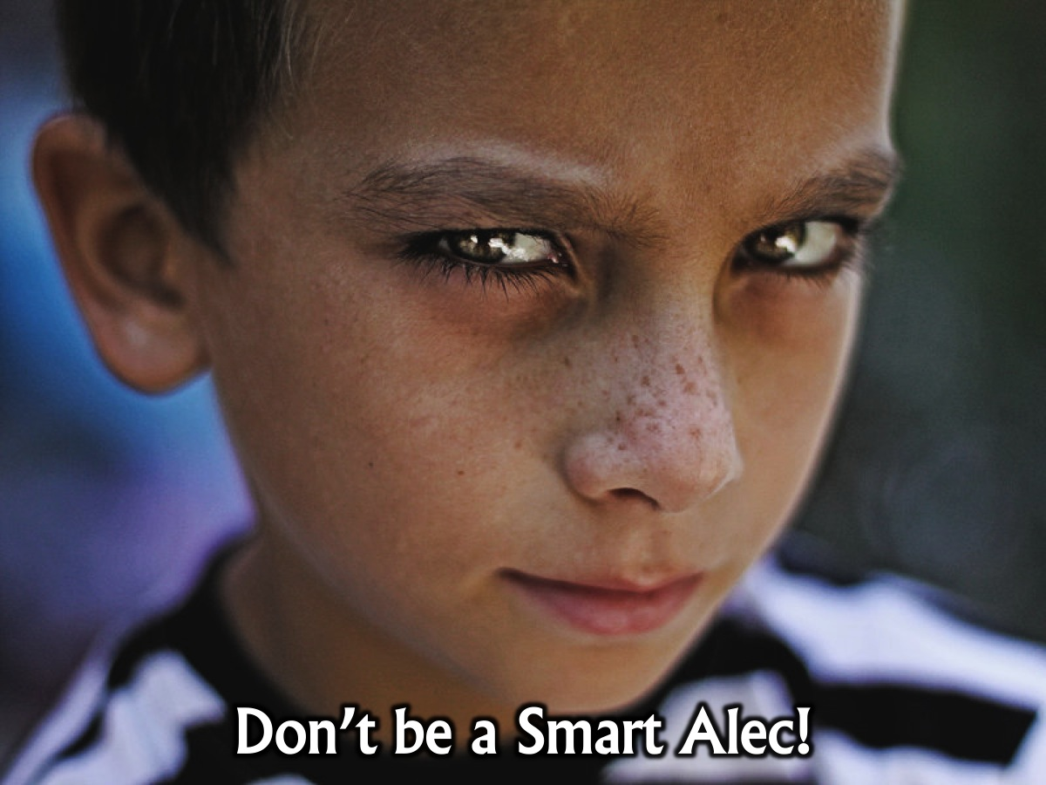
Notes:
No one like the Smart Alec who keeps knowledge to themselves! Origin of the Term “Smart Alec”: It was once thought this term was simply generic and that Alec wasn’t actually a real person. However, relatively recent research by various etymologists such as Professor Gerald Cohen, in his1985 work “Studies of Slang”, has shown, based on considerable newspaper article evidence, that “Alec” was actually very probably a real person, namely Alec Hoag. Hoag was a pimp and a thief in New York City in the 1840s. Partnered with his wife Melinda and another known as “French Jack”, they would rob his wife’s “customers” while she otherwise distracted them. They started out by simply having his wife lead the victims into dark alleys where, at some point, she’d pick their pockets then embrace them and hold her hand out behind them where Hoag would be hidden within arm’s reach to grab the stolen goods. Inevitably, some of these men would go to the police to report the theft. To get around the problem of potential police snooping around, Hoag enlisted the help of a couple of these police officers for protection and split the stolen goods with them. Hoag’s downfall came when he ran into some financial difficulties and ended up not giving the officers their fair share. The disgruntled cops arrested Hoag and Melinda. Alec Hoag was then given the nickname “Smart Alec” by the police for being too smart for his own good. The thought is that the police then used this term when dealing with other criminals who seemed a little too smart for their own good, often thinking of ways around giving police their payoffs: “Don’t be a Smart Alec”. This term, as an expression, then took about 20 years to germinate and eventually found its way in print in 1865 and popular culture shortly thereafter.
Don't become a know-it-all, do-it-all, or argumentative. It is obnoxious! It is better to be subtle, not obvious.

Slide 44
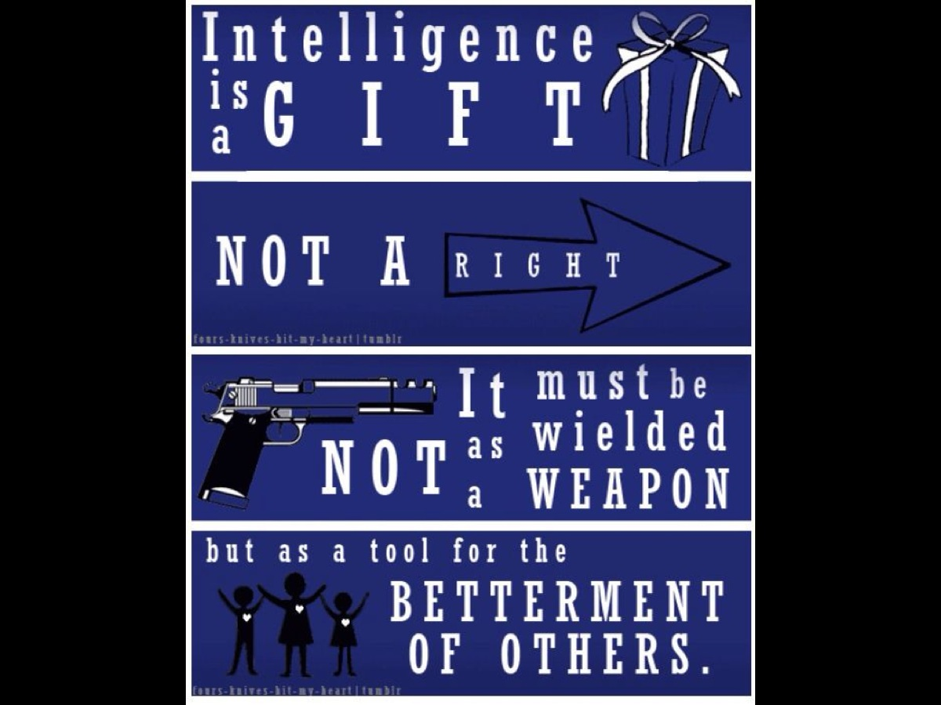
Notes:
This is what the Erudite believe: Intelligence is a gift not a right. It must not be wielded as a weapon but as a tool for the betterment of others.

Slide 45
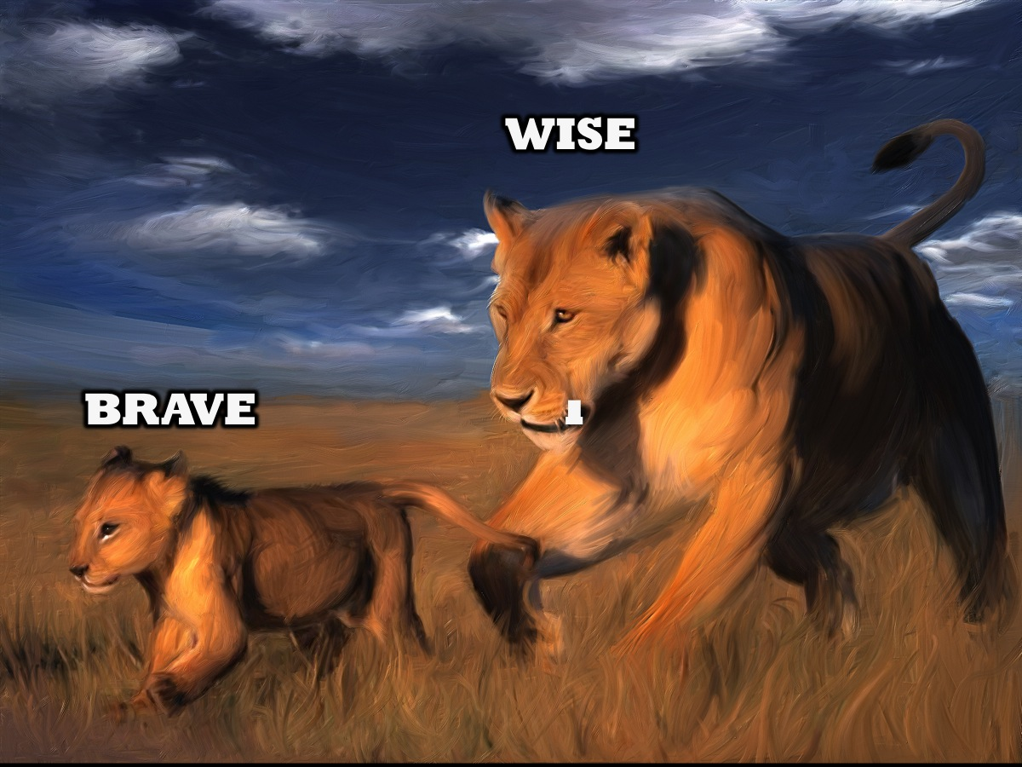
Notes:
Before you get to be old and wise, you tend to be young and reckless! We need to be both brave and wise!

Slide 46
Notes:
It is sometimes braver to run. He who runs from his enemies until he has the strength to do otherwise is both brave and wise.

Slide 47
Notes:
Prayer: May my heart be kind, my mind fierce and my spirit brave.

Slide 48
Notes:
Next week we will look at the Candor Faction – and explore what it means to be Honest.

