Slide 1

Notes:
A few weeks ago we started this series based on the book and movie called Divergent.

Slide 2

Notes:
People have been divided into five different factions focusing on different positive values.

Slide 3

Notes:
We started by looking into the world of Dauntless and learnt how to be Brave.

Slide 4

Notes:
We then looked into the world of Erudite and learnt how to be Wise:

Slide 5

Notes:
This week we will look at the Candor Faction – and explore what it means to be Honest.

Slide 6
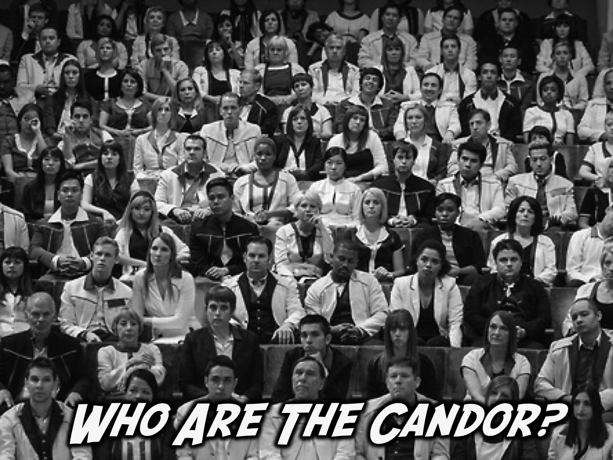
Notes:
Who Are The Candor? They are the faction who wear black and white clothes, because they see the truth as black & white. They dress formally, with suits & ties being standard uniform with men, and women seen in long skirts, while their everyday clothing is typically black pants & white shirts.

Slide 7
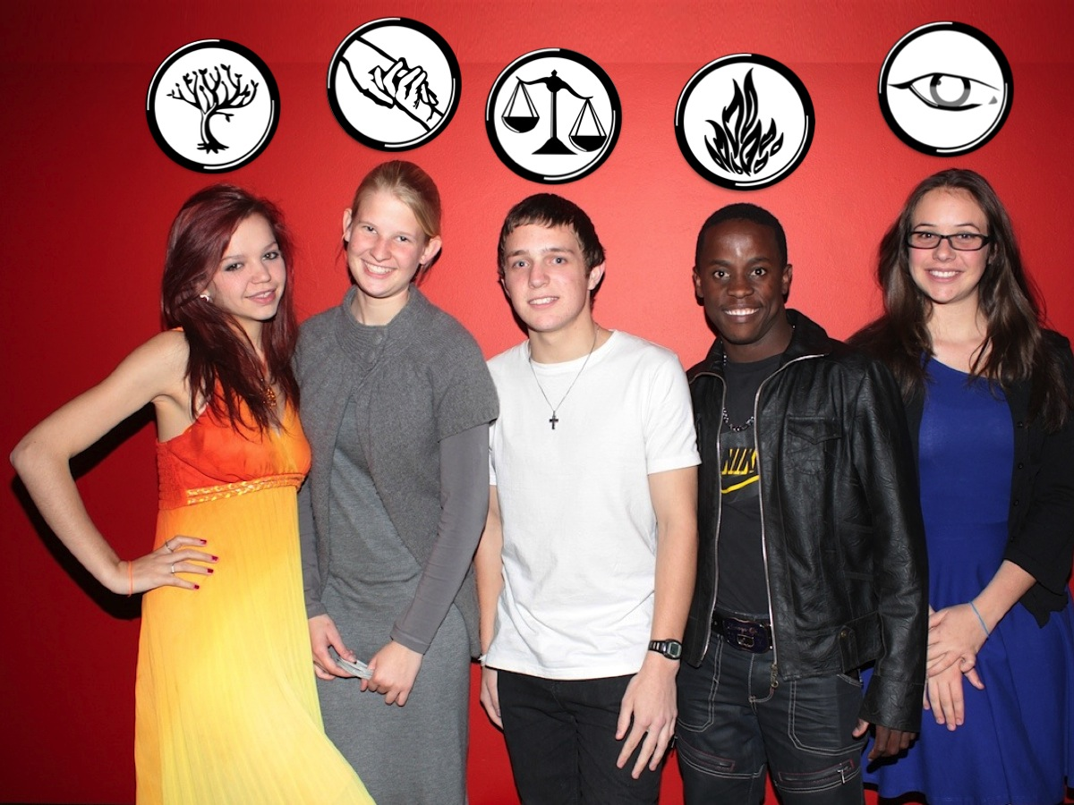
Notes:
We are talking about the faction represented by Asher Pardey in this pic – right in the middle – dressed in black and white.

Slide 8
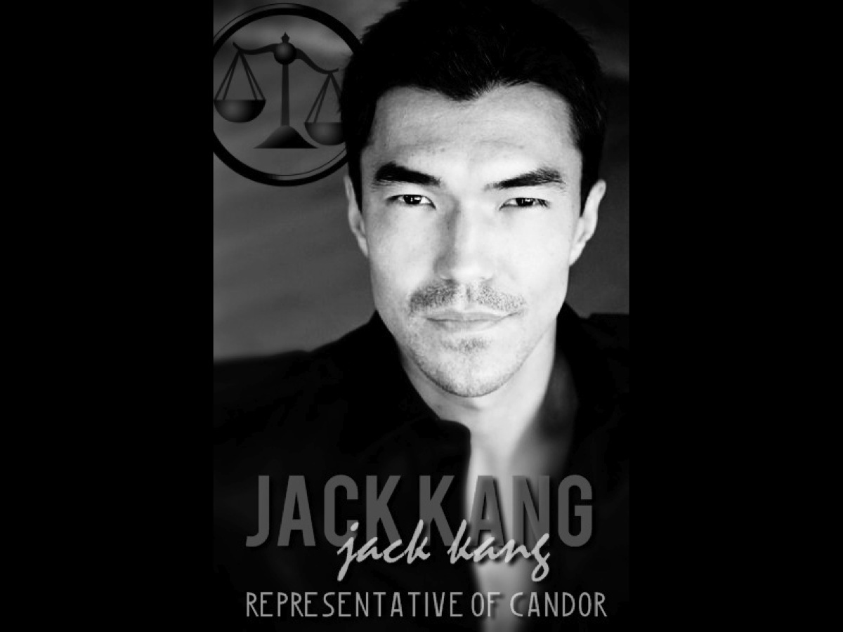
Notes:
Candor do not have a leader, but their representative is Jack Kang.

Slide 9

Notes:
What Do Candor Eat? Ice-cream is a firm favourite of the Candor faction! (Note: for this week we handed out marshmallow filled ice-cream cones – instead of using real ice-cream.)

Slide 10

Notes:
Why Was Candor Established? Candor was a faction formed by those who blamed duplicity and deception, who believed that dishonesty is the key fault in human nature which began evil and war. They believe in the principle that honesty and openness would lead to a more peaceful and perfect society.

Slide 11

Notes:
What Do Candor Value? They are honest, truthful, trustworthy, and able to read body language to detect lies.

Slide 12
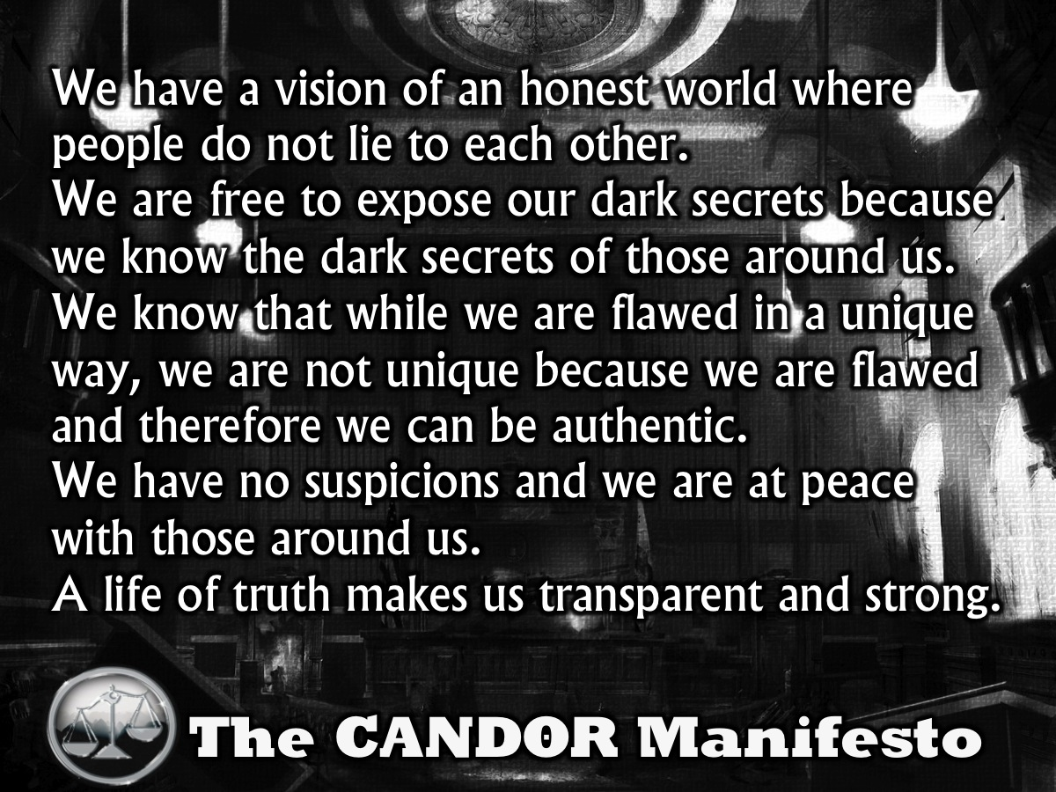
Notes:
Candor Manifesto:
We have a vision of an honest world where people do not lie to each other.
We are free to expose our dark secrets because we know the dark secrets of those around us.
We know that while we are flawed in a unique way, we are not unique because we are flawed. Therefore we can be authentic.
We have no suspicions and we are at peace with those around us.
A life of truth makes us transparent and strong.

Slide 13
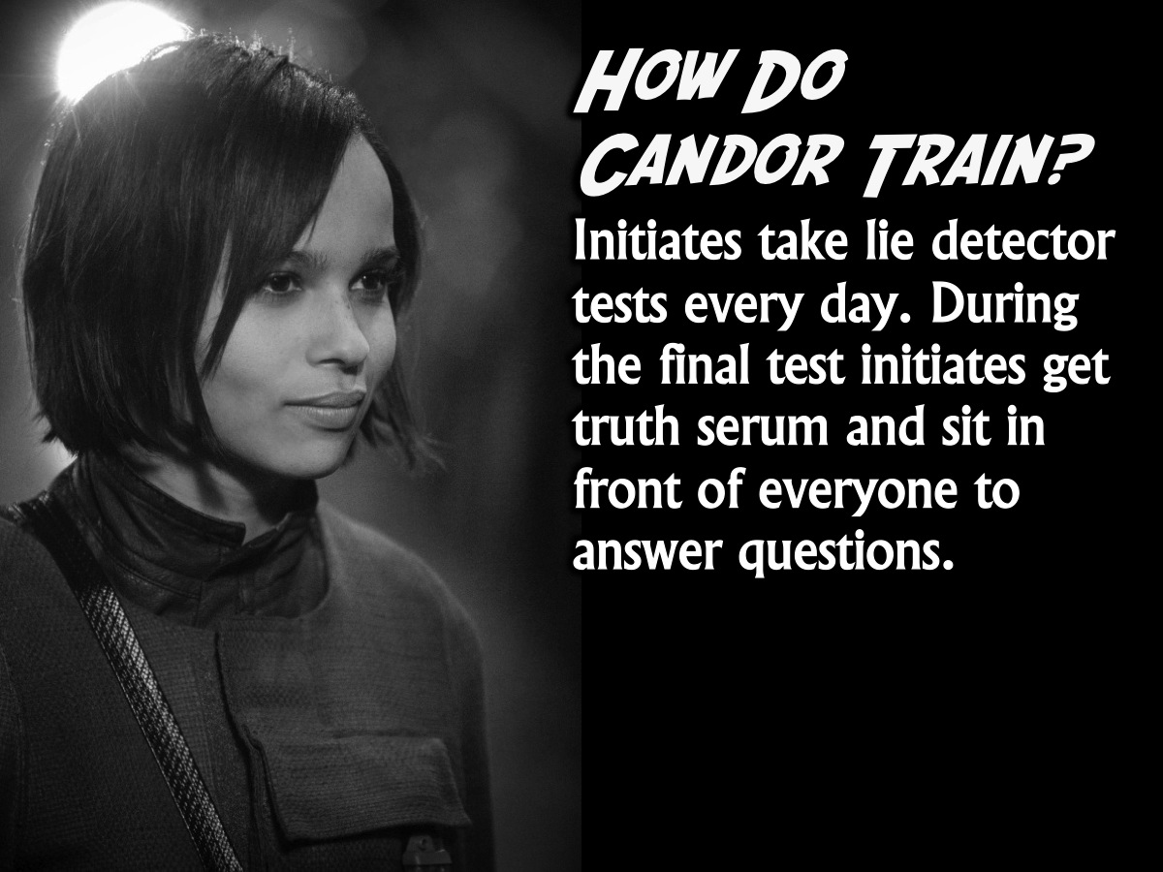
Notes:
How Do Candor Train? Initiates must take lie detector tests all day, every day. During the final test initiates get "truth serum" and must sit in front of everyone as they ask questions. They believe if you reveal all of your secrets, you'll have no desire to lie about anything, ever again because the worst is already in the open.

Slide 14

Notes:
Today we are focusing on how we can become honest.

Slide 15
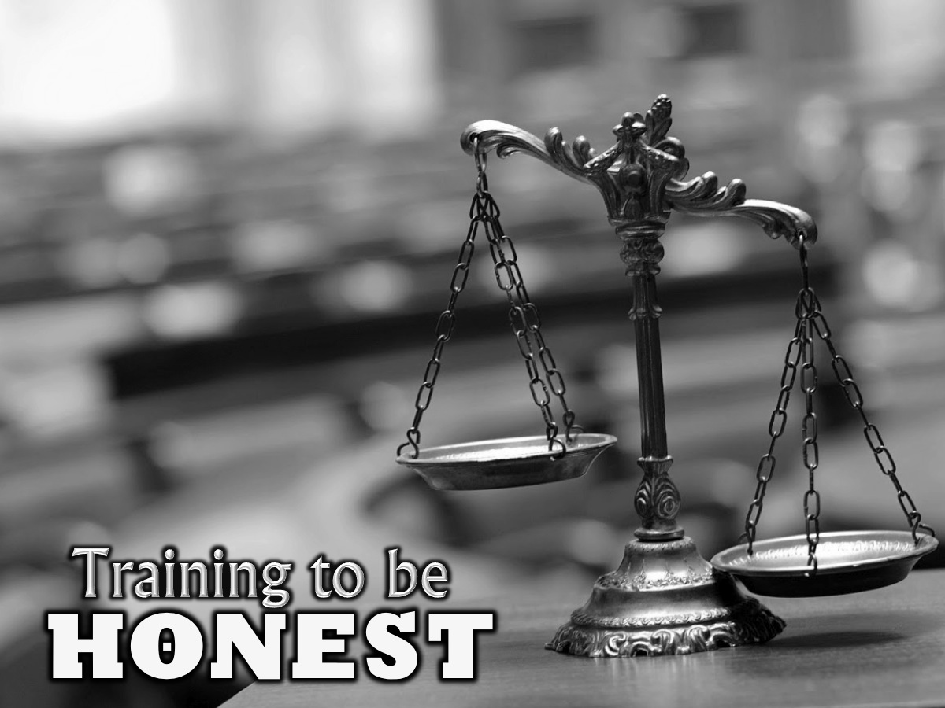
Notes:
Today are going to look at how we can train to be honest!

Slide 16
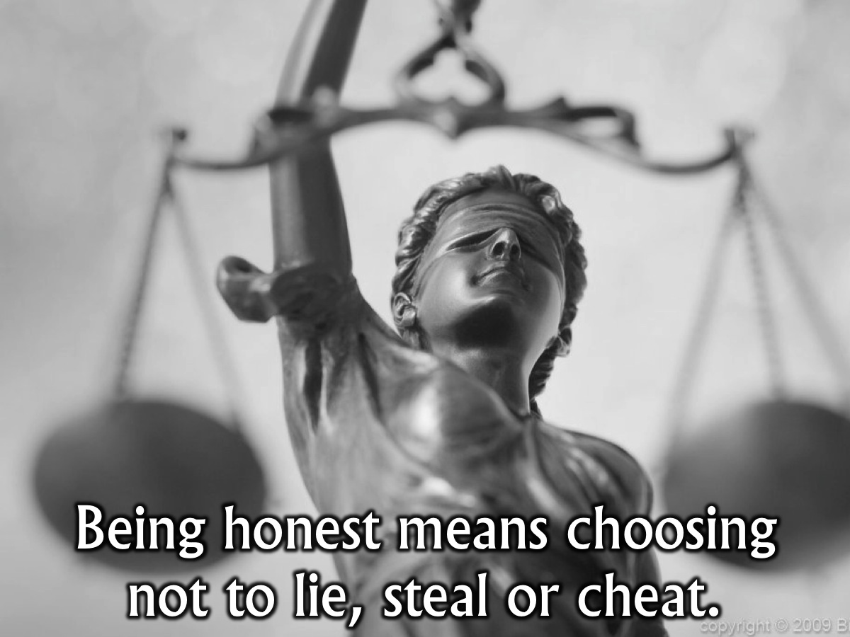
Notes:
Being honest means choosing not to lie, steal or cheat.

Slide 17
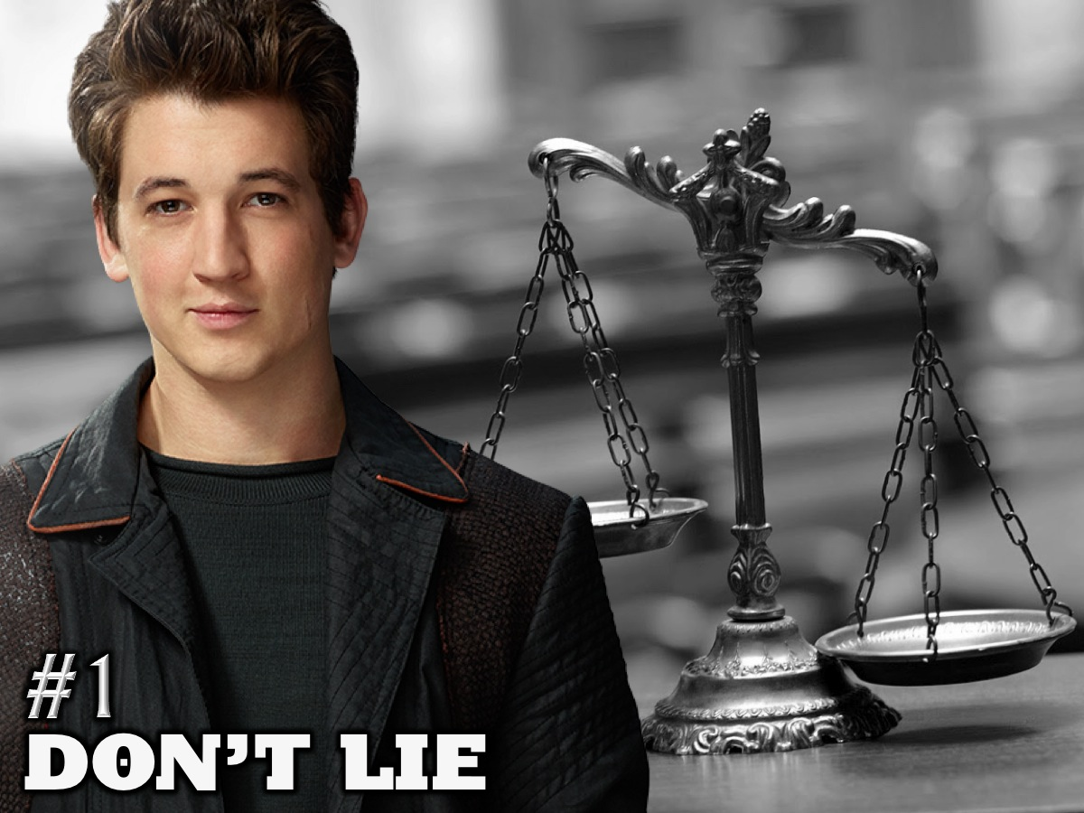
Notes:
1. Don’t Lie

Slide 18
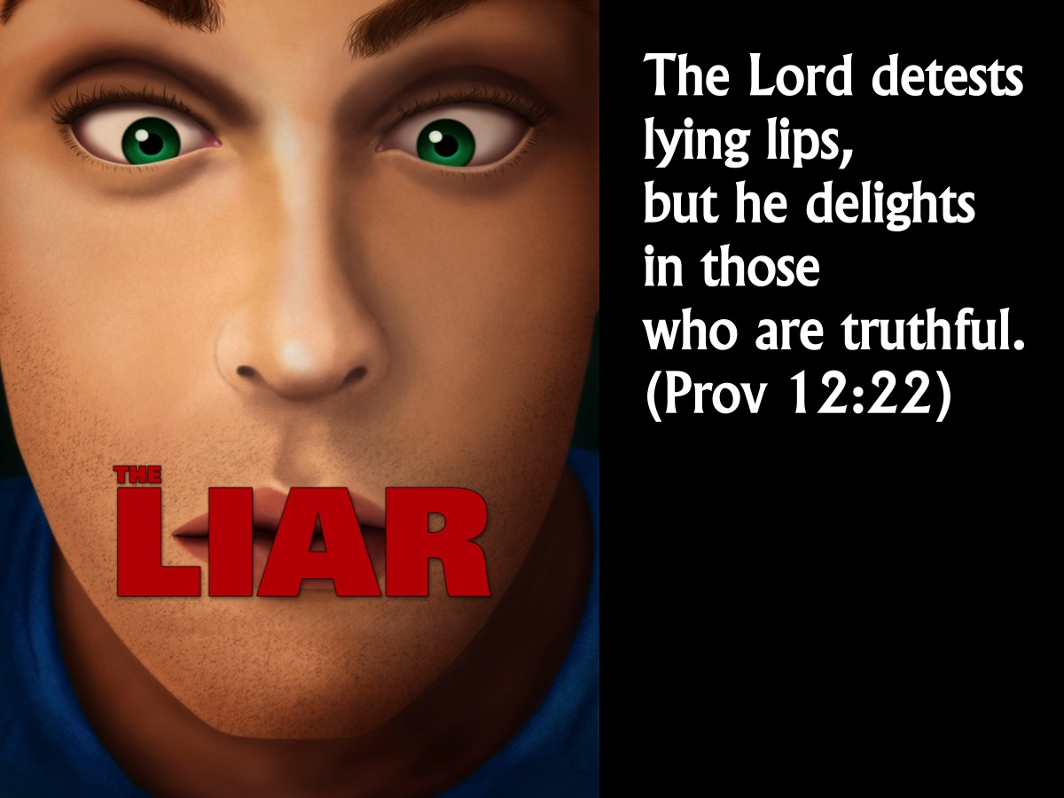
Notes:
The Lord detests lying lips, but he delights in those who are truthful. (Proverbs 12:22)

Slide 19

Notes:
Lies make your nose grow longer

Slide 20
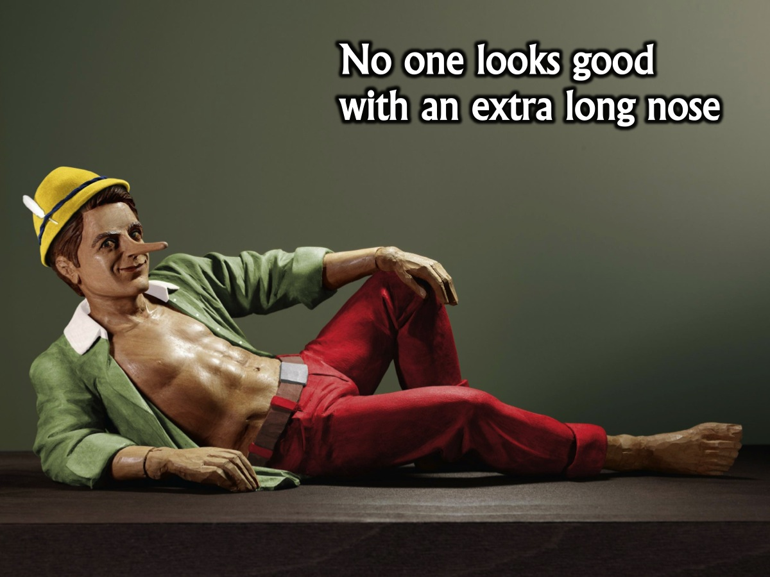
Notes:
No one looks good with a long nose!

Slide 21
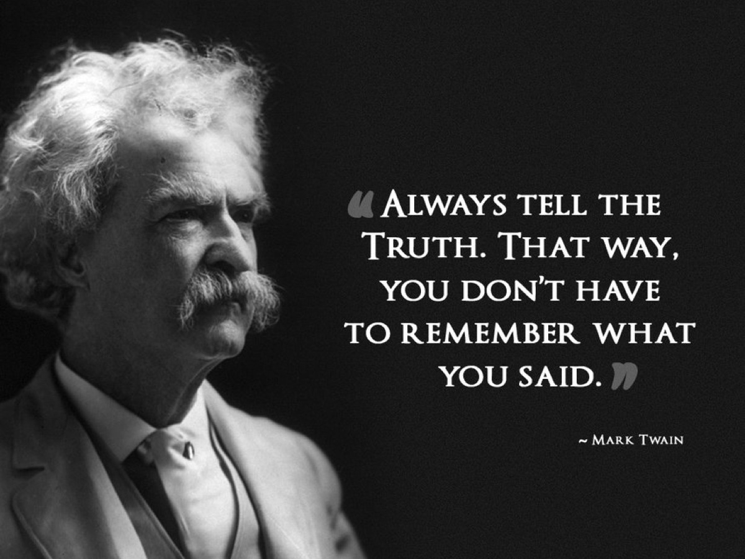
Notes:
Mark Twain said: “Always tell the truth, that way you have to remember what you said.”

Slide 22
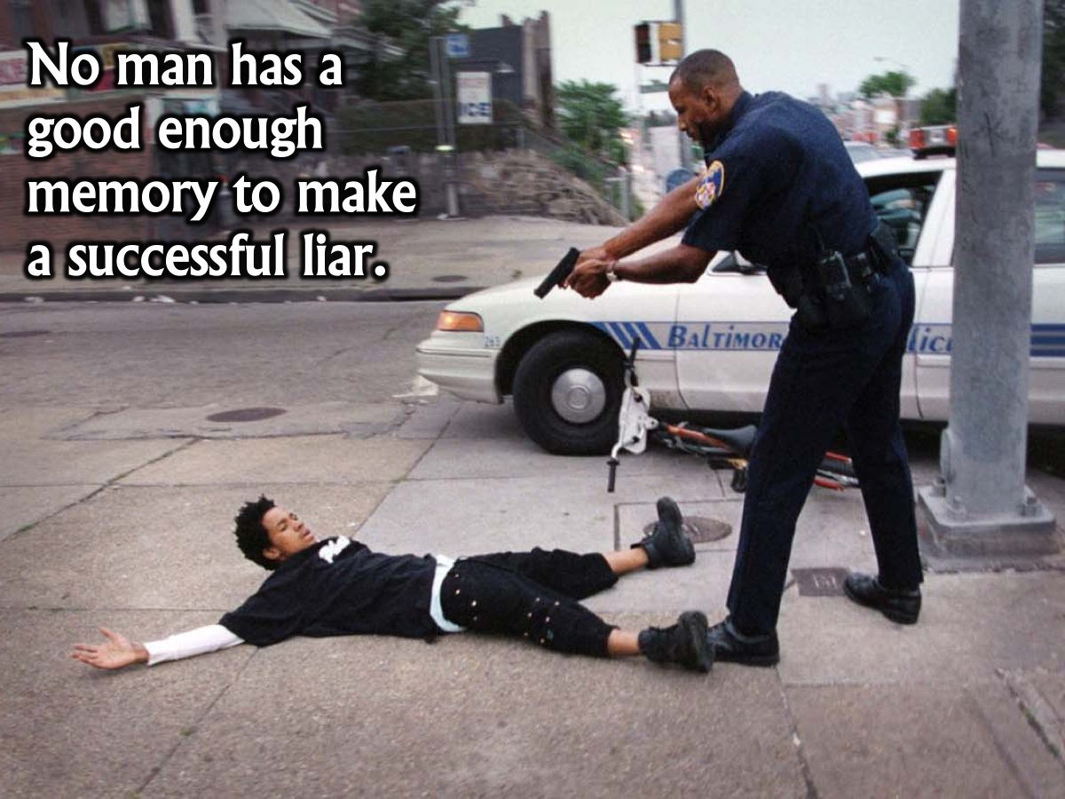
Notes:
No man has a good enough memory to make a successful liar.

Slide 23
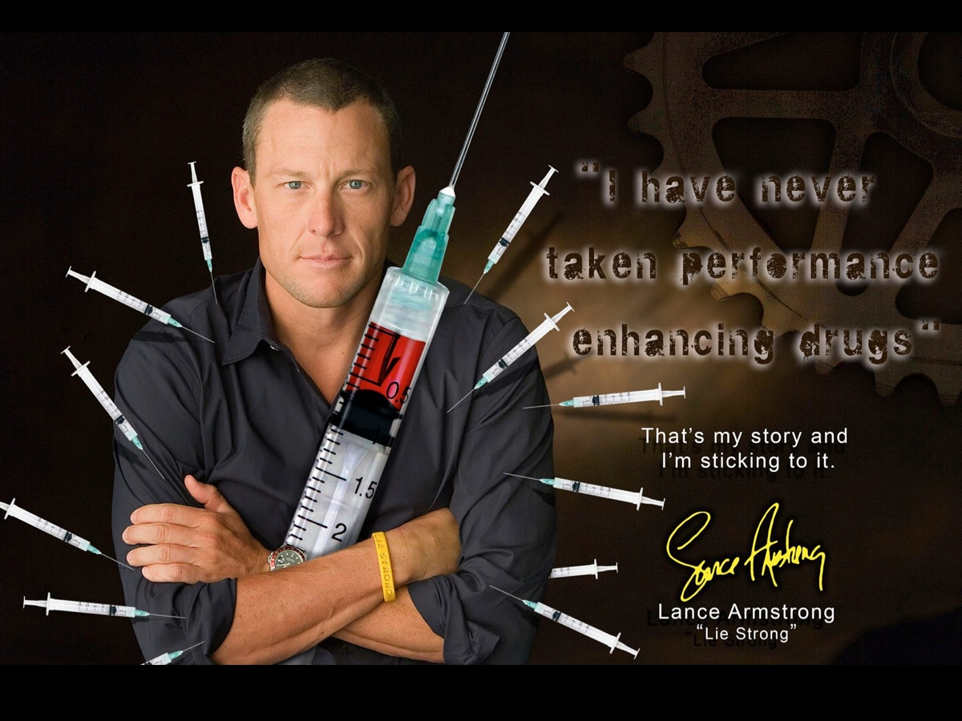
Notes:
Do you remember how Lance Armstrong was caught out for cheating and lying?

Slide 24

Notes:
Do you know these barefoot shoes that were supposed to be incredible for your feet?

Slide 25
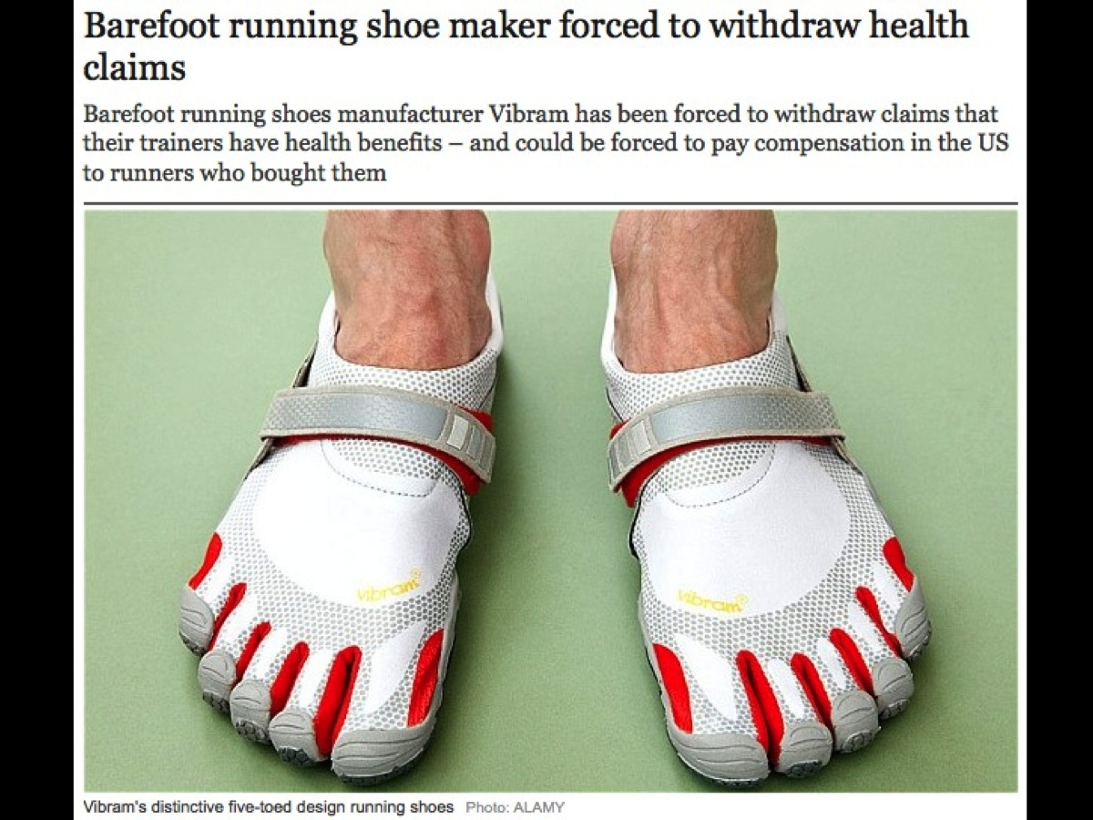
Notes:
Well turns out that the positive benefits of these shoes were unfounded and the company is currently paying back millions of dollars to people that they misled with their false advertising!

Slide 26

Notes:
Have you ever played the game called: “The Dog Ate My Homework?”

Slide 27
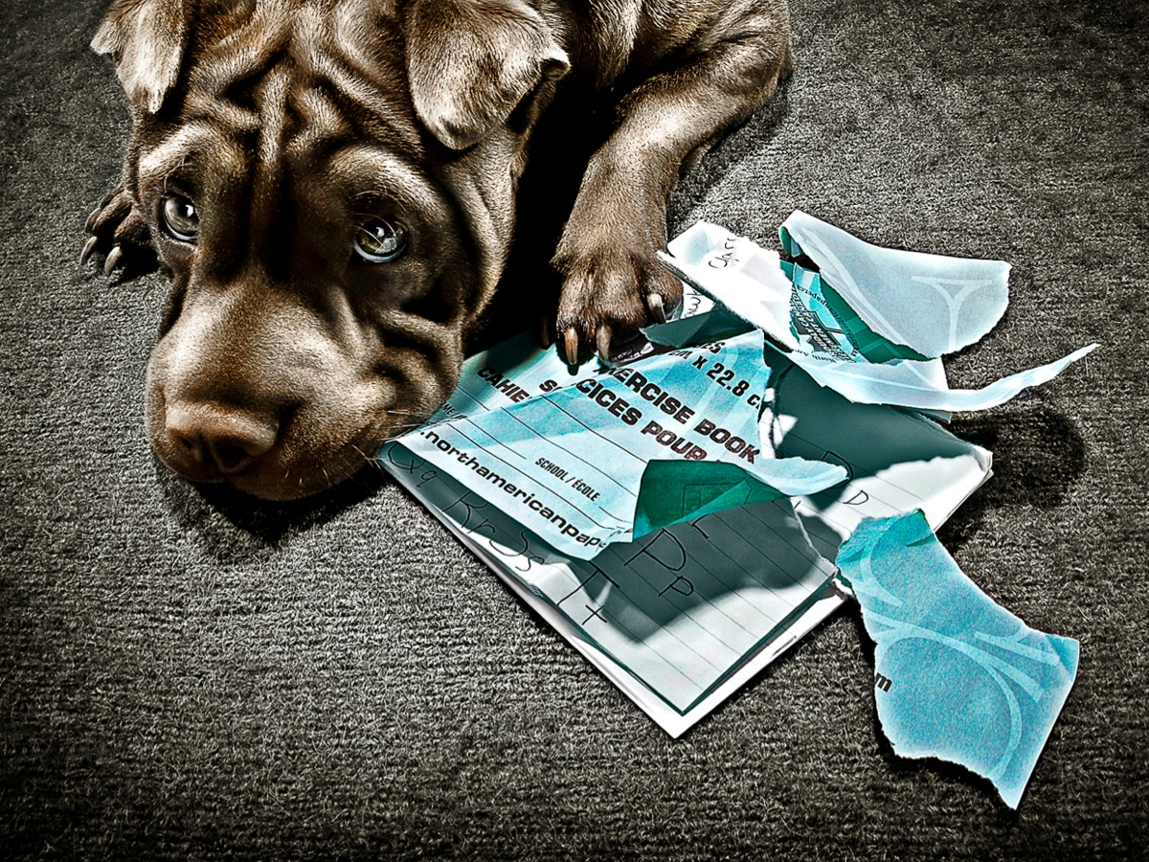
Notes:
I am sure that it does happen – dogs do like to chew things!

Slide 28

Notes:
Unless you you actually have x-ray proof – you are probably going to be caught out for lying!

Slide 29
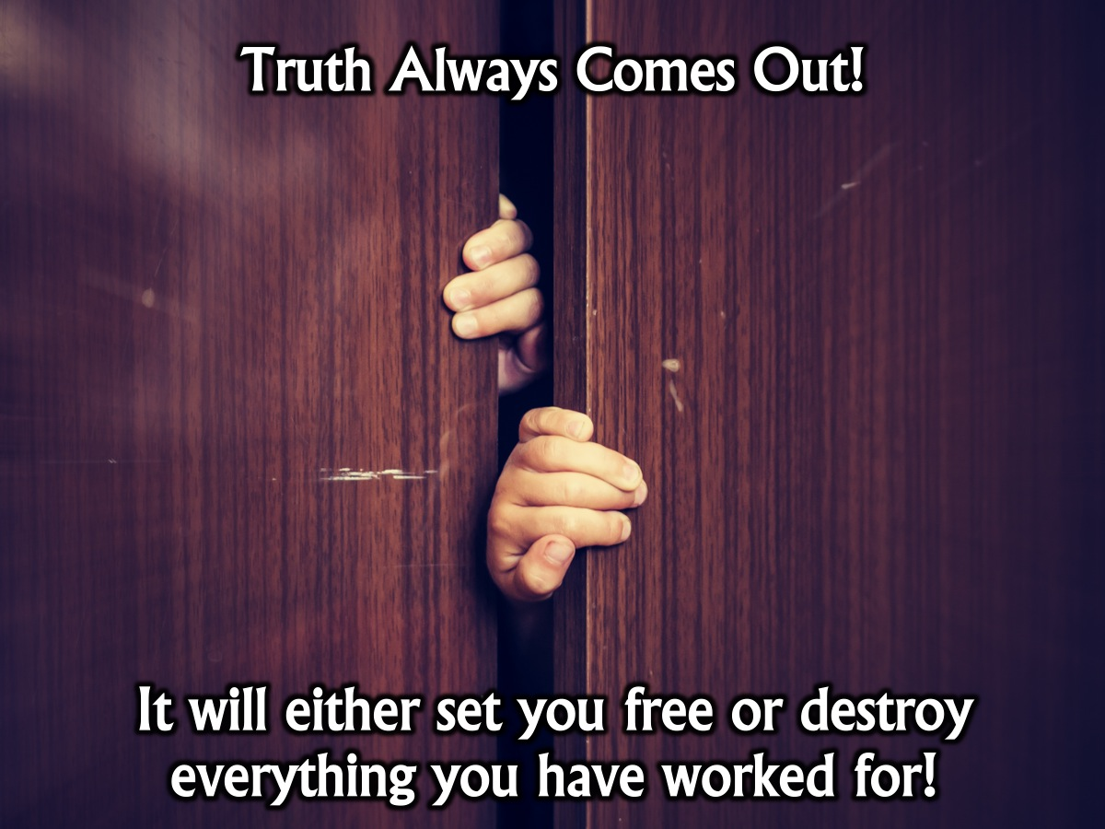
Notes:
Truth always comes out. It will either set you free or destroy everything you have worked for!

Slide 30

Notes:
Truth is the like the sun. You can shut it out for a time, but it ain’t goin’ away. (Elvis Presley)

Slide 31

Notes:
Speak the truth in love. We can be one of three things if we don’t get the Truth/Love balance right. (1) If we have all love and no truth we are like a Chameleon. (2) If we have all truth and no love we are like a Cactus. (3) If we have the correct balance of love and truth we are Contagious.

Slide 32
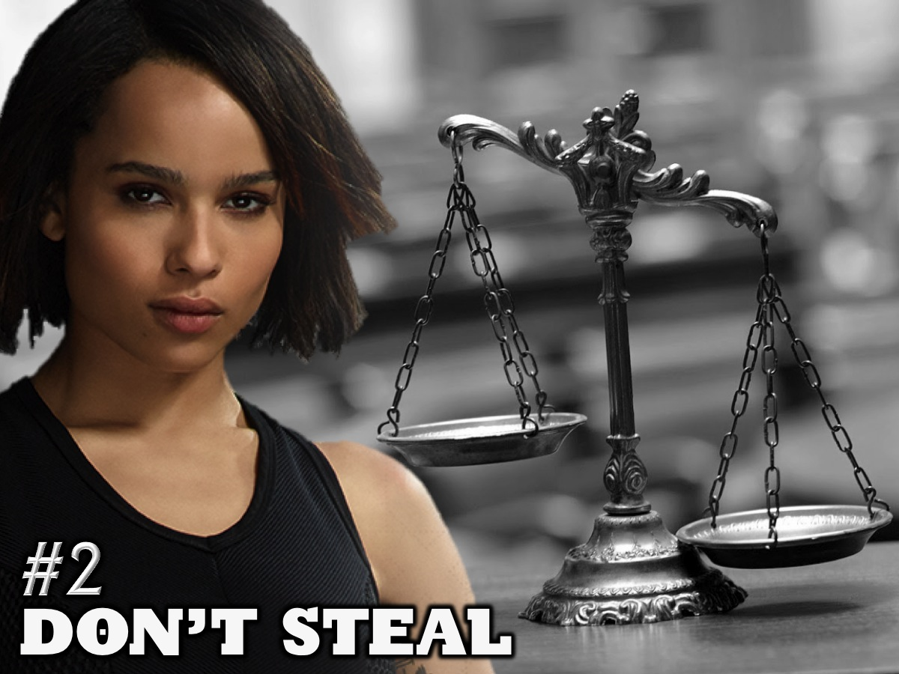
Notes:
2. Don’t Steal

Slide 33
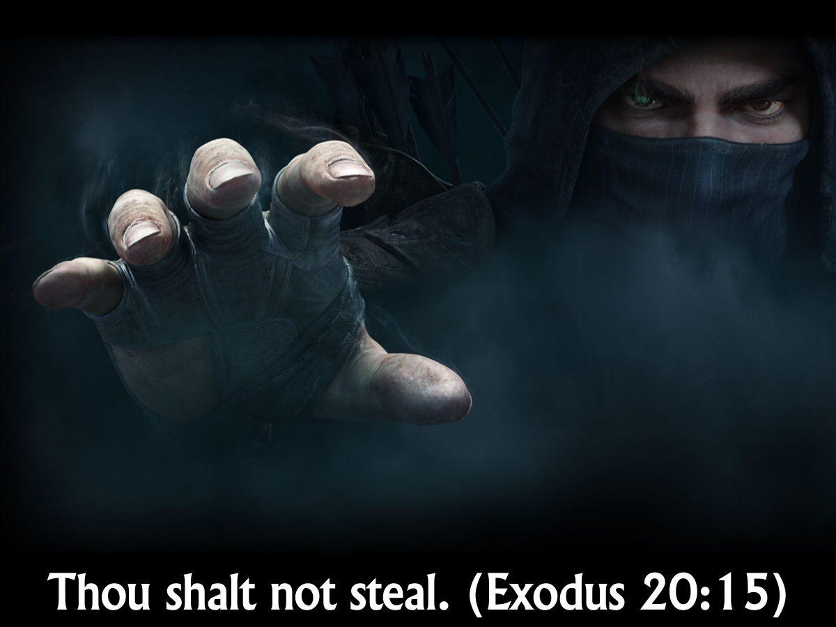
Notes:
Thou shalt not steal. (Exodus 20:15)

Slide 34
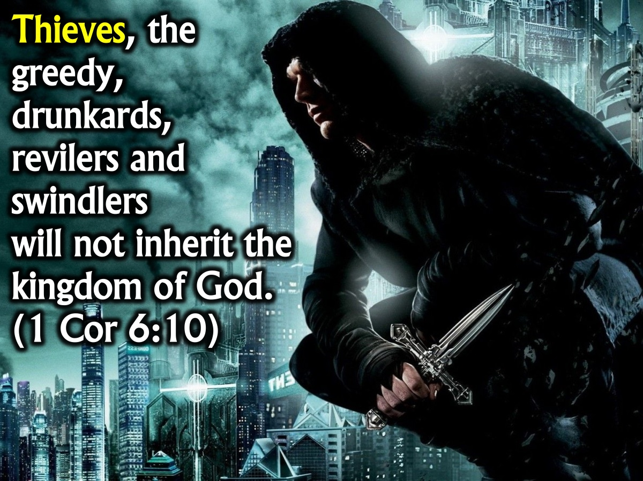
Notes:
Thieves, the greedy, drunkards, revilers and swindlers will not inherit the kingdom of God. (1 Cor 6:10)

Slide 35
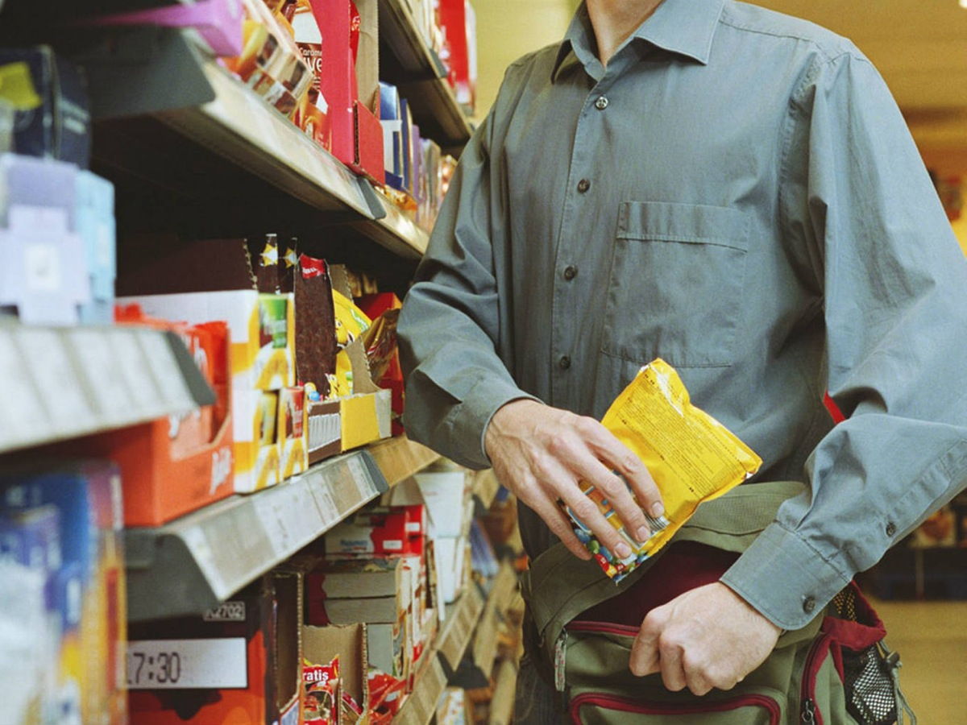
Notes:
Most of us probably won’t steal from a shop!

Slide 36

Notes:
But we will steal music or video or software or information online.

Slide 37
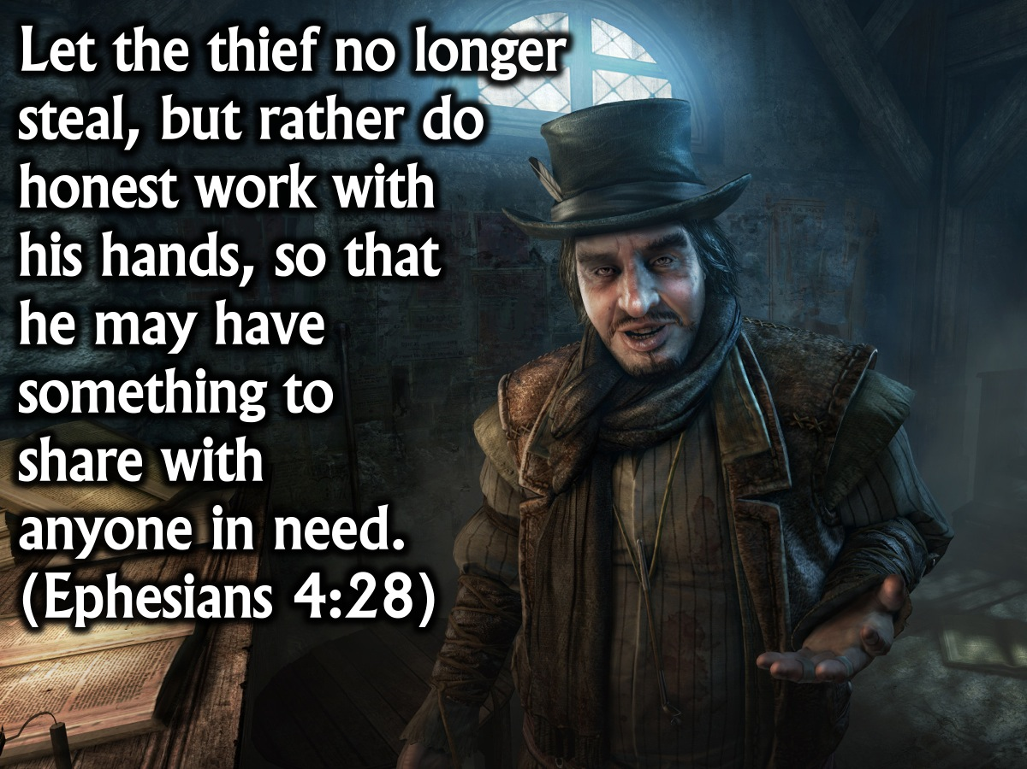
Notes:
Let the thief no longer steal, but rather let him labor, doing honest work with his own hands, so that he may have something to share with anyone in need. (Ephesians 4:28)

Slide 38
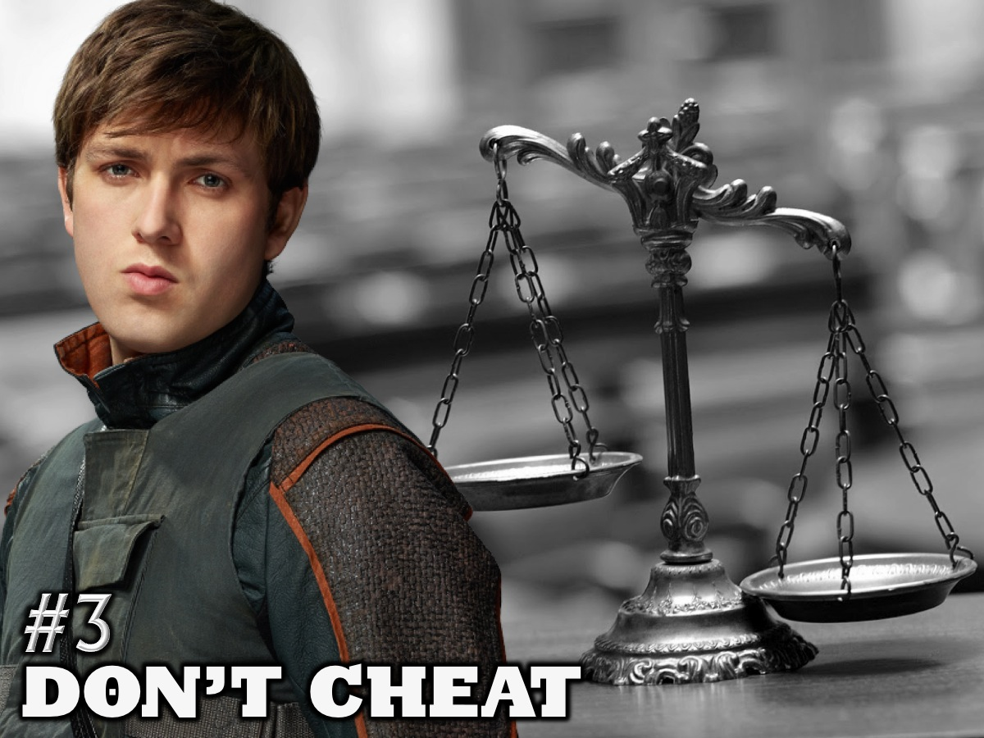
Notes:
3. Don’t Cheat

Slide 39
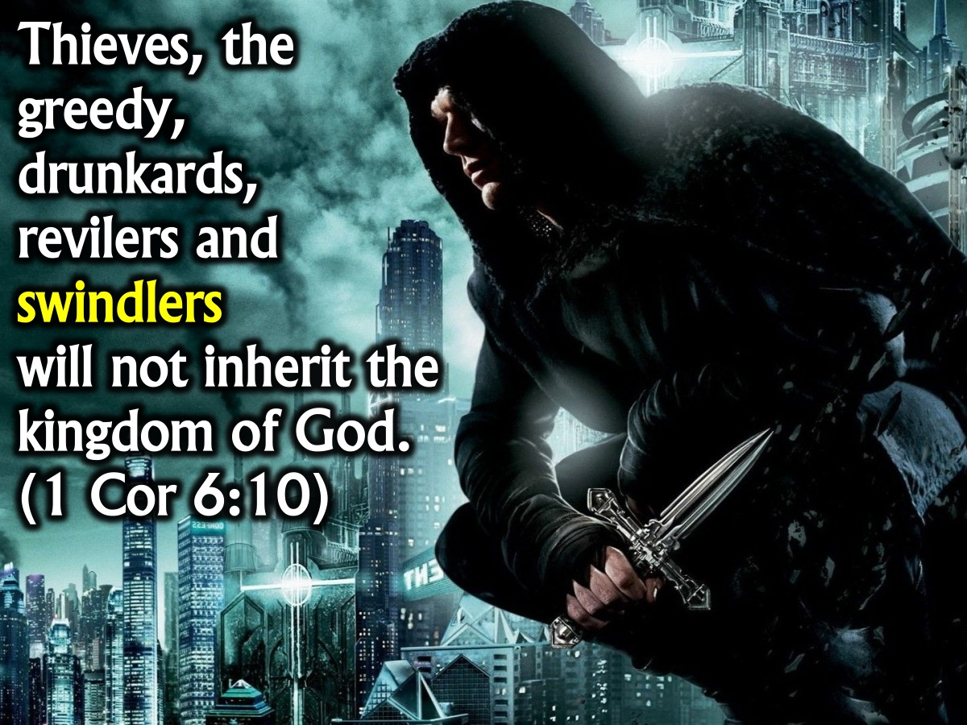
Notes:
Thieves, the greedy, drunkards, revilers and swindlers will not inherit the kingdom of God. (1 Cor 6:10)

Slide 40
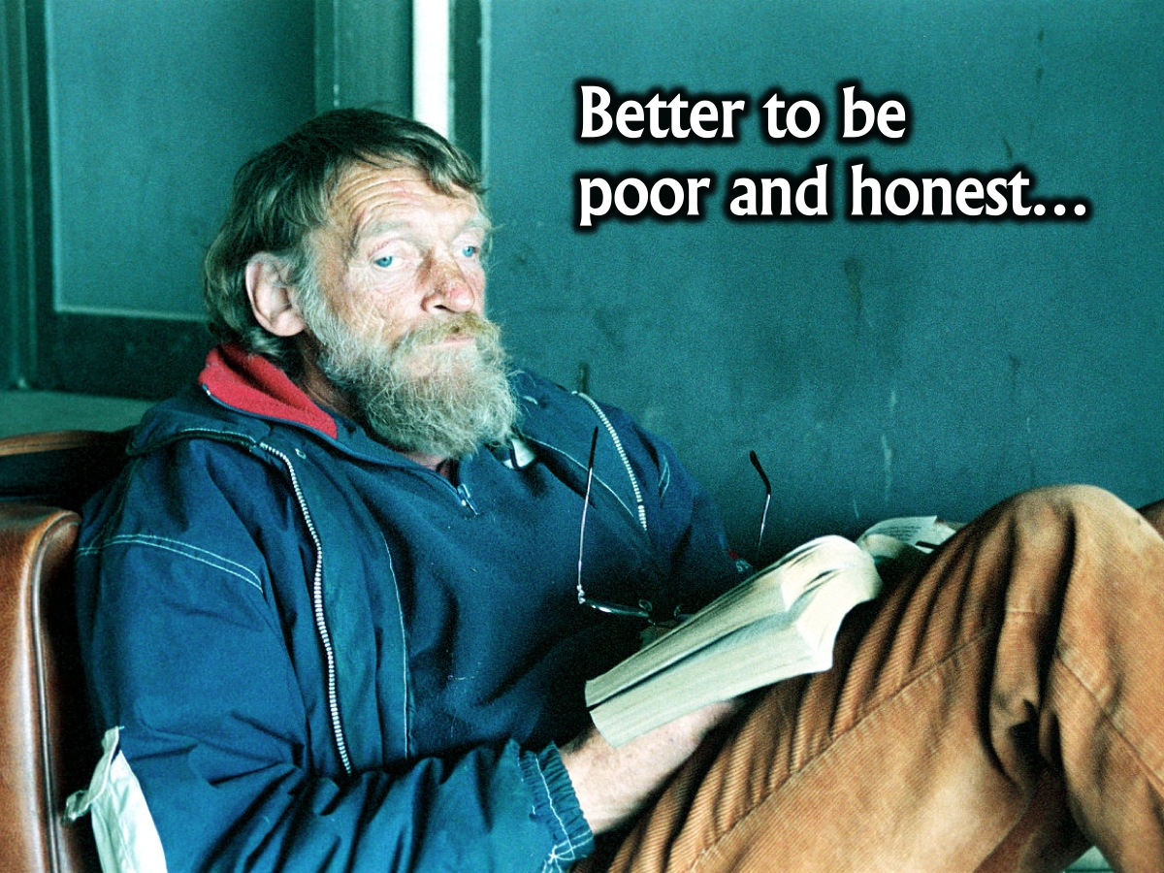
Notes:
Better to be poor and honest…

Slide 41
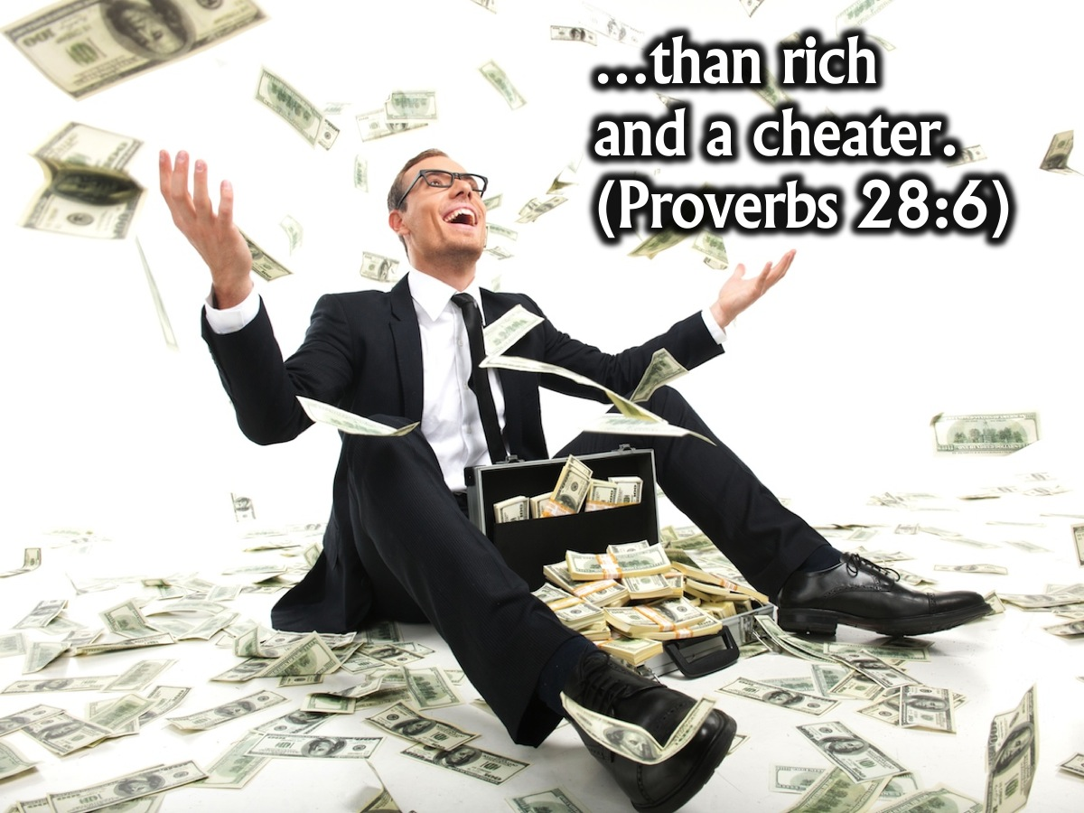
Notes:
…than rich and a cheater. (Proverbs 28:6)

Slide 42
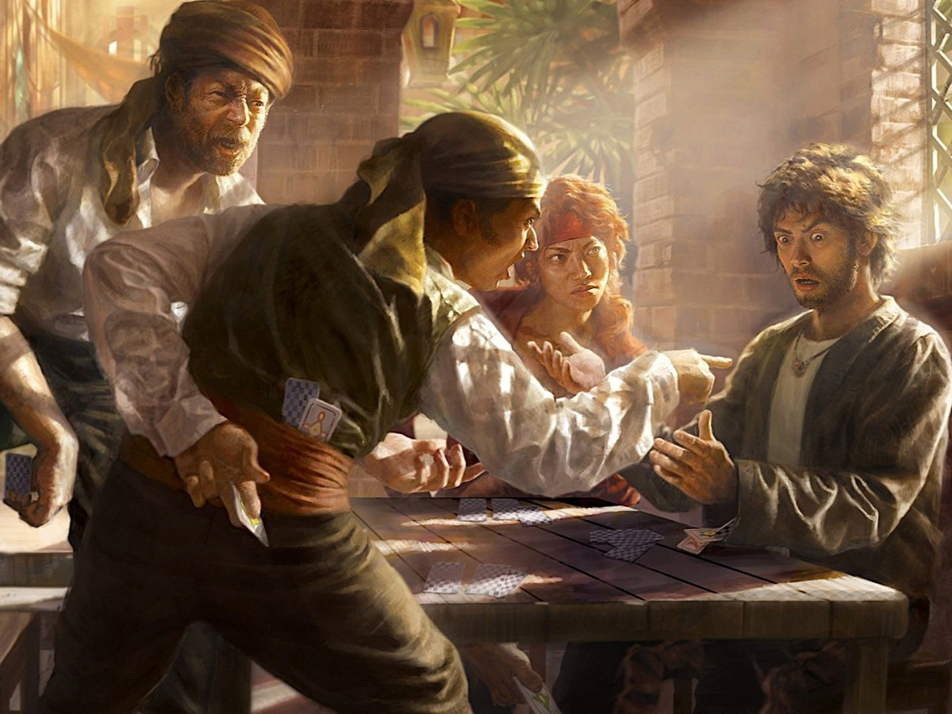
Notes:
Integrity means you don’t cheat when you play games.

Slide 43

Notes:
If you look closer at this pic you will discover that EVERYONE is actually cheating in the card game.

Slide 44

Notes:
Integrity means you don’t cheat on people

Slide 45

Notes:
You don’t wear masks to hide what you really think or feel.

Slide 46
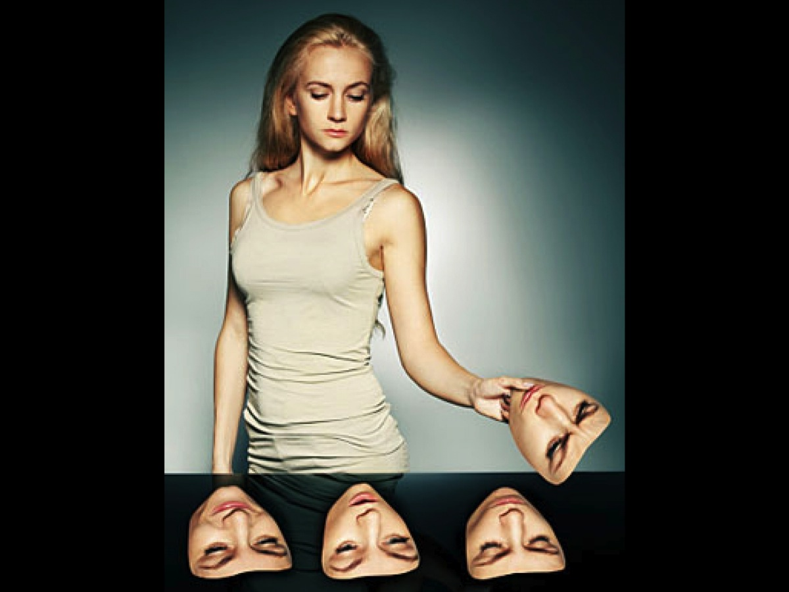
Notes:
You don’t pick and choose who you are going to be!

Slide 47
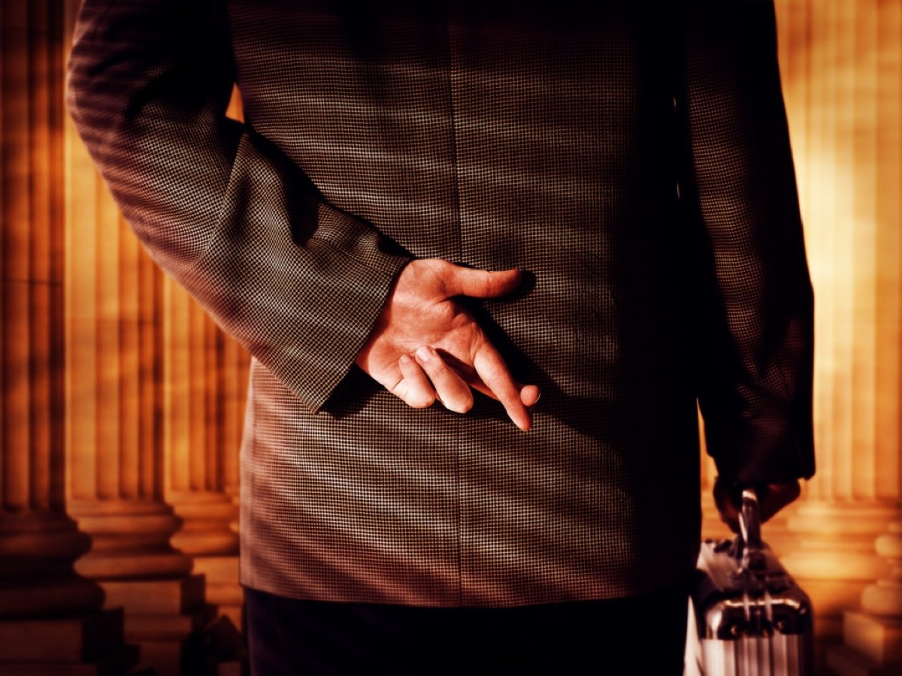
Notes:
Integrity means that you don’t play games with truth. You don’t cross your fingers behind your back.

Slide 48
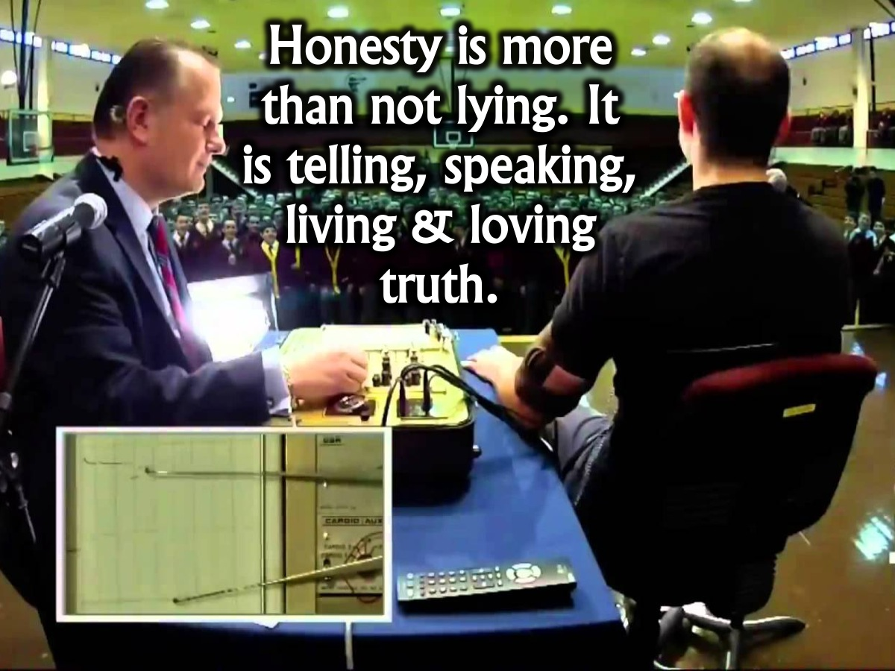
Notes:
Honesty is more than not lying. It is telling, speaking, living and loving truth.

Slide 49

Notes:
4. Do Truth

Slide 50
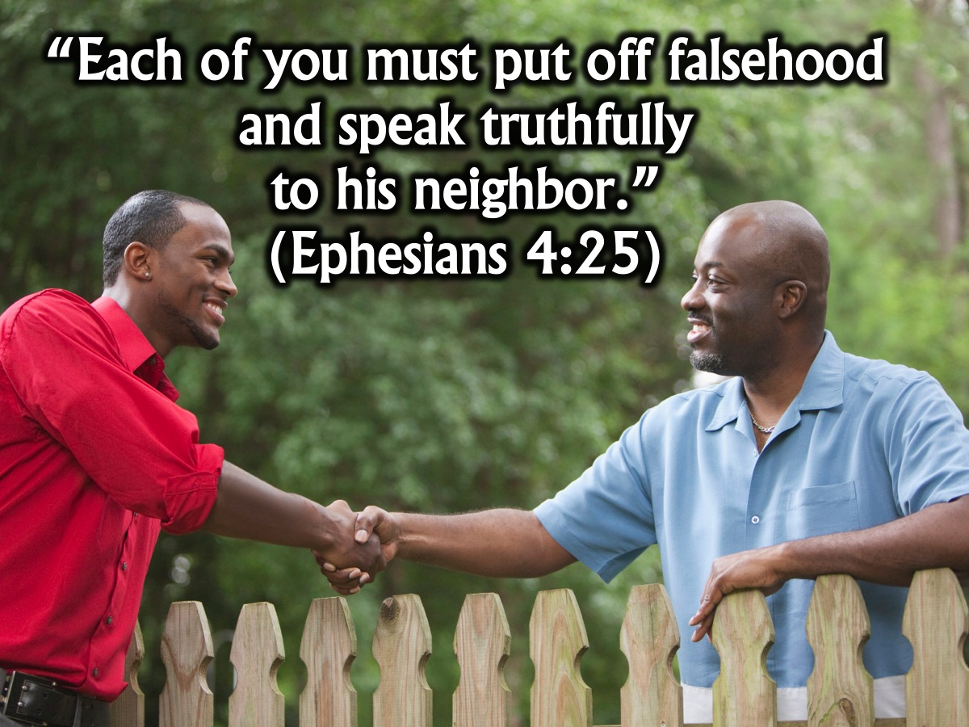
Notes:
"Each of you must put off falsehood and speak truthfully to his neighbor.” (Ephesians 4:25)

Slide 51
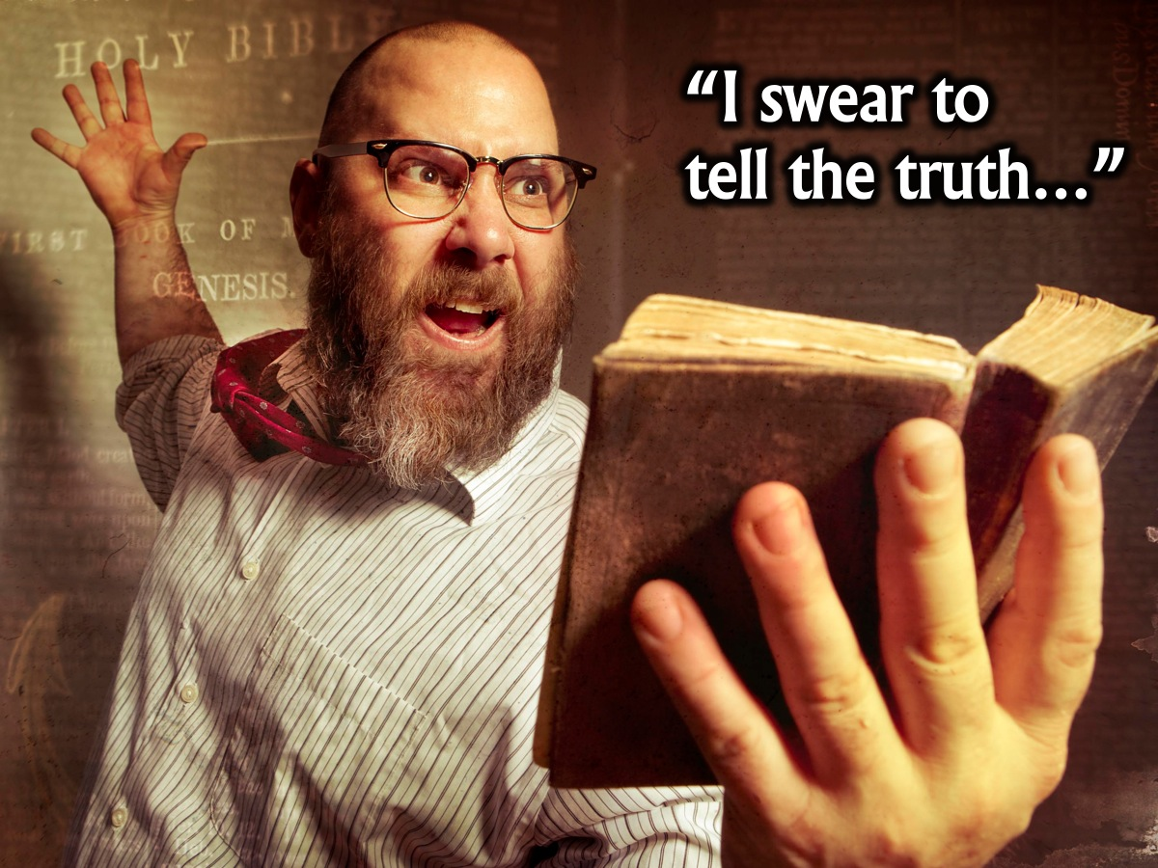
Notes:
Maybe we should all take the oath like people do in a court of law before they testify: “I swear to tell the truth, the whole truth and nothing but the truth, so help me God!”

Slide 52

Notes:
In closing, here are some steps towards honesty:

Slide 53

Notes:
1. Memorise Scripture - We hide God's Word in our hearts. We memorize one or more of the verses on this page, and we think about them when we're tempted to be dishonest.

Slide 54

Notes:
2. Imitate Jesus - We remember that Christ is the Truth. And the only way others can see him in us is to reflect that truth.

Slide 55
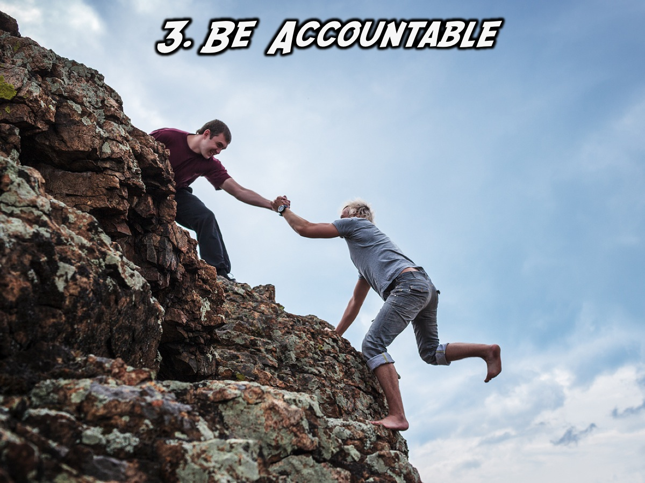
Notes:
3. Be Accountable - We ask someone to hold us accountable. Find a trusted friend whose job is to often ask, "Are you telling the truth? Told any lies lately?”

Slide 56

Notes:
4. Pray for it - We ask God to help us be truthful always, at all costs.

Slide 57
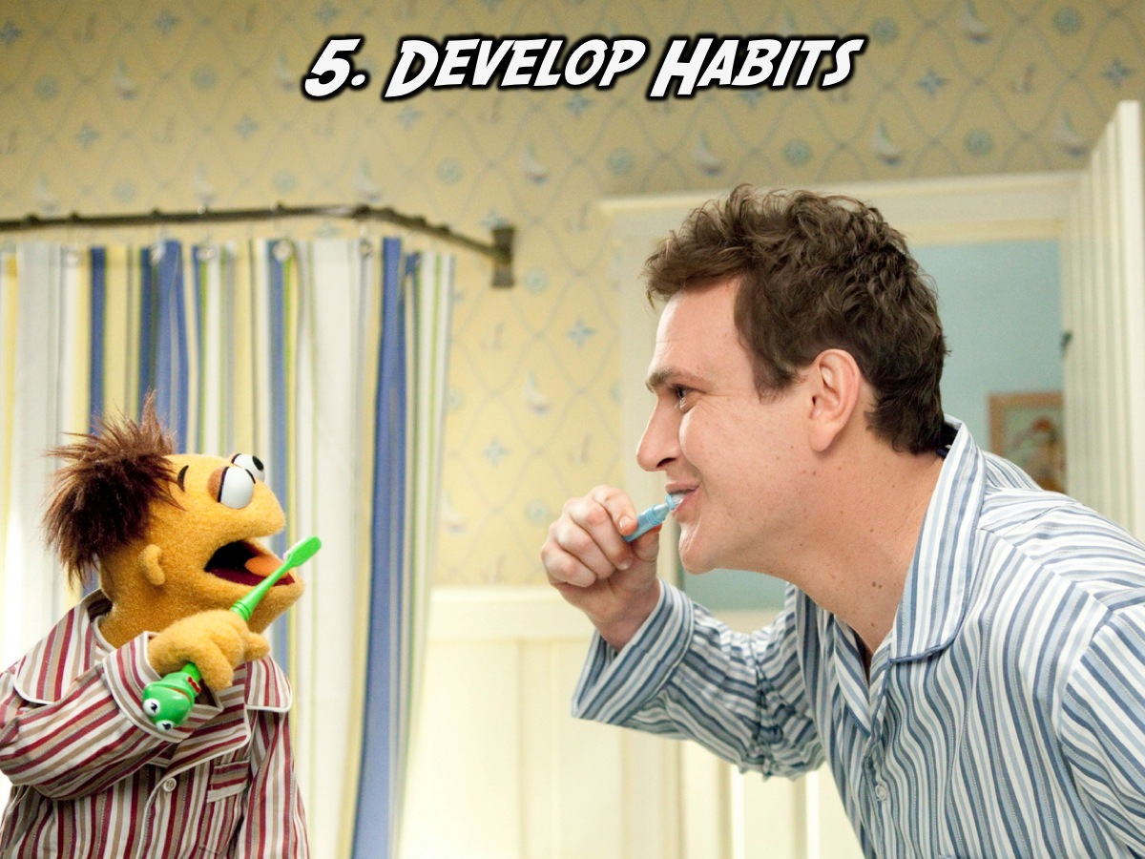
Notes:
5. Develop Habits - We make honesty a habit. The more we speak truth, the more it becomes not just what we say, but who we are. And when we are truth, it's so much easier to speak it. Always.

Slide 58

Notes:
Prayer: Father, help us to be honest in all that we think, in all that we say and in all that we do!

Slide 59

Notes:
Next week we will look at the Amity faction and learn how to be Peaceful.

