Slide 1

Notes:
A few weeks ago we started this series based on the book trilogy by Vanessa Roth.

Slide 2

Notes:
We started by looking into the world of Dauntless and learnt how to be Brave.

Slide 3

Notes:
We then looked into the world of Erudite and learnt how to be Wise.

Slide 4

Notes:
Then we looked at the Candor Faction and learnt how to be Honest.

Slide 5

Notes:
This week we will look at the Amity Faction – and explore what it means to be Peaceful.

Slide 6
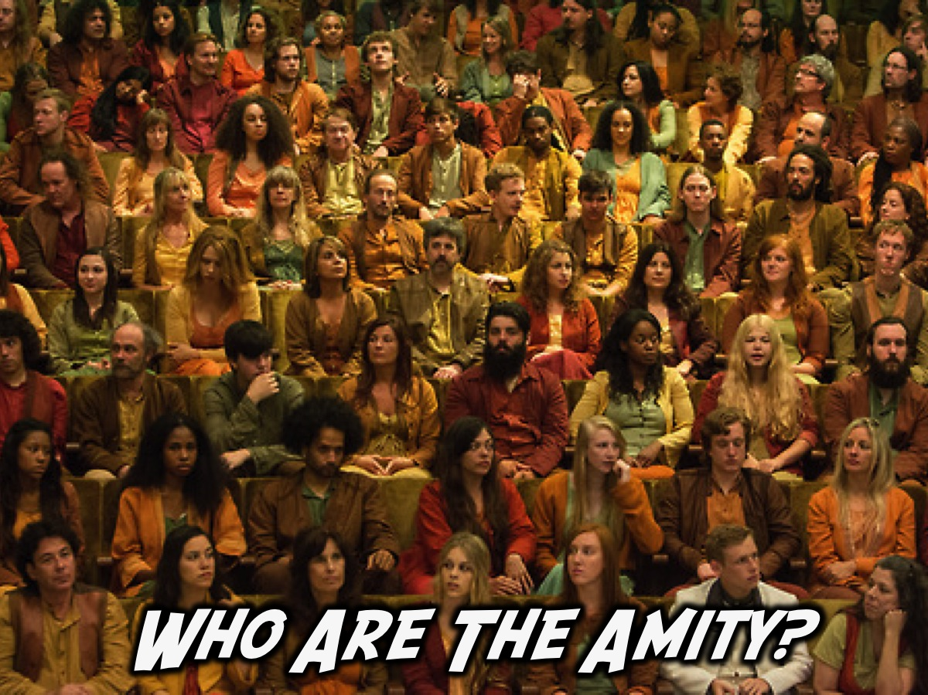
Notes:
Who Are The Amity?

Slide 7
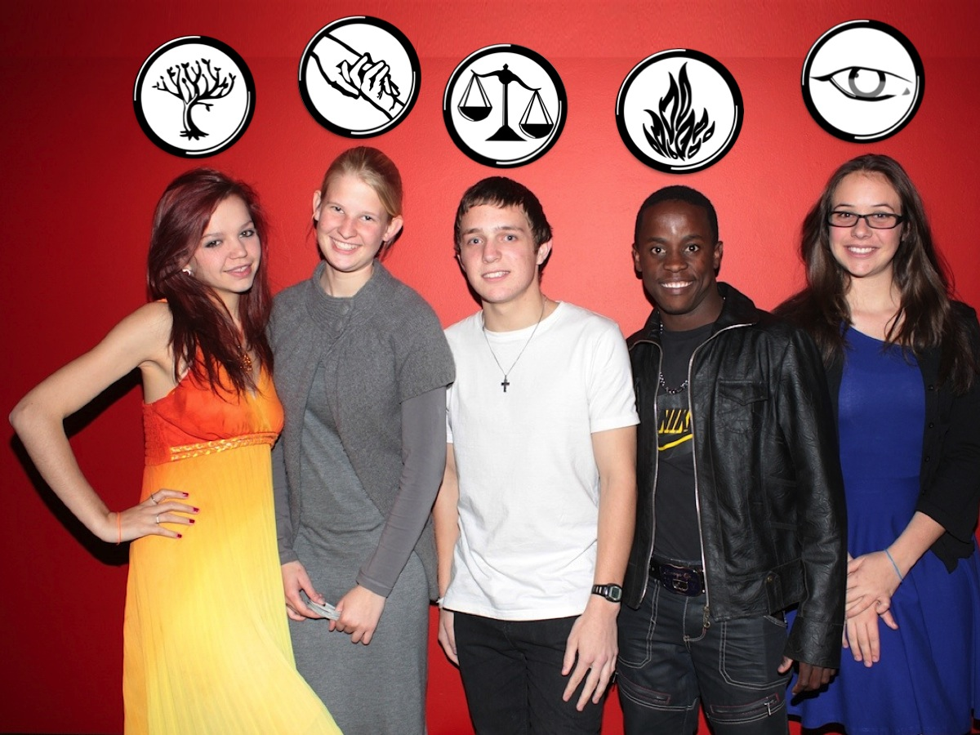
Notes:
Amity dress like my daughter on the left in this role play of Divergent that we did at youth.

Slide 8

Notes:
Like Candor, Amity don’t recognize a leader but use Johanna Reyes as their representative or “mouthpiece”. They are truly a democratic faction, voting on everything, almost unanimously. Their bread has a peace serum in it to prevent Amity’s faction members from fighting.

Slide 9

Notes:
What Do Amity Eat? They are the faction that does the farming for people in the city so they live off produce that they grow – healthy stuff.

Slide 10
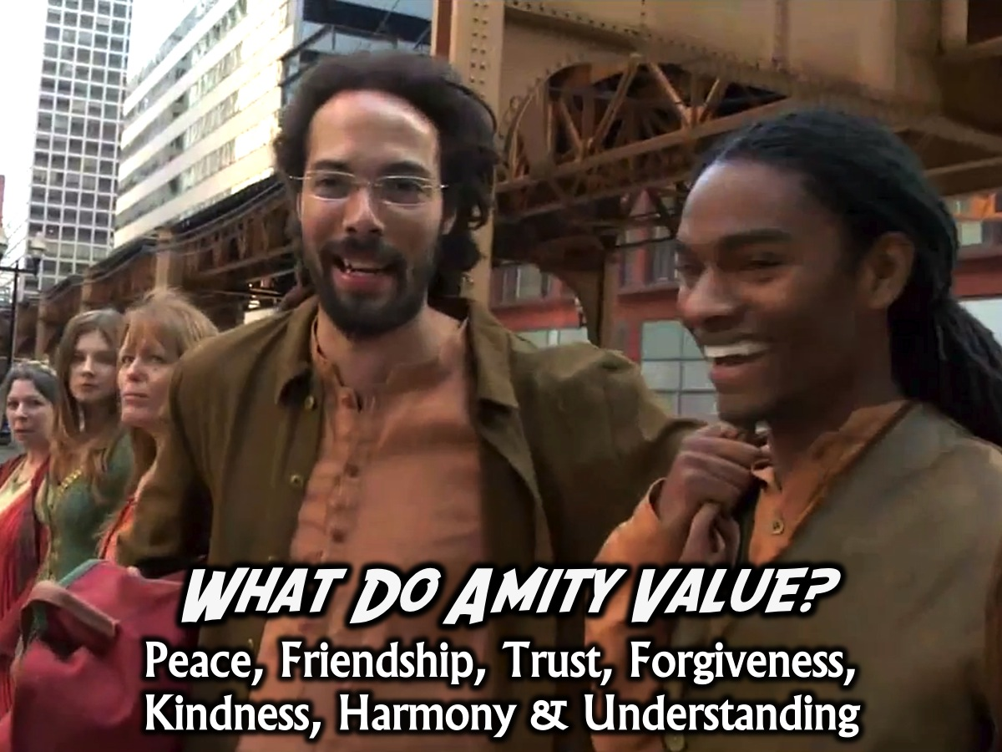
Notes:
What Do Amity Value? Amity are peace loving people, however they are prone to being dishonest to keep peace and respect, they are nature loving and provide most of the crops for all the factions.

Slide 11
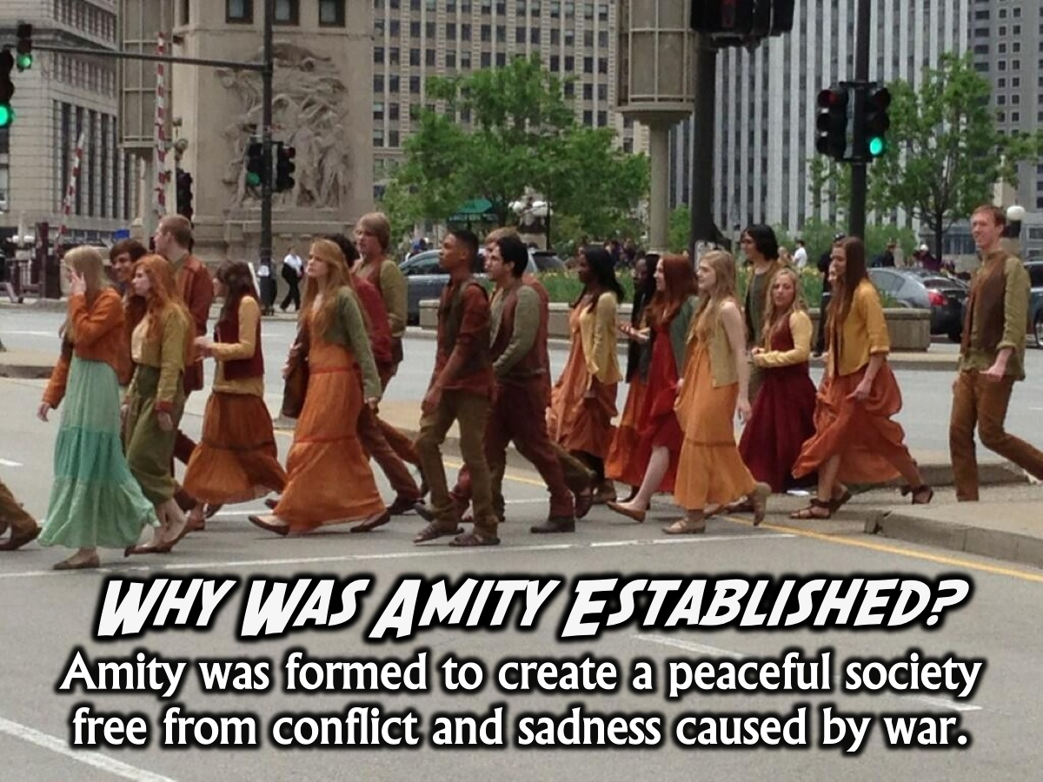
Notes:
Why Was Amity Established? Amity is the faction that dislikes war. They formed Amity in order to have a peaceful society free from conflict and sadness caused by wars and instigation.

Slide 12
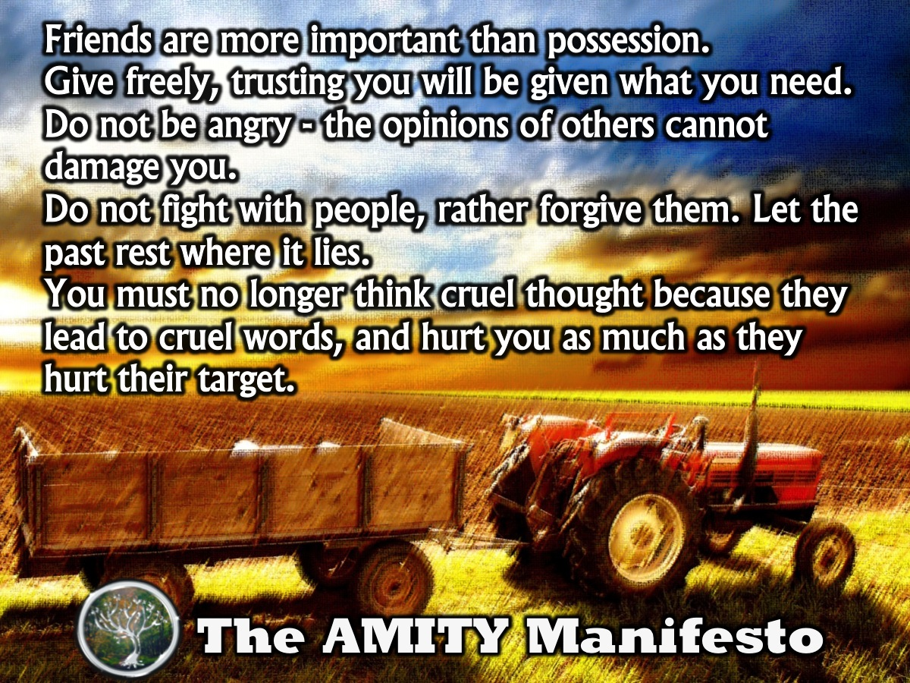
Notes:
Amity Manifesto
Friends are more important than possession.
Give freely, trusting you will be given what you need.
Do not be angry - the opinions of others cannot damage you.
Do not fight with people. The wrong is past. You must let it rest where it lies.
You must no longer think cruel thoughts. Cruel thoughts lead to cruel words, and hurt you as much as they hurt their target.

Slide 13
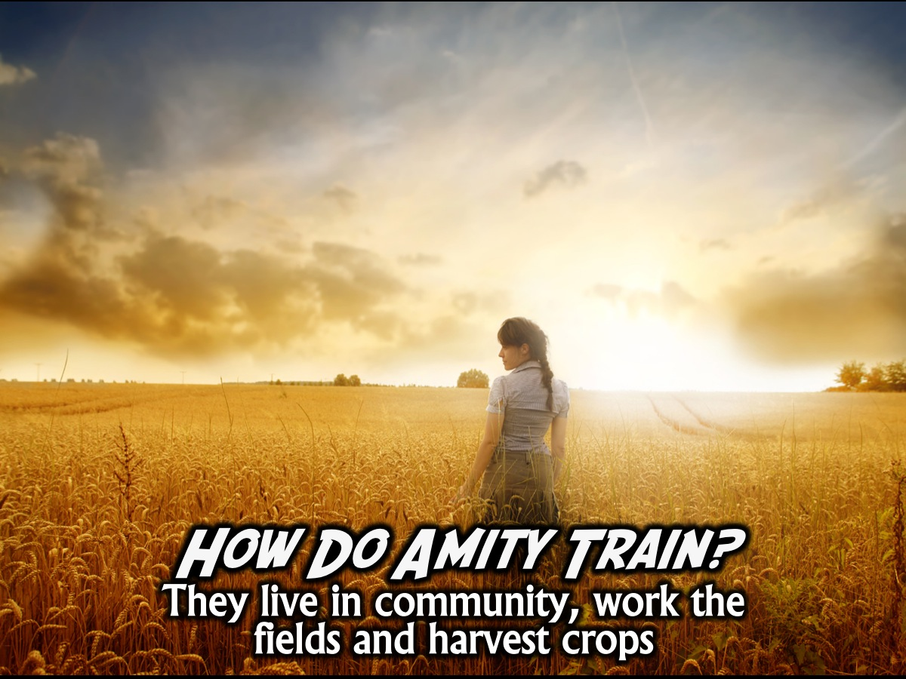
Notes:
How Do Amity Train? They live in community, work the fields and harvest crops

Slide 14

Notes:
Today are going to look at how we can be Peaceful!

Slide 15
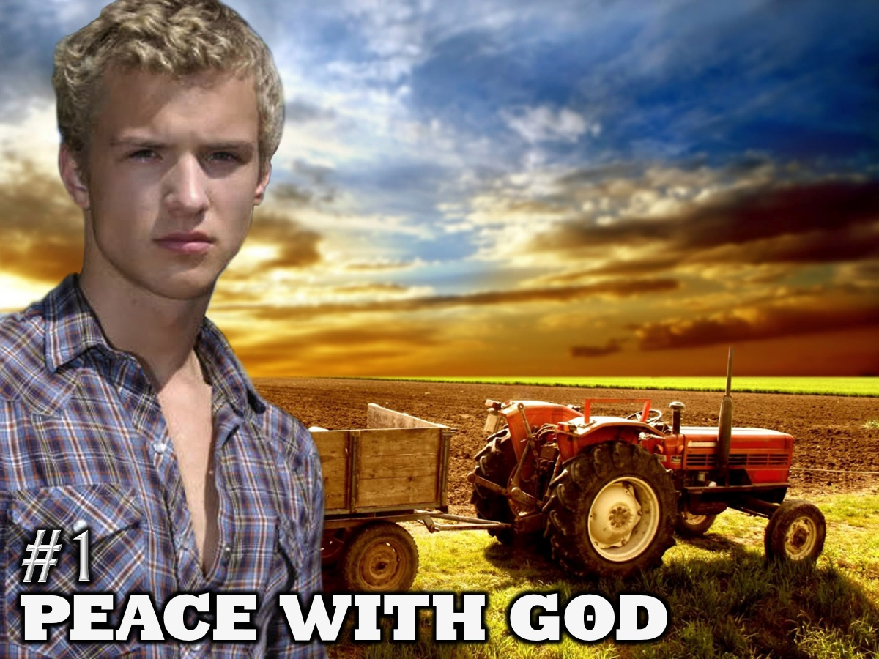
Notes:
1. Peace With God – it all starts by finding peace with God.

Slide 16
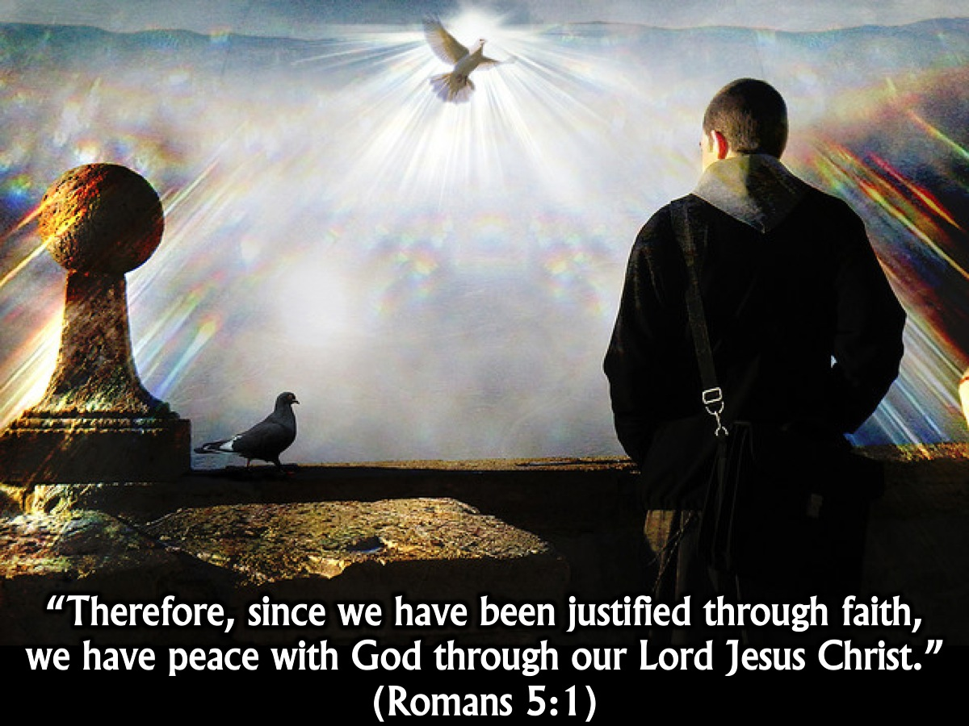
Notes:
“Therefore, since we have been justified through faith, we have peace with God through our Lord Jesus Christ, through whom we have gained access by faith into this grace in which we now stand. (Romans 5:1-2)

Slide 17
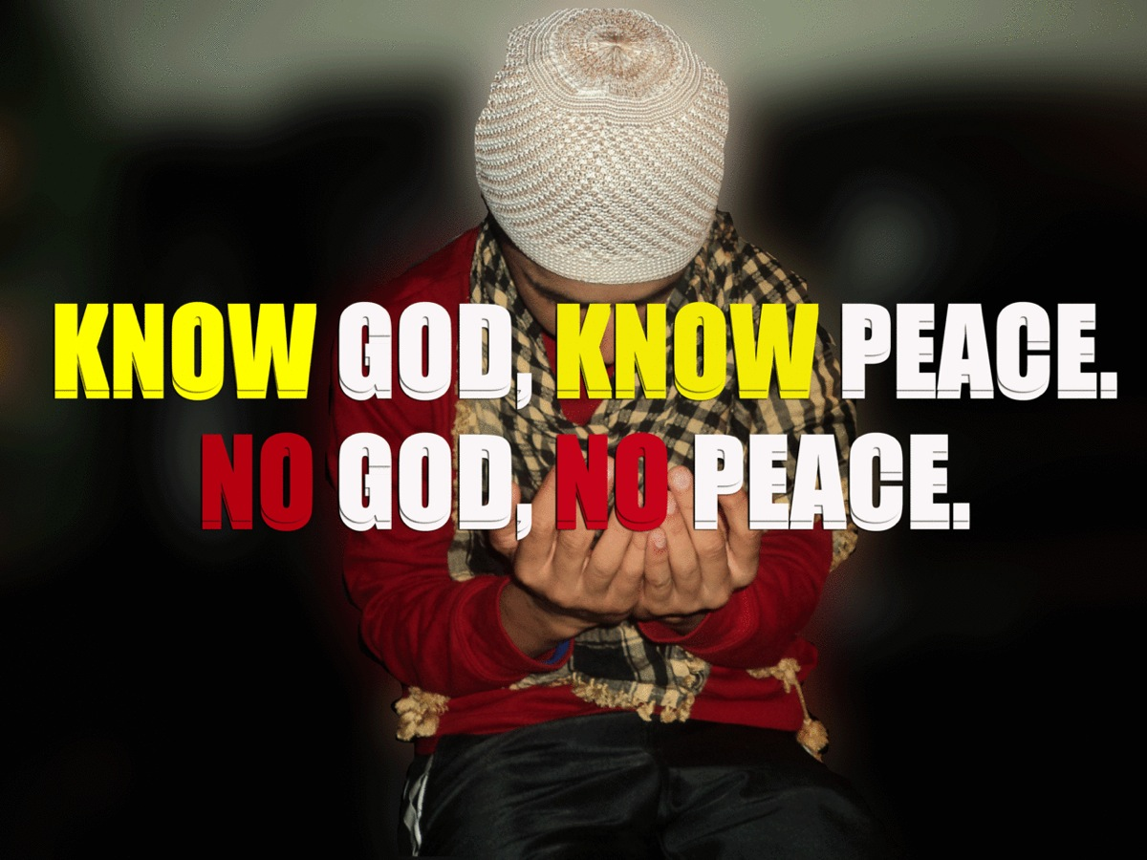
Notes:
There is a great saying: “Know God, know peace, no God, no peace.” Until we get our relationship with God sorted out we will never experience true peace.

Slide 18
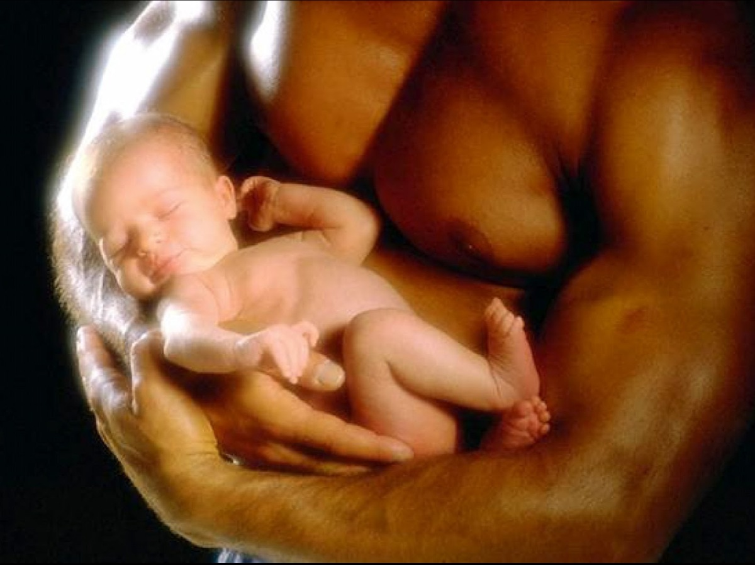
Notes:
This picture of a child lying perfectly at peace in the arms of it’s parent is a picture of what we can experience when we give our lives to God!

Slide 19
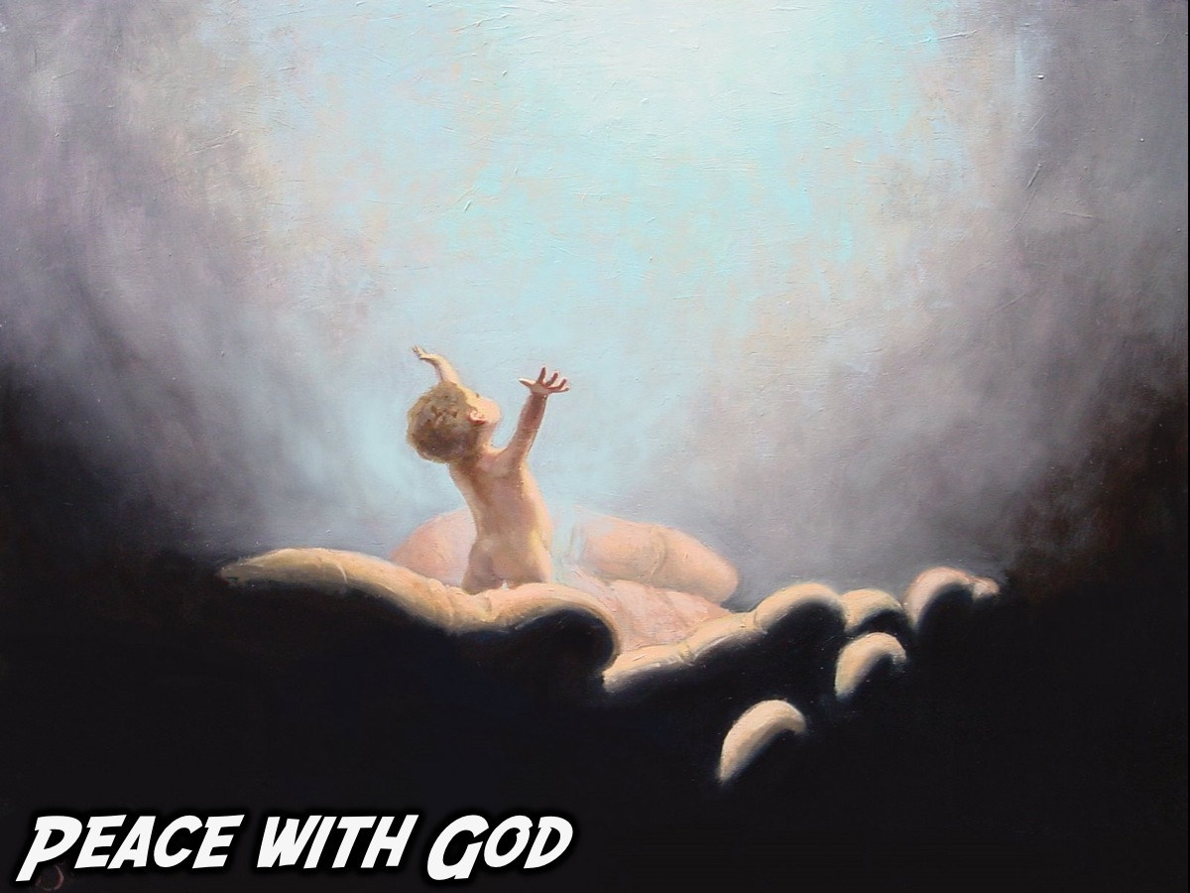
Notes:
At peace with God!

Slide 20

Notes:
2. Peace With Self

Slide 21
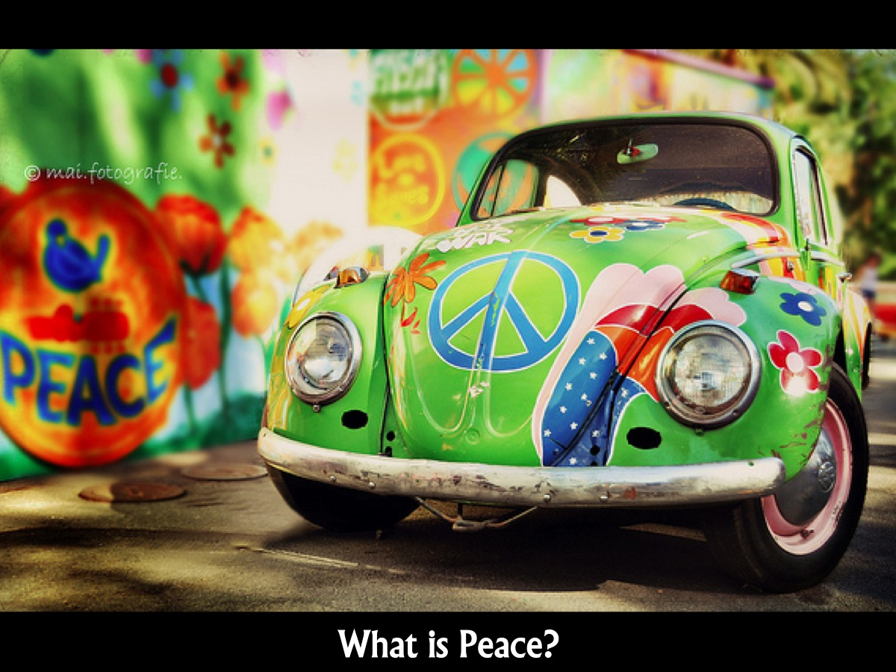
Notes:
What is Peace?

Slide 22

Notes:
When you think of peace – is this the image that comes to mind?

Slide 23

Notes:
This is a more accurate picture of what peace is.

Slide 24
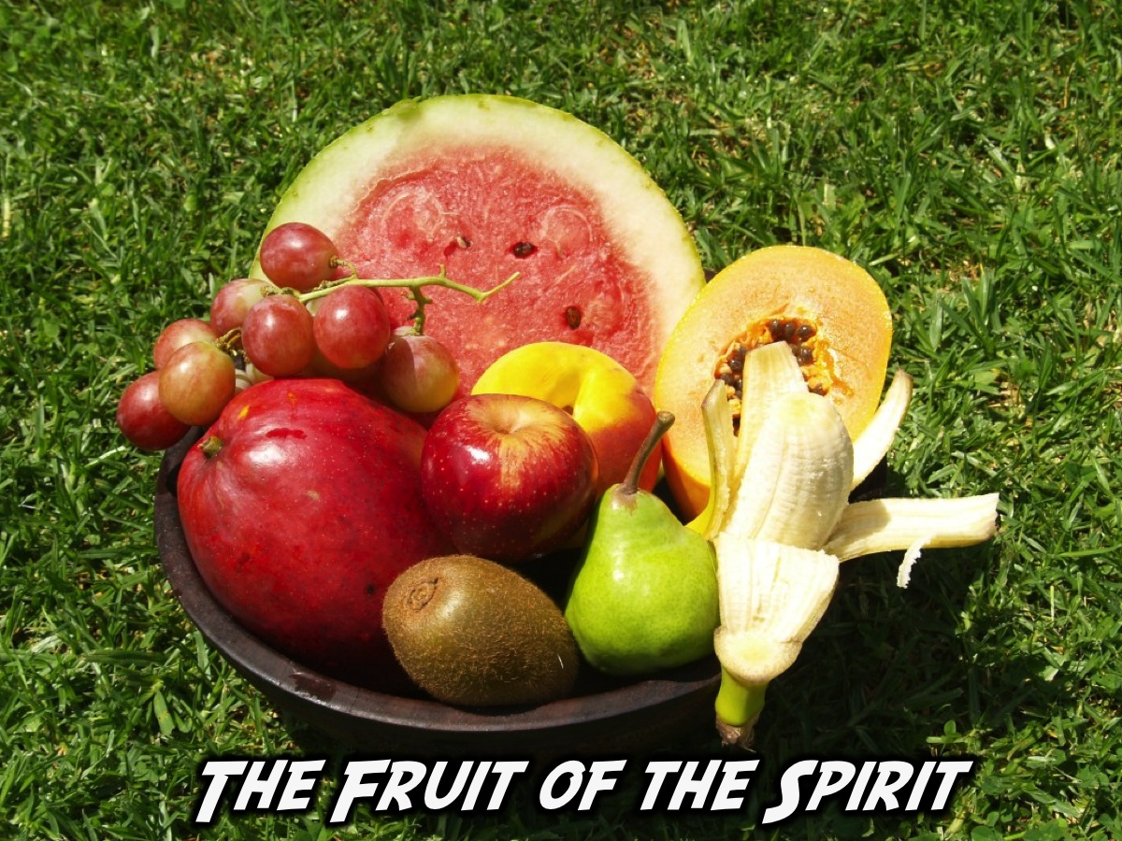
Notes:
The Bible talks about the fruit of the Spirit – 9 different character qualities that God wants to produce in our lives by His Spirit.

Slide 25
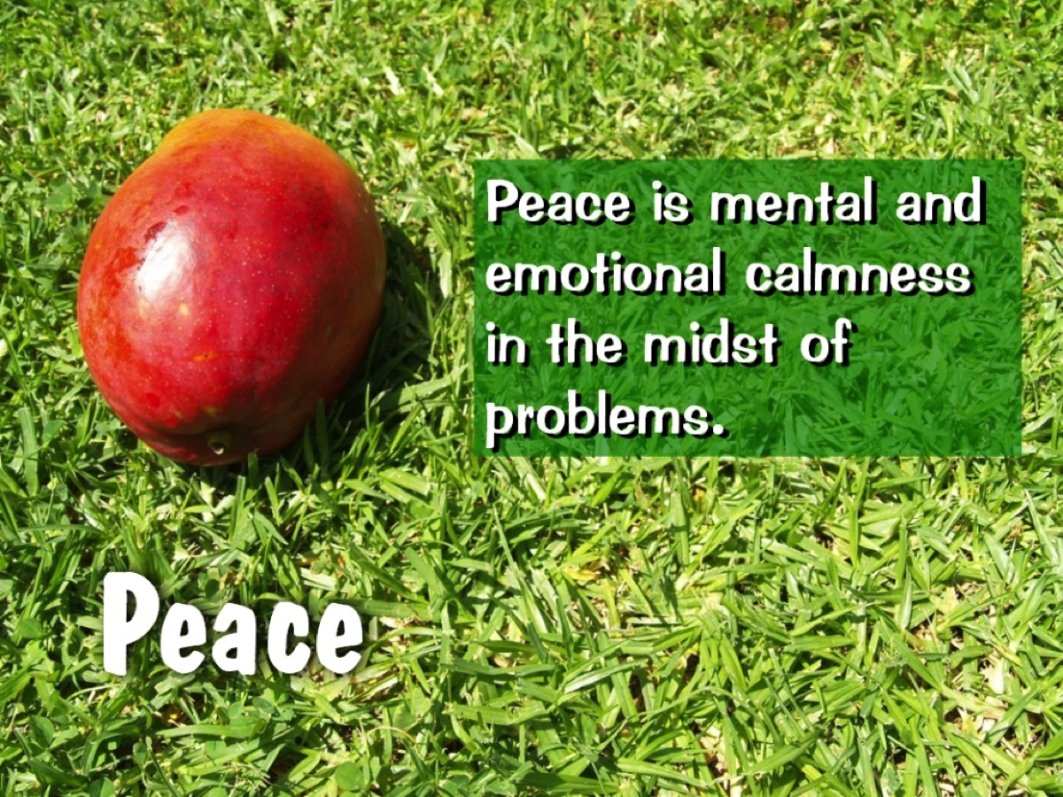
Notes:
One of the fruit of the Spirit is Peace which is mental or emotional calmness in the midst of problems.

Slide 26
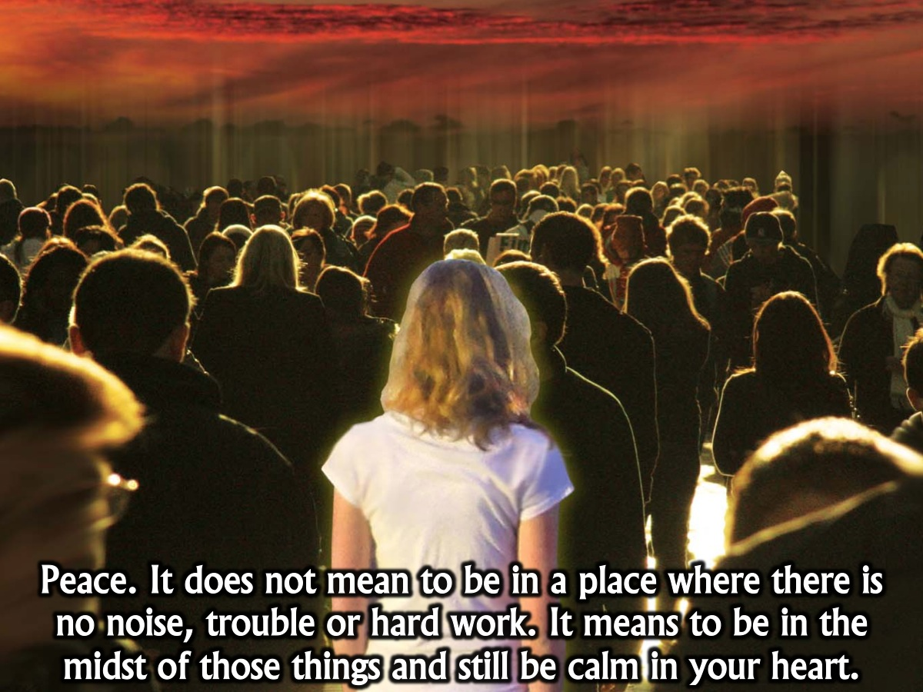
Notes:
Peace. It does not mean to be in a place where there is no noise, trouble or hard work. It means to be in the midst of those things and still be calm in your heart.

Slide 27
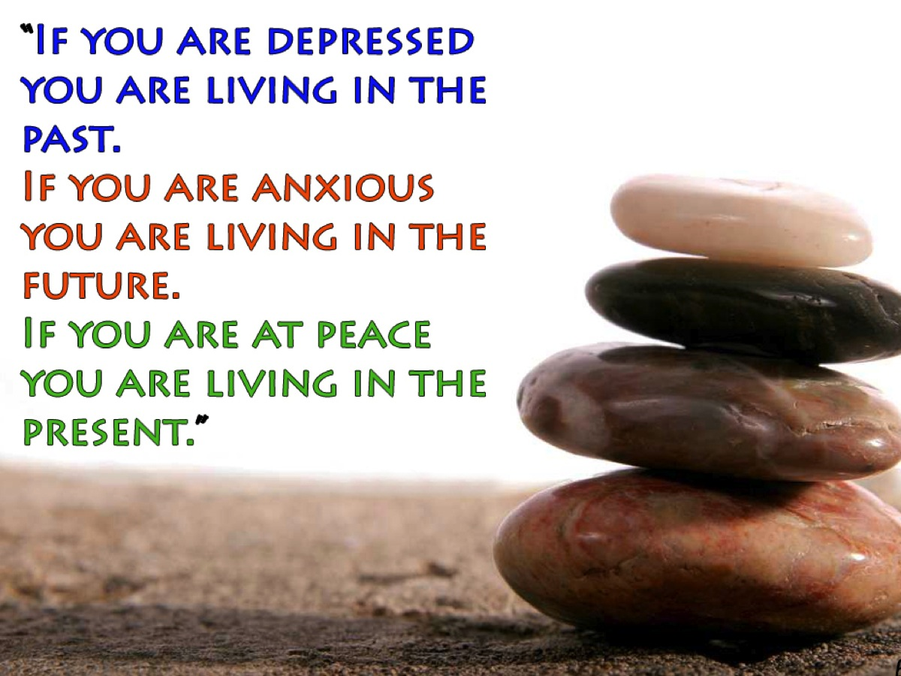
Notes:
This quote from a disputed source is helpful: “If you are depressed you are living in the past. If you are anxious you are living in the future. If you are at peace you are living in the present.” Okay, depression is a whole lot more than just being about living in the past and it is a real medical condition in some cases but there is a lot of wisdom here about experiencing peace in our lives by living in the present. We need to accept or forgive things that have happen in the past and trust our future to God – and then we can live at peace in the present.

Slide 28
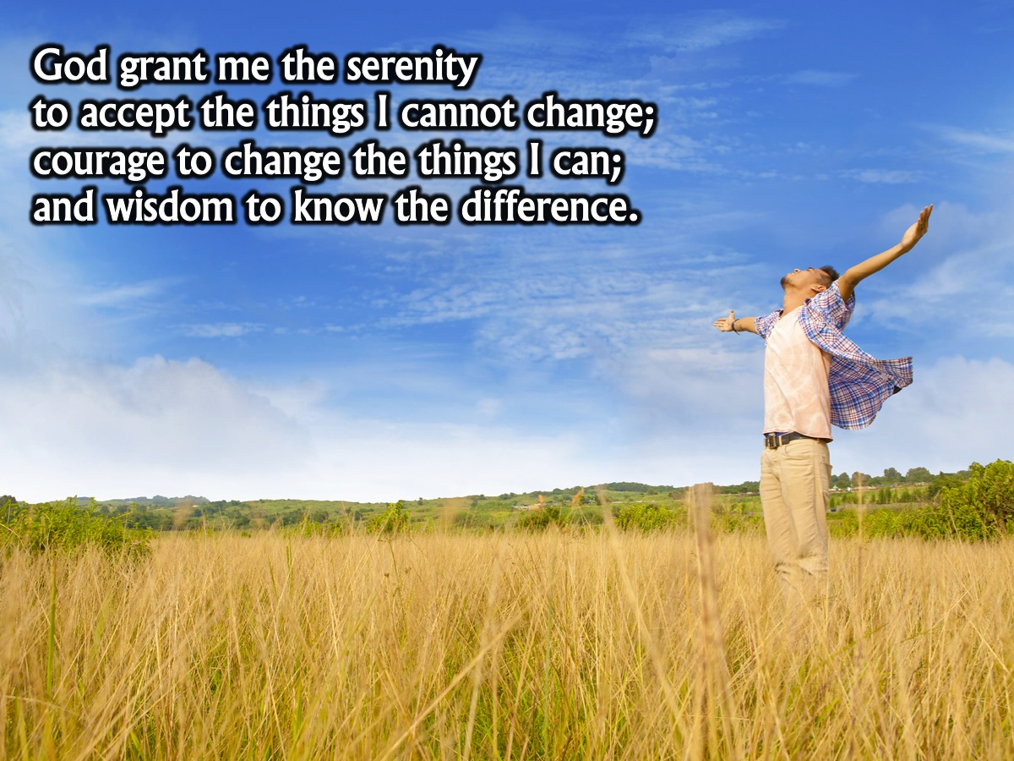
Notes:
The Serenity Prayer is another great tool to help us live peacefully in the present: It goes like this: “God grant me the serenity to accept the things I cannot change; courage to change the things I can; and wisdom to know the difference.” Clearly serenity and peace are synonyms and when we know the difference between what should be changed and what should be accepted in our lives we will be able to live at peace with the stuff that is going on in our lives.

Slide 29

Notes:
"When you find peace within yourself, you become the kind of person who can live at peace with others."

Slide 30

Notes:
3. Peace With Others.

Slide 31

Notes:
Some of us are very quick to react to people or circumstances. Either verbally…

Slide 32

Notes:
Or with more violent reactions.

Slide 33

Notes:
Is this you?

Slide 34
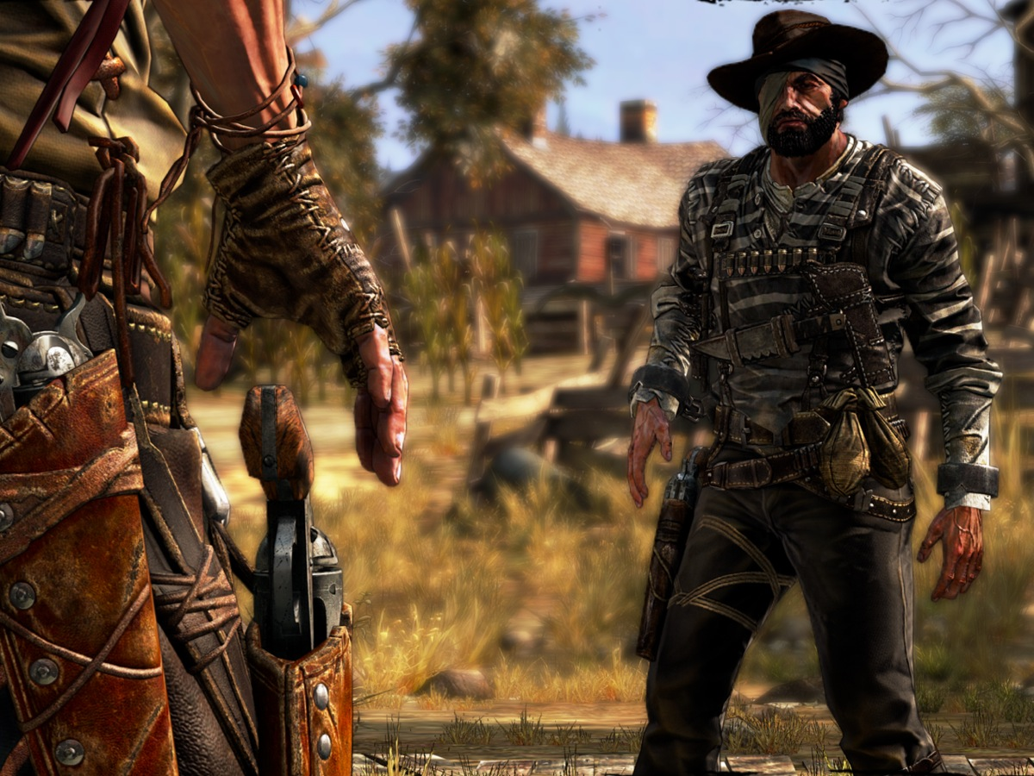
Notes:
Some of us are like gunslingers – just looking for an excuse to draw our guns and…

Slide 35
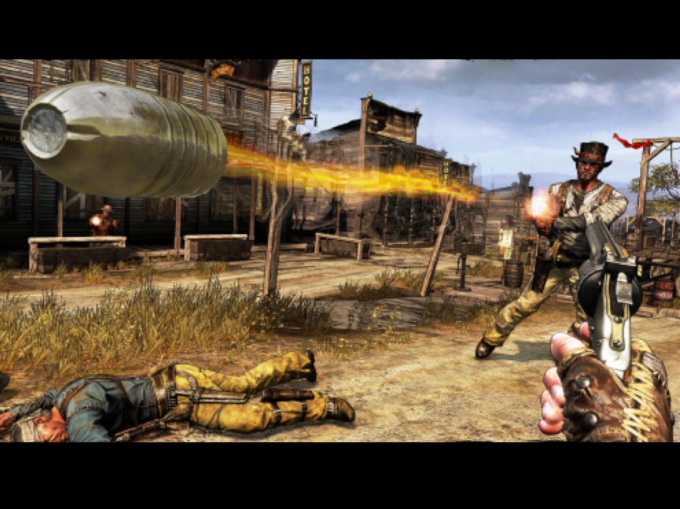
Notes:
Fire a bullet at someone standing in front of us.

Slide 36

Notes:
We should be more like Woody the Sheriff from Toy Story – always looking to keep the peace!

Slide 37

Notes:
“Don’t quarrel with anyone. Be at peace with everyone, just as much as possible.” (Romans 12:18)

Slide 38
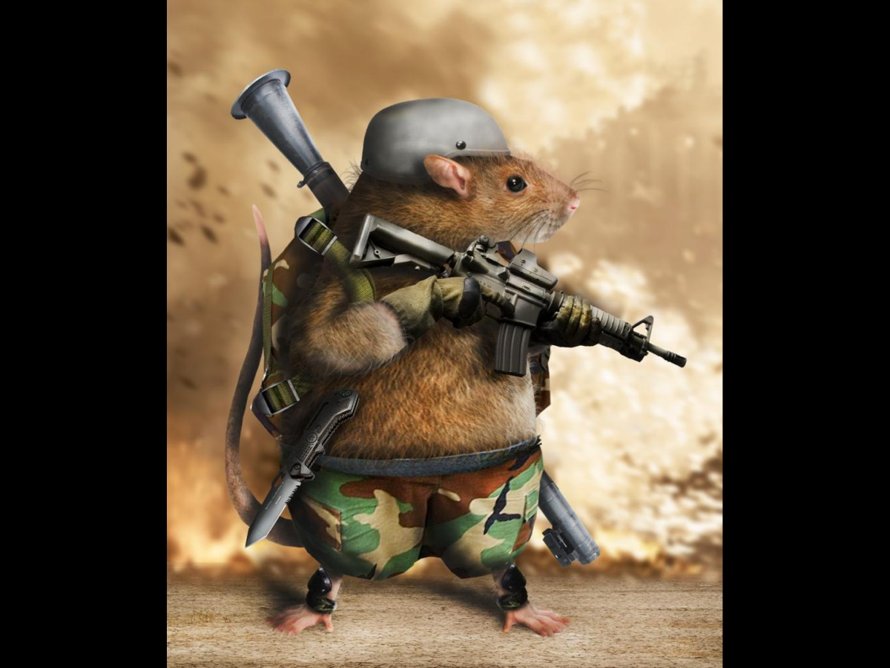
Notes:
So don’t be like this little chap….

Slide 39
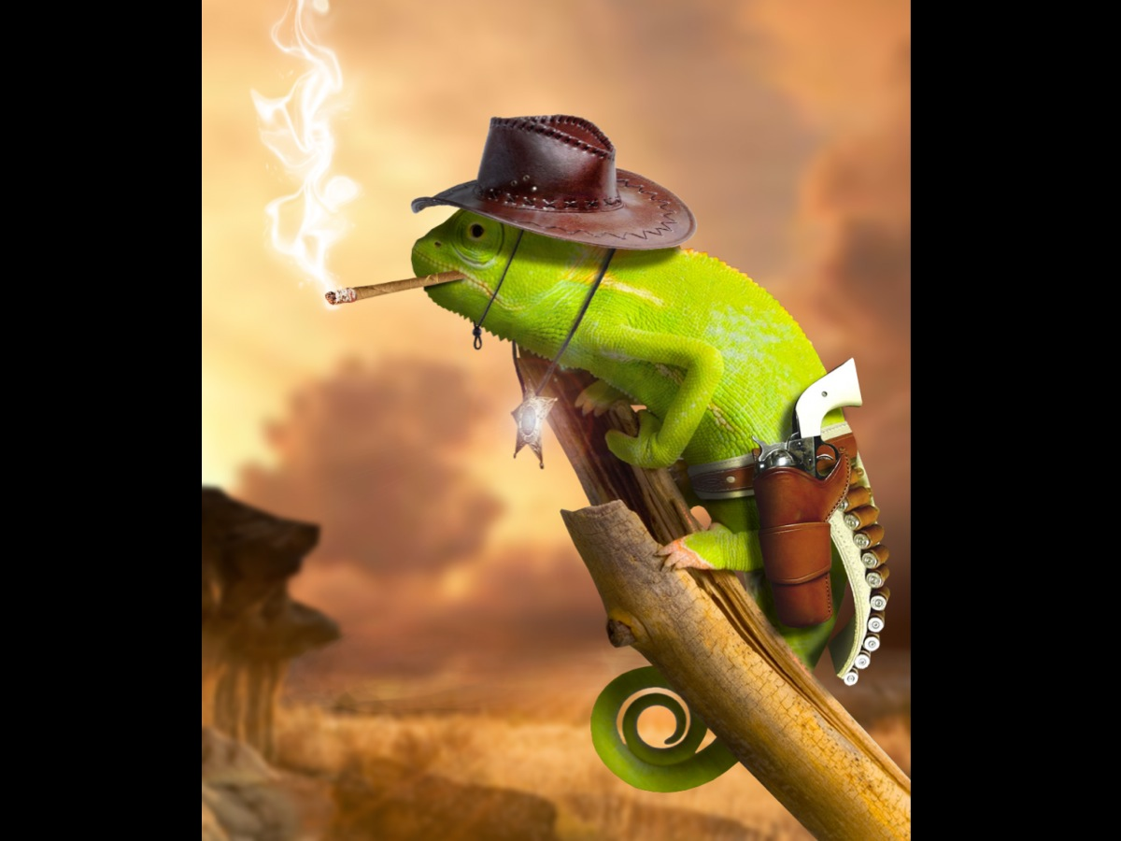
Notes:
Rather be like this one!!!

Slide 40

Notes:
4. Peace For Others – Make Peace – Be a peacemaker.

Slide 41
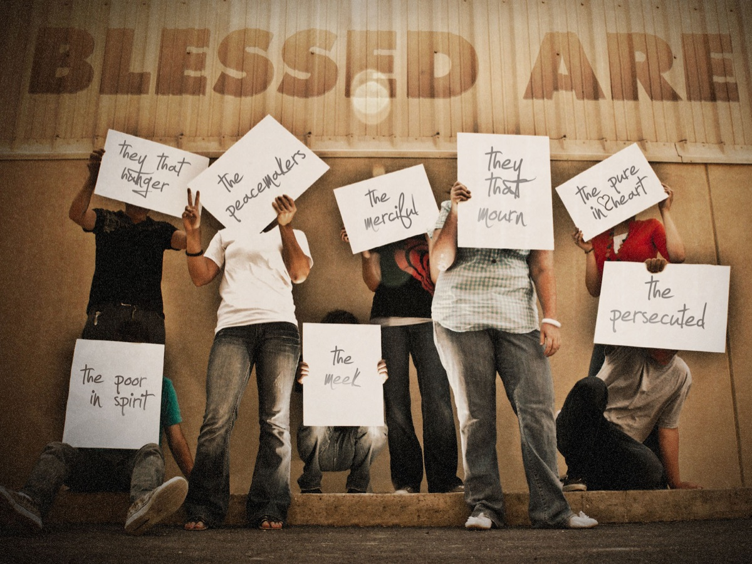
Notes:
In one of Jesus’ teaching times he presented a list of attitudes (the beatitudes) that describe ways of living that are blessed by God!

Slide 42
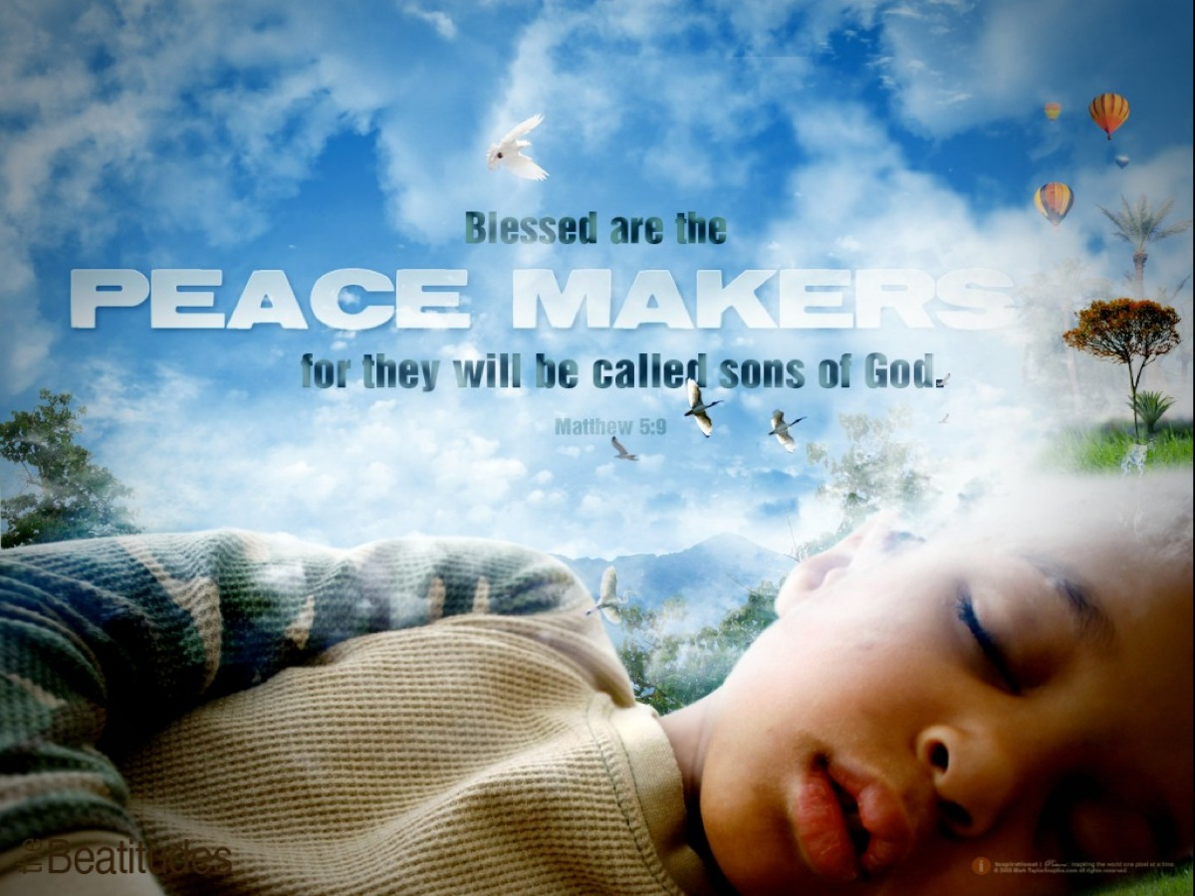
Notes:
One of them reads like this: “Blessed are the peacemakers for they will be called sons of God.”

Slide 43

Notes:
We need to build bridges between people…

Slide 44

Notes:
And break down walls between people…

Slide 45
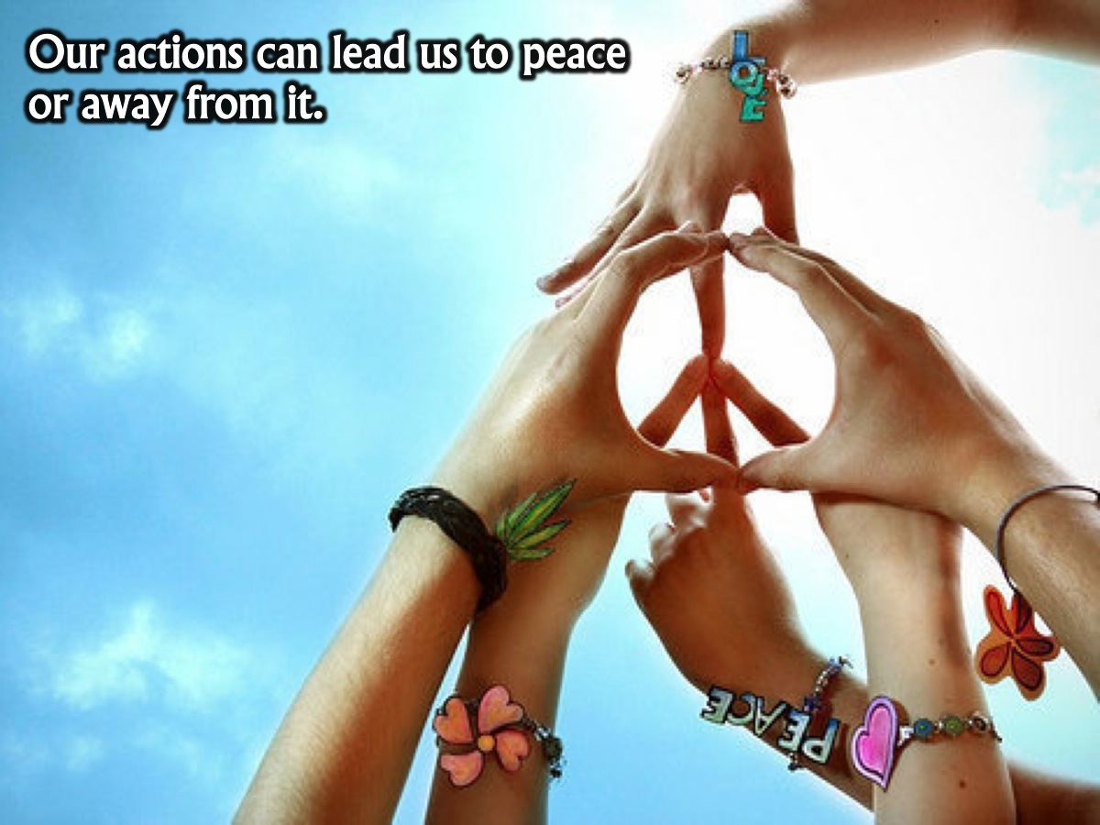
Notes:
Our actions can lead us to peace or away from it.

Slide 46
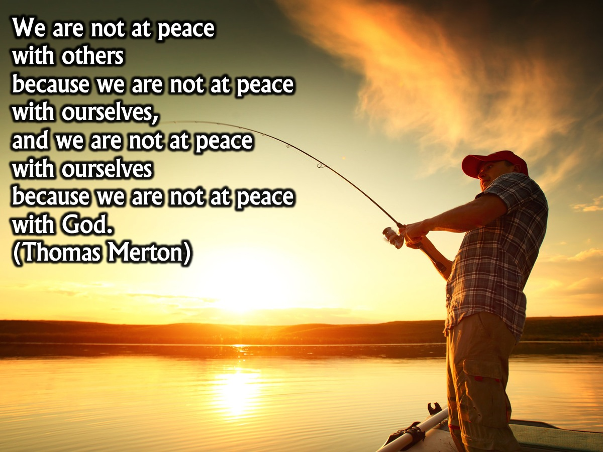
Notes:
We are not at peace with others because we are not at peace with ourselves, and we are not at peace with ourselves because we are not at peace with God. (Thomas Merton)

Slide 47
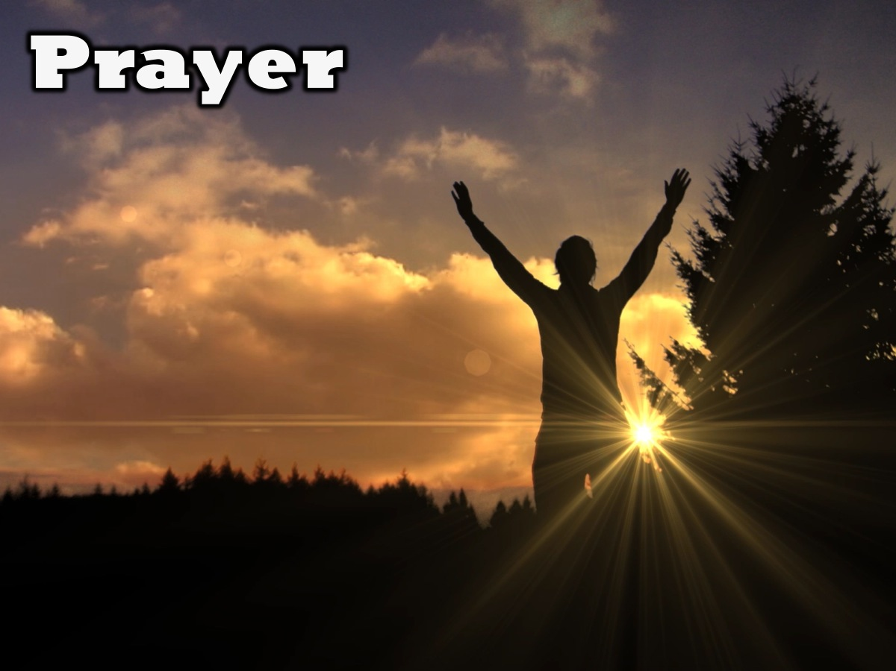
Notes:
Prayer

Slide 48

Notes:
Next week we will take a closer look at the Abnegation faction and learn what it means to be Selfless.

