Slide 1

Notes:
A few weeks ago we started this series based on the book trilogy by Vanessa Roth.

Slide 2

Notes:
We started by looking into the world of Dauntless and learnt how to be Brave.

Slide 3

Notes:
We then looked into the world of Erudite and learnt how to be Wise.

Slide 4

Notes:
Then we looked at the Candor Faction and learnt how to be Honest.

Slide 5

Notes:
Last week we looked at the Amity Faction – and explored what it means to be Peaceful.

Slide 6

Notes:
This week we will take a closer look at the Abnegation faction and learn what it means to be Selfless.

Slide 7
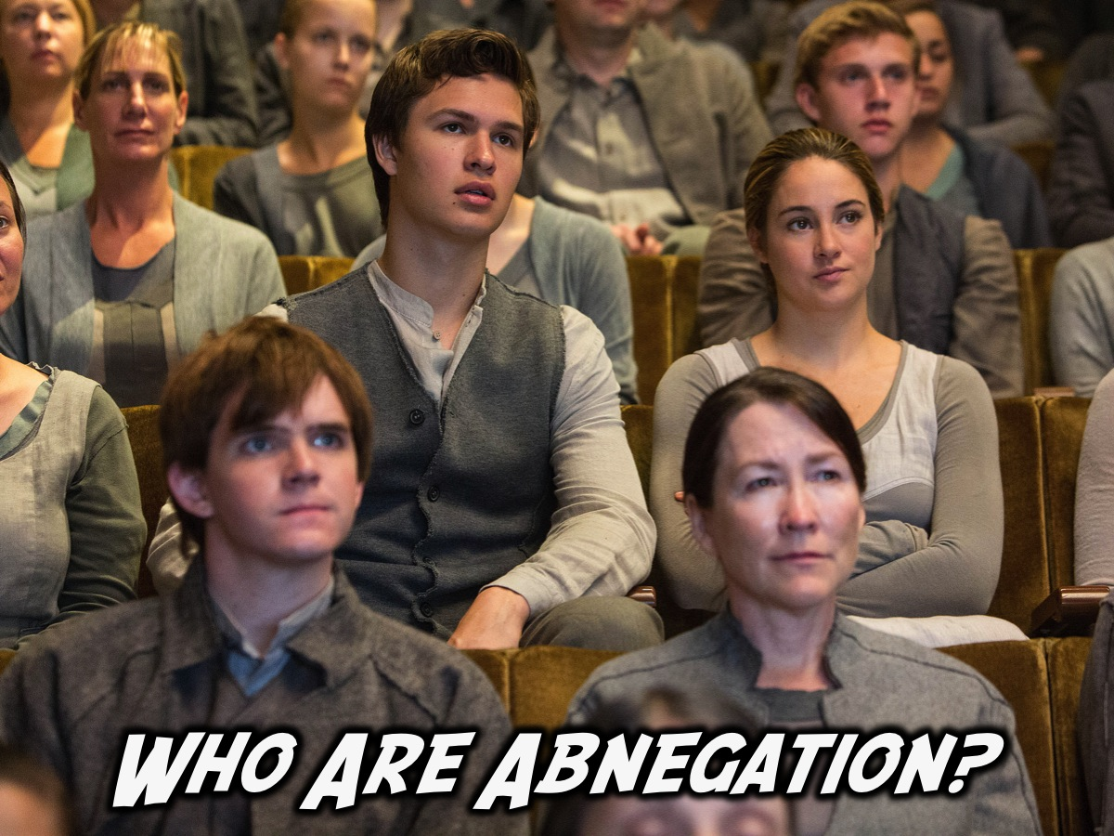
Notes:
Who Are Abnegation?

Slide 8
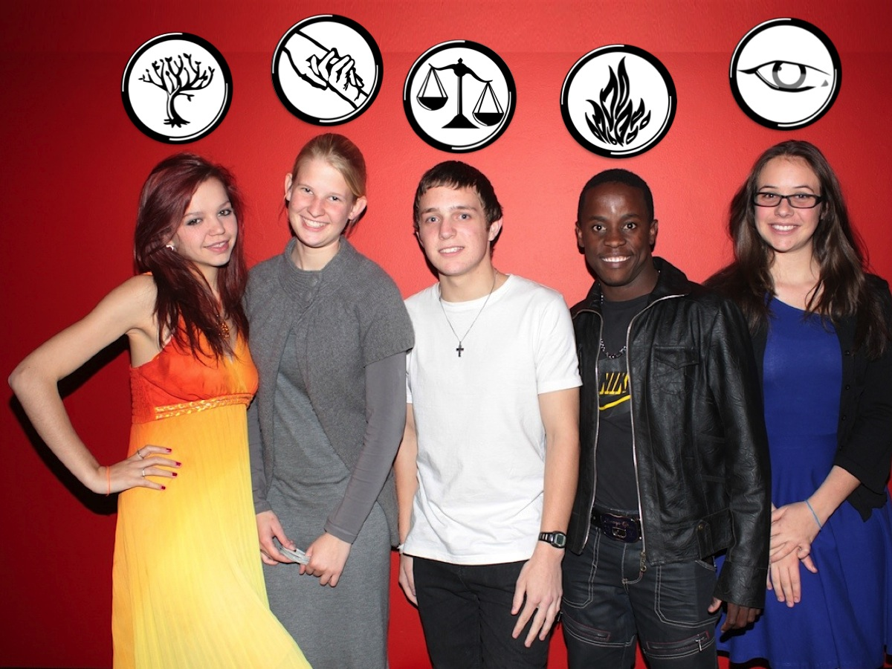
Notes:
Abnegation dress like Jo pictured second from the left in the role play of Divergent that we did at our youth groups a few weeks back.

Slide 9
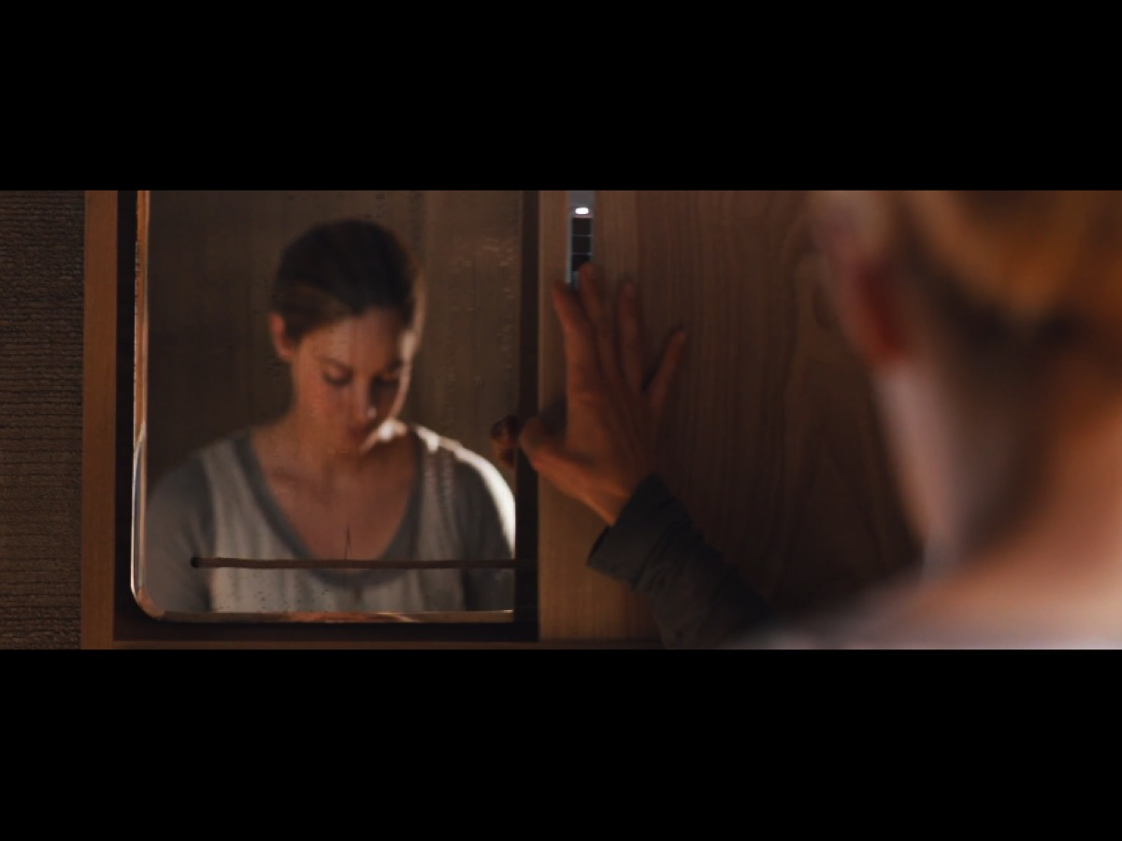
Notes:
They are not allowed to look at themselves in mirrors. That is considered vanity.

Slide 10
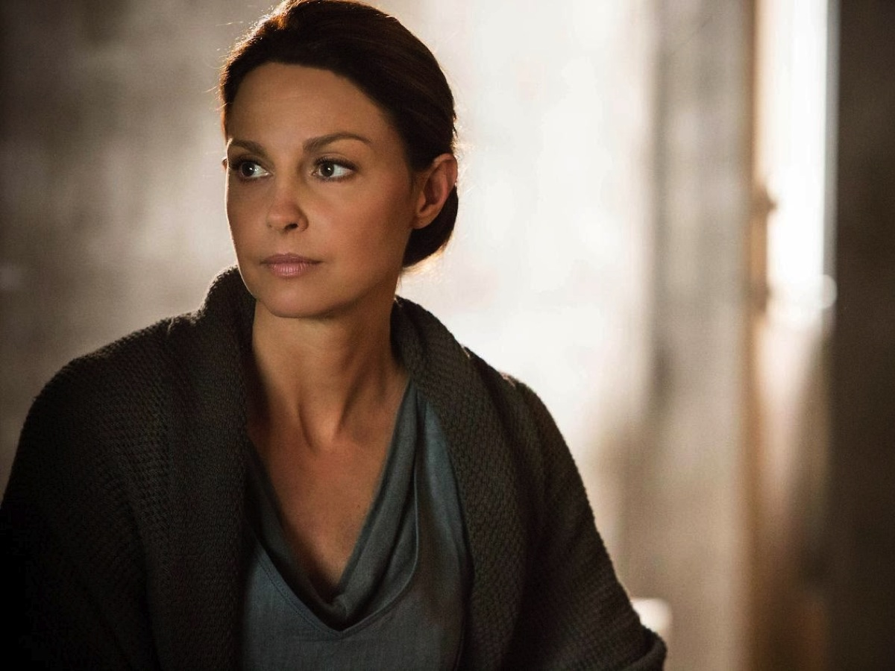
Notes:
They wear the plainest clothes possible – to attract the least attention.

Slide 11
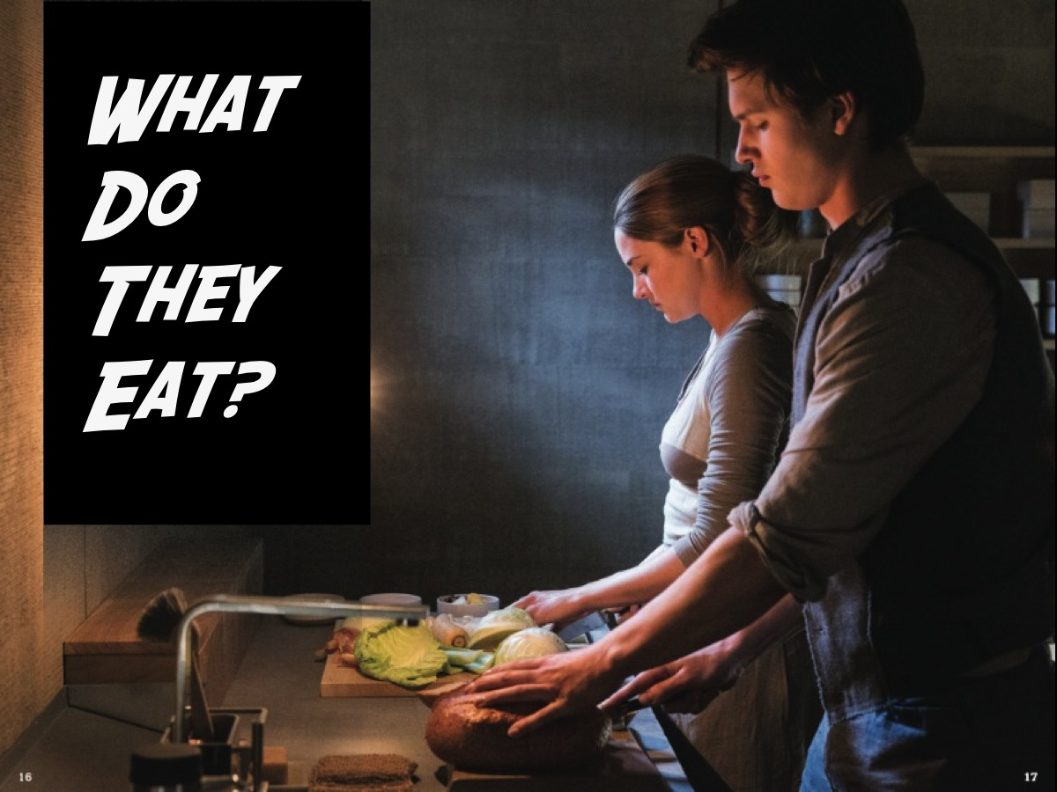
Notes:
What Do Abnegation Eat? Most of what they eat is frozen or canned because the farms are far away. They always eat dinner at the table and pass food to the right and wait to eat until everyone has been served. They eat plain food and don't drink alcohol.

Slide 12
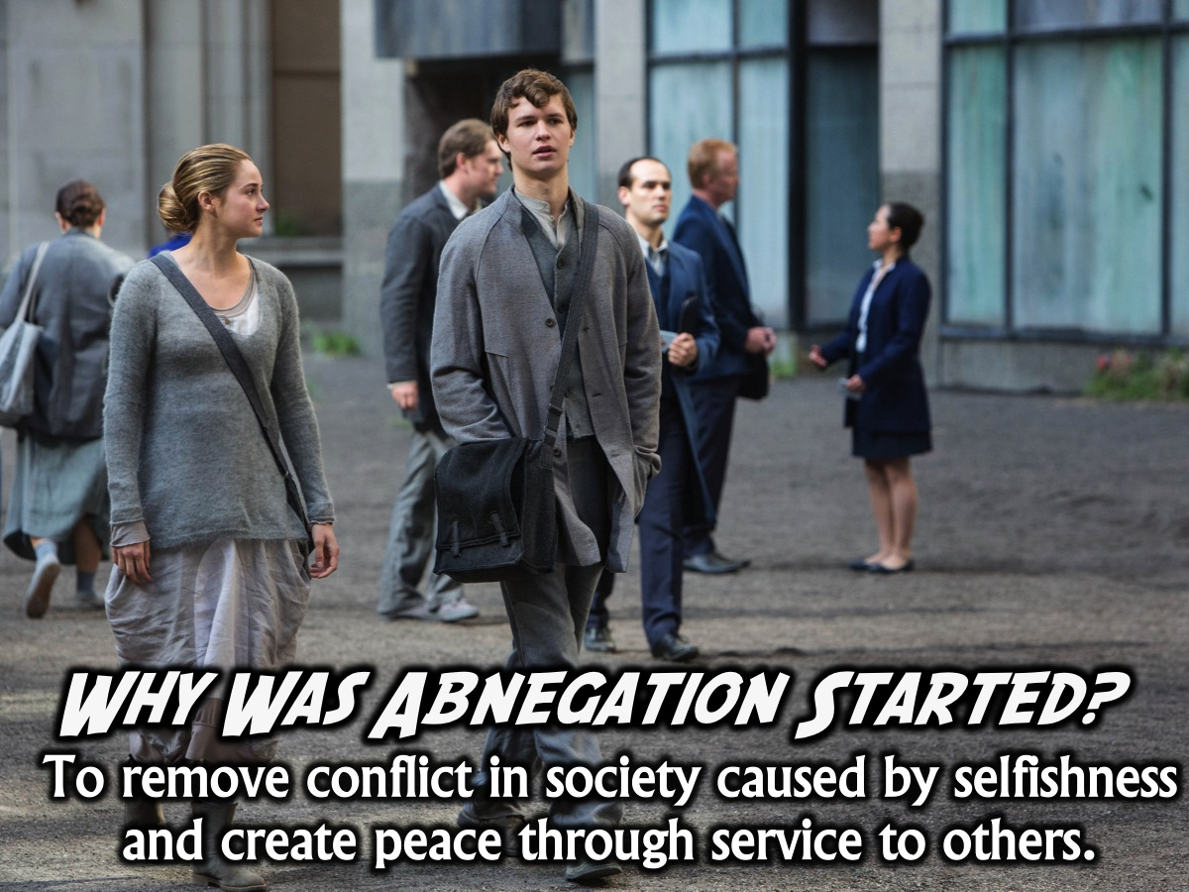
Notes:
Why Was Abnegation Started? Abnegation was formed by those who blamed selfishness for human nature's errors. They believe in selfless actions and attaining peace through the elimination of selfishness. By doing so, they choose to completely forget themselves and only serve others.

Slide 13
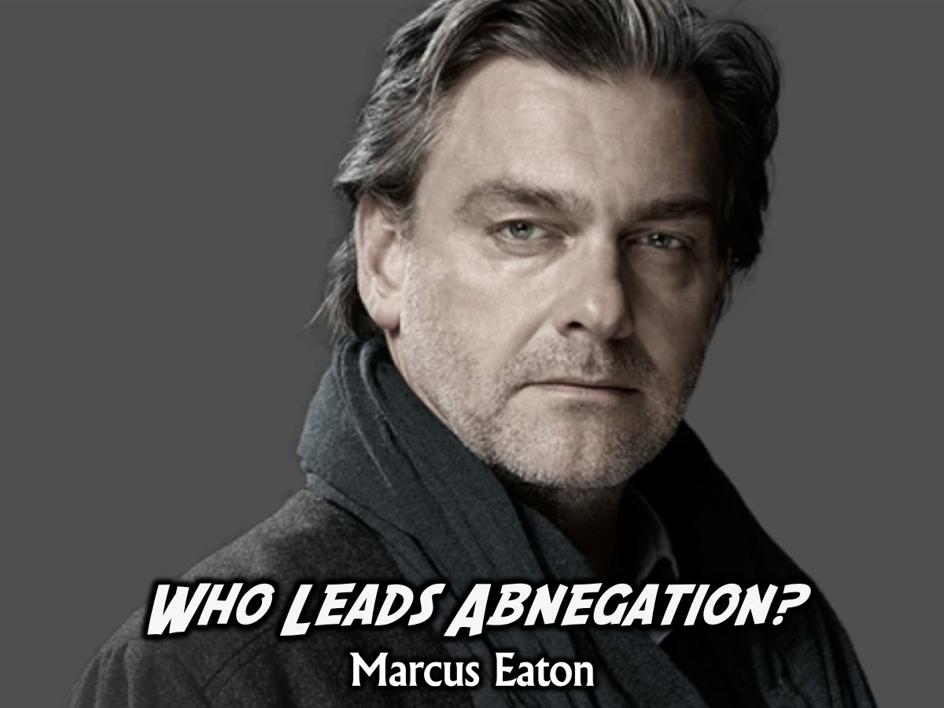
Notes:
Who Leads Abnegation? Marcus Eaton is the leader of Abnegation.

Slide 14
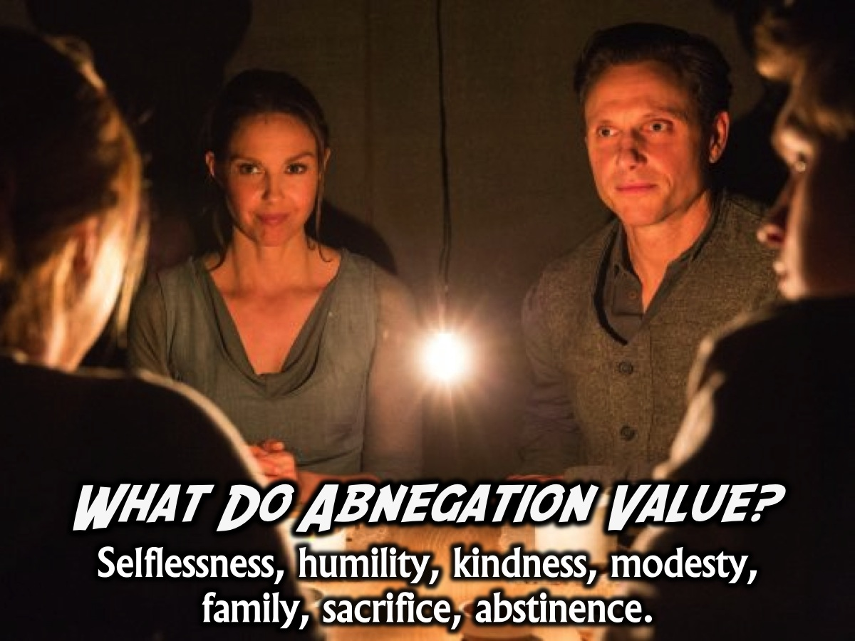
Notes:
What Do Abnegation Value? They value selflessness, humility, kindness, modesty, family, sacrifice, abstinence. The Abnegation live simple lives and are very family focused and put others first.

Slide 15
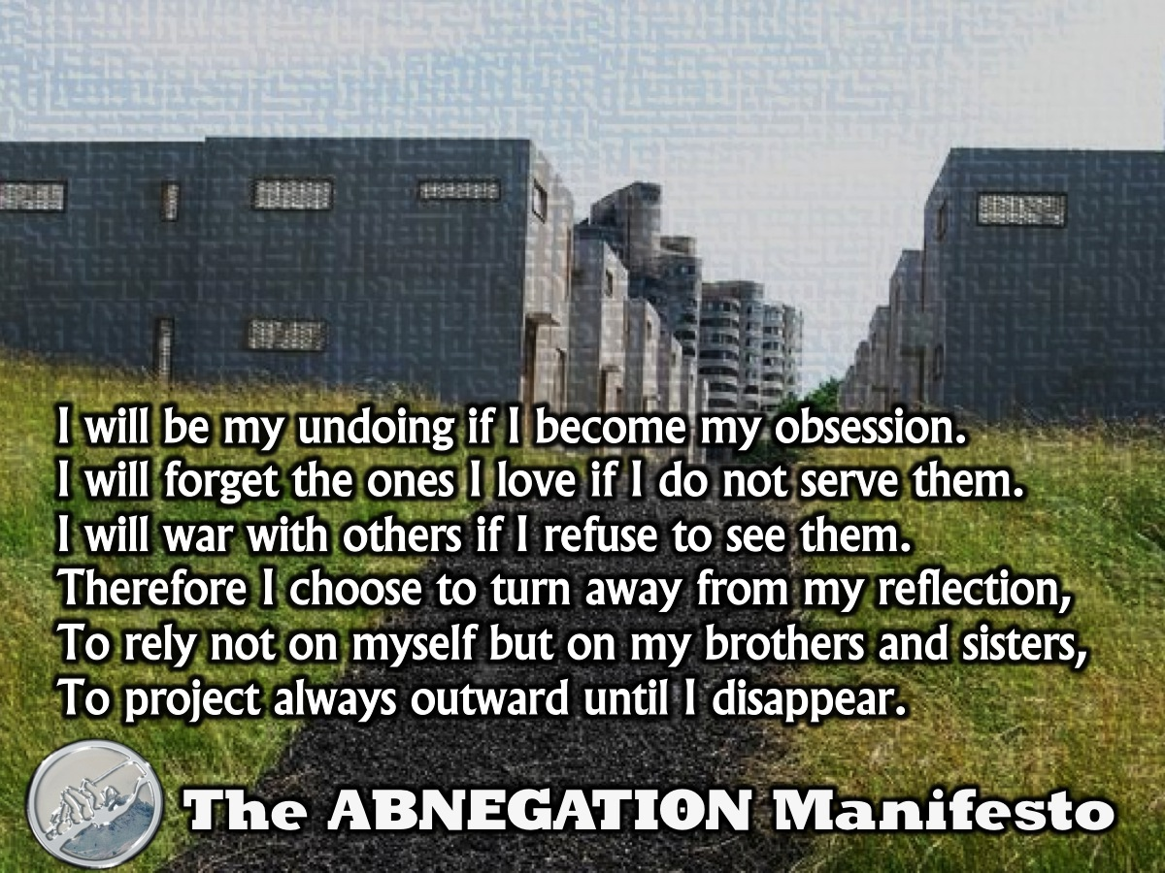
Notes:
Abnegation Manifesto: I will be my undoing if I become my obsession. I will forget the ones I love if I do not serve them. I will war with others if I refuse to see them. Therefore I choose to turn away from my reflection, to rely not on myself but on my brothers and sisters, to project always outward until I disappear.

Slide 16
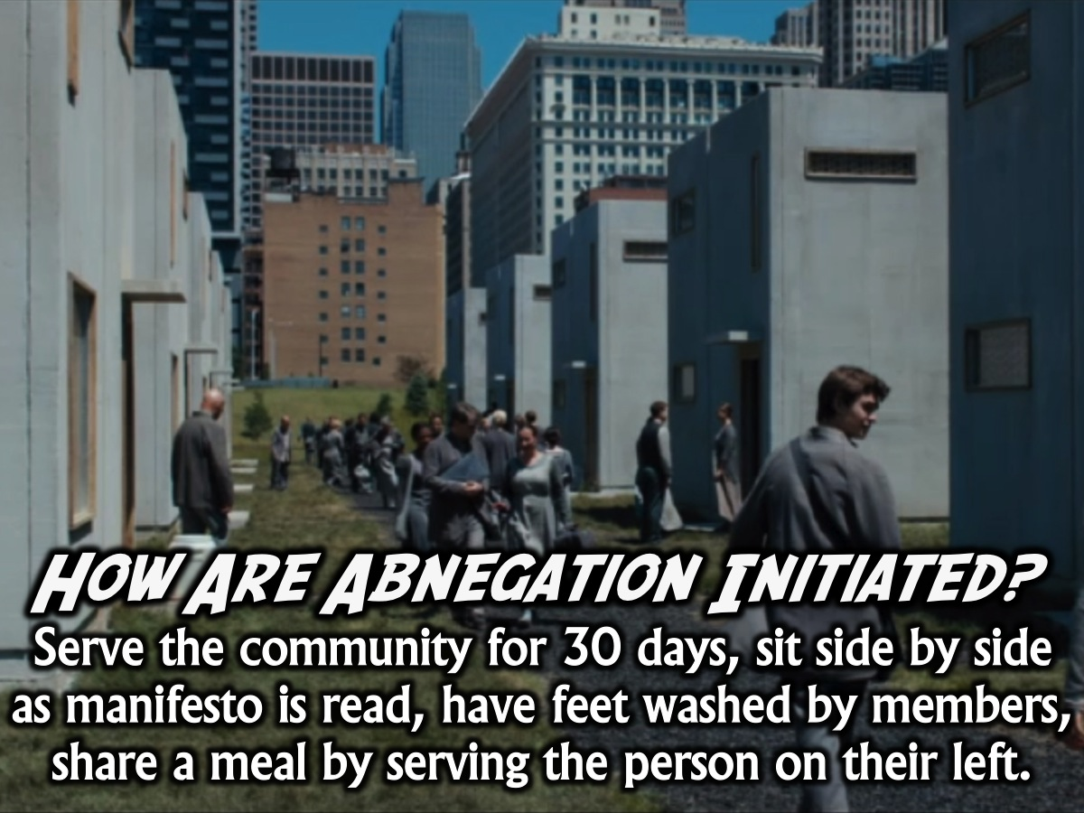
Notes:
How Are Abnegation Initiated? The initiates, who will spend thirty days performing community service before they can become full members, sit side by side on a bench while one of the older members reads the Abnegation manifesto. Then all of the older members wash the initiates feet. They all share a meal, each person serving food to the person on his left.

Slide 17
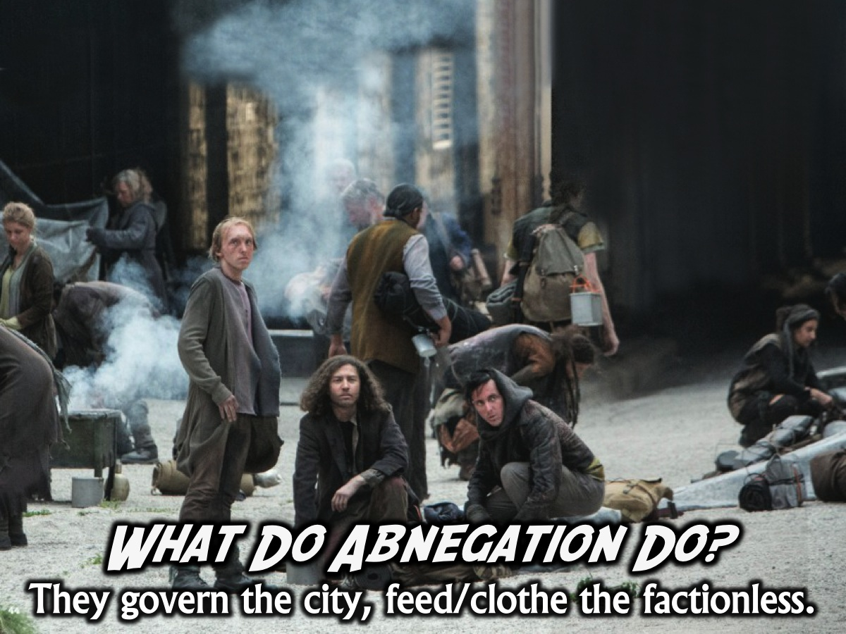
Notes:
What Do Abnegation Do? They govern the city and feed and clothe the factionless who wander the seedier parts of town.

Slide 18
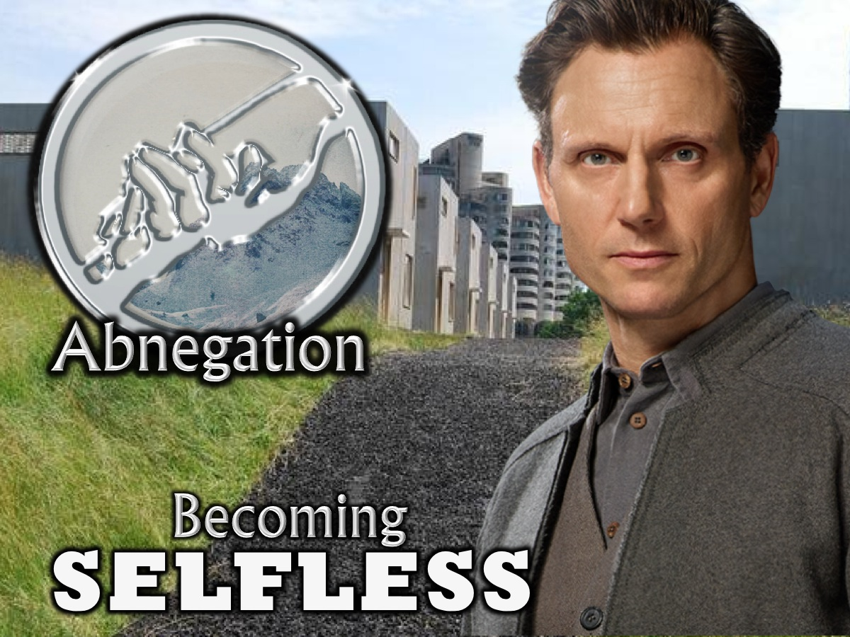
Notes:
Today are going to look at how we can become Selfless!

Slide 19
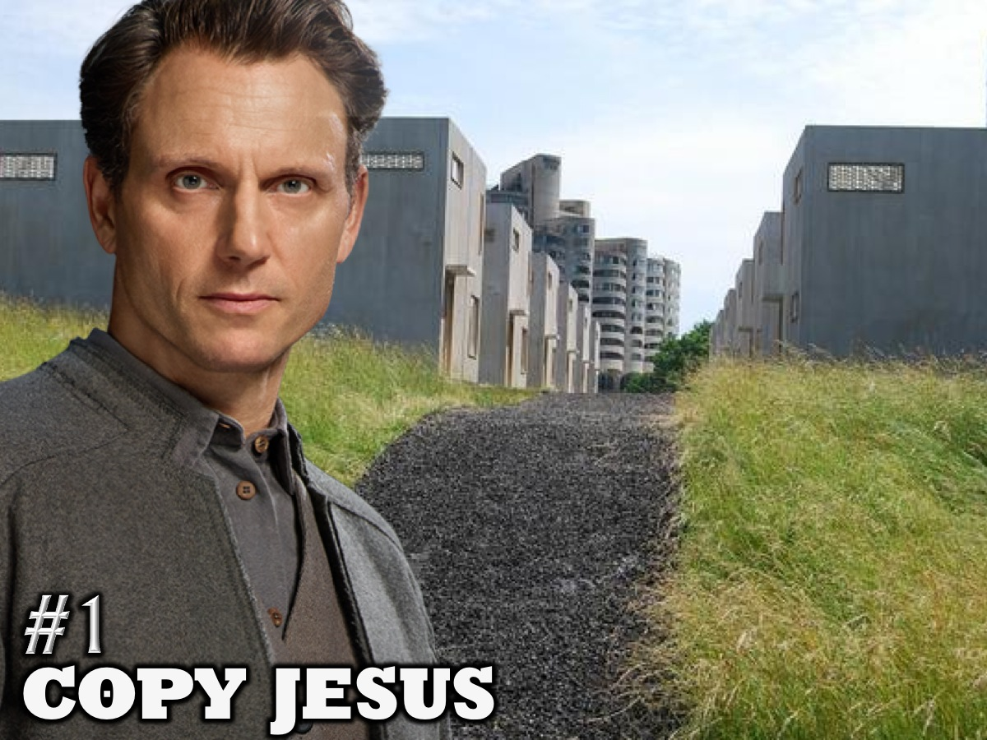
Notes:
1. Copy Jesus

Slide 20
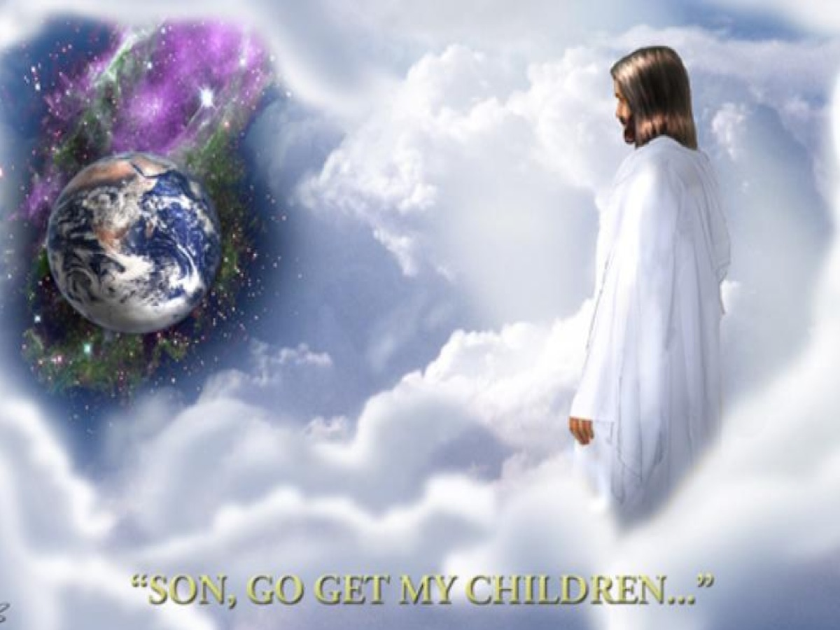
Notes:
Jesus created the world and voluntarily left the splendour of heaven and came to earth on a mission!

Slide 21
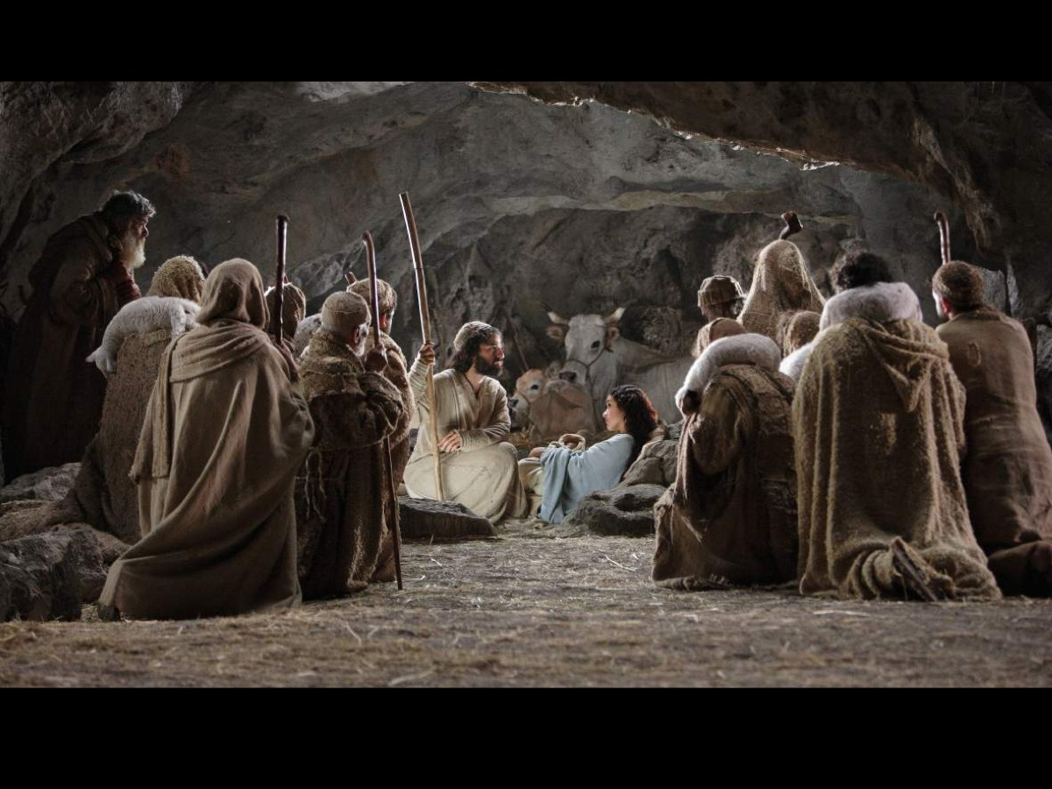
Notes:
He was born in a lowly stable surrounded by shepherds and cattle and sheep.

Slide 22
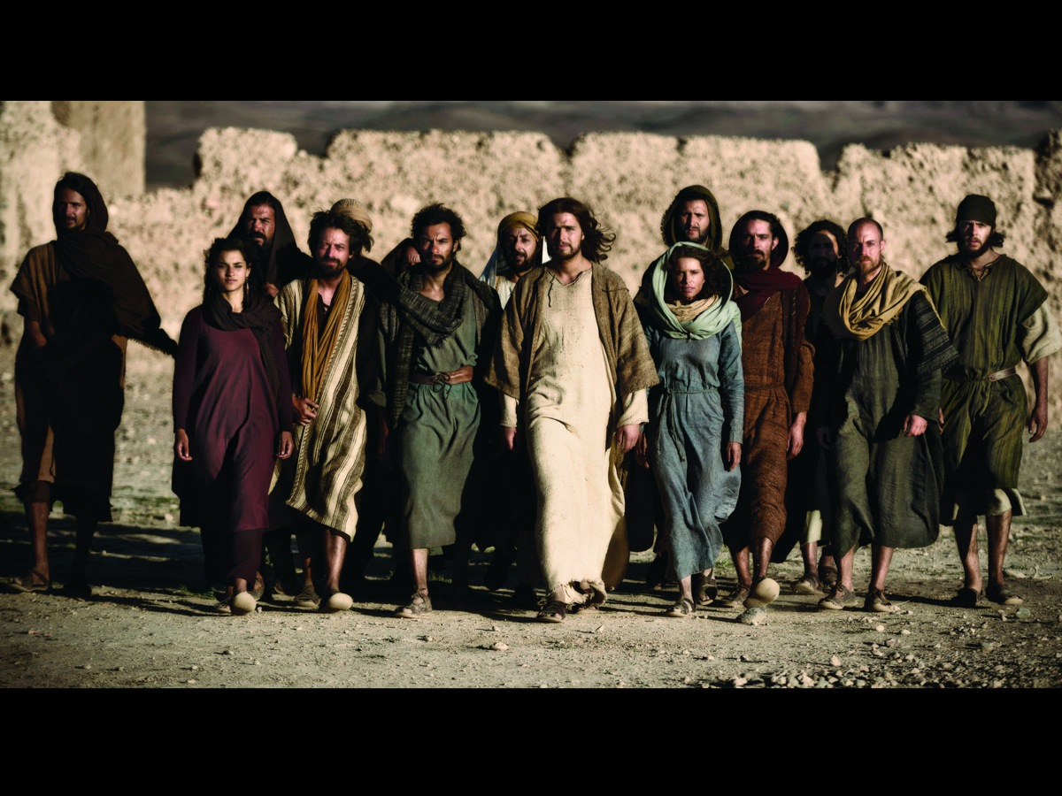
Notes:
He grew up in relative obscurity and poverty. Spending most of his time with poor fishermen.

Slide 23
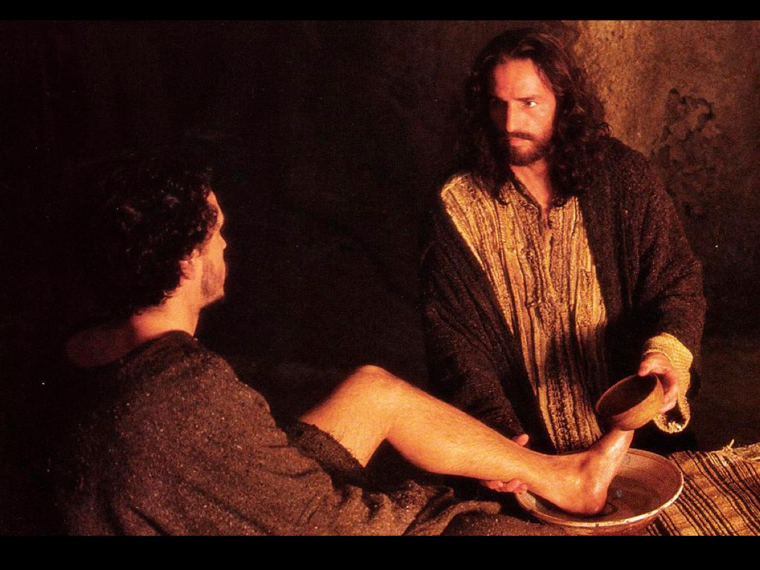
Notes:
He knelt down and washed his disciples feet!

Slide 24
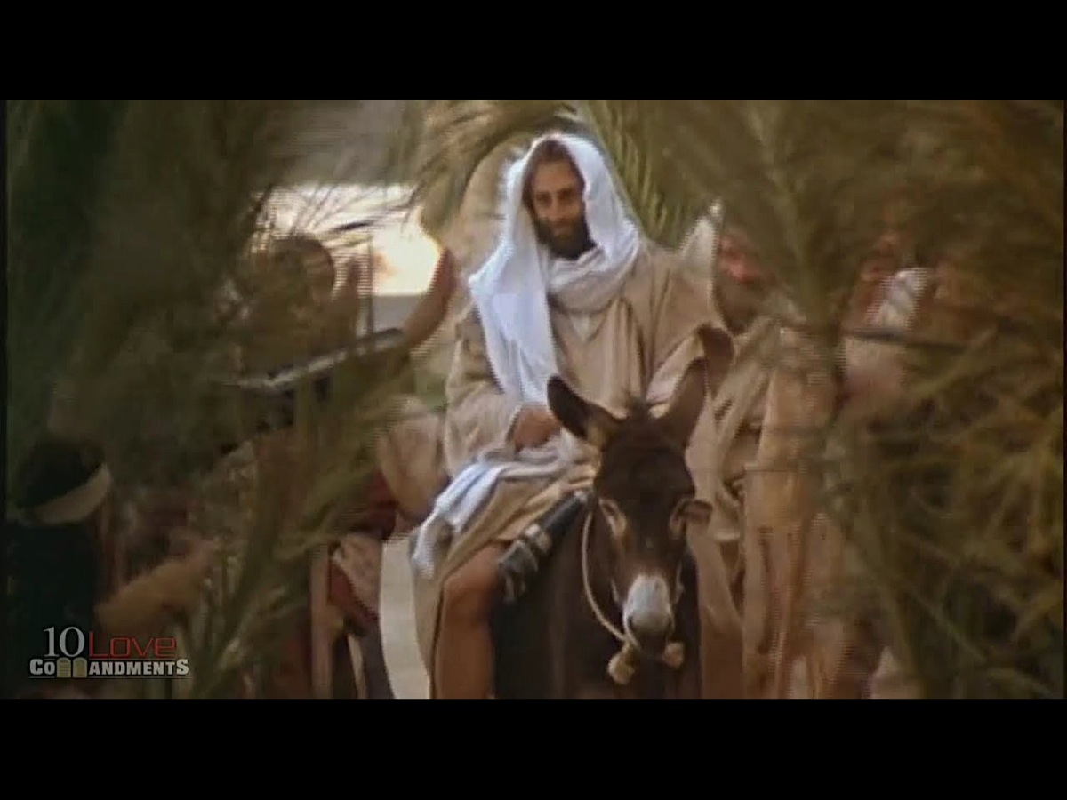
Notes:
He rode into Jerusalem on a donkey.

Slide 25
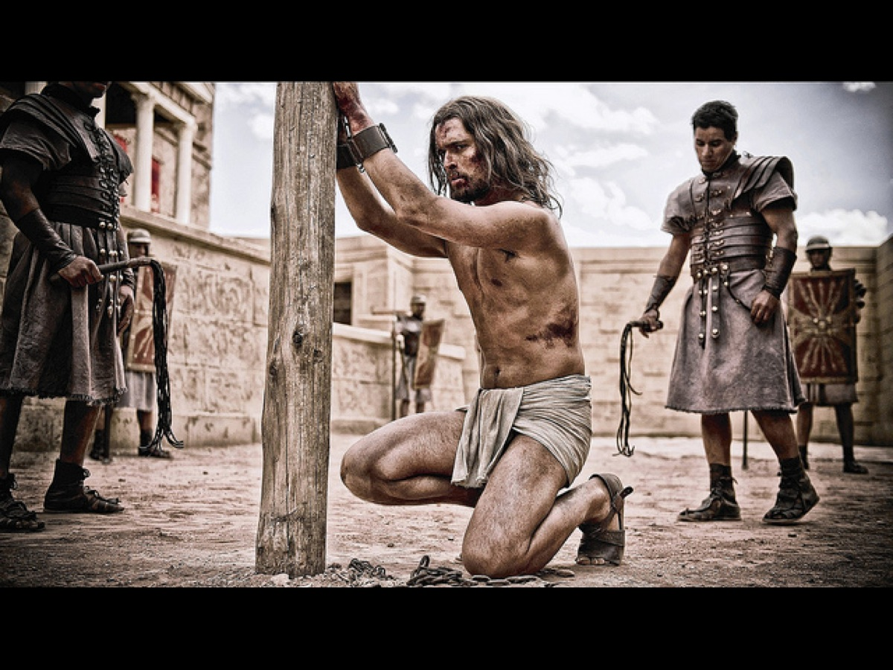
Notes:
He was viciously beaten for not fault of his own – he was truly innocent.

Slide 26
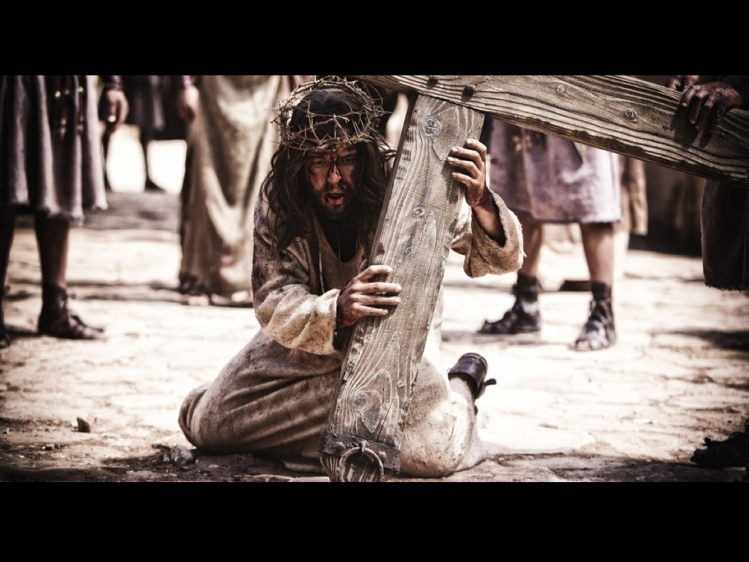
Notes:
He suffered the worst kind of death humanly possible – not for anything he had done but to bring salvation to human beings.

Slide 27
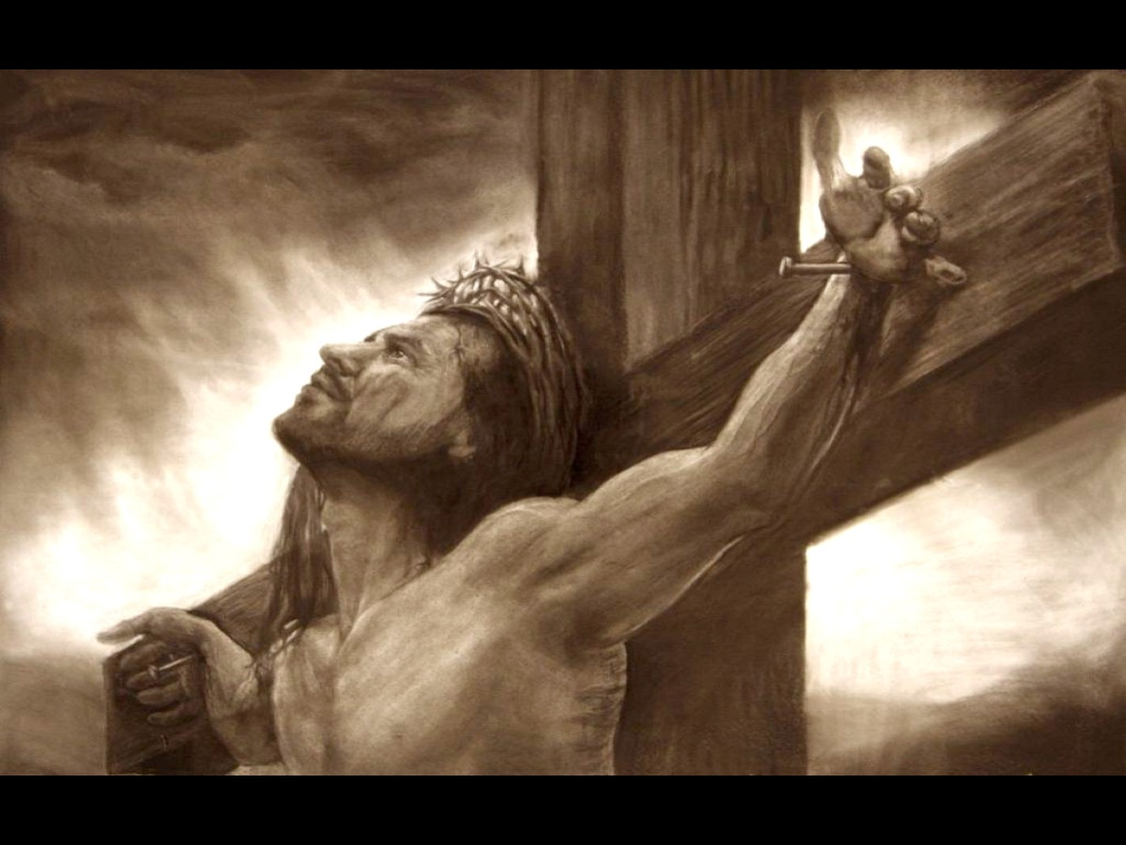
Notes:
He suffered the worst kind of death humanly possible – not for anything he had done but to bring salvation to human beings.

Slide 28
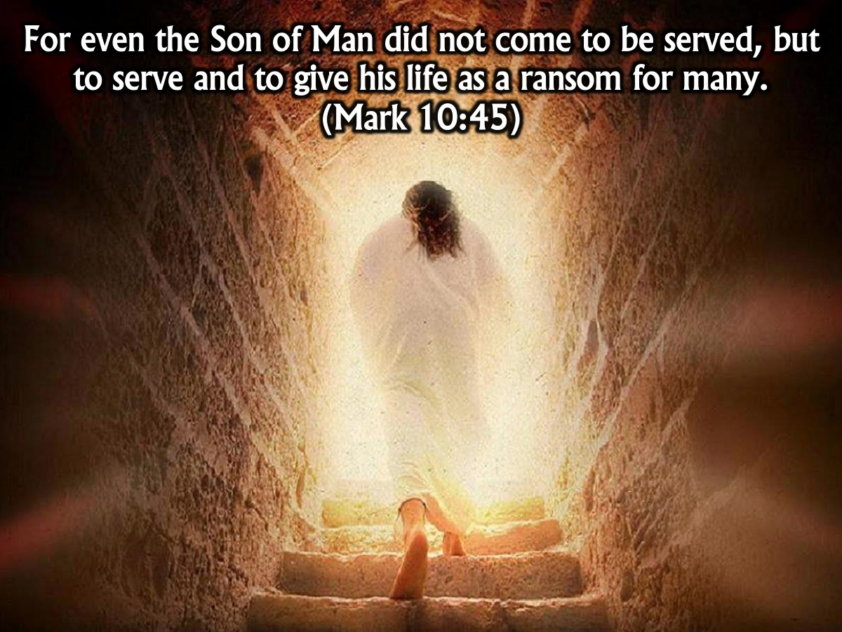
Notes:
Mark 10:45 says: “For even the Son of Man did not come to be served, but to serve and to give his life as a ransom for many.”

Slide 29
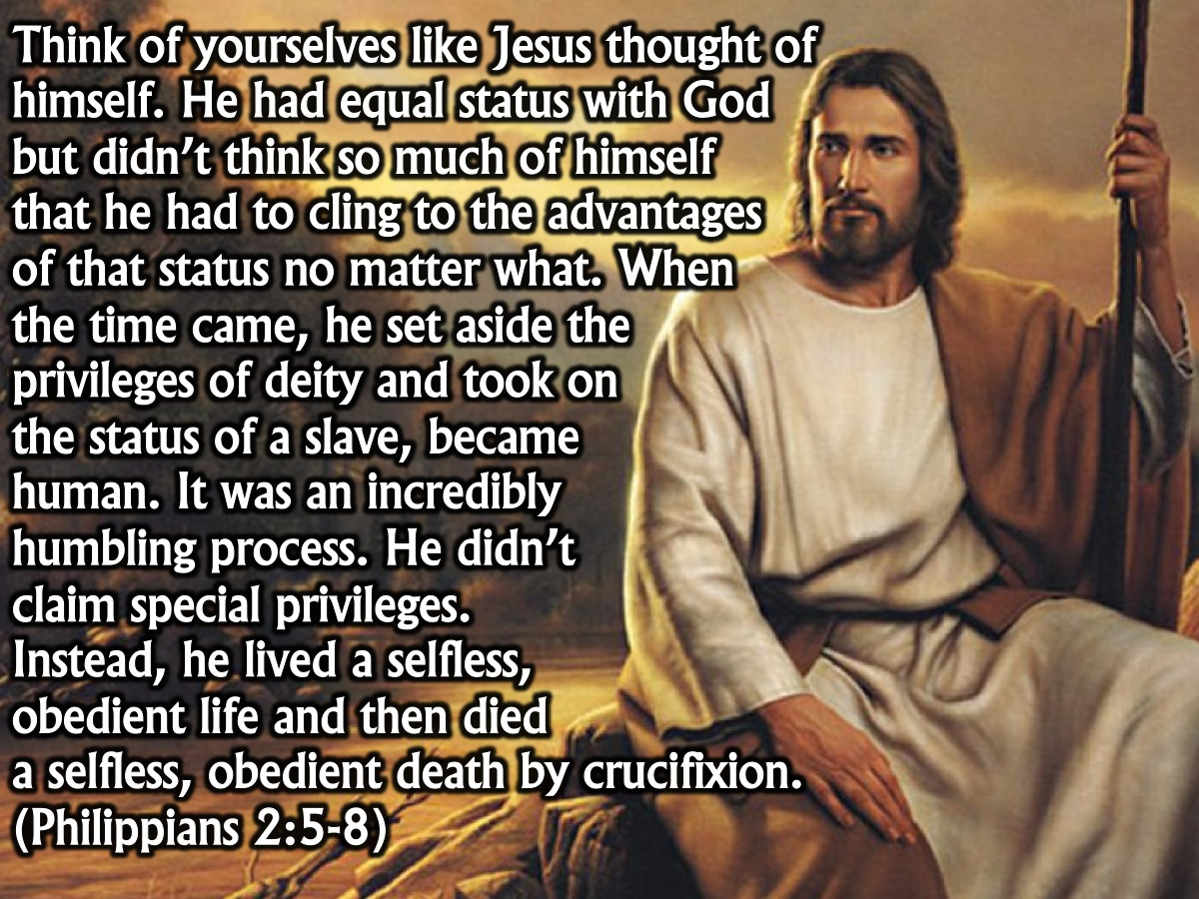
Notes:
This is how the apostle Paul described Jesus’ experience coming to earth and how we should follow his example. “Think of yourselves like Jesus thought of himself. He had equal status with God but didn’t think so much of himself that he had to cling to the advantages of that status no matter what. When the time came, he set aside the privileges of deity and took on the status of a slave, became human. It was an incredibly humbling process. He didn’t claim special privileges. Instead, he lived a selfless, obedient life and then died a selfless, obedient death by crucifixion.” (Philippians 2:5-8)

Slide 30
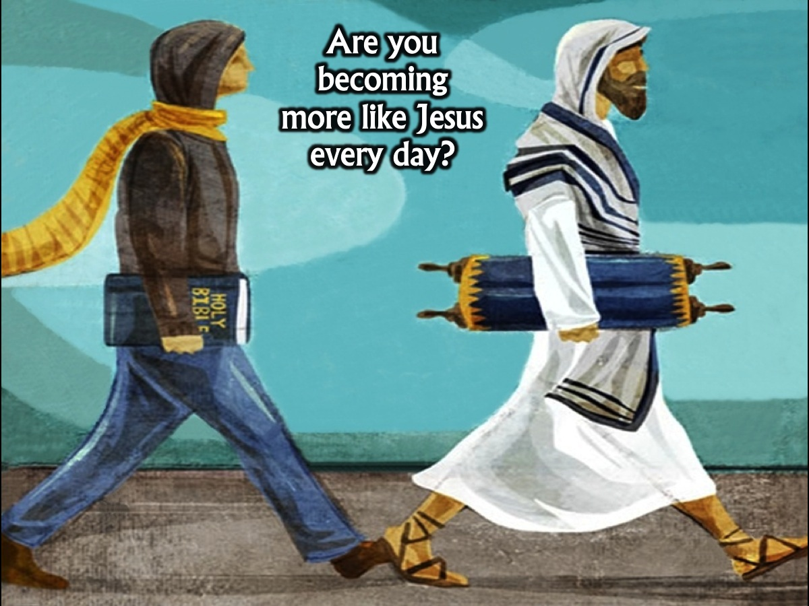
Notes:
Are you becoming more like Jesus every day?

Slide 31
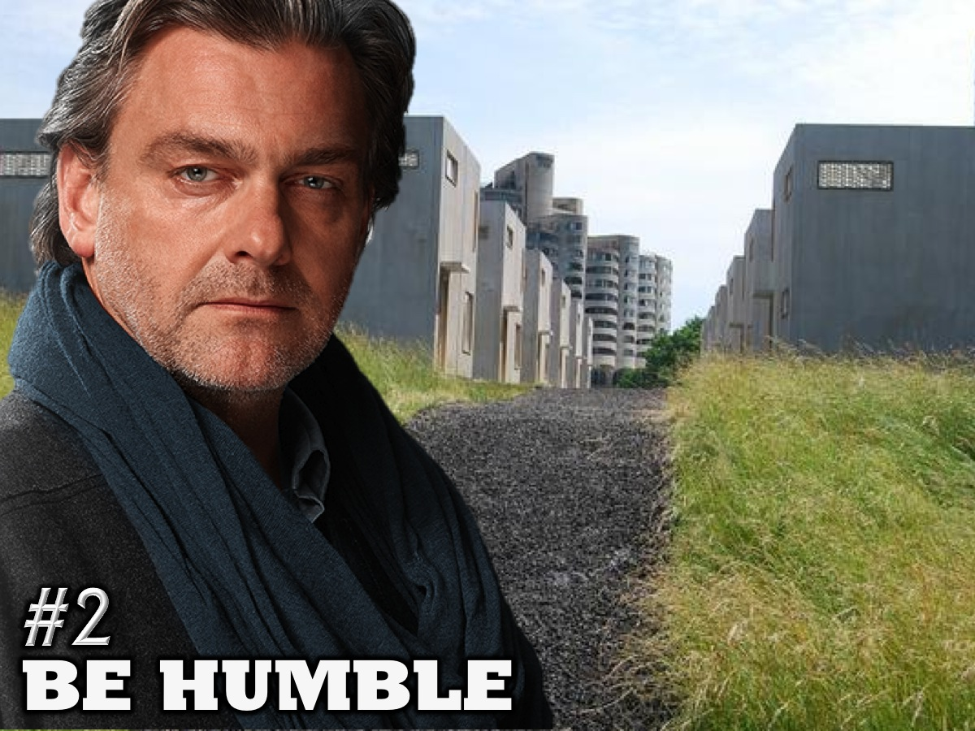
Notes:
2. Be Humble

Slide 32

Notes:
We live in the era of the selfie revolution! Digital vanity!

Slide 33
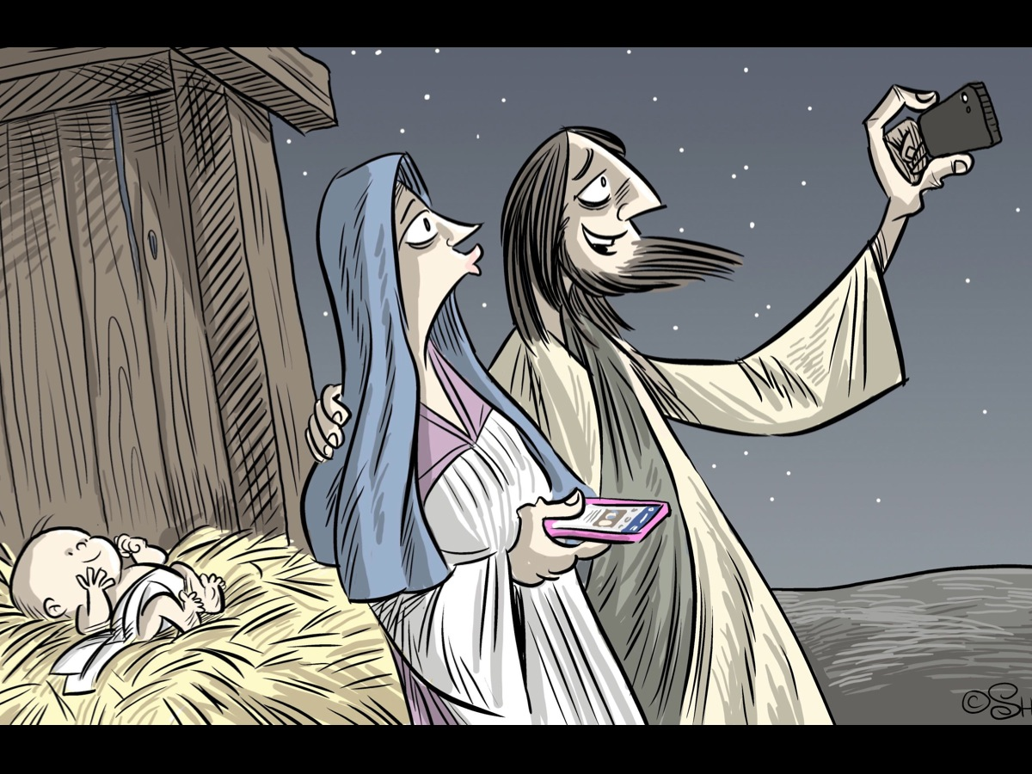
Notes:
Could you imagine if Mary and Joseph had a camera – maybe they would have taken a few selfies.

Slide 34
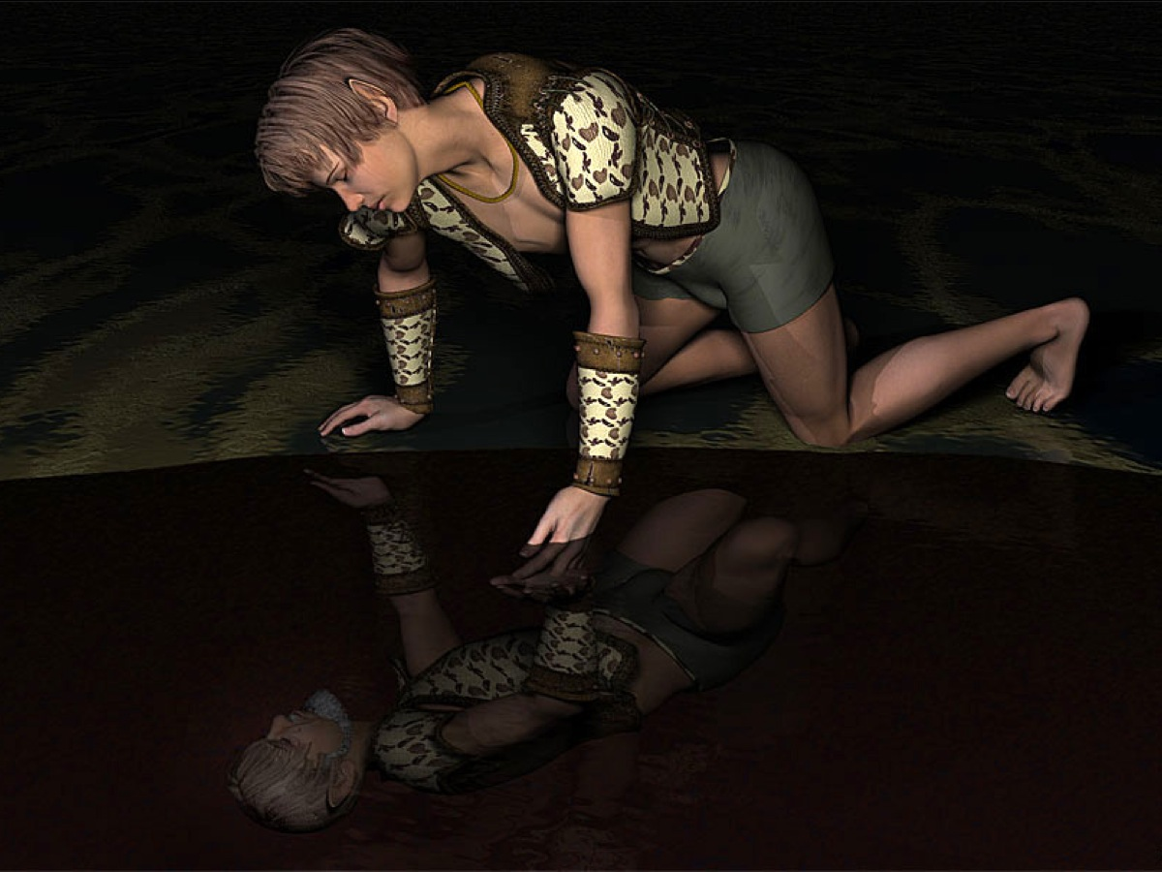
Notes:
Do you remember there was a figure in Ancient Greek mythology who became really obsessed with his own image. His name was Narcissus.We in the early 21st century are having a narcissistic moment, but it's not the first one. Narcissus, after all, was a figure from Ancient Greek mythology; we’ve been unhealthily obsessed with our own image for quite some time. Here is the story of one young man whose vanity earned the wrath of many, the pity of some and the ruin of one.
A long time ago, in the Boeotian realm of Thespiae, a boy was born to the River God Cephissus and the Naiad Liriope. Even in infancy the other nymphs, Dryads and Naiads and Oreads, of the mountain vales and forest glades could see majesty in the young boy's form. Such a sight to behold as baby became boy! His fair mother cared deeply for her boy, and sought out the legendary seer, Tiresias '"fam'd far and near for knowing things to come", for comfort as to his fate. Liriope asked the prophet if her son would enjoy a long life, or was doomed to a short one. Seeing the gift of beauty the gods had empowered the boy with beyond all other mortals, the wise sage replied "If e'er he knows himself he surely dies". "Long liv'd the dubious mother in suspence, 'till time unriddled all the prophet's sense". So the boy grew older yet, and his handsome visage stronger yet. Narcissus was the name his mother had given him, and all who set eyes upon him were stopped dead in their tracks at the sight of him. His sixteenth year began, and the list of maids who had declared their adoration for him swelled greater yet, each confession another brick in his tower of pride, each doomed to fail.
Then, one day as Narcissus hunted in the forest glades, one of the Oreads, the mountain nymphs, caught sight of him for the first time. Echo was her name, and this moment would forever haunt her destiny. Poor Echo was a cursed being. For it was the sport of Zeus the Thunderer and King of the Gods to make merry with the many nymphs of the world in secret, when Hera his wife's gaze would be averted. Many times would she have caught her husband in the act were it not for stories Echo would tell her, to delay her coming. The time came one day when the deception was laid bare before the fearsome Queen of Olympus, and the roots of the mountains shivered before her fury. "That tongue, for this thy crime, which could so many subtle tales produce, shall be hereafter but of little use". Forever would the nymph be cursed, unable to speak except the words used by others. It is from Echo's name that the aural effect today takes its name. Now Echo clapped her eyes upon the perfect youth stalking the undergrowth. Young Echo was overjoyed to see Narcissus for once alone, for usually he was trailed by a vast entourage of sycophants. But, with tears of frustration, she was unable to speak and put her feelings into words.
Long did she follow him through the woods, desperate to open her heart to Narcissus. Then, at last Narcissus is aware of her presence. Turning to see her, he laughed at her pitiable obsession, and bid her turn away. Crushed by his words, the tearful Echo took to melancholic days in solitary caves, shady glades of the woods and other dark places of despair. But the vengeful goddess Nemesis was angered by Narcissus, and wove her plans of retribution: “There stands a fountain in a darksome wood, Nor stain'd with falling leaves nor rising mud; Untroubled by the breath of winds it rests, Unsully'd by the touch of men or beasts; High bow'rs of shady trees above it grow, and rising grass and cheerful greens below... ”
So fair Narcissus, weary from his long hunt, came to the forest clearing. Wiping the sweat from his brow, he knelt at the side of a crystal pool of cool water. As he bent down to splash water on his heated face, a new kind of warmth flooded through him, as he saw a being of astonishing beauty before him. Such a handsome youth, the very image of the Olympians! Sparkling eyes, hair that Apollo himself would be loath to show. So Narcissus was consumed by the fire that was his own, though he knew not who the perfect being was in truth.
Long did Narcissus lie there, staring into the pool, thinking not of sleep or food, as his body wasted away, entranced by the passion afire within the calm ripples. To the trees of the glade Narcissus cries, languishing for he cannot ever reach his beloved, cruelly separated as they are by the surface of the pool. "When my arms I stretch, he stretches his. His eye with pleasure on my face he keeps, he smiles my smiles, and when I weep he weeps. When e'er I speak, his moving lips appear to utter something, which I cannot hear". Then the hammer blow falls, when fair Narcissus sees the truth laid bare. "It is myself I see! The happy delusion is a part of me!" A terrible sorrow gripped the proud youth for the vanity of his desire. So totally entranced was he with his own image, he did declare "I wish him absent whom I most desire, and now I faint with grief; my fate draws nigh; in all the pride of blooming youth I die. Death will the sorrows of my heart relieve!" So Narcissus turned back to the pool, as his warm tears splashed upon the surface. Now the image is but ripples and flashes, and the boy's sorrow grows "whither dost thou fly?" he laments. The Autumn began to fade, and the glorious features began to dwindle in Narcissus's form. All those things which made him desired slipped away, but there was one nearby the pool who stood there still. For Echo could not bare to leave his side, and her tears for Narcissus flowed: " She saw him in his present misery, Whom, spight of all her wrongs, she griev'd to see. She answer'd sadly to his moan, Sigh'd back his sighs, and groan'd to ev'ry groan: 'Ah youth! belov'd in vain,' Narcissus cries; 'Ah youth! belov'd in vain,' the nymph replies. 'Farewell', says he; the parting sound scarce fell from his faint lips, but she reply'd, 'farewell’. Then on th' wholesome earth he gasping lies, 'Till death shuts up those self admiring eyes... “
So Narcissus breathed his last, transfixed forever by his own reflection, and ever after one who possesses such vanity has been known as Narcissistic. Echo's heart was broken. Out of respect for her the other Naiads and Dryads sought to gather the boy's remains, but upon reaching the shore of the pool, found not bones and flesh there. In his place stood a stalk of verdant green, crowned with golden blossoms, that most majestic plant which now bears his name...

Slide 35
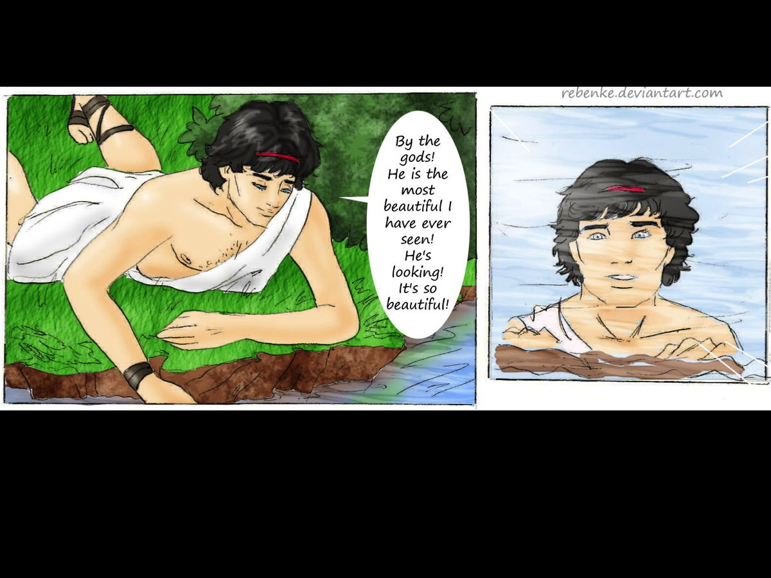
Notes:
He saw his reflection in some water one day and was attracted to it…

Slide 36
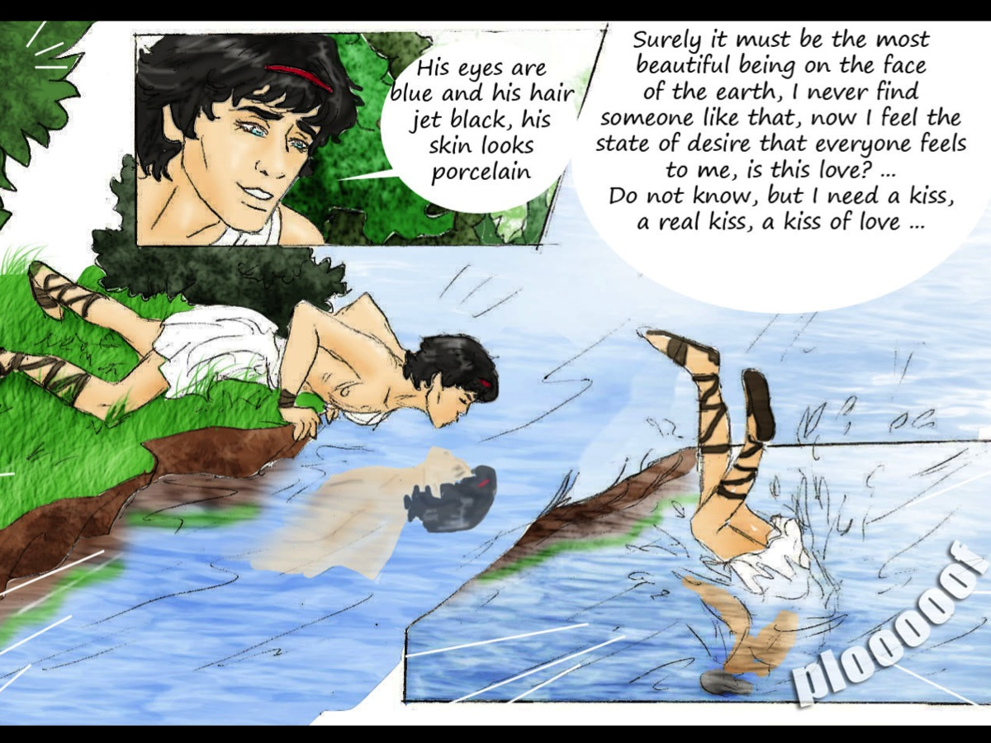
Notes:
He was so overcome that he ended up falling into the river…

Slide 37
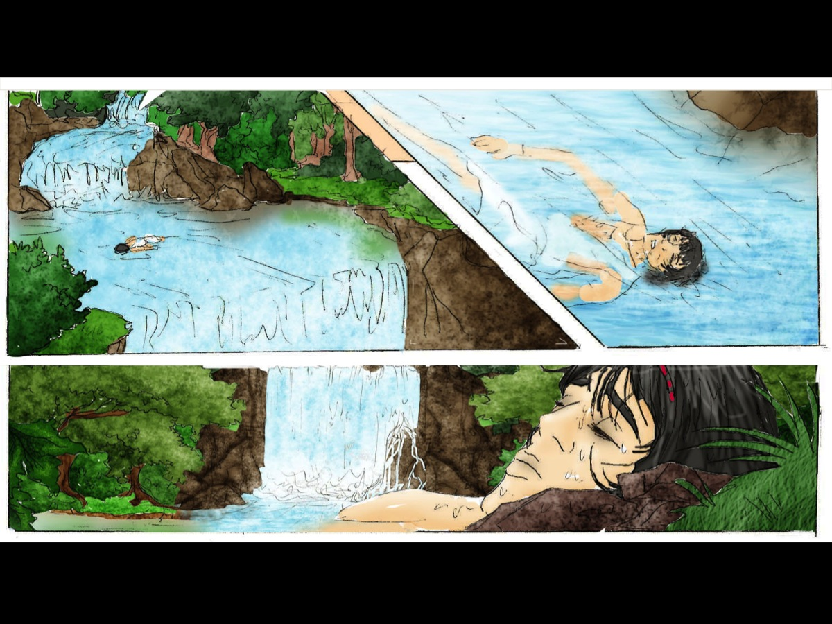
Notes:
And drowned.

Slide 38
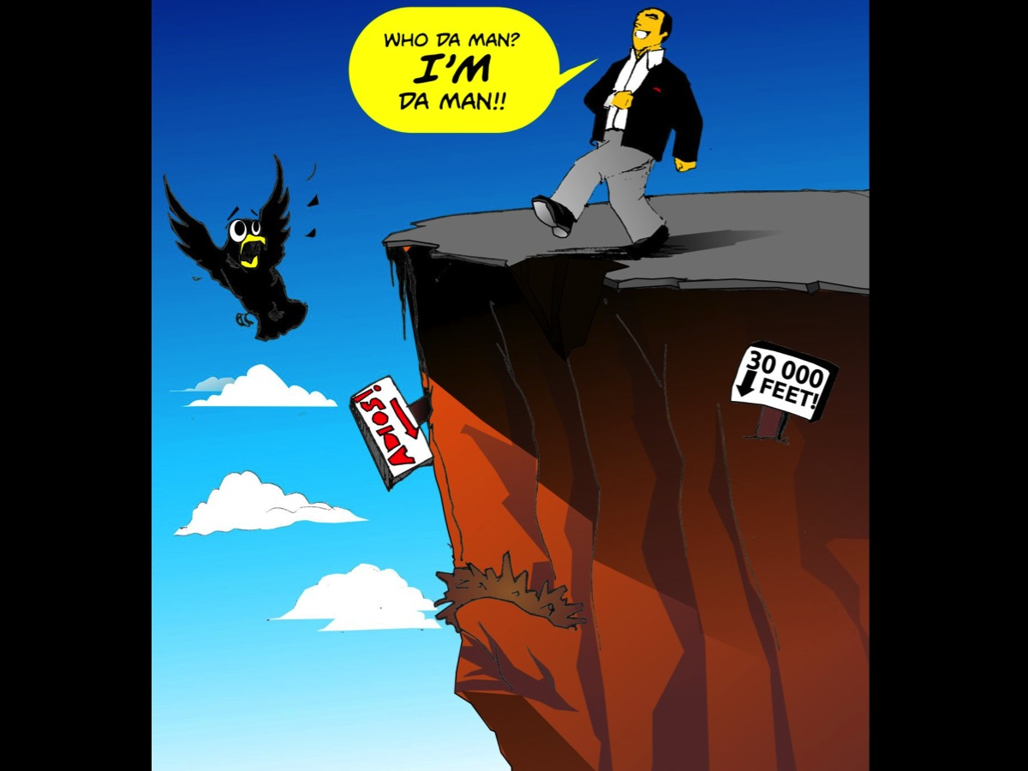
Notes:
Pride is a terrible thing!

Slide 39

Notes:
In fact, there is a true saying that pride goes before a fall.

Slide 40
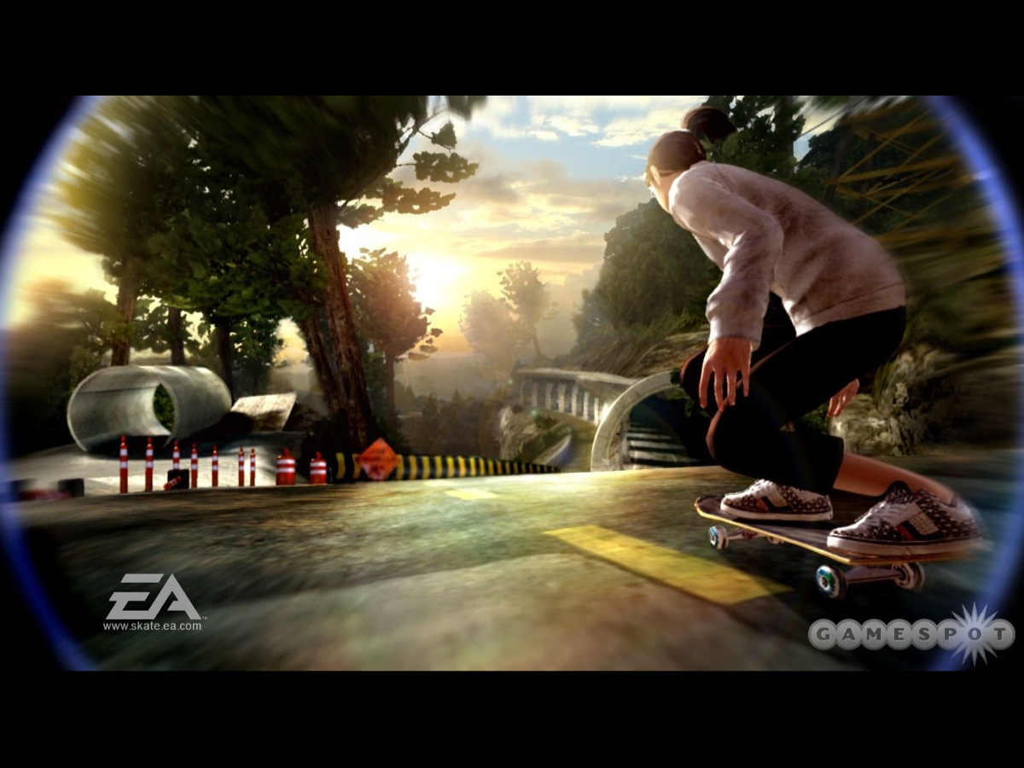
Notes:
I have always had a passion for skateboarding!

Slide 41
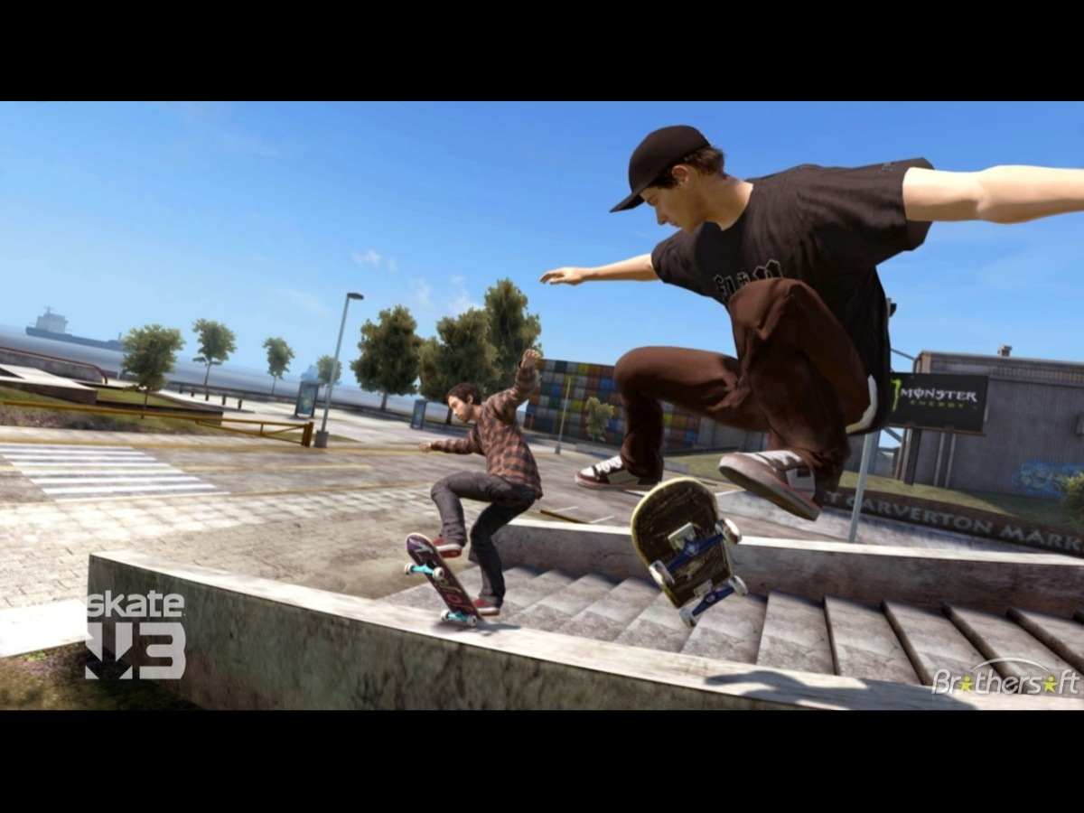

Slide 42
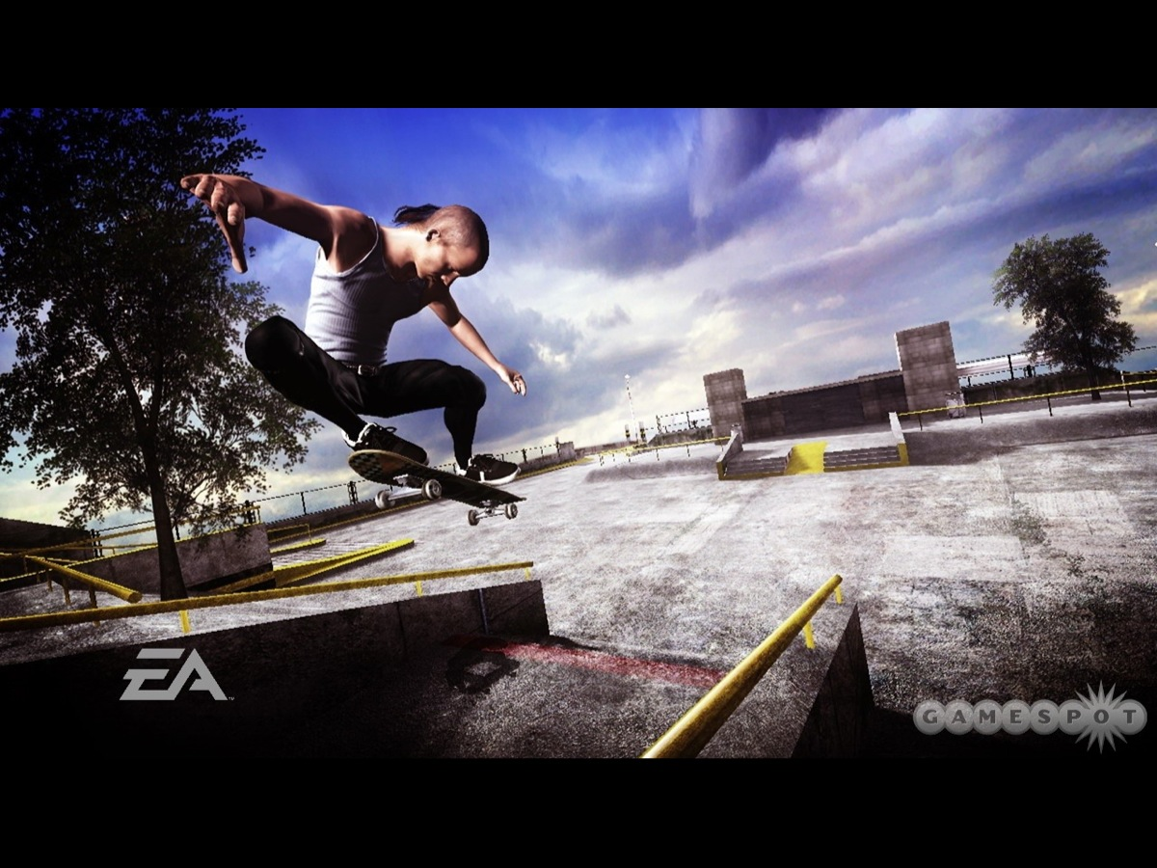

Slide 43
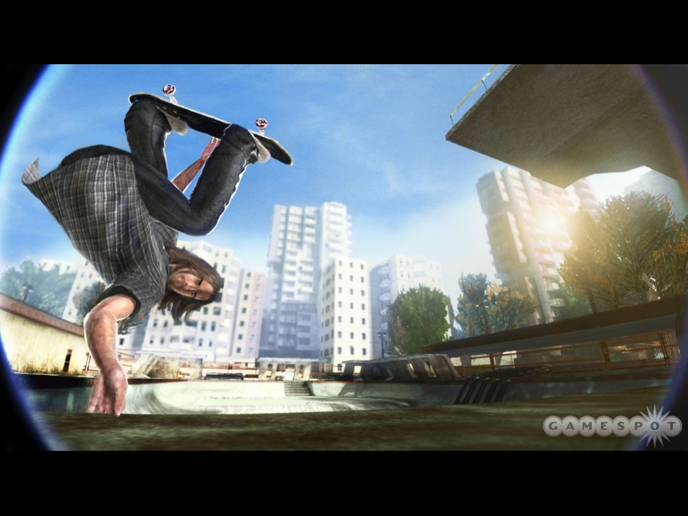

Slide 44
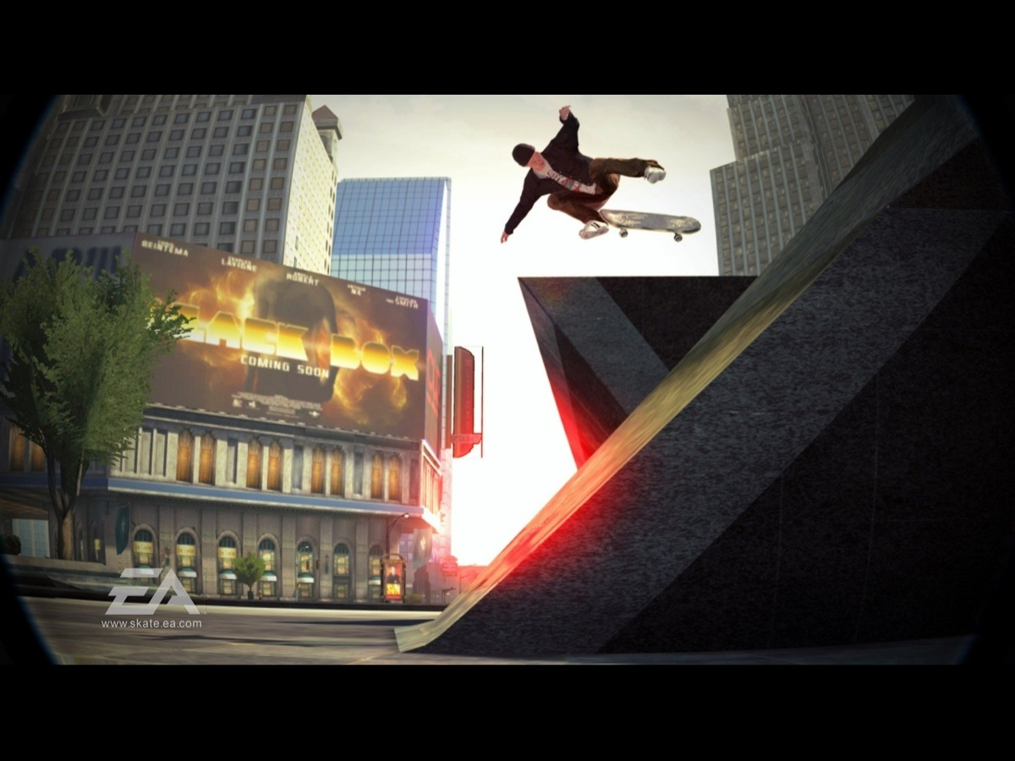

Slide 45
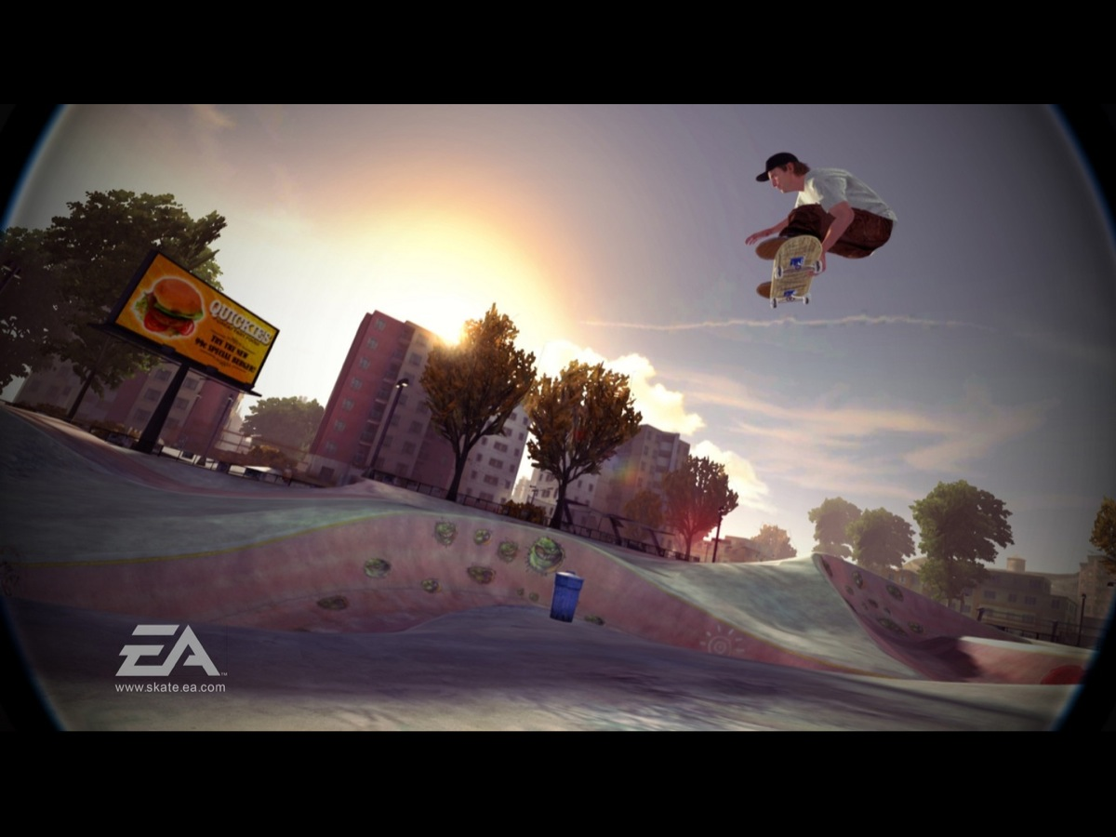

Slide 46
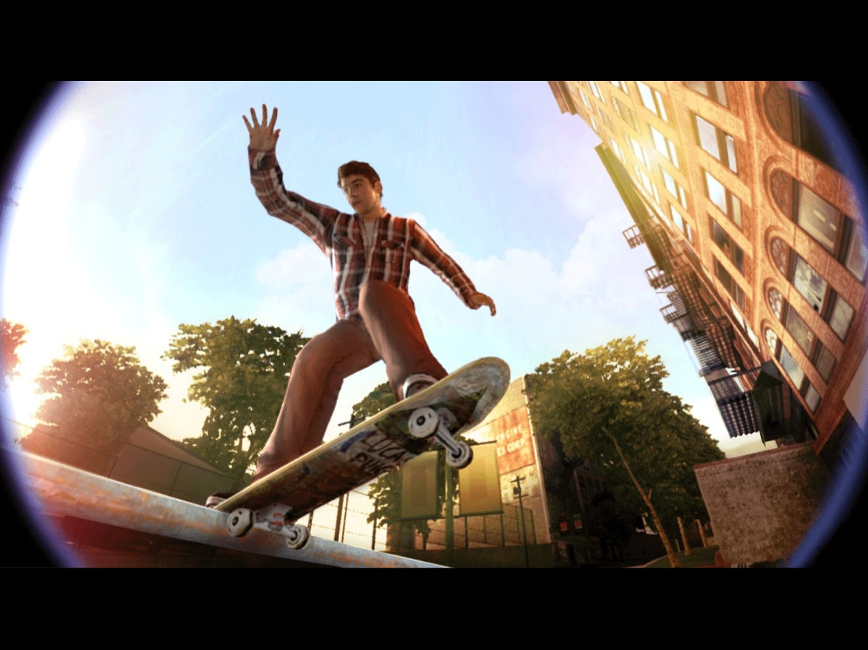
Notes:
But I have had three experiences in my life when pride literally went before a fall.

Slide 47
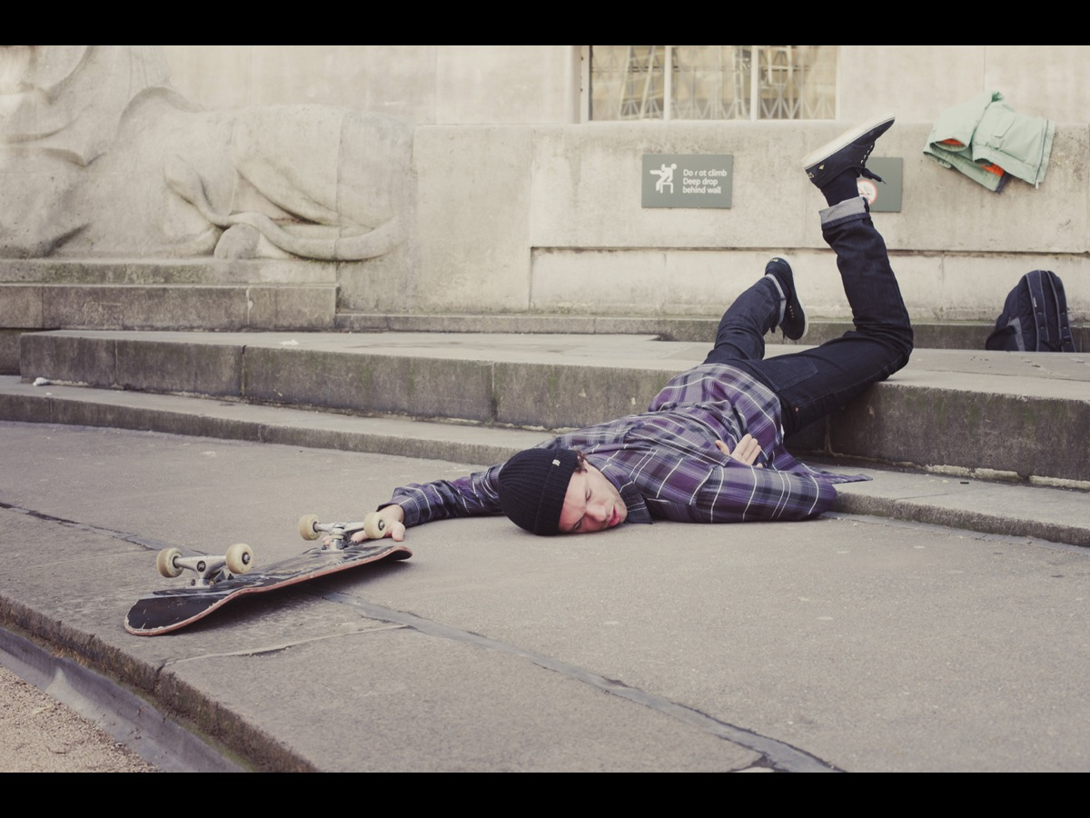
Notes:
Once when I was trying to show off to my sister in our driveway – and I ended up with very grazed knees, once when I was trying to impress Debbie who I was hoping to start dating (on that occasion I hit some gravel and tumbled really badly) and once at a youth camp where I thought I would show all the kids how it is done and the board just got away from me and the landing was not too well executed. Each time I paid the price for thinking more highly of my skills and trying to impress people.

Slide 48
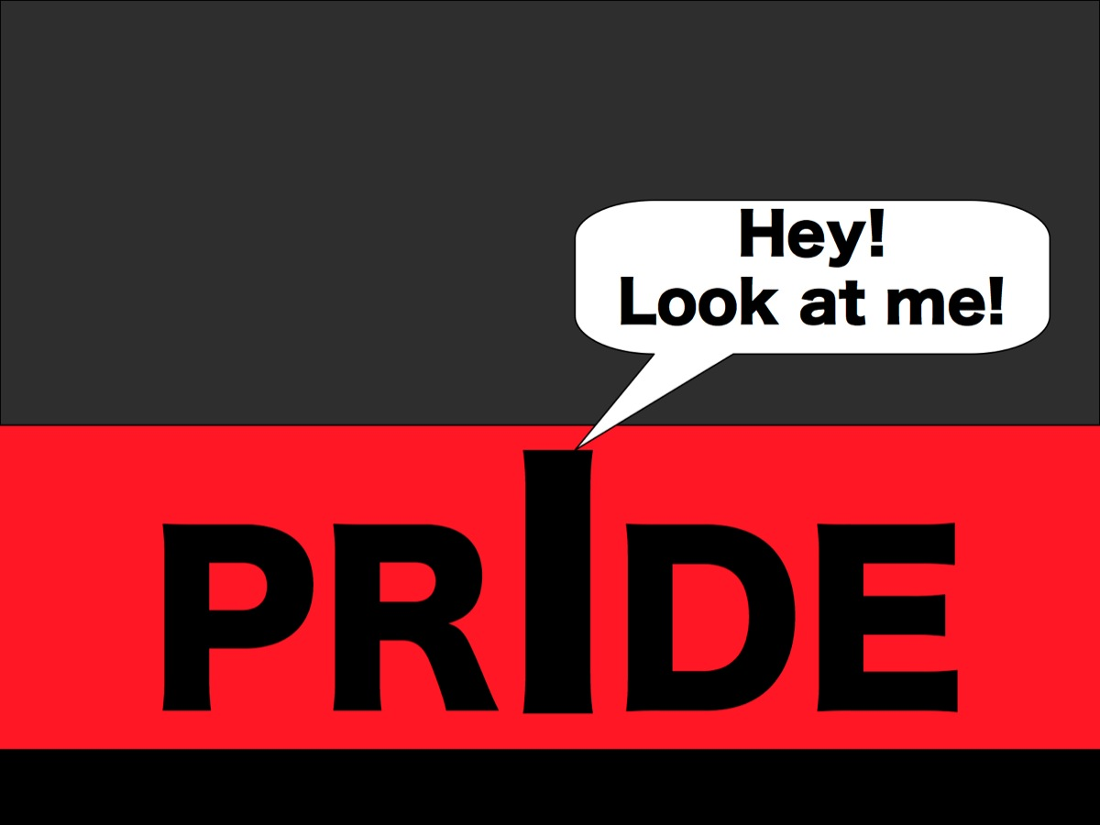
Notes:
The problem is with the i in Pride! In Zulu there is a phrase: “Booga mina! Which literally means: “Look at me!”

Slide 49
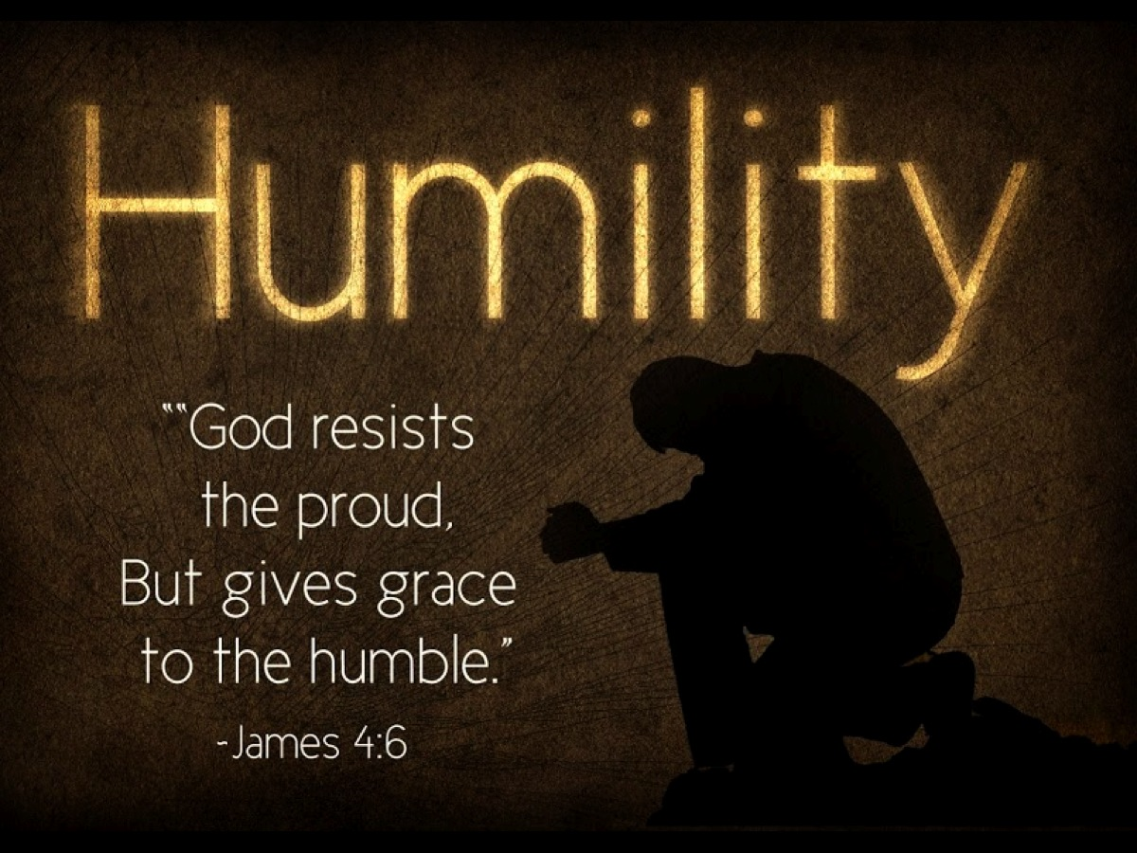
Notes:
James 4:6 says that God resists the proud but gives grace to the humble.

Slide 50
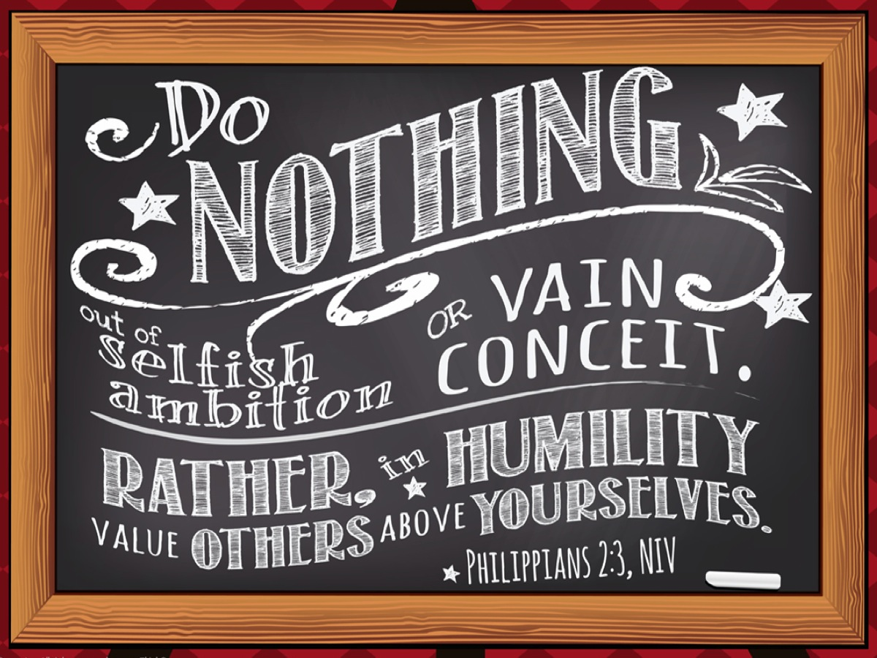
Notes:
Philippians 2:3 says: Do nothing out of selfish ambition or vain conceit. Rather, in humility value others above yourselves, ⁴ not looking to your own interests but each of you to the interests of the others.

Slide 51
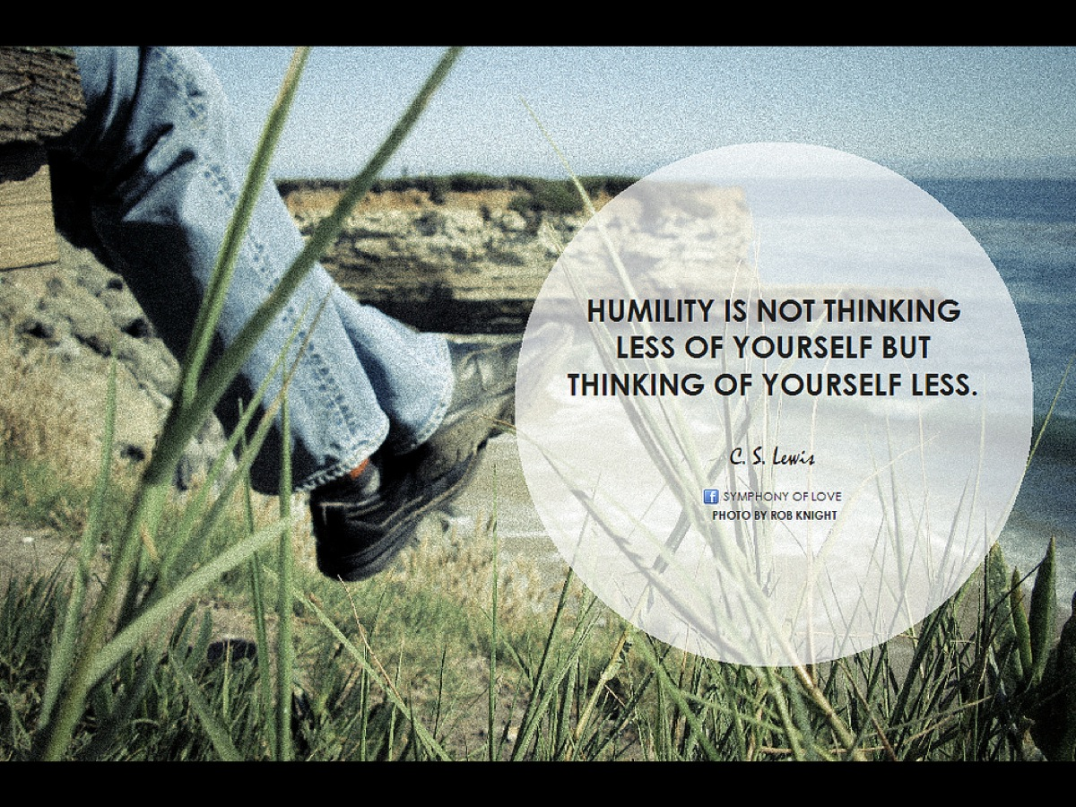
Notes:
C.S. Lewis said, “Humility is not thinking less of yourself, but thinking of yourself less.”

Slide 52
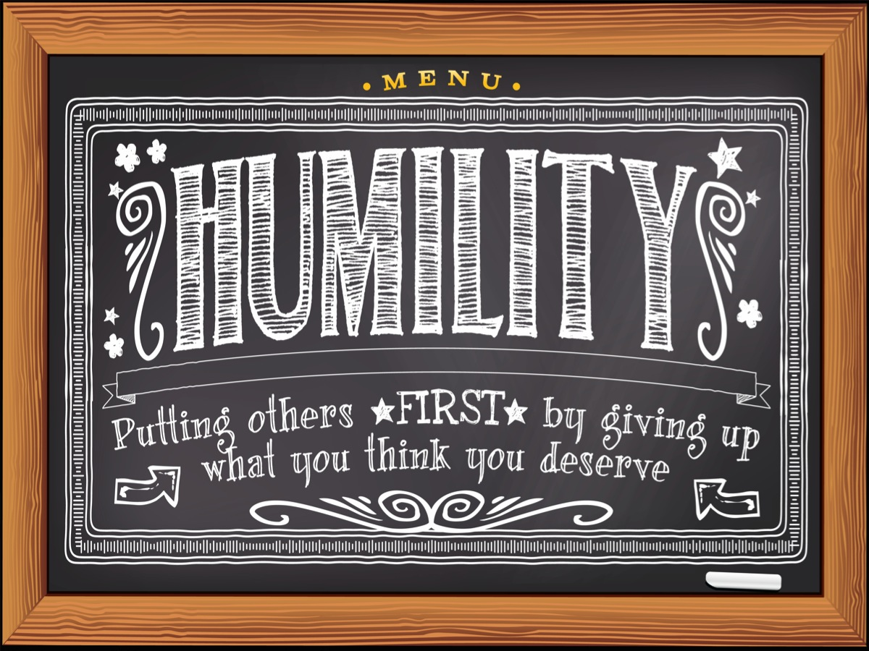
Notes:
More practically, humility is putting others first by giving up what you think you deserve.

Slide 53
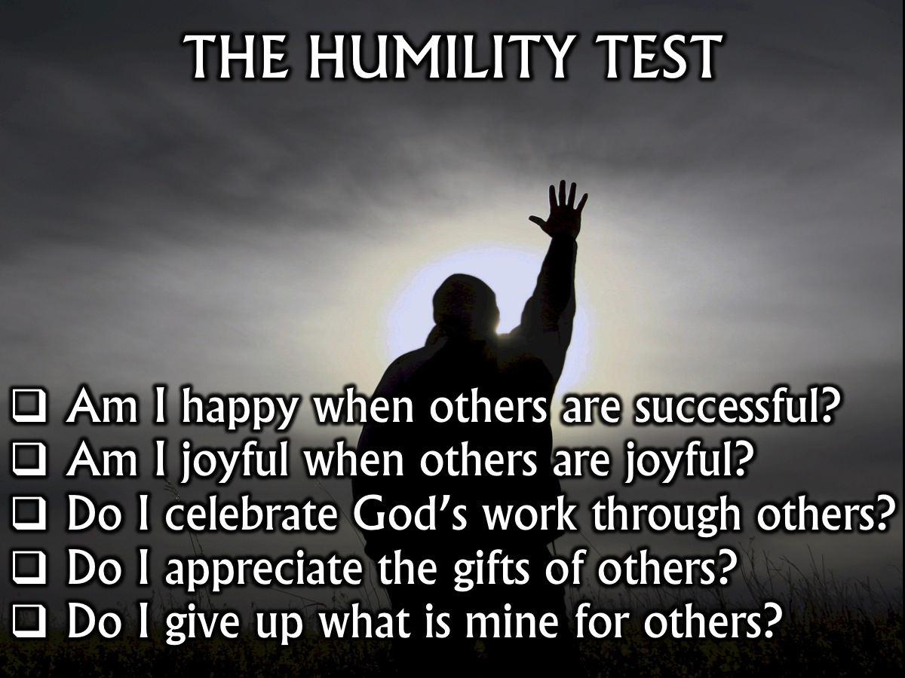
Notes:
Are you ready to take the Humility Test? Which of these could you put a tick mark next to?
* Am I happy when others are successful?
* Am I joyful when others are joyful?
* Do I celebrate God’s work through others?
* Do I appreciate the gifts of others?
* Do I give up what is mine for others?

Slide 54
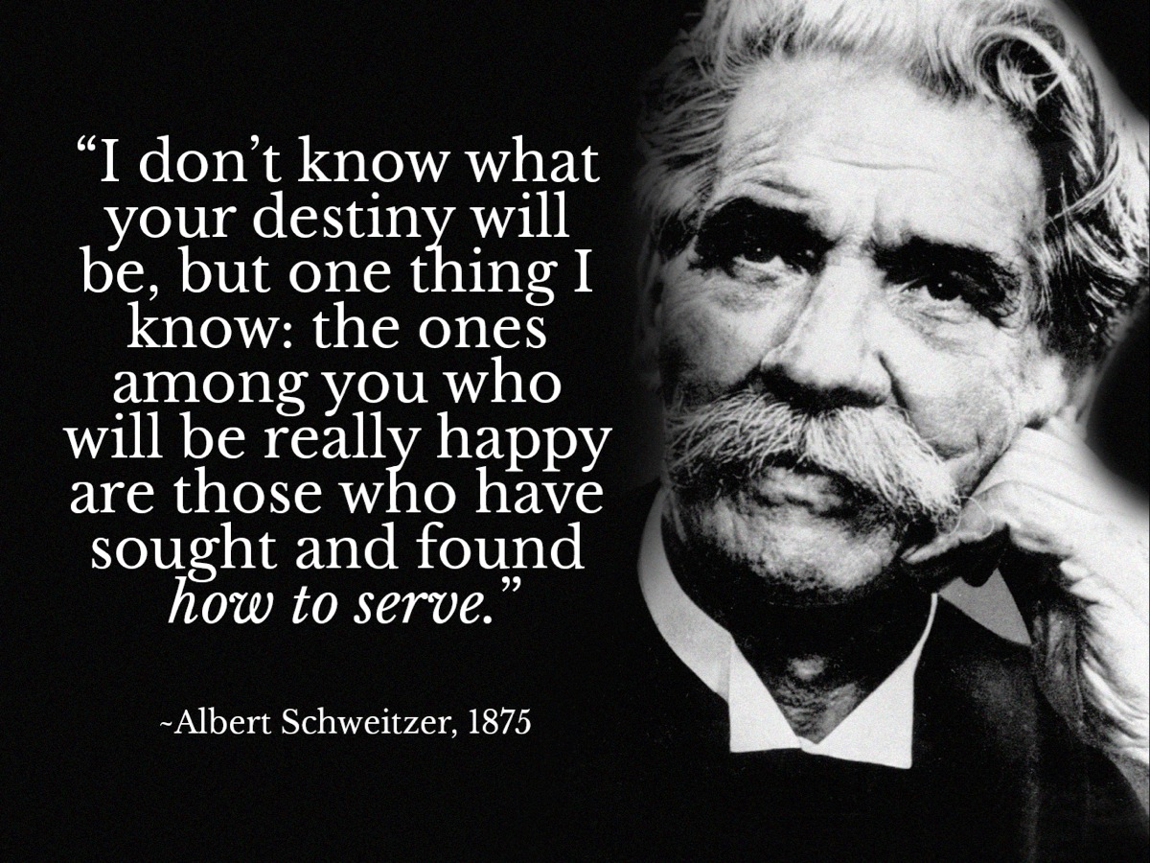
Notes:
Albert Schweitzer said: “I don’t know what your destiny will be, but one thing I know: the ones among you who will be really happy are those who have sought and found how to serve.”

Slide 55
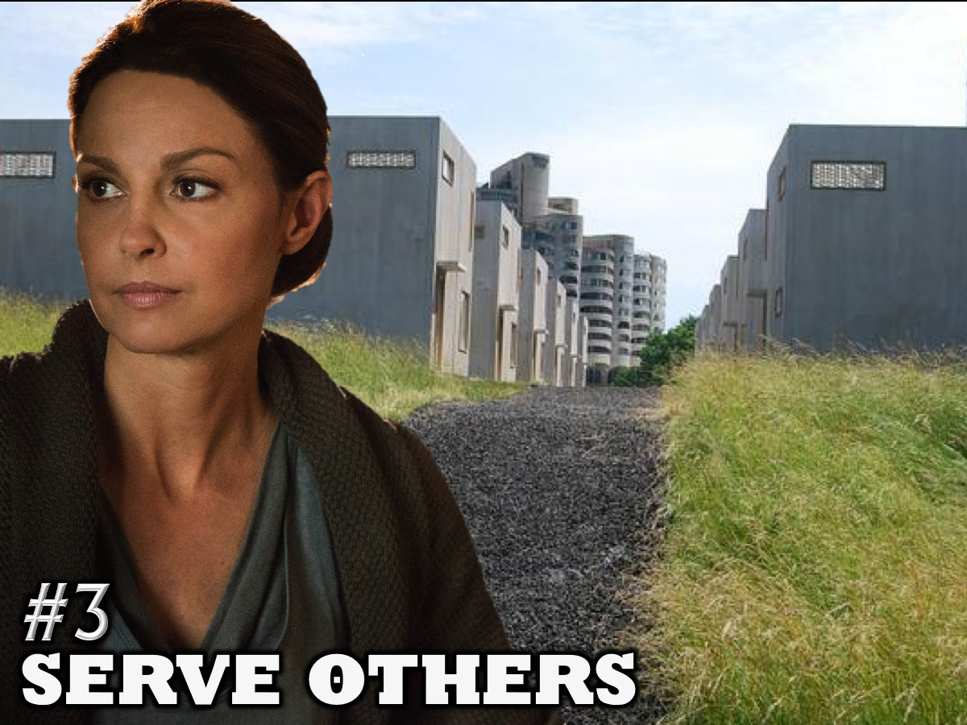
Notes:
3. Serve Others.

Slide 56
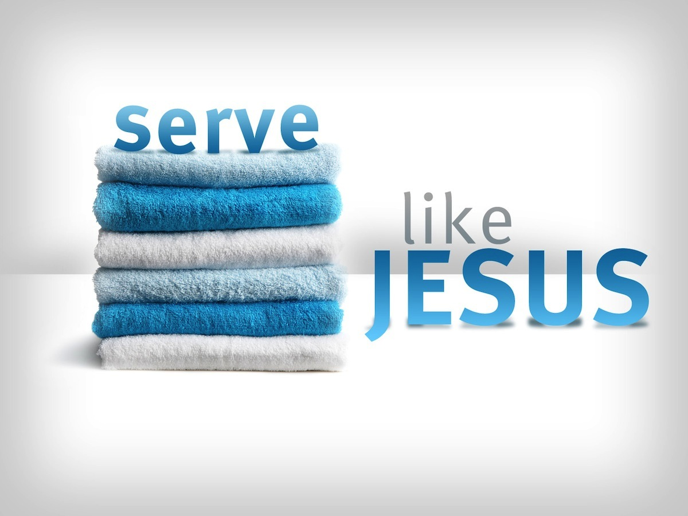
Notes:
We began by reflecting on how we are to copy the example of Jesus. His whole life was lived to serve people.

Slide 57
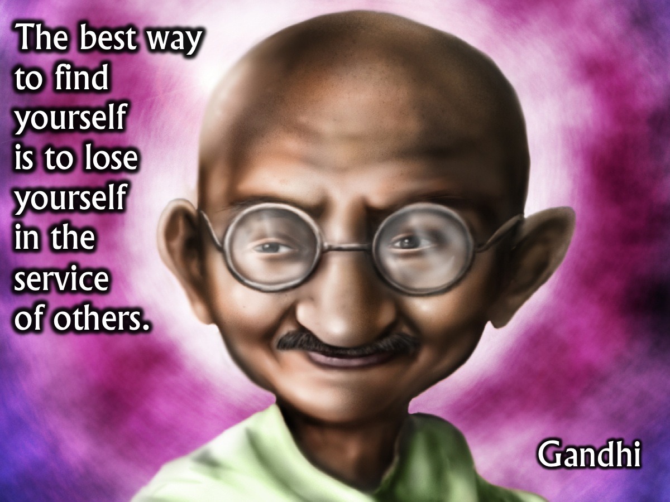
Notes:
Gandhi once said that: “The best way to find yourself is to lose yourself in the service of others”. (Gandhi)

Slide 58
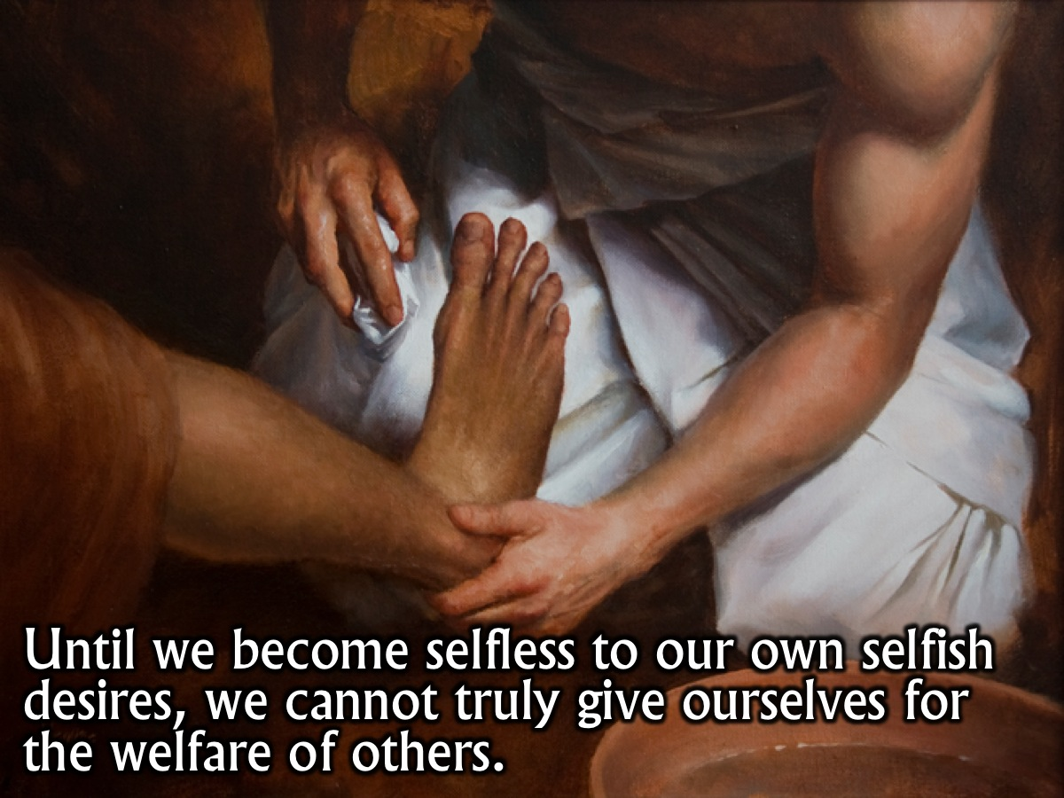
Notes:
Until we become selfless to our own selfish desires, we cannot truly give ourselves for the welfare of others.

Slide 59

Notes:
Find joy in helping others and making other people happy!

Slide 60

Notes:
“If you can’t feed a hundred people, then feed just one.” (Mother Teresa)

Slide 61

Notes:
Be more concerned with the needs and wishes of others than with your own.

Slide 62

Notes:
Give up your seat to someone who needs it more than you do!

Slide 63

Notes:
Give things away to someone who is less fortunate than you are.

Slide 64

Notes:
“Then the King will say to those on his right, ‘Come, you who are blessed by my Father; take your inheritance, the kingdom prepared for you since the creation of the world. “For I was hungry and you gave me something to eat, I was thirsty and you gave me something to drink, I was a stranger and you invited me in, I needed clothes and you clothed me, I was sick and you looked after me, I was in prison and you came to visit me.’ “Then the righteous will answer him, ‘Lord, when did we see you hungry and feed you, or thirsty and give you something to drink? When did we see you a stranger and invite you in, or needing clothes and clothe you? When did we see you sick or in prison and go to visit you?’ ‘The King will reply, ‘Truly I tell you, whatever you did for one of the least of these brothers and sisters of mine, you did for me.” (Matthew 25)

Slide 65

Notes:
“Then the King will say to those on his right, ‘Come, you who are blessed by my Father; take your inheritance, the kingdom prepared for you since the creation of the world. “For I was hungry and you gave me something to eat, I was thirsty and you gave me something to drink, I was a stranger and you invited me in, I needed clothes and you clothed me, I was sick and you looked after me, I was in prison and you came to visit me.’ “Then the righteous will answer him, ‘Lord, when did we see you hungry and feed you, or thirsty and give you something to drink? When did we see you a stranger and invite you in, or needing clothes and clothe you? When did we see you sick or in prison and go to visit you?’ ‘The King will reply, ‘Truly I tell you, whatever you did for one of the least of these brothers and sisters of mine, you did for me.” (Matthew 25)

Slide 66

Notes:
Let me remind you of some things you can do to serve: (1) Give things up, (2) Let others go first, (3) Put the needs of others first, (4) Sacrifice for others.

Slide 67

Notes:
Prayer

Slide 68


Slide 69

Notes:
I would like to be Dauntless but I’m not brave. I’d like to be Erudite but I don’t thirst for knowledge. I’d like to be Amity but I’m not happy. I’d like to be Candor but I’m not honest. I’d like to be Abnegation but I’m selfish.

Slide 70

Notes:
We are meant to be Divergent – those who live out these five values!

Slide 71

Notes:
In the first book in the trilogy, Tobias says: “I think we've made a mistake. We've all started to put down the virtues of the other factions in the process of bolstering our own. I don't want to do that. I want to be brave, and selfless and honest and smart and kind.”

Slide 72


Slide 73


Slide 74


Slide 75


Slide 76


