Slide 1
Notes:
Objective: A Friday night youth group evening to introduce the Divergent Series.
Preparation
Teens will not be allowed to enter the room before the doors open – they are given refreshments in a second venue. When it is time to start they enter the room and are randomly given wrist bands to wear – either orange, grey, white, black or blue – representing the different factions. They are seated in five different sections of chairs (with faction logos painted on canvas hanging at the back of each section.) Faction leaders help to seat the teens in their factions.
Soundtrack Music: 01 Tris

Slide 2
Notes:
Welcome to the Choosing Ceremony
Narrator: “Welcome to the choosing Ceremony – today is a really important day in your lives. As you have turned 16 you have the opportunity to reflect on the faction you were born into and the responsibility to choose the faction you will belong to for the rest of your life. Here is a video that will give you some background about this momentous occasion:”

Slide 3
Notes:
Video: Final Divergent movie trailer (the first 35 seconds). Get it on YouTube at: https://www.youtube.com/watch?v=336qJITnDi0

Slide 4
Notes:
Introduction of the 5 Factions
Narrator: “As you are all aware there are five different factions seated in this auditorium this evening. This video will set the scene as we welcome each faction:”

Slide 5
Notes:
Video: Every Faction has a role (very edited version). Get it on YouTube at: https://www.youtube.com/watch?v=336qJITnDi0

Slide 6
Notes:
Narrator: “Welcome to the Amity faction - You are the Peaceful!” (Applause)

Slide 7
Notes:
Narrator: “Welcome to the Abnegation faction - You are the Selfless!” (Applause)

Slide 8
Notes:
Narrator: “Welcome to the Candor faction – You are the Honest!” (Applause)

Slide 9
Notes:
Narrator: “Welcome to the Dauntless faction – You are the Brave!” (Applause)

Slide 10
Notes:
Narrator: “Welcome to the Erudite faction - You are the Intelligent!” (Applause)

Slide 11
Notes:
The Aptitude Test
Narrator: "I am going to ask the leader of the Erudite faction to come and explain the Aptitude Test that you will be taking tonight."
Erudite Leader: "It is time for you to take your Aptitude Test. It will help you with the decision you are going to make about which faction to join for the rest of your life. Please take the Aptitude test page and write your name on it and then as each question is read out, choose one of the answers that most suits you and write down the letter for each question – either A, B, C, D or E."
(Note: The Erudite Leader is dressed like Jeanine Matthews in Divergent. )
(Note: The Erudite Leader continues to read our the six questions allowing time for teens to record their answers)
Soundtrack Music: 02 The Test

Slide 12
Notes:
1. You want people to see you as:
A. Liked by everyone
B. Helping people in need
C. Trustworthy
D. Their protector
E. A wise counselor

Slide 13
Notes:
2. When faced with a difficult situation, you:
A. Create some art to express your feelings
B. Do whatever is best for the most people
C. Debate the issue with your friends
D. Face it head-on
E. List pros and cons and choose the best option

Slide 14
Notes:
3. What do you like to do in your spare time:
A. Paint, dance or write
B. Volunteer to help people
C. Share opinions with your friends
D. Rock climb or skydive
E. Read for pleasure

Slide 15
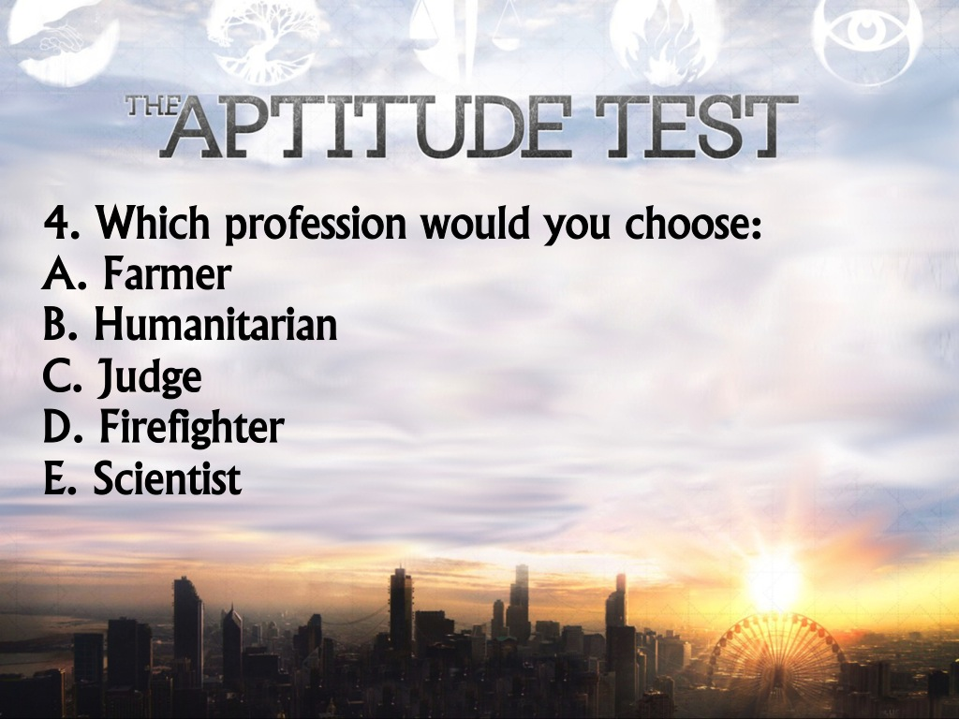
Notes:
4. Which profession would you choose from this list:
A. Farmer
B. Humanitarian
C. Judge
D. Firefighter
E. Scientist

Slide 16
Notes:
5. What do you choose to wear for the day:
A. Something comfortable
B. Whatever will attract the least attention
C. Something true to who you are
D. Whatever will attract the most attention
E. Something that makes you look smart

Slide 17
Notes:
6. What is your highest priority right now:
A. Finding peace and happiness for yourself
B. Serving those around you
C. Seeking truth in all things
D. Developing your strength of character
E. Being successful in your studies

Slide 18
Notes:
The Aptitude Test Results
Erudite Leader: “Look at your answers and see which is the most common letter you wrote down - that is the faction you should join:
If you scored mostly A’s you are AMITY
If you scored mostly B’s you are ABNEGATION
If you scored mostly C’s you are CANDOR
If you scored mostly D’s you are DAUNTLESS
If you scored mostly E’s you are ERUDITE”

Slide 19
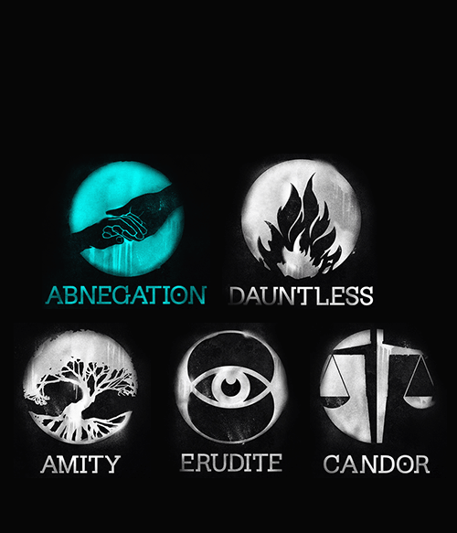
Notes:
Choosing of the New Factions
Erudite Leader Says: “It is time for you to choose your new faction. The aptitude test will give you a good idea of which faction to choose but the choice is still yours. As we ask each row across the factions to come forward you will approach the table in front, remove your old faction wrist band and place it in the container, also place your aptitude test in the jar, then take some red “blood” (confetti) and place it in the bowl that belongs to your new faction and then make your way to where your new faction is seated – you will be welcomed by them.”
(Note: Teens are instructed to choose their new faction based primarily on the test (the choice is still their) and they approach the table in front, place their old bands in the small containers (half filled with extra bands), and place their test papers in the box required and place some “blood” (red confetti) into the corresponding bowl to choose their new faction. They approach the tables line by line across all the factions and when they return to their new faction (or previous) they are welcomed by applause and cheers. The box of aptitude test papers is removed for later use!)

Slide 20
Notes:
Reading of the Faction Manifestos
(Note: A member of each faction comes to the mic and reads their respective manifesto - in the order on the slide).
Narrator: “A member from each of the five factions will now come forward to read their faction manifesto.”

Slide 21
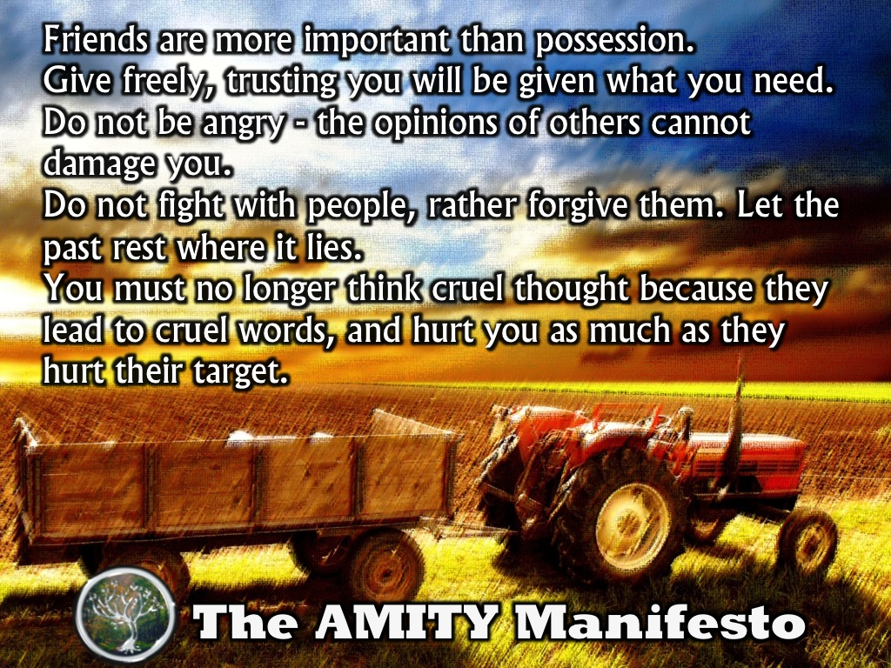
Notes:
Amity Manifesto (Read by the Amity Leader)
Friends are more important than possession.
Give freely, trusting you will be given what you need.
Do not be angry - the opinions of others cannot damage you.
Do not fight with people. The wrong is past. You must let it rest where it lies.
You must no longer think cruel thoughts. Cruel thoughts lead to cruel words, and hurt you as much as they hurt their target.

Slide 22
Notes:
Abnegation Manifesto (Read by the Abnegation Leader)
I will be my undoing if I become my obsession.
I will forget the ones I love if I do not serve them.
I will war with others if I refuse to see them.
Therefore I choose to turn away from my reflection, to rely not on myself but on my brothers and sisters, to project always outward until I disappear.

Slide 23
Notes:
Candor Manifesto (Read by the Candor Leader)
We have a vision of an honest world where people do not lie to each other.
We are free to expose our dark secrets because we know the dark secrets of those around us.
We know that while we are flawed in a unique way, we are not unique because we are flawed. Therefore we can be authentic.
We have no suspicions and we are at peace with those around us.
A life of truth makes us transparent and strong.

Slide 24
Notes:
Dauntless Manifesto (Read by the Dauntless Leader)
We believe that cowardice is to blame for the world’s injustices.
We believe that sometimes we must fight for peace.
We believe in acknowledging and facing our fear.
We believe in freedom from fear, in denying fear the power to influence our decisions.
We believe in ordinary acts of bravery, in the courage that drives one person to stand up for another.
We believe in shouting for those who can only whisper, in defending those who cannot defend themselves.
We believe in bold words and bold deeds.

Slide 25
Notes:
Erudite Manifesto (Read by the Erudite Leader)
Ignorance is defined not as stupidity but as lack of knowledge.
Lack of knowledge inevitably leads to lack of understanding which leads to a disconnect among people with differences which leads to conflict.
Knowledge is the only logical solution to the problem of conflict.
To eliminate conflict we must eliminate the disconnect among those with differences by correcting the lack of understanding that arises from ignorance with knowledge.

Slide 26
Notes:
Activities in New Factions
Narrator: “Before we proceed – please could you stack the chairs on the side of the room and make your way back to where you were seated in your factions.”
(Note: Once chairs are packed away…)
Narrator: “You are going to spend the next ten minutes or so in your factions – your leader will lead you during this times.”
(Notes: (1) AMITY faction members sit in small groups of 5 or 6 and send one person into the circle at a time and everyone shares one thing that they appreciate about each person in the middle. (2) ABNEGATION are asked to plan how they could raise money to feed people in the community (the factionless) and collect and distribute blankets as winter approaches and also have to go and get sweets from the kitchen for everyone in the room and hand them out. (3) CANDOR take turns allowing one person at a time to stand in front of their faction and they have to answer 3 questions honestly: (a) What was your most embarrassing moment? (b) What was the last lie you told? (b) What have you taken that did not belong to you? As each person finishes sharing, the group says in unison: “Thank you for your honesty!” (4) DAUNTLESS members do the following: an instructor gathers the group, has them all do 3 pushups, then gets some to arm wrestle, some to play darts and some to jump off the stage to see who can jump the further rest (chalk is used to mark each consecutive jump). (5) ERUDITE members divide into 2 or 3 small groups and are given a quiz based on general knowledge to see which group is the smartest. A prize is given to the winning group.)
Soundtrack Music: 03 Choosing Dauntless

Slide 27
Notes:
The Reveal of the Divergents
(Note: As dramatic music plays, Jeanine Matthews from Erudite comes forward with an important announcement.”)
Erudite Leader Says: As we looked at the aptitude tests that you completed tonight it came to our attention that there are individuals who are Divergent hiding among the Factions. Here is a video that will set the scene:
Soundtrack Music: 08 Fear Part 1

Slide 28
Notes:
Video: The Divergents. Get it on YouTube at: https://www.youtube.com/watch?v=Oj_dADlZNiI

Slide 29
Notes:
Rewarding of the Divergents
Erudite Leader: “I am going to read the names of all of you that are Divergent. As your name is read, please stand and make your way to the front. Do not attempt to try and escape as members of the Dauntless elite forces will ensure compliance.”
(She reads out the names of 10 people chosen from the aptitude tests – those who scored high in two or more factions.)
(Note: Dauntless members escort the Divergents to the front and stand guard over them.)
Erudite Leader: “You may be wondering why we have singled you out. Previously we used to think that people who show evidence of different factions in the way they think or act are a problem to our system of government, however, the latest research has shown that in fact, they are the hope for our future and as such, we are going to reward them and urge the rest of your to follow their examples!”
(Note: Some of the Erudite members hand out the chocolates as rewards)
Soundtrack Music: 08 Fear Part 2

Slide 30
Notes:
Message about Divergence
Narrator: "In the first book in the trilogy, Tobias says: 'I think we've made a mistake. We've all started to put down the virtues of the other factions in the process of bolstering our own. I don't want to do that. I want to be brave, and selfless and honest and smart and kind.’

Slide 31
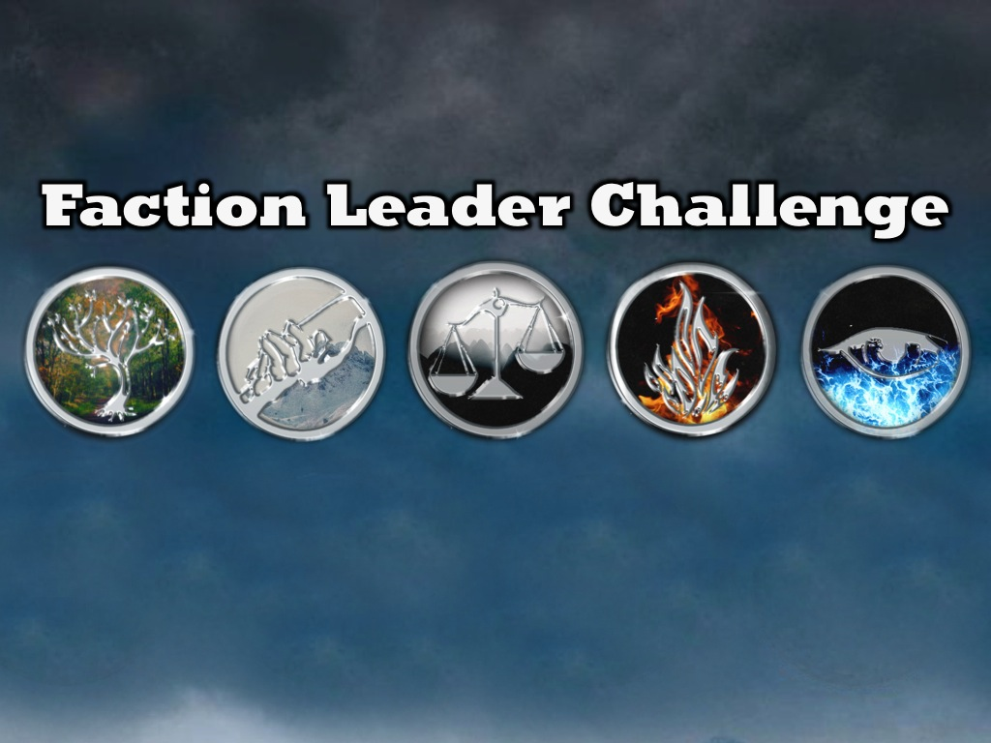
Notes:
Faction Leader Challenge
Narrator: “The faction leaders will now make their way to the stage and each will share a word of challenge with us.”
(Note: All five faction leaders make their way to the stage and stand in a line and speak in order.)

Slide 32
Notes:
Amity Faction Leader: "You need to be Peaceful! Living peacefully is what makes us get along and create a better world."

Slide 33
Notes:
Abnegation Faction Leader: “You need to be Selfless! Selflessness is what makes us able to serve each other and avoid selfishness!”

Slide 34
Notes:
Candor Faction Leader: “You need to be Honest! Honesty is what makes us live truthfully and avoid conflict!”

Slide 35
Notes:
Dauntless Faction Leader: “You need to be Brave! Bravery is what helps us speak and act with courage!”

Slide 36
Notes:
Erudite Faction Leader: “You need to be Intelligent! Intelligence is what helps us avoid conflict from a lack of knowledge!”

Slide 37
Notes:
Narrator: “We are meant to be Divergent – those who integrate the five values into our beliefs and practices.”

Slide 38
Notes:
Narrator: “Jesus was DIVERGENT! He was not ruled by one character trait. His COMPASSION, SELFLESSNESS, TRUTHFULNESS , COURAGE and WISDOM were perfectly integrated.”

Slide 39
Notes:
Narrator: “Are you Divergent? Are you brave AND intelligent AND honest AND peaceful AND selfless?”

Slide 40
Notes:
Small Group Questions
Narrator: “We are going to spend the next 20 minutes in our small groups before refreshments are served. Can the small group leaders come forward and then find a place to meet with their small groups. If you are not yet in a group for Friday nights, then come forward and we will allocate you to a leader and a group.”
1. What did you most enjoy about the experience tonight?
2. If we lived in a world like Divergent, what faction would you want to be in and why?
3. Think of examples in Jesus’ life where he was Brave, Intelligent, Honest, Peaceful and Selfless.
4. Which value do you need to most work on in your life?
5. Pray for each other to reveal the 5 values!
Soundtrack Music: 22 Medley (Tracks 18, 21, 06, 07)

