Slide 1

Notes:
Divergent Dauntless Night

Slide 2
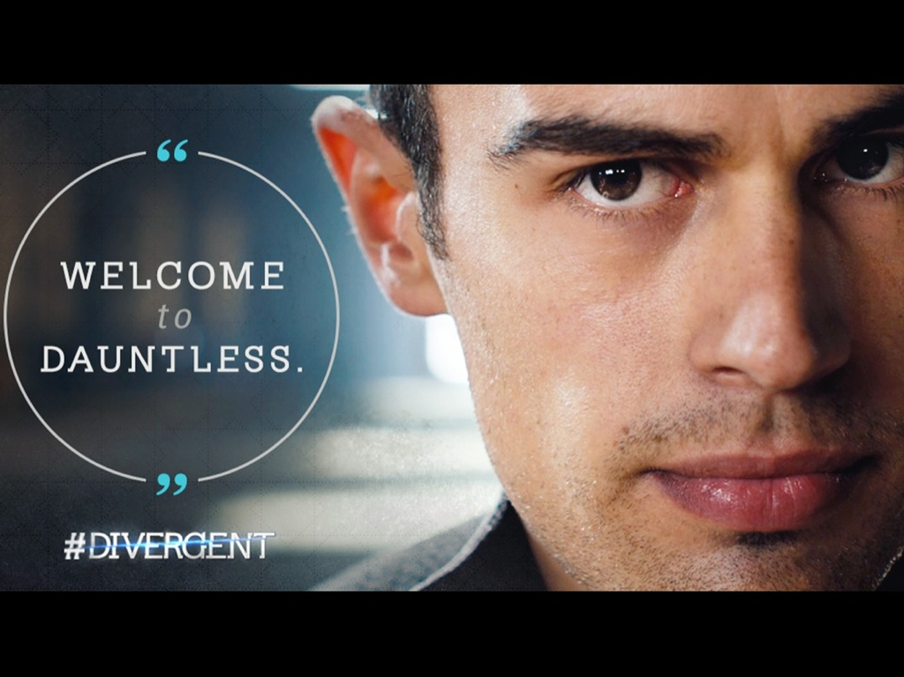
Notes:
Welcome to Dauntless!

Slide 3
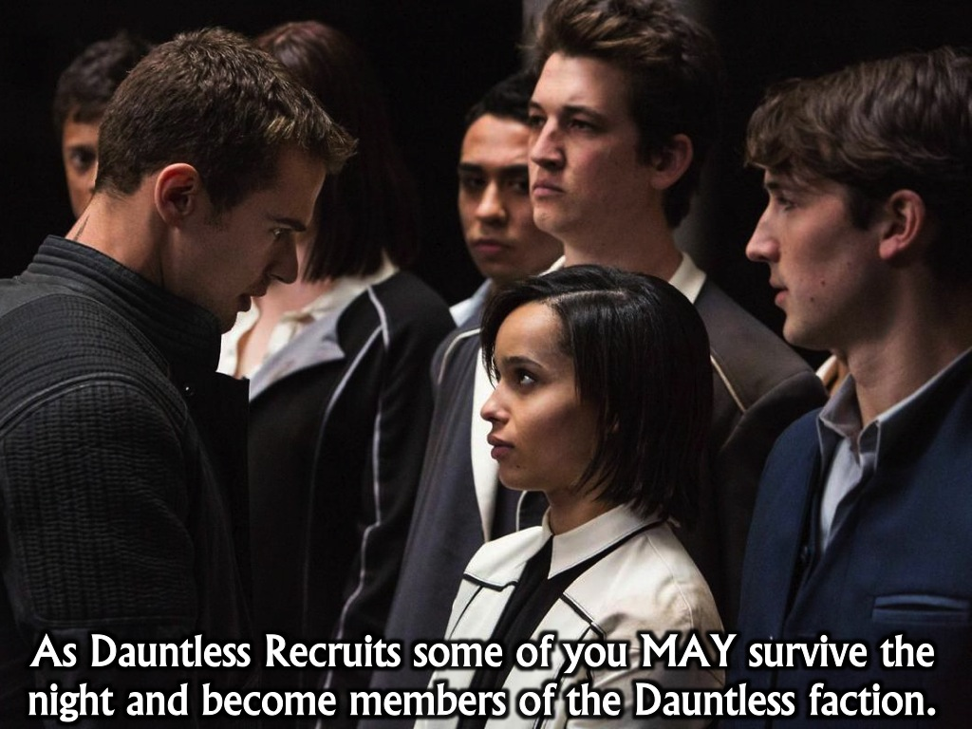
Notes:
You are all Dauntless recruits – some of you may actually survive the night and becomes members of the Dauntless faction.

Slide 4
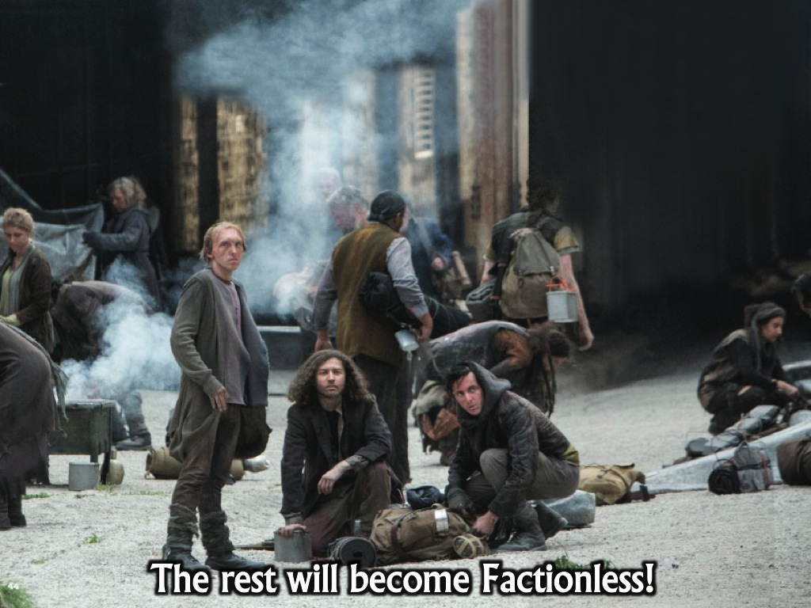
Notes:
But those who don’t make it will become factionless.

Slide 5
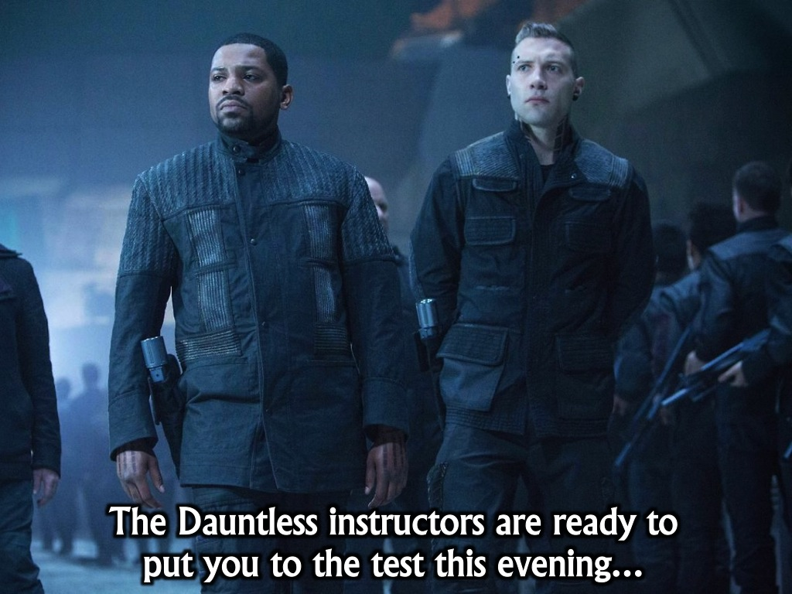
Notes:
The Dauntless instructors are here to put you to the test this evening.

Slide 6
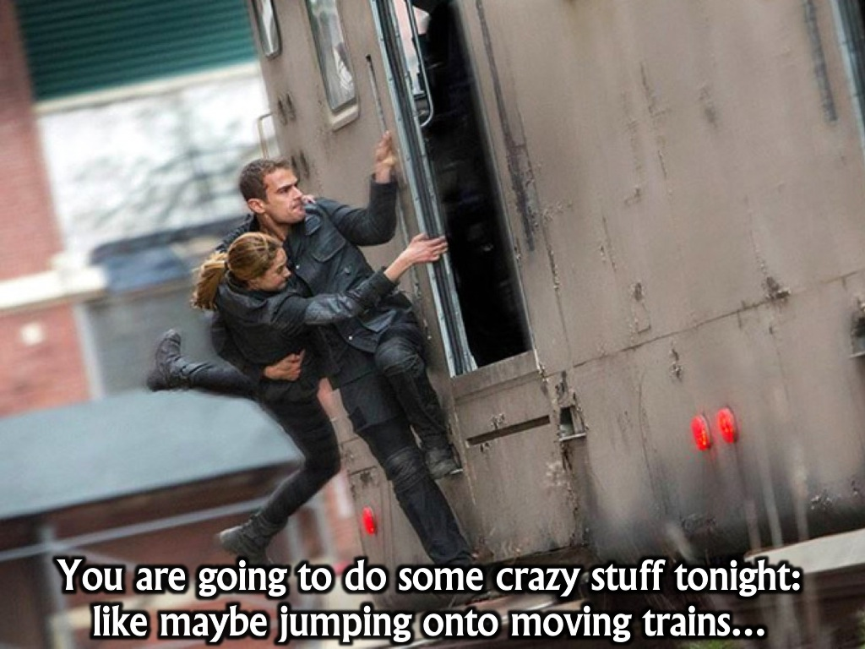
Notes:
You are going to do some crazy things this evening like jumping onto moving trains.

Slide 7
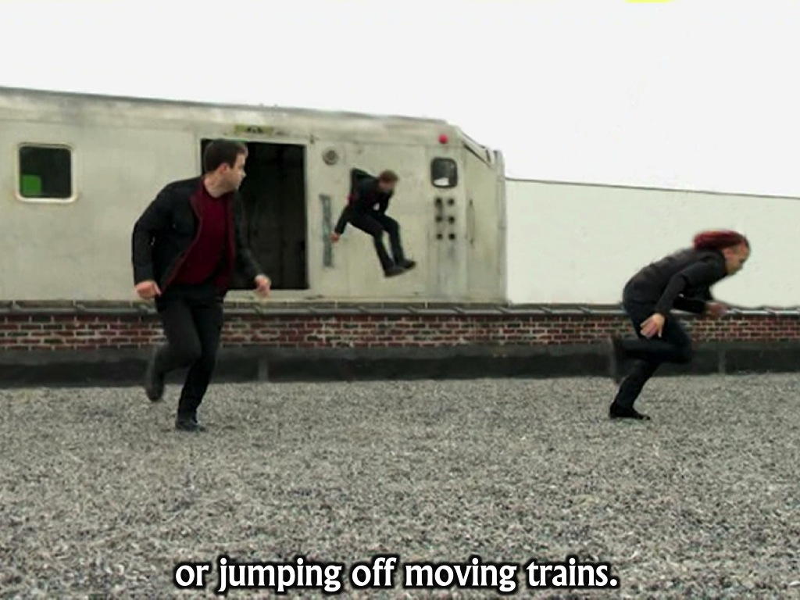
Notes:
or jumping off moving trains..

Slide 8
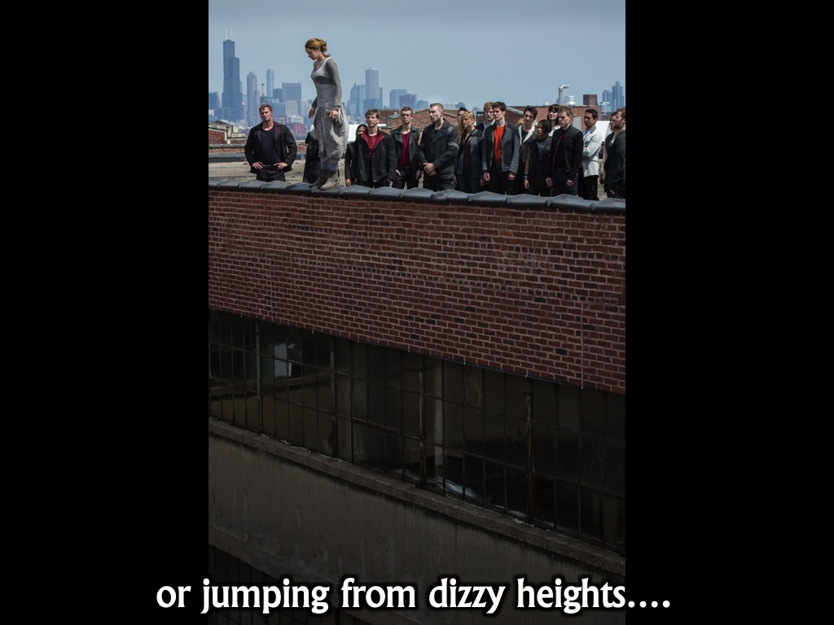
Notes:
Or jumping off buildings

Slide 9
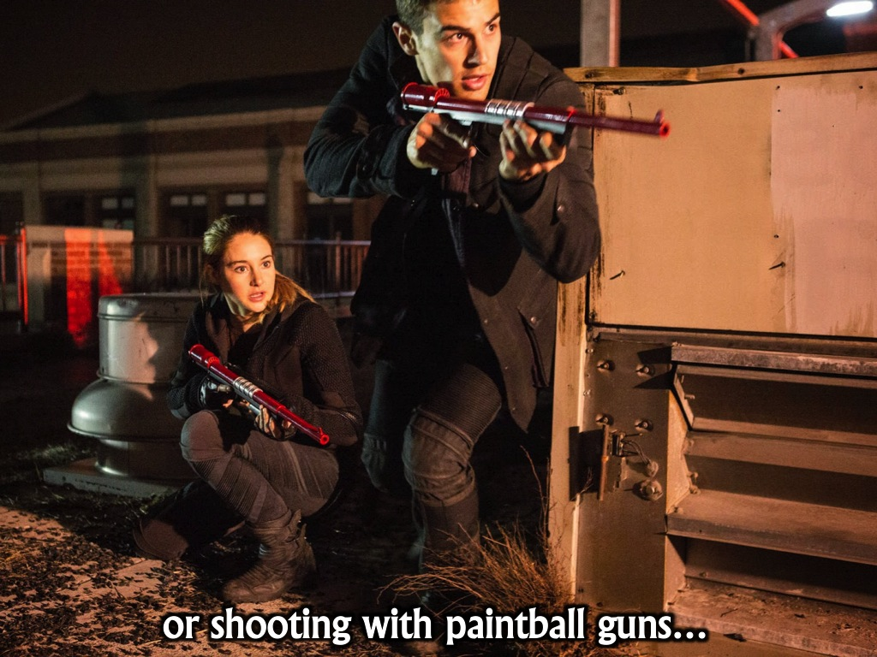
Notes:
You may get to shoot with paint ball guns.

Slide 10
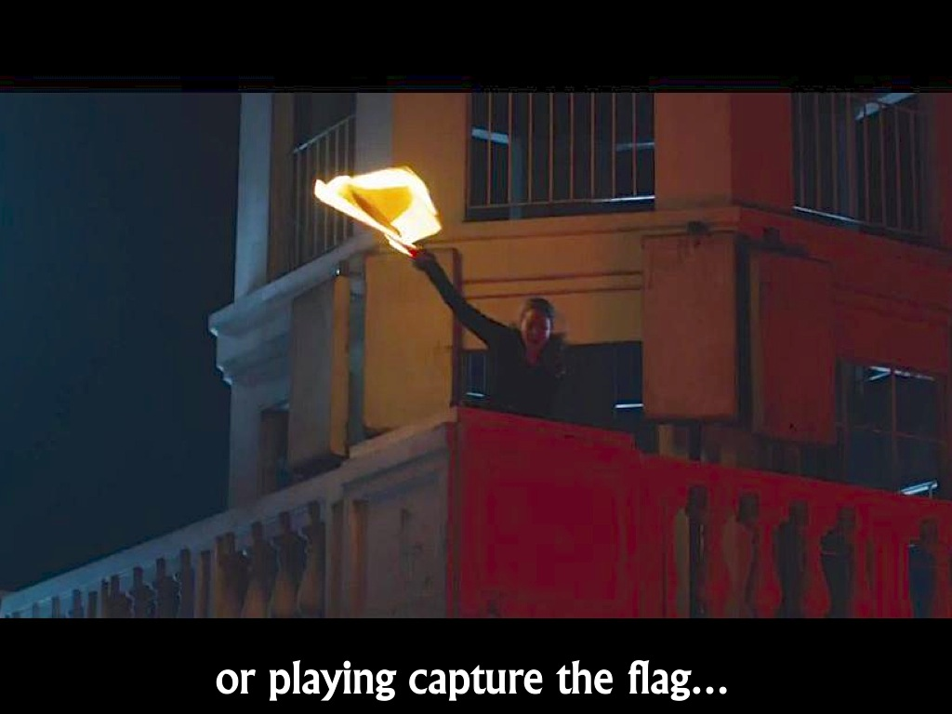
Notes:
Play capture the flag

Slide 11
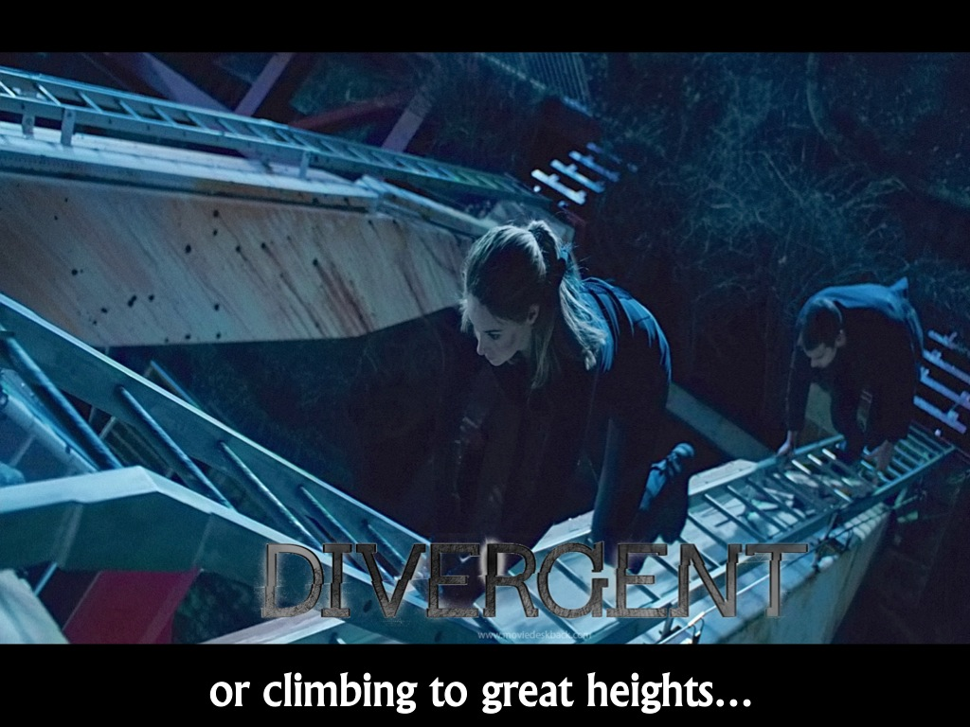
Notes:
Climb to incredible heights

Slide 12
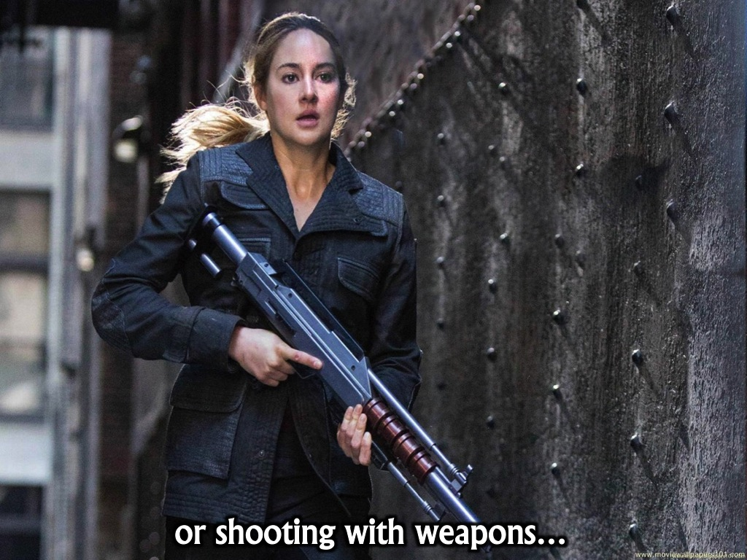
Notes:
Shoot with weapons

Slide 13
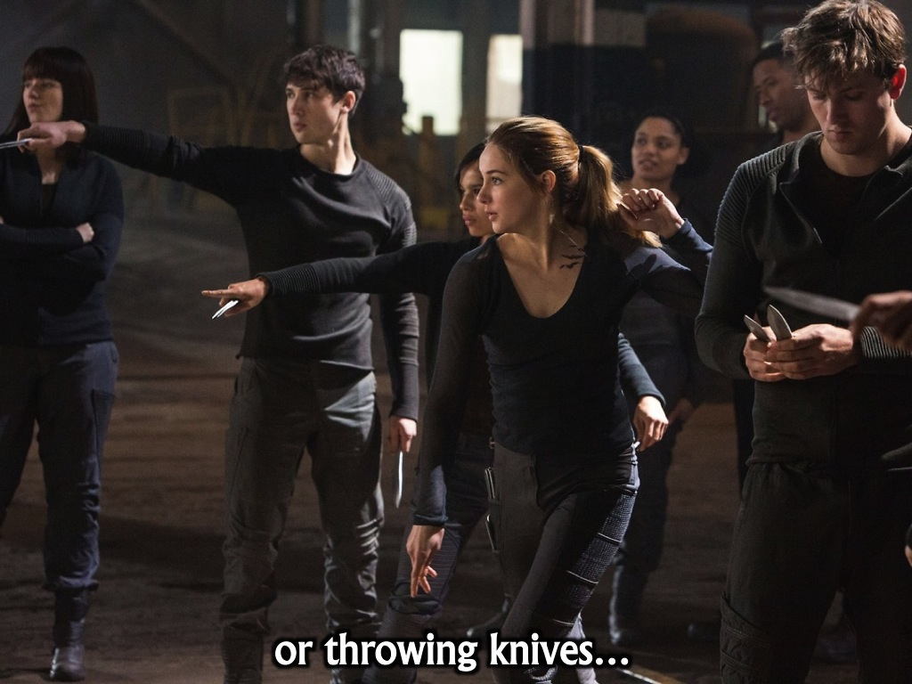
Notes:
Learn how to throw knives

Slide 14
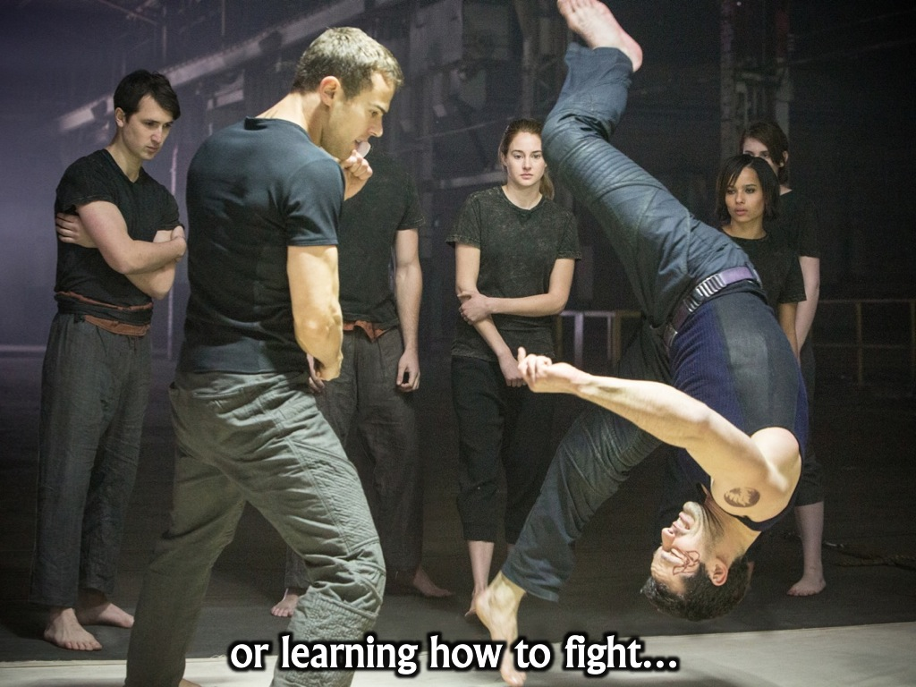
Notes:
They are trained in hand to hand combat

Slide 15
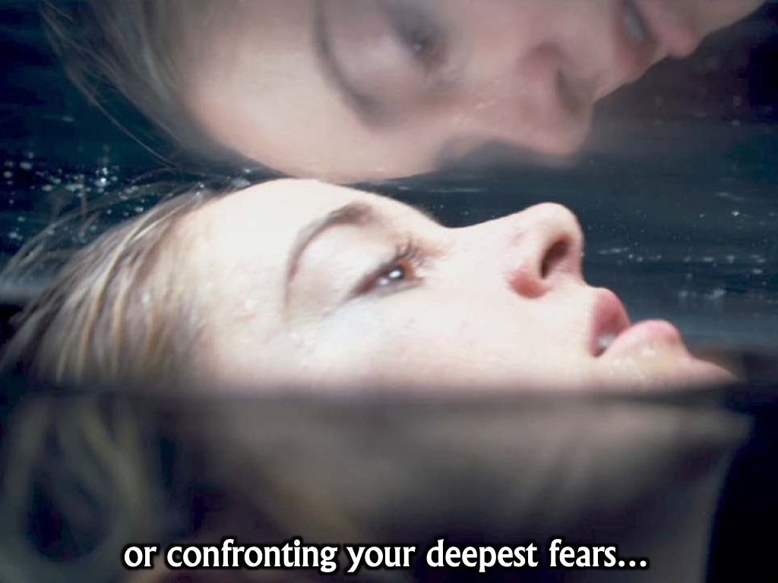
Notes:
They are forced to confront their fears

Slide 16
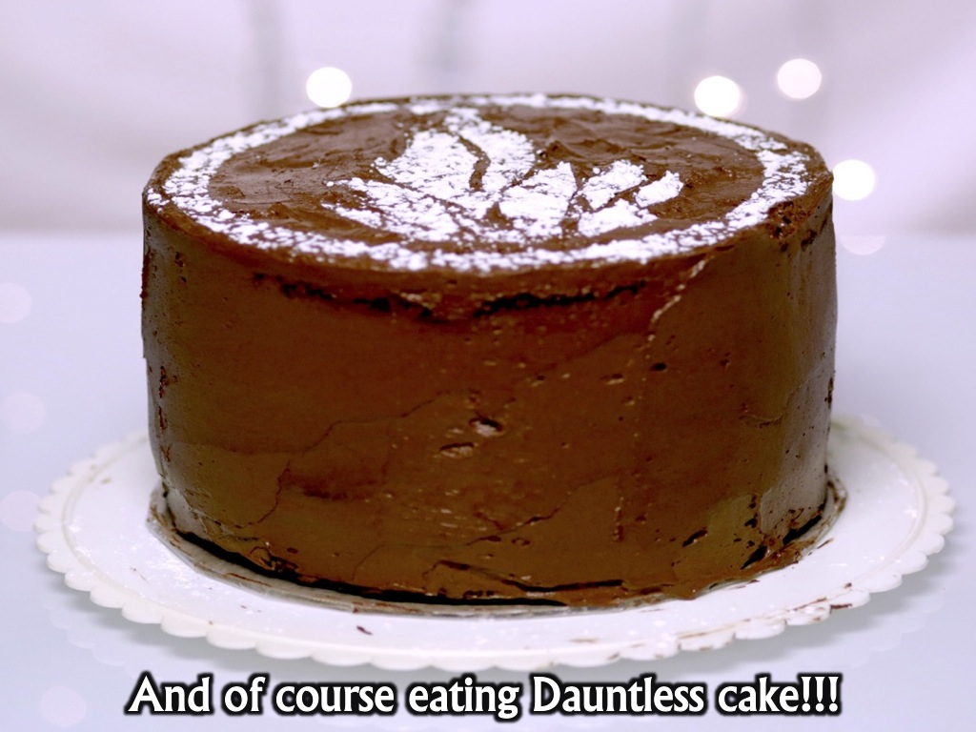
Notes:
And later we may even get to eat Dauntless chocolate cake!

Slide 17

Notes:
This week we are explore the first of five values to build into our lives: Being Brave!

Slide 18
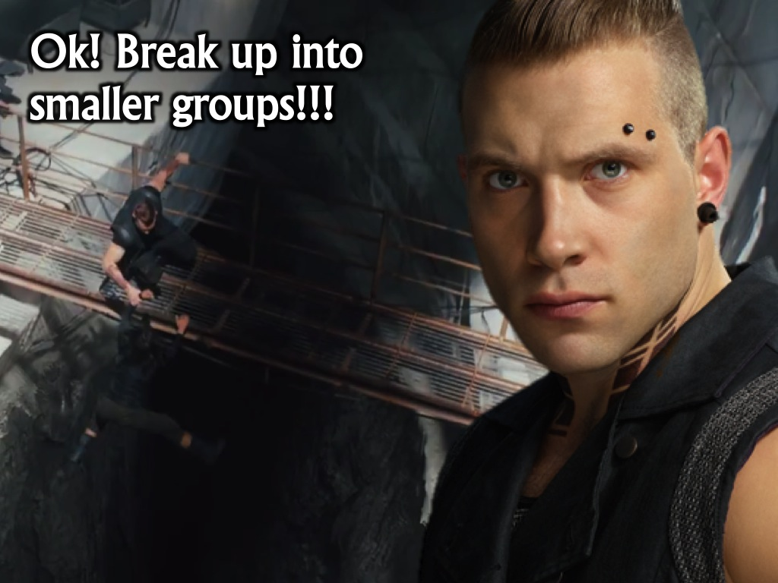
Notes:
It is time to break up into small groups.

Slide 19
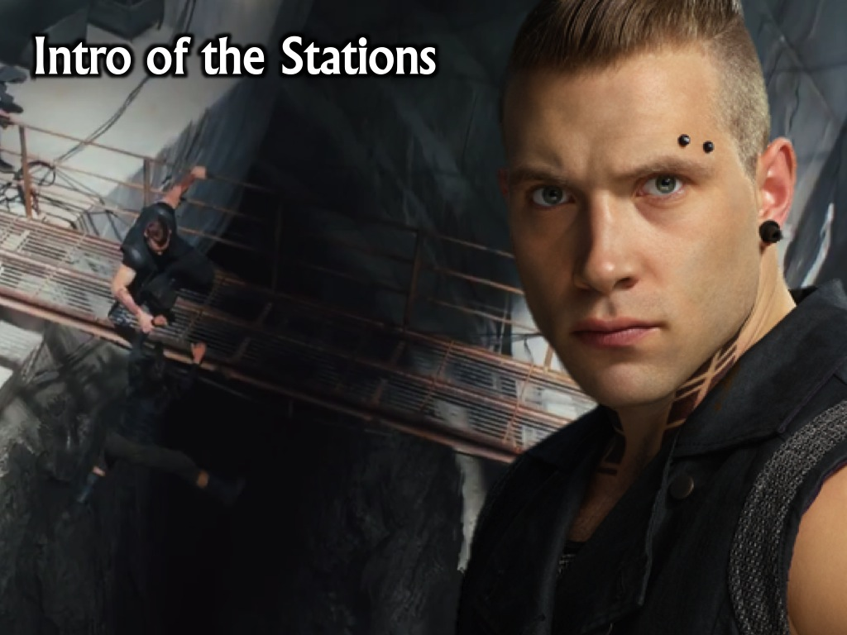
Notes:
There are six stations that you will visit that will test your courage and bravery.

Slide 20
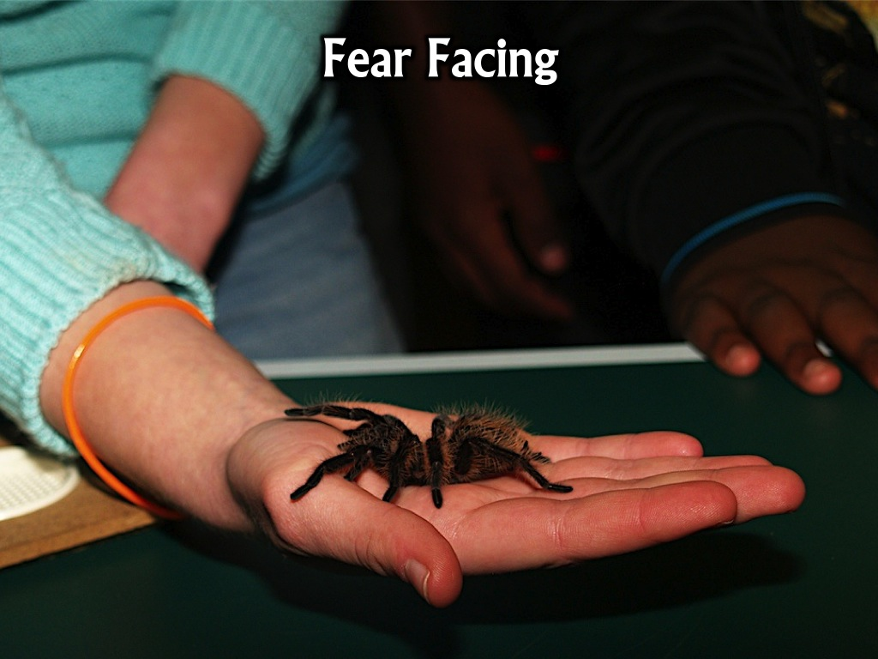
Notes:
Station 1: Fear Facing – each teen had to hold a tarantula on their hand for 30 seconds.

Slide 21
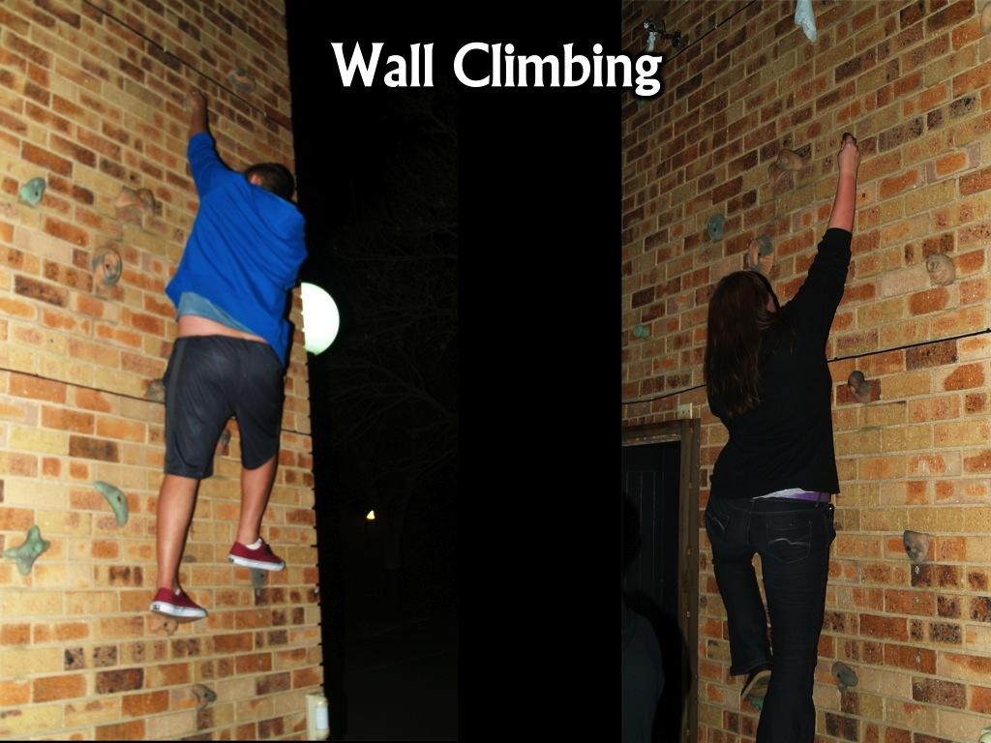
Notes:
Station 2: Wall Climbing – teens had to climb up a climbing wall to retrieve a piece of cloth. The height was not too high and strong chaps were stationed to ensure no injuries occurred if anyone fell.

Slide 22
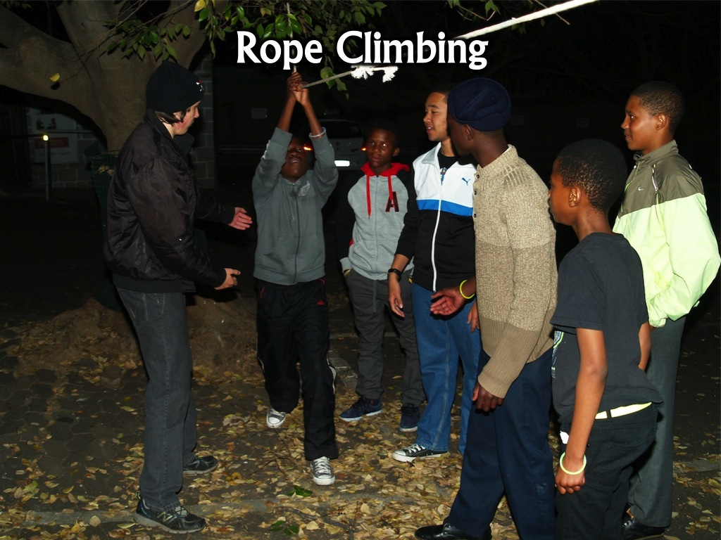
Notes:
Station 3: Rope Climbing – teens had to make their way along a rope between two trees without touching the ground.

Slide 23
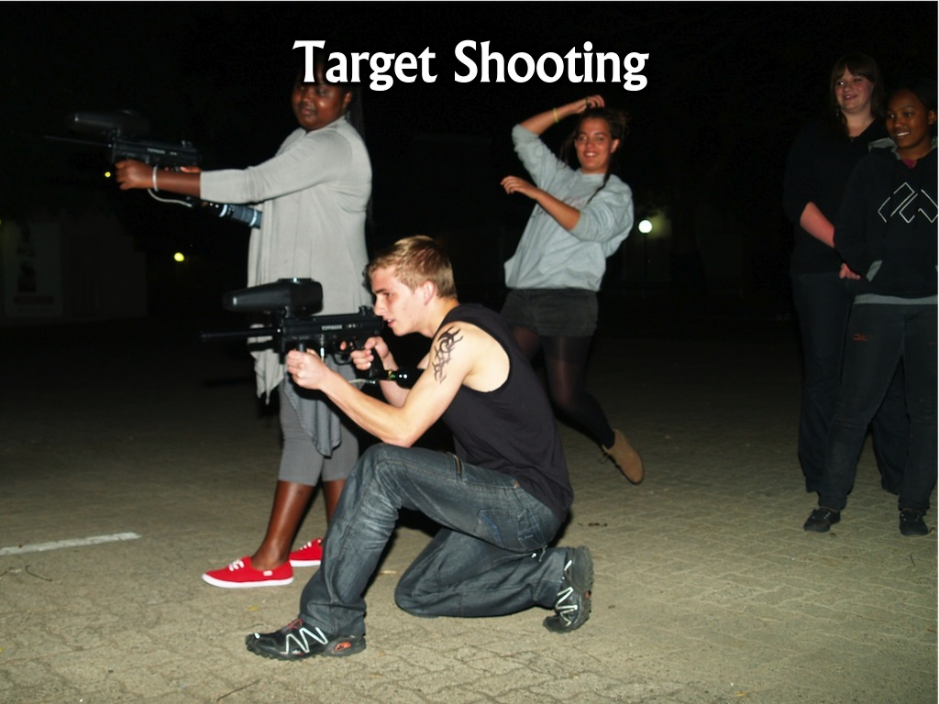
Notes:
Station 4: Target Shooting – two paintball guns were organised and teens were given a chance to shoot a few rounds at a paper target and then at a row of tin cans.

Slide 24
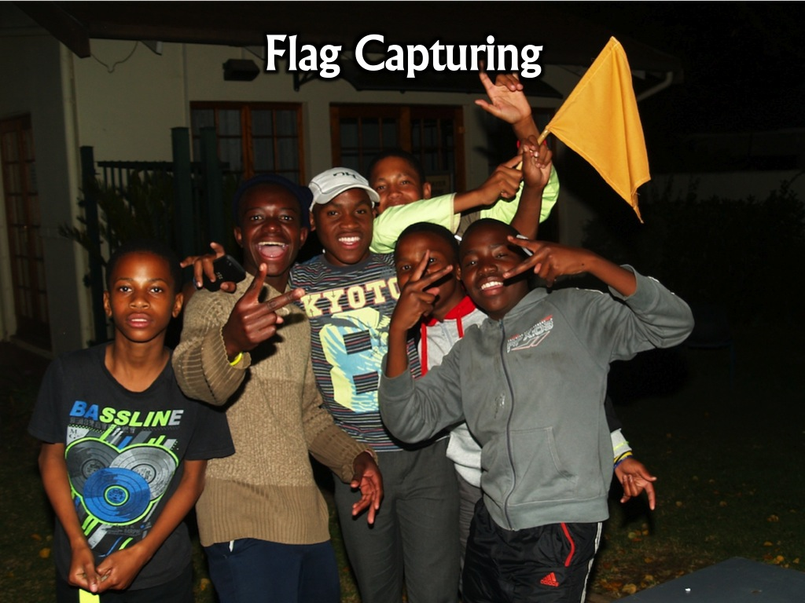
Notes:
Station 5: Flag Capturing – two teams competed against each other – they first had to hide their flag in their area and then go and find their opponents flag.

Slide 25
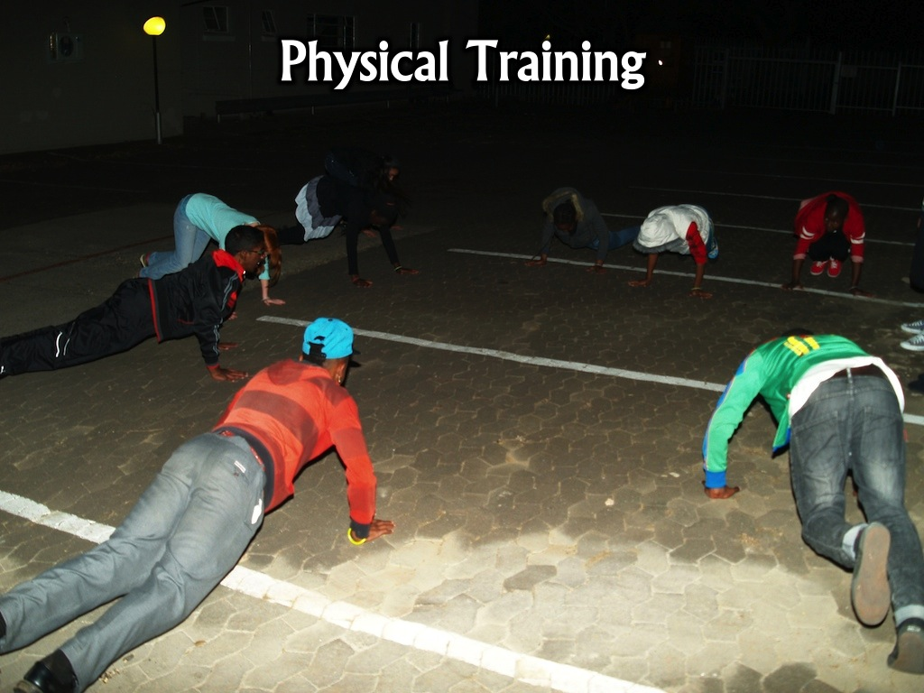
Notes:
Station 6: Physical Training – teens at this station did press ups and various running activities to test their fitness levels.

Slide 26

Notes:
Chocolate cake was served.

Slide 27
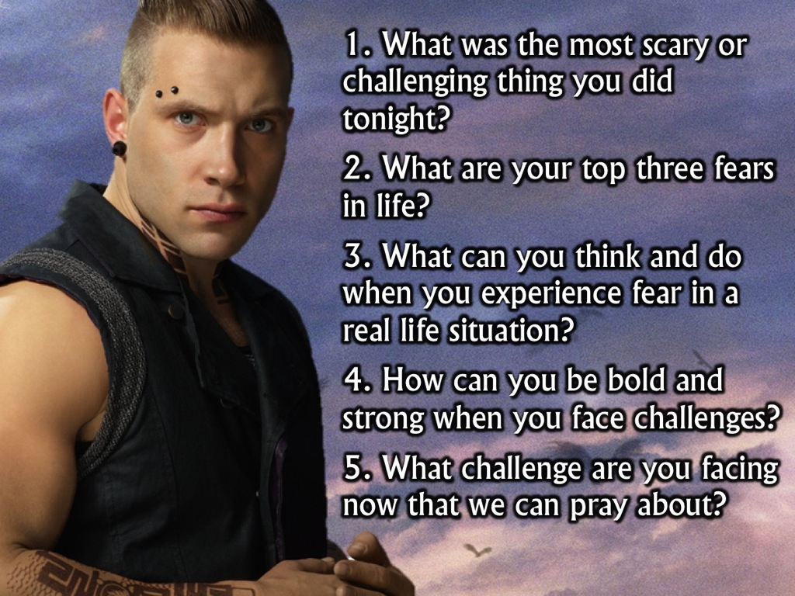
Notes:
Small Group Questions
1. What was the most scary or challenging thing you did tonight?
2. What are your top three fears in life?
3. What can you think and do when you experience fear in a real life situation?
4. How can you be bold and strong when you face challenges?
5. What challenge are you facing now that we can pray about?

