Slide 1


Slide 2
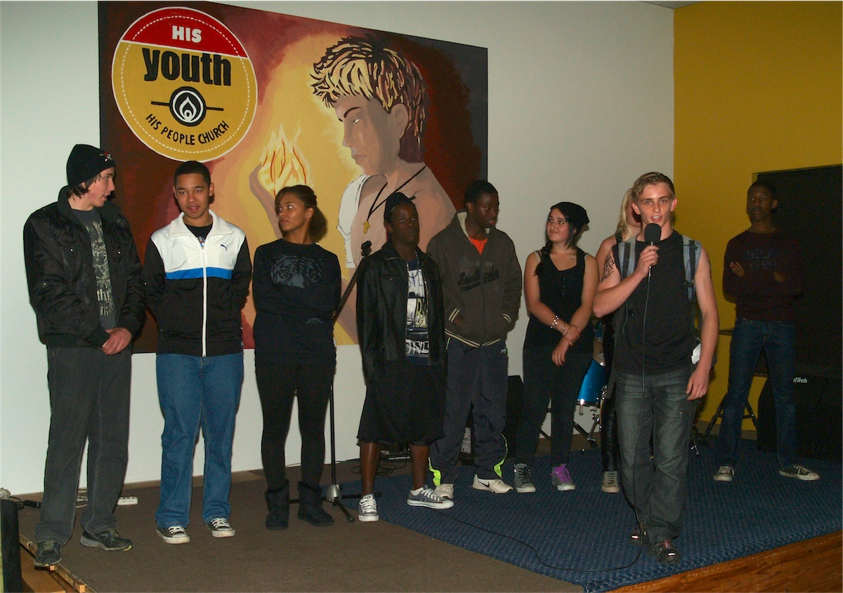
Notes:
Introduction of the Dauntless members

Slide 3
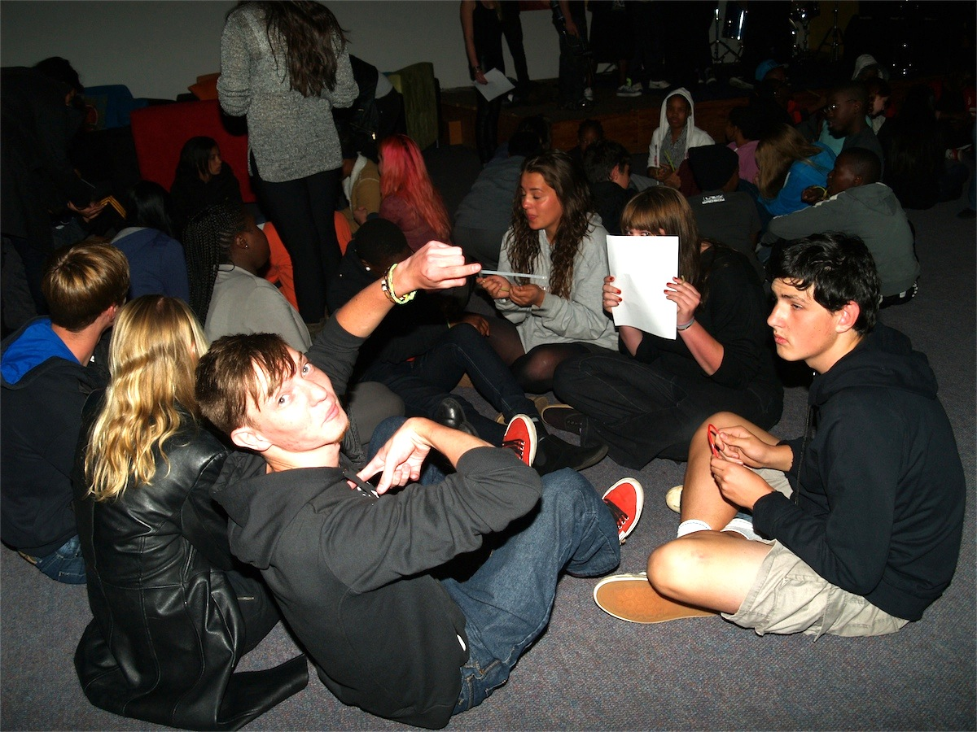
Notes:
Teens divide into small groups to start the event.

Slide 4
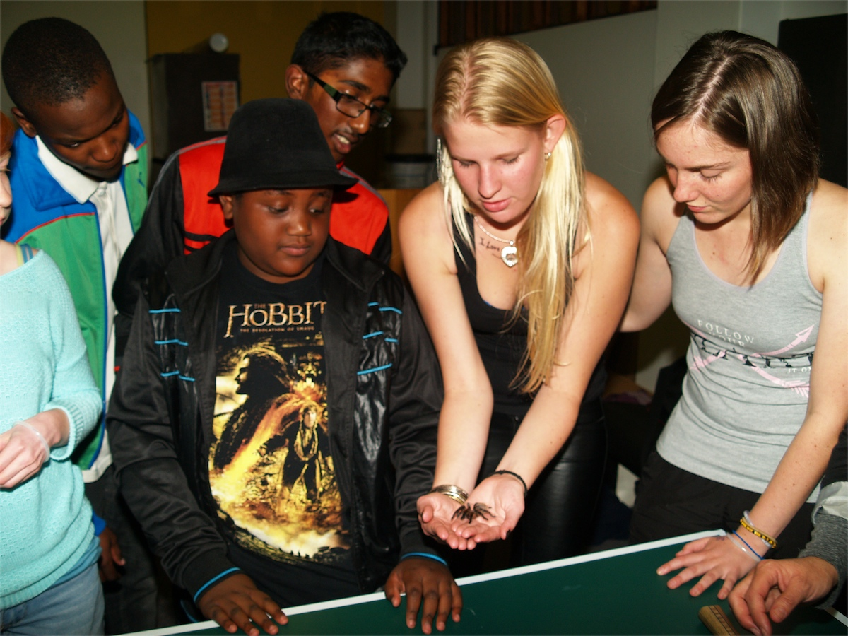
Notes:
Activity 1: The Tarantula

Slide 5
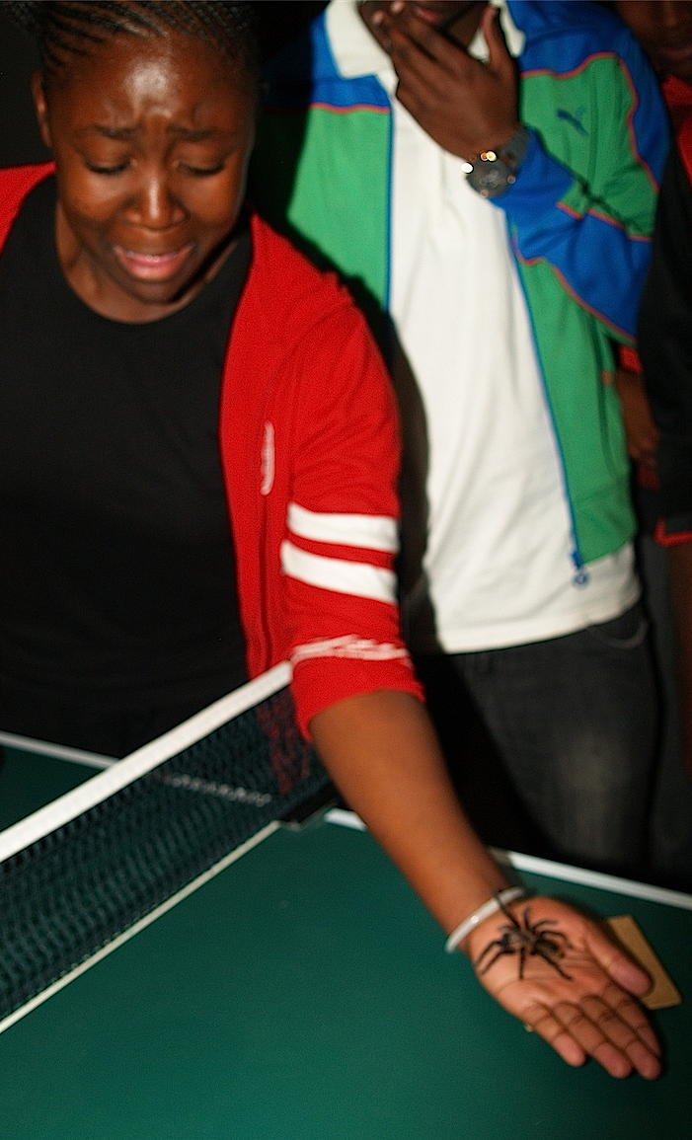
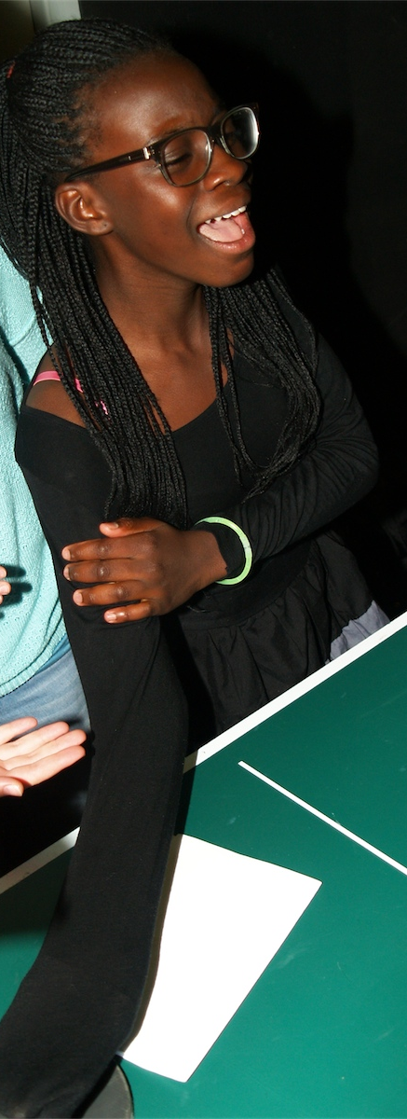
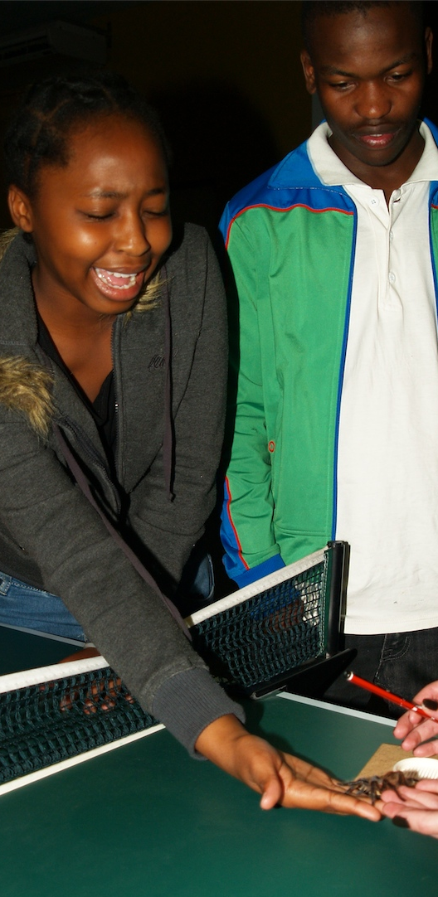

Slide 6
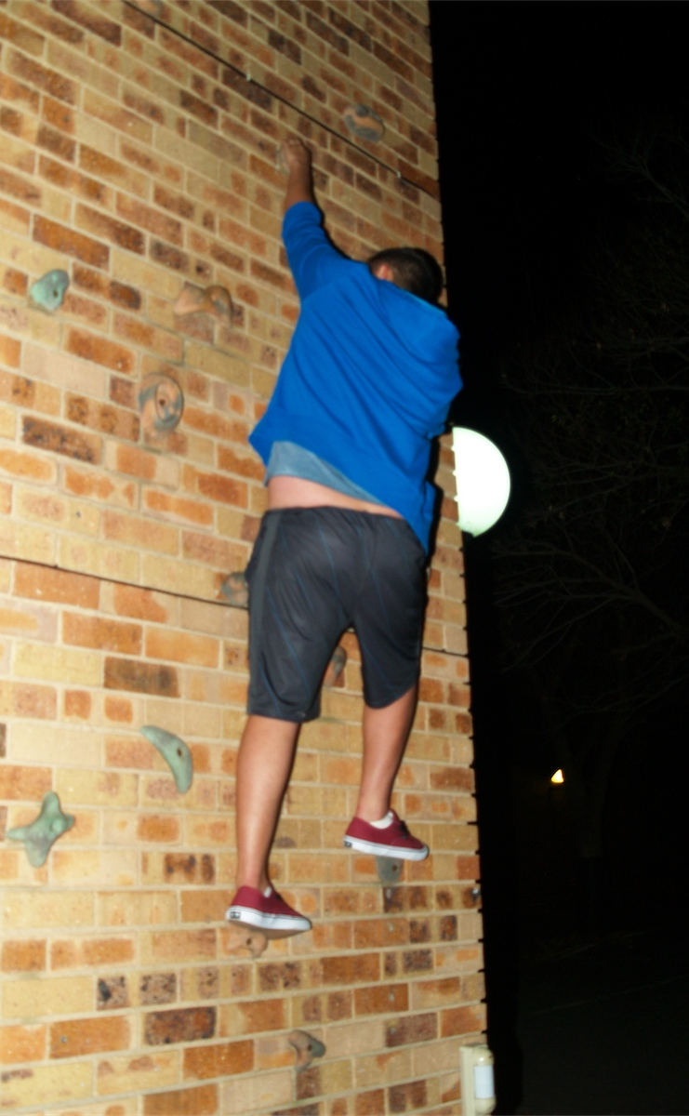
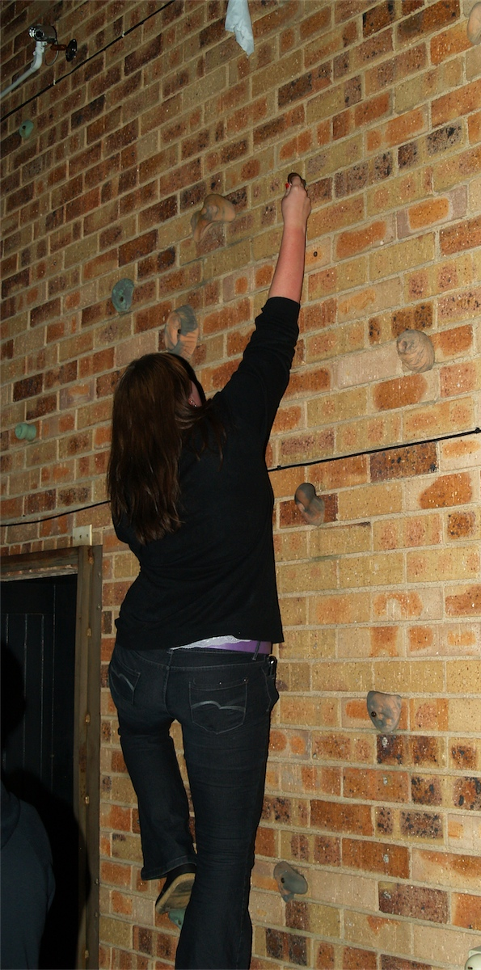
Notes:
Activity 2: The Climbing Wall

Slide 7
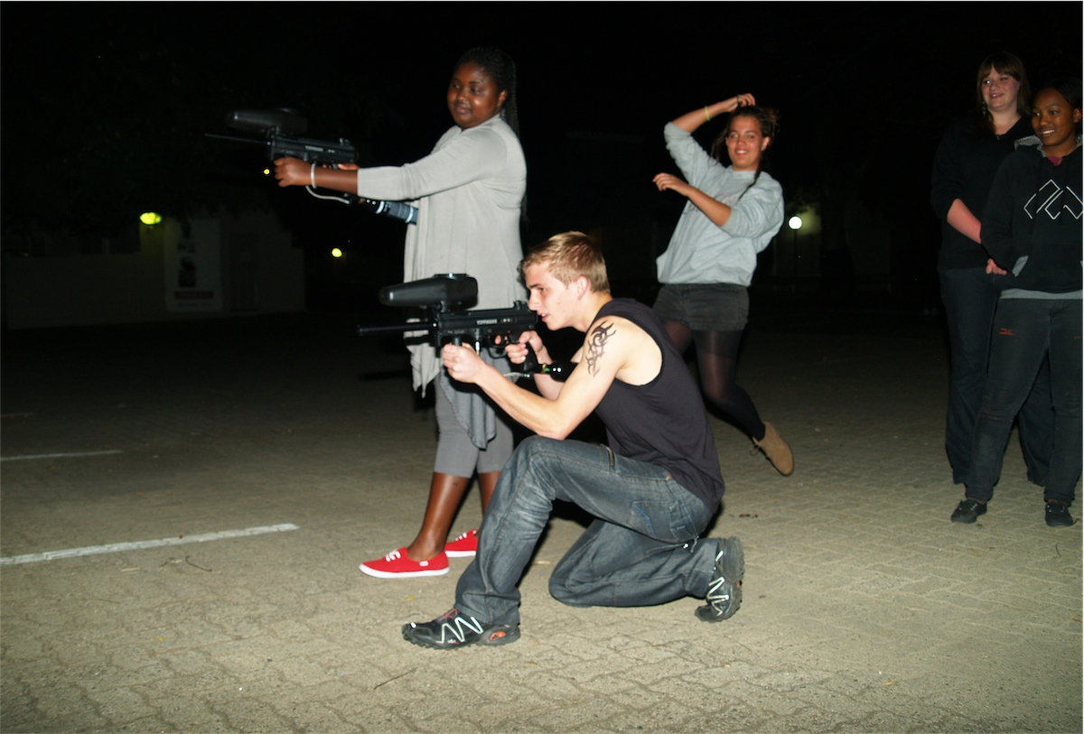
Notes:
Activity 3: The Paintball Target Shooting

Slide 8
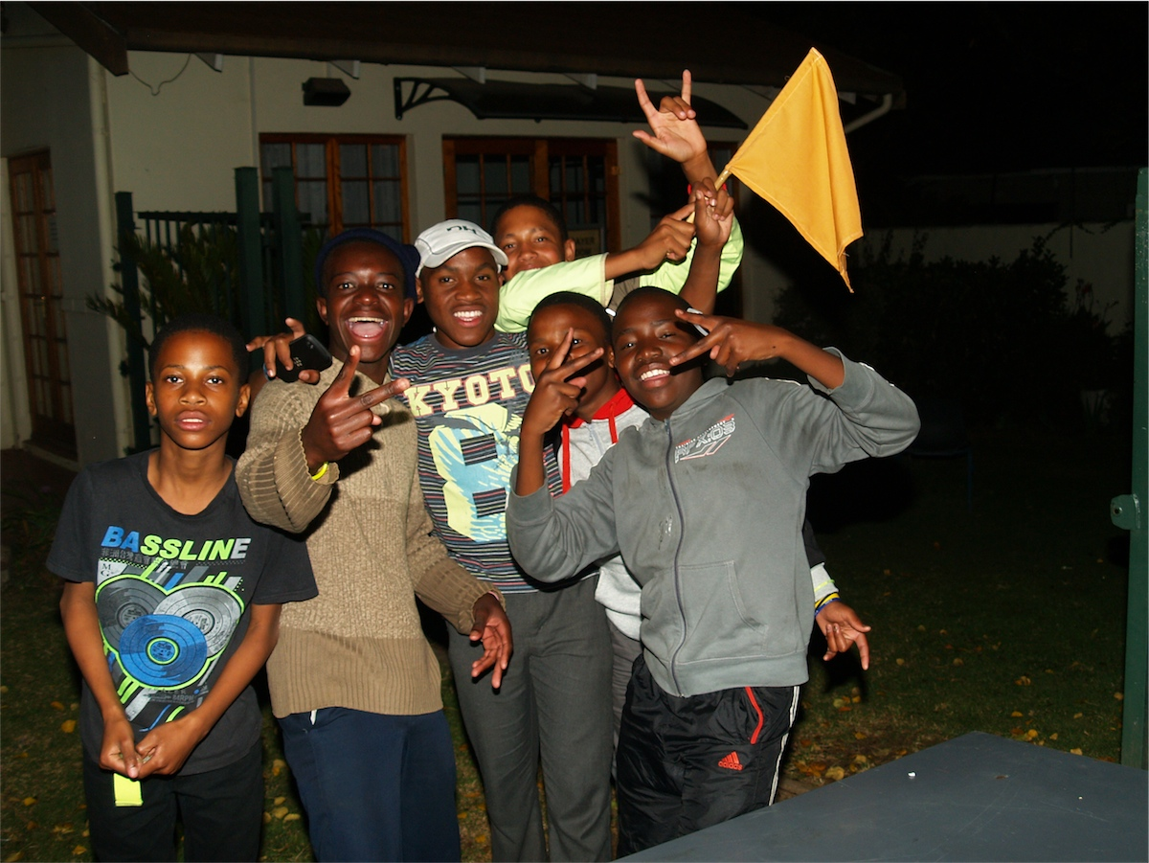
Notes:
Activity 4: Capture the Flag

Slide 9
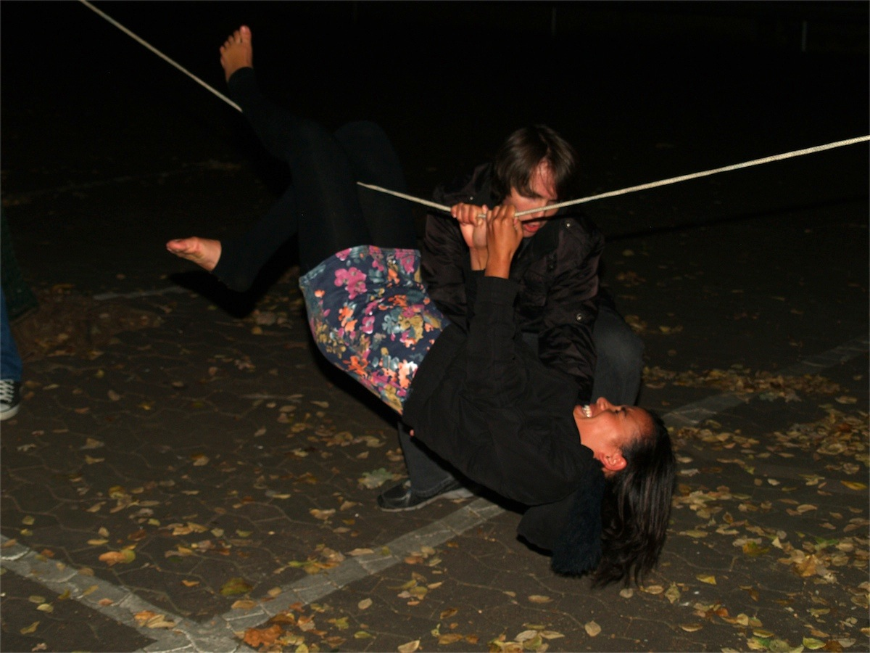

Slide 10
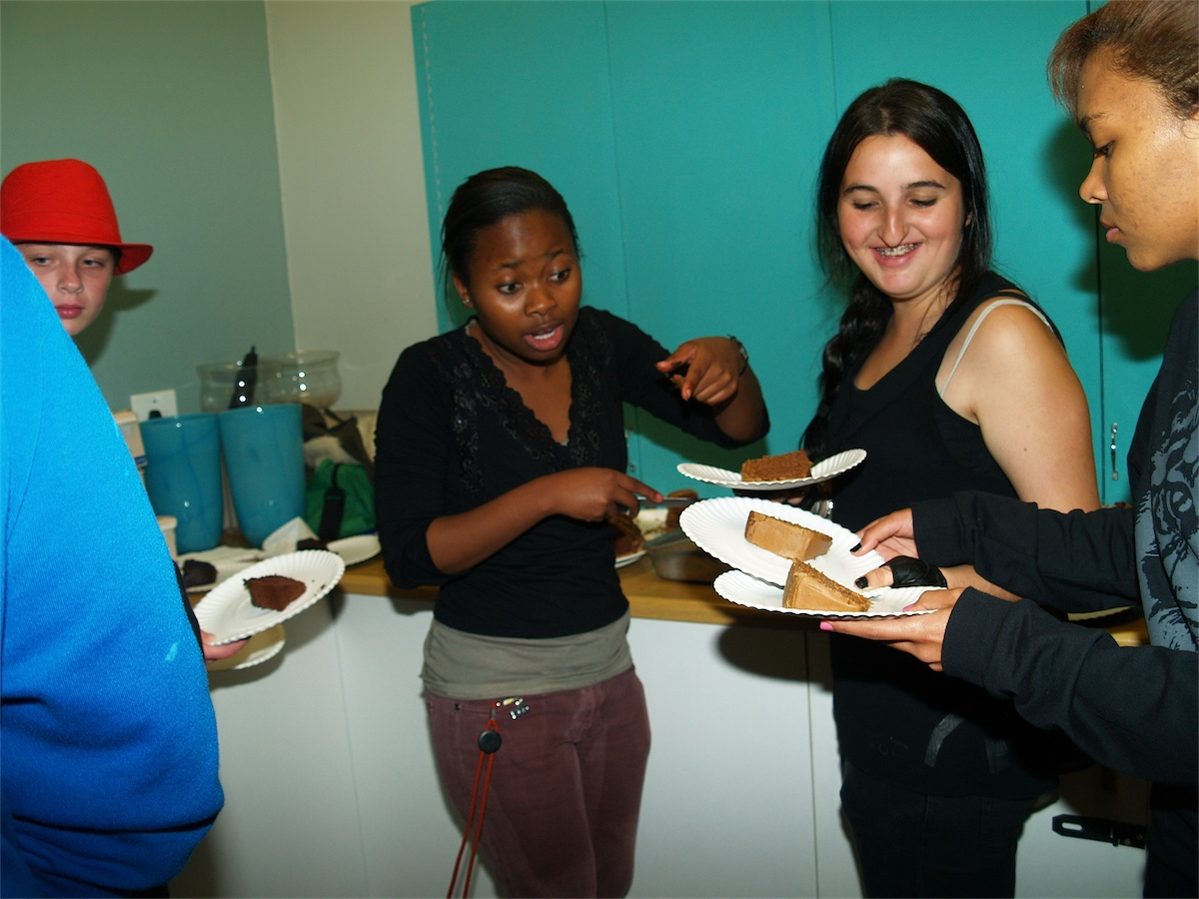
Notes:
Serving Dauntless chocolate cake

Slide 11
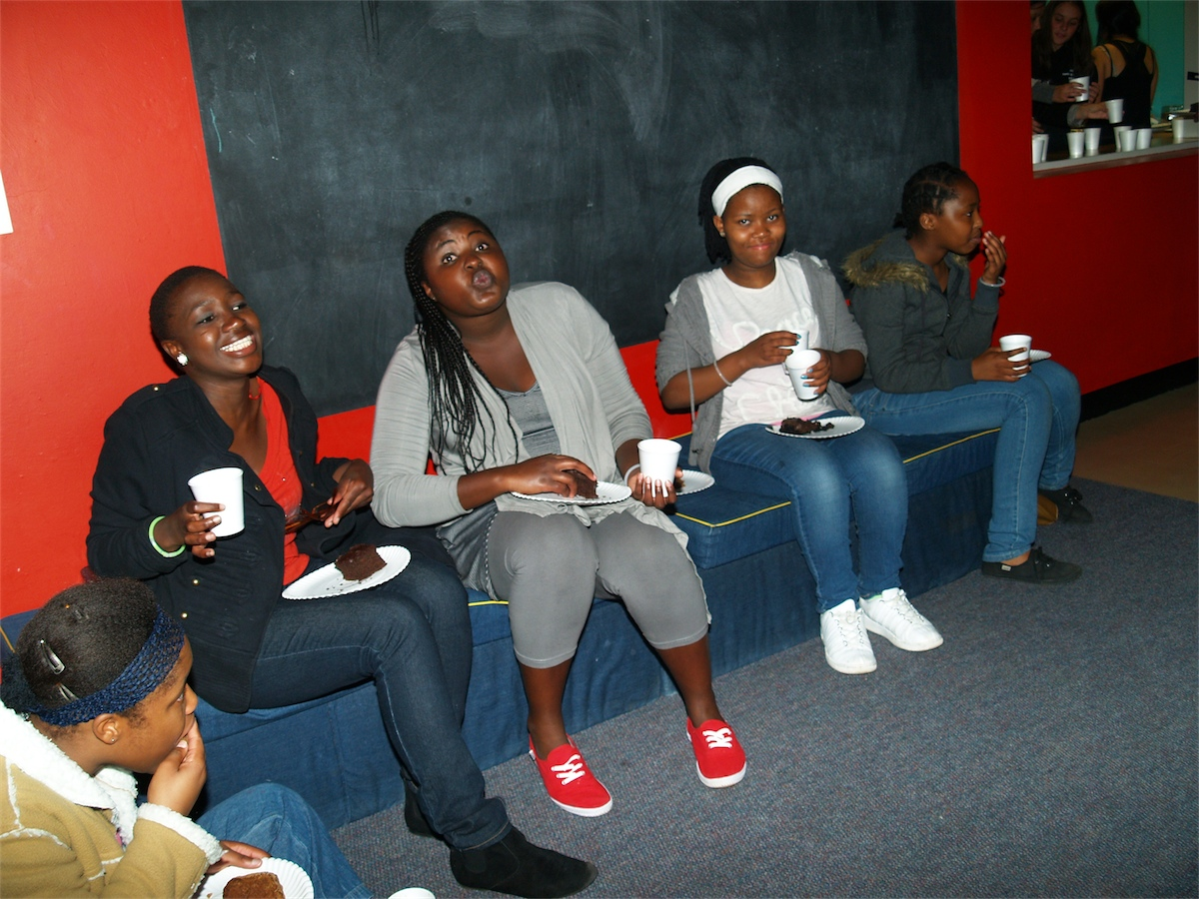
Notes:
Happy teens!

