Slide 1
Notes:
Welcome to Erudite!
Teens are given a symbol (written in permanent ink) when they walk into the venue – using different maths symbols – ie, plus sign, equals sign, Pi sign, Multiplication sign. etc. This will determine the small groups starting with the first Activity.

Slide 2
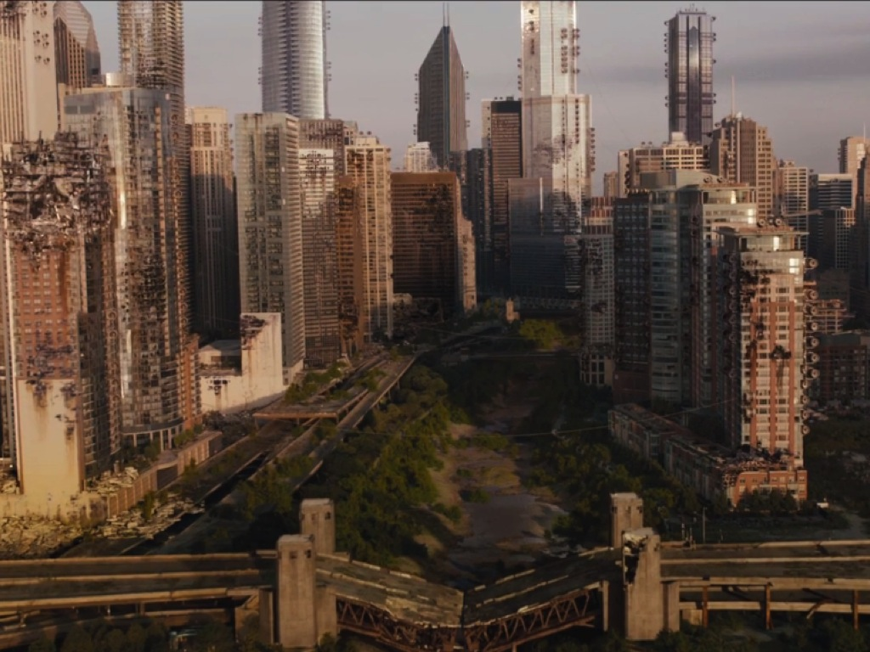
Notes:
In a future world, war has caused incredible damage to the world.

Slide 3
Notes:
People have been divided into five different factions focusing on different positive values.

Slide 4
Notes:
Tonight we are focusing on the Erudite faction.

Slide 5
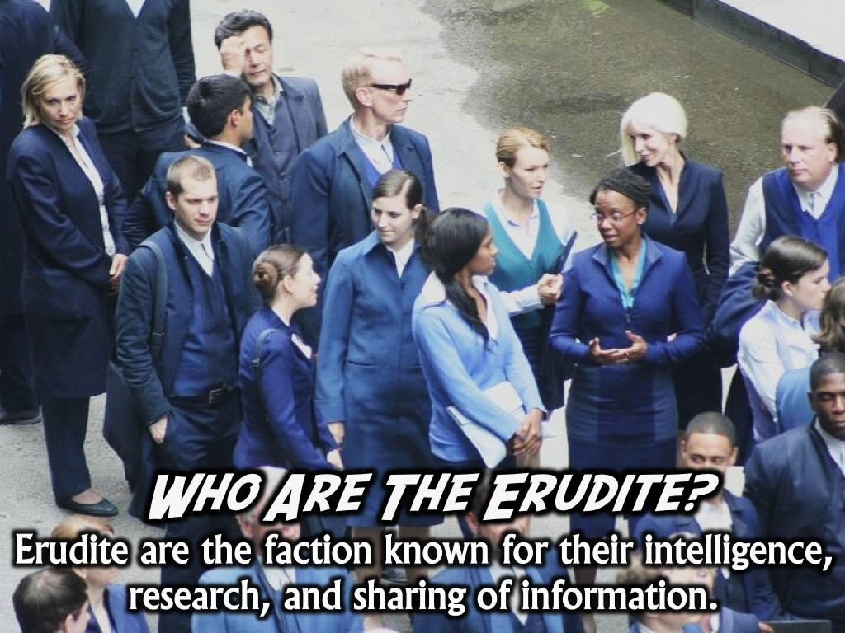
Notes:
Who are the Erudite? Erudite are the faction known for their intelligence, research, and sharing of information.

Slide 6
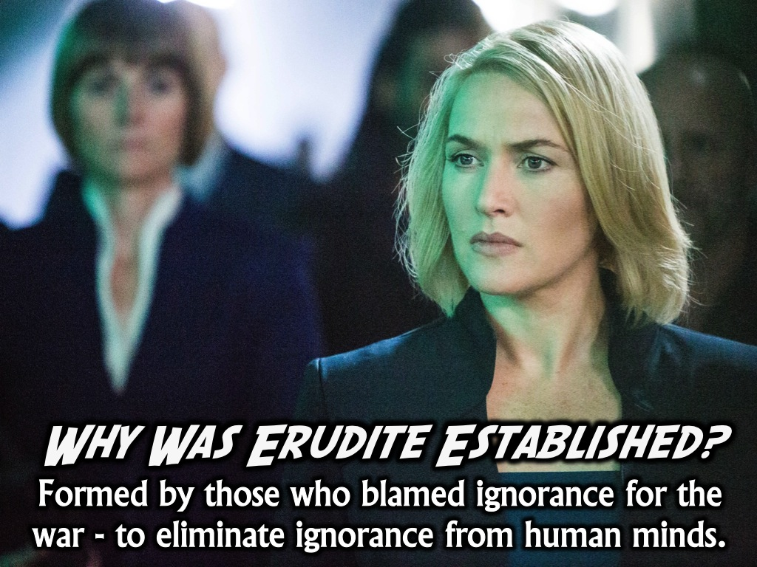
Notes:
Why Was Erudite Established? Erudite was formed by those who blamed ignorance for the war that occurred to eliminate ignorance and darkness from human minds.

Slide 7
Notes:
What Do Erudite Value? They value knowledge, wisdom, intelligence, curiosity, reading and eloquence.

Slide 8
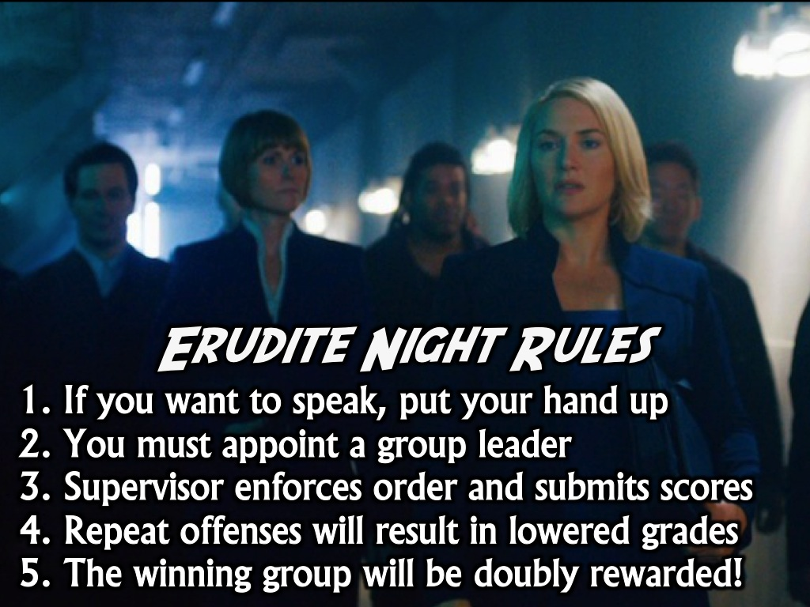
Notes:
Erudite Night Rules
1. If you want to speak, put your hand up
2. You must appoint a group leader
3. Supervisor enforces order and submits scores
4. Repeat offenses will result in lowered grades
5. The winning group will be doubly rewarded!
Divide into small groups based on the symbols written on each teen’s hand.

Slide 9
Notes:
Activity 1: Balancing Equations

Slide 10
Notes:
Balance this equation: CaO + H₃PO₄ --> Ca₃(PO₄)₂ + H₂O

Slide 11
Notes:
Here is the Solution: 3 CaO + 2 H3PO4 --> Ca3(PO4)2 + 3 H2O
Scoring: 2 Points

Slide 12
Notes:
Activity 2: History Quiz

Slide 13
Notes:
Questions:
1. In which country did the Renaissance start? (a) Russia (b) England (c) France (d) Italy
2. Who discovered the sea-route from Europe to India?
(a) Columbus (b) Vasco-da-Gama (c) Marco Polo (d) Magellan 3. What was the name of the atom bomb dropped on Hiroshima during WW2? (a) Little Boy (b) Little Fly
(c) Little Devil (d) None of these
4. What was considered the start of Jesus’ ministry?
(a) Wedding at Cana
(b) Baptism by John the Baptist
(c) Journey into the wilderness
(d) Journey to Jerusalem
5. Who was the disciple who replaced Judas?
(a) Justus
(b) Matthias
(c) Barsabbas
(d) Paul
6. How many books are there in the New Testament?
(a) 36
(b) 25
(c) 27
(d) 29

Slide 14
Notes:
Answers:
1. The Renaissance started first in: (d) Italy
2. Who discovered the sea-route from Europe to India? (b) Vasco-da-Gama
3. What was the name of the atom bomb dropped on Hiroshima during WW2? (a) Little Boy
4. What was considered the start of Jesus’ ministry? (b) Baptism by John the Baptist
5. Who was the disciple who replaced Judas? (b) Matthias
6. How many books are there in the New Testament? (c) 27
Scoring: 1 Point for each correct answer

Slide 15
Notes:
Activity 3: Logic Puzzle

Slide 16
Notes:
Five brothers, including Jake, have occupations in different cities. Who does what where?
Clues:
Travis is not a Carpenter nor Financial Advisor and does not work in Manchester.
Bob is the Bus conductor.
The Florist does not work in Liverpool.
Is Bill the TV Presenter?
The Financial Advisor works in London or Liverpool.
Bill works in Birmingham.
The Carpenter works in Swansea.
Simon works in London.

Slide 17
Notes:
The Answers:
Name Occupation City
Bob Bus Conductor Manchester
Bill Florist Birmingham
Jake Carpenter Swansea
Simon Financial Advisor London
Travis TV Presenter Liverpool
Scoring: 1 Point for each correct row. 5 Extra for 100% right

Slide 18
Notes:
Activity 4: Maths Equation

Slide 19
Notes:
1. Solve for x: x + 144 = 256
2. Solve for x: 5^{x} = 2^{x}
3. Solve for x and y: x + y = 145 and x - y = 45
4. The sum of two consecutive number is 41. What are the numbers?

Slide 20
Notes:
The Answers:
1. X = 112
2. X = 0
3. X = 95 and Y = 50
4. 20 and 21
Scoring: 1 Point for each

Slide 21
Notes:
Activity 5: Bible Translation

Slide 22
Notes:
Teens are given the following passage in Latin to translate into English:
et locutus ait sit nomen Domini benedictum a saeculo et usque in saeculum quia sapientia et fortitudo eius sunt
et ipse mutat tempora et aetates transfert regna atque constituit dat sapientiam sapientibus et scientiam intellegentibus disciplinam

Slide 23
Scoring: 1 Point for each highlighted word
^{Daniel 2:20-21 (NIV)}
²⁰ Daniel answered and said:
“Blessed be the name of God forever and ever, to whom belong wisdom and might. ²¹ He changes times and seasons; he removes kings and sets up kings; he gives wisdom to the wise and knowledge to those who have understanding
Notes:
Scoring: 1 Point for each key word they get correct – including wisdom, might, times, wisdom, knowledge, understanding.

Slide 24
Notes:
Activity 6: Cell Structure – teens are given a 7 second view of the image on the following page and they have to build the cell structure out of the packet of licorice allsorts and toothpicks they are given.

Slide 25
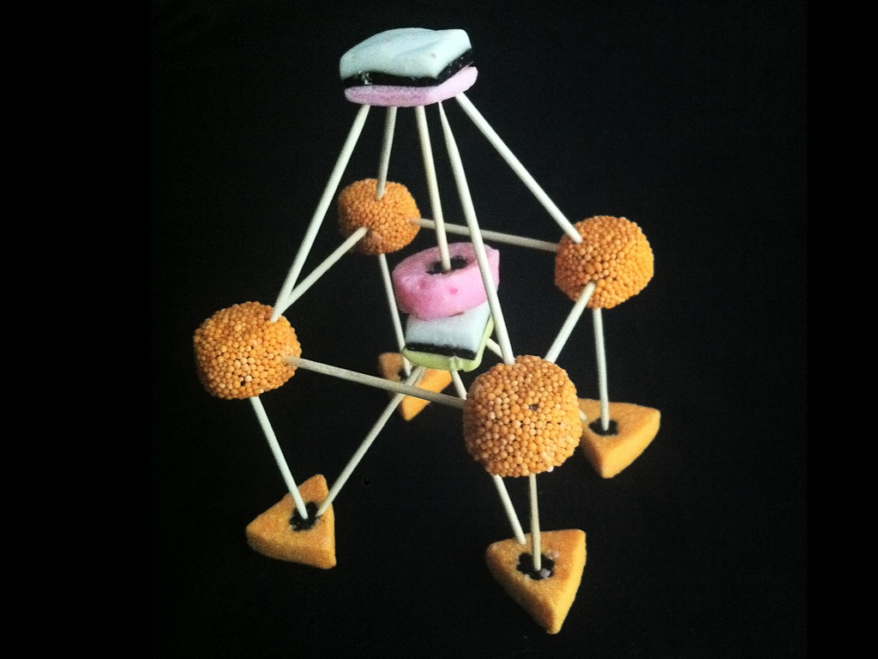
Notes:
This slide will transition after 7 seconds!

Slide 27
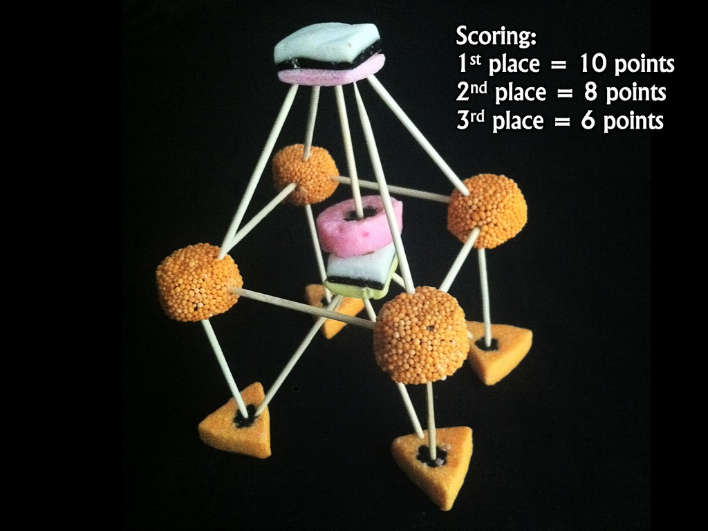
Notes:
Scoring:
1st place = 10 points
2nd place = 8 points
3rd place = 6 points

Slide 28
Notes:
Activity 7: Word Definition

Slide 29
Notes:
Find the definition of this word: Antidisestablishmentarianism

Slide 30
Notes:
It defines a 19th-century British political movement that opposes proposals for the disestablishment of the Church of England.
Points will be awarded for:
Anti = against
Dis = negative
Establishment = founding
Ism = belief
Scoring: 1 Point for each word and Whole concept = 10 points

Slide 31
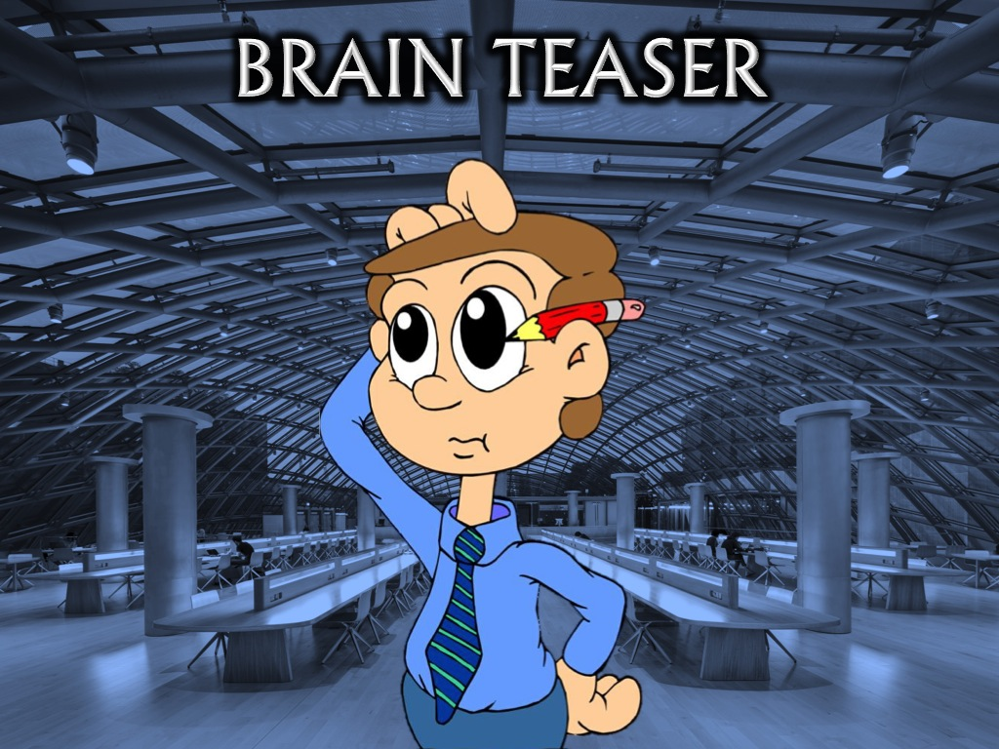
Notes:
Activity 8: Brain Teaser – this activity is included if time allows or if there is a tie between two or more teams at the end of the previous 7 activities.

Slide 34
Notes:
Congrats To The Winners! As winners you have won a two-part reward! Part 1: You now have control over everyone in the room as you are the smartest among us. Here is a list of five possible activities: choose one and everyone will be forced to obey it or become Factionless!

Slide 35
Notes:
Choose from one of the following activities that the other groups have to complete:
1. Get into groups of 6 and create a human pyramid.
2. Play “Ring a Ring o’Roses” as a big group.
3. Form a giant group hug around Ps Mark and wish him happy birthday for Wednesday.
4. Play dead for a full minute.
5. Act like lunatics and jump on one leg around the room for a full minute.

Slide 36
Notes:
Part 2: After small group time when the rest of the groups have their hot chocolate and a biscuit you are invited to a special celebratory experience on the stage in your honour!

Slide 37
Notes:
Small Group Questions:
1. Which activities were easy tonight and which were hard for you?
2. What is the different between wisdom and knowledge?
3. What can you do practically to get wisdom using these tools? Listening, Reading, Questioning and Sharing
4. James 1:5 says we can ask God for wisdom. Spend time praying for each other to become wise.

