Slide 1


Slide 2
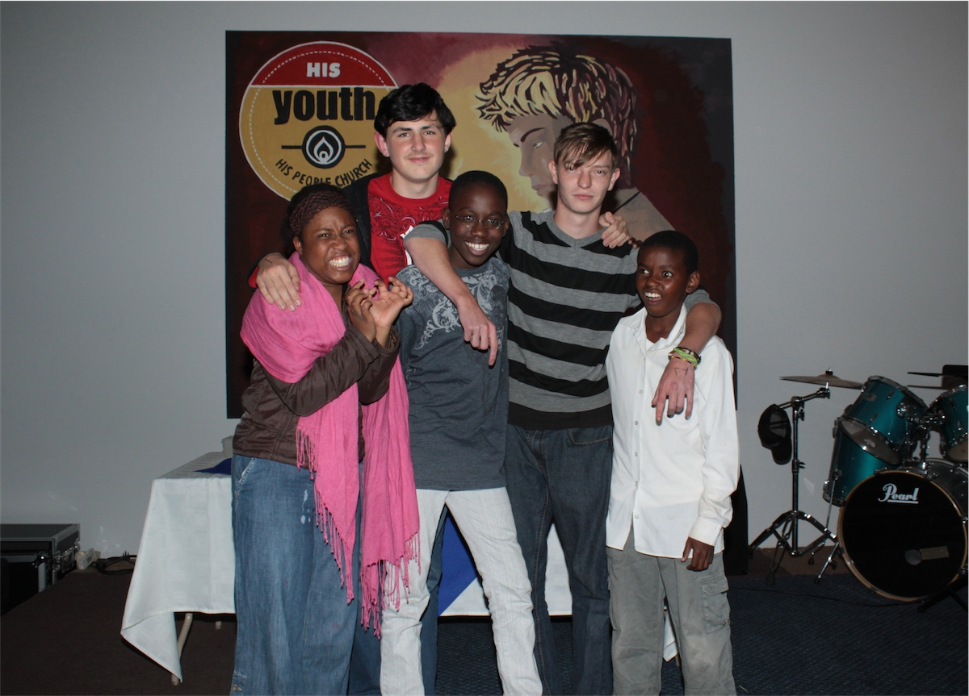
The Smartest Group!!!
Notes:
This was the winning group on the night – truly an Erudite group!

Slide 3
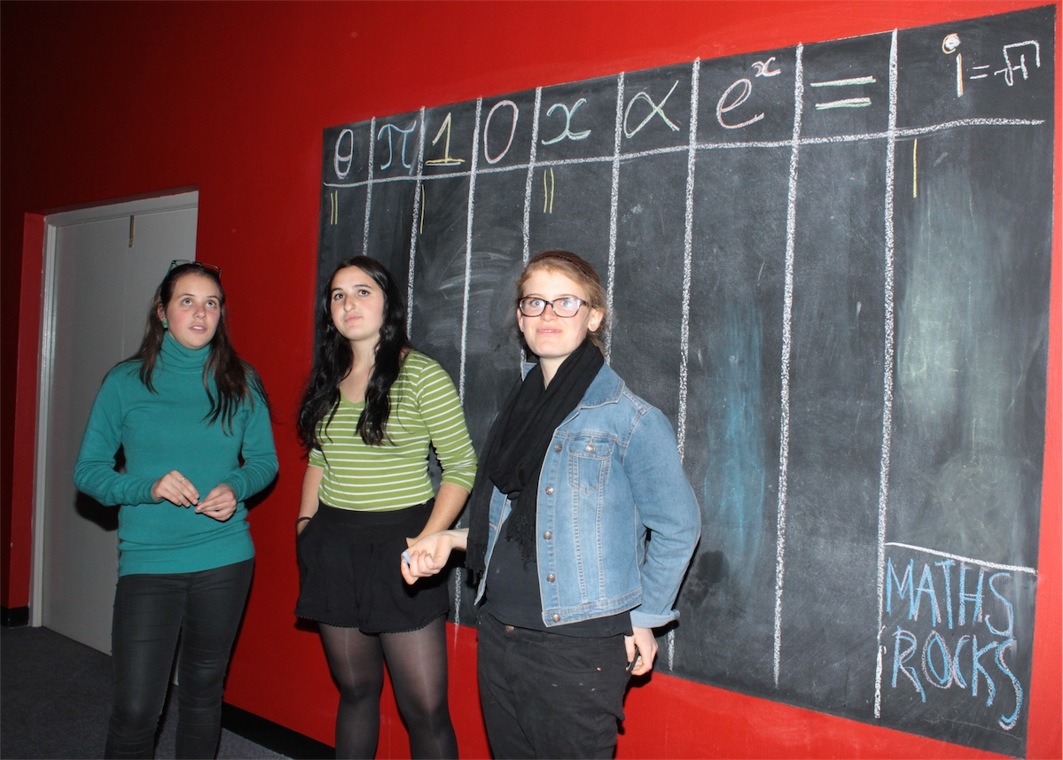
Notes:
The scoring board.

Slide 4
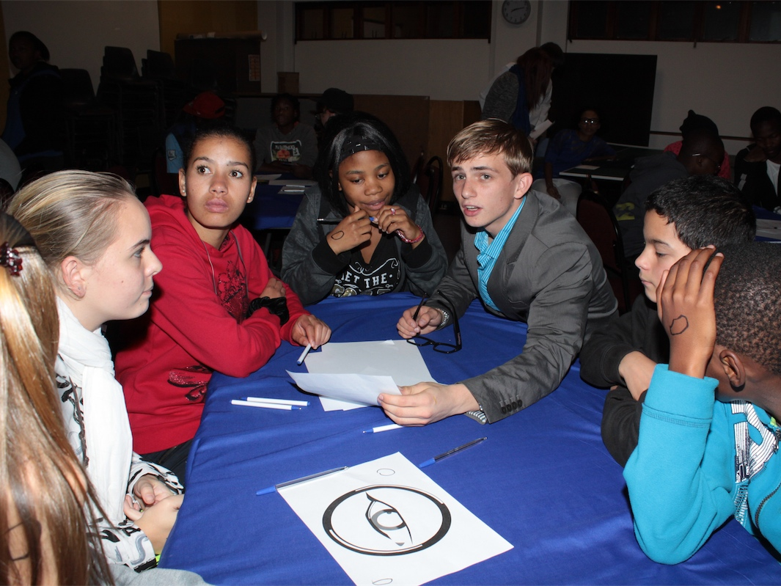
Notes:
A small group working on one of the activities.

Slide 5
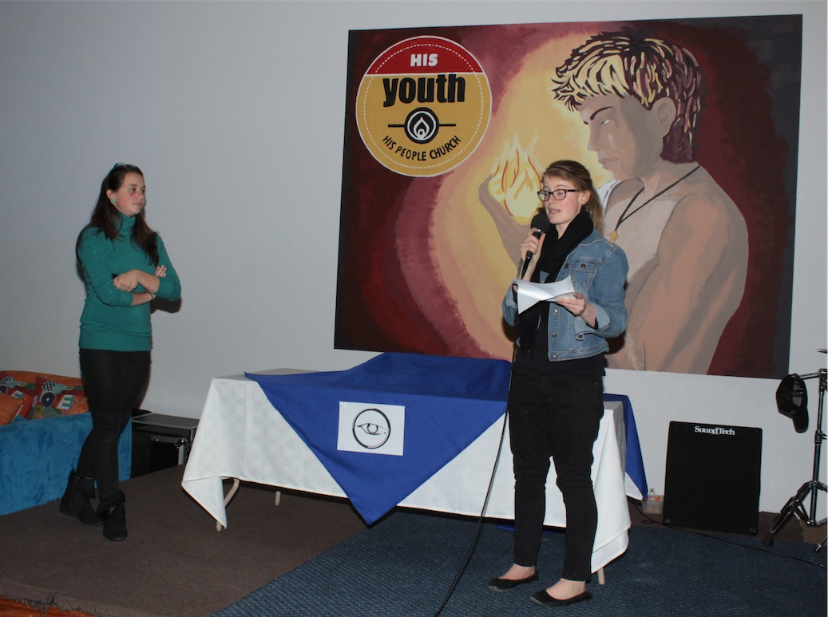
Notes:
Announcing of the half time scores for each team.

Slide 6
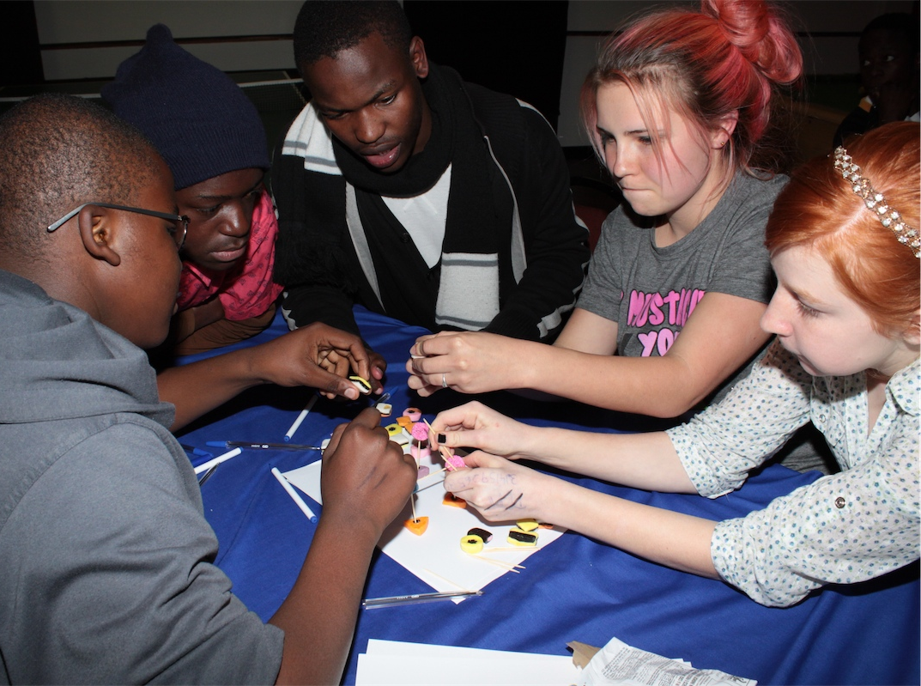
Notes:
Working on the cell structure activity!

Slide 7
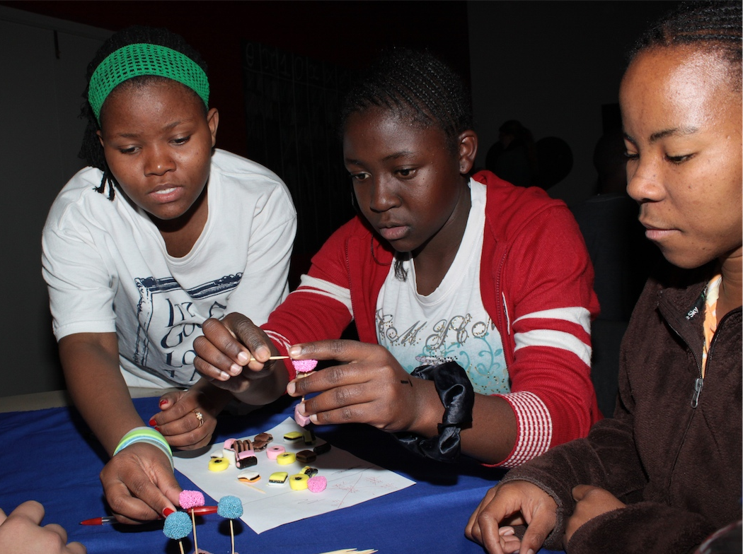

Slide 8
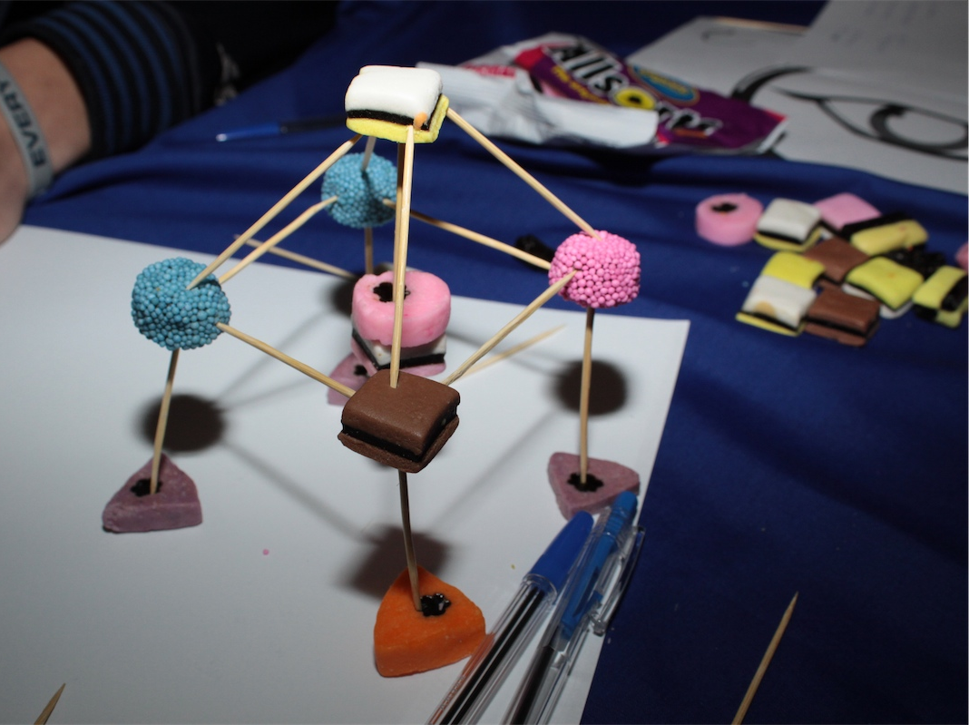

Slide 9
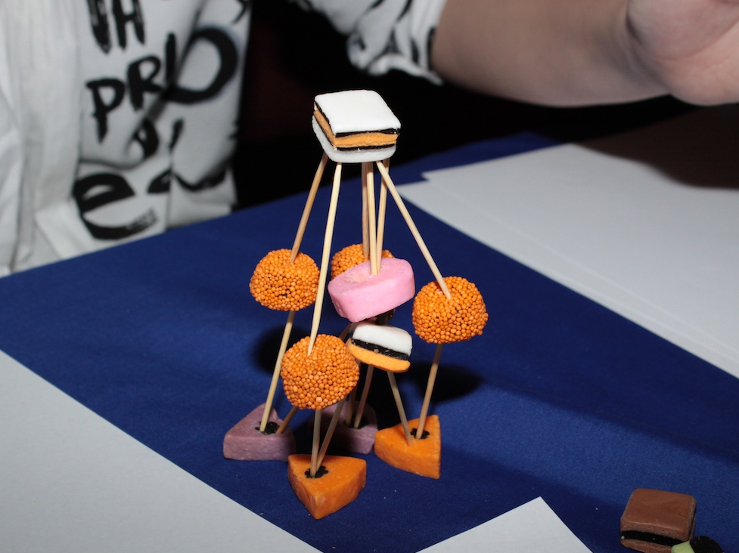

Slide 10
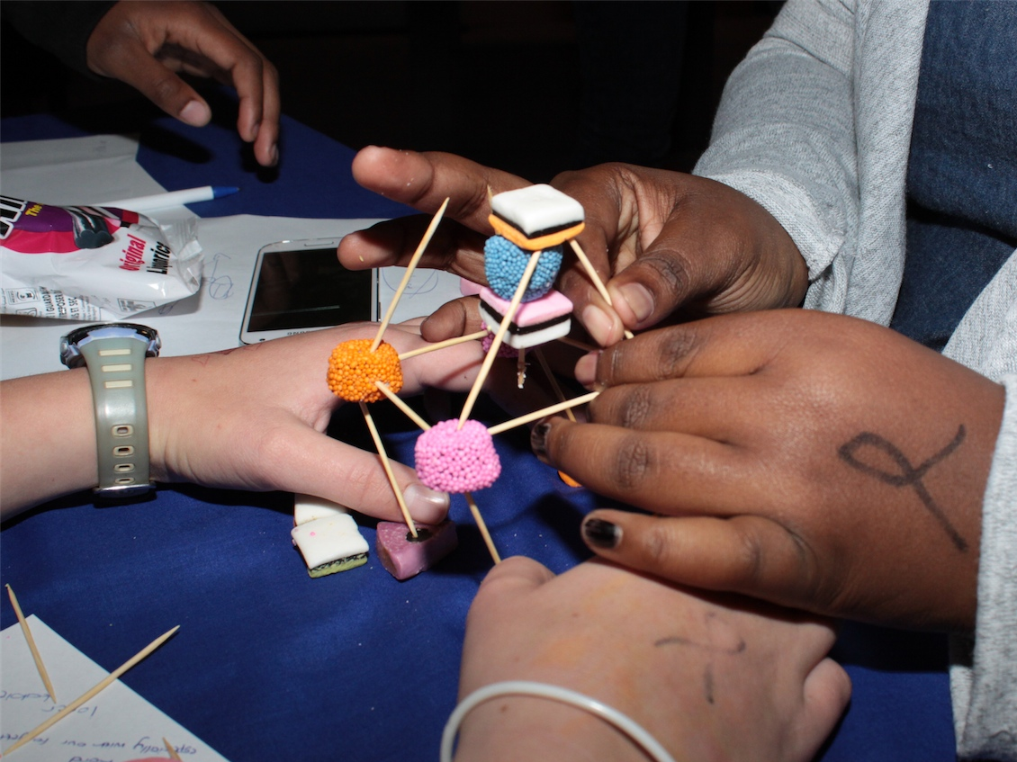

Slide 11
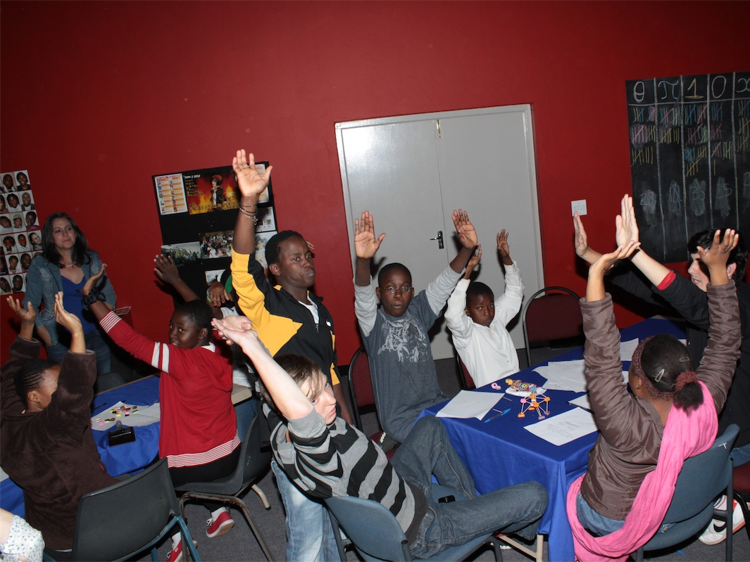
Notes:
Hands up – time is up so step away from your cell structure!

Slide 12
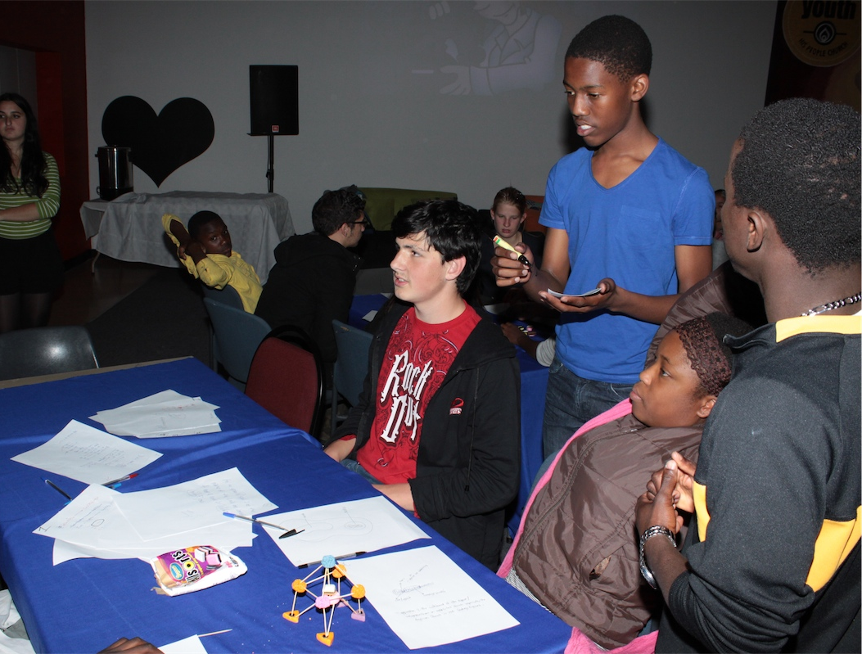
Notes:
Judges scoring the cell structures

Slide 13
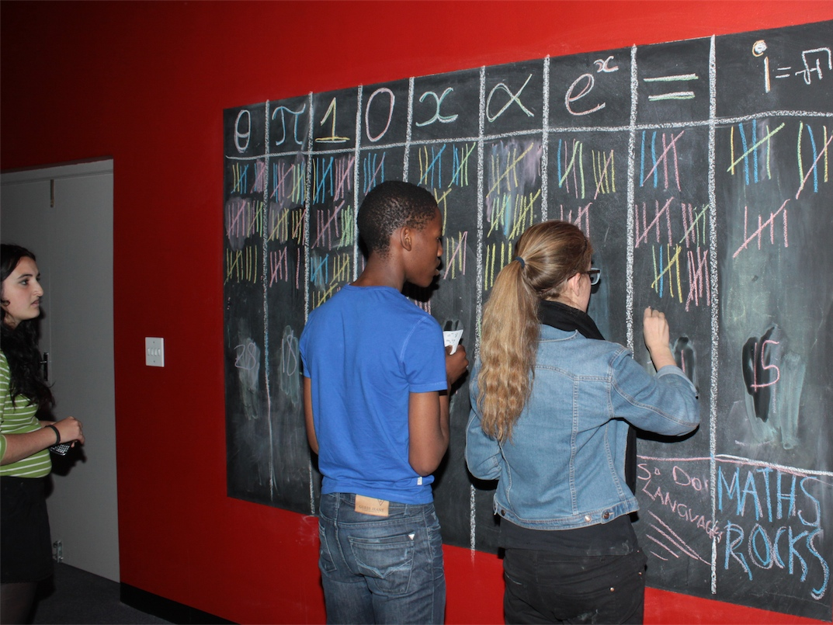
Notes:
Final scores are tallied.

Slide 14
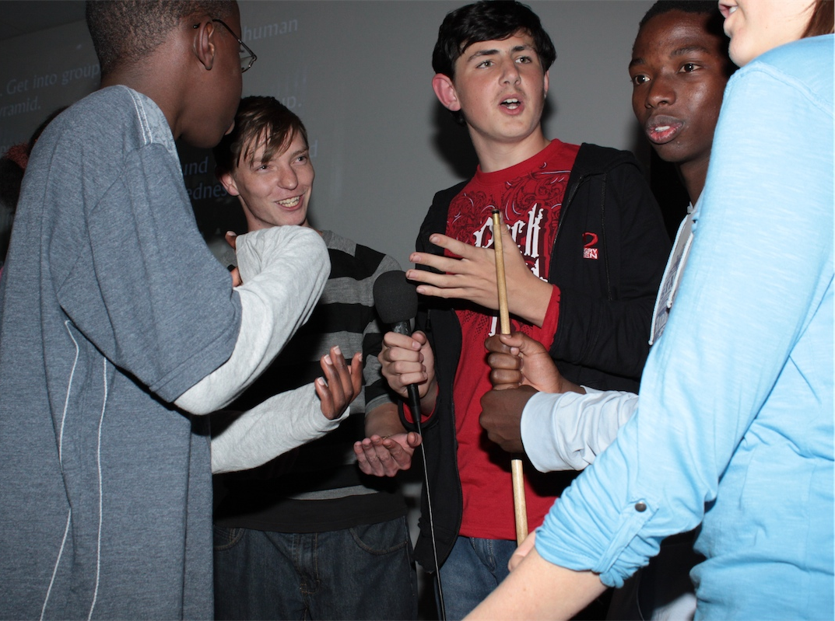
Notes:
The winning group deciding which task to inflict on the other groups.

Slide 15
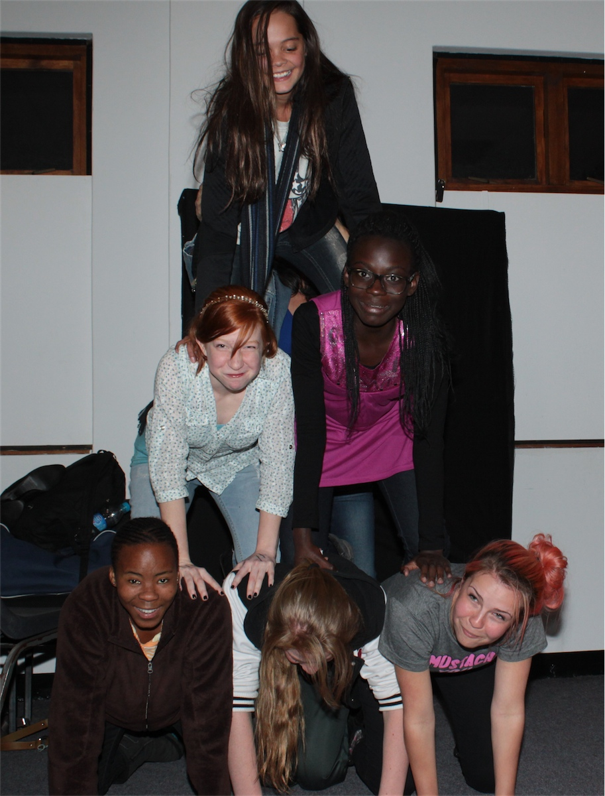
Notes:
The winning group decided that the other groups would have each build a human pyramid!

Slide 16
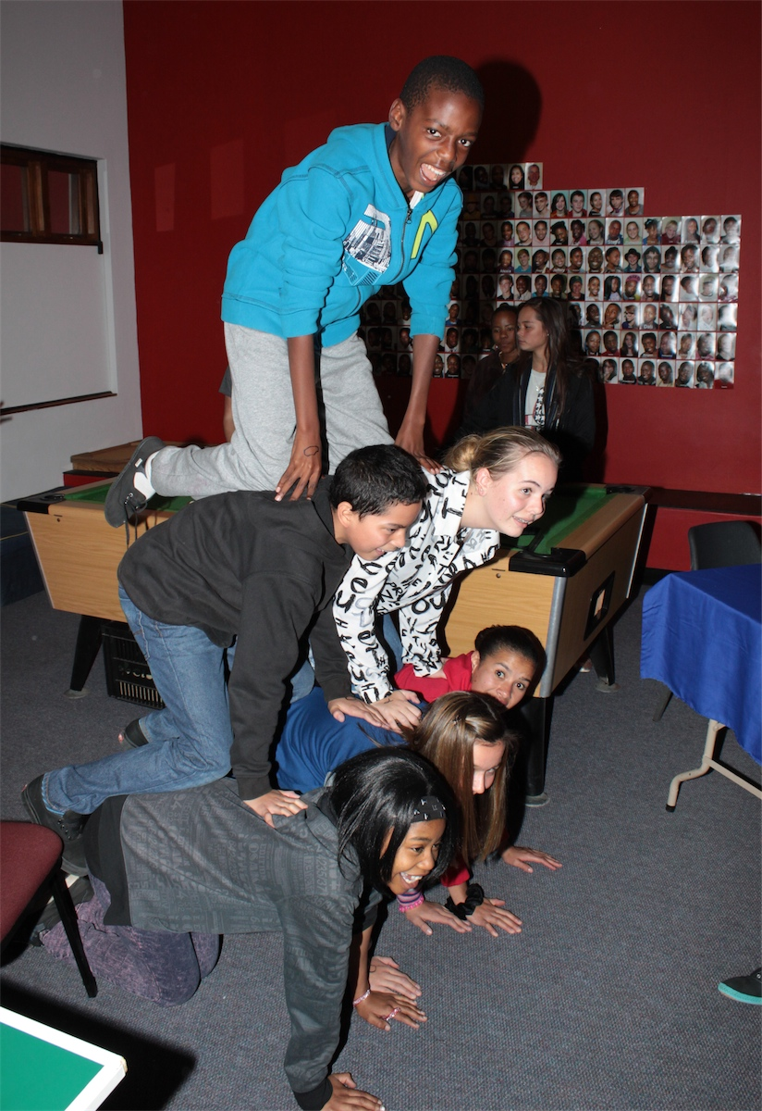
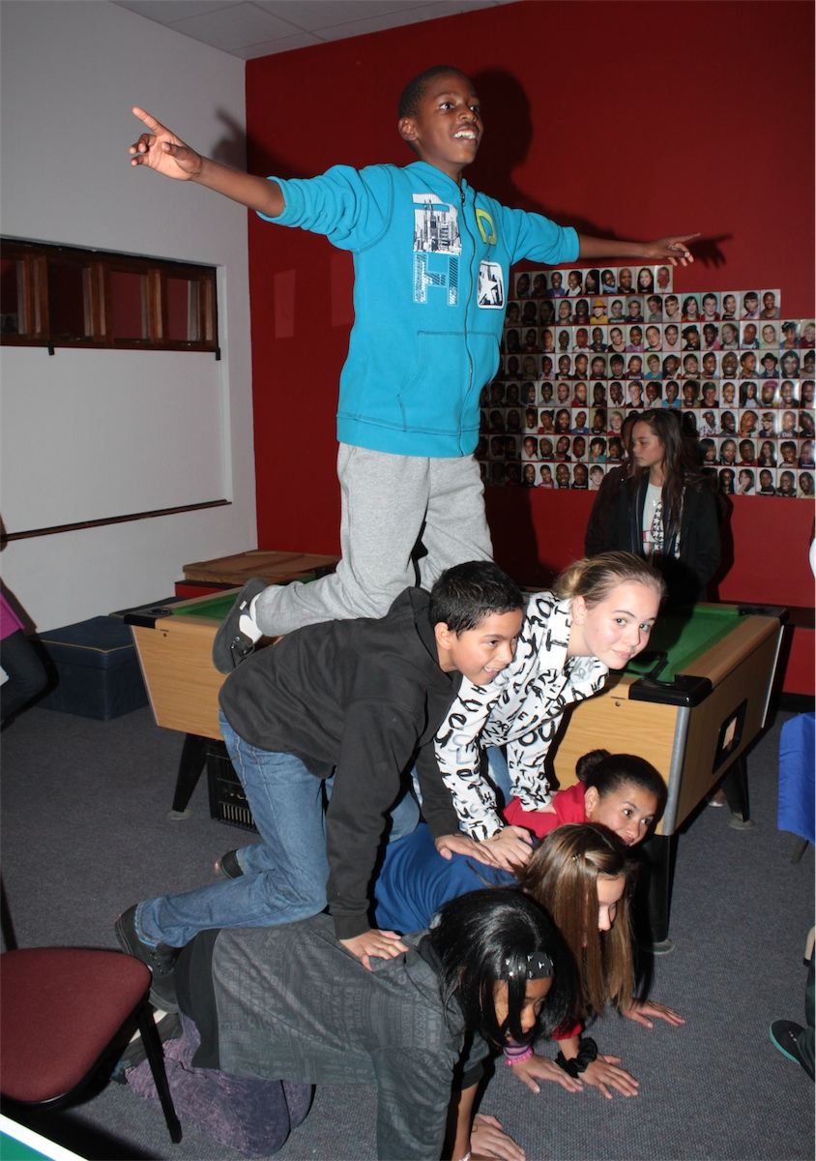

Slide 17
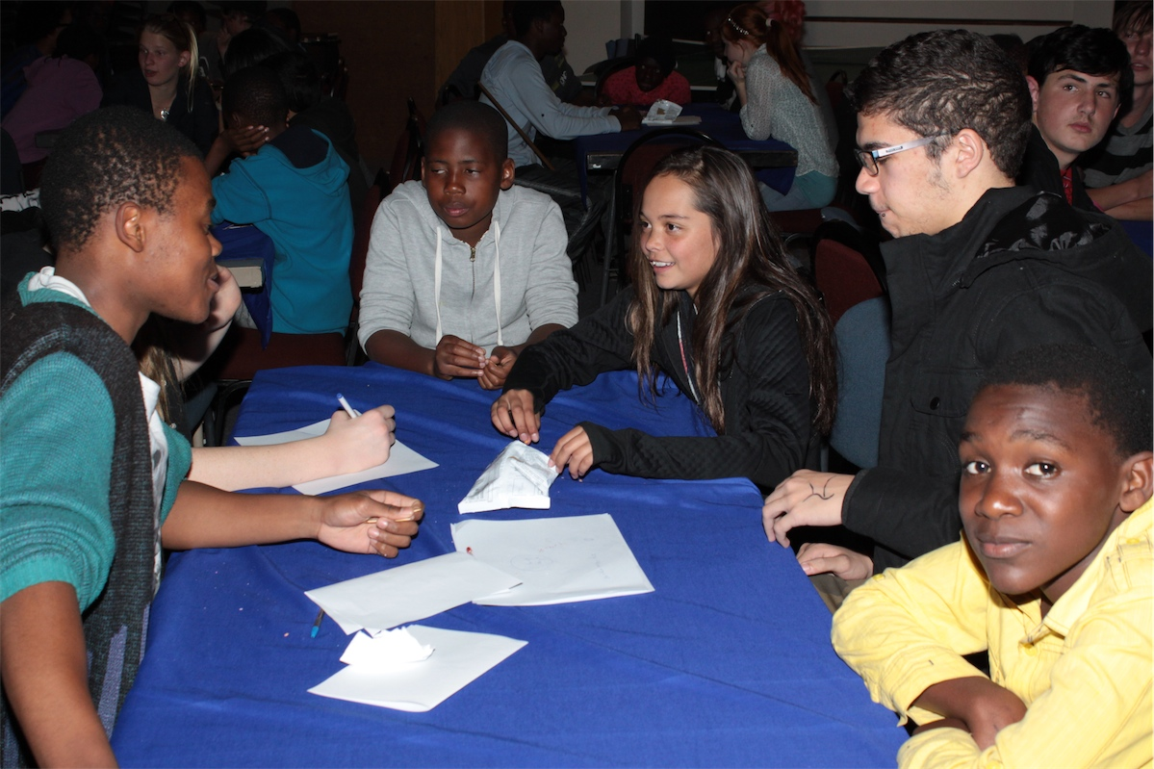
Notes:
Small group time around the same tables and in the same groups

Slide 18
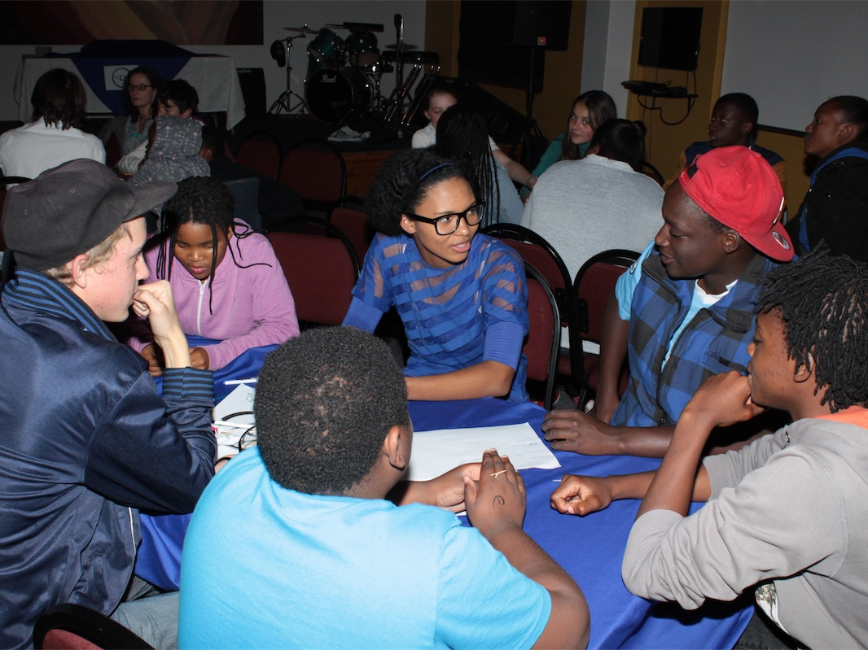
Notes:
Small group time around the same tables and in the same groups

Slide 19
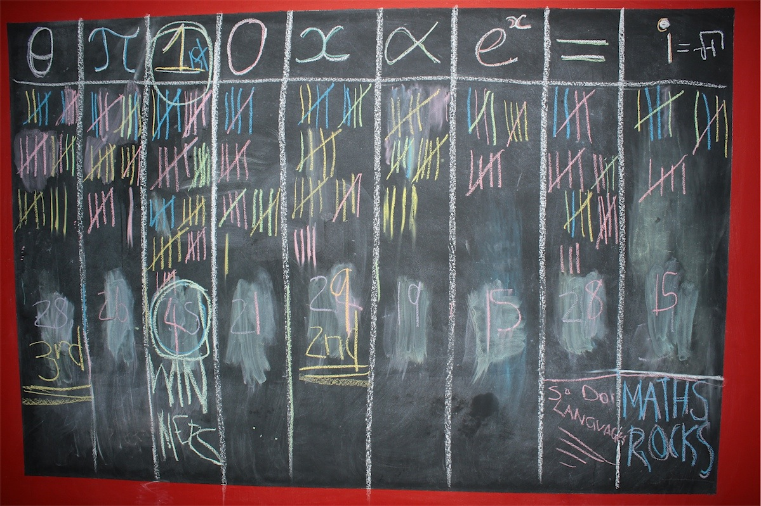
Notes:
The final scores!

Slide 20
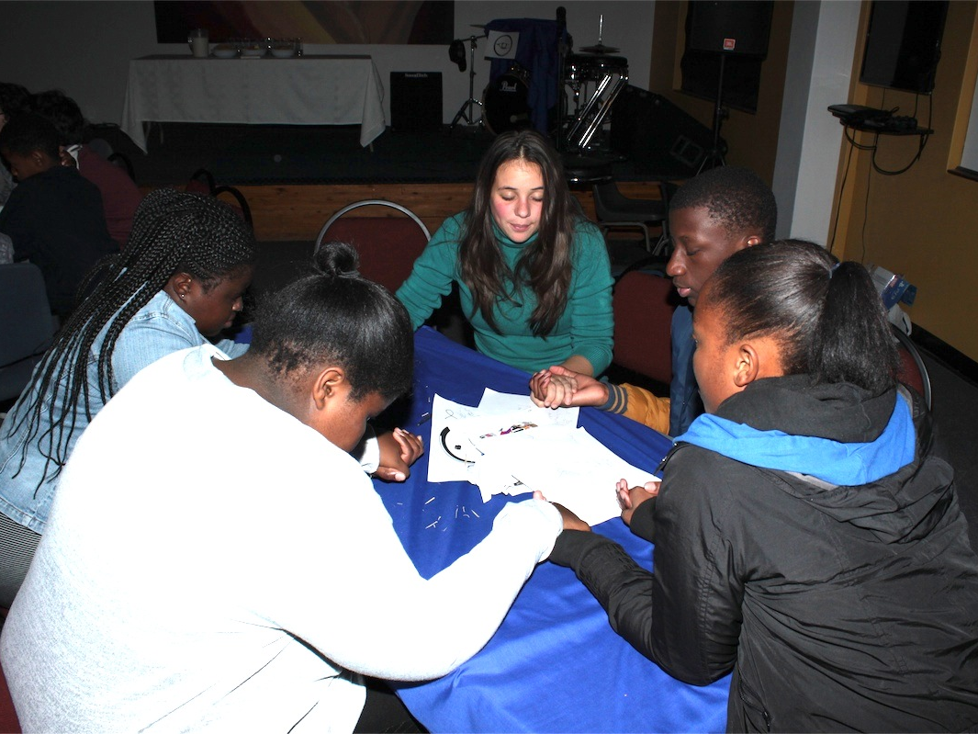
Notes:
Prayer in the small groups.

Slide 21
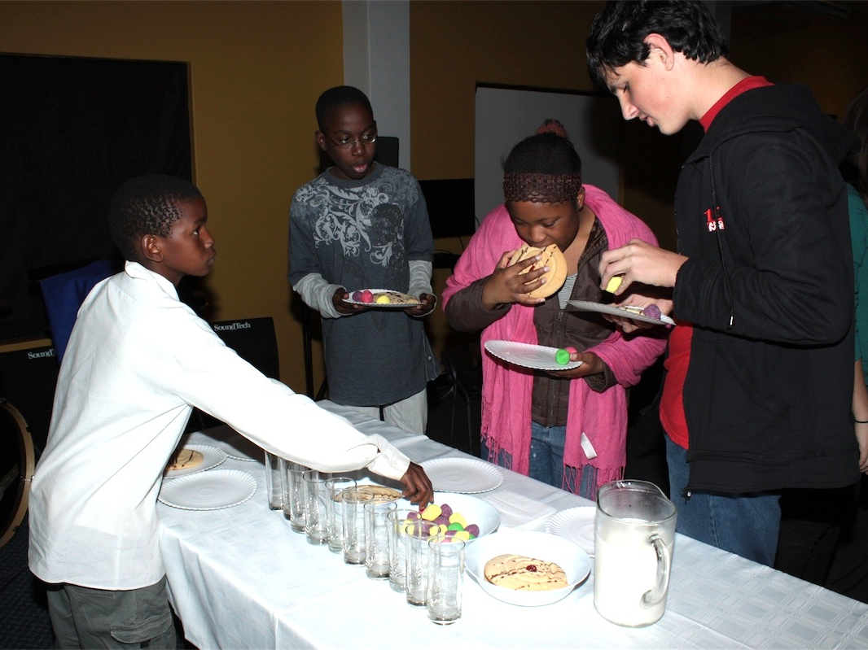
Notes:
The reward table for the winning group.

Slide 22
