Slide 1
Notes:
Divergent: Candor Night program. Teens will chill in the conference room (we will have dance music playing so people can prepare for next week's Battle Dance night. Then at around 7:40 teens will be invited to make their way into the youth room - and at the door each will be given a communion glass filled with a blue liquid (Blue Energade) which will be explained a bit later as a Truth Serum.

Slide 2
Notes:
There will be a welcome and brief overview of the Candor Faction (PLEASE NOTE: all leaders to wear a mix of white and black clothes - no other colours as far as humanly possible!)

Slide 3
Notes:
In the world of Divergent, people were divided into five different factions focusing on different positive values.

Slide 4
Notes:
Who Are Candor? They are the faction who wear black and white clothes, because they see the truth as black & white. They dress formally, with suits & ties being standard uniform with men, and women seen in long skirts, while their everyday clothing is typically black pants & white shirts.

Slide 5
Notes:
Why Was Candor Established? Candor was a faction formed by those who blamed duplicity and deception, who believed that dishonesty is the key fault in human nature which began evil and war. They believe in the principle that honesty and openness would lead to a more peaceful and perfect society.

Slide 6
Notes:
What Do Candor Value? They are honest, truthful, trustworthy, and able to read body language to detect lies.

Slide 7
Notes:
Candor Rules: Tell the Truth, Tell the Truth, Tell the Truth, Tell the Truth!

Slide 8
Notes:
Fortunately you all received a shot of truth serum at the start of this evening so telling the truth should be fairly easy tonight!

Slide 9
Notes:
Truth Circle - two circles will be formed (like we do with speed relating) and questions will be posted for teens to answer - not too revealing at this stage, but to start getting people to open up.

Slide 10
Notes:
Truth Circle Questions (Part 1)
1. How was your day? 2. What do you want to be when you grow up? 3. What is your favourite thing to do in your spare time? 4. What sports do you take part in? 5. What is your favourite subject at school, and why? 6. What is the strangest thing you have ever done? 7. If you could change one thing about yourself, what would it be, and why? 8. What is the most wild thing you want to do? 9. If you could choose to stay a certain age forever, what age would it be, and why? 10. If you won the lottery, what would you do with the money?

Slide 11
Notes:
Truth Circle Questions (Part 2) 11. What is the hardest thing you've ever had to do? 12. Who is your role-model, and why? 13. If you could move anywhere, where would it be, and why? 14. What is your favourite movie, and why? 15. What is your favourite day of the year? 16. If you had three wishes from a genie, what would you wish for? 17. Where would you go in a time travel machine? 18. What is one thing you regret in life, and wish you could redo? 19. What is your idea of a perfect holiday? 20. What are you most proud of?

Slide 12
Notes:
(2) Truth Line - everyone will step into the middle of the room in a line and questions will be asked (ie. Have you ever had a cigarette before?) and if you answer YES you take a step towards the door and if you answer NO you take a step towards the Playstation/TV wall. (Maybe the first ten people to get across a line should be rewarded - it may tempt people to cheat on their answers.)

Slide 13
Notes:
Truth Line Questions (Part 1)
1. Are you afraid of the dark? 2. Did you brush you teeth today? 3. Have you travelled outside of South Africa? 4. Have you ever been bitten by a dog? 5. Do you enjoy country music? 6. Could you go without your cellphone for a week? 7. Do you pick up litter that isn’t yours? 8. Do you have a ticket to see One Direction? 9. Are you a humble person? 10. Do you use mouth spray or breath freshener?
11. Have you ever stolen anything?

Slide 14
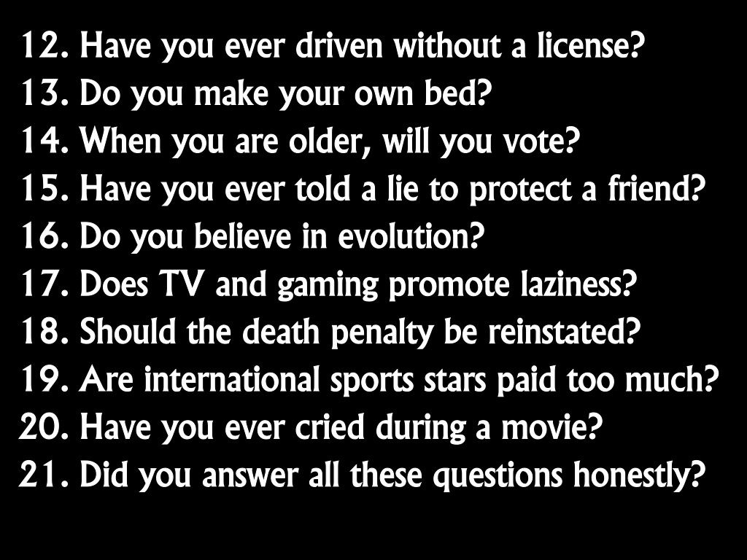
Notes:
Truth Line Questions (Part 2)
12. Have you ever driven without a license? 13. Do you make your own bed? 14. When you are older, will you vote? 15. Have you ever told a lie to protect a friend? 16. Do you believe in evolution? 17. Does TV and gaming promote laziness? 18. Should the death penalty be reinstated? 19. Are international sportsmen/women paid too much? 20. Have you ever cried during a movie? 21. Did you answer all these questions honestly?

Slide 15
Notes:
(3) Truth or Lie

Slide 16
Notes:
The big group will divide up into smaller groups of about 8 teens and each person will share one Truth and one Lie about their lives and the others need to guess which is the Lie.

Slide 17
Notes:
(4) Truth or Dare

Slide 18
Choose a card from either pile!
Notes:
In the same small groups there will be two packs of cards in the middle of each group - one marked Truth and one marked Dare. Each person will get to choose either card and either answer the Truth question or do whatever is written on the Dare card.
The Truth Cards:
Who in this room would you like to watch a movie with?
What is the first thing that attracts you to a person of the opposite sex?
What is a talent you have never told us about?
What is a secret that you have never told anyone?
What was the last lie you told?
When did you last fart in public? Did anyone know about it?
Which is the most irritating habit of the person standing next to you?
What is the one quality or feature you would like to change about yourself?
What is the longest you have gone without showering?
What is the worst fear you have in life?
What do you do when you are alone in your room?
Have you ever cooked or baked something for someone you liked?
Has anyone, apart from your family, ever seen you naked? If yes, who?
What is the stupidest thing you have done in front of a crowd?
Have you ever been mean to anyone without a reason?
What is your worst habit?
What childhood story are you most afraid of your mother telling your friends?
If you could have anything in the world, what would it be?
What feature of yours are you self-conscious about?
Would you ever cheat on someone you were in a relationship with?
If you had only 24 hours left to live, what would you do?
What one question do not want anyone to ask you in this game?
What is the meanest thing that you have done till date?
If you got a chance to make anyone in this room your slave, who would it be?
If you woke up one day and found you had become invisible, what is the first thing you would do?
What celebrity do you have a crush on?
What is the worst sin you ever committed?
What action from you past would put you in jail if the police ever found out?
Who in this room would be the worst to be trapped in a lift with?
The Dare Cards:
Lick your elbow while singing the alphabet
Kiss someone on cheek
Pretend you are Tarzan for 30 seconds
Go up to someone in the room and say loudly: “I LOVE YOU” 5 times
Act like a gorilla for 20 seconds
Moonwalk across the room
Give the person 3 places to the right a hug
Kneel down and propose to someone in the group
Make someone in the group laugh
Do a handstand
Play "This little piggy went to market" on someone’s toes
Pretend that you are underwater for the next 20 seconds
Make a funny face until everyone is laughing
Sing a nursery rhythm
Hop around like a rabbit
Do a death scene
Walk around the group barking like a dog
Suck your thumb and cry like a baby
Do the splits
Shave off your eyebrows – just kidding! Take another card!
Walk around in your socks until the end of the night
Wear your shirt backwards for the rest of the night

Slide 19
Notes:
We will then reward everyone for their honesty on the night by handing out a chocolate/vanilla ice cream cone to each person.

Slide 20
Notes:
We will then have our small group time. After small groups we will have hot chocolate and biscuits.
Small Group Questions:
1. What was it like having to speak the truth tonight?
2. How do you feel now after being honest earlier?
3. Why do you think we struggle with honesty?
4. How does Ephesians 4:15,25 help? God wants us to grow up, to know the whole truth and tell it in love. No more lies, no more pretense. Tell your neighbor the truth. In Christ’s body we’re all connected to each other. When you lie to others, you end up lying to yourself.
5. Pray for each other to develop honesty!

