Slide 1


Slide 2
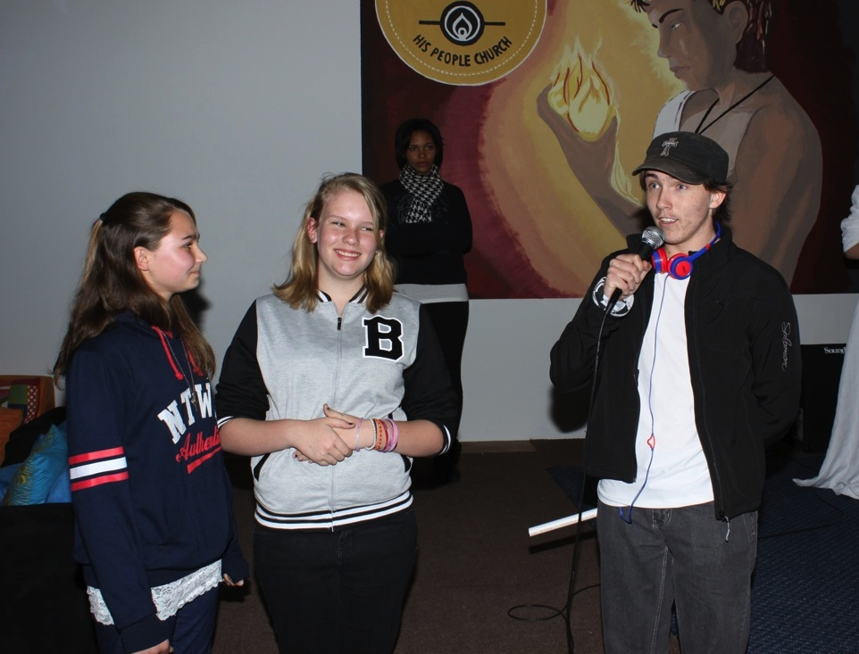
Notes:
Welcoming newcomers.

Slide 3
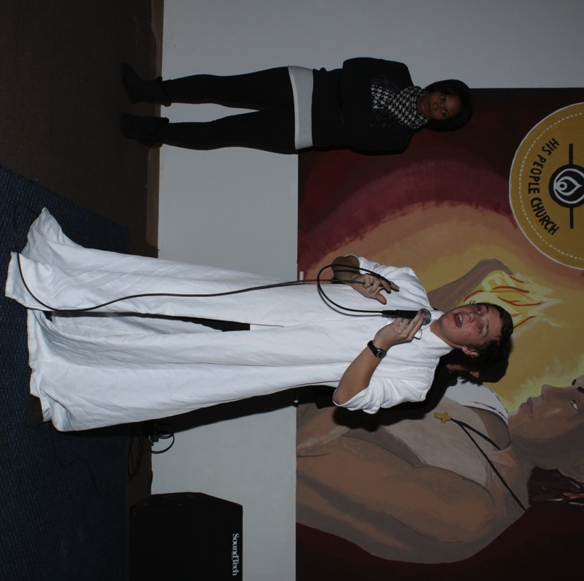
Notes:
The Candor leaders kicks off the night!

Slide 4
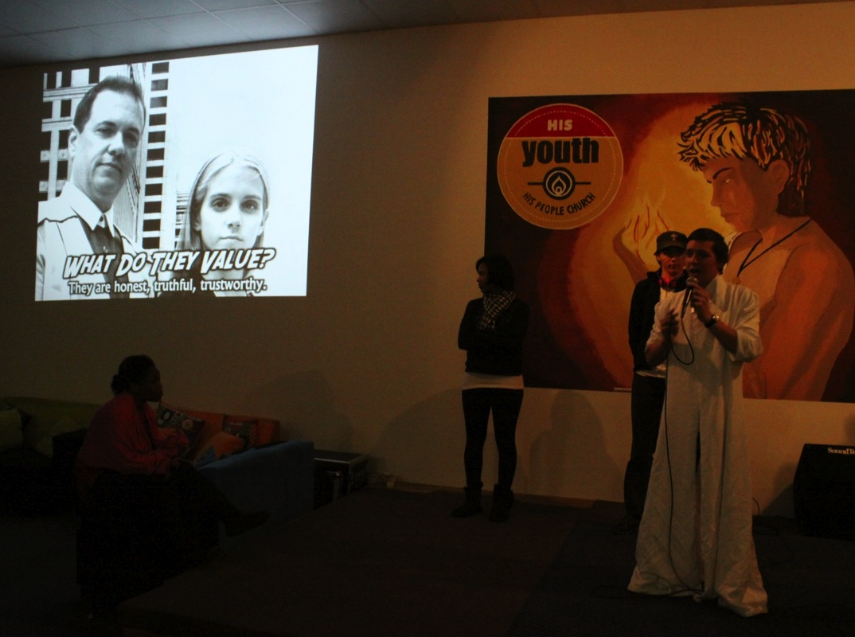

Slide 5
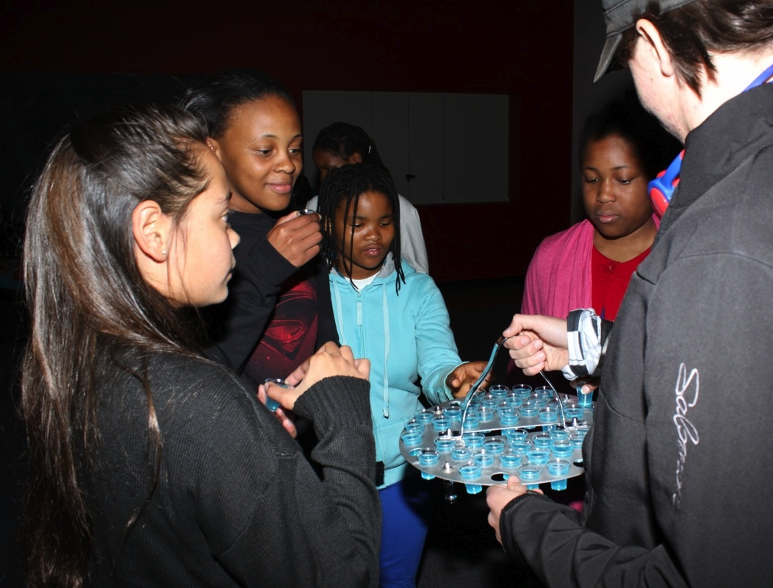
Notes:
Time for truth serum.

Slide 6
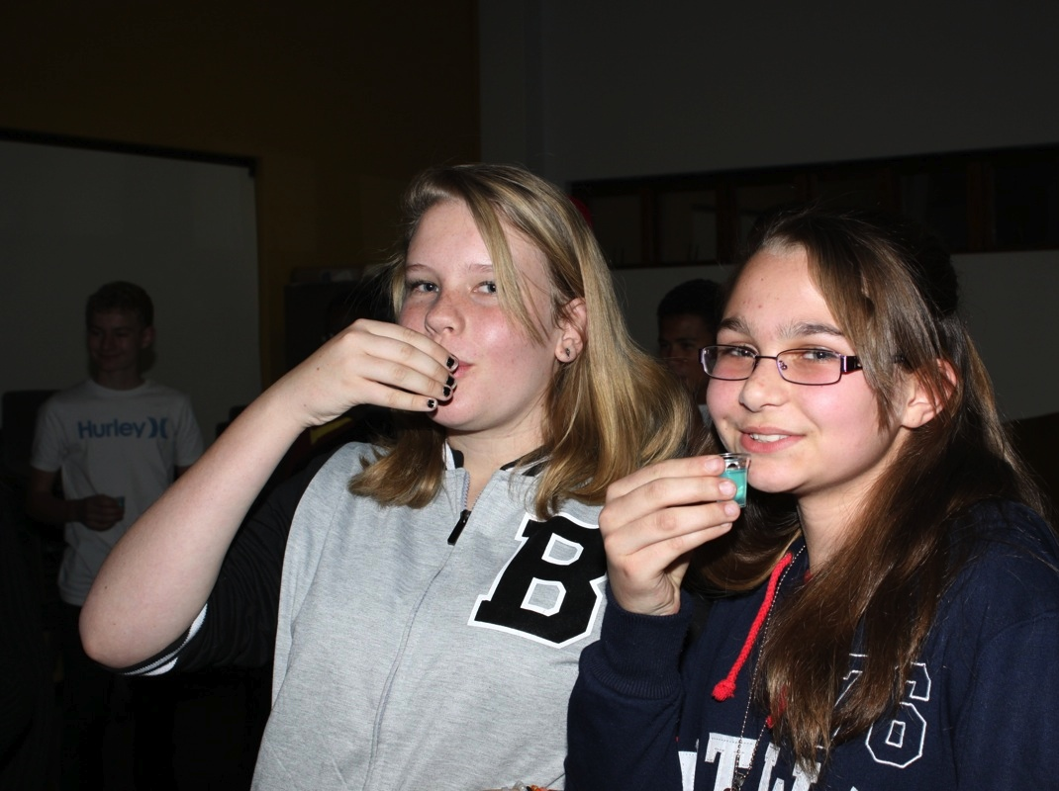

Slide 7
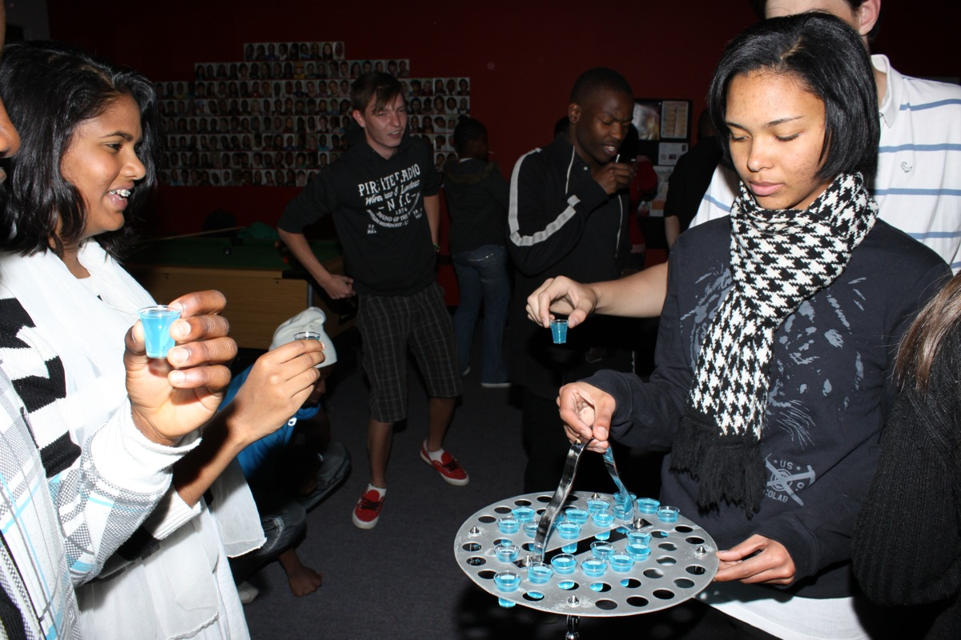

Slide 8
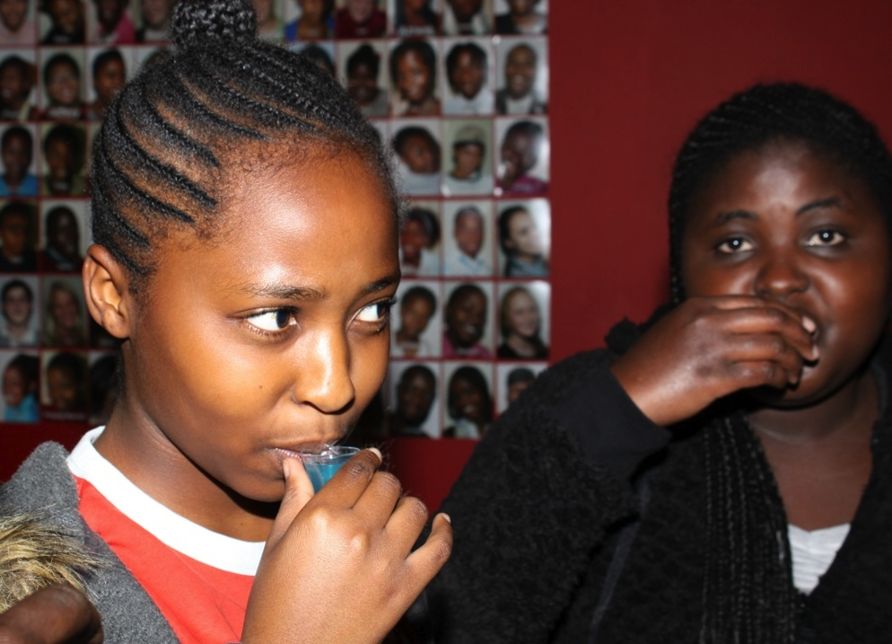

Slide 9
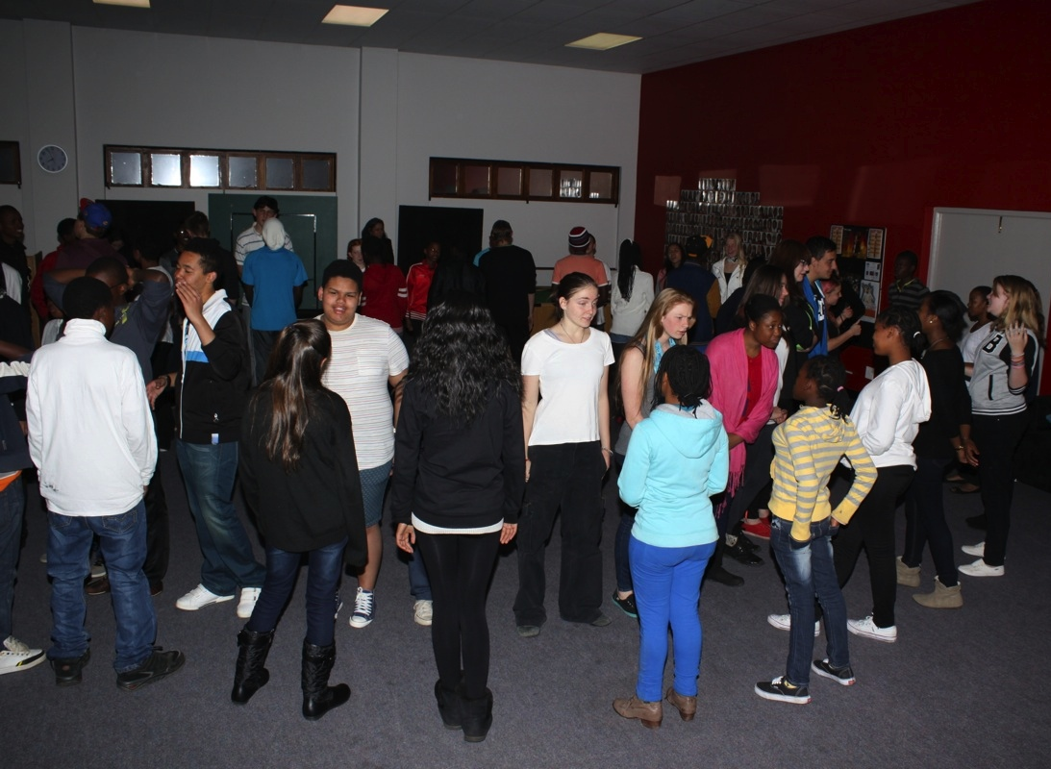
Notes:
The Truth Circle activity

Slide 10
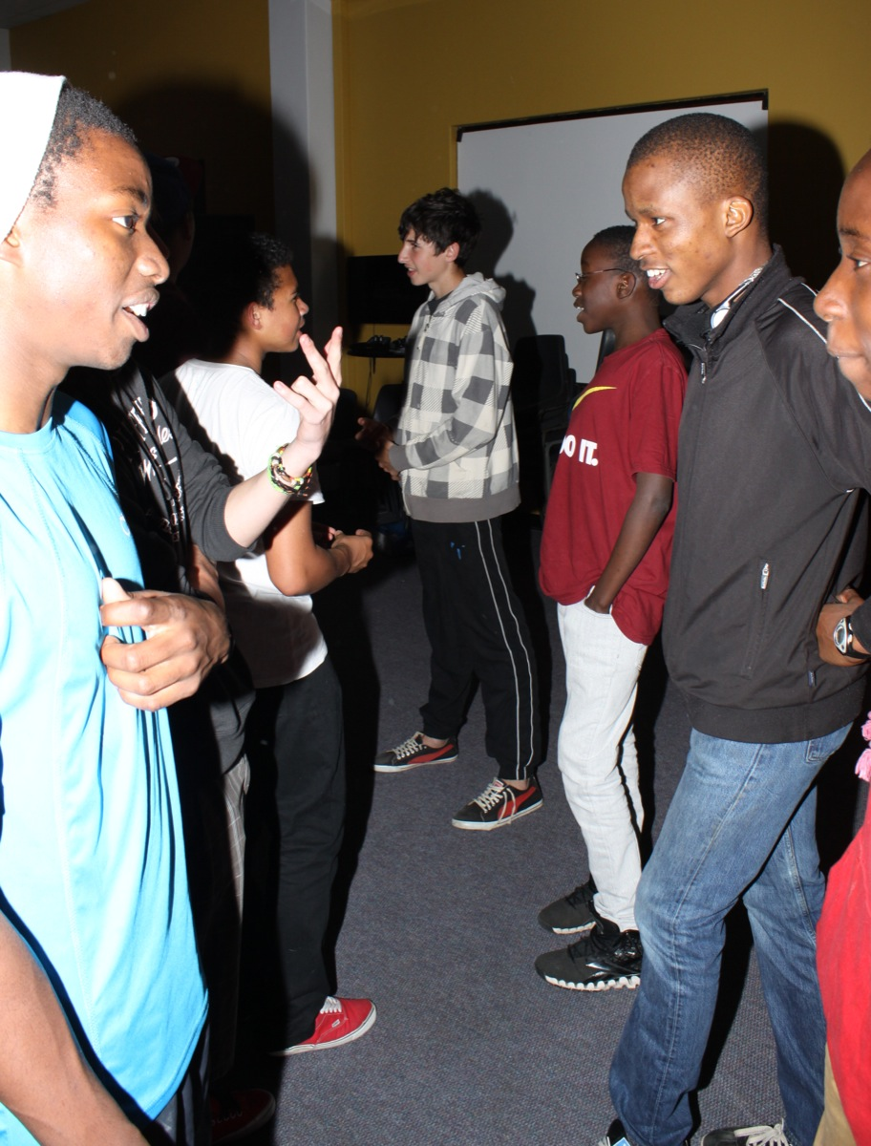
Notes:
The Truth Circle activity

Slide 11
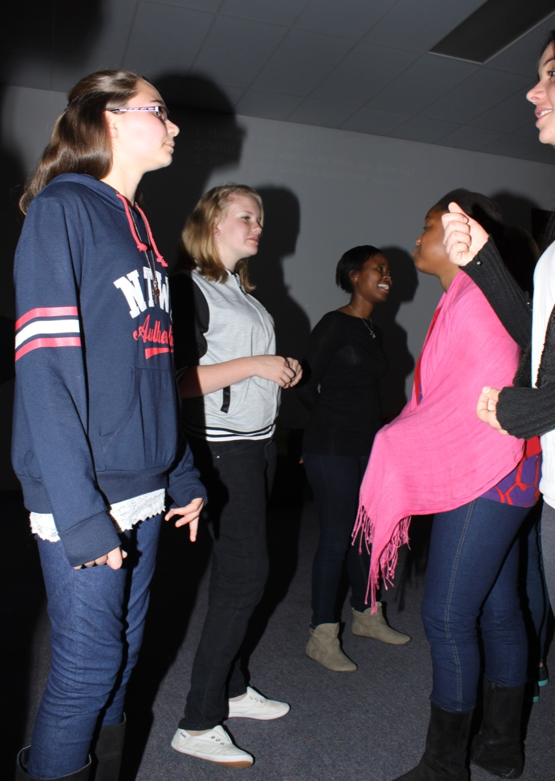

Slide 12
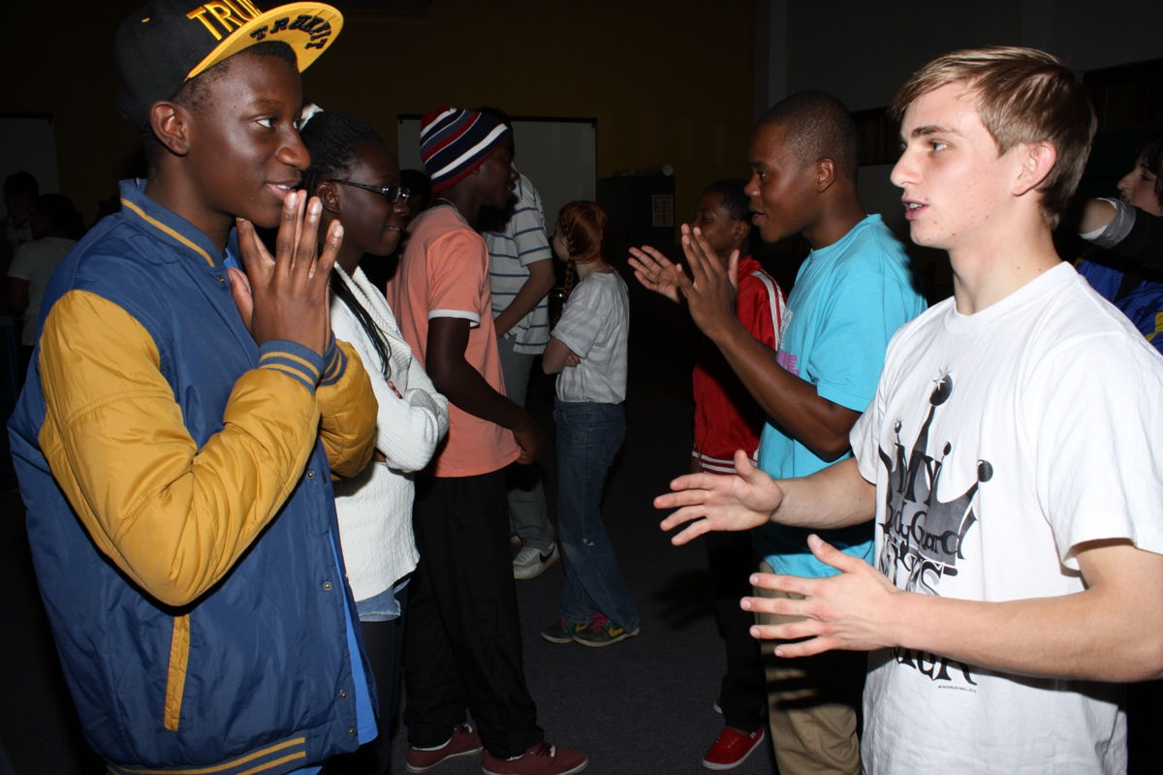
Notes:
The Truth Line activity

Slide 13
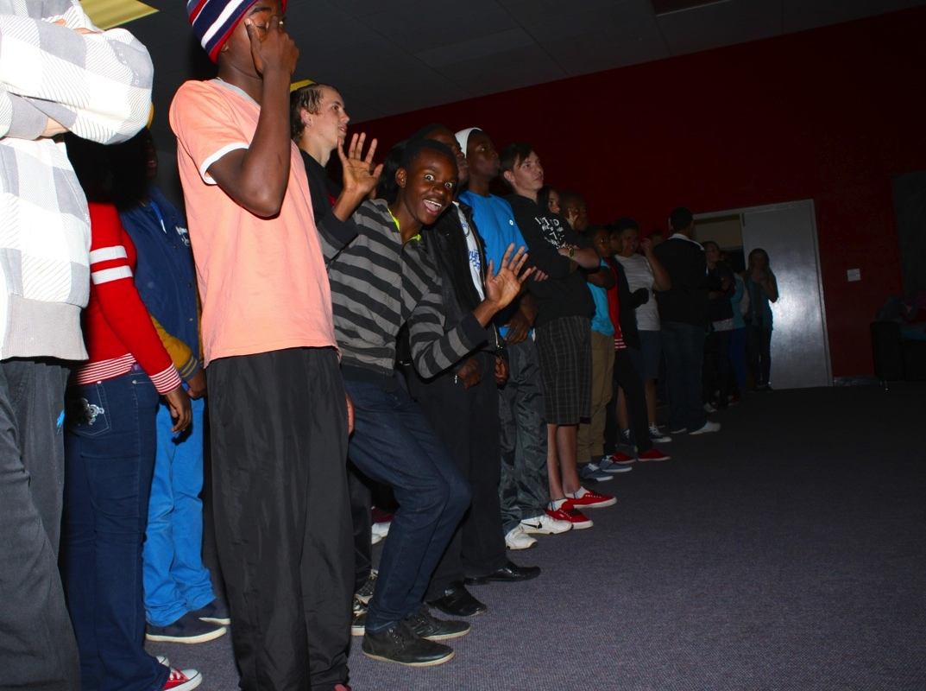

Slide 14
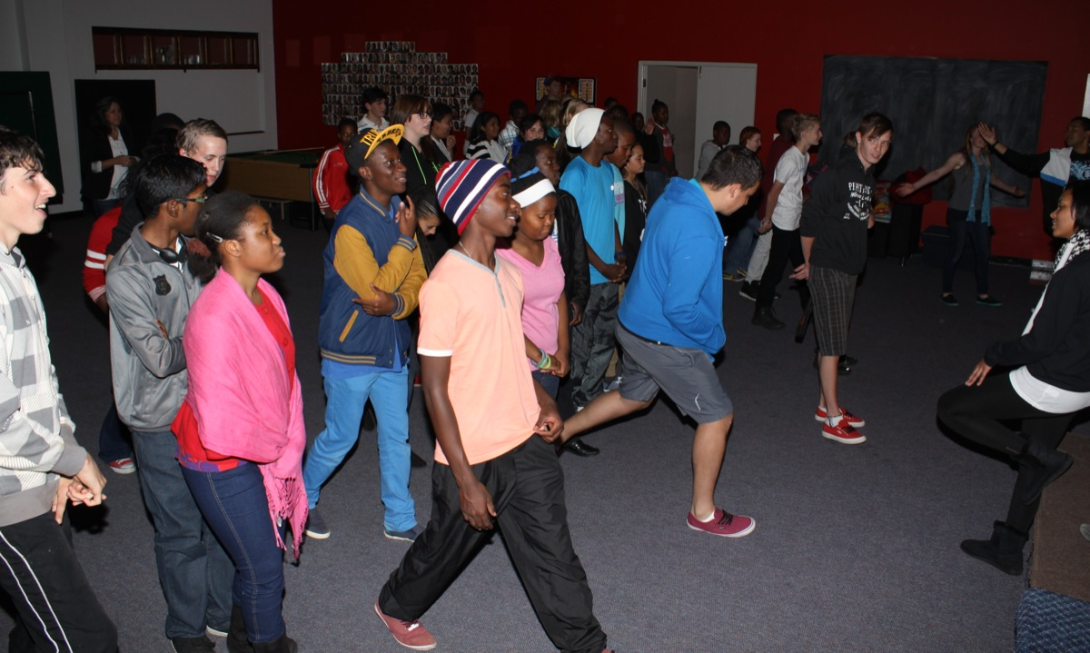

Slide 15
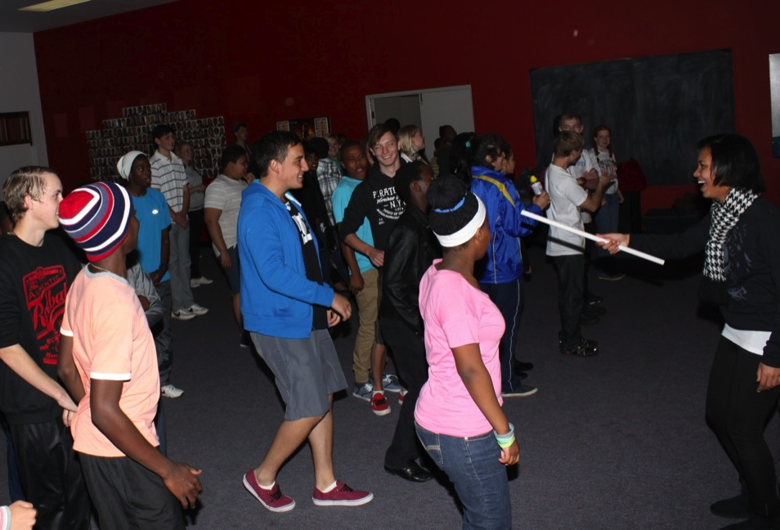

Slide 16
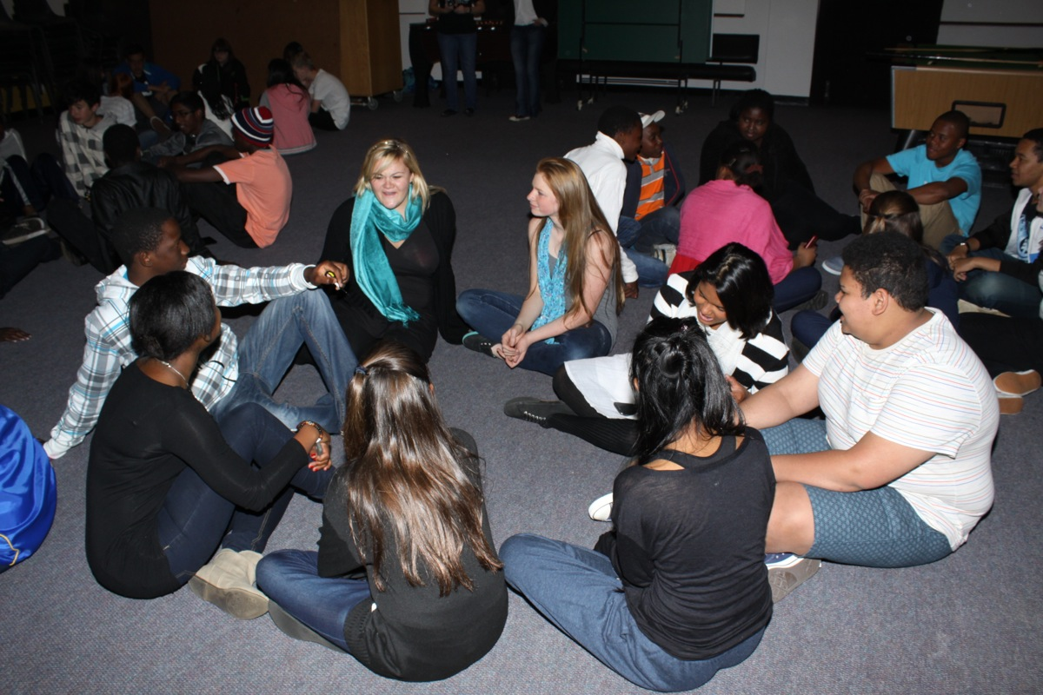
Notes:
The Truth or Lie activity

Slide 17
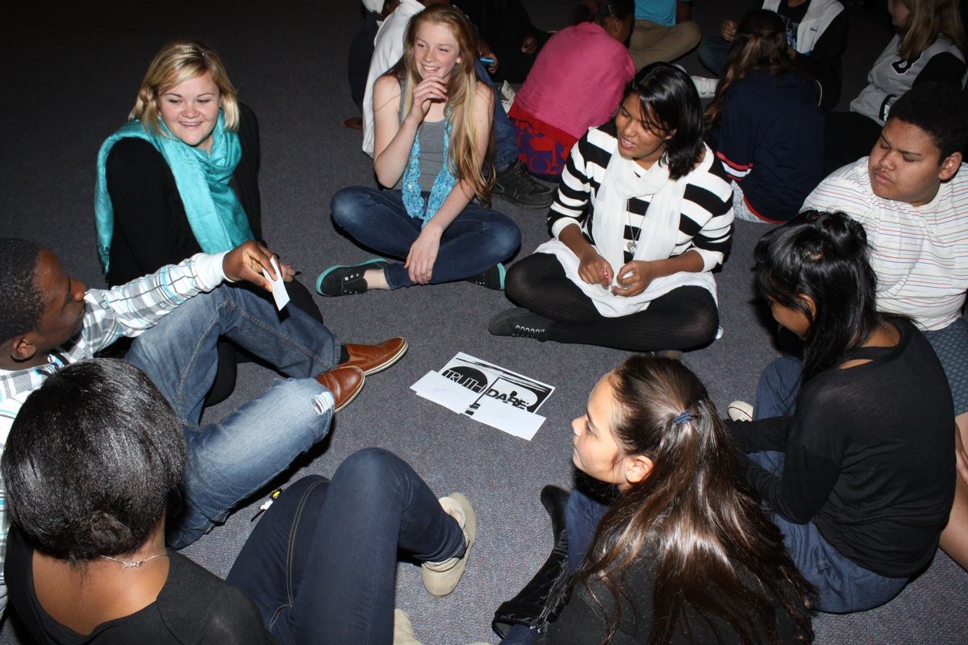
Notes:
The Truth or Dare Activity

Slide 18
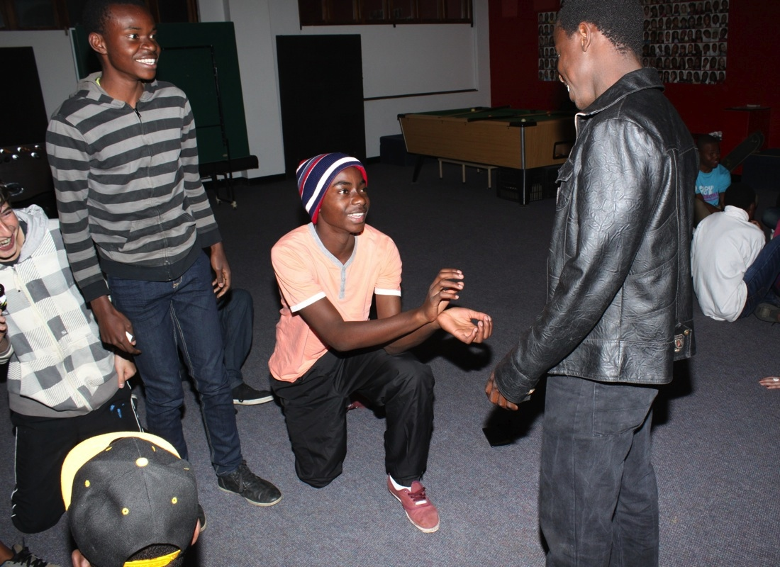
Notes:
I dare you to propose to someone in the group.

Slide 19
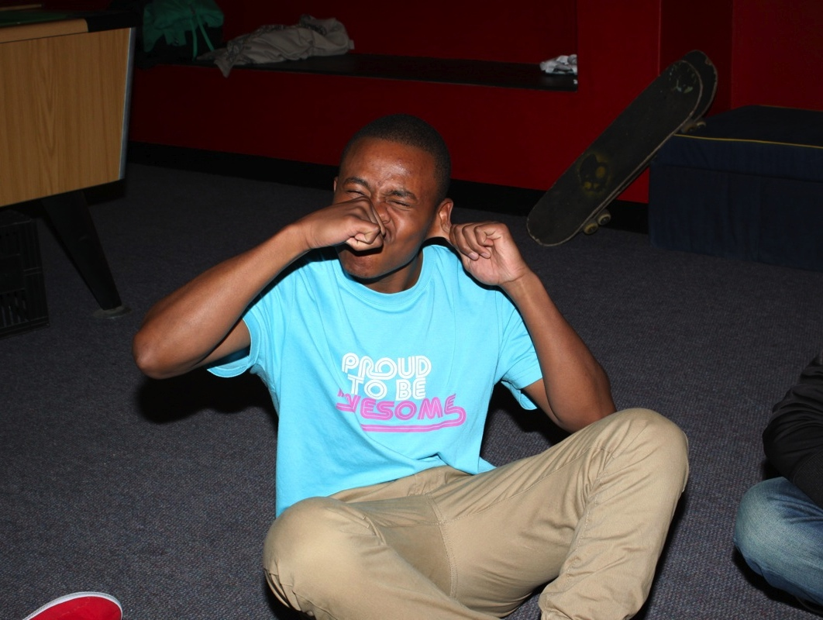
Notes:
I dare you to pull a funny face and make everyone laugh

Slide 20
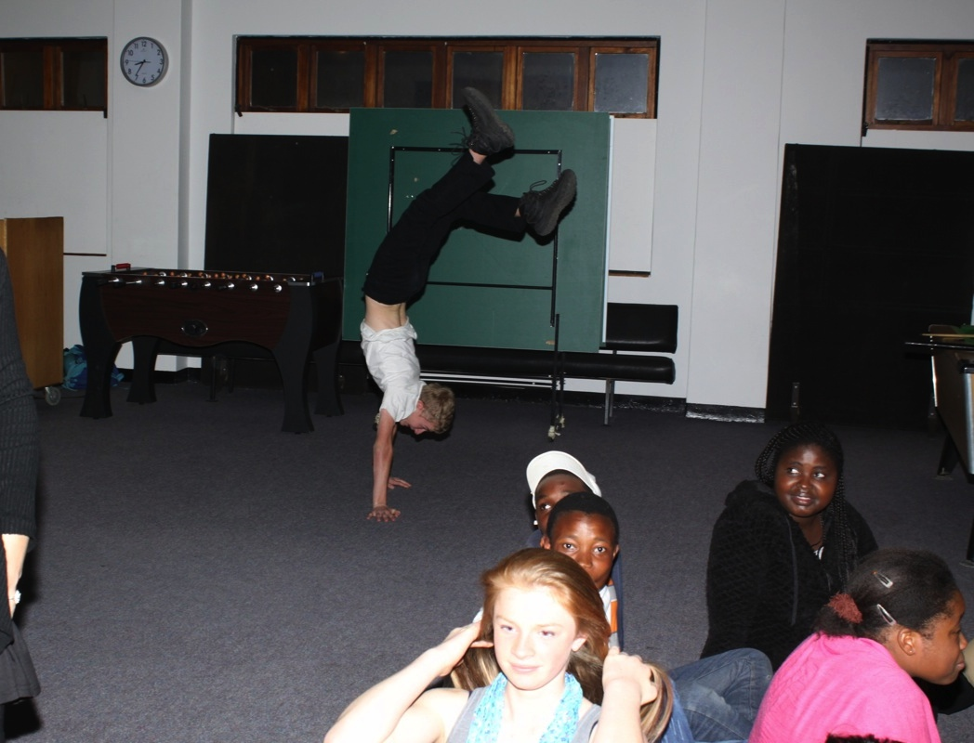
Notes:
I dare you to do a handstand

Slide 21

Notes:
I dare you to do the splits.

Slide 22

Notes:
I dare you to tell someone you love them – three times and loud.

Slide 23

Notes:
I dare you to kiss someone on the cheek.

Slide 24

Notes:
I dare you to lick your elbow.

Slide 25

Notes:
I dare you to pretend you are Tarzan for 30 seconds.

Slide 26

Notes:
I dare you to play dead.

Slide 27

Notes:
I dare you to moonwalk across the room.

Slide 28

Notes:
I dare you to suck your thumb and cry like a baby!

Slide 29

Notes:
The ice-cream reward for being honest

Slide 30

Notes:
Prayer to end the small group time.

Slide 31

Notes:
Prayer to end the small group time.

