Slide 1

Notes:
Divergent: Amity Night Program
Here are details of setup requirements for the night: (1) Paper flowers and leaves in red, yellow and orange will be cut out and thrown around the youth room. (2) Plants and garden tools will be used as decorations (3) As youth approach the youth room there will be a poster saying: "You are leaving the city.” (4) Teen leaders will be asked to wear "hippy" outfits. (5) Girls will be given a real flower to wear in their hair. (6) A gong (or appropriate sound) will go off every time a new event is introduced to get everyone's attention. (7) This will be a very colourful night reflected in outfits and the PowerPoint that is used to lead the night.
Before the welcome a PowerPoint will show slides of fields and flowers set to a medley of Beatles songs (16 minutes long) from the Sixties (the following songs were used: Hey Jude, In My Life, Let It Be and Here Comes the Sun).
1. Welcome - everyone is welcomed into the youth room and newcomers introduced. The following 5 slides will be used to introduce teens to the Amity faction.

Slide 2
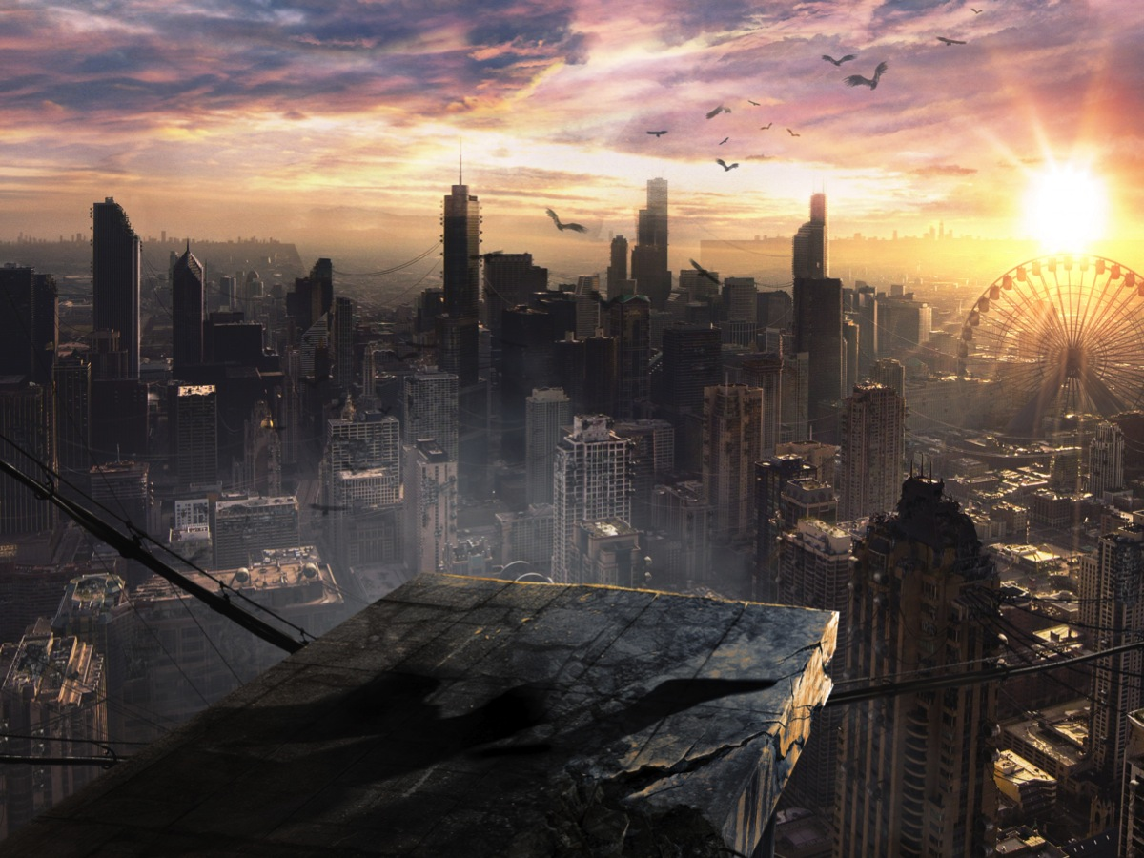
Notes:
2. Amity Overview - In a future world, war has caused incredible damage to the world and four of the five factions live in the city of Chicago.

Slide 3
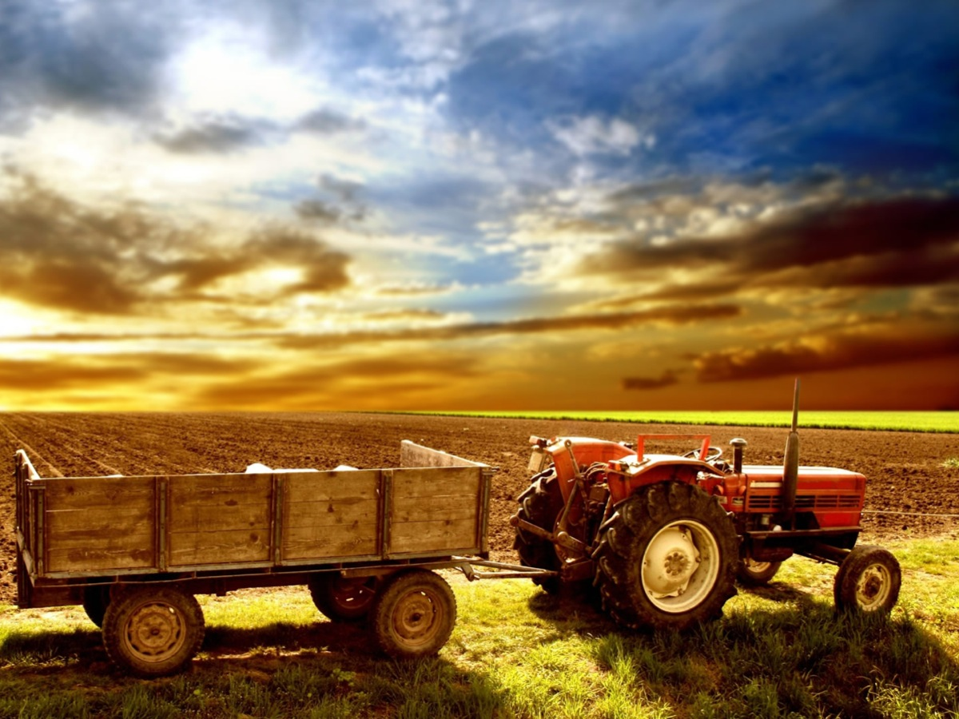
Notes:
But one faction, Amity, has left the city and live on a farm outside the walls of the city.

Slide 4
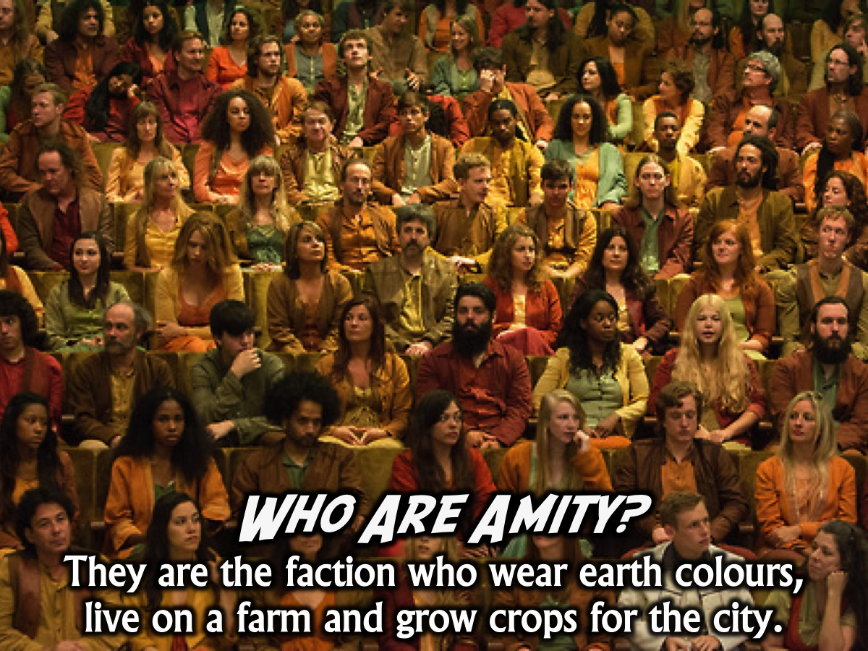
Notes:
Who Are Amity? They are the faction who wear earth colours, live on a farm and grow crops for the city.

Slide 5
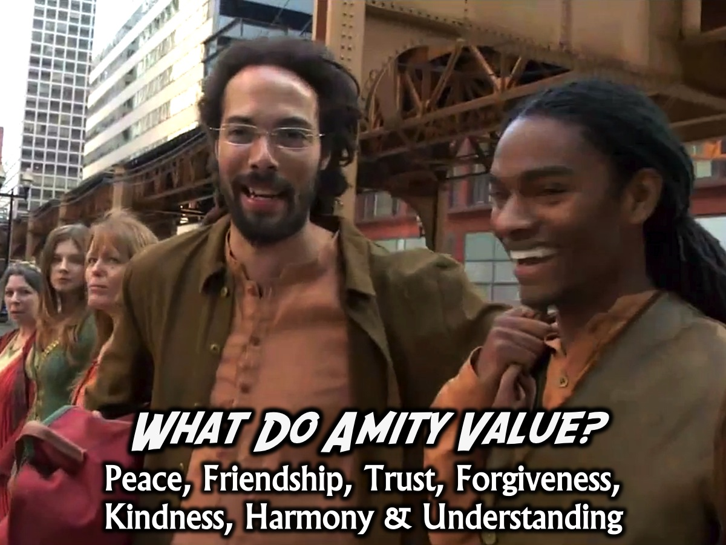
Notes:
What Do Amity Value? Amity are peace loving people, however they are prone to being dishonest to keep peace and respect, they are nature loving and provide most of the crops for all the factions.

Slide 6
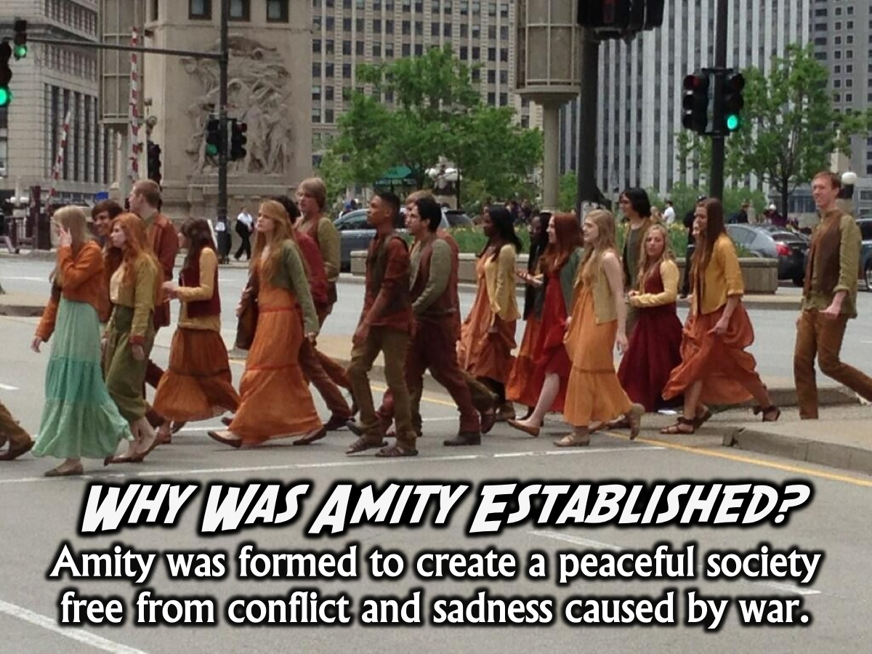
Notes:
Why Was Amity Established? Amity is the faction that dislikes war. They formed Amity in order to have a peaceful society free from conflict and sadness caused by wars and instigation.

Slide 7

Notes:
3. Amity Rules. Here are the rules for this evening: (1) Find Peace, (2) Live Peacefully, (3) Love Each Other, (4) Listen for the CHIME (each part of the program was introduced with a chime sounding as the slide appeared), and (5) Smile ALL NIGHT!!!

Slide 8
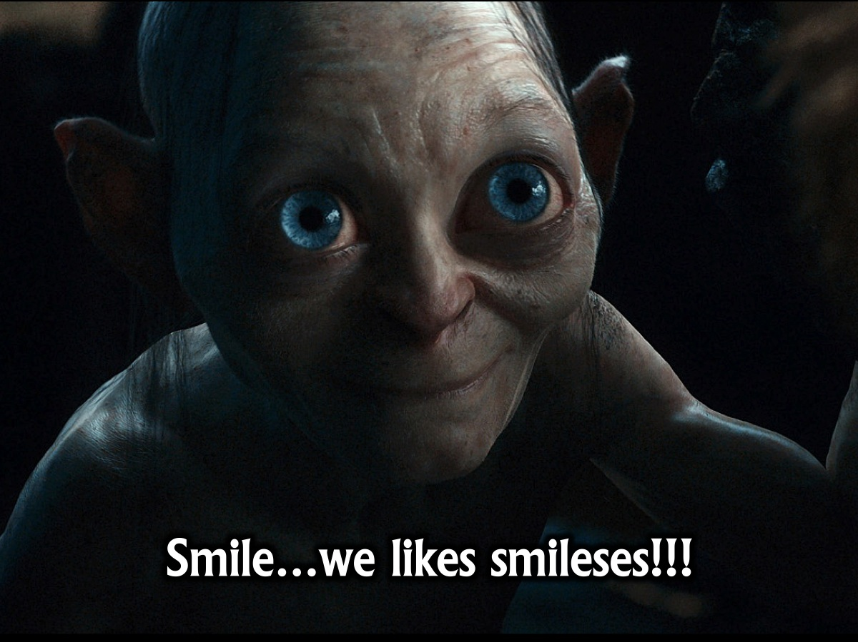
Notes:
“Smile…we like smileses!!!” (in a Gollum voice)

Slide 9

Notes:
The following “Smile” pics are set to music from the song: Don’t Worry Be Happy. Get it on YouTube at: https://www.youtube.com/watch?v=qiTG_5ond-A

Slide 10
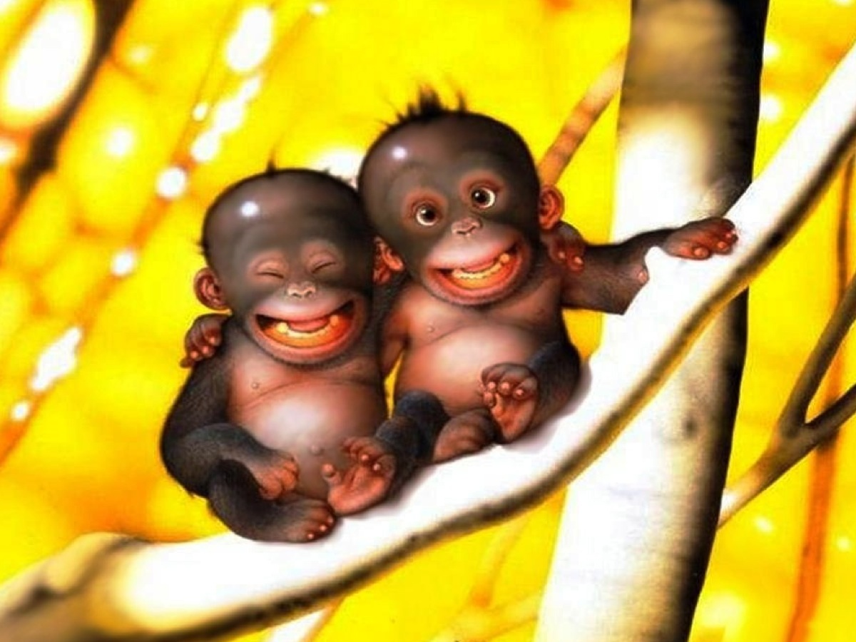

Slide 11
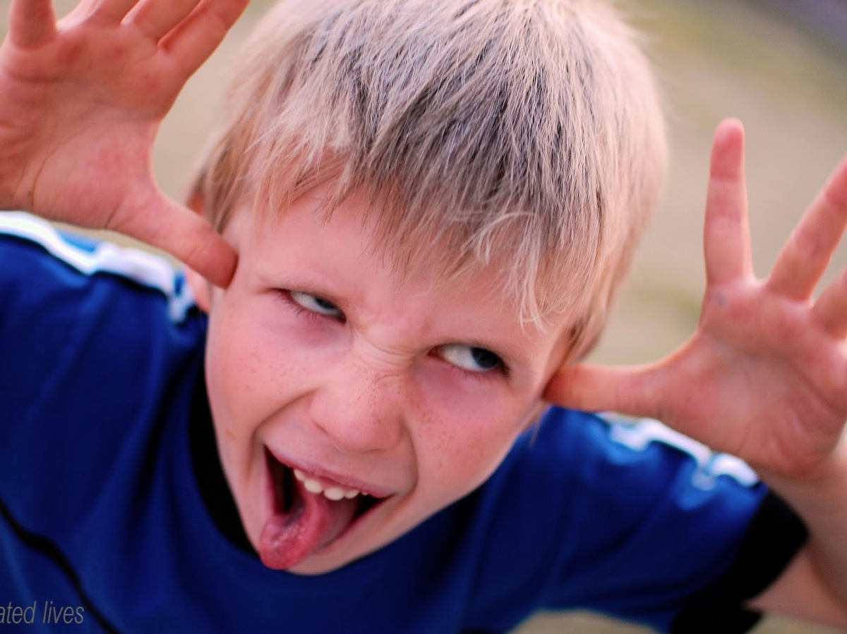

Slide 12


Slide 13


Slide 14
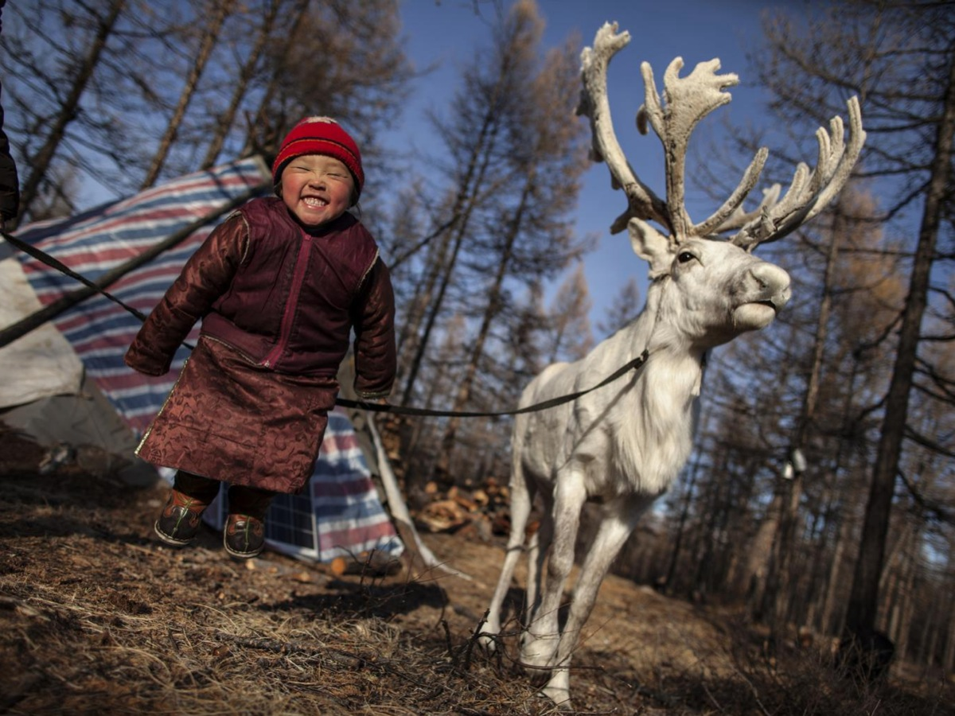

Slide 15
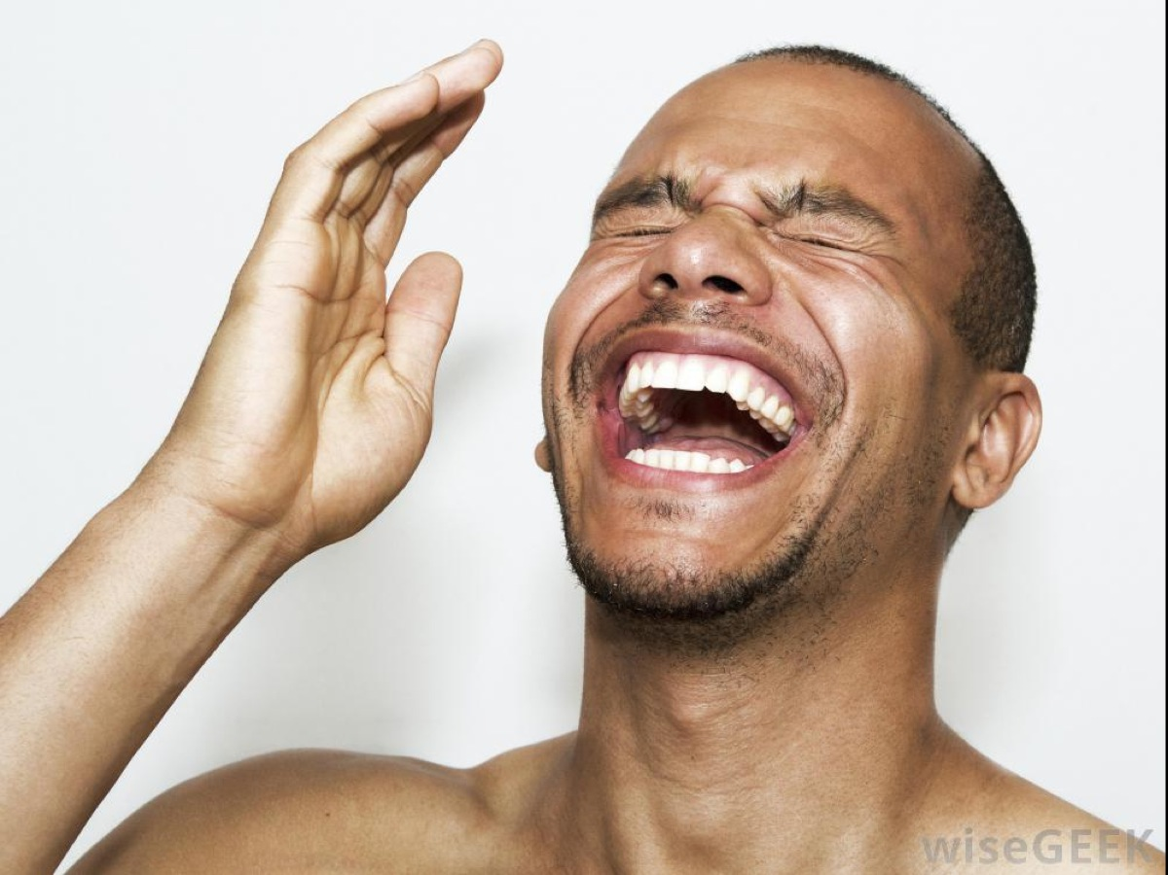

Slide 16
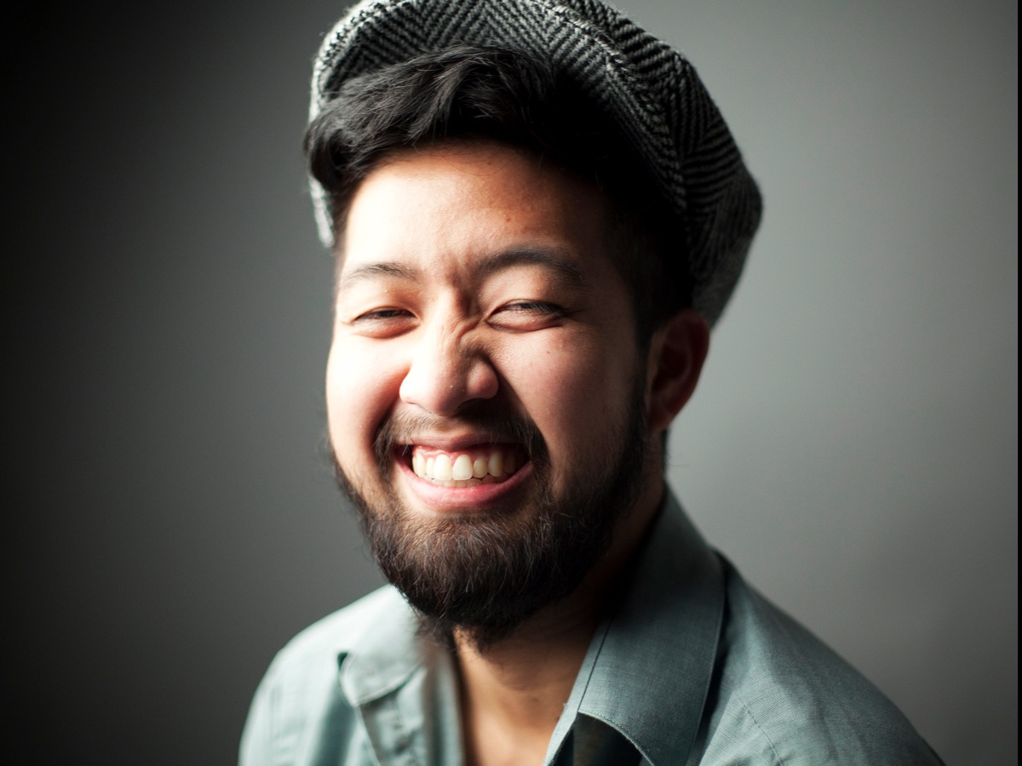

Slide 17
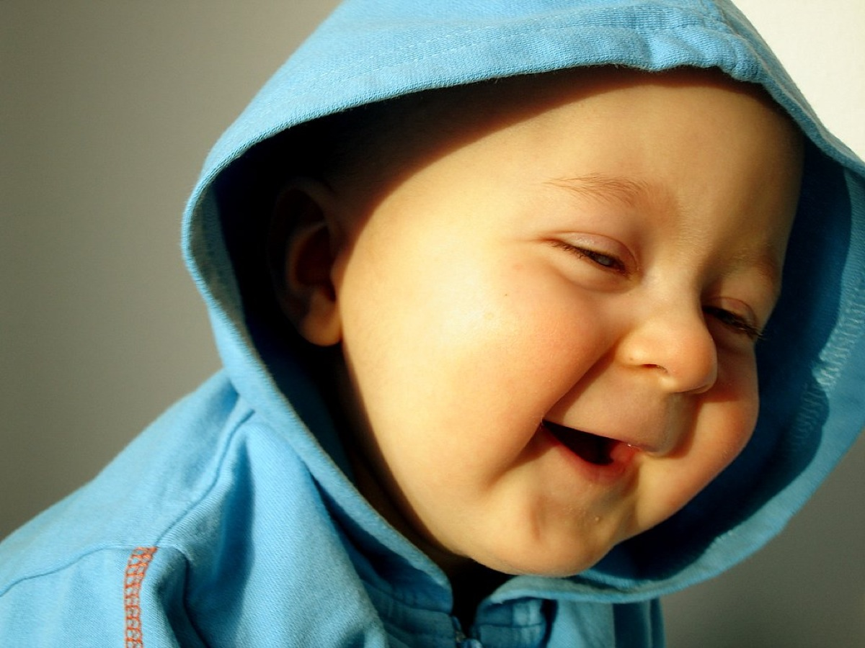

Slide 18
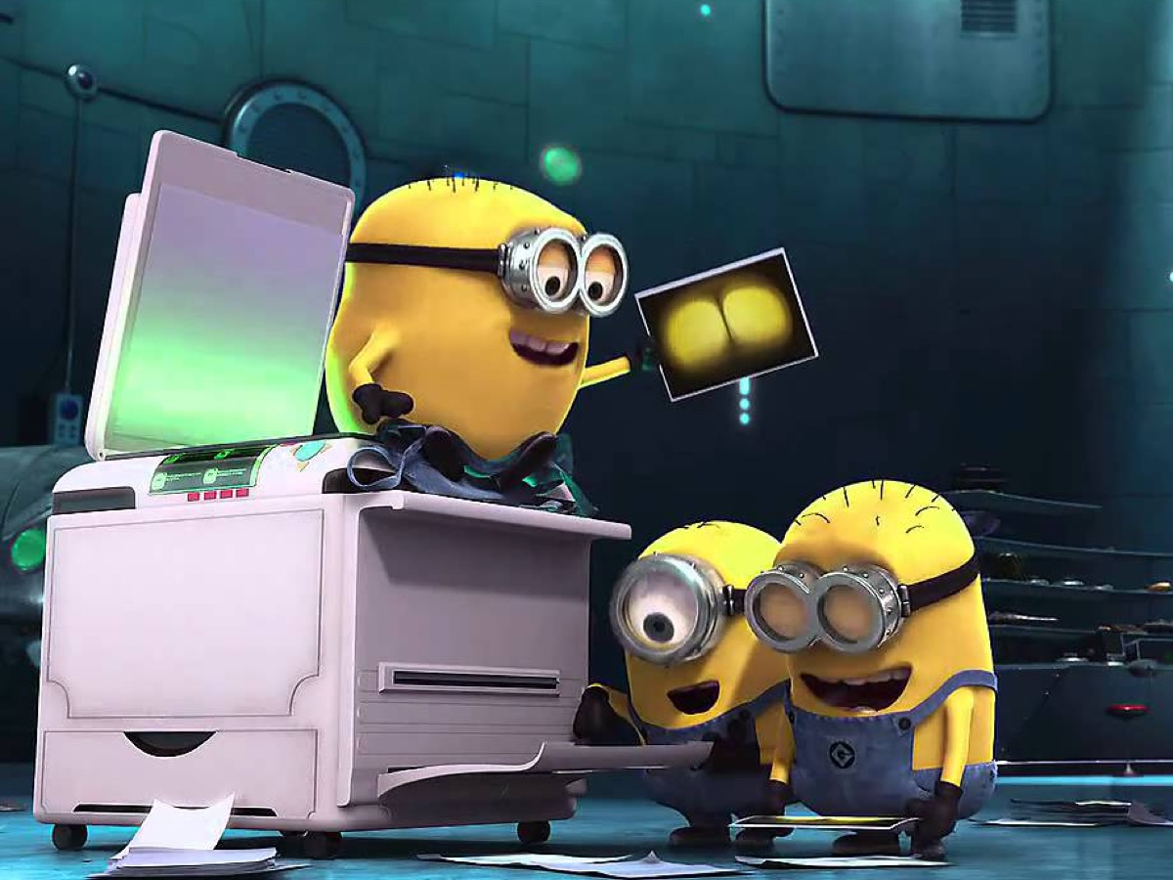

Slide 19
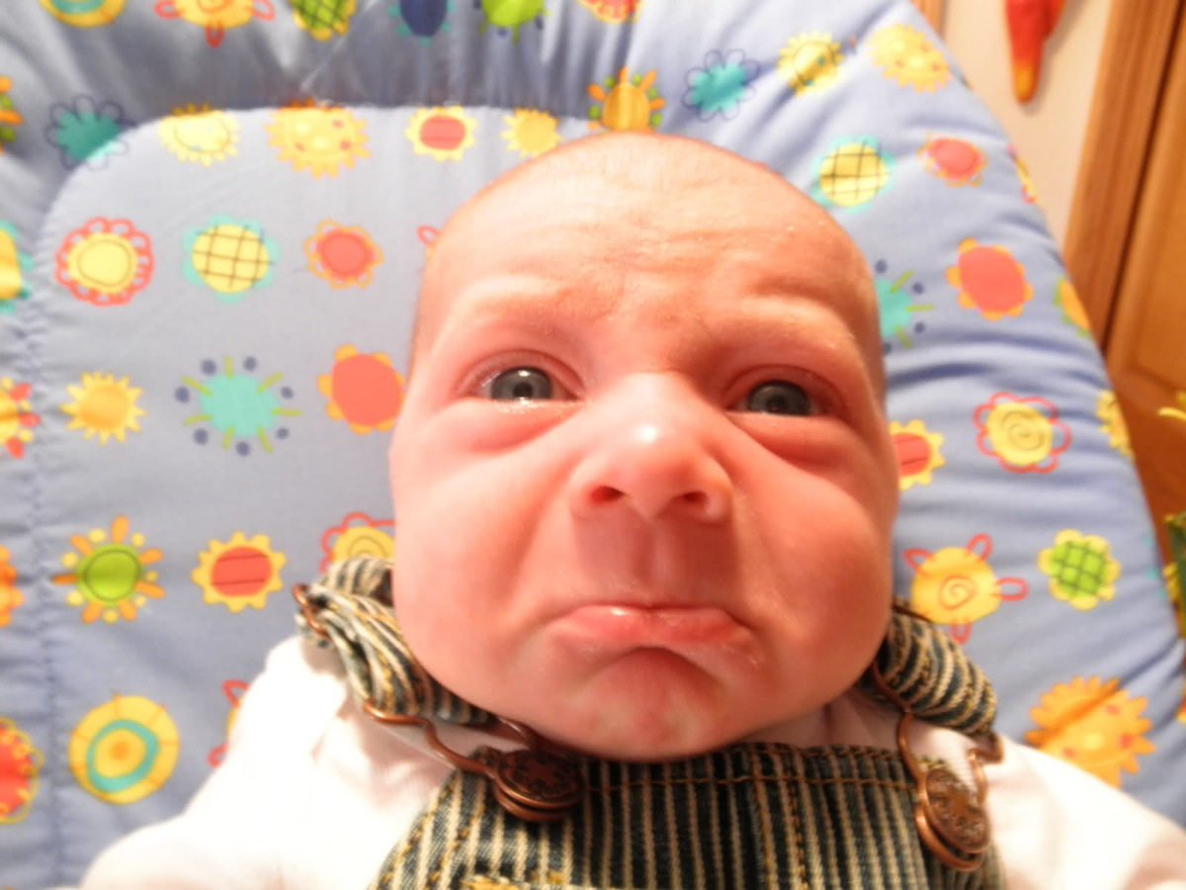

Slide 20
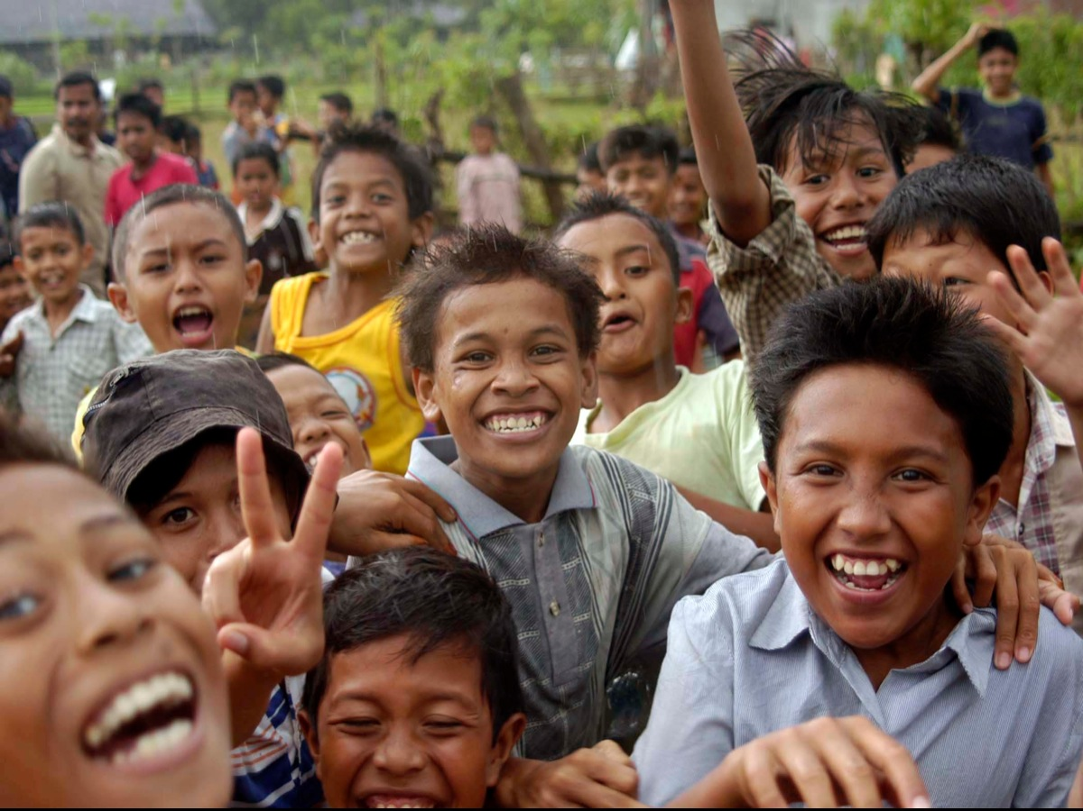

Slide 21


Slide 22


Slide 23
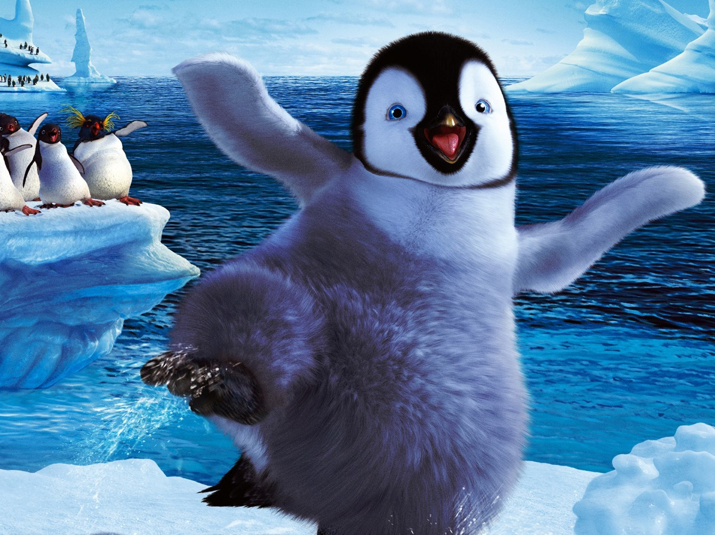

Slide 24
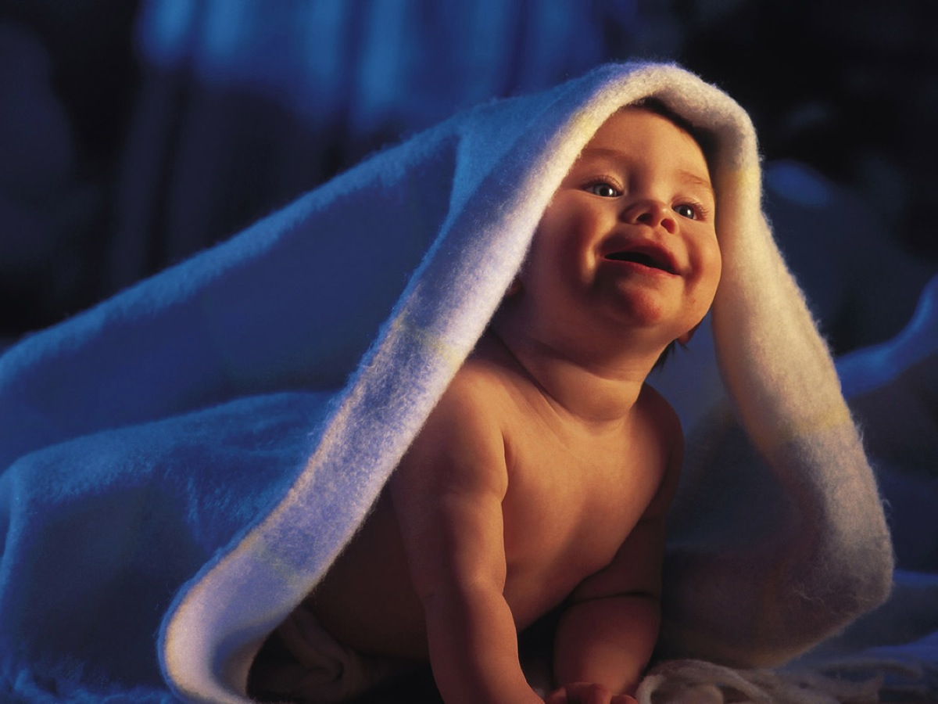

Slide 25
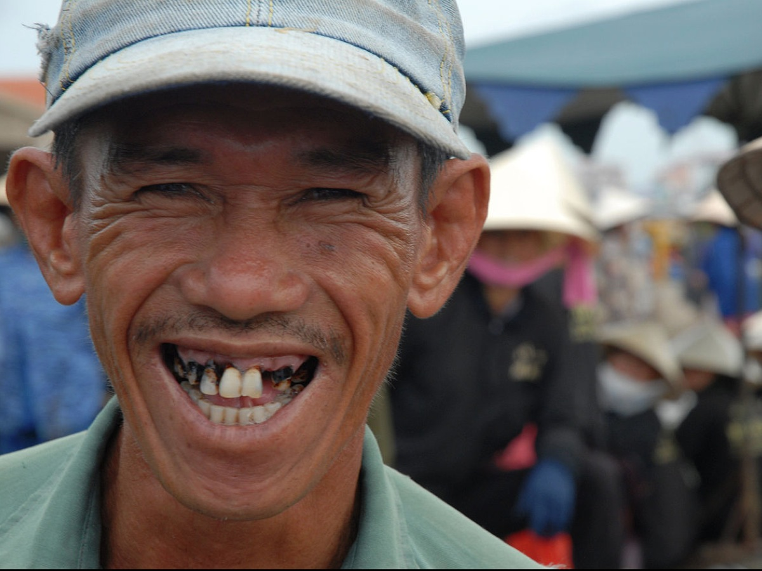

Slide 26
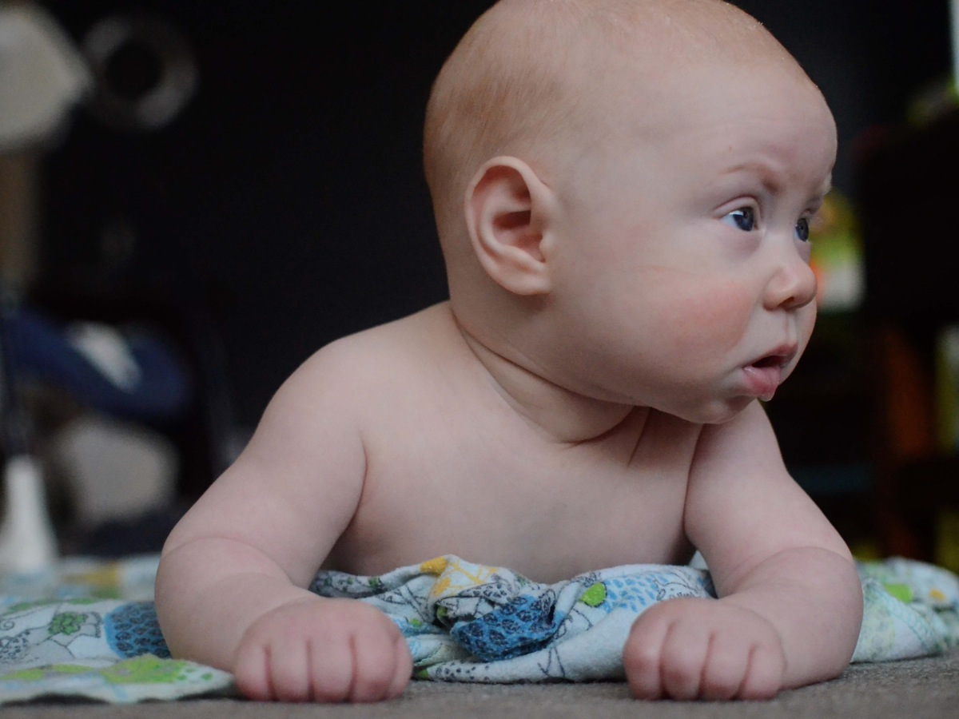

Slide 27


Slide 28
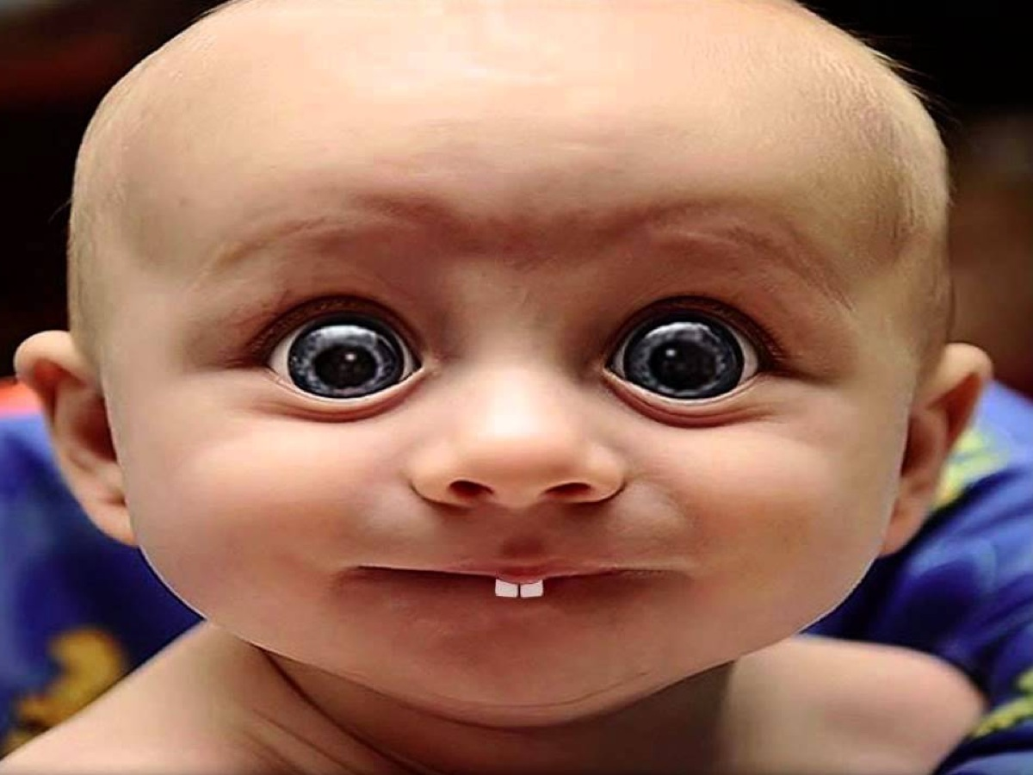

Slide 29
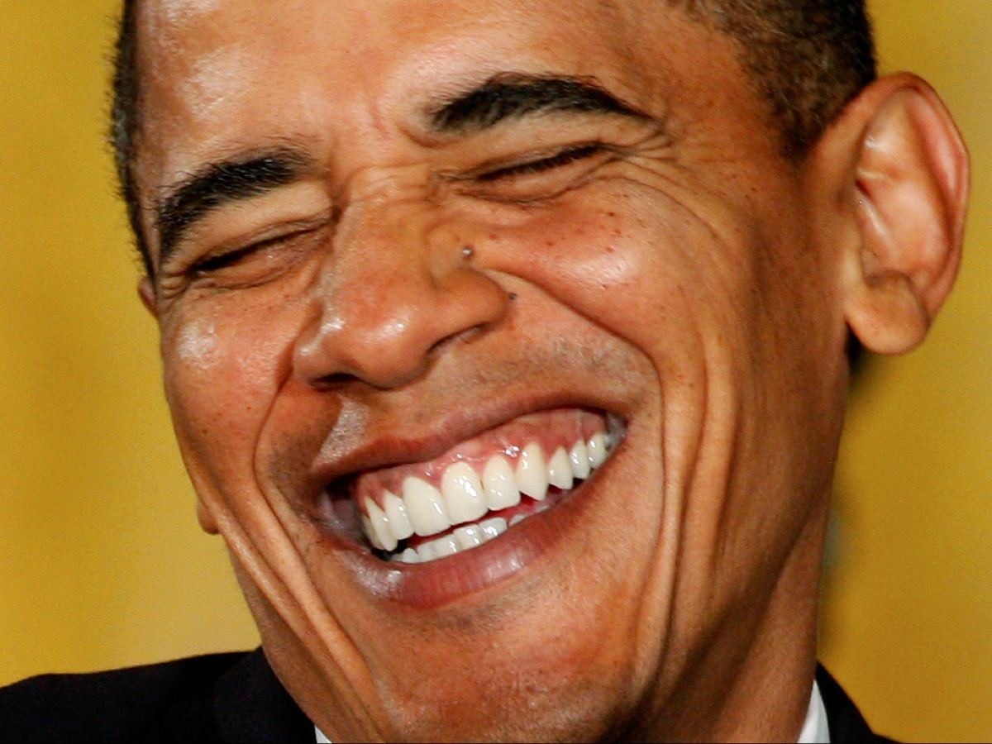

Slide 30


Slide 31
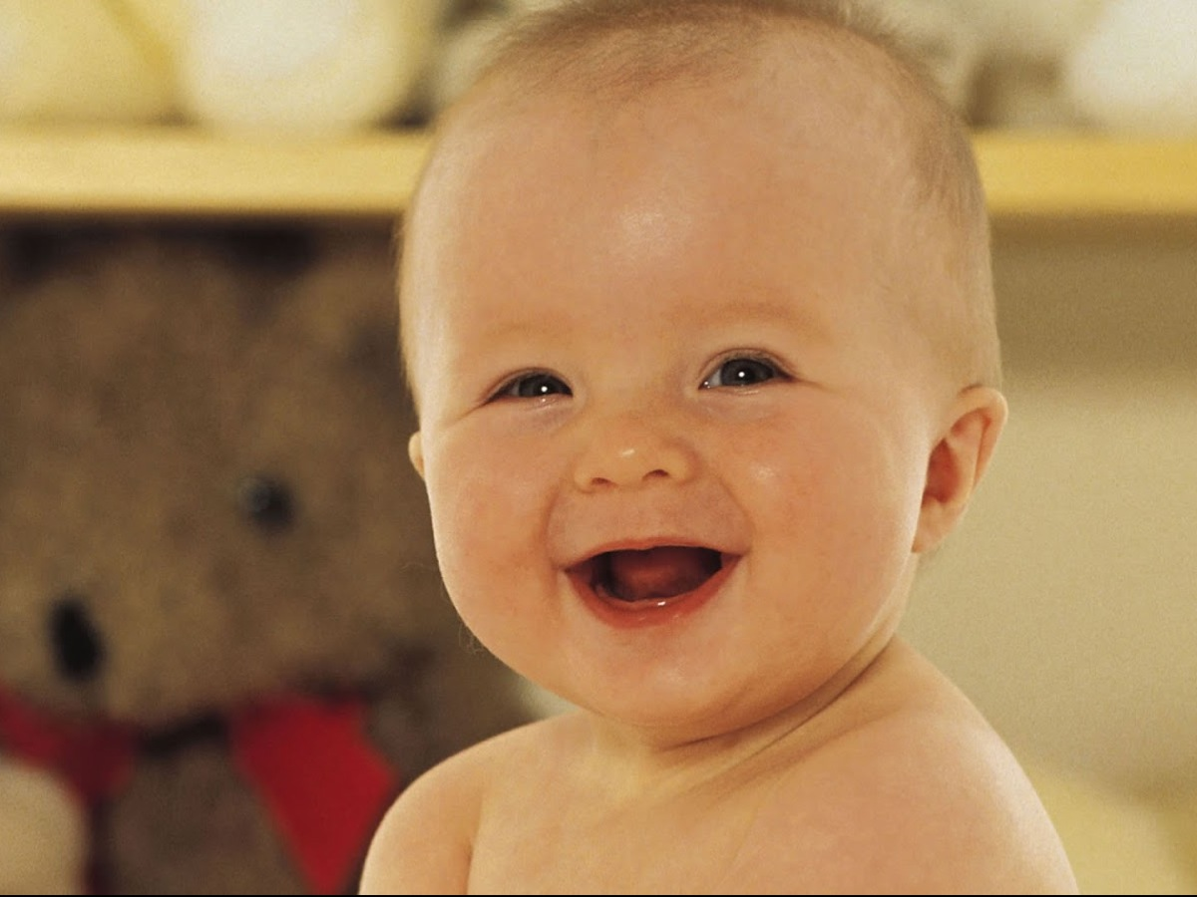

Slide 32
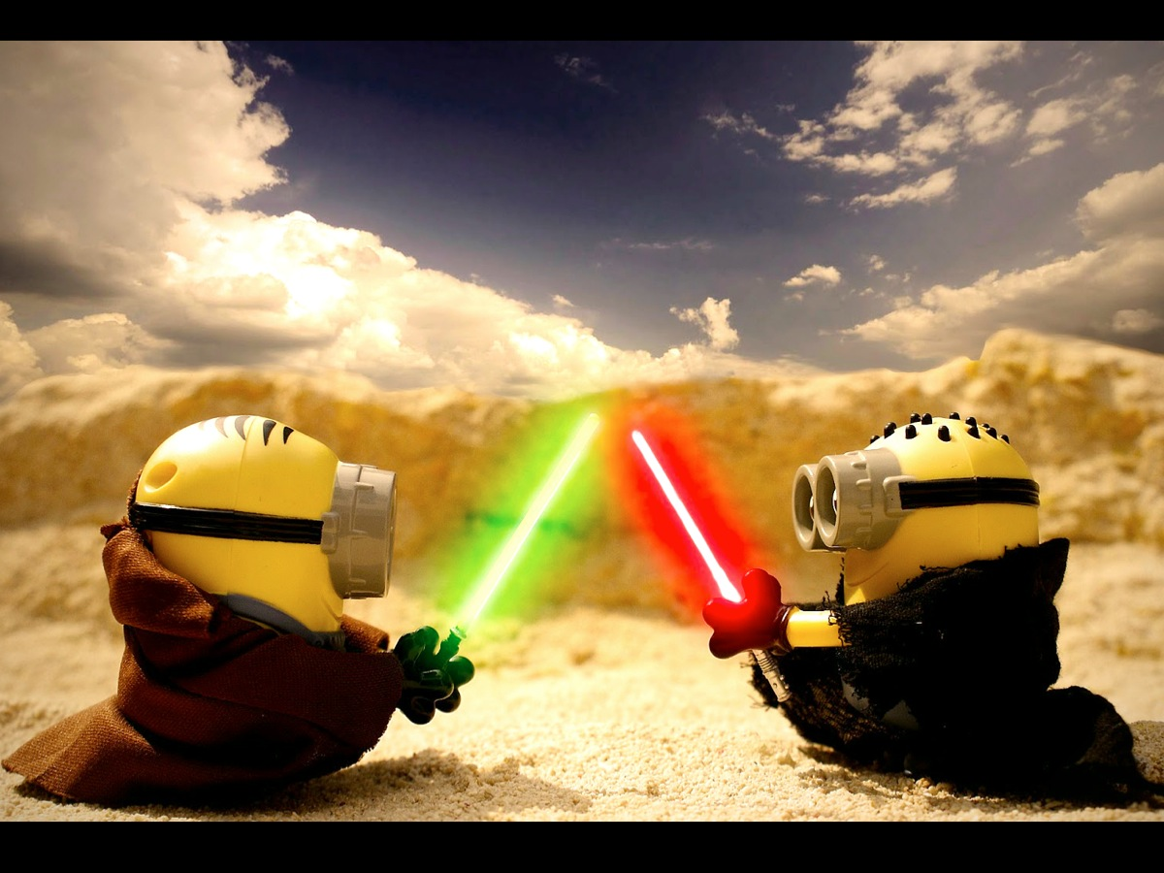

Slide 33


Slide 34
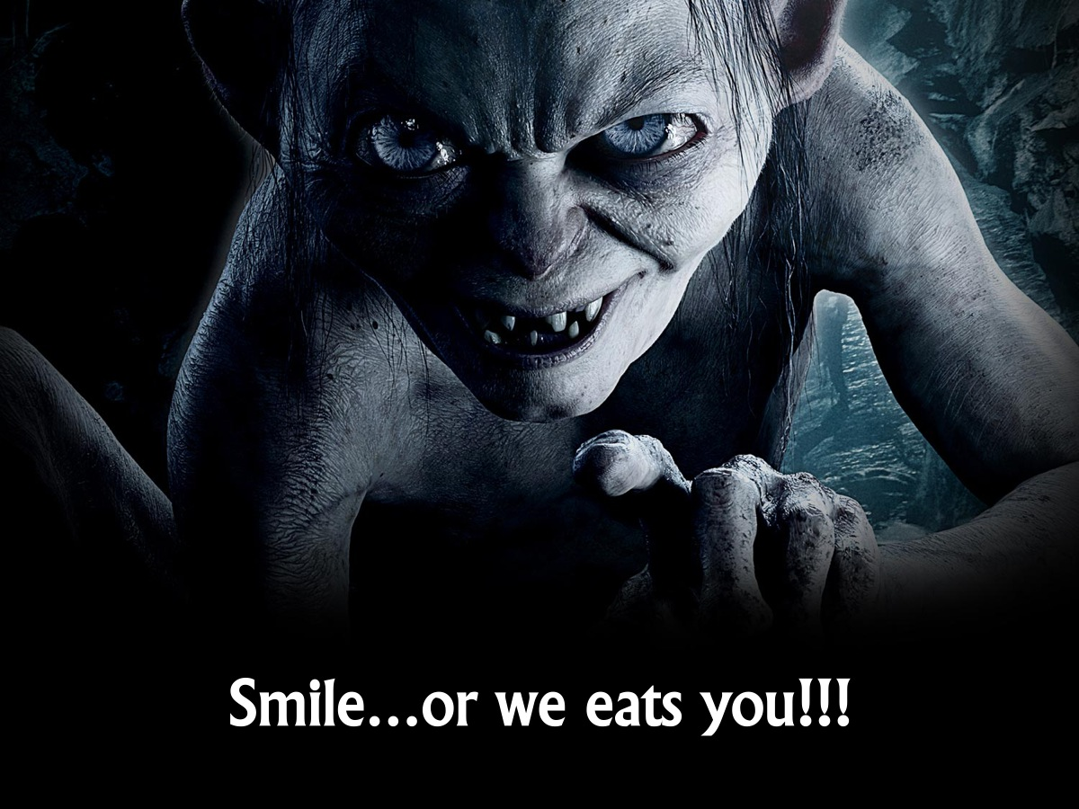
Notes:
“Smile…or we eats you!!!” (in a Gollum voice)

Slide 35
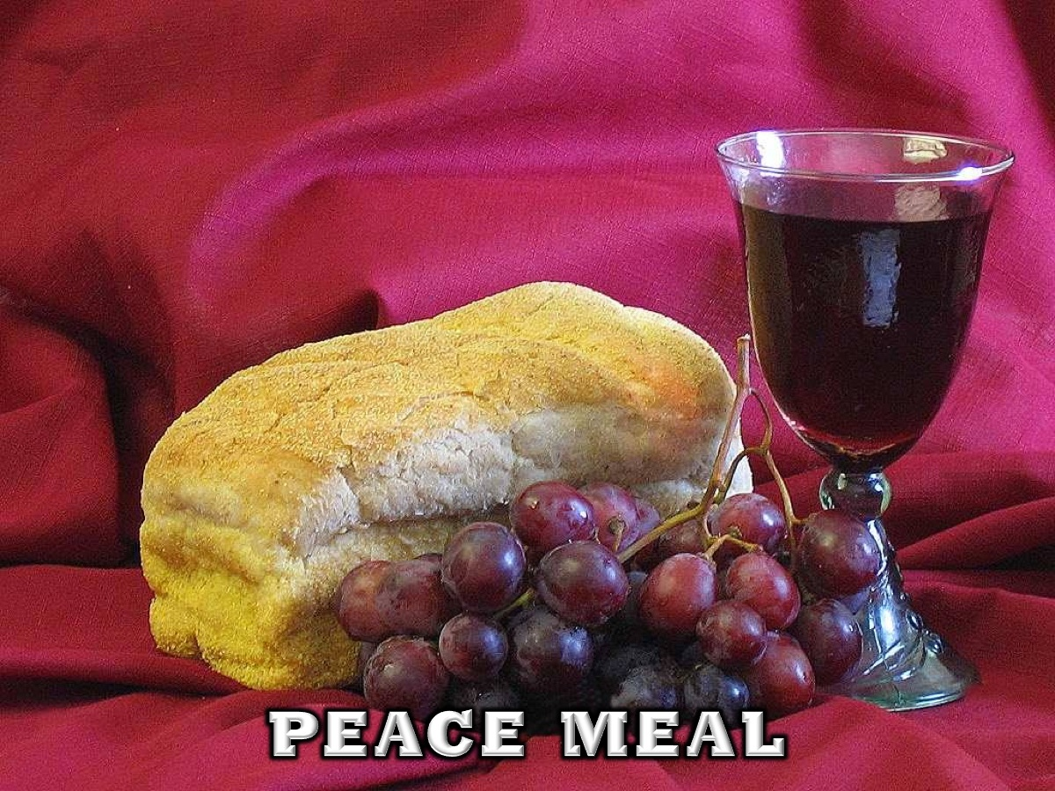
Notes:
4. Peace Meal - Bread and grape juice will be handed out explaining that there is a peace serum in the bread. And that they be told to be happy and smiley the whole night.

Slide 36

Notes:
Video: Pharrell Williams - Happy (Despicable Me 2). Get it on YouTube at: https://www.youtube.com/watch?v=Q-GLuydiMe4
This video is played while teens are enjoying their bread and grape juice.

Slide 37
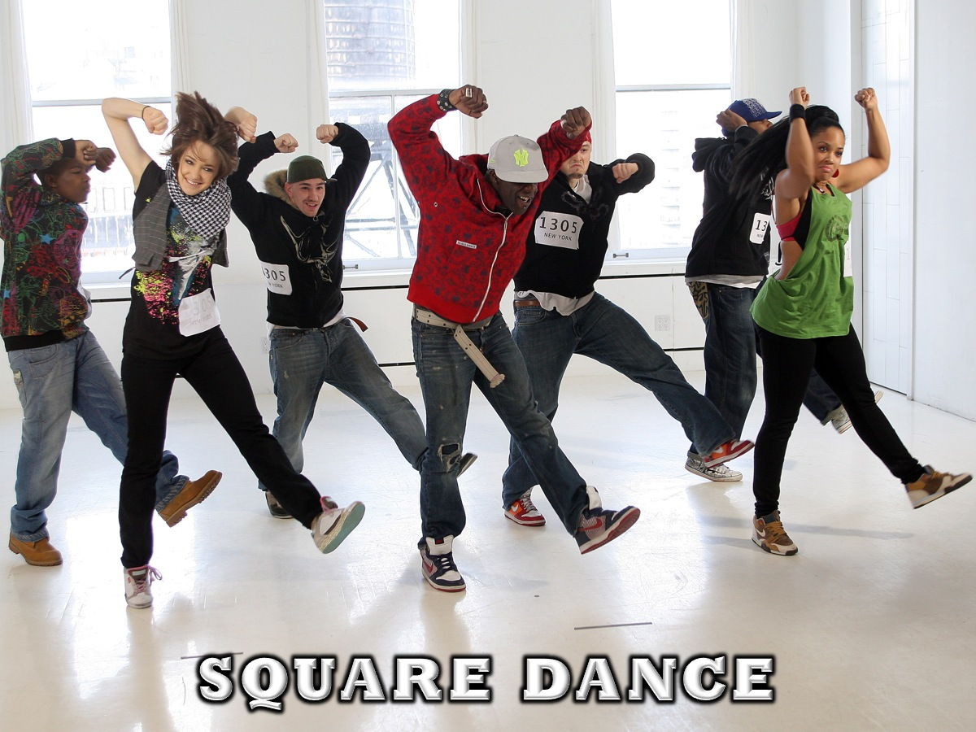
Notes:
5. Square Dance - teens stand in lines and learn a dance all together. Everyone participates.

Slide 38

Notes:
Video: Mr C The Slide Man Cha Cha Slide Part 2. Get it on YouTube at: https://www.youtube.com/watch?v=LI64R1bjN7U

Slide 39

Notes:
6. Fruit Salad – We will serve fruit salad and cream.

Slide 40
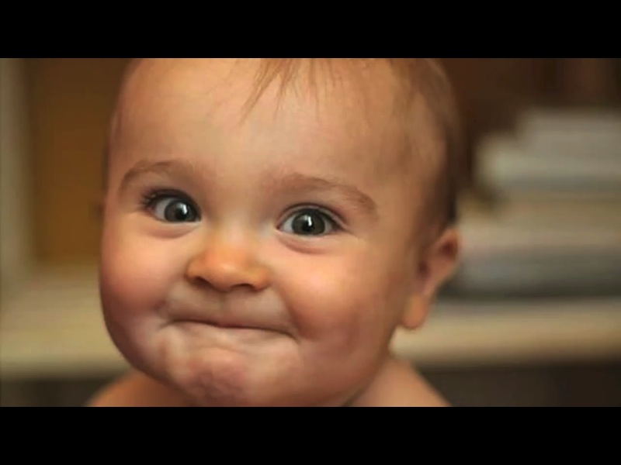
Notes:
Video: While teens are getting their fruit salad we will play this video: https://www.youtube.com/watch?v=pvlm6kMk6ys

Slide 41
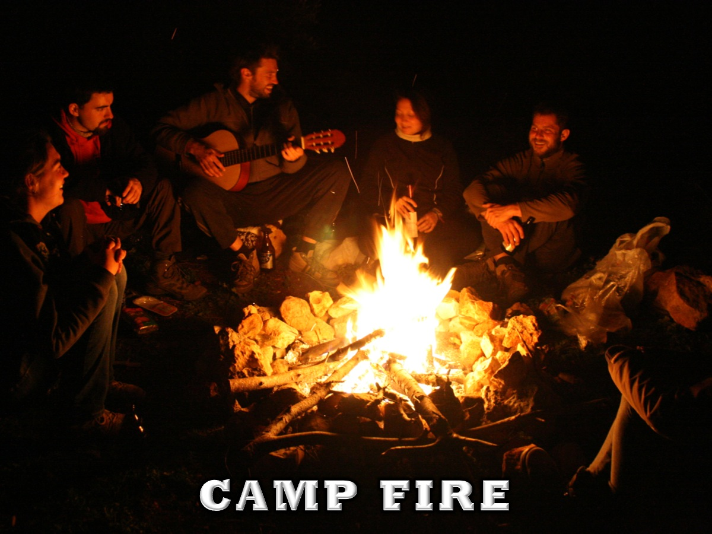
Notes:
7. Camp Fire - made out of a heavy-duty torch and coloured paper will be set in the middle of the room and the teens will sit around it like they would around a camp fire. They will eat their fruit salad and sing camp songs for 10mins or as time allows.

Slide 42

Notes:
8. Peace Journey - There will be a contemplative time using guided meditation to experience peace. The audio we used came from a YouTube video entitled: Let Go and Let God. Get it on YouTube at: https://www.youtube.com/watch?v=wKSwDv2aO6U

Slide 43

Notes:
Video: Newsboys - We Believe. Get it on YouTube at: https://www.youtube.com/watch?v=WjZ01FcK0yk

Slide 44

Notes:
9. Small Groups: (1) How do you define peace? (Actually peace is not about being in a place where there is no noise or trouble or hard work – it means to be in the midst of those things and still be calm in your heart). (2) What helped you experience peace tonight? (3) Why is it important for us to be at peace with God? (Because we have been justified through faith, we have peace with God through our Lord Jesus Christ. Romans 5:1) (4) What challenges are you facing that steal your peace? (5) Pray for each other to experience peace with God.
Audio from a YouTube video can be played during the small group time: Get it on YouTube at: https://www.youtube.com/watch?v=6HukSBkBgd4

Slide 45

Notes:
10. Upcoming Events – a time for announcements.

Slide 46

Notes:
On Sunday morning we carry on with our Firs Starters series – looking at part 2 of How to Tell God’s Story.

Slide 47

Notes:
Next Friday night is our Pancakes night!

Slide 48

Notes:
11. Refreshments - Hot chocolate will be served.

Slide 49

Notes:
Video: As refreshments are served we will be playing this video by Kirk Franklin – I Smile. Get it on YouTube at: https://www.youtube.com/watch?v=Z8SPwT3nQZ8

