Slide 1

Notes:
Divergent: Abnegation Night Program
Here are details of setup requirements for the night:
* Cover all mirrors in the rooms – including bathrooms (Divergent do not look in mirrors as it is considered vanity).
* Use room dividers on the stage covered in grey material and with a big print of the Abnegation logo.
* Play Abnegation type music before the start of the event and during the night.
* Print Bible verses about serving others or other service quotes and display them on the way up to the youth room from the ground floor.
* Just before the start show a video that shows different people who were known to serve people: Jesus washing the disciples feet, Mother Theresa caring for kids, Mandela, etc.
Place a "Welcome to Abnegation" sign on the door into the youth room.
Service Quotes:
The best way to find yourself is to lose yourself in the service of others. (Mahatma Gandhi)
I slept and I dreamed that life is all joy. I woke and I saw that life is all service. I served and I saw that service is joy. (Khalil Gibran)
The first question which the priest and the Levite asked was: 'If I stop to help this man, what will happen to me?' But...the good Samaritan reversed the question: 'If I do not stop to help this man, what will happen to him? (Martin Luther King Jr.)
For there will never cease to be poor in the land. Therefore I command you, ‘You shall open wide your hand to your brother, to the needy and to the poor, in your land. (Deuteronomy 15:11)
In everything I showed you that by working hard in this manner you must help the weak and remember the words of the Lord Jesus, that He Himself said, 'It is more blessed to give than to receive.’ (Acts 20:35)
I don’t know what your destiny will be, but one thing I know: the ones among you who will be really happy are those who have sought and found how to serve. (Albert Schweitzer)
If you want to lift yourself up, lift up someone else. (Booker Washington)
Humility is putting others first by giving up what you think you deserve.
Humility is not thinking less of yourself, but thinking of yourself less. (C.S. Lewis)
Do nothing out of selfish ambition or vain conceit. Rather, in humility value others above yourselves, 4 not looking to your own interests but each of you to the interests of the others. (Philippians 2:3)
God resists the proud but gives grace to the humble. (James 4:6)
Think of yourselves like Jesus thought of himself. He had equal status with God but didn’t think so much of himself that he had to cling to the advantages
of that status no matter what. When the time came, he set aside the privileges of deity and took on the status of a slave, became human. It was an incredibly humbling process. He didn’t claim special privileges. Instead, he lived a selfless, obedient life and then died a selfless, obedient death by crucifixion. (Philippians 2:5-8)
For even the Son of Man did not come to be served, but to serve and to give his life as a ransom for many. (Mark 10:45)
Until we become selfless to our own selfish desires, we cannot truly give ourselves for the welfare of others.
If you can’t feed a hundred people, then feed just one. (Mother Teresa)
I was thirsty and you gave me something to drink, I was a stranger and you invited me in, I needed clothes and you clothed me, I was sick and you looked after me, I was in prison and you came to visit me. Whatever you did for one of the least of these brothers and sisters of mine, you did for me. (Matthew 25)

Slide 2

Notes:
Video: Nickleback – If Today Was Your Last Day. Get it on YouTube at: https://www.youtube.com/watch?v=lrXIQQ8PeRs

Slide 3
Notes:
Video: Nickleback – If Today Was Your Last Day. Get it on YouTube at: https://www.youtube.com/watch?v=lrXIQQ8PeRs
Video is 4 minutes long

Slide 4

Notes:
Video: Bruno Mars – Grenade. Get it on YouTube at: https://www.youtube.com/watch?v=SR6iYWJxHqs

Slide 5
Notes:
Video: Bruno Mars – Grenade. Get it on YouTube at: https://www.youtube.com/watch?v=SR6iYWJxHqs
Video is 4 minutes long

Slide 6

Notes:
Video: Carrie Underwood – Change. Get it on YouTube at: https://www.youtube.com/watch?v=25FiDK40XTI

Slide 7
Notes:
Video: Carrie Underwood – Change. Get it on YouTube at: https://www.youtube.com/watch?v=25FiDK40XTI
Video is 4 minutes long

Slide 8

Notes:
Video: Nickleback – If Everyone Cared. Get it on YouTube at: https://www.youtube.com/watch?v=cTJj4ptzkMY

Slide 9
Notes:
Video: Nickleback – If Everyone Cared. Get it on YouTube at: https://www.youtube.com/watch?v=cTJj4ptzkMY or Vimeo: http://vimeo.com/6216273
Video is 4 minutes long

Slide 10

Notes:
Welcome - everyone is welcomed into the youth room and newcomers introduced. The following slides will be used to introduce teens to the Abnegation faction.
Script: “Welcome to Abnegation. Tonight is a night of being selfless, of giving without expecting anything back. Tonight is not about ourselves but those around us.”

Slide 11
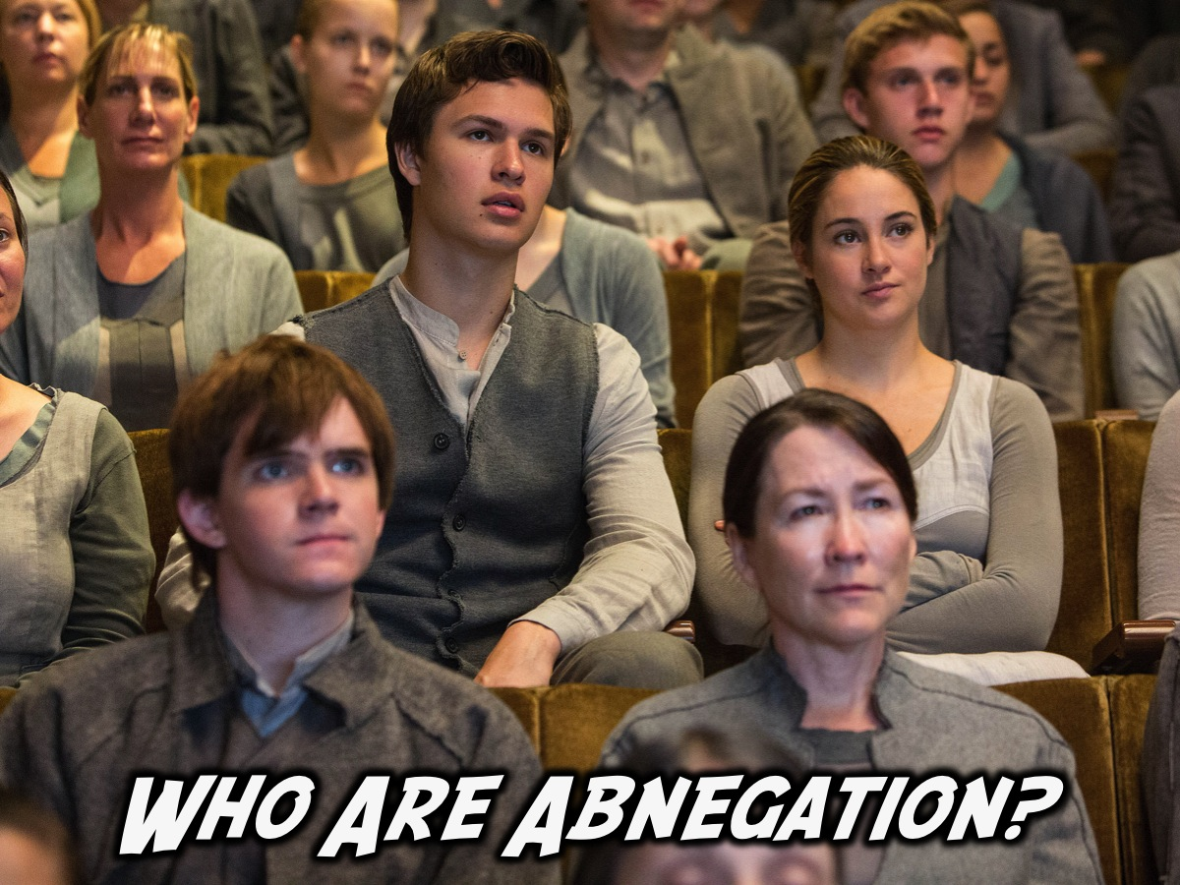
Notes:
Who Are Abnegation?

Slide 12
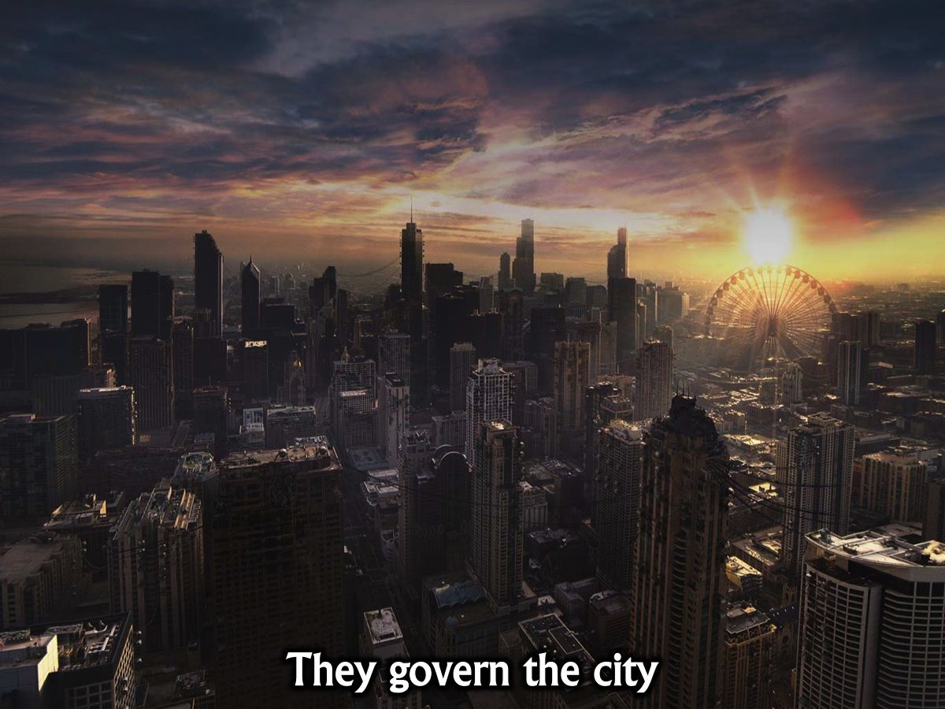
Notes:
They govern the city because their hearts are open to all and they are not blinded by greed or their own personal gain.

Slide 13
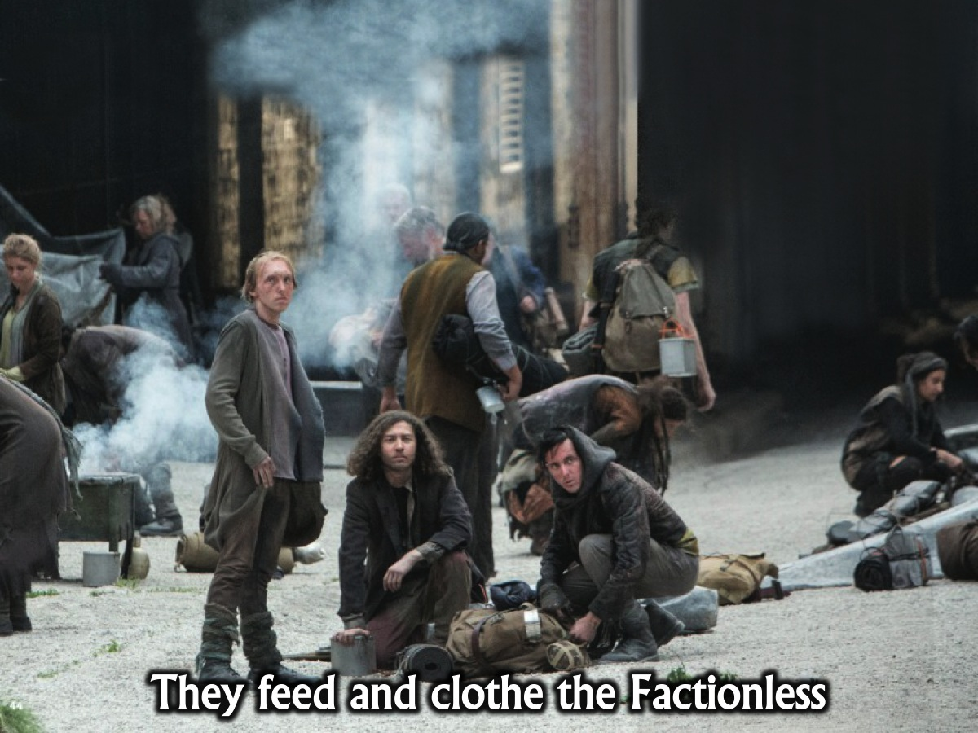
Notes:
They feed and clothe the Factionless.

Slide 14
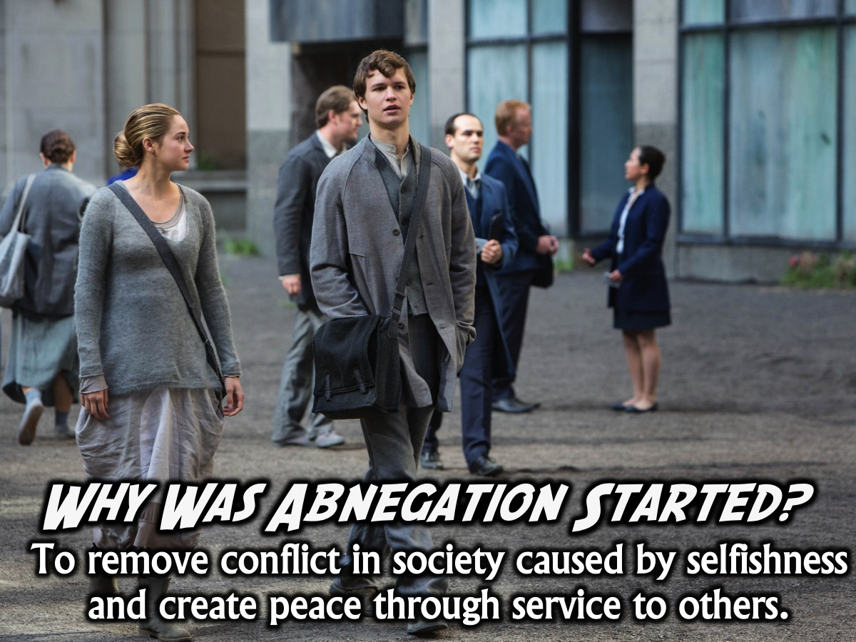
Notes:
Why Was Abnegation Started? To remove conflict in society caused by selfishness and create peace through service to others.

Slide 15
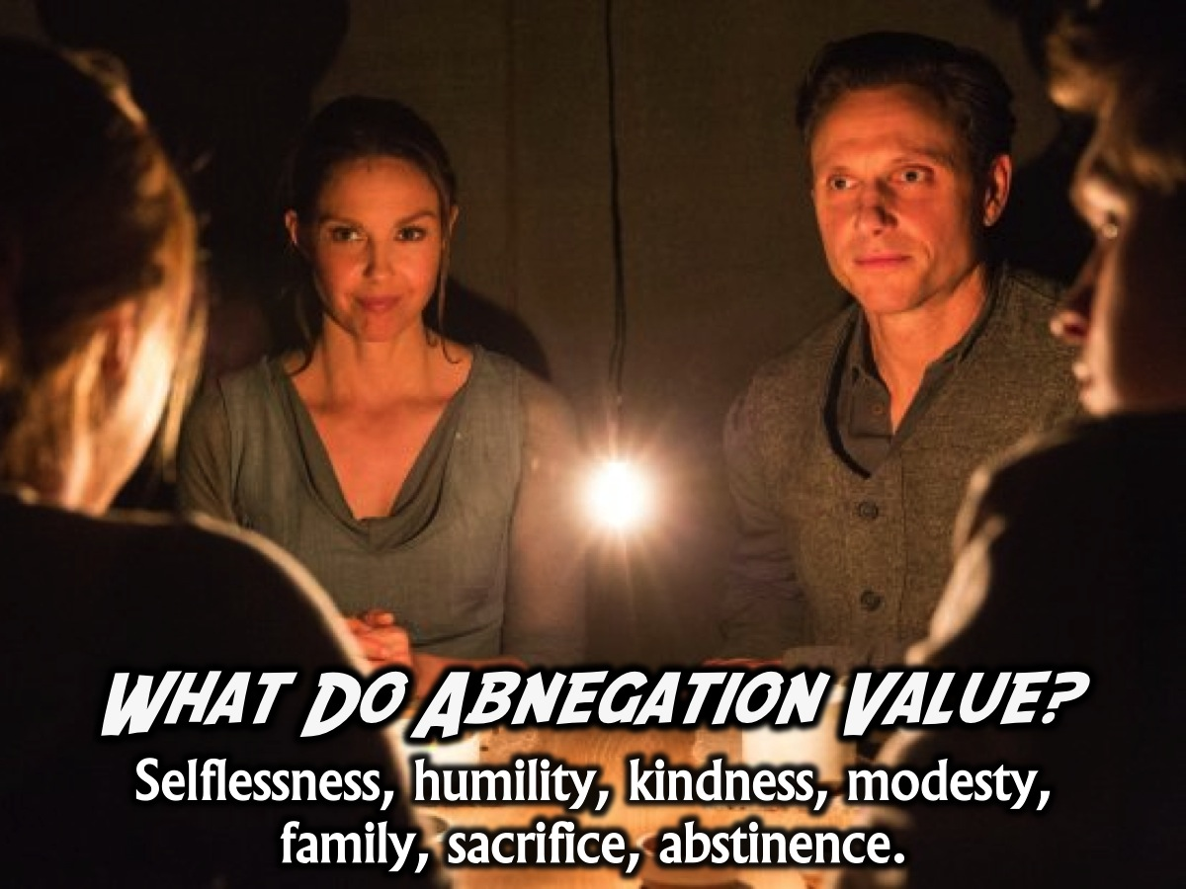
Notes:
What Do Abnegation Value? They value selflessness, humility, kindness, modesty, family, sacrifice, abstinence.

Slide 16
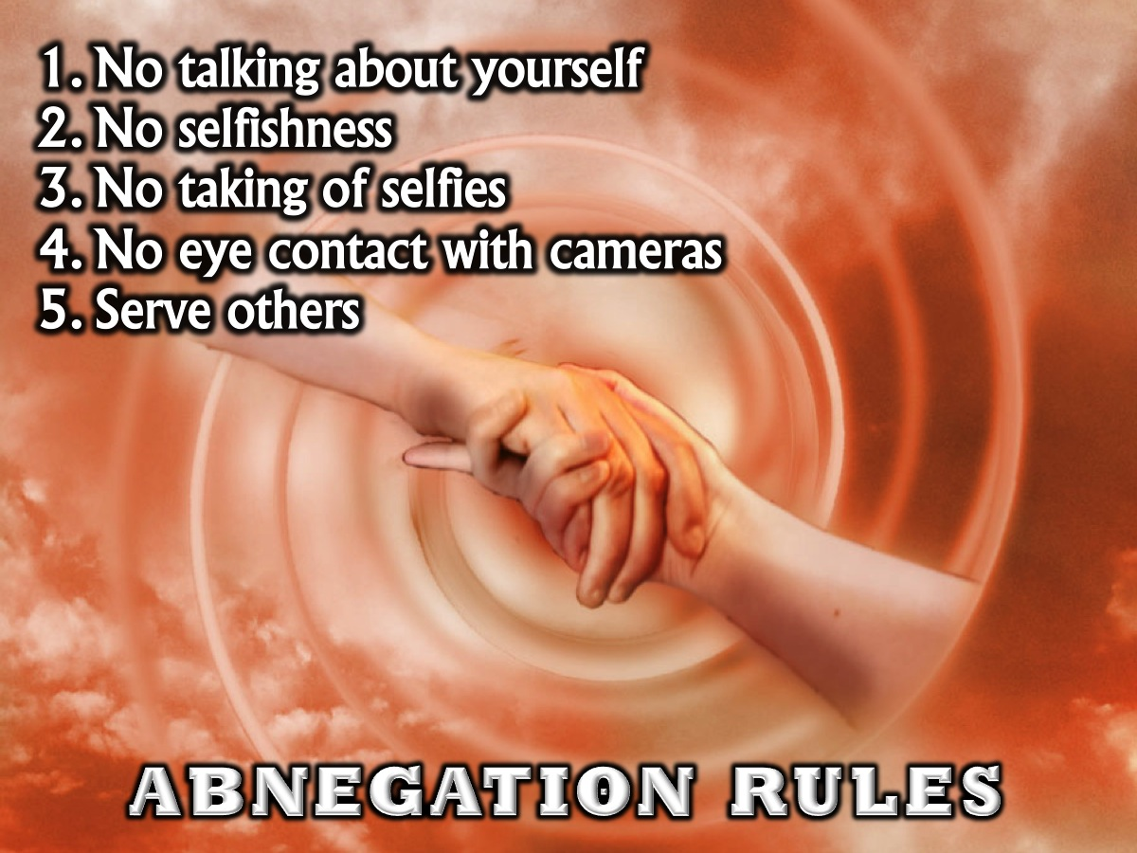
Notes:
Abnegation Night Rules:
1. No talking about yourself
2, No selfishness
3, No taking of selfies
4. No eye contact with cameras
5. Serve others

Slide 17
Notes:
Video: Kindness Boomerang. Get it on YouTube at: https://www.youtube.com/watch?v=nwAYpLVyeFU
The video is 5 minutes long

Slide 18
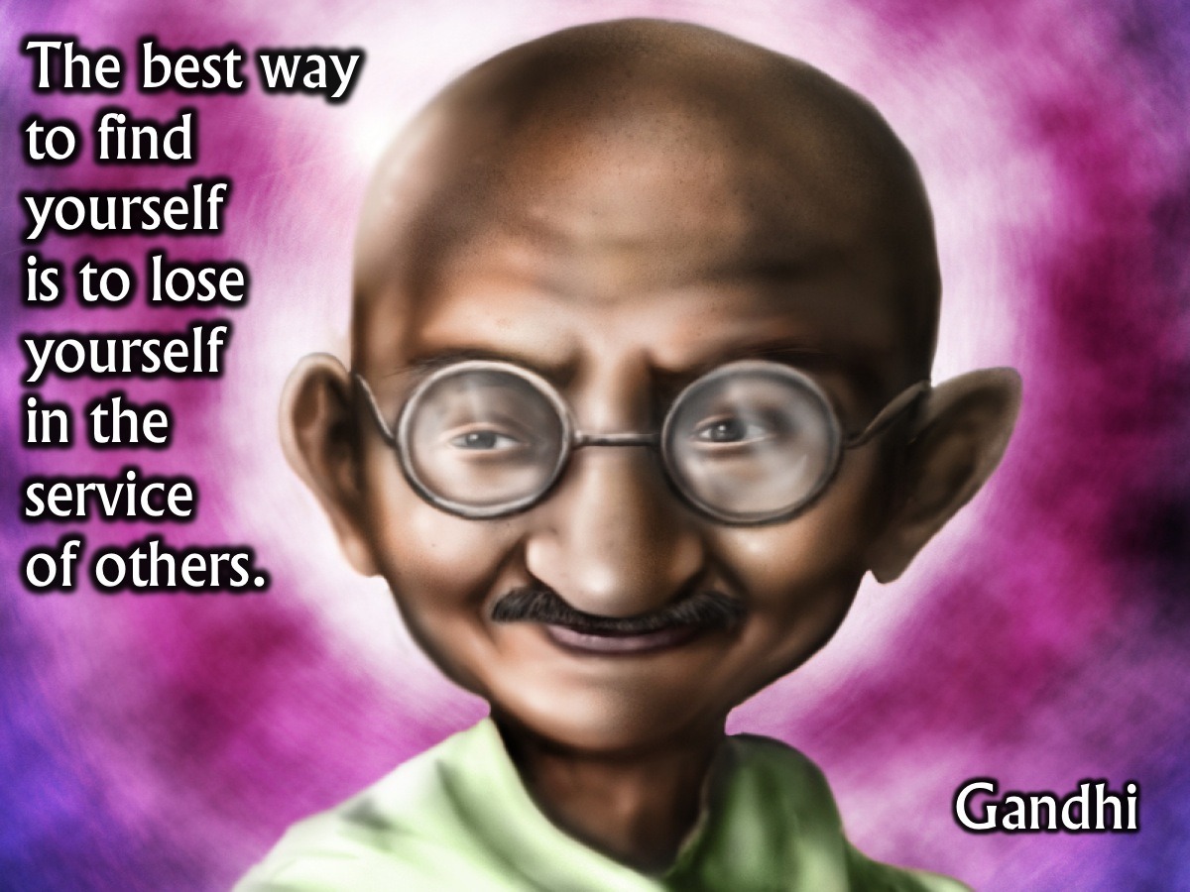
Notes:
Gandhi once said that: “The best way to find yourself is to lose yourself in the service of others”. (Gandhi)

Slide 19
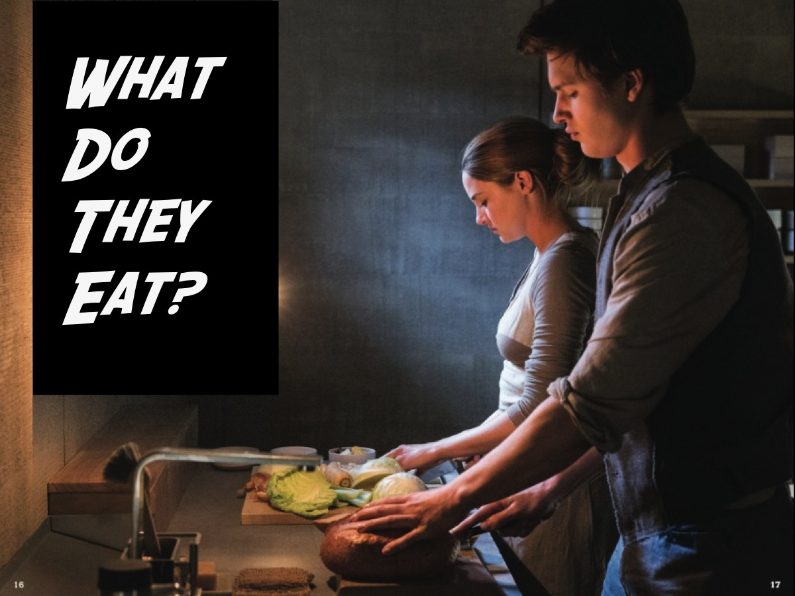
Notes:
What Do Abnegation Eat? Most of what they eat is frozen or canned because the farms are far away. They always eat dinner at the table and pass food to the right and wait to eat until everyone has been served. They eat plain food and don't drink alcohol.

Slide 20
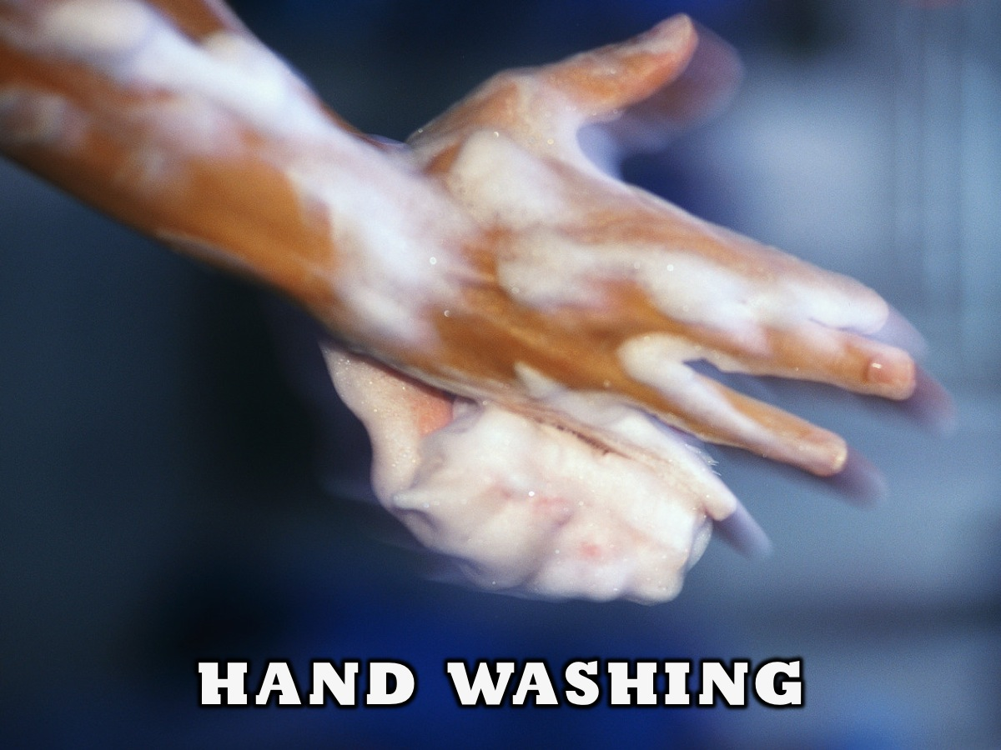
Notes:
Hand washing – everyone is ping to pair up with the person standing next to them and you are going to each wash each others hands with the wet towel that is provided. This is a symbolic gesture of serving each other as we prepare for a snack that will be served.

Slide 21
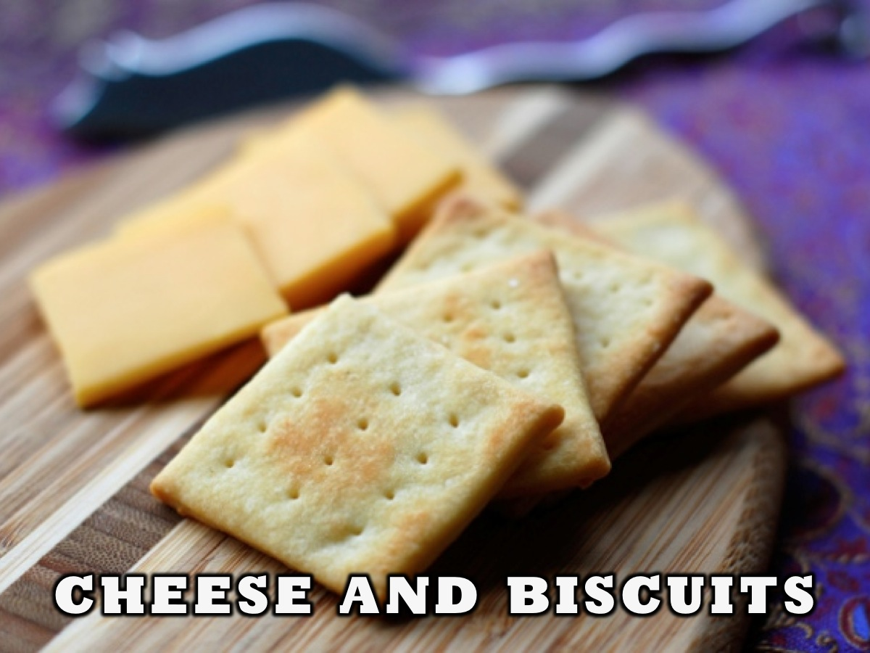
Notes:
Cheese and Biscuits – we are going to partake in a meal together. We will be serving cheese and biscuits.

Slide 22
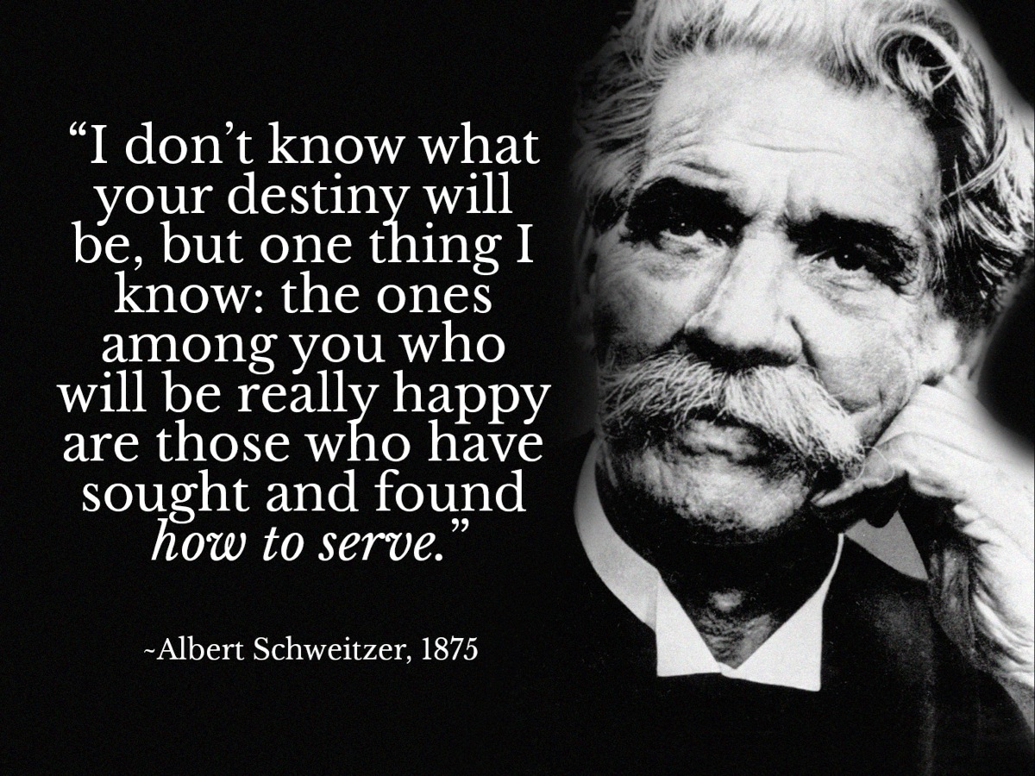
Notes:
“I don’t know what your destiny will be, but one thing I know: the ones among you who will be really happy are those who have sought and found how to serve.” (Albert Schweitzer)

Slide 23
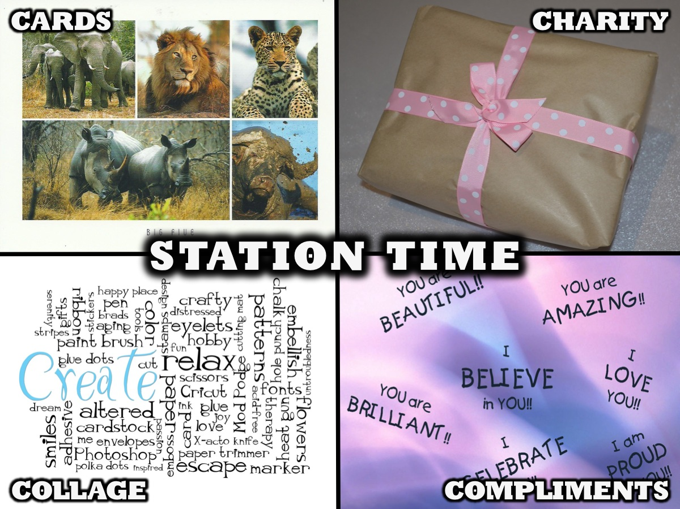
Notes:
Station Time: We have set up four stations in the room and you will spend a few minutes at each station. We will alert you each time you need to leave one station and move to the next.

Slide 24

Notes:
1. Cards: Post cards for needy kids. There is a website called Send Kids The World (http://sendkidstheworld.com/index.php/home.html) with pics and information and addresses about kids who have incurable diseases. Each group will be given a few cards and printed pages of pics and info about kids to write cards for. The card will be posted after the event.

Slide 25

Notes:
2. Charity: Pass the Parcel – this is similar to the childhood game where a parcel is sent around the circle and when the music stops the person holding the parcel gets to unwrap a layer of wrapping. Each layer had a prize in it and the person had to choose someone in the group to give the prize to. Ie. No one gets to keep a prize that they open but must give it away.

Slide 26

Notes:
3. Compliments: Write kind words about each other on a piece of paper. Each person in the group writes their name on a piece of paper and everyone gets to write one compliment about that person on the page.

Slide 27

Notes:
4. Collage: A Word Collage using Romans 12:9-21, Each group has to write a word collage that reflects what the passage says about being selfless. They should be encouraged to be as creative as possible with the collage. Here is the passage: 9 Love sincerely. Hate evil. Hold on to what is good. 10 Be devoted to each other like a loving family. Excel in showing respect for each other. 11 Don’t be lazy in showing your devotion. Use your energy to serve the Lord. 12 Be happy in your confidence, be patient in trouble, and pray continually. 13 Share what you have with God’s people who are in need. Be hospitable. 14 Bless those who persecute you. Bless them, and don’t curse them. 15 Be happy with those who are happy. Be sad with those who are sad. 16 Live in harmony with each other. Don’t be arrogant, but be friendly to humble people. Don’t think that you are smarter than you really are. 17 Don’t pay people back with evil for the evil they do to you. Focus your thoughts on those things that are considered noble. 18 As much as it is possible, live in peace with everyone. 19 Don’t take revenge, dear friends. Instead, let God’s anger take care of it. After all, Scripture says, “I alone have the right to take revenge. I will pay back, says the Lord.” 20 But, “If your enemy is hungry, feed him. If he is thirsty, give him a drink. If you do this, you will make him feel guilty and ashamed.” 21 Don’t let evil conquer you, but conquer evil with good.

Slide 28
Notes:
Station Time (this slide will be shown while the station time takes place.

Slide 29
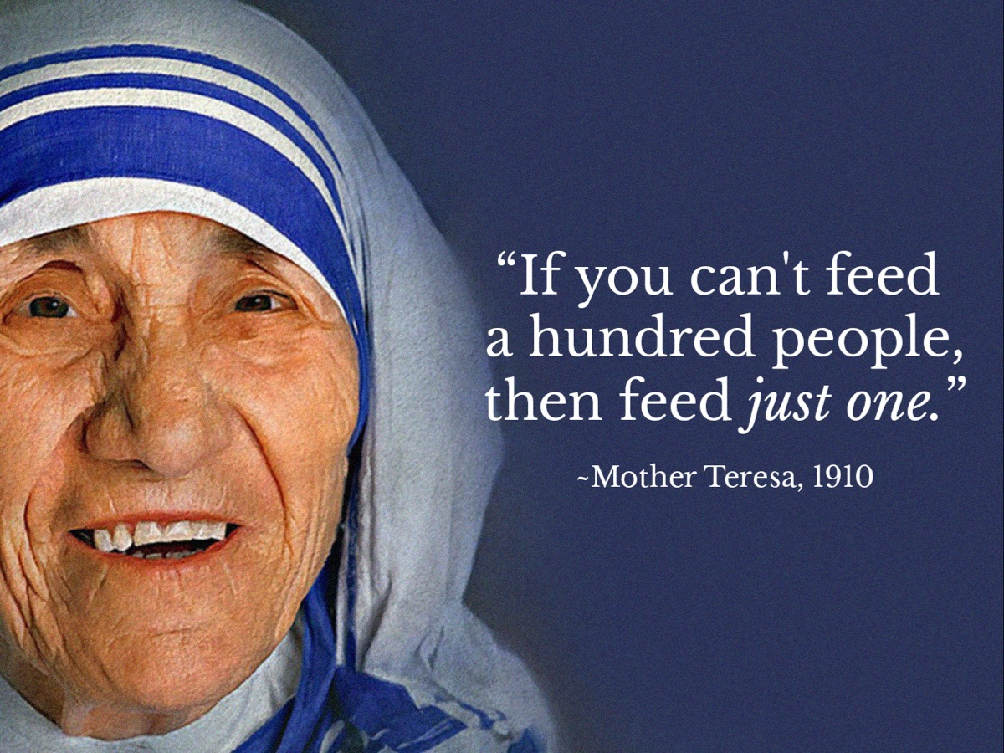
Notes:
“If you can’t feed a hundred people, then feed just one.” (Mother Teresa)

Slide 30
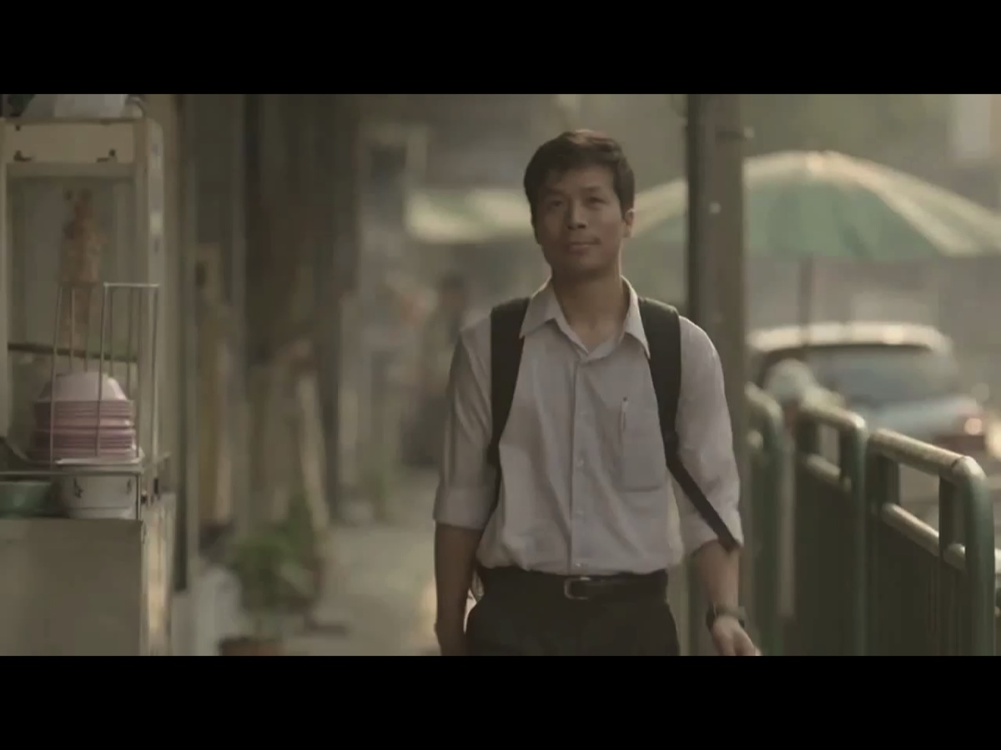
Notes:
Video: The Selfless Guy – Thai Life Insurance Commercial. Get it on YouTube at: https://www.youtube.com/watch?v=iaevzXL9Qrk
The video is 3 minutes long

Slide 31
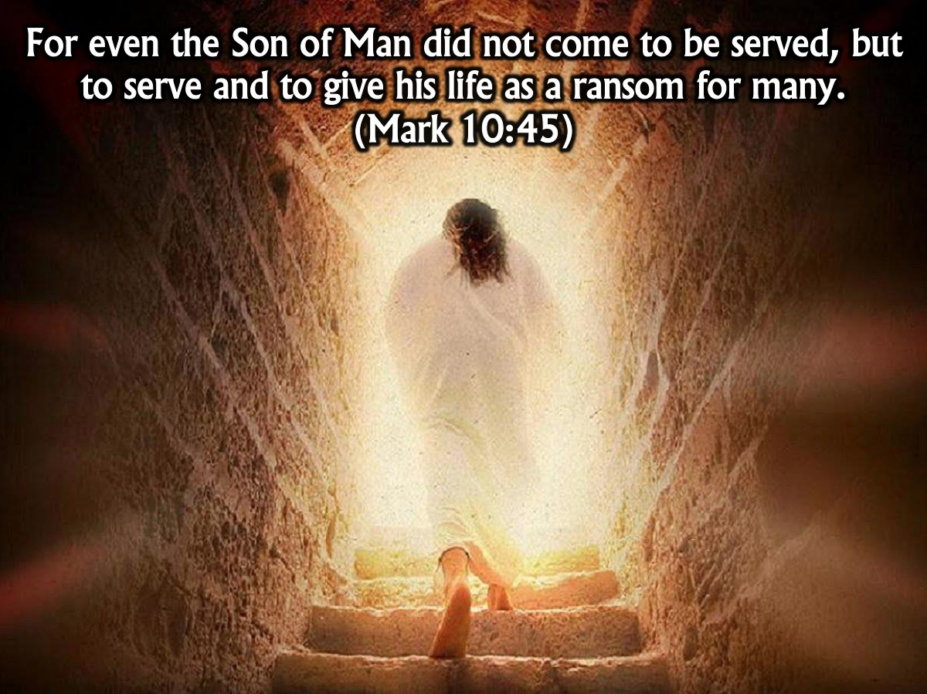
Notes:
“For even the Son of Man did not come to be served, but to serve and to give his life as a ransom for many.” (Mark 10:45)

Slide 32
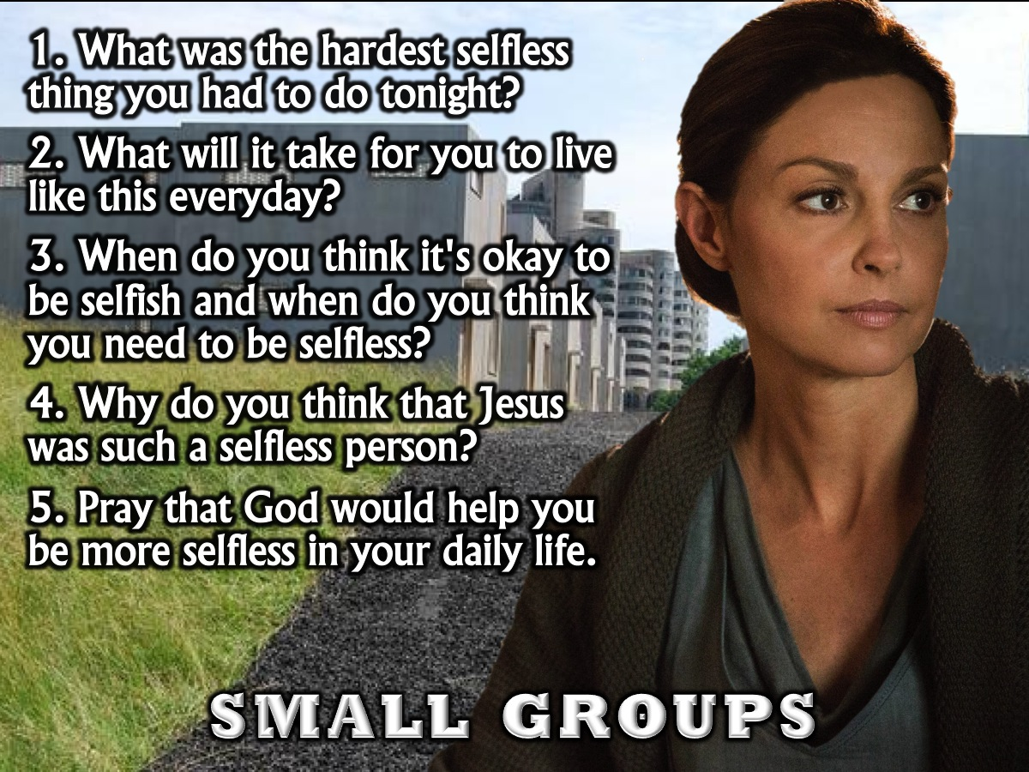
Notes:
Small Groups:
1. What was the hardest selfless thing you had to do tonight?
2. What will it take for you to live like this everyday?
3. When do you think it's okay to be selfish and when do you think you need to be selfless?
4. Why do you think that Jesus was such a selfless person?
5. Pray that God would help you be more selfless in your daily life.
Song to play during small groups: Saturn: Sleeping at Last. Get the audio track on YouTube at: http://8tracks.com/aures/augustus-hazel-grace

Slide 33
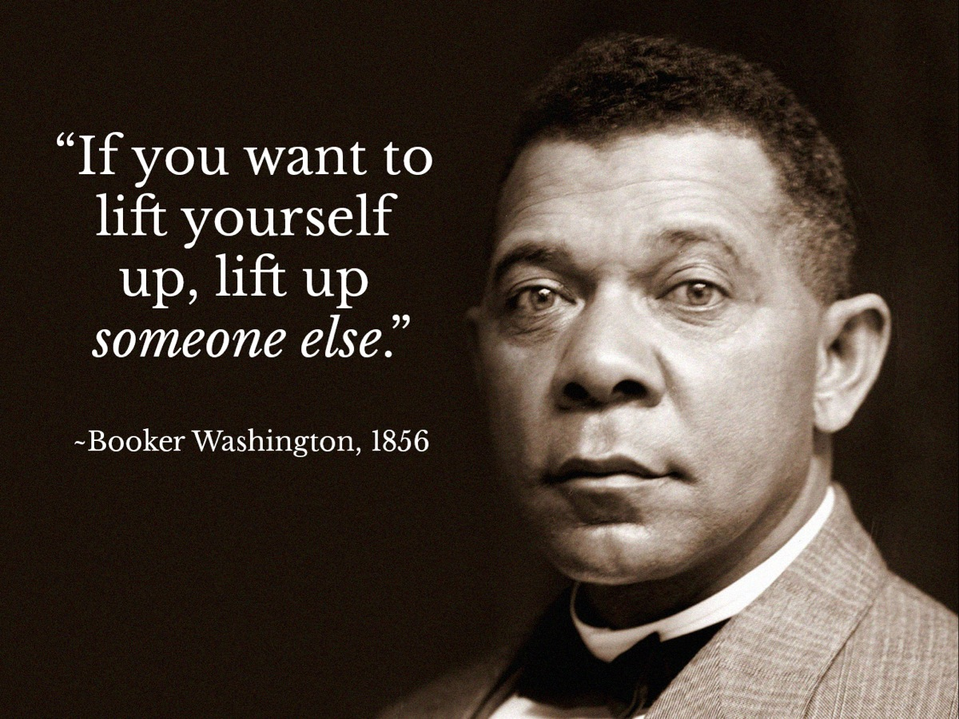
Notes:
If you want to lift yourself up, lift up someone else. (Booker Washington)

Slide 34

Notes:
Chocolate and cookies – we will end the night by serving hot chocolate and home made sugar biscuits.

