Slide 1
Notes:
Dragons Den Night

Slide 2
Notes:
Welcome: Welcome to Cash Friday - welcome to our regulars and if there are any newcomers please come up onto stage so we can welcome you!

Slide 3
Notes:
Next Week is Deal or No Deal Night.

Slide 4
Notes:
Video: Dragon’s Den Opening.

Slide 5
Notes:
Tonight is Dragons’ Den Night. Let’s start with a video to give you an idea of how the Dragons’ Den works.

Slide 6
Notes:
Video: Dragon’s Den Parkour Pitch.

Slide 7
Notes:
The Rules: (1) The Dragons have cash to give away (R1000 in total). (2) Individuals will enter the Den to ask for cash. (3) You will either walk away with cash or get burned. Notes: Each Dragon will be given R200 in R10 notes. During each round, a teen will ask for a specific amount of money. A Dragon can choose to give all the money or contribute a certain amount (together with other Dragons) to make up the full amount. If a person does not get all the money from the Dragons, they walk away with nothing.

Slide 8
Notes:
Meet the Dragons: We welcome the Dragons to the stage…
(Dragons will be seated on the blue cloth chairs on the stage)

Slide 9
Notes:
Making a Pitch - If you choose to enter the Dragons’ Den to need to have a great pitch or you will walk away empty handed! Here are some guidelines:

Slide 10
Notes:
1. Be Specific

Slide 11
Notes:
2. Be Creative

Slide 12
Notes:
3. Be Convincing

Slide 13
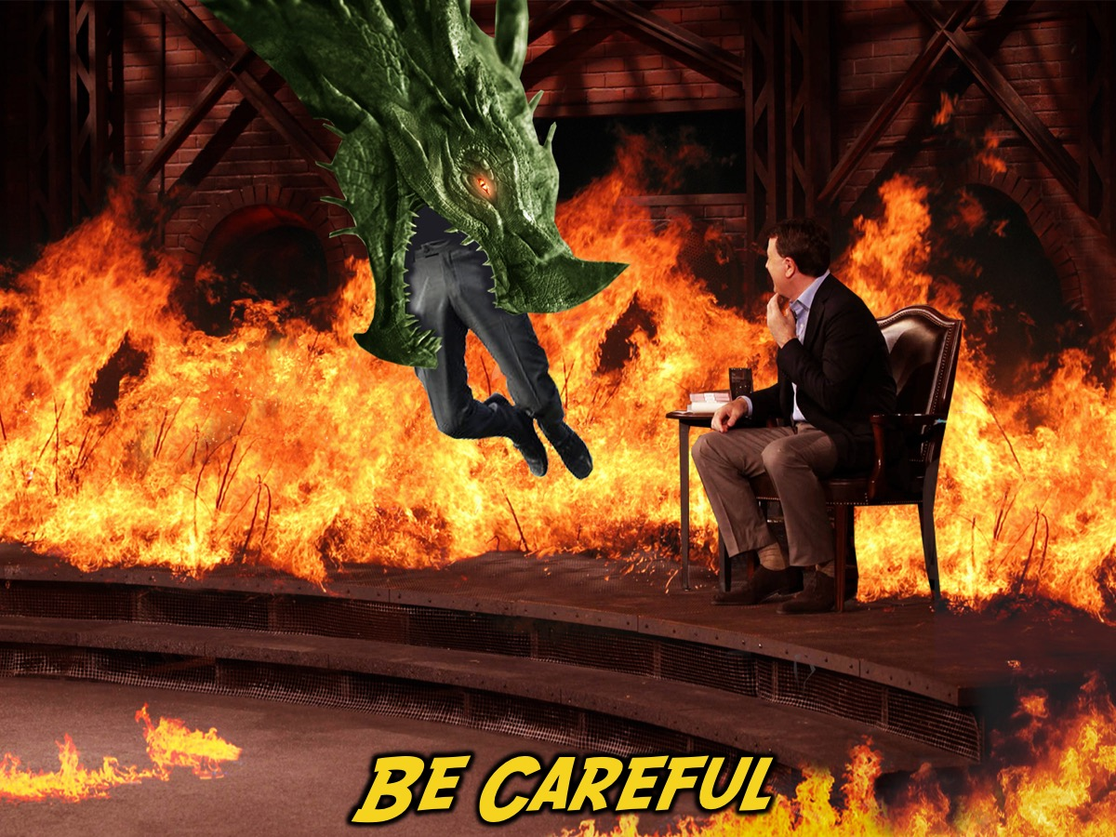
Notes:
4. Be Careful

Slide 14
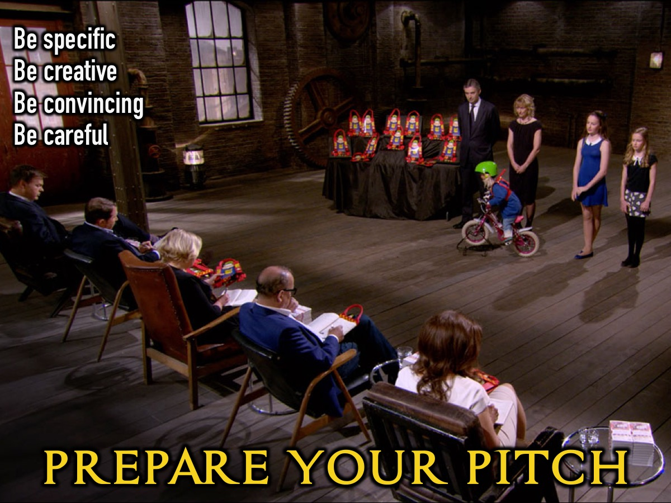
Notes:
Prepare Your Pitch - you have 10 minutes to prepare your presentation to get money from the Dragons - you can work alone, or with a partner or a group.

Slide 15
Notes:
Submit Your Name - write your name on the card provided and we will drawn names to enter the Dragons’ Den.

Slide 16
Notes:
It is time to enter the Dragon’s Den! You have exactly 1 minute to present your pitch to the dragons and they may choose to ask you a question or breathe fire on you.

Slide 17
Notes:
Who is next to face the Dragons?

Slide 18
Notes:
Small Groups. Here are the questions for our small group time: (1) What did you learn about asking for help tonight? (2) How should we go about asking God for help? “Let us come boldly to the throne of our gracious God. There we will receive his mercy and we will find grace to help us when we need it most.” (Hebrews 4:16). (3) What help do you need in your life at the moment? (4) Pray for each other to receive help from God.

Slide 19
Notes:
Refreshments. It is time for cookies and hot chocolate.

