Slide 1
Notes:
For each of the monthly leaders meeting for high school and adult leaders, this template is used as a framework for the meeting time. Each month I select a current movie that youth are interested in and which has some connection to ministry and the presentation is structured around it using title slides with stills from the movie, the movie font is used for the slides and some devotion is built around the themes in the movie. This presentation is an example, and it was based on the movie, Allegiant when it was released a while back.

Slide 2
Notes:
The title slide that is shown as teens are leaving the room and the adult leaders are making their way to the circle of chairs in front of the serving hatch where the meeting will take place and where lunch will be served.

Slide 3
Notes:
Video: Allegiant Trailer.

Slide 4
Notes:
(Some thoughts taken from the trailer are shared) It is time to go beyond the walls!

Slide 5
Notes:
There are experiences waiting for us on the other side of the boundaries we see around us.

Slide 6
Notes:
There are people on the other side of the walls we create between those who are in the church and outside the church.

Slide 7
Notes:
Video: Allegiant Go Beyond.

Slide 8
Notes:
We may need to blow some stuff up to break free of anything that is hindering us.

Slide 9
Notes:
Video: Allegiant Generator.

Slide 10
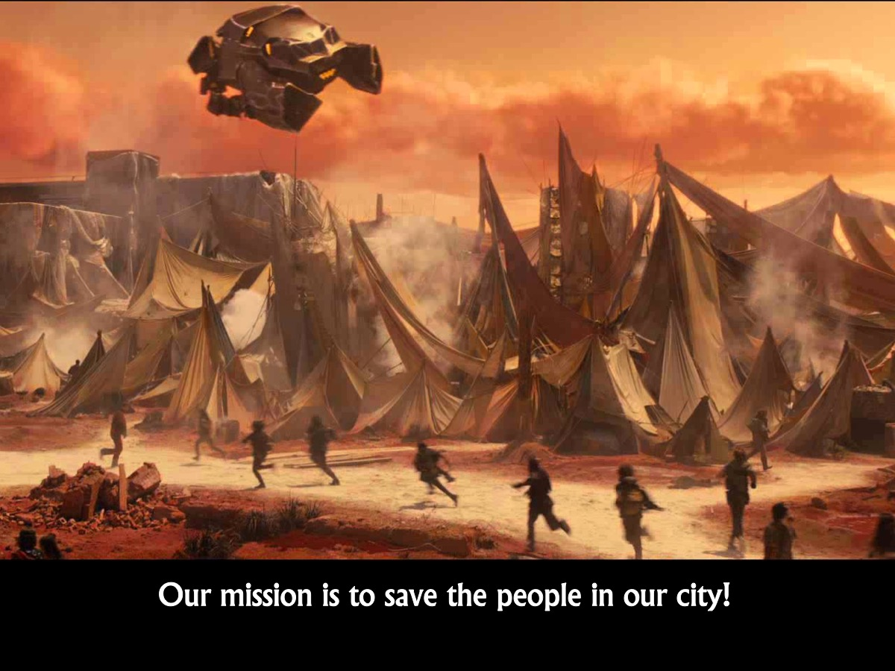
Notes:
Our mission is to save the people in our city!

Slide 11
Notes:
Video: Allegiant The Truth Lies Beyond.

Slide 12
Notes:
Christ died for everyone - so people matter!

Slide 13
Notes:
Video: Allegiant - Their World.

Slide 14
Notes:
Prayer (for this prayer time I identified a number of areas that we needed to pray into):
* Growth in numbers
* More leaders
* Growth in small group (trust, depth, consistency)
* Growth in faith
* Holy Spirit to touch and soften hearts
* Leaders discipling teenagers
* Depth in teaching
* Encounters with God
* Teens open to hear from God
* Growth in gifts and talents

Slide 15
Notes:
Training: Each month some skill is identified and training is provided for the team. Check out this presentation for some of the leadership training we have done in recent months:
http://www.ymresourcer.com/documents/Encounter_Volunteer_Training.pptx

Slide 16
Notes:
Firstly, we reminded ourselves - as we do each time we meet - the reason why we exist as a youth ministry which is to see lives, communities and society transformed through discipleship in the Word, the presence and the power of God.

Slide 17
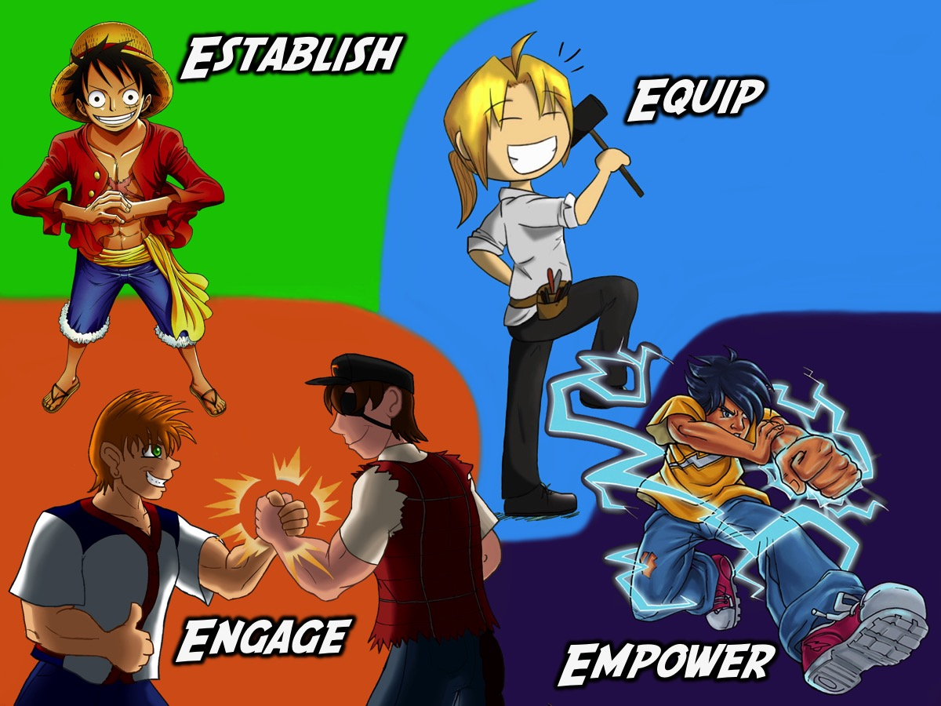
Notes:
Secondly, we restated our disciplemaking path and how each stage leads to the next stage: starting with Engage and ending with Empower - although those who are being established, equipped and empowered are taught to engage with their lost friends.

Slide 18
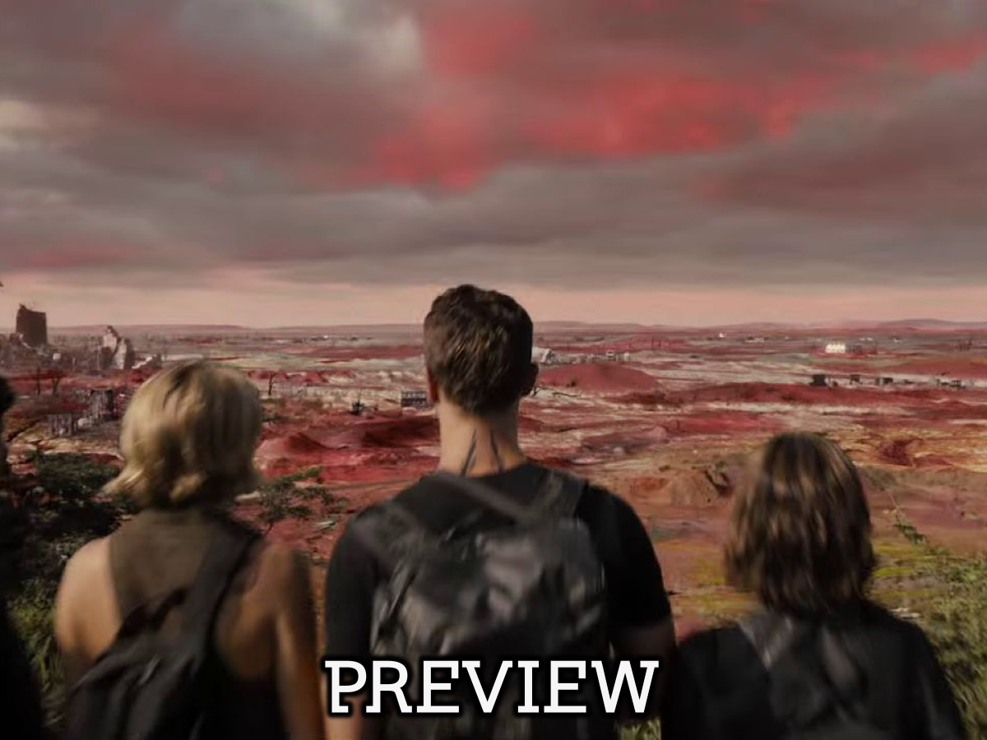
Notes:
Preview (the next section is usually a look ahead to the upcoming month of meetings - of if it is the first meeting for the term, then we preview the whole upcoming term. If this is the last leaders meeting of the term, then we spend time reviewing the term that has passed and then spend time planning the new term.

Slide 19
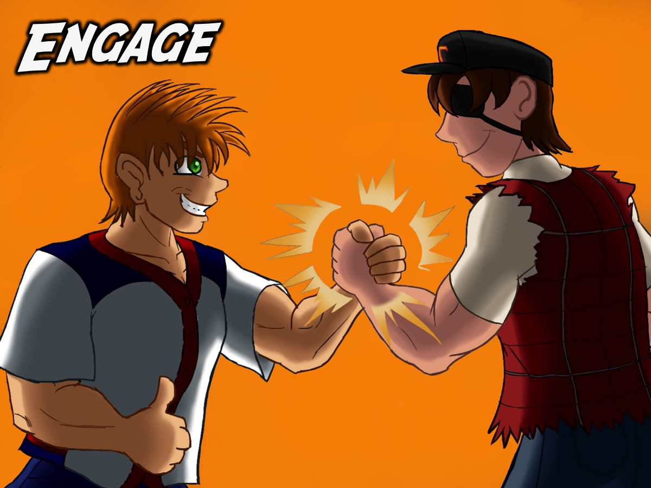
Notes:
Our planning focuses on our Engage events which take place on Friday nights…

Slide 20
Notes:
This would be the title slide for the term following by each of the upcoming Friday night events that we are previewing…

Slide 33
Notes:
Next we focus on the upcoming Establish events - which take place on Sunday mornings.

Slide 34
Notes:
The upcoming series for this leaders meeting was The WORD Series - The idea is to do a series focusing on topics that we can explore by looking at the Bible - calling it "The Word-On Series”.

Slide 35
Notes:
Here are the topics we decided to address in the Word-On series.

Slide 38
Notes:
We remained in the sanctuary for the whole services on this week because we were attending the Lead The Cause weekend event and our leaders were not around to run Friday night or Sunday morning services.

Slide 46
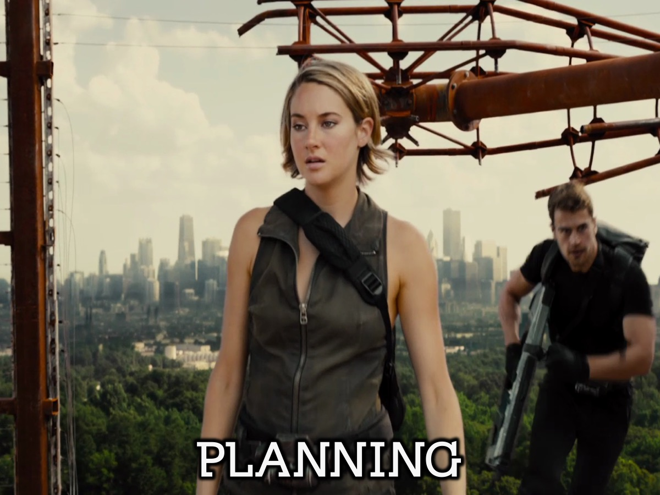
Notes:
Planning: In this section of our meeting we focus on upcoming events than need our attention.

Slide 47
Notes:
For example, we planned what needed to happen to attend this conference.

Slide 48
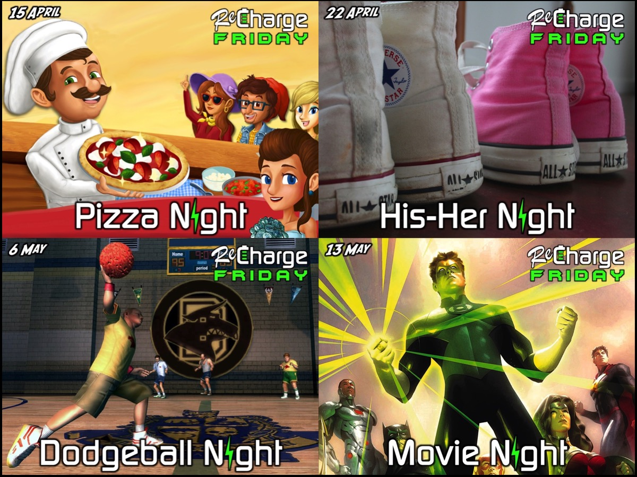
Notes:
We spoke about the need for four champions to head up teams to plan the upcoming Friday night events and we gave them time in small groups to start planning for these events.

Slide 49
Notes:
This slide is used when our Sunday series is focused on equipping high schoolers rather than establishing them or for when events are advertised which are aimed at equipping high schoolers.

Slide 50
Notes:
This is the section where our upcoming leadership meetings are advertised or other empowering activities are focused on.

Slide 51
Notes:
The announcement of the next leaders meeting.

Slide 52
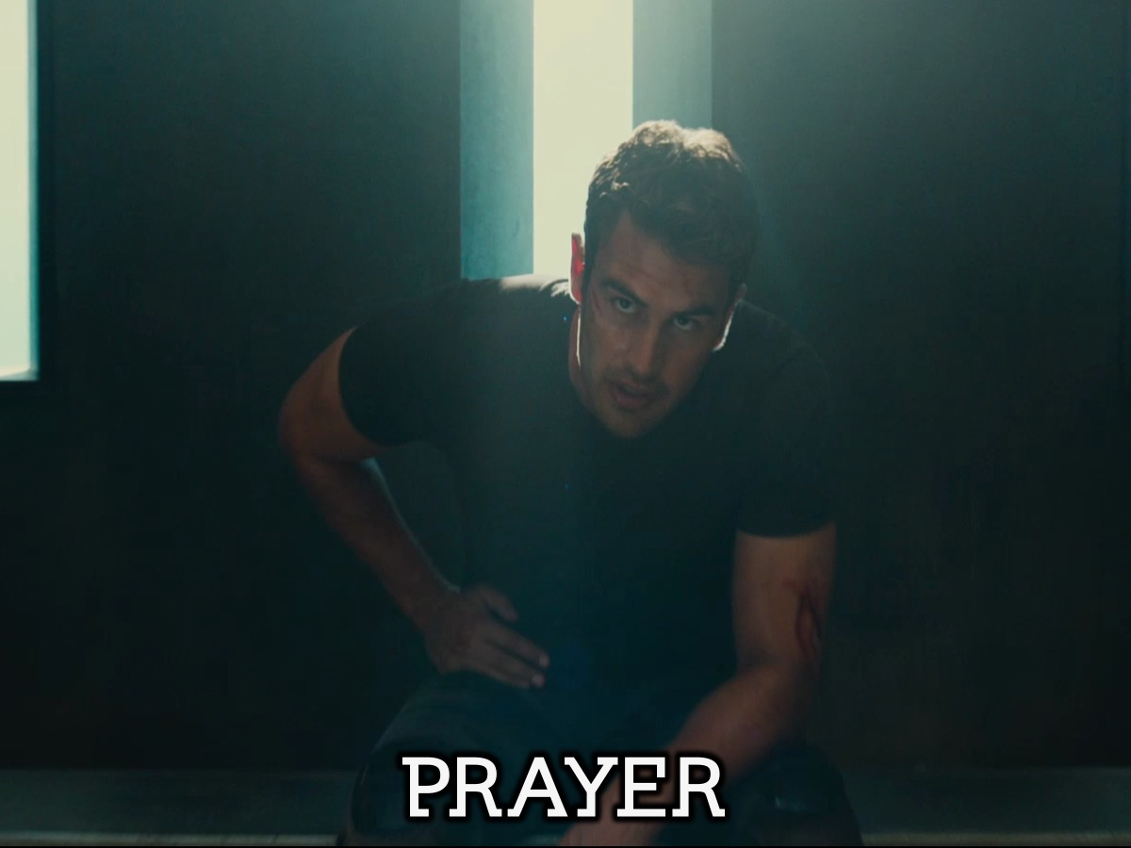
Notes:
Our meetings end in prayer.

Slide 53
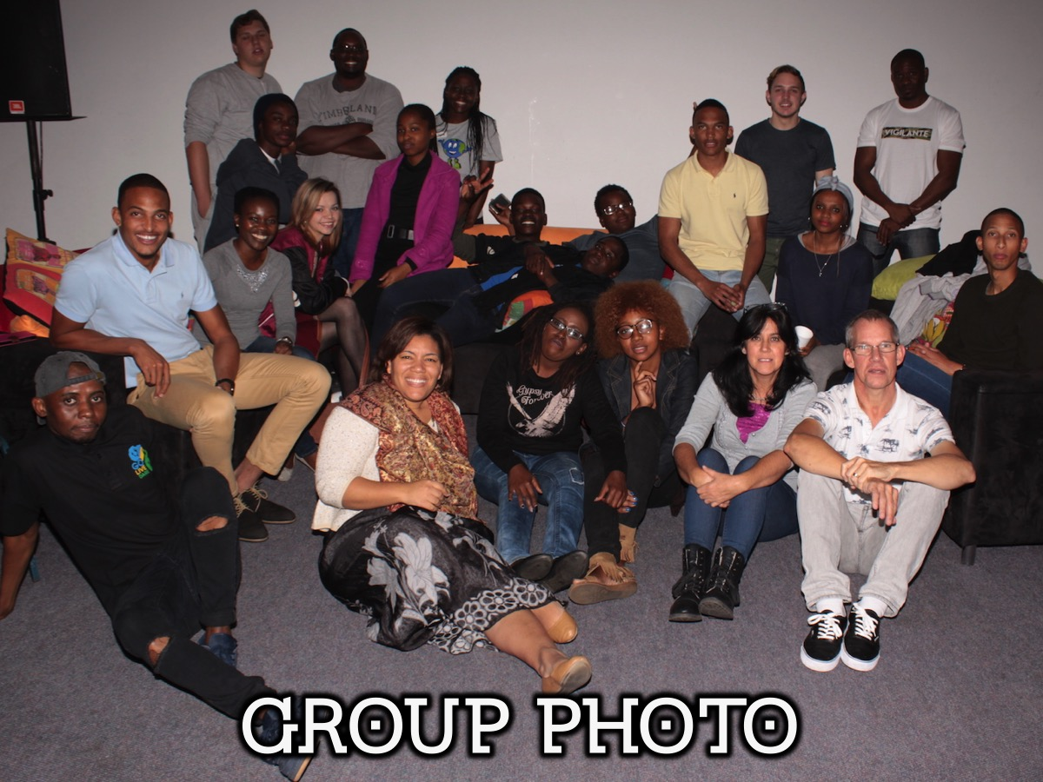
Notes:
We generally take a team photo before we depart.

