Slide 1


Slide 2

Notes:
OUR VISION: We see high schoolers and their world transformed through discipleship in the Word, the presence and the power of God.

Slide 3
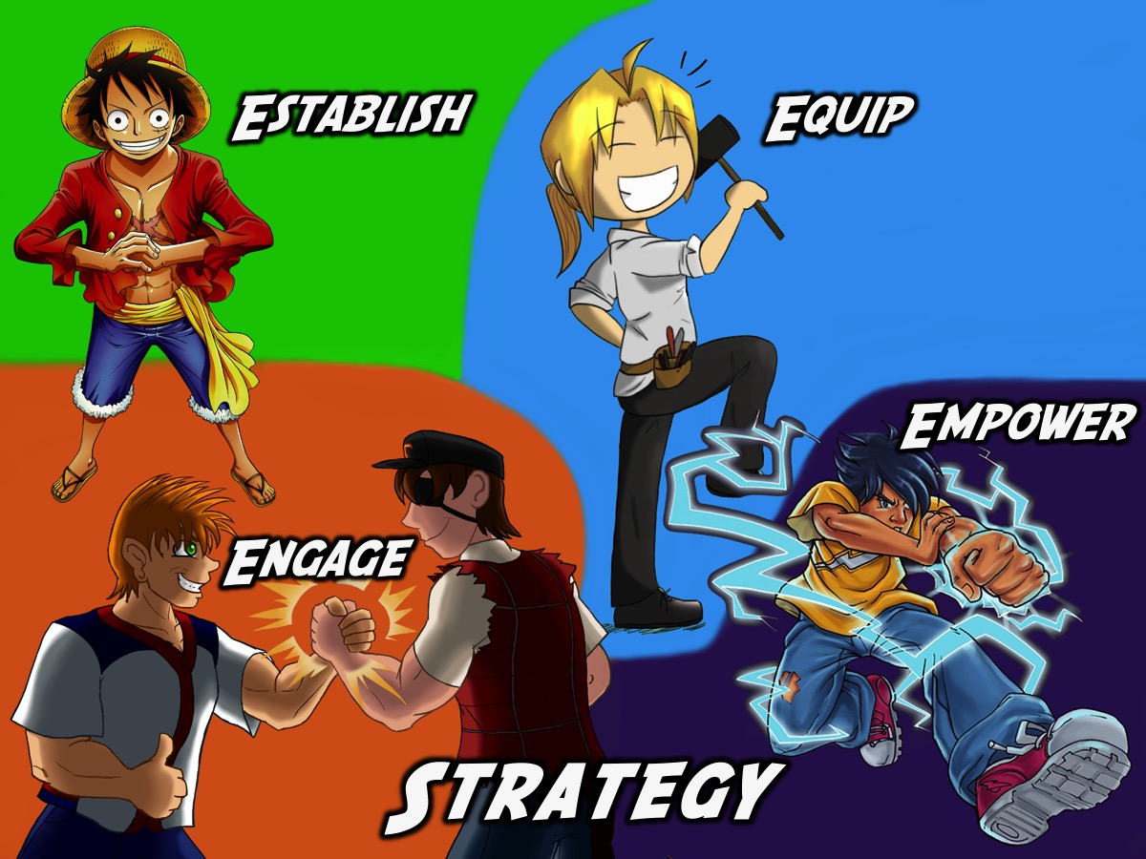

Slide 4
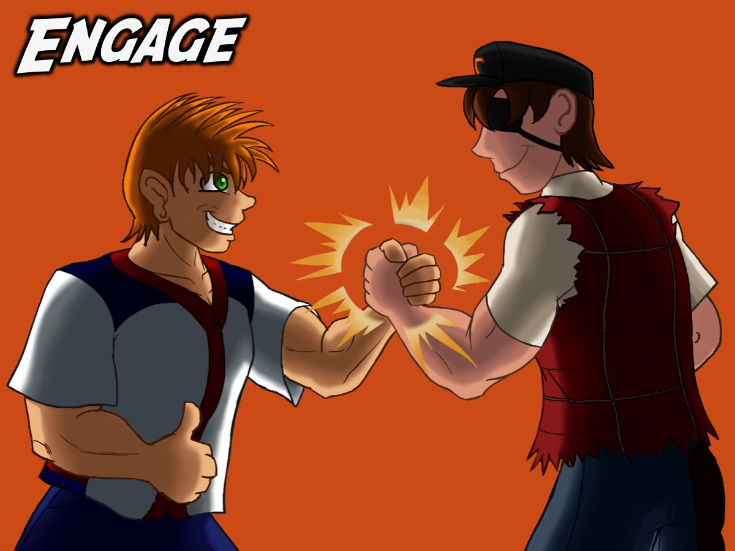
Notes:
The Engage Level

Slide 5
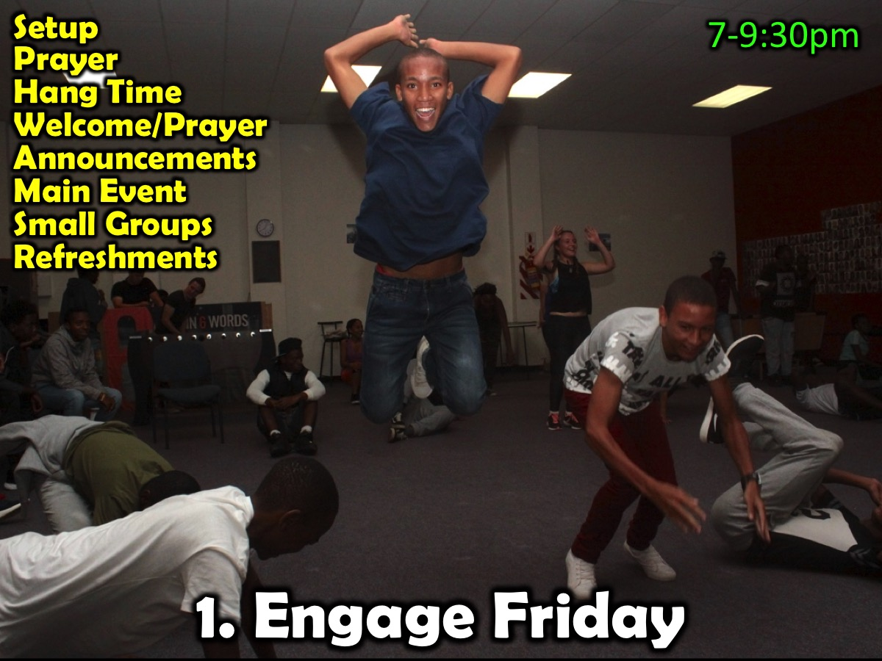
Notes:
Here are some of the key components of our Engage event that takes place on a Friday night: Setup, Prayer. Hang Time, Welcome, Announcements, Main Event, Small Groups and Refreshments.

Slide 6

Notes:
Here is an example of a Friday night event…

Slide 7
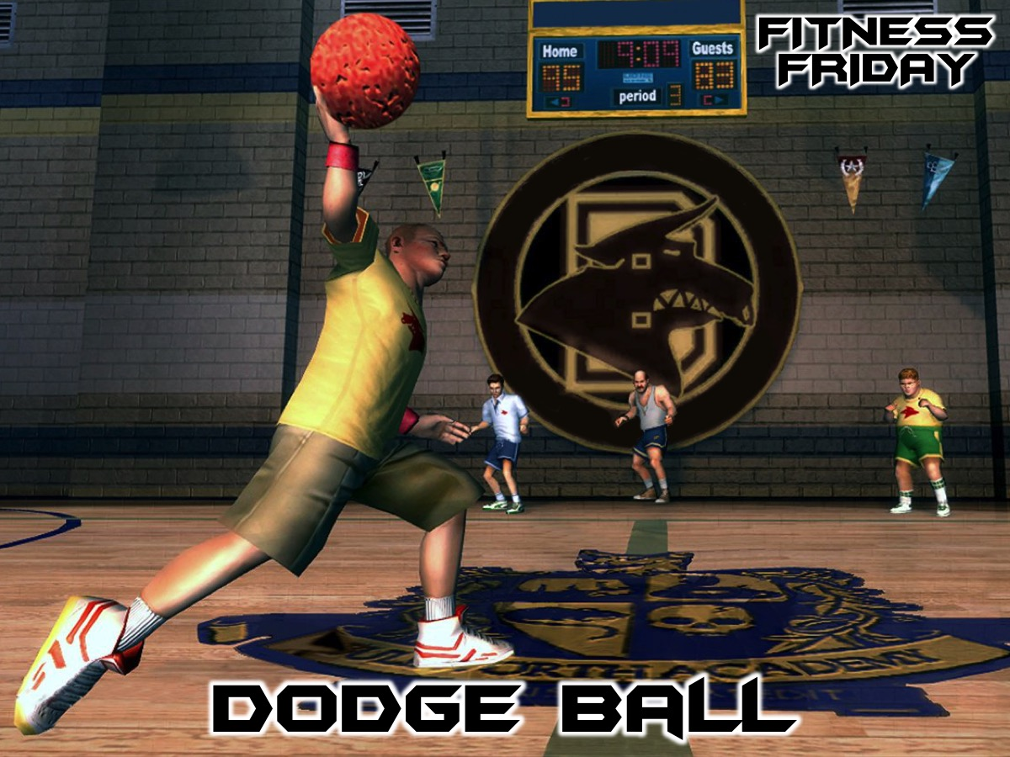
Notes:
Tonight is our Dodge Ball night.

Slide 8
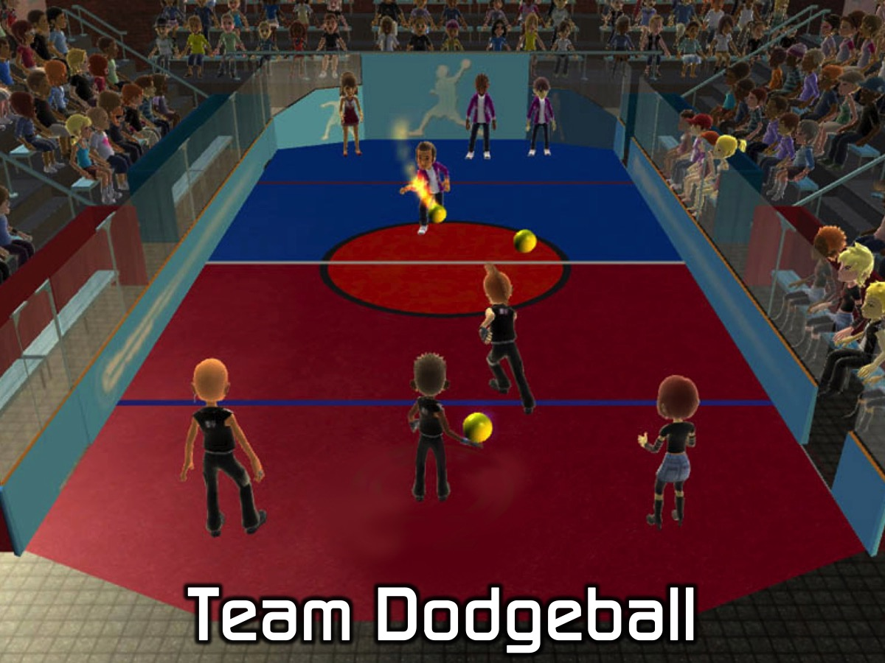
Notes:
Team Dodgeball - we will divide into 6 teams and start with a round of friendly games where two team play each other and then the other two teams play each other. Then we will have a knockout competition and there will be a draw to see which two teams play each other and then the next two teams play each other followed by a final game to reward the ultimate winners.

Slide 9
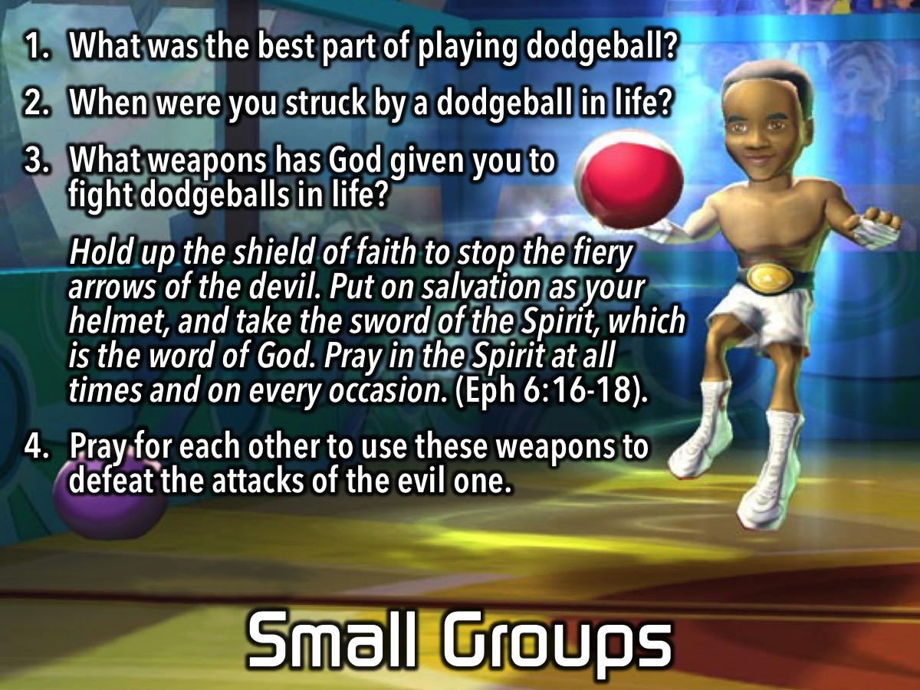
Notes:
Small Group Questions: (1) What was the best part of playing dodgeball? (2) When were you struck by a dodgeball in life? (Leaders Note: Life can be like a game of dodgeball where blows come from friends, family members, bad luck, the Devil, etc. Try and get your group members to talk about actual things that have harmed them in life). (3) What weapons has God given you to fight dodgeballs in life? “Hold up the shield of faith to stop the fiery arrows of the devil. Put on salvation as your helmet, and take the sword of the Spirit, which is the word of God. Pray in the Spirit at all times and on every occasion.” (Ephesians 6:16-18). (4) Pray for each other to use these weapons to defeat the attacks of the evil one.

Slide 10
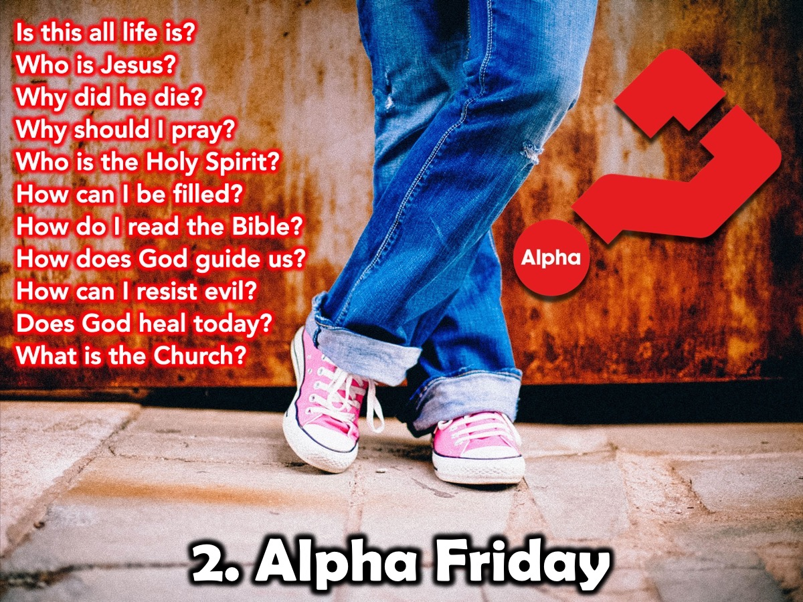
Notes:
We use the Youth Alpha Series as an outreach tool to lead high schoolers into a saving relationship with Jesus!

Slide 11
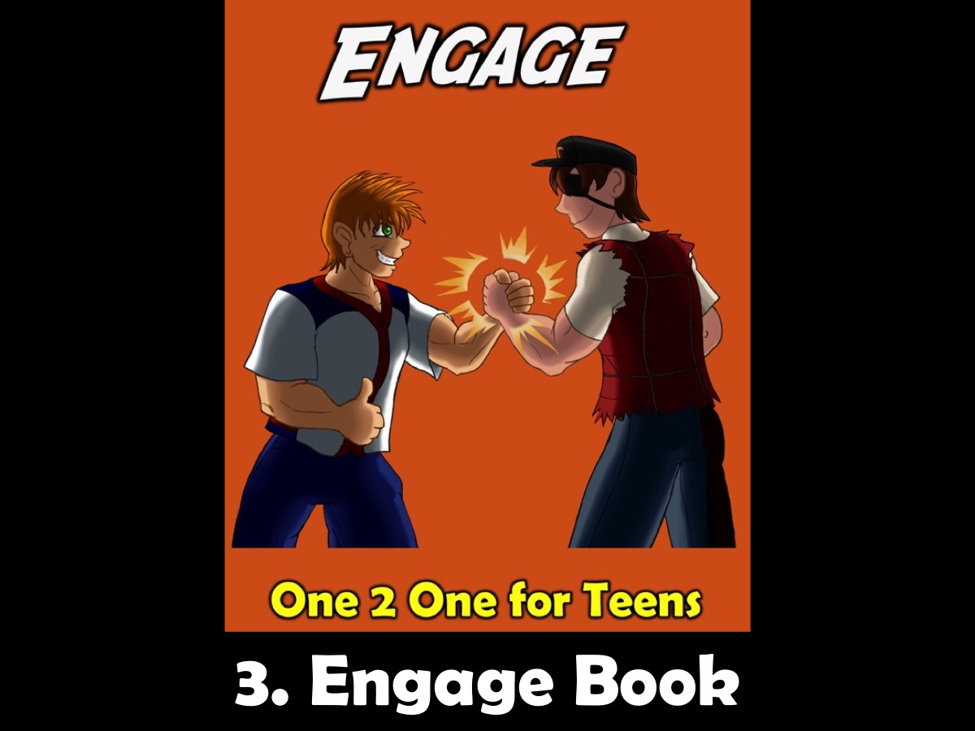
Notes:
We use the Engage Booklet to follow up with high schoolers who have given their lives to Jesus.

Slide 12
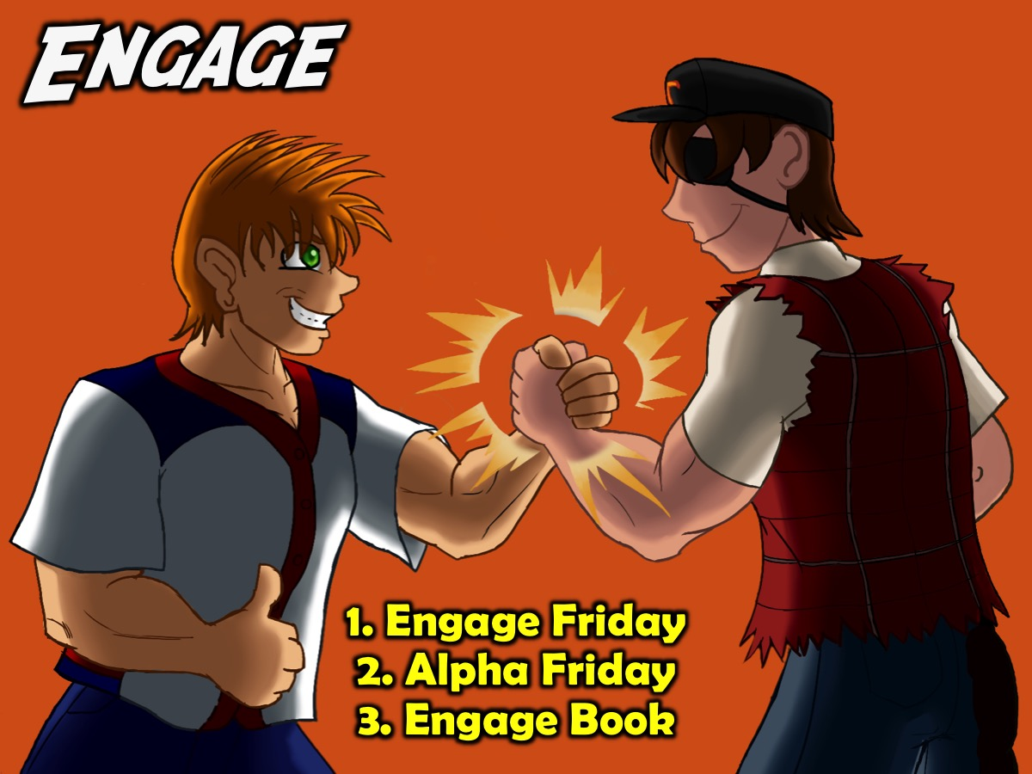
Notes:
Summary: There are three interventions for Engage: (1) Engage Friday, (2) Alpha Friday and the (3) Engage Book.

Slide 13

Notes:
The Establish Level

Slide 14
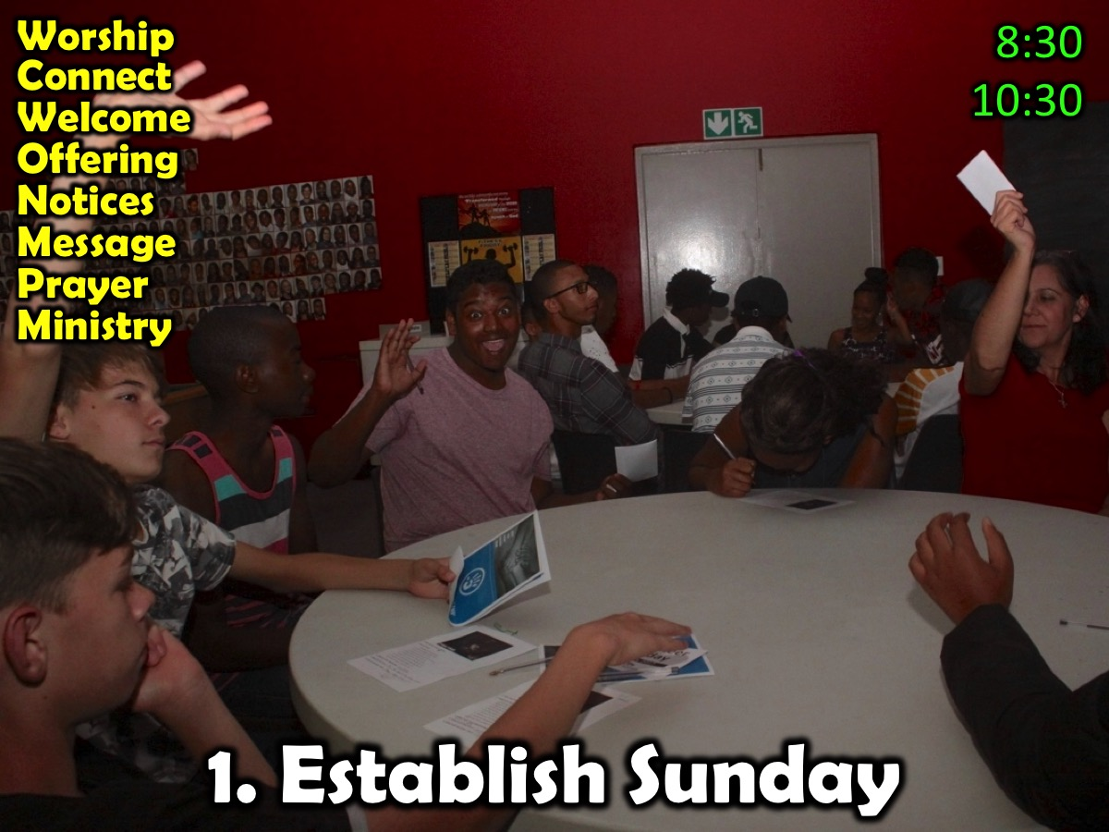
Notes:
Here are some of the key components of our weekly Establish event (currently presented during the first two services on a Sunday morning): Worship; Connect; Welcome; Offering; Notices; Message; Prayer and Ministry.

Slide 15

Notes:
We present the Call to Victory series over 10 Sunday mornings.

Slide 16

Notes:
We use the Establish Booklet to help high schoolers be established in their faith.

Slide 17

Notes:
Summary: There are three interventions for Establish: Establish Sunday, Victory Sunday and the Establish Book.

Slide 18
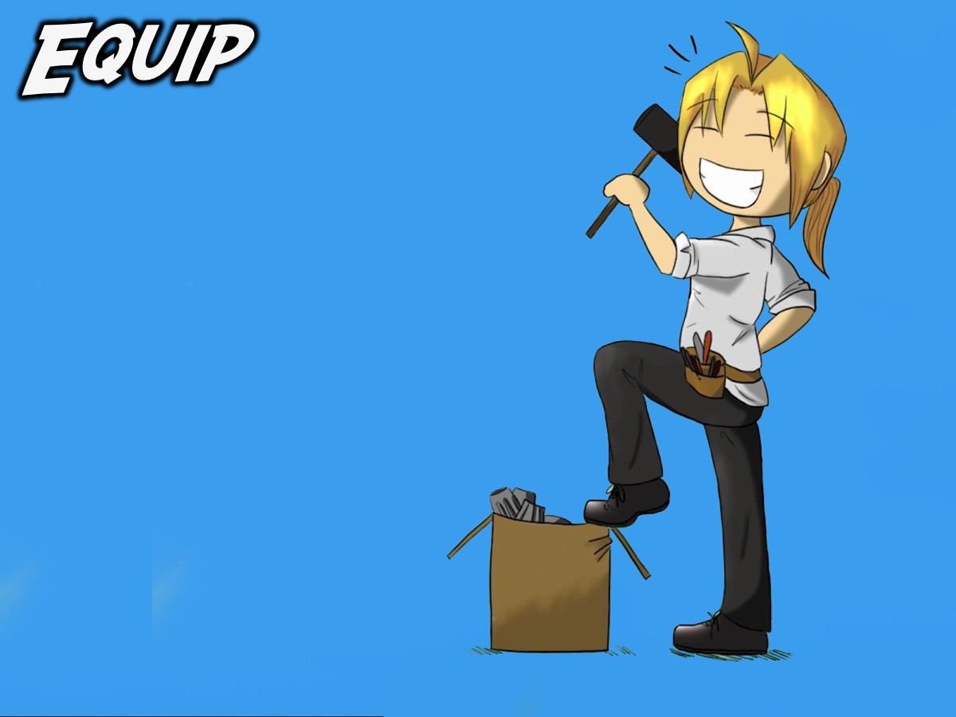
Notes:
The Equip Level

Slide 19
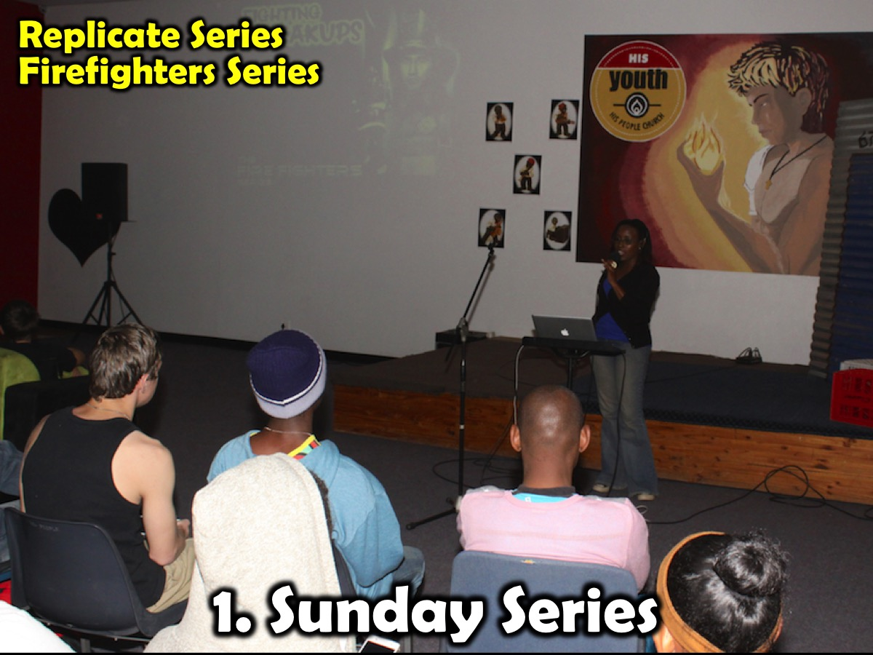

Slide 20
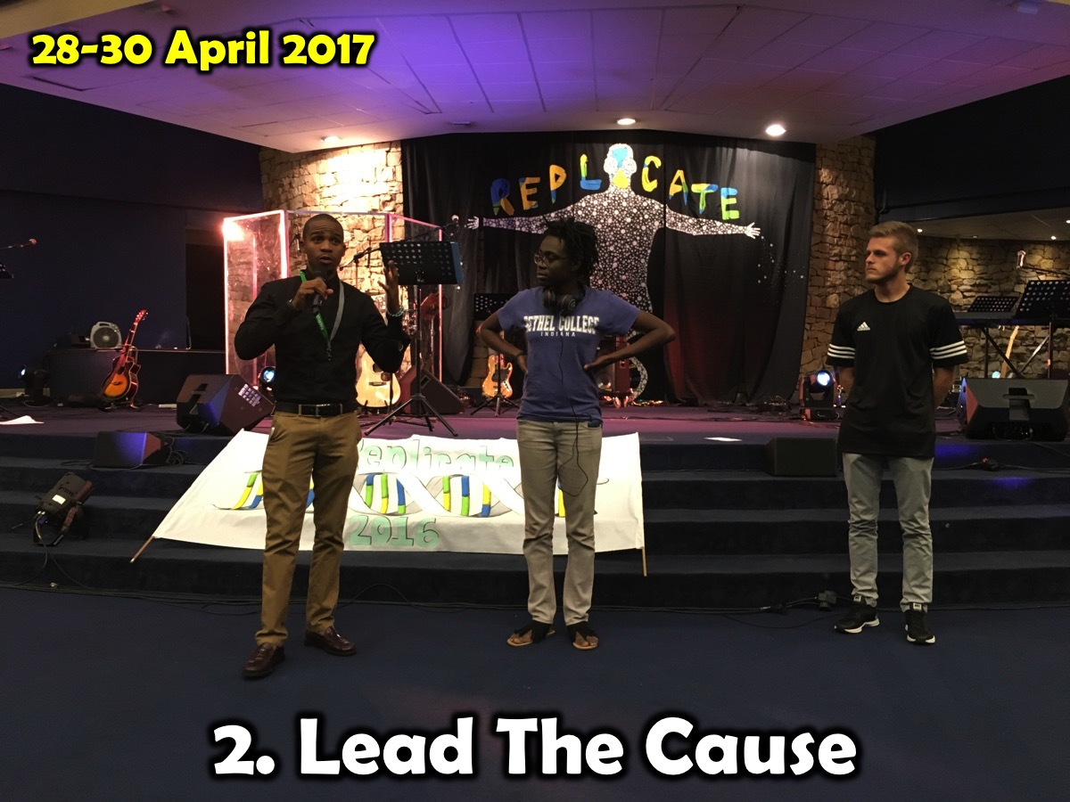
Notes:
We either host or attend The annual Lead The Cause peer evangelism equipping event that is run by Go Live Dare.

Slide 21
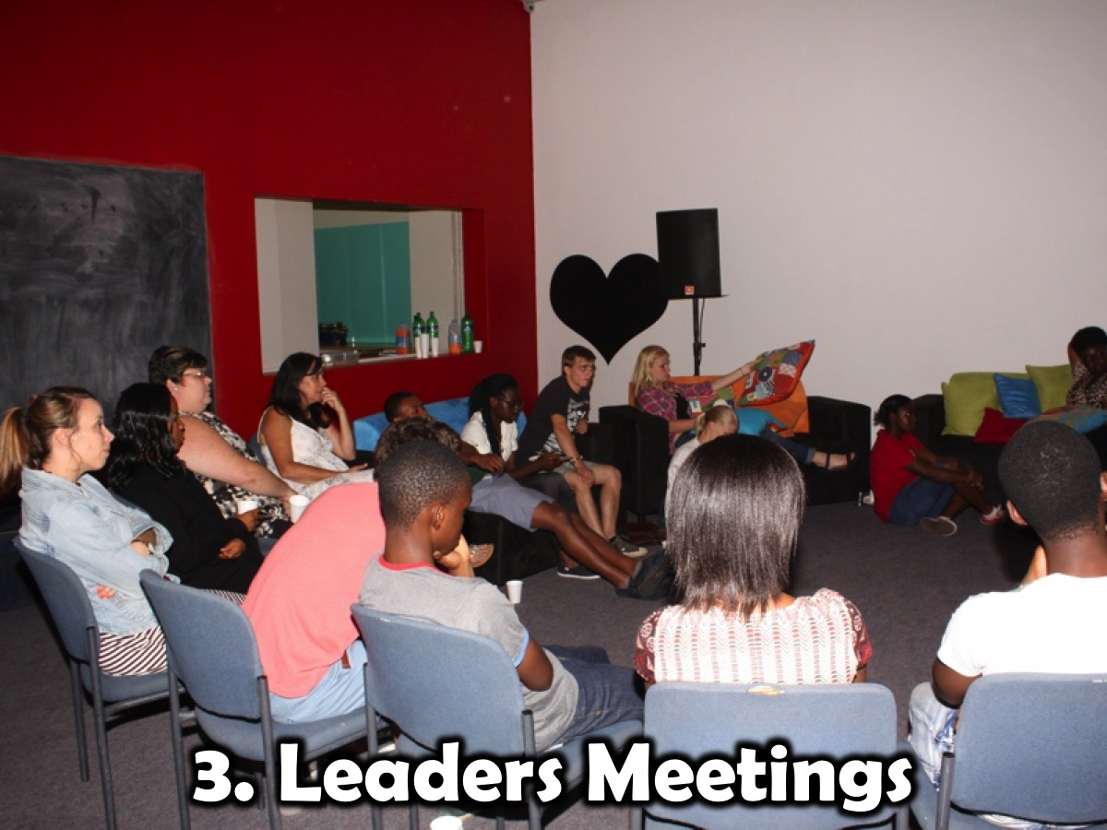
Notes:
Leadership Meetings: Our teen and adult leaders gather once a month on a Sunday afternoon for 2 hours to plan either the upcoming term or the next month’s events. Each leader is responsible for one Friday night a term and work with a small group of Connect Leaders to plan and present Friday night events. These leaders connect with each other via a WhatsApp group.

Slide 22
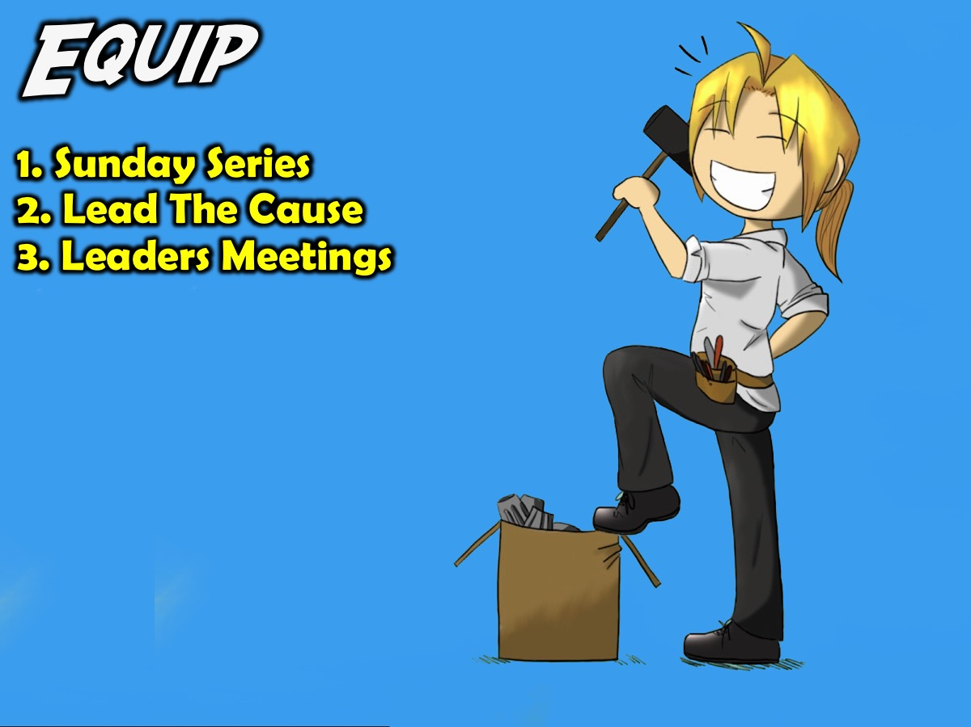
Notes:
Summary: There are three interventions at our Equip level: Sunday series, Lead The Cause, Leaders Meetings.

Slide 23
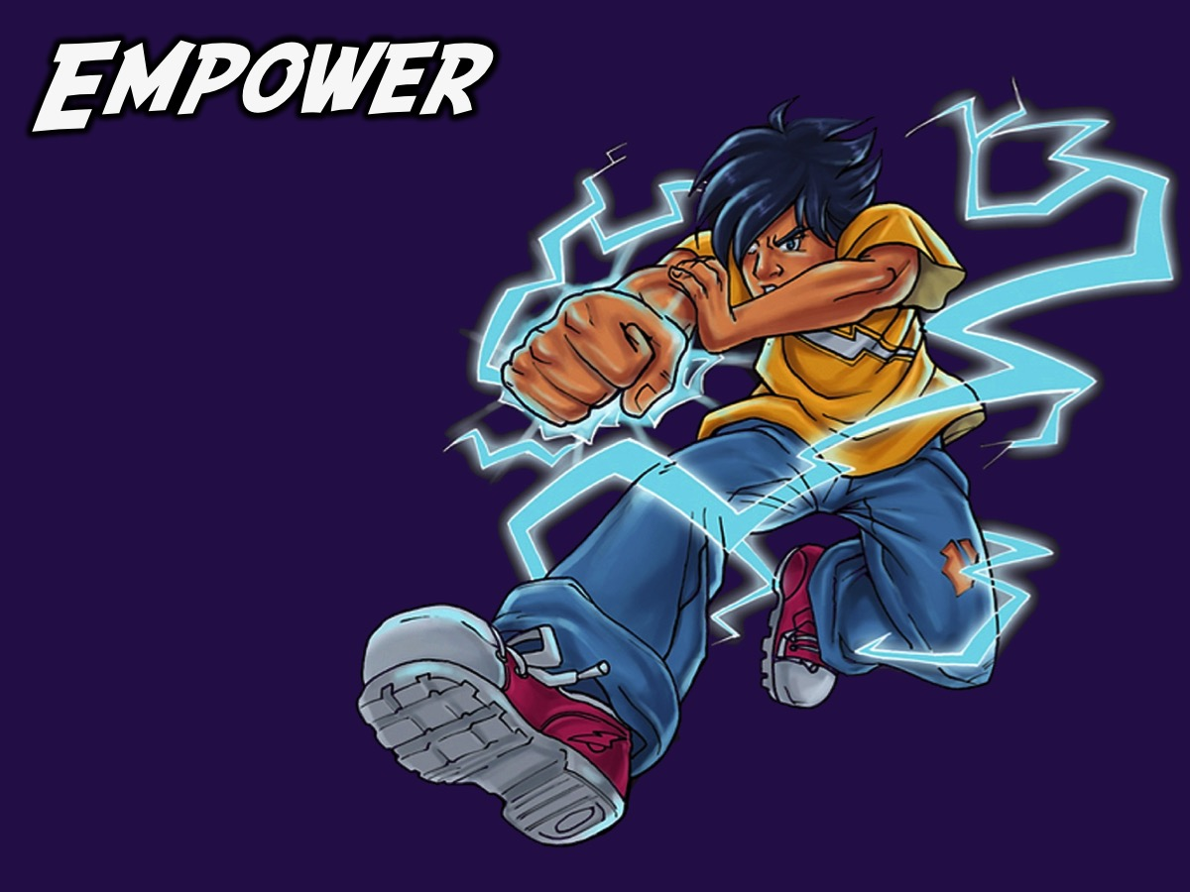
Notes:
The Empower Level

Slide 24
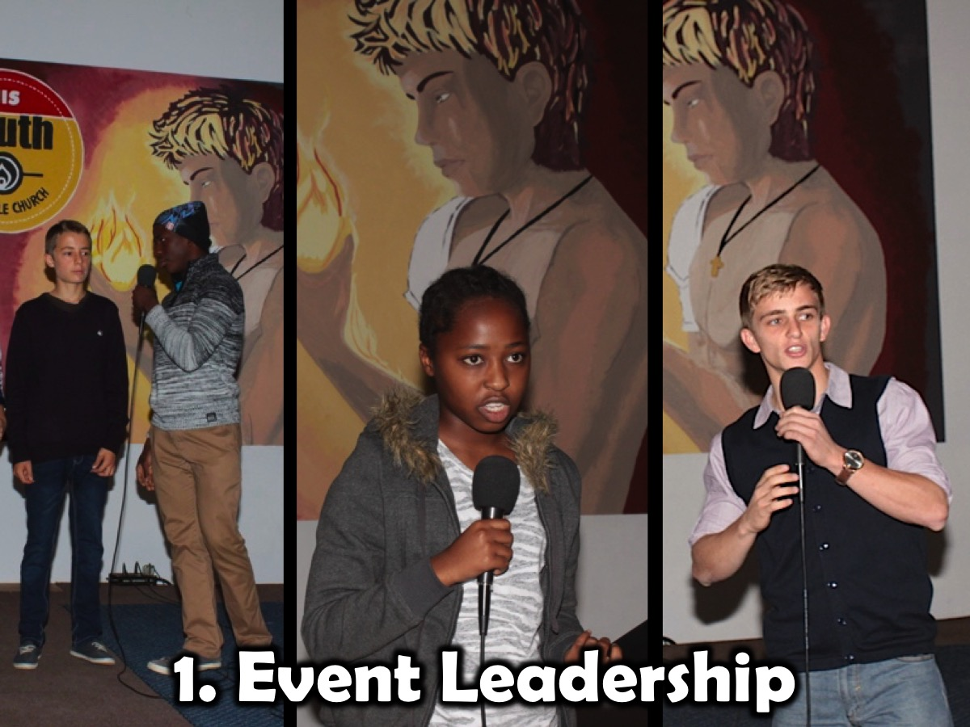
Notes:
We use the Establish Event on Sunday mornings to empower teens for ministry - by having them do the Welcome, Offering, Announcements and give Testimonies - and even preaching.

Slide 25
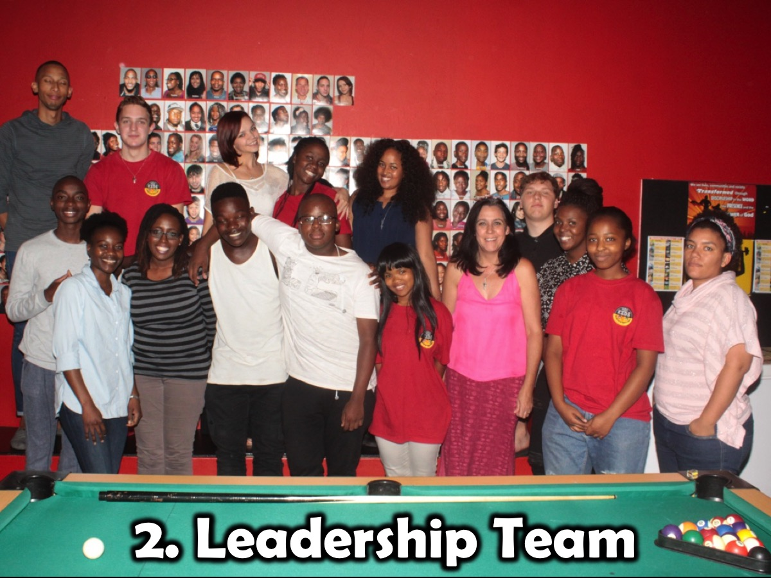
Notes:
We use the Engage Event on Friday nights to empower teens for ministry - by having them take responsibility for an event in the term, planning and involving other teens in running the event and also serving as small group leaders on the night.

Slide 26
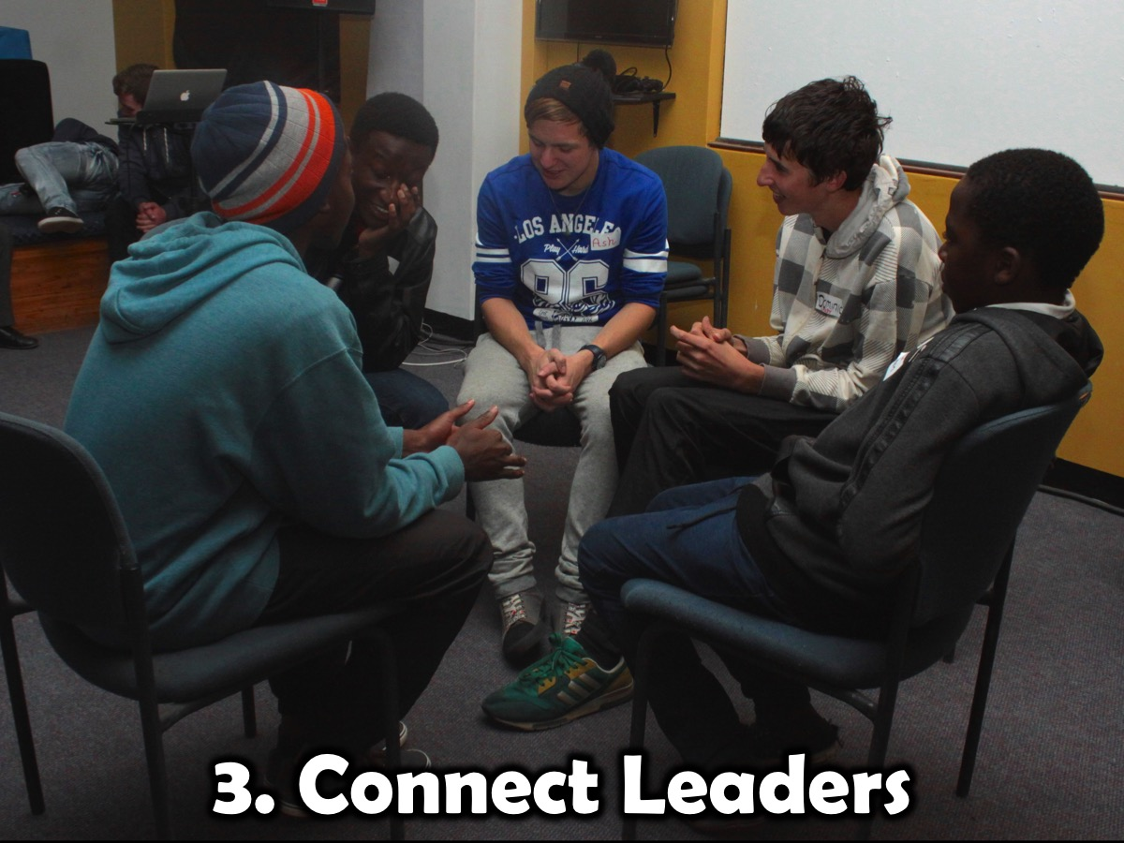
Notes:
We use the Engage Event on Friday nights to empower teens for ministry - by having them take responsibility for an event in the term, planning and involving other teens in running the event and also serving as small group leaders on the night.

Slide 27
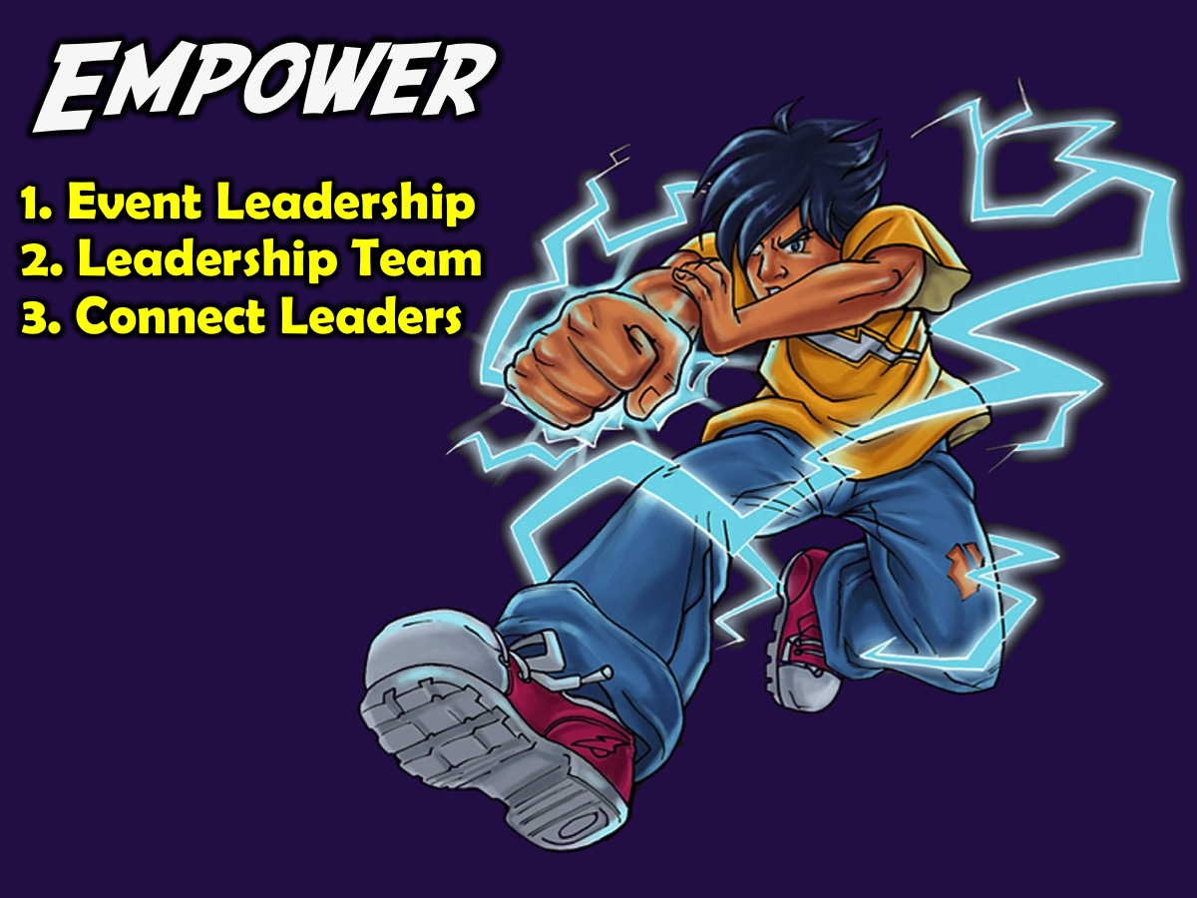
Notes:
Summary: There are 3 interventions at our Empower Level: (1) Event Leadership; (2) Leadership Team and (3) Connect Leaders.

Slide 28


Slide 29
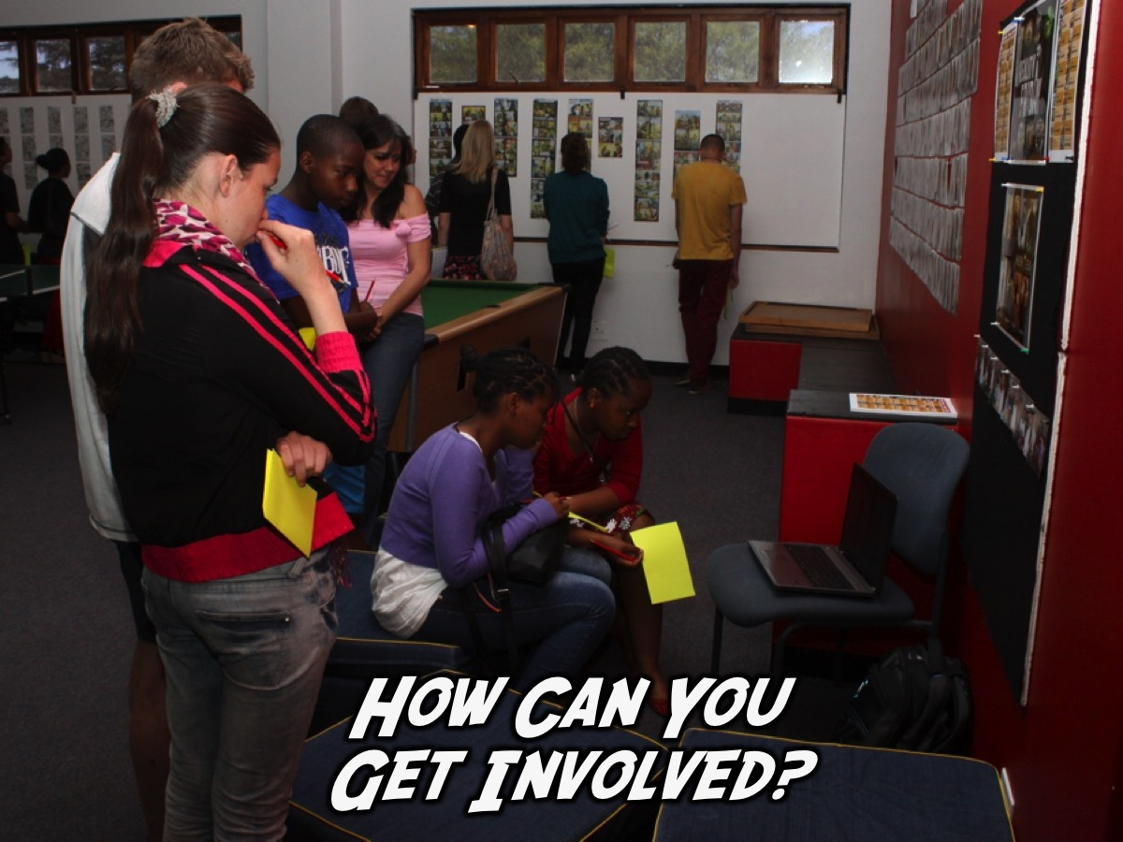
Notes:
How Can You Get Involved? Here are 10 guidelines as you consider becoming an adult volunteer at Encounter Youth:

Slide 30
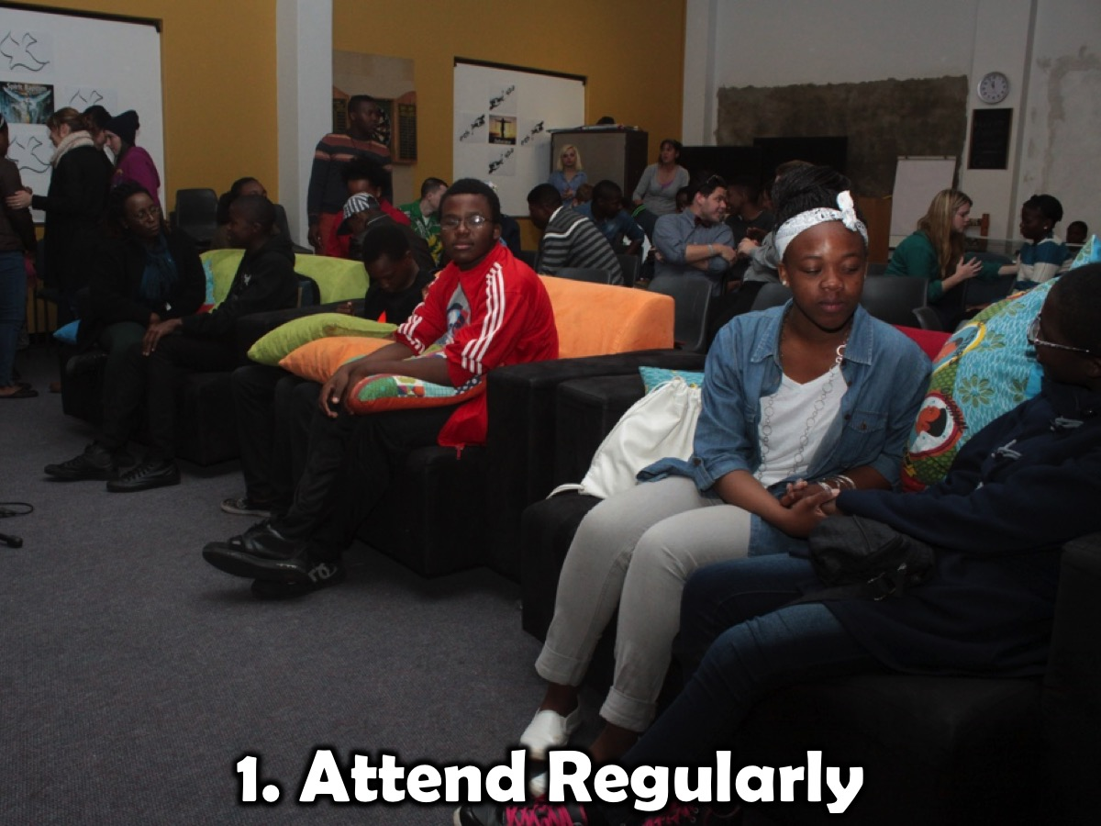
Notes:
1. Attend Regularly: High school ministry can’t be rostered - it takes regular contact with youth to build relationships with them and impact their lives.

Slide 31
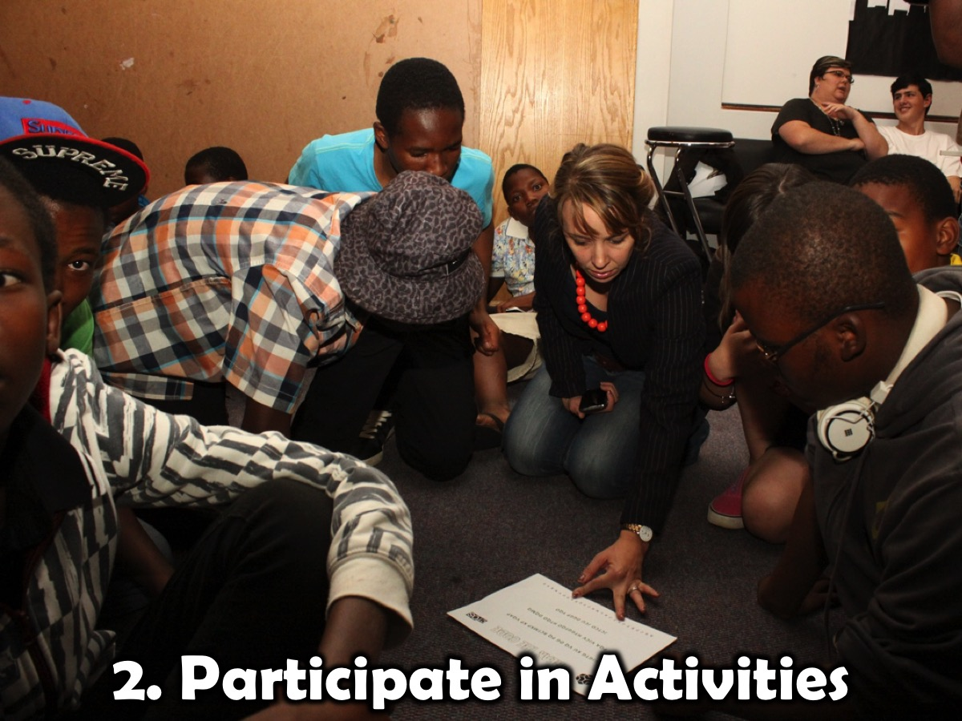
Notes:
2. Participate in Activities: Jump in alongside youth and you will very quickly be accepted.

Slide 32
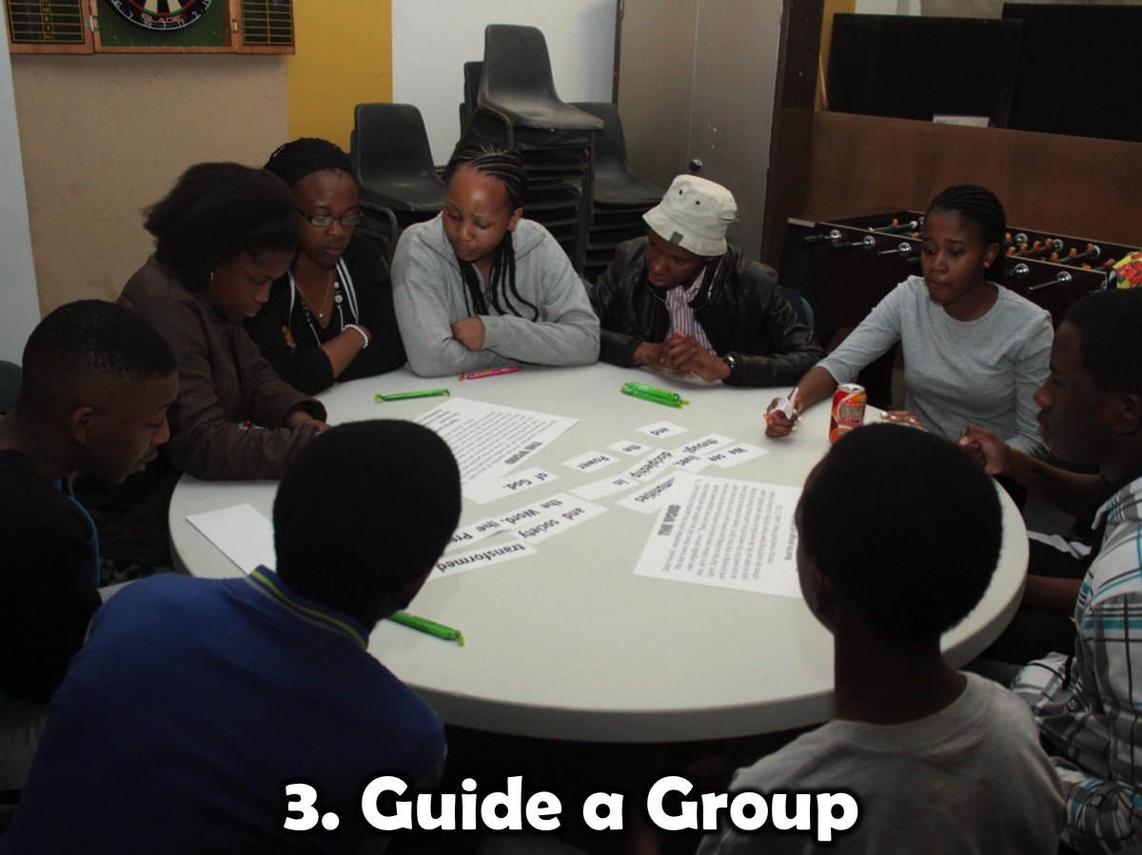
Notes:
3. Guide a Group: Sit at a table and help to keep discussion on track and involve quieter youth.

Slide 33
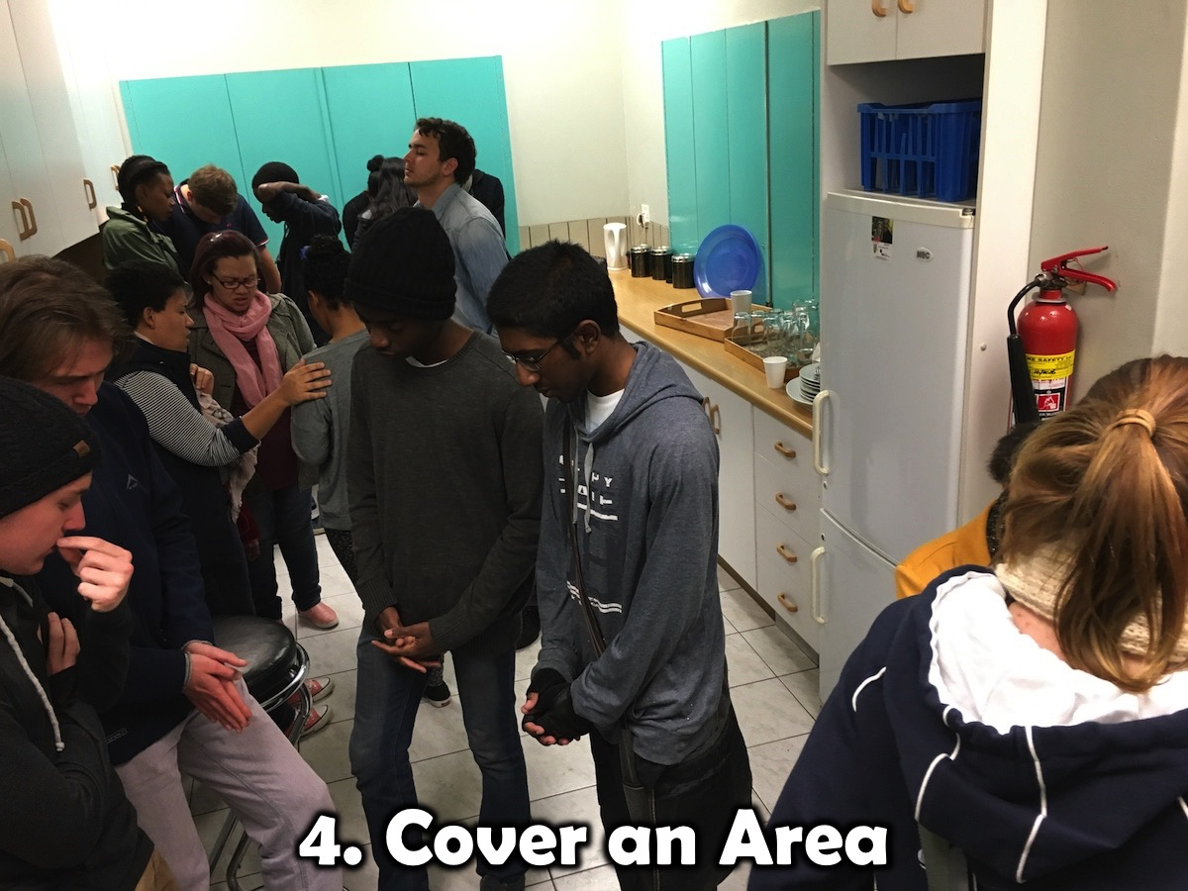
Notes:
4. Cover An Area: Look out for a specific area of ministry that you can take responsibility for.

Slide 34
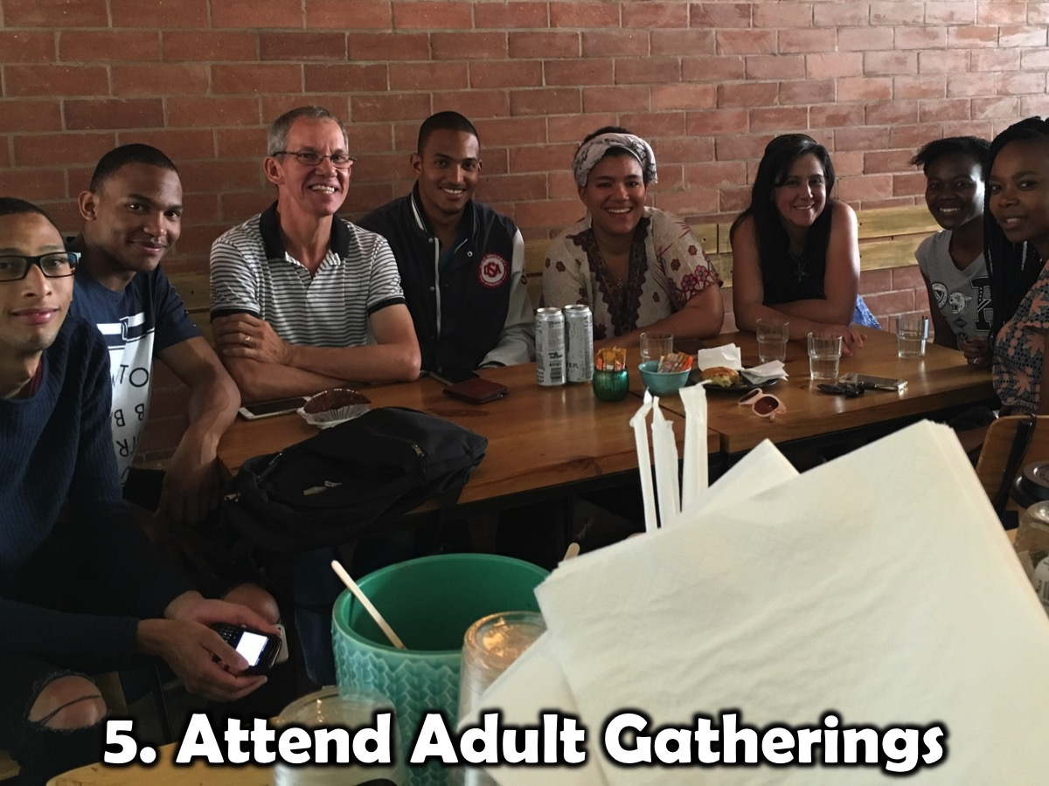
Notes:
5. Attend Adult Gatherings: Adult leaders meet together once a month for encouragement and sharing about the ministry.

Slide 35
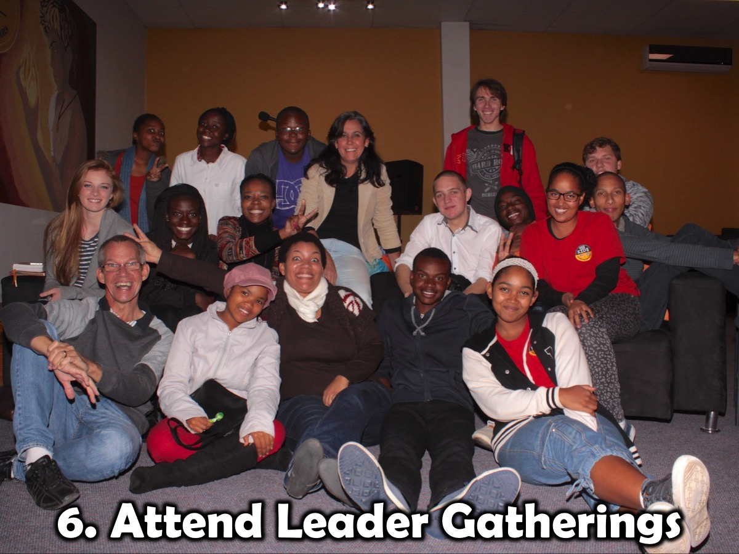
Notes:
6. Attend Leader Gatherings: Adult and teen leaders gather once a month on a Sunday after the second service.

Slide 36
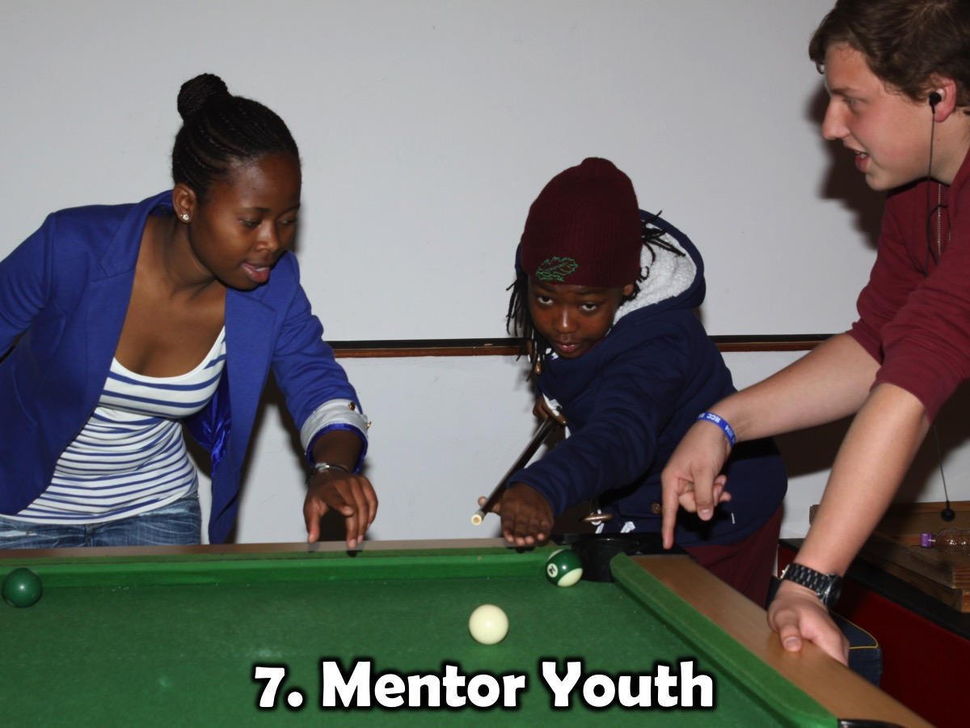
Notes:
7. Mentor Youth: Look for ways to share skills and help youth develop in areas of their lives.

Slide 37
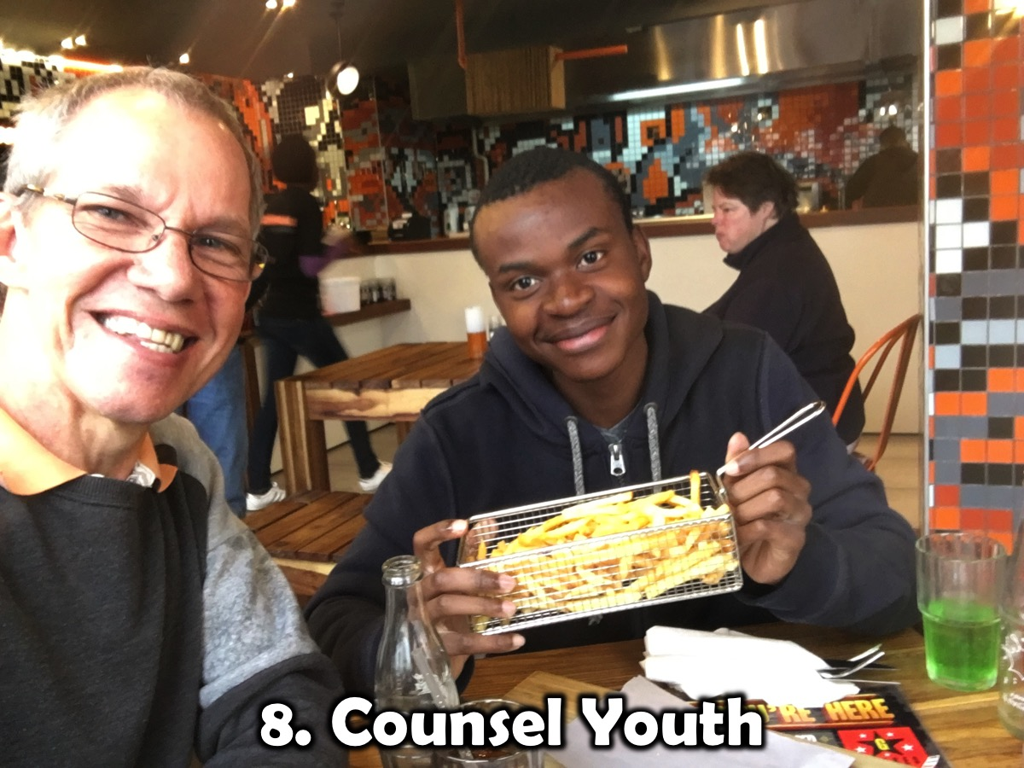
Notes:
8. Counsel Youth: As relationships develop you will have opportunities to help youth with issues they struggle with.

Slide 38
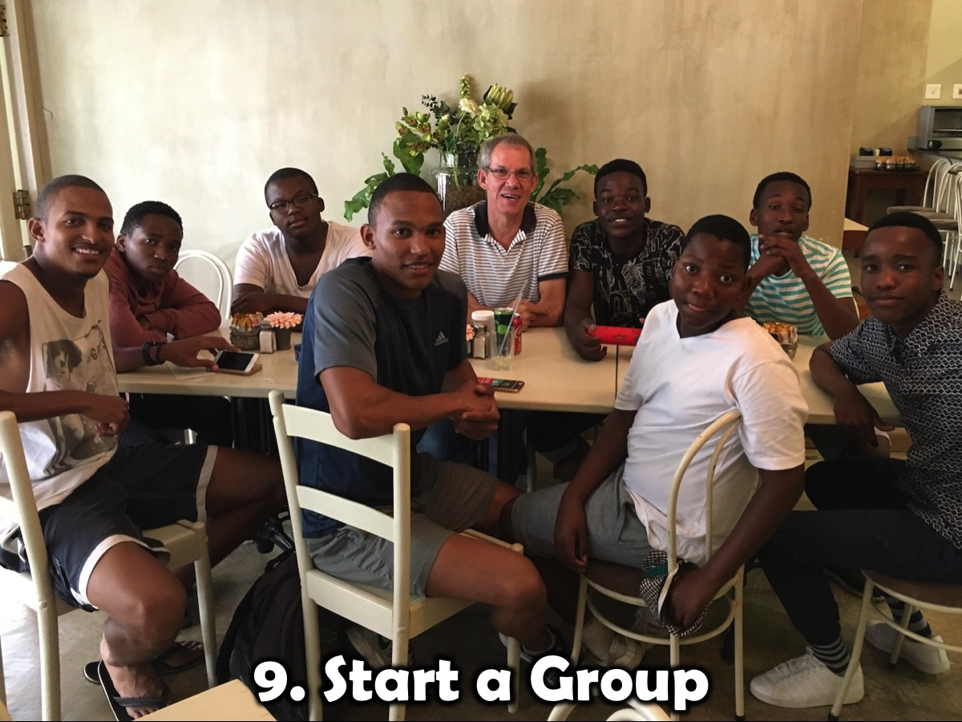
Notes:
9. Start a Group: God may have you launch and run a connect group with a segment of youth like these leaders have done with lads from Parkhurst.

Slide 39
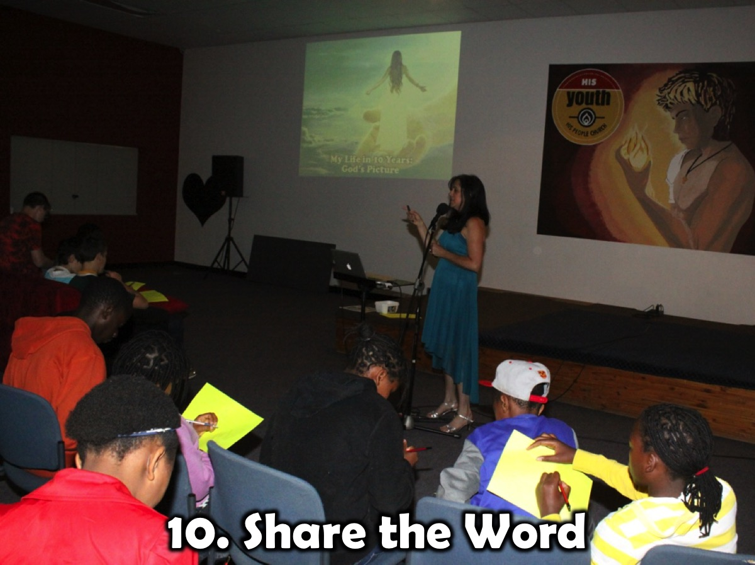
Notes:
10. Share the Word: Adult leaders may even get to share the Word on Sunday mornings or speak at other events.

Slide 40
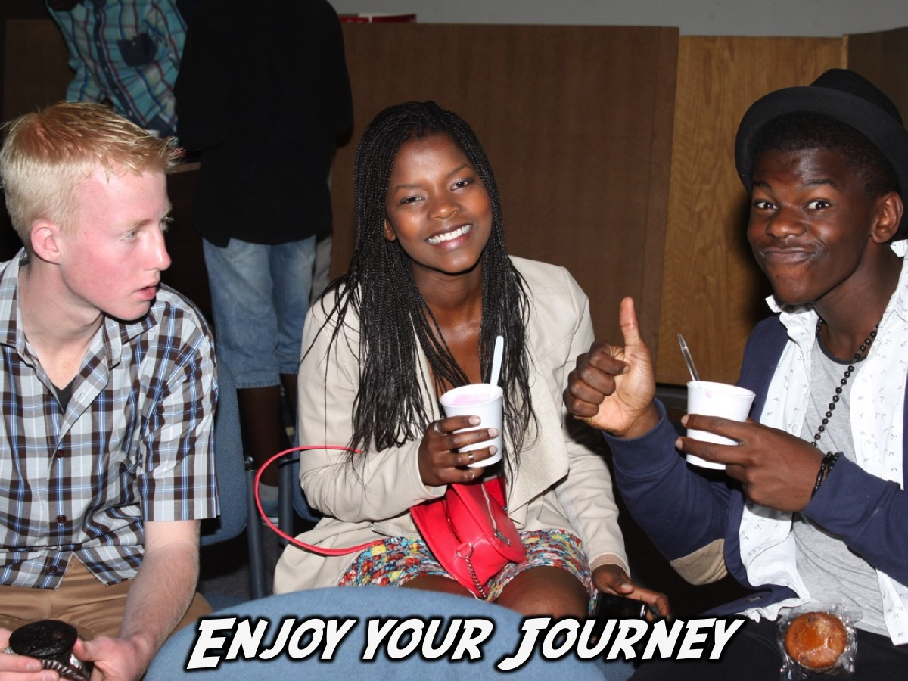

Slide 41
